Slide 1

Notes:
Welcome to the Trilogy Series.

Slide 2

Notes:
Last week we spoke about experiencing the presence of God in worship.

Slide 3
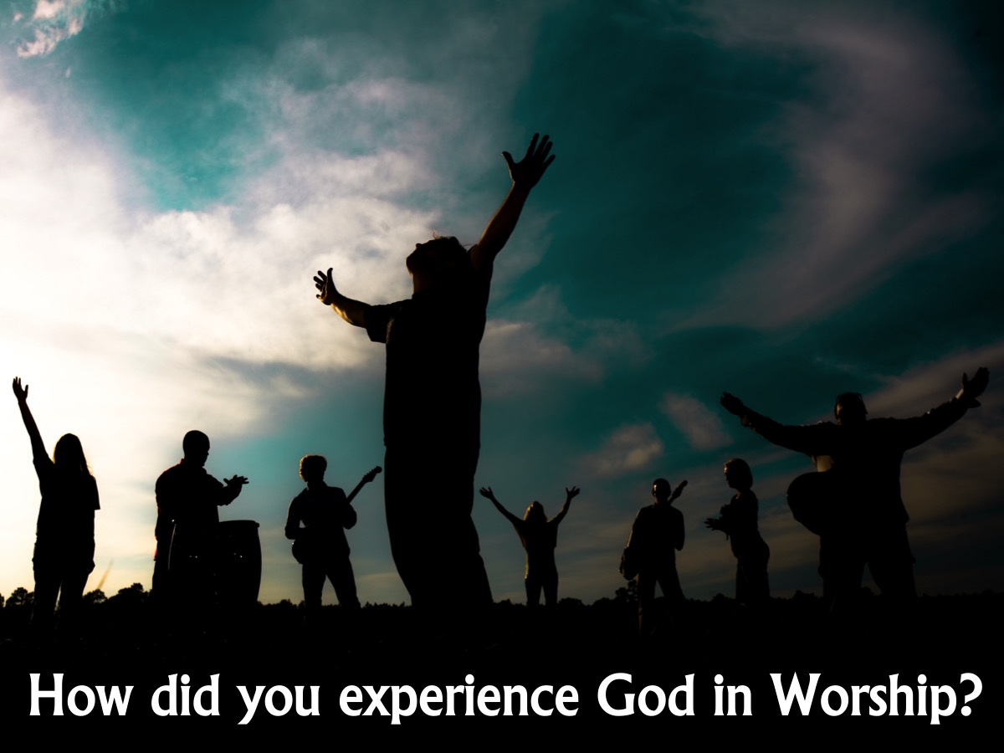
Notes:
Share: At your table, talk about how you experienced God in worship! What helped? What hindered?

Slide 4
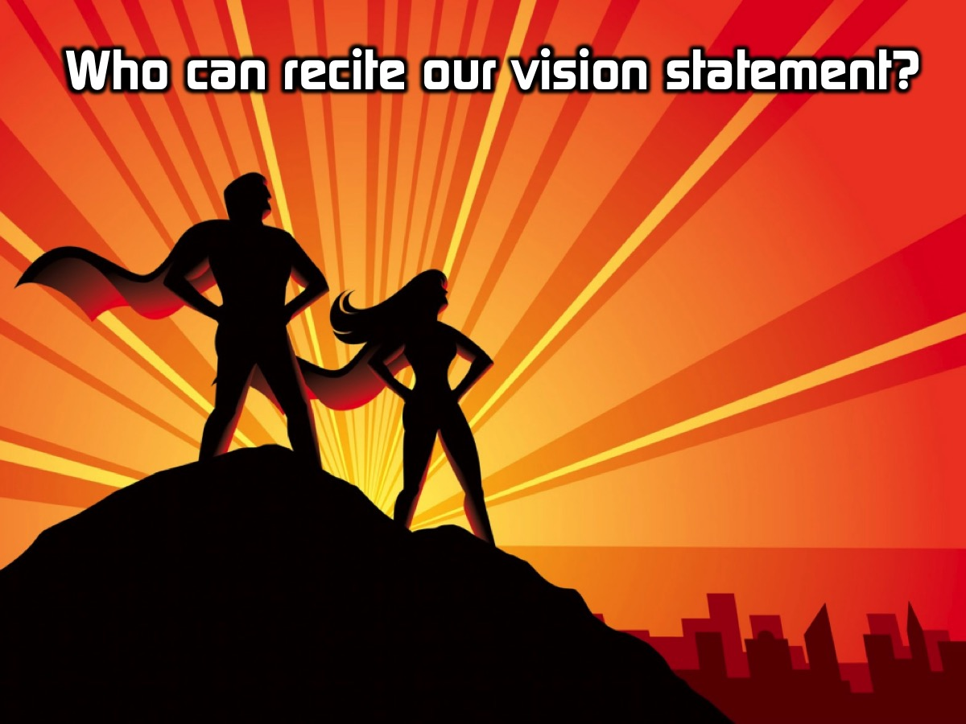
Notes:
Who can recite our vision statement from memory? I have some chocolates to give to those who can do it.

Slide 5
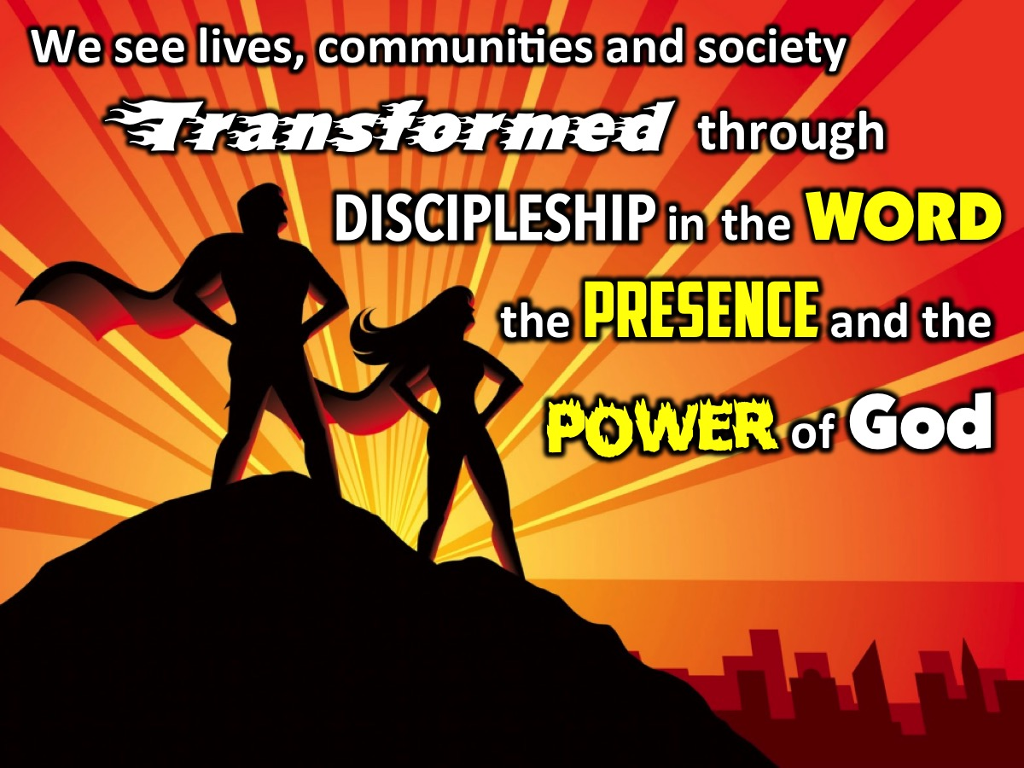
Notes:
Here is our mission statement - let's say it together.

Slide 6

Notes:
Today we start the final part of our Trilogy series where we will be looking at the Power of God!

Slide 7

Notes:
Have any of your watched the TV series - The Flash? Here is a trailer:

Slide 8
Notes:
Video: The Flash Story. An edited version of the extended trailer for the Flash TV series. Get it on YouTube at: https://www.youtube.com/watch?v=Yj0l7iGKh8g

Slide 9

Notes:
This ordinary guy, Barry, get’s zapped with millions of volts of electricity

Slide 10
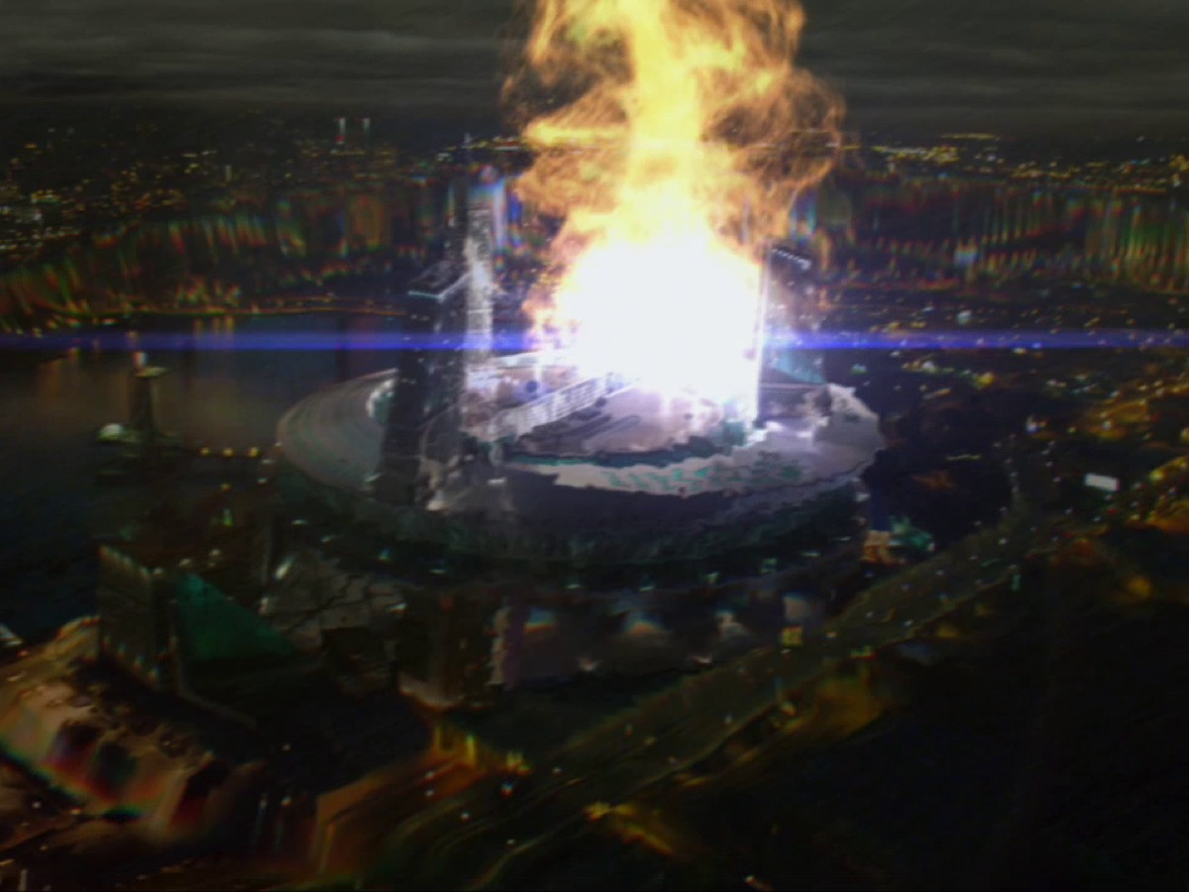
Notes:
When the STAR labs particle accelerator malfunctions

Slide 11
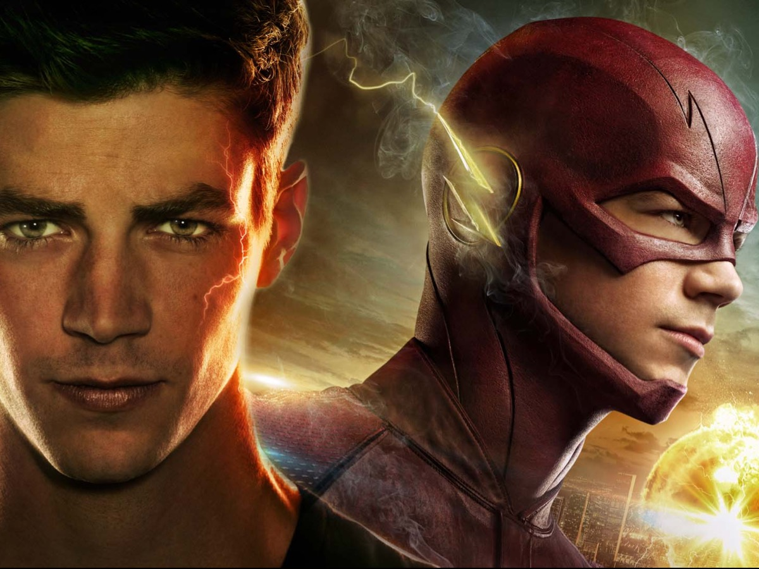
Notes:
And he undergoes a radical transformation

Slide 12
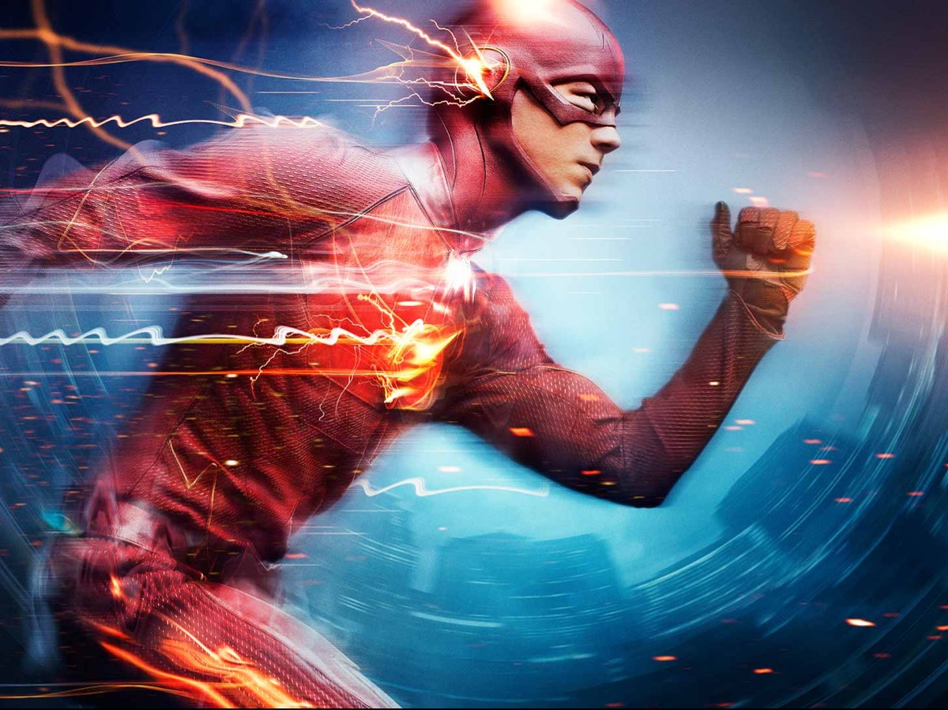
Notes:
Changing into a vigilante known as The Flash with the ability to move at incredible speeds.

Slide 13

Notes:
And he goes around fighting mutants and criminals

Slide 14
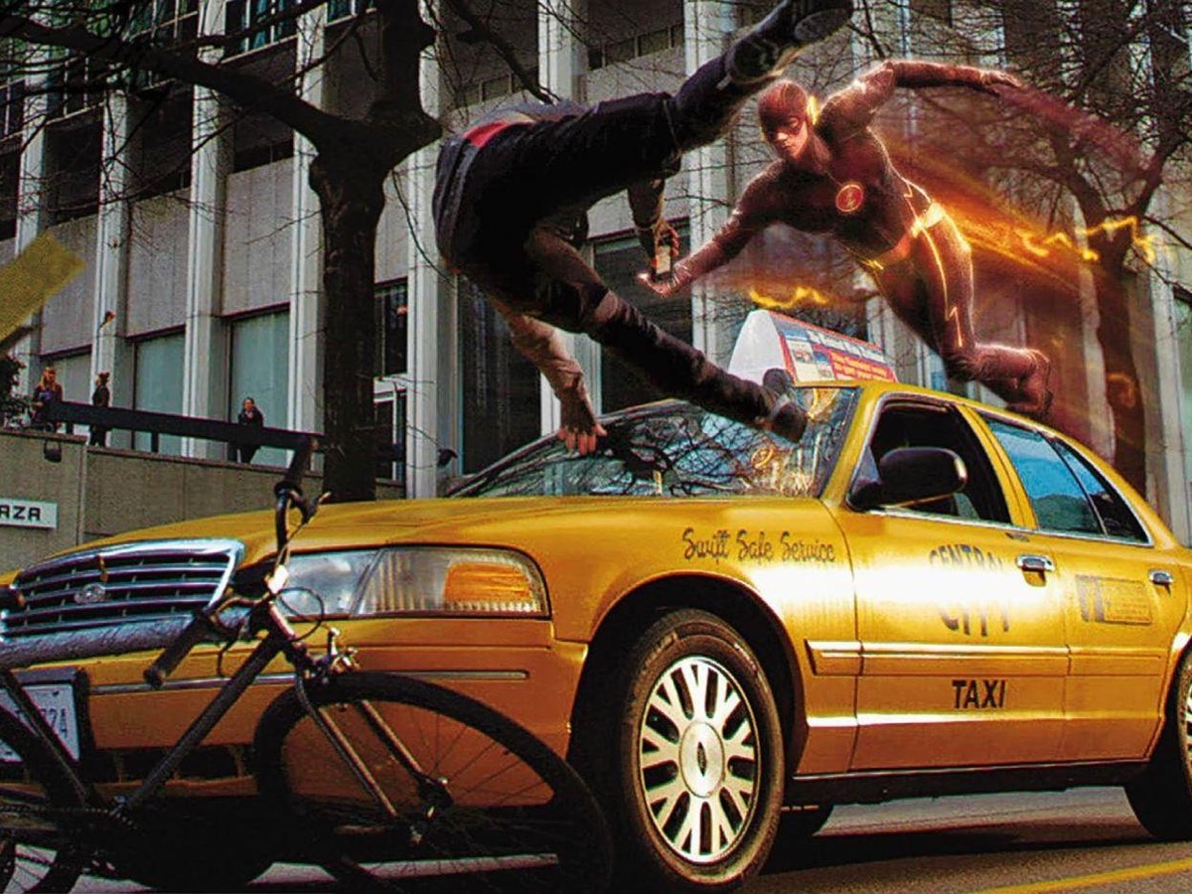
Notes:
And using his power to do good in society

Slide 15
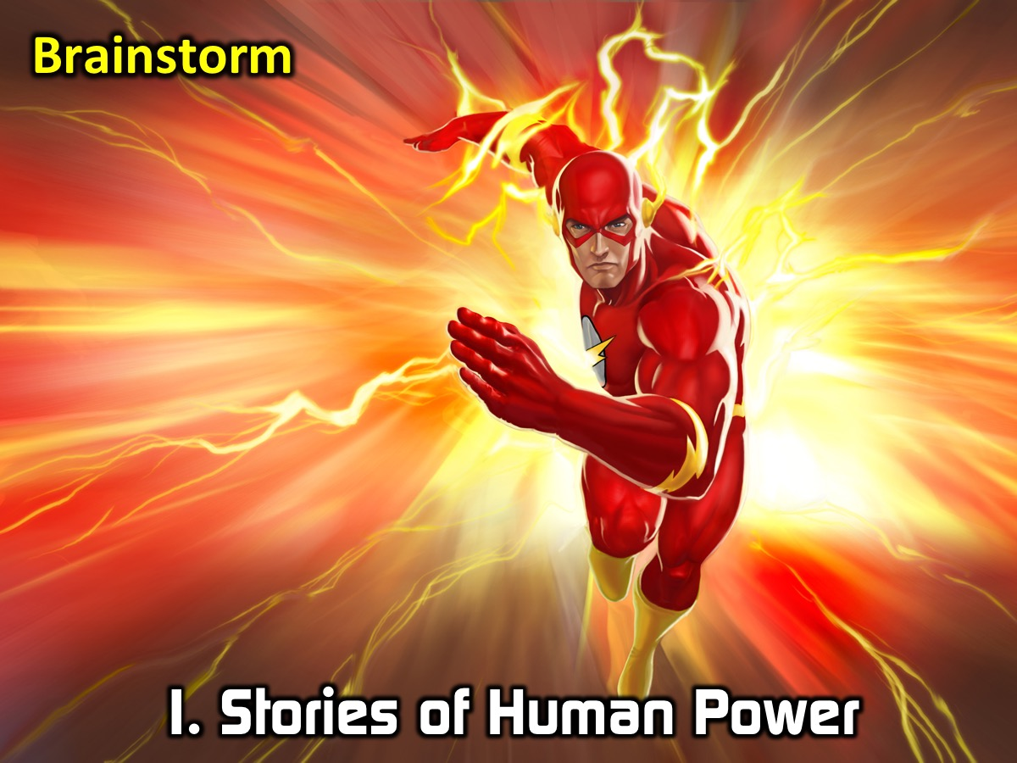
Notes:
1. Stories of Human Power - at your table - brainstorm some of the characters or show on TV or in them movies that deal with humans beings with unique or supernatural power. Each table will get to share the greatest example of superhuman power.

Slide 16
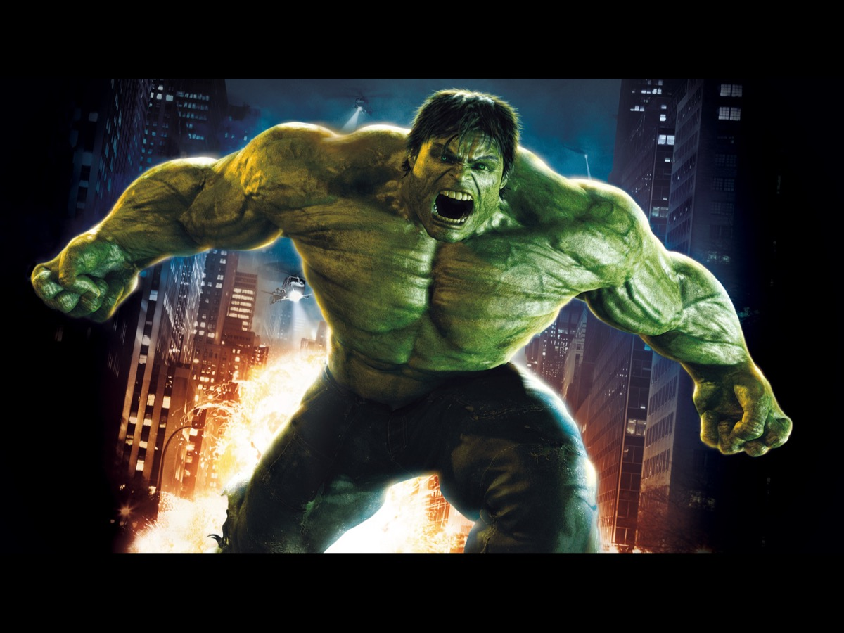
Notes:
Here are some of my favourites:
Hulk

Slide 17
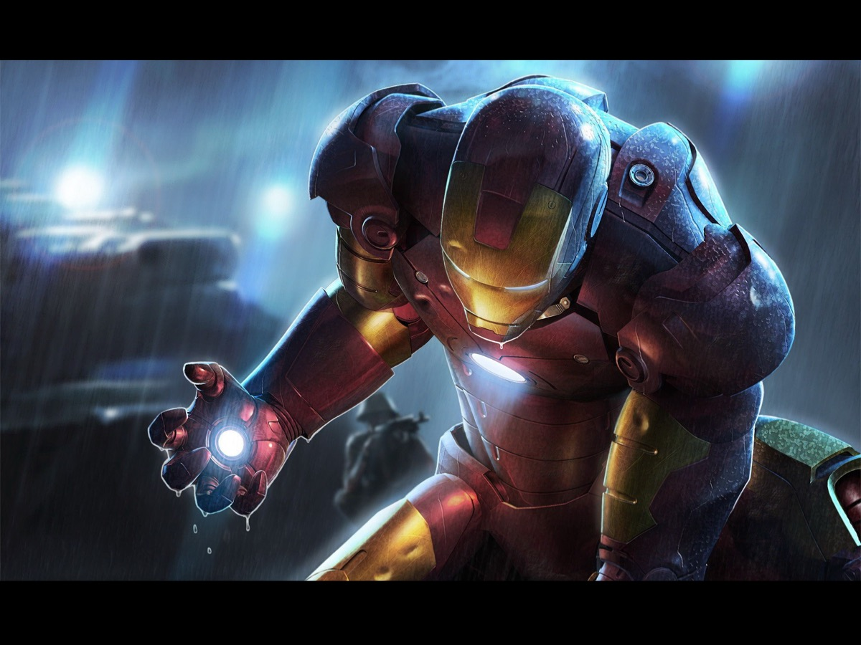
Notes:
Iron-Man

Slide 18
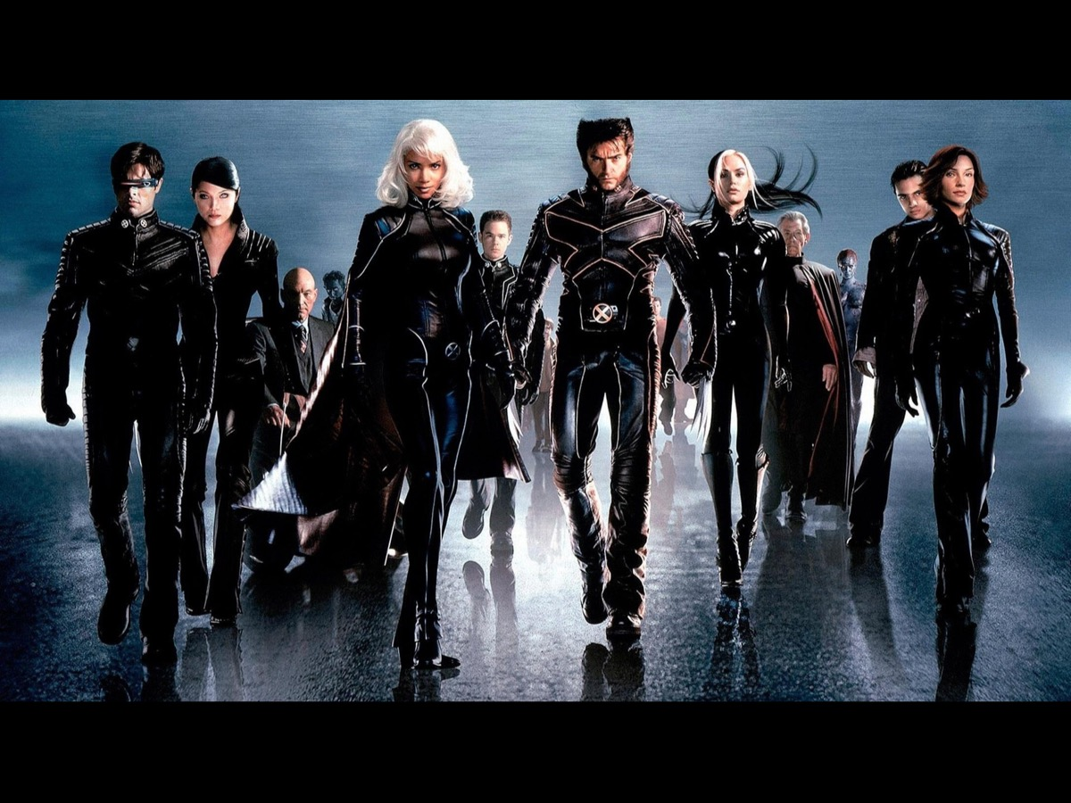
Notes:
The X-Men

Slide 19

Notes:
Heroes

Slide 20

Notes:
The Incredibles

Slide 21
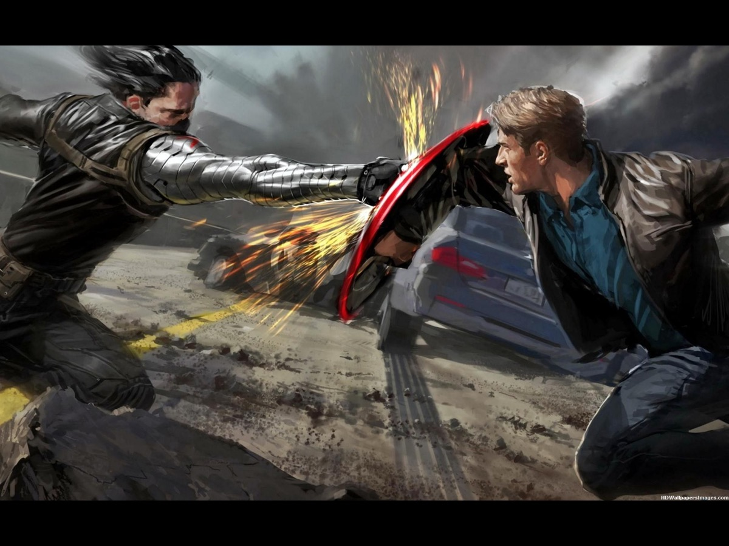
Notes:
Captain America

Slide 22

Notes:
Spiderman

Slide 23
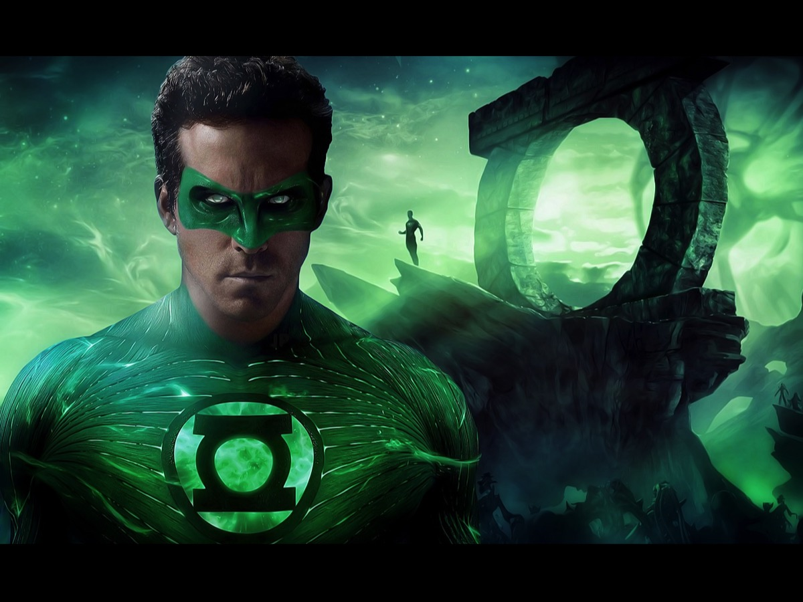
Notes:
Green Lantern

Slide 24

Notes:
Elektra

Slide 25

Notes:
Daredevil

Slide 26
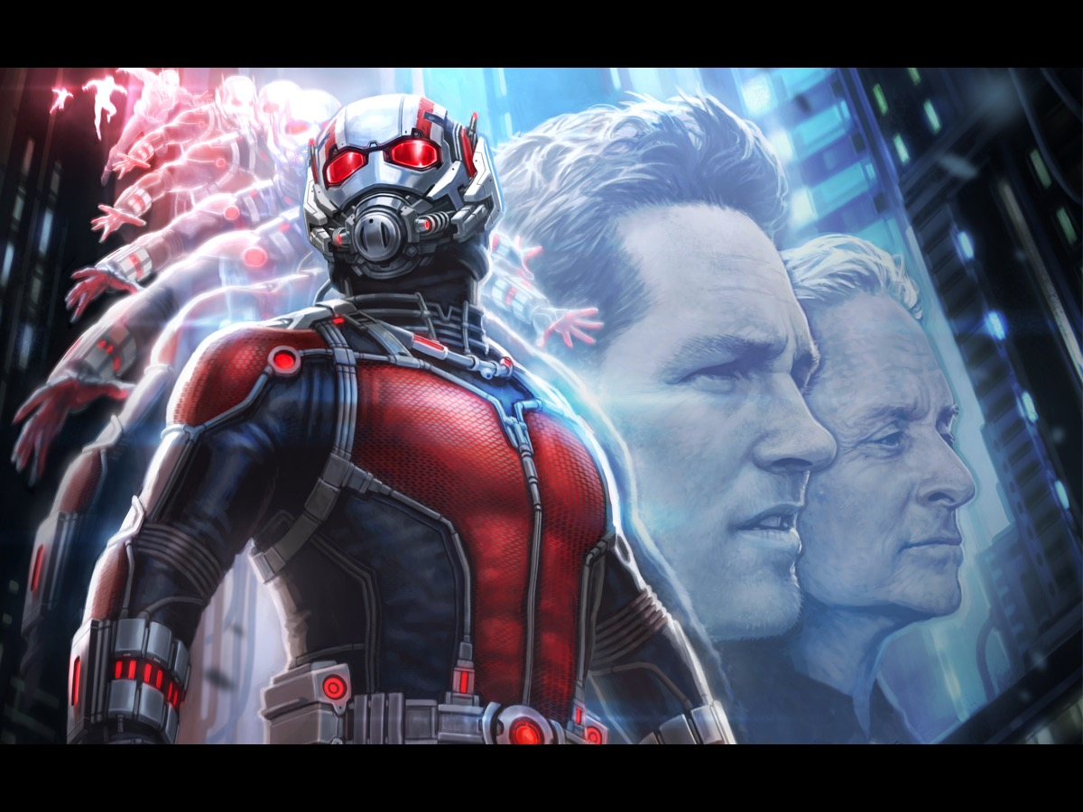
Notes:
Antman

Slide 27
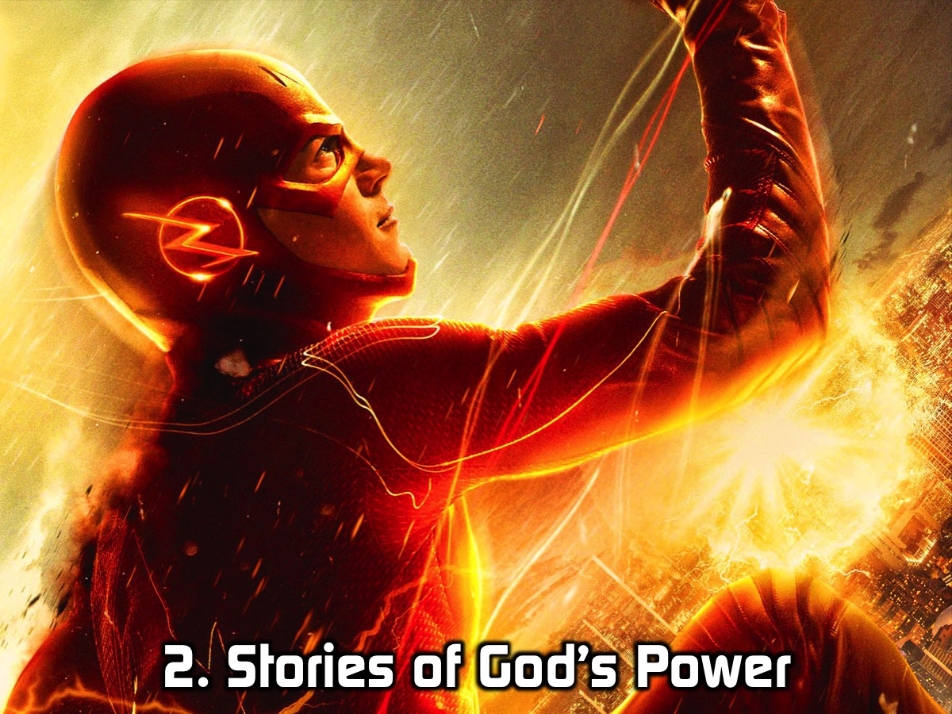
Notes:
2. Stories of God’s Power. We are going to be looking at seven stories of God’s Power working through a human being - all from the life of Elisha and found in just 2 chapters in the book of 2 Kings. At your tables each person is going to read one of the stories and briefly share it with the group - focus on how God’s power is experienced in the story.

Slide 28
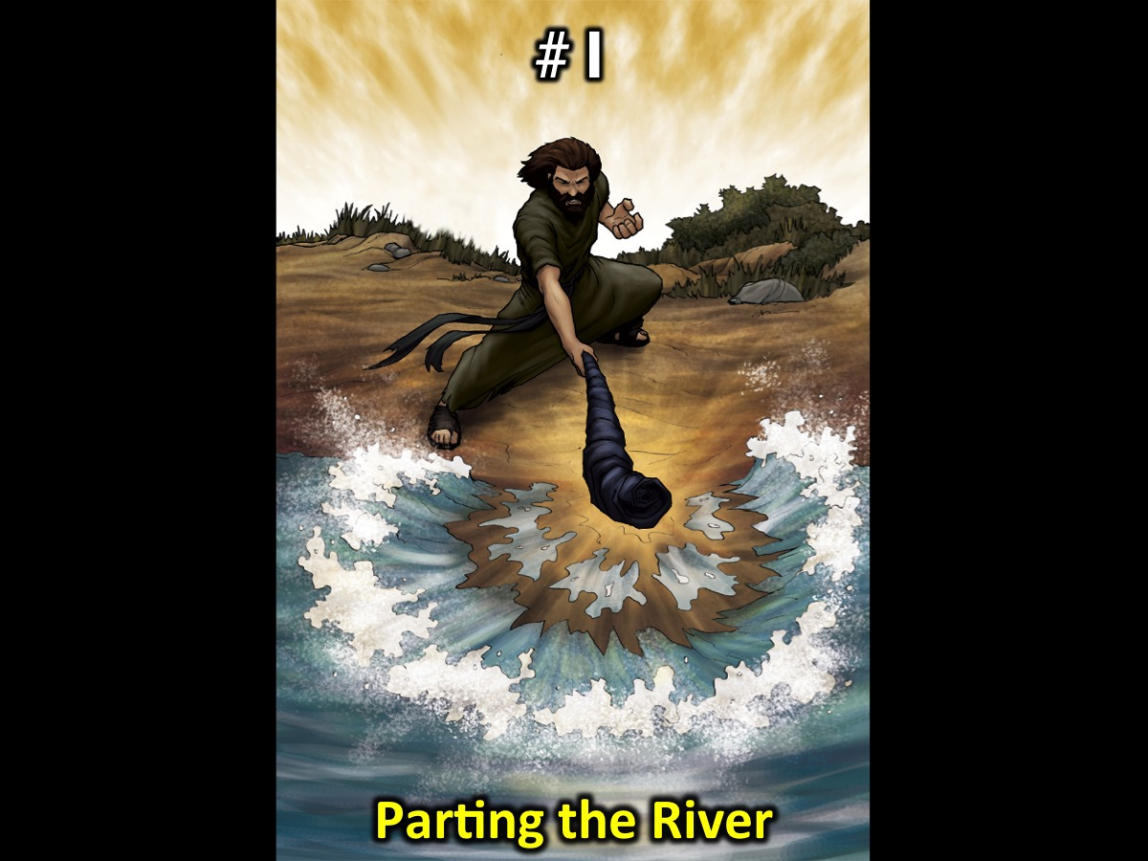
Notes:
#1. Elisha and the Cloak (Parting the River): Elisha then picked up Elijah’s cloak that had fallen from him and went back and stood on the bank of the Jordan. He took the cloak that had fallen from Elijah and struck the water with it. “Where now is the Lord, the God of Elijah?” he asked. When he struck the water, it divided to the right and to the left, and he crossed over. (2 Kings 2:13-14)

Slide 29
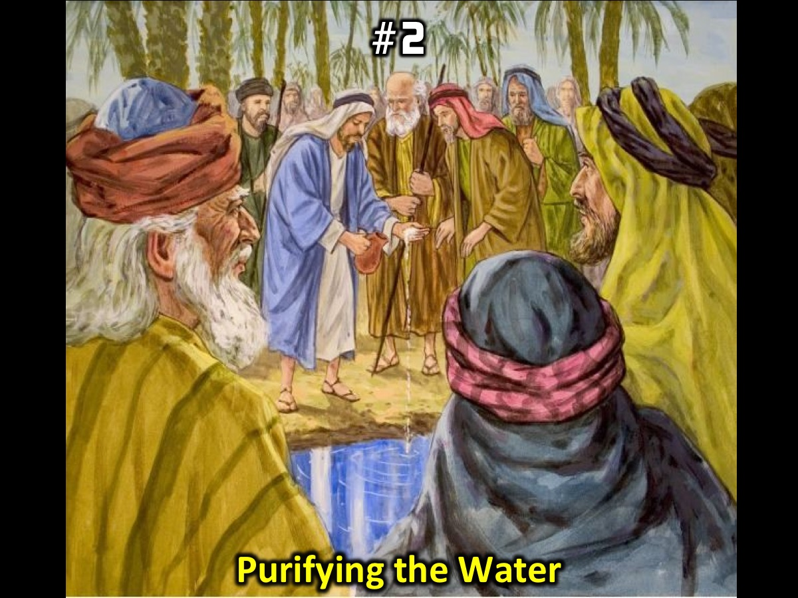
Notes:
#2. Elisha and the Salt (Purifying the Water): The people of the city said to Elisha, “Look, our lord, this town is well situated, as you can see, but the water is bad and the land is unproductive.” “Bring me a new bowl,” he said, “and put salt in it.” So they brought it to him. Then he went out to the spring and threw the salt into it, saying, “This is what the Lord says: ‘I have healed this water. Never again will it cause death or make the land unproductive.’” And the water has remained pure to this day, according to the word Elisha had spoken. (2 Kings 2:19-22)

Slide 30
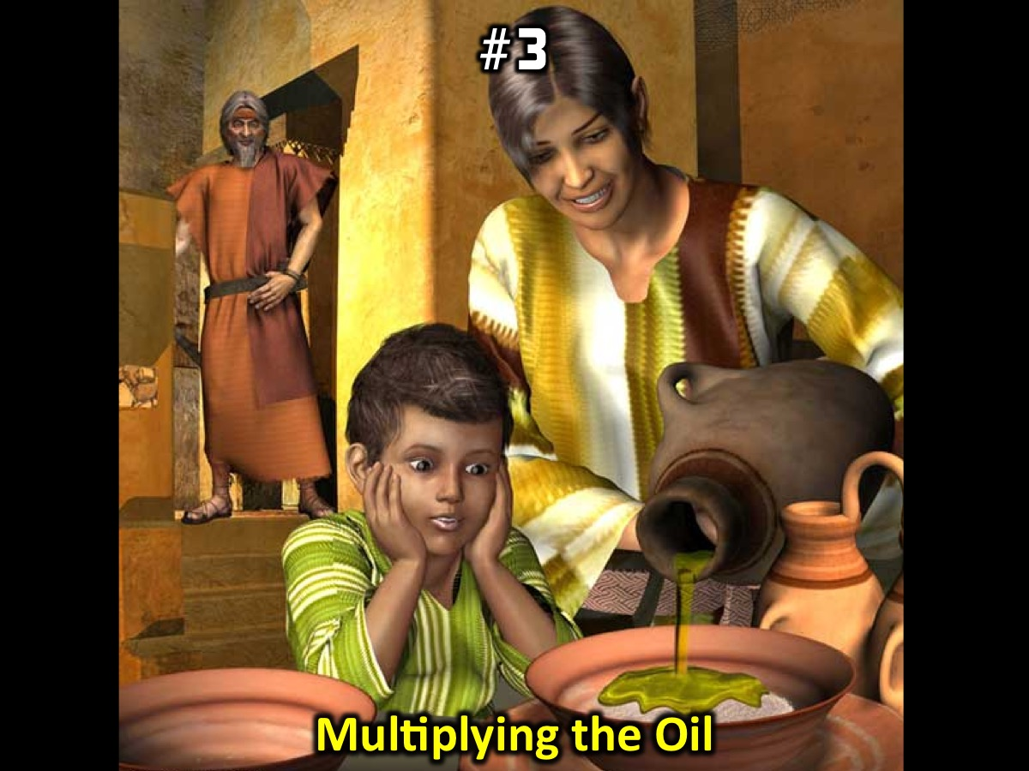
Notes:
#3. Elisha and the Oil (Multiplying the Oil): The wife of a man from the company of the prophets cried out to Elisha, “Your servant my husband is dead, and you know that he revered the Lord. But now his creditor is coming to take my two boys as his slaves.” Elisha replied to her, “How can I help you? Tell me, what do you have in your house?” “Your servant has nothing there at all,” she said, “except a small jar of olive oil.” Elisha said, “Go around and ask all your neighbors for empty jars. Don’t ask for just a few. Then go inside and shut the door behind you and your sons. Pour oil into all the jars, and as each is filled, put it to one side.” She left him and shut the door behind her and her sons. They brought the jars to her and she kept pouring. When all the jars were full, she said to her son, “Bring me another one.” But he replied, “There is not a jar left.” Then the oil stopped flowing. She went and told the man of God, and he said, “Go, sell the oil and pay your debts. You and your sons can live on what is left.” (2 Kings 4:1-7)

Slide 31
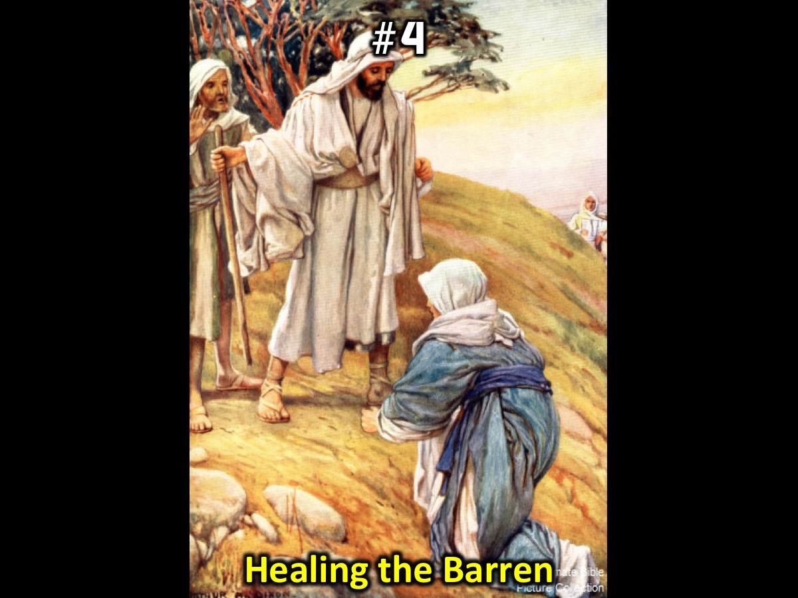
Notes:
#4. Elisha and the Woman (Healing the Barren): One day when Elisha came, he went up to his room and lay down there. He said to his servant Gehazi, “Call the Shunammite.” So he called her, and she stood before him. Elisha said to him, “Tell her, ‘You have gone to all this trouble for us. Now what can be done for you? Can we speak on your behalf to the king or the commander of the army?’” She replied, “I have a home among my own people.” “What can be done for her?” Elisha asked. Gehazi said, “She has no son, and her husband is old.” Then Elisha said, “Call her.” So he called her, and she stood in the doorway. “About this time next year,” Elisha said, “you will hold a son in your arms.” “No, my lord!” she objected. “Please, man of God, don’t mislead your servant!” But the woman became pregnant, and the next year about that same time she gave birth to a son, just as Elisha had told her. (2 Kings 4:11-17)

Slide 32
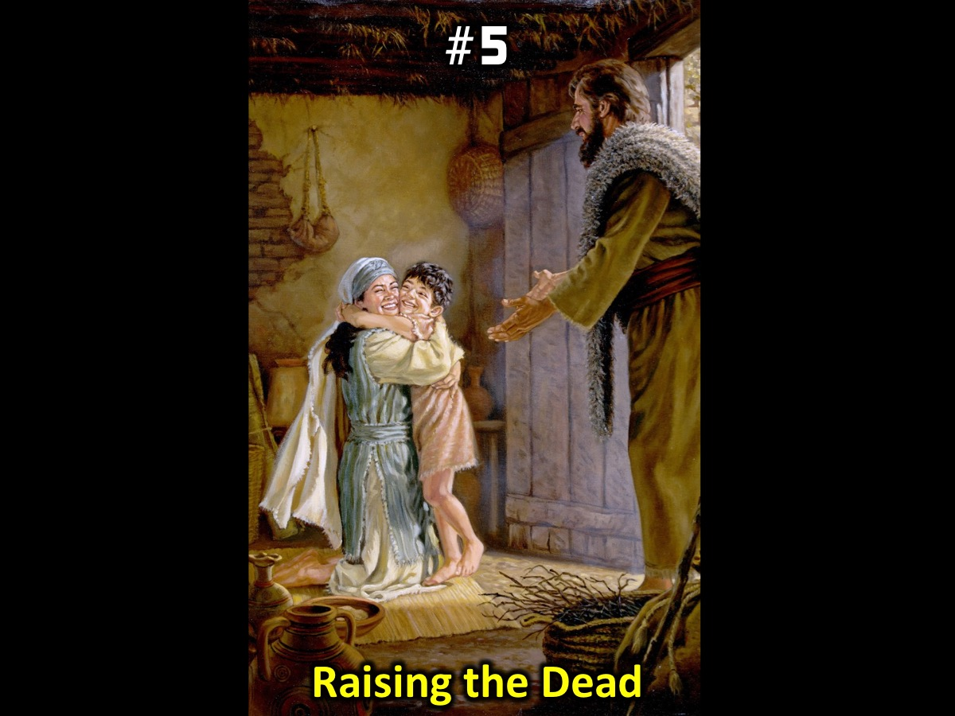
Notes:
#5. Elisha and the Son (Raising the Dead): The child grew but one day he sat in his mother’s lap until noon, and then he died. She went up and laid him on the bed of the man of God, then shut the door and went out. When Elisha reached the house, there was the boy lying dead on his couch. He went in, shut the door on the two of them and prayed to the Lord. Then he got on the bed and lay on the boy, mouth to mouth, eyes to eyes, hands to hands. As he stretched himself out on him, the boy’s body grew warm. Elisha turned away and walked back and forth in the room and then got on the bed and stretched out on him once more. The boy sneezed seven times and opened his eyes. (2 Kings 4:18-21, 32-35)

Slide 33
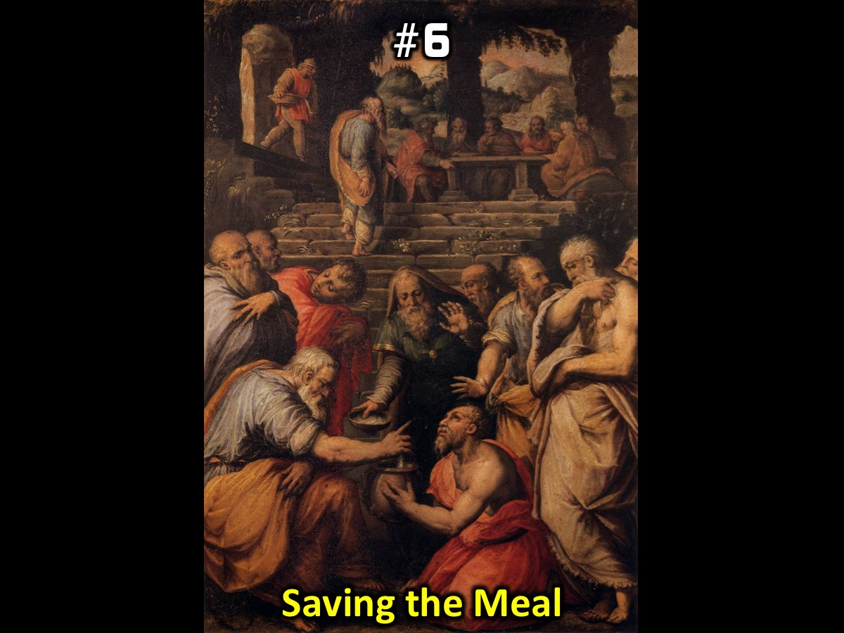
Notes:
#6. Elisha and the Pot (Saving the Meal): Elisha returned to Gilgal and there was a famine in that region. While the company of the prophets was meeting with him, he said to his servant, “Put on the large pot and cook some stew for these prophets.” One of them went out into the fields to gather herbs and found a wild vine and picked as many of its gourds as his garment could hold. When he returned, he cut them up into the pot of stew, though no one knew what they were. The stew was poured out for the men, but as they began to eat it, they cried out, “Man of God, there is death in the pot!” And they could not eat it. Elisha said, “Get some flour.” He put it into the pot and said, “Serve it to the people to eat.” And there was nothing harmful in the pot. (2 Kings 4:38-41)

Slide 34
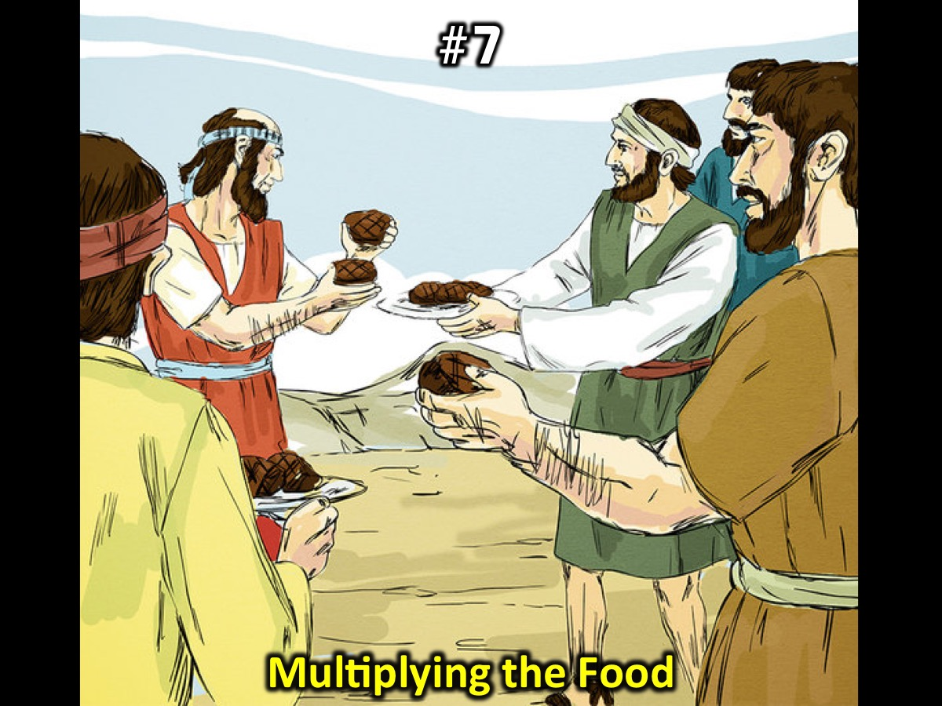
Notes:
#7. Elisha and the Bread (Multiplying the Food): A man came from Baal Shalishah, bringing the man of God twenty loaves of barley bread baked from the first ripe grain, along with some heads of new grain. “Give it to the people to eat,” Elisha said. “How can I set this before a hundred men?” his servant asked. But Elisha answered, “Give it to the people to eat. For this is what the Lord says: ‘They will eat and have some left over.’” Then he set it before them, and they ate and had some left over, according to the word of the Lord. (2 Kings 4:42-44)

Slide 35
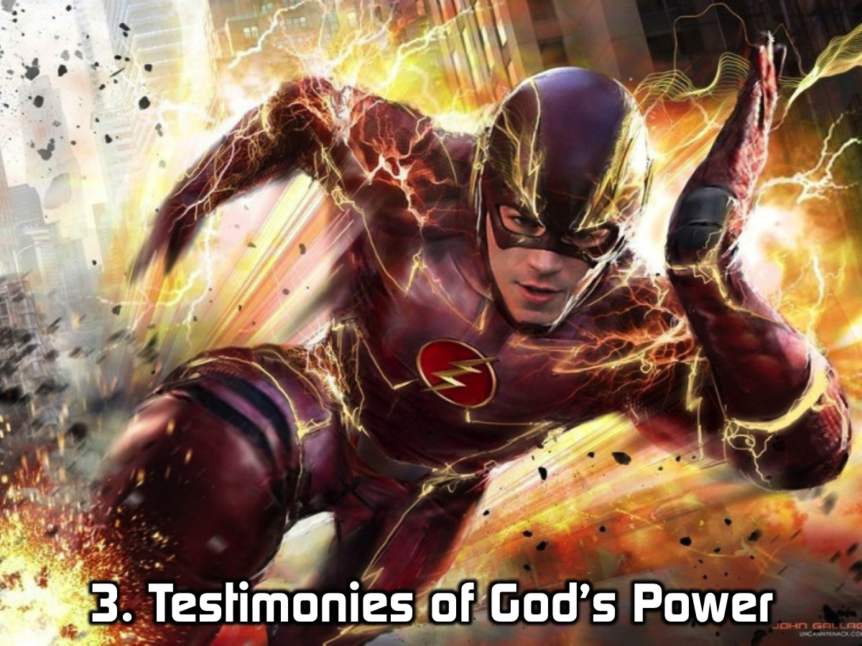
Notes:
3. Testimonies of God’s Power - it is now your turn to share stories of God’s power that you have either heard about or experienced in your life. Each table will select one story that can be shared with the whole group.

Slide 36
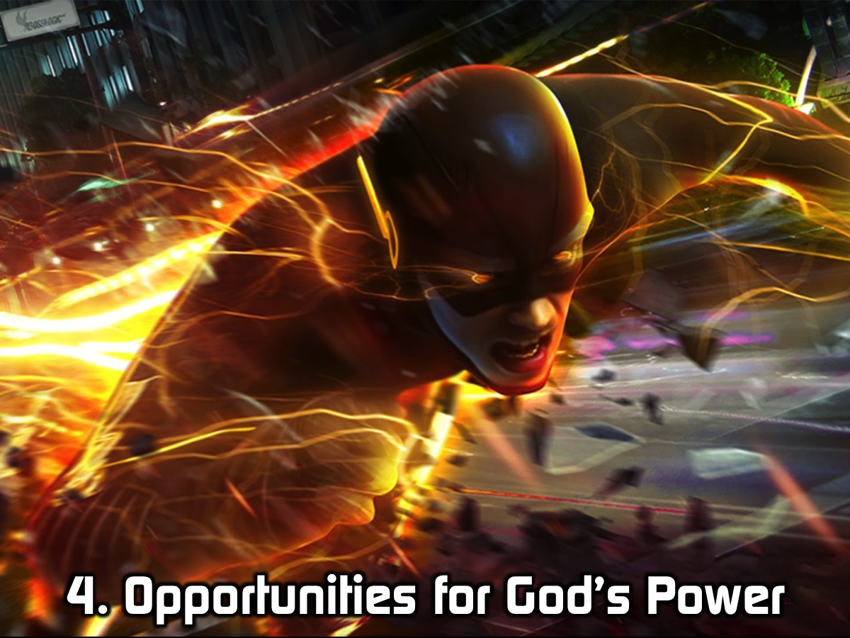
Notes:
4. Opportunities for God’s Power. Let’s talk about some of the ways in which God’s Power is available in our lives, communities and society today:

Slide 37
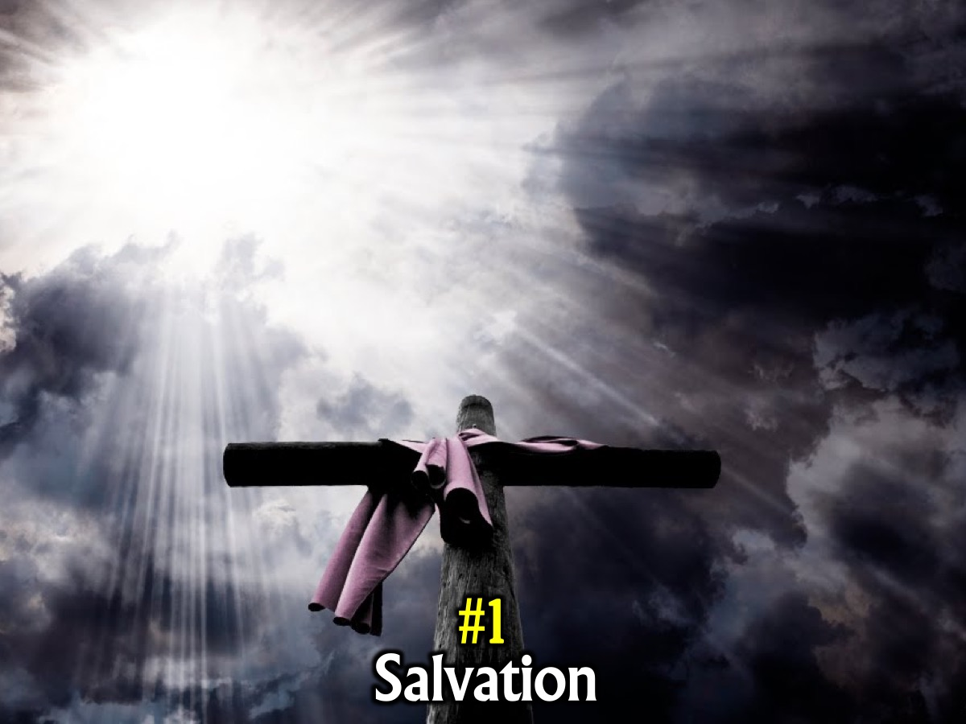
Notes:
#1. Salvation. It is God’s power that secured our salvation.

Slide 38
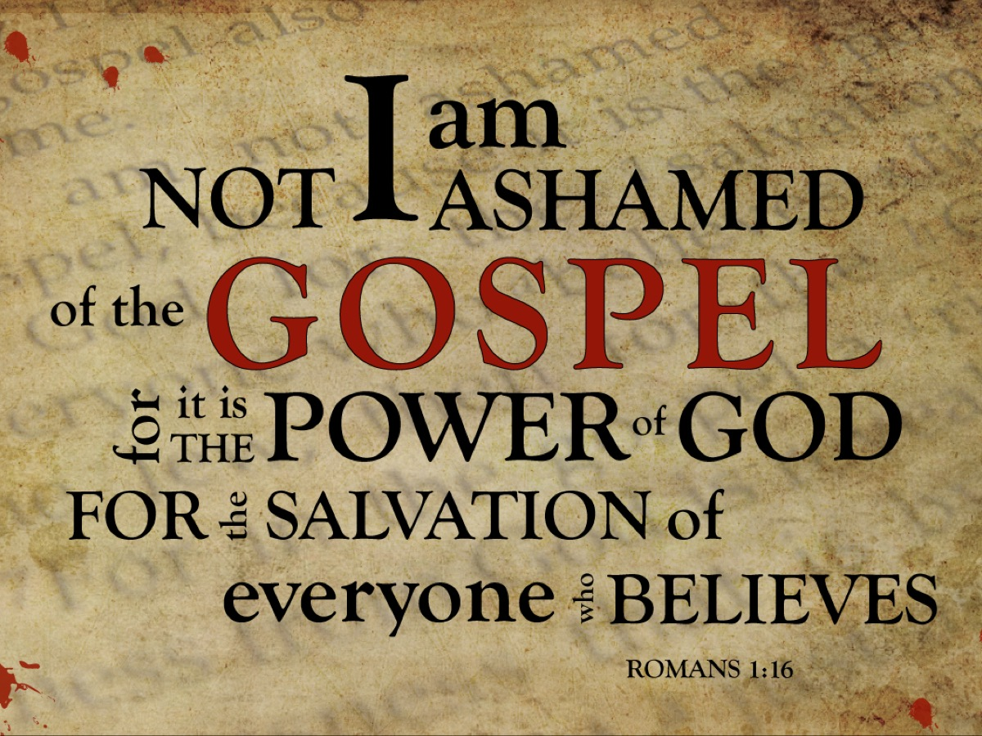
Notes:
I am not ashamed of the gospel, because it is the power of God that brings salvation to everyone who believes. (Romans 1:16)

Slide 39
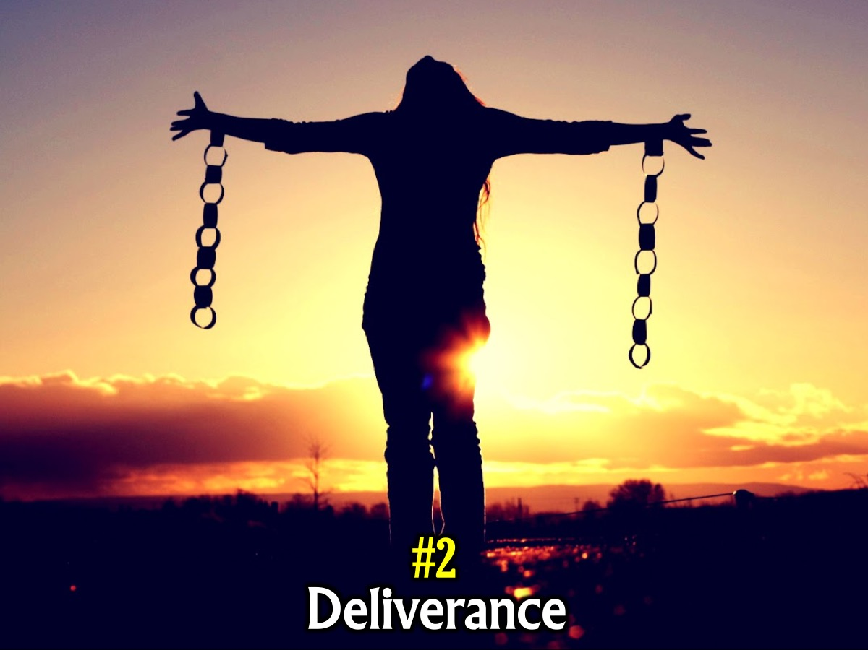
Notes:
#2. Deliverance. It is God’s power that sets us from from sin, Satan and the kingdom of darkness.

Slide 40
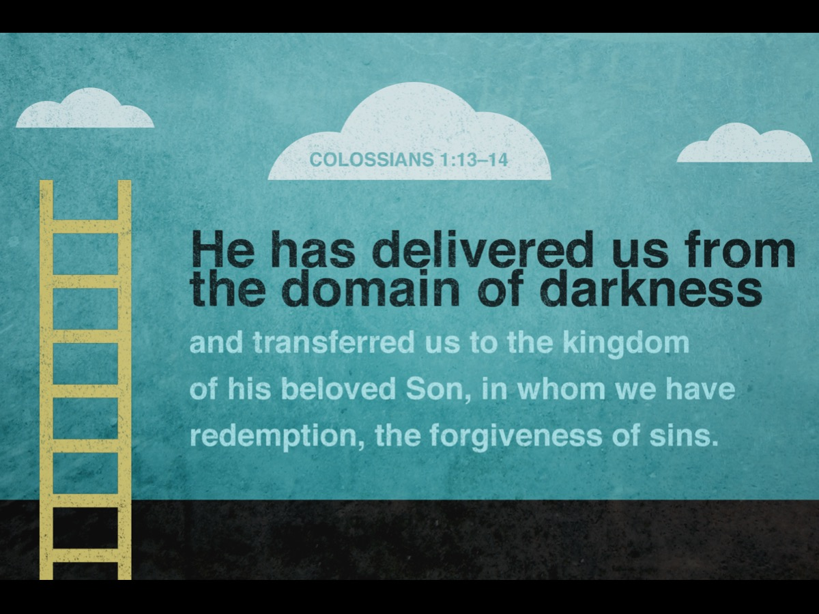
Notes:
He has rescued us from the dominion of darkness and brought us into the kingdom of the Son he loves, in whom we have redemption, the forgiveness of sins. (Colossians 1:13-14)

Slide 41
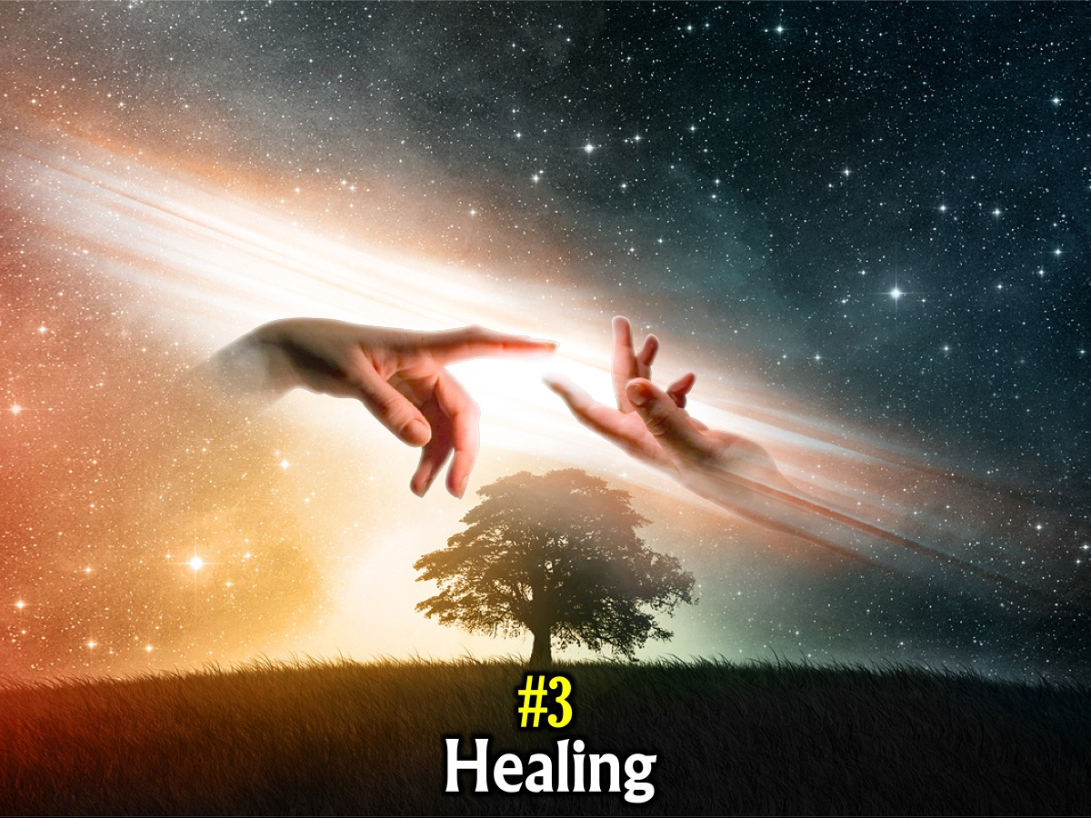
Notes:
#3. Healing. Whenever someone is healed - it is because of God’s power.

Slide 42
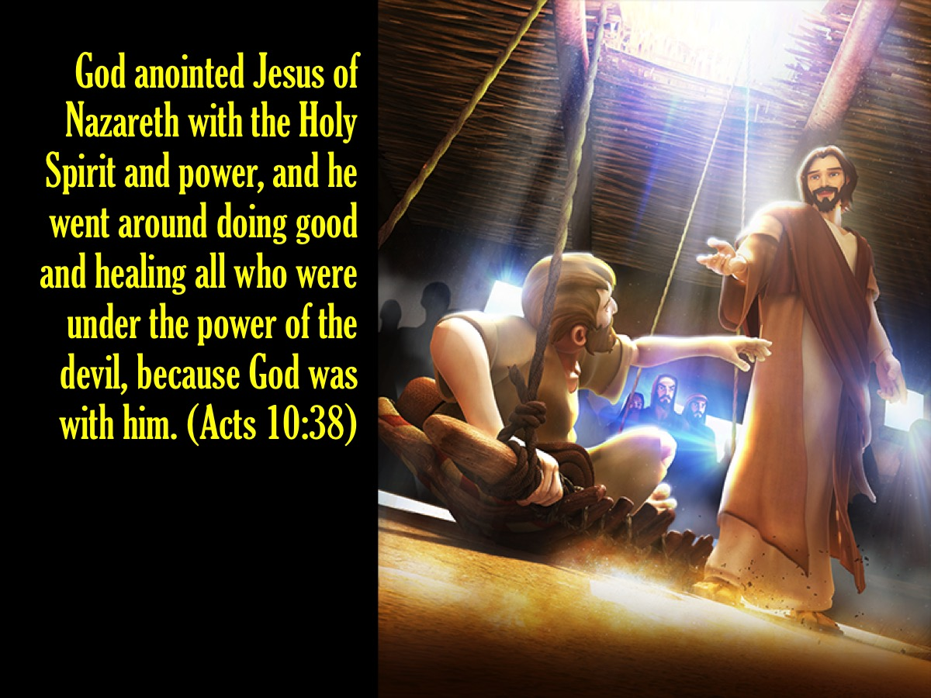
Notes:
God anointed Jesus of Nazareth with the Holy Spirit and power, and how he went around doing good and healing all who were under the power of the devil, because God was with him. (Acts 10:38)

Slide 43
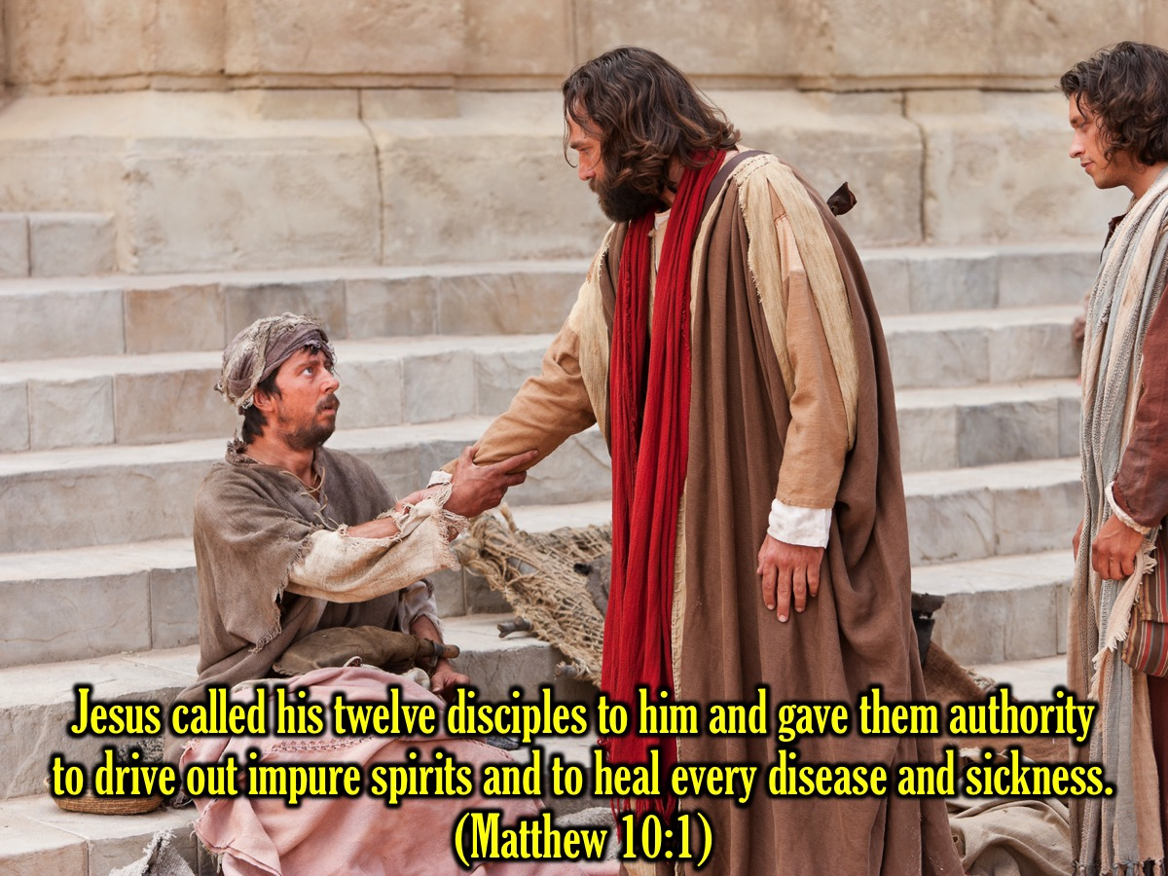
Notes:
Jesus called his twelve disciples to him and gave them authority to drive out impure spirits and to heal every disease and sickness. (Matthew 10:1)

Slide 44
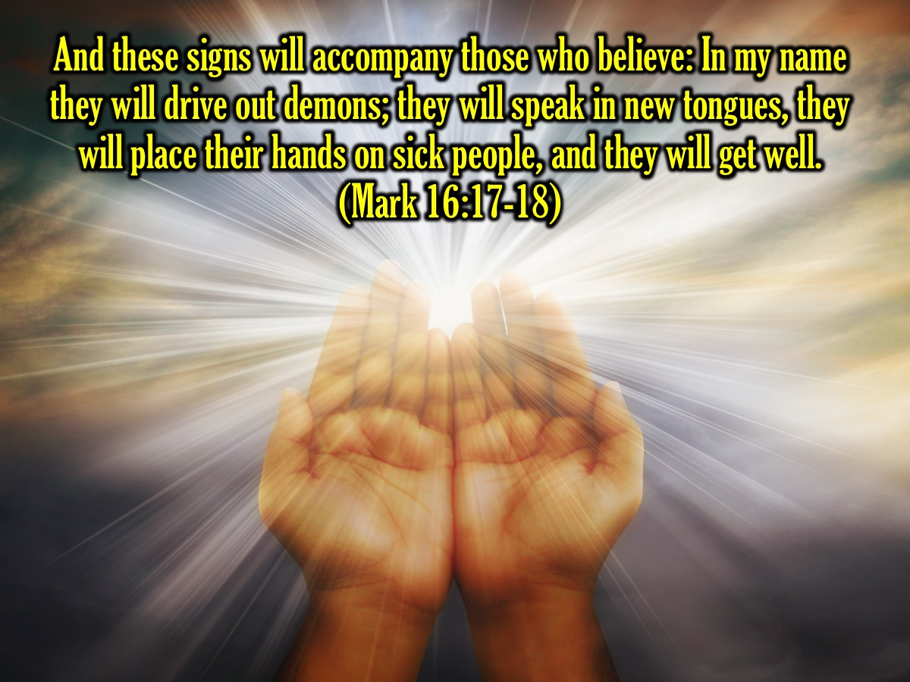
Notes:
And these signs will accompany those who believe: In my name they will drive out demons; they will speak in new tongues; they will pick up snakes with their hands; and when they drink deadly poison, it will not hurt them at all; they will place their hands on sick people, and they will get well. (Mark 16:17-18)

Slide 45
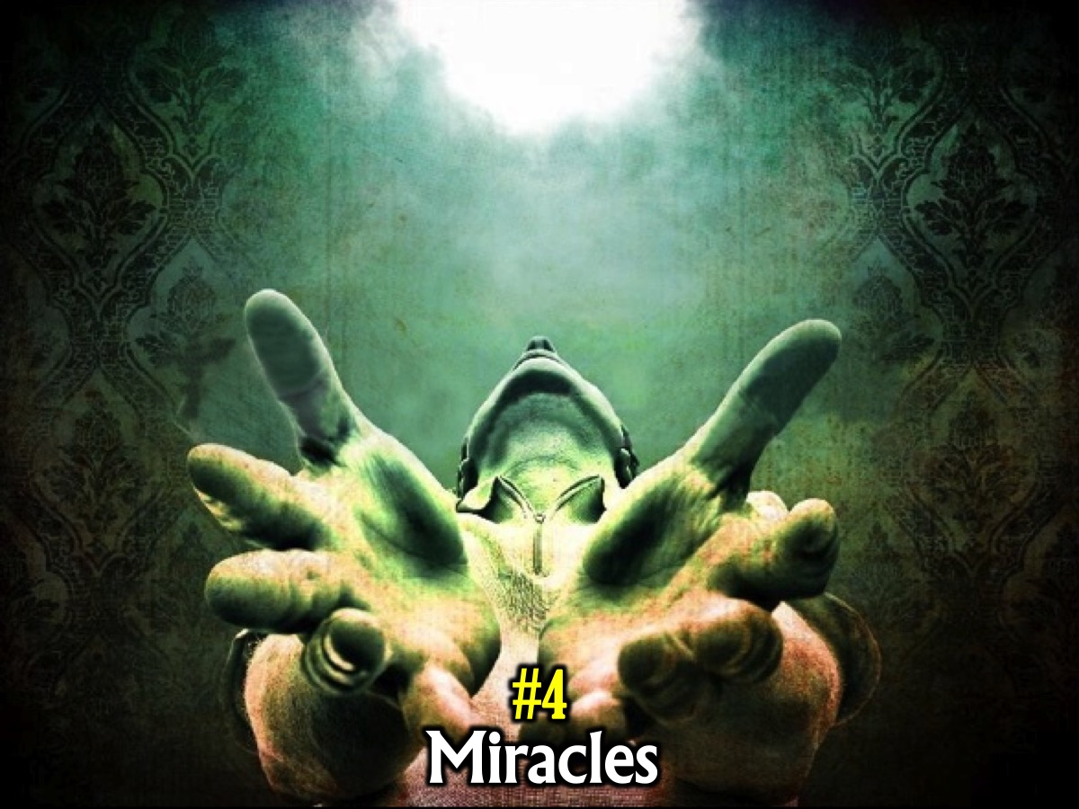
Notes:
#4. Miracles. God’s power performs miracles through believers.

Slide 46
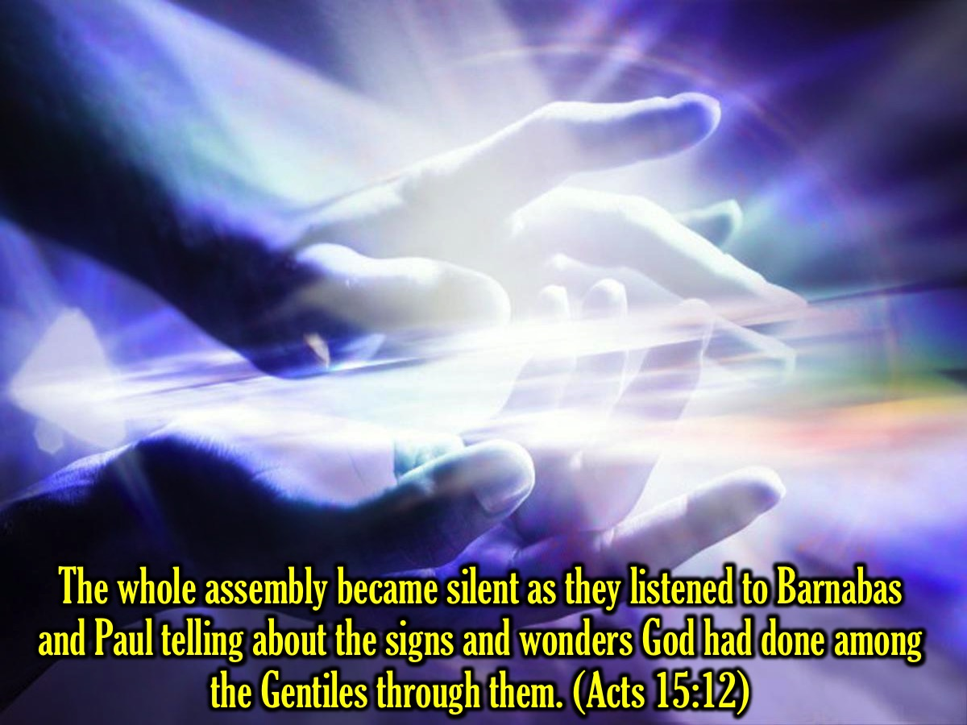
Notes:
The whole assembly became silent as they listened to Barnabas and Paul telling about the signs and wonders God had done among the Gentiles through them. (Acts 15:12)

Slide 47
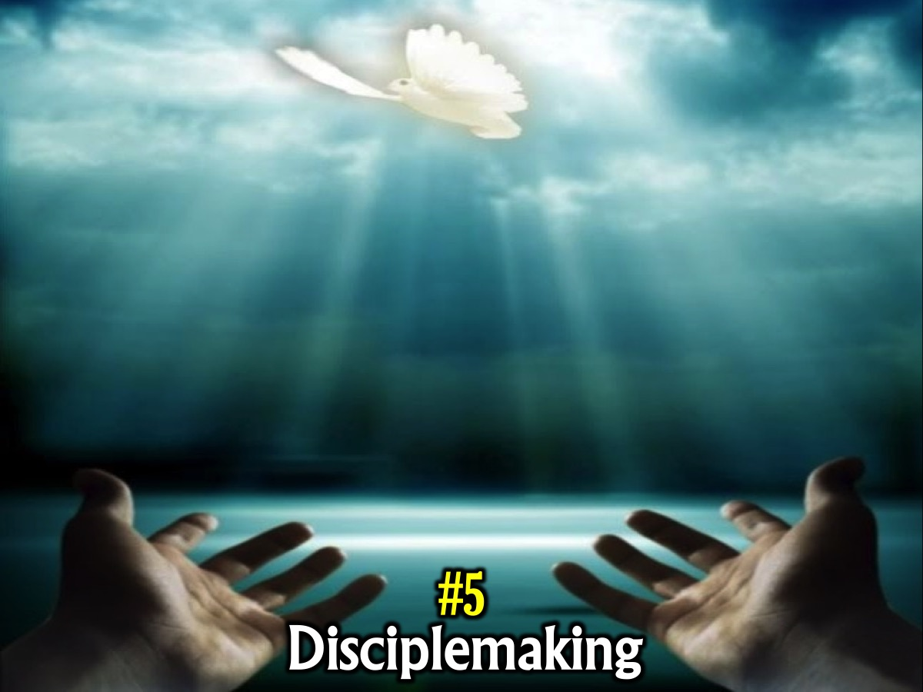
Notes:
#5. Disciplemaking. God’s power helps us to make disciples.

Slide 48
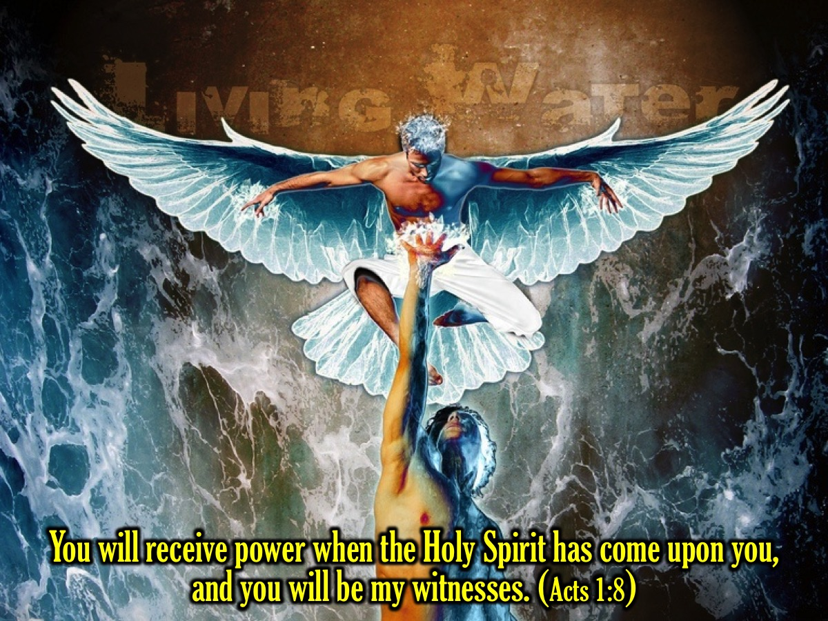
Notes:
You will receive power when the Holy Spirit has come upon you, and you will be my witnesses. (Acts 1:8)

Slide 49
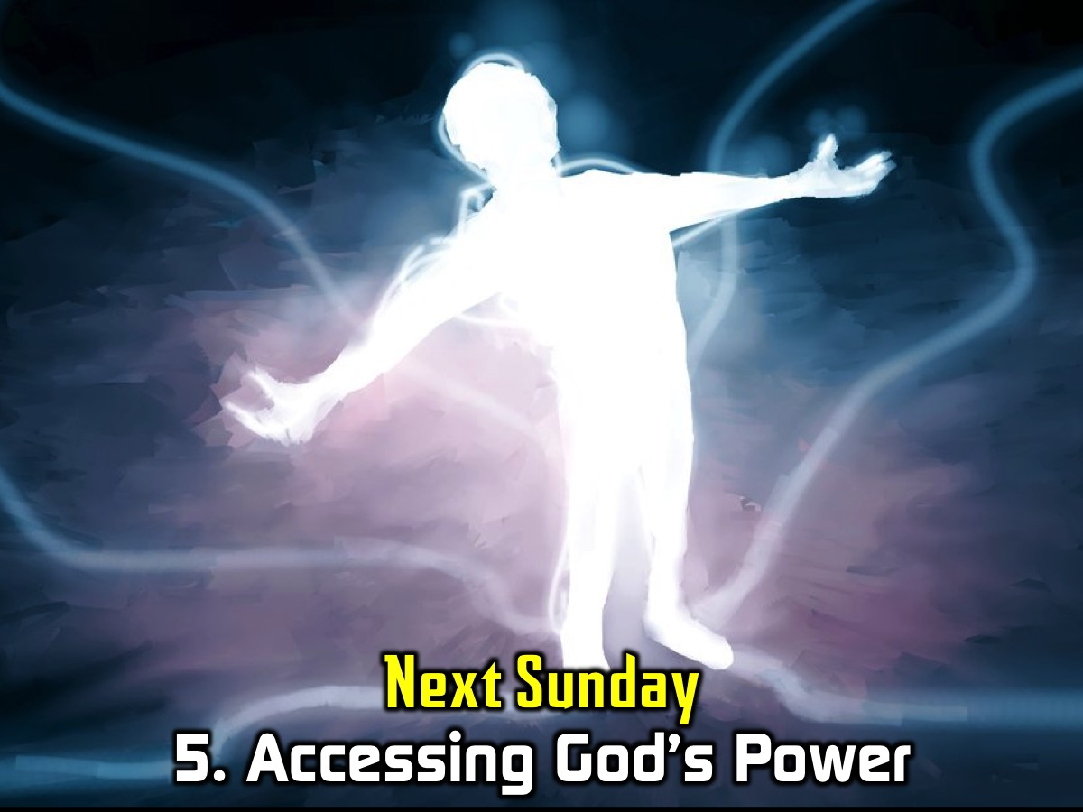
Notes:
5. Accessing God’s Power - next week we will look at how we can actually go about accessing or unleashing God’s Power.

Slide 50
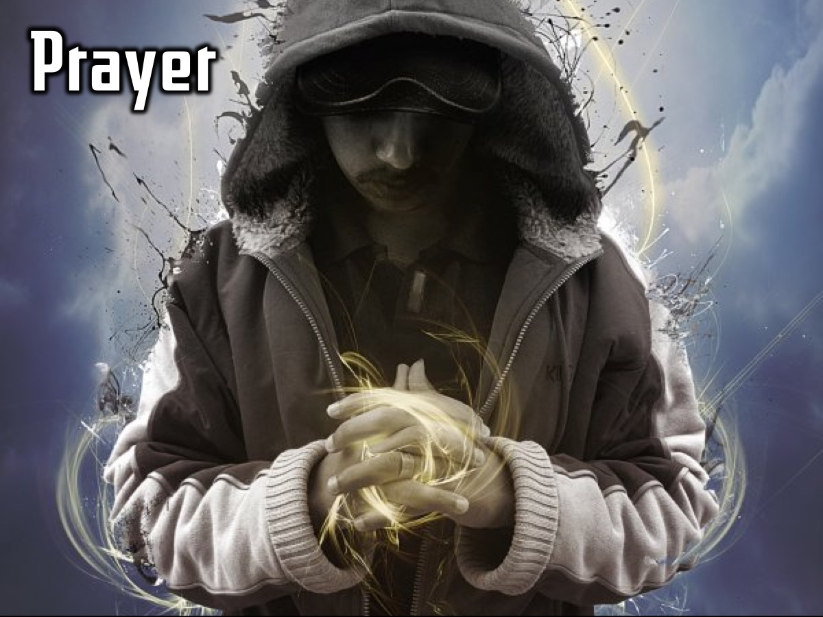
Notes:
Prayer

Slide 51

Notes:
Next Sunday we start the final part of our Trilogy series where we will be looking at the Power of God!

