Slide 1

Notes:
Welcome to Celebration Sunday where will be reviewing the Trilogy series.

Slide 2

Notes:
Can you believe that another term has raced by at His Youth and we have completed the Trilogy Series.

Slide 3

Notes:
To remember our vision statement we are going to have a little race - you will build a puzzle out of the words in the vision statement - and the first table to finish will win a prize!

Slide 4

Notes:
Let say our Vision statement one more time together: “We see lives, communities and society transformed through DISCIPLESHIP in the WORD, the PRESENCE and the POWER of God.”

Slide 5

Notes:
To remember part 1 - the Word - we are going to do a SPECK exercise on a passage of Scripture.

Slide 6
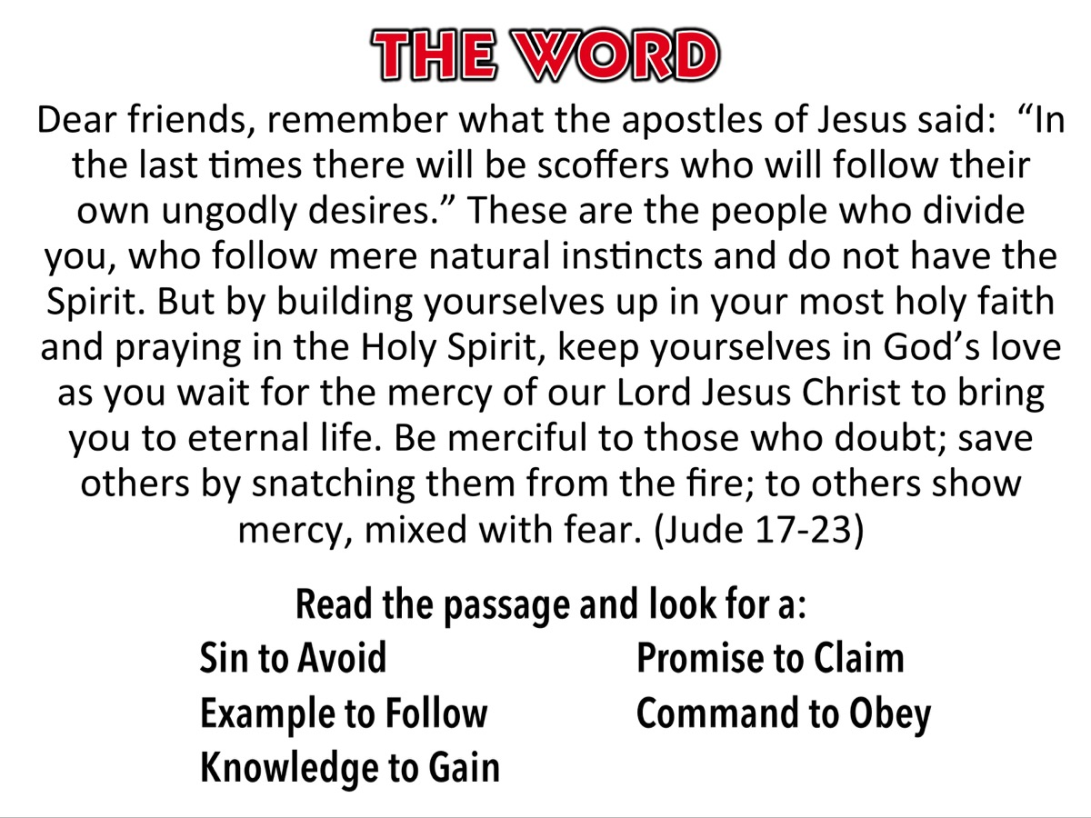
Notes:
Read this passage from Jude 17-23 and look for a Sin to Avoid, a Promise to Claim, an Example to Follow, a Command to Obey, and a Knowledge to Gain. “Dear friends, remember what the apostles of Jesus said: “In the last times there will be scoffers who will follow their own ungodly desires.” These are the people who divide you, who follow mere natural instincts and do not have the Spirit. But by building yourselves up in your most holy faith and praying in the Holy Spirit, keep yourselves in God’s love as you wait for the mercy of our Lord Jesus Christ to bring you to eternal life. Be merciful to those who doubt; save others by snatching them from the fire; to others show mercy, mixed with fear.” (Jude 17-23).

Slide 7
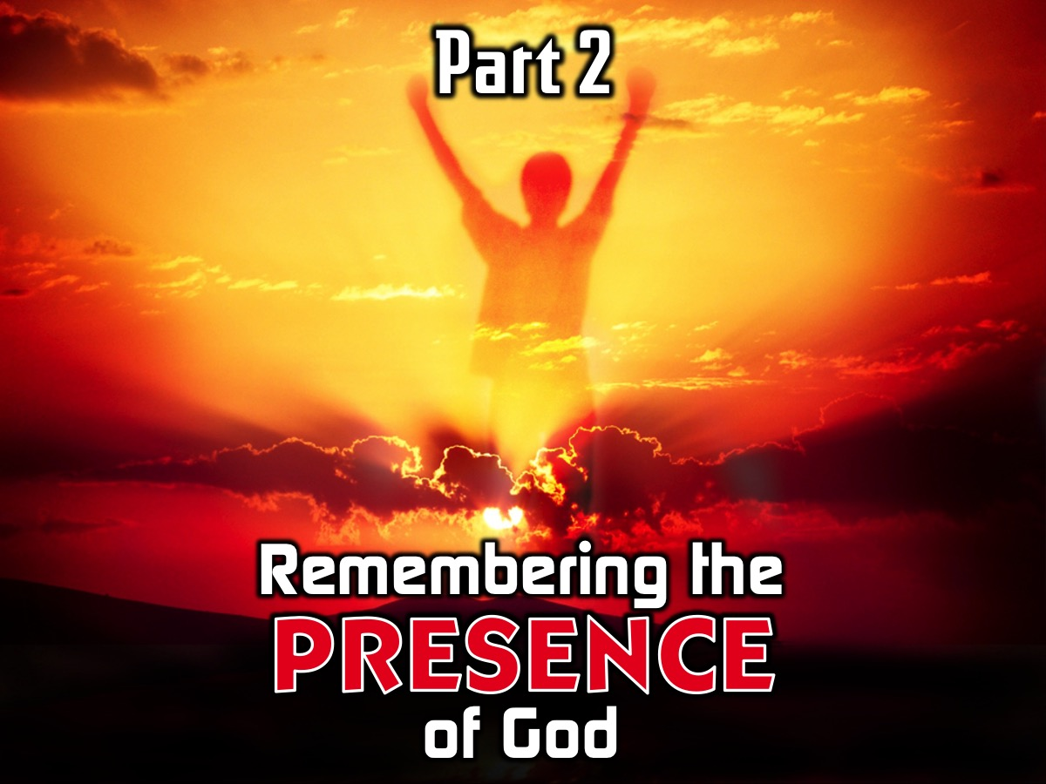
Notes:
To remember Part 2 - the Presence of God we are going to each think of 1 thing we can do in this coming week to remind ourselves that God is always with us.

Slide 8

Notes:
What are some reminders of God’s presence?

Slide 9
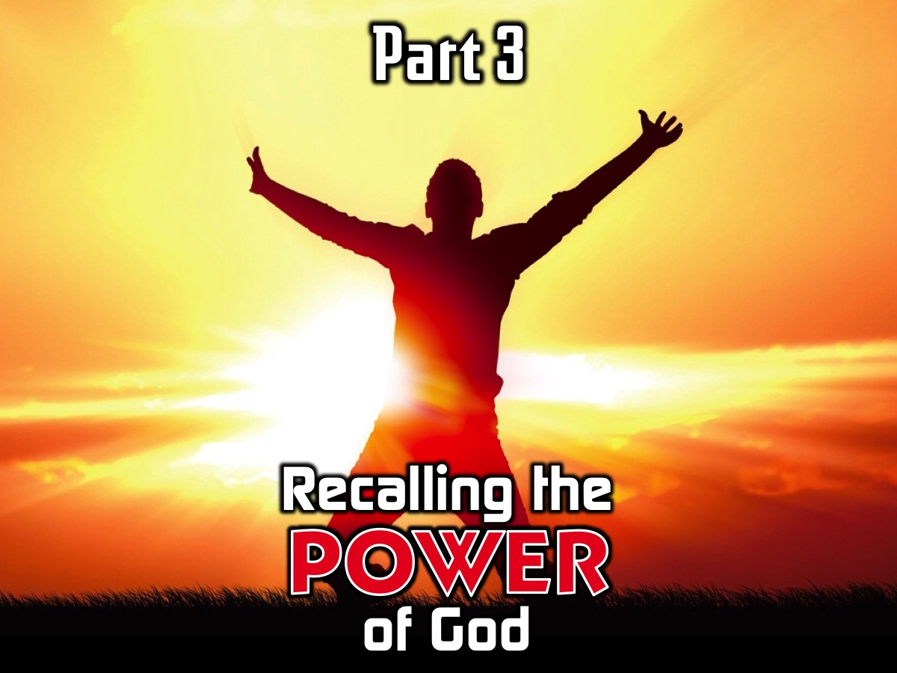
Notes:
To remember the incredible experience we had last week with the Power of God we are going to share testimonies about our experience last week or anything that happened since last Sunday.

Slide 10
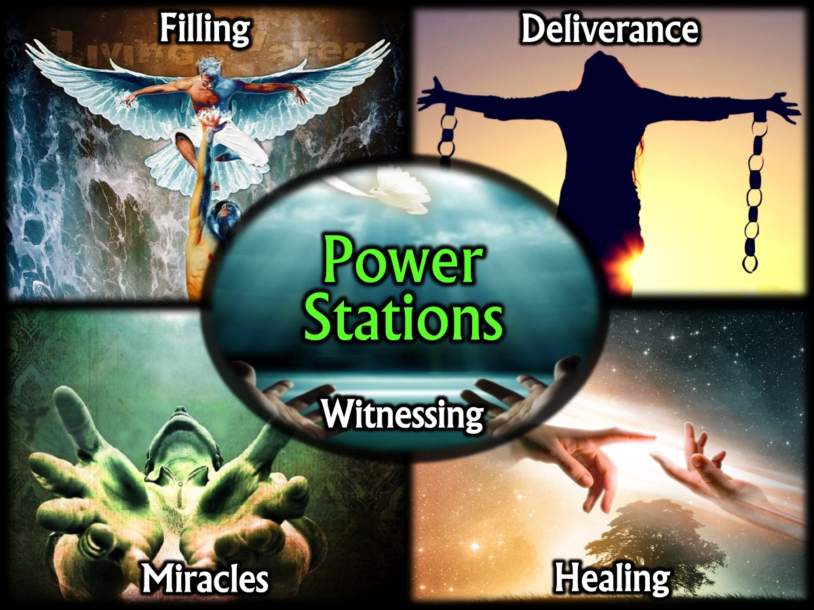
Notes:
What did you experience in one of the five Power Stations?

Slide 11
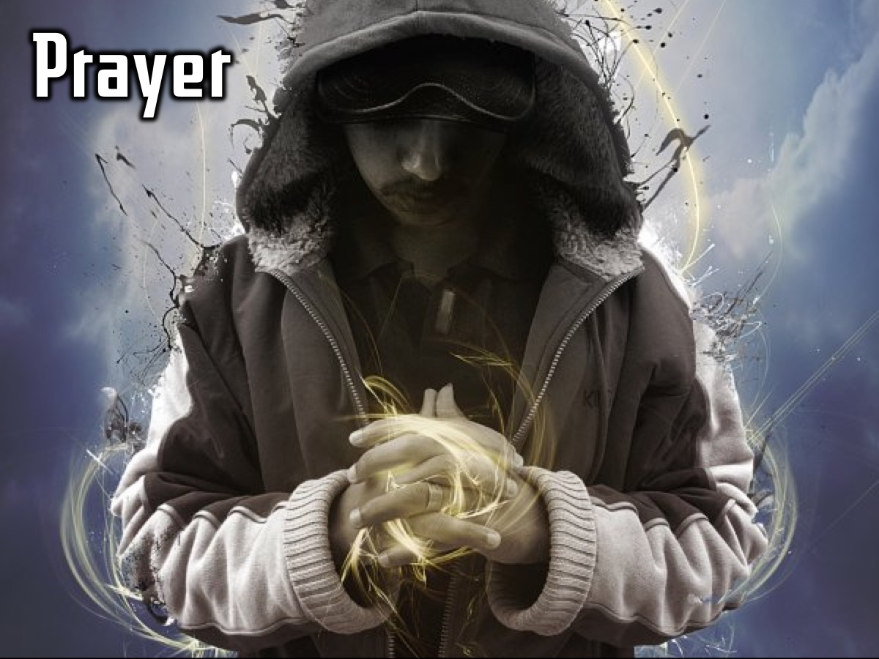
Notes:
Prayer

Slide 12

Notes:
We meet in the Sanctuary until School Reopens on the 26th July.

