Slide 1


Slide 2
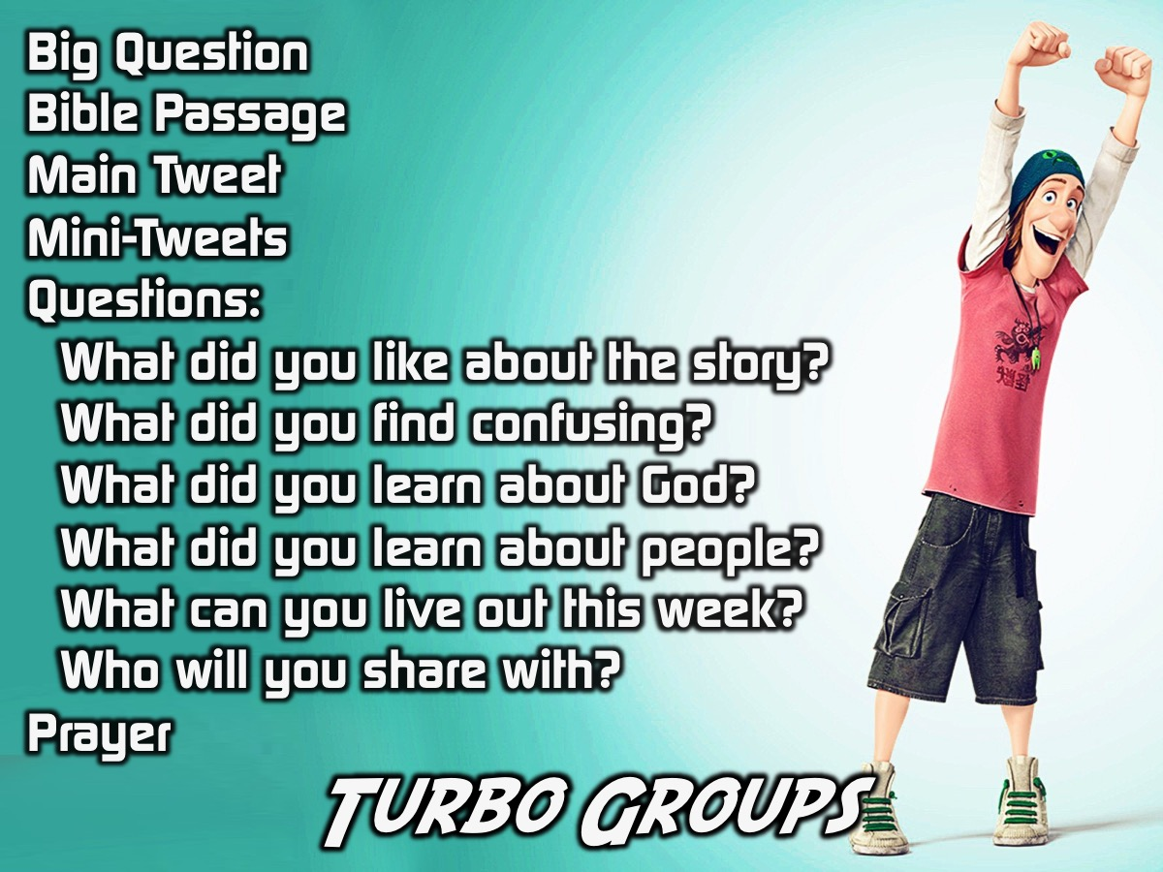
Notes:
In 2015 we rolled out a small group strategy for high schools in partnership with the GodFirst church – starting at Greenside and then at Parktown Boys and Girls. They are called Turbo Groups. Here is an outline for how the small group time works:
(1) Ask the Big Question
(2) Read a Passage
(3) Share the Main Tweet
(4) Share the Mini-Tweets
(5) Join the Conversation Questions:
* What did you like about the story?
* What did you find confusing?
* What did you learn about God?
* What did you learn about people?
* What can you live out this week?
* Who will you share with?
(6) Prayer

Slide 3
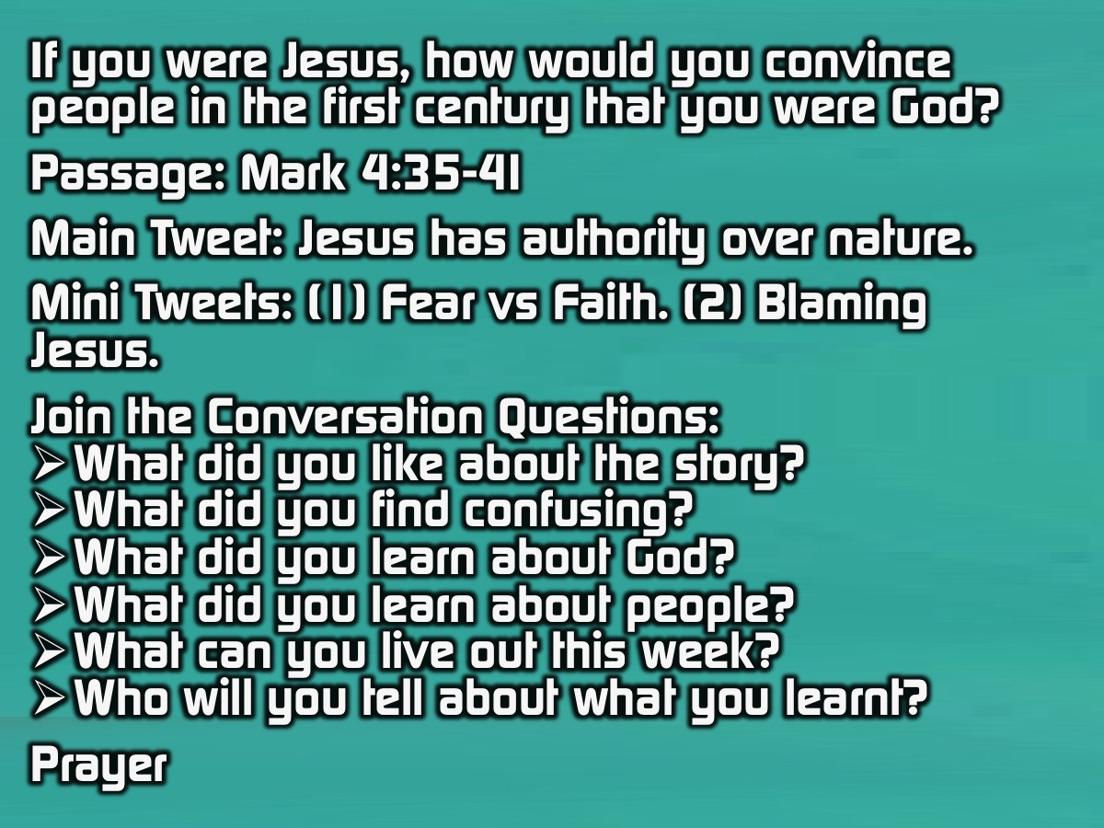
Notes:
Let’s give it a try using a passage from Mark chapter 4:
(1) Big Question: If you were Jesus, how would you convince people in the first century that you were God?
(2) Passage: Mark 4:35-41
(3) Main Tweet: Jesus has authority over nature.
(4) Mini Tweets: (1) Fear vs Faith. (2) Blaming Jesus.
(5) Join the Conversation Questions:
* What did you like about the story?
* What did you find confusing?
* What did you learn about God?
* What did you learn about people?
* What can you live out this week?
* Who will you tell about what you learnt?
(6) Prayer

