Slide 1

Notes:
Utopia Night
Stuff to Buy:
* 4 cans of Coke
* Slabs of chocolates for winning teams
Stuff to Organise:
* Black room dividers
* 4 Tables in youth room
* Crates next to the tables
* Table cloths
During the Night:
* Set up Report back table/chairs for the TASK
* Appoint World leaders

Slide 2
Notes:
Video: Change the World by Eric Clapton. Get it on YouTube: https://www.youtube.com/watch?v=oBIxScJ5rlY

Slide 3
Notes:
Video: Heal the World by Michael Jackson. Get it on YouTube: https://www.youtube.com/watch?v=PC49th-Jf0s

Slide 4
Notes:
Video: Waiting on the World to Change by John Mayer. Get it on YouTube: https://www.youtube.com/watch?v=oBIxScJ5rlY

Slide 5
Notes:
Video: That’s How We Change the World by the Newsboys. Get it on YouTube at: https://www.youtube.com/watch?v=WtkTXBTTcAw

Slide 6
Notes:
Welcome to Utopia Night.

Slide 7
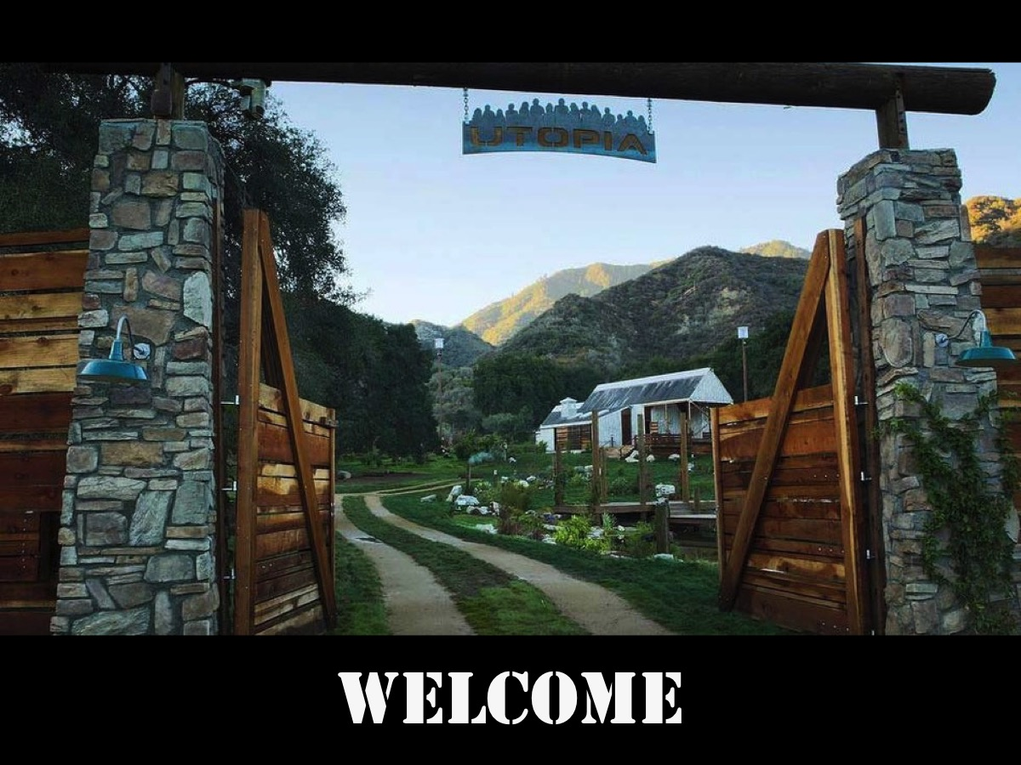
Notes:
Welcome to regulars and to our newcomers.

Slide 8
Notes:
Video: Utopia Series Trailer. Get it on YouTube at: Get it on YouTube at: https://www.youtube.com/watch?v=e3fu7j02Mks

Slide 9


Notes:
The Current Reality: The world is a mess! There are incurable diseases everywhere; people are poor and hungry; people are lazy and unproductive; and people are generally sad and depressed!

Slide 10
Notes:
Video: Avengers: Age of Ultron Trailer. Get it on YouTube at: https://www.youtube.com/watch?v=tmeOjFno6Do
(An example of a world in turmoil)

Slide 11

Notes:
It does not have to be like this!

Slide 12
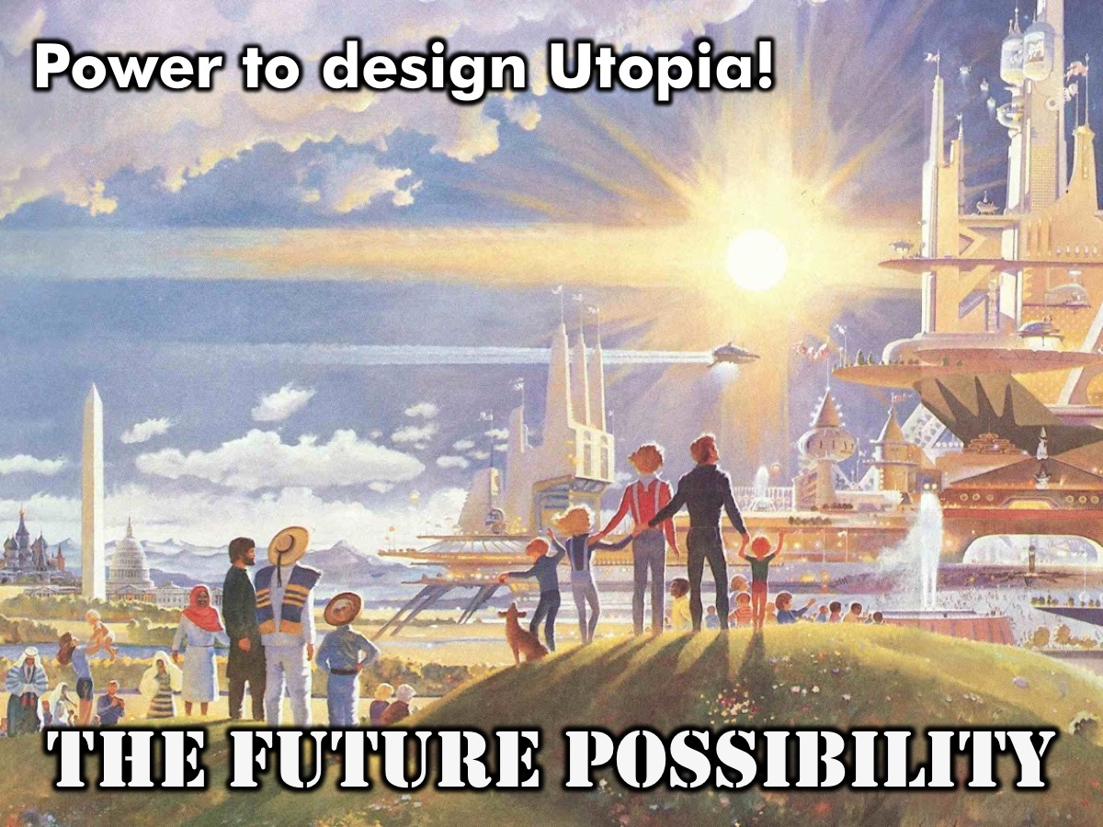
Notes:
The Future Possibility: You have been given the power to design a brand new world – a utopia (heaven on earth). You are not just going to see the future - you are going to make the future.

Slide 13

Notes:
Utopia is a place or a state or condition that is perfect in respect of politics, laws, customs and conditions.

Slide 14
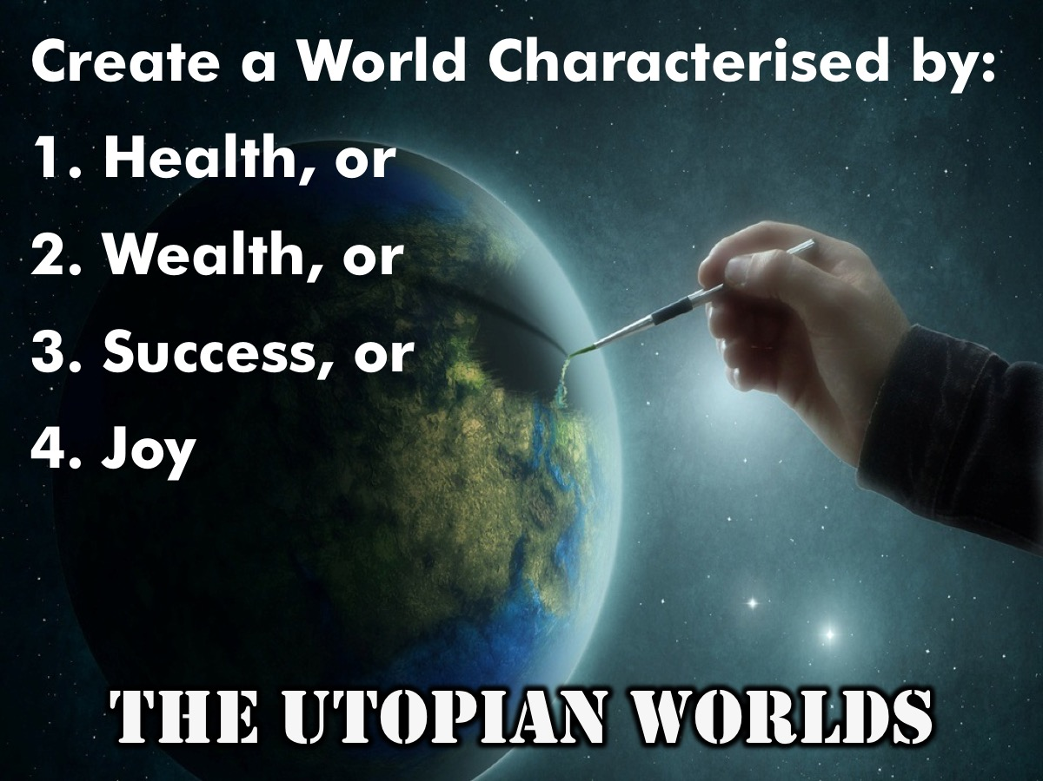
Notes:
The Utopian Worlds: You will be divided into four groups and each group will create one of the following worlds:
1. A World characterized by HEALTH
2. A World characterized by WEALTH
3. A World characterized by SUCCESS
4. A World characterized by JOY
(Each person is given one of four coloured elastic bands to wear representing each of the four worlds.

Slide 15
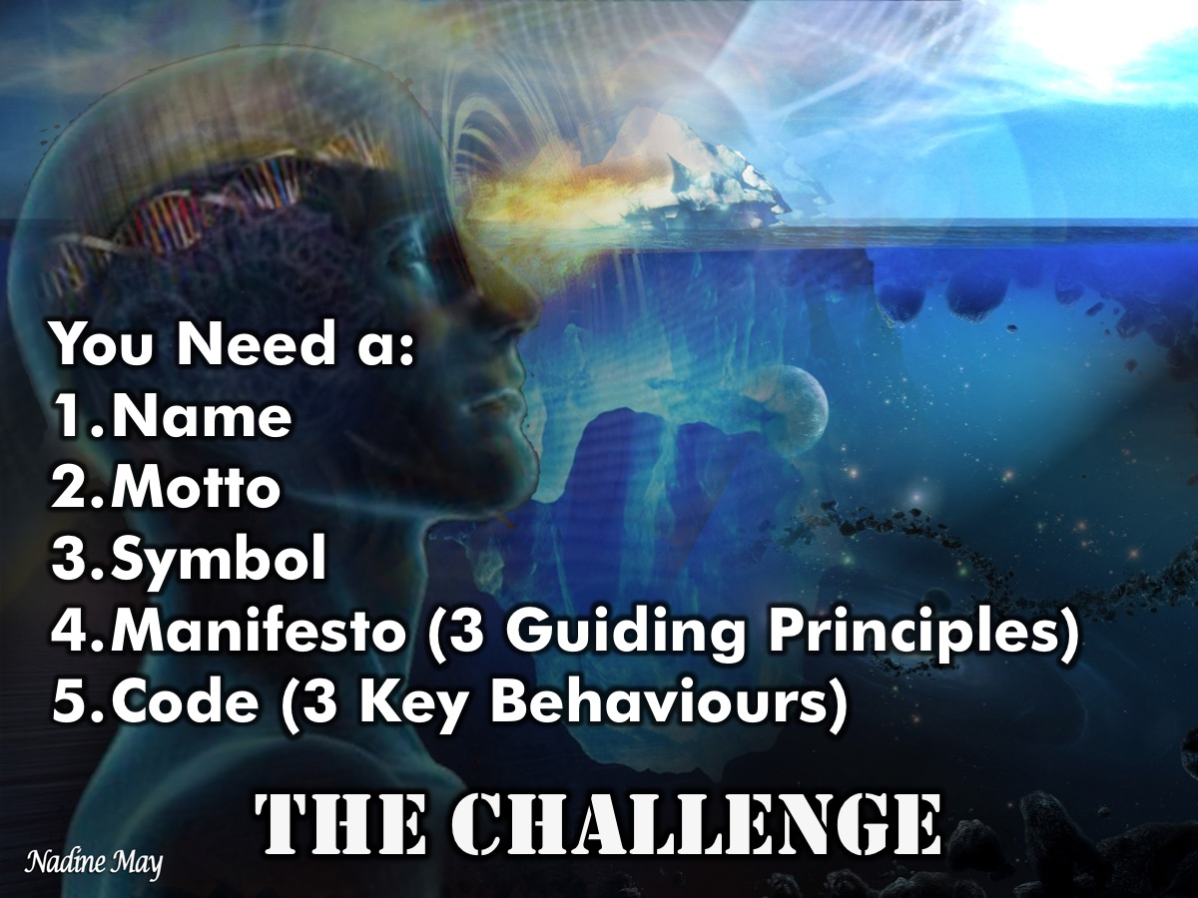
Notes:
You will have to come up with the following items for your world:
1. A Name
2. A Motto
3. A Symbol
4. A Manifesto: 3 Guiding Principles
5. A Code: 3 Key Behaviours
(Each group will work at a table in front of a room divider – the table has a large piece of paper, pens, markers, pastels and also sweets as rewards as each of the 5 items are created)

Slide 16
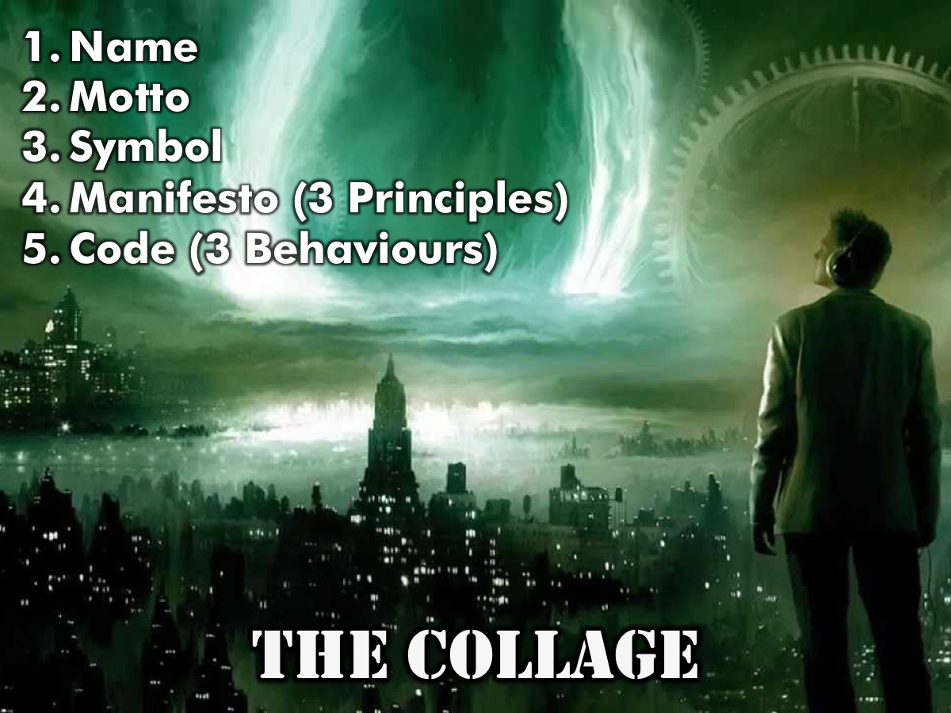
Notes:
The Collage: Each group will draw these elements onto their white board on the wall – using words and images.

Slide 17

Notes:
The Presentation: Each group will have 2 minutes to share their world with the architects of the other worlds – in front of their murals.

Slide 18

Notes:
The Games: We will play three different games – and each world will send a person(s) to play on their behalf. The winning world will be rewarded. They will have to play in a way that is in line with the manifesto and code of conduct of their world – and as far as possible it must be extended to cover everything that is taking place in the room and not just how they play the games.

Slide 19
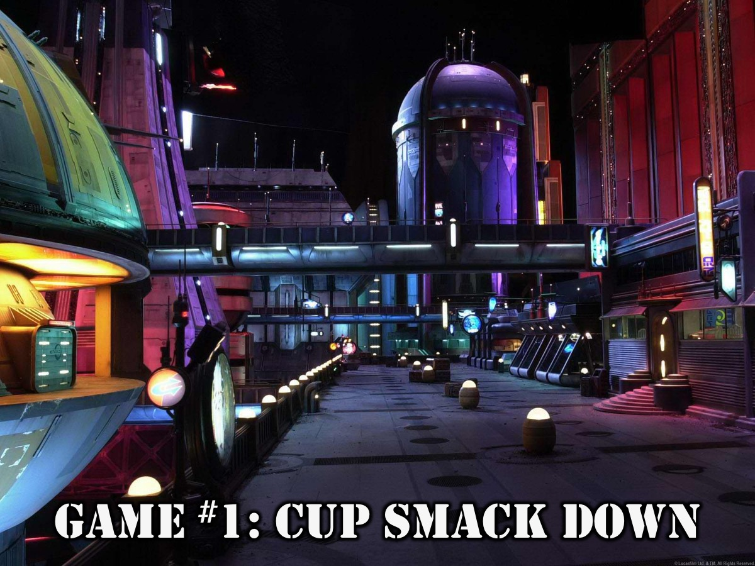
Notes:
Game 1: Cup Smack Down – Each team sends a contestant into the arena and they are given a small tray and a cup which they must keep on the tray as they try to knock their opponents cups to the ground. The last one with their cup on their tray wins a prize.

Slide 20
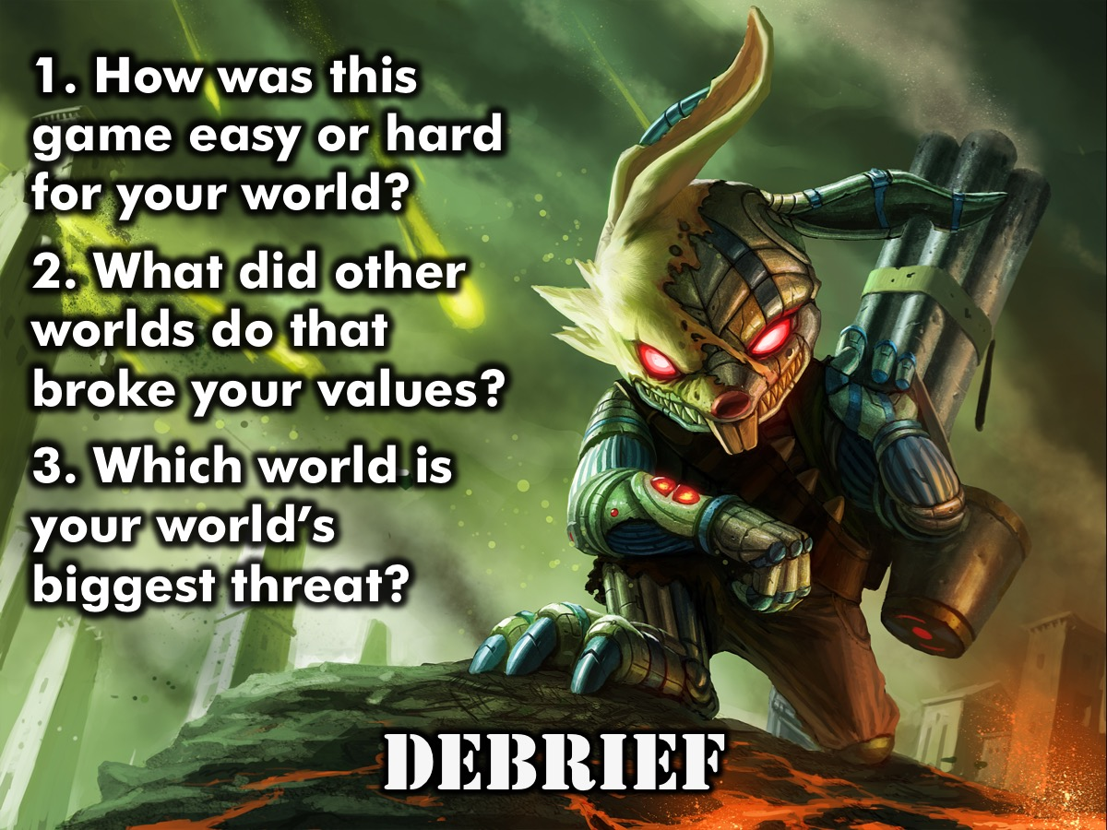
Notes:
The Debrief:
1. How was this game easy or hard for your world?
2. What did other worlds do that broke your values?
3. Which world is your world’s biggest threat?

Slide 21
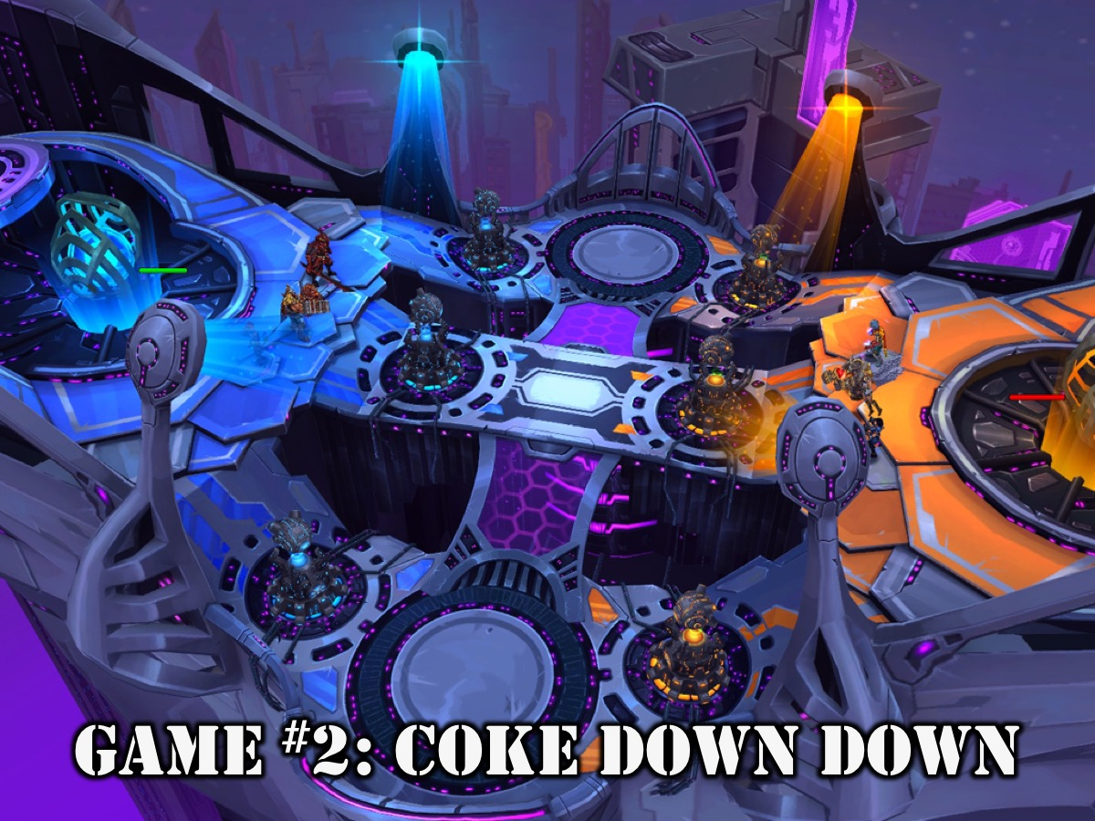
Notes:
Game 2: Coke Down Down. Each team sends a contestant into the area to down a Coke – the first one finished wins a prize.

Slide 22
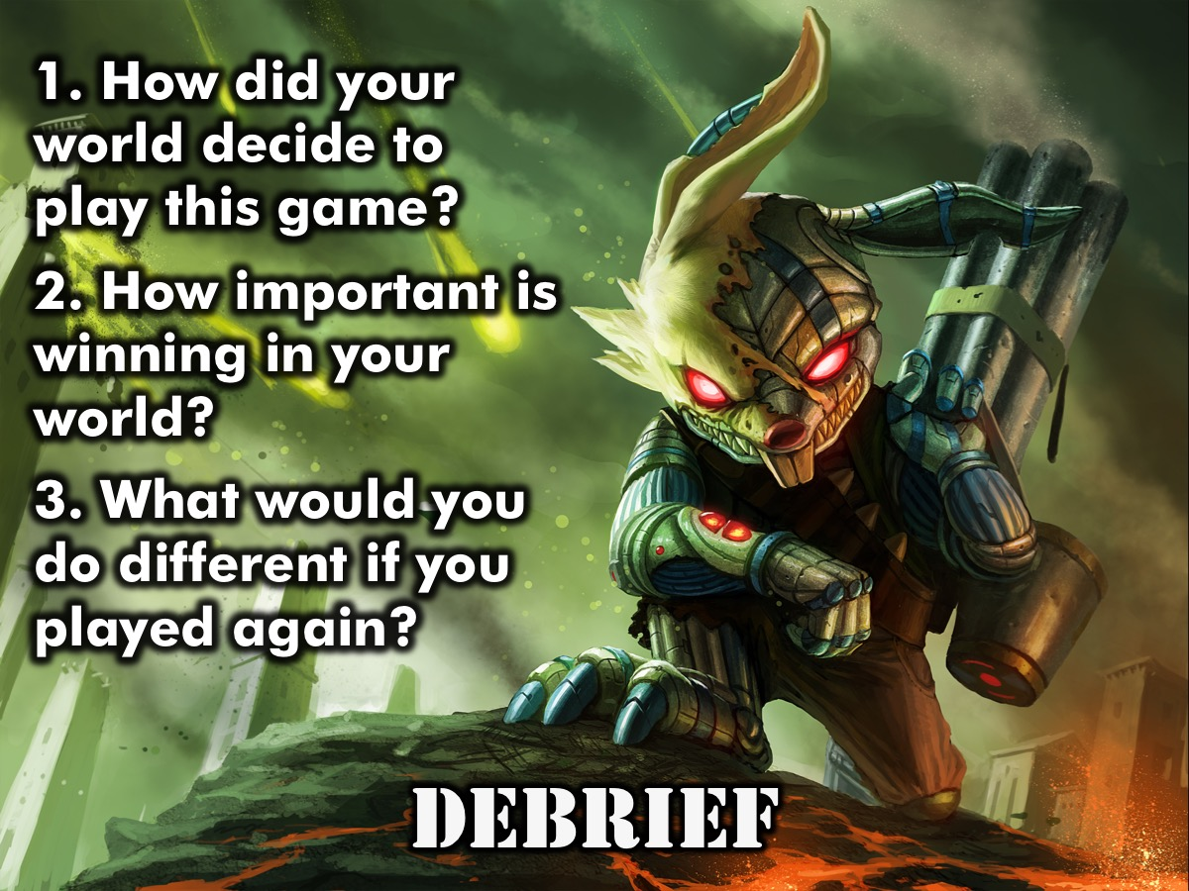
Notes:
Game Debrief:
1. How did your world decide to play this game?
2. How important is winning in your world?
3. What would you do different if you played again?

Slide 23
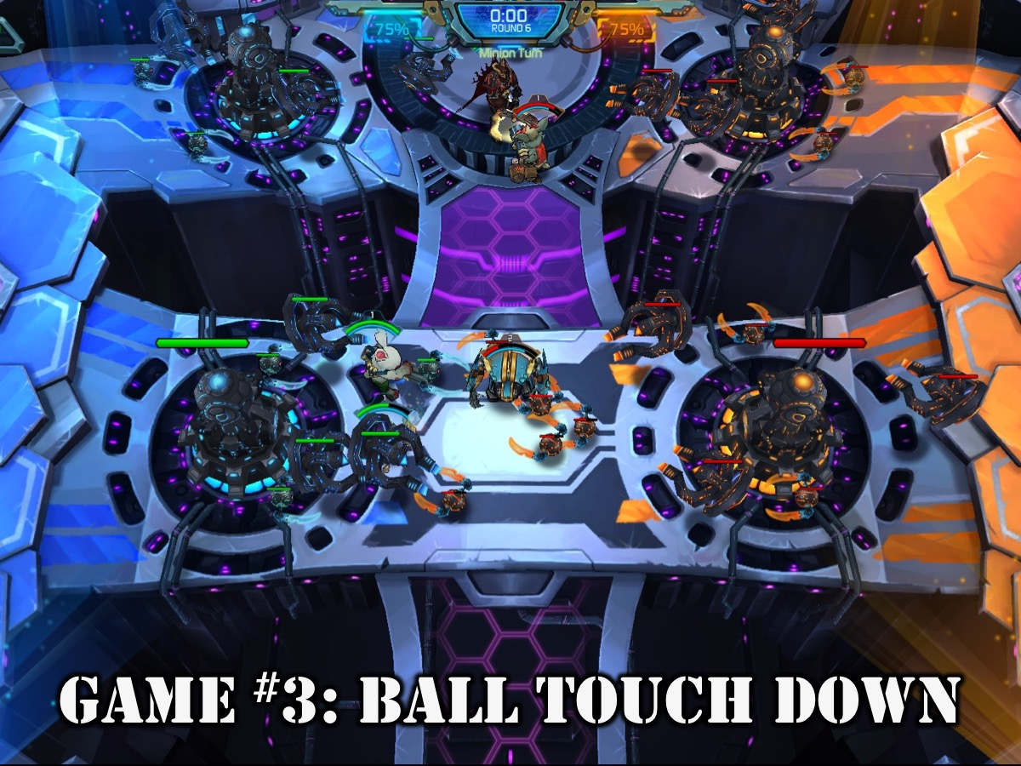
Notes:
Game 3: Ball Touch Down – play a game of netball using four goals (a person standing on the crate catches the ball that is thrown to them to score a goal). The goal is to score goals while preventing other teams from scoring goals. The team who scores the most goals in 3 minutes wins a prize.

Slide 24
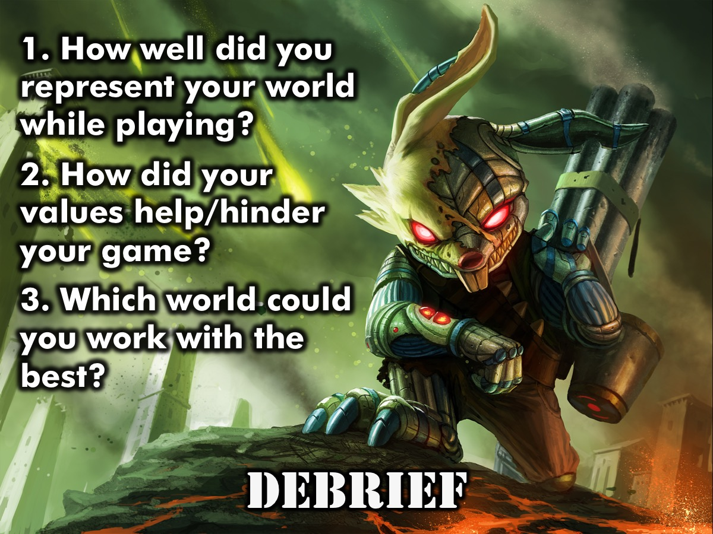
Notes:
Game Debrief:
1. How well did you represent your world while playing?
2. How did your values help/hinder your game?
3. Which world could you work with the best?

Slide 25
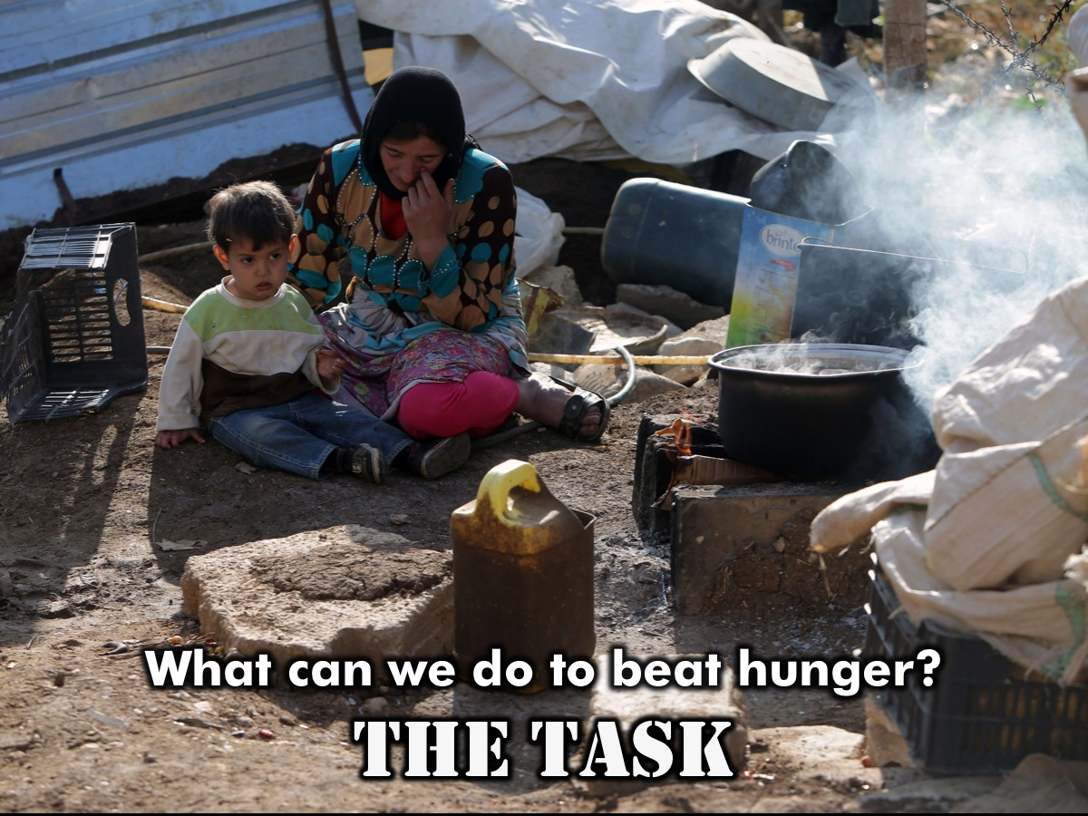
Notes:
The Task: We are going to tackle an issue in the world today: What can we do to beat hunger? Each group must put forward a solution based on their world’s values.

Slide 26

Notes:
Feedback: Set up a table in the middle of the room with four chairs around it and invite one person from each group to sit around the table and read the solution their team came up with.

Slide 27

Notes:
Small Group Time Questions:
1. What did you learn about making a better world tonight?
2. What do these verses say about our responsibility to be world changers?
3. What can you do personally next week to make the world a little better?
4. Pray that God will use us to change the future of the world!
Scriptures About Changing the World
1. Then God blessed them and said, “Be fruitful and multiply. Fill the earth and govern it. Reign over the fish in the sea, the birds in the sky, and all the animals that scurry along the ground.” (Genesis 1:28)
2. “I will bless those who bless you, and whoever curses you I will curse; and all peoples on earth will be blessed through you.” (Genesis 12:3)
3. “You are the salt of the earth, but if salt has lost its taste, how shall its saltiness be restored? It is no longer good for anything except to be thrown out and trampled under people's feet.” (Matthew 5:13)
4. “You are the light of the world. A city set on a hill cannot be hidden. . . . So let your light shine before others, so that they may see your good works and give glory to your Father who is in heaven.” (Matthew 5:14,16)
5. “Do not be overcome by evil, but overcome evil with good.” (Romans 12:21)

Slide 28

Notes:
Next Friday night is Star School.

Slide 29

Notes:
Refreshments.

