Slide 2
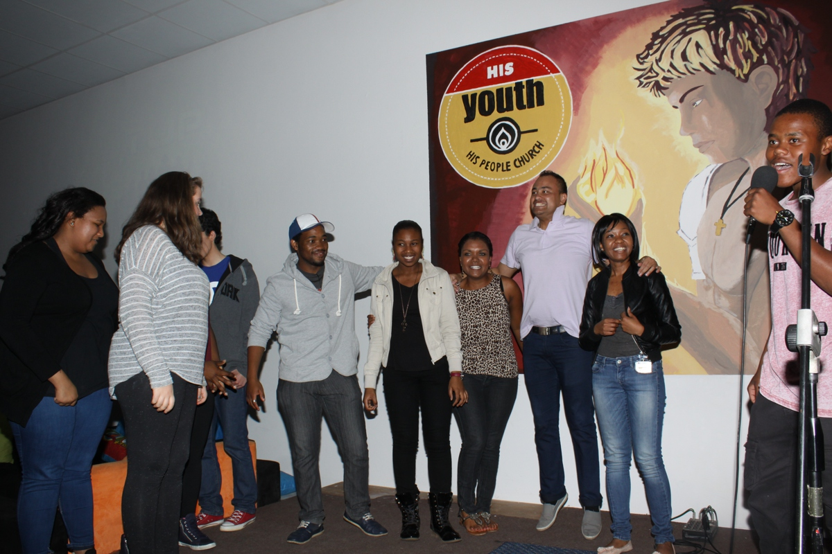
Notes:
Welcome of newcomers

Slide 3
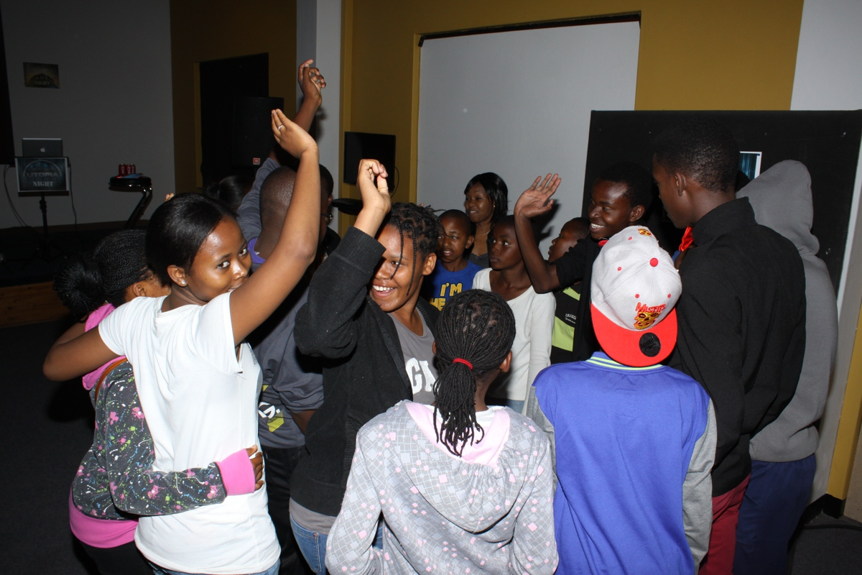
Notes:
Teens forming groups

Slide 4
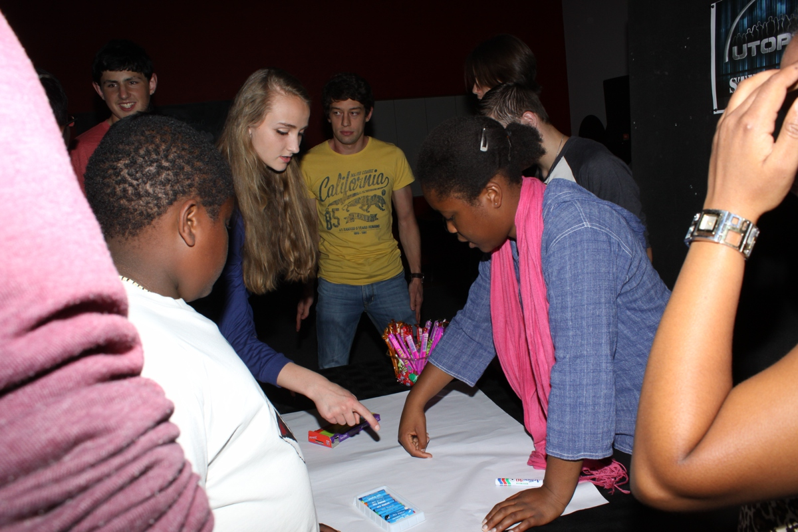
Notes:
Teens creating their world collage

Slide 5
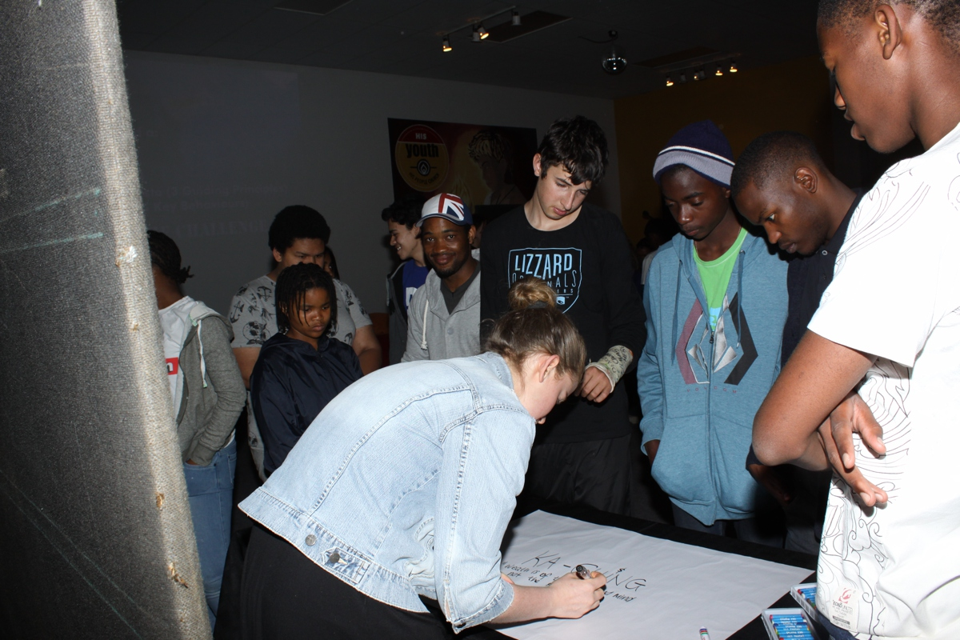

Slide 6
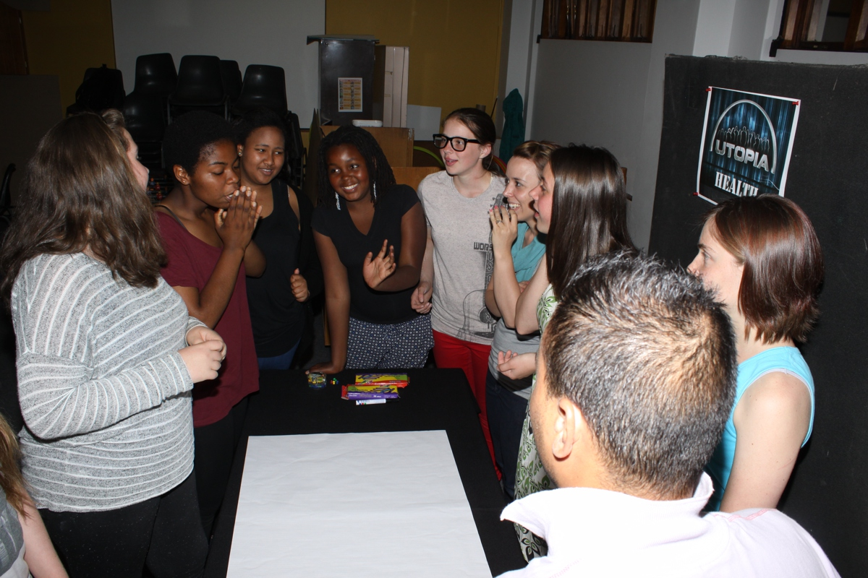

Slide 7
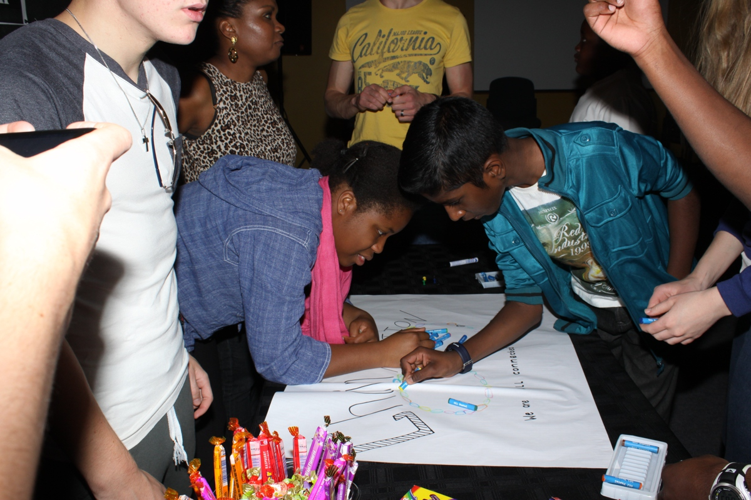

Slide 8
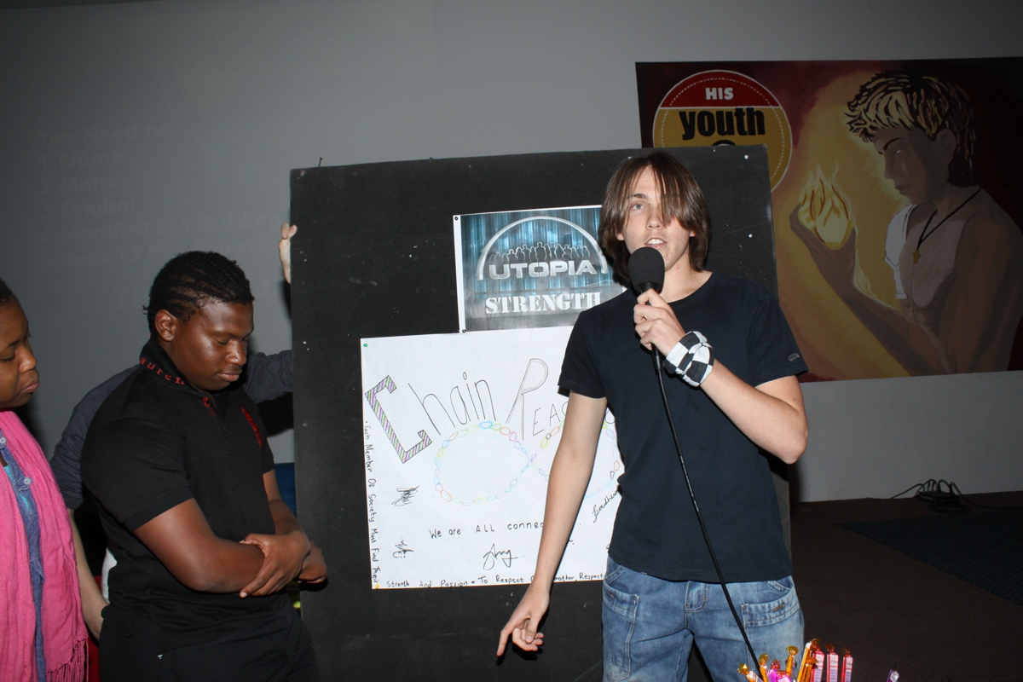
Notes:
Teens presenting their Utopia world collage

Slide 9
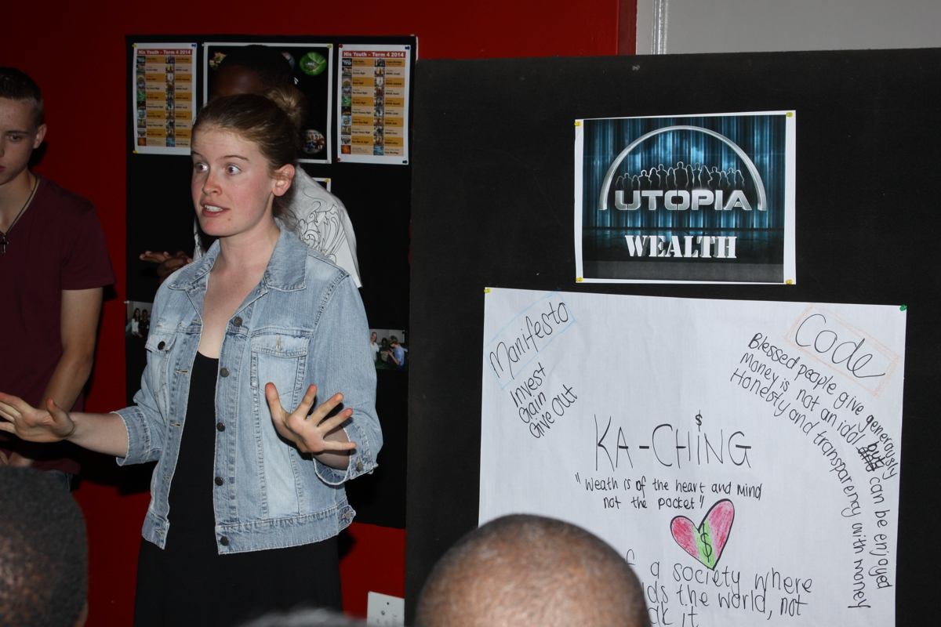
Notes:
Teens presenting their Utopia world collage

Slide 10
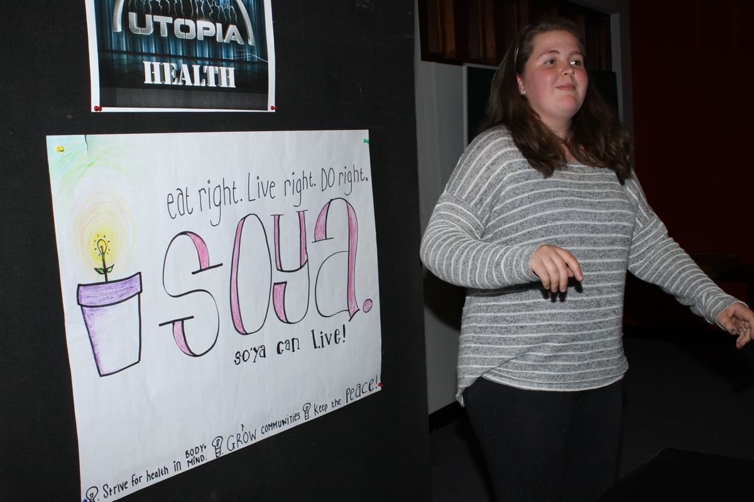
Notes:
Teens presenting their Utopia world collage

Slide 11
Notes:
Teens presenting their Utopia world collage

Slide 12
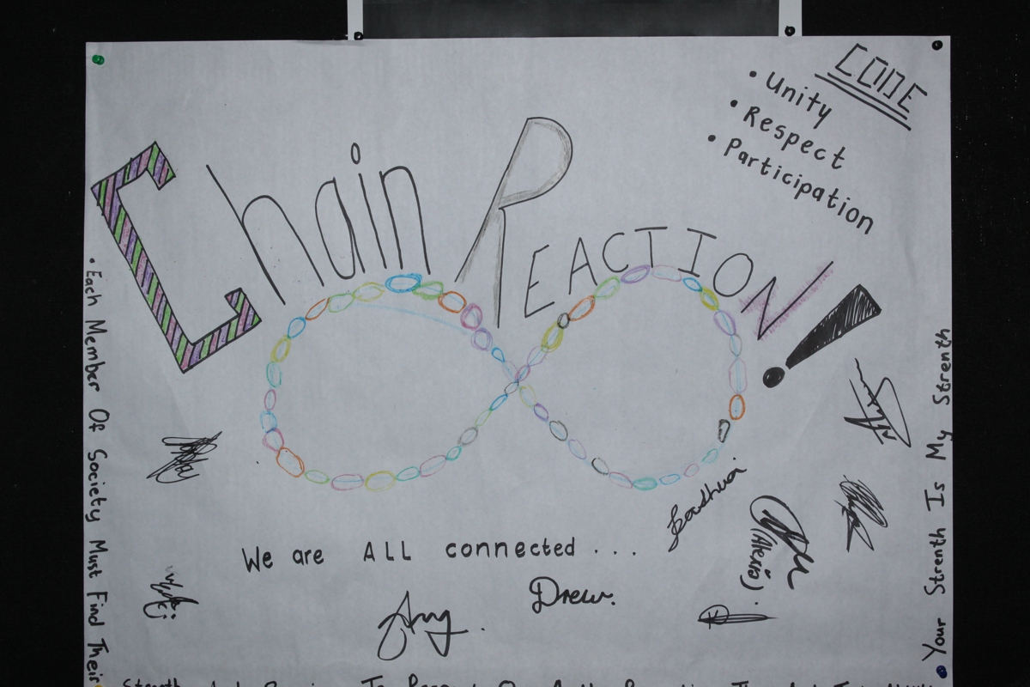
Notes:
A completed Utopia world collage

Slide 13
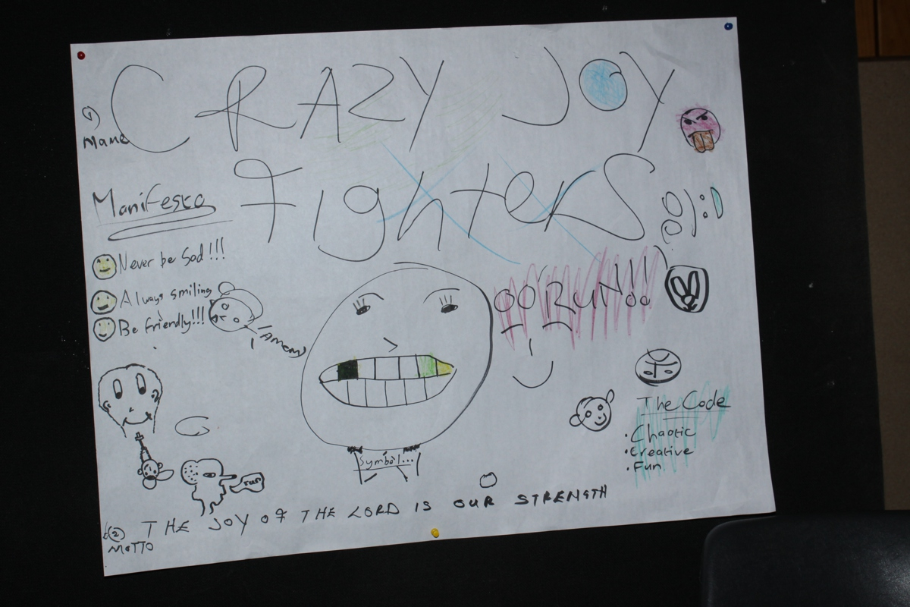
Notes:
A completed Utopia world collage

Slide 14
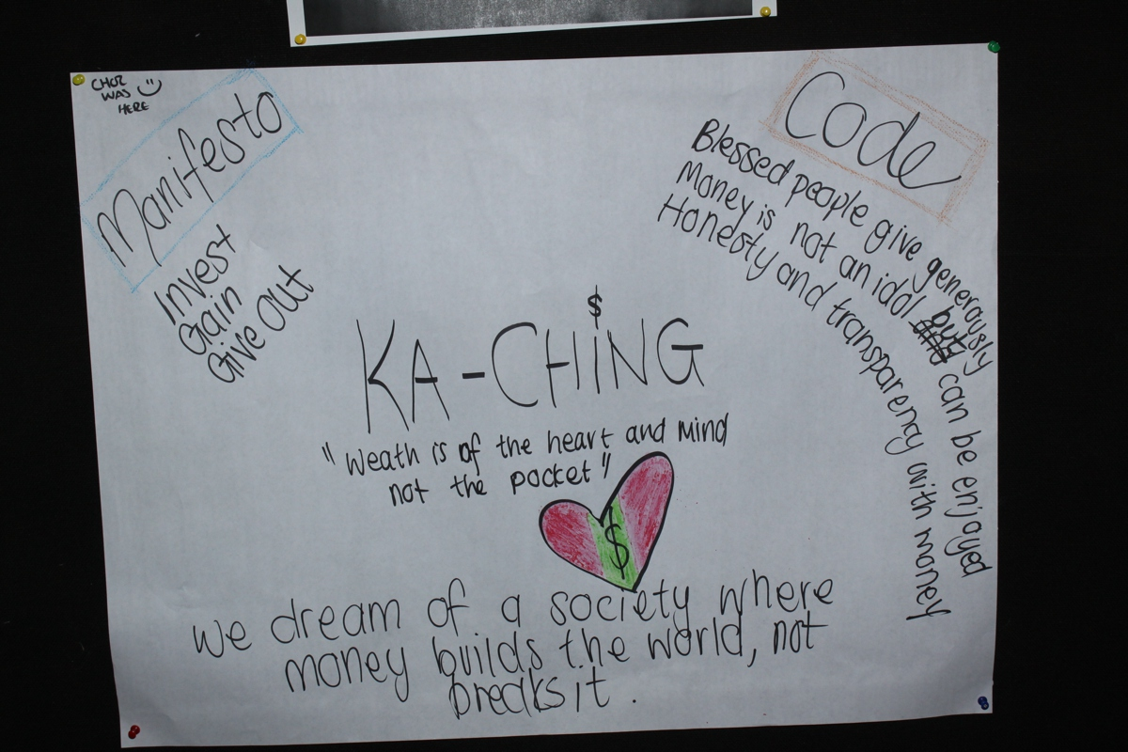
Notes:
A completed Utopia world collage

Slide 15
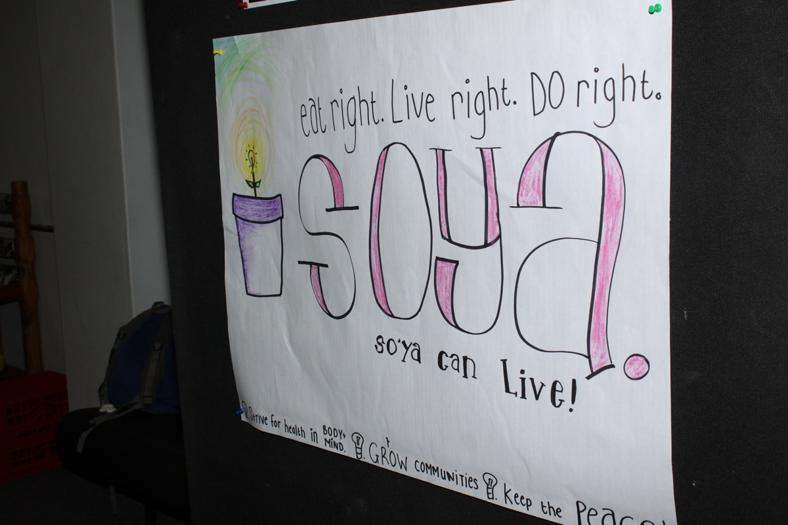
Notes:
A completed Utopia world collage

Slide 16
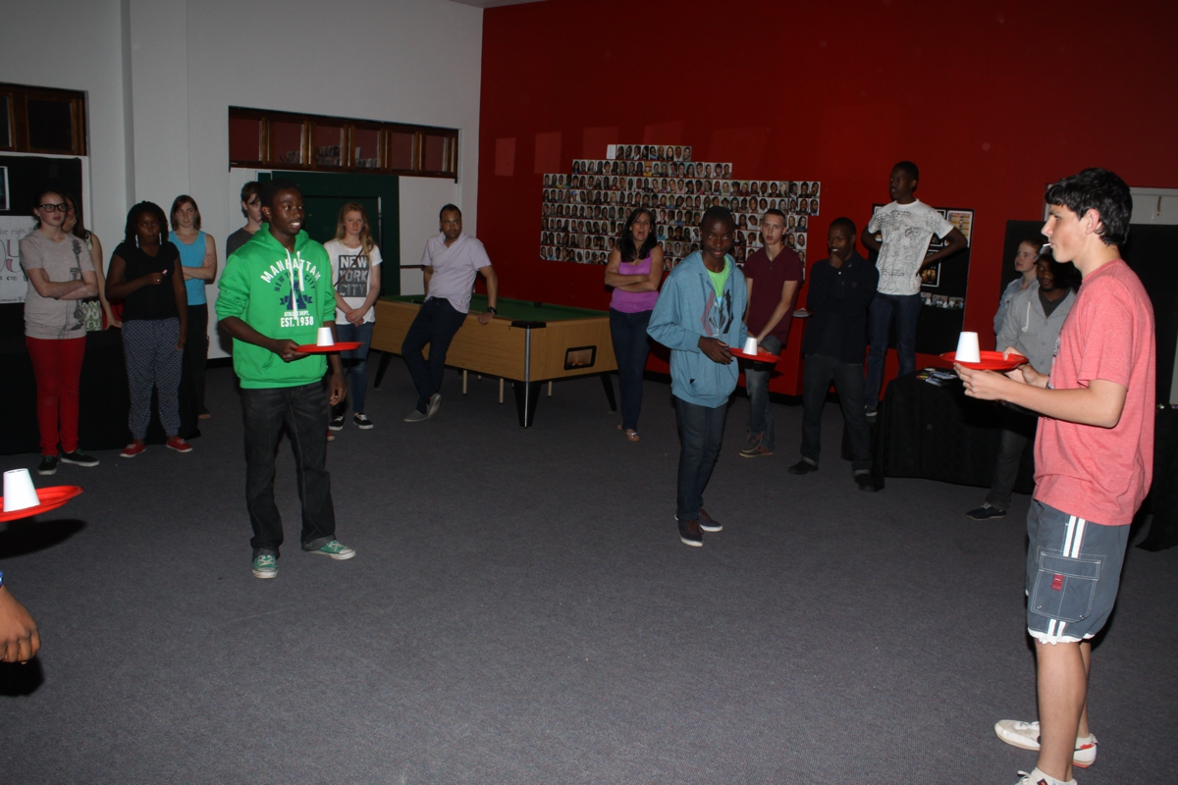
Notes:
The first inter-utopia challenge: cup smack down

Slide 17
Notes:
A prize for the winning Utopia

Slide 18
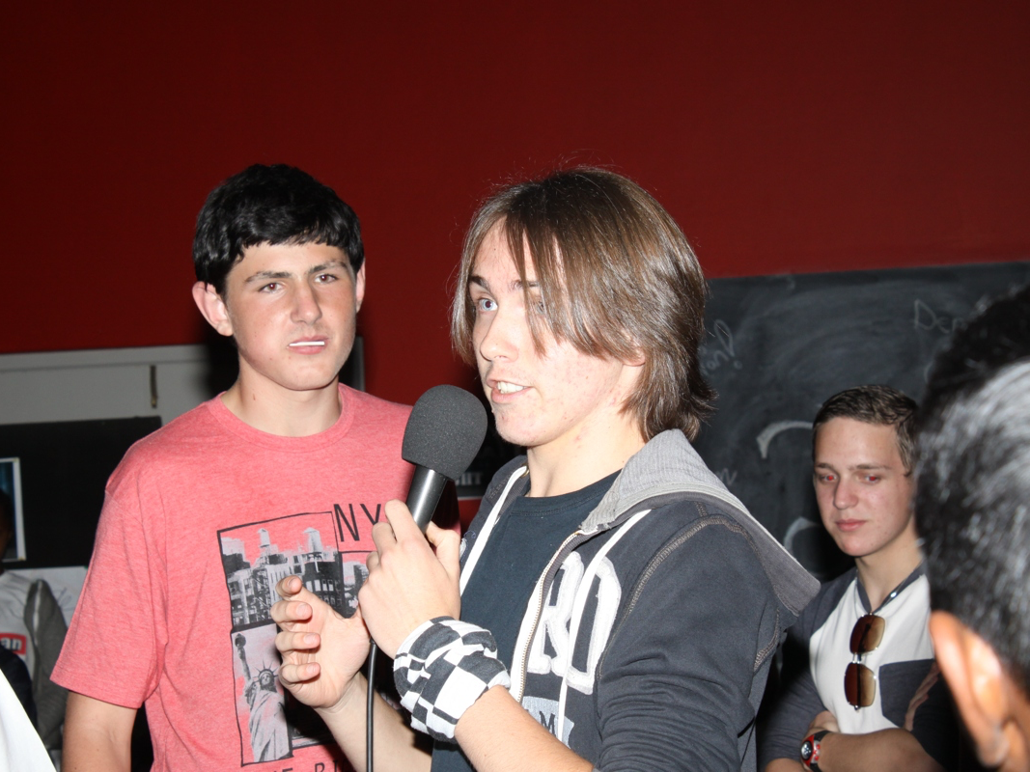
Notes:
The debrief after the game.

Slide 19
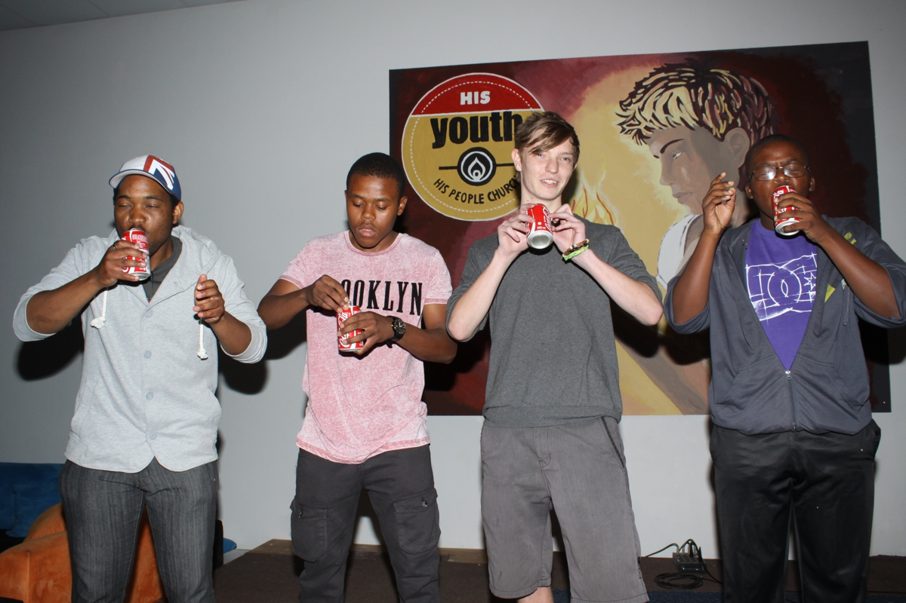
Notes:
The second inter-utopia challenge: Coke down down

Slide 20
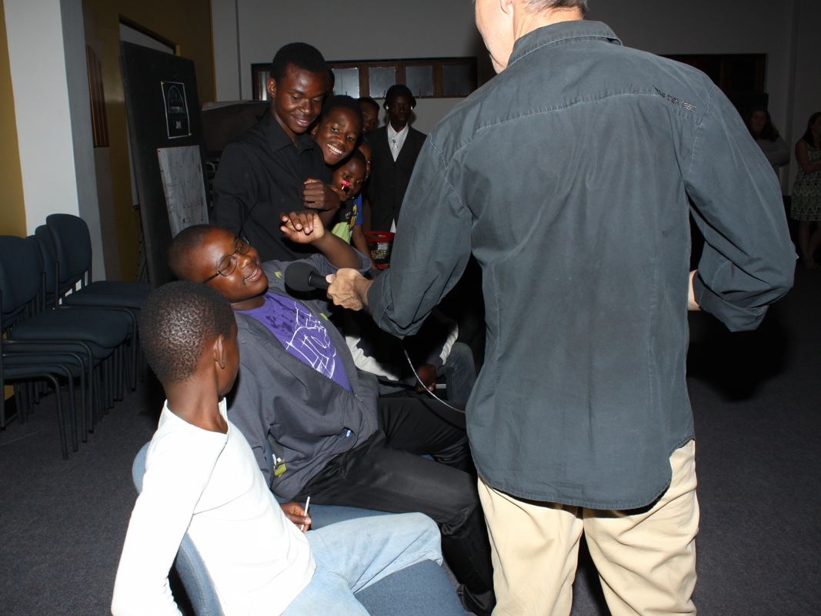
Notes:
The debrief after the game.

Slide 21
Notes:
The third inter-utopia challenge: Ball touch down

Slide 22
Notes:
The debrief after the game.

Slide 23
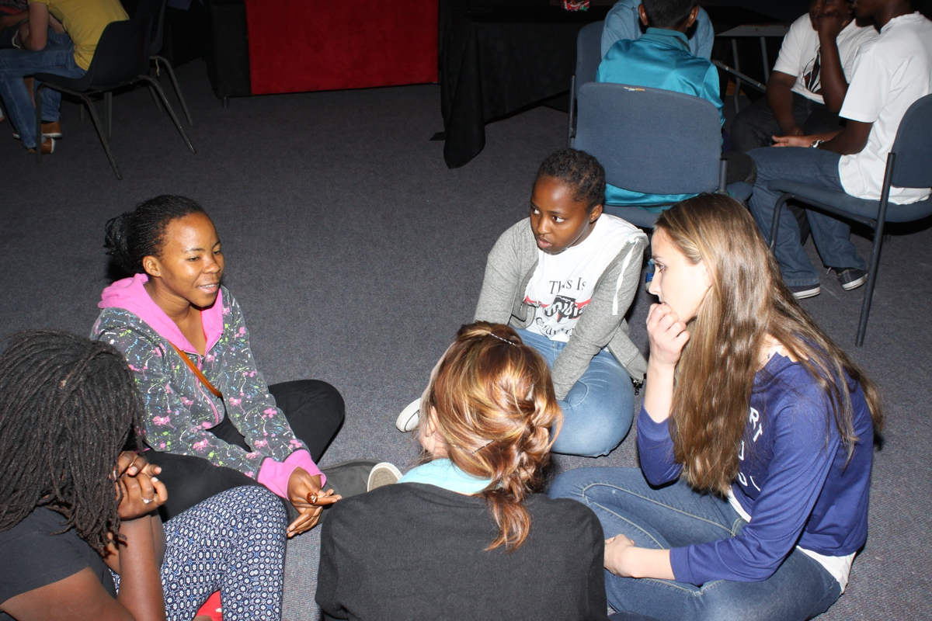
Notes:
Small group time.

Slide 24
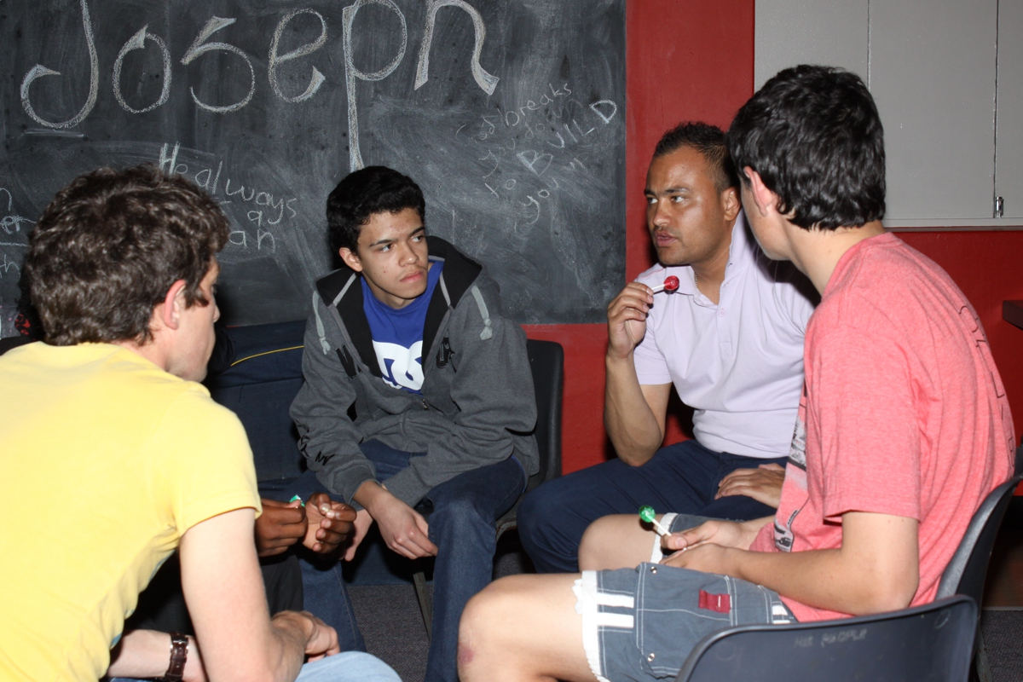
Notes:
Small group time.

Slide 25
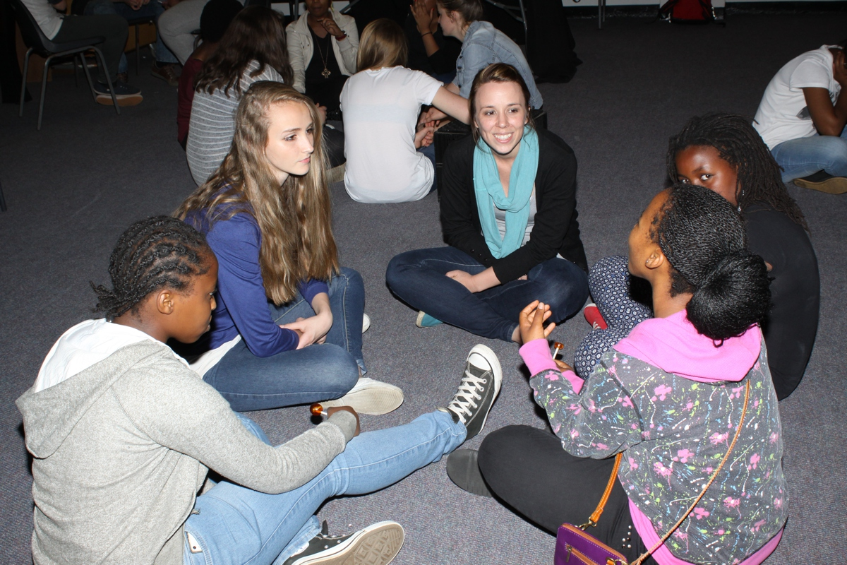
Notes:
Small group time.

Slide 26
Notes:
Small group time.

