Slide 1

Notes:
This week is Valentines Night.

Slide 2

Notes:
Welcome to Escape Friday.

Slide 3

Notes:
On Sunday morning in our Breakout Series we are dealing with Heartache.

Slide 4
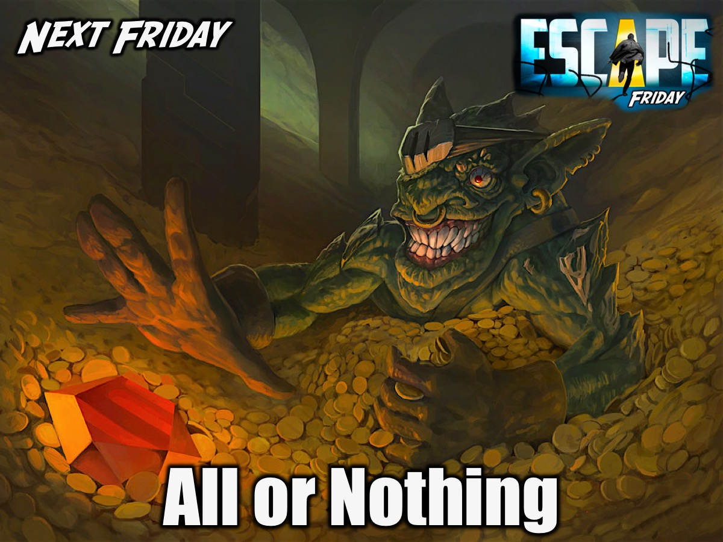
Notes:
Next Friday is All or Nothing Night.

Slide 5
Notes:
Tonight is our Valentines Night.

Slide 6
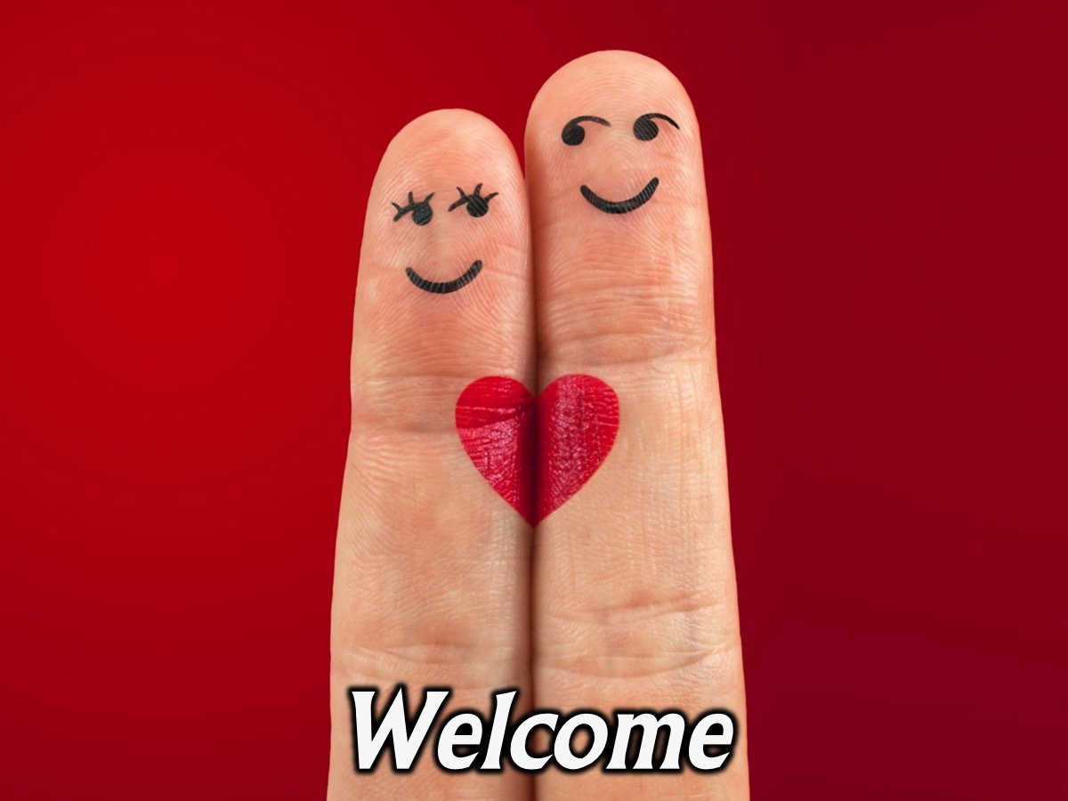
Notes:
Welcome to newcomers and regulars.

Slide 7
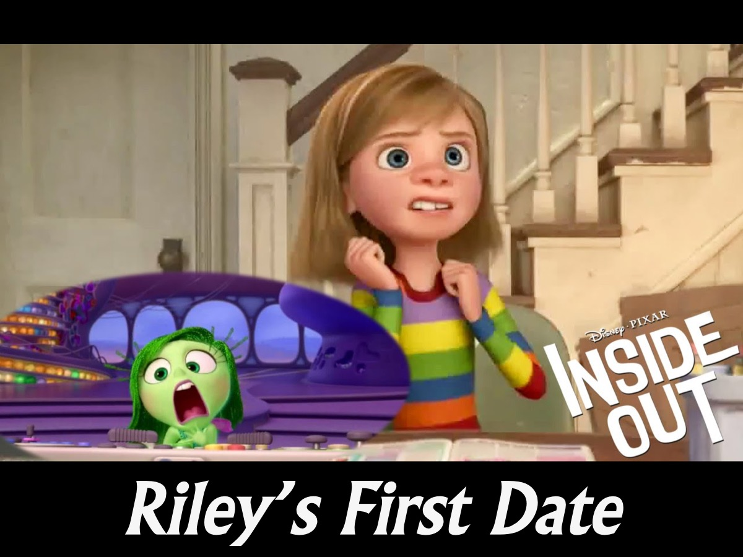
Notes:
Video: Because it is Valentine’s Day on Sunday we are going to watch a short from the movie Inside Out called Riley’s First Date. If you have not seen the movie all you need to know is that while we watch what is taking place in the real world we get views of what is going on in the charaters minds with emotions that are represented by different characters.

Slide 8
Notes:
Riley’s First Date Short. Get it from the Inside Out DVD.
Video Length: 4:30

Slide 9
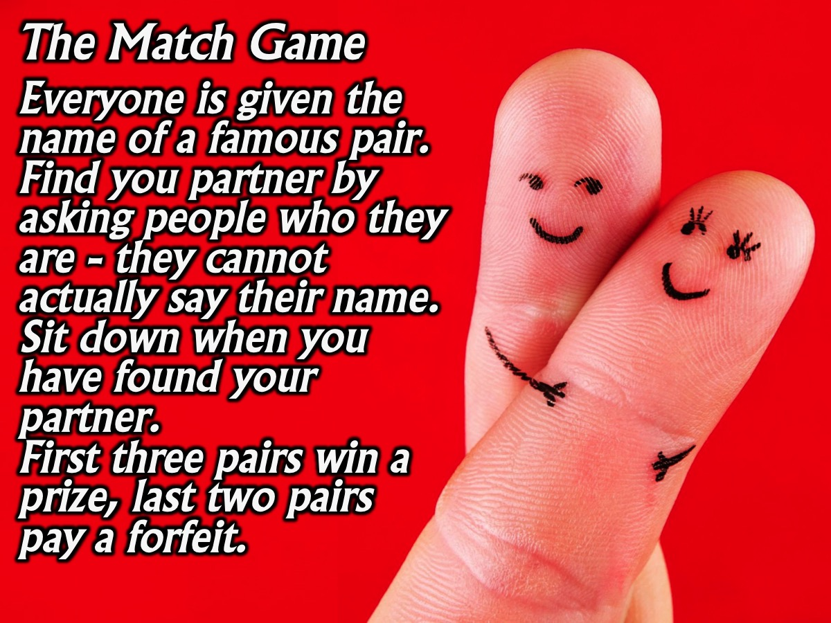
Notes:
1. The Match Game. Each teen is given the name of a famous pair (like Minnie and Mickey) and they have to go around and they have to go around and find their partner. They have to ask people who they are and the person has to answer without actually using their name. When their find their partner they sit down together. The first three pairs win a prize - the last two pairs pay a forfeit.
Here is a giant list of pairs: http://famous-duos.blogspot.co.za/2008/11/list-of-famous-duos.html

Slide 10
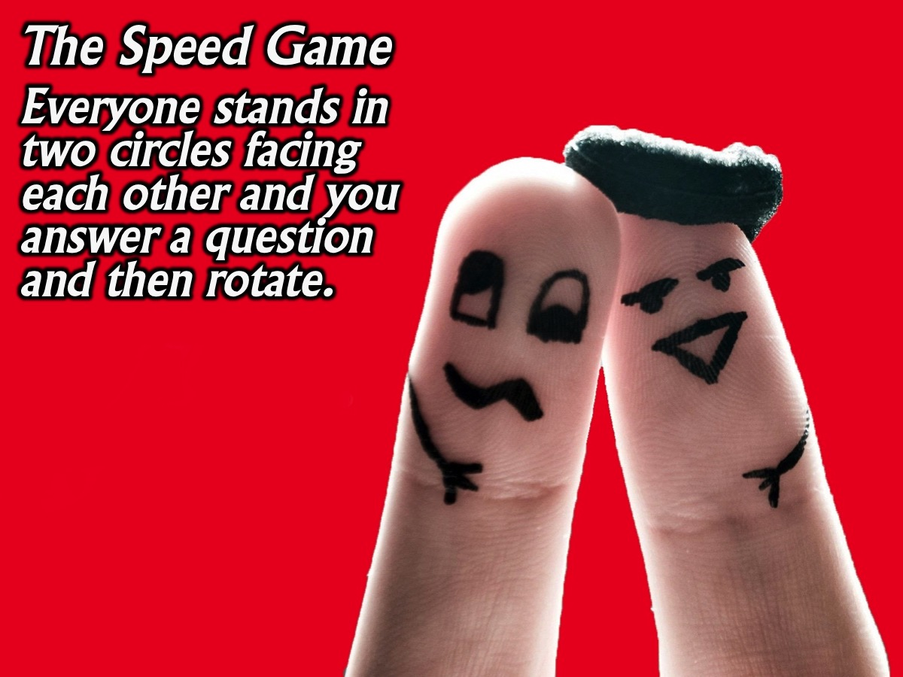
Notes:
2. The Speed Game. Everyone stands in two circles facing each other and you answer a question and then rotate.

Slide 11
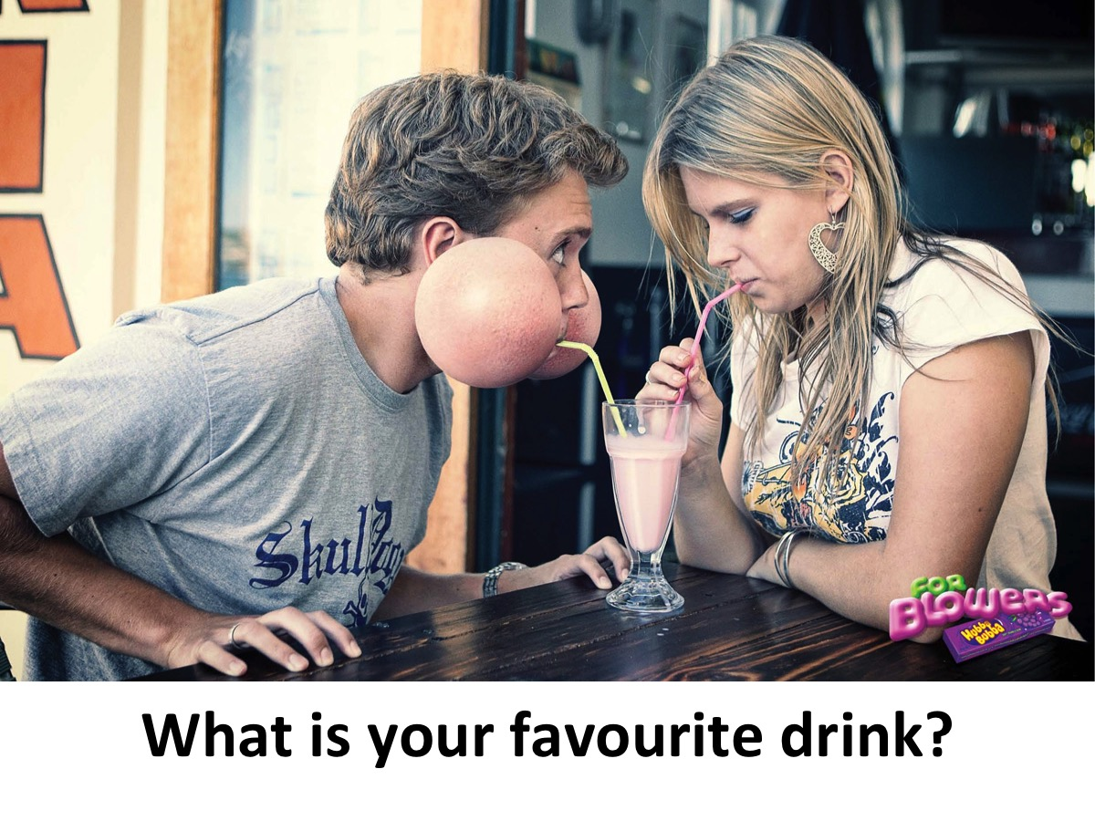
Notes:
What is your favourite drink?

Slide 12
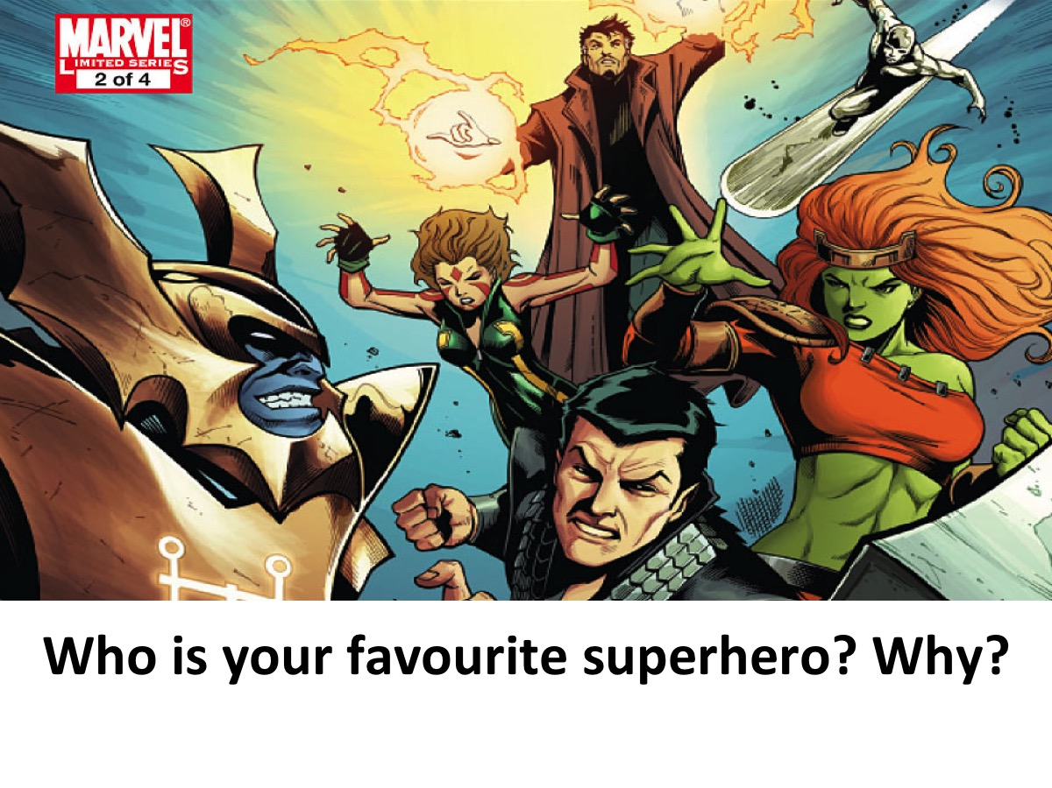
Notes:
Who is your favourite superhero? Why?

Slide 13
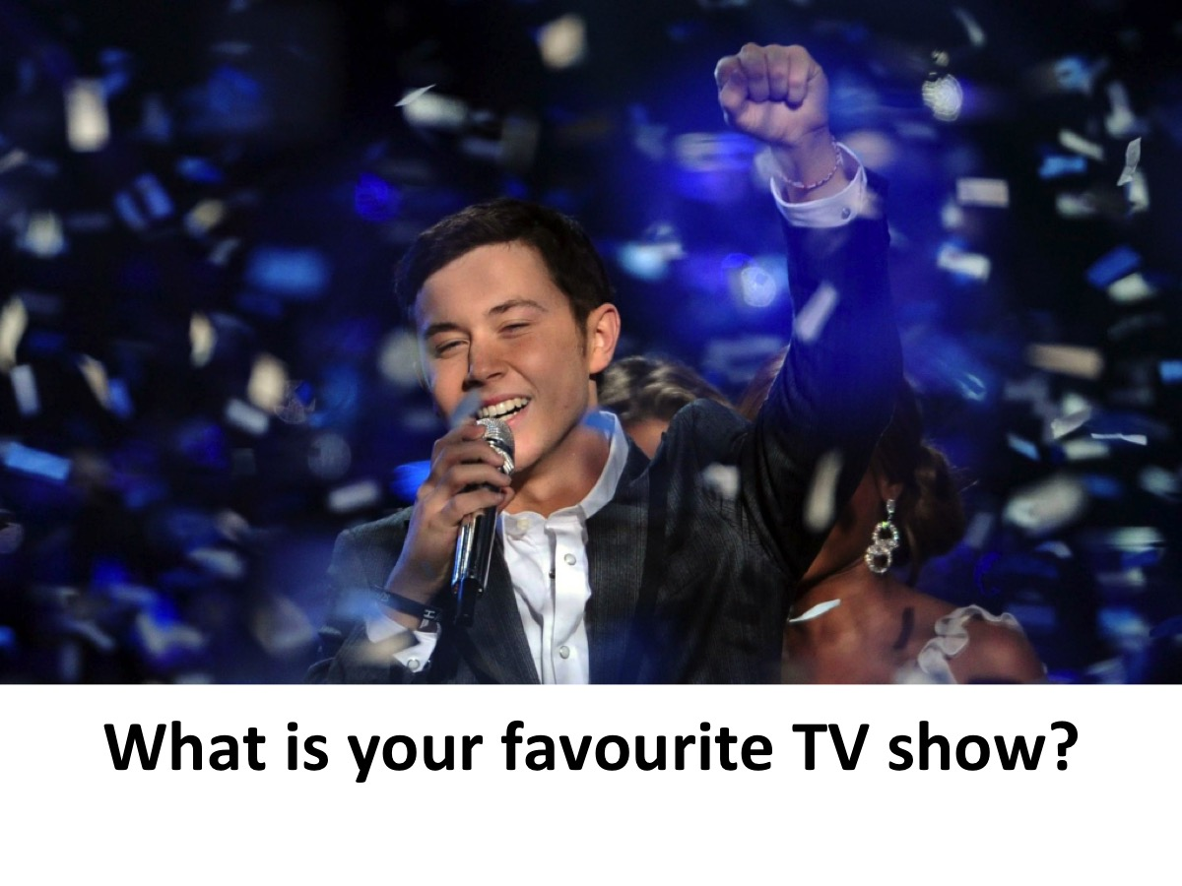
Notes:
What is your favourite TV show?

Slide 14
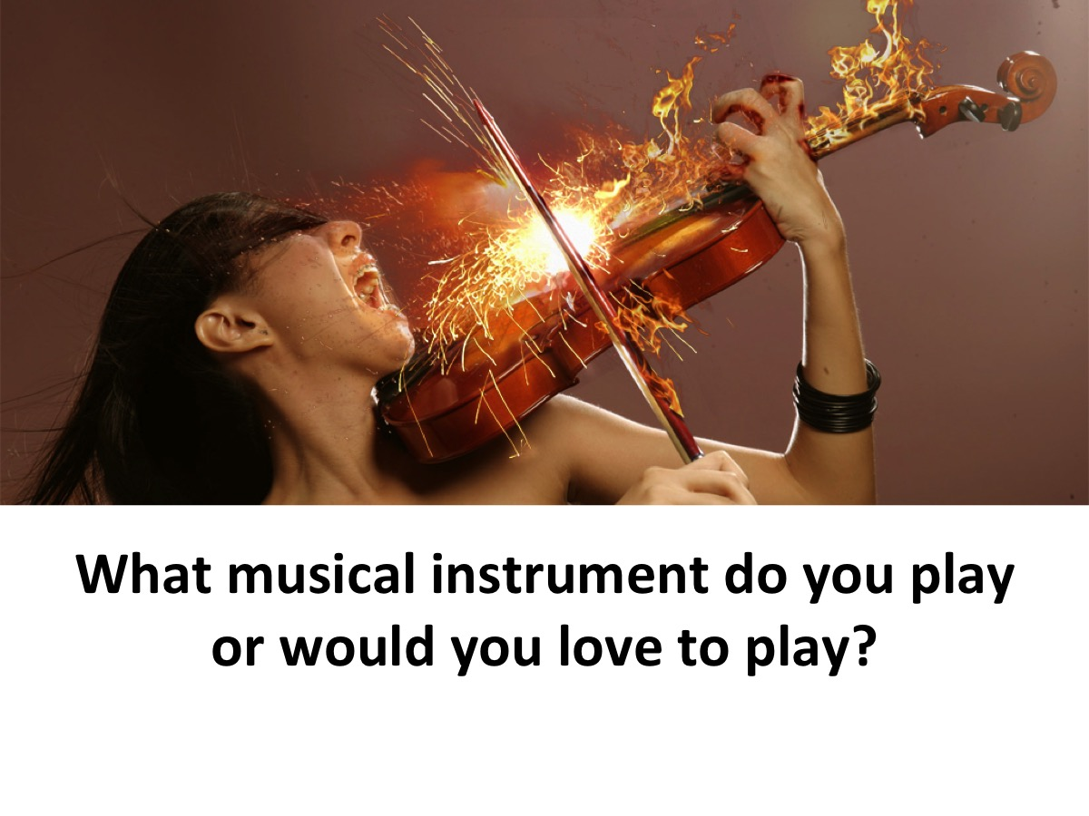
Notes:
What musical instrument do you play or would you love to play?

Slide 15
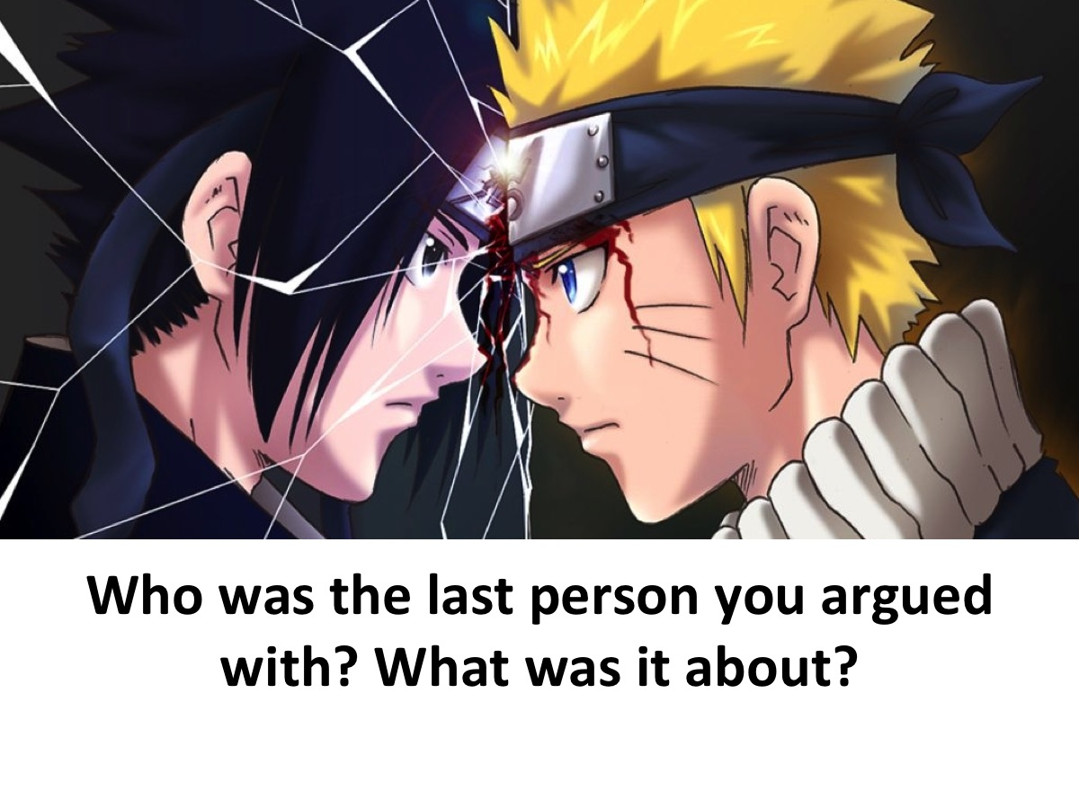
Notes:
Who was the last person you argued with and what was it about?

Slide 16
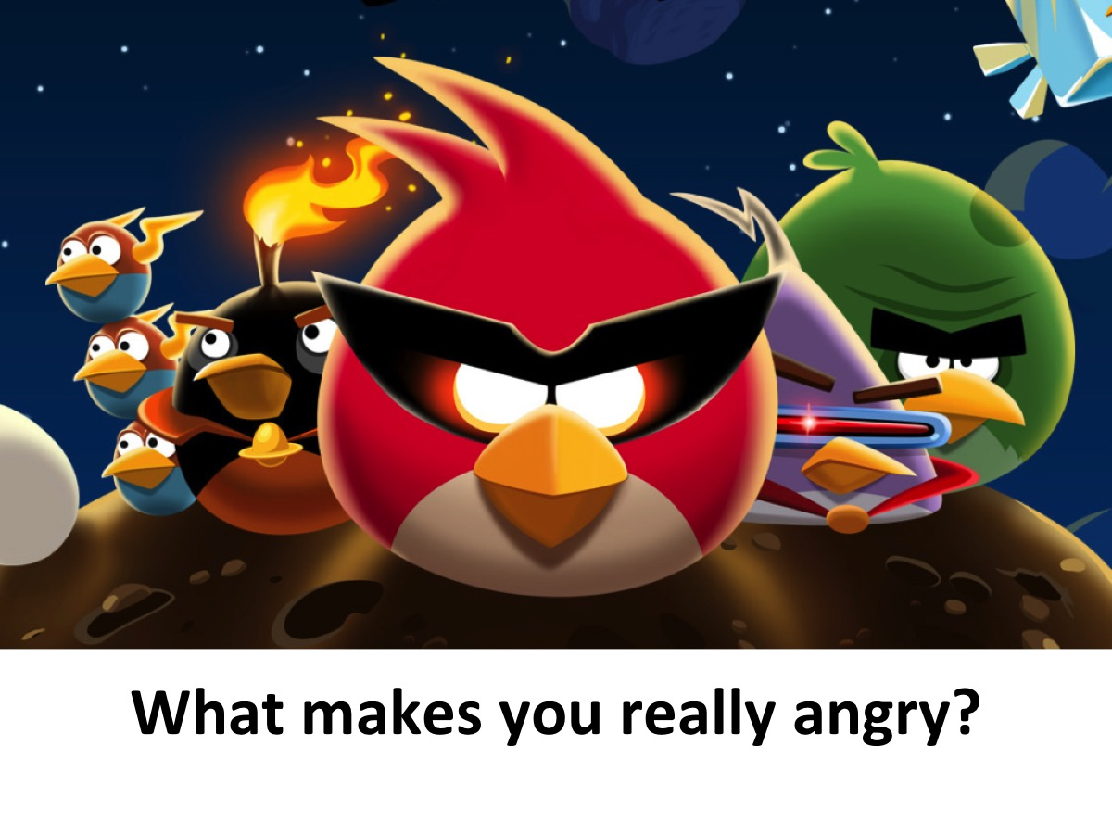
Notes:
What makes you really angry?

Slide 17

Notes:
What do you love about youth group?

Slide 18
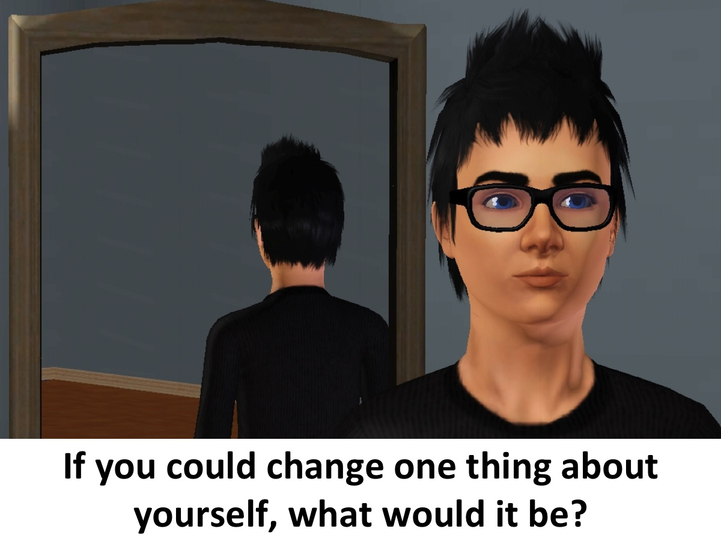
Notes:
If you could change one thing about yourself, what would it be and why?

Slide 19
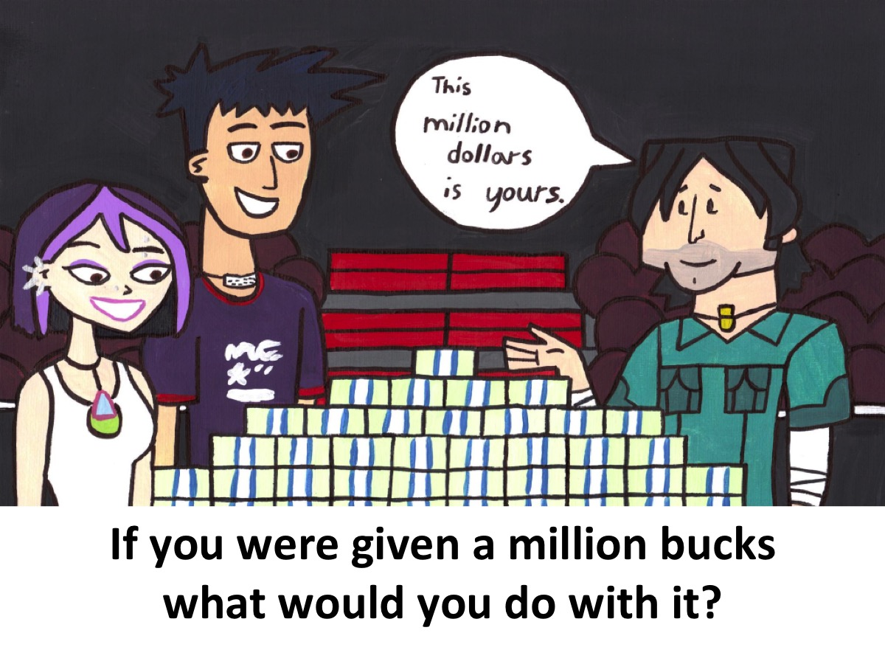
Notes:
If you would given a million bucks, what would you do with it?

Slide 20

Notes:
What would you be willing to die for?

Slide 21

Notes:
If you could ask God one question, what would it be?

Slide 22
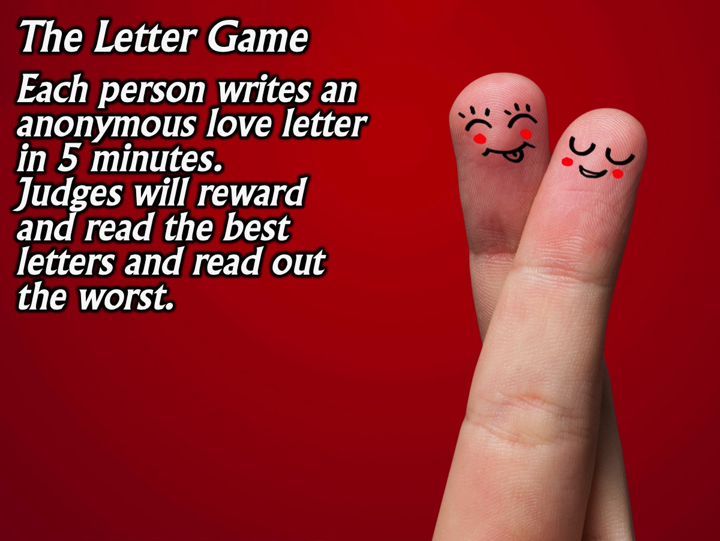
Notes:
3. The Letter Game. Teens have 5 minutes to write an anonymous love letter. After the last game a judge will read the letters and give the 3 best a prize and also read out the 3 best/worst letters.

Slide 23
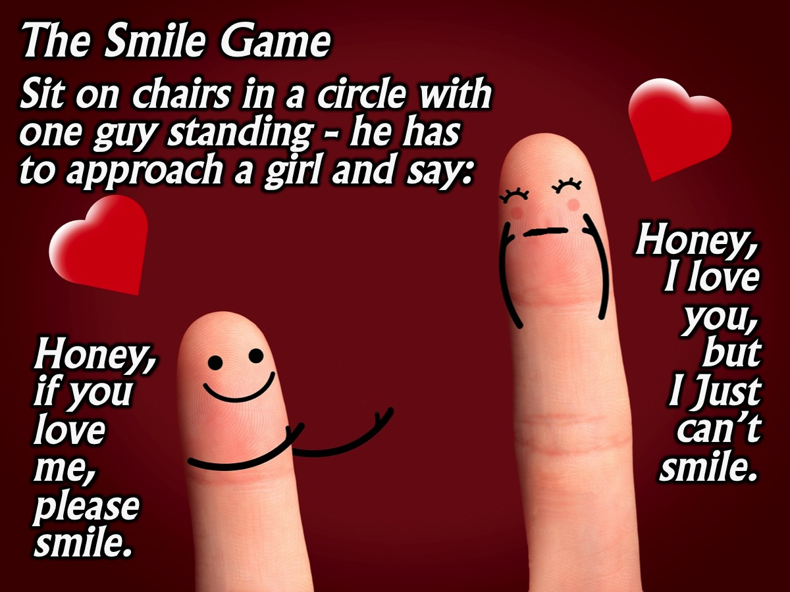
Notes:
4. The Smile Game. Everyone is sitting in a big circle. One person, who does not have a chair to sit on, has to get up and go to a person of the opposite sex and try and get them to laugh by saying: “Honey, if you love me, please smile.” The person has to respond, with a straight face, “Honey. I love you, but I just can’t smile.” If the girl can say it without laughing the guy has to find another girl to ask. If the girl laughs, she has to get up (while the guy sits on her chair) and go to a guy and say the line to him and try get him to laugh. You are not allowed to touch the person you are trying to make laugh.

Slide 24
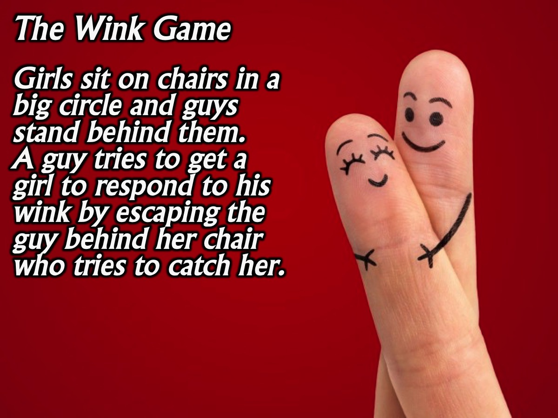
Notes:
5. The Wink Game. Girls are seated on the chairs while a guy stands behind each girl. One guy is standing behind an empty chair and he has to wink at a girls (all the guys must be looking down) and she has to try and get up from her chair and move to the empty chair without her partner stopping her from leaving.

Slide 25
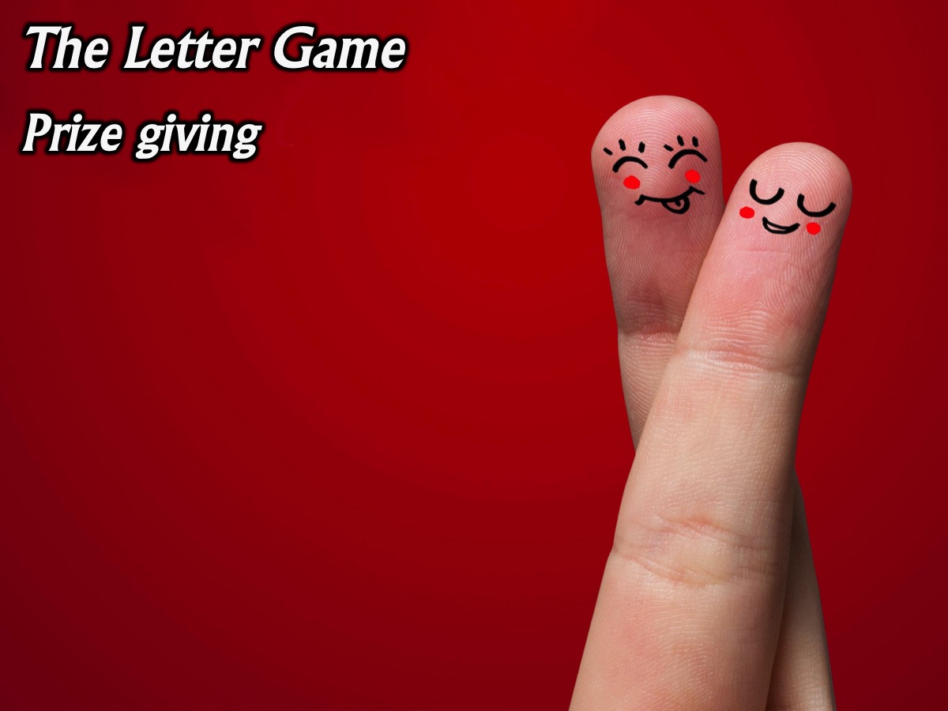
Notes:
The Letter Game prize giving for the 3 best love letters and the 3 worst love letters.

Slide 26

Notes:
Small Groups. Here are the small group questions: (1) What has been your best/worst Valentine’s experience? (2) Have you ever had your heart broken? What happened? (3) What can we do when we experience heartache? Here are some verses: “The Lord is near to the brokenhearted and saves the crushed in spirit.” (Ps 34:18). “Cast your burden on the Lord, and he will sustain you.” (Ps 55:22). “Fear not, for I am with you; I will strengthen you, I will help you. (Isa 41:10). (4) Pray for each other to know God’s love.

Slide 27
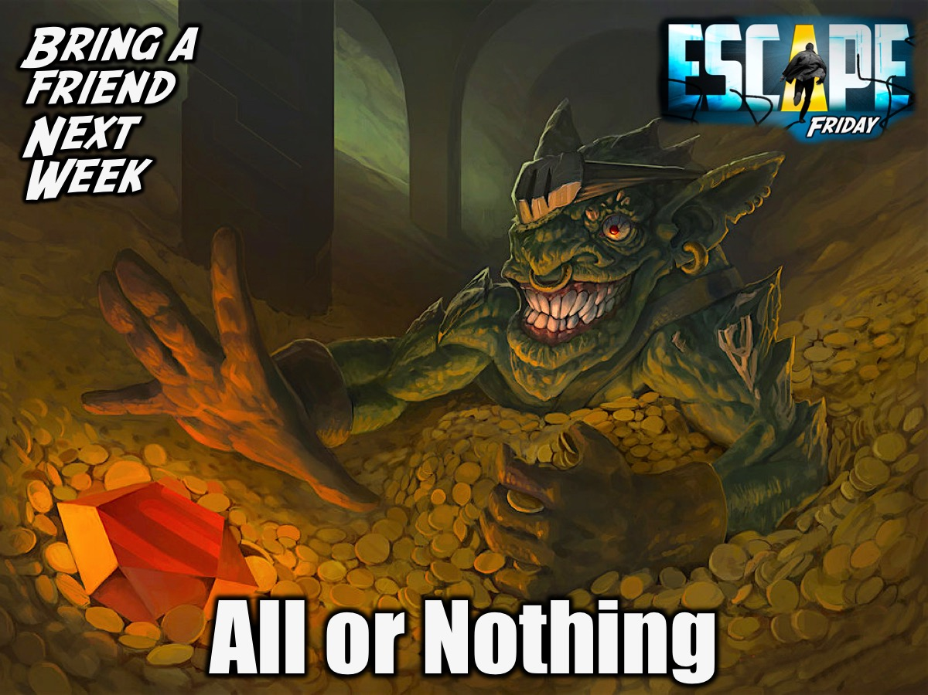
Notes:
Don’t forget that next Friday is All or Nothing Night - bring a friend.

Slide 28
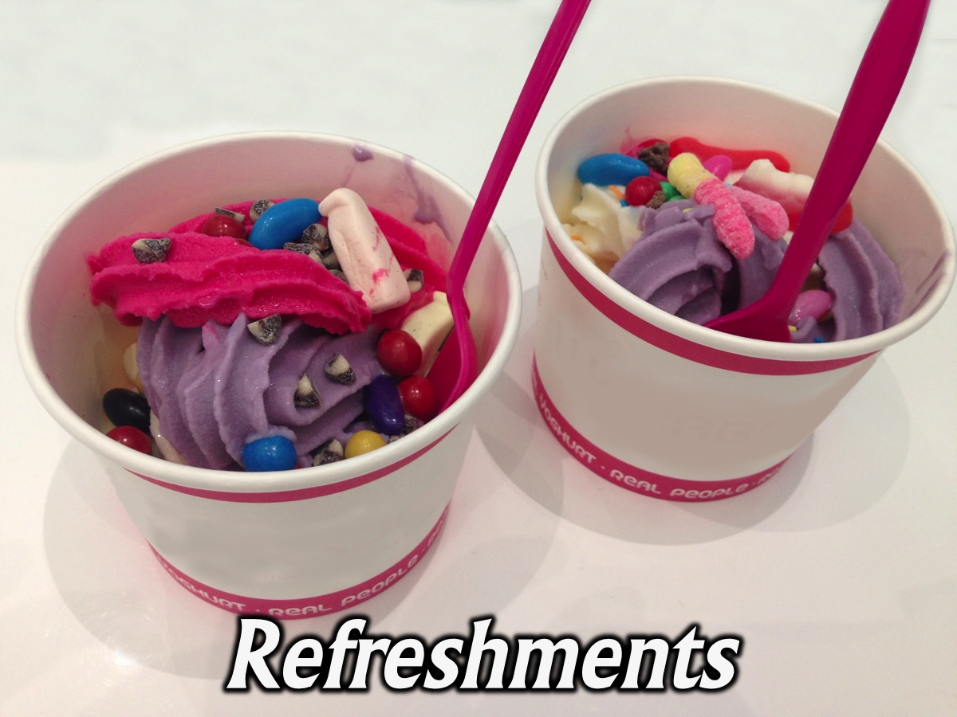
Notes:
Refreshments: Tonight teens will add toppings to their ice-cream.

Slide 29
Notes:
Don’t forget that next Friday is All or Nothing Night - bring a friend.

