Slide 1
Notes:
Welcome to the Victory Series!

Slide 2
Notes:
Video: An edited version of Official Call of Duty Advanced Warfare - Campaign Story Trailer. Get it on YouTube at: https://www.youtube.com/watch?v=pUysNWHffWg

Slide 3
Notes:
The Victory Series is a 9-week Journey to help you walk in Victory:

Slide 4
Notes:
In Week 1 we will be Preparing for Victory.
Hand out Preparing for Victory Books on this week.

Slide 5
Notes:
In Week 2 we will be looking at what the Cross has to do with victory in our lives.

Slide 6
Notes:
In Week 3 we will be looking at how our identity affects our victory.

Slide 7
Notes:
In Week 4 we will look at the first of five big issues in our lives: Generational Curses.

Slide 8
Notes:
In Week 5 we will look at the second of five big issues in our lives: Relational Issues.

Slide 9
Notes:
In Week 6 we will look at the third of five big issues in our lives: Spiritual Errors.

Slide 10
Notes:
In Week 7 we will look at the fourth of five big issues in our lives: Sexual Sins.

Slide 11
Notes:
In Week 8 we will look at the fifth of five big issues in our lives: Addictions.

Slide 12
Notes:
In Week 9 we will end with how to Live in Victory!
Water Baptism in church!
Spirit Baptism in this session!

Slide 13
Notes:
This week is all about Preparing for Victory.

Slide 14
Notes:
The Bible teaches that we can and should live victorious lives.

Slide 15
Notes:
This weekend will help you understand that you can walk in the victory that Christ bought on the Cross for you.

Slide 16
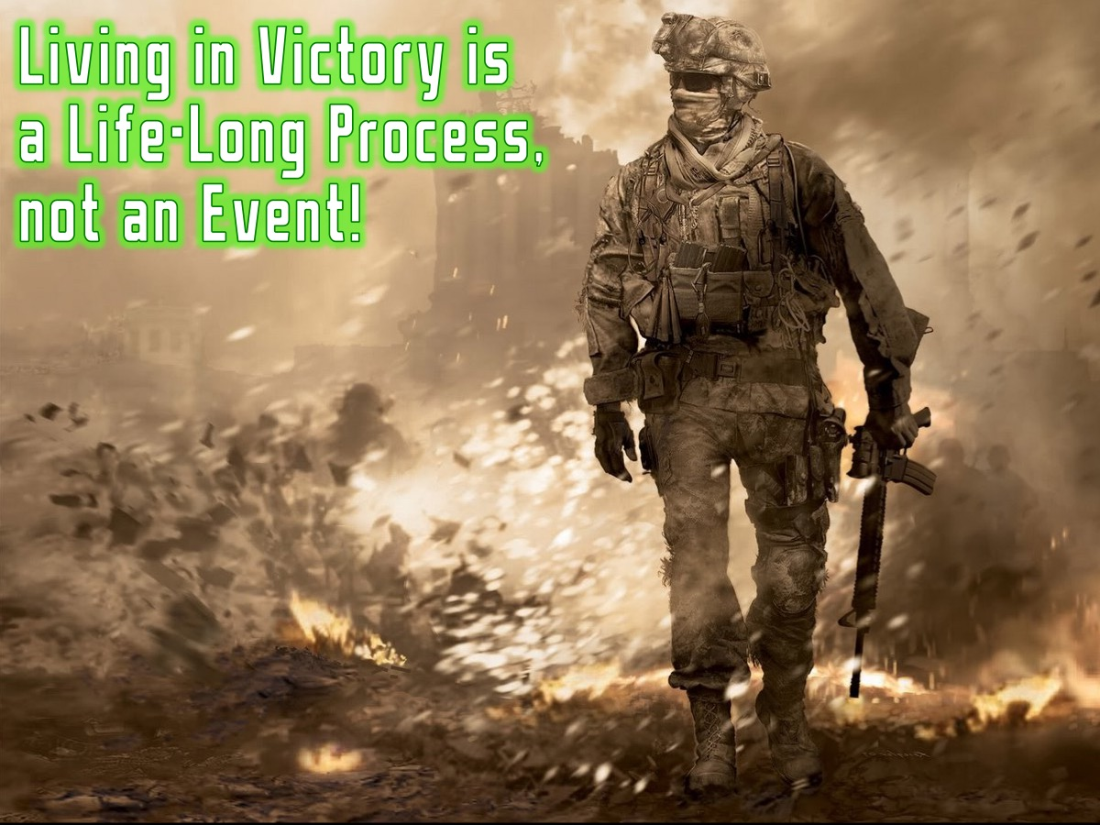
Notes:
Living in victory is a life-long process – not an event!

Slide 17
Notes:
The Victory Series is a launch pad to victory!

Slide 18
Notes:
Before soldiers go on a patrol they have a mission briefing. Here is your mission briefing:

Slide 19
Notes:
(1) This series will lay a foundation for walking in victory (it is not intense inner healing. It is effective in laying foundations as part of the process of growing in God. It is not a quick-fix, but will bring significant breakthrough to launch out into the process of walking in victory).

Slide 20
Notes:
(2) You must believe that God will bring healing and victory - we must come with expectation and faith for a supernatural work of healing and freedom – we believe that the same anointing of the Holy Spirit that rested on Jesus (Luke 4:17-21; Isaiah 61) is present with us this term to set us free.

Slide 21
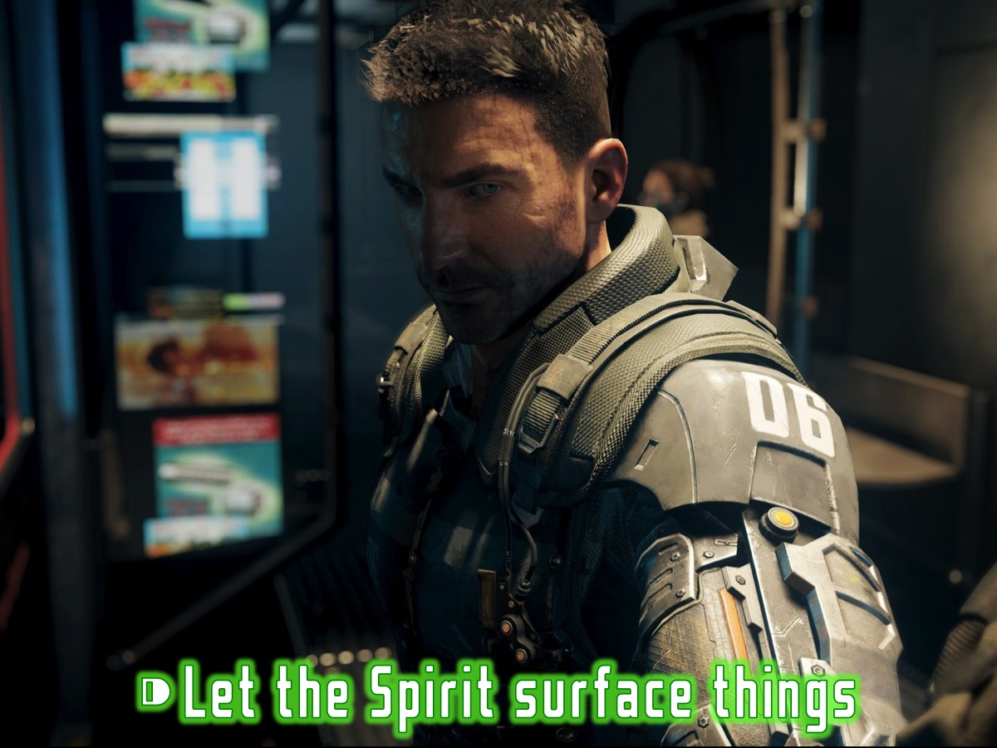
Notes:
(3) The Holy Spirit will bring things to the surface in his time - not everything will be dealt with during this time but you will receive tools and principles for dealing with things as they arise later in your Christian walk.

Slide 22
Notes:
There are three targets for this Victory Series:

Slide 23
Notes:
1. Build Foundations. The first target of Victory Weekend is to establish foundations that are strong and biblical.

Slide 24
Notes:
He who comes to me and hears my words and puts them into practice is like a man building a house, who dug down deep and laid the foundation on rock. When a flood came, the torrent struck that house but could not shake it, because it was well built. (Luke 6:47-48)

Slide 25
Notes:
This famous building (The Leaning Tower of Pisa) in Italy is collapsing because it’s foundations were not strong enough!

Slide 26
Notes:
There are five foundations for a victorious life in Acts 2:36-41:

Slide 27
Notes:
#1 Lordship - Therefore let all Israel be assured of this: God has made this Jesus, whom you crucified, both Lord and Christ. (Acts 2:36)

Slide 28
Notes:
#2 Repentance - When the people heard this, they were cut to the heart and said to Peter and the other apostles, "Brothers, what shall we do?" Peter replied, "Repent and be baptized, every one of you, in the name of Jesus Christ for the forgiveness of your sins." (Acts 2:37,38a)

Slide 29
Notes:
#3 Baptism - Peter replied, "Repent and be baptized, every one of you, in the name of Jesus Christ for the forgiveness of your sins." (Acts 2:38a)

Slide 30
Notes:
#4 Holy Spirit - And you will receive the gift of the Holy Spirit. The promise is for you and your children and for all who are far off-for all whom the Lord our God will call. (Acts 2:38b-39)

Slide 31
Notes:
#5 Church - Those who accepted his message were baptized, and about three thousand were added to their number that day. (Acts 2:41)

Slide 32
Notes:
2. Discover Freedom. The second target of the Victory Series is to discover how to walk in freedom.

Slide 33
Notes:
Freedom is the power to do what is right, not the right to do what we want!

Slide 34
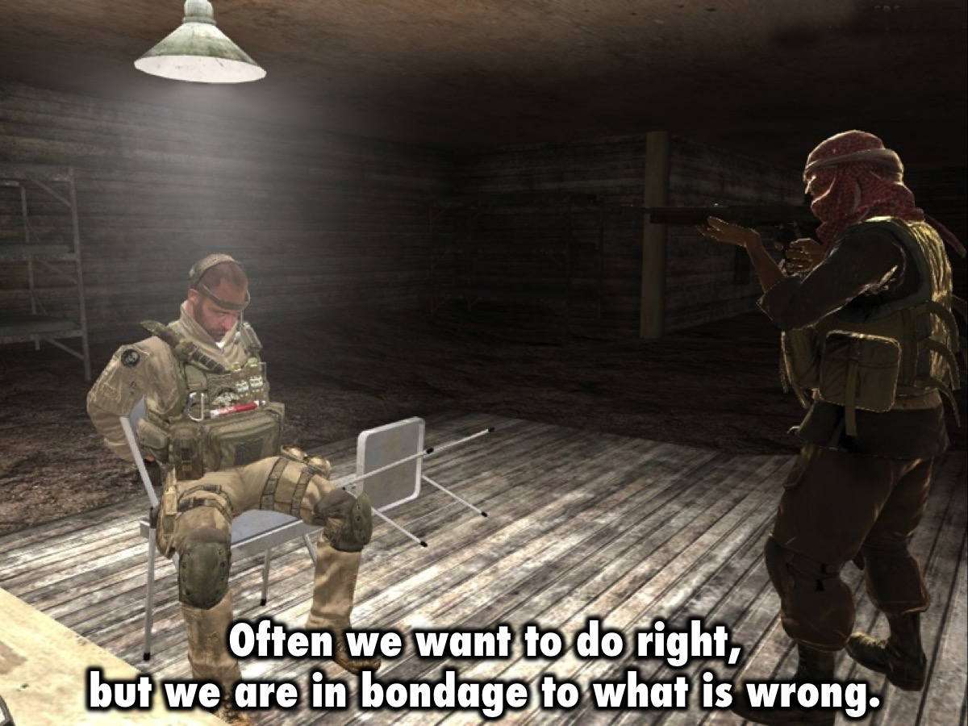
Notes:
Often we want to do right, but we are in bondage to what is wrong.

Slide 35
Notes:
Jesus promised spiritual freedom: “Then you will know the truth, and the truth will set you free.” (Luke 6:47-48)

Slide 36
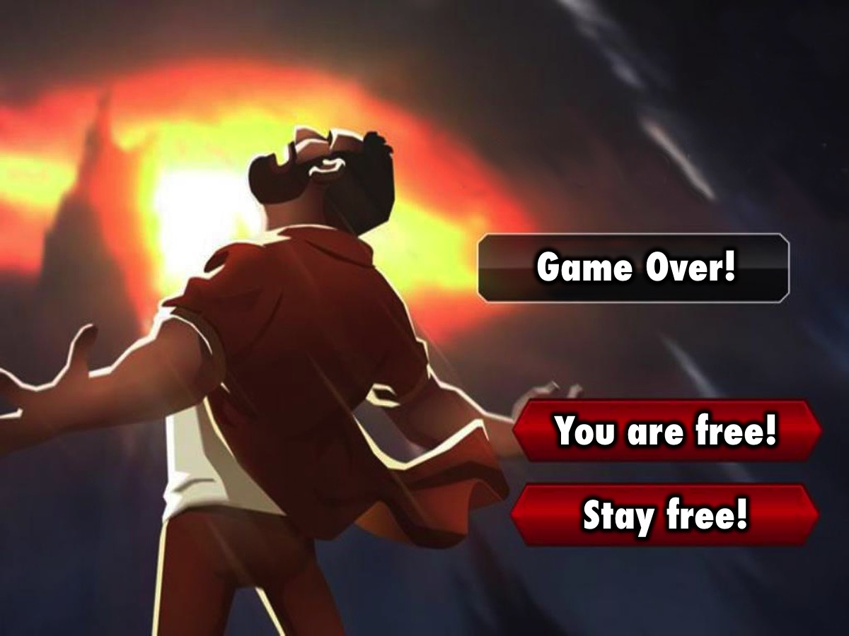
Notes:
So why are you still in prison, when Jesus has broken you out?

Slide 37
Notes:
You will gain freedom from the big five areas that we have identified: Generational curses, Relational issues, Spiritual errors, Sexual sins and Addiction.

Slide 38
Notes:
3. Become Fruitful. The third target of this Victory Series is to become fruitful as a follower of Jesus!

Slide 39
Notes:
Jesus said: This is to my father’s glory – that you bear much fruit, showing yourselves to be my disciples. (John 15:8)

Slide 40
Notes:
Jesus said: "Come, follow me, and I will make you fishers of men.” (Matthew 4:19). When followers become fishermen they fulfill their destiny!

Slide 41
Notes:
In Summary, there are three targets of the Victory Series: (1) Build Foundations. (2) Discover Freedom. (3) Become Fruitful.

Slide 42
Notes:
Small Group Questions: (1) Which Foundation do you need to work on? Lordship. Repentance. Water Baptism. Spirit Baptism. Church. (2) In what area of your life do you need to get Freedom? (3) What Fruit do you need to produce in your life?

Slide 43
Notes:
Let’s pray!

Slide 44
Notes:
Homework: Work through the Preparing for Victory Booklet this week – from Monday to Thursday – there is a page for each day!

Slide 45
Notes:
Next Week we will look at what the Cross has to do with victory in our lives.

