Slide 1

Notes:
Welcome to Victory Weekend - this is week 2 in our series!

Slide 2
Notes:
Video: Official Call of Duty Black Ops III Reveal Trailer. Get it on YouTube at: https://www.youtube.com/watch?v=58Pspqx0XGs

Slide 3

Notes:
Last Week we looked at how we need to prepare for victory.

Slide 4

Notes:
This Week we will be looking at what the Cross has to do with victory in our lives.

Slide 5
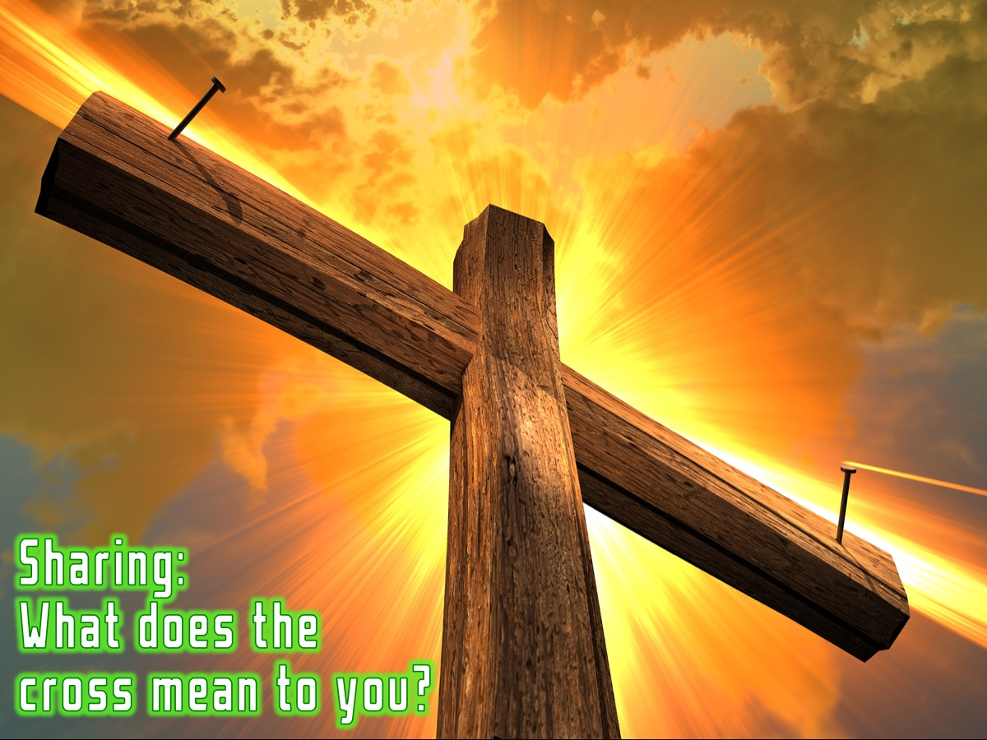
Notes:
Sharing: Turn to the person next to you and ask them: “What does the cross mean to you?”

Slide 6
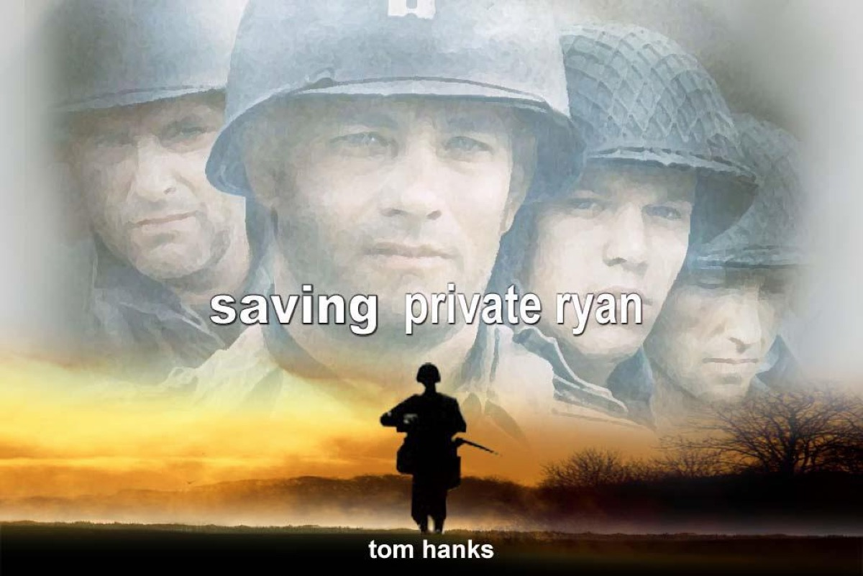
Notes:
Have any of you seen the movie: Saving private Ryan?

Slide 7
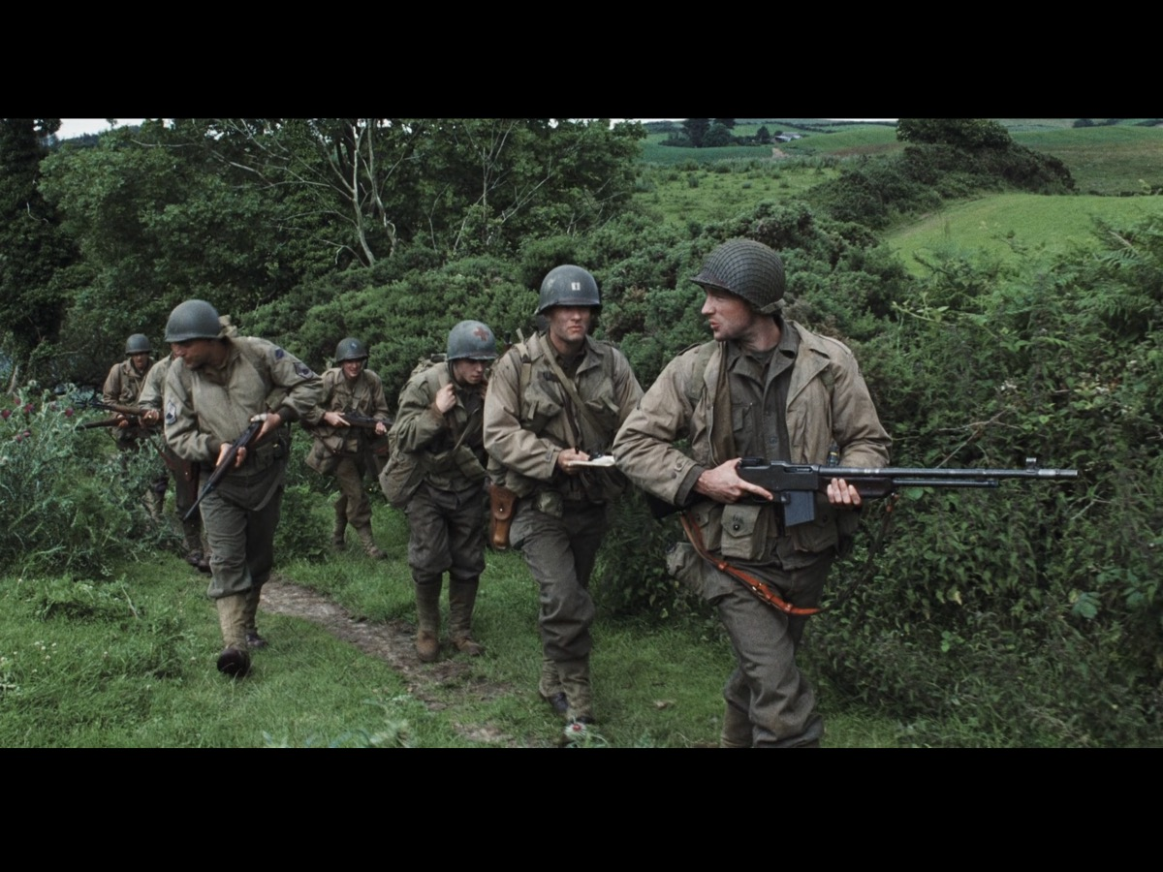
Notes:
This is the small group of soldiers who were sent behind enemy lines under the leadership of Captain Miller (played by Tom Hanks) to rescue Private Ryan because 3 of his brothers had just been killed in action and the army did not want his Mother to lose another son!

Slide 8
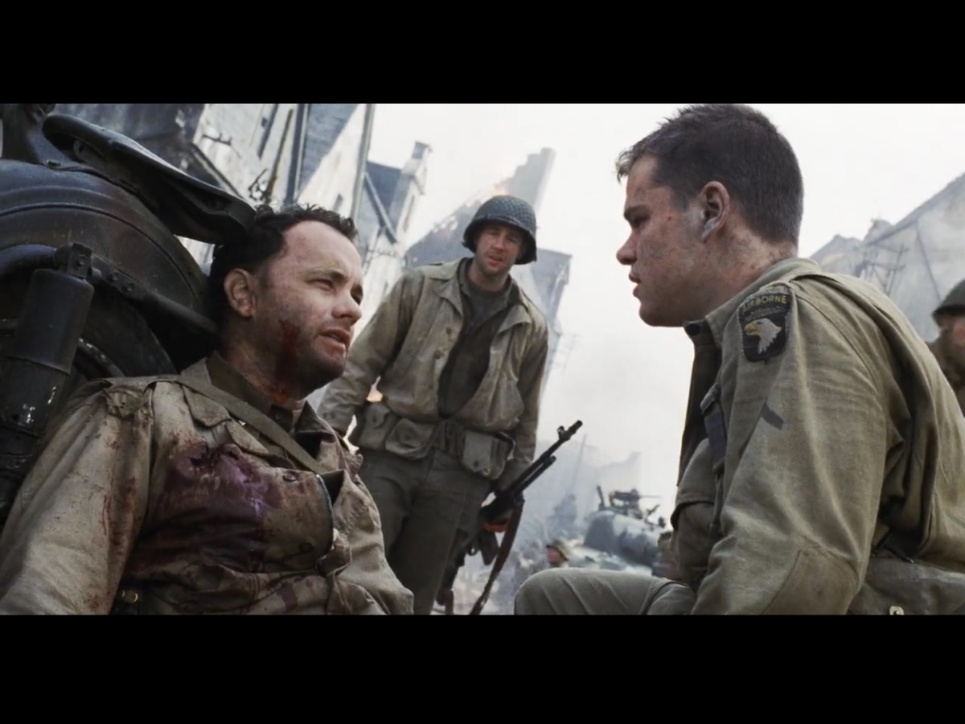
Notes:
Some of the men, including Captain Miller, sacrifice their lives trying to save him but in the end the mission is successful because Private Ryan is saved!

Slide 9
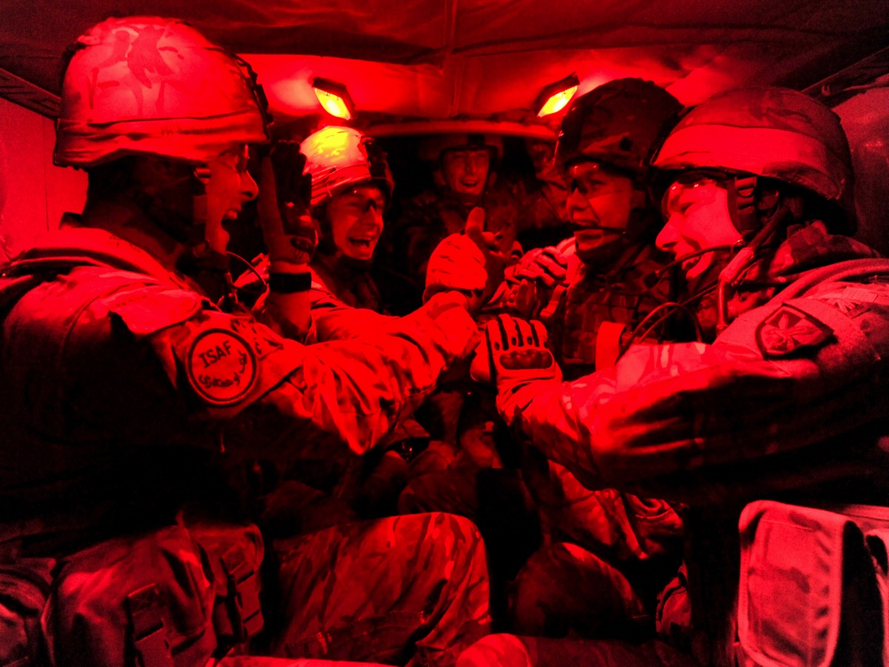
Notes:
Soldiers always look after their own - even being willing to go on a mission to rescue one of their own - they never leave anyone behind!

Slide 10
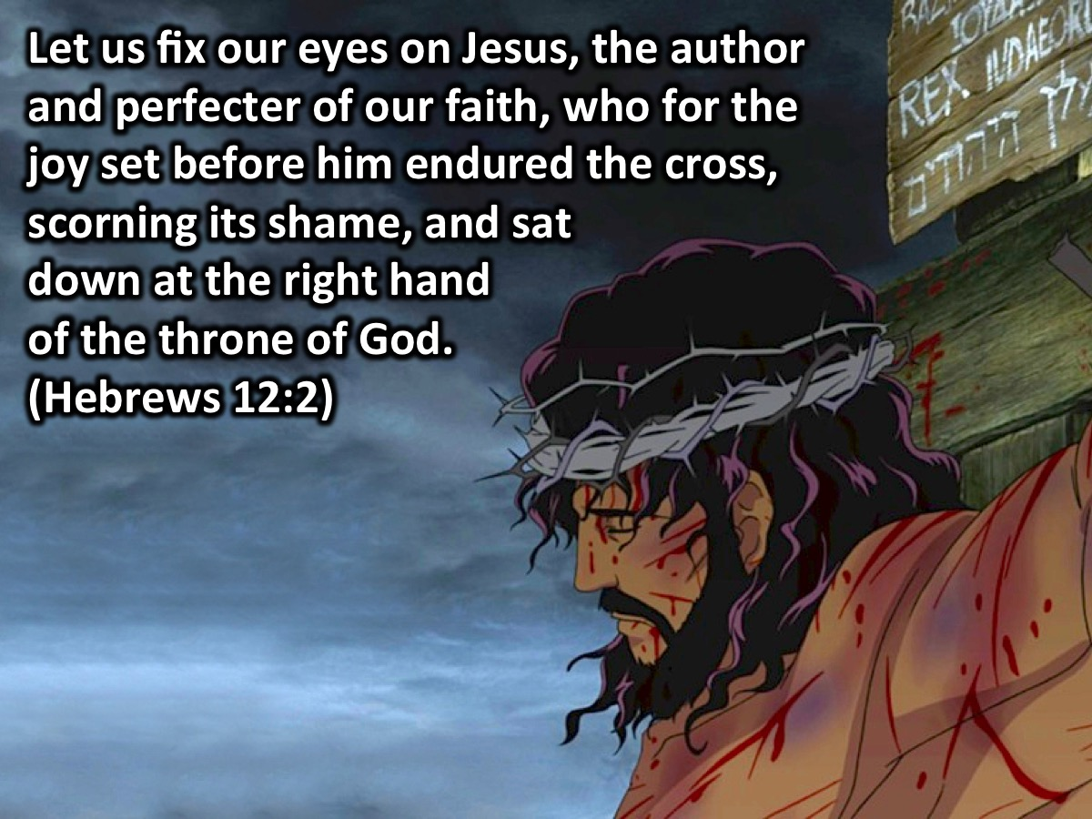
Notes:
Let us fix our eyes on Jesus, the author and perfecter of our faith, who for the joy set before him endured the cross, scorning its shame, and sat down at the right hand of the throne of God. (Hebrews 12:2). What was the joy set before Jesus? It was bringing us back into a relationship with Father God! Restoring lost sons and daughters into the kingdom! Like Captain Miller who set out to save private Ryan – Jesus set out with a mission to save us through his death on the cross.

Slide 11
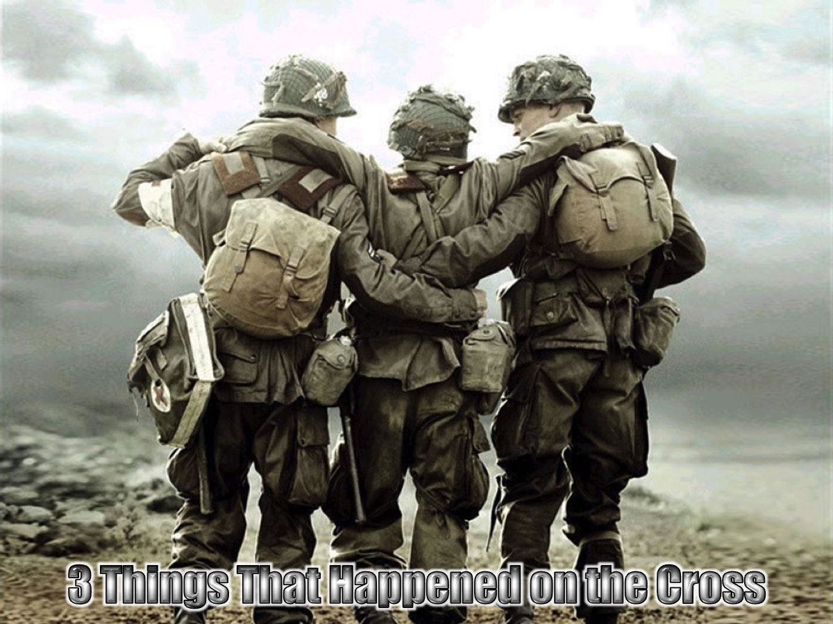
Notes:
The cross was the central message of the New Testament apostles. To understand and experience the cross of Christ, we must understand the three things that happened on the cross. But first here is a video from the movie, Son of God.

Slide 12
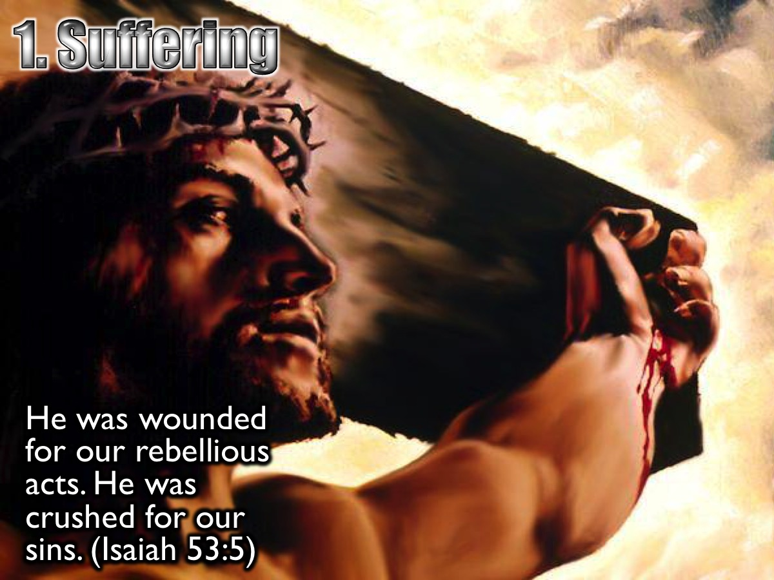
Notes:
1. Suffering. Jesus suffered the pain of the cross because of my sins. He was wounded for our rebellious acts. He was crushed for our sins. He was punished so that we could have peace, and we received healing from his wounds. (Isaiah 53:5)

Slide 13
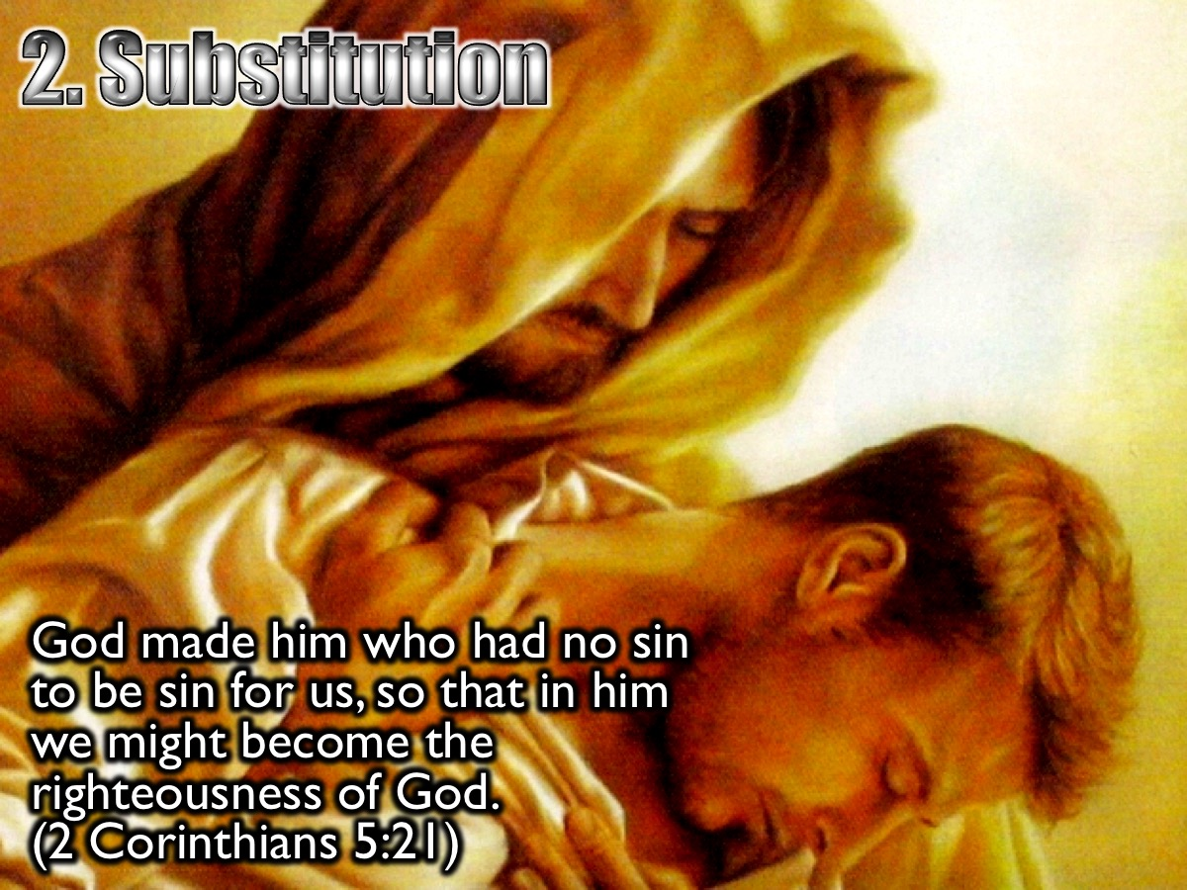
Notes:
2. Substitution. Jesus took our place on the cross, becoming our sin and suffering our punishment, so we could receive his righteousness. God made him who had no sin to be sin for us, so that in him we might become the righteousness of God. (2 Corinthians 5:21). The Wrath of God that Jesus took on our behalf is mentioned in the book of Romans.

Slide 14
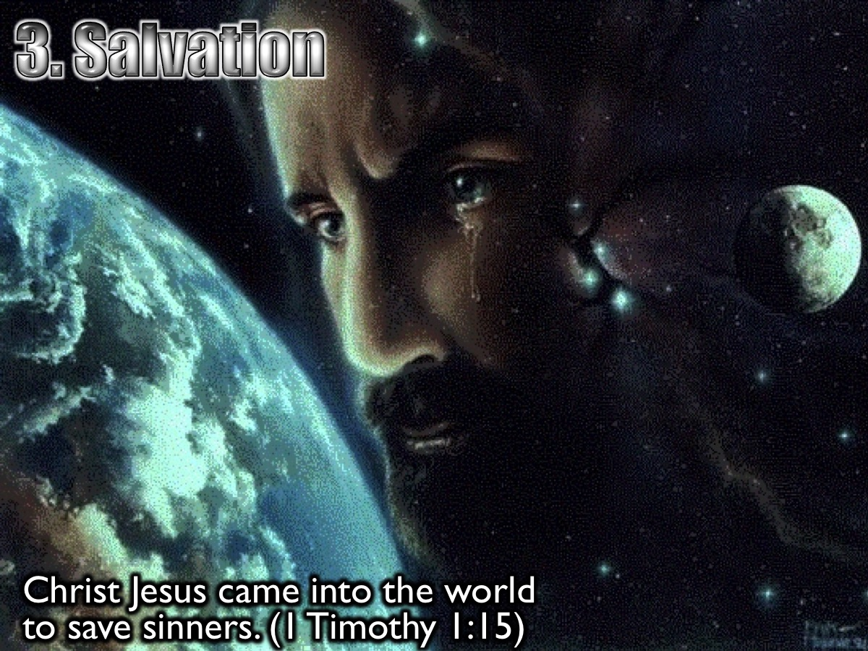
Notes:
3. Salvation. Jesus came to seek and save the Lost – to save sinners from the wrath of God. Christ Jesus came into the world to save sinners. (1 Timothy 1:15). Since we have now been justified by his blood, how much more shall we be saved from God's wrath through him! (Romans 5:9)

Slide 15
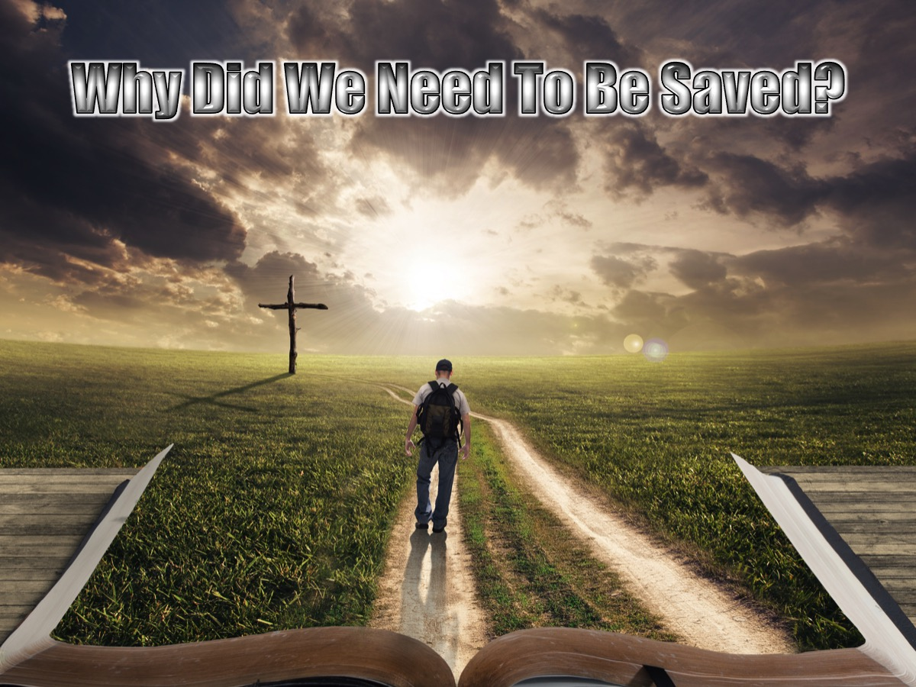
Notes:
Why Did We Need To Be Saved?

Slide 16
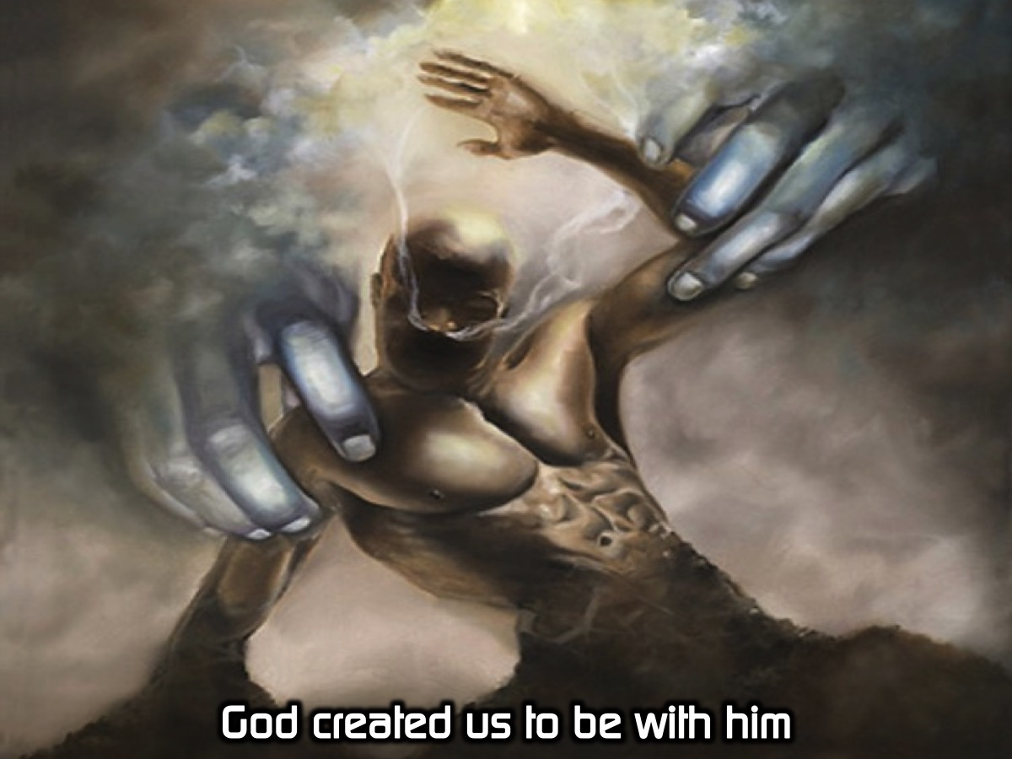
Notes:
God created us to be with him.

Slide 17
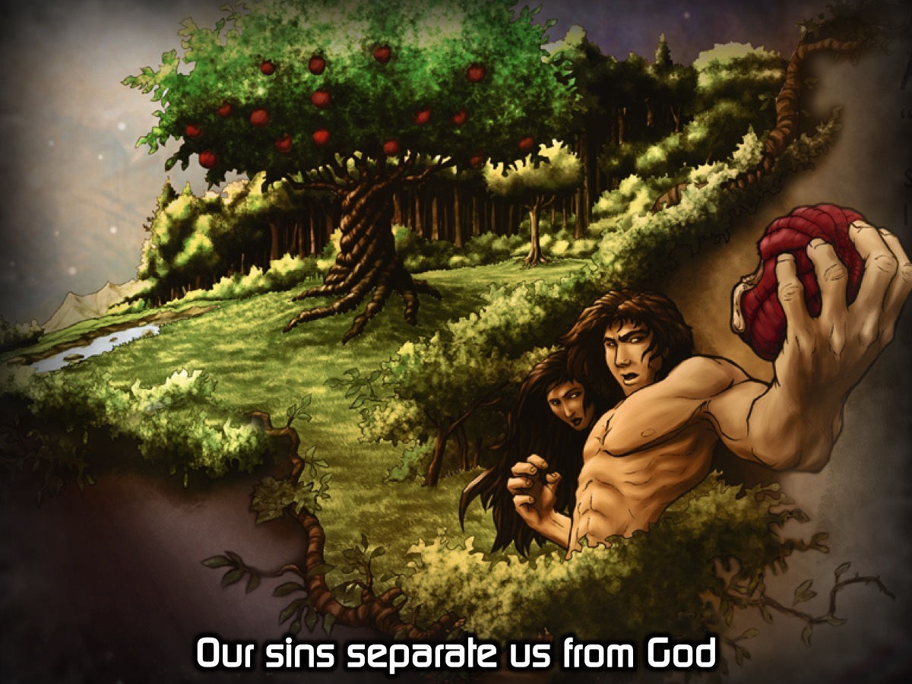
Notes:
Our sins separate us from God.

Slide 18
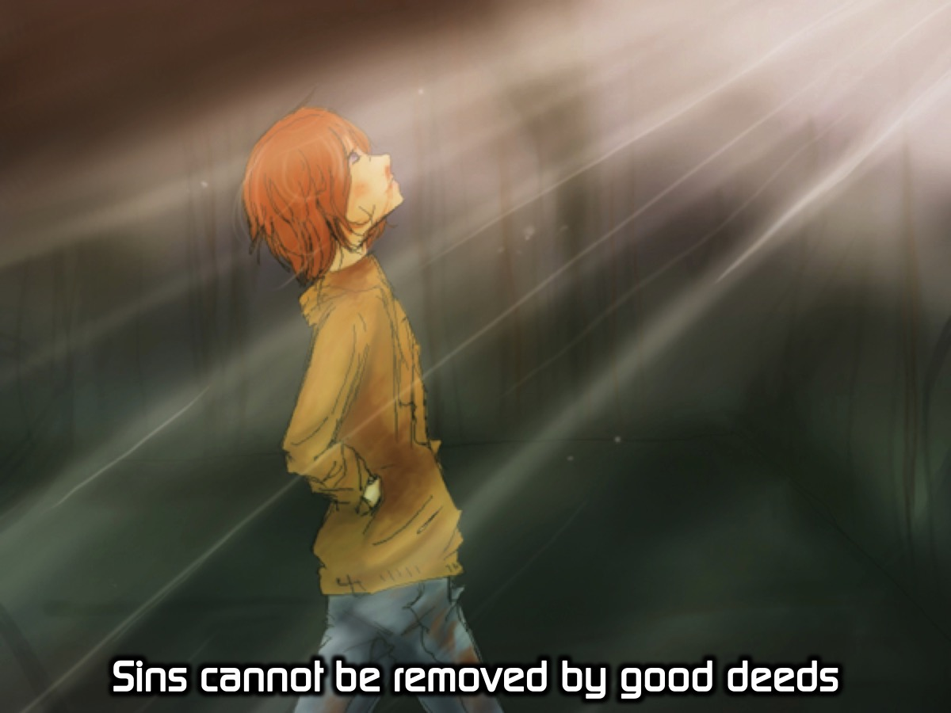
Notes:
Sins cannot be removed by good deeds.

Slide 19
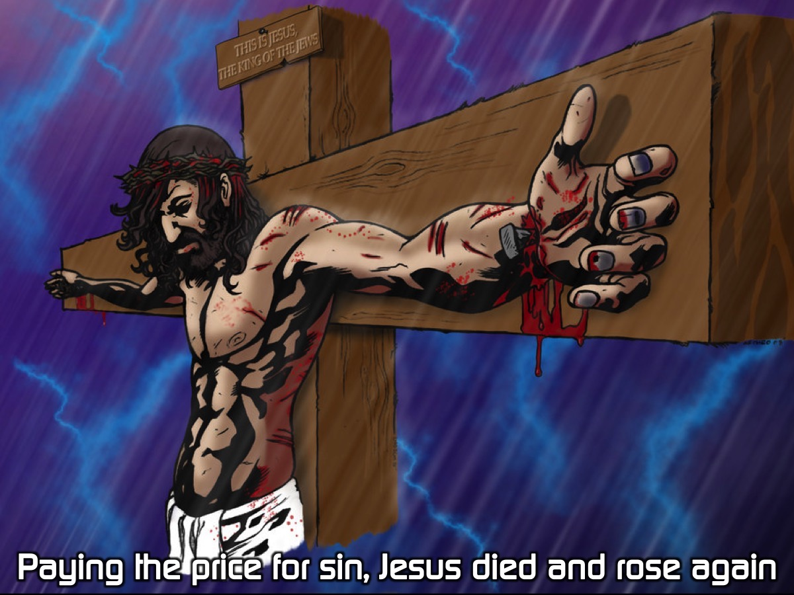
Notes:
Paying the price for sin, Jesus died and rose again.

Slide 20
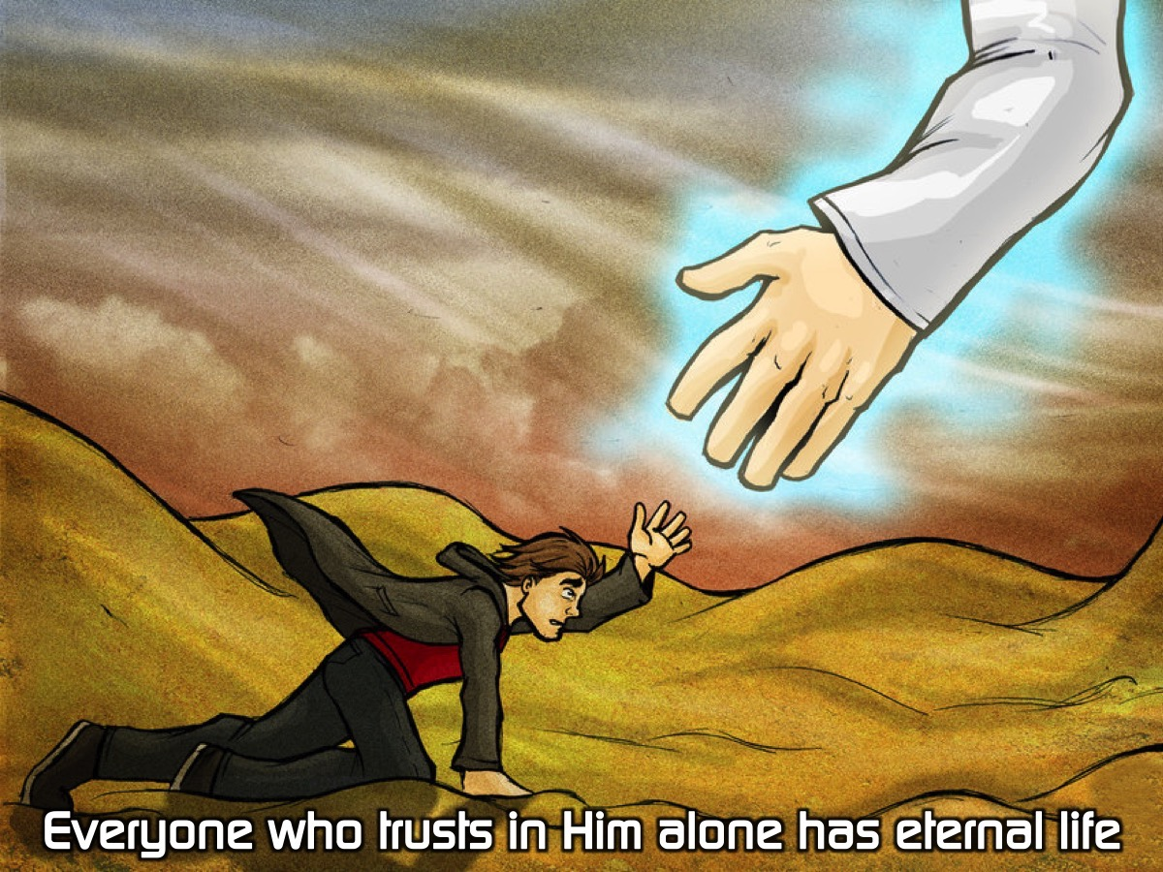
Notes:
Everyone who trusts in Him alone has eternal life.

Slide 21
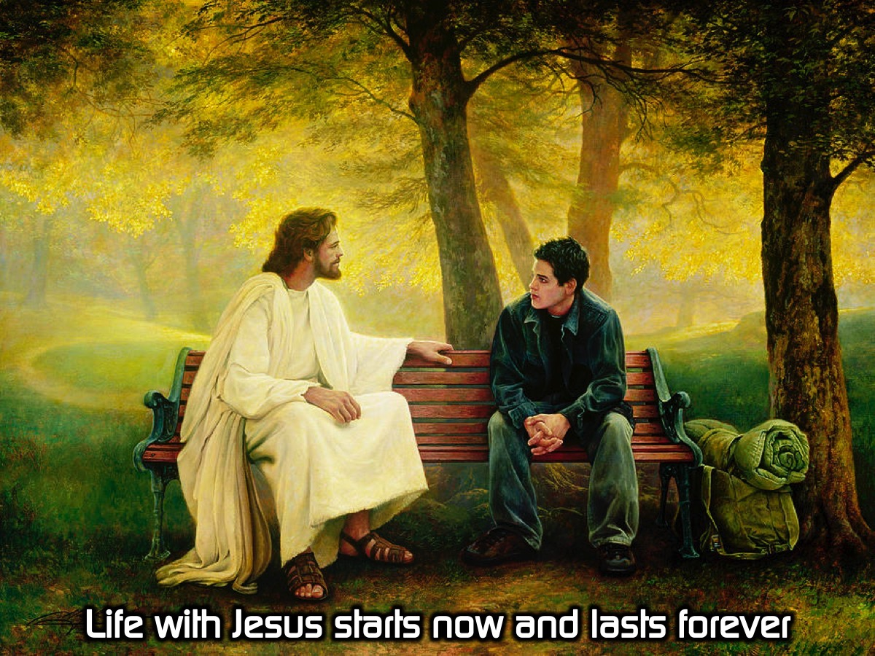
Notes:
Life with Jesus starts now and lasts forever.

Slide 22
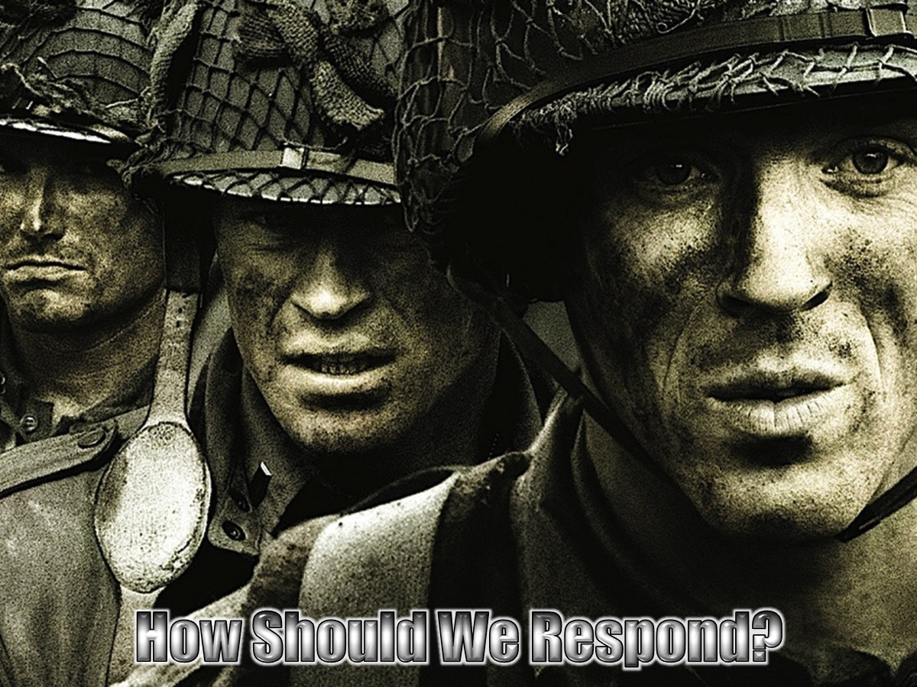
Notes:
How Should We Respond to What Jesus Did on the Cross?

Slide 23
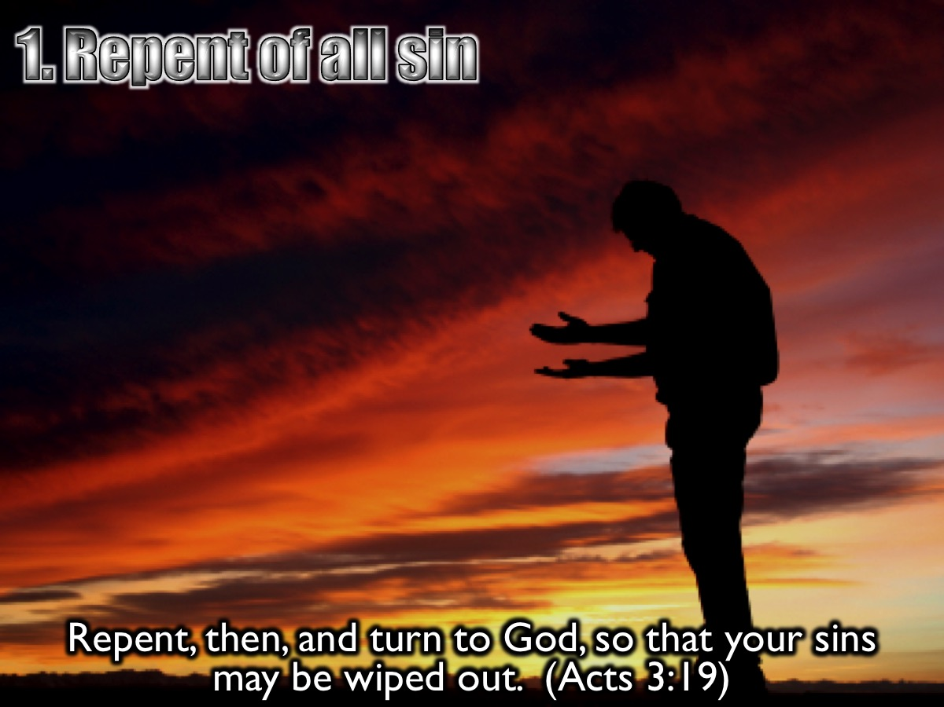
Notes:
1. Repent of all sin. Repent, then, and turn to God, so that your sins may be wiped out. (Acts 3:19)

Slide 24
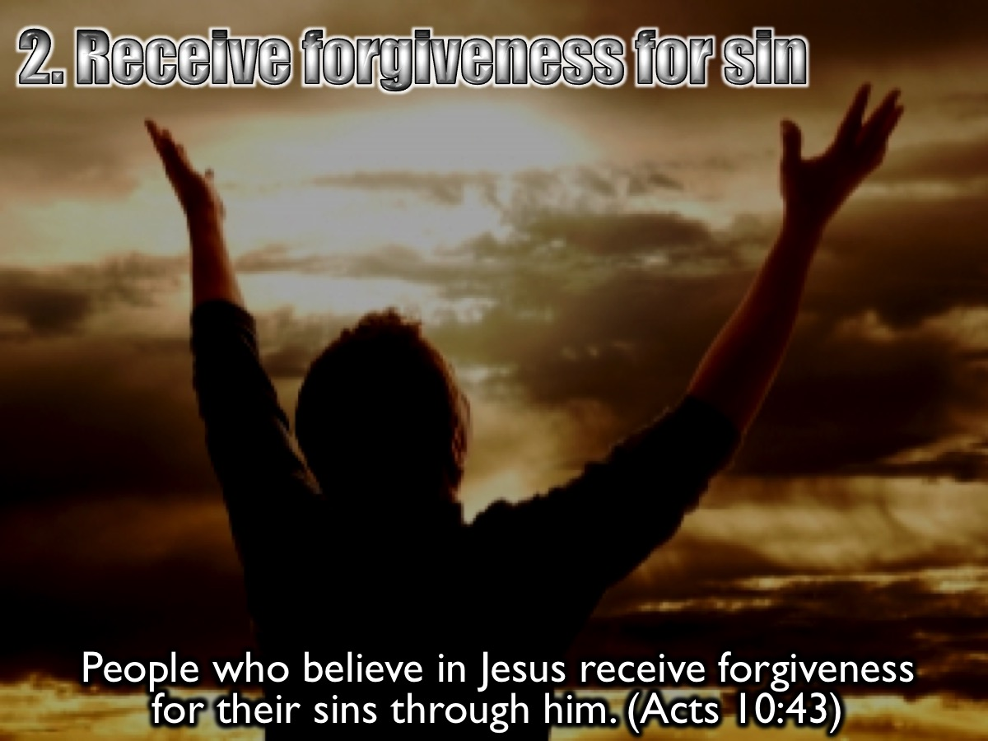
Notes:
2. Receive forgiveness for Sin. People who believe in the one named Jesus receive forgiveness for their sins through him. (Acts 10:43)

Slide 25
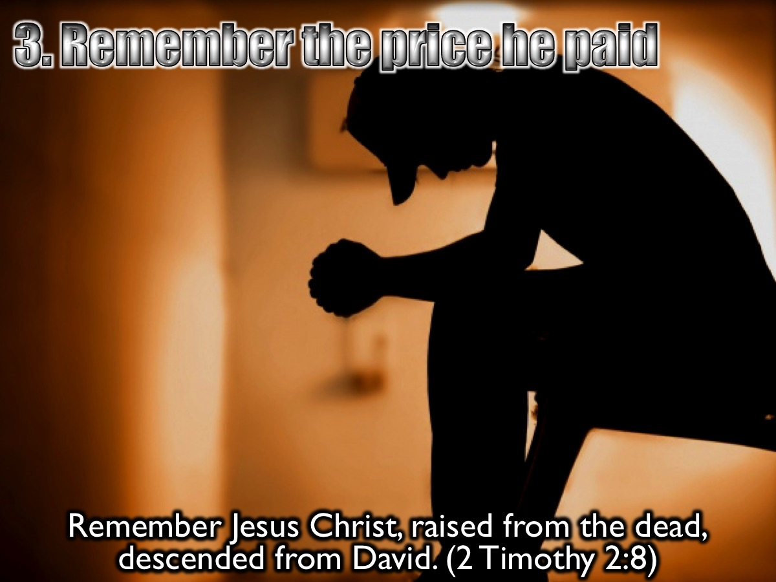
Notes:
3. Remember the price he paid for our sin. Remember Jesus Christ, raised from the dead, descended from David. (2 Timothy 2:8)

Slide 26
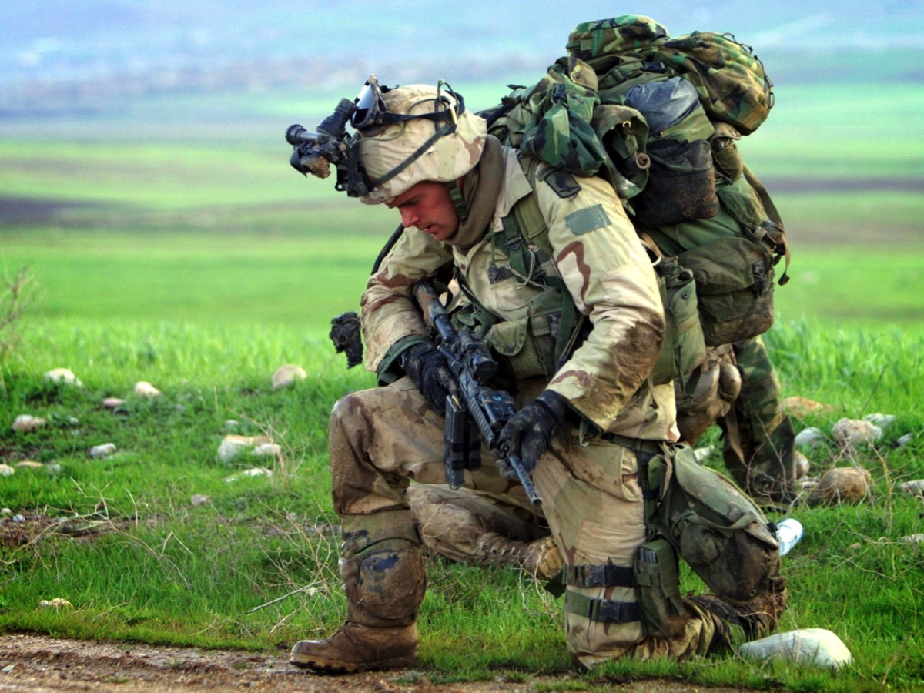
Notes:
If you have never received Jesus as your Saviour – now is a good time to receive him as your Lord and Saviour! Let’s all stand. If you have never asked Jesus to be your Saviour, I want you to raise your hand so I can pray with you.

Slide 27
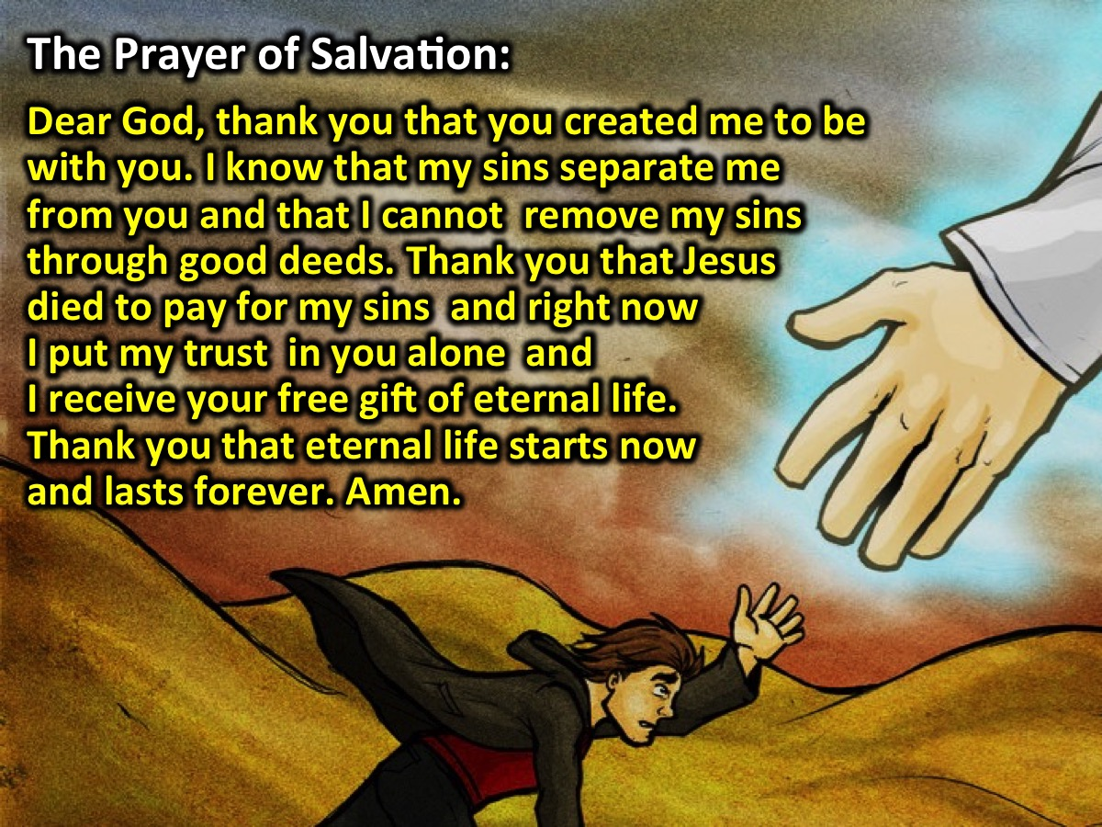
Notes:
The Prayer of Salvation: Dear God, thank you that you created me to be with you. I know that my sins separate me from you and that I cannot remove my sins through good deeds. Thank you that Jesus died to pay for my sins and right now I put my trust in you alone and I receive your free gift of eternal life. Thank you that eternal life starts now and lasts forever. Amen.
Challenge: If you prayed that prayer for the first time then please come forward so I can pray for you.

Slide 28
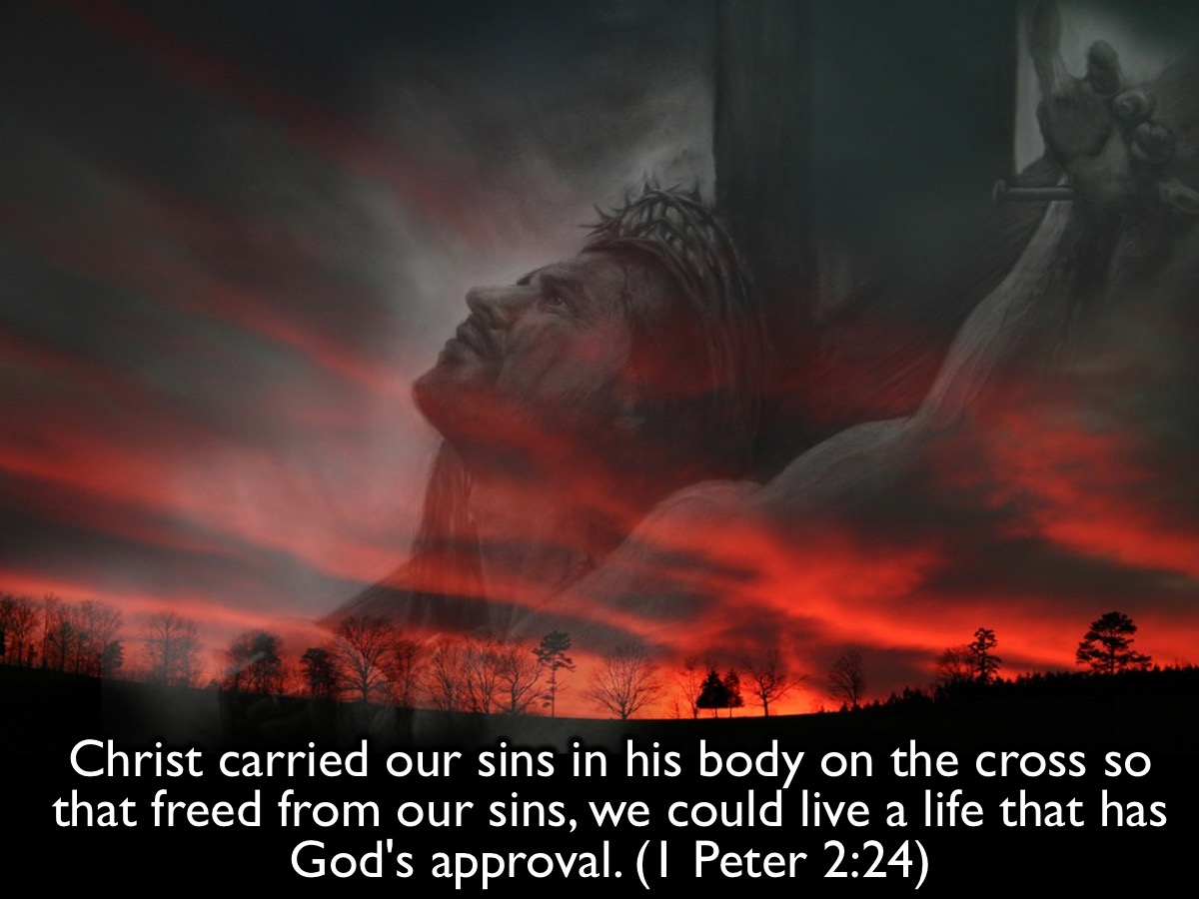
Notes:
The cross has everything to do with victory! “Christ carried our sins in his body on the cross so that freed from our sins, we could live a life that has God's approval.” (1 Peter 2:24)

Slide 29
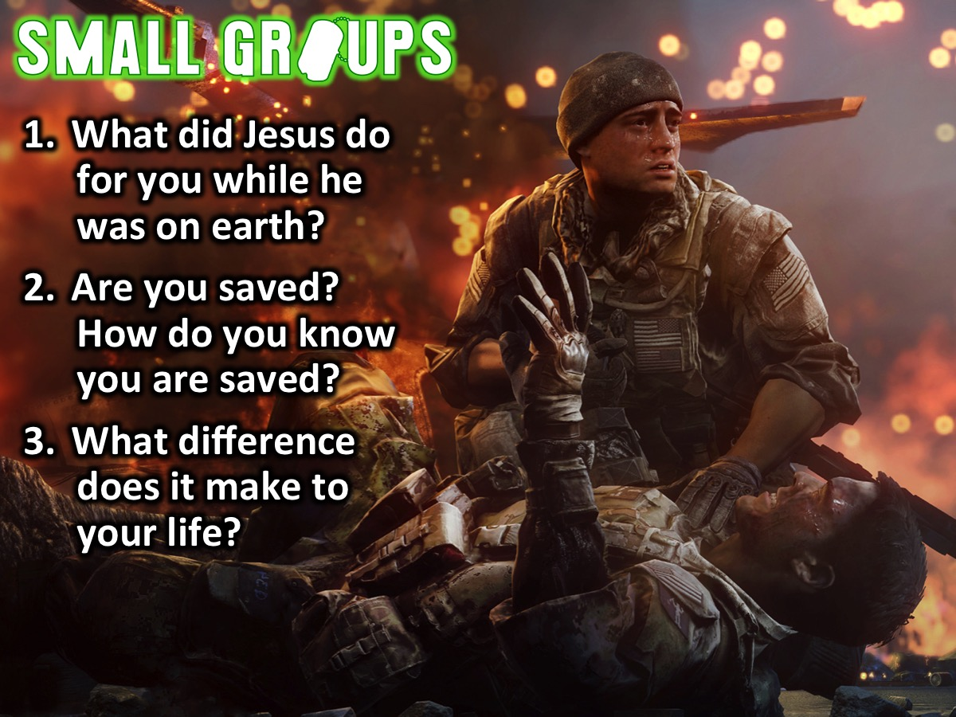
Notes:
Small Group Questions: (1) What did Jesus do for you while he was on earth? (2) Are you saved? How do you know you are saved? (3) What difference does it make to your life?

Slide 30
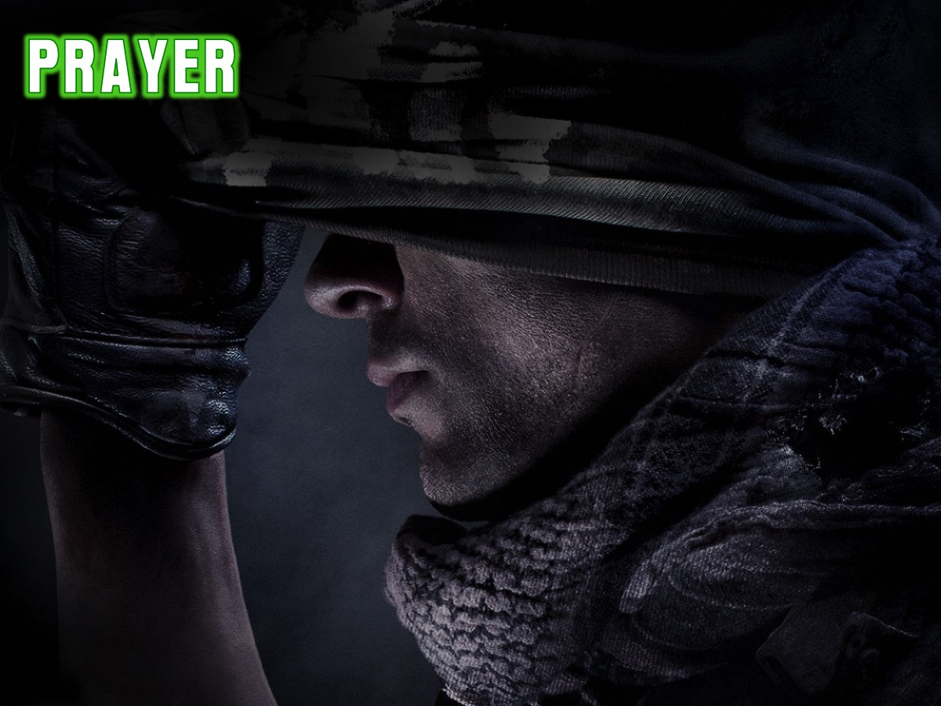
Notes:
Let’s pray!

Slide 31

Notes:
Next Week we will look at how our identity affects our victory.

