Slide 1

Notes:
Welcome to Victory Weekend! Let’s start with another Call of Duty video:

Slide 2
Notes:
Video: Call of Duty Vet and Noob. Get it on YouTube at: https://www.youtube.com/watch?v=zuzaxlddWbk

Slide 3

Notes:
Last Week we looked at how our identity affects our victory.

Slide 4

Notes:
We looked at who we are in Christ:

Slide 5

Notes:
1. We are Chosen

Slide 6
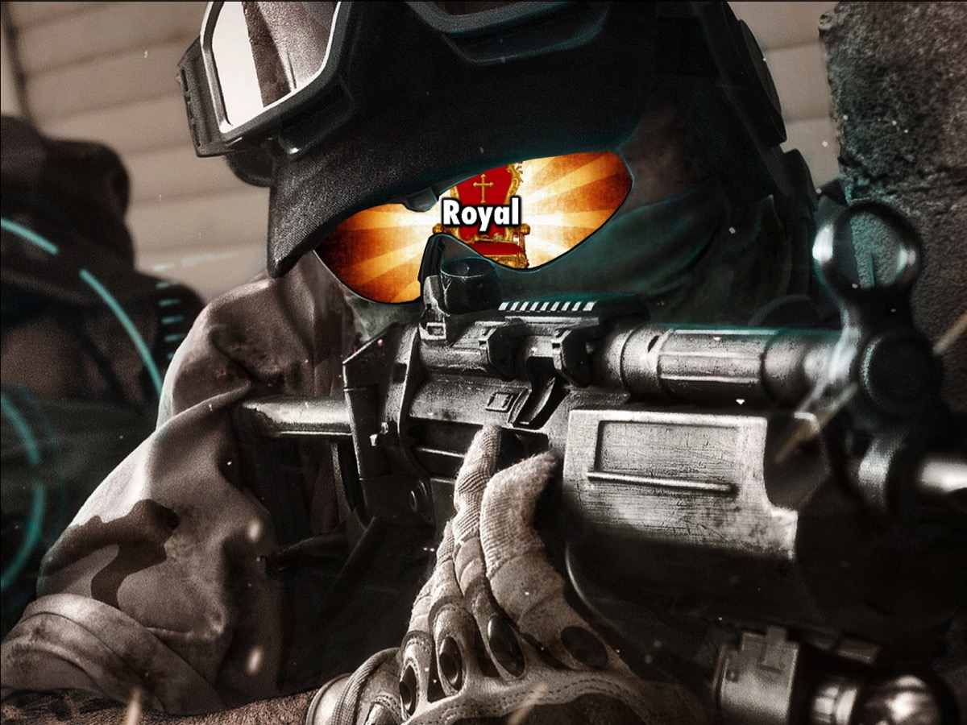
Notes:
2. We are Royal

Slide 7
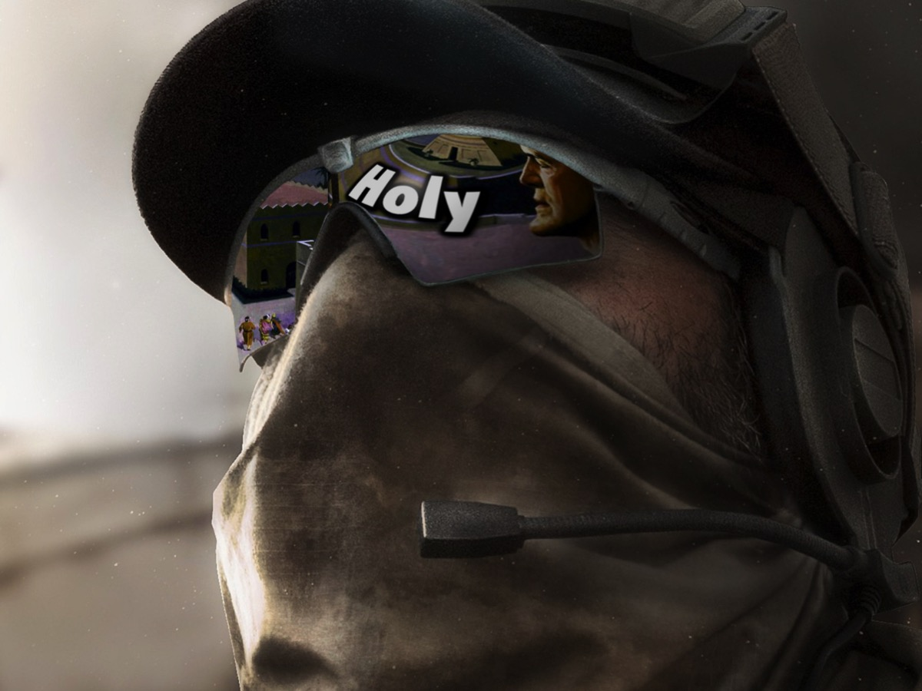
Notes:
3. We are Holy

Slide 8

Notes:
We spent time looking at what baptism is all about.
Why should we be baptised? To follow Jesus’ example, to obey Jesus’ command and to show you are a believer.
What water baptism all about? It illustrates Jesus’ burial and resurrection and my new life as a Christian
Who should be baptised? Everyone who believes in Jesus!
When should we be baptised? As soon as you have believed!

Slide 9
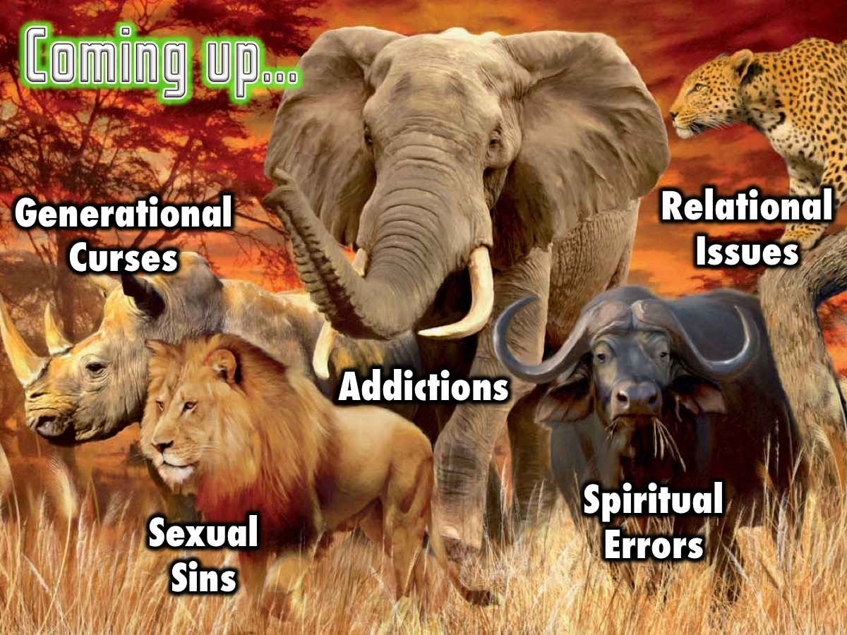
Notes:
In the next five weeks we will look at five big issues in our lives: Generational Curses, Relational Issues, Spiritual Errors, Sexual Sins and Addictions.

Slide 10

Notes:
This Week we are going to explore the first of five issues that we need victory from: Generational Curses.

Slide 11
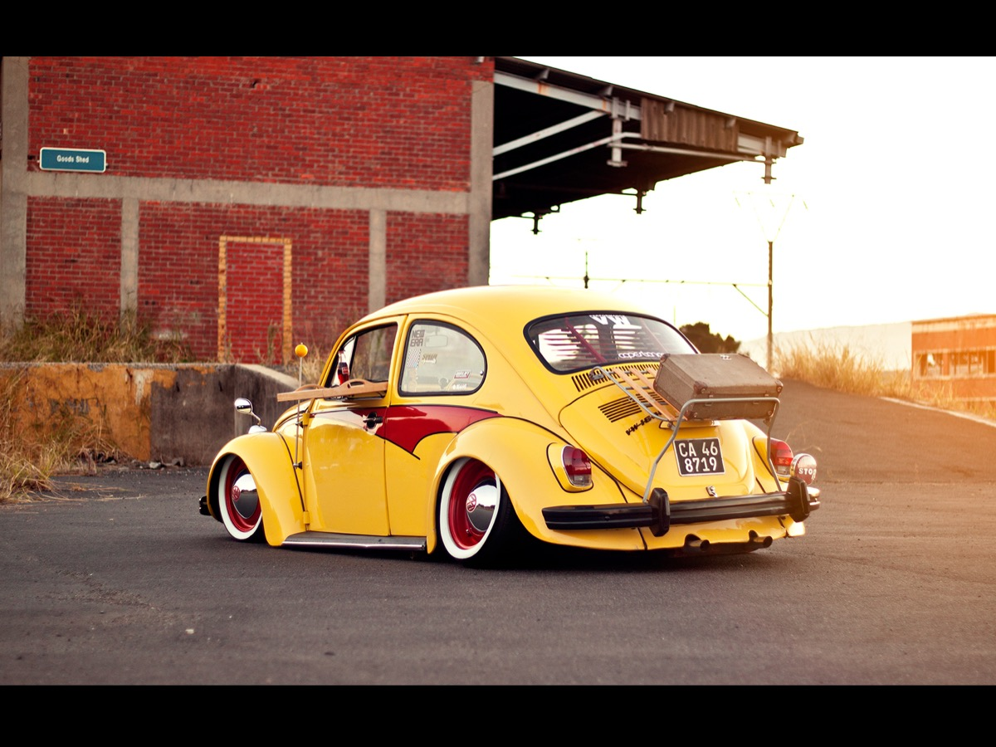
Notes:
How do you like this old car? A vintage old VW Beetle!

Slide 12
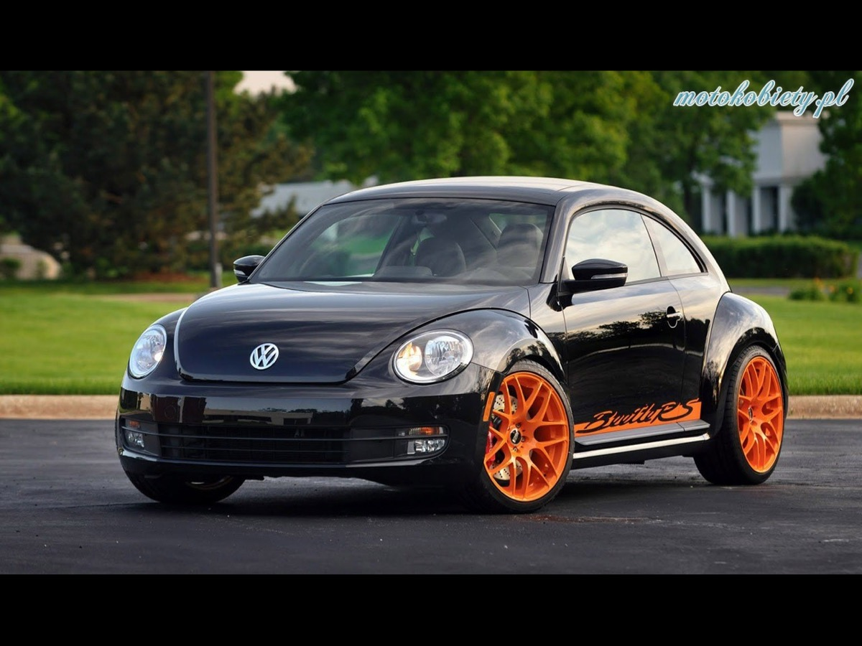
Notes:
And this new one? A new enhanced Beetle! But they are still both recognizable as Beatles!

Slide 13

Notes:
Here is a photo of 2 generations of VW Beetle – one from 1951 and the other from 2013!

Slide 14
Notes:
Here are five generations of the VW Transporter.

Slide 15
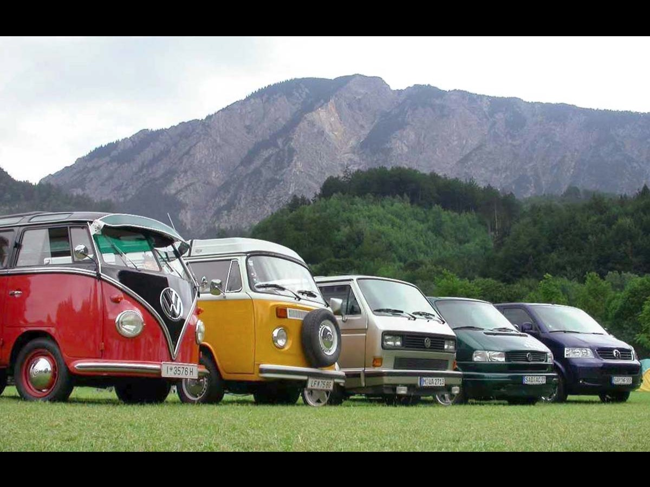
Notes:
And here are five generations of the VW Golf!

Slide 16
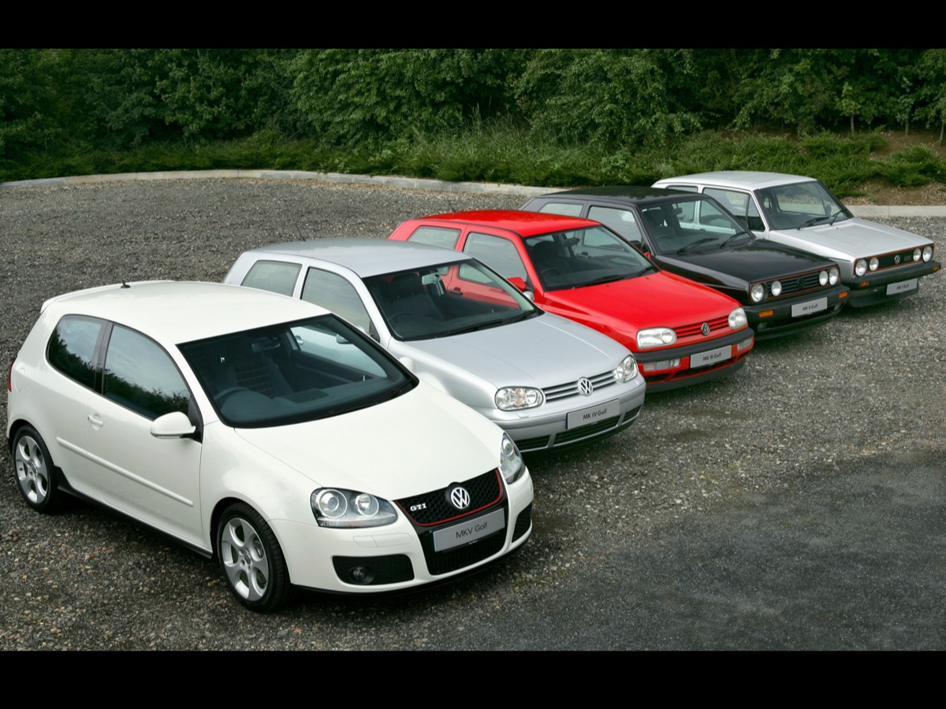
Notes:
Believe it or not, here is a photo of five living generations of people in the same family!

Slide 17
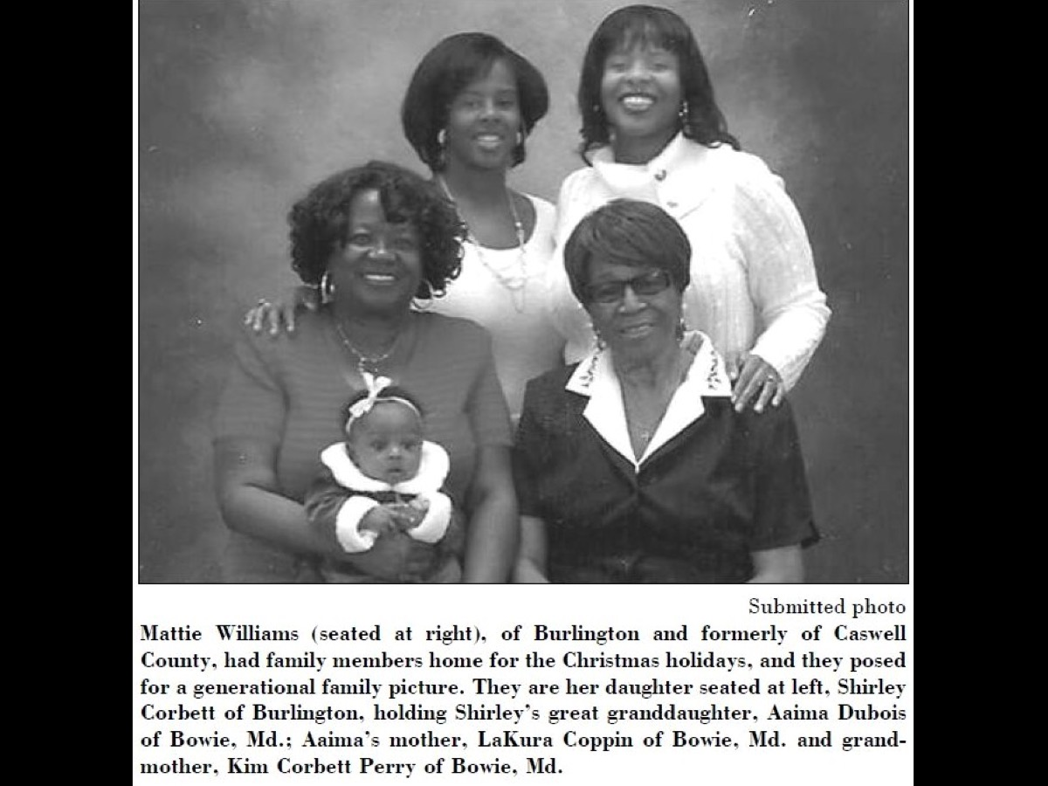
Notes:
Here is another one. Notice how family likeness is passed on from generation to generation.

Slide 18
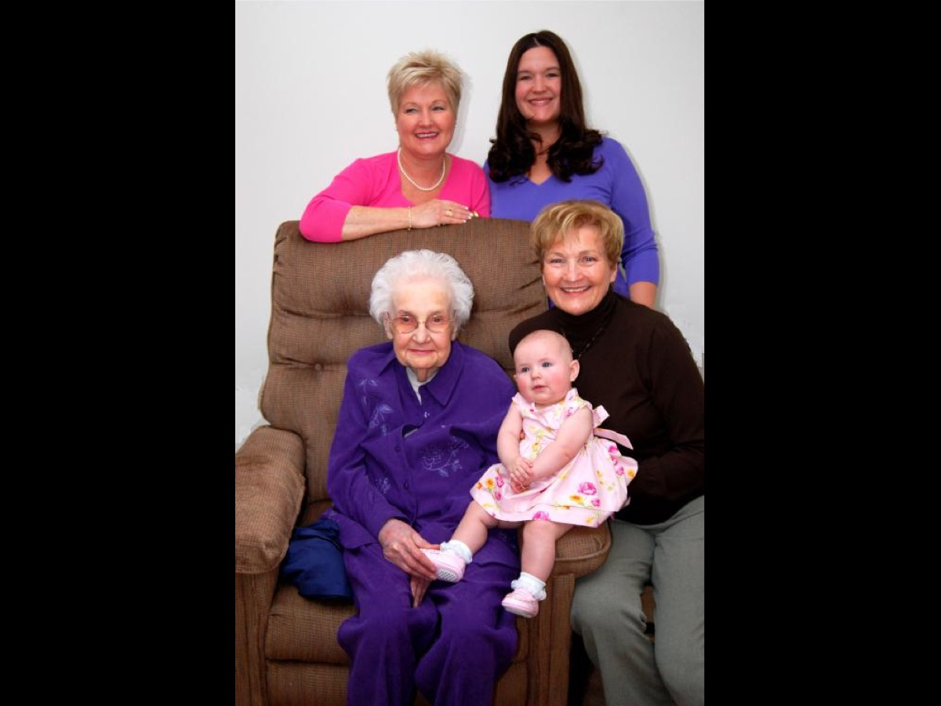
Notes:
Sin Affects Generations! The scriptures speak of the sins of one generation negatively affecting future generations: You shall not bow down to them or worship them; for I, the LORD your God, am a jealous God, punishing the children for the sin of the fathers to the third and fourth generation of those who hate me. (Exodus 20:5). If you do not carefully follow all the words of this law, which are written in this book, and do not revere this glorious and awesome name - the LORD your God - the LORD will send fearful plagues on you and your descendants, harsh and prolonged disasters, and severe and lingering illnesses. (Deuteronomy 28:58-59)

Slide 19
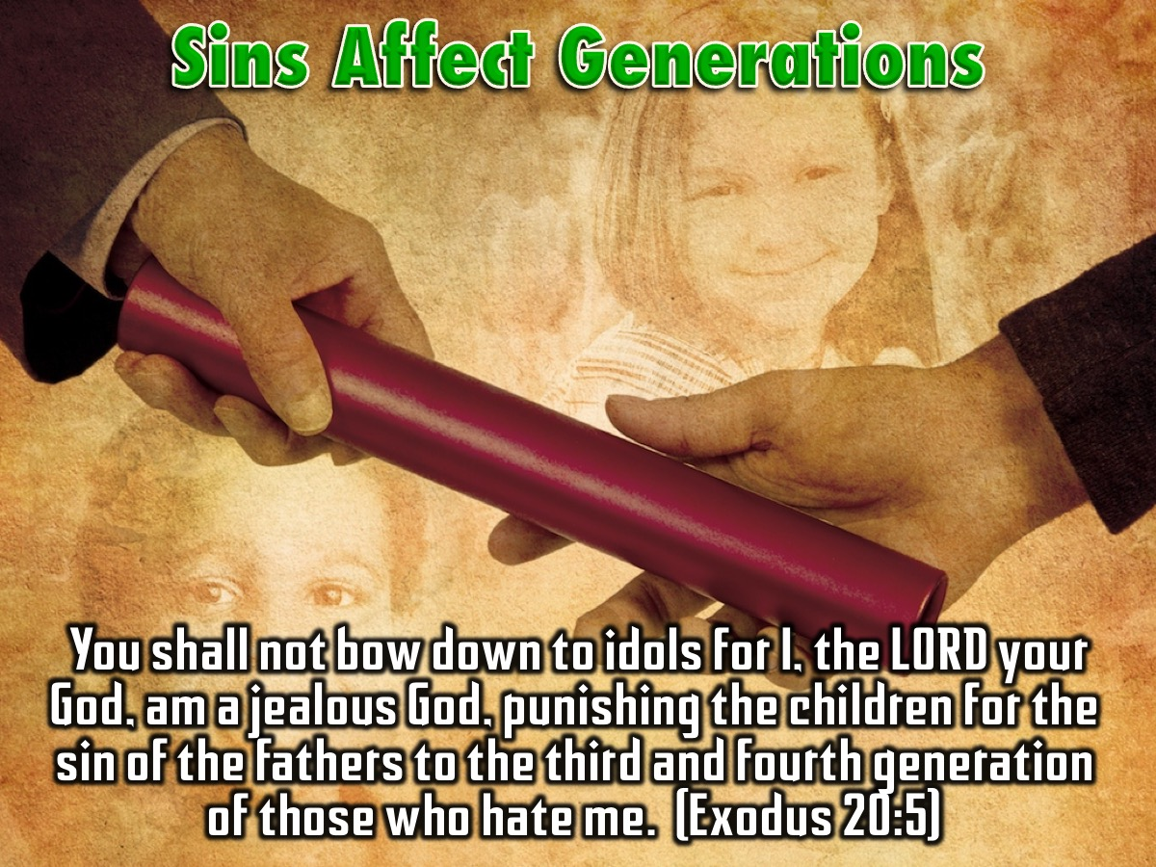
Notes:
Sin Runs Through Family Lines: This idea of sin running through family lines is today referred to as an addiction or a disease. What the Bible calls the sin of drunkenness is now called the disease of alcoholism. Far from being mere physical addictions, diseases, or uncontrollable forces of genetics, some sinful patterns that run in family lines can be spiritual in nature.

Slide 20
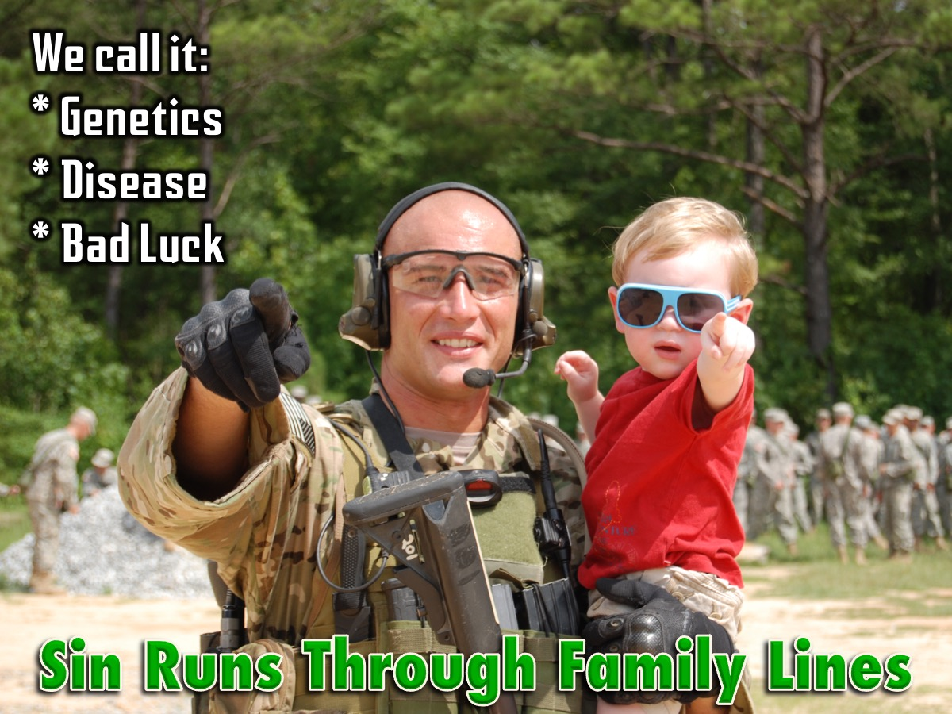
Notes:
As Christians, we should live under the blessing of God, but sometimes we experience curses!

Slide 21

Notes:
Spiritual blessings and curses share some common characteristics: (1) They are transferred by spoken words, (2) They affect more than just the individual, (3) They are passed from generation to generation and (4) They continue unless they are cancelled.

Slide 22
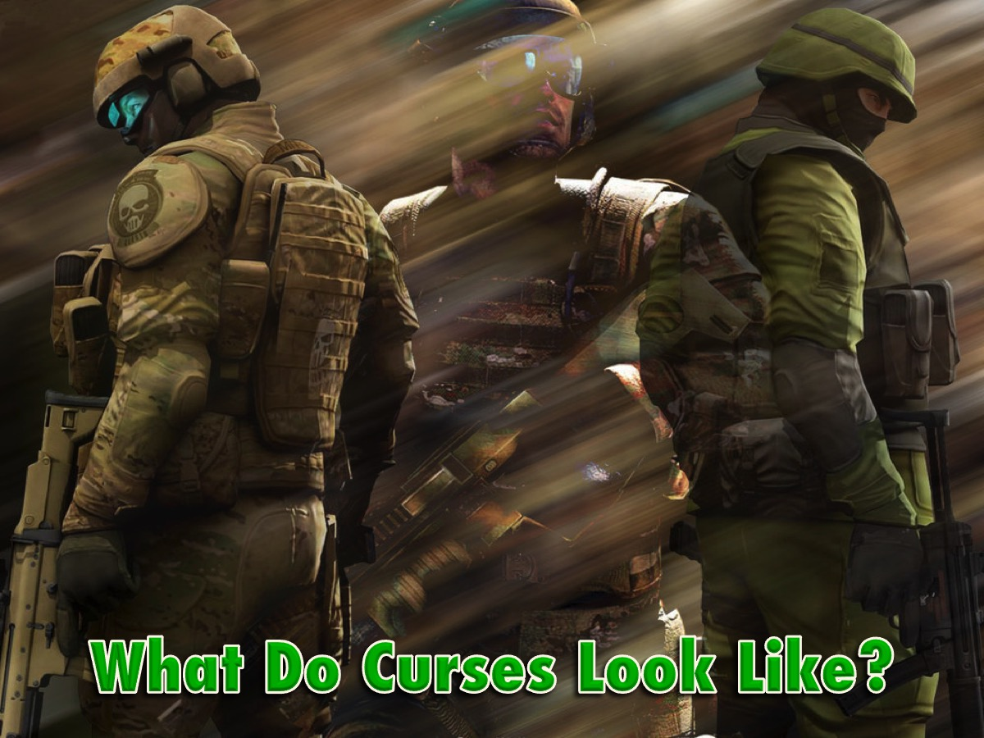
Notes:
What Do Curses Look Like? If one or more of the following signs repeatedly show up generation after generation, there is possibly a generational curse at work.

Slide 23

Notes:
1. Recurring Financial Lack

Slide 24
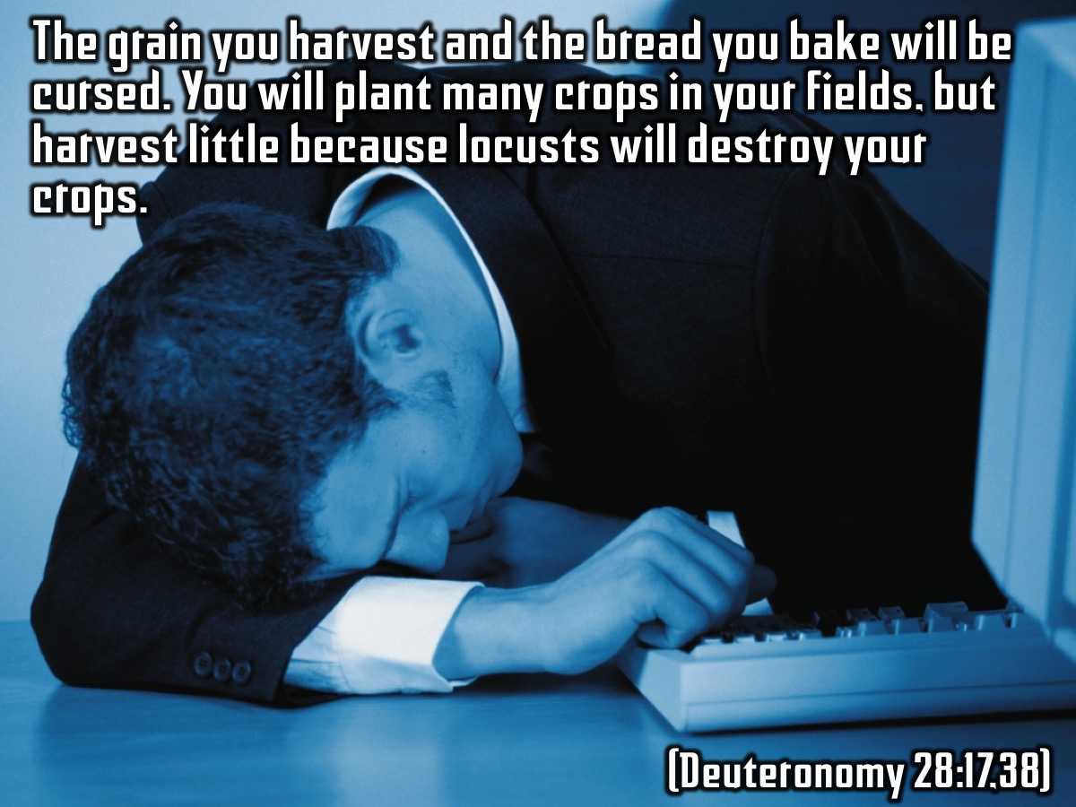
Notes:
The grain you harvest and the bread you bake will be cursed. You will plant many crops in your fields, but harvest little because locusts will destroy your crops. (Deuteronomy 28:17,38)

Slide 25
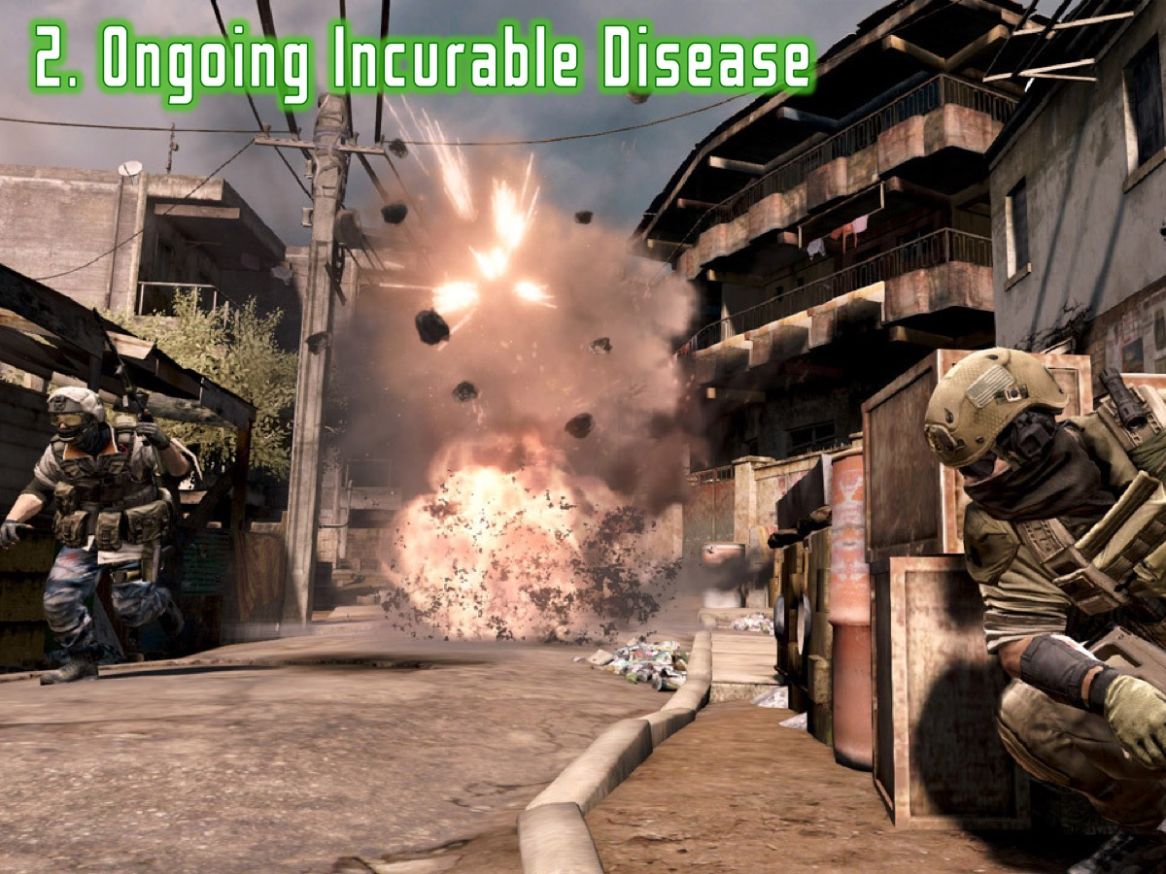
Notes:
2. Ongoing Incurable Disease

Slide 26
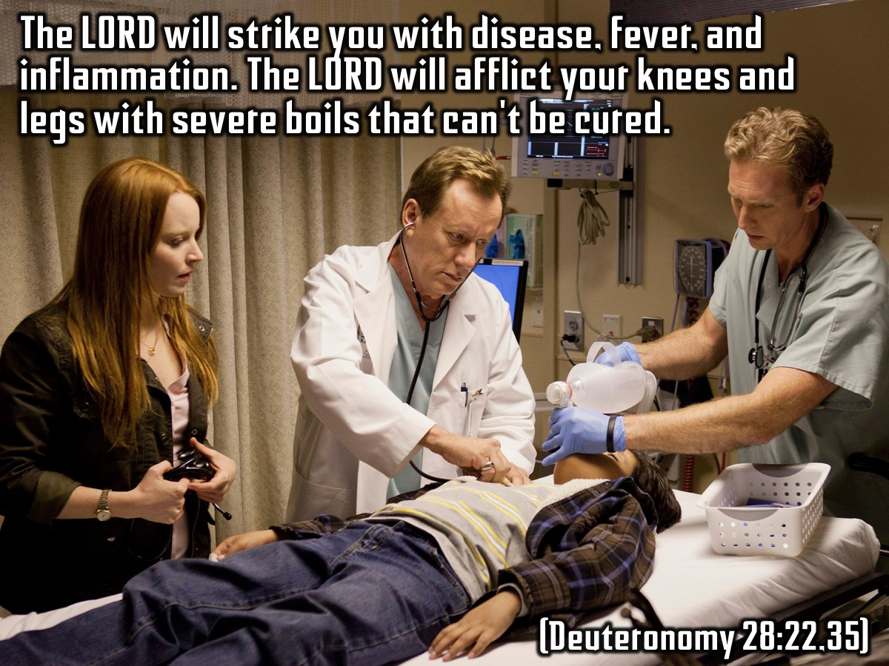
Notes:
The LORD will strike you with disease, fever, and inflammation. The LORD will afflict your knees and legs with severe boils that can't be cured. (Deuteronomy 28:22,35)

Slide 27
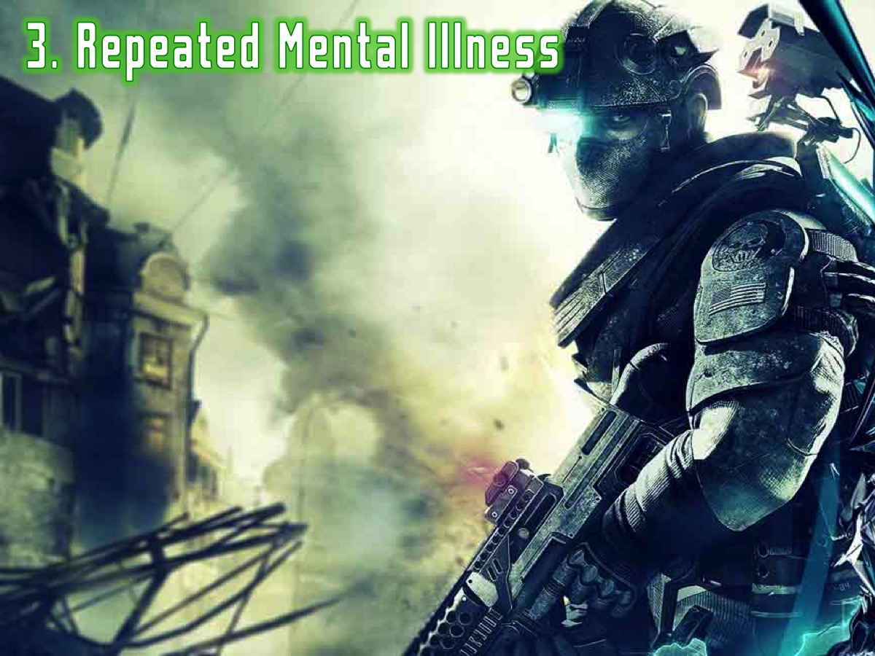
Notes:
3. Repeated Mental Illness (or Emotional Dysfunction)

Slide 28
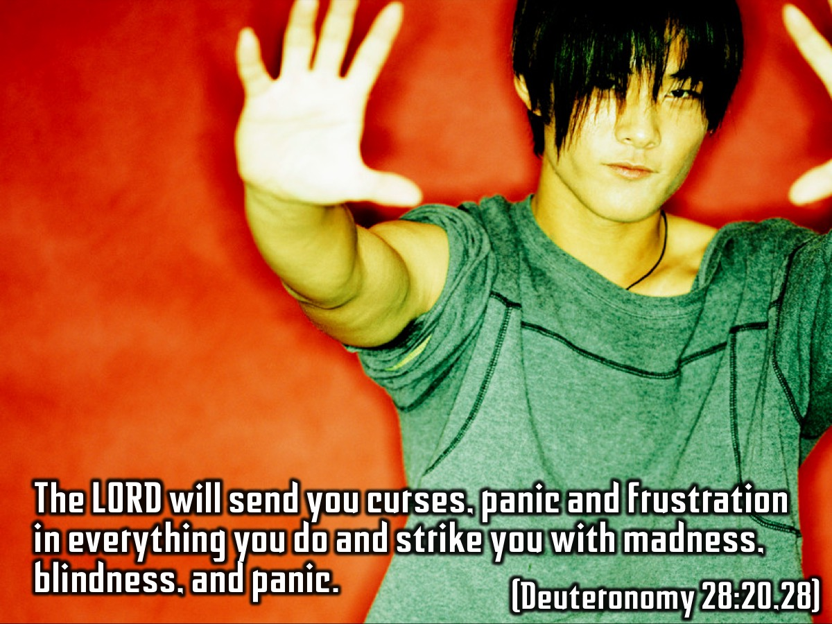
Notes:
The LORD will send you curses, panic, and frustration in everything you do. The LORD will strike you with madness, blindness, and panic. (Deuteronomy 28:20,28)

Slide 29
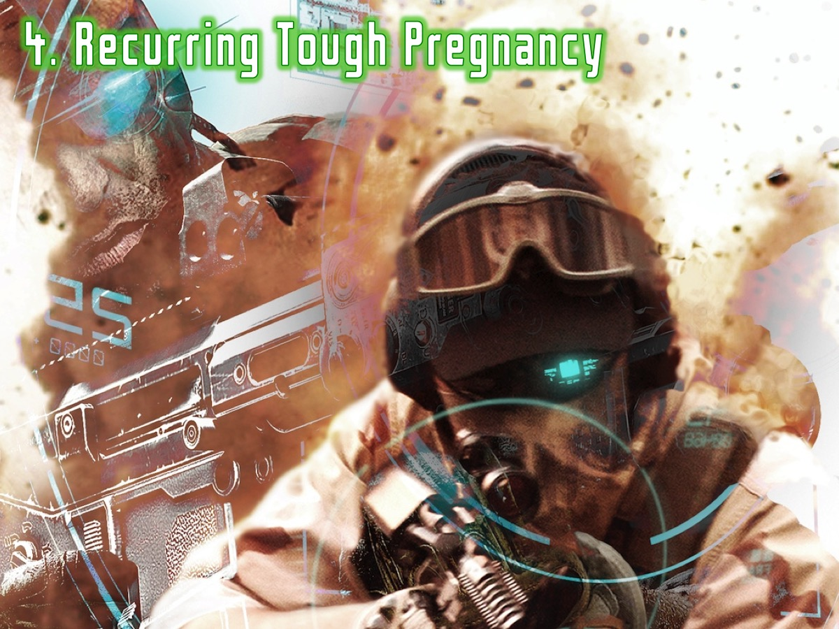
Notes:
4. Recurring Tough Pregnancy (Miscarriage or Barrenness)

Slide 30
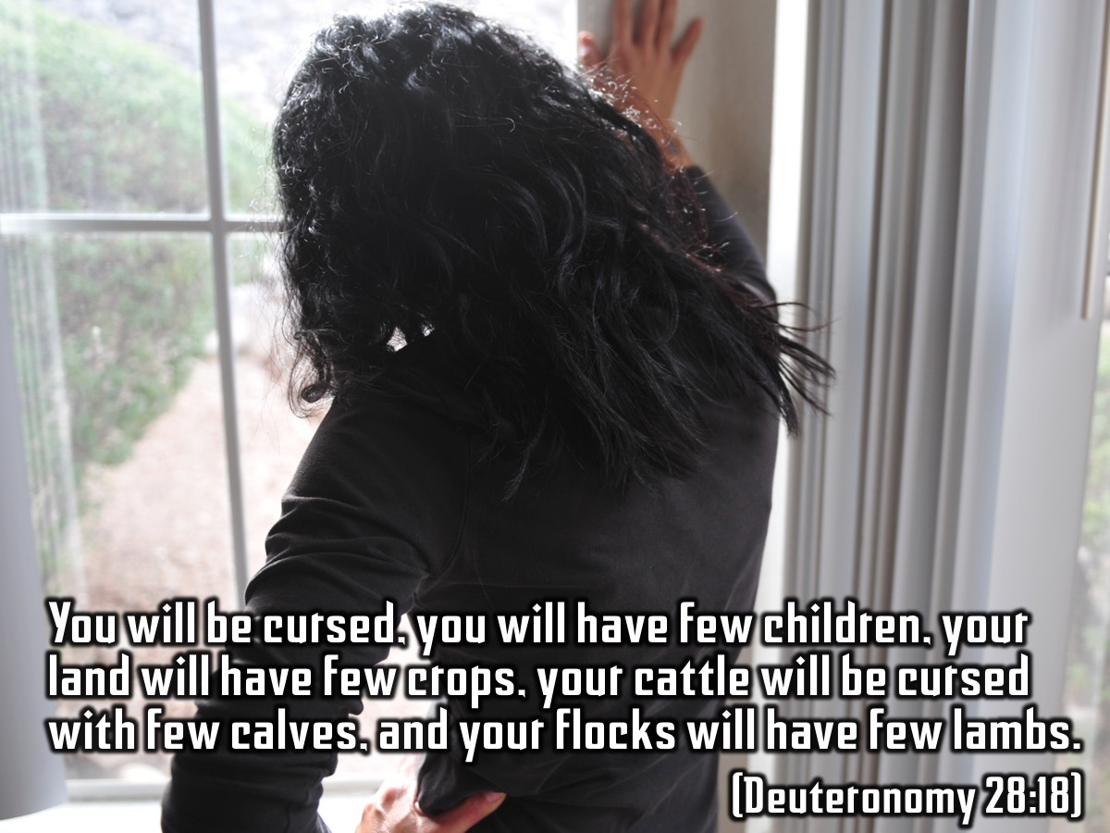
Notes:
You will be cursed. You will have few children. Your land will have few crops. Your cattle will be cursed with few calves, and your flocks will have few lambs and kids. (Deuteronomy 28:18)

Slide 31

Notes:
5. Repeated Oppression (or failure)

Slide 32
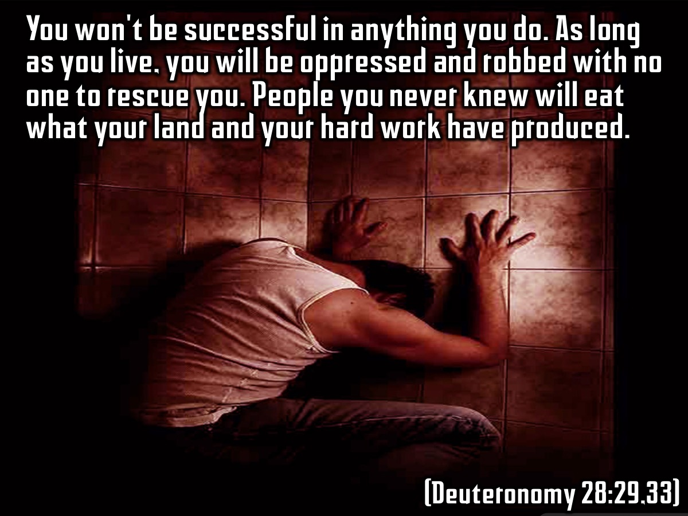
Notes:
You won't be successful in anything you do. As long as you live, you will be oppressed and robbed with no one to rescue you. People you never knew will eat what your land and your hard work have produced. As long as you live, you will know nothing but oppression and abuse. (Deuteronomy 28:29,33)

Slide 33
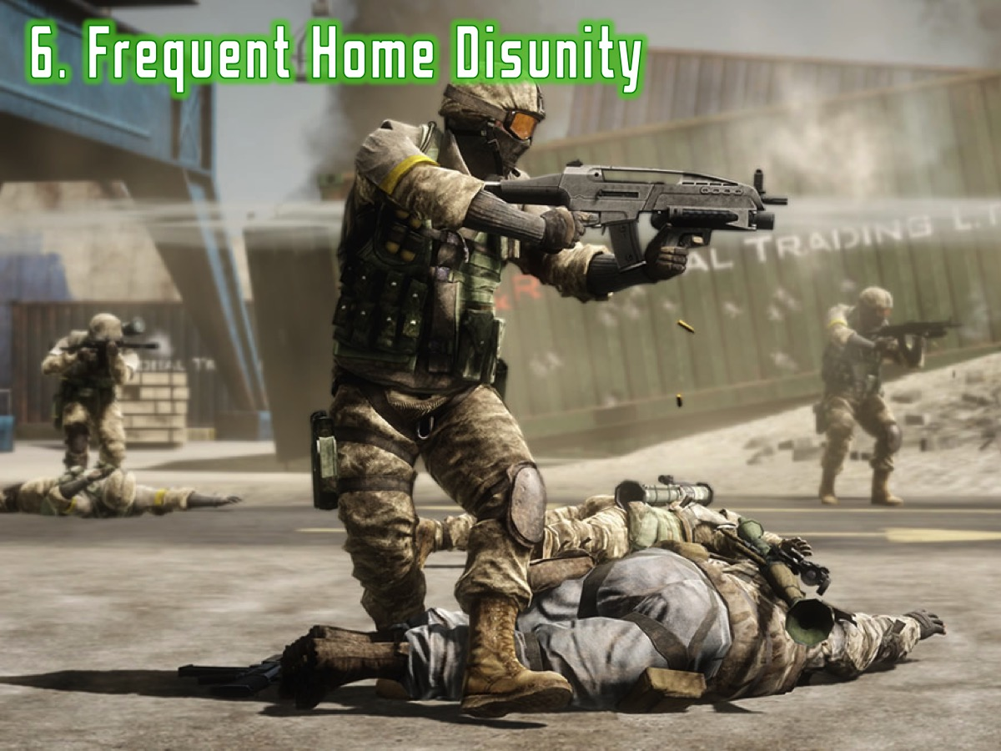
Notes:
6. Frequent Home Disunity (or Calamity)

Slide 34
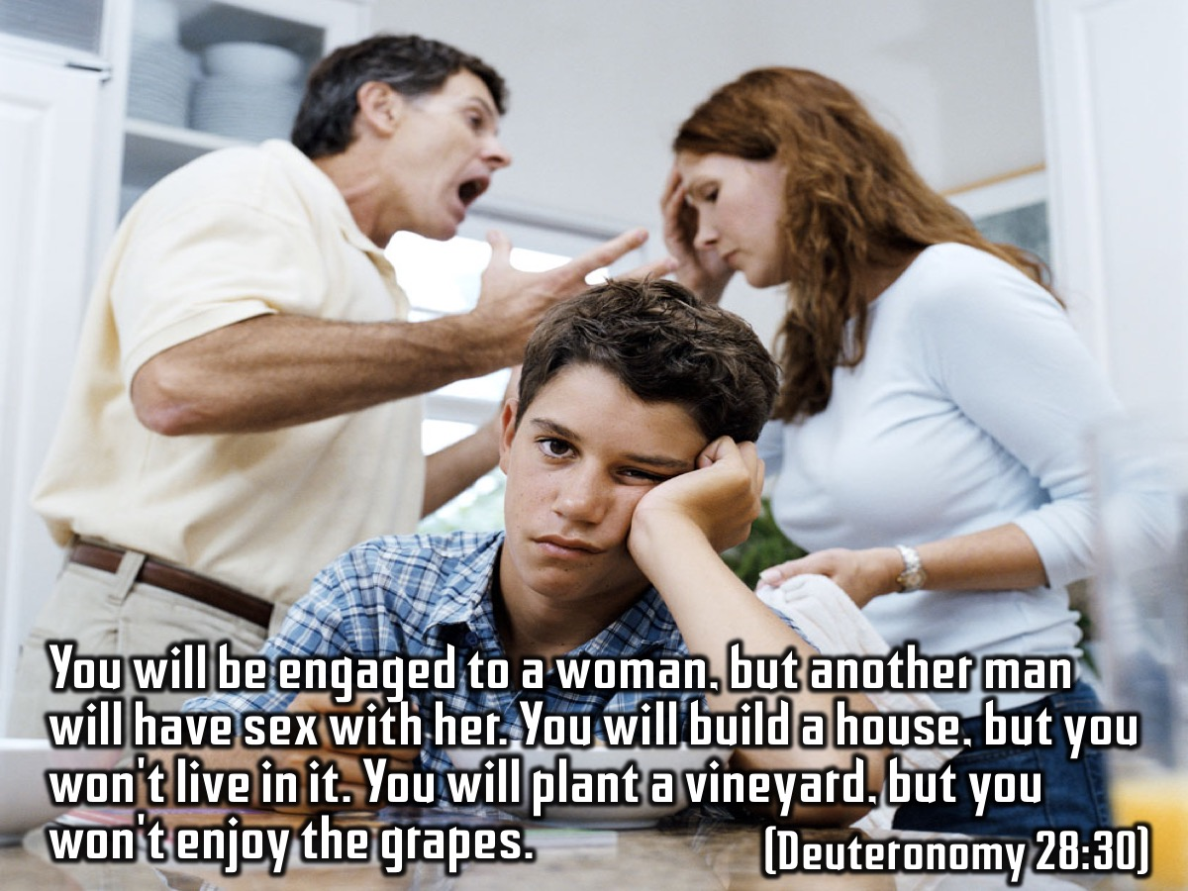
Notes:
You will be engaged to a woman, but another man will have sex with her. You will build a house, but you won't live in it. You will plant a vineyard, but you won't enjoy the grapes. (Deuteronomy 28:30)

Slide 35
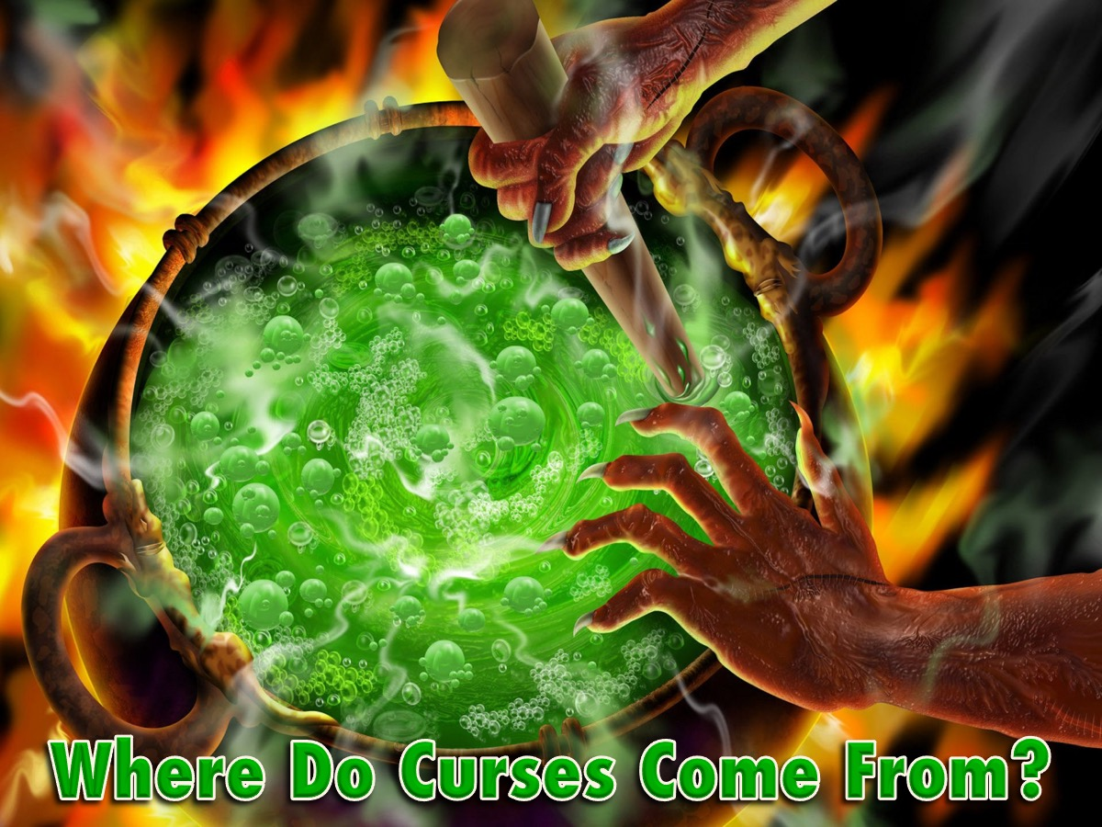
Notes:
Where Do Curses Come From? According to the Bible there are seven causes of curses:

Slide 36
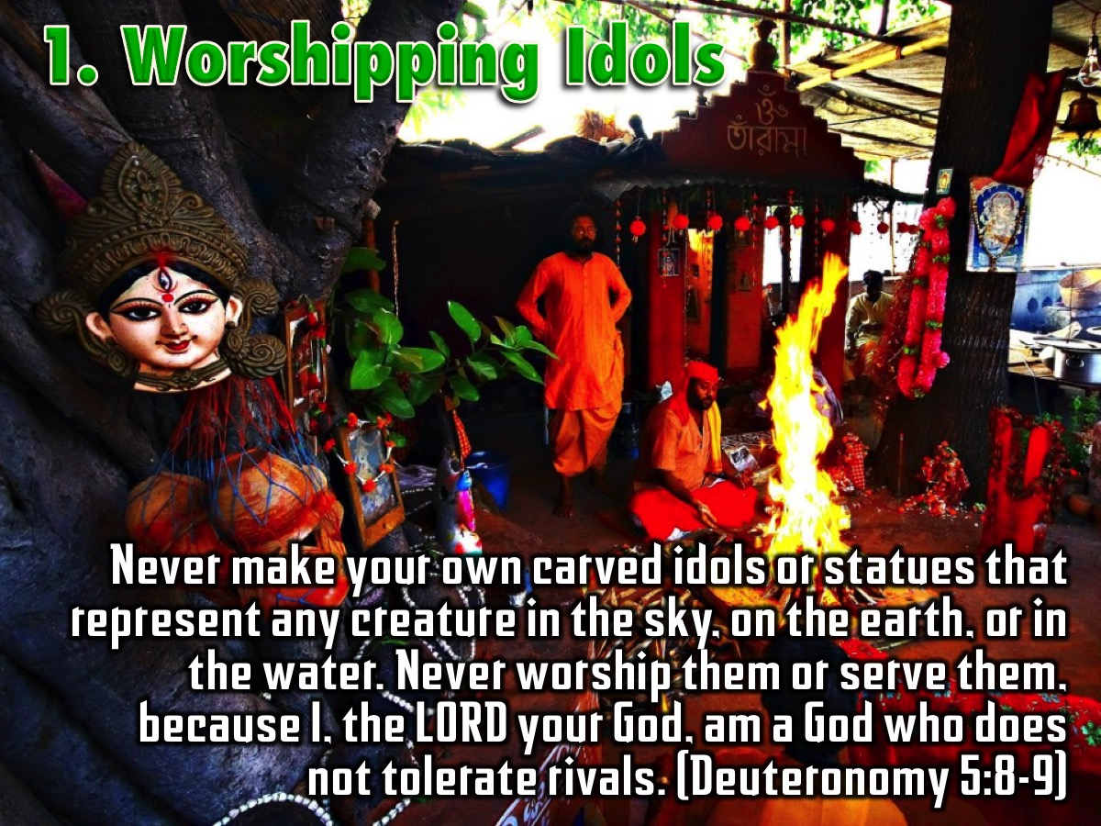
Notes:
1. Worshipping Idols. Never make your own carved idols or statues that represent any creature in the sky, on the earth, or in the water. Never worship them or serve them, because I, the LORD your God, am a God who does not tolerate rivals. (Deuteronomy 5:8-9)

Slide 37

Notes:
2. Dishonouring Parents. Cursed is the person who dishonors his father or his mother. (Deuteronomy 27:16)

Slide 38
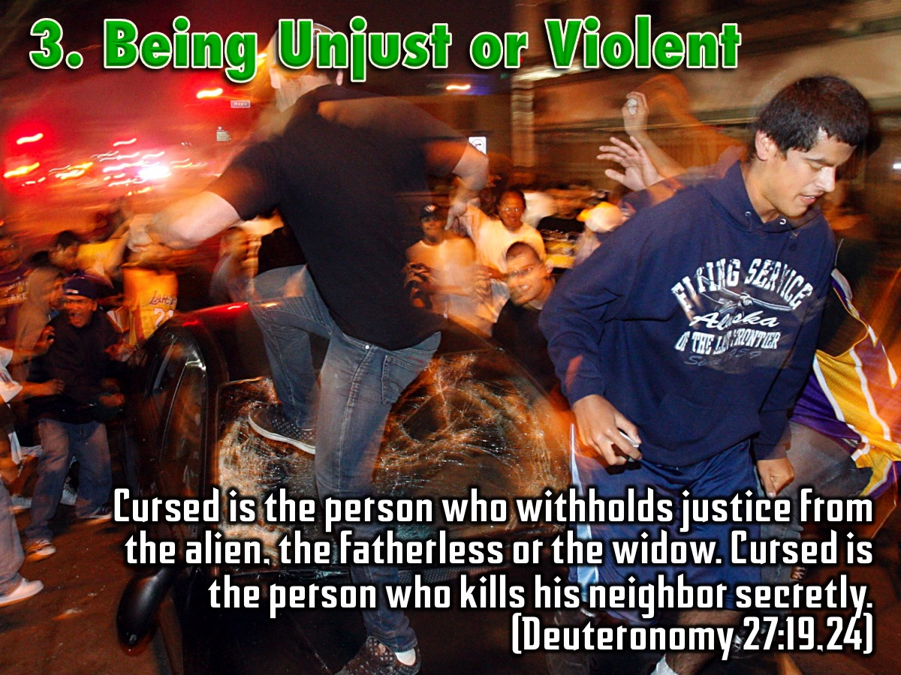
Notes:
3. Being Unjust or Violent. Cursed is the person who withholds justice from the alien, the fatherless or the widow. Cursed is the person who kills his neighbor secretly. (Deuteronomy 27:19,24)

Slide 39
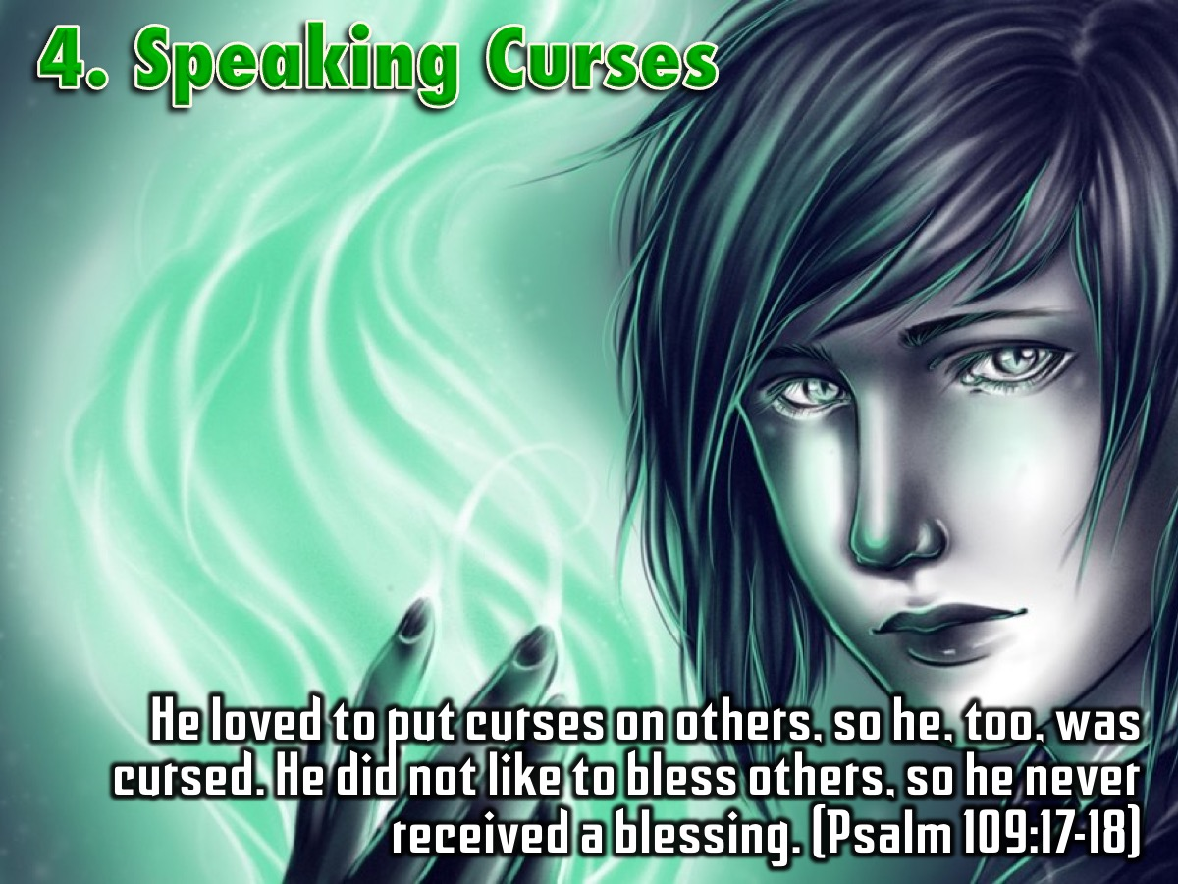
Notes:
4. Spoken Curses. He loved to put curses on others, so he, too, was cursed. He did not like to bless others, so he never received a blessing. He wore cursing as though it were clothing, so cursing entered his body like water and his bones like oil. (Psalm 109:17-18)

Slide 40
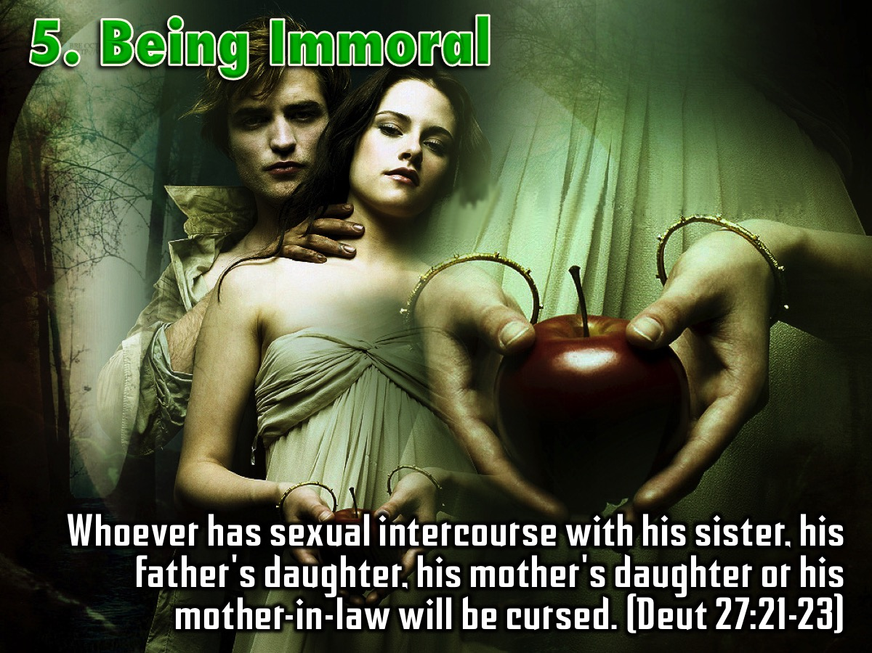
Notes:
5. Being Immoral. Whoever has sexual intercourse with his sister, his father's daughter, or his mother's daughter will be cursed. Whoever has sexual intercourse with his mother-in-law will be curse. (Deuteronomy 27:21-23)

Slide 41
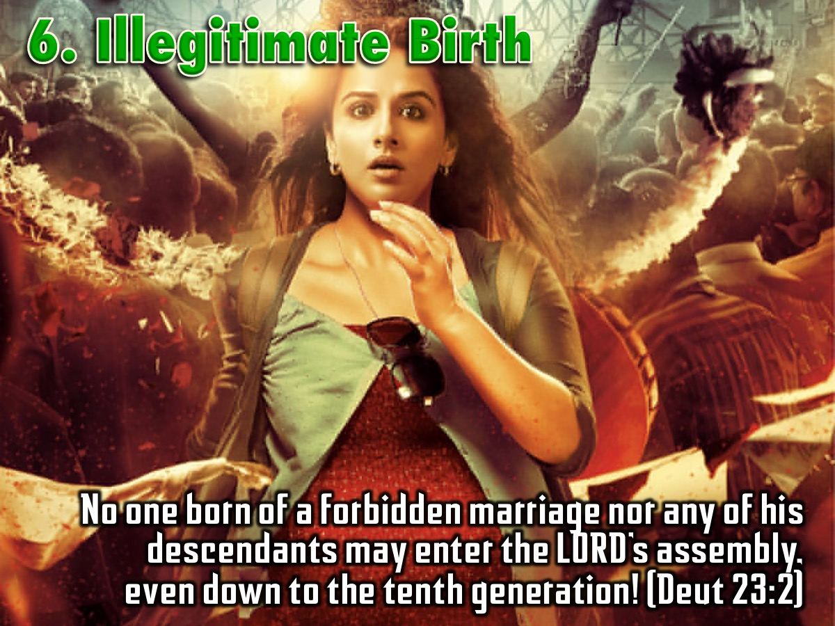
Notes:
6. Illegitimate Birth. No one born of a forbidden marriage nor any of his descendants may enter the LORD’s assembly, even down to the tenth generation! (Deuteronomy 23:2)

Slide 42
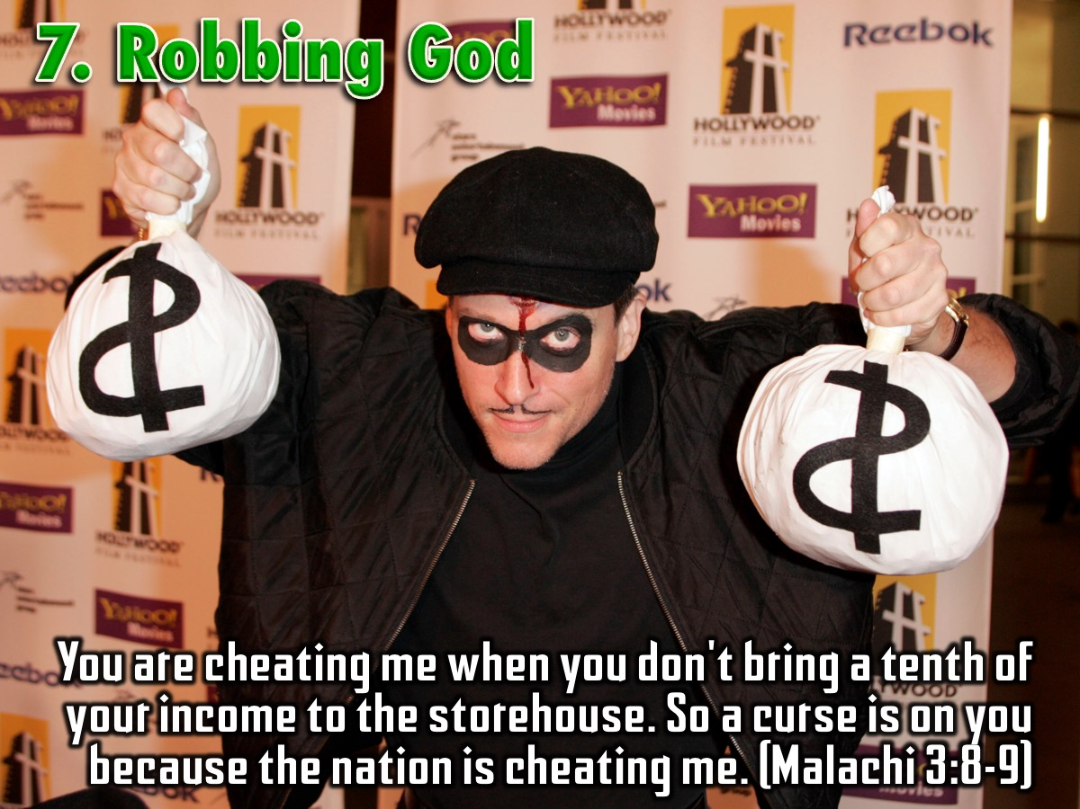
Notes:
7. Robbing God. You are cheating me when you don't bring a tenth of your income to the storehouse. So a curse is on you because the nation is cheating me. (Malachi 3:8-9)

Slide 43
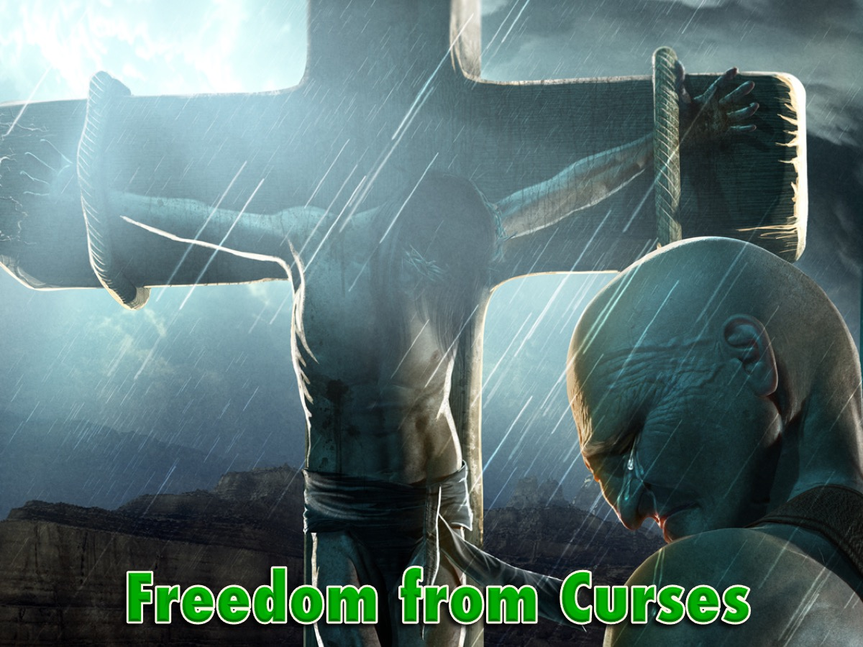
Notes:
Do you remember we spoke about the cross of Jesus two weeks ago? Well the cross is the key to gaining freedom from curses!

Slide 44
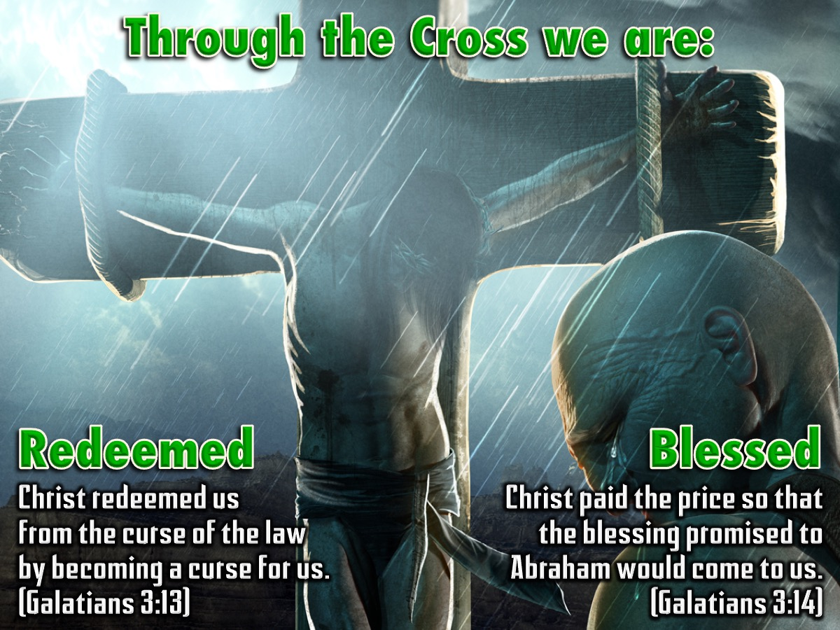
Notes:
Through the cross we are: (1) Redeemed: Christ redeemed us from the curse of the law by becoming a curse for us. (Galatians 3:13) and (2) Blessed: Christ paid the price so that the blessing promised to Abraham would come to us. (Galatians 3:14).

Slide 45
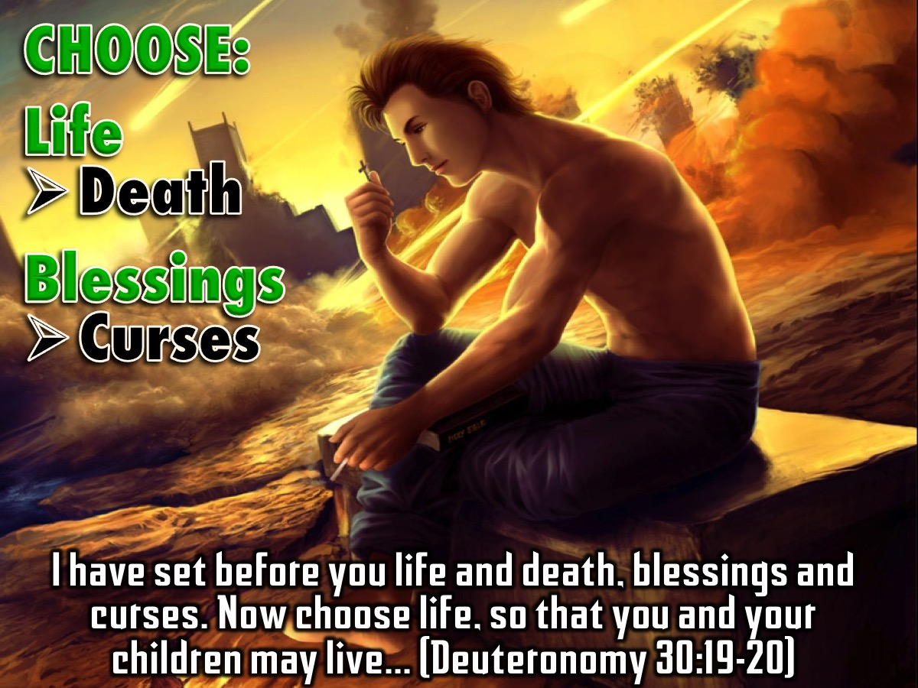
Notes:
You Can Choose! We have a choice to make: Life or death, Blessings or curses. God has offered us his blessing and is waiting for us to claim it by faith. I have set before you life and death, blessings and curses. Now choose life, so that you and your children may live and that you may love the LORD your God, listen to his voice, and hold fast to him. (Deuteronomy 30:19-20).

Slide 46

Notes:
Handout: Spend a few minutes completing the Handout on Generational Curses.

Slide 47
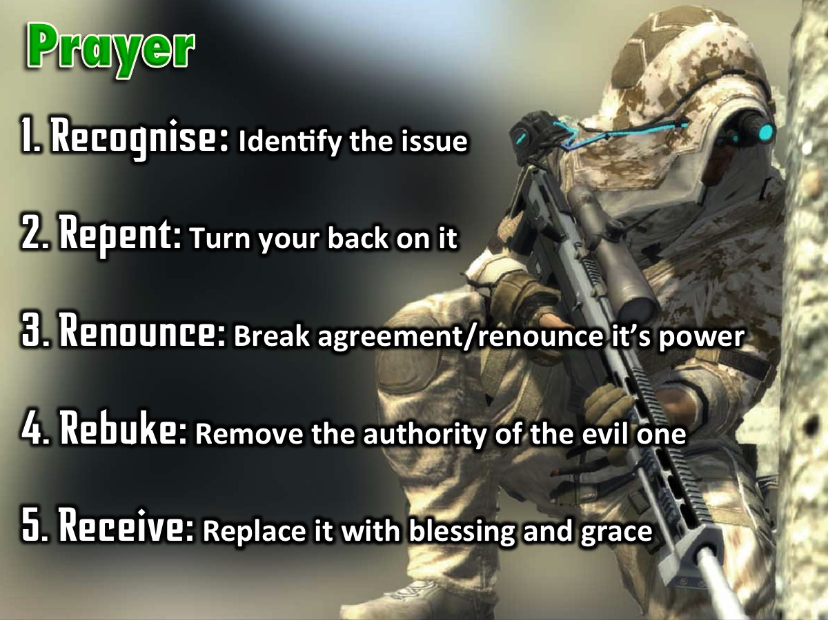
Notes:
Prayer! The Process of Deliverance. To experience freedom in the area of generational curses we are going to pray through the process of deliverance:
A. The first step to victory is to Recognise any issue that God has brought to your attention that you need to deal with.
B. The second step is Repent – where you commit to turn your back on the issue, choose to renew your mind and ask God to help you think differently about it.
C. The third step is to Renounce – which means to fall out of agreement with the issue and renounce its power over your life. If it is a curse you fall out of agreement with the curse and you renounce its power to operate in your life, you renounce its power to operate in your children’s life - when you have them one day - and the generations to come. If it is sin you have been involved in, you renounce the power of that sin. You close the door on the enemy - he does not have a hold on you anymore! The enemy no longer has authority to operate in your life in the area.
D. The fourth step is Rebuke – when we rebuke the evil one, any demonic spirit that is associated with the issue has to leave – there is no shouting - it just has to go because you have taken its authority away.
E. The fifth step is Receive – where you now ask God to replace what has been taken away with his blessing and grace. Where there was unforgiveness and bitterness you pray to receive God’s grace to forgive; where there was a curse you receive the Lord’s blessing to replace the curse – we speak and announce the blessings of God in areas of poverty for example.

Slide 48
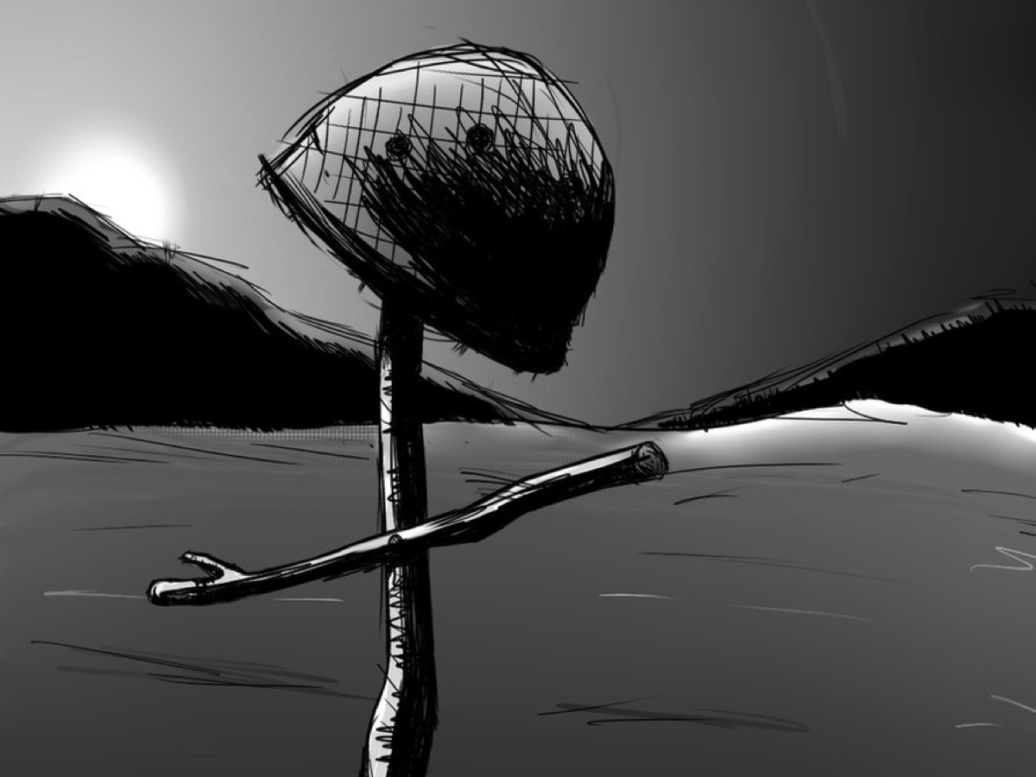
Notes:
As a sign that the generational curses over your life have been broken you need to crumple up your personal profile and come and place them in the helmet on the stage and we will destroy them for you!

Slide 49

Notes:
You are free – you can walk in a new direction!!!

Slide 50

Notes:
Next Week we will look at the second of five big issues in our lives: Relational Issues.

