Slide 1

Notes:
Welcome to the Victory Series! As usual we kick off with a video clip.

Slide 2

Notes:
Video: Battlefield Capture the Flag. Get it on YouTube at: http://www.youtube.com/watch?v=wK5f7az5dIY

Slide 3
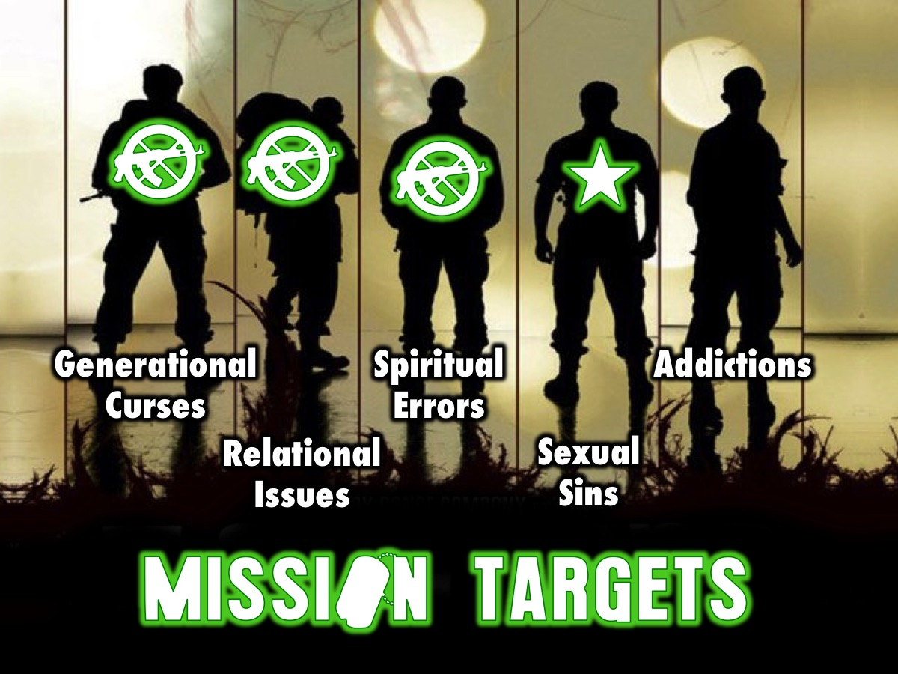
Notes:
Over five sessions we have the following targets to destroy: Generational Curses, Relational Issues, Spiritual Errors, Sexual Sins and Addictions.

Slide 4

Notes:
Last Week we looked at the third of five big issues in our lives: Spiritual Errors.

Slide 5

Notes:
This Week we are going to look at the fourth of five big issues in our lives: Sexual Sins.

Slide 6
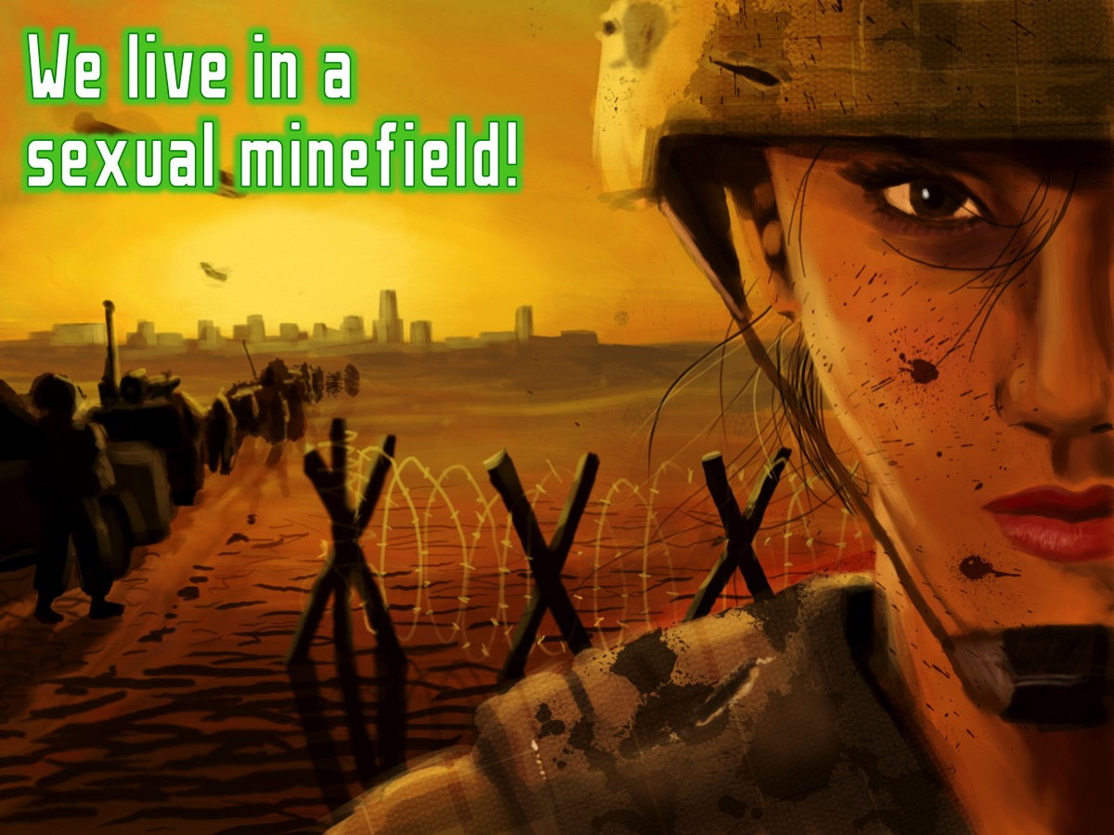
Notes:
We live in a sexual minefield! Here are some issues that are traps in the area of sexuality…

Slide 7
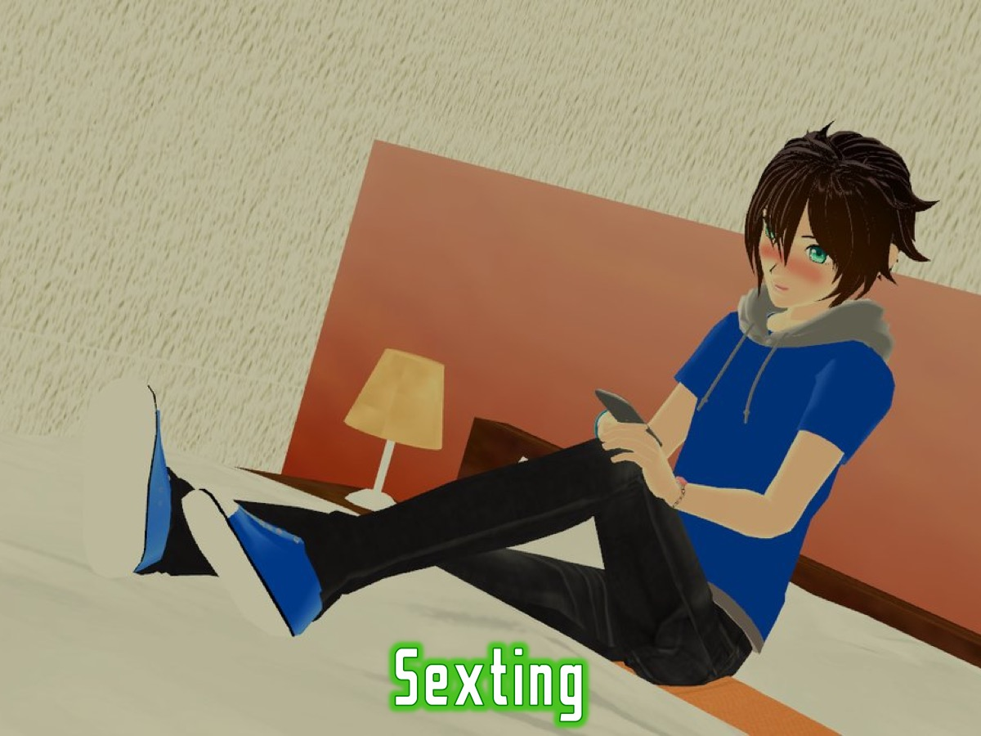
Notes:
Sexting Messages

Slide 8
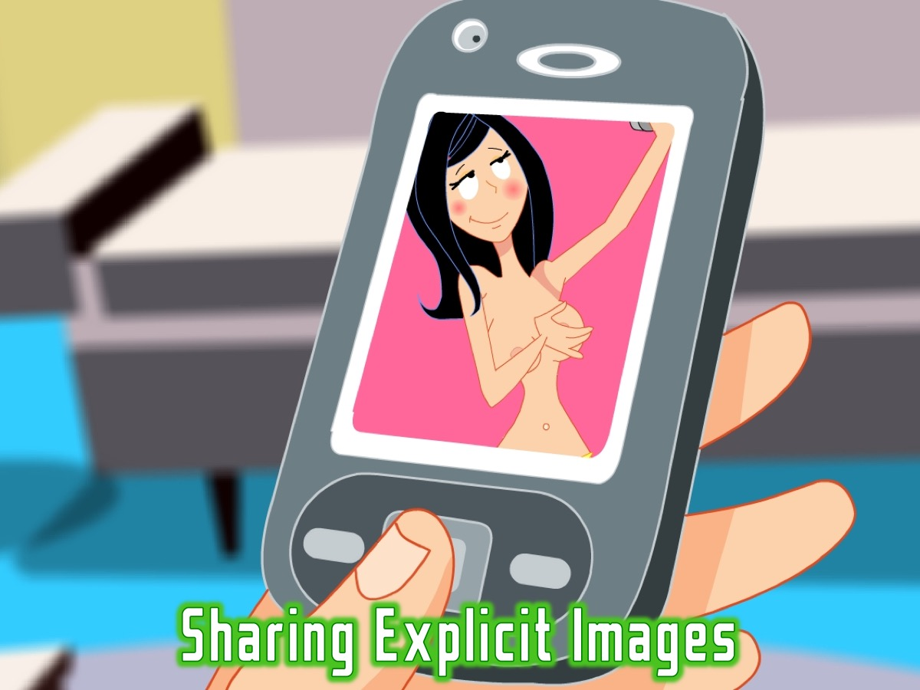
Notes:
Sharing Explicit Images

Slide 9

Notes:
Fantasizing

Slide 10

Notes:
Watching Pornography

Slide 11
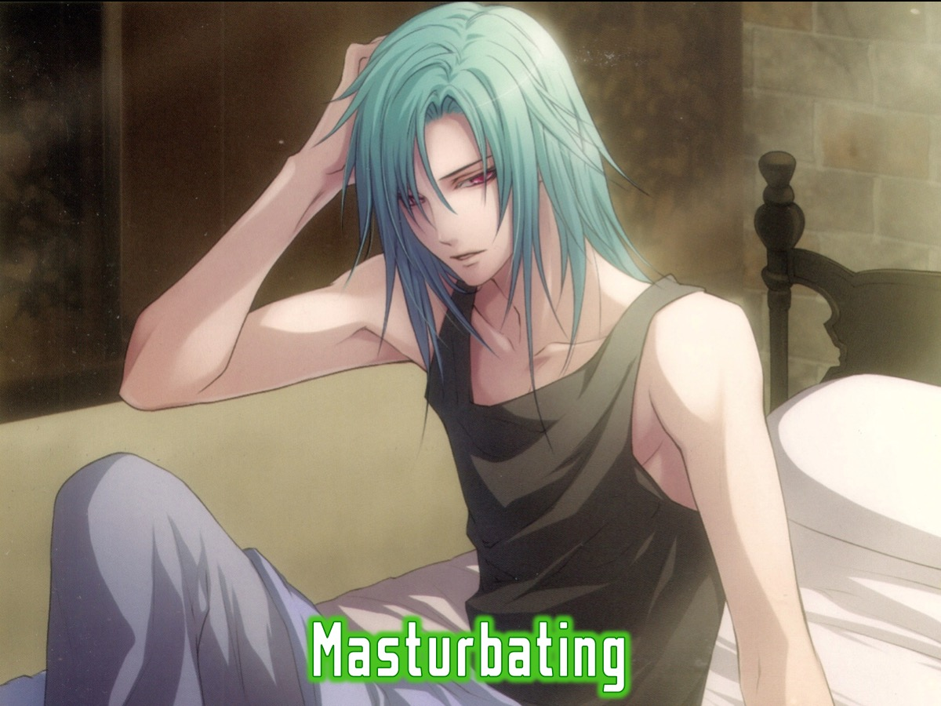
Notes:
Masturbating

Slide 12
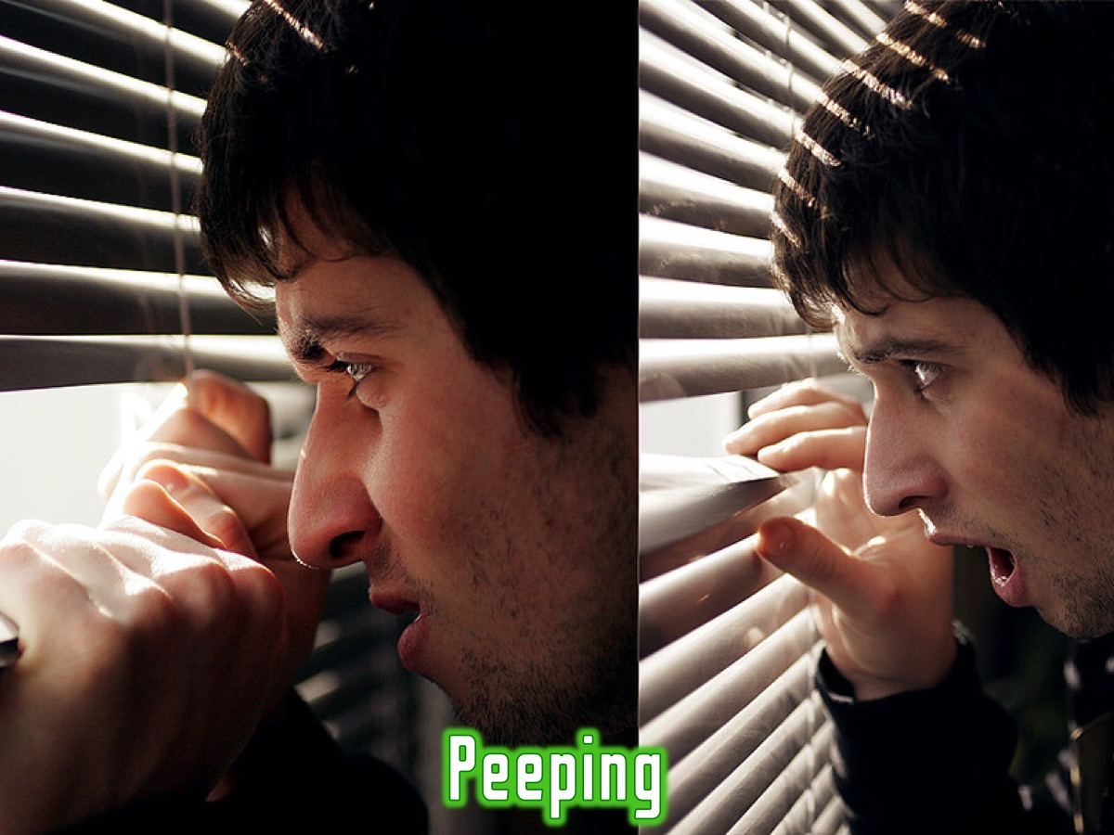
Notes:
Peeping

Slide 13

Notes:
Flirting

Slide 14

Notes:
Lesbian Relationships

Slide 15

Notes:
Homosexual Relationships

Slide 16

Notes:
Sex Before Marriage

Slide 17
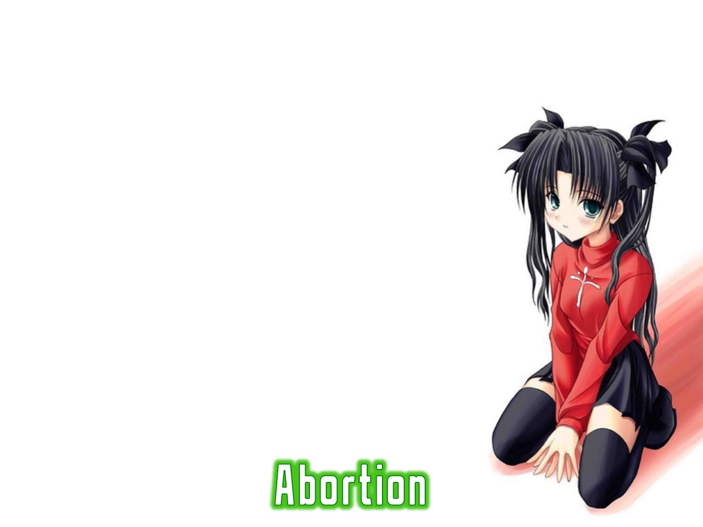
Notes:
Abortion

Slide 18

Notes:
Why are we vulnerable to attack?

Slide 19
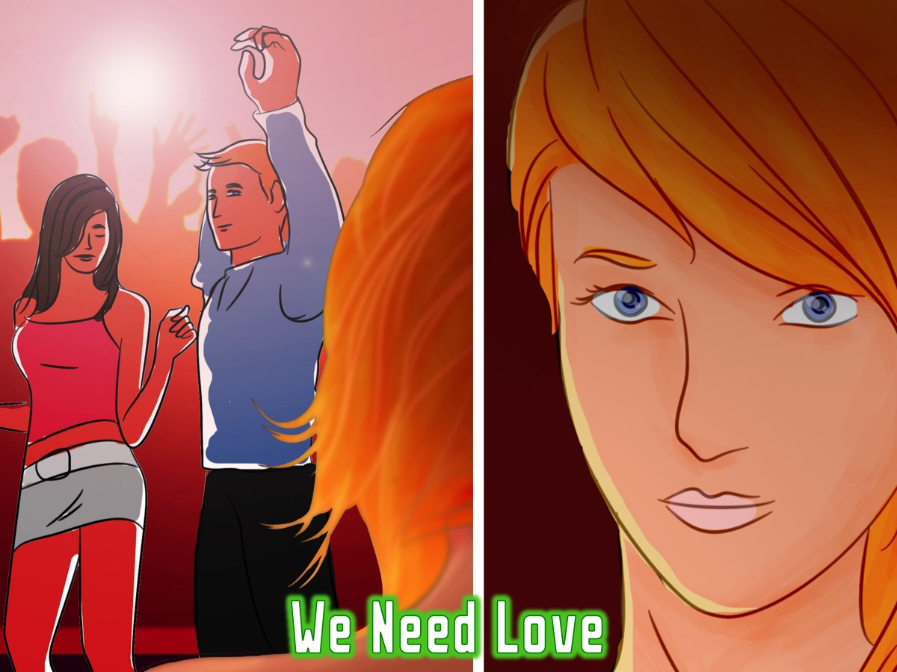
Notes:
* We Need Love

Slide 20

Notes:
* We Have Strong Passions

Slide 21

Notes:
*We Face Peer Pressure

Slide 22

Notes:
* We Feel Lonely

Slide 23

Notes:
* We Are Media Influenced

Slide 24

Notes:
* We Have Evil Desires

Slide 25
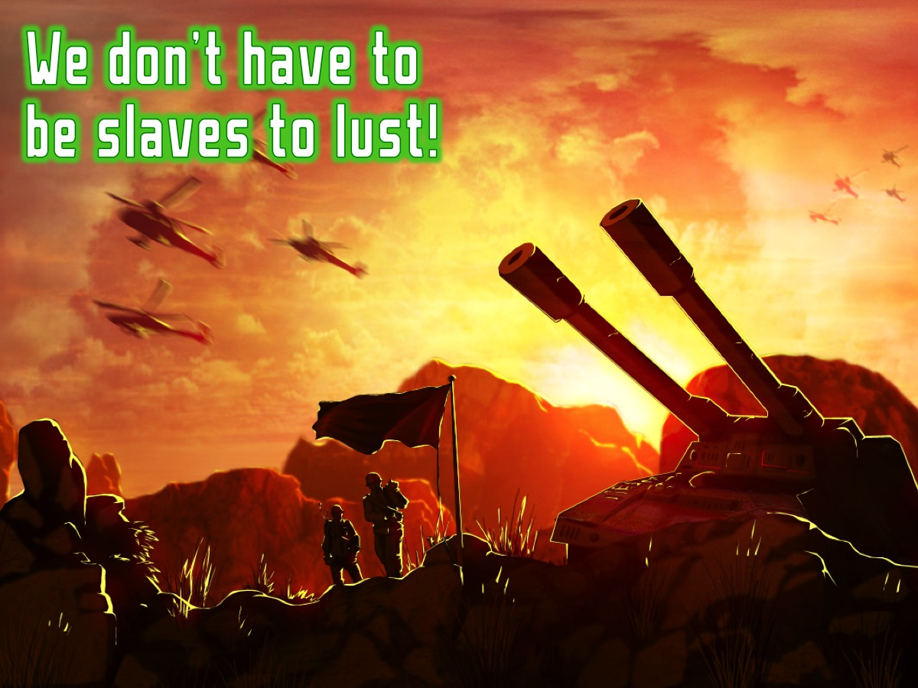
Notes:
But we don’t have to be slaves to lust!

Slide 26
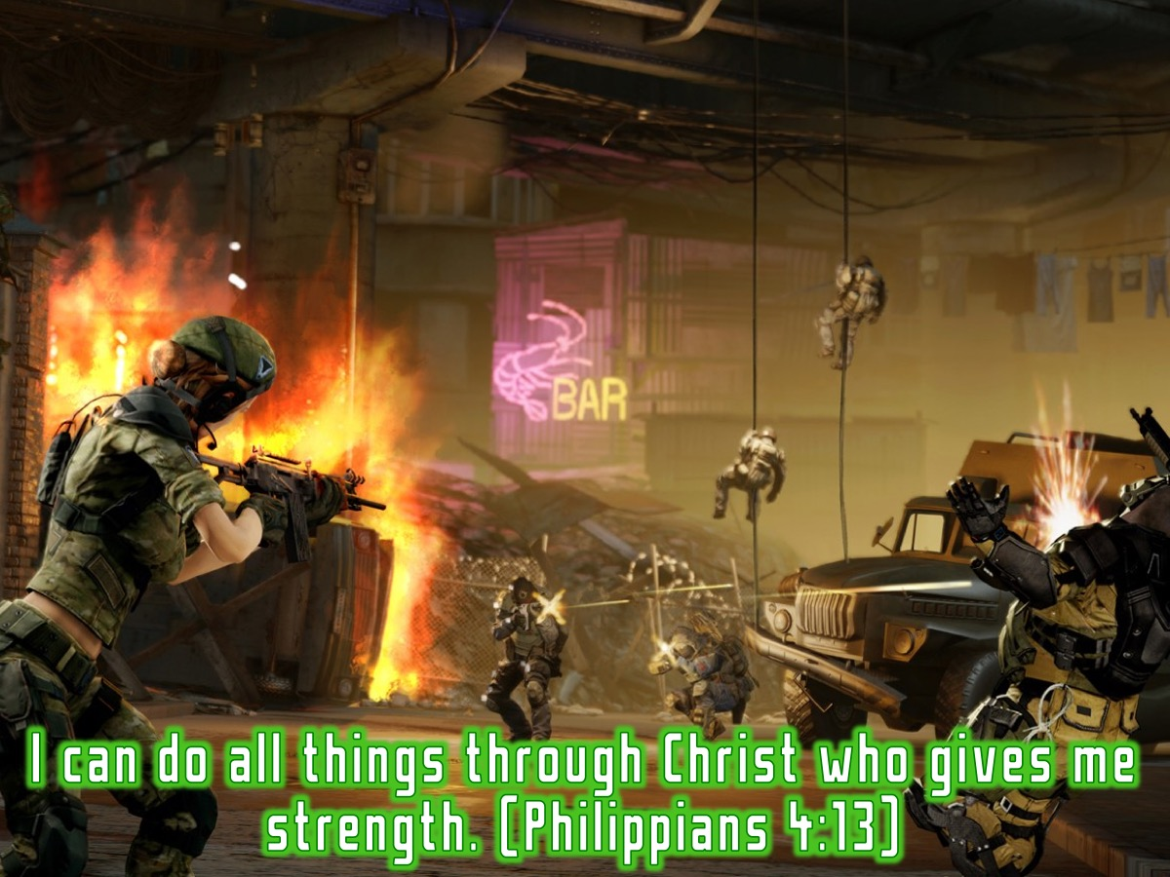
Notes:
The Bible says: "I can do all things through Christ who gives me strength". (Philippians 4:13)

Slide 27
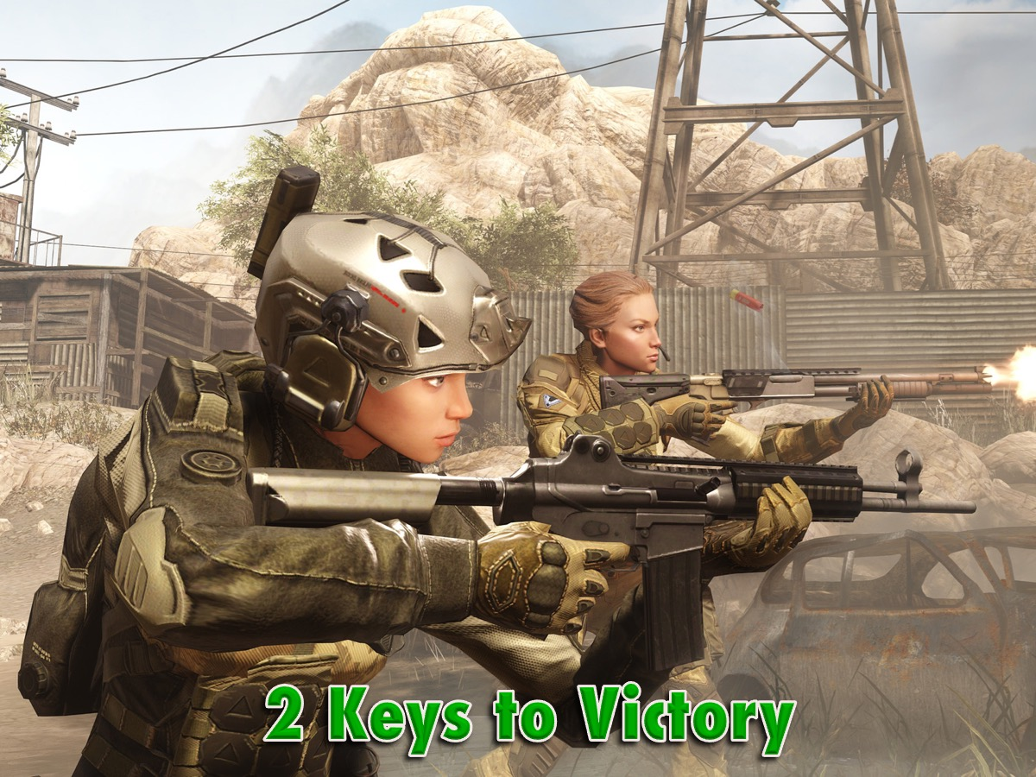
Notes:
There are 2 Keys to Victory in the area of your sexuality:

Slide 28

Notes:
Firstly, you need to make boundaries. How do you do this?

Slide 29

Notes:
A. Avoid Immoral Situations

Slide 30

Notes:
You spent enough time in the past doing what unbelievers like to do. You were promiscuous, had sinful desires, got drunk and went to wild parties. (1 Peter 4:3-5)

Slide 31

Notes:
B. Have Godly Relationships

Slide 32
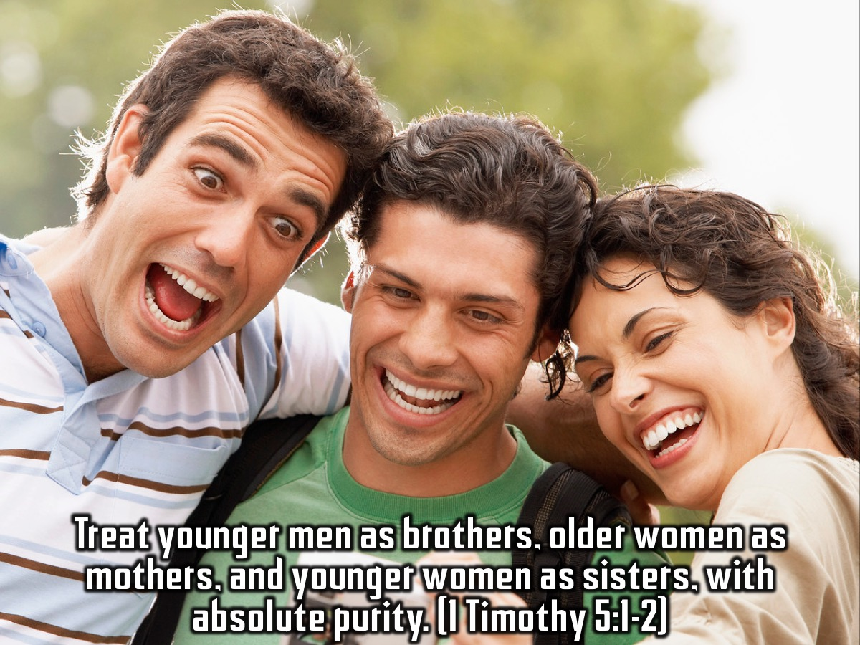
Notes:
Treat younger men as brothers, older women as mothers, and younger women as sisters, with absolute purity. (1 Timothy 5:1-2)

Slide 33

Notes:
C. Make a Covenant With Your Eyes

Slide 34
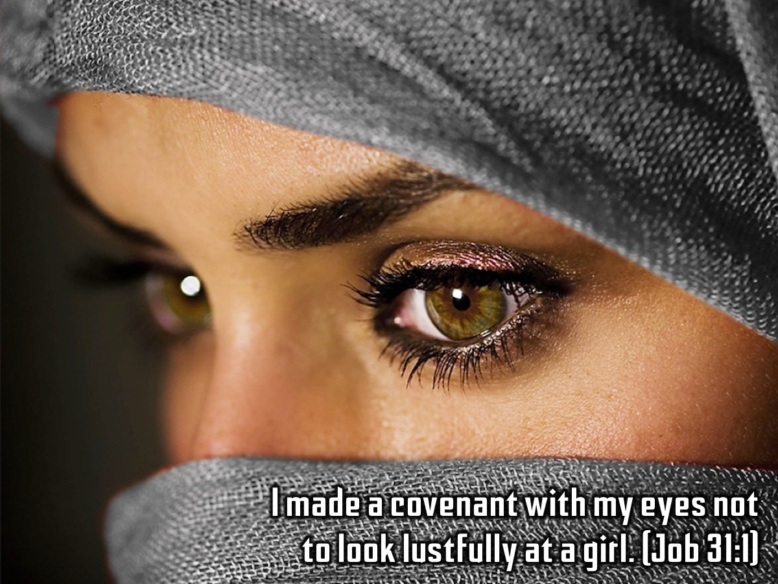
Notes:
I made a covenant with my eyes not to look lustfully at a girl. (Job 31:1)

Slide 35
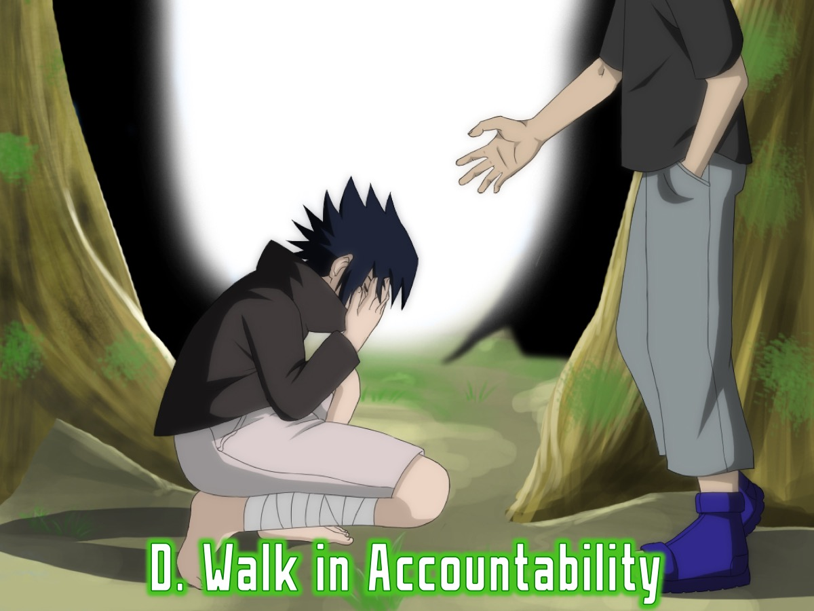
Notes:
D. Walk in Accountability

Slide 36
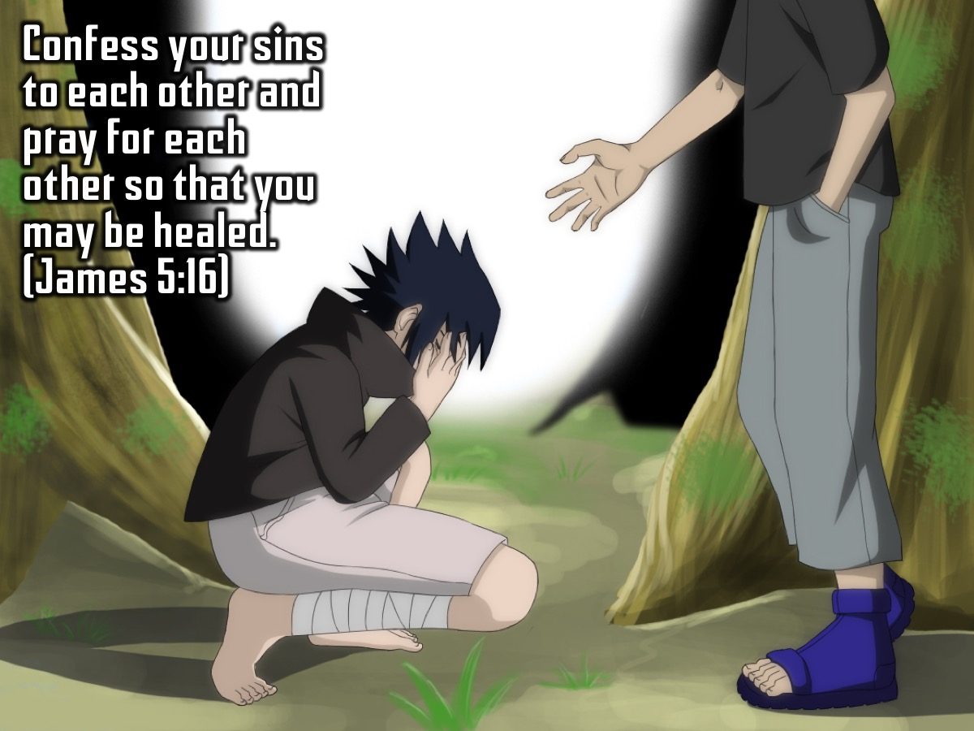
Notes:
Confess your sins to each other and pray for each other so that you may be healed. (James 5:16)

Slide 37

Notes:
2. Renew Your Mind. How do you renew your mind?

Slide 38

Notes:
A. Accept God’s Standards

Slide 39
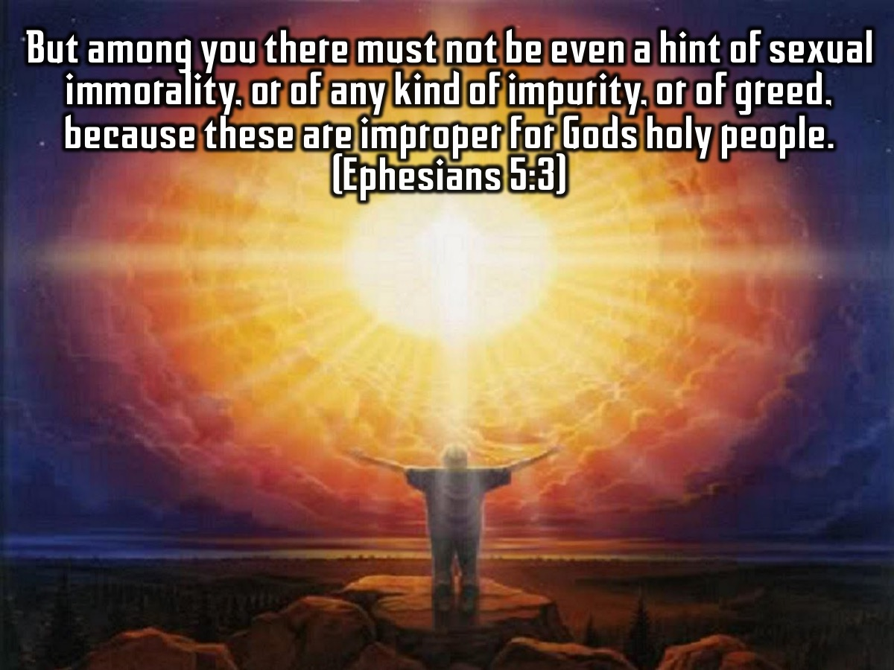
Notes:
But among you there must not be even a hint of sexual immorality, or of any kind of impurity, or of greed, because these are improper for Gods holy people. (Ephesians 5:3).

Slide 40
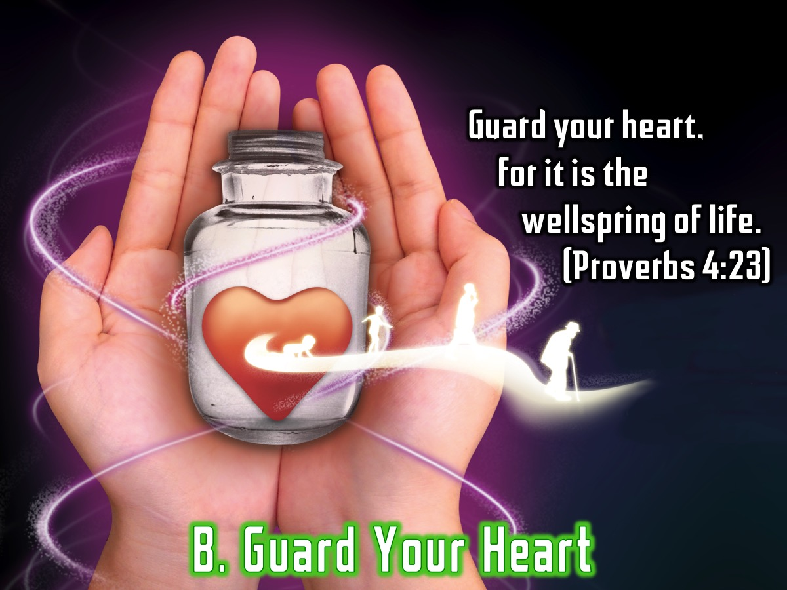
Notes:
B. Guard Your Heart. Guard your heart, for it is the wellspring of life. (Proverbs 4:23).

Slide 41
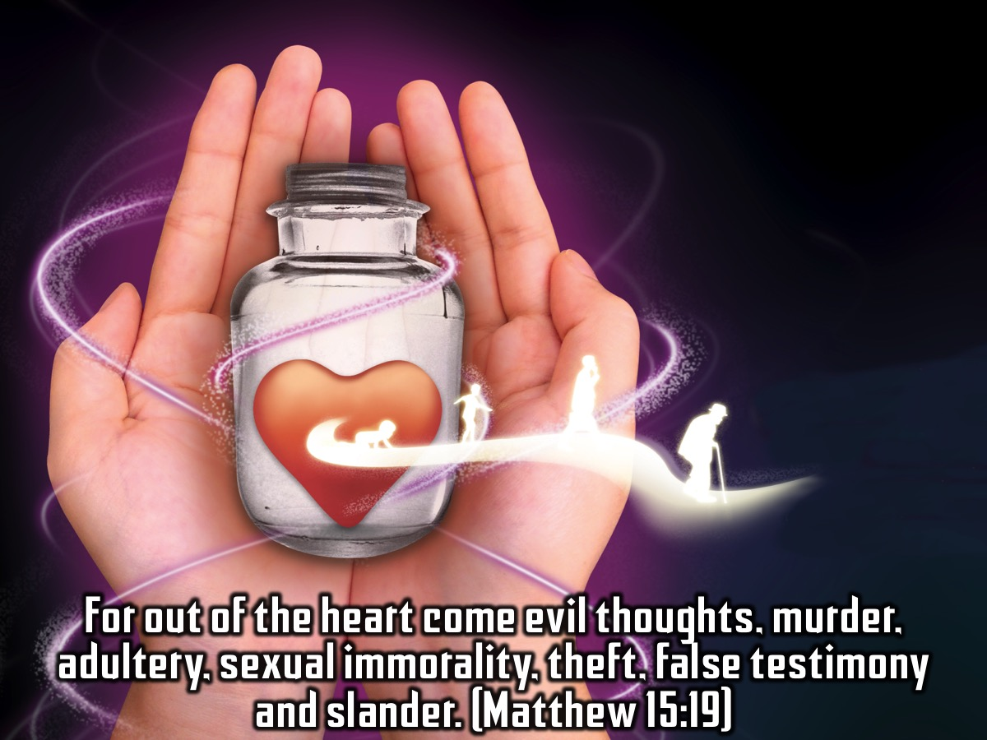
Notes:
For out of the heart come evil thoughts, murder, adultery, sexual immorality, theft, false testimony and slander. (Matthew 15:19)

Slide 42

Notes:
C. Believe Victory is Possible

Slide 43
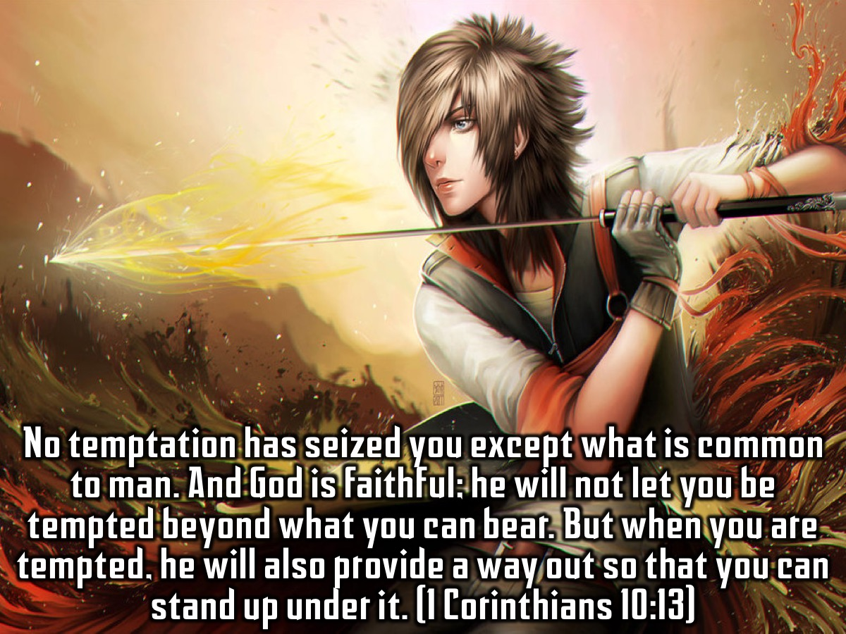
Notes:
No temptation has seized you except what is common to man. And God is faithful; he will not let you be tempted beyond what you can bear. But when you are tempted, he will also provide a way out so that you can stand up under it. (1 Corinthians 10:13)

Slide 44

Notes:
D. Fill Your Mind With God’s Word

Slide 45

Notes:
How can a young person keep their way pure? By living according to your word. I have hidden your word in my heart that I might not sin against you. (Psalm 119:9,11)

Slide 46

Notes:
Handout: Spend a few minutes completing the Sexual Sins Handout.

Slide 47
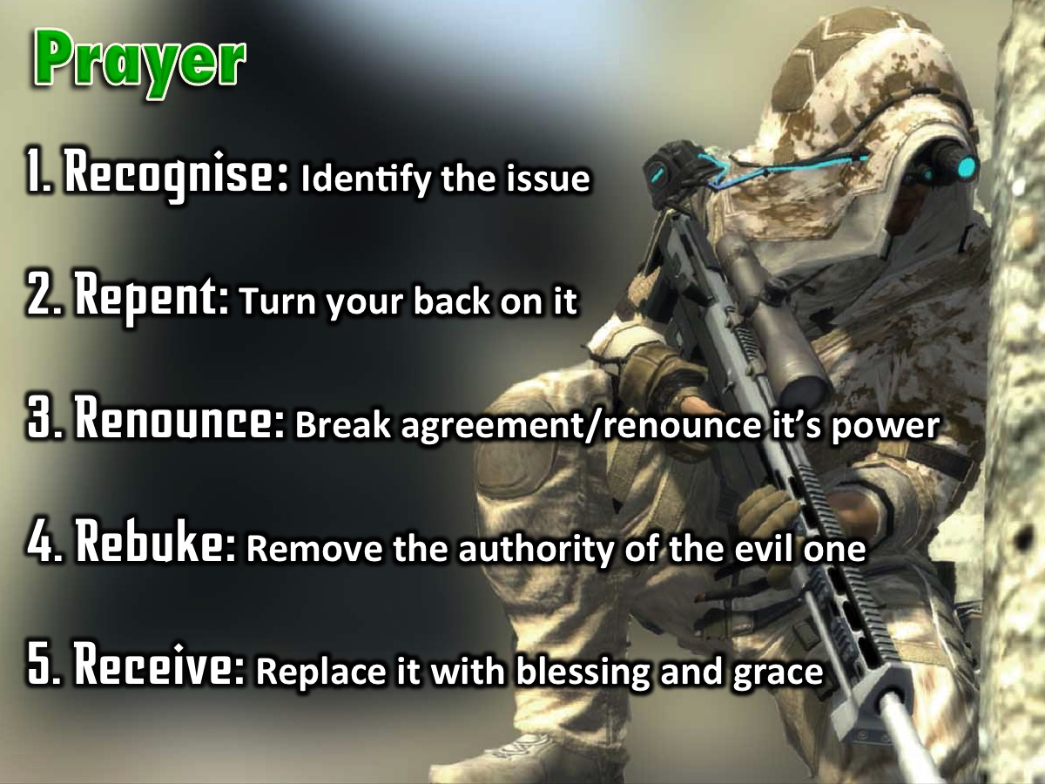
Notes:
Prayer! The Process of Deliverance. To experience freedom in the area of sexual sins we are going to pray through the process of deliverance: (1) The first step to victory is to Recognise any issue that God has brought to your attention that you need to deal with. (2) The second step is Repent – where you commit to turn your back on the issue, choose to renew your mind and ask God to help you think differently about it. (3) The third step is to Renounce – which means to fall out of agreement with the issue and renounce its power over your life. If it is a curse you fall out of agreement with the curse and you renounce its power to operate in your life, you renounce its power to operate in your children’s life - when you have them one day - and the generations to come. If it is sin you have been involved in, you renounce the power of that sin. You close the door on the enemy - he does not have a hold on you anymore! The enemy no longer has authority to operate in your life in the area. (4) The fourth step is Rebuke – when we rebuke the evil one, any demonic spirit that is associated with the issue has to leave – there is no shouting - it just has to go because you have taken its authority away. (5) The fifth step is Receive – where you now ask God to replace what has been taken away with his blessing and grace. Where there was unforgiveness and bitterness you pray to receive God’s grace to forgive; where there was a curse you receive the Lord’s blessing to replace the curse – we speak and announce the blessings of God in areas of poverty for example.

Slide 48
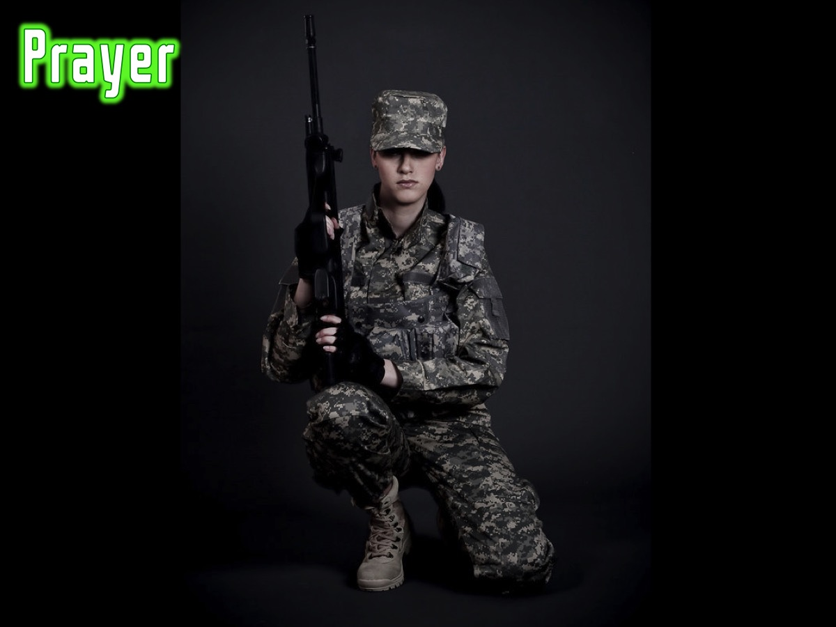
Notes:
Prayer

Slide 49
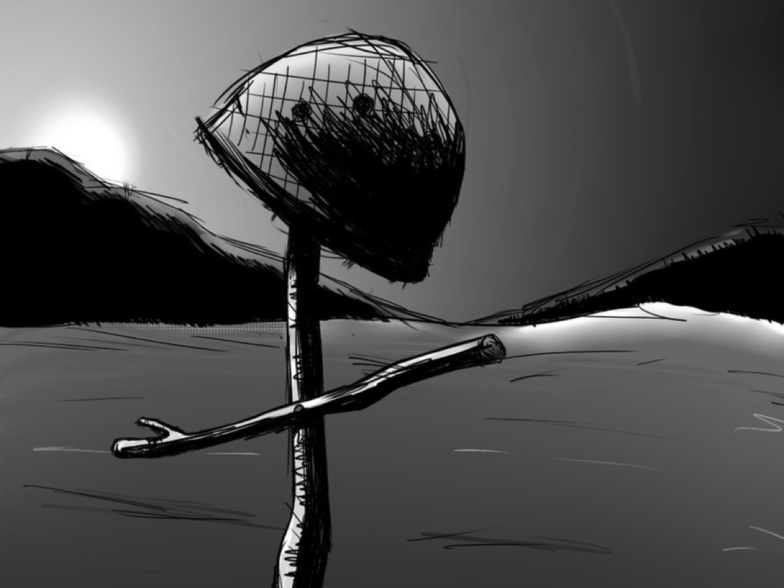
Notes:
As a sign that you have been set free from sexual sins you need to crumple up your personal profile and come and place them in the helmet on the stage and we will destroy them for you!

Slide 50

Notes:
Next Week we will be looking at the fifth big issues in our lives: Addictions.

