Slide 1

Notes:
Welcome to the Victory Series!

Slide 2

Notes:
Video: Ghost Recon : Future Soldier - US Launch Trailer. Get it on YouTube at: https://www.youtube.com/watch?v=GB9c9C1dp7Q
File: Ghost Recon London.mp4

Slide 3

Notes:
Session 1 was about Preparing for Victory

Slide 4

Notes:
Session 2 was about the Cross.

Slide 5

Notes:
Session 3 was about our Identity.

Slide 6

Notes:
Session 4 was about dealing with Generational Curses.

Slide 7

Notes:
Session 5 was about dealing with Relational Issues.

Slide 8

Notes:
Session 6 was about dealing with Spiritual Errors.

Slide 9

Notes:
Session 7 about dealing with Sexual Sins.

Slide 10

Notes:
Session 8 was about dealing with Addictions.

Slide 11

Notes:
This Week we are going to look at How to Live in Victory!

Slide 12
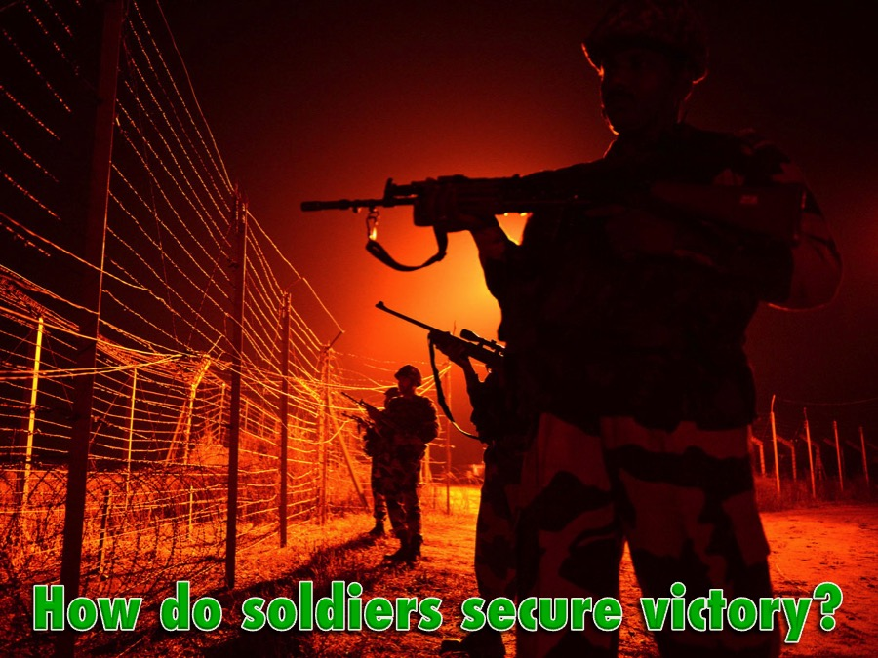
Notes:
How do soldiers secure their victory?

Slide 13
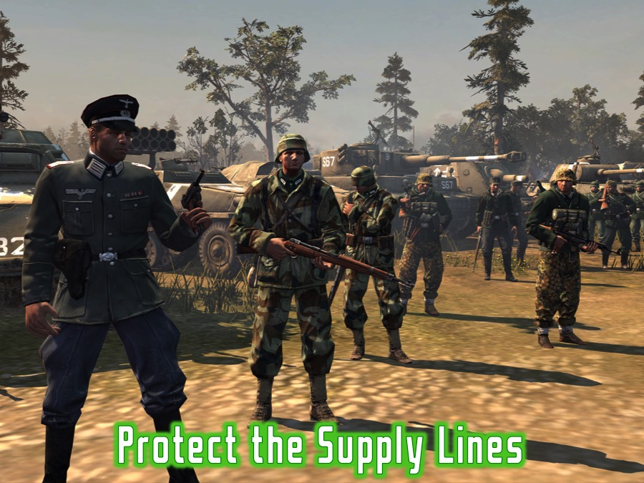
Notes:
1. Protect the supply lines

Slide 14
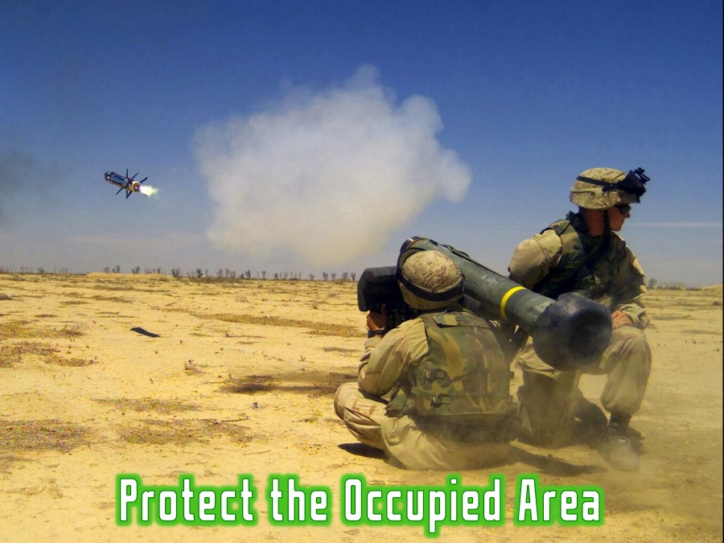
Notes:
2. Protect the occupied area (watch out for counter attacks)

Slide 15
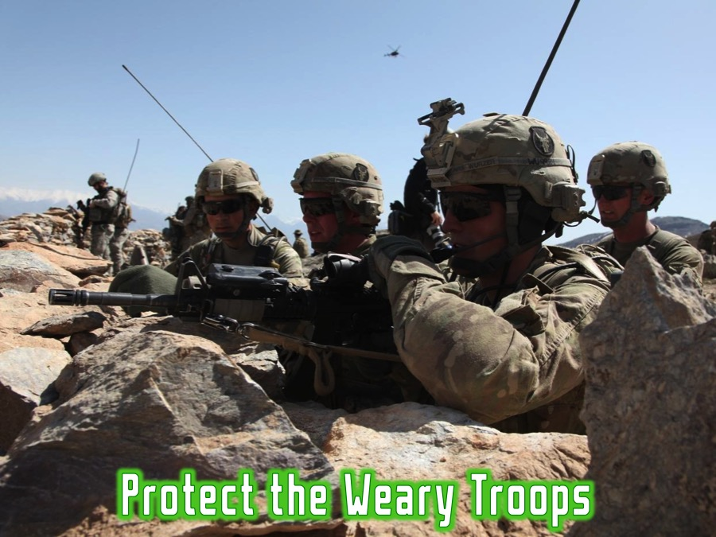
Notes:
3. Protect the Weary Troops

Slide 16
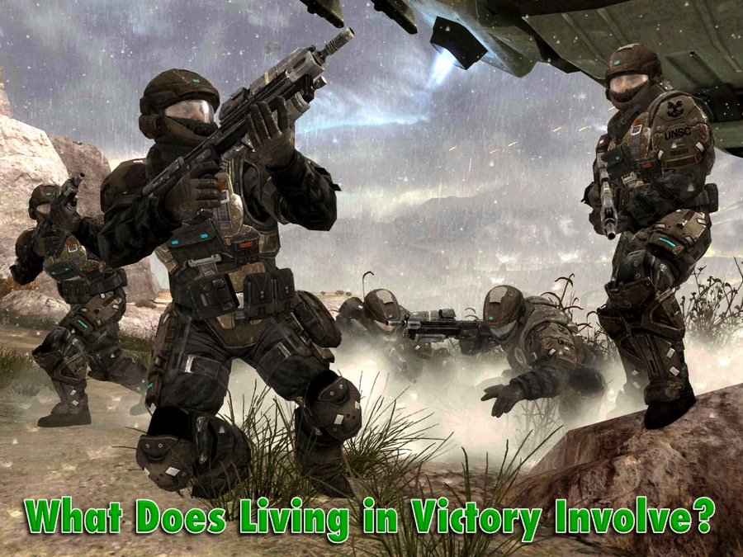
Notes:
What Does Living in Victory Involve for believers?

Slide 17
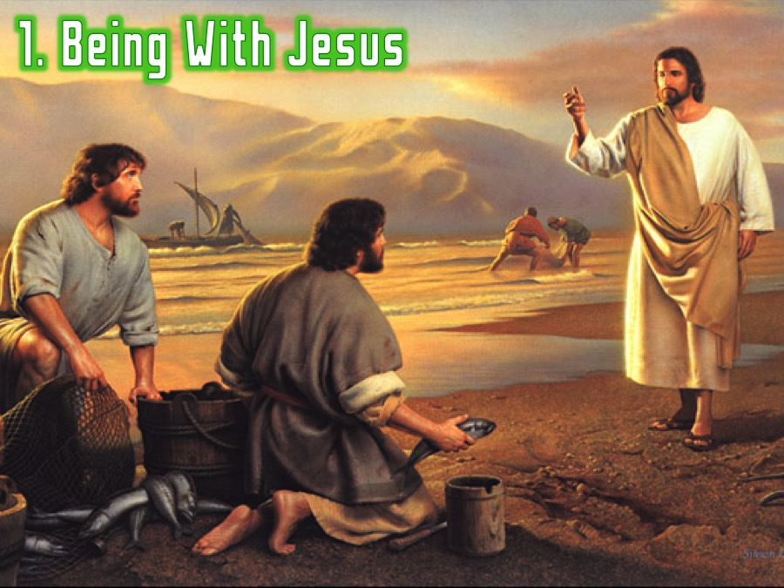
Notes:
1. Being With Jesus

Slide 18
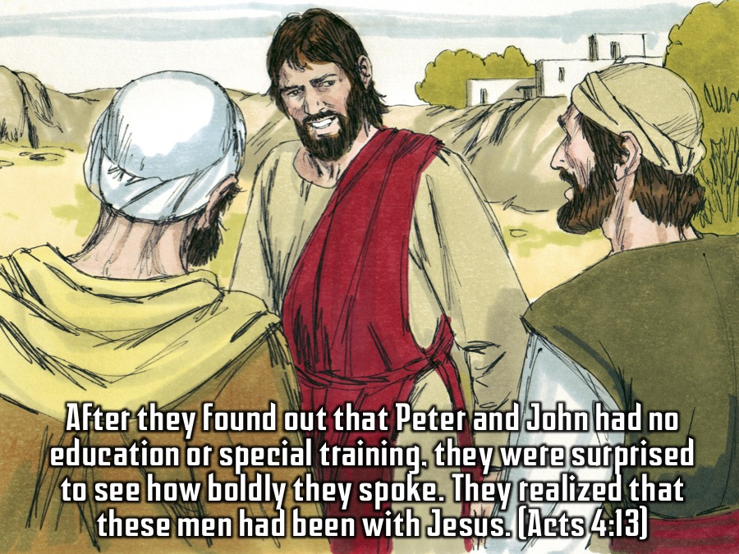
Notes:
After they found out that Peter and John had no education or special training, they were surprised to see how boldly they spoke. They realized that these men had been with Jesus. (Acts 4:13)

Slide 19
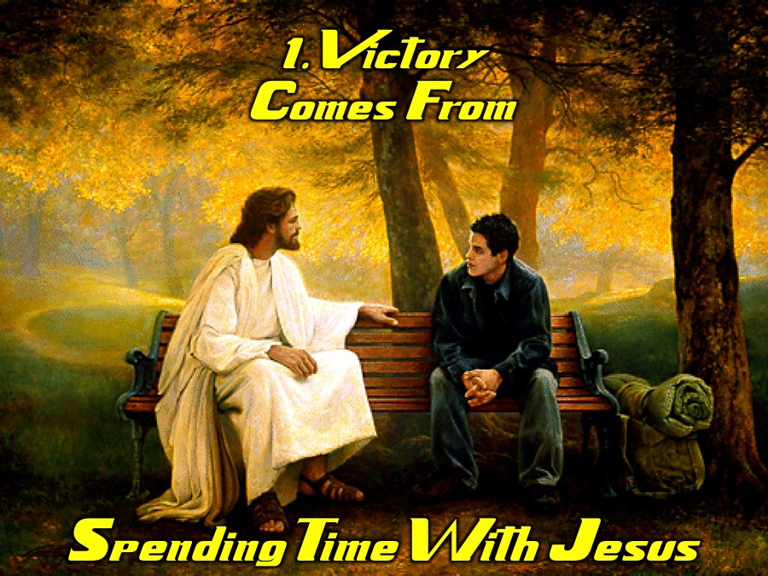
Notes:
Victory Comes From Spending Time With Jesus

Slide 20
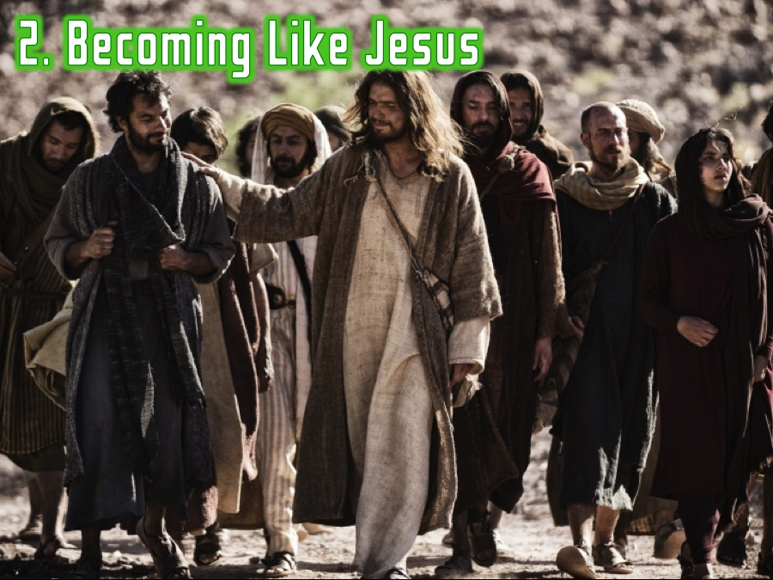
Notes:
2. Becoming Like Jesus

Slide 21
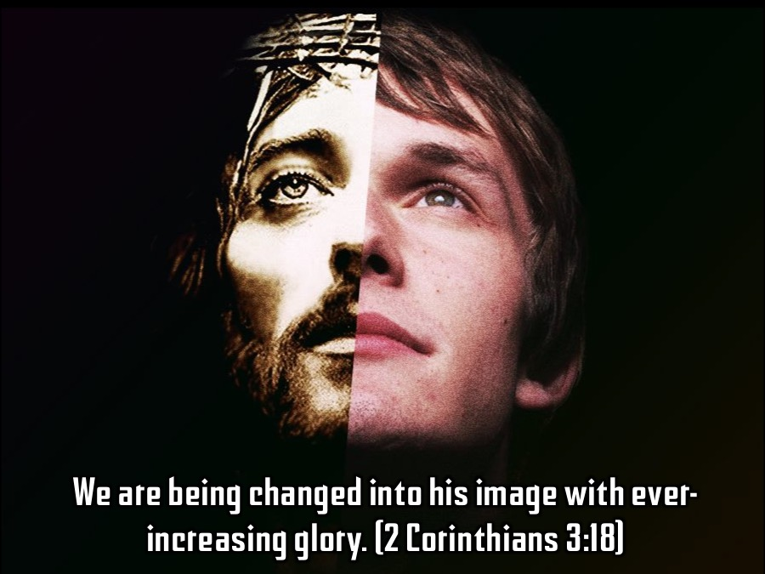
Notes:
We are being changed into his image with ever-increasing glory. (2 Corinthians 3:18)

Slide 22
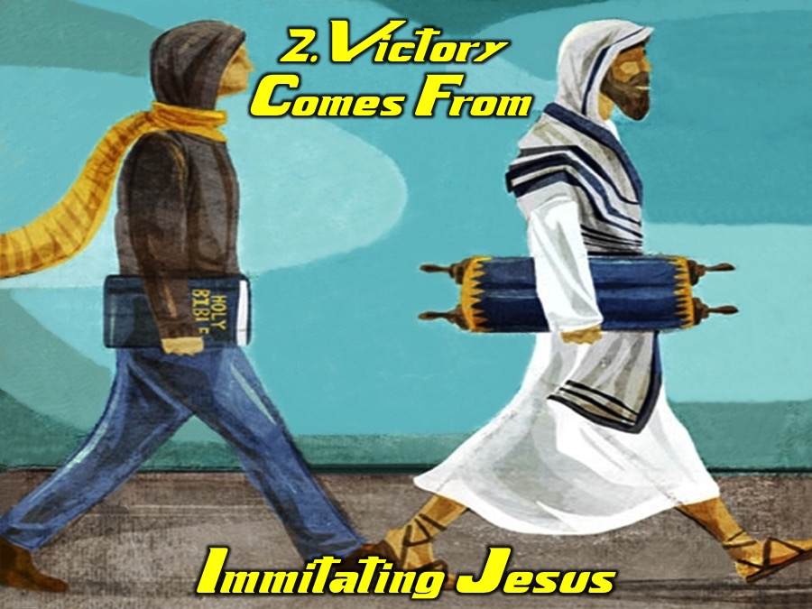
Notes:
Victory Comes From Imitating Jesus

Slide 23
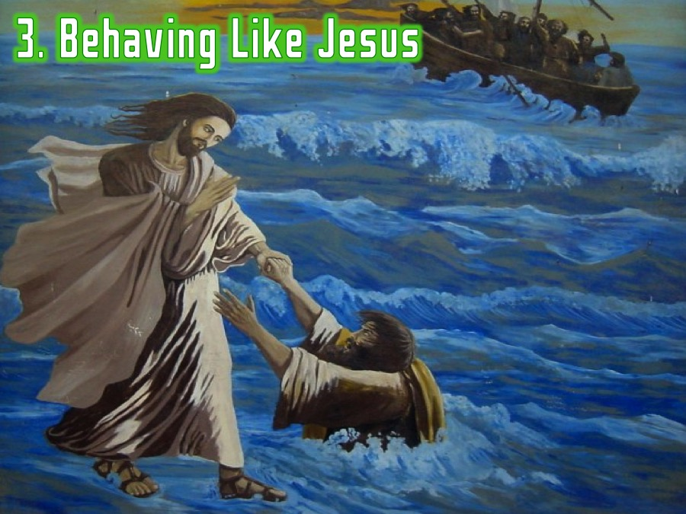
Notes:
3. Behaving Like Jesus

Slide 24
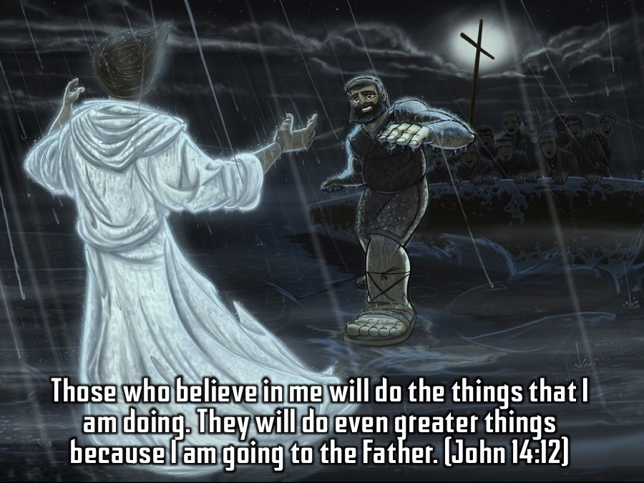
Notes:
Those who believe in me will do the things that I am doing. They will do even greater things because I am going to the Father. (John 14:12)

Slide 25

Notes:
Victory Comes From Acting Like Jesus

Slide 26

Notes:
How Do I Actually Live in Victory?

Slide 27
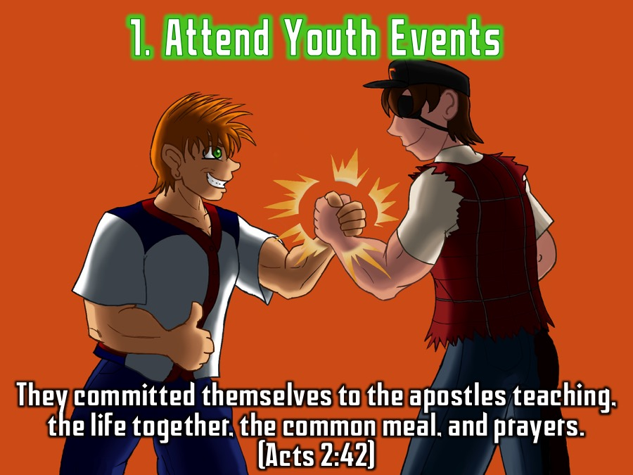
Notes:
1. Attend Youth Events. They committed themselves to the apostles teaching, the life together, the common meal, and prayers. (Acts 2:42)

Slide 28
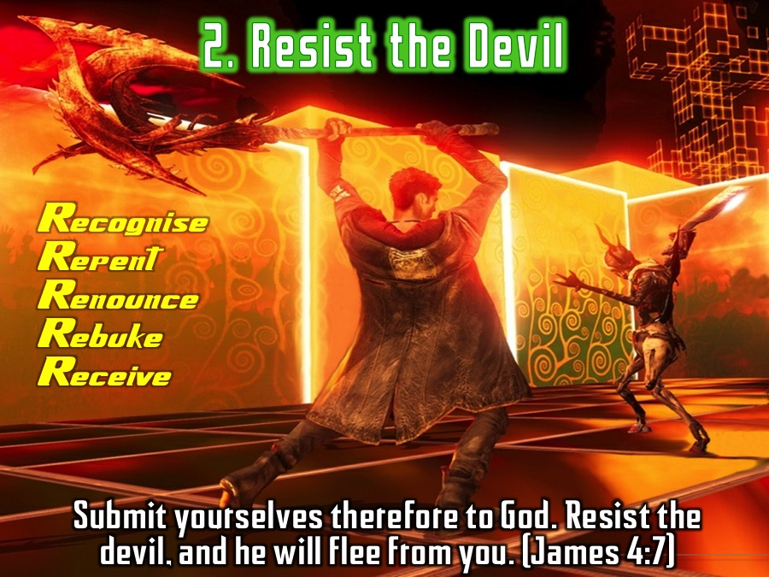
Notes:
2. Resist the Devil: Submit yourselves therefore to God. Resist the devil, and he will flee from you. (James 4:7). Practise the process of deliverance that we have used in the past five weeks to deal with the big five issues: Recognise the issue, Repent by turning your back on it, Renounce it’s power over you, Rebuke the Devil and Receive blessings in the place of curses.

Slide 29
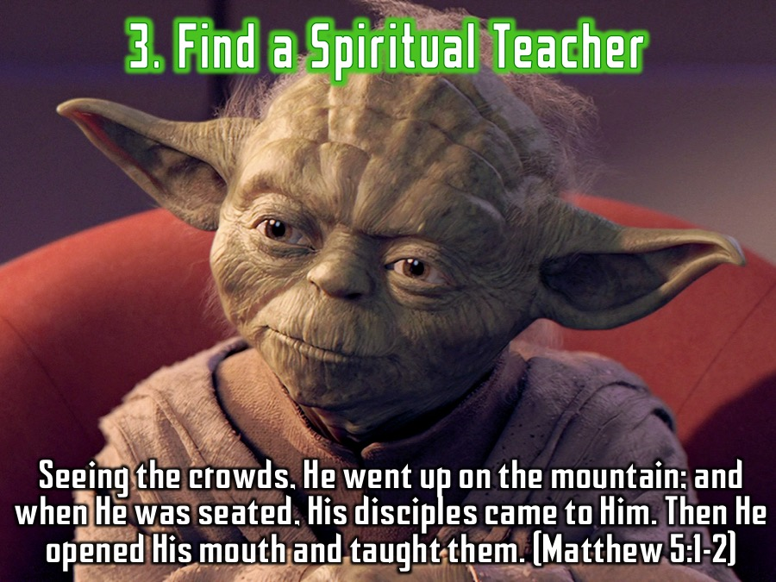
Notes:
3. Find a Spiritual Teacher. Seeing the crowds, He went up on the mountain; and when He was seated, His disciples came to Him. Then He opened His mouth and taught them. (Matthew 5:1-2)

Slide 30
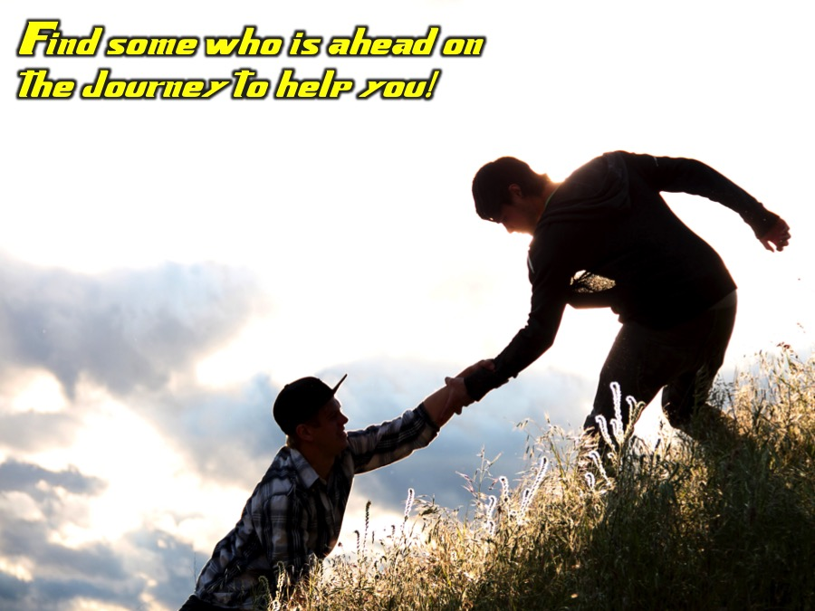
Notes:
Find some who is ahead on the journey to help you!

Slide 31
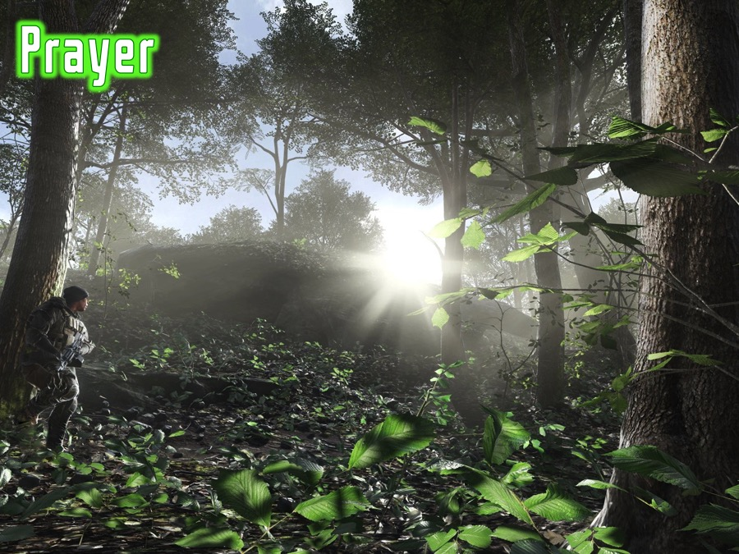
Notes:
Prayer

Slide 32
Notes:
Thank you for being a part of our Victory Series!

