Slide 1
Notes:
Welcome to the What On Earth Am I Here For Series.

Slide 2

Notes:
Welcome to regulars and newcomers!

Slide 3

Notes:
Prayer: Let’s open our meeting in prayer.

Slide 4

Notes:
Announcements: Please Listen up to the following announcement.

Slide 5

Notes:
Sunday Morning: We begin our series on Sunday by looking at: The Call is For You

Slide 6

Notes:
Next Friday we begin our Campaign, “What On Earth Am I Here For.”

Slide 7
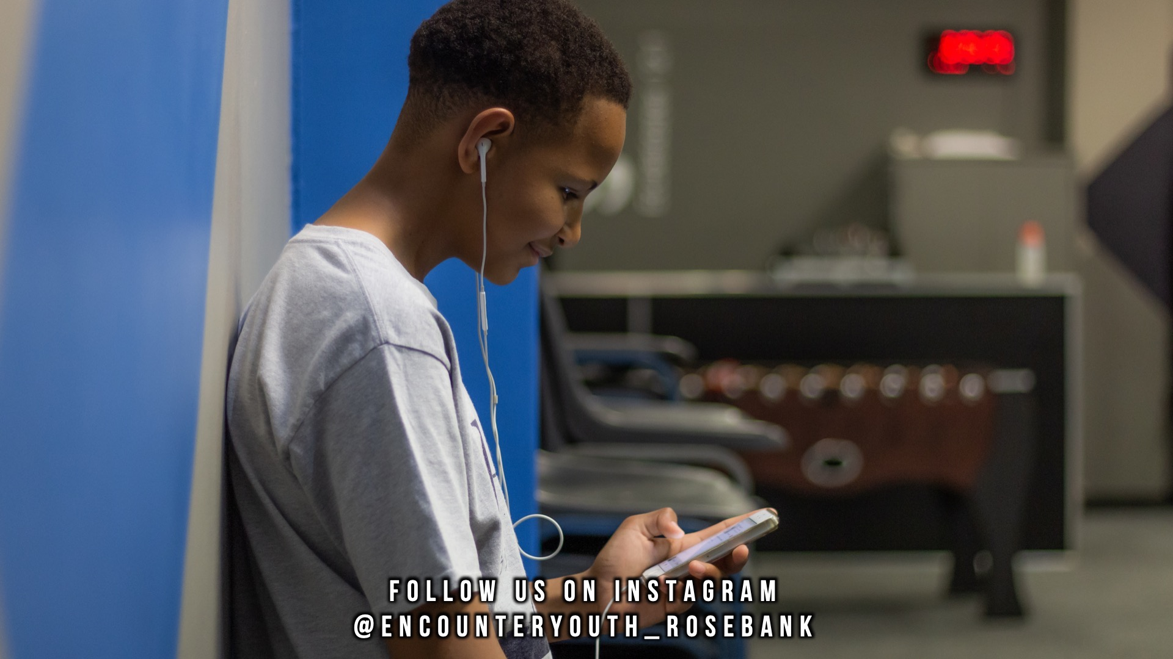
Notes:
Announcements: Follow us on Instagram! @EncounterYouth_Rosebank

Slide 8

Notes:
Announcements: Join our WhatsApp group!

Slide 9

Notes:
Tonight: We begin our Series, What on Earth Am I here for?

Slide 10

Notes:
8 March: Revival Youth Night: Save the Date!

Slide 11

Notes:
Games with Asher

Slide 12

Notes:
Praise and Worship

Slide 13

Notes:
Video on Purpose: Find it on YouTube at: https://www.youtube.com/watch?v=ysJfKrgeA4Y

Slide 14

Notes:
Video on Purpose: Find it on YouTube at: https://www.youtube.com/watch?v=ysJfKrgeA4Y

Slide 15

Notes:
Purpose: Purpose means,” the reason for which something is done or created or for which something exists.”

Slide 16

Notes:
Interactive Moment: (1) What is your favorite thing to do? (2) What kind of people do you like to hang out with? (3) If you could have one job, no matter how impossible, what would it be? (4) What is the best thing about you and the worst thing about you? (5) If you could change one thing about yourself what would it be? (6) What makes you, you? All these things help to make you you, and God has a unique purpose for who He wants you to be? Ask Him to show you what it is.

Slide 17

Notes:
Divide into your Groups

Slide 18

Notes:
Small Group Time: (1) What was your favourite part of tonight? (2) What is the scariest part of finding your purpose for you?
Romans 8:28 says,” And we know that for those who love God all things work together for good, for those who are called according to his purpose.” (3) How do you think that relates to your purpose? (4) Pray for each other that God would define what you were made for and show you where you will be happiest, His best for you.

Slide 19

Notes:
Ministry Time at the front

Slide 20

Notes:
Refreshments

Slide 21

Notes:
Join us on Sunday!

