Slide 1

Notes:
Welcome to the What on Earth Am I Here For Series.

Slide 2

Notes:
Welcome to regulars and newcomers!

Slide 3
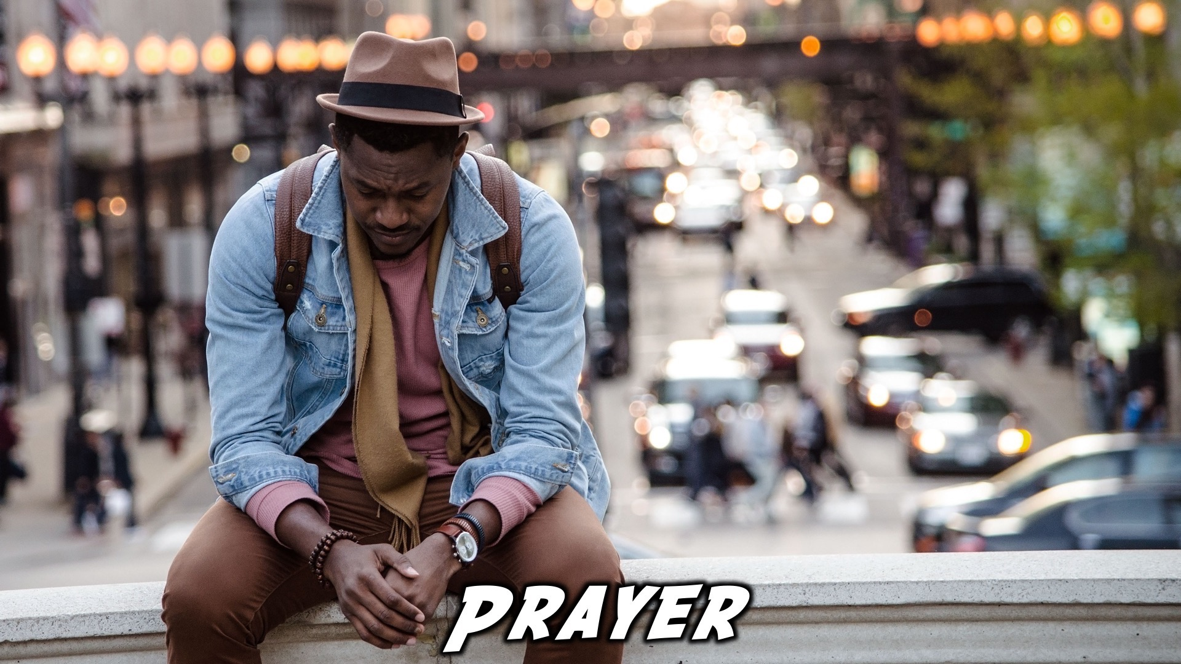
Notes:
Prayer: Let’s open our meeting in prayer.

Slide 4

Notes:
Announcements: Please Listen up to the following announcement.

Slide 5

Notes:
Sunday Morning: Called to Belong

Slide 6

Notes:
Revival Youth Night: Next Friday, invite your friends!

Slide 7

Notes:
Youth Outreach: Tomorrow from 10 - 12

Slide 8
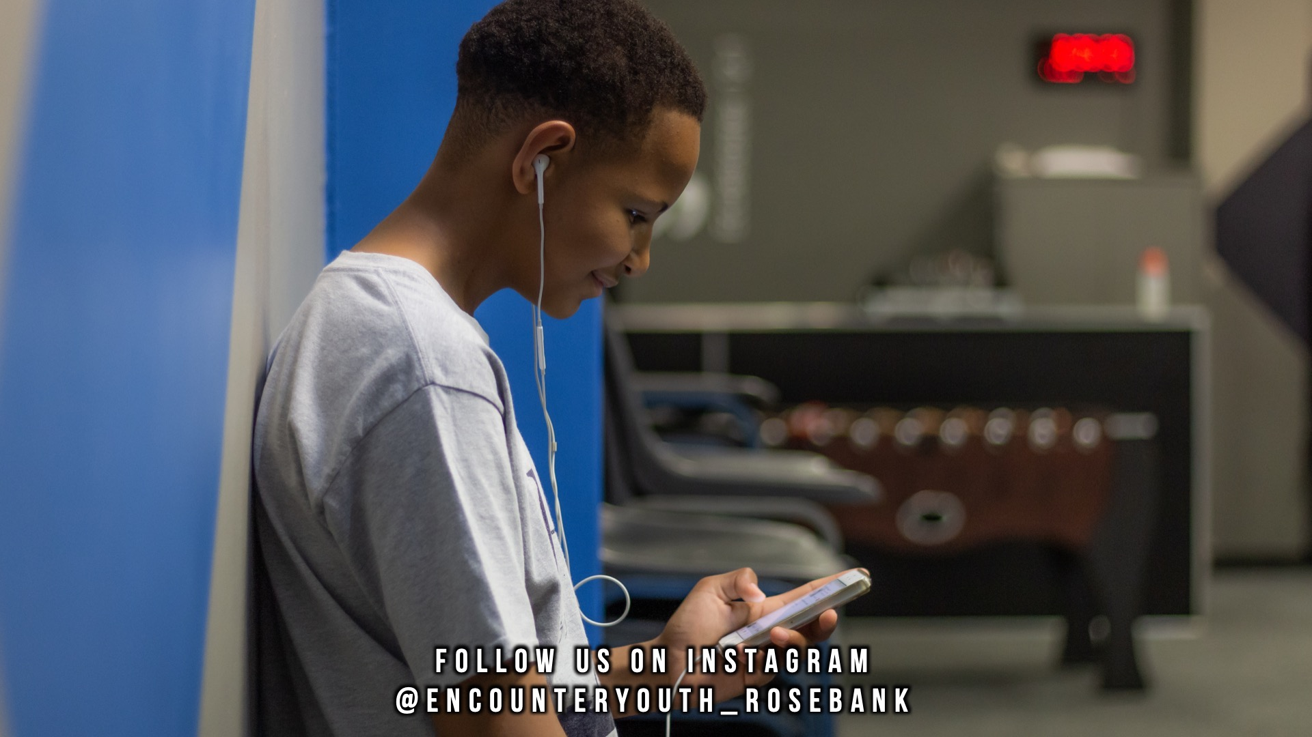
Notes:
Announcements: Follow us on Instagram! @EncounterYouth_Rosebank

Slide 9

Notes:
Announcements: Join our WhatsApp group!

Slide 10

Notes:
Tonight: Planned For His Pleasure

Slide 11

Notes:
Games:

Slide 12

Notes:
Dodgeball.

Slide 13
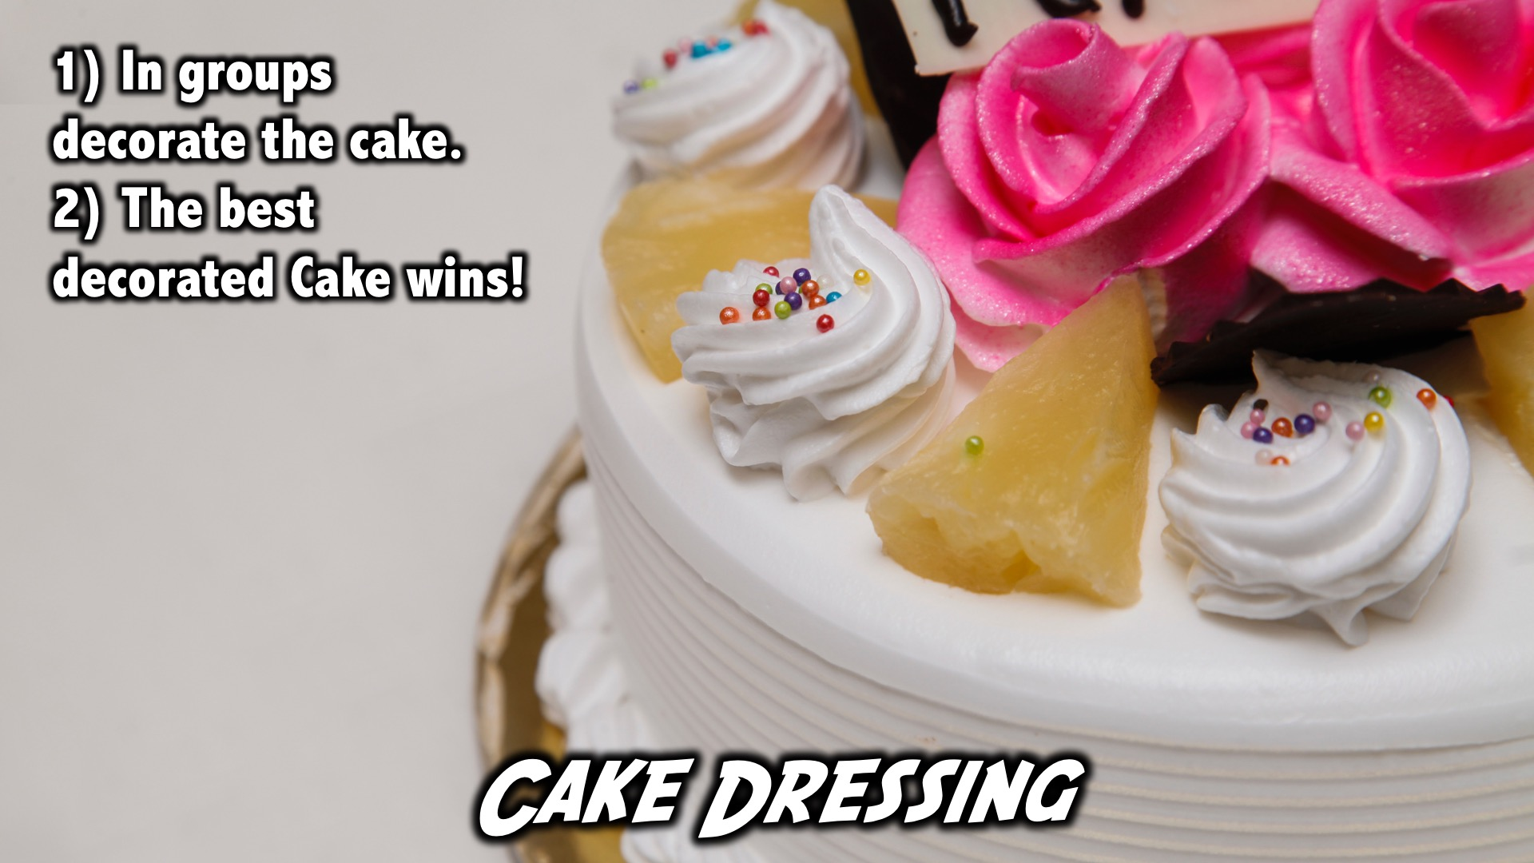
Notes:
Cake Dressing: (1) In groups decorate the cake. (2) The best decorated Cake wins!

Slide 14

Notes:
Praise and Worship

Slide 15

Notes:
Let’s Go

Slide 16

Notes:
Mvini

Slide 17

Notes:
Planned for His Pleasure

Slide 18

Notes:
Questions: (1) What about me makes You Happy? (2) What do I need to change in my life for it to be one that makes You proud?

Slide 19

Notes:
Divide into your Groups

Slide 20
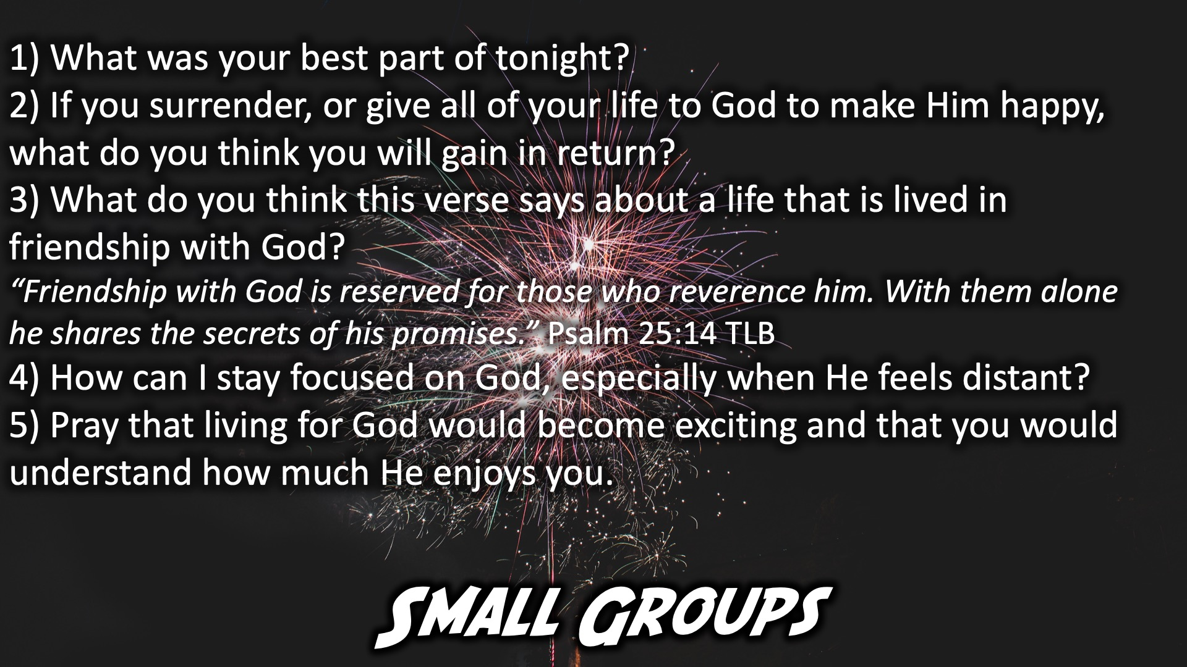
Notes:
Small Group Time: (1) What was your best part of tonight? (2) If you surrender, or give all of your life to God to make Him happy, what do you think you will gain in return? (3) What do you think this verse says about a life that is lived in friendship with God? “Friendship with God is reserved for those who reverence him. With them alone he shares the secrets of his promises.” Psalm 25:14 TLB (4) How can I stay focused on God, especially when He feels distant? (5) Pray that living for God would become exciting and that you would understand how much He enjoys you.

Slide 21

Notes:
Ministry Time at the front

Slide 22

Notes:
Refreshments

Slide 23

Notes:
Join us on Sunday!

