Slide 1

Notes:
Welcome to our campaign, What On Earth Am I Here For?

Slide 2

Notes:
Last week Sunday we concluded our relationship series, the last topic was a Relationship with God.

Slide 3

Notes:
Today we begin our campaign, What On Earth Am I Here For. Our first session is titled, The Call is for You.

Slide 4
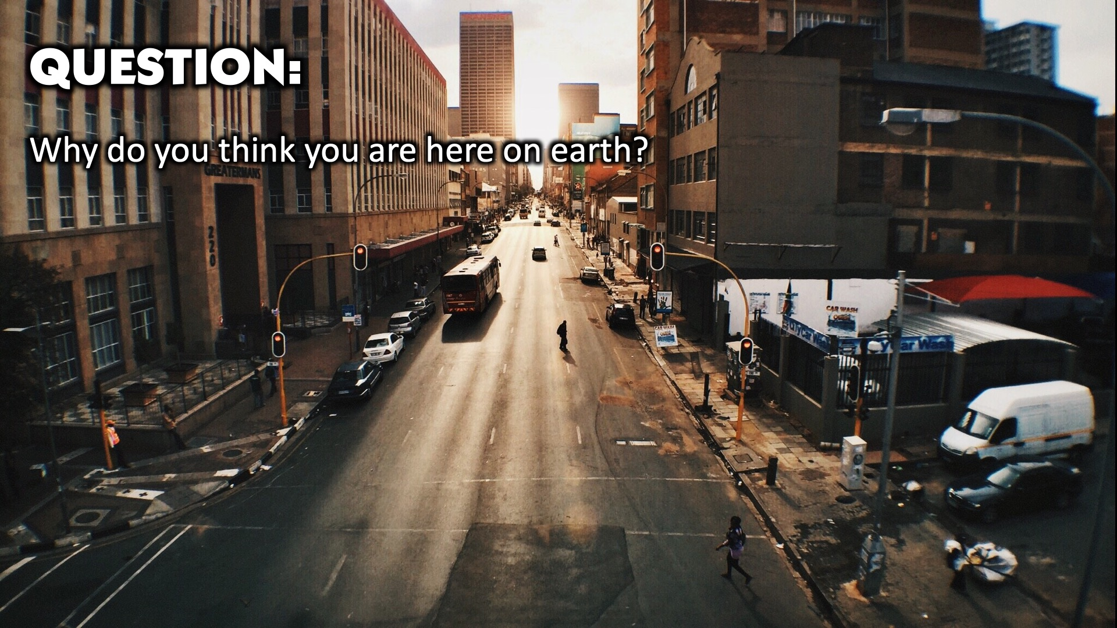
Notes:
Question: Why do you think you are here on earth?

Slide 5
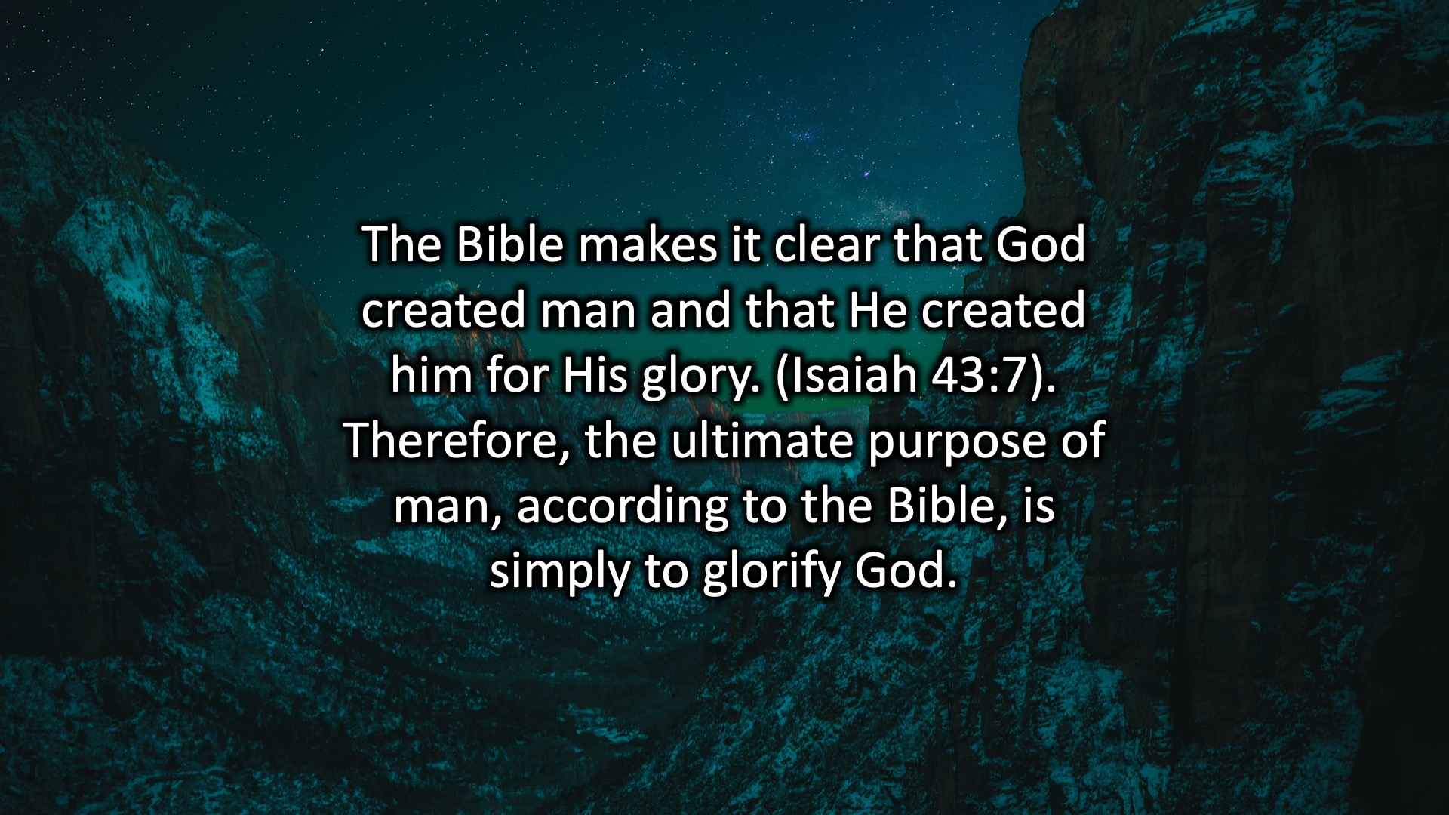
Notes:
The Bible makes it clear that God created man and that He created him for His glory. (Isaiah 43:7). Therefore, the ultimate purpose of man, according to the Bible, is simply to glorify God.

Slide 6
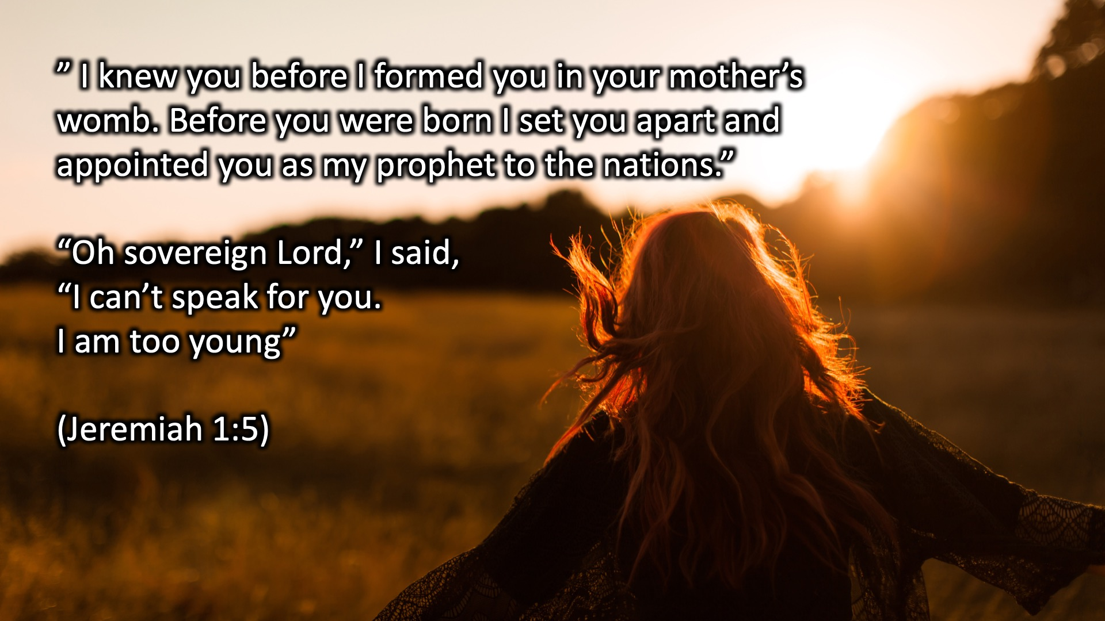
Notes:
” I knew you before I formed you in your mother’s womb. Before you were born I set you apart and appointed you as my prophet to the nations.”
“Oh sovereign Lord,” I said, “I can’t speak for you. I am too young”
(Jeremiah 1:5)

Slide 7
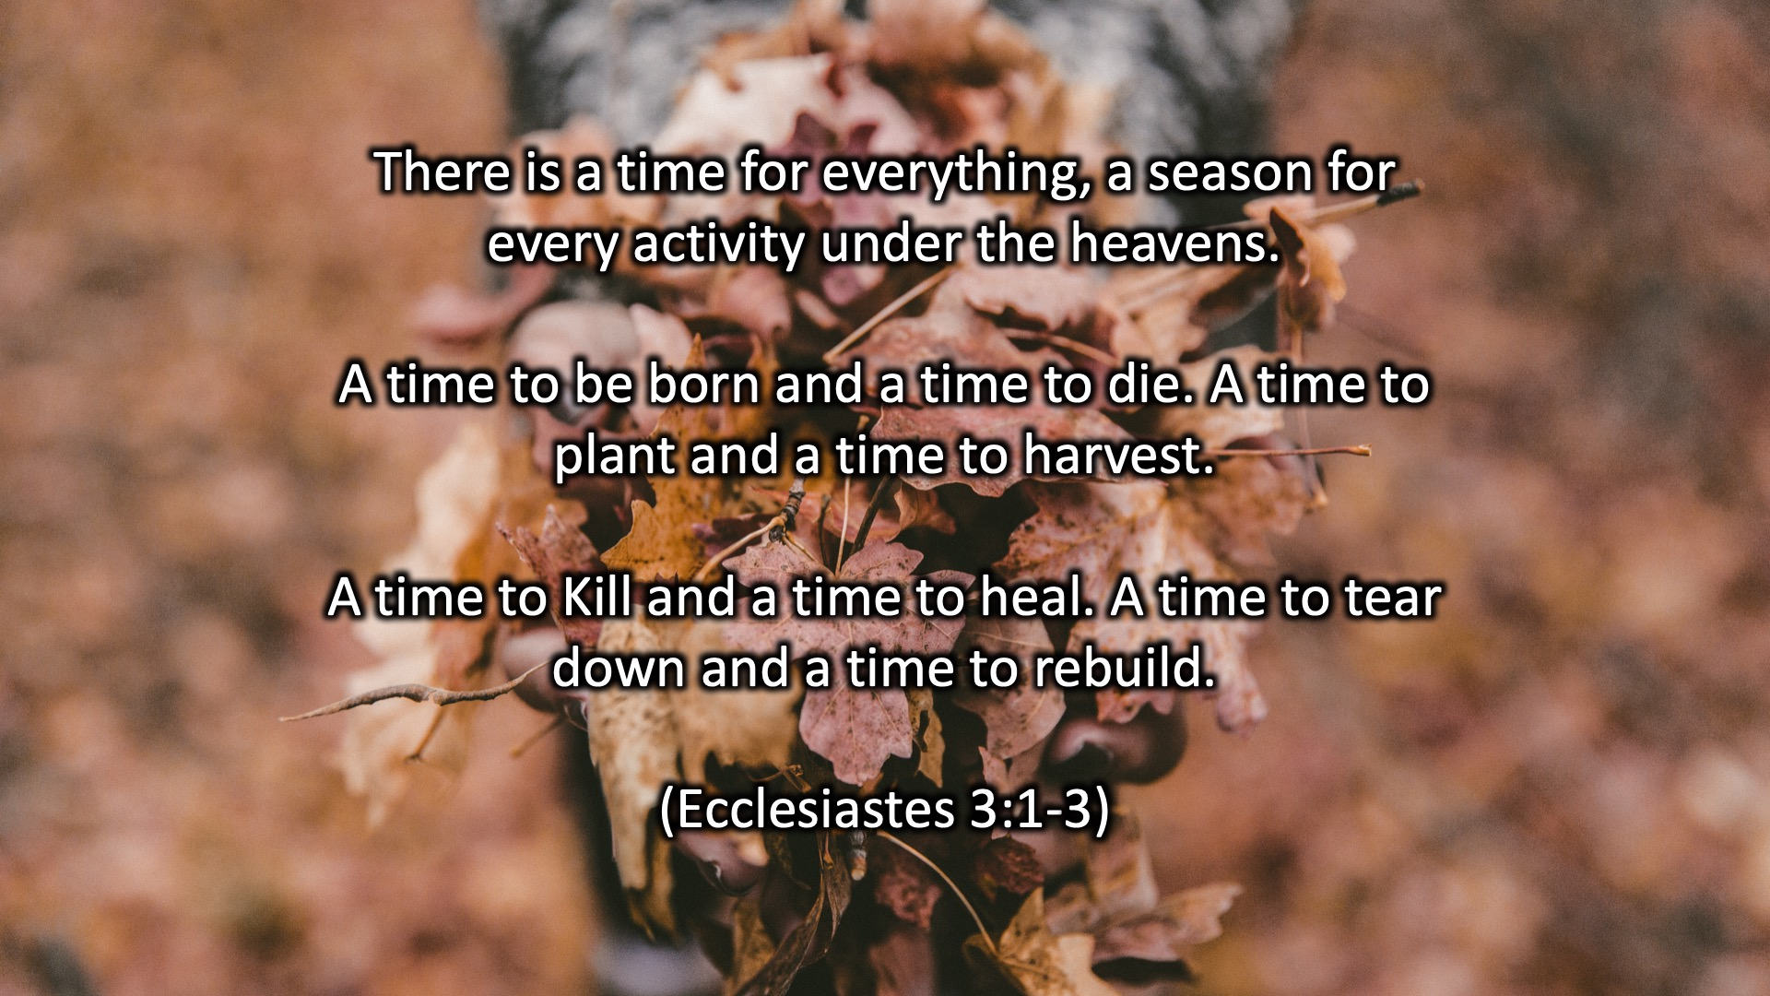
Notes:
There is a time for everything, a season for every activity under the heavens.
A time to be born and a time to die. A time to plant and a time to harvest.
A time to Kill and a time to heal. A time to tear down and a time to rebuild.
(Ecclesiastes 3:1-3)
“Oh sovereign Lord,” I said, “I can’t speak for you. I am too young”
(Jeremiah 1:5)

Slide 8
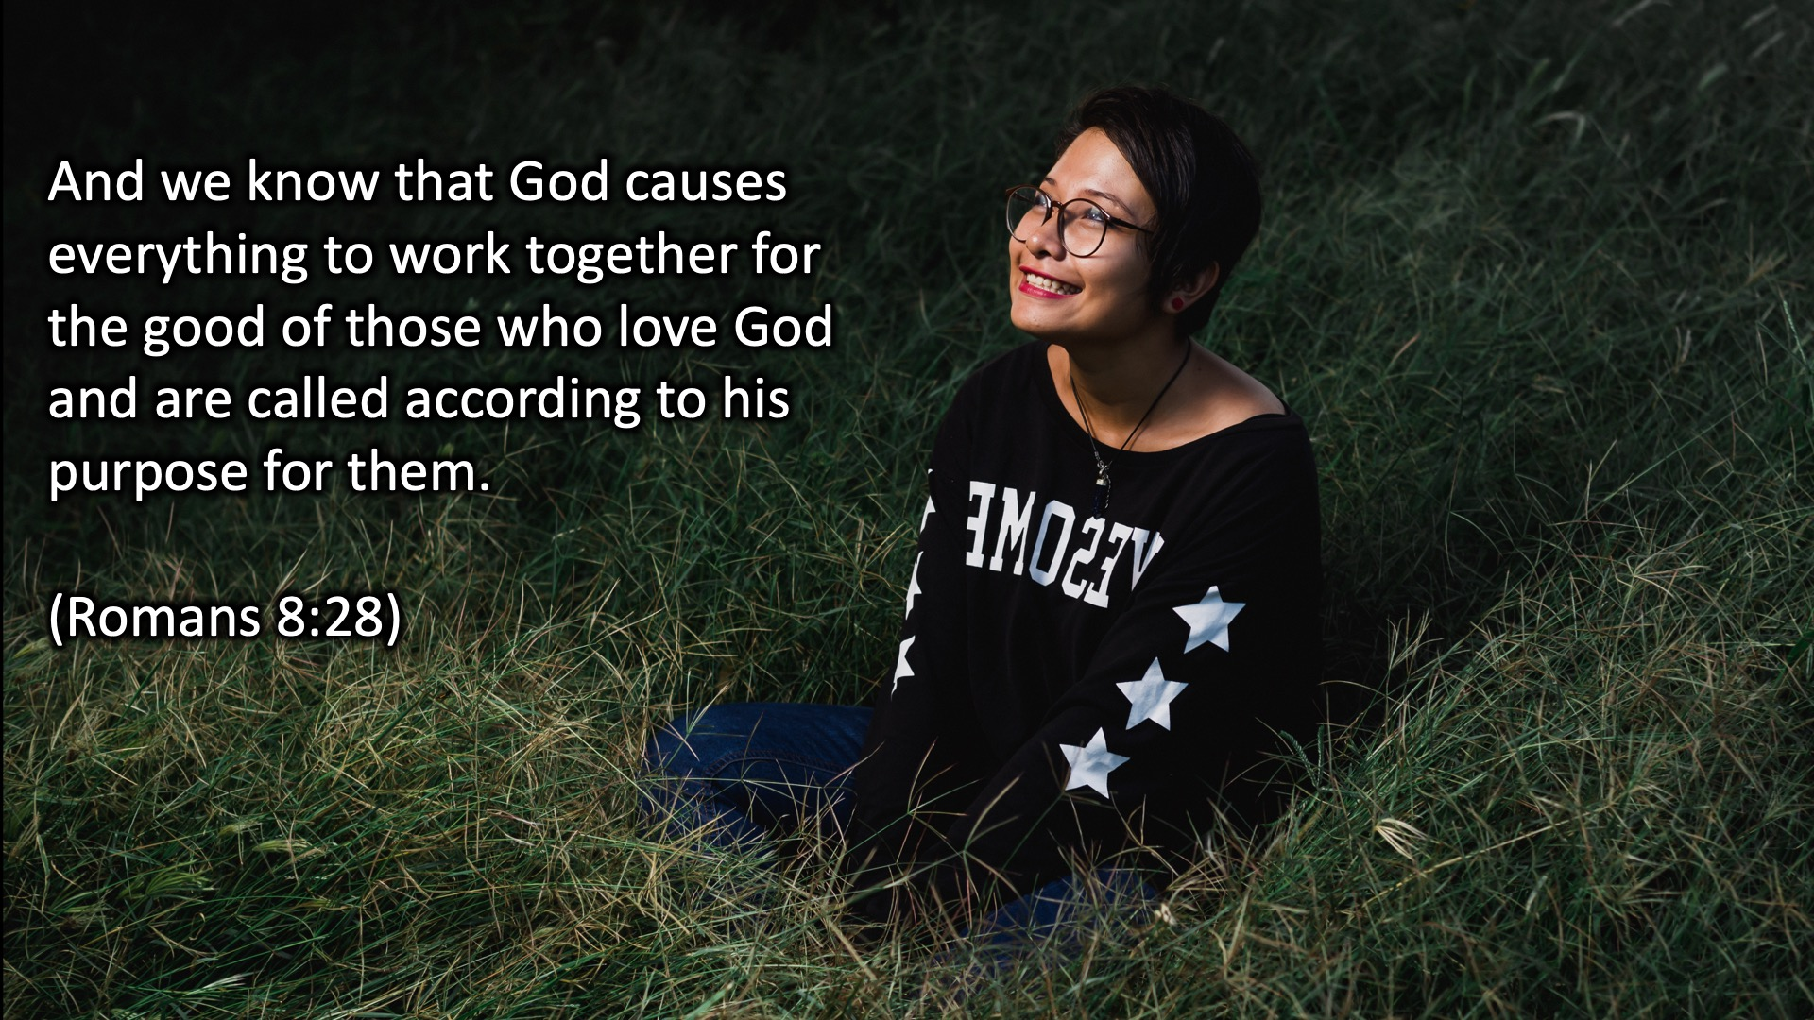
Notes:
And we know that God causes everything to work together for the good of those who love God and are called according to his purpose for them.
(Romans 8:28)
A time to be born and a time to die. A time to plant and a time to harvest.
A time to Kill and a time to heal. A time to tear down and a time to rebuild.
(Ecclesiastes 3:1-3)
“Oh sovereign Lord,” I said, “I can’t speak for you. I am too young”
(Jeremiah 1:5)

Slide 9

Notes:
Question: (1) How is your relationship with God? (2) What is your purpose on earth? (3) What makes you feel alive?

Slide 10

Notes:
Wrap Up: A healthy relationship with yourself will unlock your purpose and God wants to use that for His glory.

Slide 11
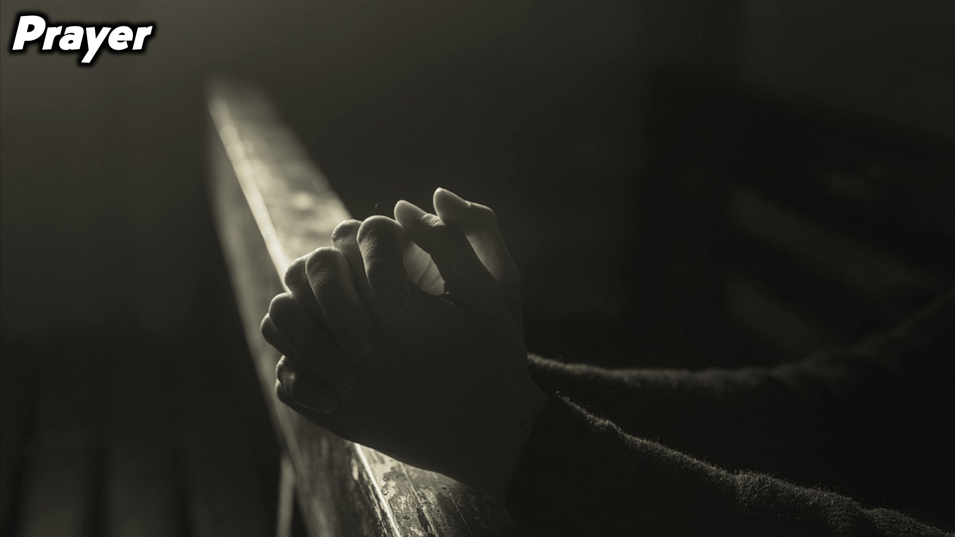
Notes:
Prayer.

Slide 12

Notes:
Daily Devotions: We will post devotions on the Sunday WhatsApp group every night of the week throughout this series

Slide 13

Notes:
Next Week: Called to Be Loved

