Slide 1

Notes:
Welcome to our campaign, What On Earth Am I Here For?

Slide 2

Notes:
Today we begin our campaign, What On Earth Am I Here For. Our first session is titled, The Call is for You.

Slide 3

Notes:
Called to be loved

Slide 4
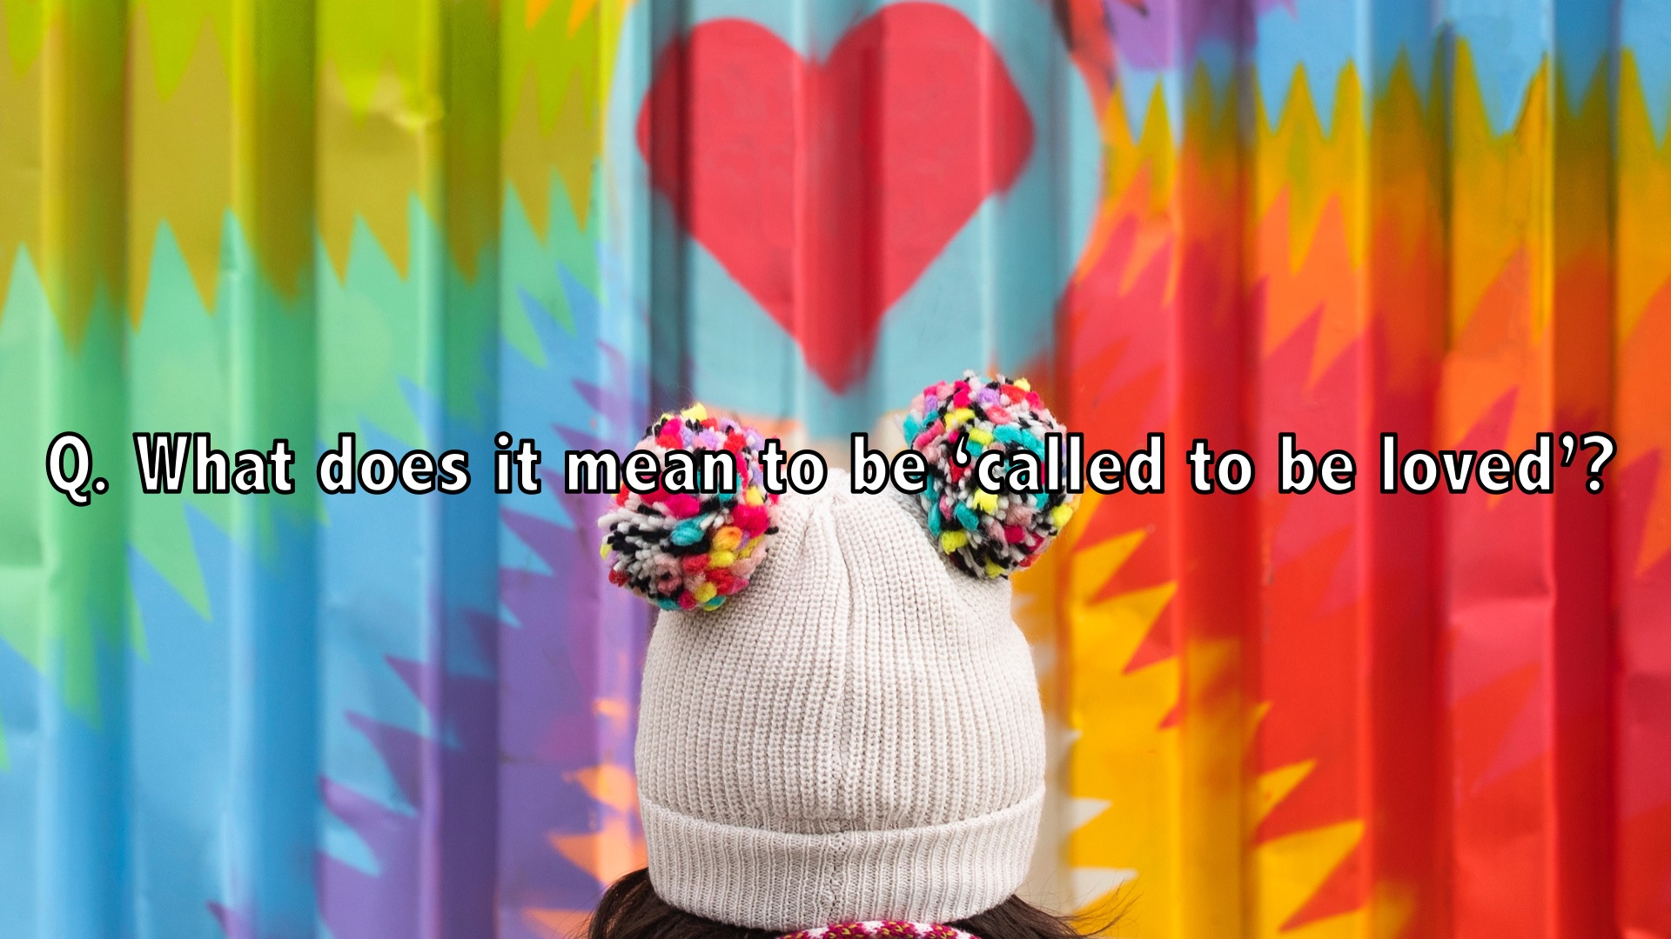
Notes:
Question: What does it mean to be ‘called to be loved’?

Slide 5
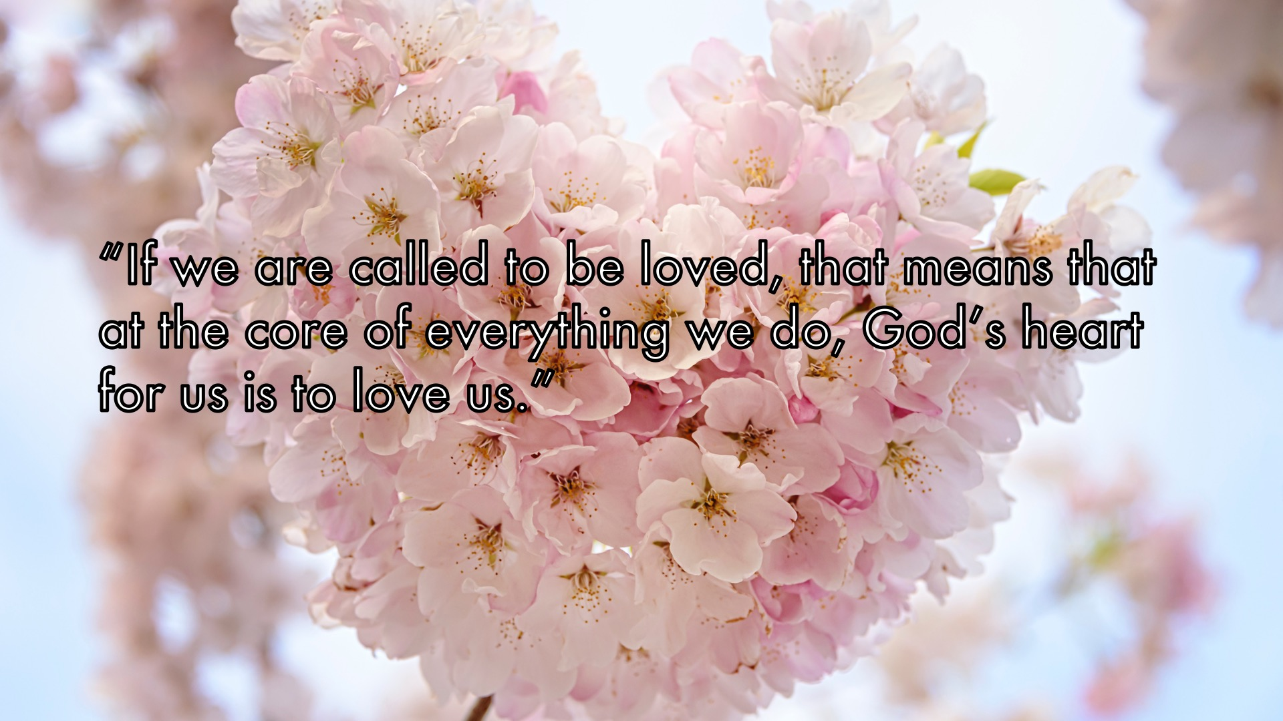
Notes:
“If we are called to be loved, that means that at the core of everything we do, God’s heart for us is to love us.”

Slide 6
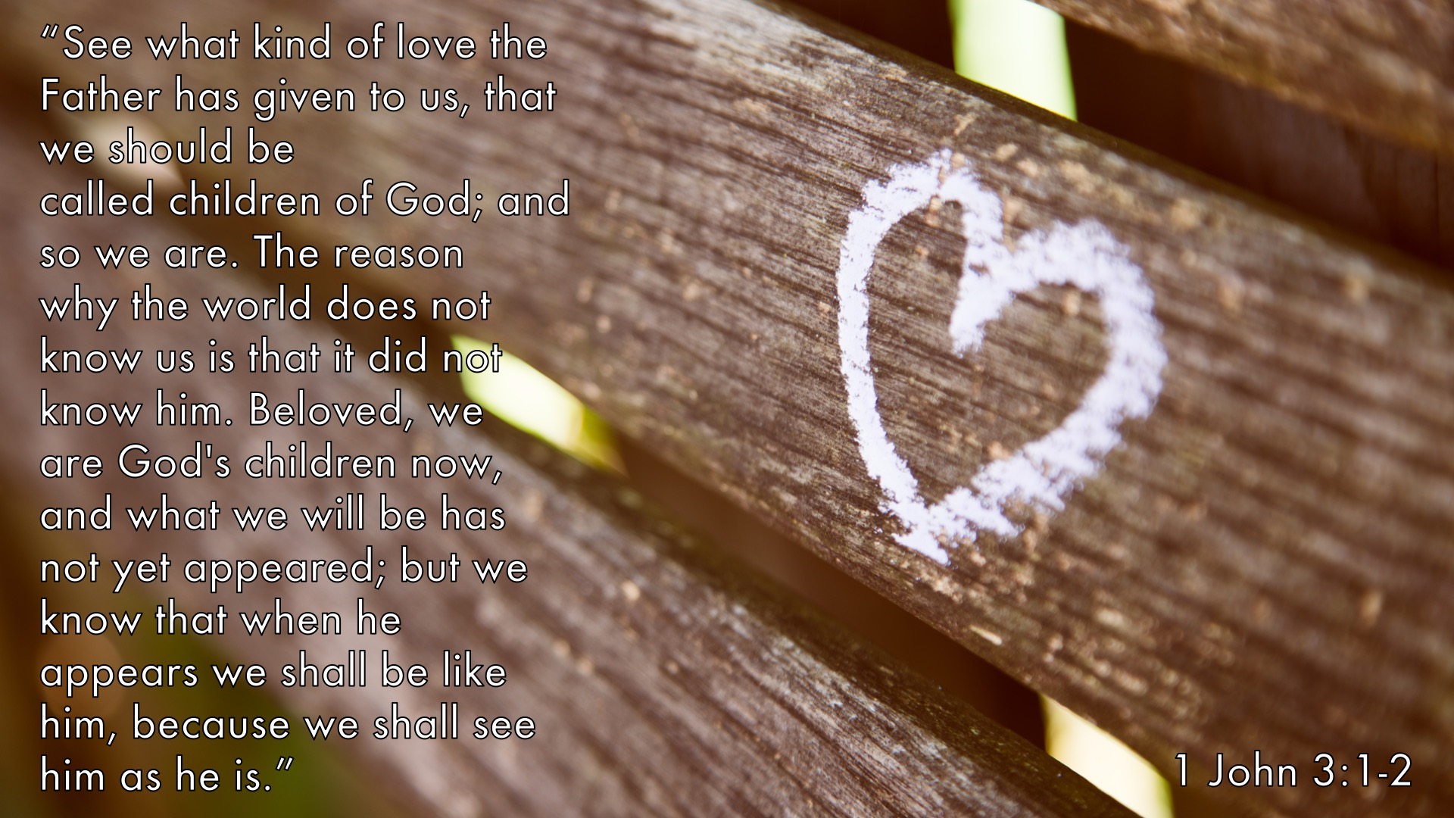
Notes:
“See what kind of love the Father has given to us, that we should be called children of God; and so we are. The reason why the world does not know us is that it did not know him. Beloved, we are God's children now, and what we will be has not yet appeared; but we know that when he appears we shall be like him, because we shall see him as he is.” 1 John 3:1-2

Slide 7

Notes:
1. SEE what love the Father gives us. Open your eyes to see the ways God loves you every day.

Slide 8
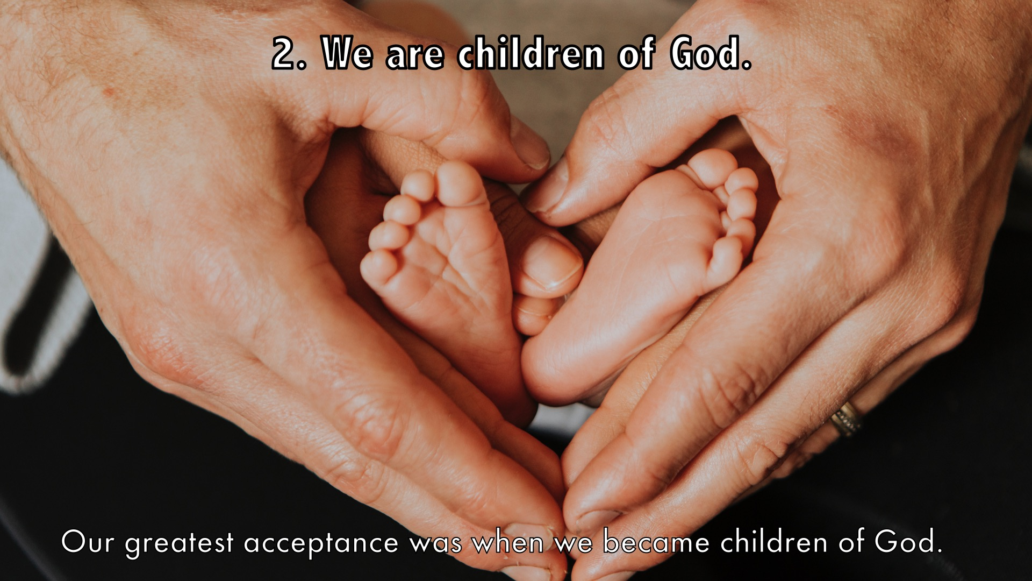
Notes:
2. We are children of God. Our greatest acceptance was when we became children of God.

Slide 9
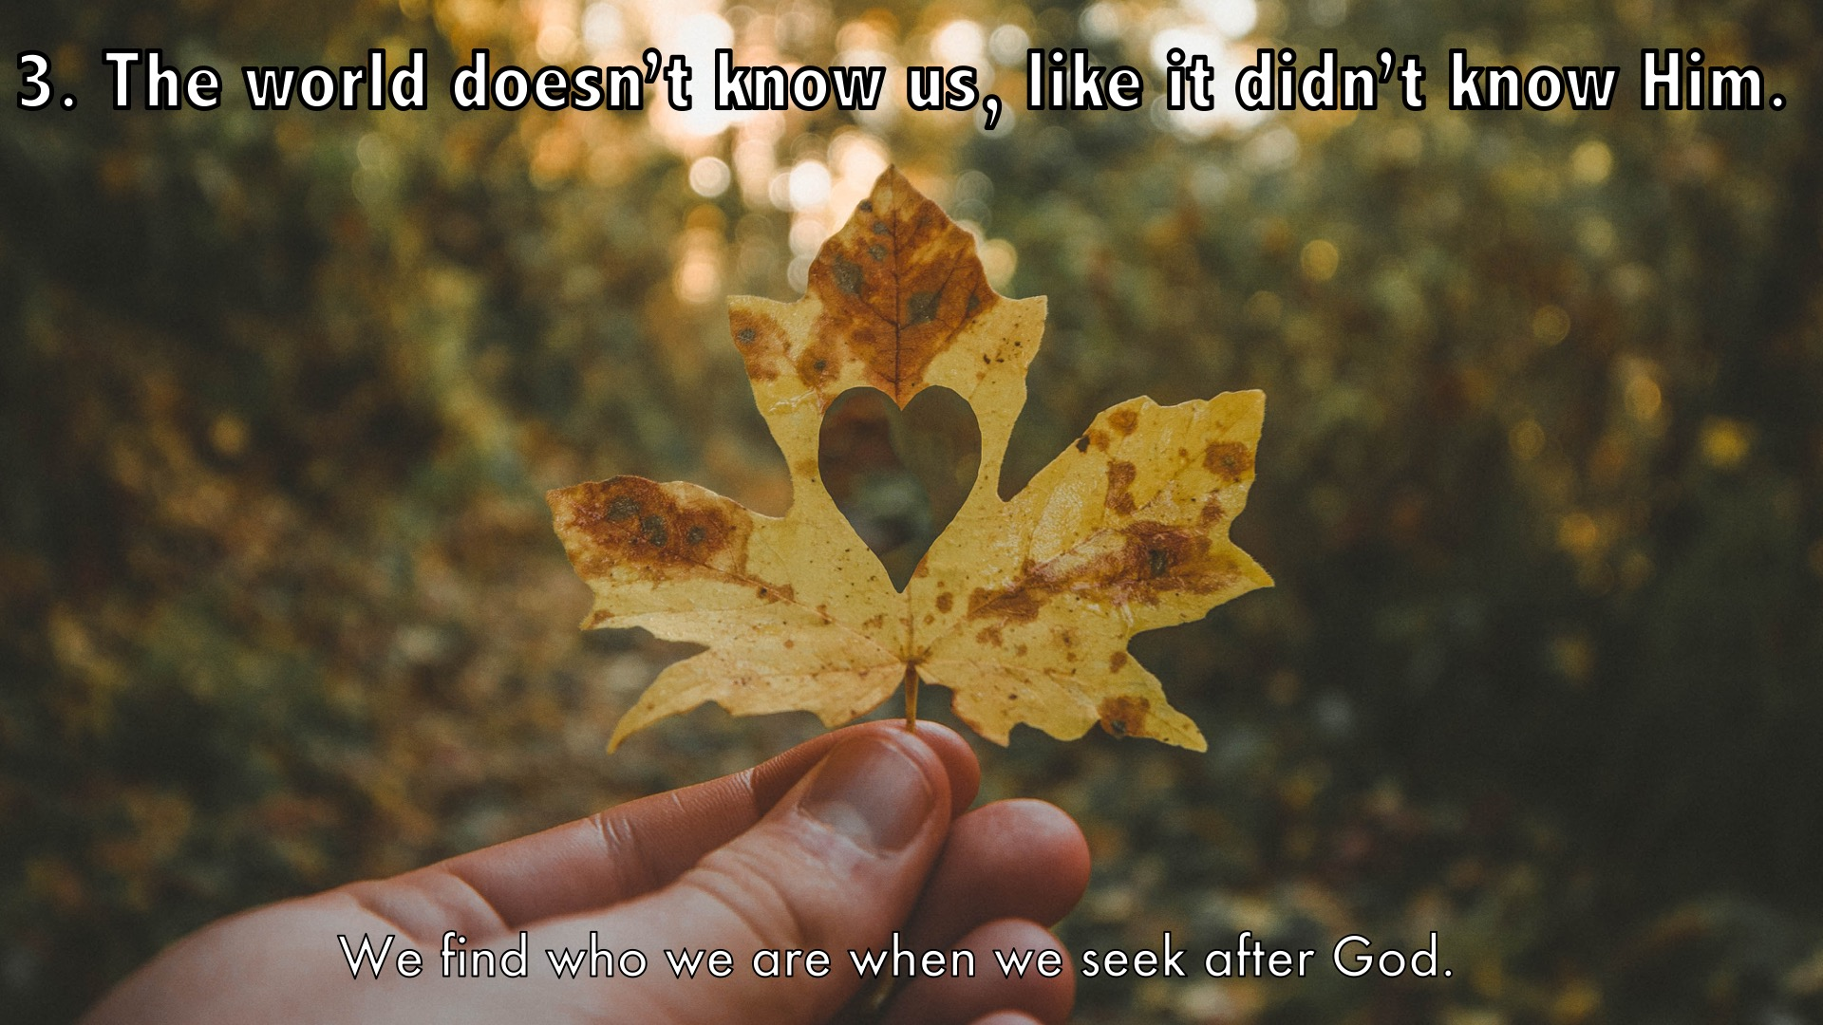
Notes:
3. The world doesn’t know us, like it didn’t know Him. We find who we are when we seek after God.

Slide 10
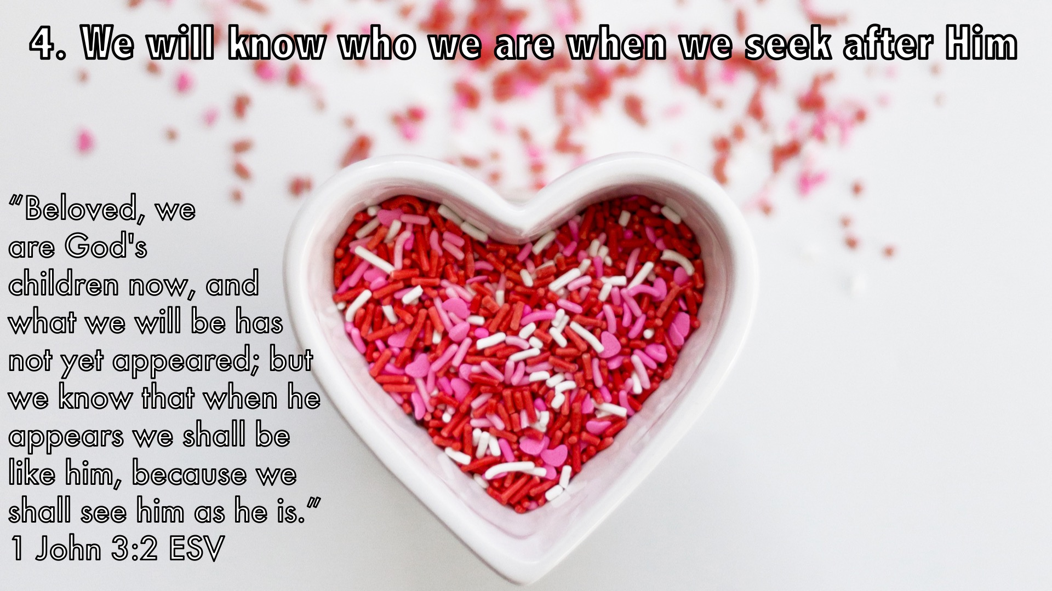
Notes:
4. We will know who we are when we seek after Him. “Beloved, we are God's children now, and what we will be has not yet appeared; but we know that when he appears we shall be like him, because we shall see him as he is.”
1 John 3:2 ESV

Slide 11
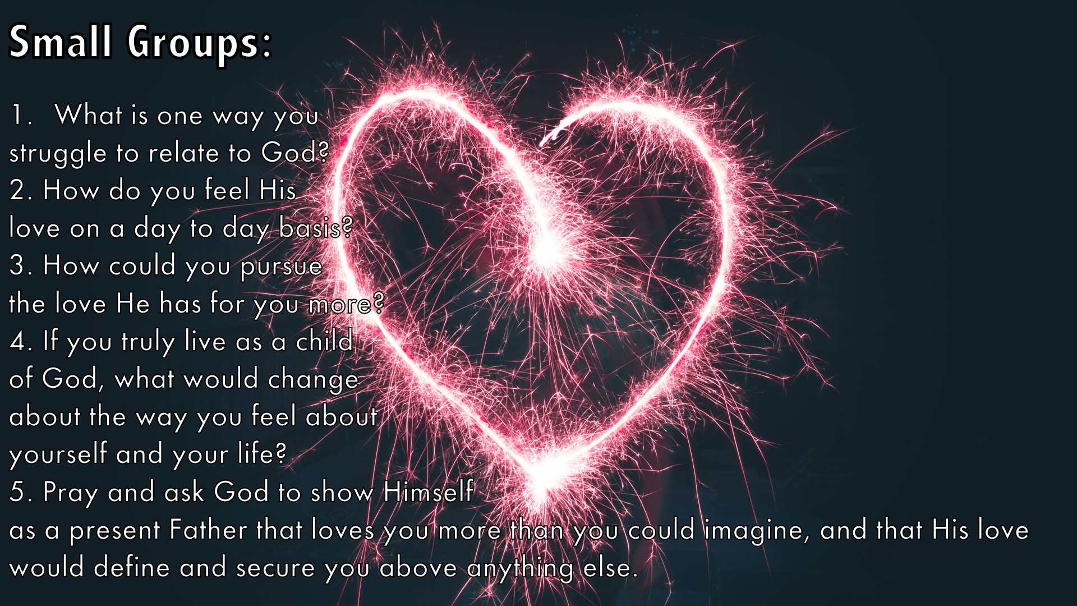
Notes:
Small Groups: (1) What is one way you struggle to relate to God? (2) How do you feel His love on a day to day basis? (3) How could you pursue the love He has for you more? (4) If you truly live as a child of God, what would change about the way you feel about yourself and your life? (5) Pray and ask God to show Himself as a present Father that loves you more than you could imagine, and that His love would define and secure you above anything else.

Slide 12
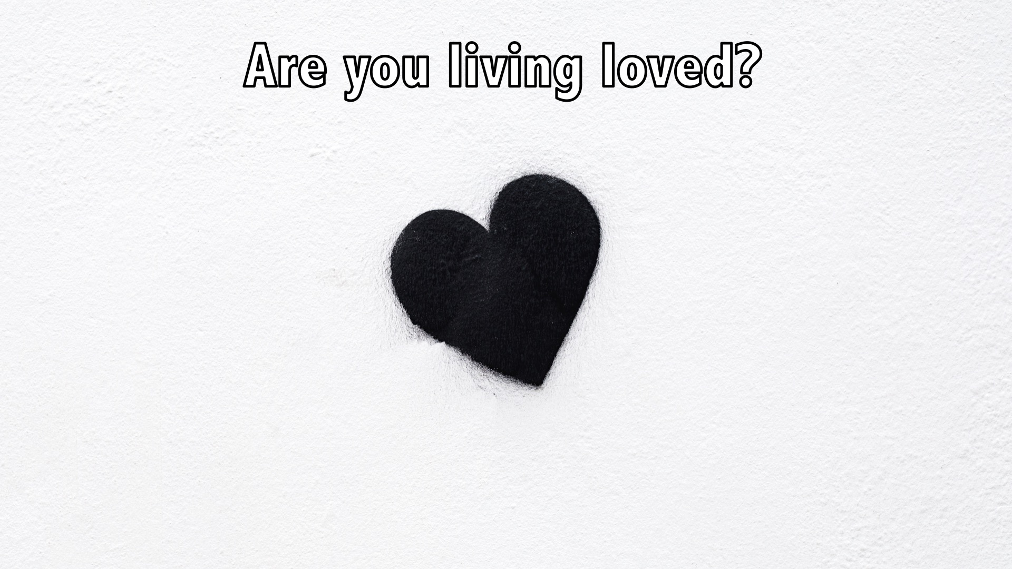
Notes:
Are you living loved?

Slide 13
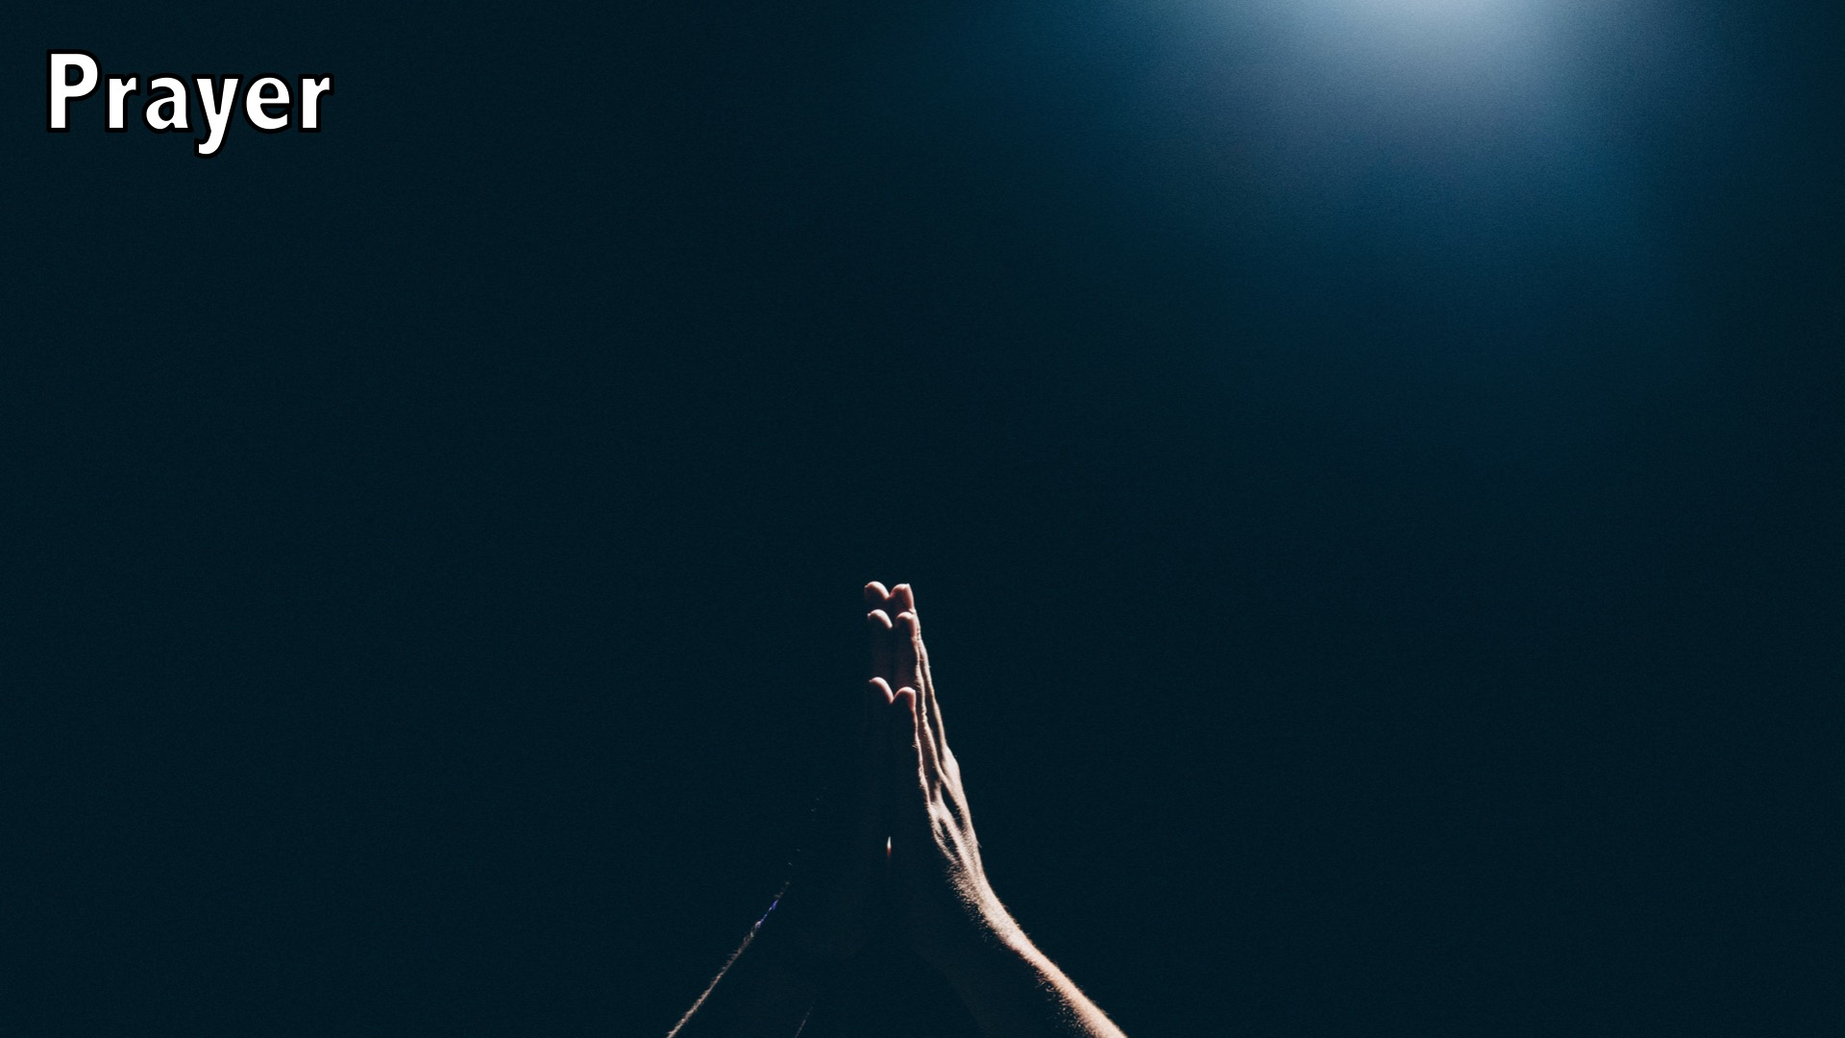
Notes:
Prayer

Slide 14

Notes:
Devotions

Slide 15

Notes:
Next Sunday the topic is: “Called to Belong”

