Slide 1

Notes:
Welcome to our campaign.

Slide 2

Notes:
Last week we discussed the topic, Called to Belong.

Slide 3

Notes:
Today we are talking about being Called to Become.

Slide 4

Notes:
Question: What are you called to become?

Slide 5
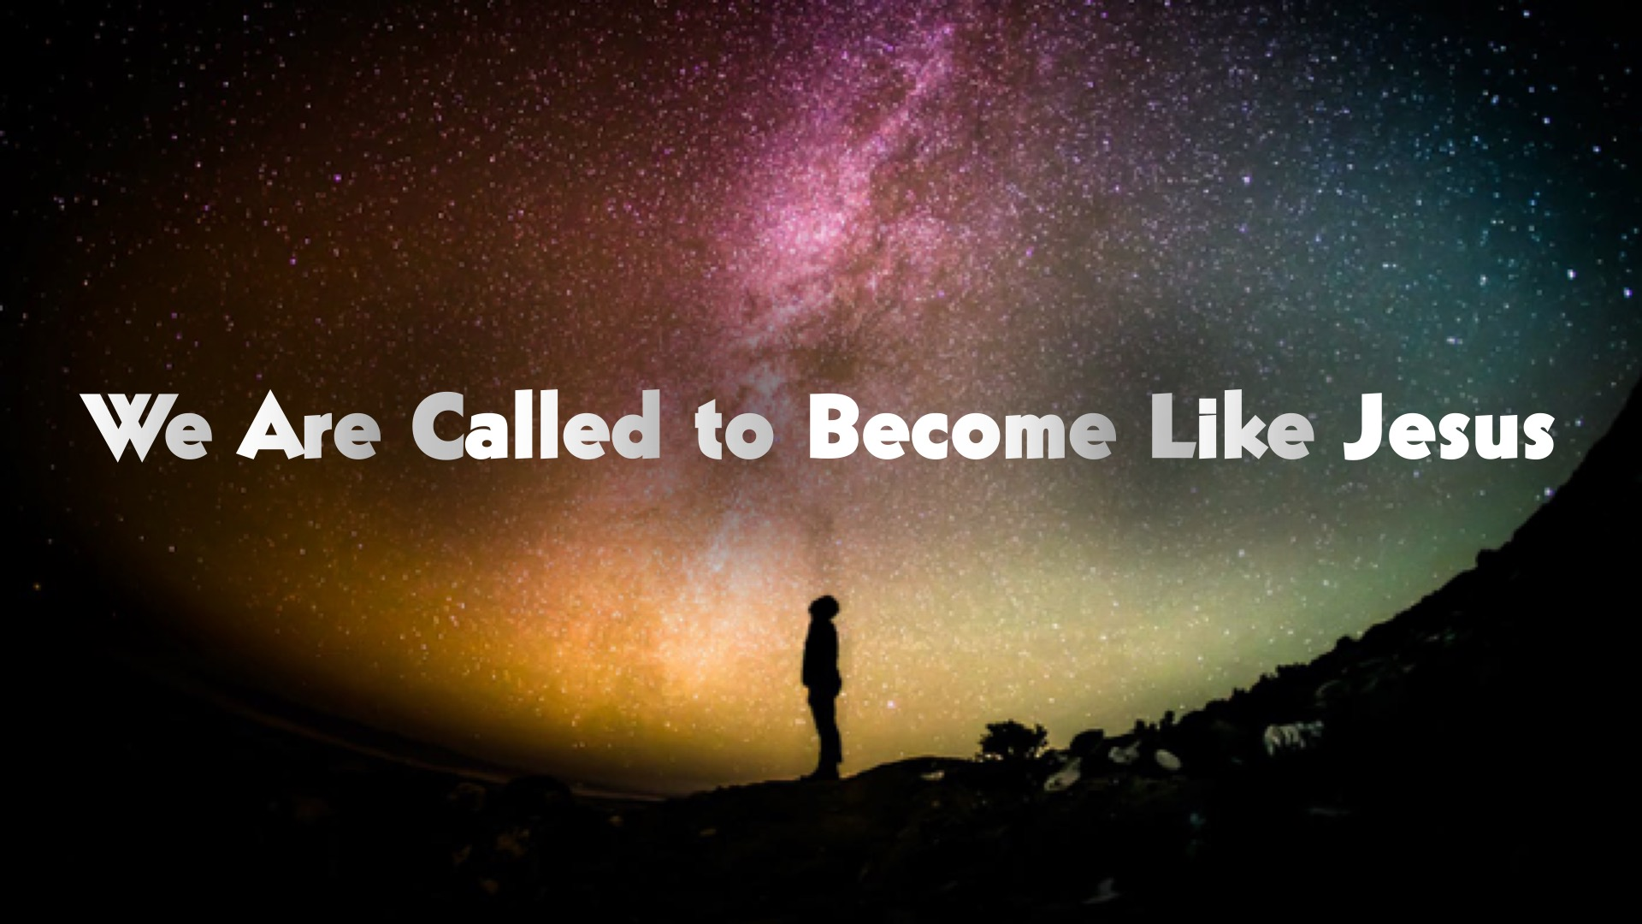
Notes:
You are called to become like Jesus. Meaning that You are called to become the best you you can ever be. That is who God created you to be

Slide 6
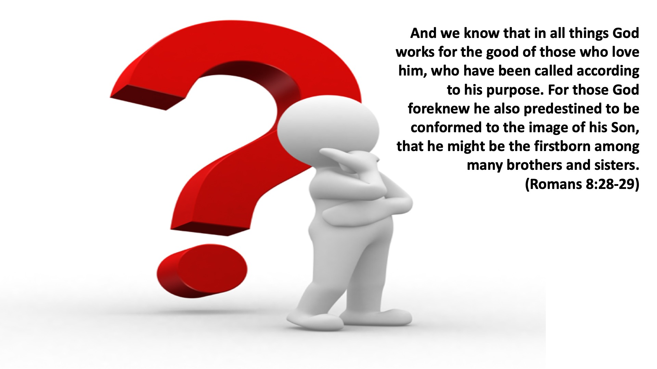
Notes:
Now how do I become like Jesus? How do I become who God wants me to be? Romans 8:28-29 says, “And we know that in all things God works for the good of those who love him, who have been called according to his purpose. For those God foreknew he also predestined to be conformed to the image of his Son, that he might be the firstborn among many brothers and sisters.”

Slide 7
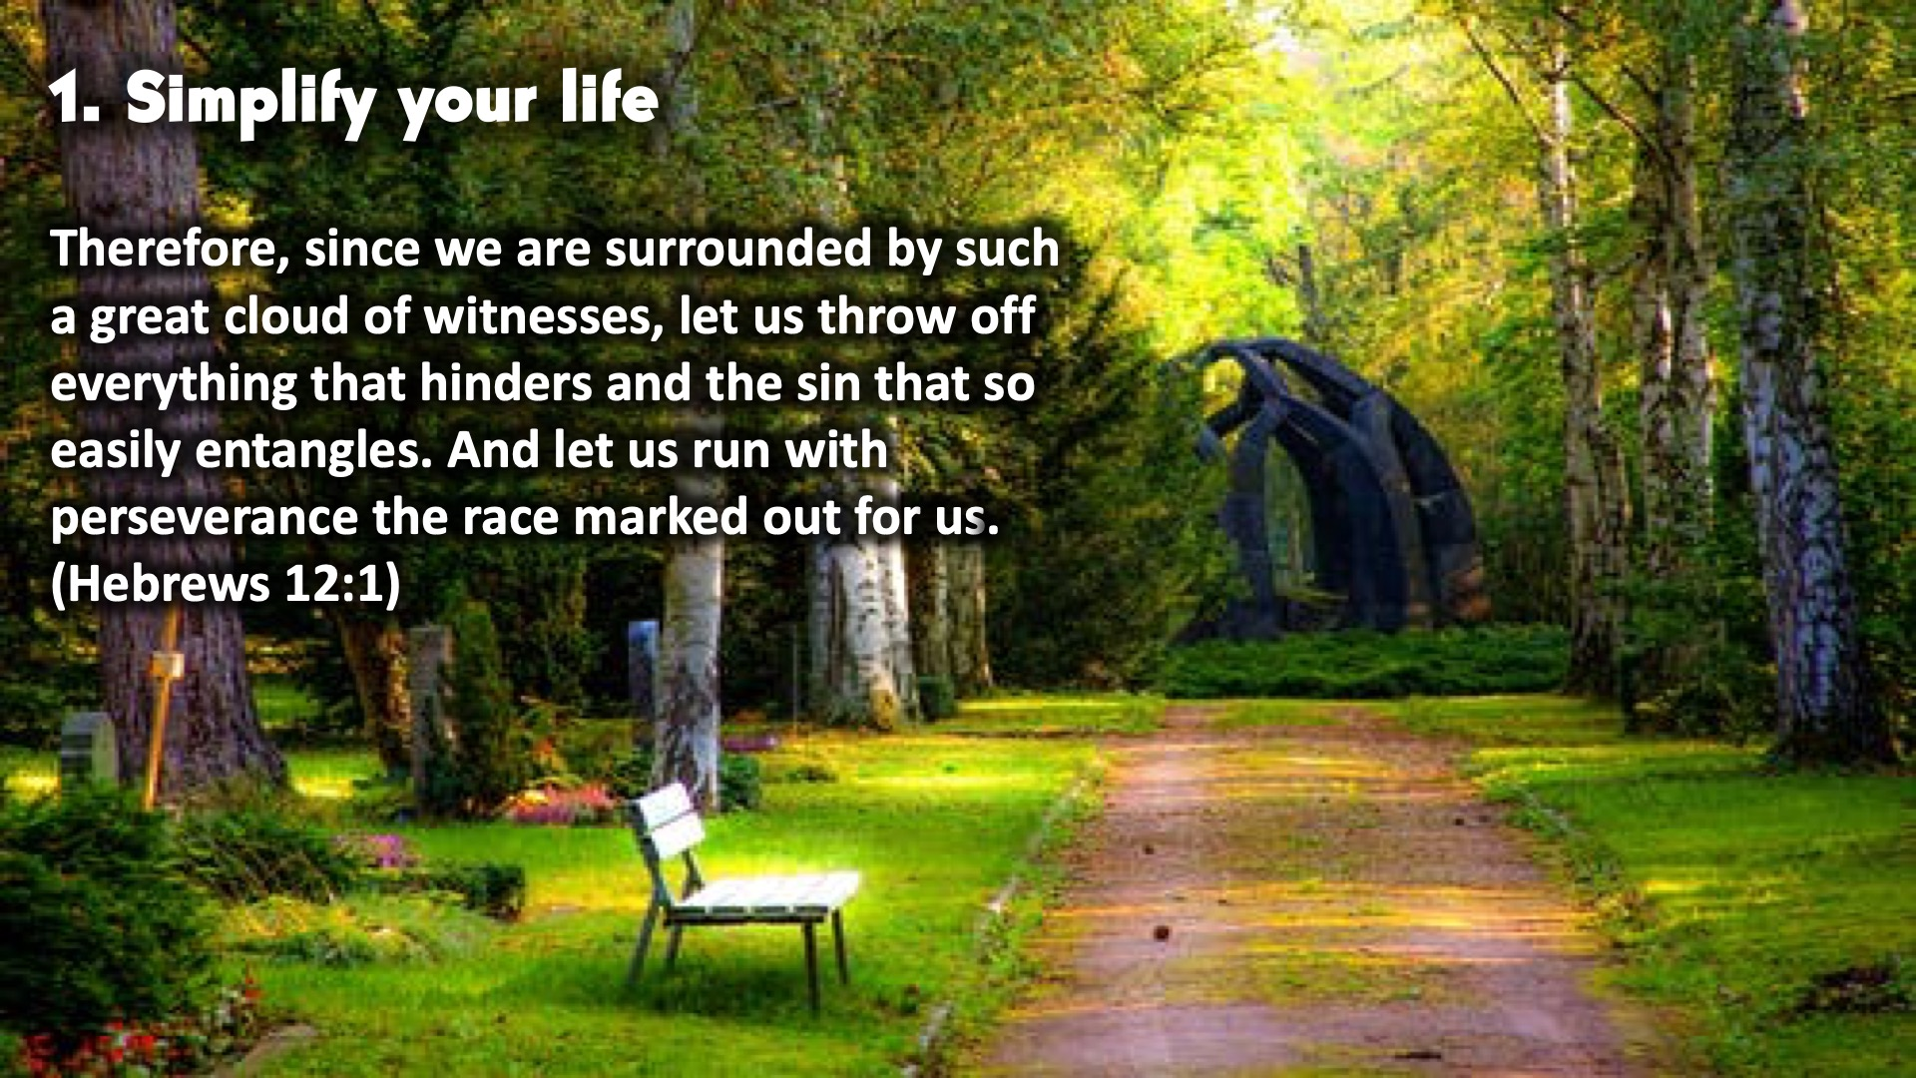
Notes:
1. Simplify Your Life. Therefore, since we are surrounded by such a great cloud of witnesses, let us throw off everything that hinders and the sin that so easily entangles. And let us run with perseverance the race marked out for us. (Hebrews 12:1) When people are running in a race they don't complicate it by putting on a lot of clothes. The dress less. So in this race of becoming, let us get rid of Sin, people holding is back, and negative thoughts.

Slide 8
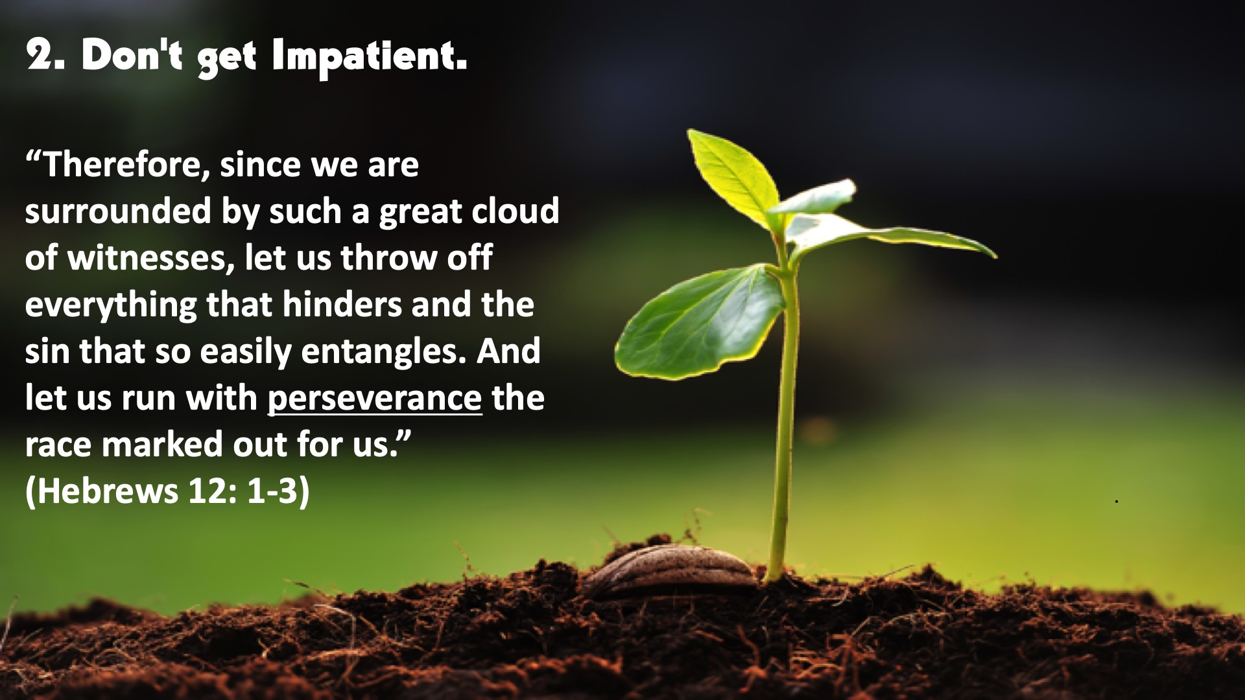
Notes:
2. Don’t get impatient. “Therefore, since we are surrounded by such a great cloud of witnesses, let us throw off everything that hinders and the sin that so easily entangles. And let us run with perseverance the race marked out for us.” (Hebrews 12: 1-3) Alone you can run fast. But together you can run far. Have patience. Wait on the Lord. Life is like a marathon not a 100m run. We are always learning. Even Jesus had to learn. He was a child once. Take it easy.

Slide 9
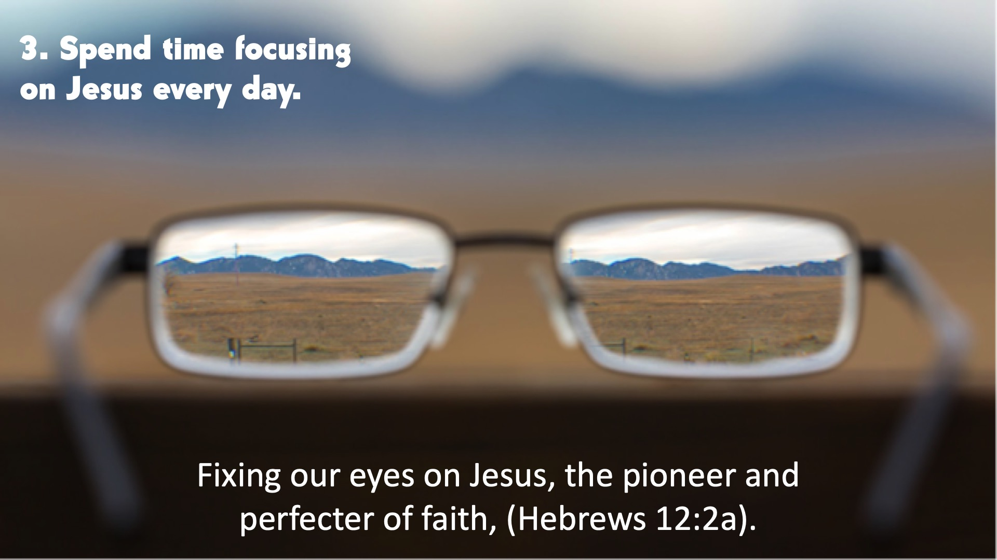
Notes:
3. Spend time focusing on Jesus. Fixing our eyes on Jesus, the pioneer and perfecter of faith, (Hebrews 12:2a). Make it a habit to spend time with God. Because who you spend most of your time with Influences you the most. Show me your Friends and I'll show you who you are

Slide 10
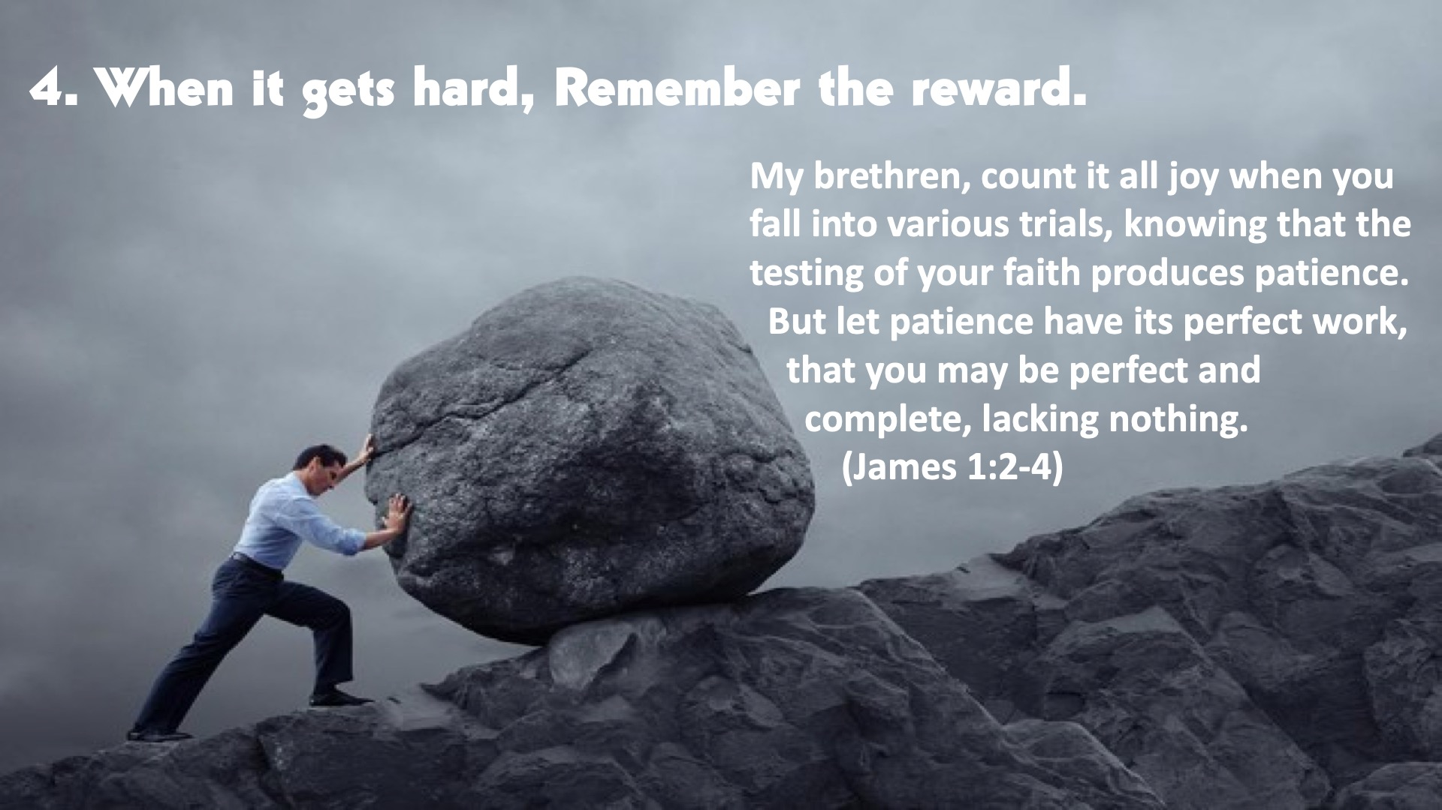
Notes:
4. When it gets hard, remember the reward. My brethren, count it all joy when you fall into various trials, knowing that the testing of your faith produces patience. “But let patience have its perfect work, that you may be perfect and complete, lacking nothing.” (James 1:2-4) Do not Give up. God has your back. Even Jesus found His life hard. God never said it will be easy. The hardships teach us patience. They sharpen us.

Slide 11
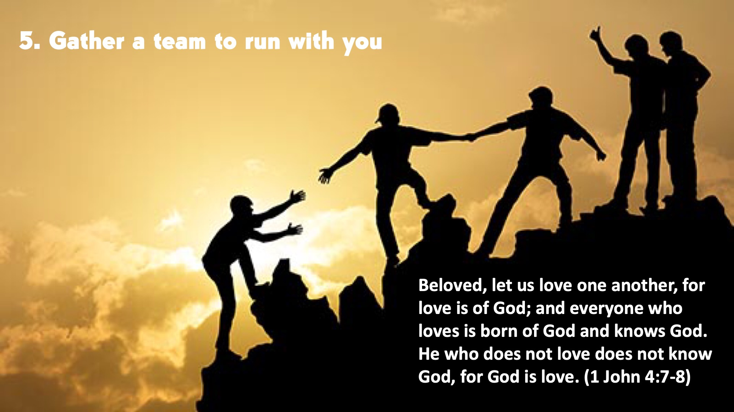
Notes:
5. Gather a team to run with you. “Beloved, let us love one another, for love is of God; and everyone who loves is born of God and knows God. He who does not love does not know God, for God is love.” (1 John 4:7-8) Church is a perfect place. That's why we have connect, people who will keep you accountable. People who are like minded and will motivate you

Slide 12

Notes:
6. God has a plan for you. “For I know the plans I have for you,” declares the Lord, “plans to prosper you and not to harm you, plans to give you hope and a future.” (Jer 29:11) It is easier to follow God's plan than your own. Allow God to be in the drivers seat, for you to become the beat you

Slide 13
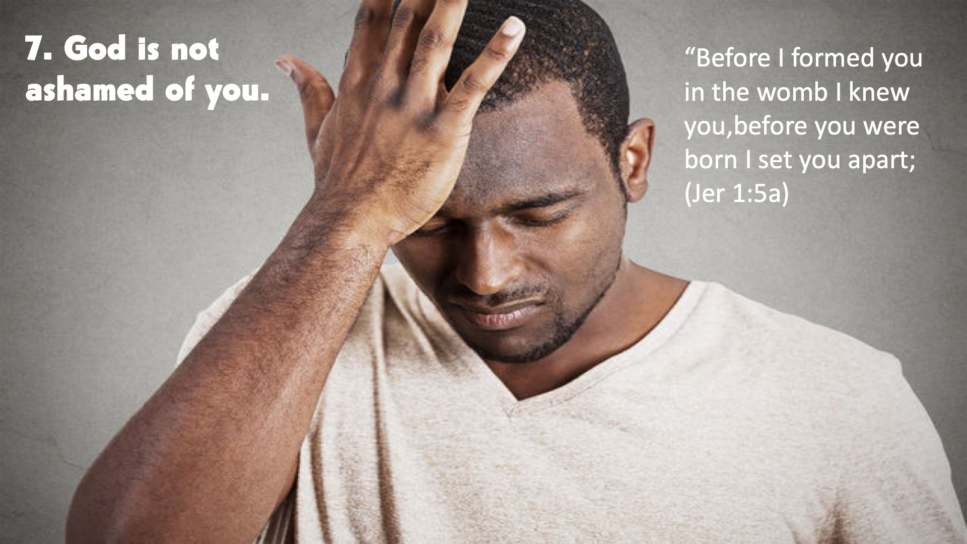
Notes:
7. God is not ashamed of you. “Before I formed you in the womb I knew you,before you were born I set you apart; (Jer 1:5a) Even when you mess up. Just come back to him. He is the beginning and the end. There is no life without Him.

Slide 14
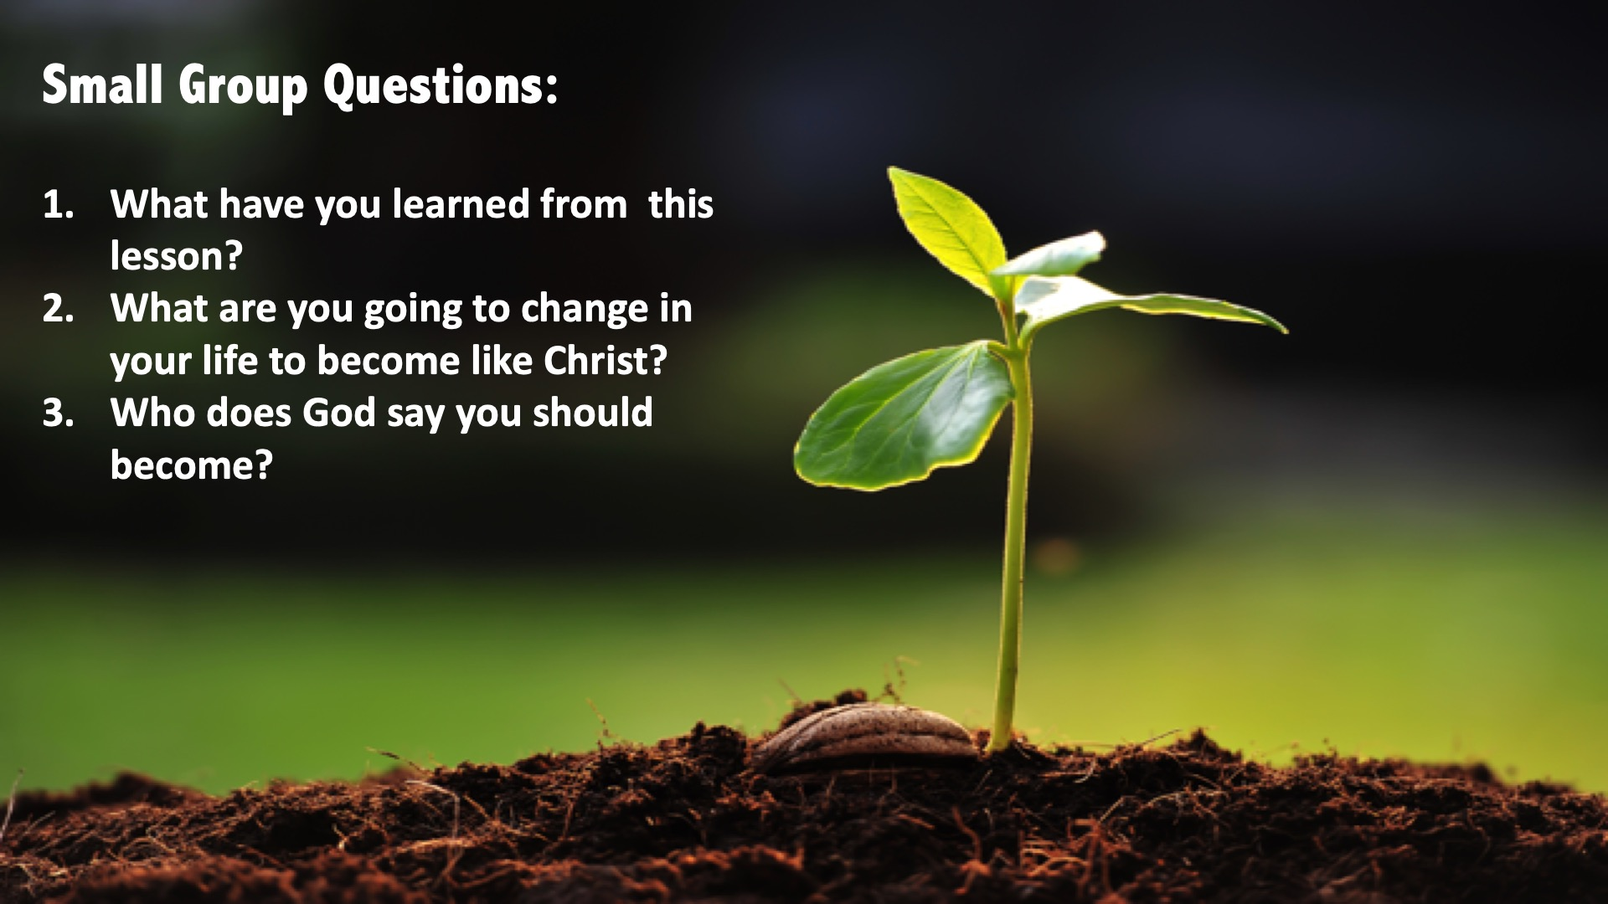
Notes:
Small Group Questions: (1) What have you learned from this lesson? (2) What are you going to change in your life to become like Christ? (3) Who does God say you should become?

Slide 15
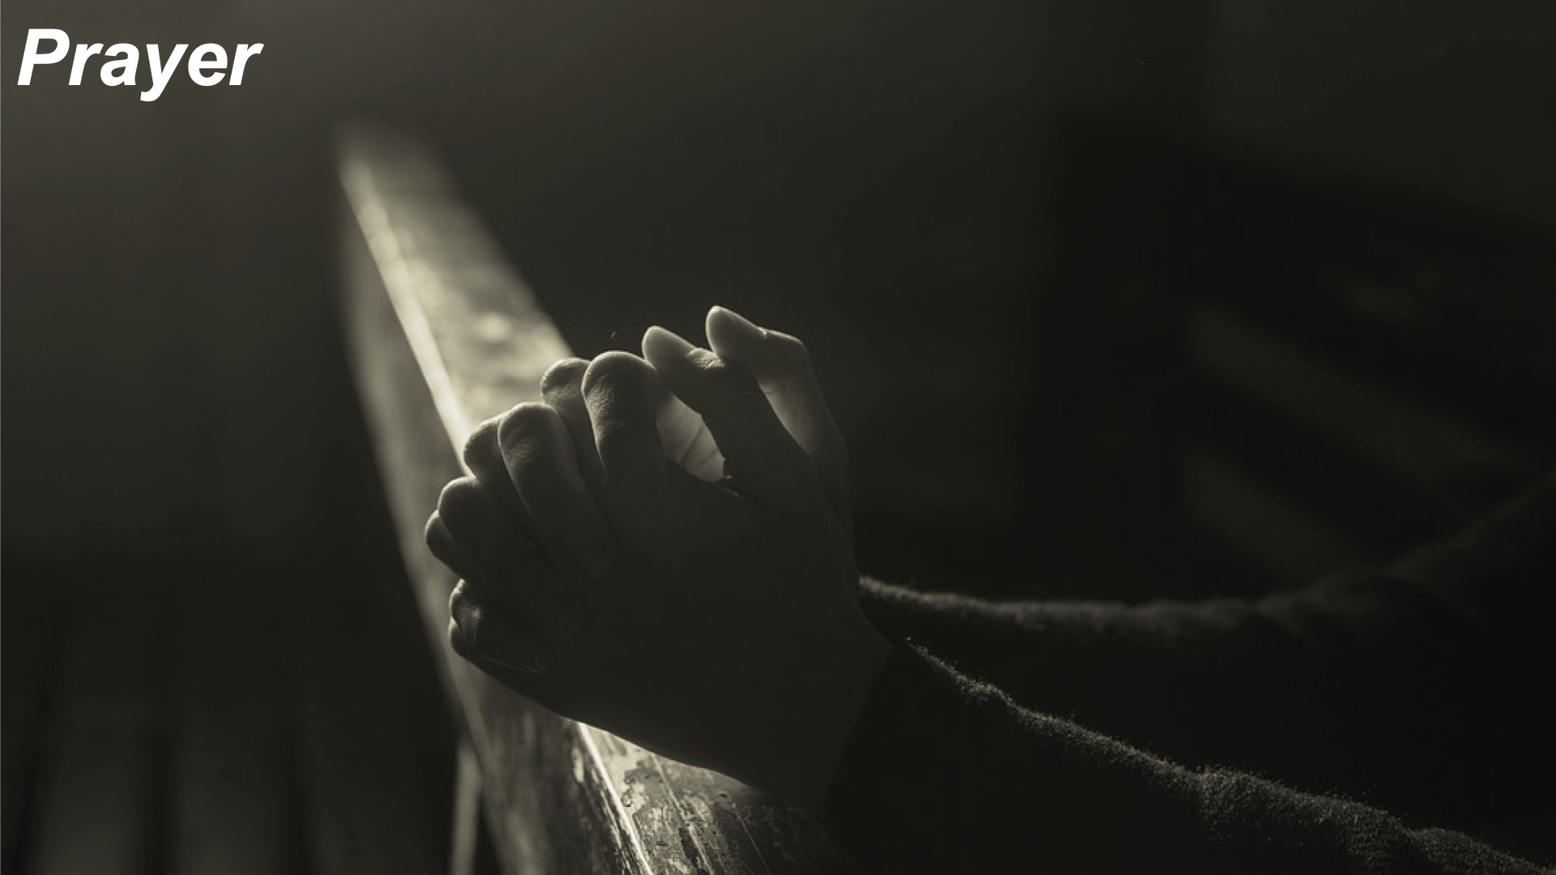
Notes:
Prayer: Pray for three groups of people.
Teens who don’t know Jesus and want a relationship with Him.
Teens who want to reconnect to God
God to reveal their gifts in oder for them to know their purpose and where they fit in the family.

Slide 16

Notes:
Daily Devotions: We will post devotions on the Sunday WhatsApp group every night of the week throughout this series

Slide 17
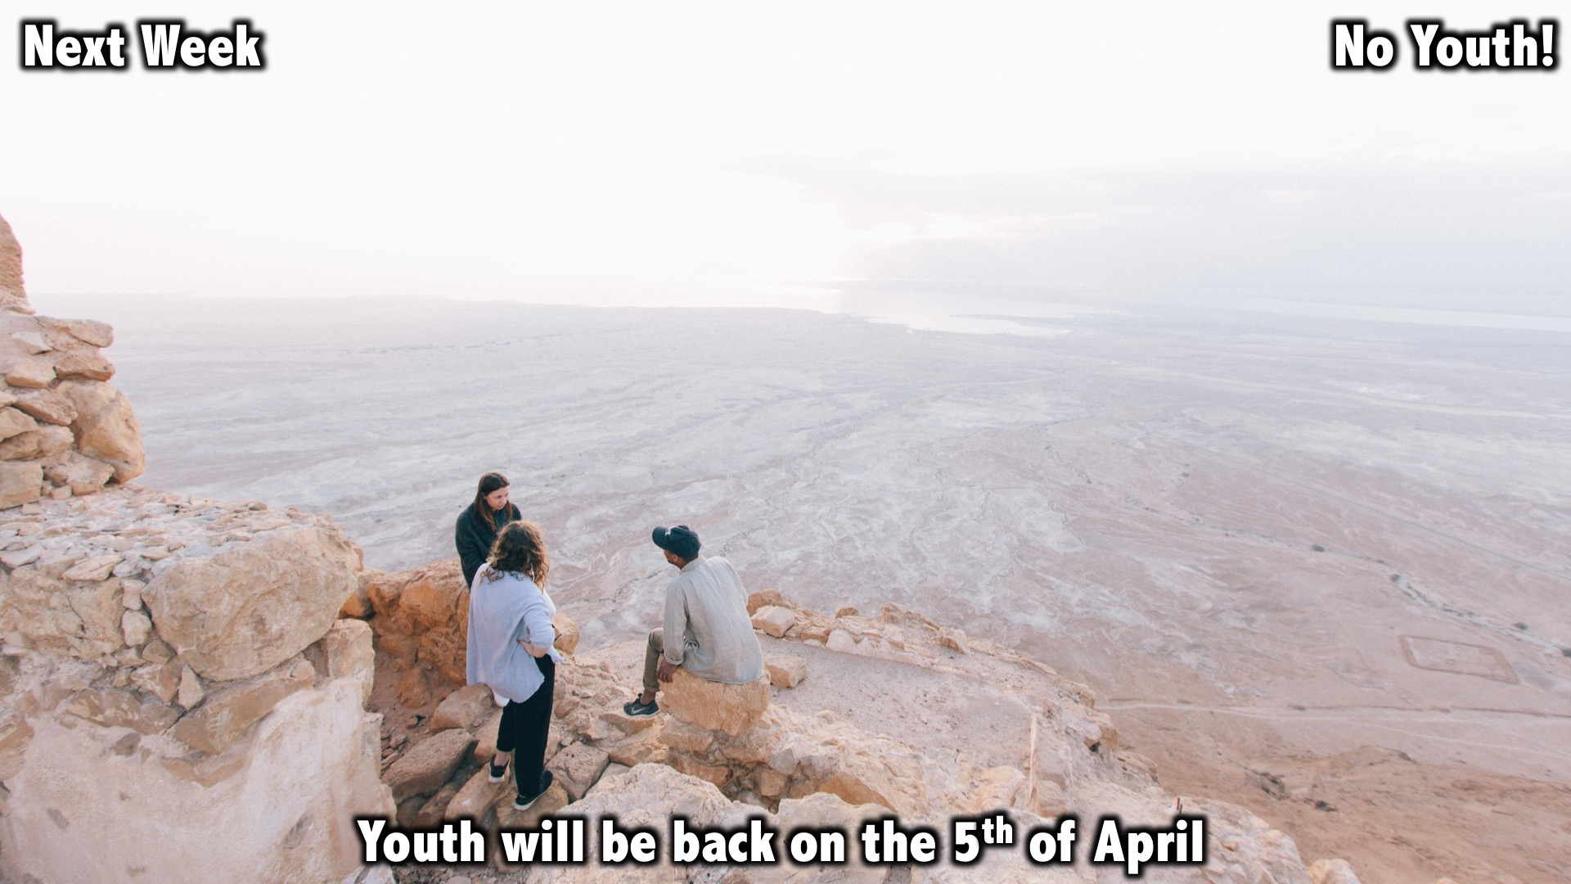
Notes:
Next Week: No Youth!

