Slide 1
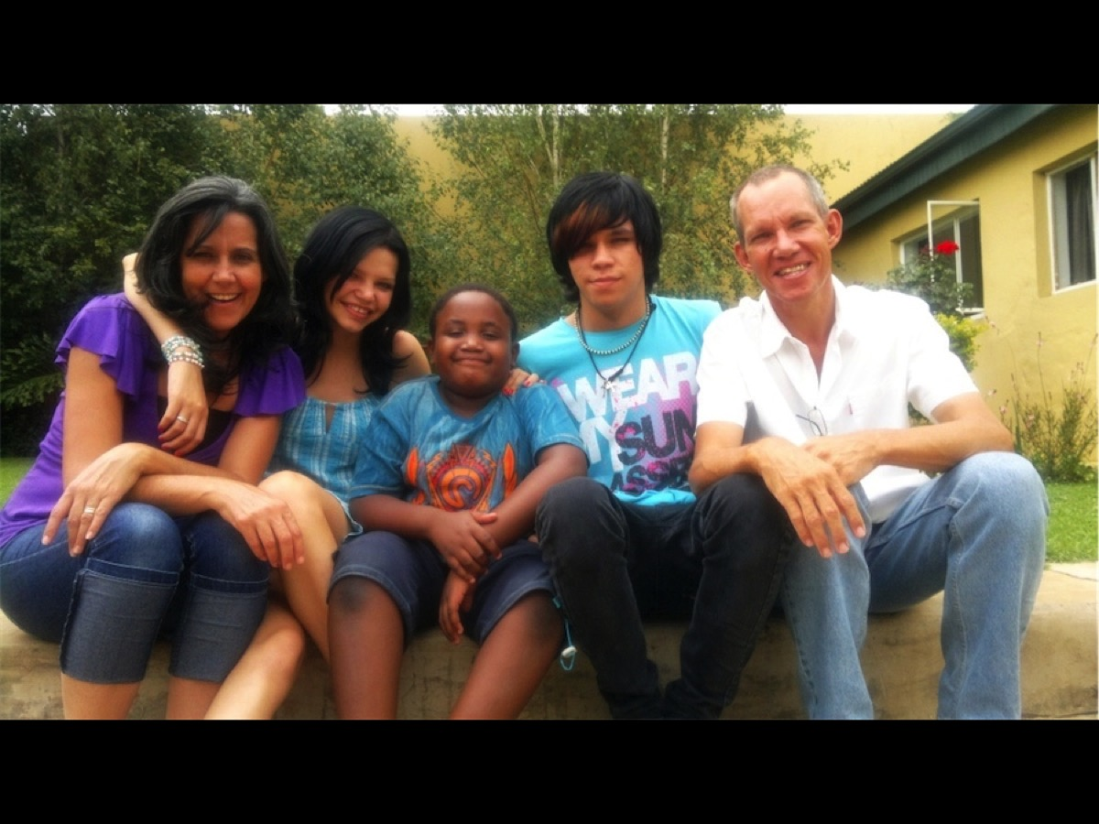

Slide 2


Slide 3
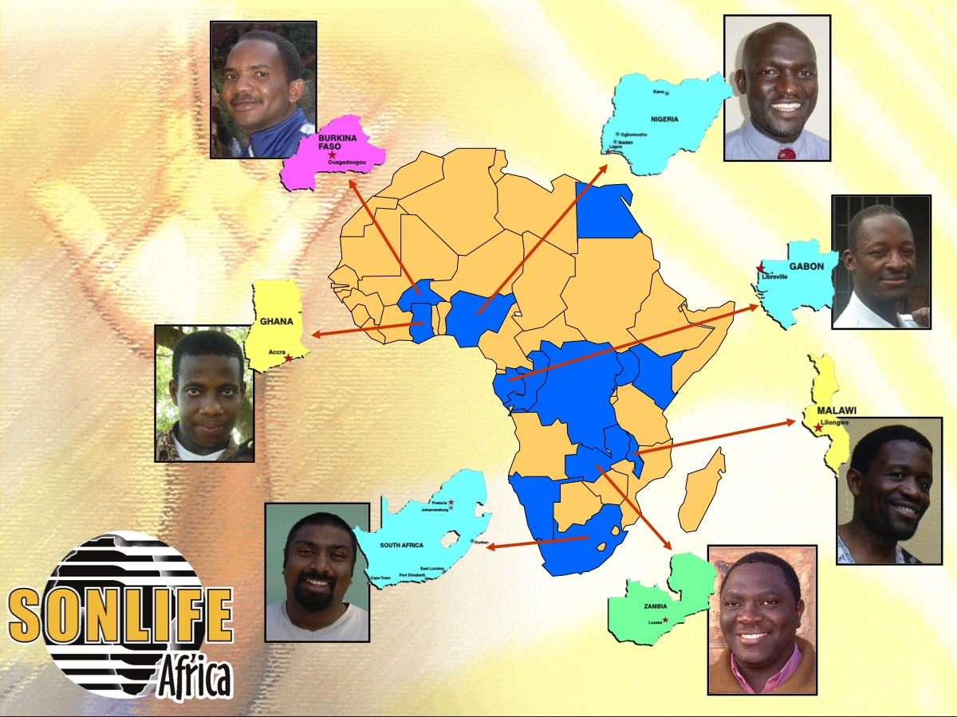

Slide 4
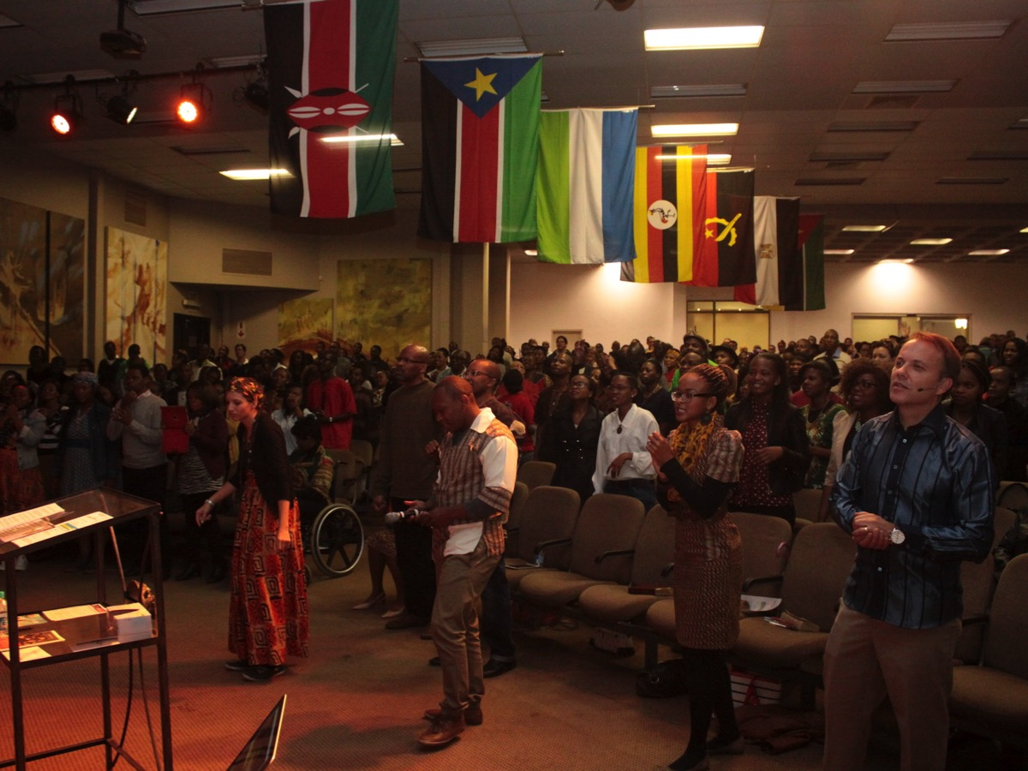
Notes:
For the past 10 years I have been the youth pastor at His People Church in Rosebank. My wife, Debbie, serves as a pastor alongside me in the youth youth. Our job is to keep watch over the flock - you could say that we are…

Slide 5
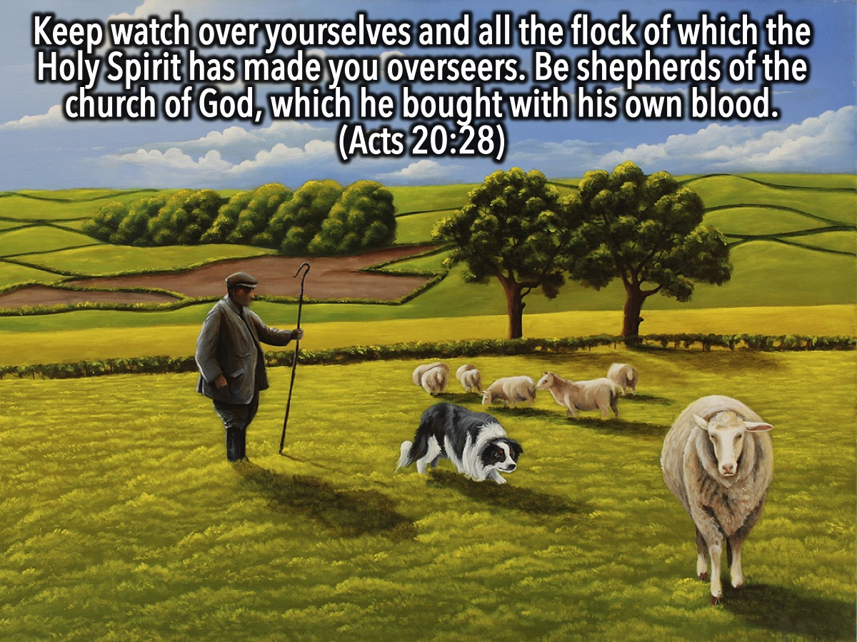
Notes:
According to Acts 20:28 (Keep watch over yourselves and all the flock of which the Holy Spirit has made you overseers. Be shepherds of the church of God, which he bought with his own blood) our job is to keep watch over the flock - you could say that we are…

Slide 6

Notes:
Watch Dogs! As some of you probably know, Watch_Dogs is a popular game among teens. In many ways I envy the main character who gets to control the whole city using just his cell phone.

Slide 7
Notes:
Pre-Event Video: Watch Dogs Launch Trailer. Get it on YouTube at: https://www.youtube.com/watch?v=CH8HZ0TK5-U

Slide 8
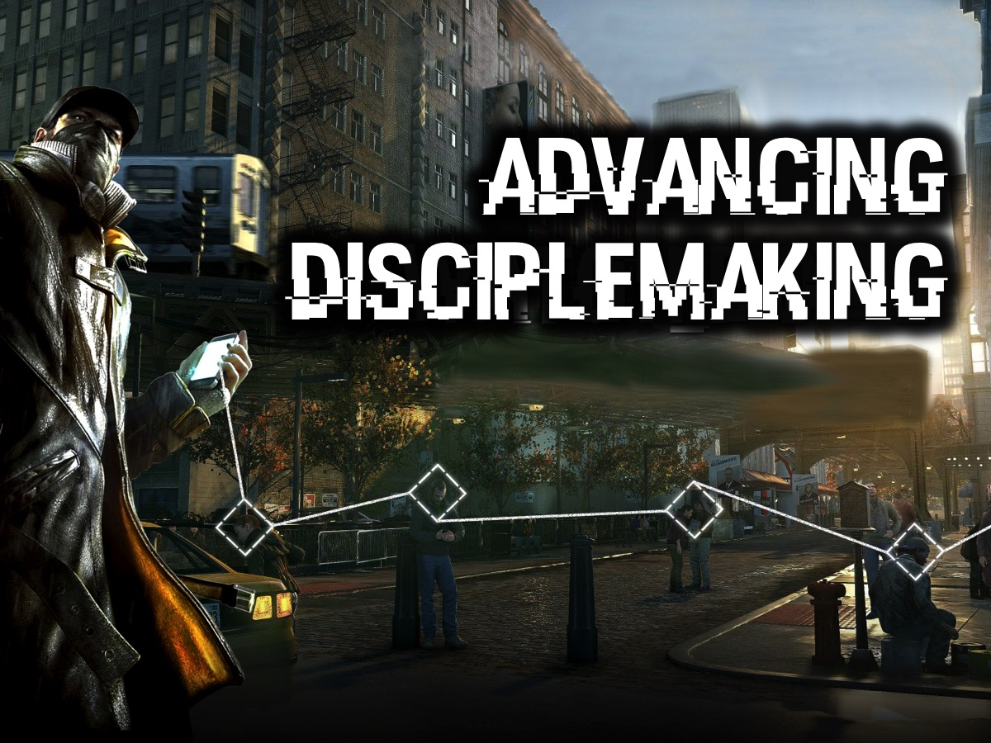
Notes:
Advancing Disciplemaking: In this first session, I am going to be exploring how to go about advancing disciplemaking in a youth ministry. I will be sharing my personal journey in creating a disciplemaking youth ministry - looking at 15 key principles that will give you a framework to reflect on your ministry. You should ideally be sitting with members of your youth ministry team because after ever principle there will be a few questions to answer - there won’t be time to go too deep but at least you can start the conversation!

Slide 9

Notes:
1. Survey the Land

Slide 10

Notes:
Some years before my appointment as youth pastor at His People Church I learnt from reading the book of Nehemiah that I needed to pray and seek God’s face about my role in the ministry and become thoroughly acquainted with the history of the youth ministry at the church. I met with as many people as possible – both youth leaders, teenagers and church leaders to exlore the history. Some of the leaders expected me to implement my ministry strategy but I believed it was better to spend a few months surveying the land and discerning together where God wanted the ministry to go.

Slide 11
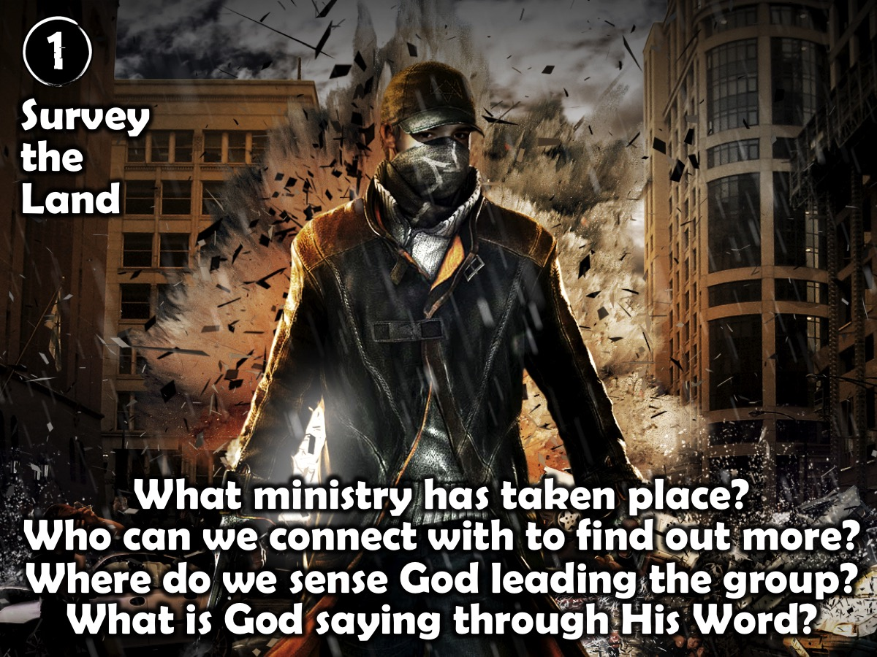
Notes:
Step 1 Reflection: Here are some questions to ask as you reflect on the need to survey the land: What ministry has taken place? Who can we connect with to find out more? Where do we sense God leading the group? What is God saying through His Word?

Slide 12

Notes:
2. Craft the Mission. One of the first challenges was to both affirm and seek permission to change the existing youth ministry mission which it read as follows: Be a youth generation who are active in our faith by: (1) Connecting with other believers, (2) Honouring God by being salt and light, and (3) Serving my church community. What the vision lacked was a connection to how the wider church described their ministry but it did contain key elements that we would be able to build on in the coming months. This started a process of rewriting the mission and I chose to not only include the youth staff in the process, but also one of the pastors who had a burden for social transformation and who operated in the area of the prophetic. Any mission writing process must involve listening to God to hear what His intentions are for ministry in our context. We spent time reflecting together, talking about the history of the ministry and what we were sensing God saying to us from His Word. We began to sense that God was calling us to mobilise a generation of young disciples into a movement that would impact the church, the city and our continent – a massive dream was forming in our minds. A word dropped into our collective thinking that was linked to a prayer movement that started in South Africa and that was sweeping the globe – the word was Transformation. It captured our desire to see our efforts bring about the transformation of lives and the world in which we live.
A phrase that bubbled to the surface was: kingdom movement. We had no desire to baby sit teenagers while their parents got on with the real ministry in the adult congregation. We wanted to start a movement of teens that would bring about the transformation that God desired. A final word emerged that ended up being used as the name for our ministry: ignition – or ignite as we finally settled on. It captured our desire to initiate something that would be uncontrollable in terms of influence or impact. By the end of the process we had fashioned (as an iron smith does with a piece of red hot iron that he heats in the fire and then pounds into shape with a hammer) the following mission statement that was used for five years: Igniting a kingdom movement of young disciplemakers who will transform their city and beyond. And so igniteYOUTH was born – the youth ministry of His People Christian Church in Johannesburg. Some years later, with a church-wide rebranding exercise, we changed the name and His Youth was formed which resulted in a closer connection with the wider church body, His People and the children’s ministry, His Kids. Along with the changing of the name came a further alignment with the wider church where the churches mission statement was adopted: We see lives, communities and societies transformed by discipleship in the Word, the Presence of God and the Power of God. As His People Church is part of a global movement known as Every Nation Ministries we also decided at some stage to embraced a common approach to disciplemaking so our four stages were tweaked as follows: Engage – Establish – Equip – Empower.

Slide 13


Slide 14


Slide 15

Notes:
Crafting Your Mission Statement: Find our what the mission statement of the wider church is and then invite a small group of leaders (adults/teens; staff/volunteers) to craft a youth mission statement. Seek the Lord for direction and key phrases to build the mission statement around. Then write it out. Don't be afraid to adapt it over the course of time if that helps to stay aligned with the wider church.

Slide 16
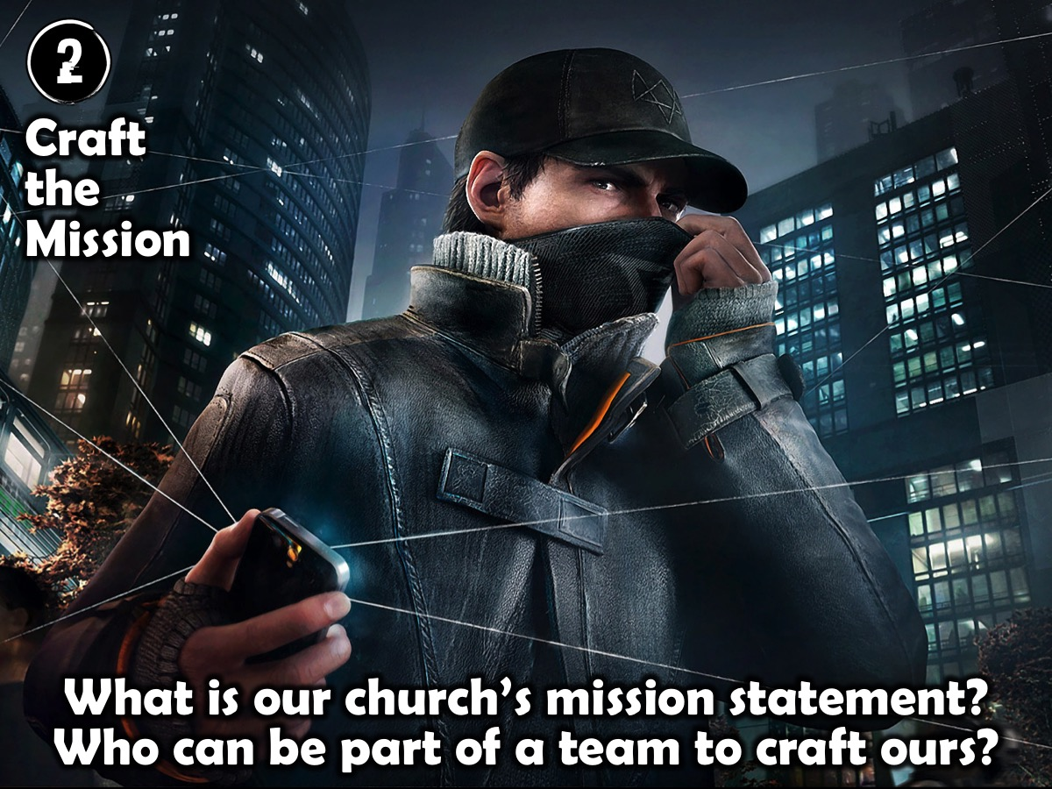
Notes:
Step 2 Reflection: Here are some questions to reflect on as you think about crafting your mission statement: What is our church’s mission statement? Who can be part of a team to craft ours?

Slide 17
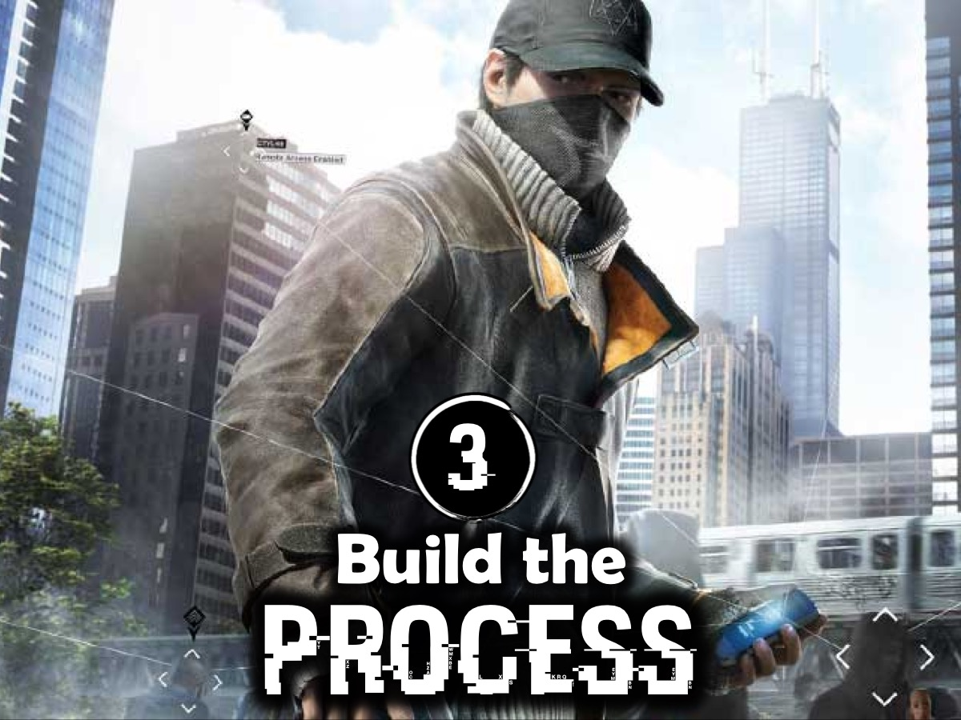
Notes:
3. Build the Process
The next step was to put flesh onto the skeleton of the ministry strategy. Once again we looked to the wider church and wisely adopted the same disciplemaking process that the wider church was using.

Slide 18
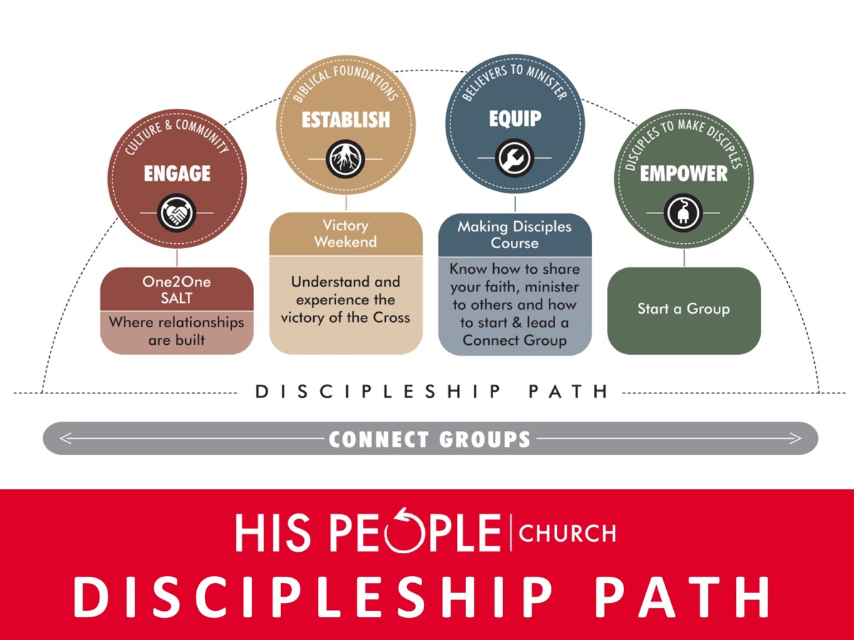
Notes:
This is the disciplemaking strategy that our church uses - four phases - Engage, Establish, Equip and Multiply.

Slide 19
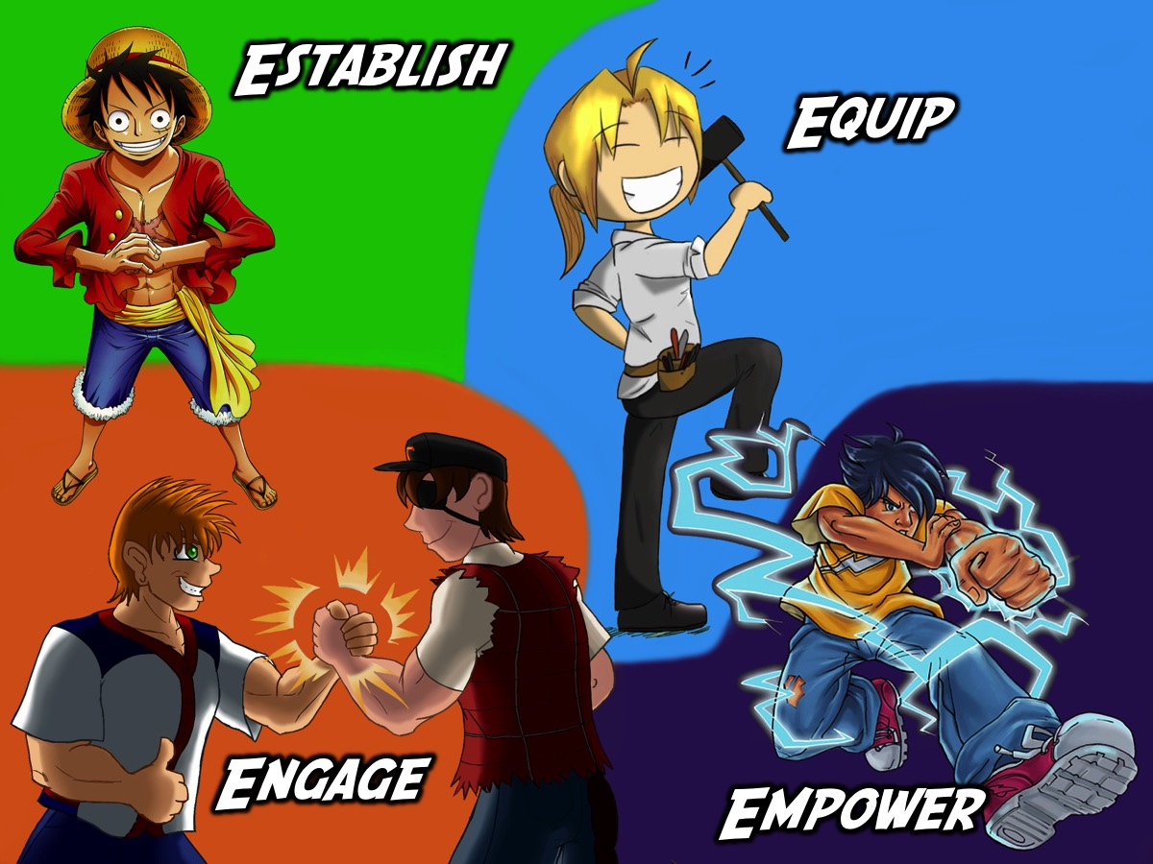
Notes:
And we designed our youth strategy using the same four stages and just use some funky images to make it more youthy!

Slide 20
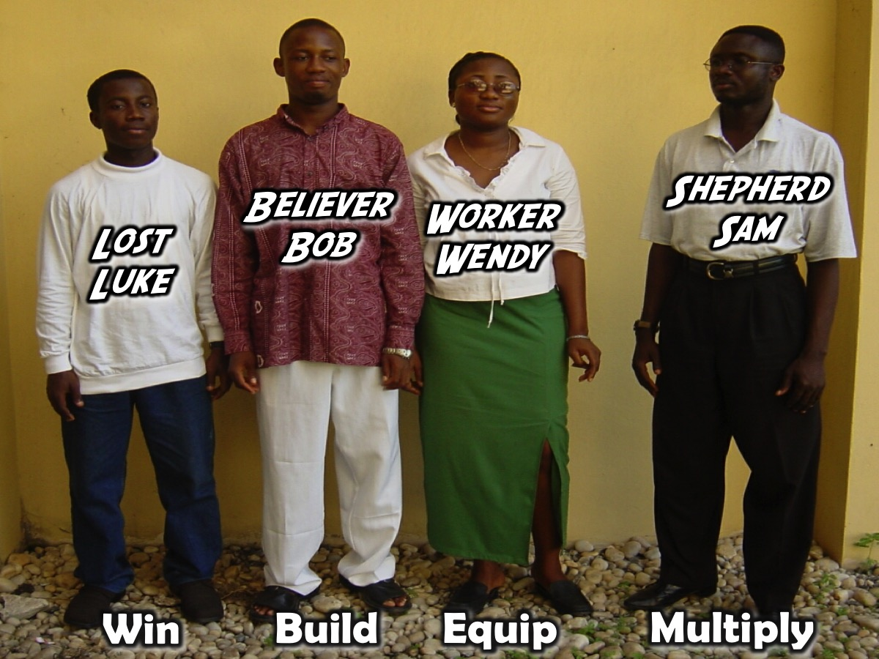
Notes:
If you church does not have a disciplemaking strategy you would need to look around and see what is out there. The strategy we used in the minustry of Sonlife Africa had 4 stages and we even identified profiles of the typical teenager journeying through the processs.

Slide 21
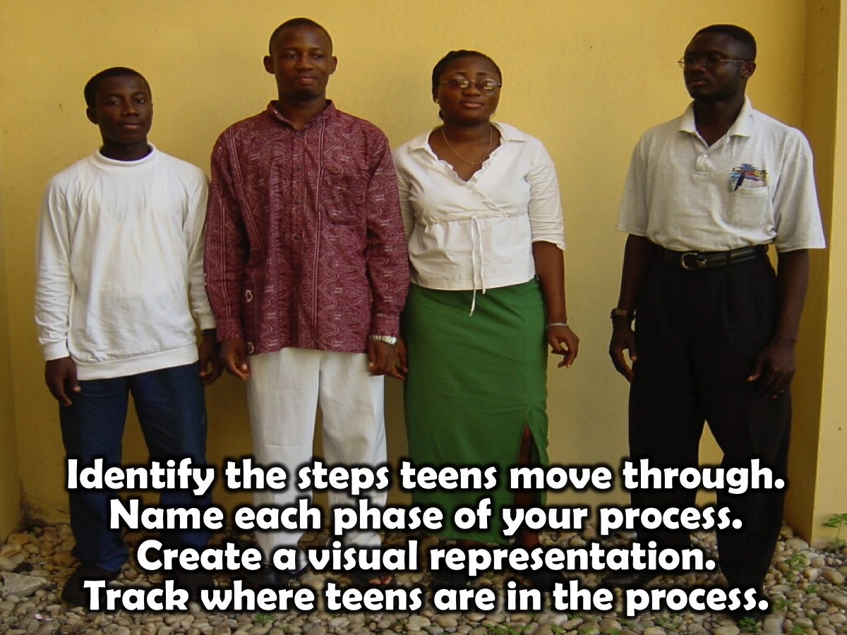
Notes:
Here are some guidelines for building your disciplemaking process: Identify the process that teens will move through as they become followers of Jesus, grow to maturity and are equipped to minister among their peers. Name each phase in your process and create a visual representation of your strategy and track where teens are in their discipleship journey.

Slide 22
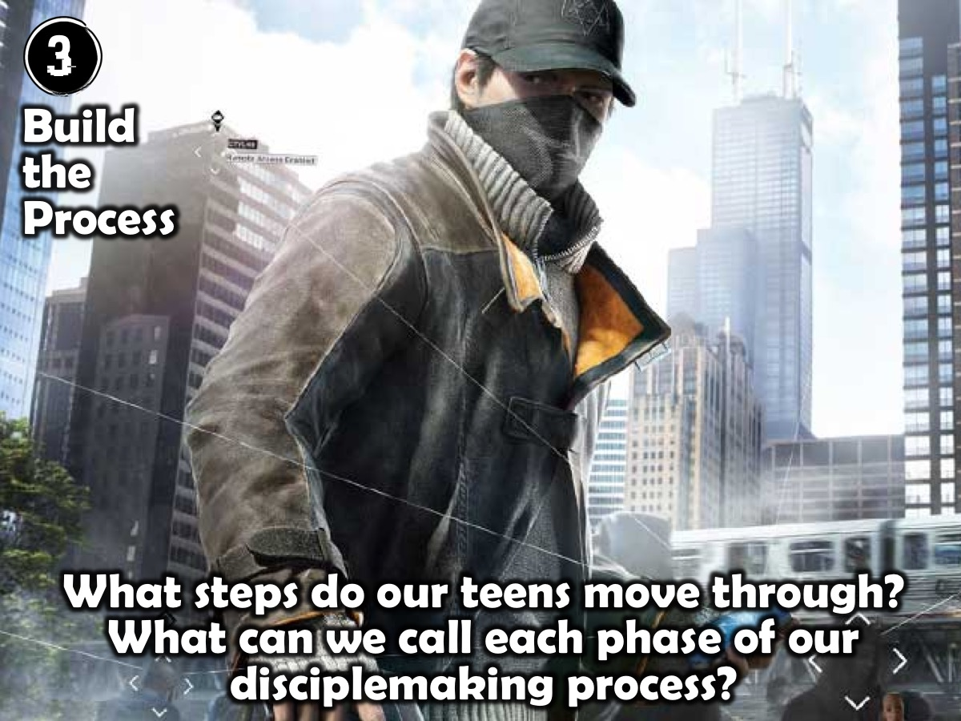
Notes:
Step 3 Reflection: Here are some questions to reflect on: What steps do our teens move through? What can we call each phase of our disciplemaking process?

Slide 23
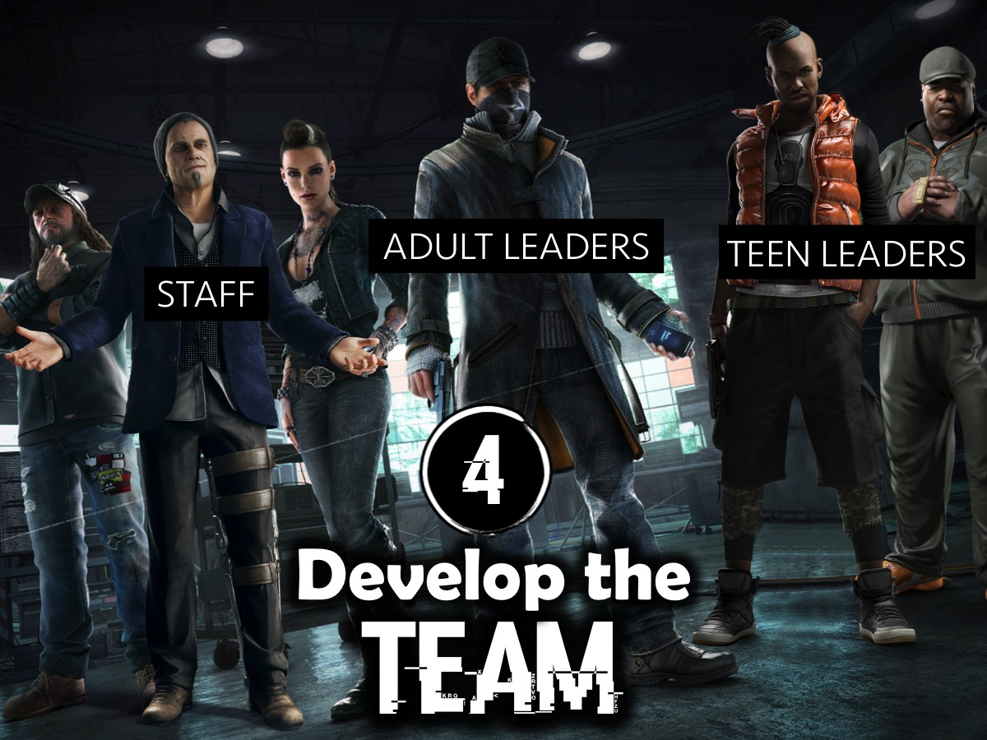
Notes:
A key part of our development process was working on building capacity for ministry and that meant that we needed to focus attention on the following areas of team development: (1) Staff. It is a difficult task to run a youth ministry in a church using just volunteers, so if the church is able to emply a youth pastor that is ideal. (2) Adult Leaders. We appointed a team of adult leaders who volunteered their time to the ministry. They were not able to attend weekly staff meetings due to work commitments, but they attended monthly leadership meetings. They provides oversight and help at weekend events and mentored teens. (3) Teen Leaders. We identified teens to serve among their peers and equipped them to be small group leaders and help design and run events on Friday nights and on Sunday mornings.
We identified the following expectations for all leaders: (1) Pray for the teens, leaders and spiritual impact in our ministry. (2) Develop a daily devotional life where you pray, read the Word, practice God’s presence and serve. (3) Serve in at least one area of ministry either as a team leader or a team member. (4) Make contact with and develop conversations with newcomers at events. (5) Look out for teens at event that are in need of ministry: encouragement, advice or counselling. (6) Ask staff at youth events if there are ways that you can be of practical assistance. (7) Limit chatting with your peers during events. (8) Deliberately disciple a few teens. (9) Attend a peer connect group. (10) Attend a weekly church worship service.
In order to ensure our leaders were fully engaged in our ministry we created Ministry Portfolios and wrote job descriptions for each area of ministry. Some of the portfolios were: Care, Catering, Cleaning, Creative Arts, Design, Foundations, New Comers, Prayer, Resource, Small Groups, Speaking, Sports, Tech, Transport and Worship. We appointed an adult leader to oversee each portfolio and created teams around them.

Slide 24
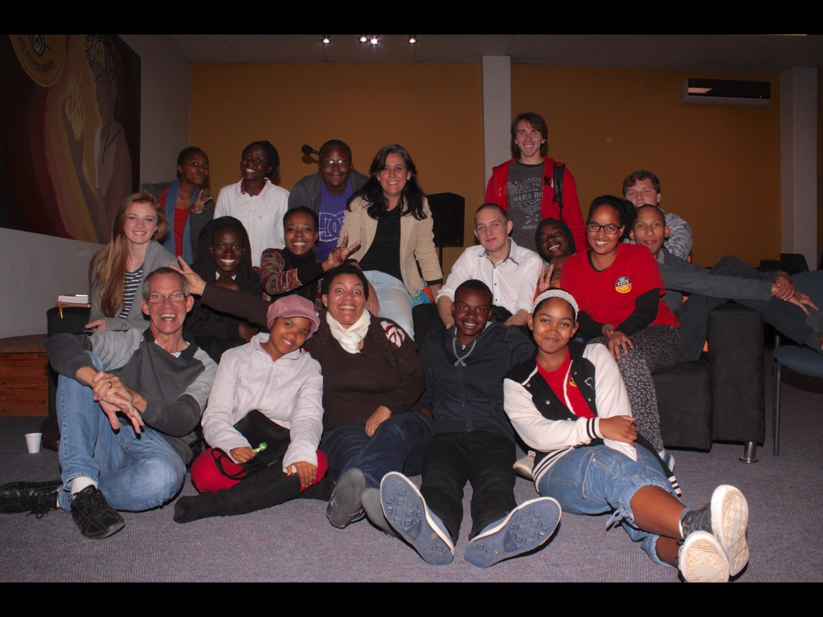
Notes:
A recent pic of our leadership team - including teens and adult leaders and staff members.

Slide 25

Notes:
Each leader gets a copy of our Leadership Survival Kit which spells out our mission and strategy and describes their various responsibilities.

Slide 26
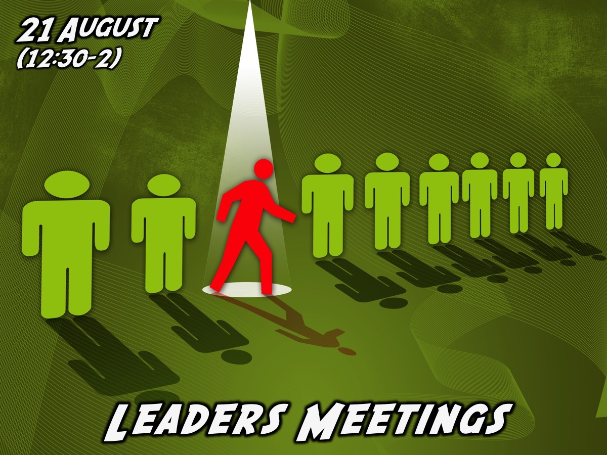
Notes:
We have a monthly leadership meeting for all our leaders on a Sunday afternoon, over lunch, from 12:30 -2. Our next one is next Sunday.

Slide 27

Notes:
I am gong to have a lot more to say about developing your team in the next workshop!

Slide 28
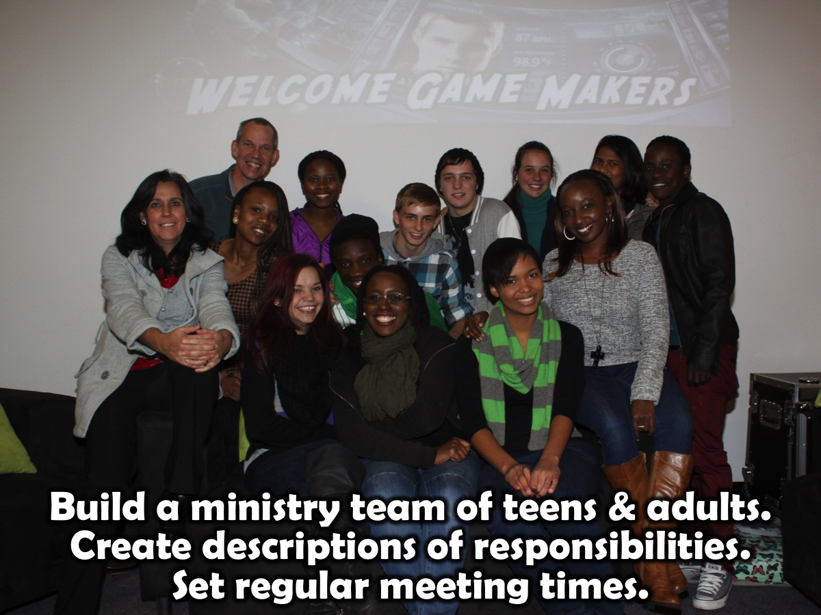
Notes:
Here are some guidelines for building a team: Build a ministry team of teens and adults to lead the ministry, create descriptions of their responsibilities, and create regular meeting times for encouragement and development.

Slide 29
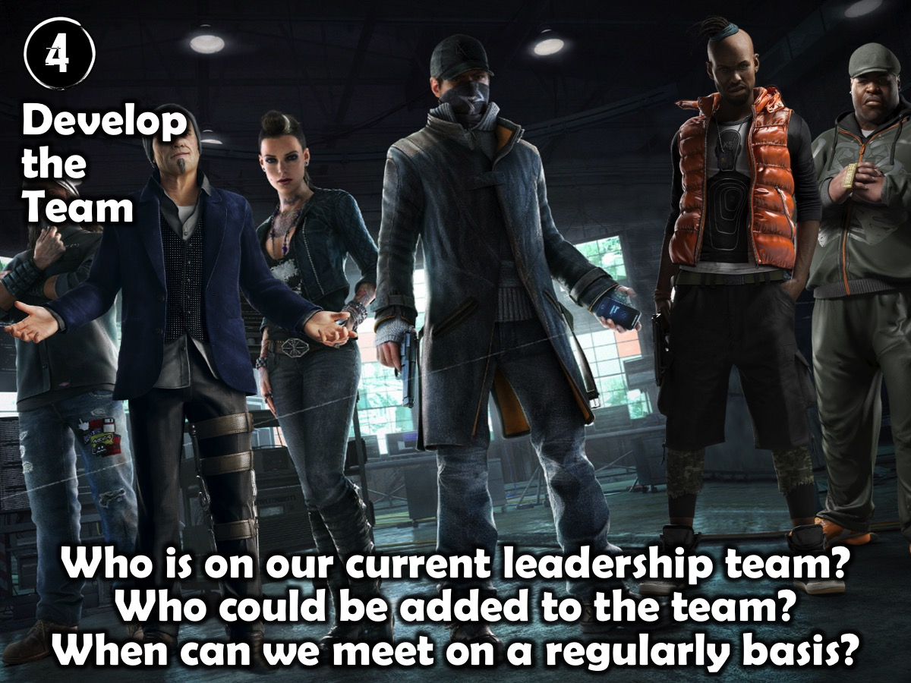
Notes:
Step 4 Reflection: Here are some questions for reflection: Who is on our current leadership team? Who could be added to the team? When can we meet on a regularly basis?

Slide 30

Notes:
5. Create the Environment. We were then ready to develop an environment where the ministry would take place. The youth space was intentionally designed around our value of creating relationship with teens and ensuring a multi-purpose layout that does not feel like school or a pew-style church setup. We do have stacks of chairs in one area of the room, but the space is left free for teens to engage with each other around activities in the room such as PlayStation; fuseball; table tennis and pool. Bean bags, couches and other informal seating areas are scattered around the room. For our more formal teaching events, like on Sunday mornings we begin our meeting with no chairs laid out but when we transition to the teaching time we invite teens to pull up a chair or couch to sit on. After all, no one is comfortable sitting on the floor for a long period of time.
We designed two images that captured our mission and painted them onto the stage wall and a side wall. We also painted murals of the four phases of disciplemaking and our teen leaders painted them onto the walls. Currently our mission statement is shown on our notice board using an A3 colour print.

Slide 31
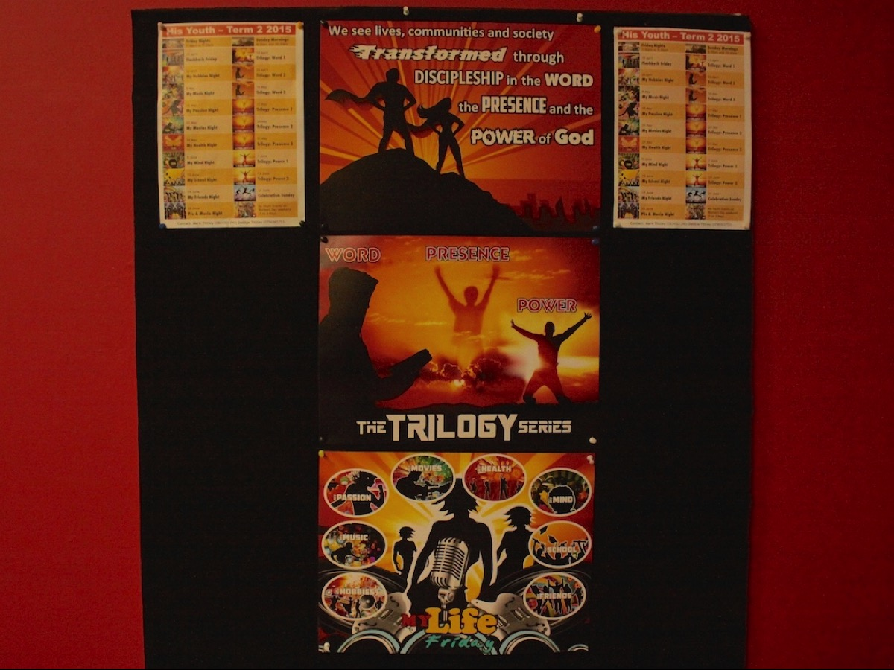
Notes:
Our youth notice board our vision statement and term posters are displayed.

Slide 32
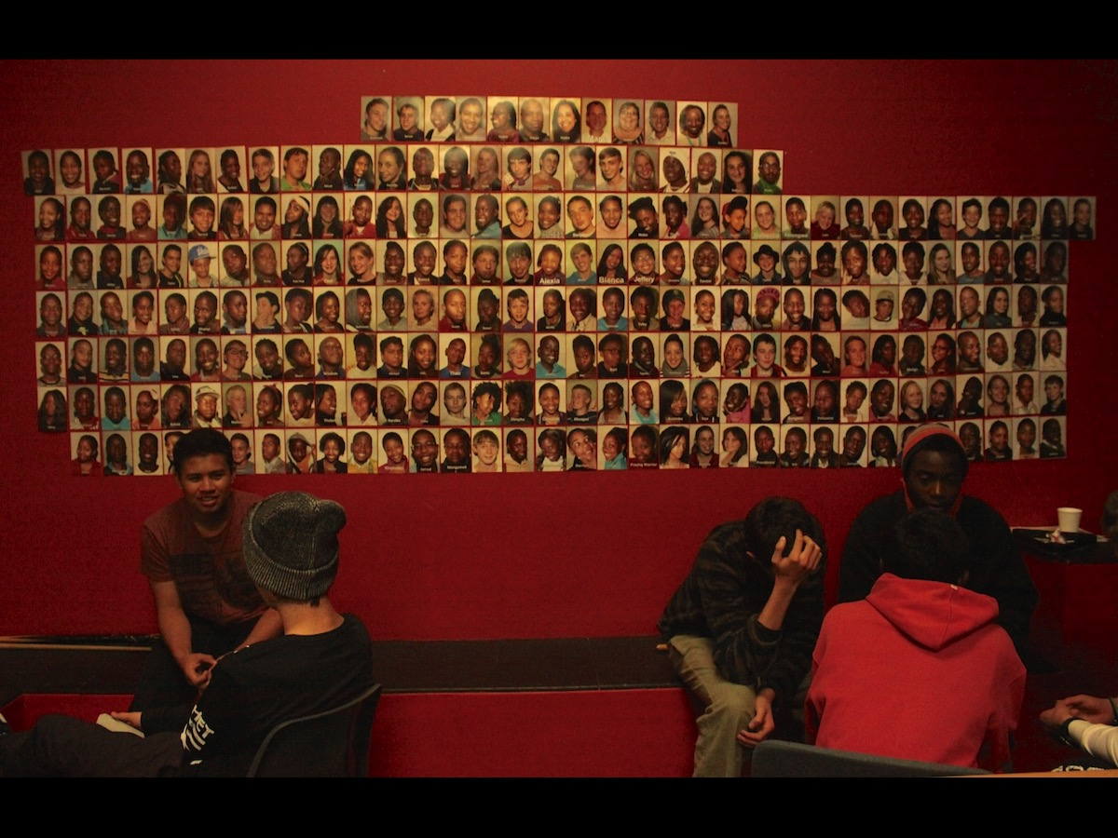
Notes:
Consider having a photo wall of teens who attend…

Slide 33
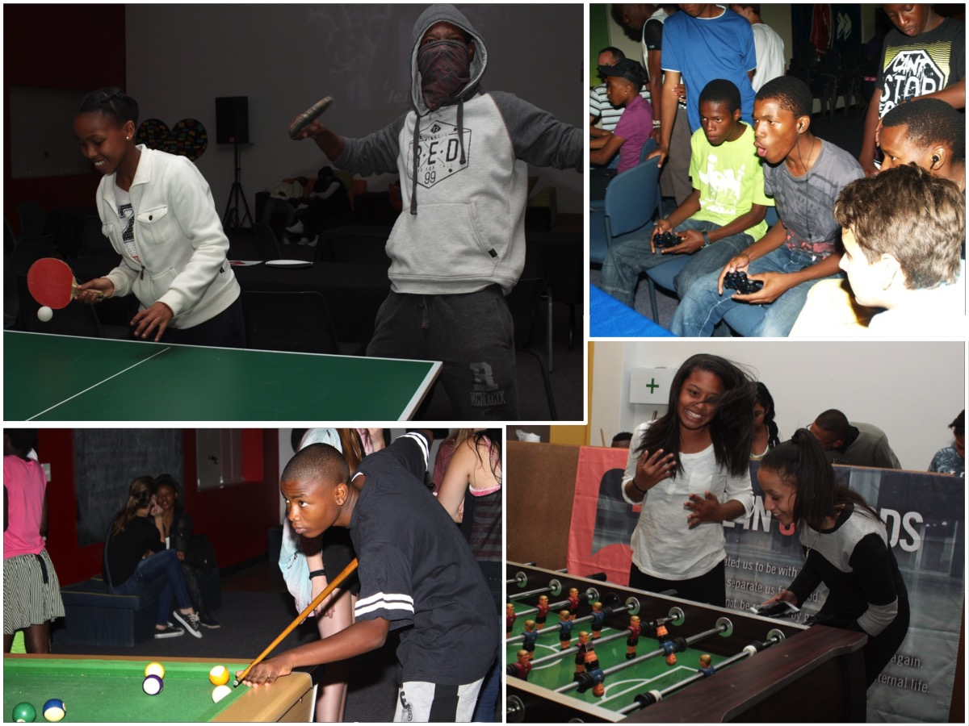
Notes:
Throw in some activities

Slide 34
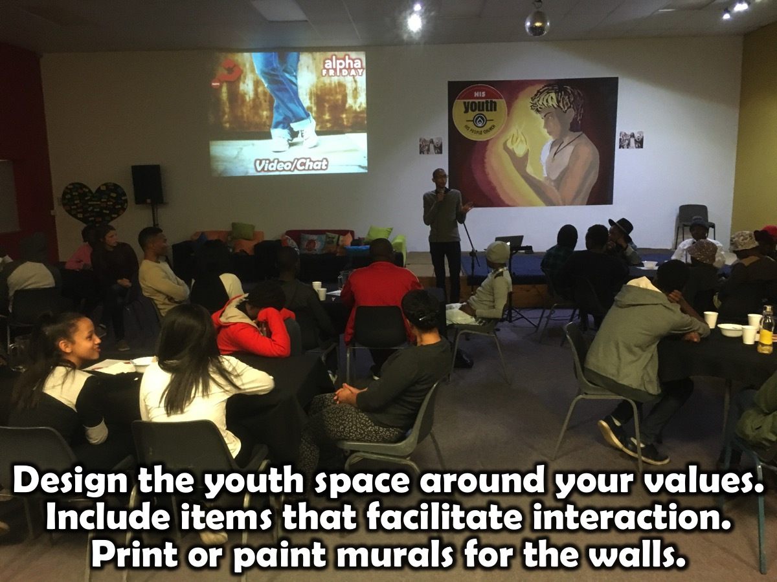
Notes:
Here are some guidelines for creating your environment: Design the youth space around your values (connecting, worship, teaching, etc.) and include items that facilitate interaction among teens: games, seating, refreshments, etc.

Slide 35
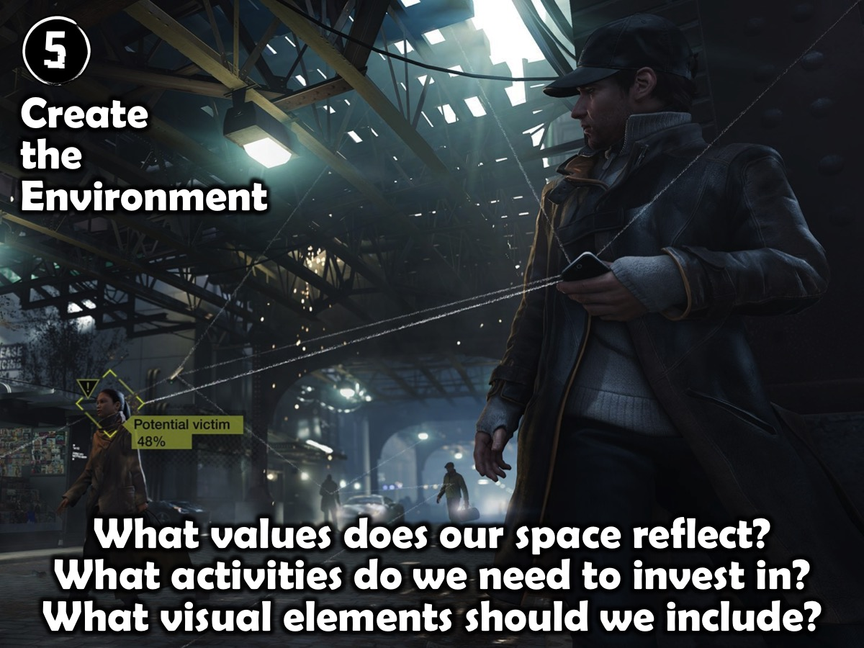
Notes:
Step 5 Reflection: What values does our space reflect? What activities do we need to invest in? What visual elements should we include?

Slide 36
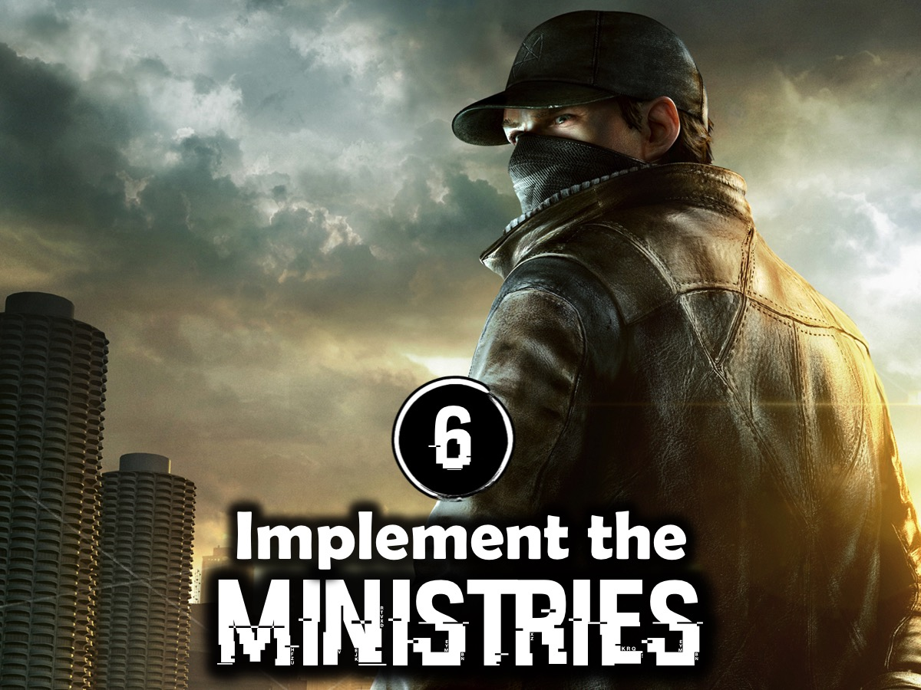
Notes:
6. Implement the Ministries
Over a period of time we implemented ministries for each of the four disciplemaking stages:

Slide 37
Notes:
I am going to walk you through what we do to make disciples through the four phases of our disciplemaking ministry:

Slide 38
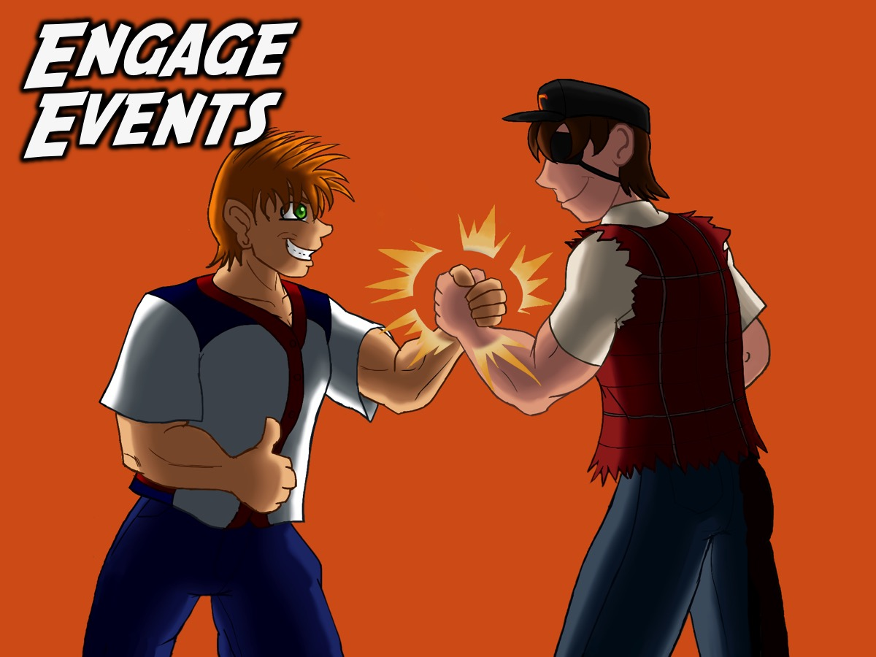
Notes:
A. ENGAGE: The first phase in our disciplemaking strategy is to Engage teens by connecting with them and bringing them to faith in Christ. Our Friday night weekly ministry focuses primarily on this phase and is an opportunity for believers to bring teens that they are building relationships with into an event in which they can engage with others believers and with God. Here is an outline of an Engage event:

Slide 39

Notes:
The My Life Friday Series – each week we focused on a different area of a teen’s life (their Hobbies, Music, Movies, Passion, Health, Mind, School and Friends) to explore how to bring God into that part of their world)

Slide 40

Notes:
I will show some slides along the way and photos so you can see what the various part of the night look like. Most of these images have been taken from the My Health Night program we presented recently.

Slide 41
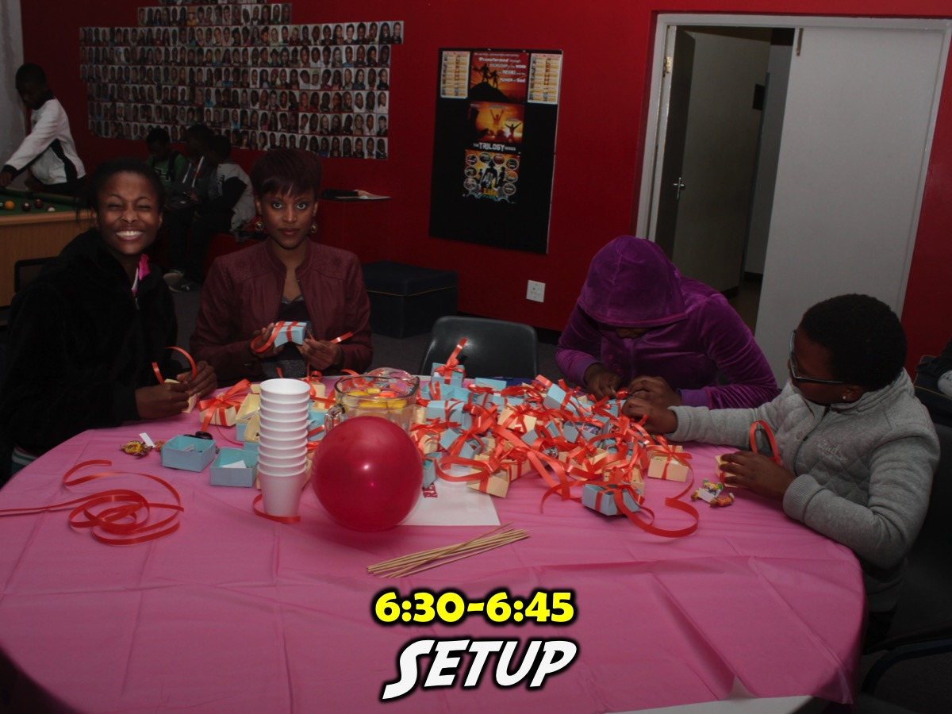
Notes:
6:30-6:45 Pre-Meeting Setup. Those responsible for the night meet to walk through the night - set up any decor and get all the materials for the night on order. Those presenting the night are walked through the PowerPoint Presentation that drives the whole Friday night event. They would have seen most of the presentation during the week as I sent images of each slide in a facebook message to those presenting the night - but this is usually the first proper run through with all the media and videos in the right place and order. A teen runs the PowerPoint and it is critical that they are there at 6:30 as well. Those responsible for sound engineering on the night also need to be there at 6:30.

Slide 42
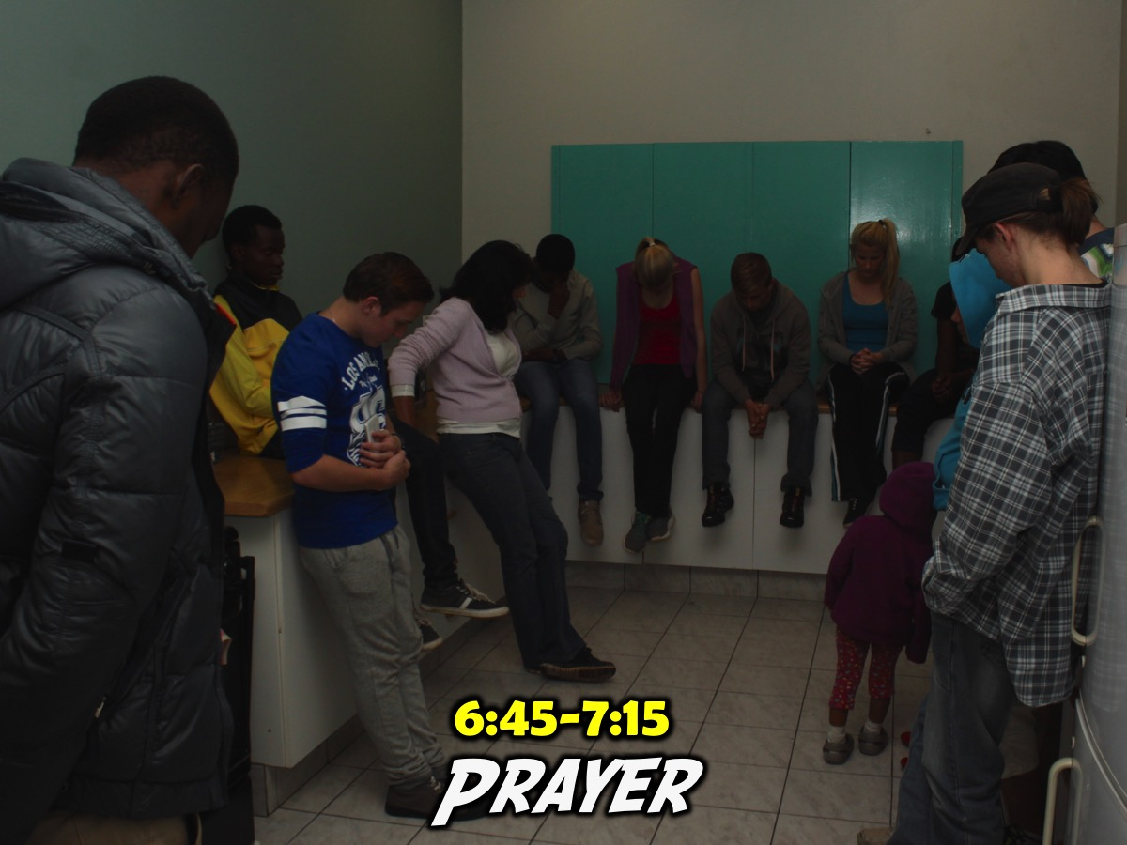
Notes:
6:45-7:15 Pre-Meeting Prayer. Our large group of leaders meets once a week for prayer - and it also allows us to brief our leaders - who are our small group leaders on the night - about anything they need to do to make the night work well. We urge them to connect with newcomers and give them a feel of what we are trying to accomplish on the night - especially in terms of the small groups. I email the small group questions out via WhatsApp to all the small group leaders on Wednesday night so this is the not first time they are seeing the questions.

Slide 43
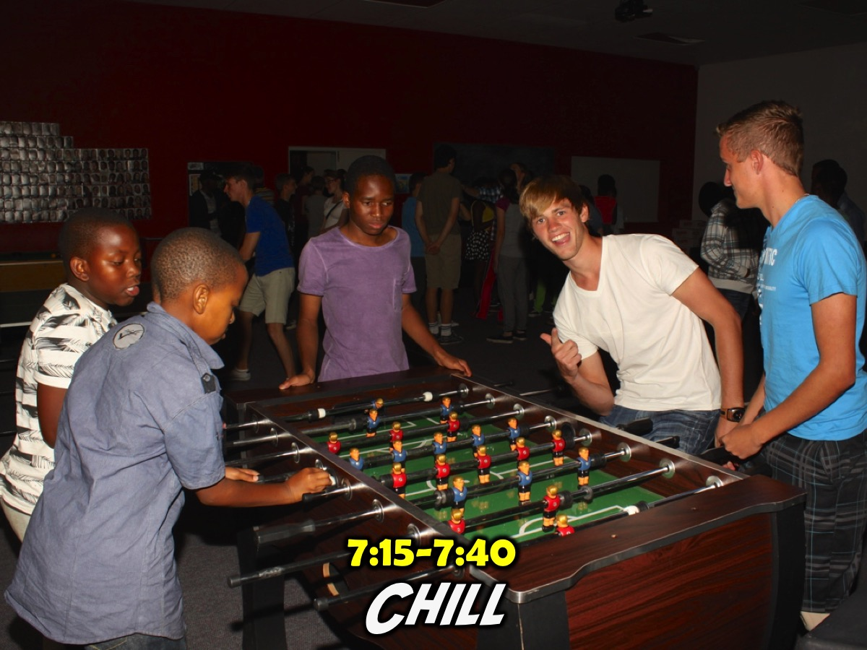
Notes:
7:15-7:40 Teens Arrive. This is our hang time - some teens arrive as early at 7pm (some even are the by 6:30 when I get there playing games in the room like Pool, Table Tennis, Foosball and Darts or just chilling) - so our prayer time happens in the kitchen. The teen and adult leaders are encouraged to spend this time connecting with teens while those few running the program do last minute checks that everything is ready.

Slide 44
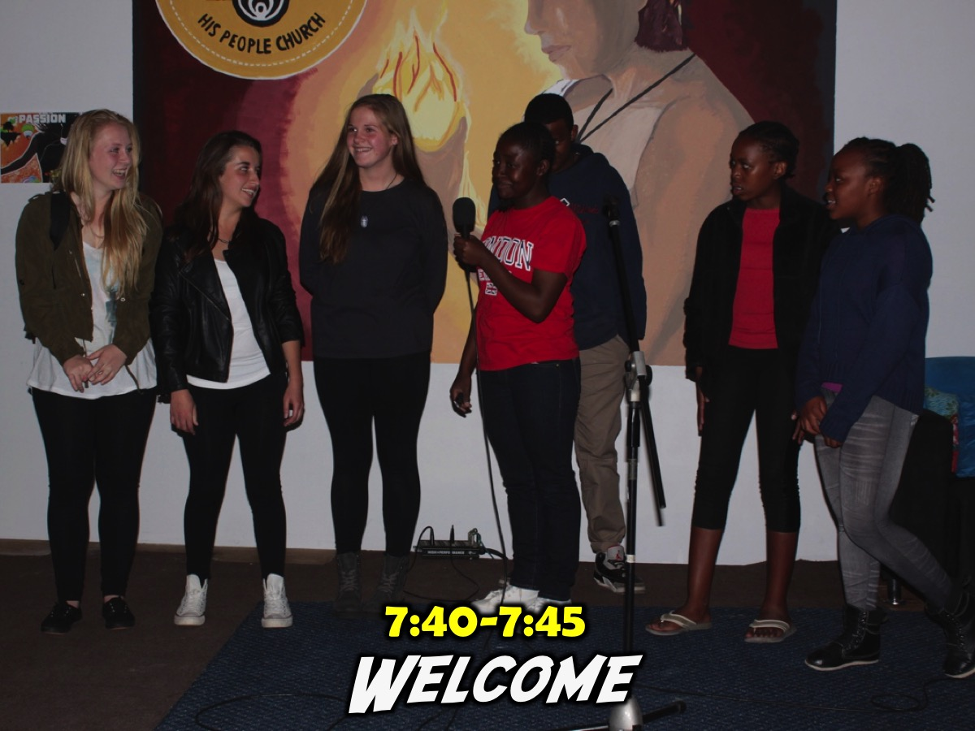
Notes:
7:40-7:45 Welcome and Introduction of Newcomers
We welcome teens to the night and ask any newcomers to come forward to be introduced. We ask them their name, what school they are from and sometime a silly question like the colour of their toothbrush or something like that.

Slide 45
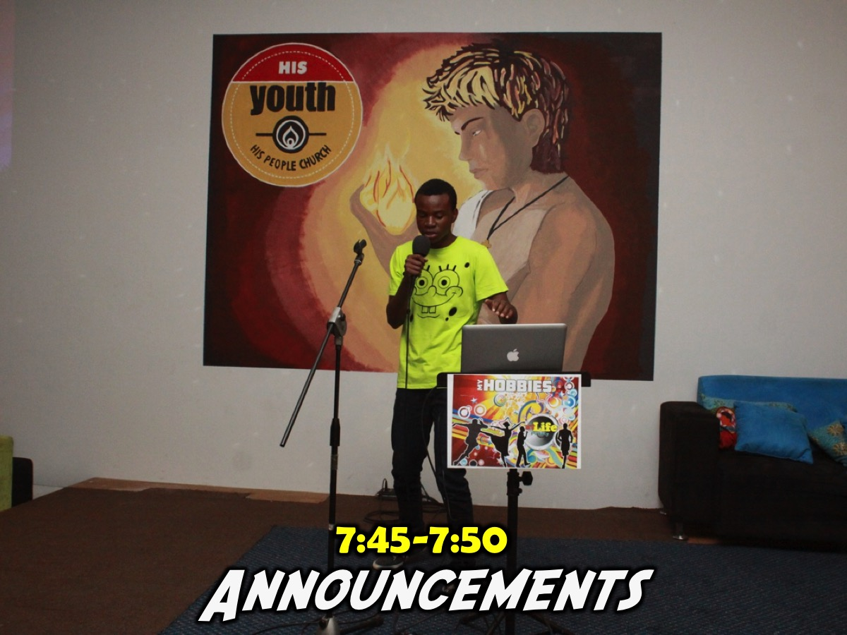
Notes:
7:45-7:50 Announcements
This is a very important part of the night as it helps to connect newcomers and regulars into the rest of our ministry. We advertise what we are going to be doing on Sunday morning (mentioning the series title and the theme for that morning) in our teaching series and also mention the theme for Next Friday night's event.

Slide 46

Notes:
7:50-8:40 Main Event Time. Now starts the real program part of our night where we introduce the theme for the night - normally with a video clip and then we launch into the event. The theme for the term and the night will determine what is involved in this time - but for example, on the My Health Night the group we divided into two groups. They split up and each spent 10 minutes at 2 fitness stations and then joined together to visit a spiritual fitness station.

Slide 47

Notes:
Station #1: Crossfit Workout. An instructor led a 10 minute Crossfit workout session.

Slide 48
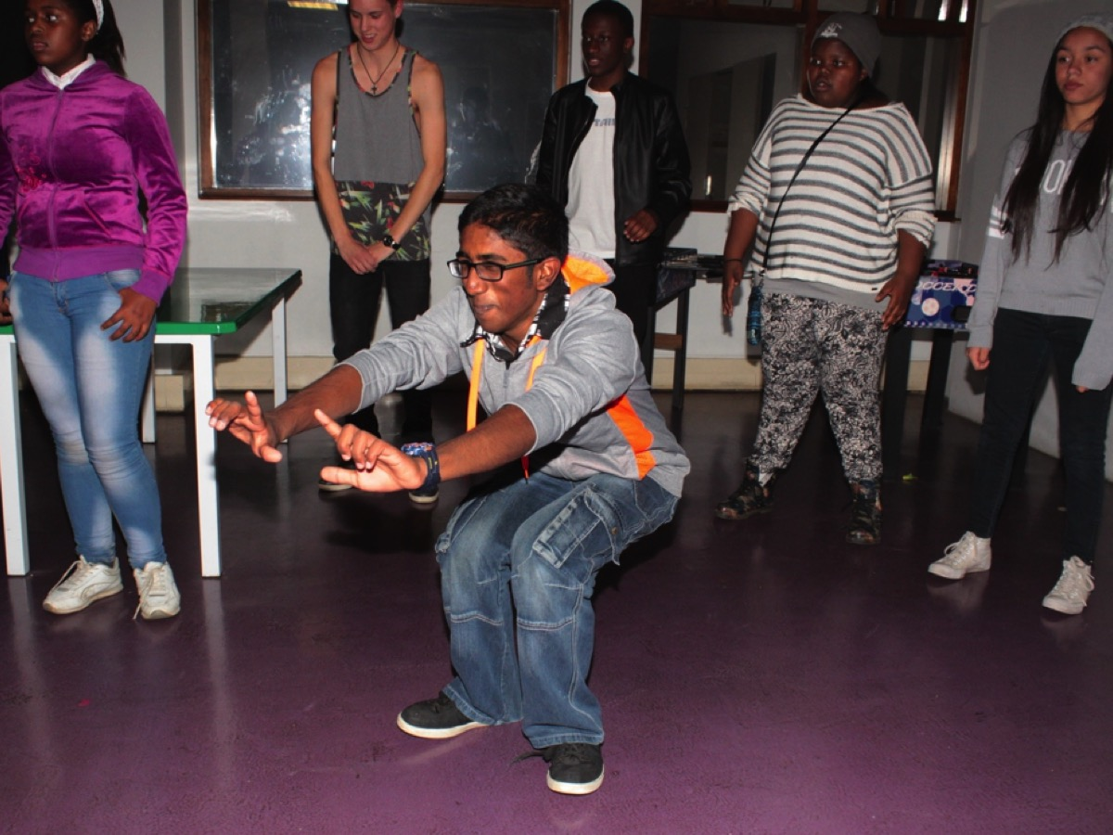
Notes:
Here are some teens at the Crossfit station.

Slide 49
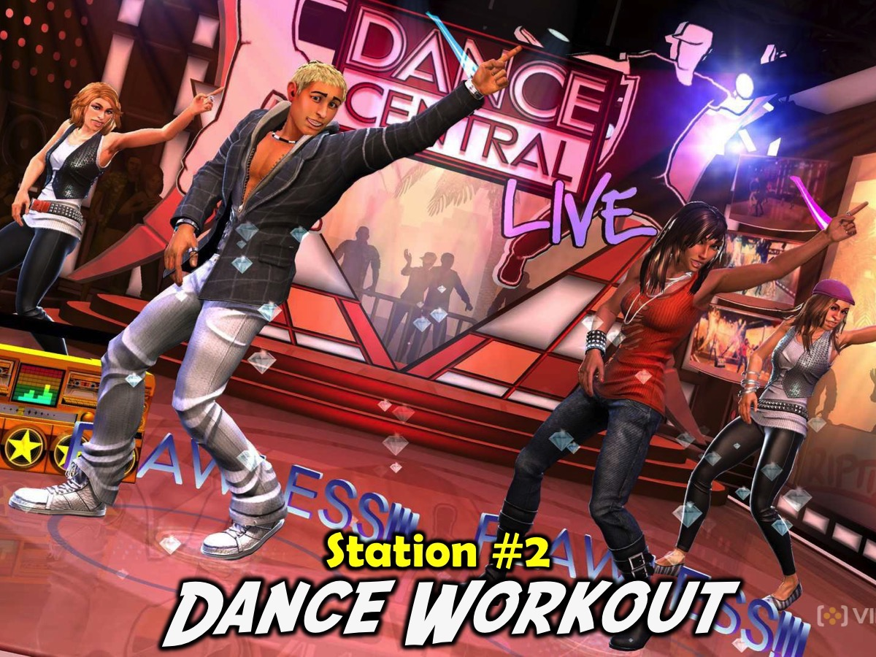
Notes:
Station #2: Dance Workout. The group had 2 instructional Zumba videos to dance to.

Slide 50
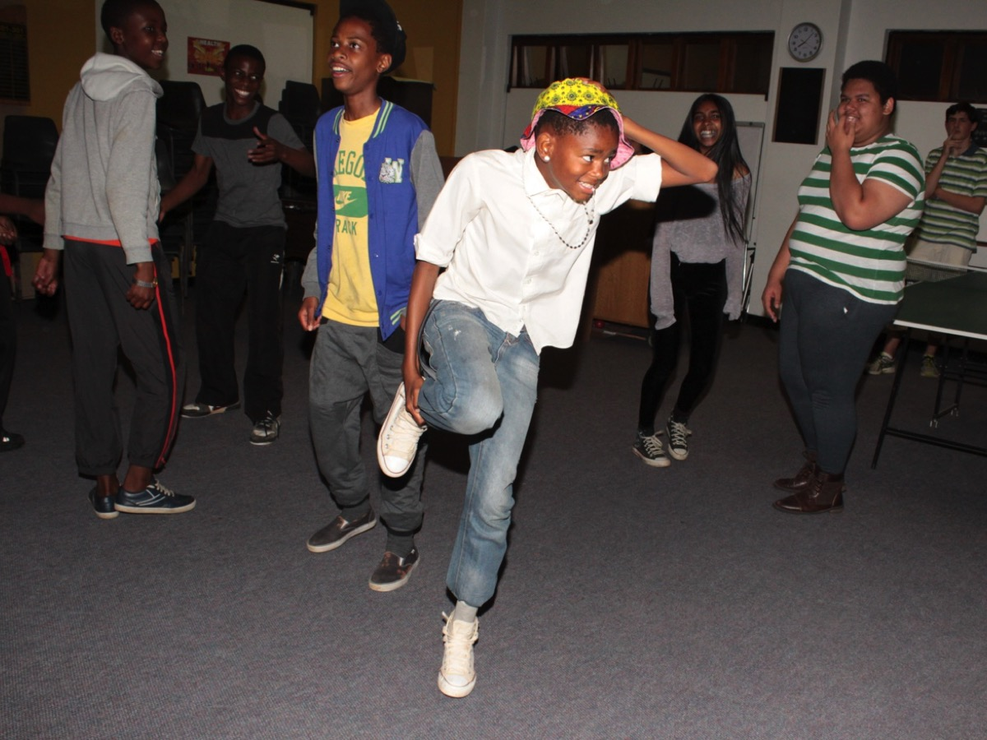
Notes:
Here are some teens at the Zumba dance station.

Slide 51
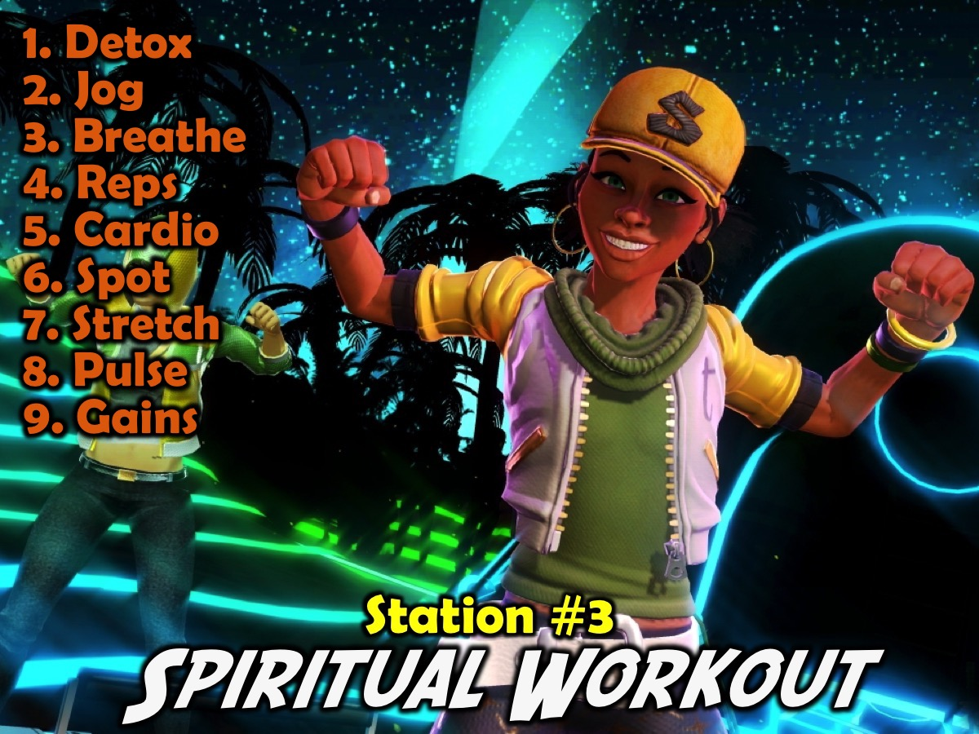
Notes:
Station #3: Spiritual Workout. We created 9 mini-9 stations around the room for teens to visit in any order to engage in spiritual exercise. The Stations:
1. Detox. Confess anything to God that you have done in the past week that he is not please about.
2. Jog. Jog your memory about God’s love by saying this verse 5 times: “For God so loved the world that he gave his one and only Son, that if I believe in him I will not perish but have eternal life.” Thank God for loving you!
3. Breathing. Say the Lord’s Prayer out loud - slowly line by line - actually say it as a prayer to God. “Our Father in heaven, hallowed be your name, your kingdom come, your will be done, on earth as it is in heaven. Give us today our daily bread. And forgive us our debts, as we also have forgiven our debtors. And lead us not into temptation, but deliver us from the evil one. For yours is the kingdom and the power and the glory forever. Amen.”
4. Reps. Say this verse over a few times until you can say it without looking: "This is how God showed his love among us: He sent his one and only Son into the world that we might live through him.” (1 John 4:9)
5. Cardio. Ask God to speak to you as you meditate on His Word. Say the verse over slowly at least 7 times - pausing between each time you repeat it. Pause and ask God what he wants to say to you. Thank God for having spoken to you. Verse: “Love the Lord your God with all your heart, and all your soul and all your mind, and love your neighbour as you love yourself.” (Luke 10:27)
6. Spot. Ask God to show you one person that you need to speak to about how much he loves them. Write their name down on the wall. (Use the heart shape on the wall)
7. Stretch. Which of these Fruit of the Spirit do you need to work on in your life? “But the fruit of the Spirit is love, joy, peace, patience, kindness, goodness, faith, gentleness, self-control.” (Galatians 5:22-23). What can you do to develop it in your life?
8. Pulse. Take your spiritual pulse by asking yourself whether you are more in love with God now than you were 6 months ago. If your answer is YES, then think of 3 reasons why you are in a better place. If your answer is NO, then ask God to show you what you need to do or stop doing to get into a better place in the next 6 months.
9. Gains. Think about something that you have learnt in the last month about God and write it on the page. God is…

Slide 52
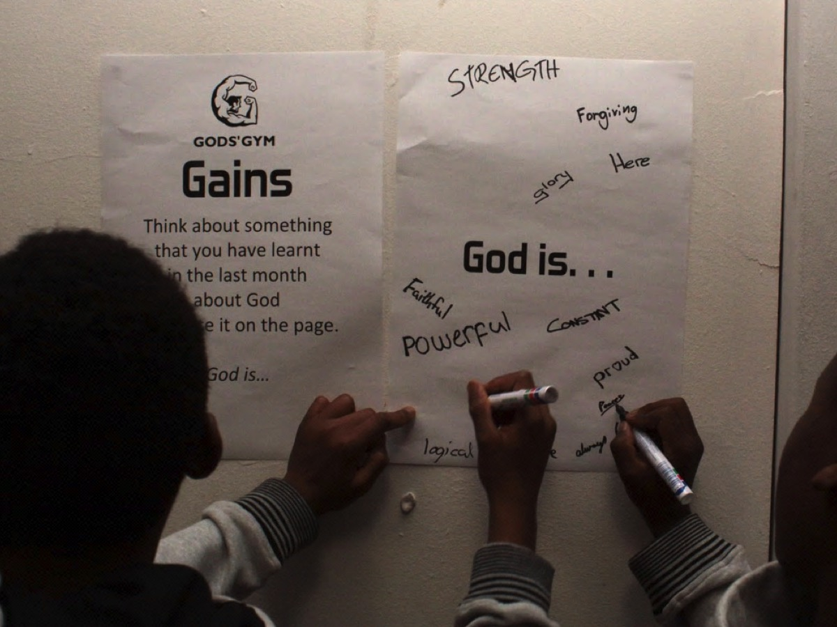
Notes:
Here are some teens at the Gains station where they had to think about something they had learnt in the last month about God and write it on the page.

Slide 53
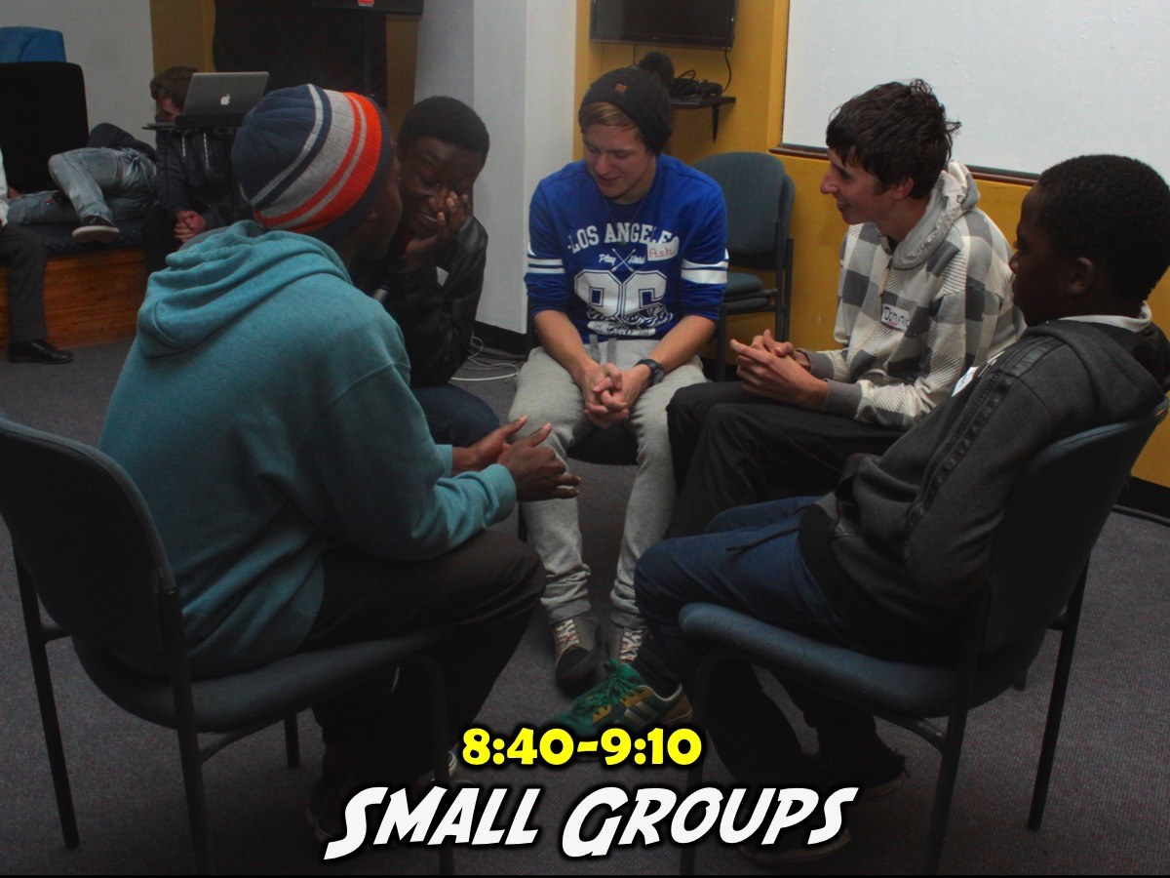
Notes:
8:45-9:10 Small Group Time. We currently use 4 to 5 small group question for this time - the first one refers back to what we explored last week and gets them to talk about how they implemented what they learnt and the next two to three questions focus on implementing the new learning for this week (based on the night's theme) and then the final question is a pray item on the topic.

Slide 54

Notes:
Small Groups: Here are the questions: (1) What did you most enjoy doing tonight? (2) What does it mean to be healthy? (3) What is your current physical and spiritual health status? (4) How can you improve your physical and spiritual health? (5) Pray for God to help you as you work on your health.

Slide 55
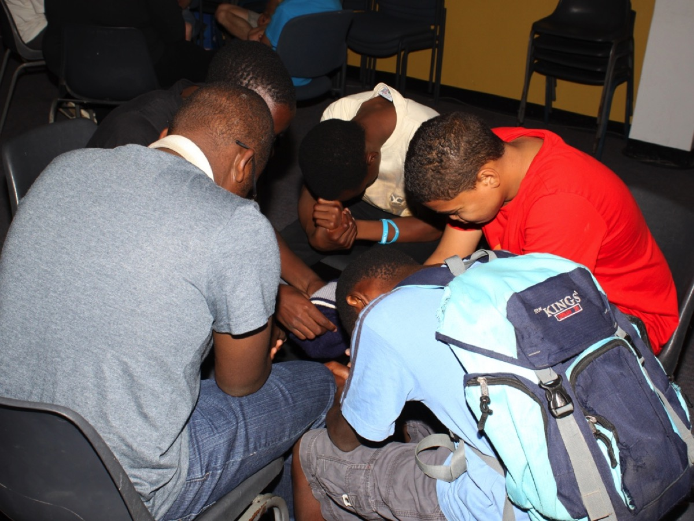
Notes:
Small groups always end with teens praying for each other.

Slide 56
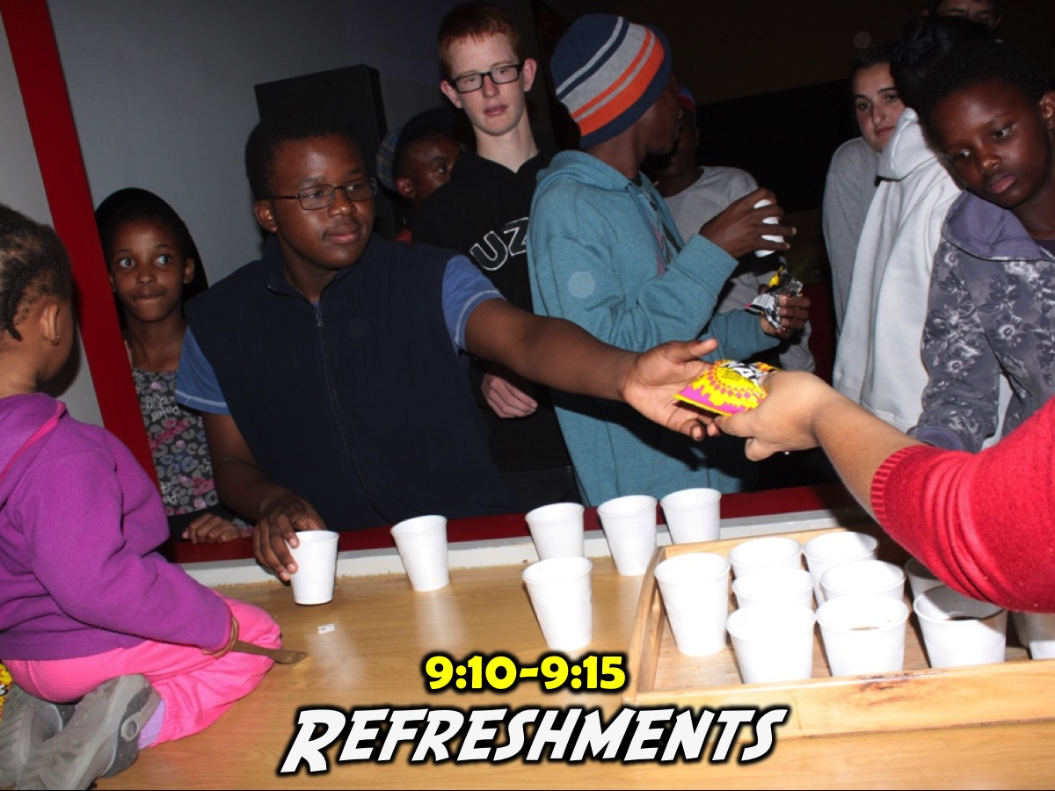
Notes:
9:10-9:15 Refreshments. We serve juice and biscuits in summer and Hot Chocolate and biscuits in winter. Some nights the main program includes some food - like this week where Coke and Fruit Loops are available throughout the gaming experience but we generally still end with a drink at the end. If the night is a meal then we often build the drinks into the main program.

Slide 57
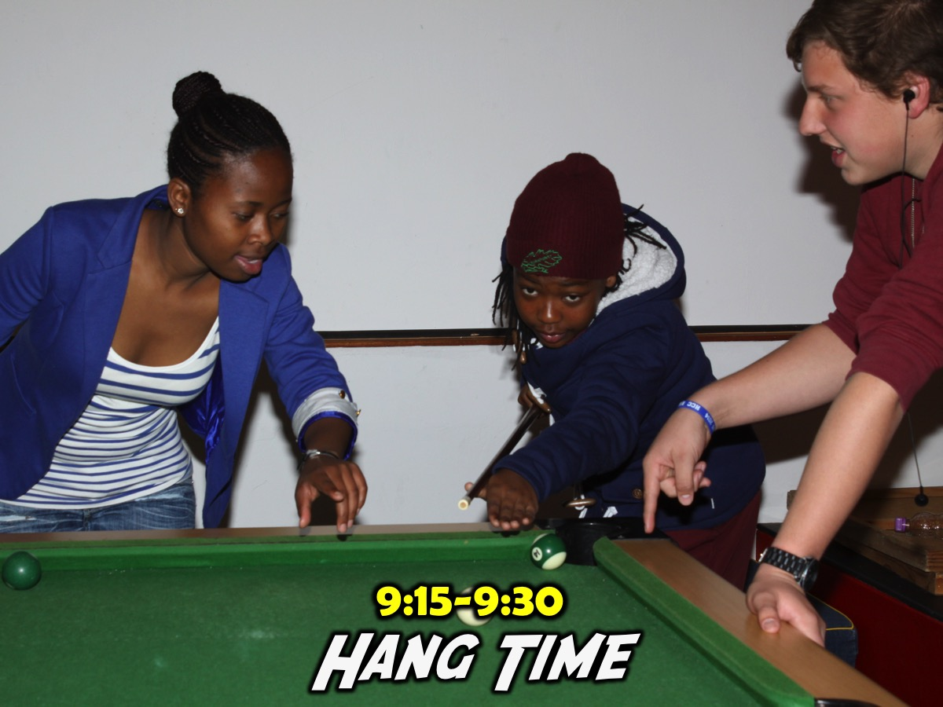
Notes:
9:15-9:30 Hang Time. We allow more time for the teens to hang, play games in the room (Darts, Fooseball, Pool, Table Tennis, Free-style Dancing, One Bounce, etc) from when small groups end and refreshments start to 9:30 but we have a hard close at 9:30 - when we start to flash the lights in the youth room and teens know that it is home time.

Slide 58
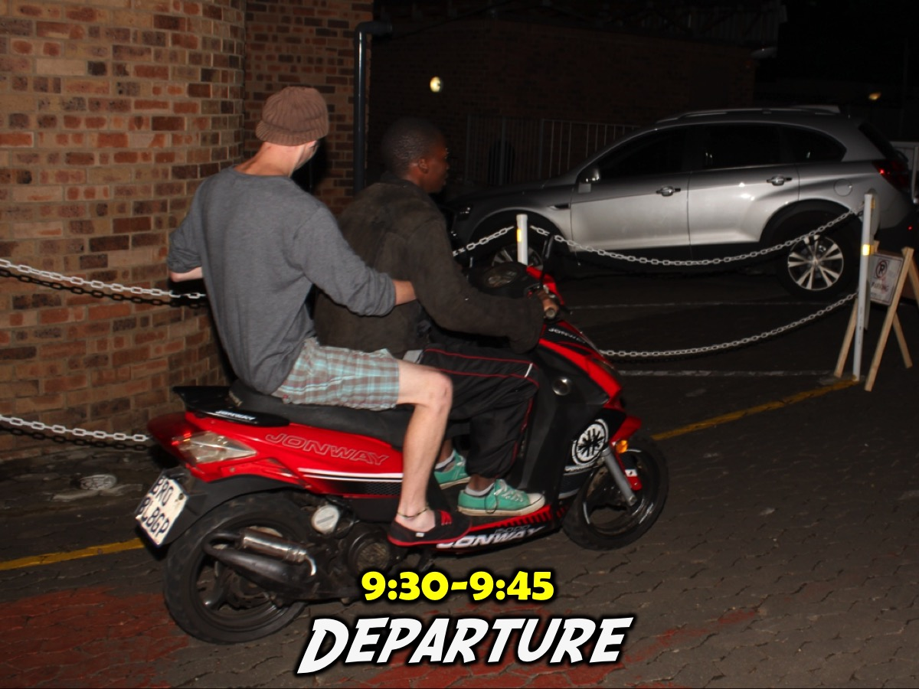
Notes:
9:30-9:45 Departure. We spend some time in the parking lot making sure everyone has a lift home (and also have adult leaders do some dropping off which is a great way to engage with teens).

Slide 59
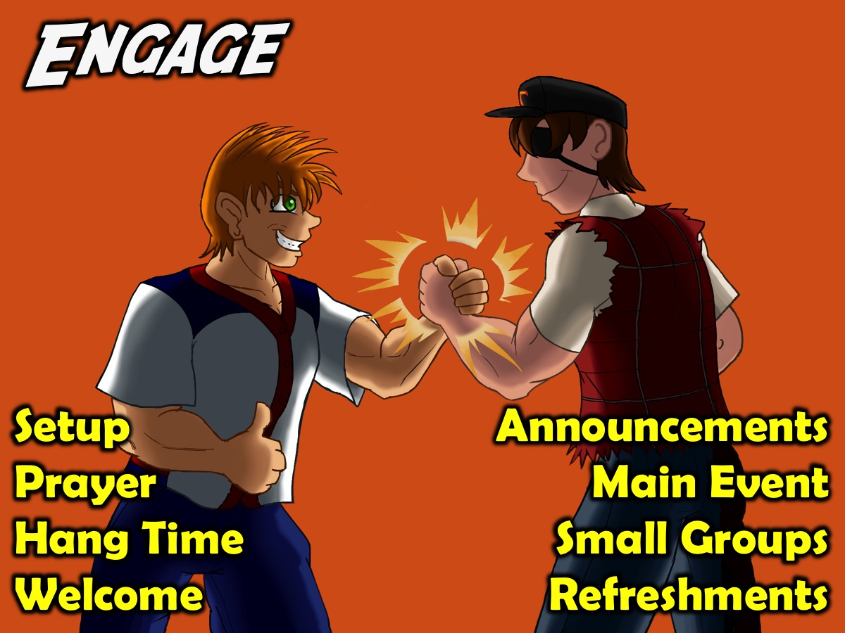
Notes:
So, in summary, here are some of the key components of our Engage event that takes place on a Friday night: Setup, Prayer. Hang Time, Welcome, Announcements, Main Event, Small Groups and Refreshments.

Slide 60

Notes:
B. ESTABLISH: The second phase in our disciplemaking strategy is to Establish teens in the faith. Our Sunday morning weekly ministry focuses on this phase. Here is an outline of our Sunday morning service:

Slide 61
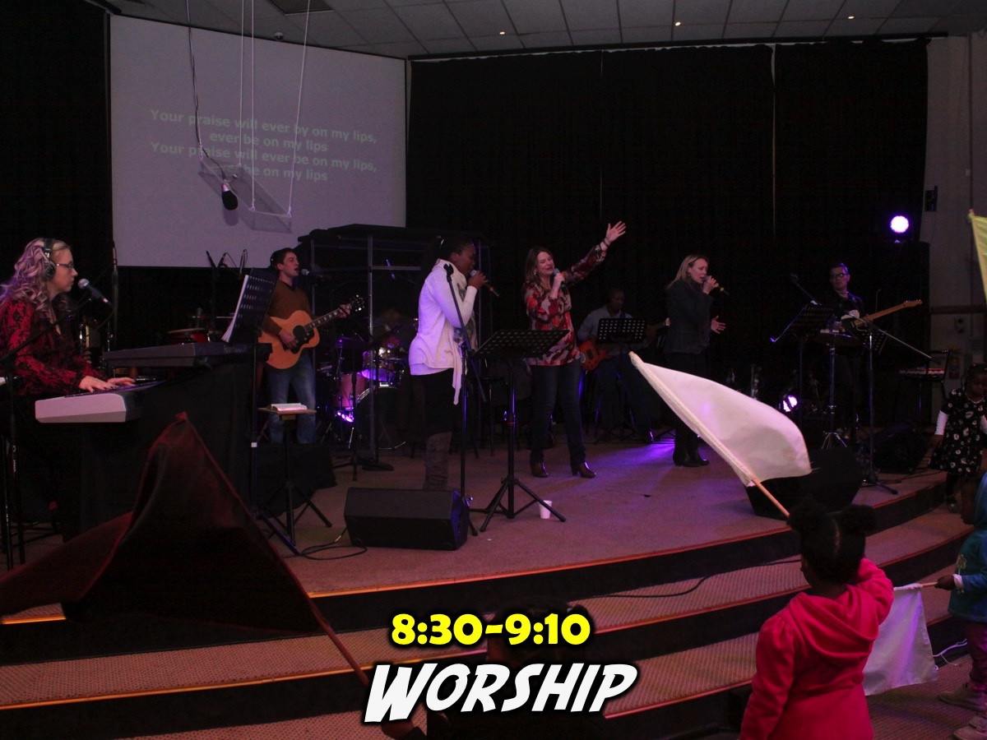
Notes:
(1) Worship: We start by worshipping together with the adult congregation and we exit the sanctuary when worship ends. After worship is finished there is a slide that goes up in the Sanctuary advertising our series (with the topic or character we are focusing on for that particular week) and it has our logo and it says: "High Schoolers are welcome to move to the youth room now!" This helps us catch new teens who are attending church with their parents and who don't yet know about our youth service.

Slide 62

Notes:
So after worship is finished there is a slide that goes up in the Sanctuary advertising our series (with the topic or character we are focusing on for that particular week) and it has our logo and it says: "High Schoolers to the youth room now!" This helps us catch new teens who are attending church with their parents and who don't yet know about our youth service.

Slide 63
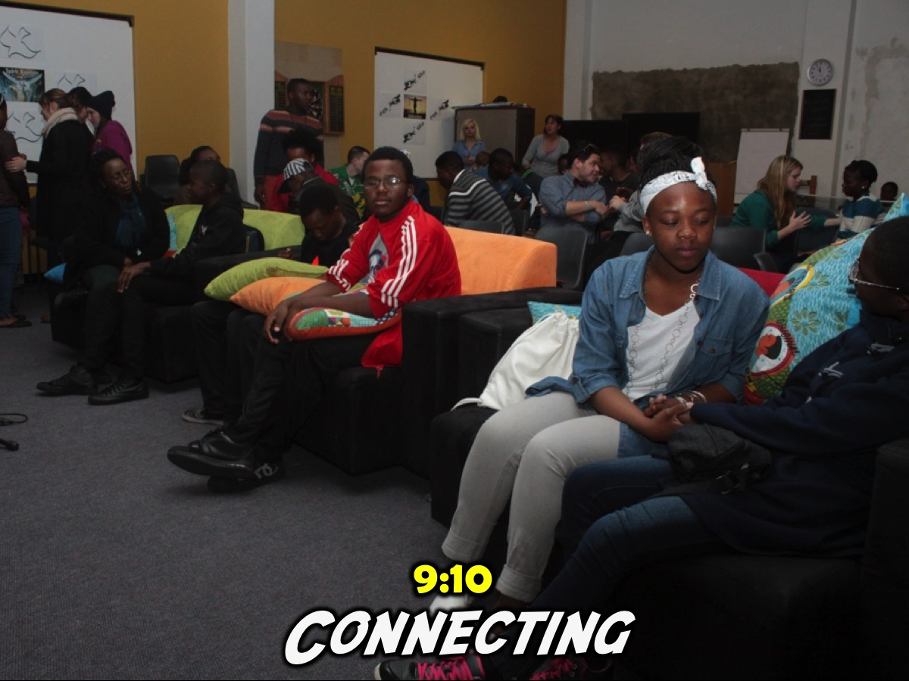
Notes:
(2) Connecting: Once we get into the youth room we wait up to 3 to 5 minutes for the teens to connect with their friends and also grab a chair to sit on. As they enter the room there is music playing and also a PowerPoint presentation is looping with photos that have been chosen from the Friday night event – this helps the Sunday congregation know what we do on Friday nights and also teens enjoy seeing themselves on the big screen.

Slide 64
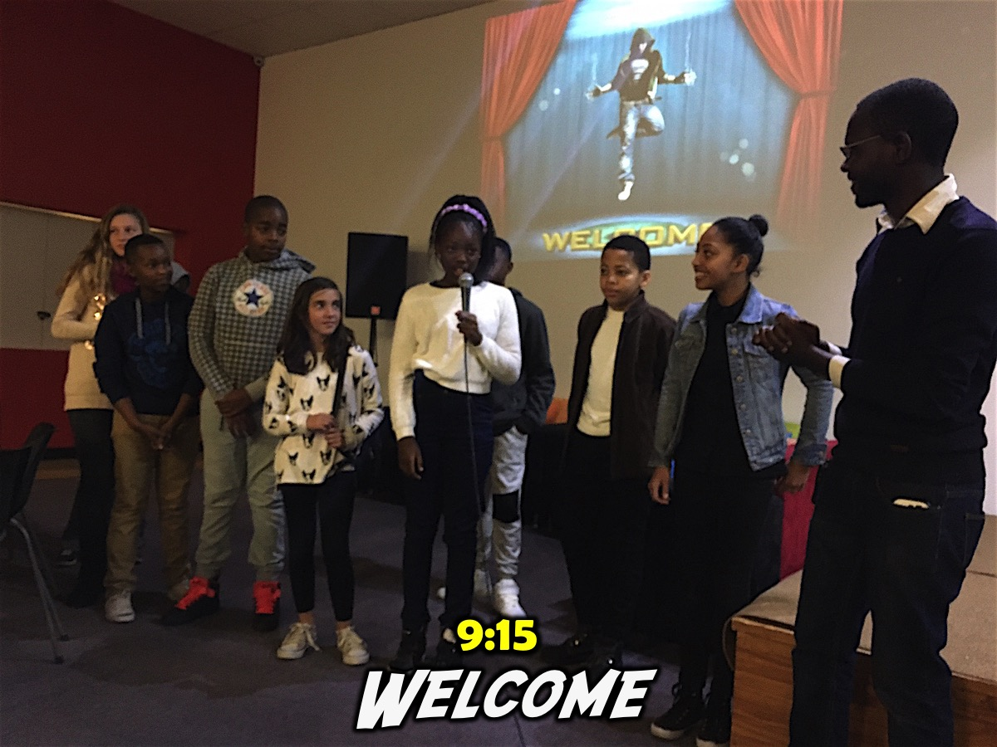
Notes:
(3) Welcome: A teen welcomes people to the service and ask newcomers to come up to the stage. They are then asked to share their name, the school they attend (sometimes their grade) and usually one stilly bit of information about themselves – like their favourite colour or the colour of their toothbrush. Once they have shared this information about themselves, the person welcoming them will interact with the audience and ask: “What is their name?” and “What school do they go to?” And everyone has to repeat it back. We are then asked: “What are they?” To which we answer: “Family!” The next question is: “And what must we do to them?” To which we answer: “Love them”. And the person asks: “And what else?” To which we answer: “Care for them.” And finally the person says: And what else: “Don’t chase them away!” The person is told to take their seat and the next person is welcomed - if there is more than one visitor on the day.

Slide 65
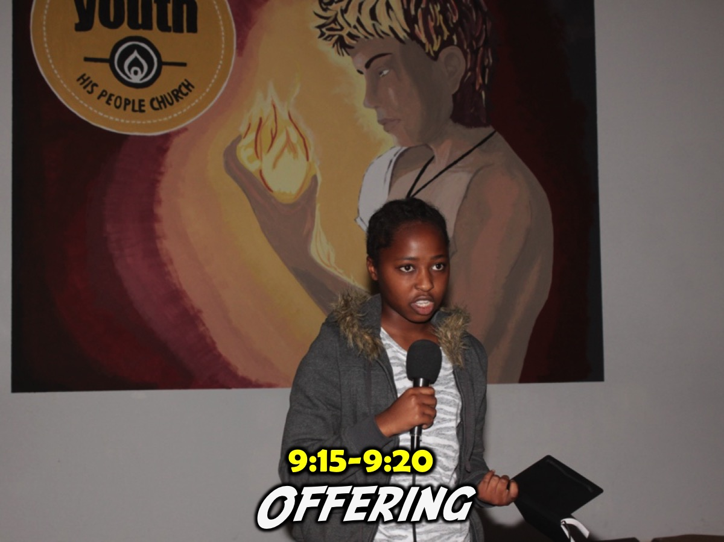
Notes:
(4) Offering: A teen presents the offering message to motivate teens to give of their tithes and offerings and the box is sent around. This is a great training opportunity to develop teens towards preaching.

Slide 66
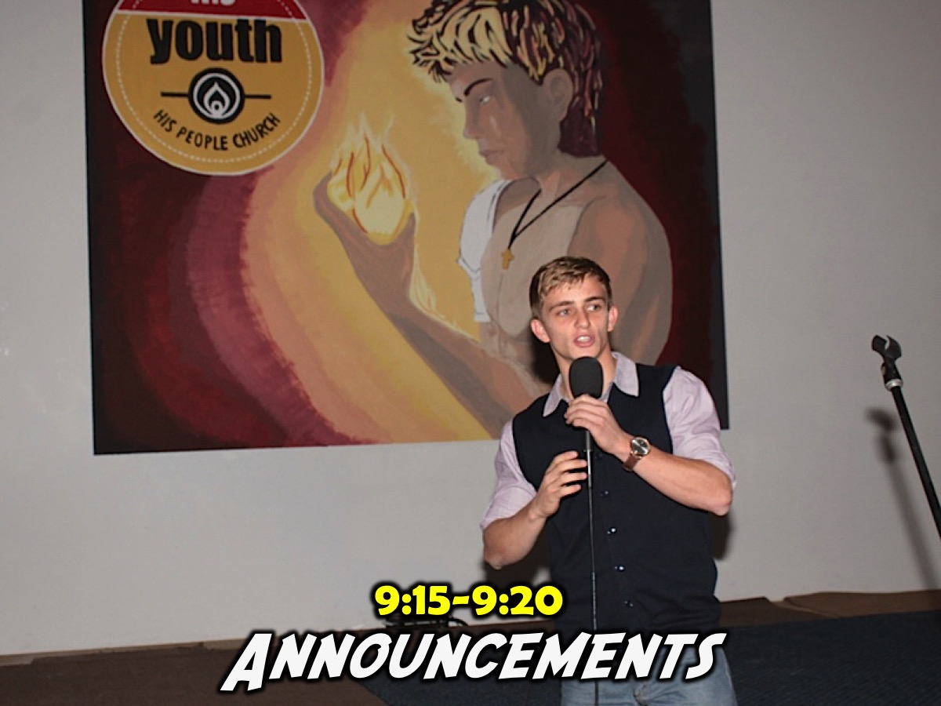
Notes:
(5) Announcements: A teen does the announcements (there are overheads slides for each of these parts of the service to help keep things moving and prevent us forgetting any of the key items). Here are some items that are include: A challenge to like our Facebook page, to get their photo taken for the wall, a review of the Friday night event with a few select photos, a preview of the coming Friday night’s event and the introduction of the preacher.

Slide 67
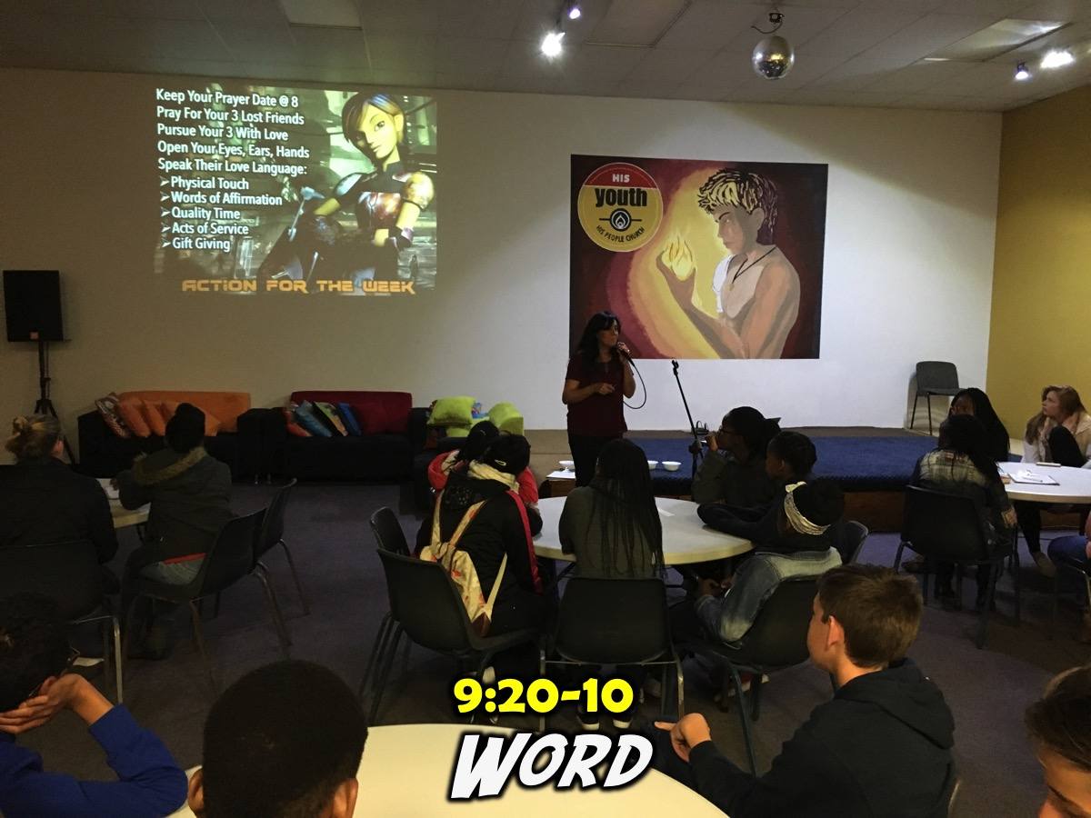
Notes:
(6) Word: The Welcome, Offering and Announcements takes around 10 minutes which leaves us about 40 minutes for the ministry of the Word. A recent series was entitled Heroes where we have spent eight Sunday mornings focusing on different Bible characters (Joseph, Rebekah, Daniel, Hannah, Jonah, Ruth, Peter and Esther. A key focus of the term was to get the teens to get into the Word for themselves, to Connect with the life of that Bible character and discover for themselves keys to growing in their relationship with Jesus. Some Sundays included video, images printed and placed on walls, drama, reflective reading, narrated readings, small group discussion and report back, etc. Teens often get a worksheet to use during the service and we also made use of the chalkboard to capture insights that the teens learnt and reported back on from their small groups. We usually seat teens around tables – 6 at a table with no-one sitting with their back to the preacher – and this encourages the preacher to engage teens in the message and interact with each other at their tables.

Slide 68

Notes:
The Revelation Series

Slide 69

Notes:
The Word-on Series

Slide 70
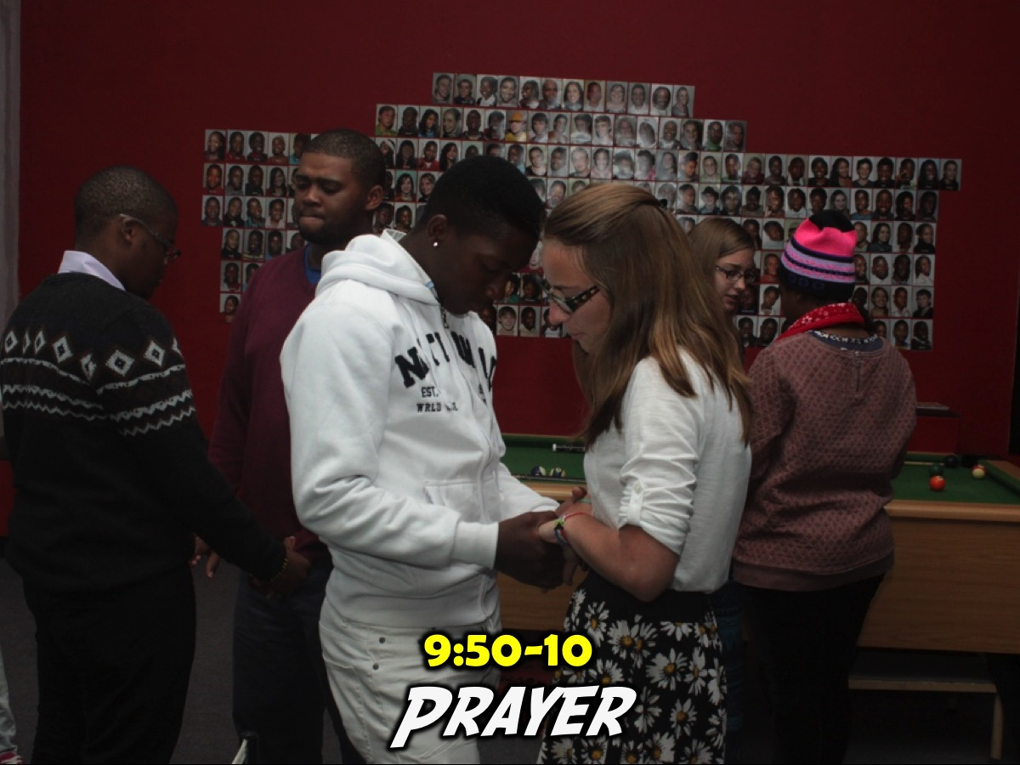
Notes:
(7) Prayer: The service ends with prayer and often a time of response or ministry before music is played as teens either hang around playing pool or foosball or table tennis or chat with their friends or leaders.

Slide 71
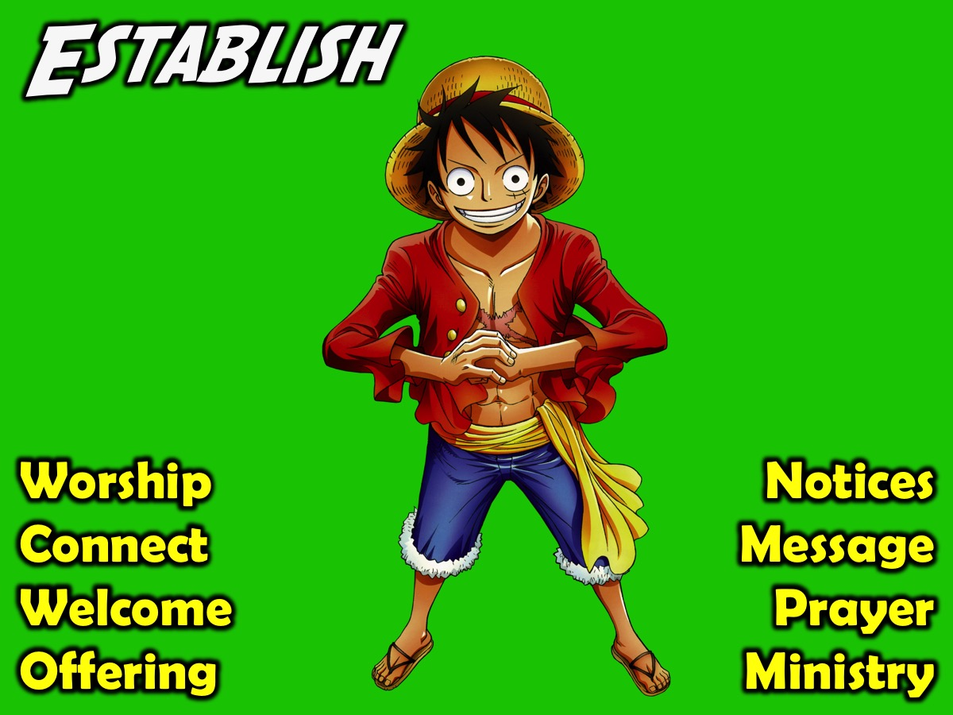
Notes:
Here are some of the key components of our weekly Establish event:

Slide 72

Notes:
C. EQUIP: The third phase in our disciplemaking strategy is to Equip teens for ministry. As teens are being established in their faith we watch for those who are ready to be equipped to minister among their peers and we equip them through the following initiatives:

Slide 73
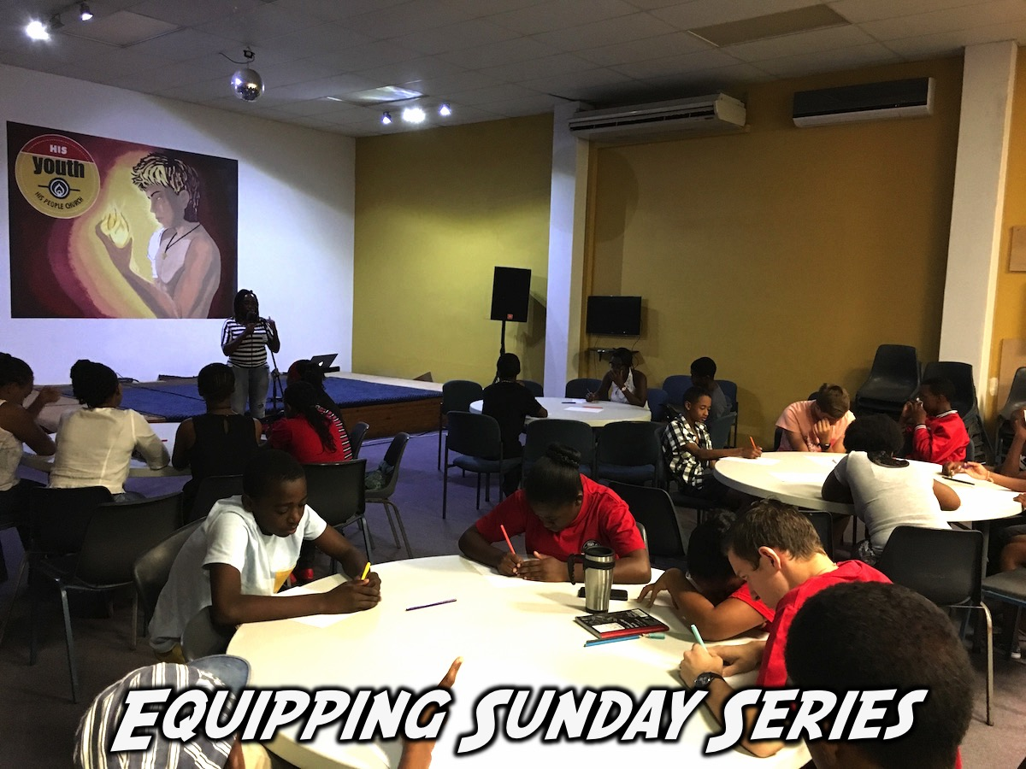
Notes:
(1) Equipping Sundays Series: At least once a year our Sunday teaching series is designed to equip teens – either to minister to their peers or to share their faith with their lost friends.

Slide 74


Slide 75

Notes:
(2) Monthly Leadership Meetings: Our teen leaders gather once a month on a Sunday afternoon for 2 hours with adult leaders to plan either the upcoming term or the next month’s events. Each leader is responsible for one Friday night a term and work with a small group of Connect Leaders to plan and present Friday night events. These leaders connect with each other via a WhatsApp group.

Slide 76

Notes:
(3) Weekly Prayer Meetings: All our leaders gather every Friday night for a time of prayer before the Friday event starts and this time includes elements of encouragement and equipping.

Slide 77

Notes:
(4) Equipping at Engage Events. We use the Engage Event on Friday nights to equip teens for ministry - by having them take responsibility for an event in the term, planning and involving other teens in running the event and also serving as small group leaders on the night.

Slide 78

Notes:
(5) Equipping at Establish Events. We use the Establish Event on Sunday mornings to equip teens for ministry - by having them do the Welcome, Offering, Announcements and give Testimonies - and even preaching.

Slide 79

Notes:
D. EMPOWER: The fourth phase in our disciplemaking strategy is to Empower teens to minister. We empower teens by releasing them to serve in the following areas:

Slide 80

Notes:
(1) Small Group Leaders: Teen leaders are each responsible to lead a small group on Friday nights – the groups are no larger than 4 or 5 teens and the leaders are given the small group questions a few days before the event.

Slide 81

Notes:
(2) Friday Meeting Presenters: Teen leaders are given the responsibility to lead Friday night meetings (they may open in prayer, welcome newcomers, or MC the night)

Slide 82

Notes:
(3) Sunday Meeting Presenters: Teen leaders are also responsible to present part of a Sunday morning service (they may do the welcome, announcements or share the offering message or even preach).

Slide 83

Notes:
(4) Small Groups in Schools. Another aspect of ministry is to equip and empower teens to lead small groups within their high schools. We are currently developing and releasing leaders in 3 high schools and hope to add at least another school in 2016.

Slide 84

Notes:
You can get loads of resource for each of these four levels of our disciplemaking strategy from my Ministry Resource website where the program resource material and sermons get uploaded each week is at: http://www.ymresourcer.com (the Programs link on that page is where I upload what we do on Fridays and on Sundays).

Slide 85

Notes:
Step 6 Reflection: What ministries or events do we present for each level of our disciplemaking strategy?

Slide 86

Notes:
7. Create the Material. We created material for each phase of our disciplemaking strategy – booklets that could be used to follow up new converts, establish young believers in the faith and equip workers. We made sure that the booklets were interactive, inductive, story-based and skills-based. We also branded the material with a consistent look and feel that was teen-friendly and attractive. You can download our disciplemaking material by visiting: http://www.ymresourcer.com/Programs.php - the booklets are at the top of the page and free to download and print for your ministry.

Slide 87

Notes:
Here are some of the booklets that we have developed.

Slide 88

Notes:
Step 7: What material do we have/need for each level of our disciplemaking ministry?

Slide 89

Notes:
8. Minister in Schools. Teenagers spend a large part of their lives in school and that is the place where they are most in contact with friends who are unsaved. Our disciplemaking strategy must include ministry in high schools. Youth pastors should look for doors into schools such as helping run the Christian societies, coaching sport or finding practical ways to serve the school. At His Youth we currently have active ministry in three high schools not far from our church and we look for opportunities to minister in local primary schools to reach learners in their final year of primary school. You can get resource for ministry in school by visiting: http://www.ymresourcer.com/School.php.

Slide 90


Slide 91


Slide 92


Slide 93


Slide 94

Notes:
Step 8 Reflection: Which schools are we currently working in? What can we do to get into schools?

Slide 95

Notes:
9. Pastor the Teens. A key function of a youth ministry is to ensure that timeous and effective pastoral care is provided for the teens that God has entrusted into its care. We are called to provide pastoral care to teenagers or their families who experience challenges like illness, medical operation or bereavement in their lives. There are times when we need to drop everything we are doing and move into crisis response mode to show the love of Jesus in a practical way to those in need. These efforts will have a profound impact on the life of the group, as well as bring a sense of closeness and cohesion to the group.

Slide 96

Notes:
Teens may look happy and all together when they come to youth events - but underneath the surface they are often struggling with tough issues and need pastoral care and counselling at times.

Slide 97

Notes:
Challenge: Watch social media or listen for needs. Respond as soon as you hear of a crisis.

Slide 98

Notes:
Step 9 Reflection: How will we know if a teen is in crisis? What will we do when a teen needs care?

Slide 99

Notes:
10. Work with Others. In our area, the youth pastors from different congregations have been meeting every month for the past 10 years. We spend time catching up around coffee and snacks, and devote the bulk of the time to checking up on each other’s souls and relationship with God and family, praying for one another and spend some time planning our next youth event. We allow youth pastors from outside our geographic area to attend to observe what we do but encourage them to start something similar in their own area. We had a season where we met together as youth groups once a term where we played together, ate together, worshipped together and listened to speakers who share the Word of God. We also meet once a year as youth groups either on a weekend for a social or sports event – some times it takes the form of an end of the year dinner, or a mid-year bash. We also meet as youth pastors at the end of the year for a dinner together with our spouses and here we reflect on the year together, honour each other and thank God for what He has done in and through us. We call our monthly gatherings as youth pastors the Unity Fraternal as it is a demonstration of the unity that Christ has called us to reflect in the city in which we live and minister.

Slide 100


Slide 101

Notes:
Challenge: Make contact with youth pastors in your area and meet on a regular basis.

Slide 102

Notes:
Step 10 Reflection: Which youth leaders do we/should we meet with in our area each month?

Slide 103

Notes:
11. Connect with Leadership. We work really hard in our ministry to ensure that we maintain a close connection with the wider church so that our youth ministry does not become a para-church ministry that teens leave when they graduate high school and never make the transition into the adult congregation. Here are some of our current initiatives: (1) Our teens worship in the main sanctuary with the adults each Sunday morning which helps they feel connected to the church. (2) As full-time staff we attend weekly meetings with church leaders to stay in touch with what God is doing in the wider church family. (3) We design ministries that do not conflict with church events. (4) We find ways to connect teens into the wider church through service or mission opportunities. (5) We keep church leaders informed about what is happening among youth. (6) We promote the ministry when given opportunities in church services or at meetings.

Slide 104

Notes:
My wife and I meet once a month with the couple who cover our youth ministry from the senior eldership team (It is currently Simon and Lindi Lerefolo - honestly it is one of the meetings that I most look forward to every month!)

Slide 105

Notes:
We look for opportunities to engage with wider church leadership at any opportunity - but also don’t try and attend everything else that is happening in the wider church.

Slide 106

Notes:
We have our teens worship in the main sanctuary every Sunday morning to keep them connected with the wider church family.

Slide 107

Notes:
We even get them up front sometimes to teach the older generation how to dance!

Slide 108

Notes:
Step 11 Reflection: How can we connect with the wider church? How can we connect youth to the church?

Slide 109

Notes:
12. Develop the Covering. We learnt along the way, given the spiritual attack we experienced, that it is critical to create prayer cover for our youth ministry and we need to wait on God to discern what He wants to do in all our events. Here are some strategies we use at present: (1) Leaders are encouraged to pray personally for the ministry. (2) We share prayer needs on our leadership WhatsApp groups. (3) Leaders gather before all events for prayer. (4) We share prayer needs each week with intercessors in the church. (5) We spend time praying during our leader planning meetings.

Slide 110

Notes:
Every Tuesday I send an email to the facilitator of the prayer ministry in our church and list some prayer needs that are current in our ministry.

Slide 111

Notes:
Here is an example of how I share prayer needs with our adult leaders.

Slide 112

Notes:
Here is an example of how we have our teens pray online each night of the week from 8pm - usually for between 30 to 45 minutes.

Slide 113

Notes:
Our leaders gather before all our events for prayer.

Slide 114

Notes:
Step 12 Reflection: What can we do to develop prayer covering for our ministry?

Slide 115

Notes:
13. Connect with Teens. We are always looking for ways to increase our “airtime” with teenagers outside of our events so we do the following: (1) Getting adult leaders to connect one on one with teens (we budget so leaders can connect with teens in coffee shops). (2) Attending cultural or sports events at schools. (3) Connecting with teens when we do schools ministry. (4) Making sure that teens going through any level of struggle are met with on a weekly basis until they have worked through the issues. (5) Spending time fetching and dropping teens off after events. (6) Socialising in the parking lot before leaving after events.

Slide 116


Slide 117

Notes:
Challenge: Find ways to connect with teens outside events at church.

Slide 118

Notes:
Step 13 Reflection: What can we do to connect with teens outside of the events on our property?

Slide 119

Notes:
14. Connect with Media. We make significant use of media that is relevant to the teenagers in our context. At present we focus on WhatsApp and Facebook and connect teens to resource material on a website. Here are some of our tactics: (1) We use the group’s Facebook page (http://bit.ly/Youth01) to show photos of events and tag teens and link teens to sermon or event resource material. (2) We use a Facebook Preview group to have our teen and adult leaders preview presentations. (3) We use WhatsApp to plan events and share prayer needs. (4) We have a youth website (http://bit.ly/Youth02) where term planners, sermons or articles can be downloaded.

Slide 120

Notes:
Here are some relevant links to the sites I maintain directly connected to our youth ministry:
A. Our Facebook site is: https://www.facebook.com/pages/His-Youth/149262733386

Slide 121

Notes:
B. Our Youth Group Website is: http://youth.hispeoplejoburg.org (this site is updated each week with podcasts and other items like photo albums although that is mostly driven through Facebook).

Slide 122

Notes:
C. Our Adult Leaders WhatsApp group is used to stay in touch with our adult leaders.

Slide 123

Notes:
D. Our Connect leaders WhatsApp group is used to stay in touch with our teen and adult leaders.

Slide 124

Notes:
E. Our teen WhatsApp groups are used to engage with teens who attend either our Friday or our Sunday events.

Slide 125

Notes:
Step 14 Reflection: How are we using social media to assist our disciplemaking ministry?

Slide 126

Notes:
15. Refine the Strategy
Over the years we have not been afraid to change our strategy or our disciplemaking tactics. We remind ourselves that there is no perfect ministry strategy and we can always improve. We keep reflecting on our ministry, adapting when something is not working or can be improved, visit other ministry to see what is working there and we attend leadership training events to improve our skills and approach.

Slide 127

Notes:
We have a monthly leadership meeting over lunch on a Sunday that normally ends at 2pm, but once a term we end at 3pm which gives us time to do some forward planning to ensure we are on track for the next term.

Slide 128

Notes:
Challenge: Make it your aim to keep improving your approach to ministry in the coming years.

Slide 129

Notes:
Step 15 Reflection: What can we do to keep improving our approach to ministry in the future?

Slide 130

Notes:
Here is a summary of my keys to advancing disciplemaking in a youth ministry.

