Slide 1

Notes:
Raising Team

Slide 2

Notes:
In the not-too-distant future, our planet has come under attack from a malevolent race of aliens known as the Formics. Incredibly, fearless International Fleet Commander Mazer Rackham (Ben Kingsley) sent them fleeing back into the stars, becoming a living legend in the process. But decorated Colonel Hyrum Graff (Harrison Ford) knows that the Formics will soon return even stronger than they were before, and he's determined to find a new hero who can meet them head on. Enter Ender Wiggin (Asa Butterfield), a modest young man with vast untapped potential. Upon being recruited into Battle School, Ender partakes in a grueling series of simulations, effortlessly mastering every challenge presented to him. Celebrated by his peers and respected by his superiors, Ender is quickly promoted to Command School, where the one and only Mazer Rackham provides him with the knowledge and tools needed to save mankind from certain extinction. As the final battle approaches, Ender prepares to embrace his destiny as one of the greatest heroes in the history of planet Earth.

Slide 3
Notes:
Video: Ender’s Game Trailer 1 2013. Get it on YouTube at: https://www.youtube.com/watch?v=2SRizeR4MmU

Slide 4
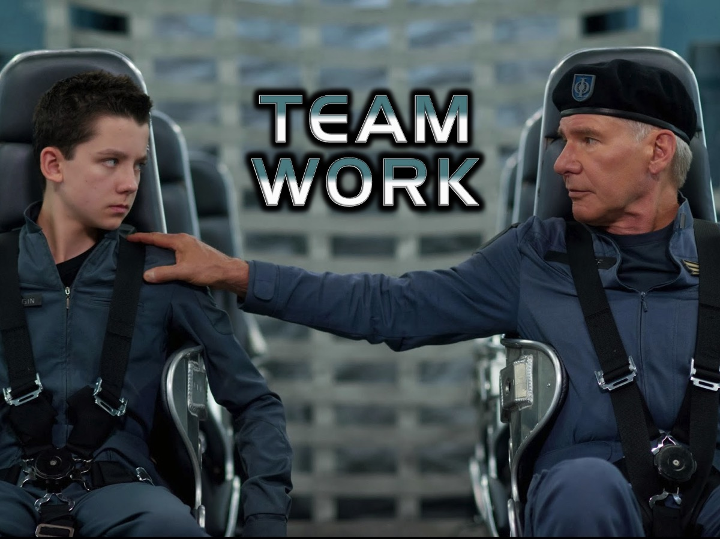
Notes:
Teamwork!

Slide 5

Notes:
The Lone Ranger has always been used as a reference to someone who wants to do everything on his own.

Slide 6
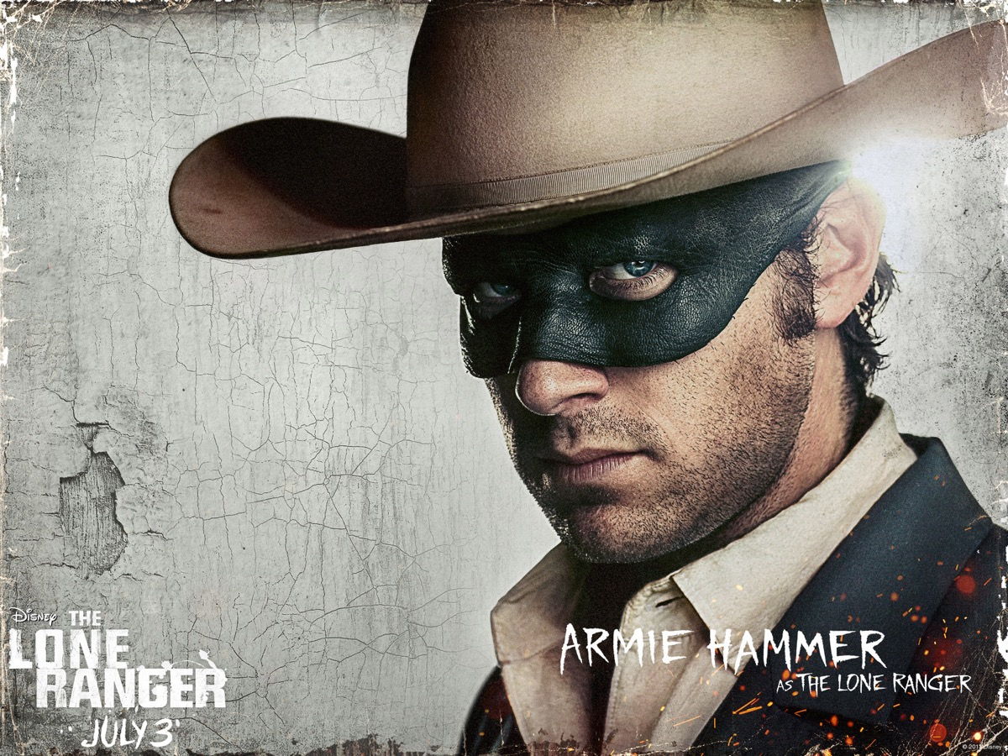
Notes:
He is a guy that prefers to work alone.

Slide 7
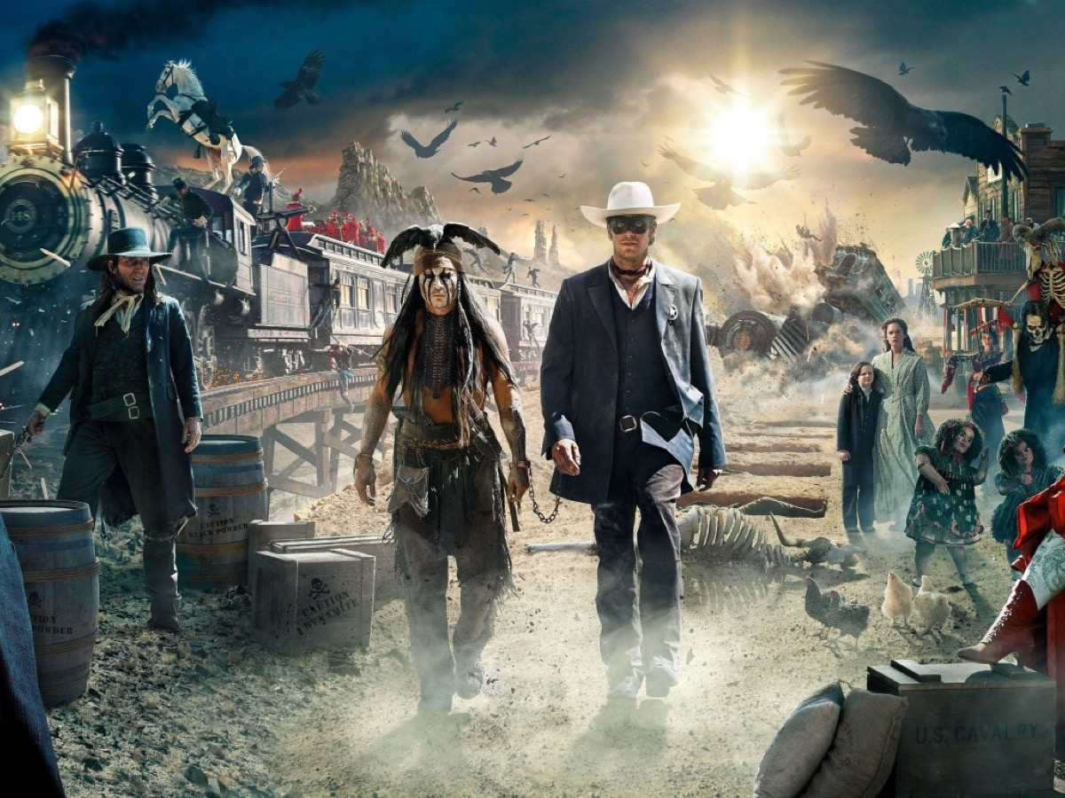
Notes:
But invariably he needs help

Slide 8
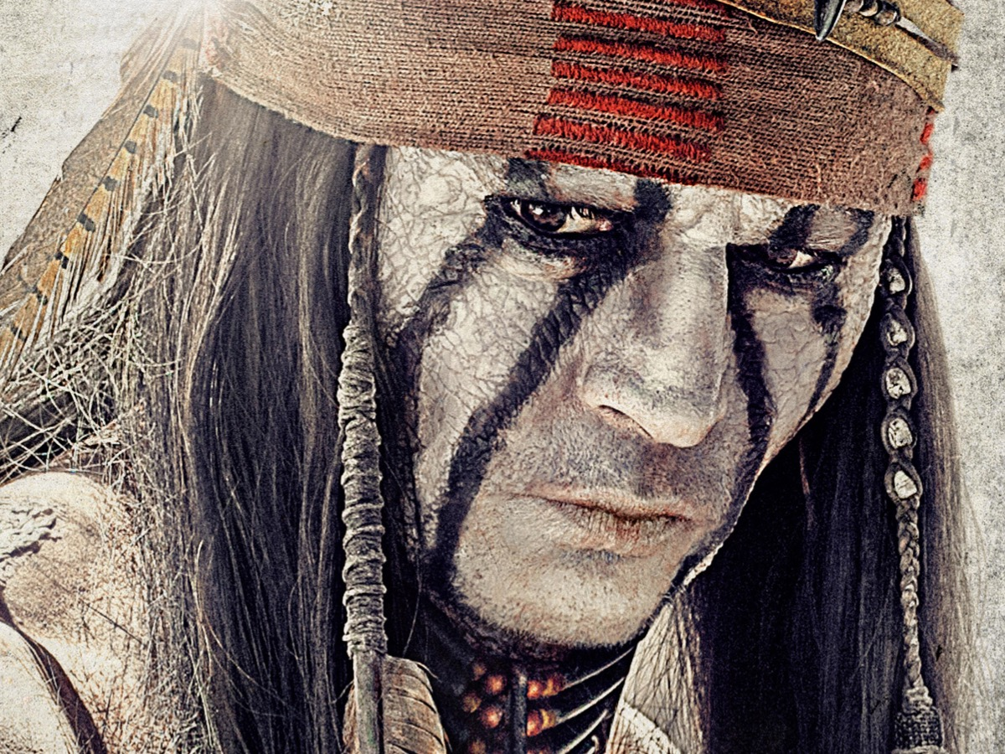
Notes:
either from Tonto

Slide 9
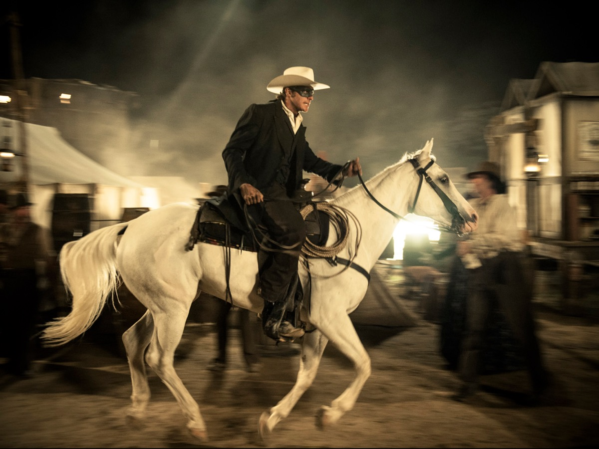
Notes:
Or his horse!

Slide 10

Notes:
Some ministry leaders are like the lone ranger!

Slide 11
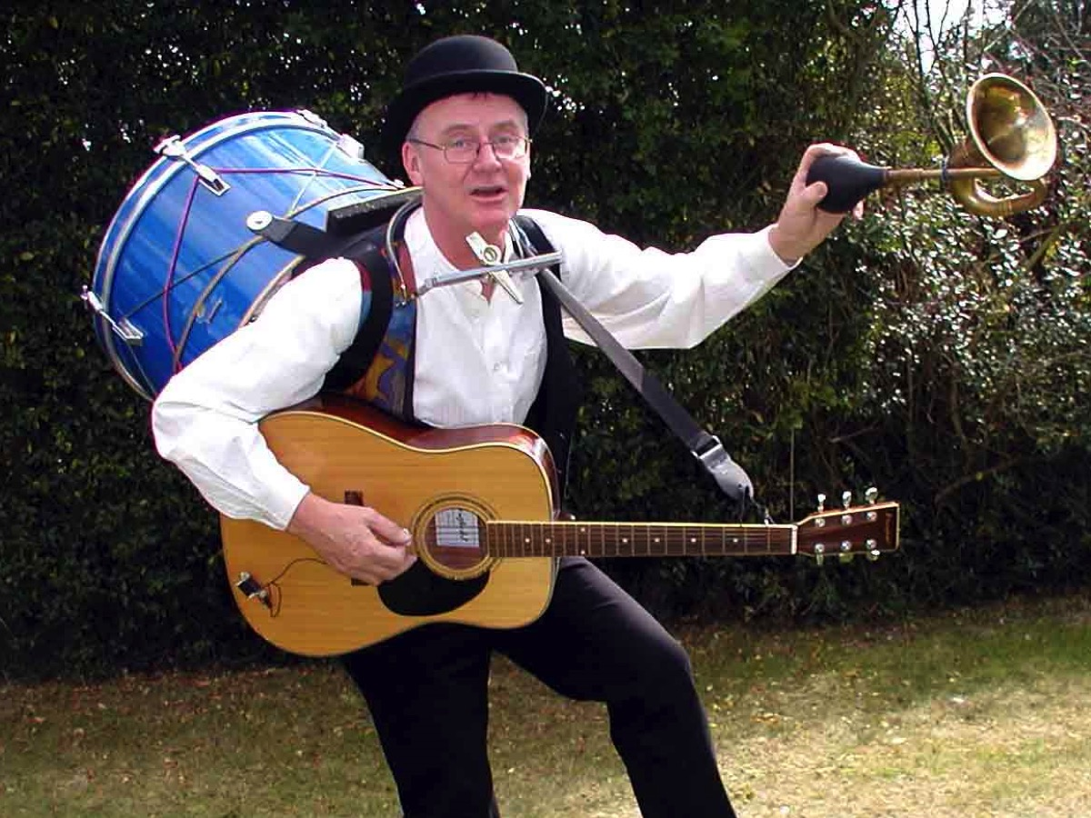
Notes:
They function like a one-man band!

Slide 12
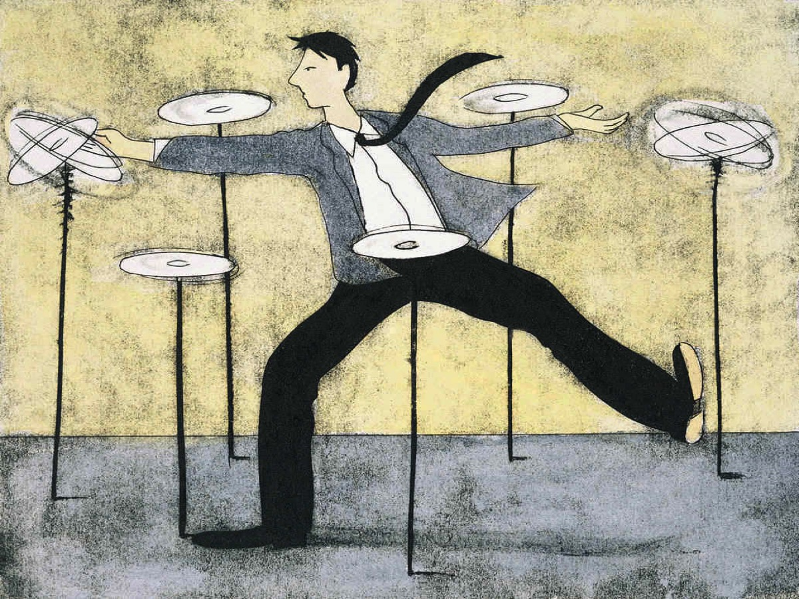
Notes:
Leaders who function like this spend most of their time trying to keep plates spinning.

Slide 13

Notes:
Let’s agree that the Lone Ranger Pastor is not acceptable and should be outlawed!

Slide 14
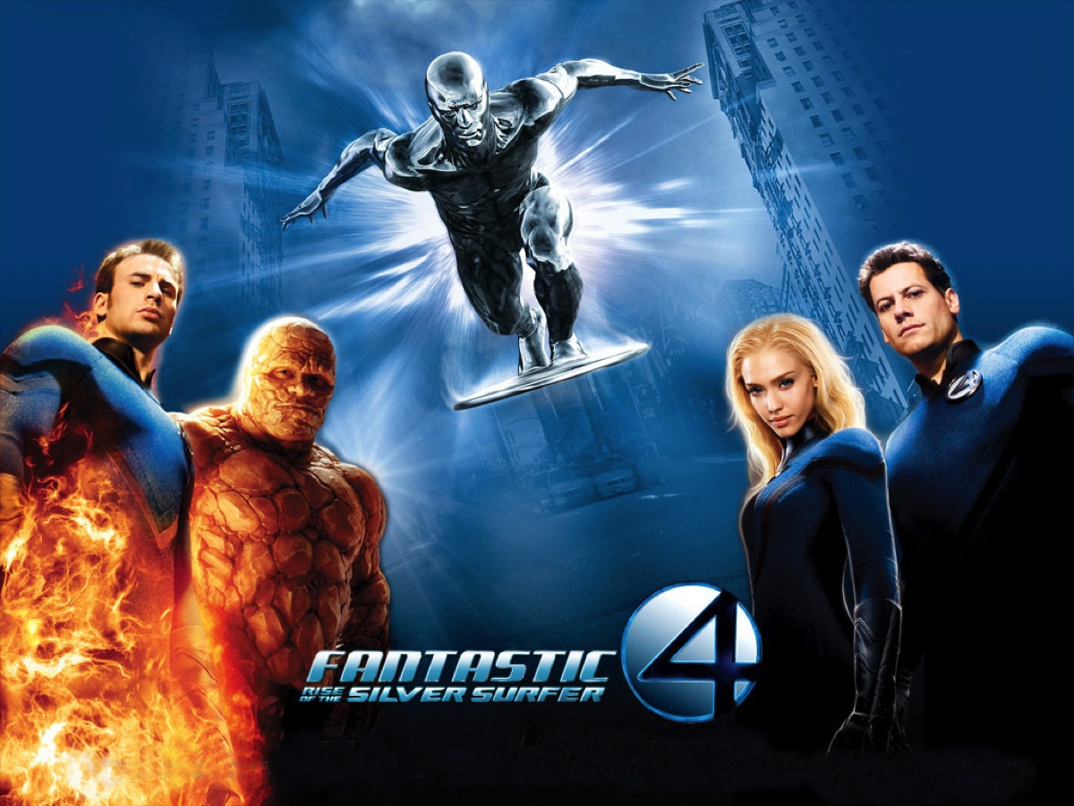
Notes:
The Fantastic Four – a great example of different people working together as a team.

Slide 15
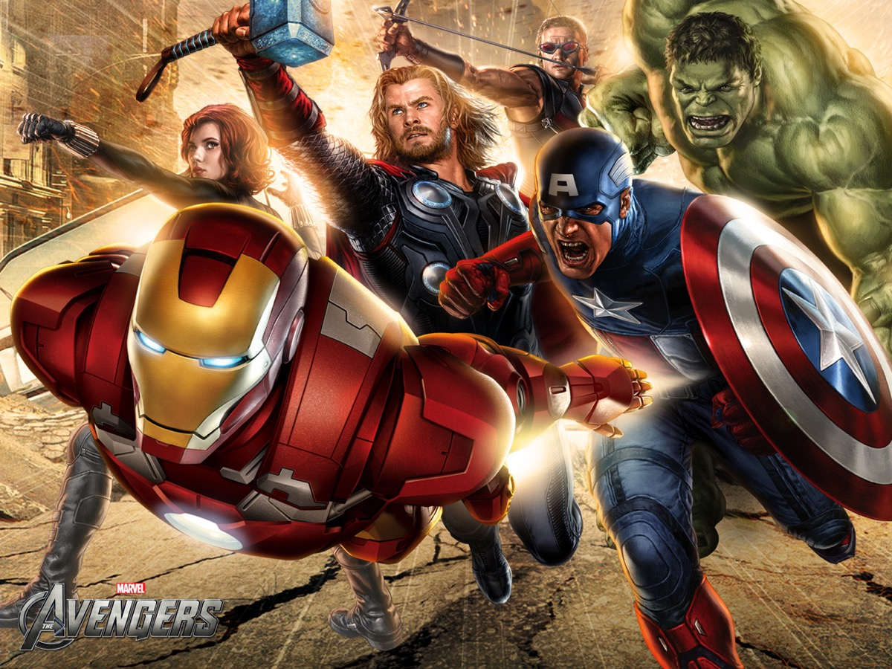
Notes:
The Avengers – a great example of different people working together as a team.

Slide 16

Notes:
The Guardians of the Galaxy – a great example of very different people working together as a team.

Slide 17
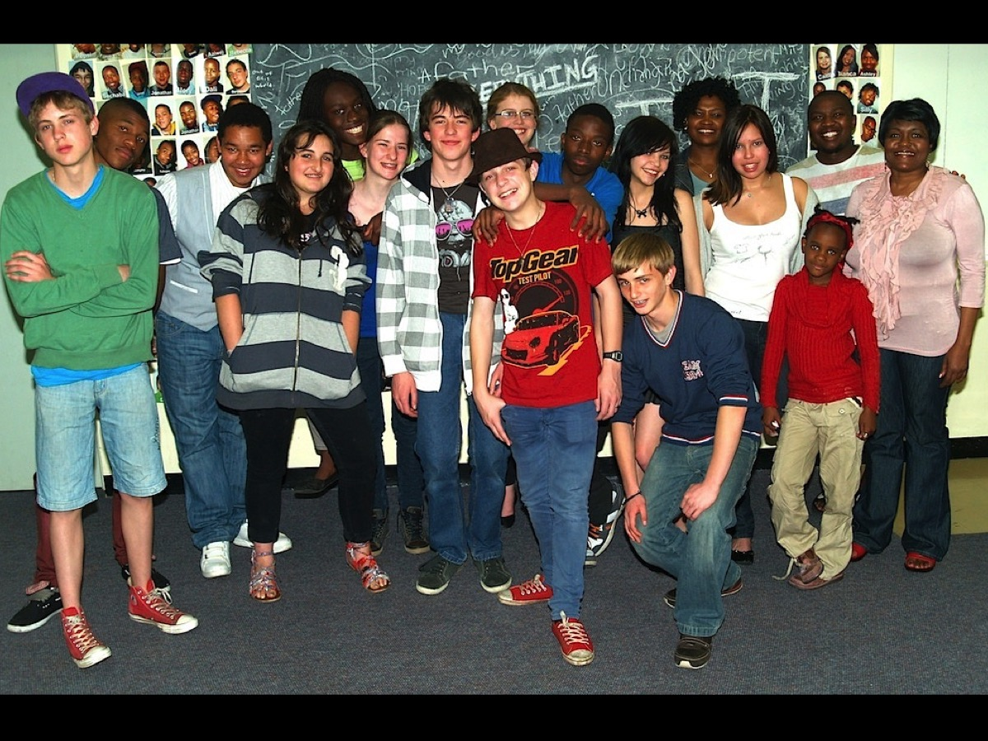
Notes:
I want to show you a few images from the past few years of the teams we have raised at His Youth in Johannesburg. Firstly one in 2012…

Slide 18
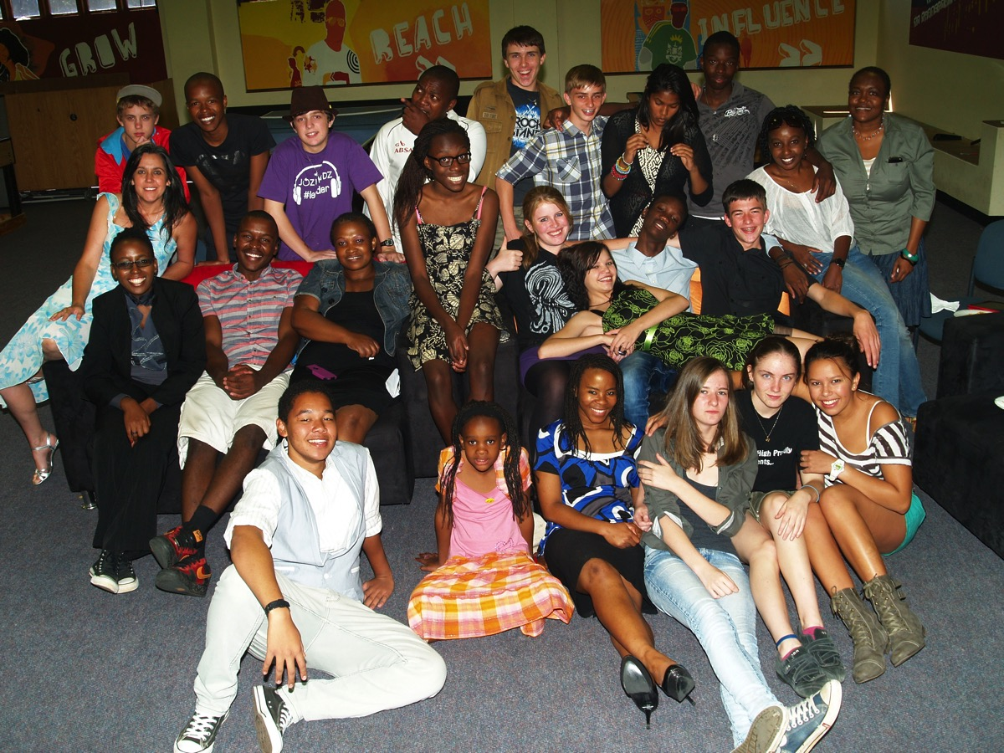
Notes:
One from early 2013…

Slide 19
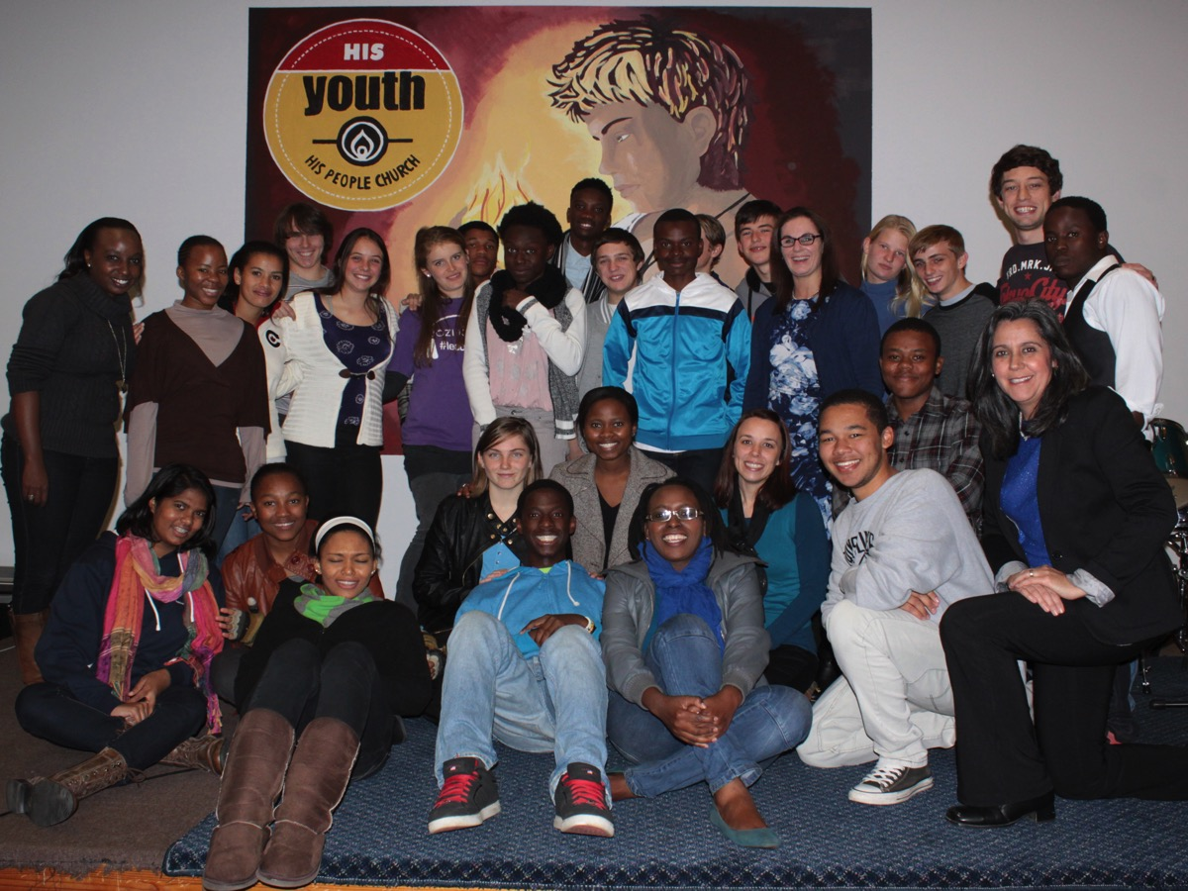
Notes:
And our most recent group pic…

Slide 20
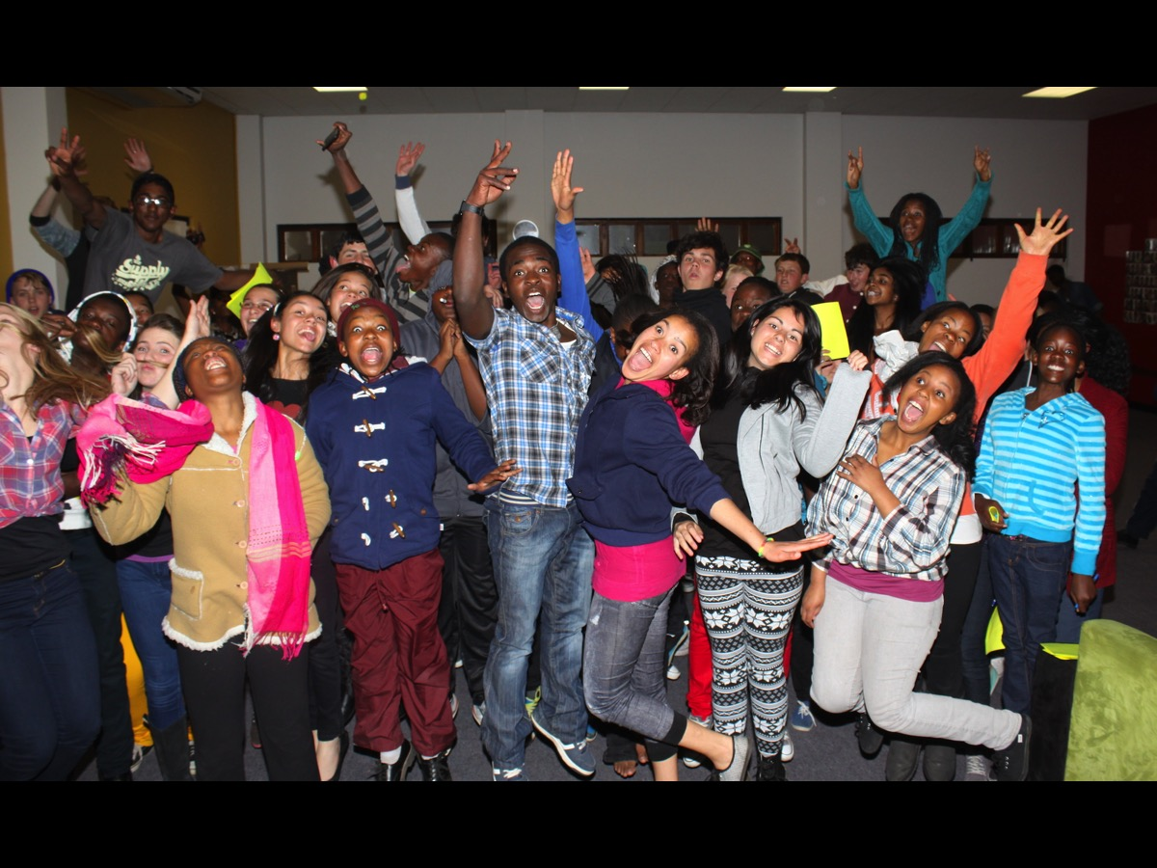
Notes:
And this leadership team is in the context of a ministry that is around 100 to 120 teens.

Slide 21
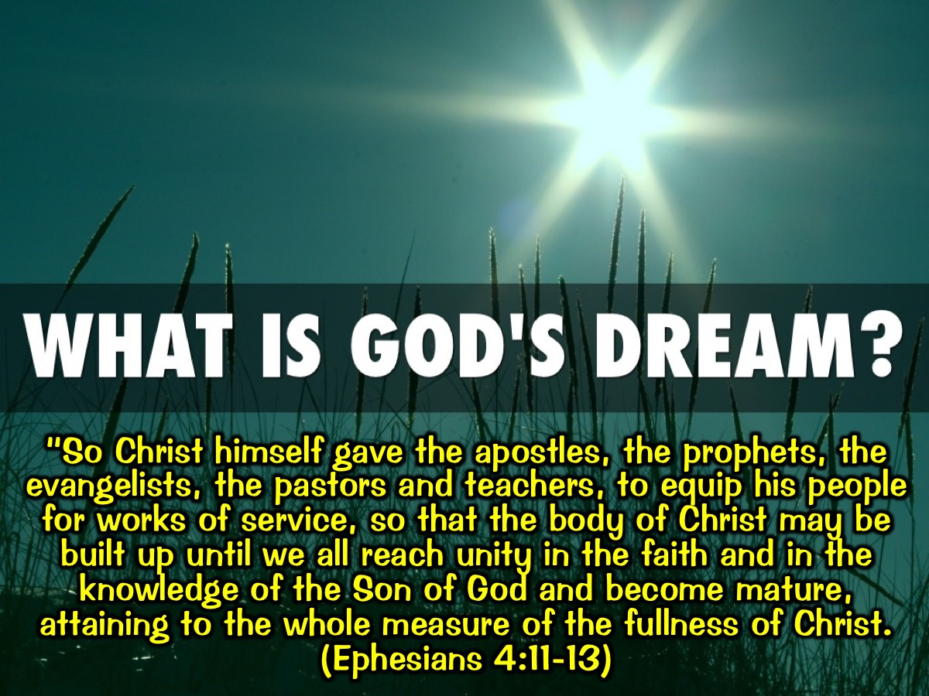
Notes:
Team is God’s Dream for His Church. God gave gifts to His Church so they will equip His people for works of service. “So Christ himself gave the apostles, the prophets, the evangelists, the pastors and teachers, to equip his people for works of service, so that the body of Christ may be built up until we all reach unity in the faith and in the knowledge of the Son of God and become mature, attaining to the whole measure of the fullness of Christ. (Ephesians 4:11-13)

Slide 22

Notes:
It takes Teamwork to make the Dreamwork! An adult leader in our ministry used to say this all the time. It is also the title of a book by John Maxwell.

Slide 23
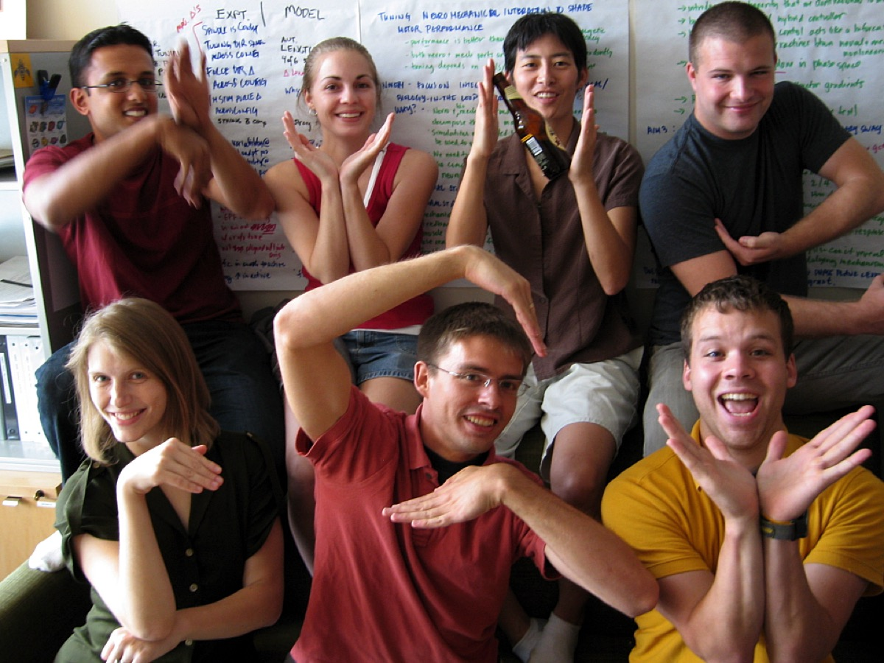
Notes:
What are they spelling out? It is “Synergy”.

Slide 24

Notes:
Synergy

Slide 25
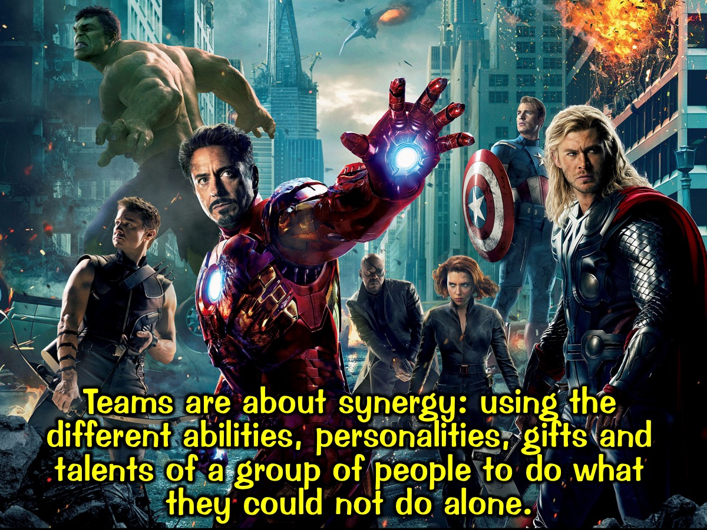
Notes:
Teams are about synergy: using the different abilities, personalities, gifts and talents of a group of people to do what they could not do alone.

Slide 26
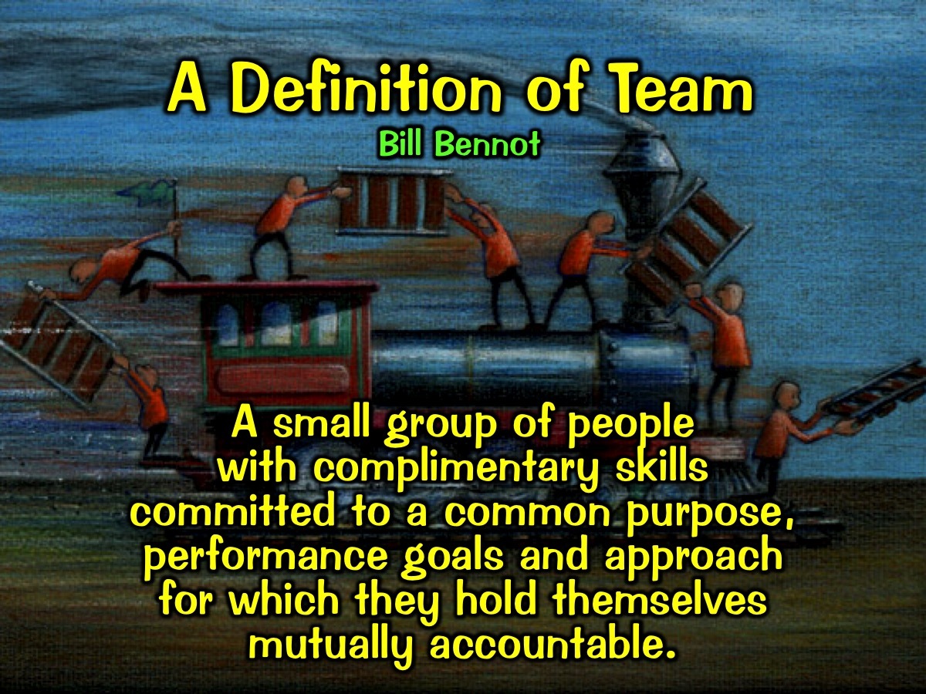
Notes:
Bill Bennot’s Definition of Team: A team is a small group of people with complimentary skills committed to a common purpose, performance goals and approach for which they hold themselves mutually accountable.

Slide 27
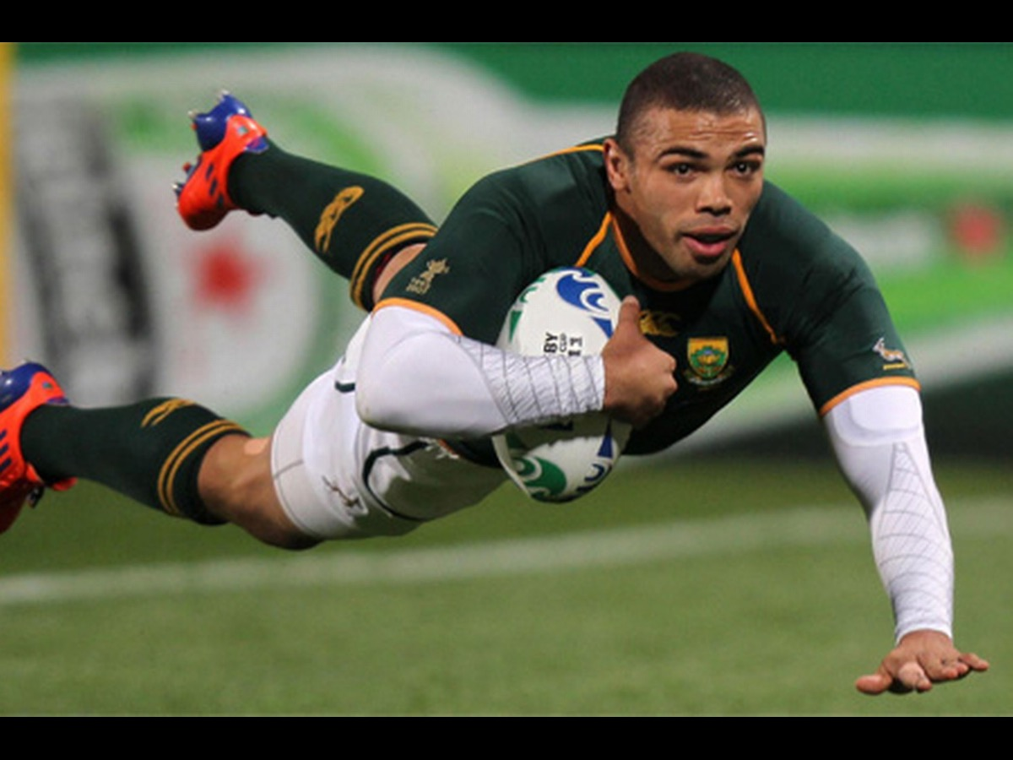
Notes:
There is nothing like watching Brian Habana flying over the try line to score for the Springboks.

Slide 28
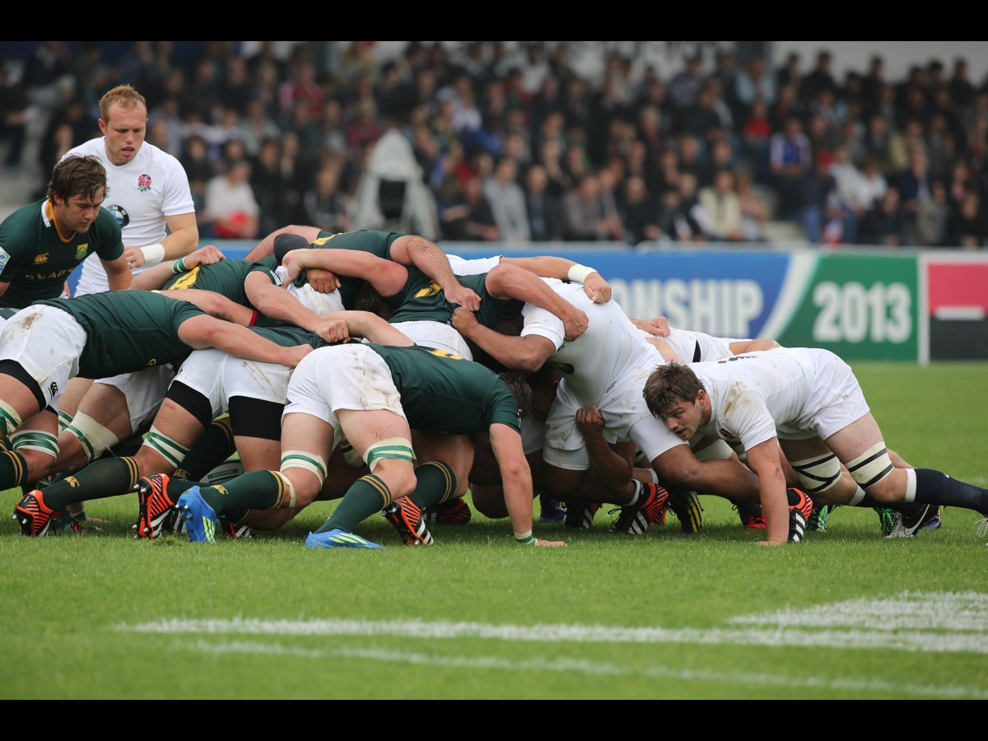
Notes:
But invariably it is a team effort that led to the try being scored. In the scrums.

Slide 29
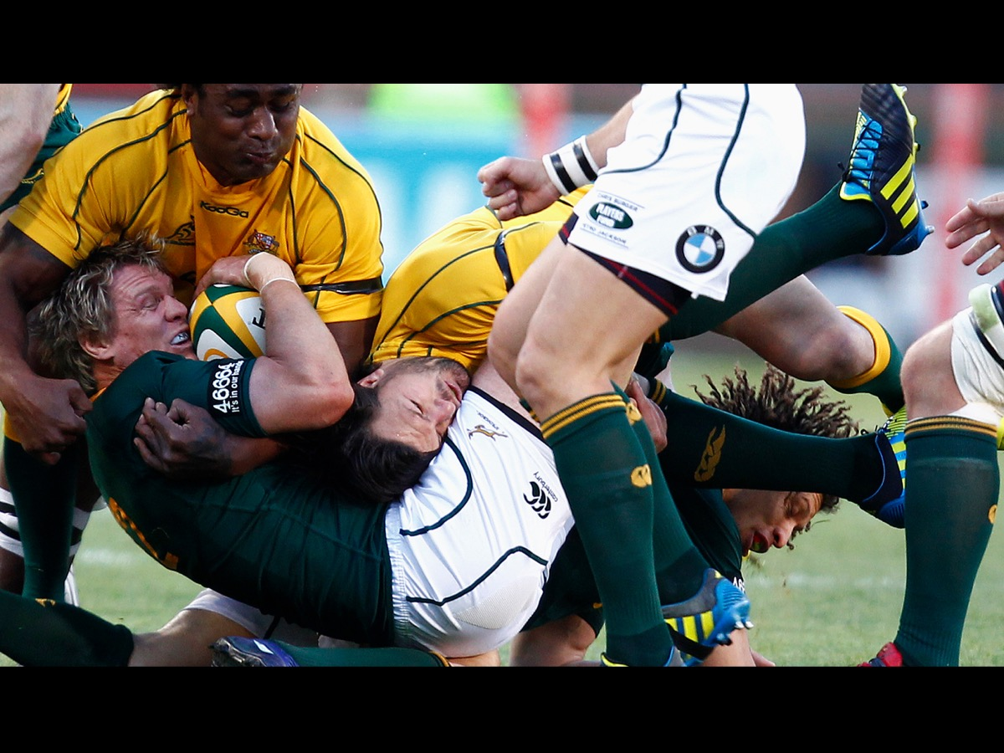
Notes:
In the loose play

Slide 30
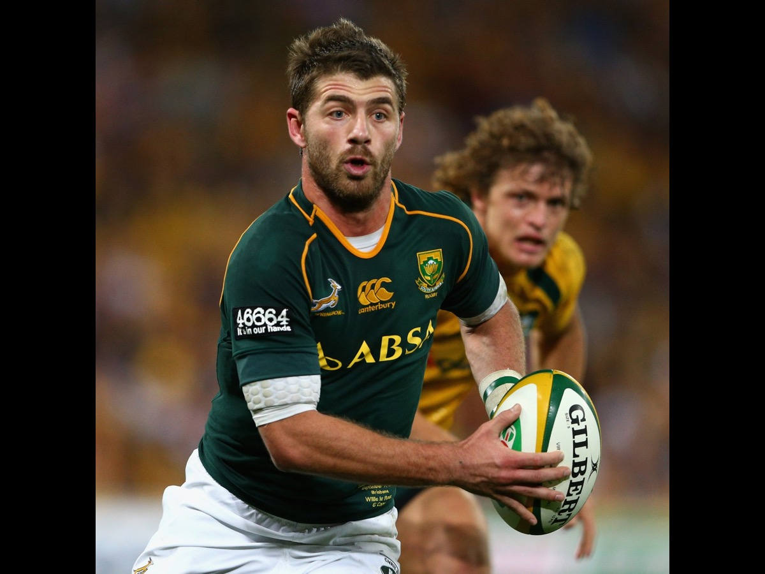
Notes:
In the running and passing

Slide 31
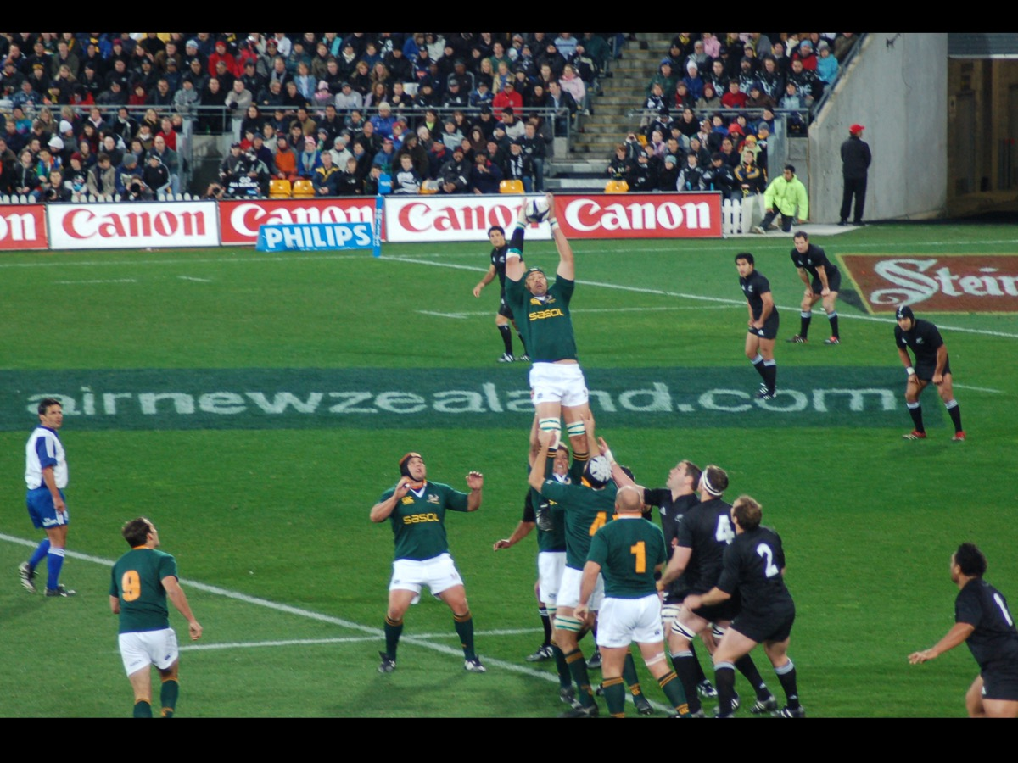
Notes:
In the line outs

Slide 32
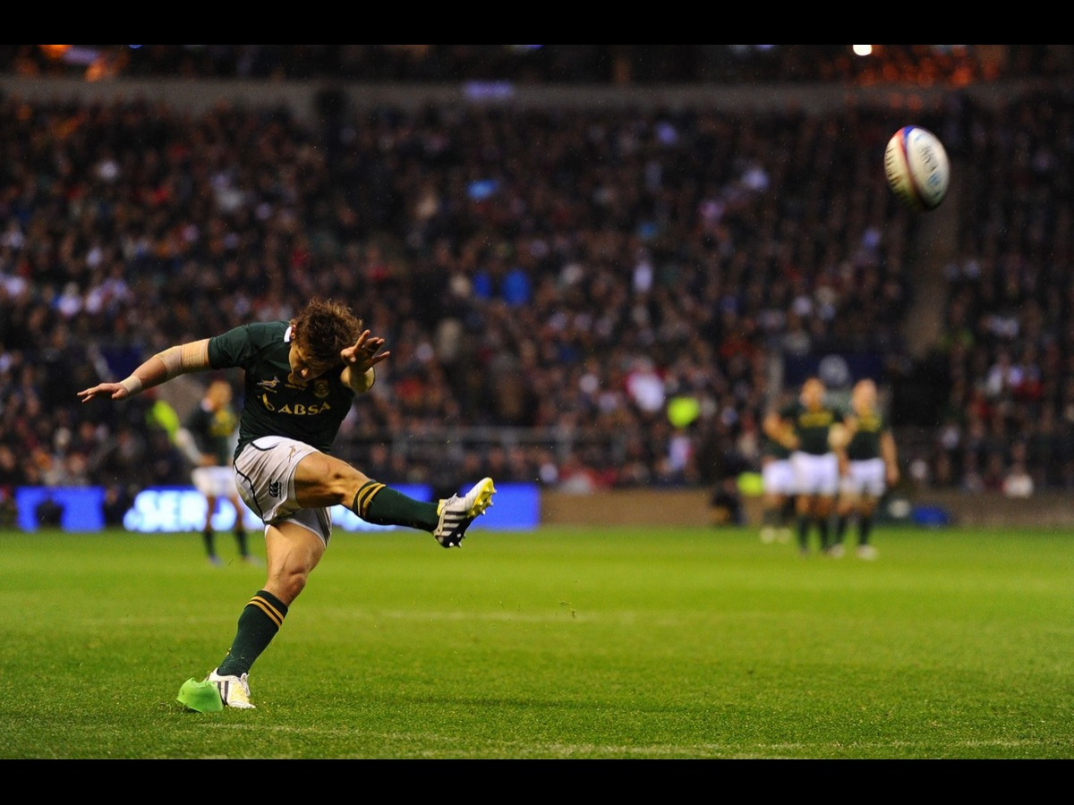
Notes:
And the kicking

Slide 33
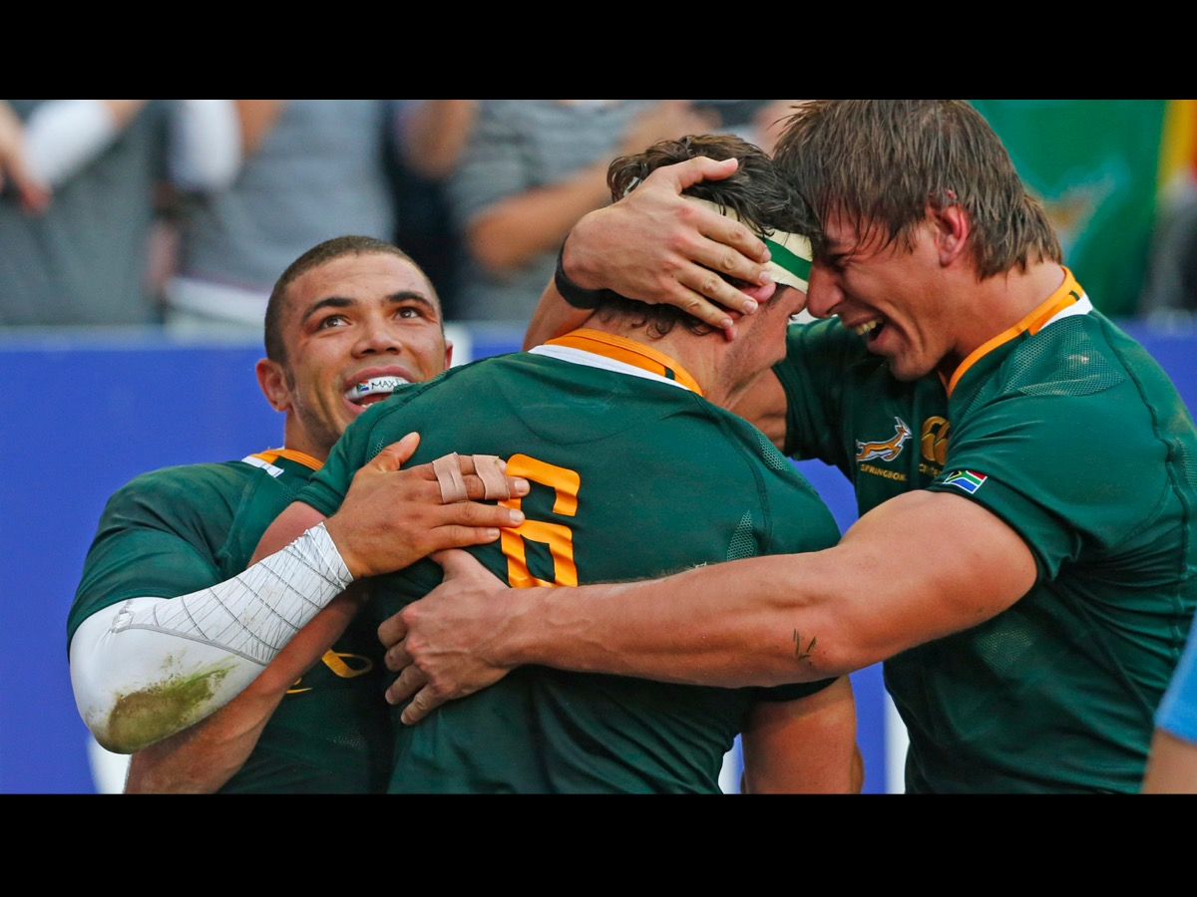
Notes:
Soon people are congratulating each other on the win

Slide 34
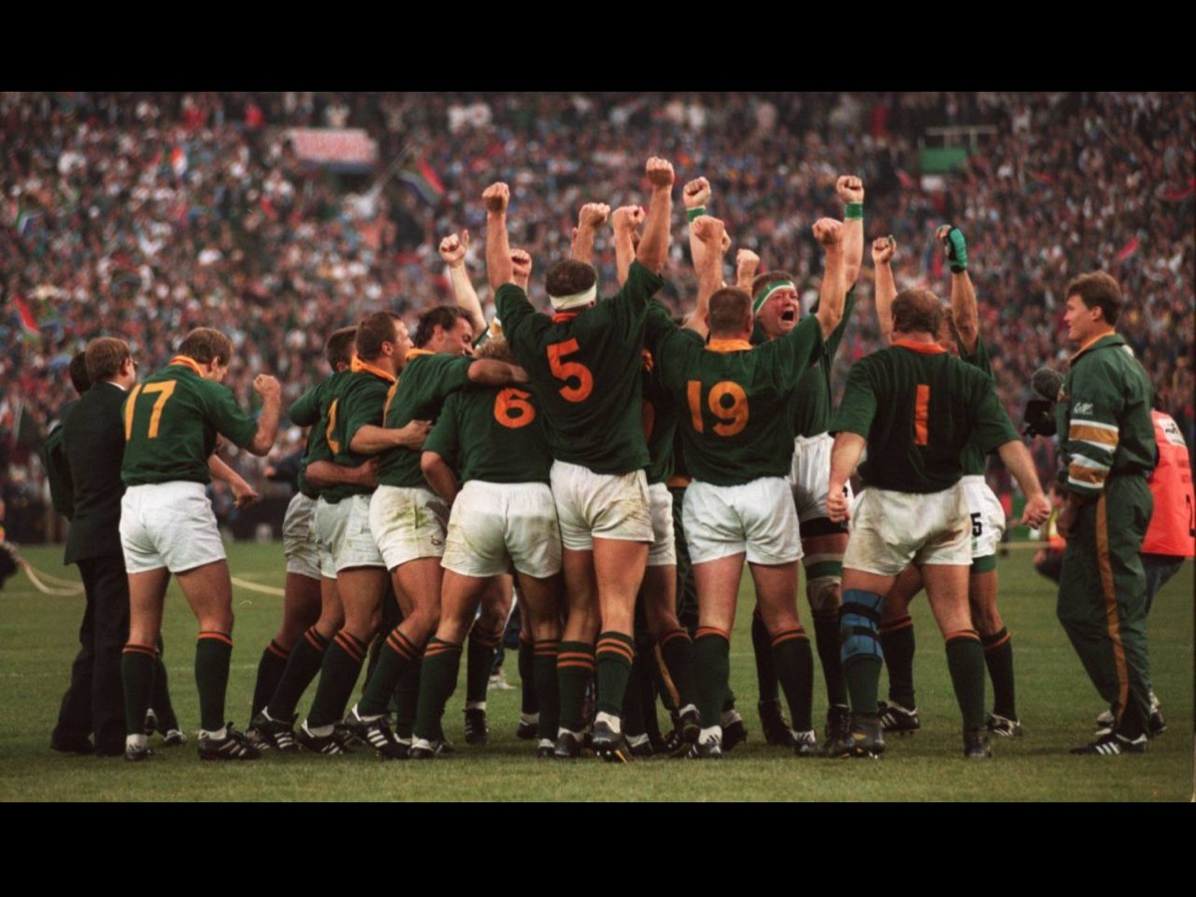
Notes:
Ultimately it is the team effort that is remembered!

Slide 35
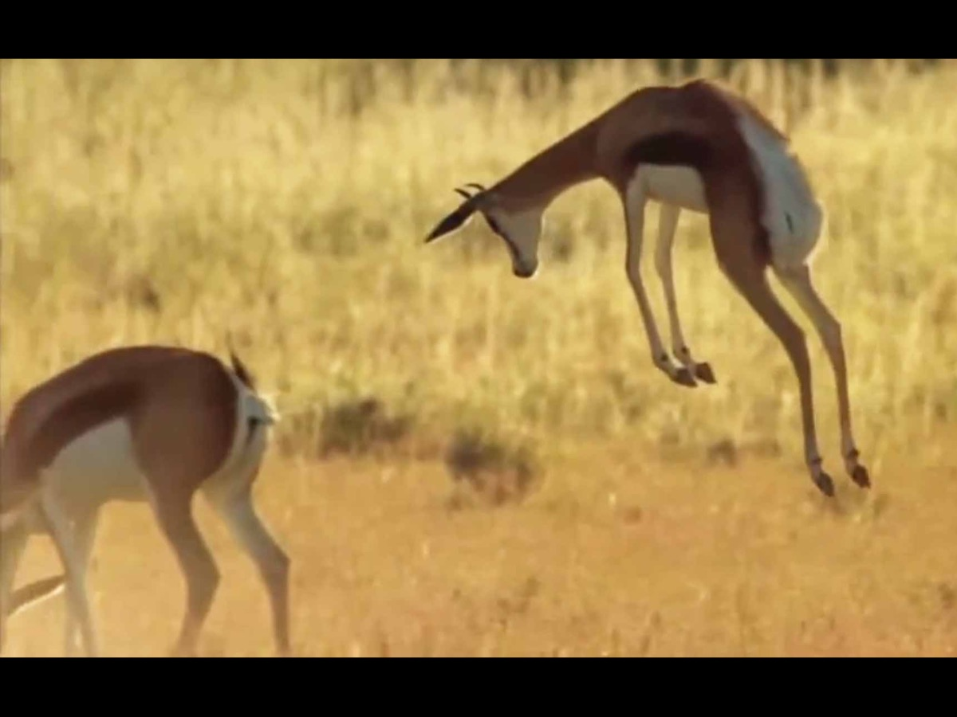
Notes:
And even in the Kruger national park the Springboks celebrate when their team wins.

Slide 36
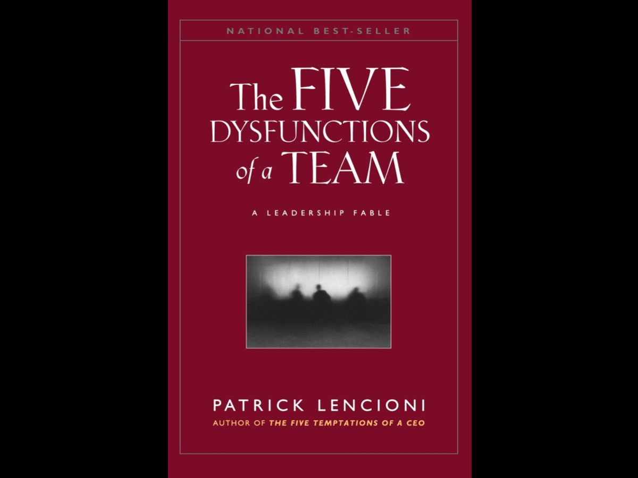
Notes:
The Five Dysfunctions of a Team. This section is based on a book by Patrick Lencioni: The Five Dysfunctions of a Team.

Slide 37
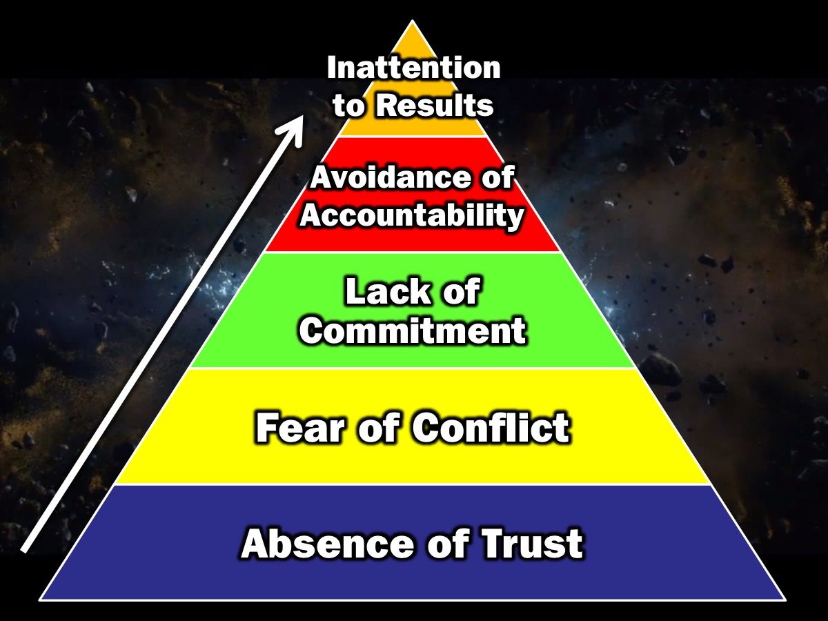
Notes:
The 5 Dysfunctions Pyramid. A journey from the Absence of Trust to Inattention to Results. (1) The first dysfunction is the absence of trust among team members. Essentially this stems from their unwillingness to be vulnerable within the group. Team members who are not genuinely open with one another about their mistakes and weaknesses make it impossible to build a foundation for trust. (2) This failure to build trust is damaging because it sets the tone for the second dysfunction: fear of conflict. Teams that lack trust are incapable of engaging in unfiltered and passionate debate of ideas. Instead, they resort to veiled discussions and guarded comments. (3) A lack of healthy conflict is a problem because it creates the third dysfunction of a team: lack of commitment. Without having aired their opinions in the course of passionate and open debate, team members rarely, if ever, buy in and commit to decisions, though they may agree in meetings. (4) Because of this lack of real commitment and buy in, team members develop the fourth dysfunction: avoidance of accountability. Without committing to a clear plan of action, even the most focussed and driven people are often hesitant to call their peers on actions and behaviours that seem counterproductive to the good of the team. (5) Failure to hold one another acountable creates an environment where the fifth dysfunction thrives: Inattention to results. It occurs when team members put their personal needs (such as ego, career development, or recognition) or even the needs of their department about the collective goals of the team.

Slide 38
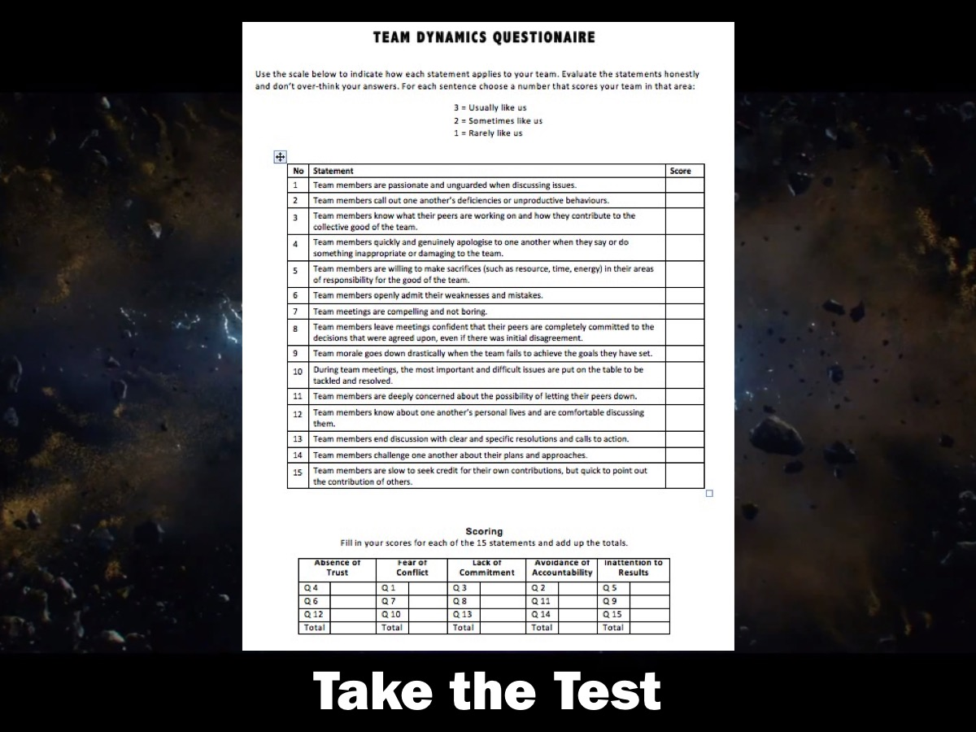
Notes:
Exercise: Complete the Team Dymanics questionnaire based on your current team situation.

Slide 39
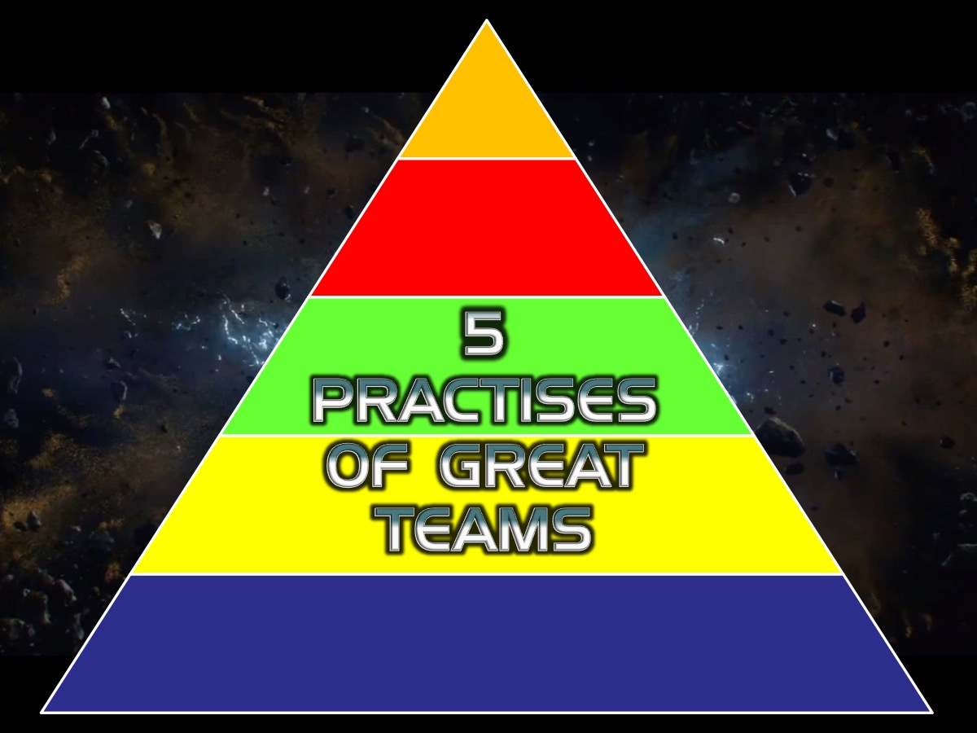
Notes:
Another way to understand the model is to take the opposite approach – a positive one – and imagine how members of truly cohesive teams behave. Here are the 5 Practises of Great Teams:

Slide 40
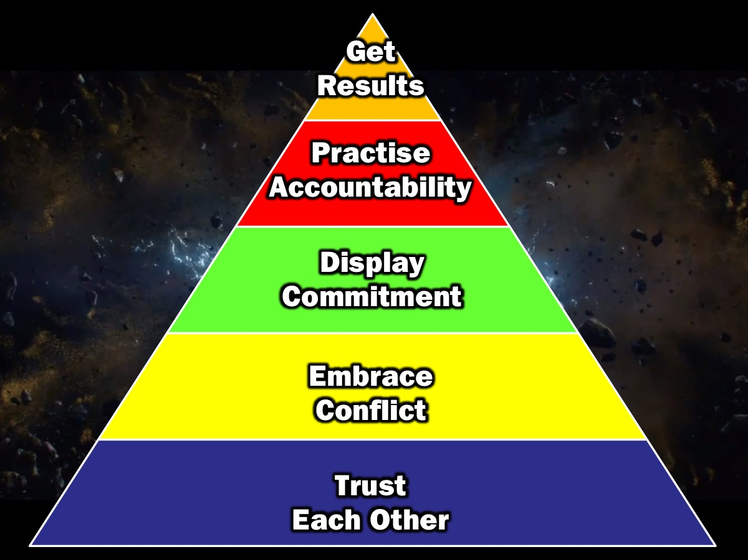
Notes:
(1) They trust Each Other. (2) They Embrace Conflict. (3) They Display Commitment. (4) They Practise Accountability. (5) They Get Results.

Slide 41
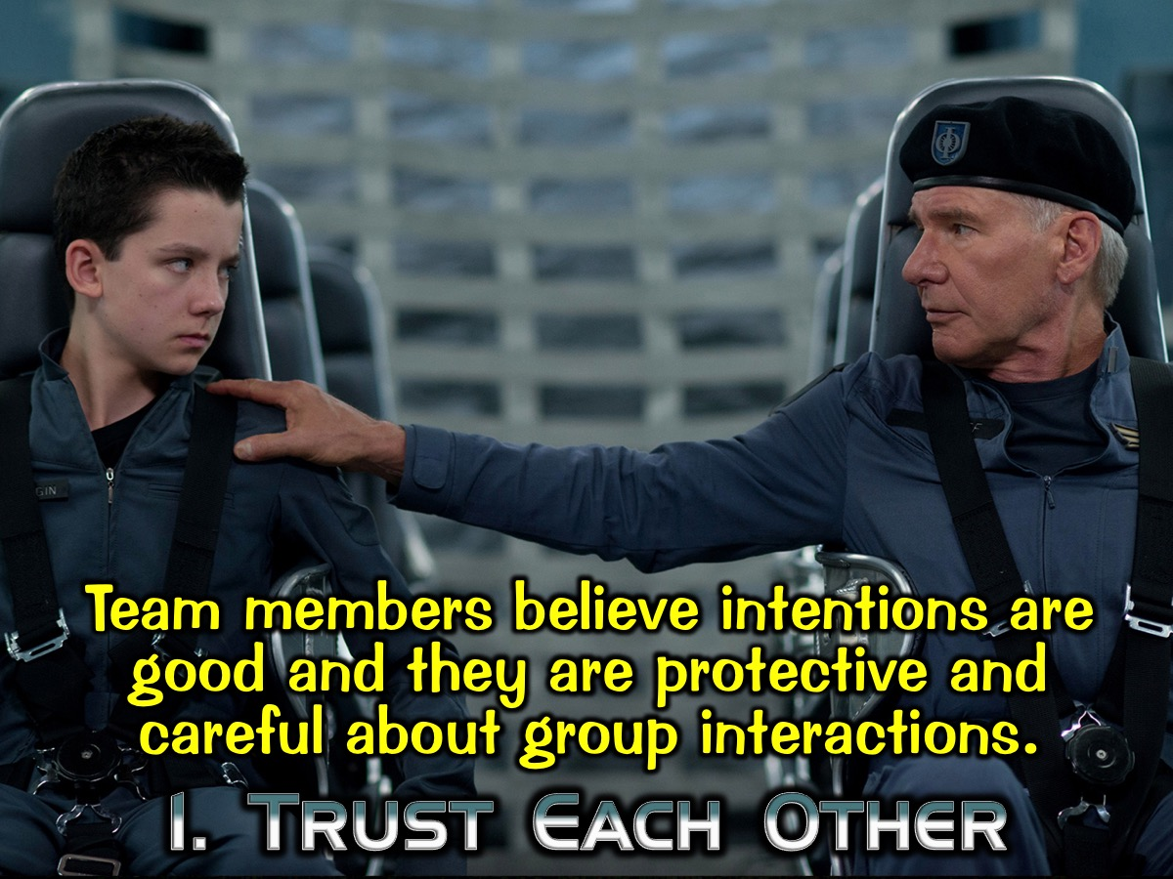
Notes:
1. They Trust Each other: Team members believe their peer’s intentions are good and they are protective and careful about group interactions.

Slide 42
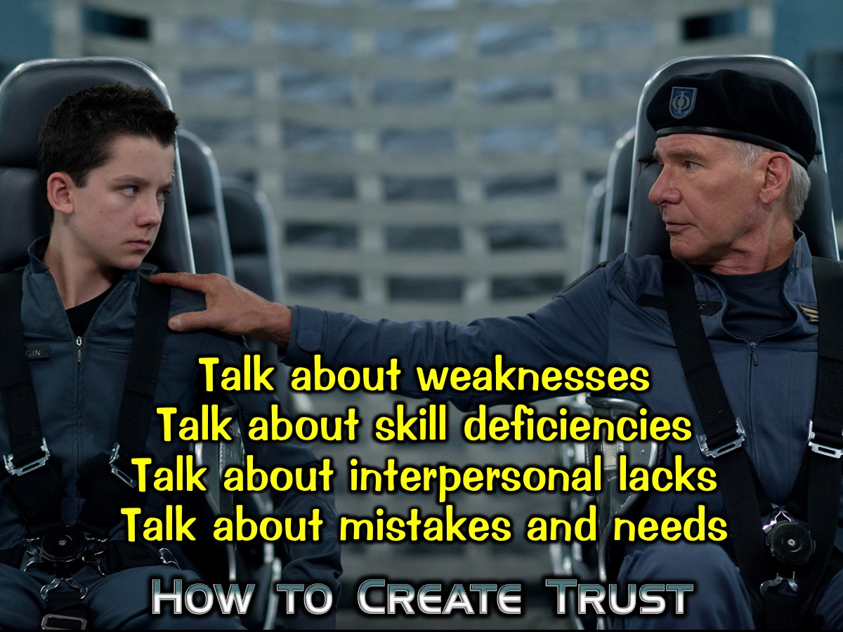
Notes:
How to Create Trust: Get people to talk about weaknesses; skill deficiencies; interpersonal lacks; mistakes and needs.

Slide 43
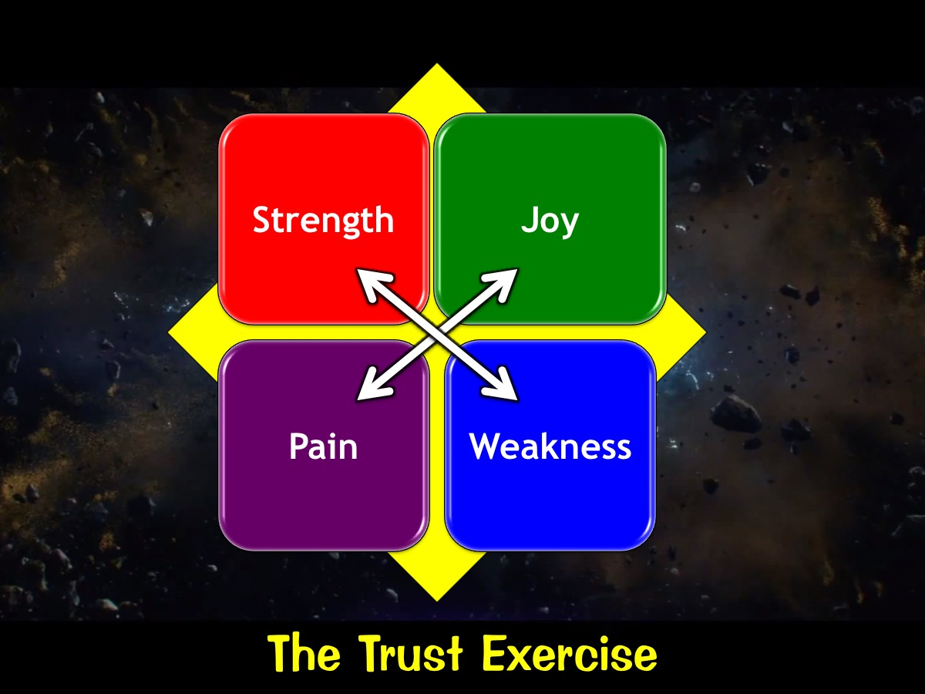
Notes:
Trust Exercise: Share a strength and a weakness, a joy and a pain with each other.

Slide 44
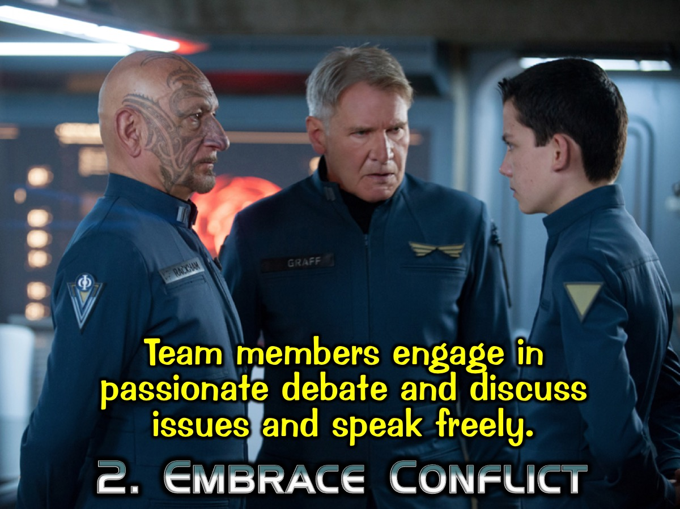
Notes:
2. They Embrace Conflict. Team members engage in passionate debate and discuss issues and speak freely.

Slide 45
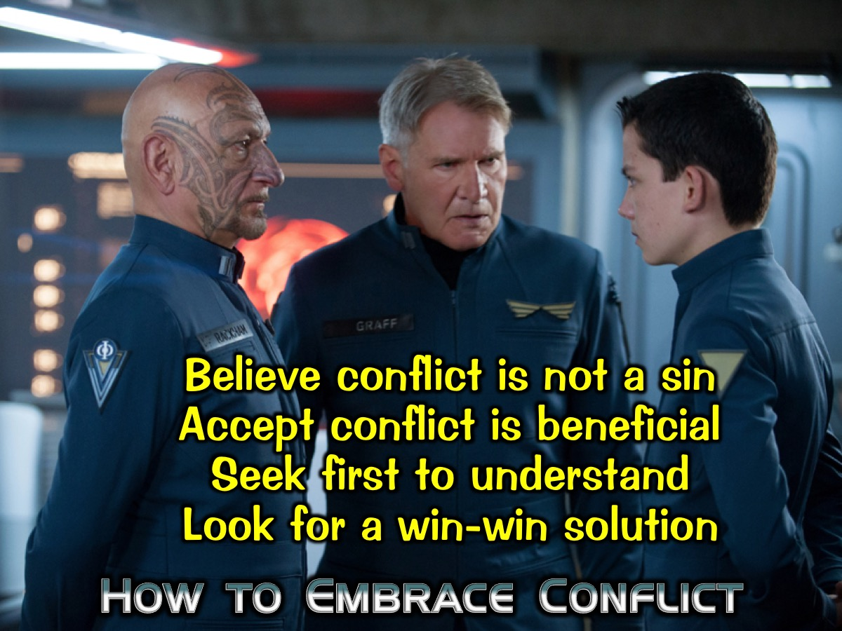
Notes:
How to Embrace Conflict: Believe conflict is not a sin; Accept conflict is beneficial; Seek first to understand; Look for a win-win solution.

Slide 46
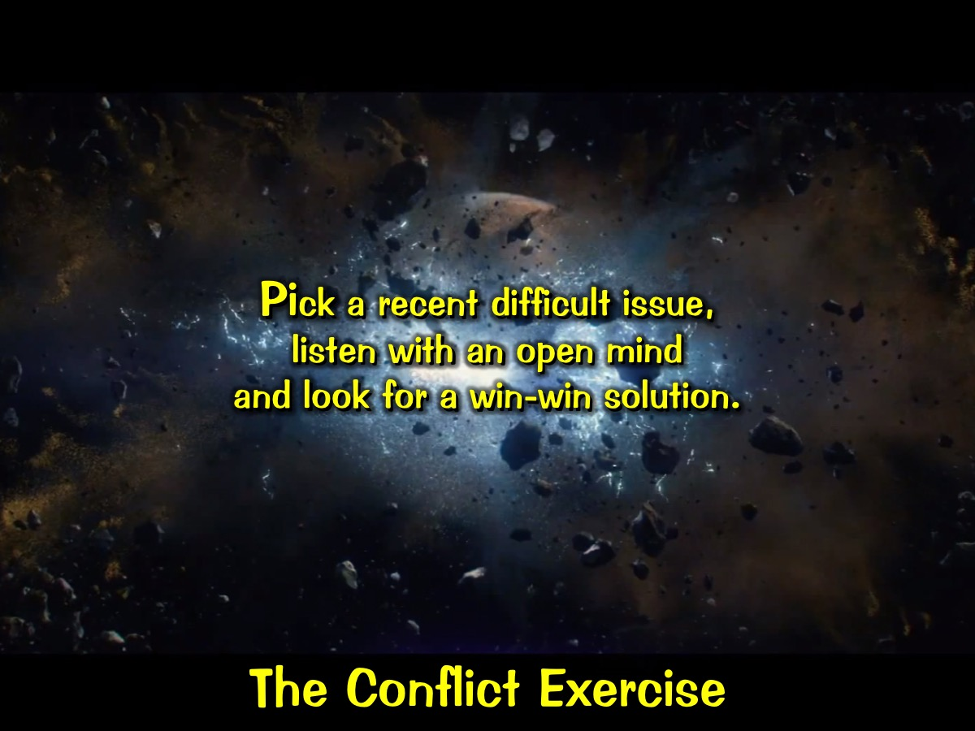
Notes:
Conflict Exercise: Pick a recent difficult issue, listen with an open mind and look for a win-win solution.

Slide 47
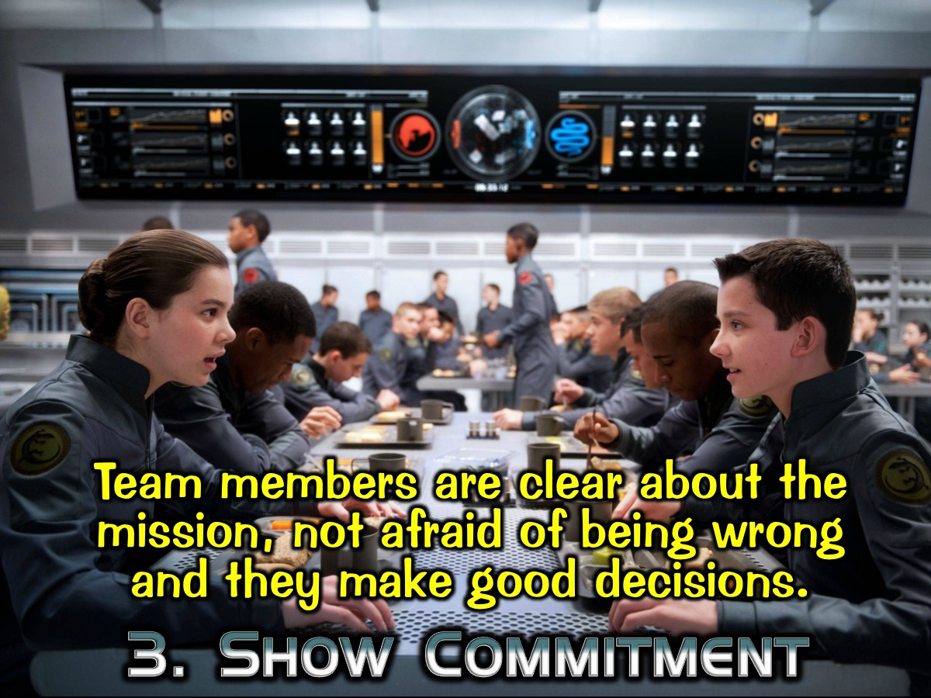
Notes:
3. They Commit to Plans: Team members are clear about the mission, not afraid of being wrong and they make timely and definitive decisions.

Slide 48
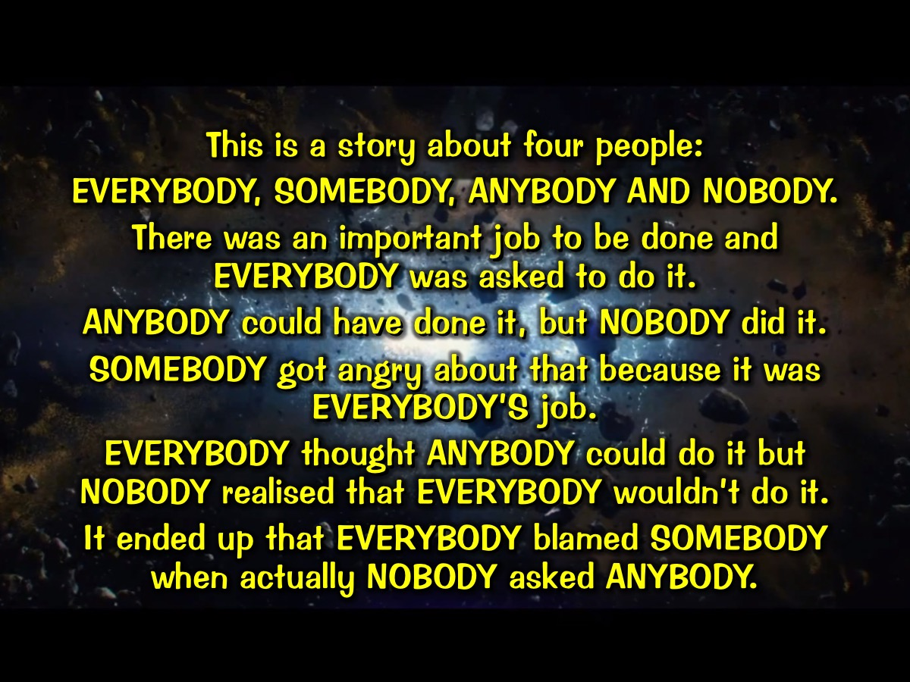
Notes:
This is a story about four people EVERYBODY, SOMEBODY, ANYBODY AND NOBODY. There was an important job to be done and EVERYBODY was asked to do it. ANYBODY could have done it, but NOBODY did it. SOMEBODY got angry about that because it was EVERYBODY’S job. EVERYBODY thought ANYBODY could do it but NOBODY realised that EVERYBODY wouldn’t do it. It ended up that EVERYBODY blamed SOMEBODY when actually NOBODY asked ANYBODY.

Slide 49
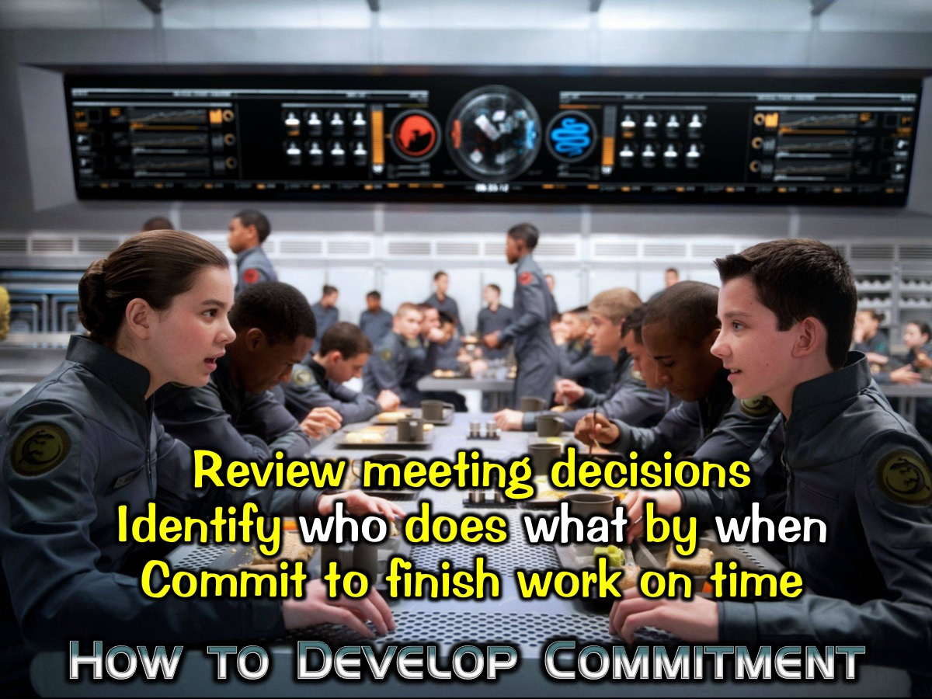
Notes:
How to Build Commitment: Review meeting decisions; Identify who does what by when; Commit to finish work on time.

Slide 50
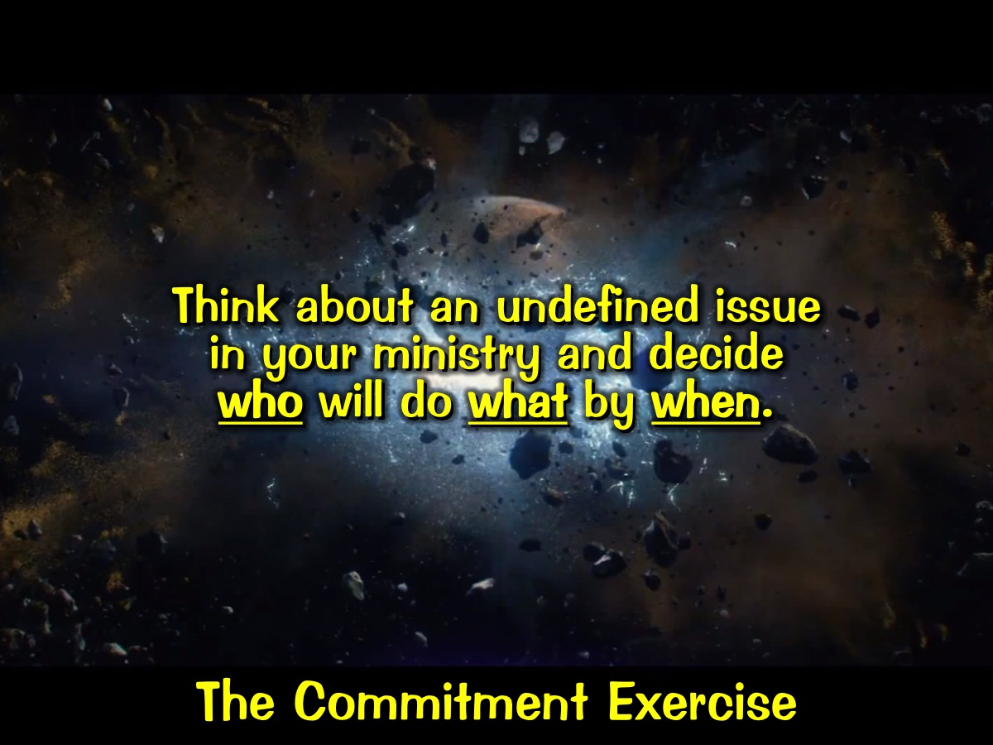
Notes:
Commitment Exercise: Think about an undefined issue in your ministry and decide who will do what by when.

Slide 51
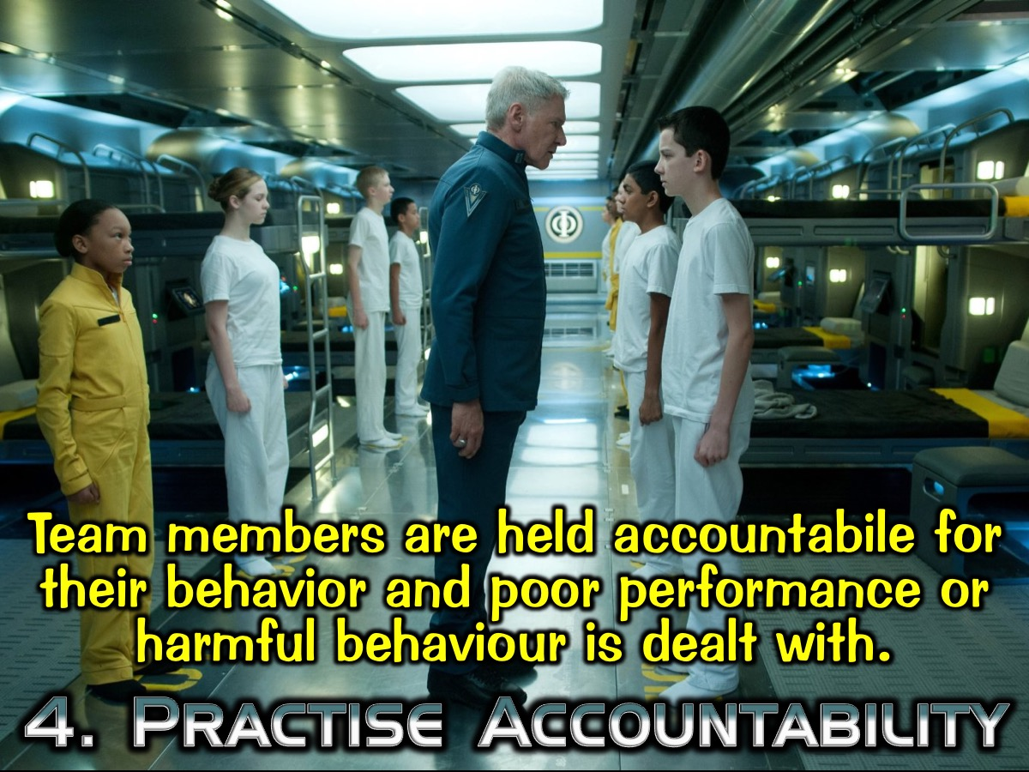
Notes:
4. They Practise Accountability: Team members are held accountabile for their behavior and poor performance or harmful behaviour is dealt with.

Slide 52
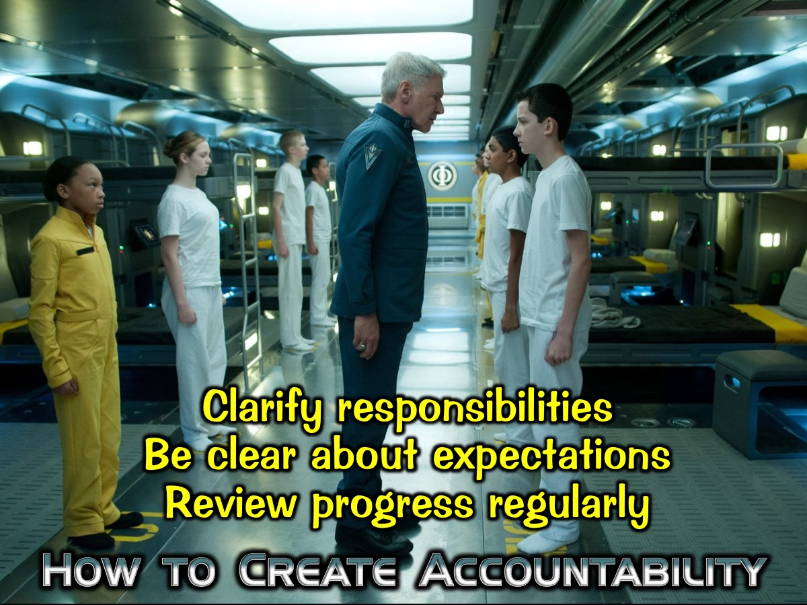
Notes:
How to Create Accountability: Clarify responsibilities; Be clear about expectations; Review progress regularly.

Slide 53
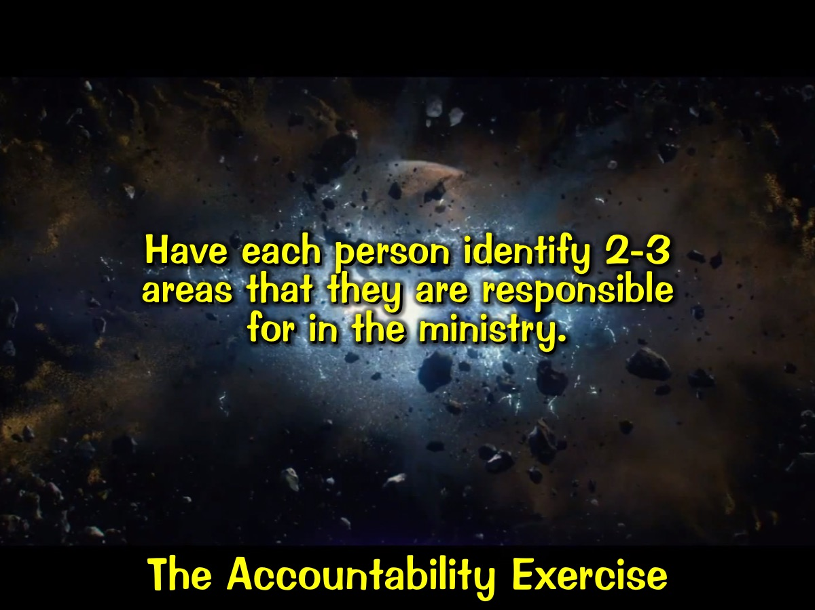
Notes:
Accountability Exercise: Have each person identify 2-3 areas that they are responsible for in the ministry.

Slide 54
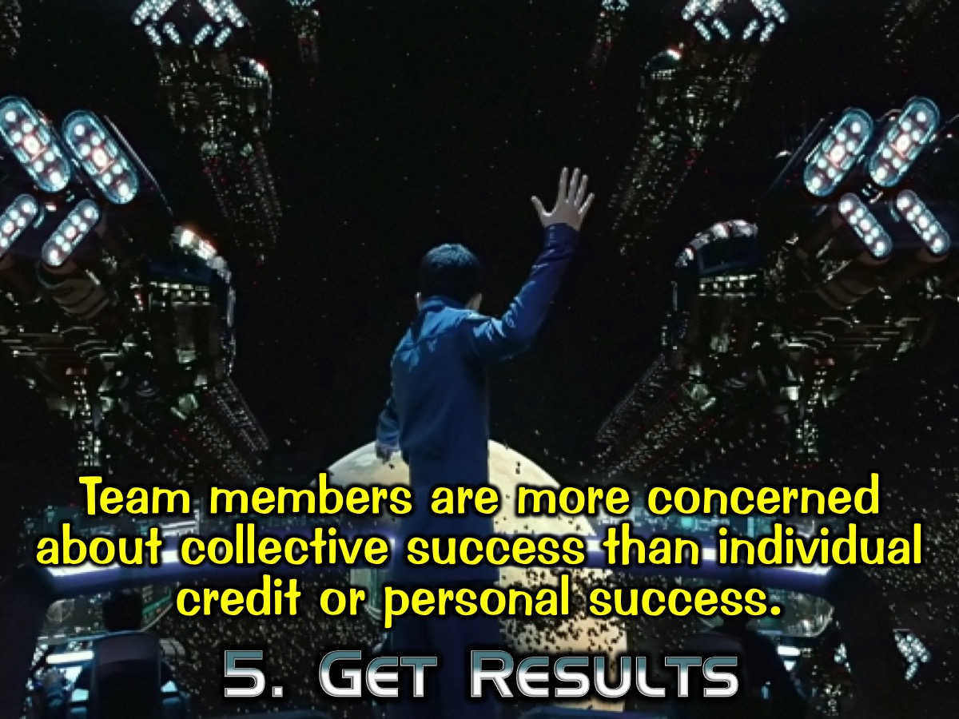
Notes:
5. They Get Results: Team members are concerned about collective success and not individual credit or personal success.

Slide 55
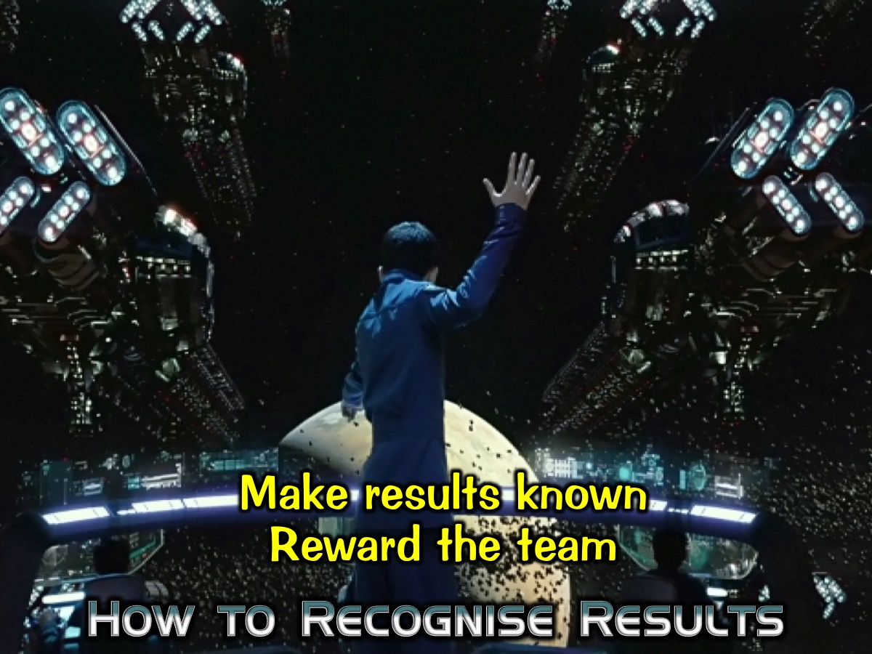
Notes:
How to Recognise Results: Make results known; Reward the team.

Slide 56
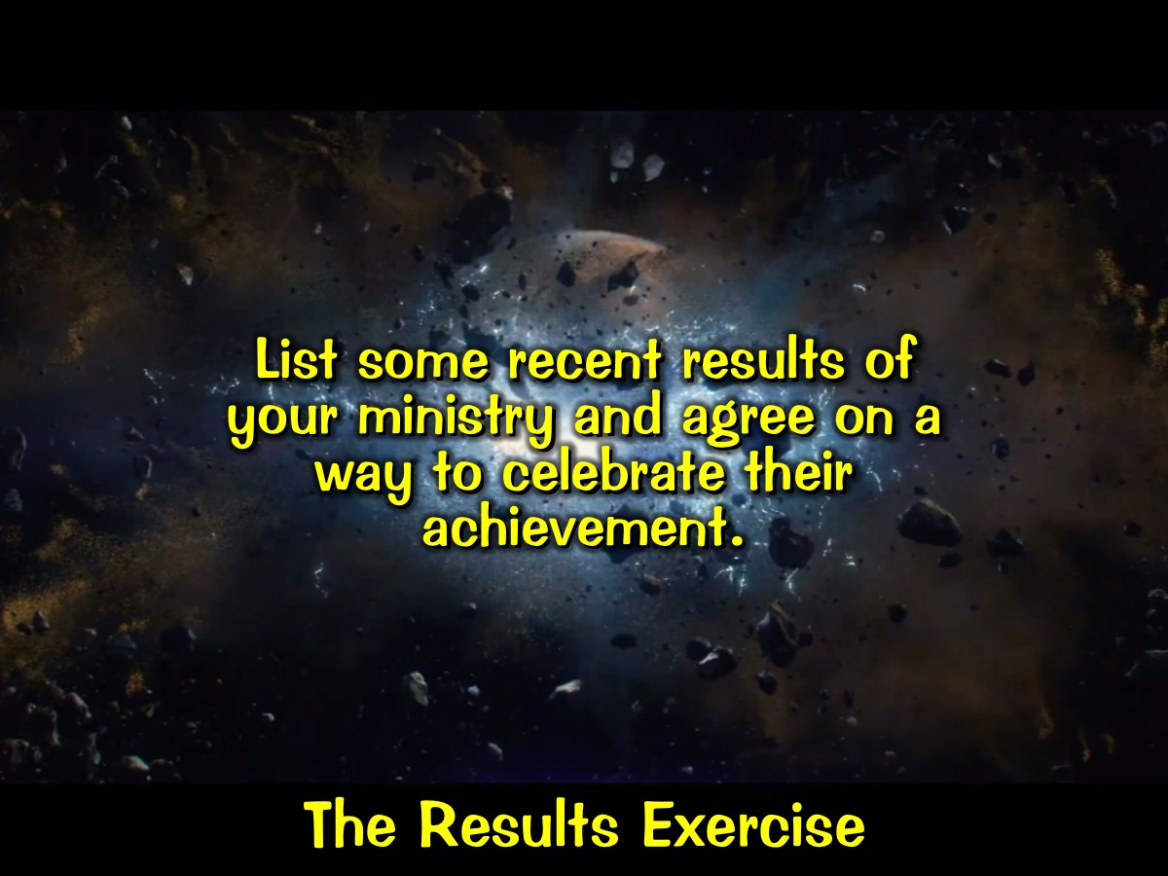
Notes:
Results Exercise: List some recent results of your ministry and agree on a way to celebrate their achievement.

Slide 57

Notes:
Here is a summary of what we have explored so far:

Slide 58
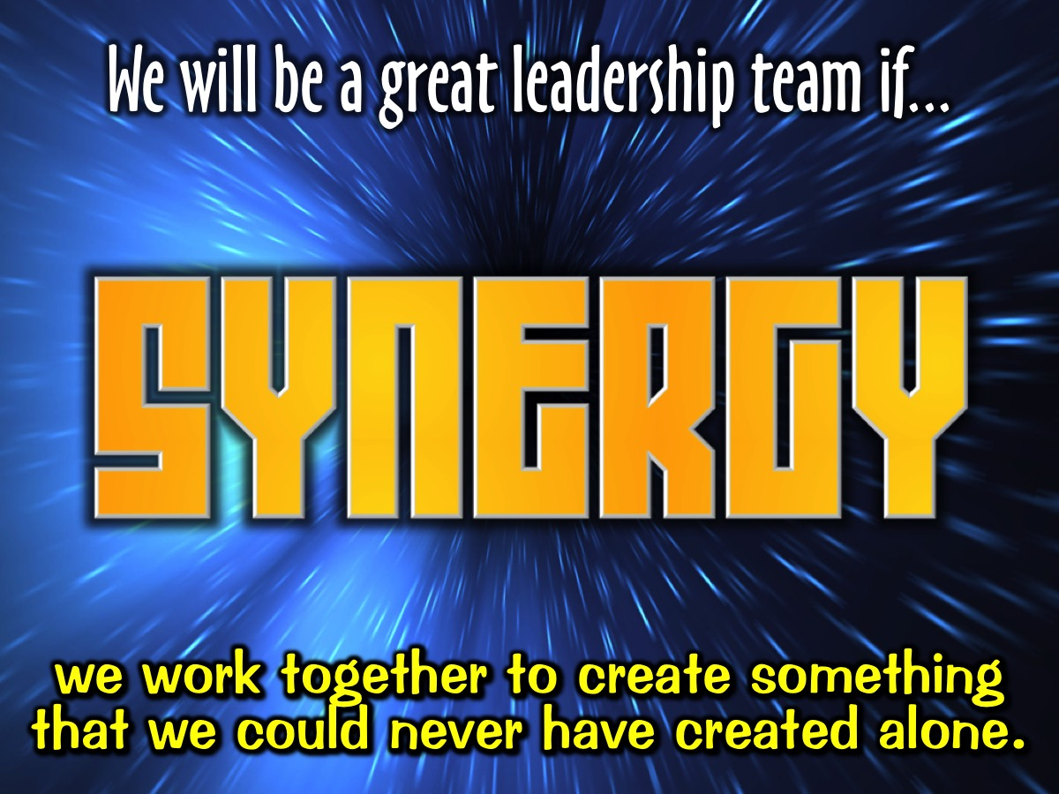
Notes:
We will be a great leadership team if work together to create something that we could never have created alone.

Slide 59
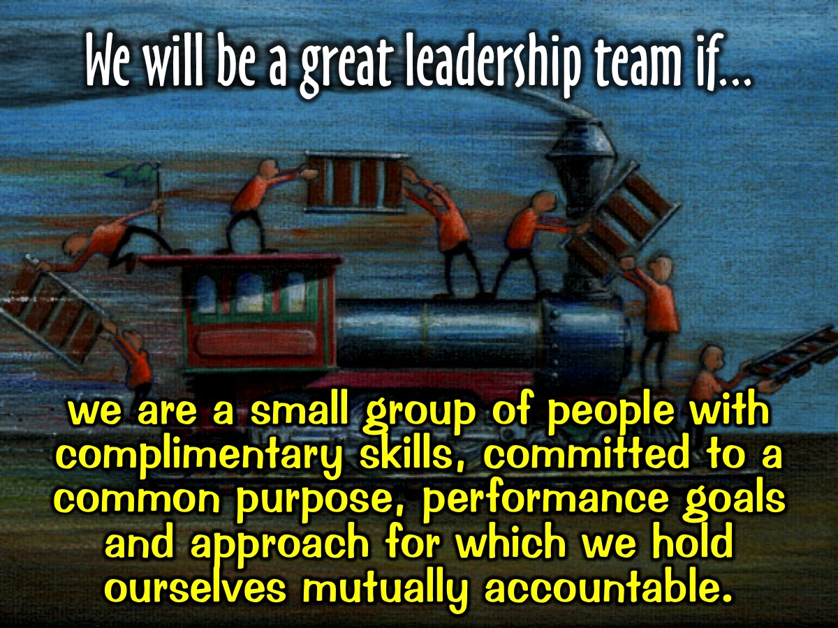
Notes:
We will be a great leadership team if we are a small group of people with complimentary skills, committed to a common purpose, performance goals and approach for which we hold ourselves mutually accountable.

Slide 60
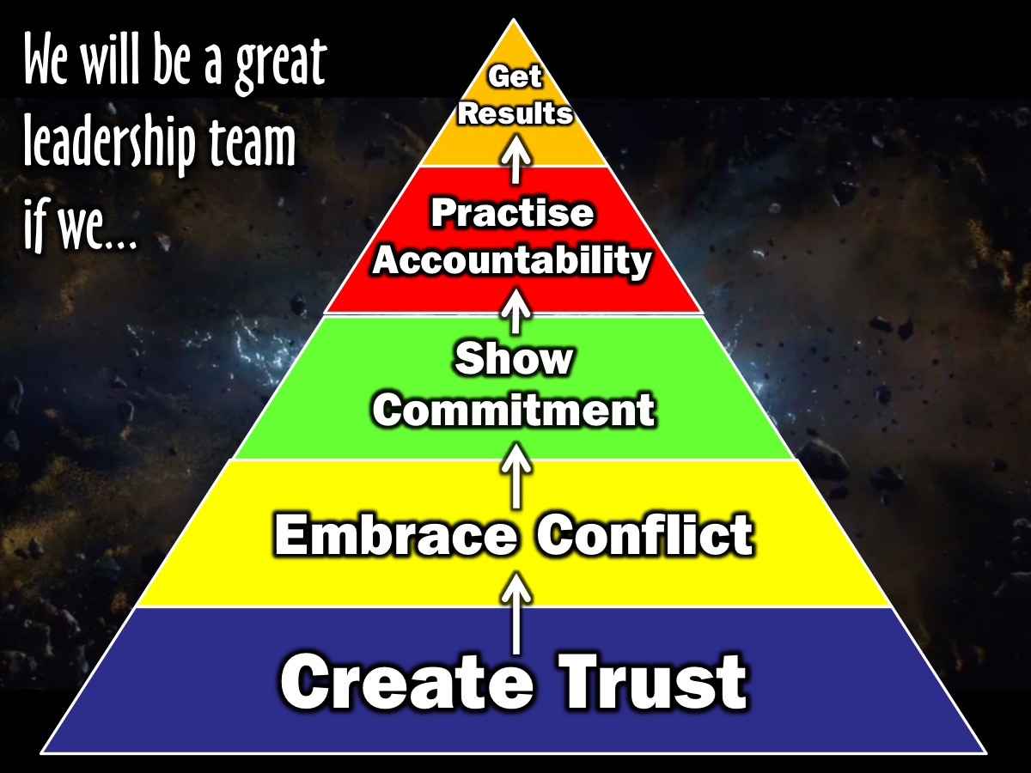
Notes:
We will be a great leadership team if we create trust, embrace conflict, show commitment, practise accountability and get results.

Slide 61

Notes:
Share: What one insight did you learn in this session that has the potential to significantly change your ministry?

Slide 62

Notes:
Youth Ministry Teamwork - here are some closing thoughts applying what we have explored in this session to youth ministry:

Slide 63

Notes:
1. Lead with a Team Mindset: avoid the long ranger approach and build healthy teams.

Slide 64

Notes:
2. Recruit Adult Leaders to minister among teens: preaching, mentoring, administrating, planning.

Slide 65

Notes:
Here are our current adult leaders at His Youth.

Slide 66

Notes:
3. Develop Teen Leaders: leading small groups, planning and running events, ministering spiritually.

Slide 67

Notes:
Here are our teen leaders at His Youth: On the top row are the matric leaders who leave us this year, then there is the existing group of teen leaders.

Slide 68

Notes:
4. Build Healthy Teams: create trust, allow conflict, commit to decision, ensure accountability, achieve result.

Slide 69

Notes:
5. Keep Expanding Teams: Find people who are faithful, available and teachable.

Slide 70

Notes:
Here are some of the teens that we are developing to bring onto our leadership team.

Slide 71

Notes:
6. Use Social Media: Set up interactive networks on Facebook, Whatsapp, etc.

Slide 72

Notes:
We have three WhatsApp group at presented: One for adult leaders, one for our small group of teens leader (including adult leaders) and one for the Connect Group leaders (which included every one).

Slide 73
Notes:
Raising Team

