Slide 1


Slide 2
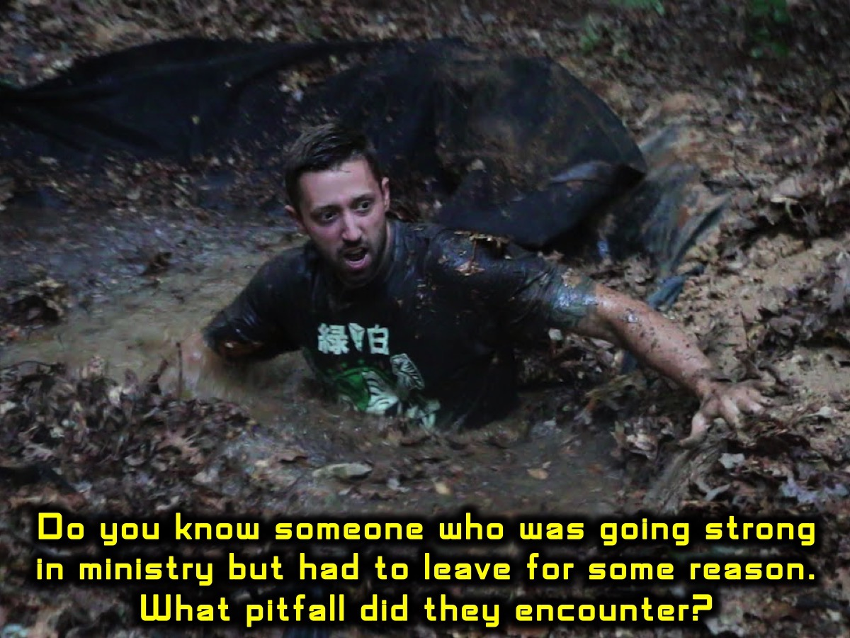
Notes:
Sharing: Think of a person you know who was going strong in ministry and who had to leave ministry for some reason. What pitfall did they encounter?

Slide 3
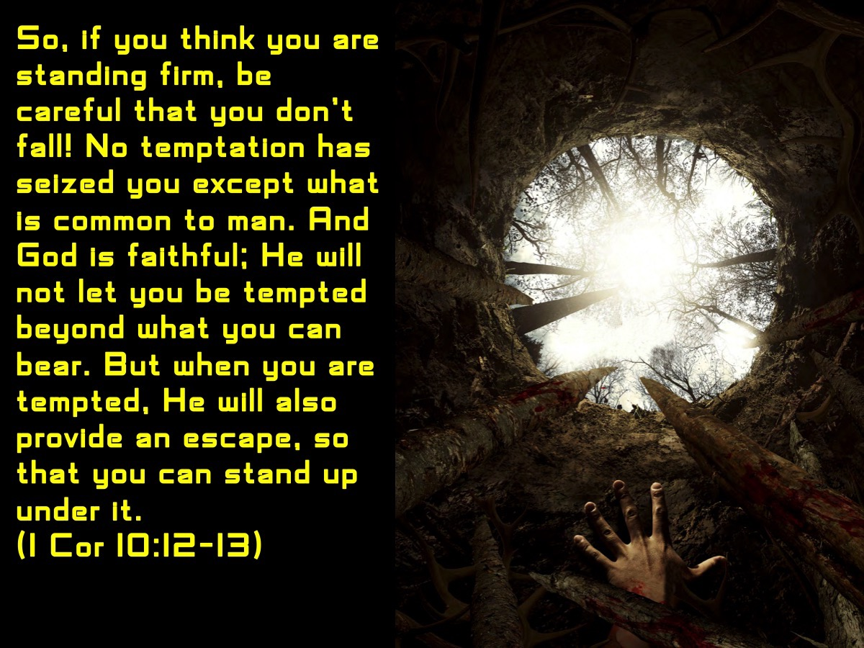
Notes:
We would be wise to avoid thinking that we are immune from falling into a pit: “So, if you think you are standing firm, be careful that you don't fall! No temptation has seized you except what is common to man. And God is faithful; He will not let you be tempted beyond what you can bear. But when you are tempted, He will also provide an escape, so that you can stand up under it.” (1 Corinthians 10:12-13)

Slide 4
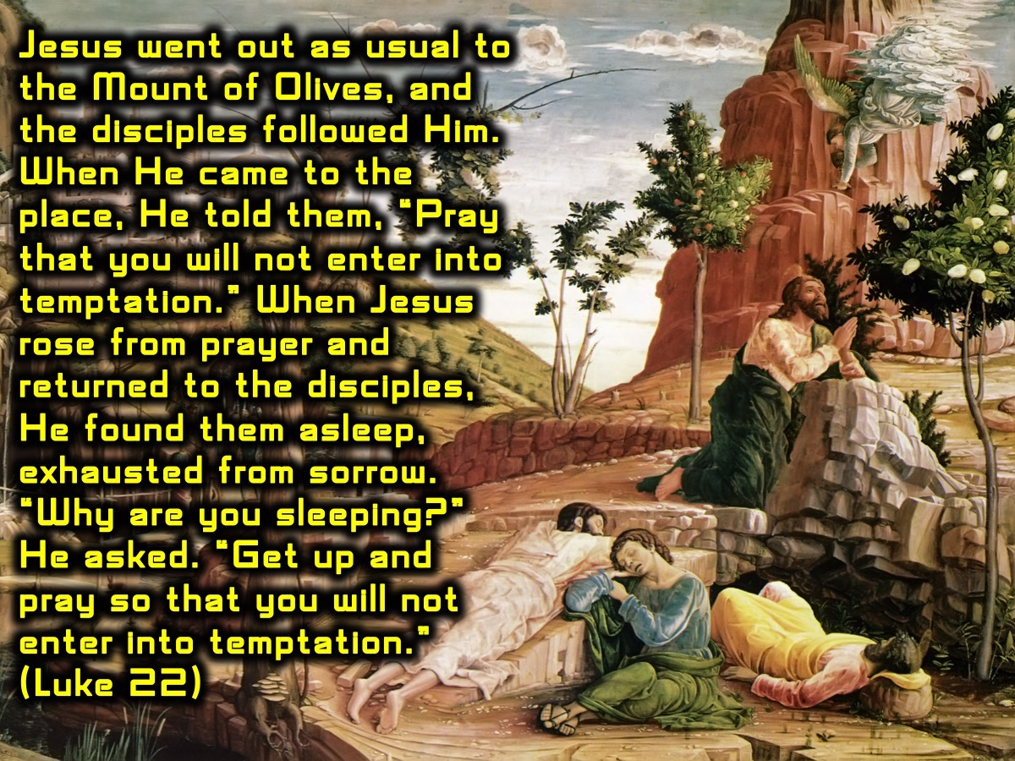
Notes:
Even Jesus’ disciples fell into a pit at least on one occasion: “Jesus went out as usual to the Mount of Olives, and the disciples followed Him. When He came to the place, He told them, “Pray that you will not enter into temptation.” When Jesus rose from prayer and returned to the disciples, He found them asleep, exhausted from sorrow. “Why are you sleeping?” He asked. “Get up and pray so that you will not enter into temptation.” (Luke 22:39,40,45,46)

Slide 5
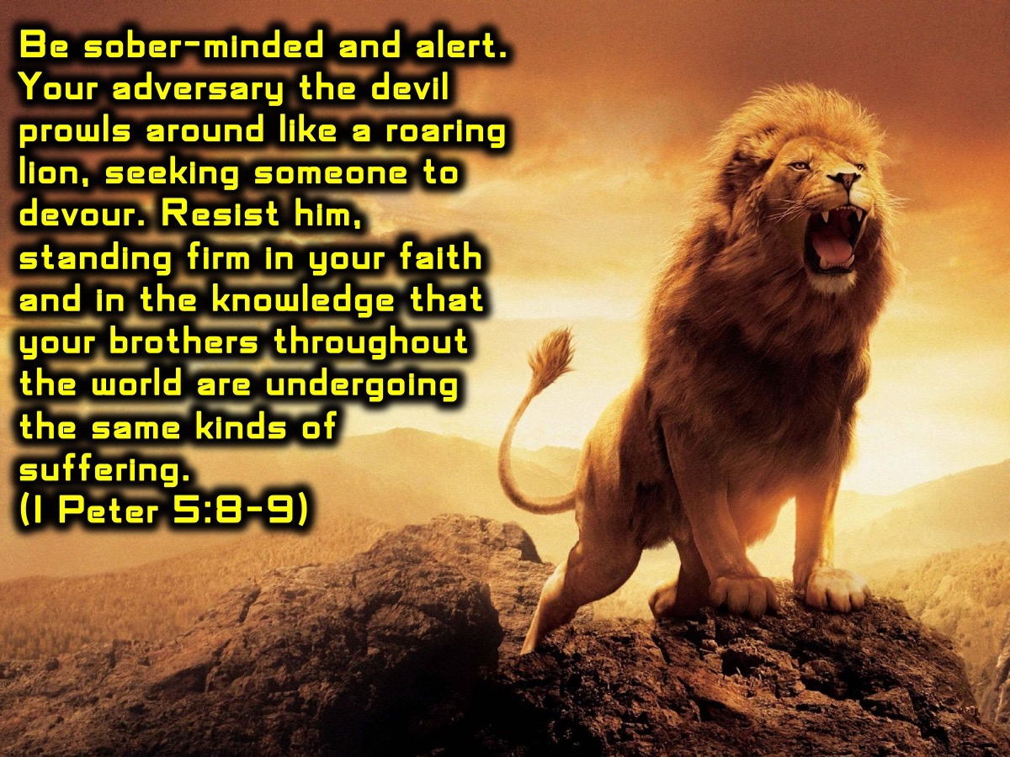
Notes:
The Evil One is always at work to trip us up and get us to fall into a pit: “Be sober-minded and alert. Your adversary the devil prowls around like a roaring lion, seeking someone to devour. Resist him, standing firm in your faith and in the knowledge that your brothers throughout the world are undergoing the same kinds of suffering. (1 Peter 5:8-9).

Slide 6
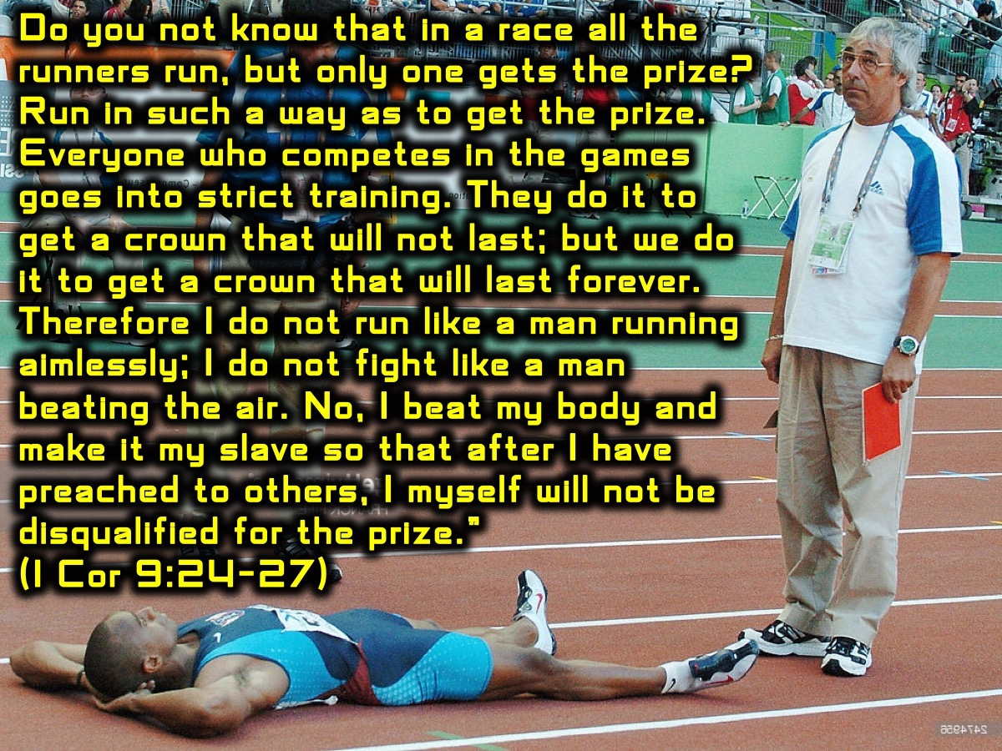
Notes:
The Apostle Paul urged us to make sure we don’t end up being disqualified: “Do you not know that in a race all the runners run, but only one gets the prize? Run in such a way as to get the prize. Everyone who competes in the games goes into strict training. They do it to get a crown that will not last; but we do it to get a crown that will last forever. Therefore I do not run like a man running aimlessly; I do not fight like a man beating the air. No, I beat my body and make it my slave so that after I have preached to others, I myself will not be disqualified for the prize.” (1 Corinthians 9:24-27)

Slide 7
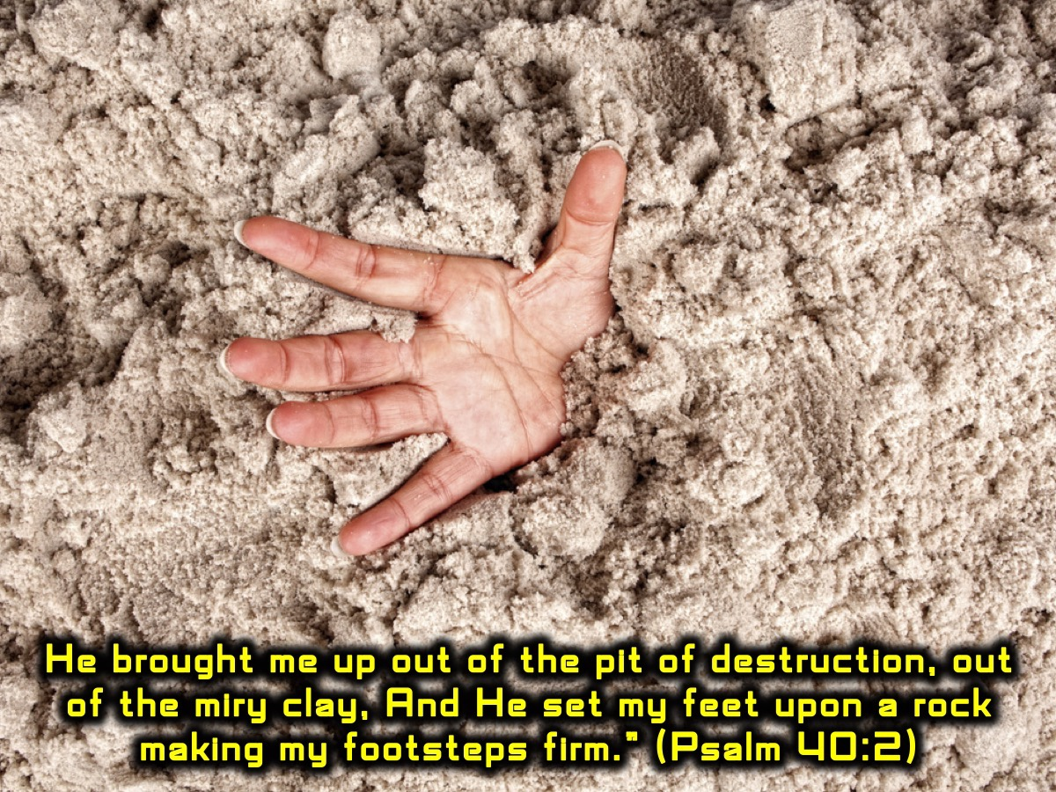
Notes:
Here is the good news that God is able to restore us even when we have fallen into a pit: “He brought me up out of the pit of destruction, out of the miry clay, And He set my feet upon a rock making my footsteps firm.” (Psalm 40:2)

Slide 8
Notes:
Here are my top 10 pitfalls to avoid in youth ministry – and they just happen to all be about losing something:

Slide 9
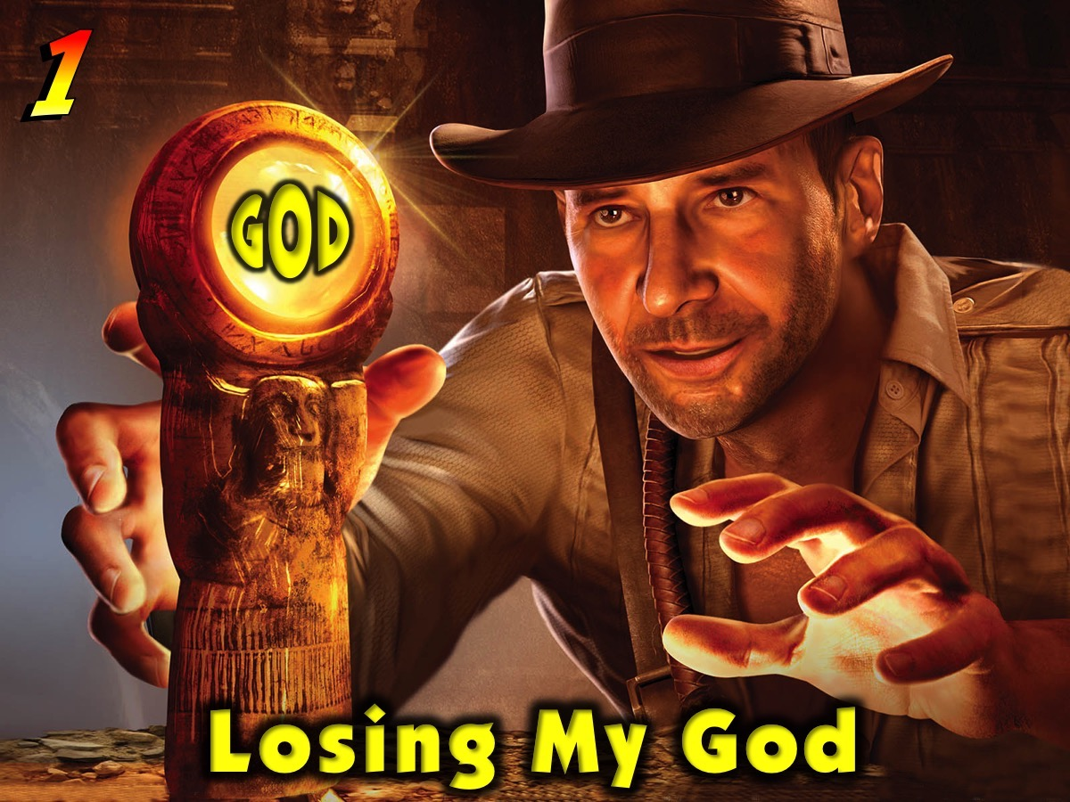
Notes:
1. Losing My God.

Slide 10
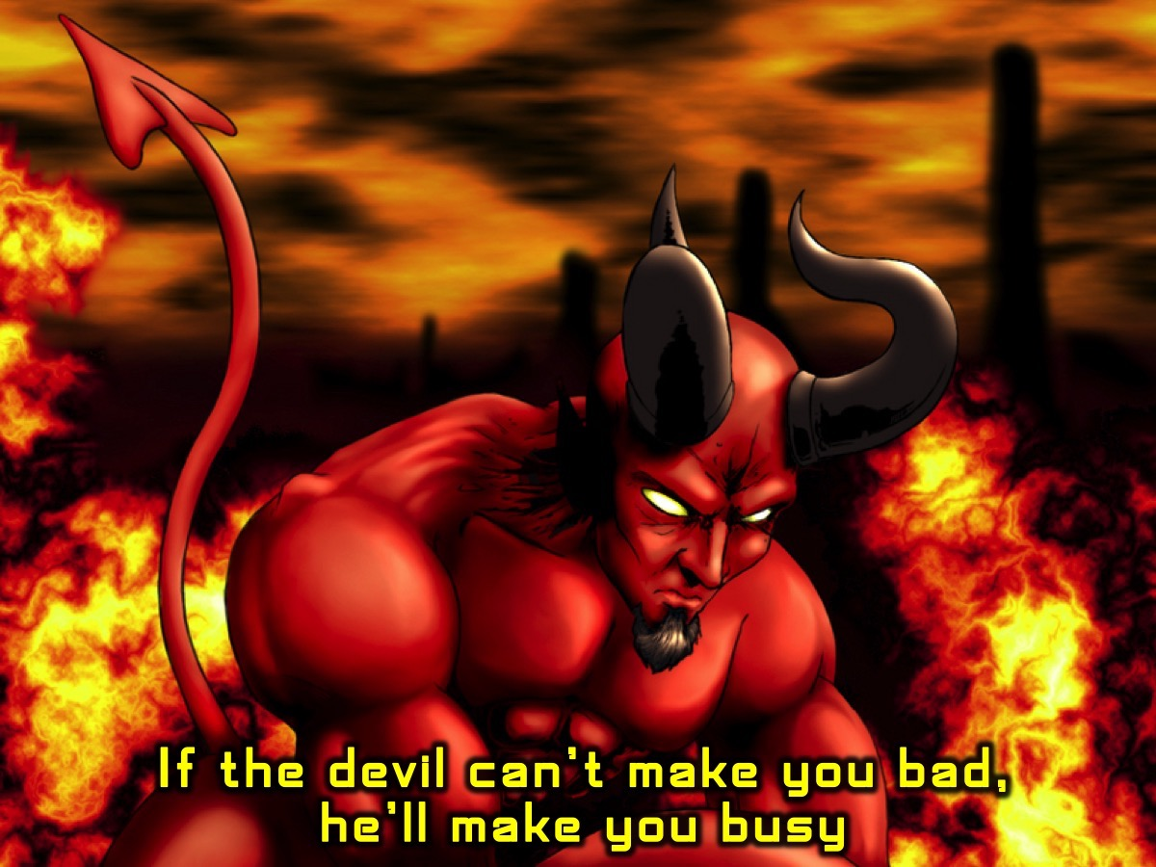
Notes:
Someone once said: “If the devil can’t make you bad, he will make you busy.” It is possible to get so busy doing God’s work that we don’t have time to connect with God in personal devotions including prayer and the Word.

Slide 11
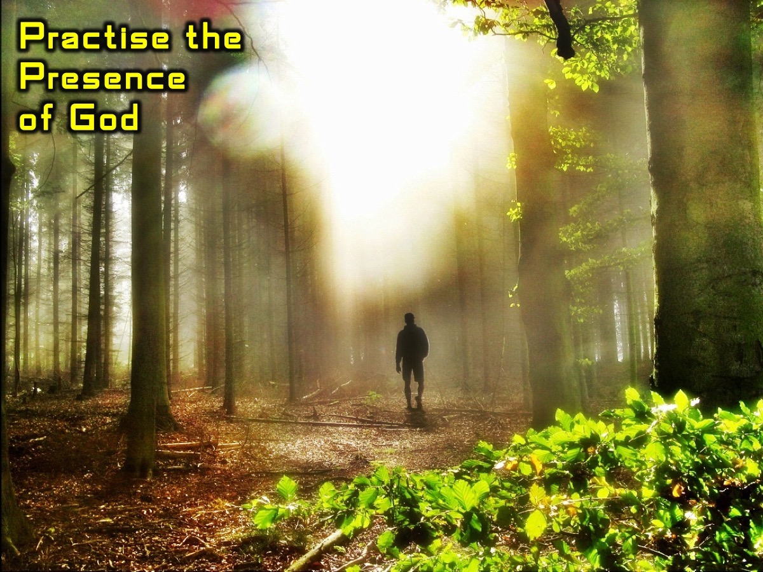
Notes:
It is critical to practice the presence of God throughout your day

Slide 12

Notes:
and also carve out time for devotions, especially when we find we have a full schedule and deadlines are mounting.

Slide 13
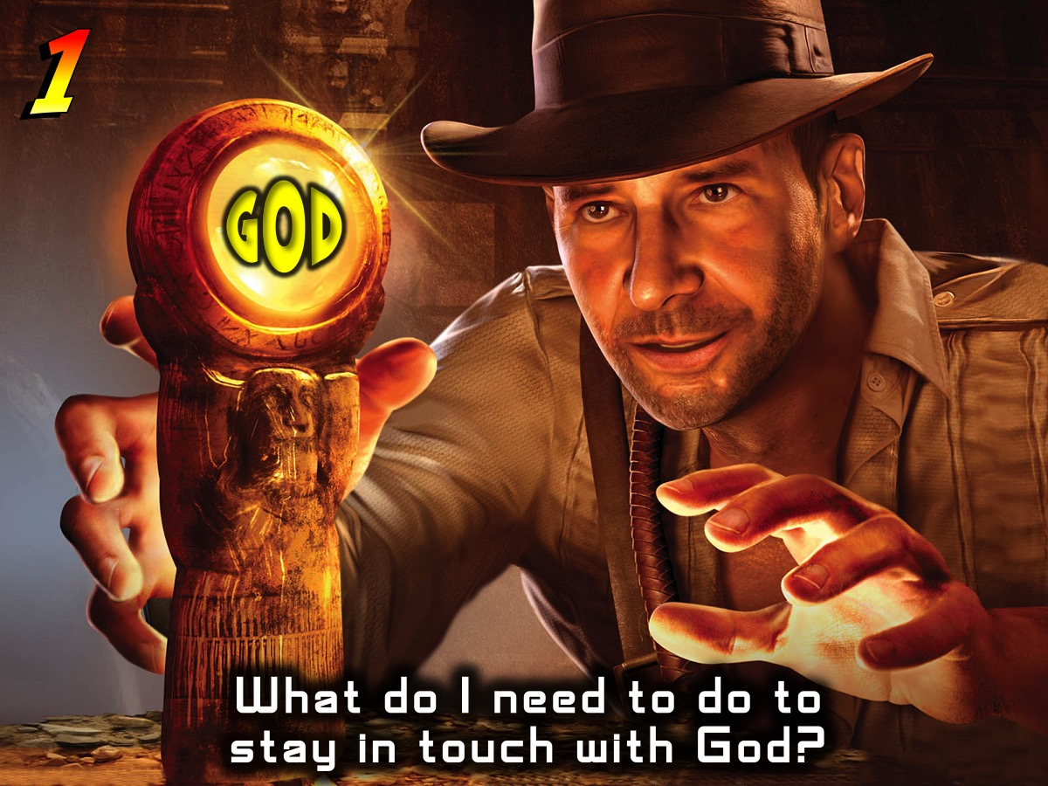
Notes:
Reflection: What do I need to do to ensure that I don’t lose my God.

Slide 14
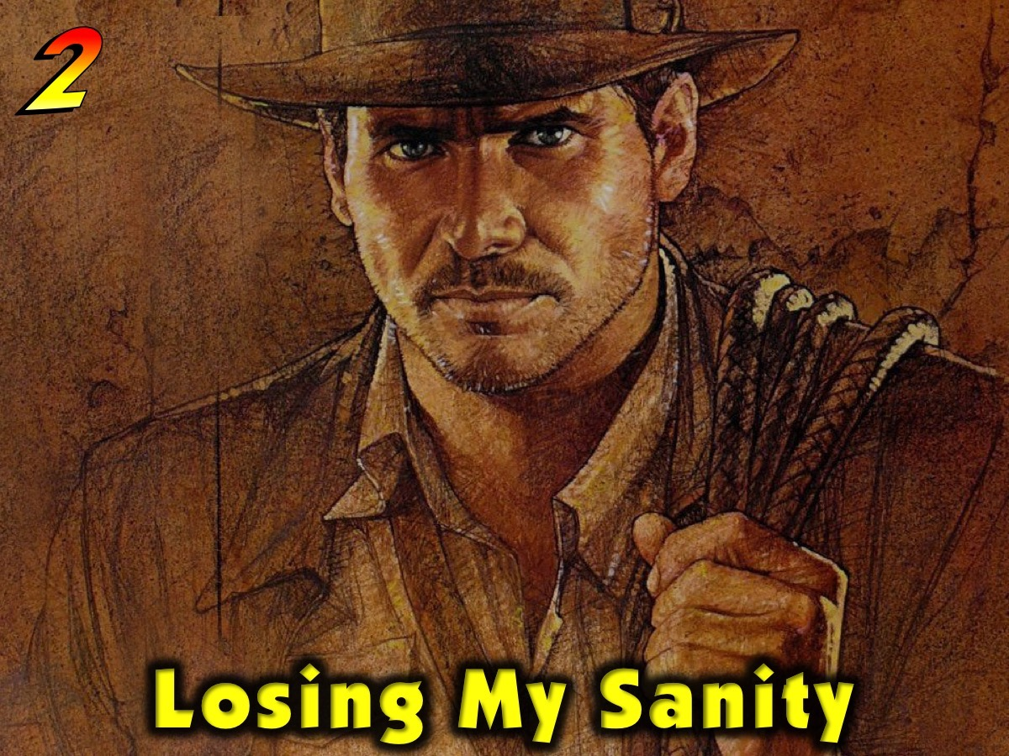
Notes:
2. Losing My Sanity: It is possible to get to a dangerous place where everything I eat, sleep or drink is related to youth ministry.

Slide 15
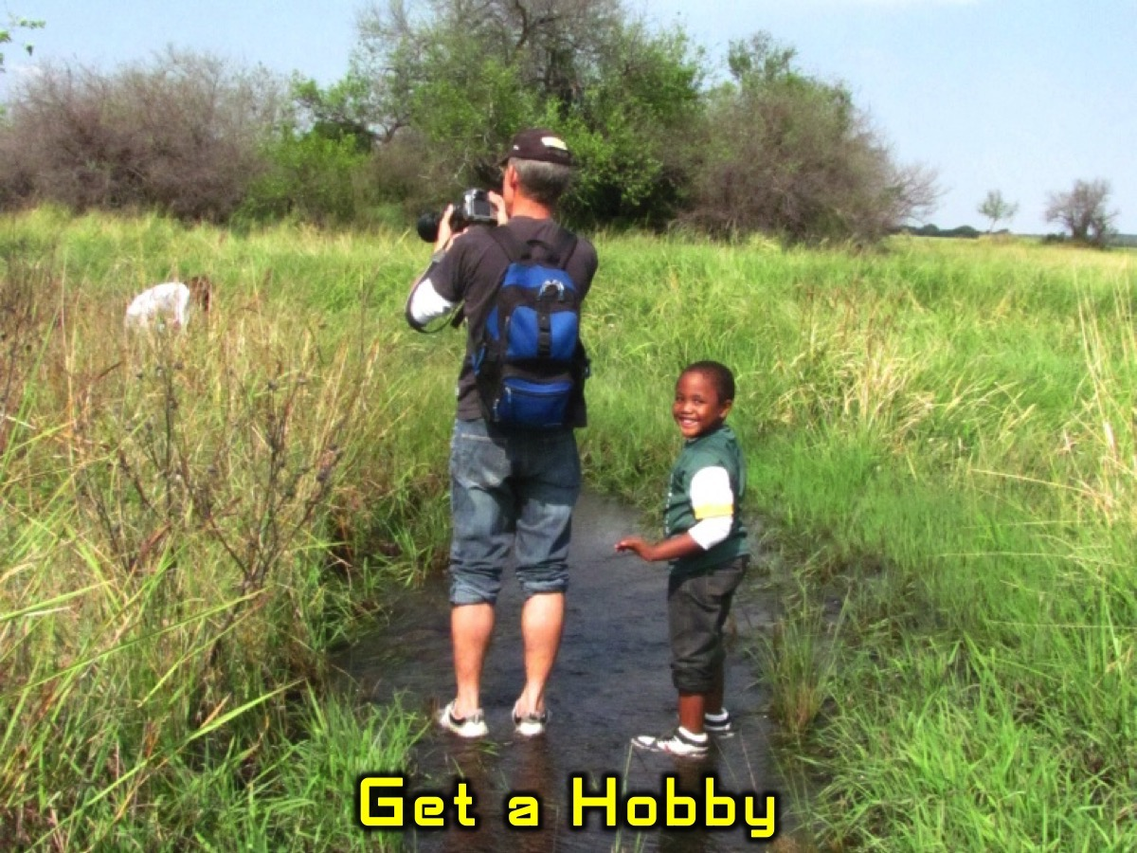
Notes:
At one point, my wife actually challenged me that I needed to get a hobby because I had become totally obsessed with youth work and all that goes with seeking to have a local and global impact. I took up birdwatching as a hobby and have found that time out in the bush on a Monday is the perfect way to reconnect with myself and ensure that I start each week rested and refreshed – hey, even God takes time out to rest, so why don’t we?

Slide 16
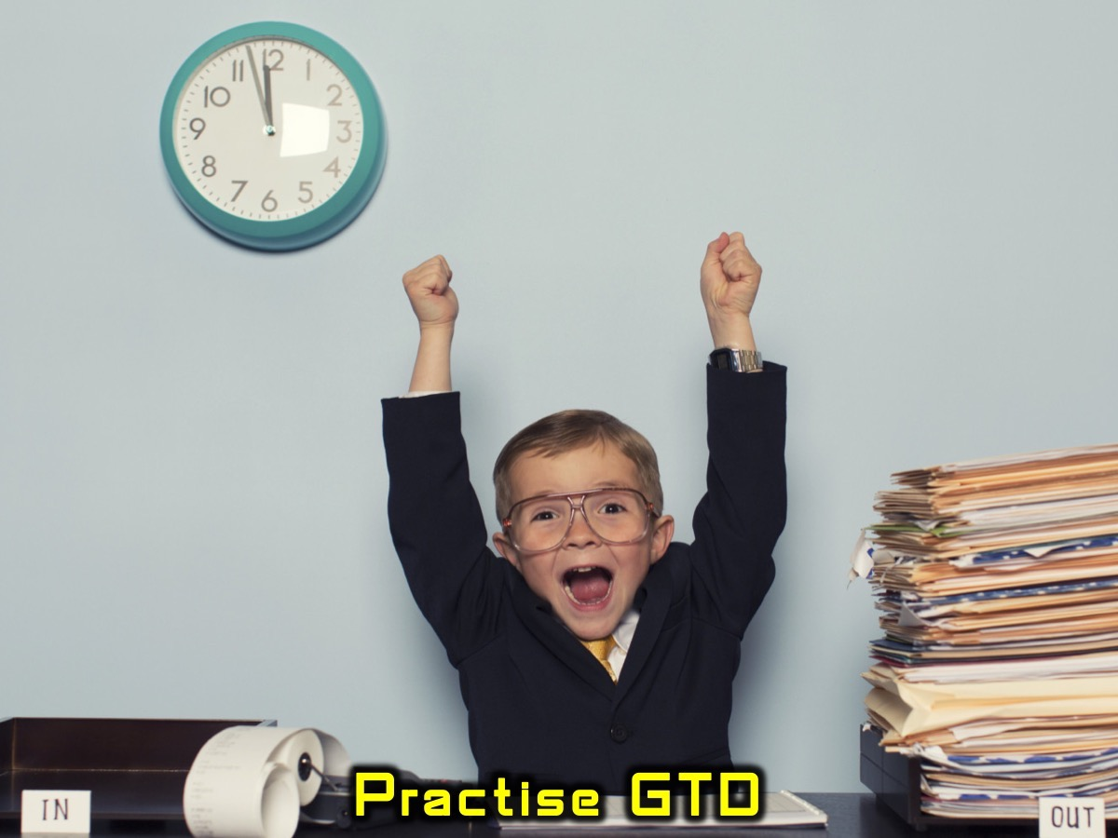
Notes:
Another way in which my sanity is preserved is by following the Getting Things Done approach – an action management system that ensures that all my commitments are tracked and nothing stays in my mind but is captured and tracked in an effective system that is reviewed regularly.

Slide 17
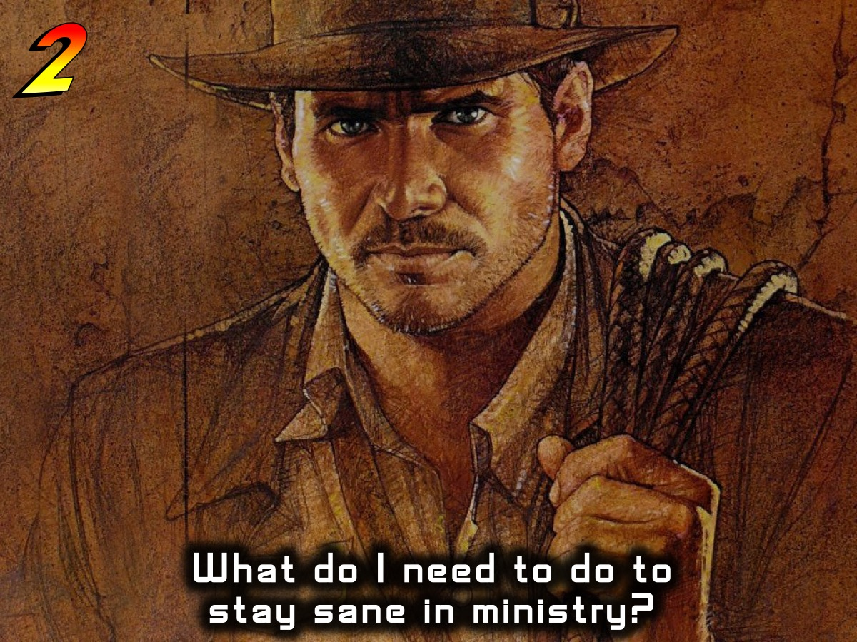
Notes:
Reflection:

Slide 18
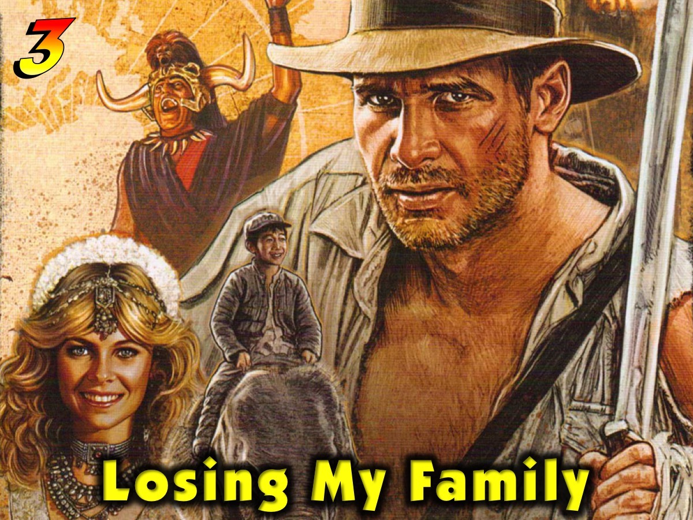
Notes:
3. Losing My Family: Some years back I nearly lost my marriage because of my addiction to work and a habit of giving time to everyone and everything else instead of my family.

Slide 19
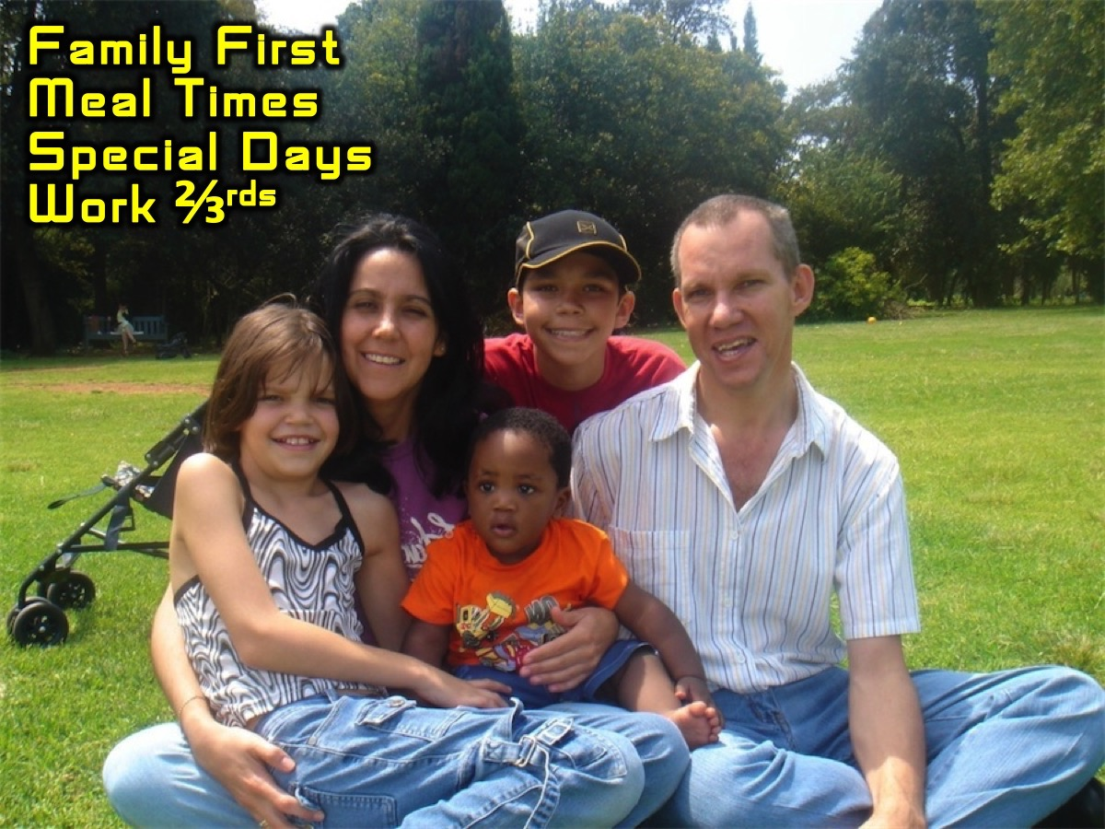
Notes:
God has called us to give our best to our family and not just the leftovers. This means making tough choices about what we will get involved in both inside and outside our youth ministry at church and also ensure that we build healthy habits around time off, meal times, birthdays and other celebrations. If we have kids to carve out one-on-one time to hang out with each kid. One of my habits has been to try and only work two-thirds of the day – so if I have an evening meeting then I will take some downtime for myself and my family either during that morning or afternoon – or the following day.

Slide 20
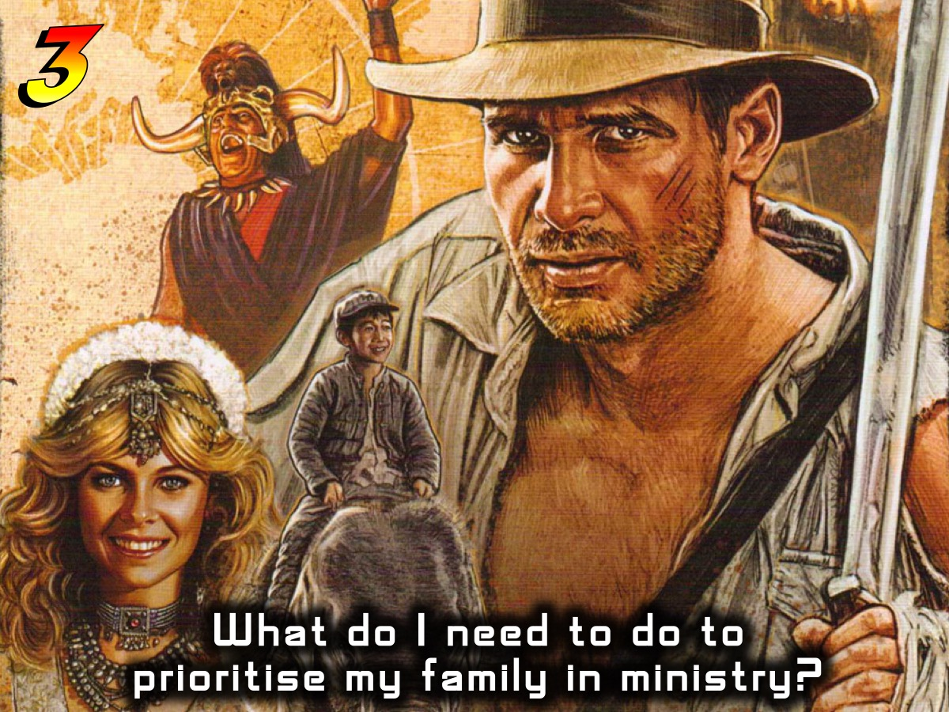
Notes:
Reflection:

Slide 21
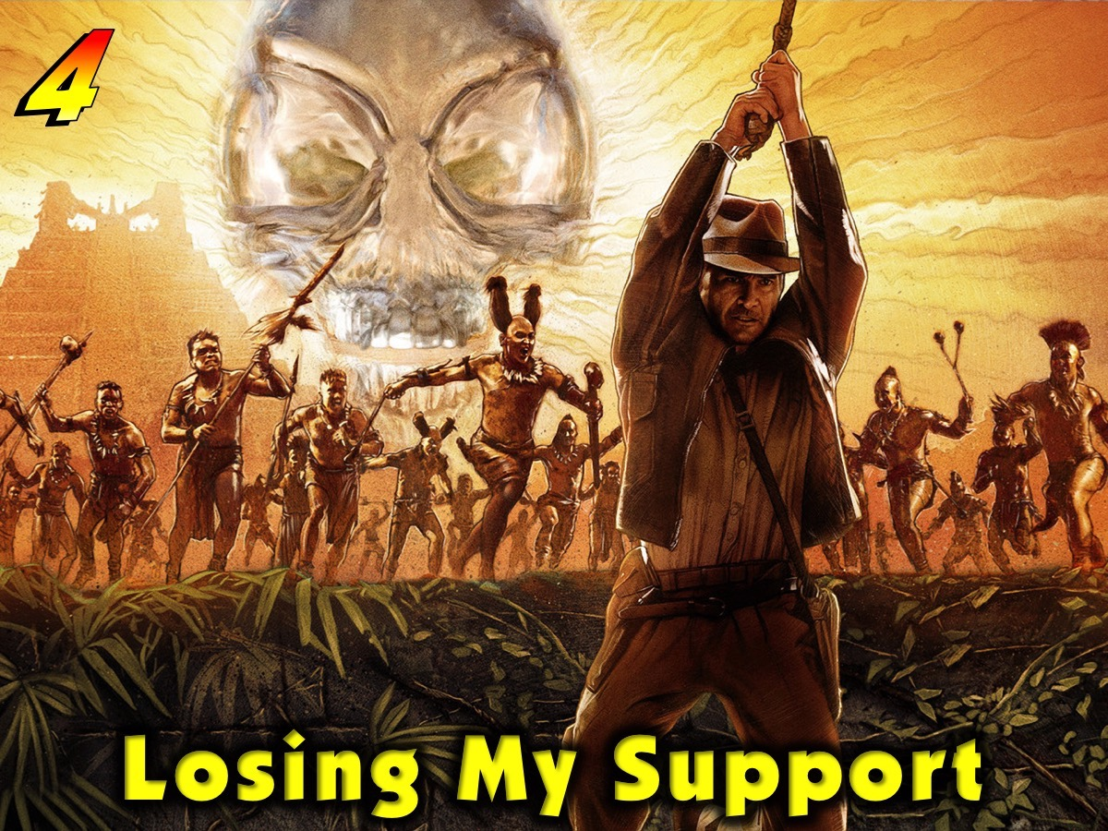
Notes:
4. Losing My Support: I thought of calling this pitfall, Lone Rangering. When we function in isolation from others who can pour into our lives or even help us do ministry we are heading for disaster.

Slide 22
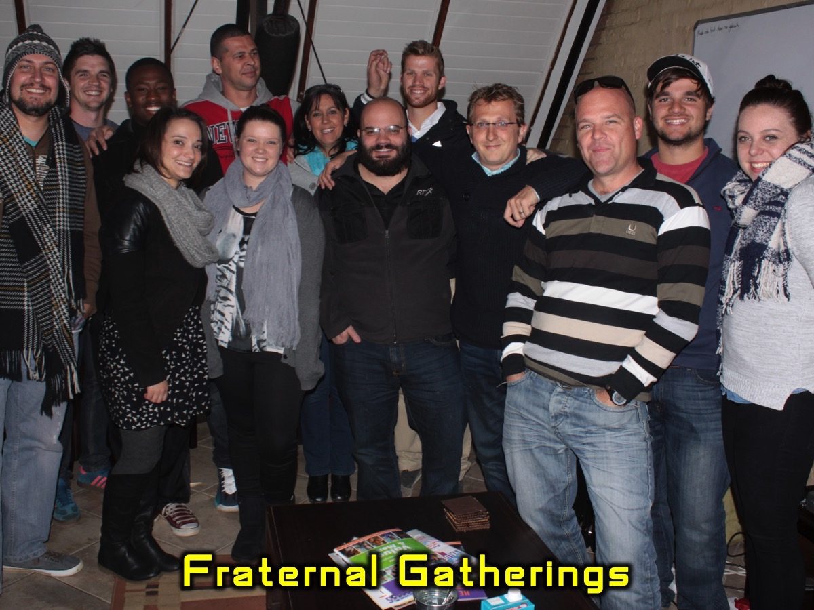
Notes:
I meet every month in a fraternal with all the youth pastors who serve in our geographical area from different denominations.

Slide 23
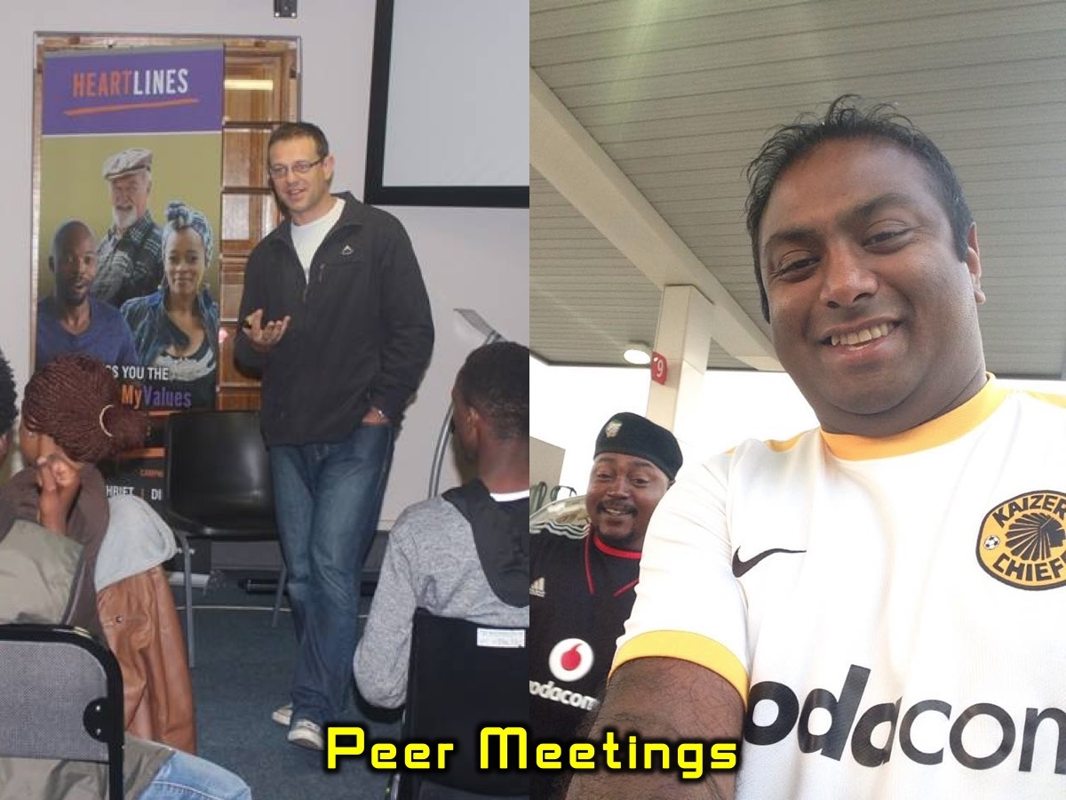
Notes:
I carve out time every week to meet with a friend in ministry so we can share our journey in ministry together.

Slide 24
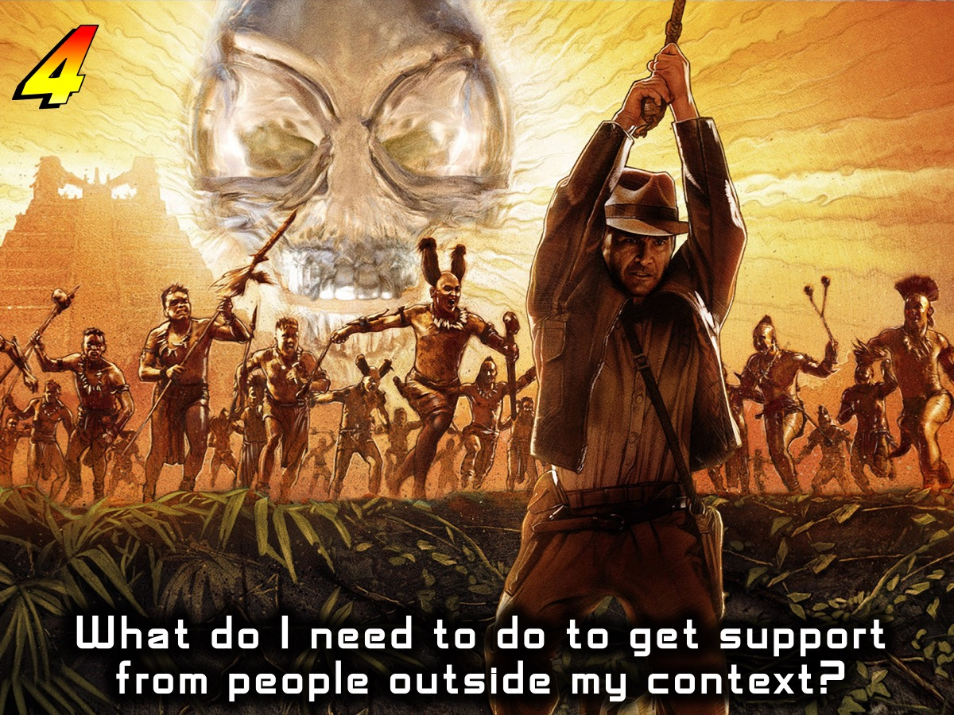

Slide 25
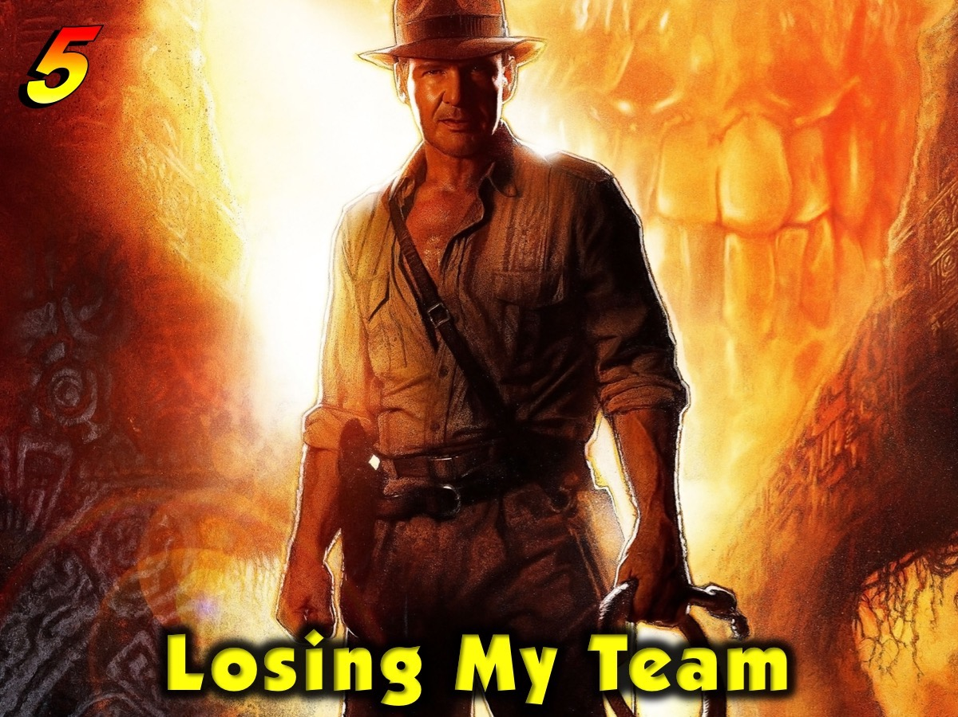
Notes:
5. Losing My Team: Another element of Lone Rangering is to fall into the pitfall of not building ministry around team.

Slide 26
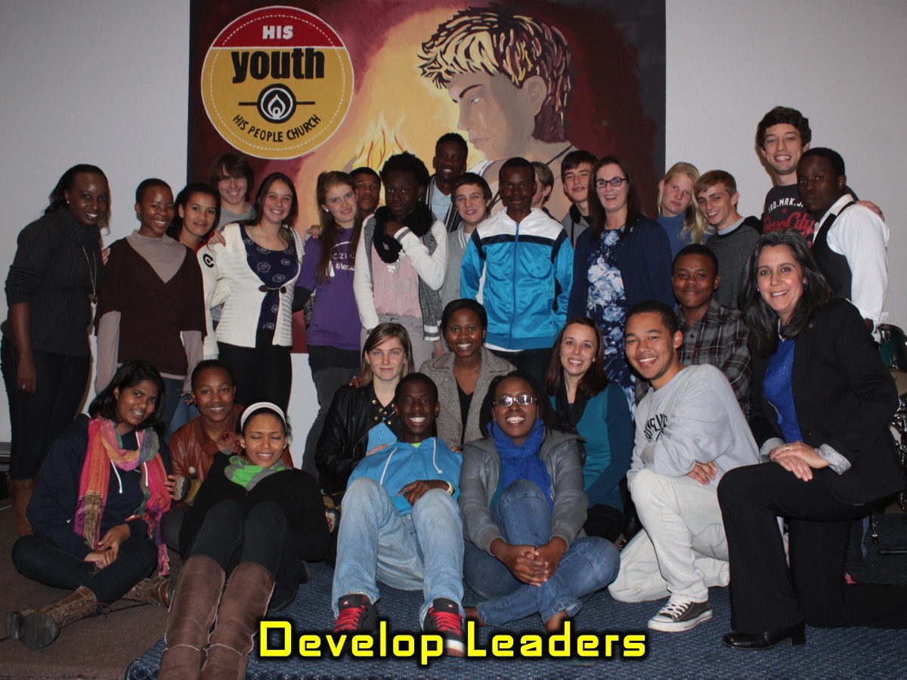
Notes:
When we do everything ourselves we may think we are doing a great job but are not doing what we are called to do which involves developing leaders and helping teenagers gain skills that will prepare them for adulthood. We may love preaching but must equip adult and teen leaders to preach God’s Word!

Slide 27
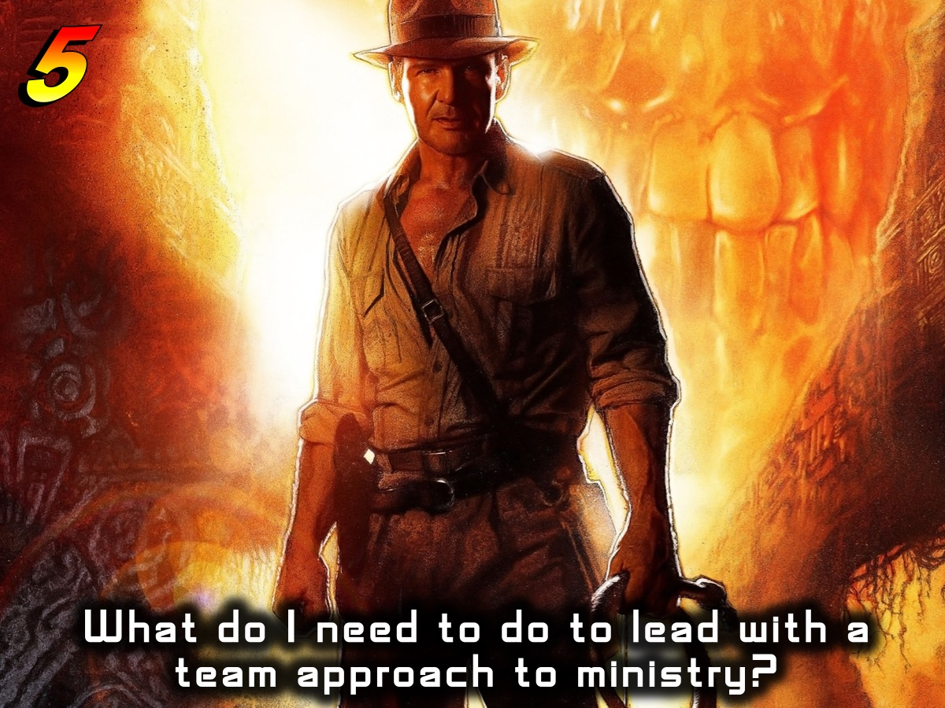

Slide 28
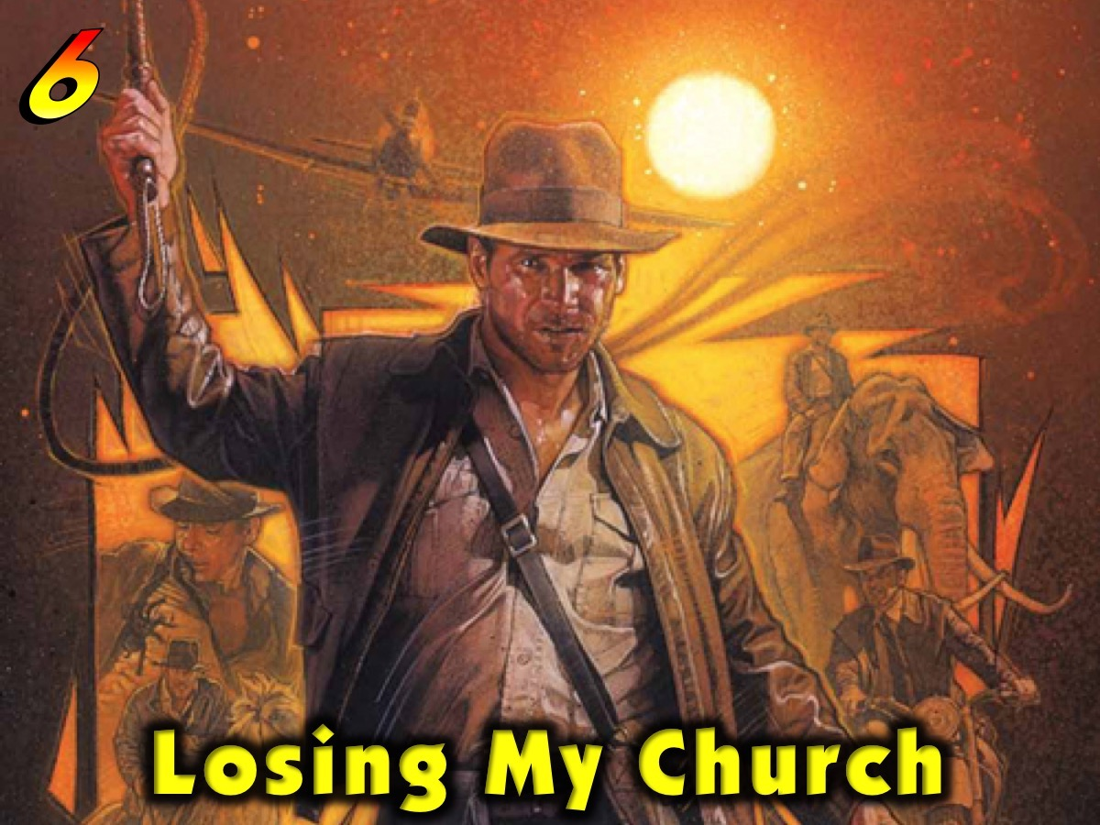
Notes:
6. Losing My Church: It is possible to operate as if we are running a para-Church ministry rather than one that is a vital part of the wider church. It is essential to build a youth ministry that is connected to the life of the church.

Slide 29
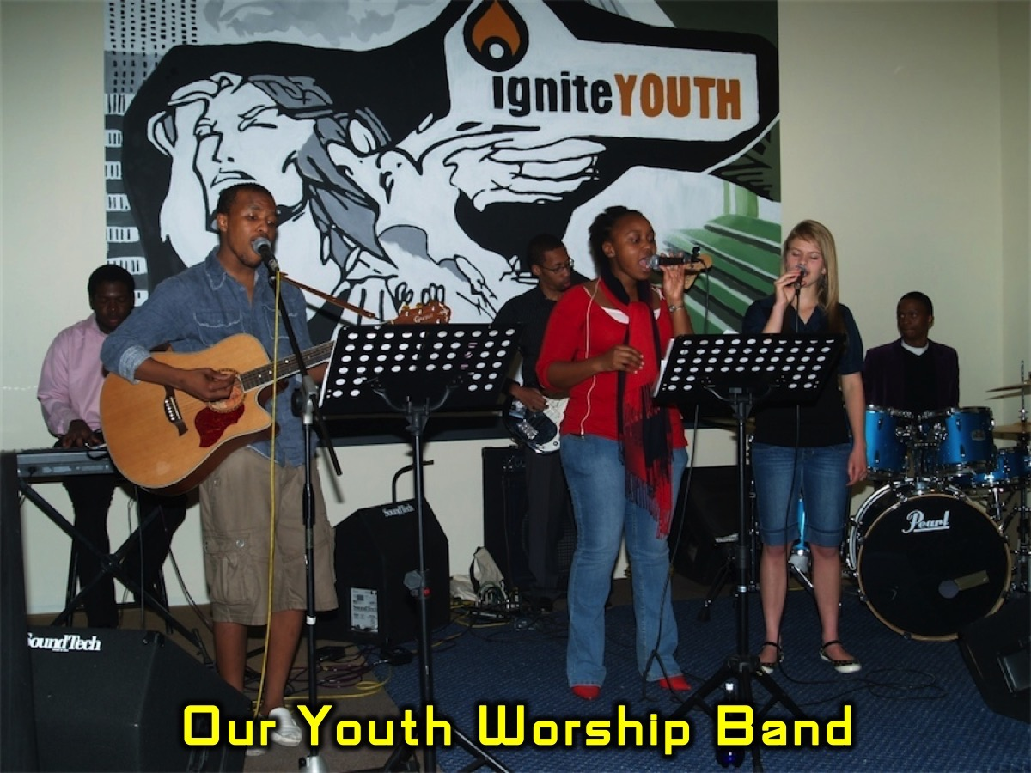
Notes:
Some years back we had our own youth worship band and almost never worshipped with the wider church on Sunday mornings. We came to a realization that what we were doing was not helping teens make the transition into the adult body

Slide 30
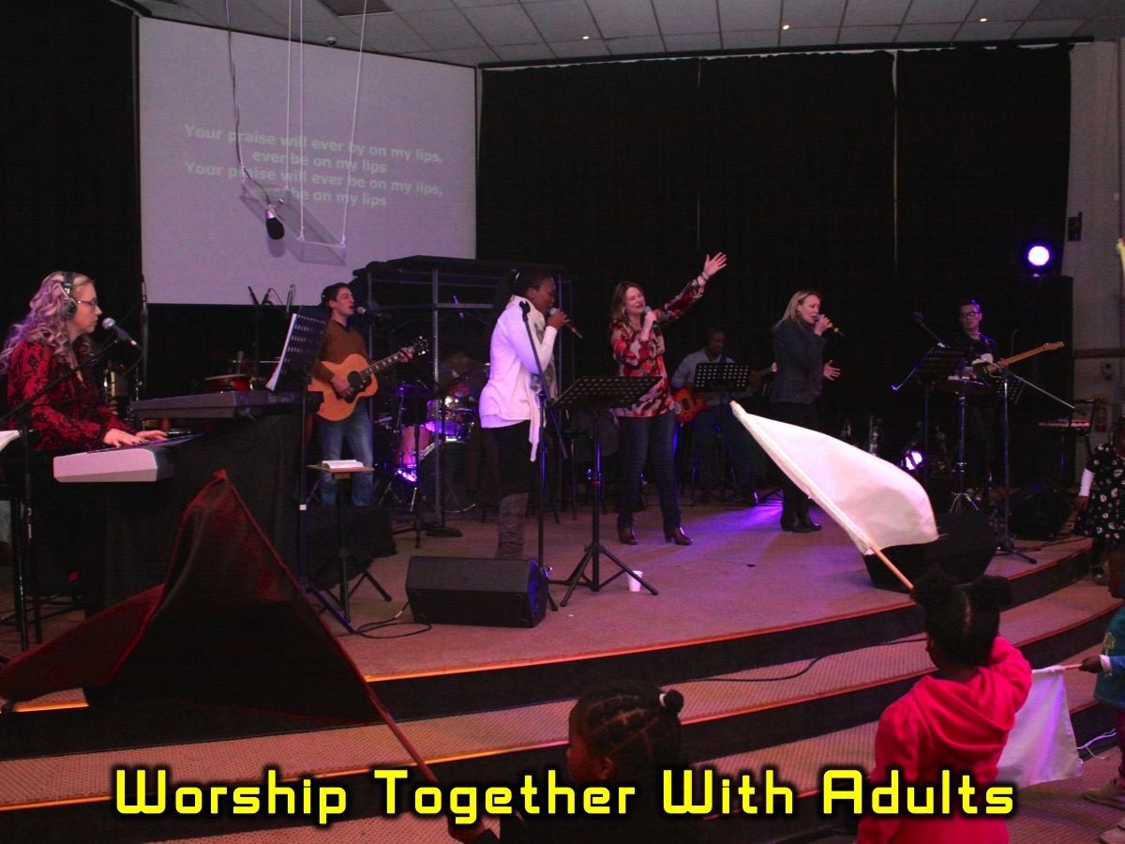
Notes:
So we scrapped the band and now meet regularly in worship with the wider body on Sunday mornings.

Slide 31
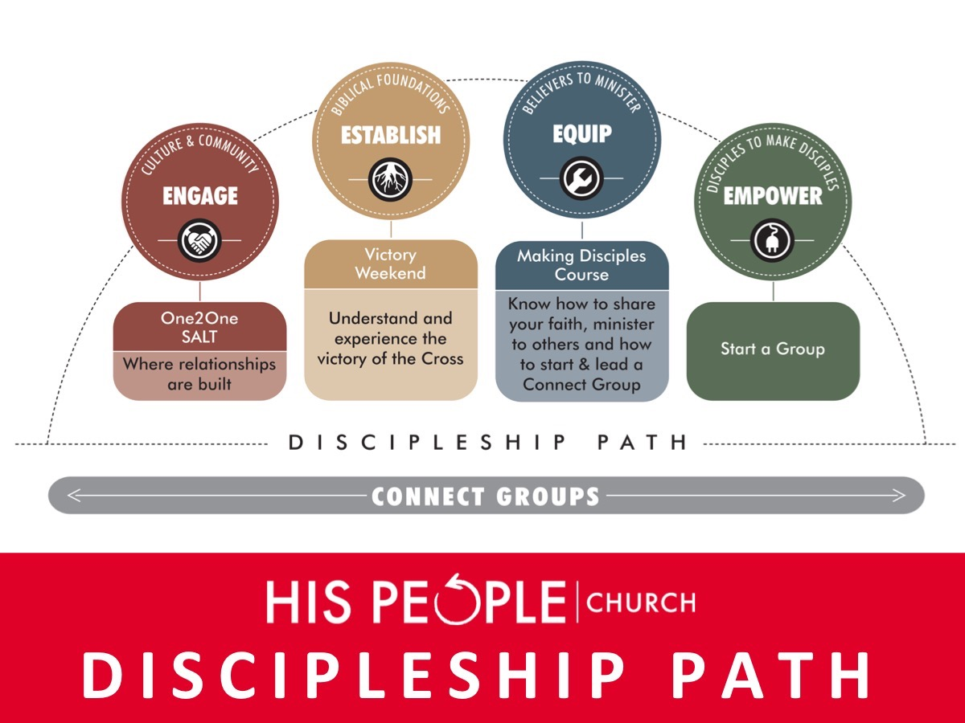
Notes:
We must follow the same disciplemaking approach as the church (even though we need to adapt ministry to teens) and ensure age-specific and age-inclusive ministry takes place.

Slide 32
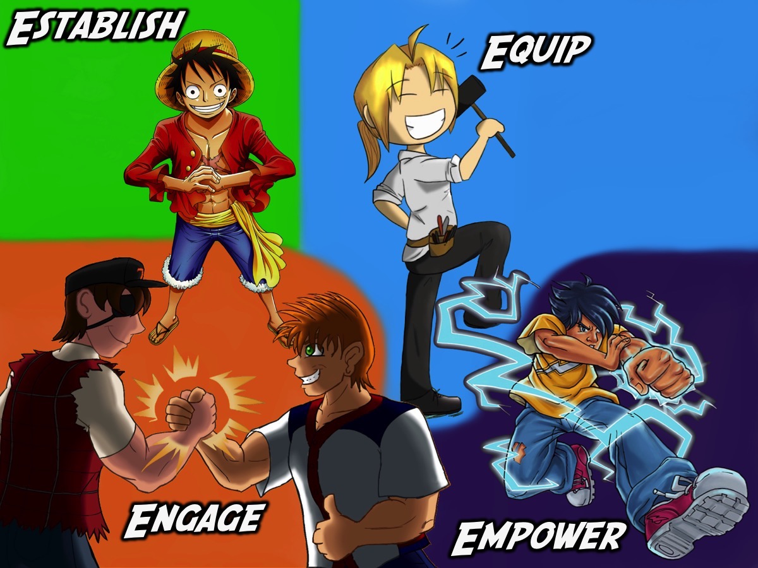
Notes:
Here is our branding for our disciplemaking path - essentially the same as the church with some tweaks!

Slide 33
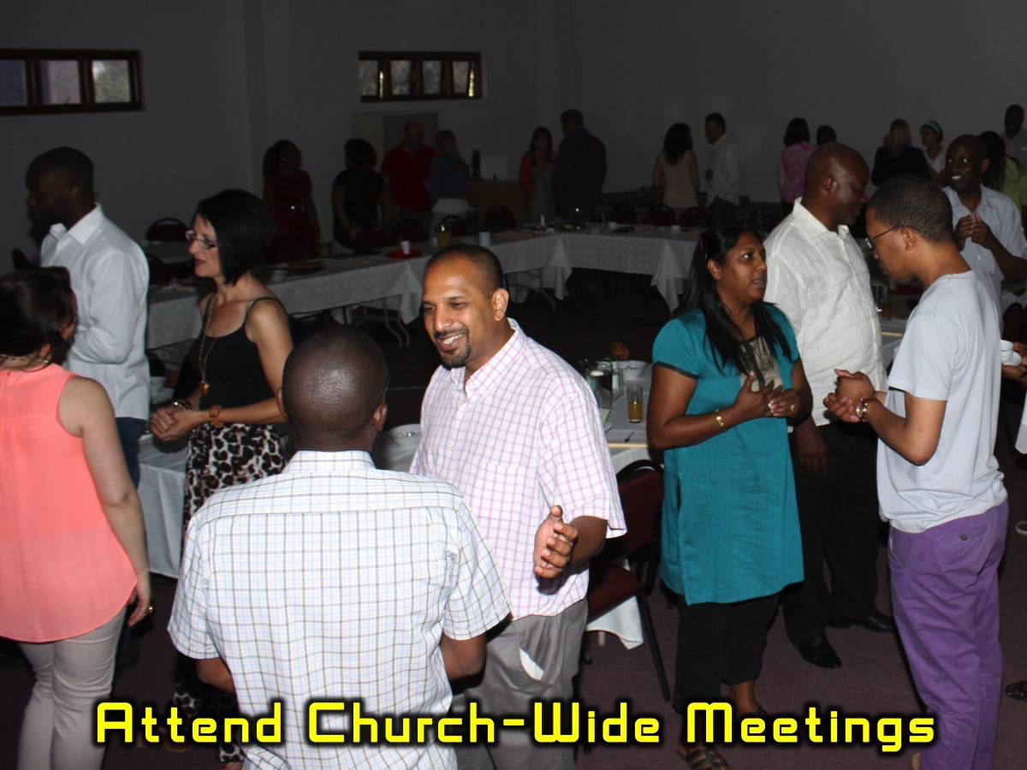
Notes:
As youth pastor, it is critical that I am vitally connected to the other leaders of the church and attend as many meetings as possible dealing with how the church operates and participate in planning and shaping the direction the church is taking.

Slide 34
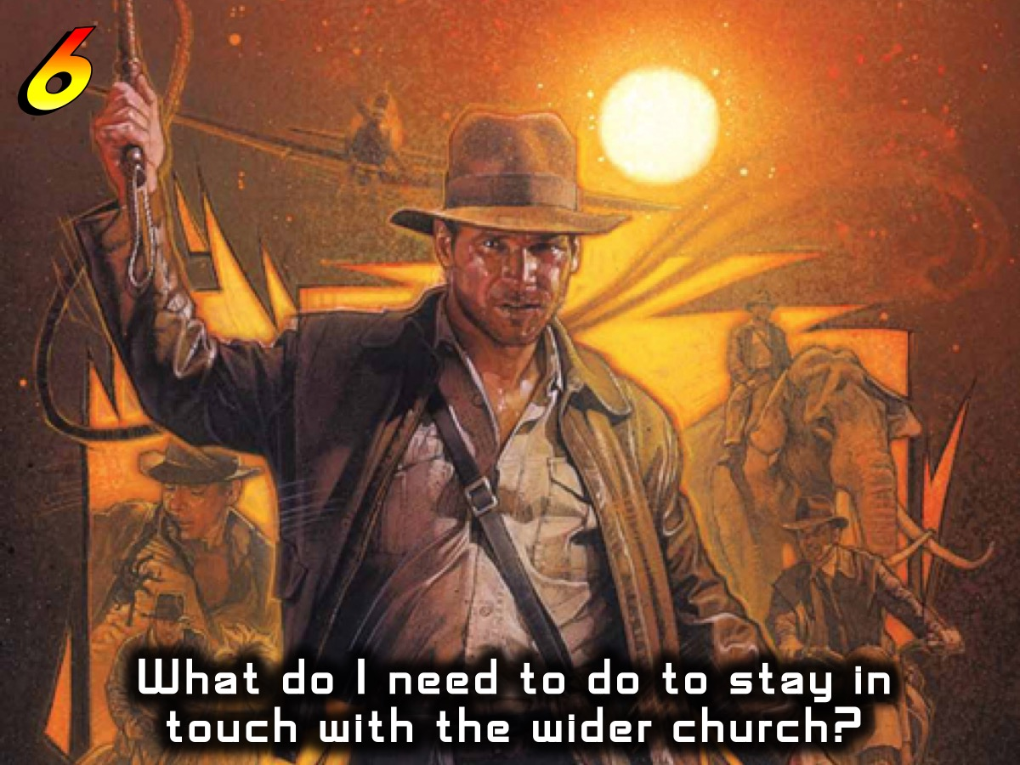

Slide 35

Notes:
7. Losing My Cool: Someone once said that in ministry you can expect to get more bricks thrown at you than bouquets. They will be criticism from teens, parents, ministry leaders, church leaders, etc.

Slide 36
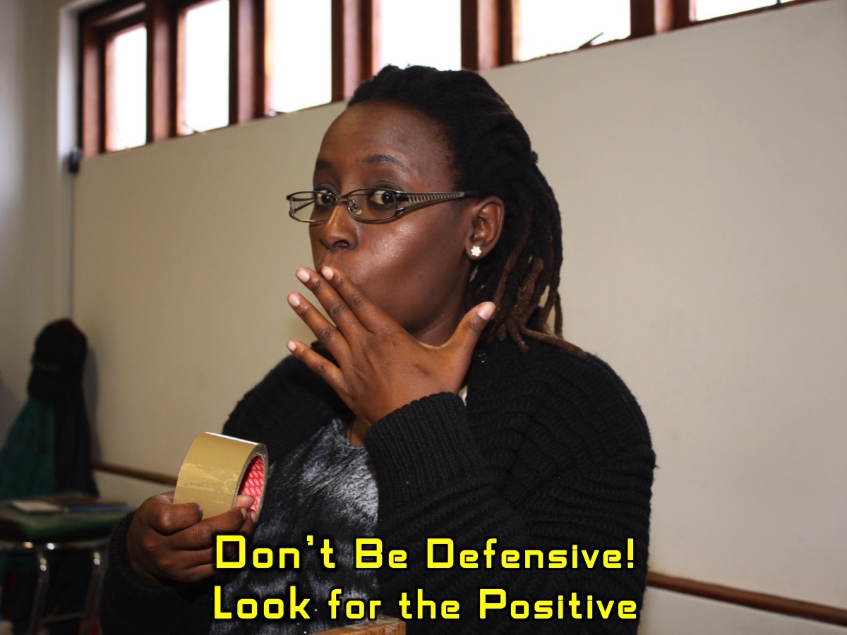
Notes:
As long as we don’t get defensive and look for the truth in what is being shared and respond in a positive and loving way we won’t go off the deep end and lose our cool!

Slide 37
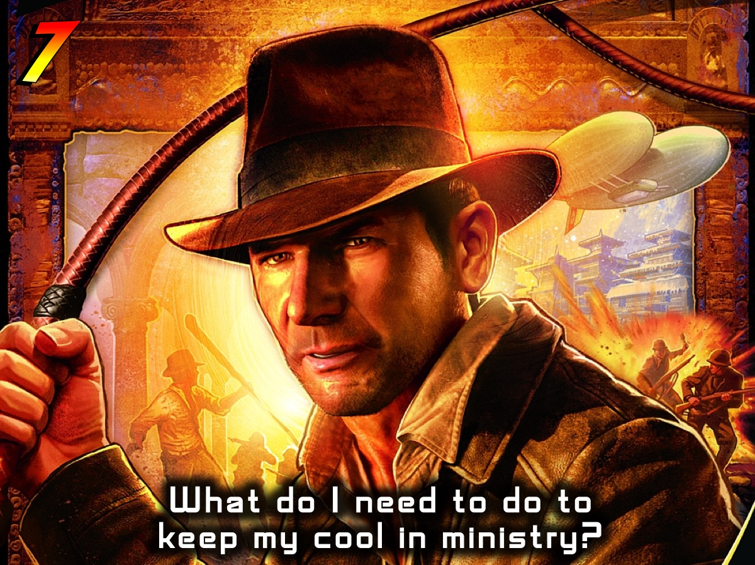

Slide 38
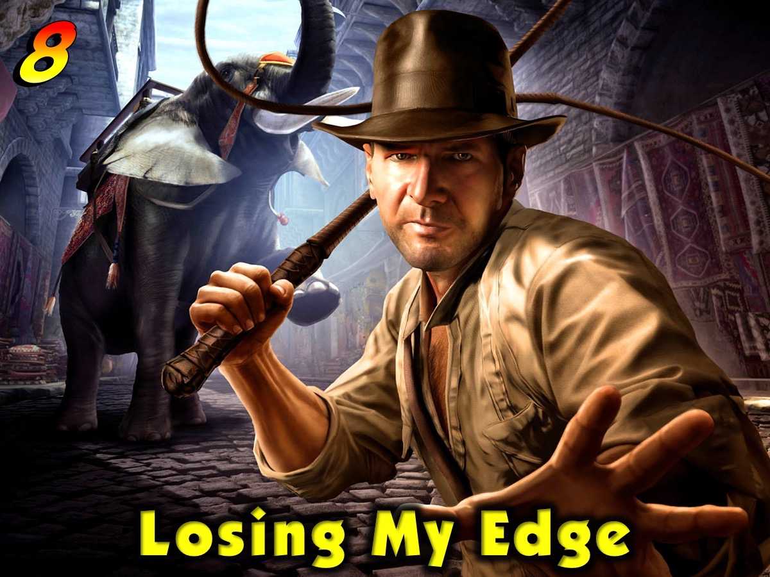
Notes:
8. Losing My Edge: Sometimes we can get into a comfortable place in ministry and end up doing some great things for just a little too long (past the sell-by-date) and suddenly we wake up and realize that our momentum has dipped and we are losing traction in ministry. There are no easy solutions to avoid doing the same thing for too long but maybe when things are going really well we should already be considering the need to change some aspect of what we are doing! Innovation and creativity has to be central in youth ministry.

Slide 39
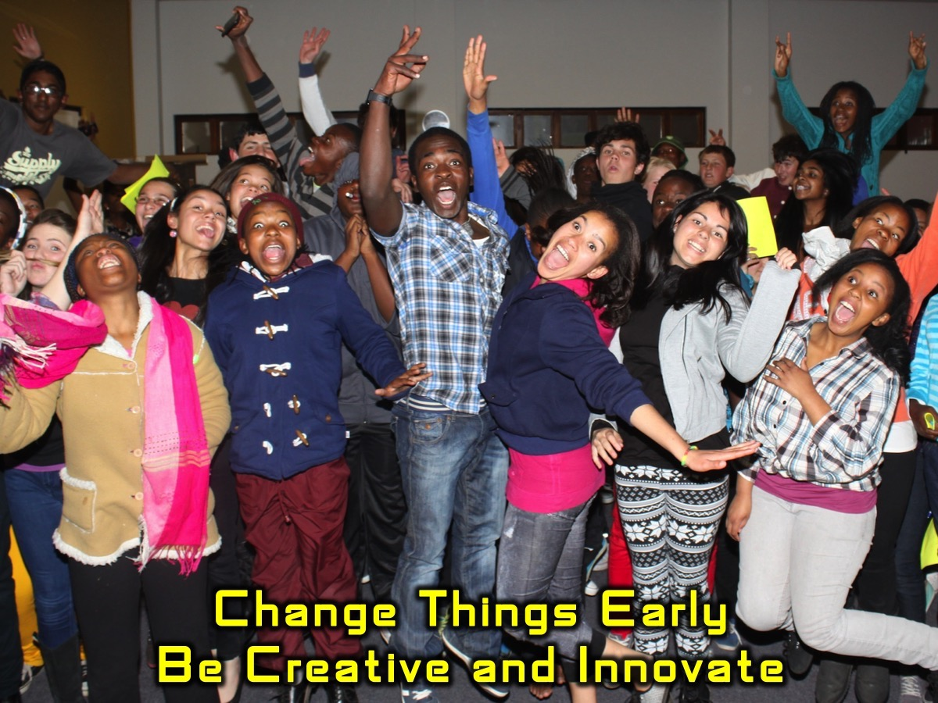
Notes:
There are no easy solutions to avoid doing the same thing for too long but maybe when things are going really well we should already be considering the need to change some aspect of what we are doing! Innovation and creativity has to be central in youth ministry.

Slide 40
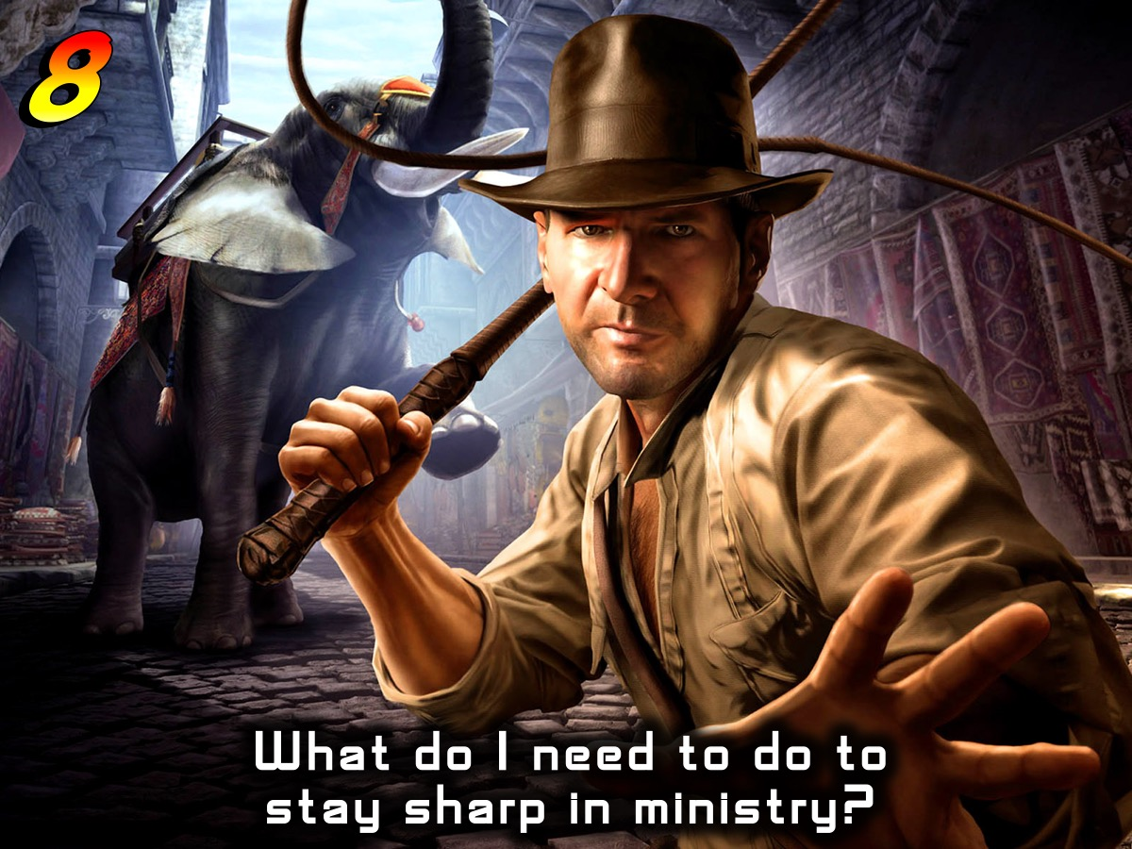

Slide 41

Notes:
9. Losing My Balance: Our vision statement at His People in Johannesburg is: “We see lives, communities and society transformed through discipleship in the Word, the presence and the power of God”. I have come to realize that it refers to three legs of a stool: The Word of God, the Presence of God and the Power of God. When any of these are lacking in our personal lives or in our ministry than we are heading for a fall.

Slide 42

Notes:
Build your life and ministry around Word, Presence and Power

Slide 43
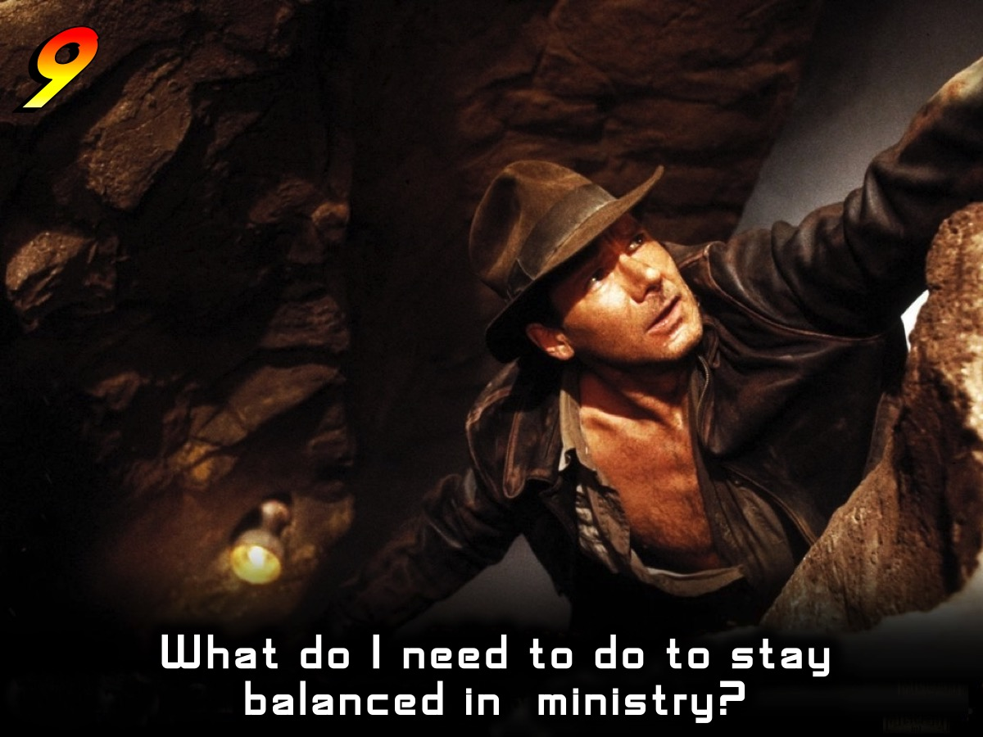

Slide 44

Notes:
10. Losing my Focus: So finally, it is possible to say yes to so many different things in life that we end up drowning in a sea of activities and do a lot but do nothing really well or properly.

Slide 45
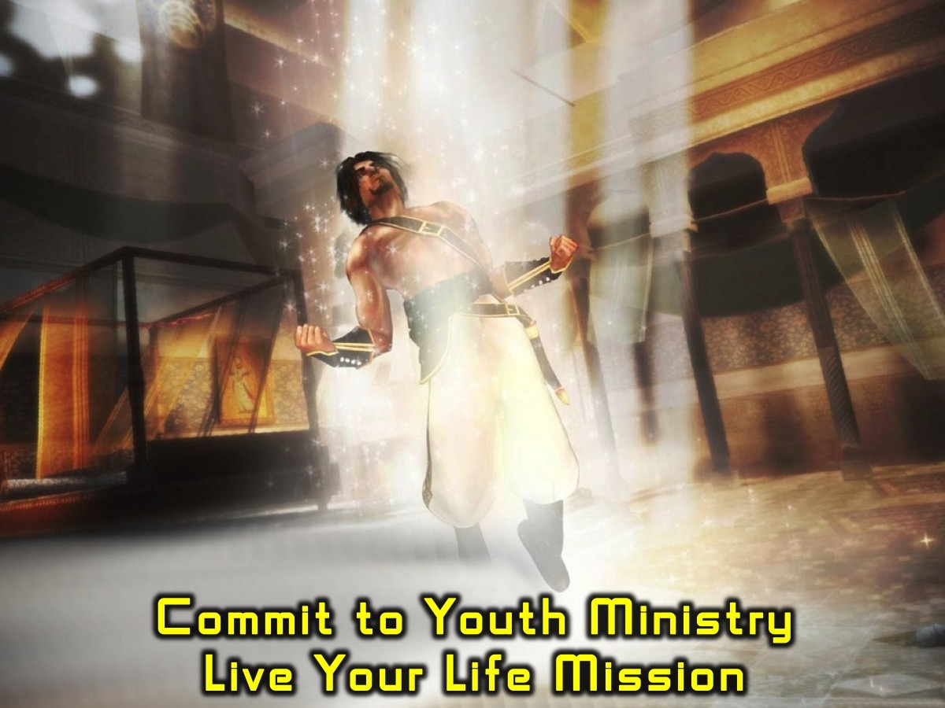
Notes:
I made it my aim some years back to devote my life to working among teenagers and so far nothing has derailed me from that focus. It helps me make wise decisions about my use of time and resources and has helped me to stay focused on what God has called me to do with my life. A well-crafted mission statement with clear roles defined for our lives will also help in this are. My mission is to be a Christ-follower who equips family, friends and next generation leaders to be disciplemakers. And I live my mission through six roles: Disciple, Husband, Father, Youth Pastor, Mentor and Student. Creating two goals for each role each week and scheduling something in my diary that will move me towards achieving those goals is a critical part of staying focused for me.

Slide 46
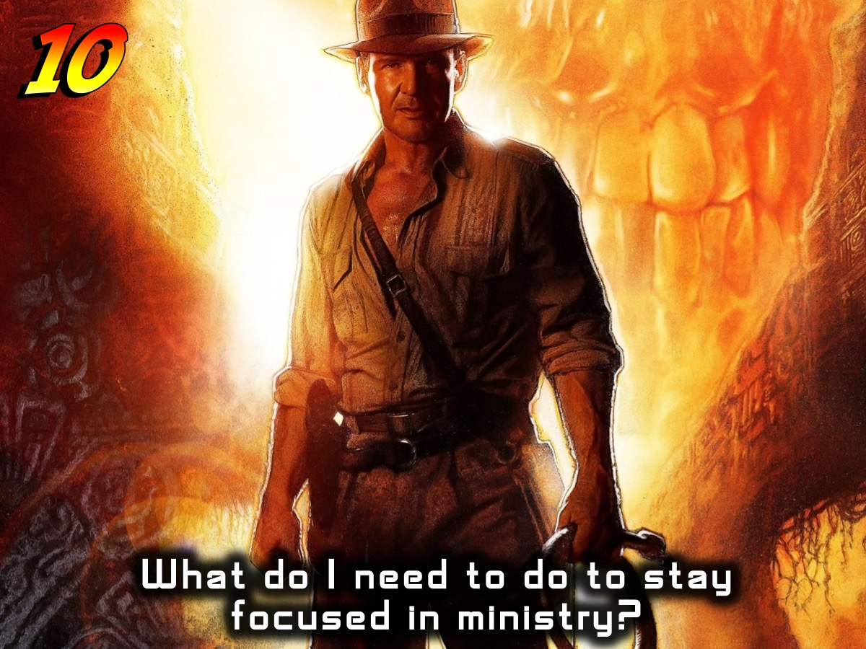

Slide 47
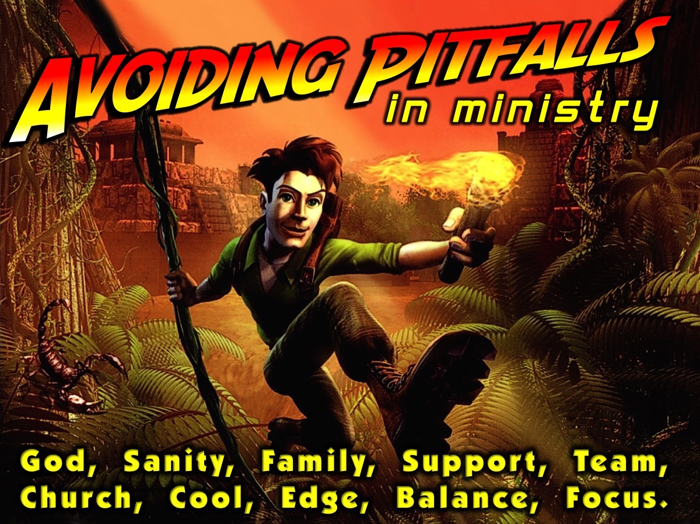
Notes:
That was my top 10 pitfalls to avoid in youth ministry!

