Slide 1
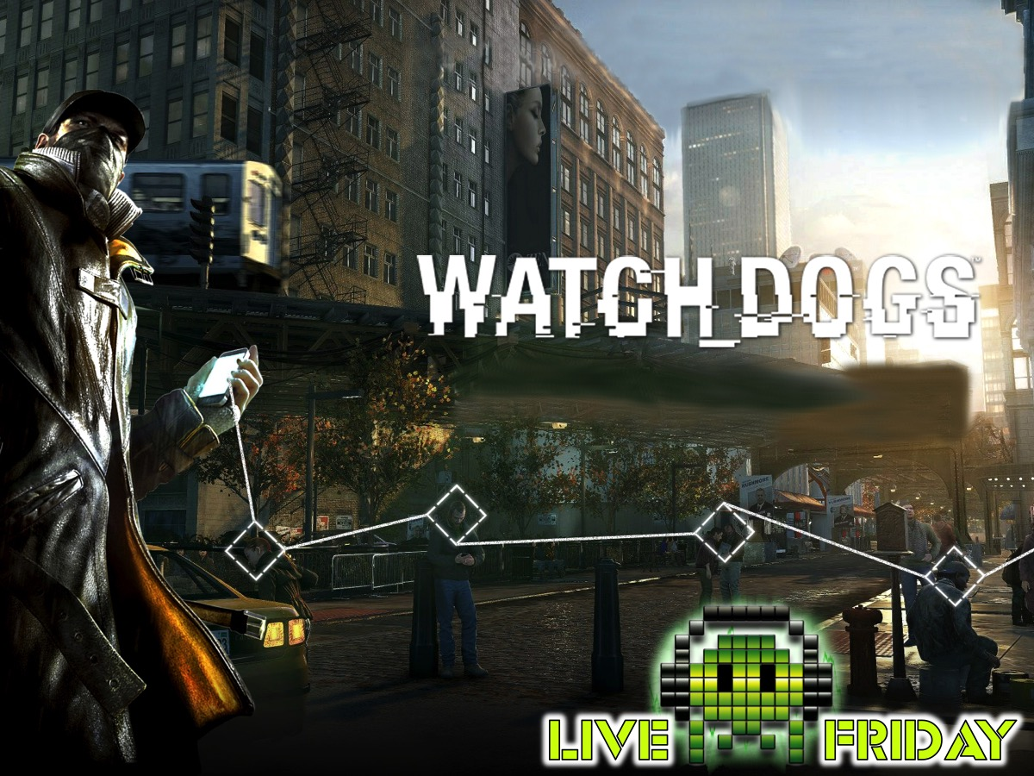
Notes:
Watch_Dogs Night (The Font is called Hacked)
Setup: Create a darkened hacking atmosphere using lights, sound effects, and costumes (leaders to dress up like characters from Watch_Dogs).
Game Notes:
Setting and characters: In the backstory of Watch Dogs, a computer hacker is discovered to have been behind the Northeast blackout of 2003, which led to eleven deaths. This event prompted the Blume Corporation to develop ctOS (CenTral Operating System). The ctOS supercomputer connects to everyone and everything—including personal information, security cameras, and traffic lights. Over time, Blume installs ctOS supercomputers in multiple cities across the United States, including Chicago, Illinois, the setting of the game.
Gameplay: In the game, players take control of Aiden Pearce, a grey hat hacker and vigilante. After a tragic accident kills his niece Lena, Aiden seeks to bring his own kind of justice to the people responsible, all while protecting his sister Nicole and nephew Jackson. Aiden meets a host of allies over the course of the game: Jordi Chin, a "fixer" and Aiden's hired partner; Clara Lille, a tattoo artist and member of the "DedSec" hacker group (under the alias 'BadBoy17'); and Raymond "T-Bone" Kenney, a former ctOS engineer, and the hacker responsible for the north-east blackout in 2003. Aiden also encounters many enemies, including Delford "Iraq" Wade, a gang leader with a military background; and Dermot "Lucky" Quinn, owner of the Merlaut Hotel and crime boss of Chicago's crime underground. Other characters include Damien Brenks, Aiden's former mentor and partner-in-crime; and Maurice Vega, the triggerman who caused the accident that claimed Lena's life.
Plot: In October 2012, Aiden Pearce and his mentor Damien Brenks launch an electronic bank heist at the Merlaut Hotel, with Aiden transferring the funds through his smartphone. When they come across a strange file and alert another hacker, Damien tries to find the hacker, giving them both away. Unable to talk Damien out of it, Aiden stops him by leaving. Fearing for the safety of his family— sister Nicole, and her children Lena and Jackson—Aiden decides to drive them to safety under the guise of a surprise trip. However, on the way, two hitmen are hired to intercept the car and take Aiden out. One of the hitmen, Maurice Vega, fires the shot that crashes the car and puts Lena in a coma, and she dies two months later.
A year later, Aiden, now a vigilante known as "The Fox", or "The Vigilante", tracks down Maurice in the Parker Square district. After a fruitless interrogation about Maurice's contractor, Aiden leaves Maurice in the hands of Jordi Chen while he hacks the ctOS to help them escape unnoticed. As Aiden investigates further, Damien (whom he cut ties with since the Merlaut robbery) approaches him, requesting to find the other hacker from the Merlaut job. Upon Aiden's refusal, Damien kidnaps Nicole, forcing Aiden to comply with Damien's demands in order to ensure her safety, though he manages to prevent Jackson from being kidnapped and leaves him under the care of his psychiatrist.
With the help of Clara Lille, a member of hacking syndicate DedSec, Aiden tracks down the second hacker: ex-military gang leader Delford "Iraq" Wade. Aiden obtains the electronic key to Iraq's server room and obtains a sample of the data from his servers. He and Clara find that Iraq has secrets on almost every citizen of Chicago, effectively protecting his gang from the authorities. When they come across encrypted data beyond Clara's ability, she directs Aiden to seek out Raymond "T-Bone" Kenney. After Aiden completes some tasks for him, T-Bone agrees to help decrypt the data.
Aiden mounts an assault on Iraq's compound, making it to his server room. After Aiden downloads the server data, Iraq confronts him; Aiden kills him and leaves the compound. While browsing the server information, another hacker–JB "Defalt" Marcowicz–infiltrates their system, stealing the information before deleting it from their servers. Defalt also leaves a recording that reveals Clara helped locate Aiden and Damien eleven months prior, which ultimately led to his niece's death. Angered, Aiden demands that Clara leave. Later, when Aiden confronts Damien about the loss of the server data, Damien publicizes Aiden's vigilantism, alerting the authorities of his identity.
Eventually, Aiden and T-Bone locate and take down Defalt, and retrieve the data again. Meanwhile, Aiden discovers where Nicole is being kept, and frees her. Aiden drives Nicole and Jackson out of town to keep them safe. Examining the server data, T-Bone discovers the contractor who ordered the hit that killed Aiden's niece: Dermot "Lucky" Quinn, leader of the Chicago South Club mob, notorious human trafficker, and owner of the Merlaut Hotel.
Aiden tracks down and confronts Quinn, shutting off his pacemaker. In his dying moments, Quinn reveals that he ordered the hit because he thought that Aiden was searching for blackmail footage of the mayor, whom Quinn is closely associated with. After Quinn finally dies, Aiden races to Clara, who is ambushed and killed by Quinn's men. During Aiden's attempts to track down Damien, he discovers that Damien has unlocked ctOS, allowing him access to the entire city. In order to find him, Aiden uploads a virus into ctOS and shuts down the entire system, blacking out the city. By doing this, Aiden reaches Damien, who is hiding in a lighthouse. As he confronts Damien, Jordi arrives, revealing that he has switched allegiance. Nevertheless, Aiden manages to stun Jordi and kill Damien. As he watches Chicago come back to life, Aiden accepts his role of "the Vigilante", to protect and, if necessary, to punish. After the credits, Jordi calls Aiden one last time to tell him where Maurice is being held. Aiden heads there, and chooses to either kill him or spare him. The Blume Corporation also announces that the ctOS will be adopted in several major cities across the country, using ctOS 2.0.
One year after the events of the single-player campaign, Aiden Pearce has gone into hiding while T-Bone erases all traces leading to him from Blume's databases and prepares to leave Chicago when he is contacted by his friend Tobias Frewer, asking for help after he had been kidnapped by Fixers. Upon rescuing Tobias, T-Bone realizes that both are being hunted by Blume and works with him to erase all their traces before fleeing the city, but their efforts are hindered by Defalt, who is working with Blume to track them down. T-Bone confronts Defalt and learns that he is after them in revenge for his brother, who was killed in the north-east blackout caused by him ten years ago. After joining forces to defeat and kill Defalt, T-Bone and Tobias decide to stay in Chicago to fight against Blume and consider asking Aiden to join their cause.

Slide 2
Notes:
Pre-Event Video: Watch Dogs Launch Trailer. Get it on YouTube at: https://www.youtube.com/watch?v=CH8HZ0TK5-U

Slide 3

Notes:
Welcome to Live Friday

Slide 4
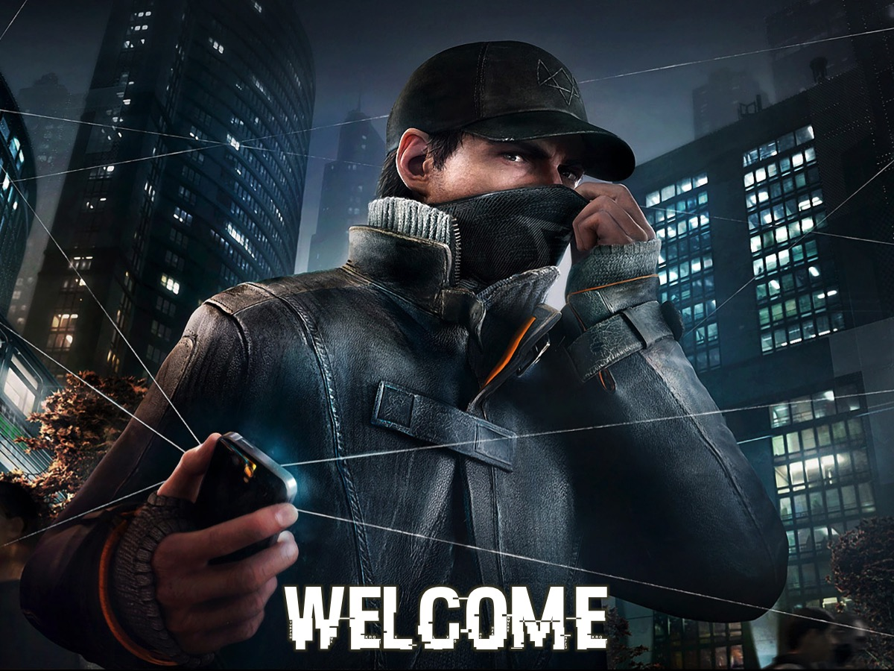
Notes:
Welcome to our regulars and any newcomers.

Slide 5

Notes:
Announcements: On Sunday morning we continue with our Revolution Series. And next Friday night it is our Karaoke and Waffles Night.

Slide 6
Notes:
Tonight is Watch_Dogs Night.

Slide 7
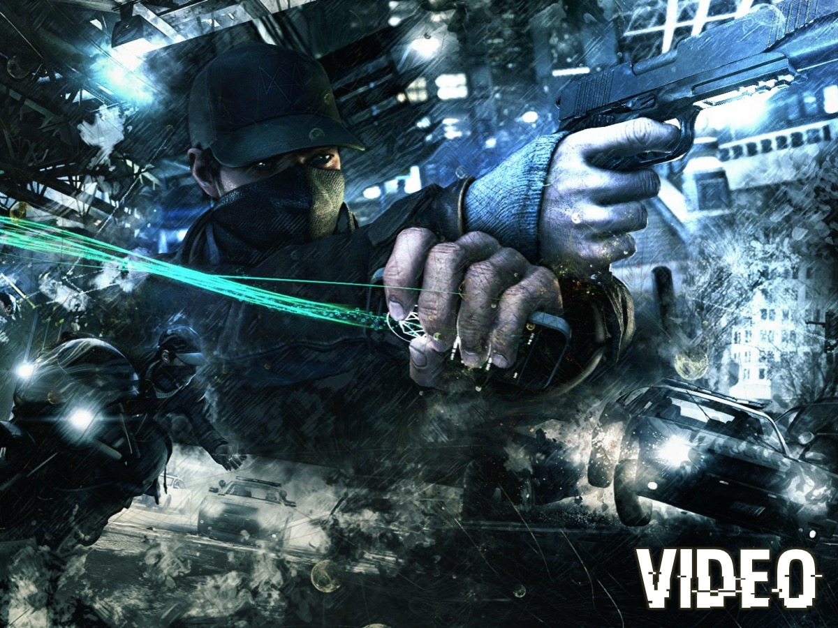
Notes:
Let’s start off with a video from Watch_Dogs.

Slide 8
Notes:
Video: An edited version of “Watch_Dogs 101 Trailer”. Get it on YouTube at: https://www.youtube.com/watch?v=ulFeUCAI5xM

Slide 9
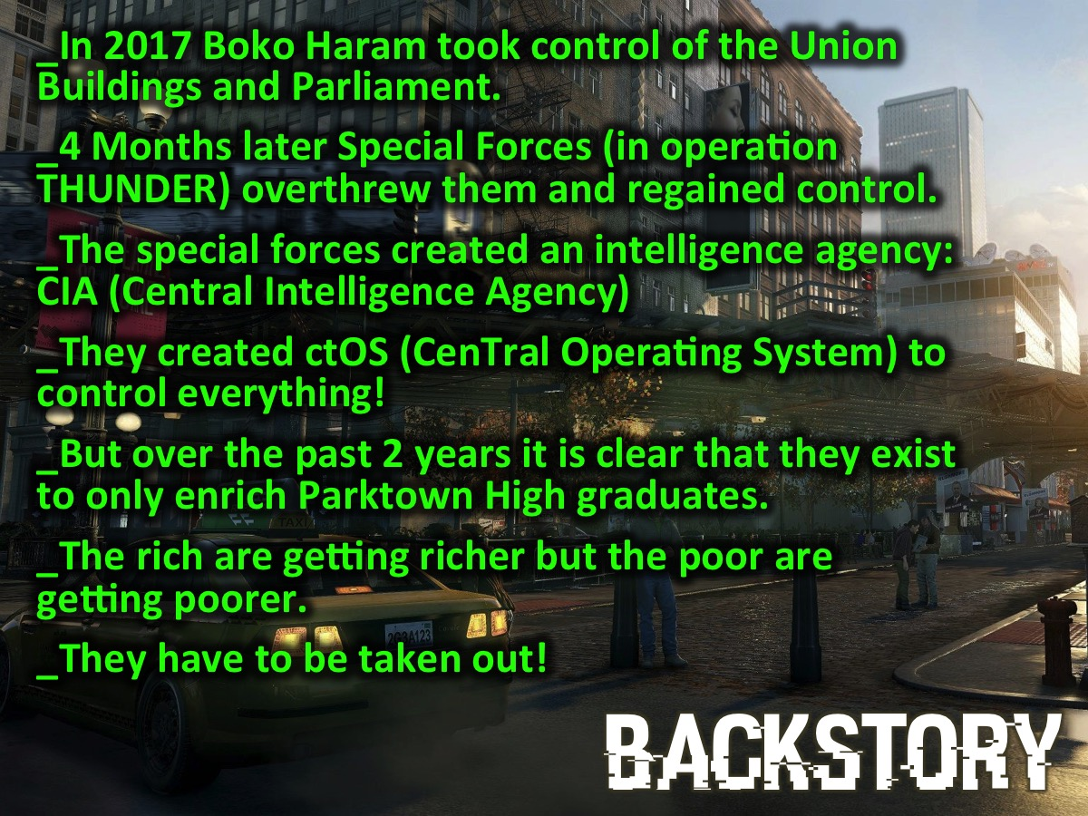
Notes:
Backstory: In 2017 our country was taken over when Boko Haram took control of the Union Buildings in Pretoria and Parliament in Cape Town (all the national leaders were executed and the future of the country looked very dark indeed). Thankfully just 4 months later a small group of special forces (in operation THUNDER) were able to defeat them and regain control of the country. To ensure that a hostile takeover of our country never happened again the special forces created a secret service, called CIA (Central Intelligence Agency) who developed ctOS (CenTral Operating System) – a nation-wide computer system that controlled the movement of every citizen and monitored every bit of information that came into or left the country. Sadly it seems that the CIA is not the kind and friendly group that we thought it was. A very small group of people have been chosen – graduates of Parktown Boys and Girls high school – and they are the only ones who are benefitting from the resources of the country – everyone else has ended up serving them as they get richer and the rest get poorer! They have to be taken out!

Slide 10
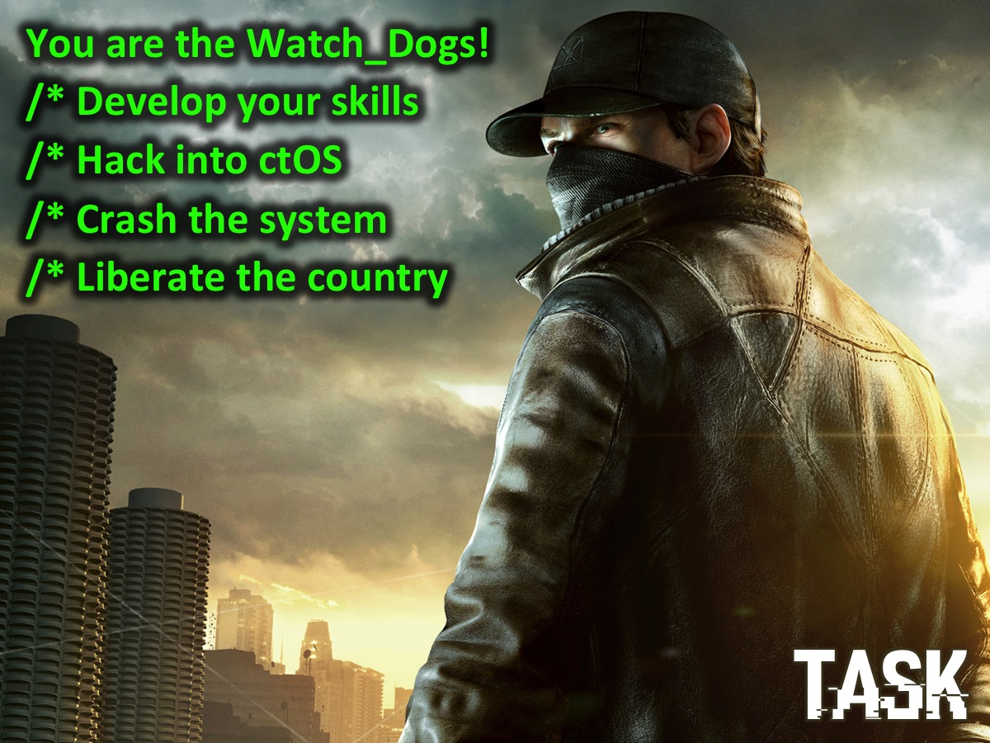
Notes:
Task: You are the Watch_Dogs. Tonight you must develop your hacking skills in a number of challenges and ultimately be good enough to hack into ctOS (CenTral Operating System), crash the system and liberate us in the first ever techno war in South Africa!

Slide 11
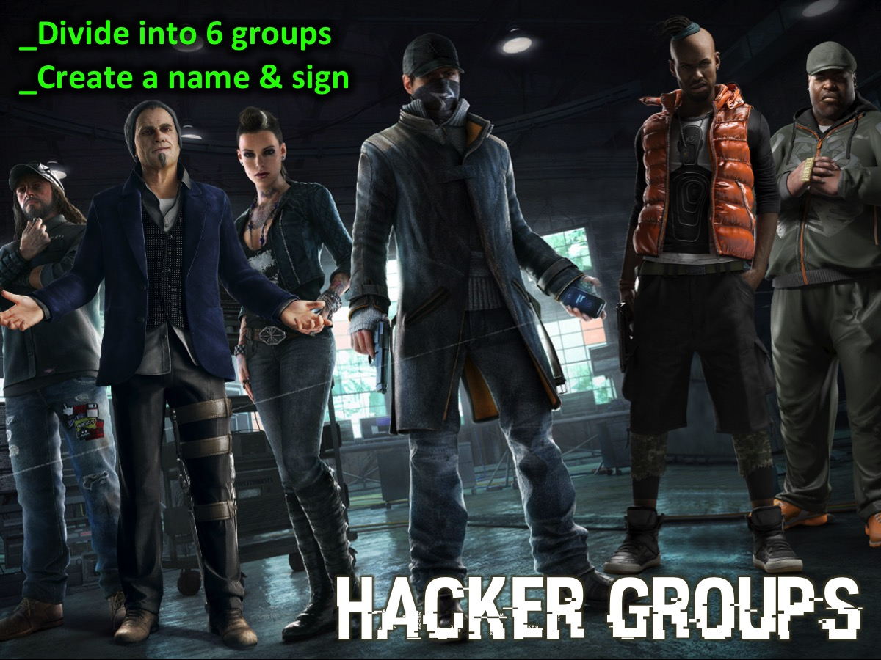
Notes:
Groups: Divide the teens into “Hacker Groups” - they come up with their own name and signal (like a secret handshake or sign).

Slide 12
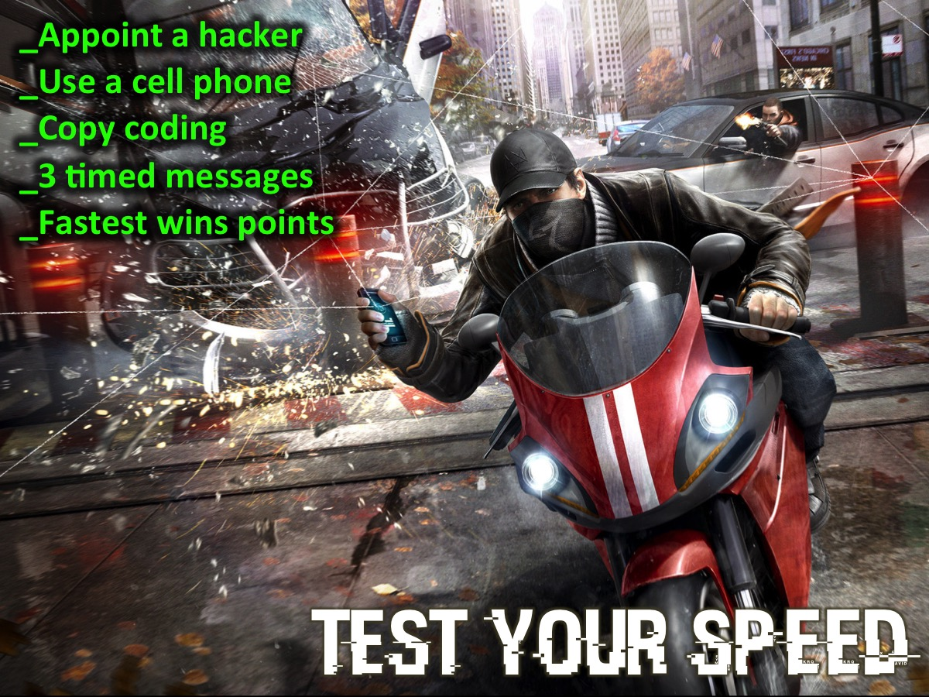
Notes:
Test Your Speed: You need to Appoint a hacker, Use a cell phone, Copy coding from the screen. The fastest team finished wins points for their team. There will be three messages that appear for a limited time. The more you copy and get correct the more chance you have of winning!

Slide 13
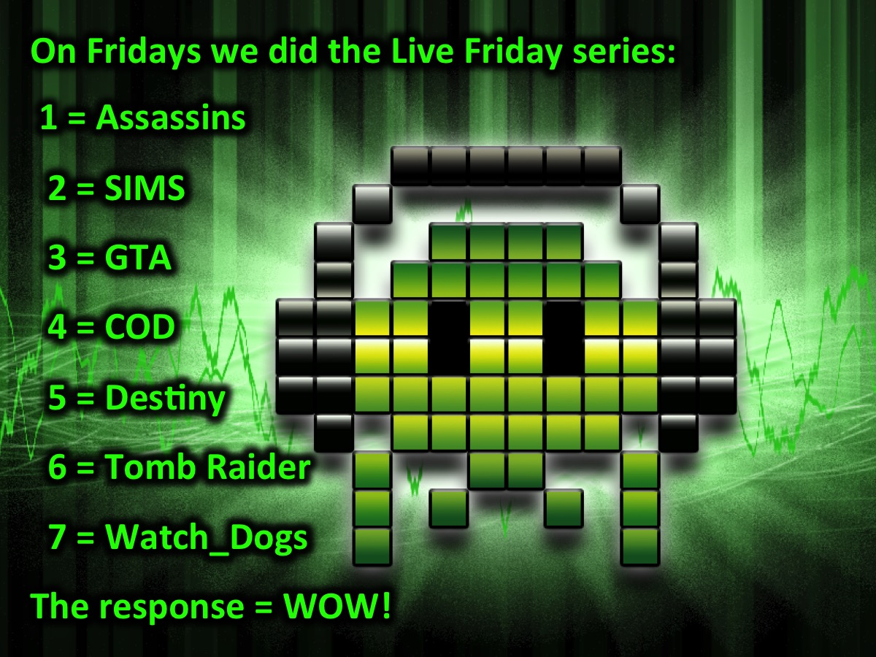
Notes:
Here is the text for the first message:
On Fridays we did the Live Friday series:
1 = Assassins
2 = SIMS
3 = GTA
4 = COD
5 = Destiny
6 = Tomb Raider
7 = Watch_Dogs
The response = WOW

Slide 14
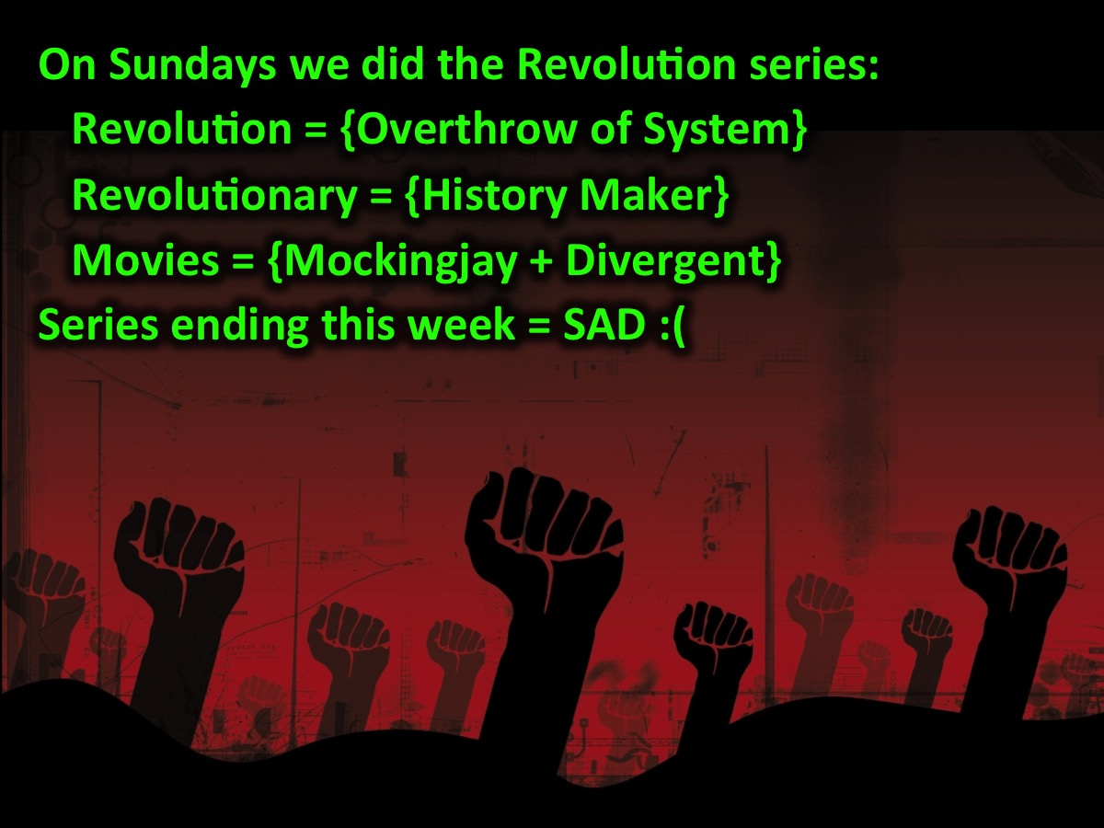
Notes:
Here is the text for the second message:
On Sundays we did the Revolution series:
Revolution = {Overthrow of System}
Revolutionary = {History Maker}
Movies = {Mockingjay + Divergent}
Series ending this week = SAD :(

Slide 15

Notes:
Here is the text for the third message:
Our mission at His Youth is the focus for Term 2 in the Trilogy Series:
We see lives, communities and society
transformed through discipleship
in the Word
the Presence of God
and the Power of God
Series starting = AWESOME :)

Slide 16
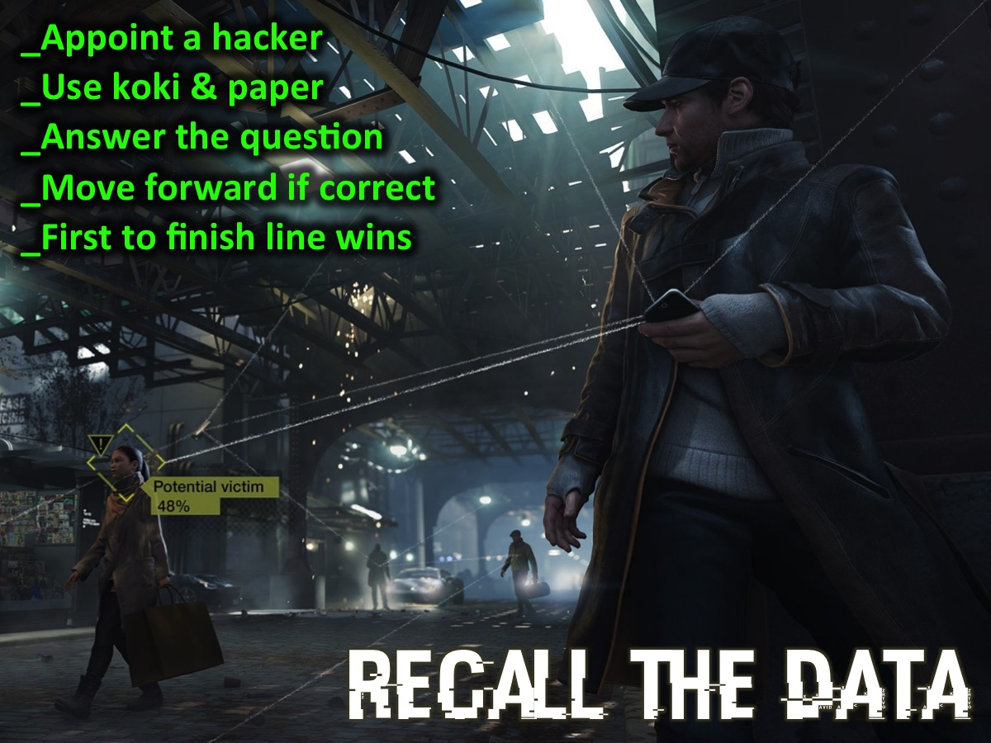
Notes:
Recall the Data: It is time to learn how to break through a computer’s firewall. In this activity you are going to have to recall critical data that would be useful in hacking into the system. This is a Survivor style activity where one person from each group participates and questions are presented and they write the answer down on sheets of paper and reveal it when asked to do so. Those who get it right advance to the next line. The team or teams to reach the end line first wins points. We will mark out four rows of lines with masking tape on the floor – with a start and finish line. Here are the questions:
In what year did Boko Haram take over South Africa? 2017
What two cities did they target? Pretoria and Cape Town
How long did Boko Haram rule in South Africa? 4 Months
What was the operation called led by the Special Forces? Thunder
What was the name of the intelligence agency they created? CIA
What operating system did they create? ctOS
What school did the special forces favour? Parktown High
What is the surname of the guy in Watch_Dogs? Pearce
In what city is the game of Watch_Dogs located? Chicago

Slide 17
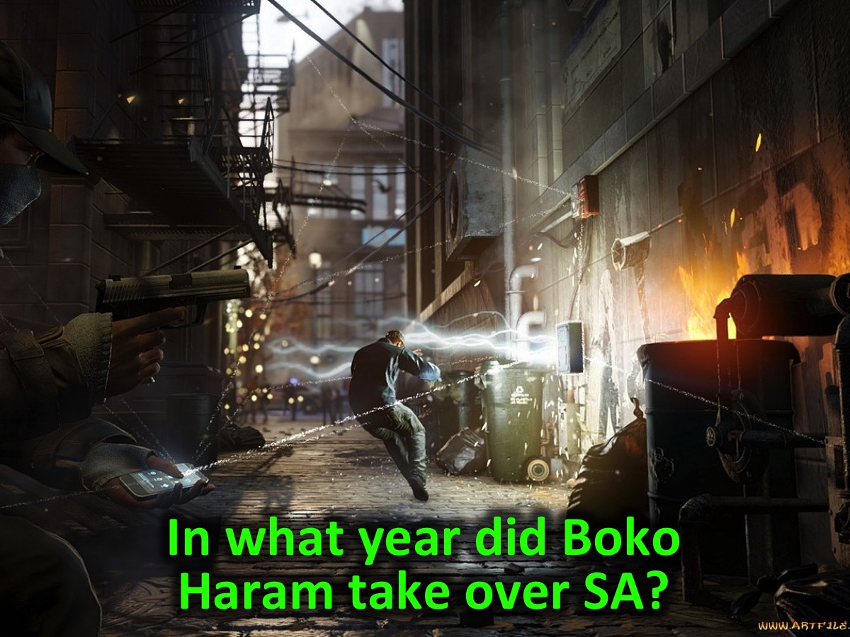
Notes:
In what year did Boko Haram take over South Africa?

Slide 18

Notes:
In what year did Boko Haram take over South Africa? 2017

Slide 19
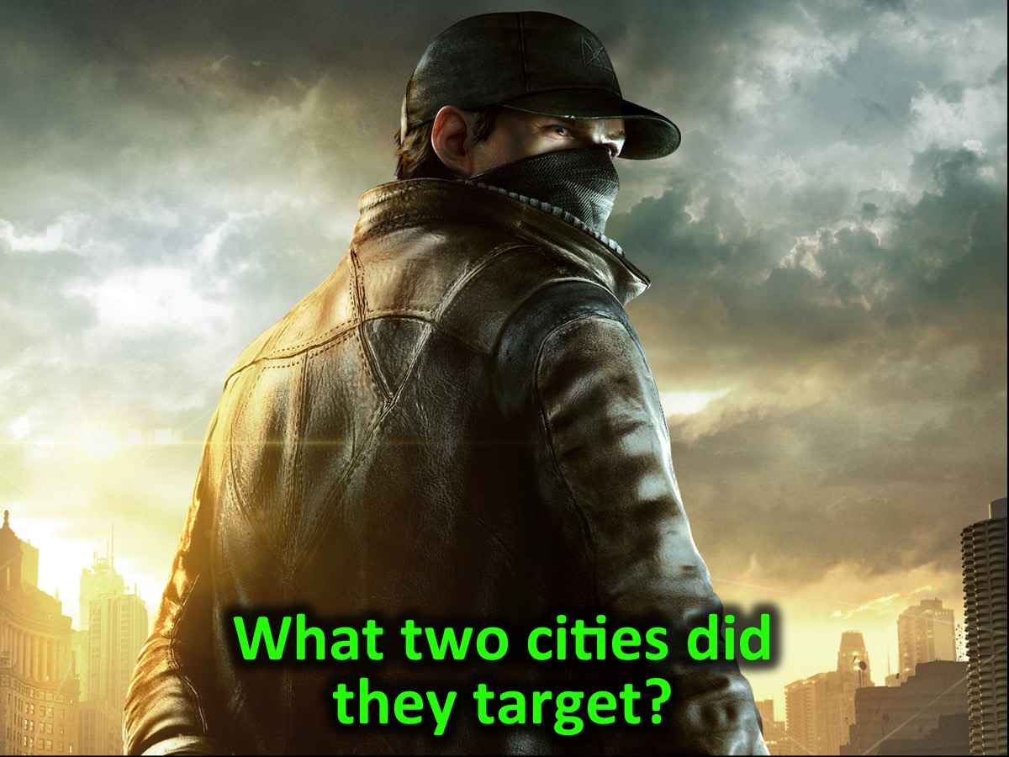
Notes:
What two cities did they target?

Slide 20

Notes:
Pretoria and Cape Town

Slide 21
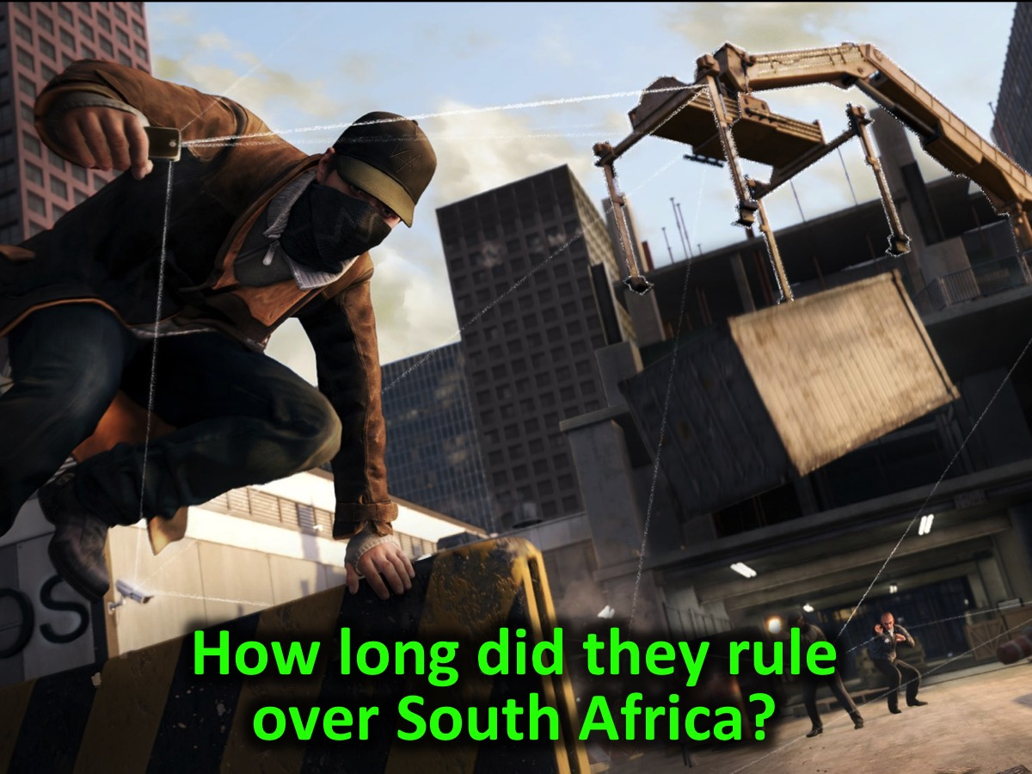
Notes:
How long did they rule over South Africa?

Slide 22
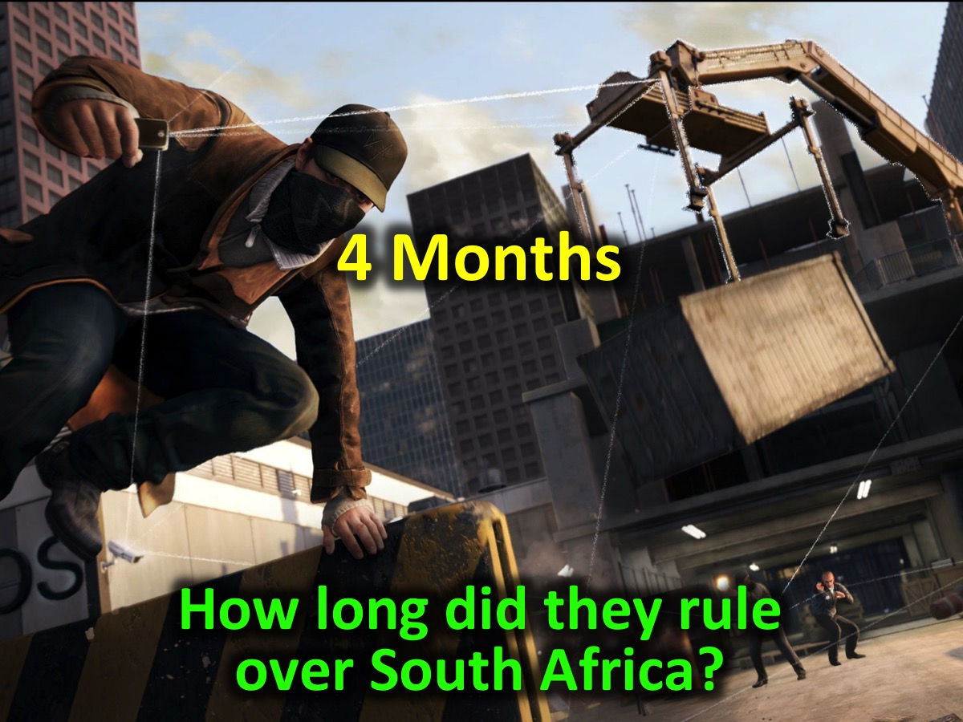
Notes:
4 Months

Slide 23
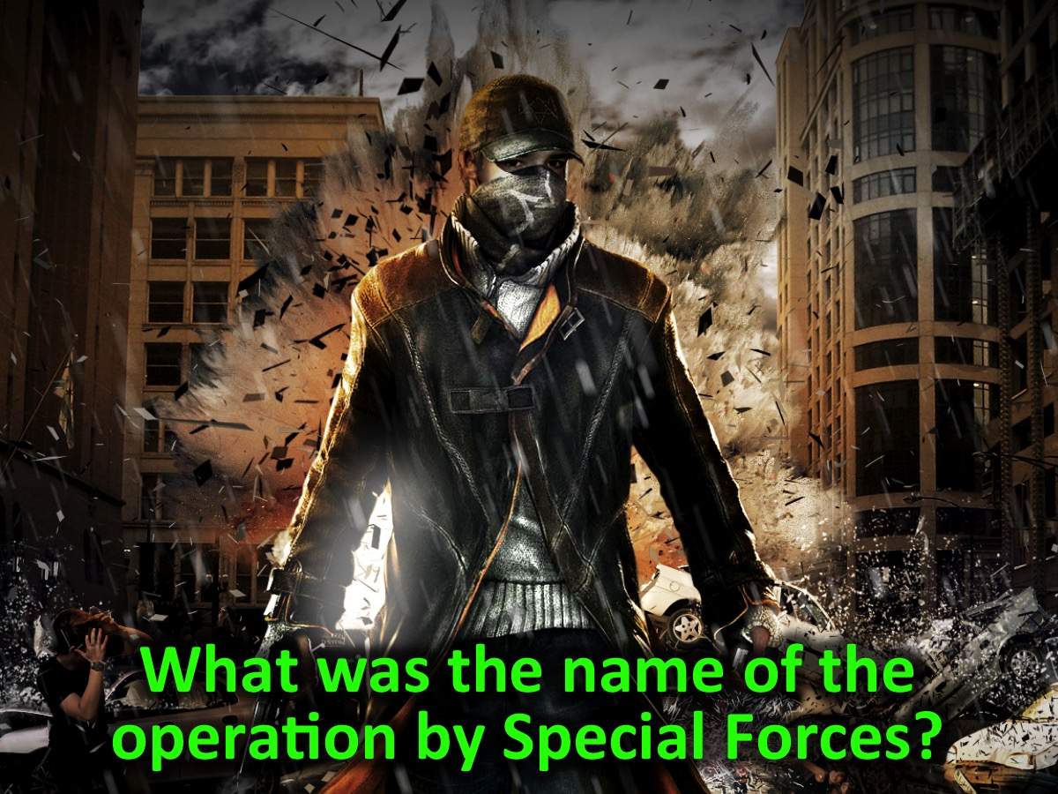
Notes:
What was the name of the operation by Special Forces?

Slide 24
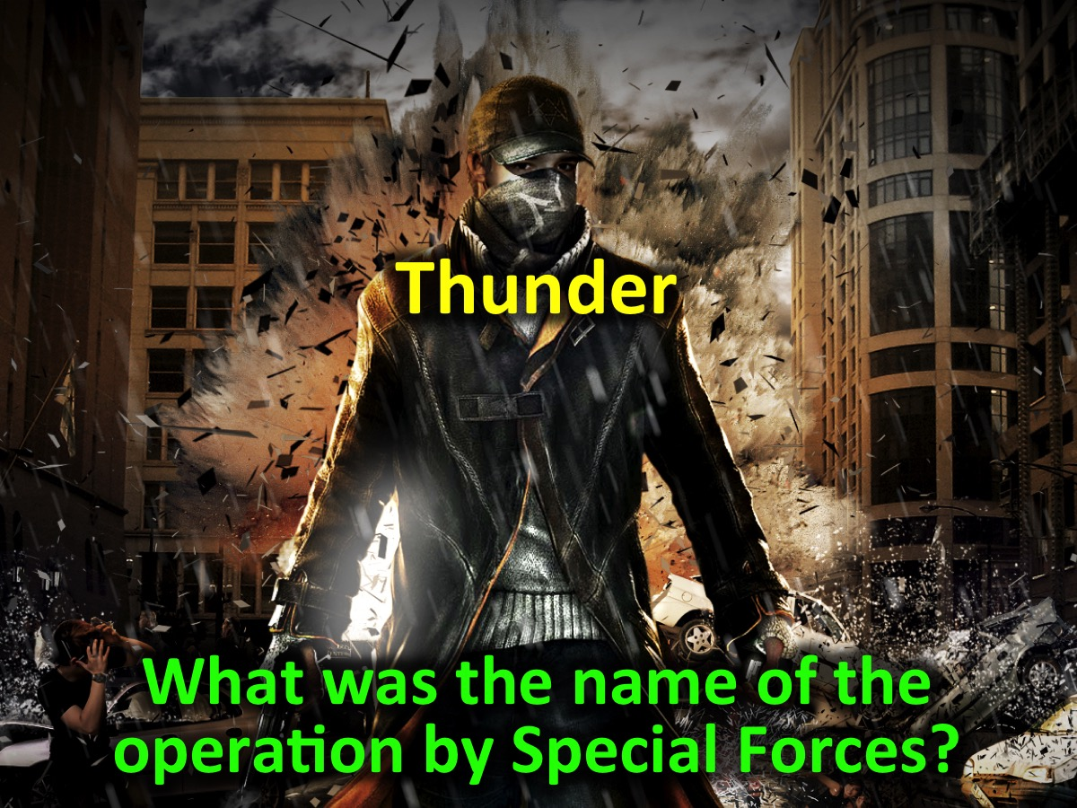
Notes:
Thunder

Slide 25
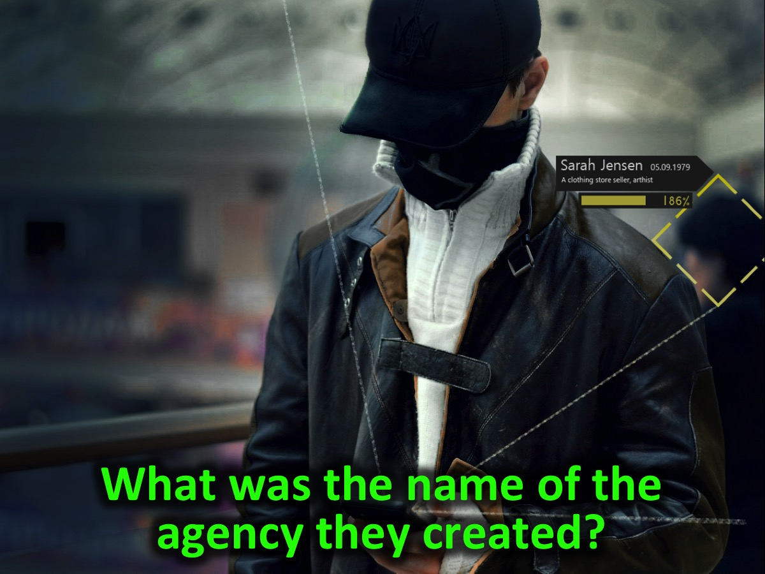
Notes:
What was the name of the agency they created?

Slide 26

Notes:
CIA

Slide 27
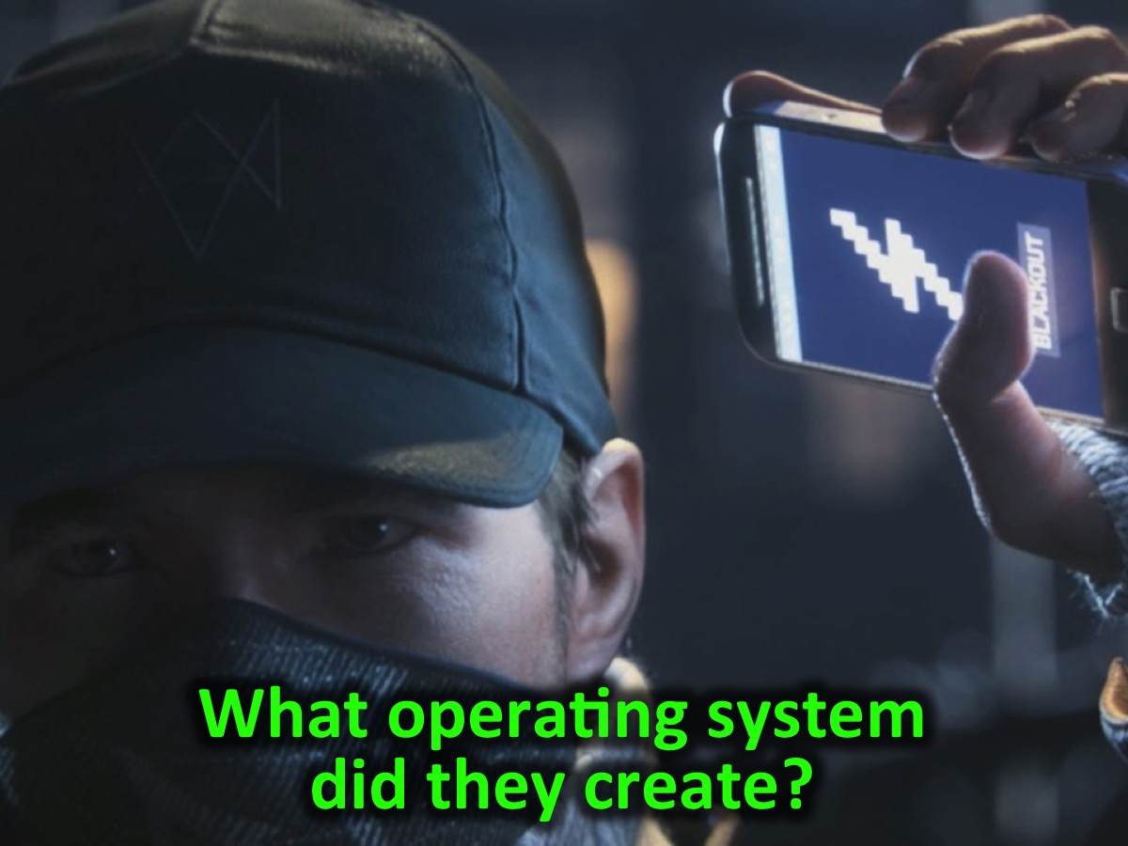
Notes:
What operating system did they create?

Slide 28
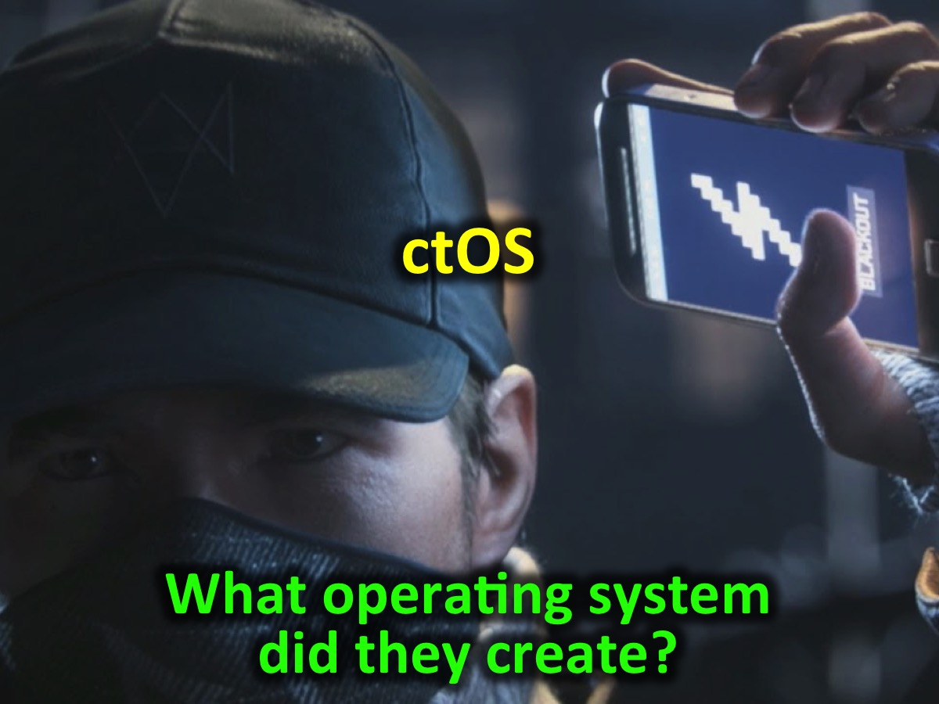
Notes:
ctOS

Slide 29
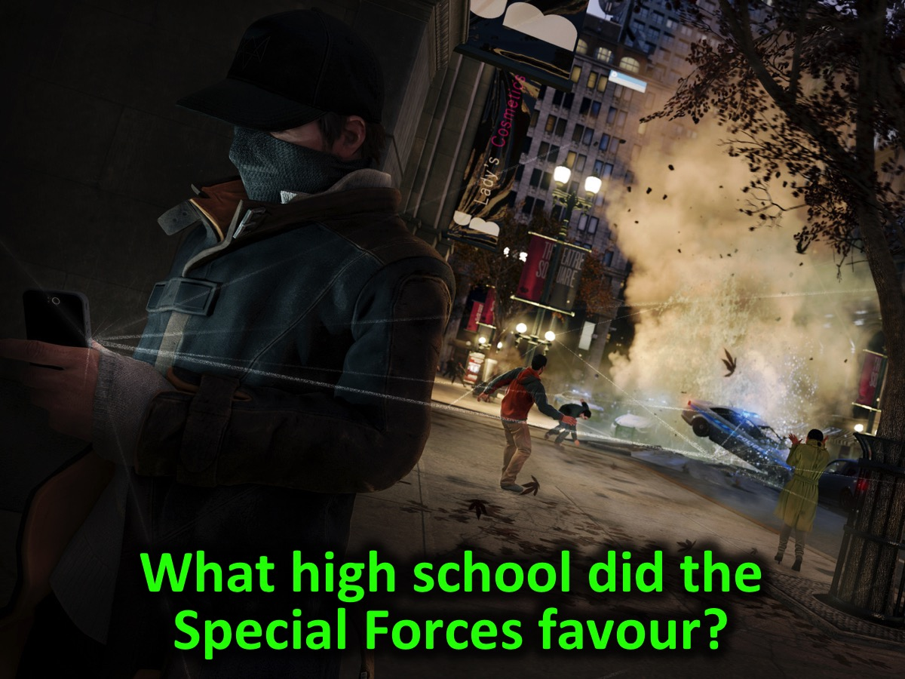
Notes:
What high school did the Special Forces favour?

Slide 30
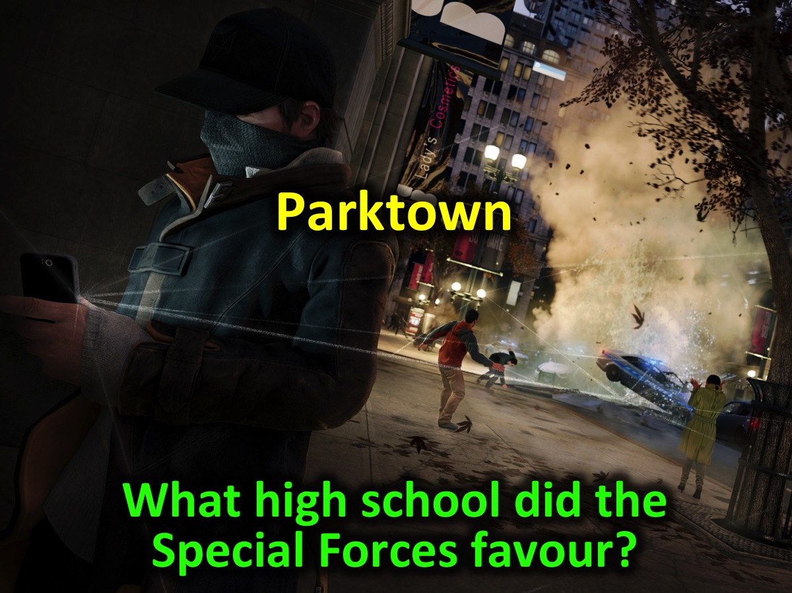
Notes:
Parktown High

Slide 31
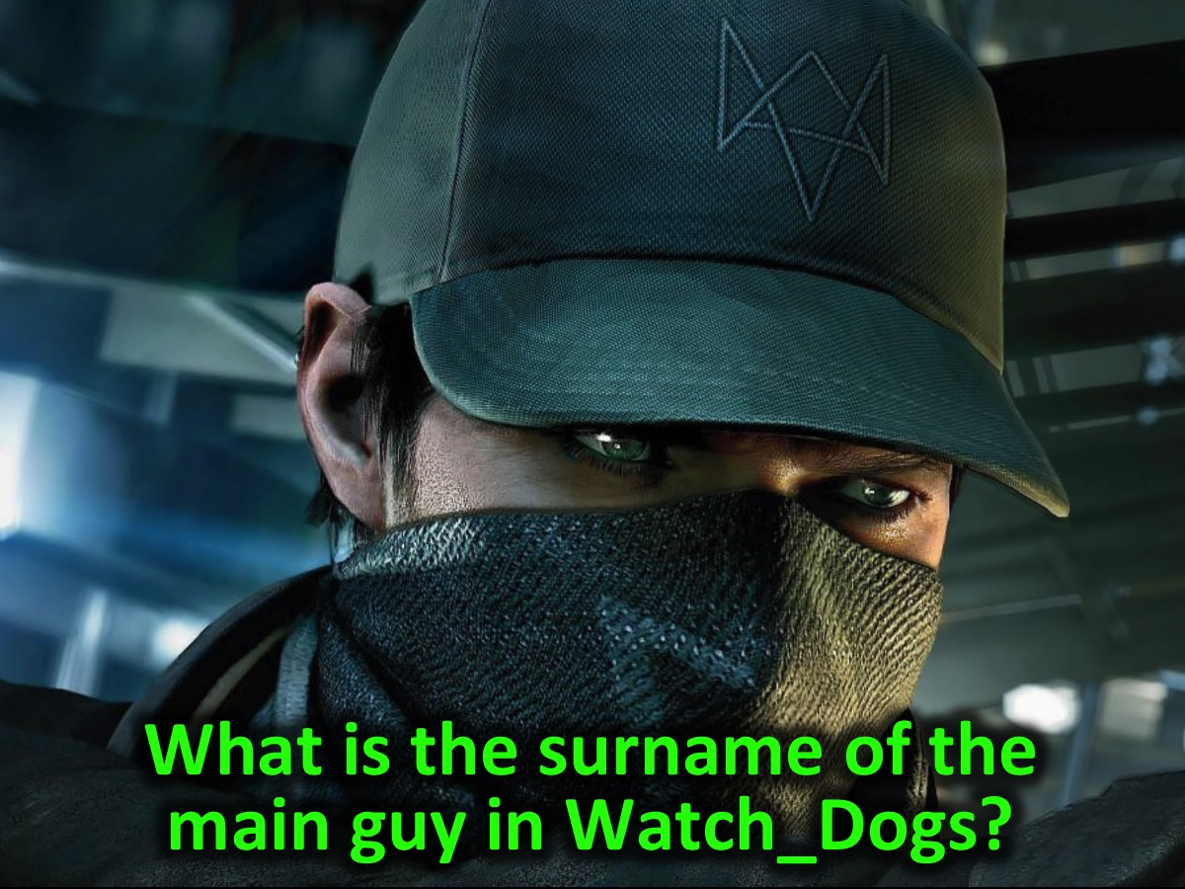
Notes:
What is the surname of the guy in Watch_Dogs?

Slide 32
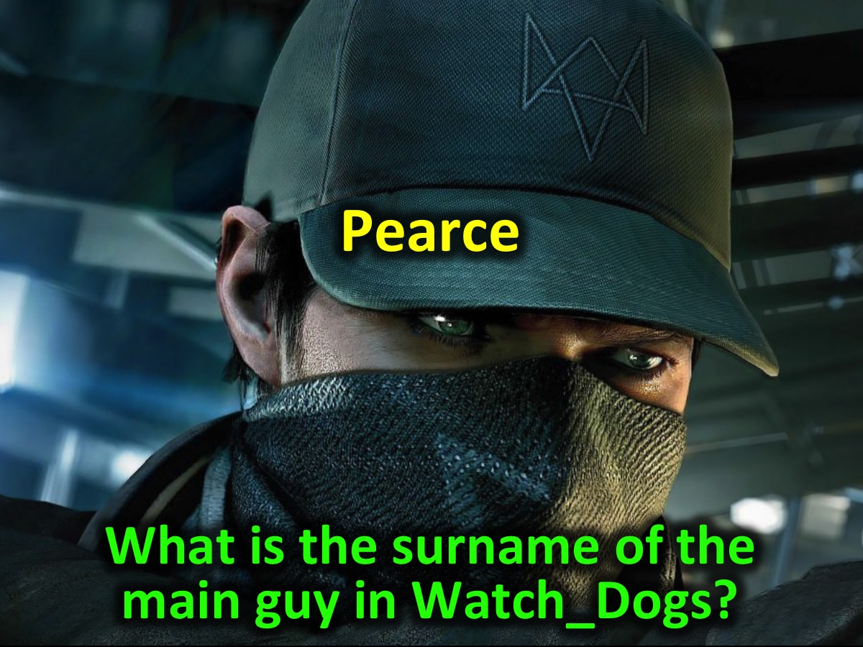
Notes:
Pearce

Slide 33
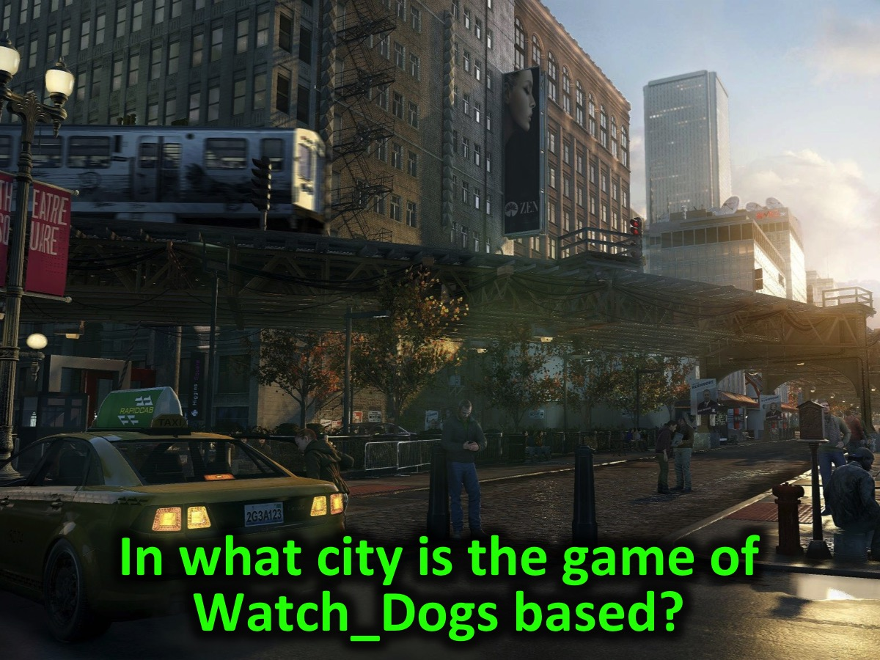
Notes:
In what city is the game of Watch_Dogs based?

Slide 34
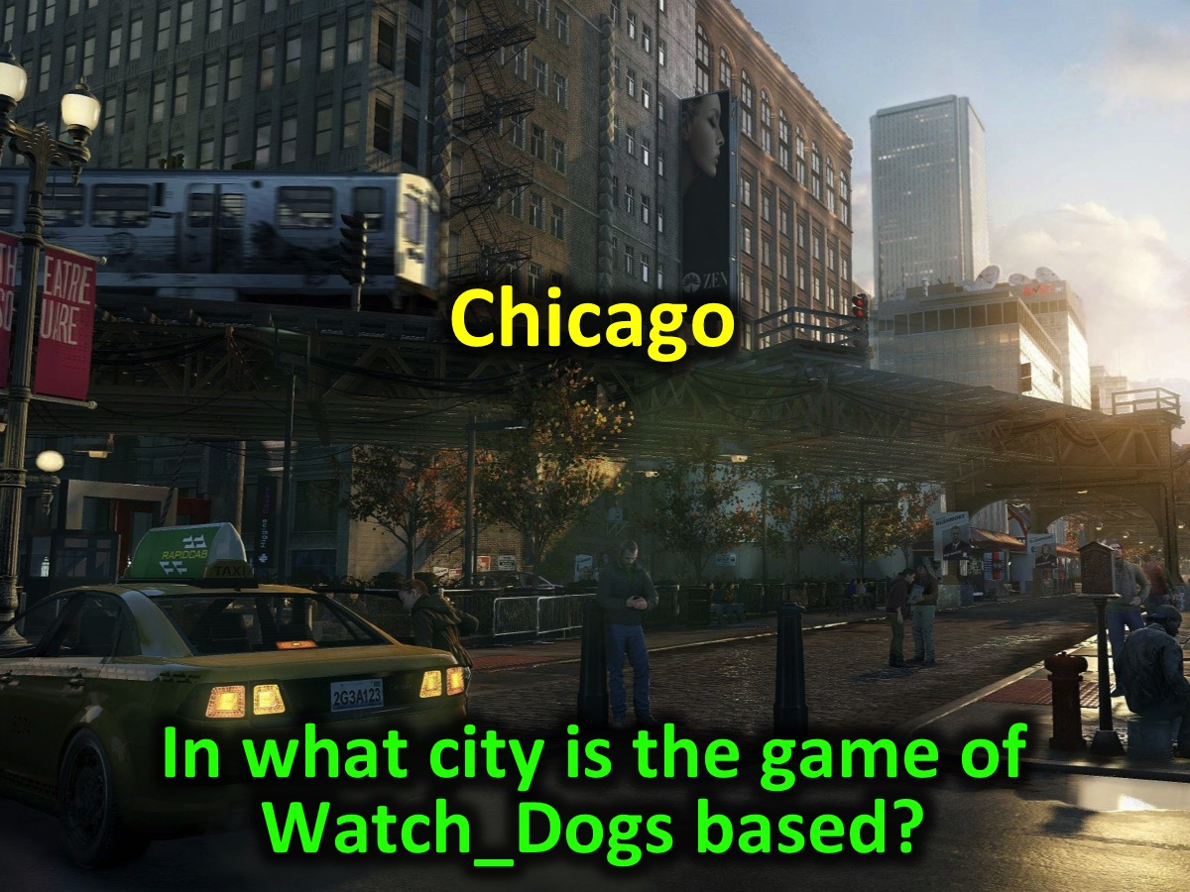
Notes:
Chicago

Slide 35
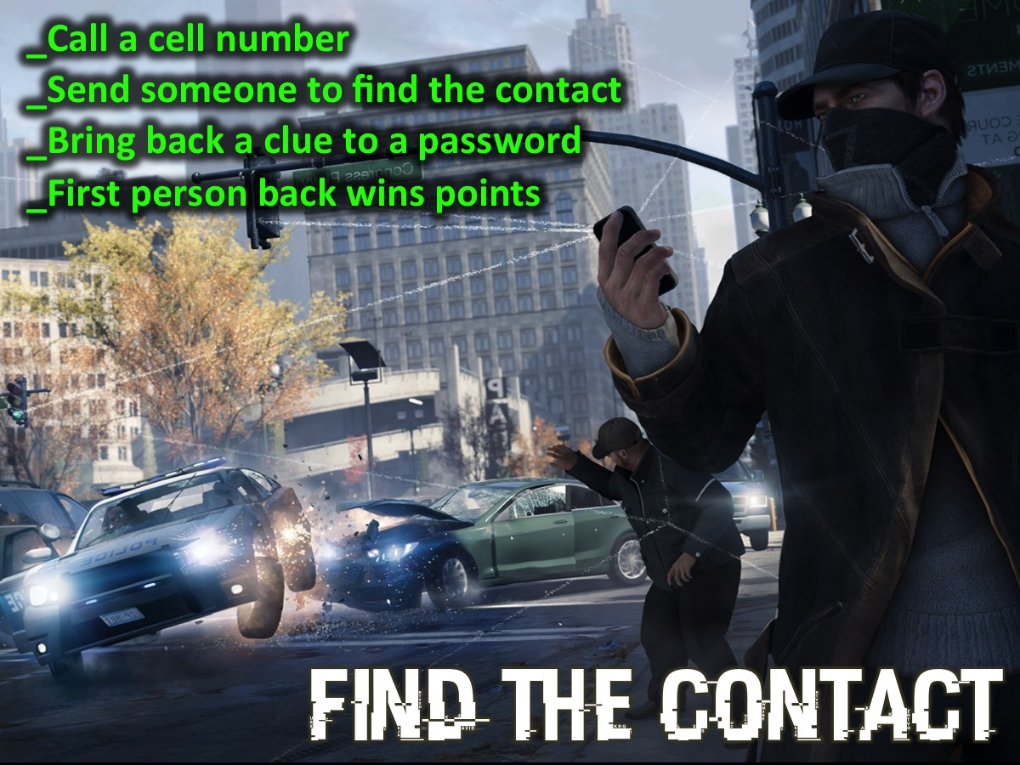
Notes:
Find the Contact: Teams have to find a cellphone by calling a specific number, and locating it when it rings. Note: We give each group the cell number of a different leader. These leaders are dispatched to position themselves somewhere on the church property. Each group has to call their number and discover the leaders’ identity and directions to their location and send just one person to find them and bring something back from them. The Clue is: “It’s just a game!”

Slide 36
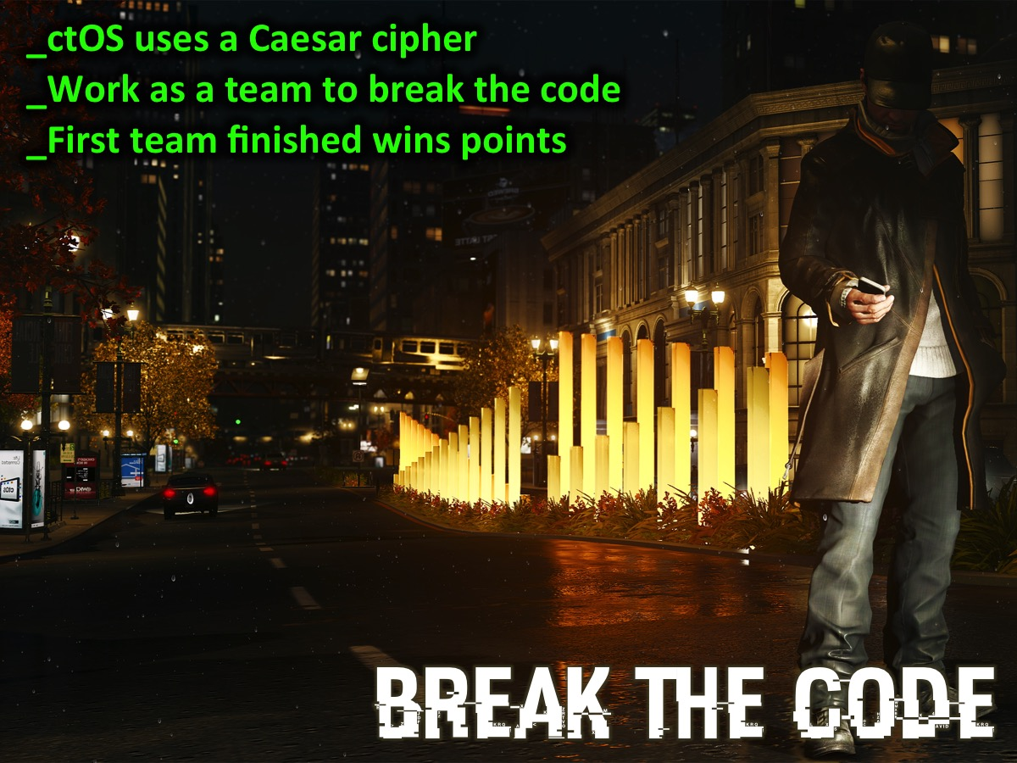
Notes:
Break the Code: ctOS uses a Caesar cipher so you need to work as a team to figure out how to break the code to understand the message. The first team finished wins points.
A simple Caesar cipher is presented to the groups and the first to break the code and give the correct answer wins.

Slide 37
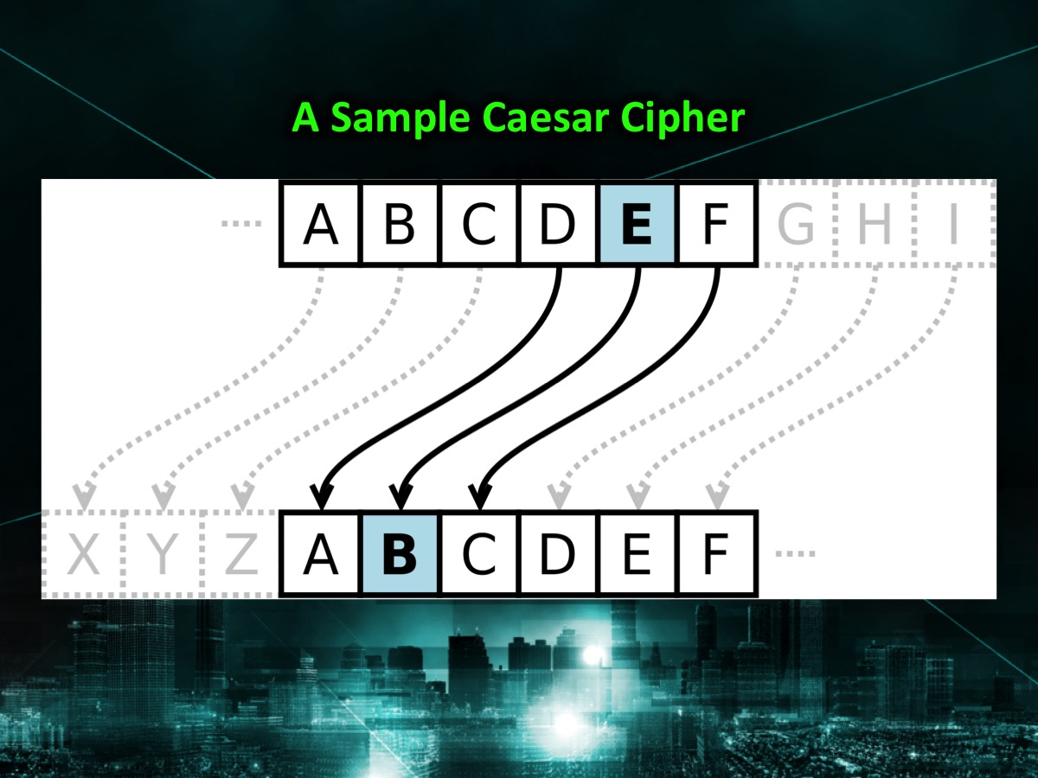
Notes:
Here is an example of how to break the code: In cryptography, a Caesar cipher is one of the simplest and most widely known encryption techniques. It is a type of substitution cipher in which each letter in the plaintext is replaced by a letter some fixed number of positions down the alphabet. For example, with a left shift of 3, D would be replaced by A, E would become B, and so on. The method is named after Julius Caesar, who used it in his private correspondence.

Slide 38
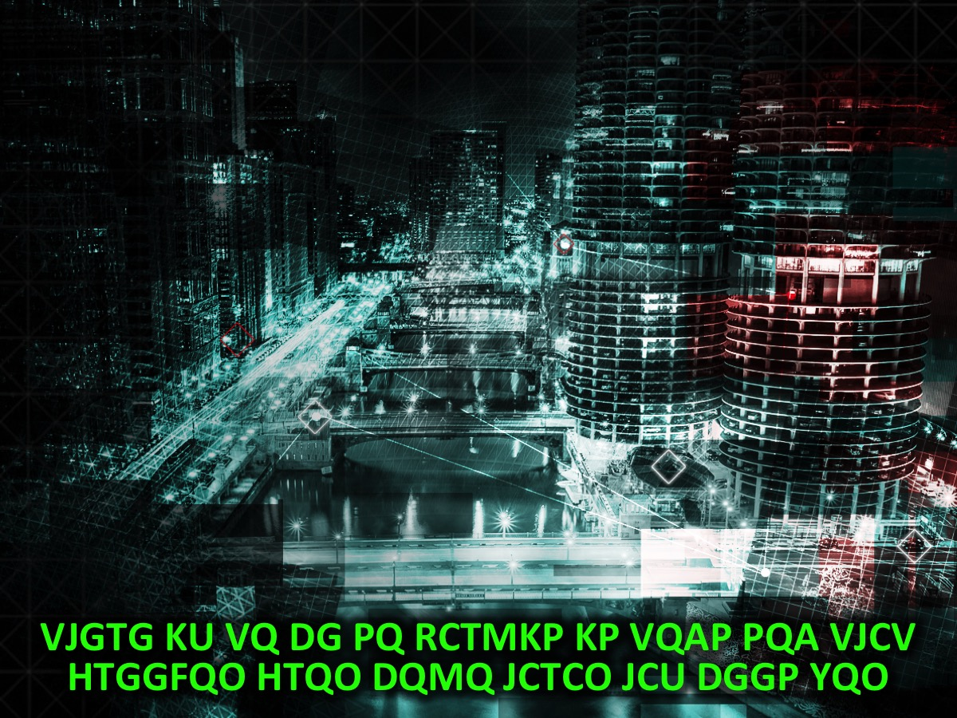
Notes:
Here is the encoded message:
VJGTG KU VQ DG PQ RCTMKP KP VQAP PQA VJCV HTGGFQO HTQO DQMQ JCTCO JCU DGGP YQO

Slide 39
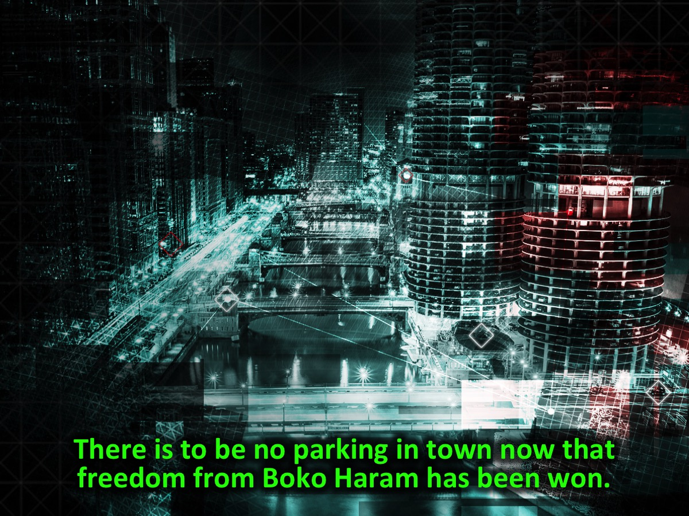
Notes:
Here is the decoded message:
There is to be no parking in town now that freedom from Boko Haram has been won.

Slide 40
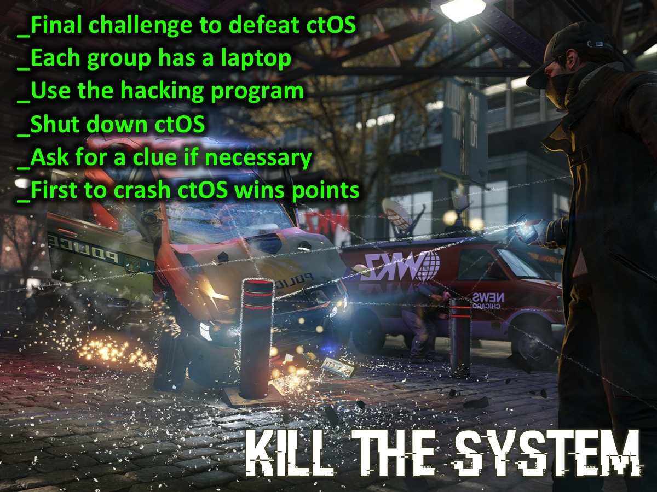
Notes:
Kill the System: A computer hacking program has been written that will be used by the 6 groups each with their own laptop. The first group to shut the system down successfully will win points for their team.
You can download a PowerPoint with instructions for using the program from this link: http://www.ymresourcer.com/documents/ctOS.pptx
You can download the ctOS program with this link: http://www.ymresourcer.com/documents/ctOS.exe

Slide 41
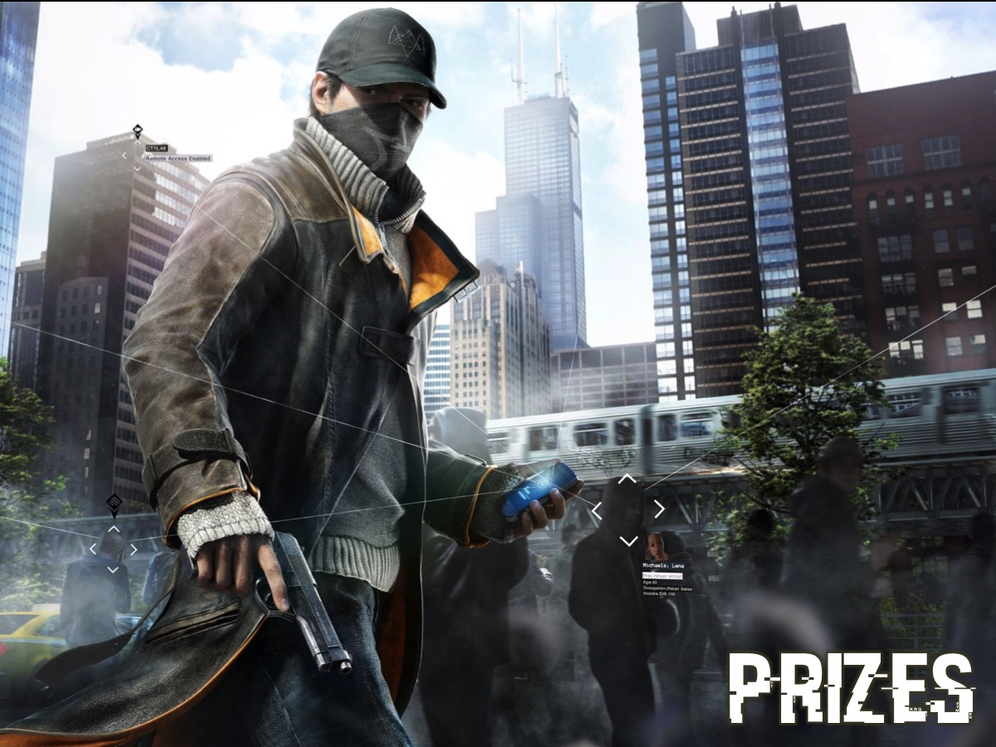
Notes:
Prizes: The team that Hacks the best (earned the most points) will win a prize.

Slide 42
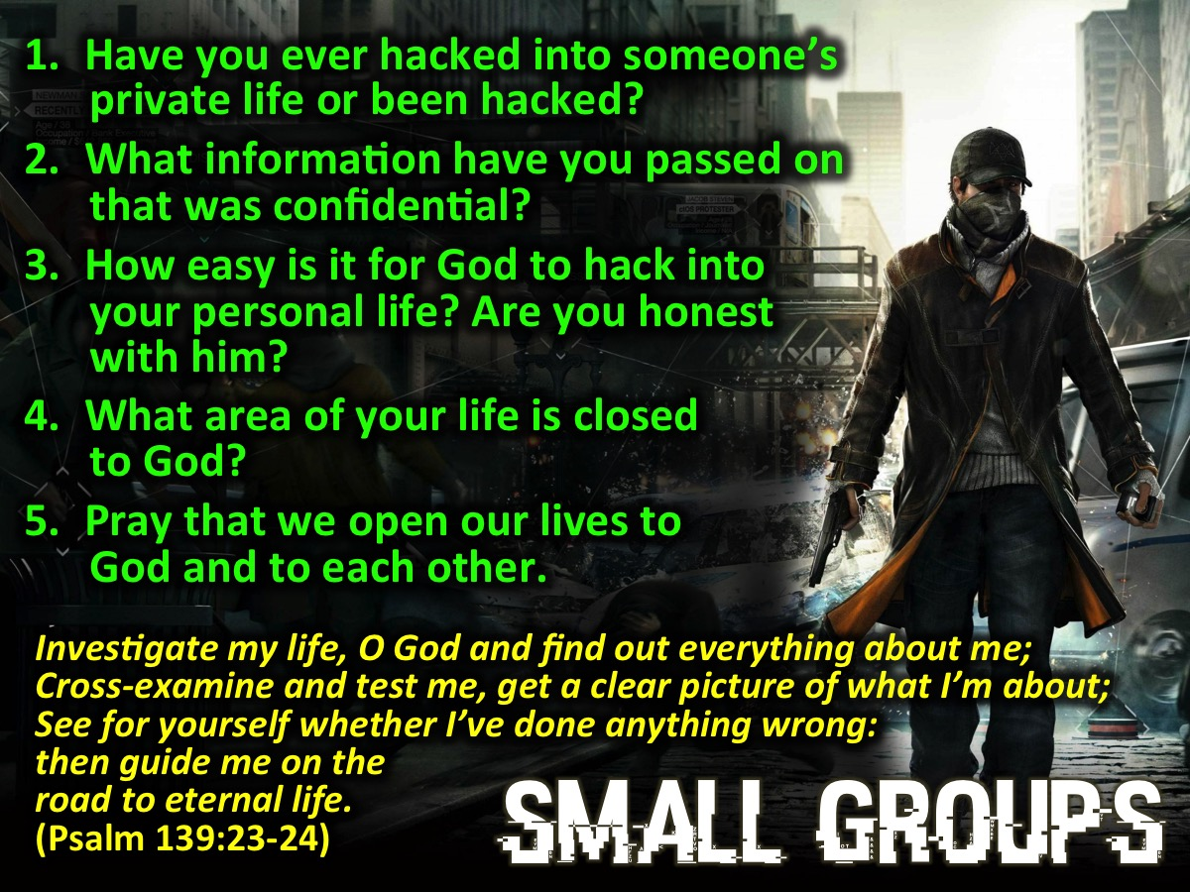
Notes:
Small Groups: Here are the questions for small group time: (1) Have you ever hacked into someone’s private life (invaded their privacy, read their diary or messages) or been hacked? (2) What information have you passed on that was confidential? (3) How successfully is God able to hack into your personal life? Ie. Are you open with him? Do you share honestly with him? (4) What area of your life is out of bounds to God? (5) Pray that we open our lives to God and to each other.

Slide 43
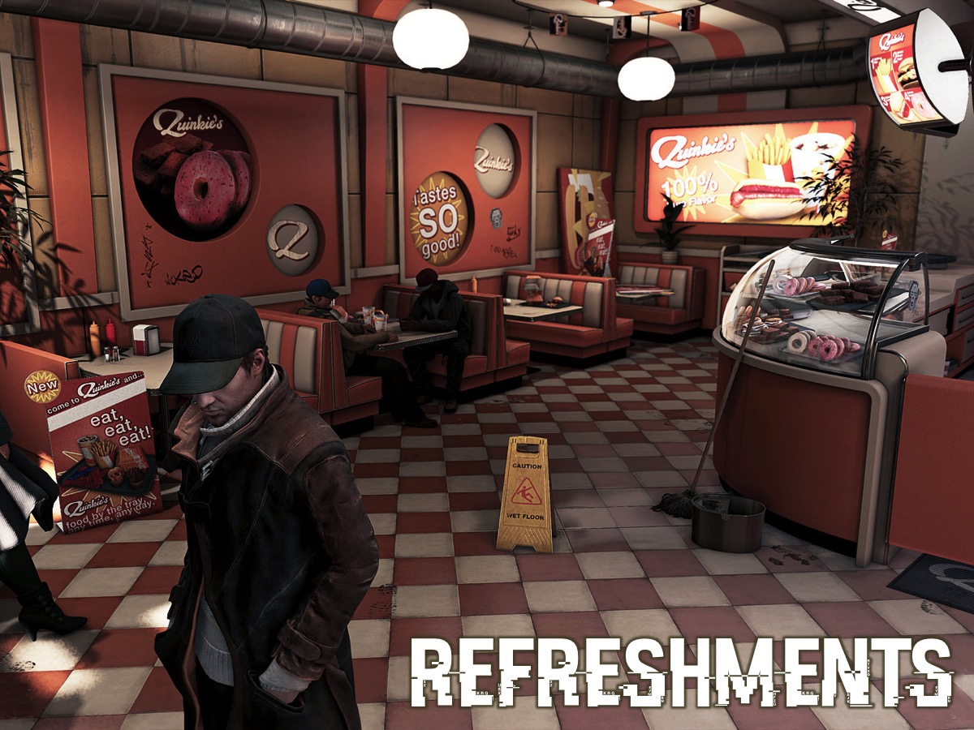
Notes:
Refreshments.

Slide 44
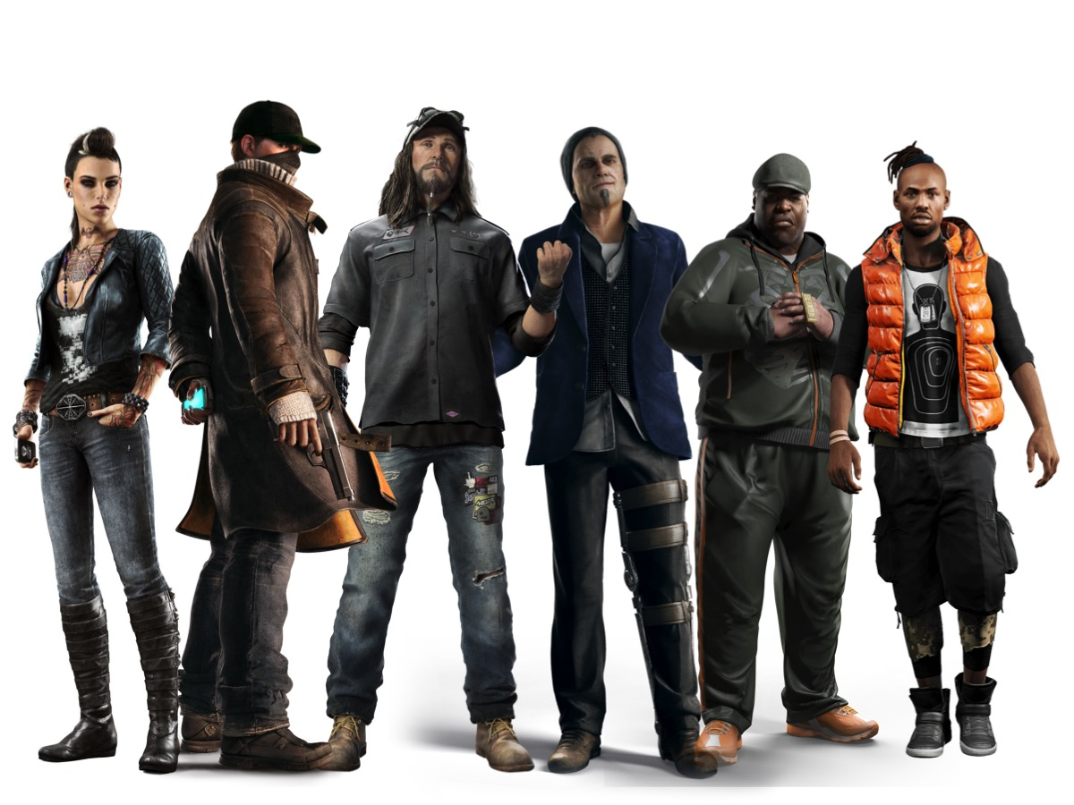
Notes:
The Watch_Dog Characters: From left to right: (1) Clara Lille - Clara may be pretty but she is dangerous. She’s the trapdoor spider you never saw living right under you. She can weave her way through any system and she can expose every secret you hide. (2) Aiden Pearce - Aiden is a man shaped by violence and obsessed with surveillance, who monitors his family 24/7 in secret to protect them from something that happened in the past. Unfortunately, his family will get endangered once again. Pushed to his limits, he will take justice into his own hands and confront a corrupt system using every weapon available to him. Aiden will become a modern Vigilante Hero – not a hero from the 70's with a cape, but a real human being that will deal with all the repercussions of his actions. (3) T-Bone Grady. T-Bone grew up a tinkerer and a basement hacker before the Internet was barely a byte. He can’t help challenging his mind to unlock areas forbidden to him. And it hasn’t gone without punishment. But he’ll take his jabs. And he’ll give his share in return. (4) Damien Brenks. Damien’s is a restless mind. He’s easily distracted by fresh ideas, but when he does find focus, he’s precise. Self-absorbed bordering on narcissistic, it was a horrendous blow to his psyche when he was left beaten near-death. Damien plays the world around him like a chess board: seeing many intricate moves ahead and manipulating his opponents from the opening moves. He’ll have his revenge. His own way. (5) Tyrone "BedBug" Hayes - Bedbug is the simple cousin to Iraq, leader of the Black Viceroys. Iraq has taken Bedbug under his wing, given the boy a place inside the gang. Bedbug’s not leadership material and he knows it, but that doesn’t mean he’s content to sit back while other people rise to the top. He’s determined to make the most of his opportunity. Impress his cousin and maybe he’ll earn a place close to the Viceroy leadership. (6) Delford "Iraq" Wade - IRAQ is the paranoid leader of the Black Viceroys. He is passionate, he’s loud. He knows how to inspire his troops. A seasoned vet from the Iraq war, he’s brought his tactical training to the mean streets of Chicago. He knows the battles of the future are won through technology. And he’s aligning his soldiers to place the Viceroys front and center in the digital war.

