Slide 1

Notes:
Welcome to week 1 of the brand new Word-On series where each week we will be looking at what the Bible says about different topics such as:

Slide 2

Notes:
God

Slide 3

Notes:
Evolution

Slide 4

Notes:
Humanity

Slide 5

Notes:
We break for the long weekend where the leaders will be attending a training event/

Slide 6

Notes:
Warfare

Slide 7

Notes:
Media

Slide 8
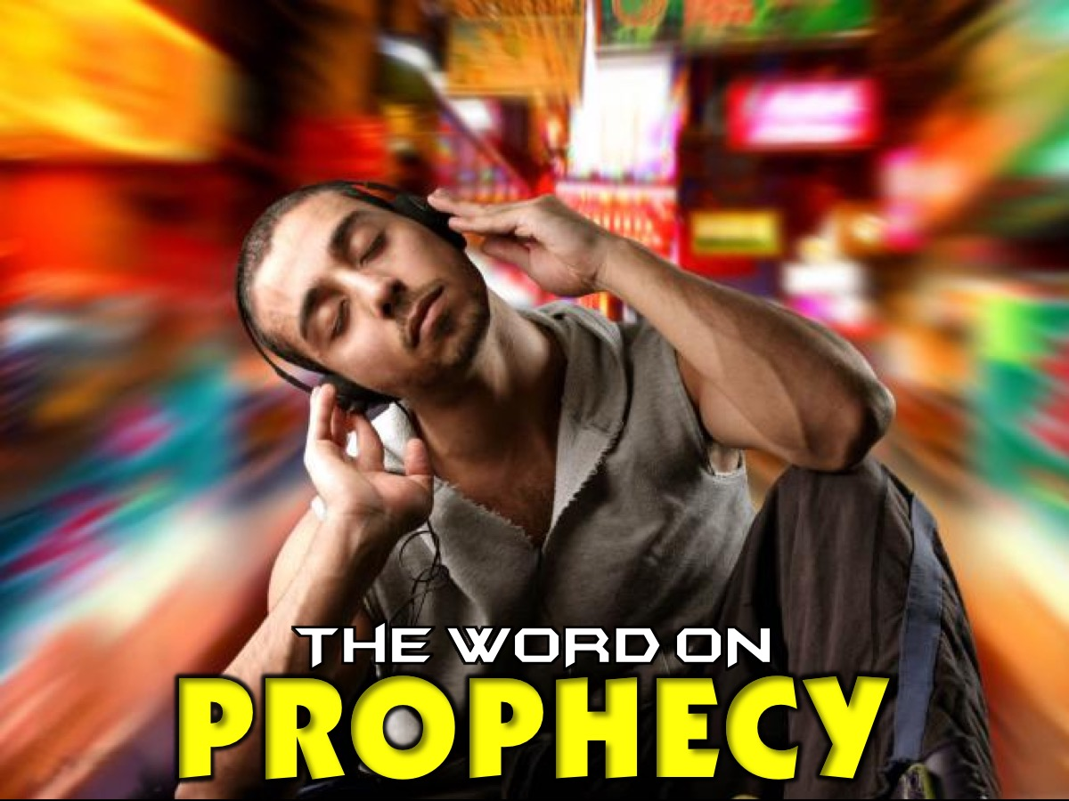
Notes:
Prophecy

Slide 9

Notes:
Lifestyle

Slide 10

Notes:
Gifts

Slide 11

Notes:
Suffering

Slide 12

Notes:
Miracles

Slide 13

Notes:
Today we are going to be looking at the Word On God! What does the Bible say about God?

Slide 14

Notes:
There is a new movie out called Gods of Egypt - here is the trailer:

Slide 15
Notes:
Video: Gods of Egypt. Get it on YouTube at: https://www.youtube.com/watch?v=tuVg_6UaQsU

Slide 16
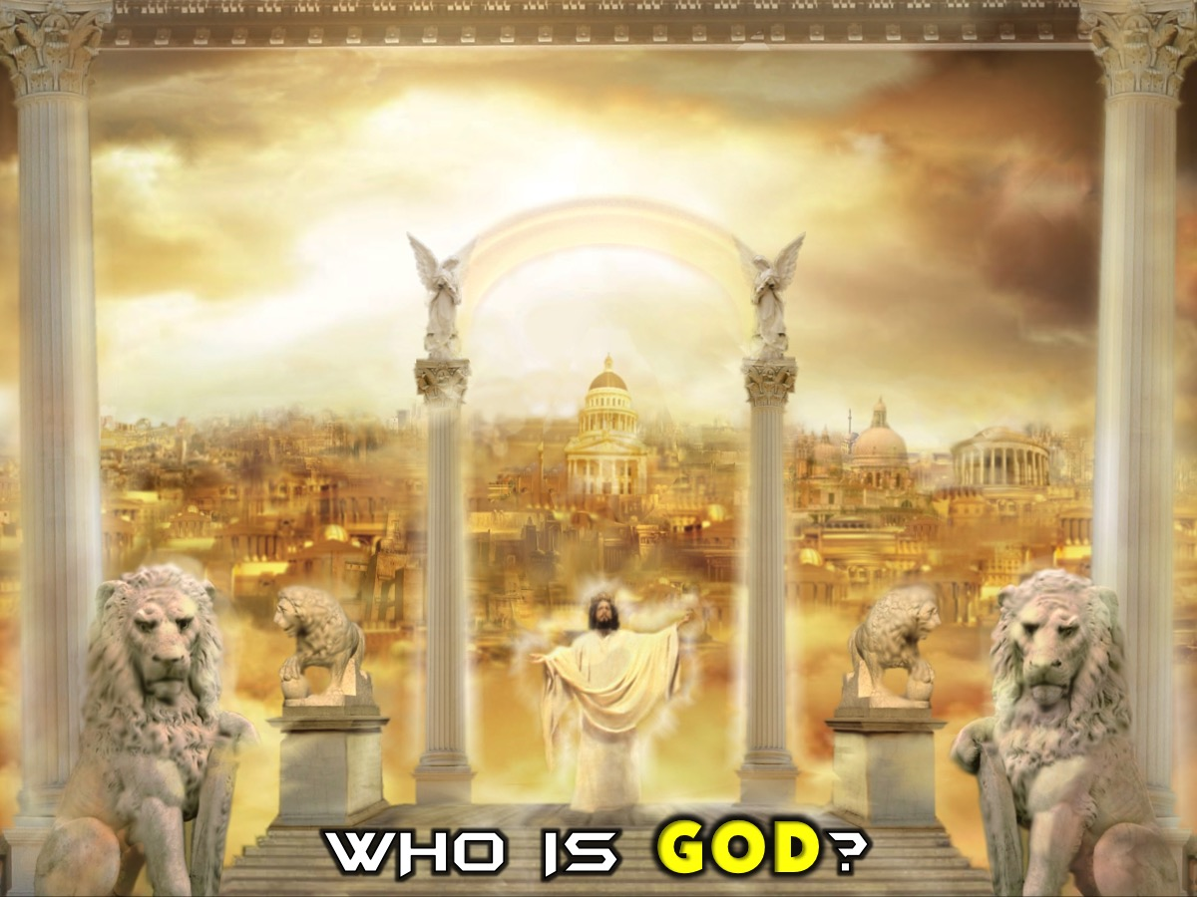
Notes:
So what does the Bible say about God? Who Is the God Of The Bible?

Slide 17

Notes:
The Bible is the story of God - so actually, it contains endless references to who God is and how he relates to us.

Slide 18
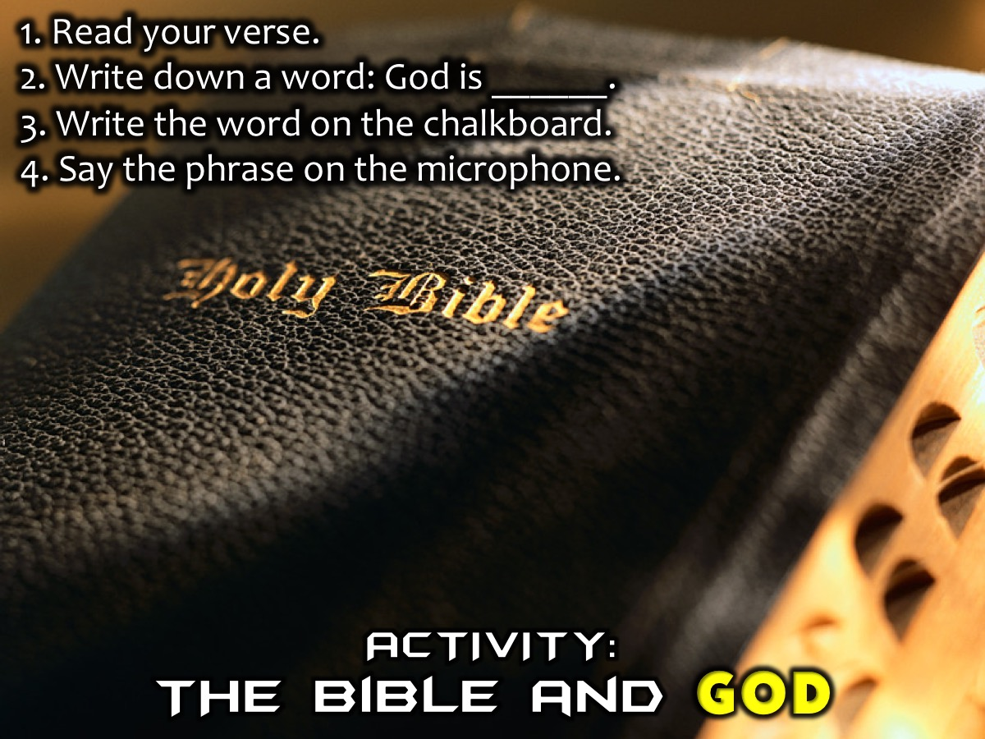
Notes:
Activity: Each person will be given a Bible verse on a piece of paper. You read the verse and they choose a word to fill in next to the phrase: God is ______________. Once you have written the phrase down you will go the chalk board and you write that phrase in chalk around the phrase: “God is…” You then go past the microphone and your say the phrase: God is (inserting the word that you added).

Slide 19
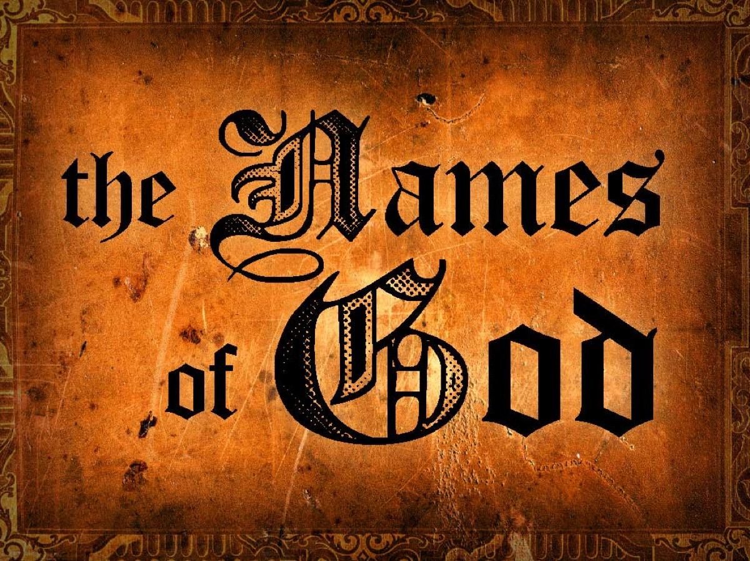
Notes:
The Names of God. In the Bible times, just like in Africa culture, names were really important and were filled with meanings. There are over 200 names for God in the Bible and each one of them reflect an aspect of who God is!

Slide 20
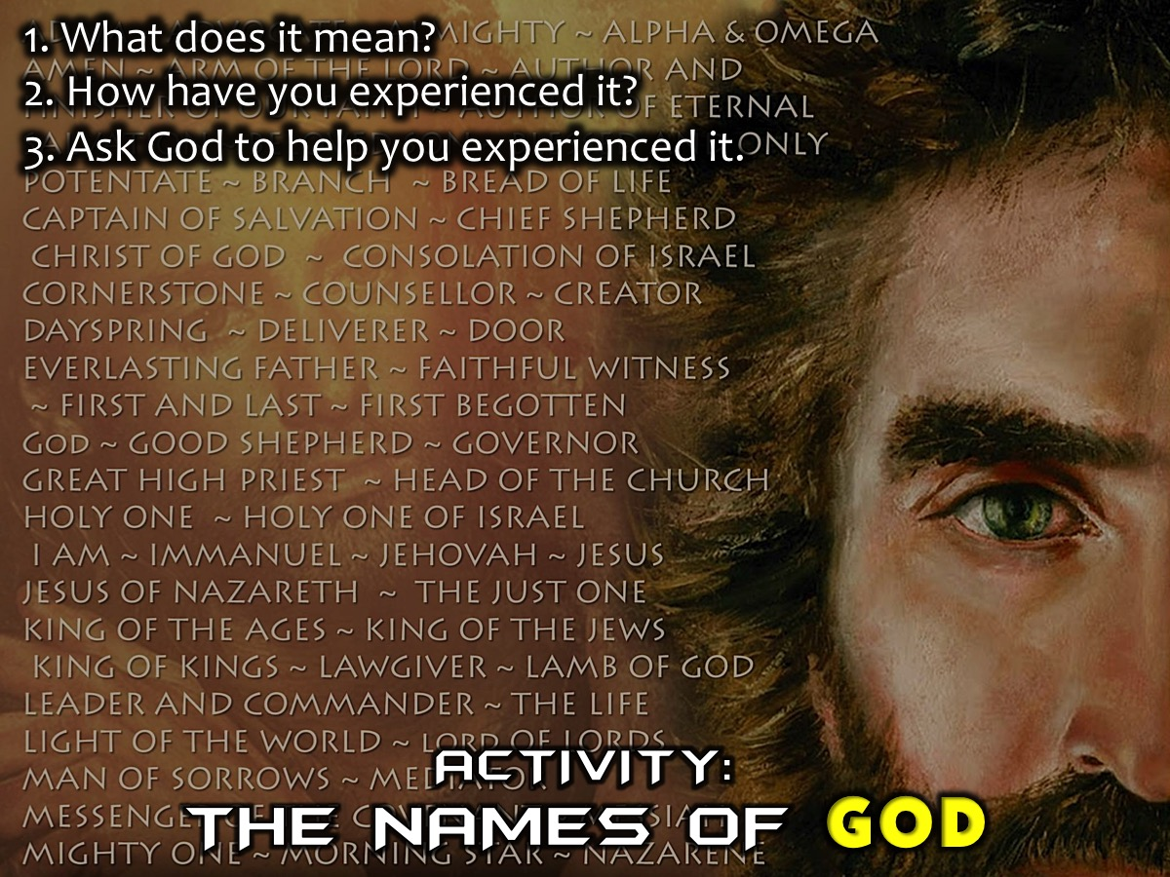
Notes:
Activity: Each person will be given a name of God on a piece of paper. You need to do the following in pairs: (1) What does that characteristic of God mean? (2 How have you experienced that characteristic of God? (3) Ask God to help you experience him in that way this week.

Slide 21
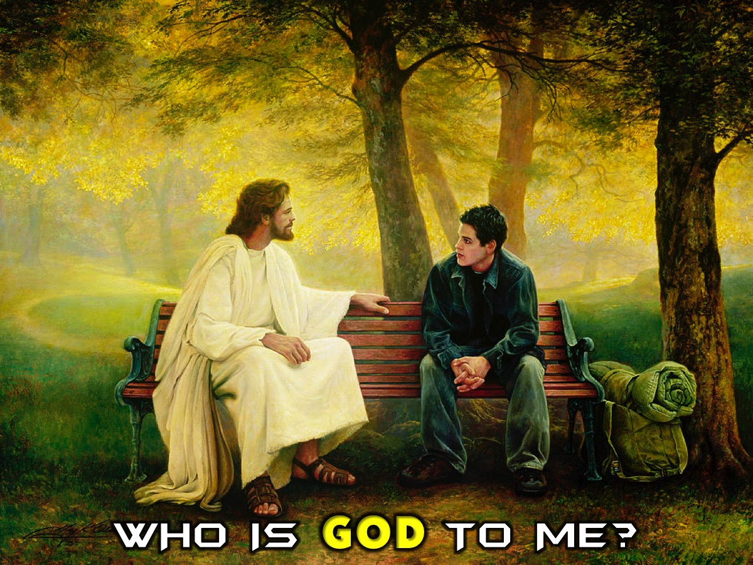
Notes:
I am going to end this morning by reflecting on some of the ways in which God has revealed himself to me over the years of my lifetime.

Slide 22
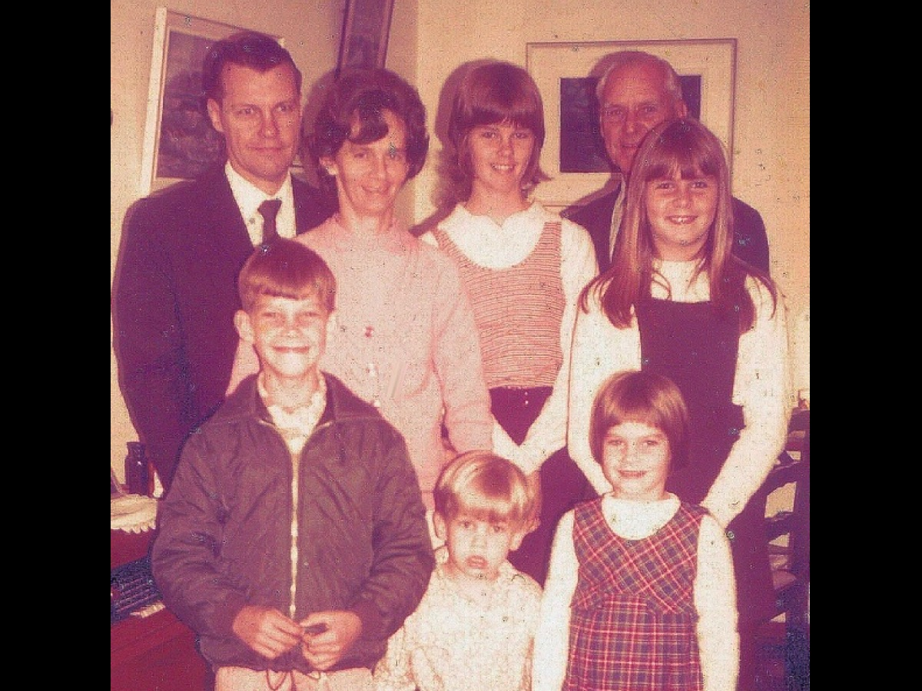
Notes:
Story #1. God My Saviour. When I was just 7 years of age, an evangelist came to our church - a ventriloquist who had two dolls, Timmy and Tessa - and he used them to share the story of how Jesus died for my sins and how that God does not have any grandchildren - just children. We are not saved if our parents are saved - we have to invite Jesus into our lives. I asked Jesus to be the Saviour and the Lord of my life and he has been Lord of my life ever since!

Slide 23

Notes:
Psalms 68 says that God is my Saviour. Our God is a God who saves; from the Sovereign LORD comes escape from death. (Psalms 68:20)

Slide 24
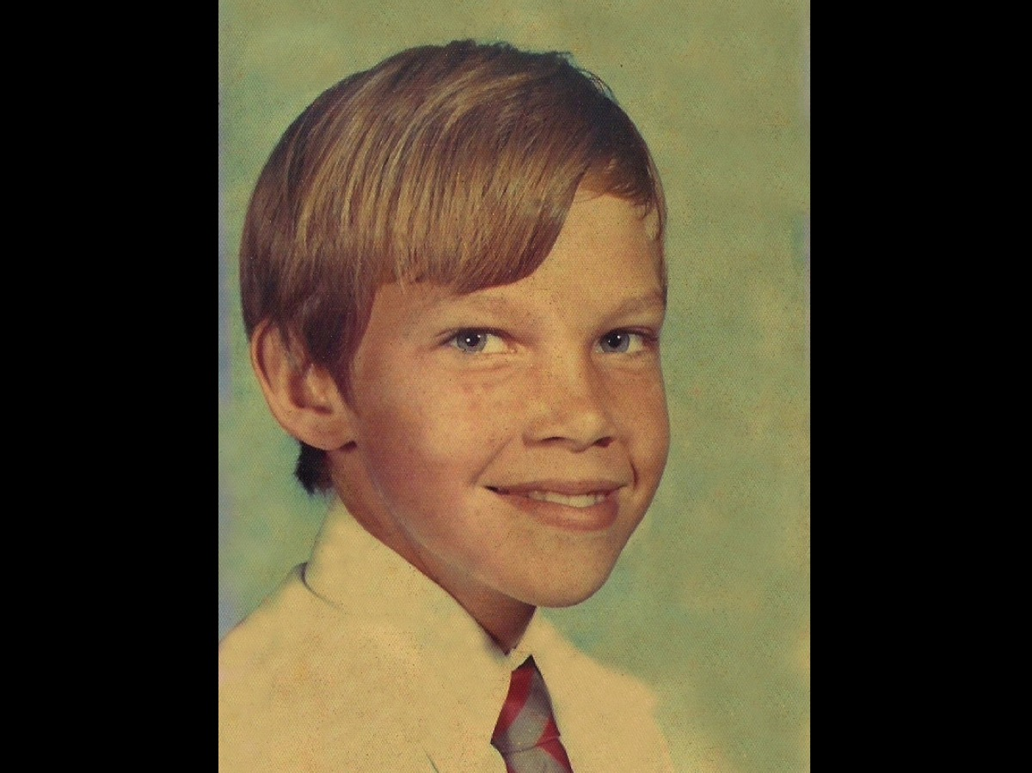
Notes:
Story #2. God My Healer. When I was just 10 years of age, I got TB and was dying. The leader of our church movement flew down from Johannesburg to visit me in the hospital and he prayed for me and I was totally healed and discharged from hospital the next day. I suffered no consequences of the lung infection and have been fine ever since.

Slide 25
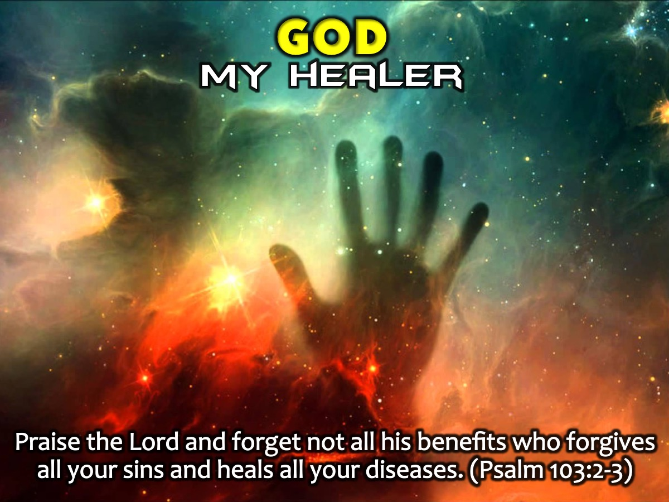
Notes:
Psalm 103 says that God is my Healer! Praise the Lord, my soul, and forget not all his benefits who forgives all your sins and heals all your diseases. (Psalm 103:2-3)

Slide 26
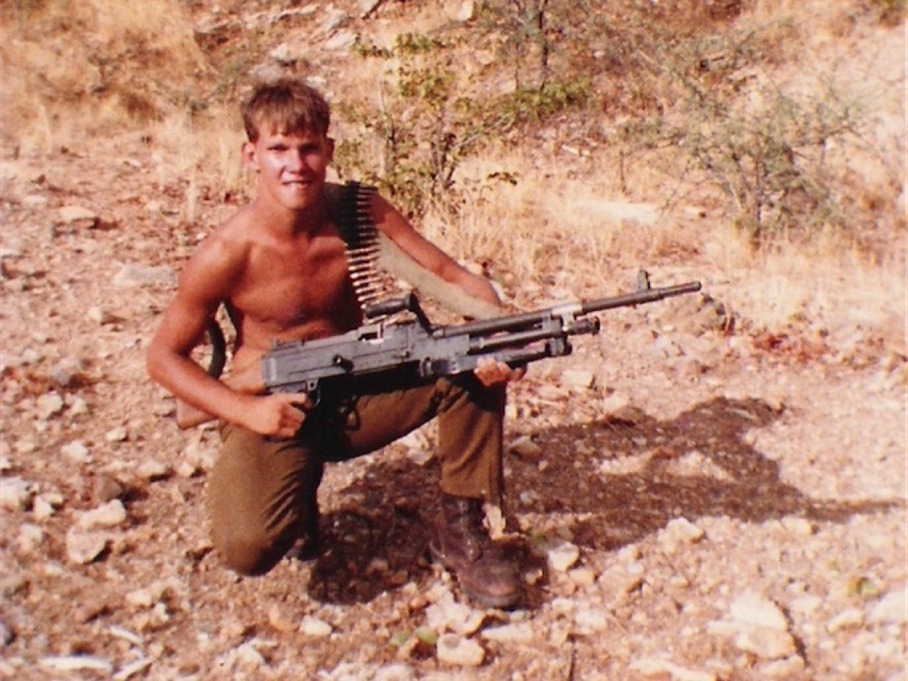
Notes:
Story #3. God My Deliverer. When I was about 19 I was in a dining hall and a drunk guy came running at me with a knife - I was powerless to defend myself and all I could do was put out my arm and say: “Stop in the name of Jesus.” He immediately stopped and froze for a moment before dropping the knife and walking away almost embarrassed and confused as to what he was doing.

Slide 27
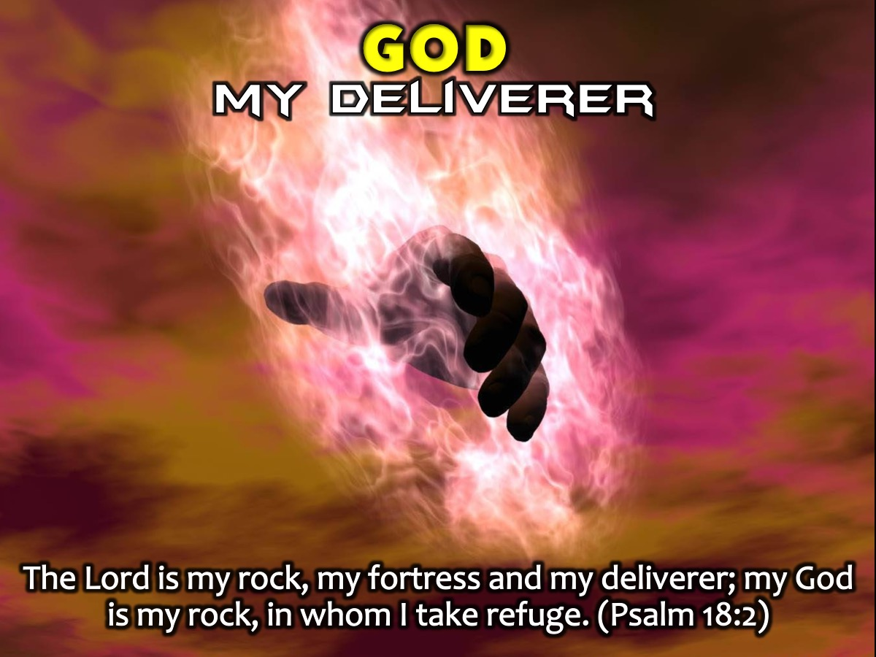
Notes:
Psalm 18 says that God is my Deliverer! The Lord is my rock, my fortress and my deliverer; my God is my rock, in whom I take refuge. (Psalm 18:2)

Slide 28

Notes:
Story #4. God My Helper. One day in ministry I was hosting a ministry team and we were booked to take an assembly at a local high school in Durban. We met at our church and prayed that God would use the music and drama team and when we went to the mini-bus we found that someone had locked the keys in the van. We knew that the ministry leader would be furious if we broke the window to get into the van - but we had to do something because it was our only transport and all the equipment was in the van. So we said a prayer for God to help us in the impossible situation and I took the key from my Ford Escort and stuck it in the lock of the VW Mini-van and miraculously it opened the door first time and we headed off to the school for a powerful time of ministry. For the rest of that week I tried to replicate the miracle using that key but not once did it open the lock!

Slide 29
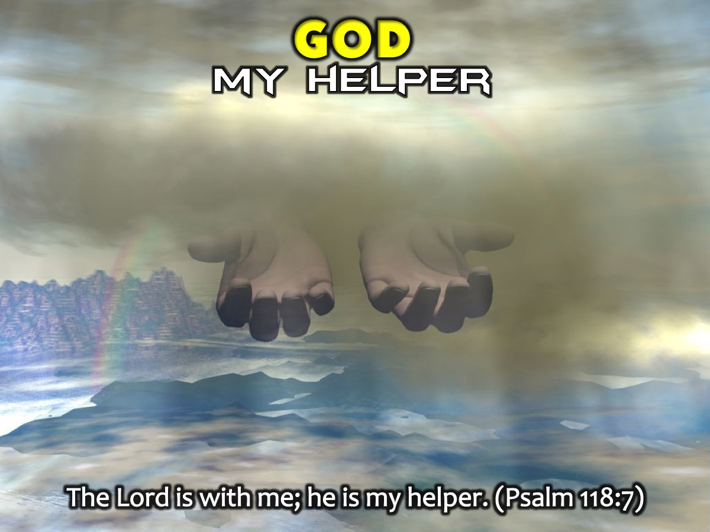
Notes:
Psalm 118 says that God is my Helper! The Lord is with me; he is my helper. (Psalm 118:7)

Slide 30
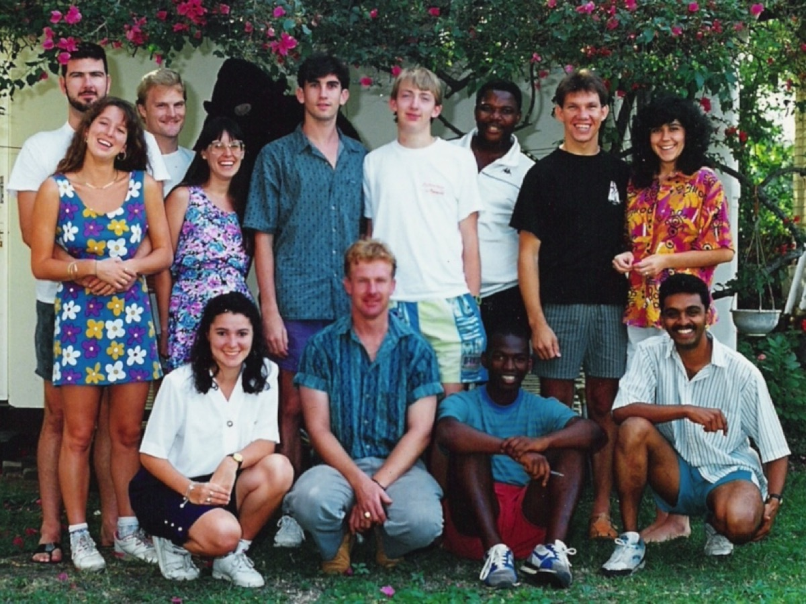
Notes:
Story #5. God My Protector. When I was about 26 Debbie and I were driving through Pinetown when I saw a guy snatch a handbag from a woman. I pulled up the hand break, jumped out of the car (leaving Debbie stuck in the middle of traffic as she did not have a licence) and I ran after the guy - catching up with him within 30 meters but suddenly he came at me with a knife. Suddenly a police reservist stuck his revolver over my shoulder and he said to the guy: “take a step and you are dead!” The guy was arrested and I was escaped unharmed.

Slide 31
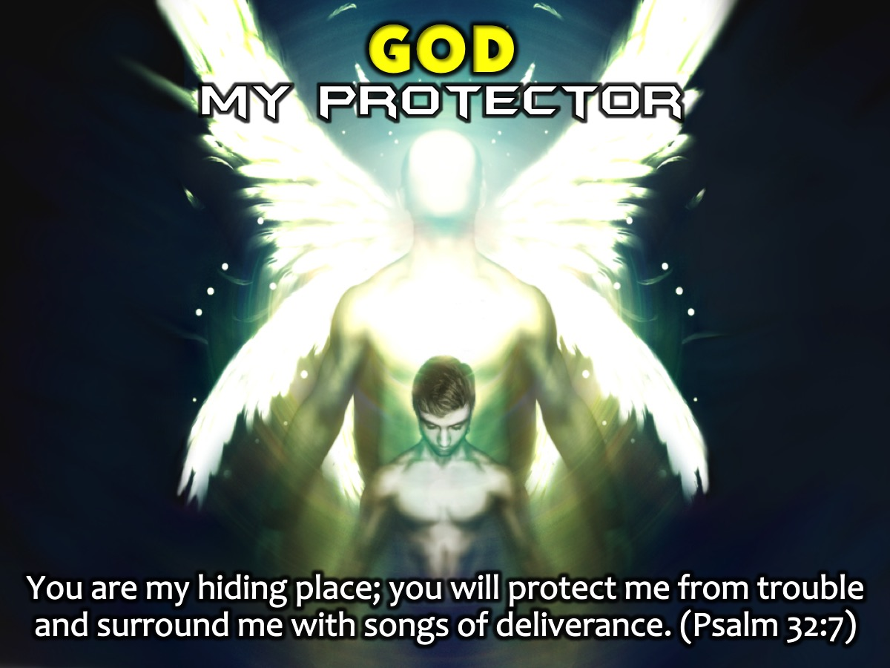
Notes:
Psalm 32 says that God is my Protector! You are my hiding place; you will protect me from trouble and surround me with songs of deliverance. (Psalm 32:7)

Slide 32
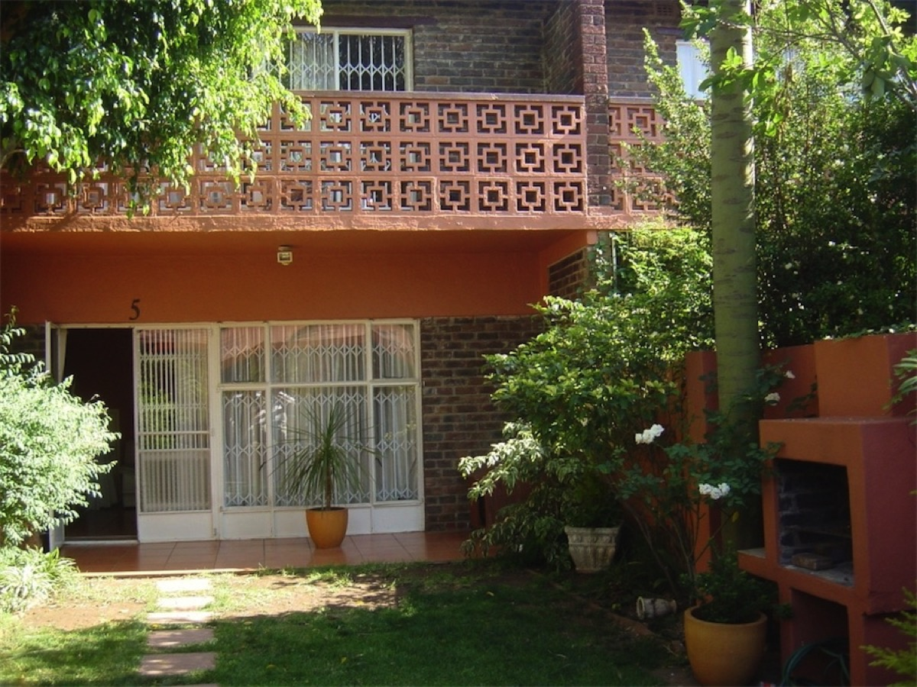
Notes:
Story #6. God my Provider. When I was about 32, Debbie and I were renting a home in Florida and we doubted that we would ever be able to buy our own home. One day, a friend called and said he wanted to give us R20 000 as a deposit on a home. I told him that I could never afford to pay that back - but he said, “I never said it was a loan - it is a gift!” We were blown away and we were able to use the R20 000 to put a deposit down on a home in Windsor East and pay all the legal costs to transfer the home into our own name. Ten years later we sold that home making a 300% profit and were able to invest it in the home we now have in Greymont.

Slide 33
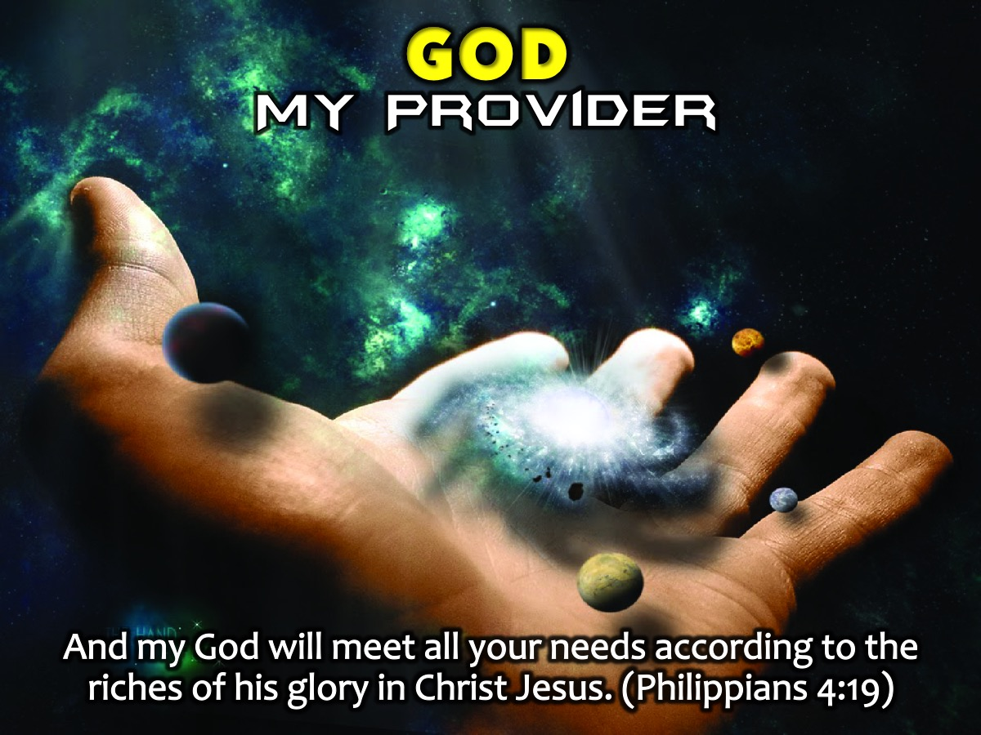
Notes:
Philippians 4 says that God is my Provider! And my God will meet all your needs according to the riches of his glory in Christ Jesus. (Philippians 4:19)

Slide 34
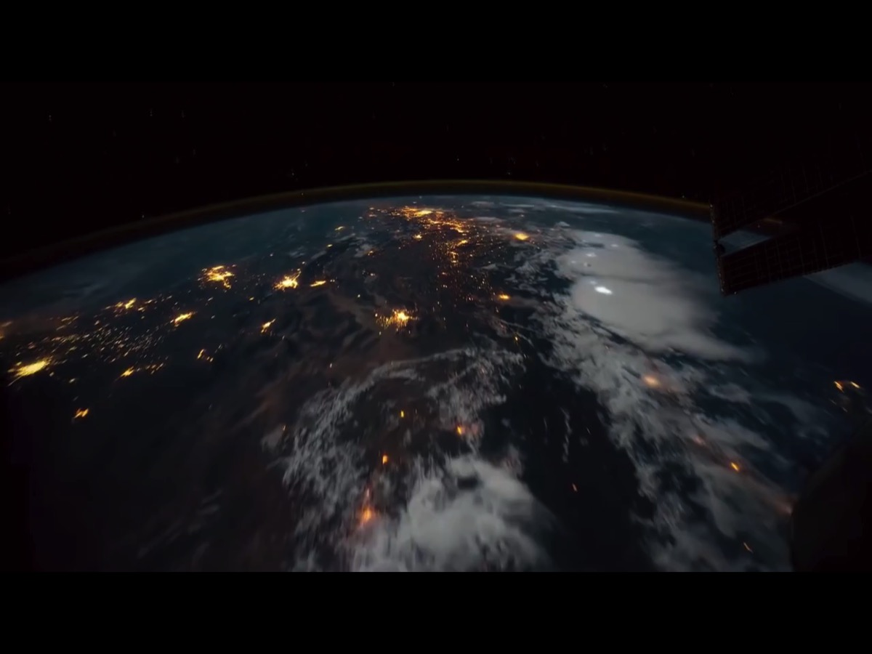
Notes:
Video: Who is God Really? Get it on YouTube at: https://www.youtube.com/watch?v=1hpi10cQkBQ

Slide 35
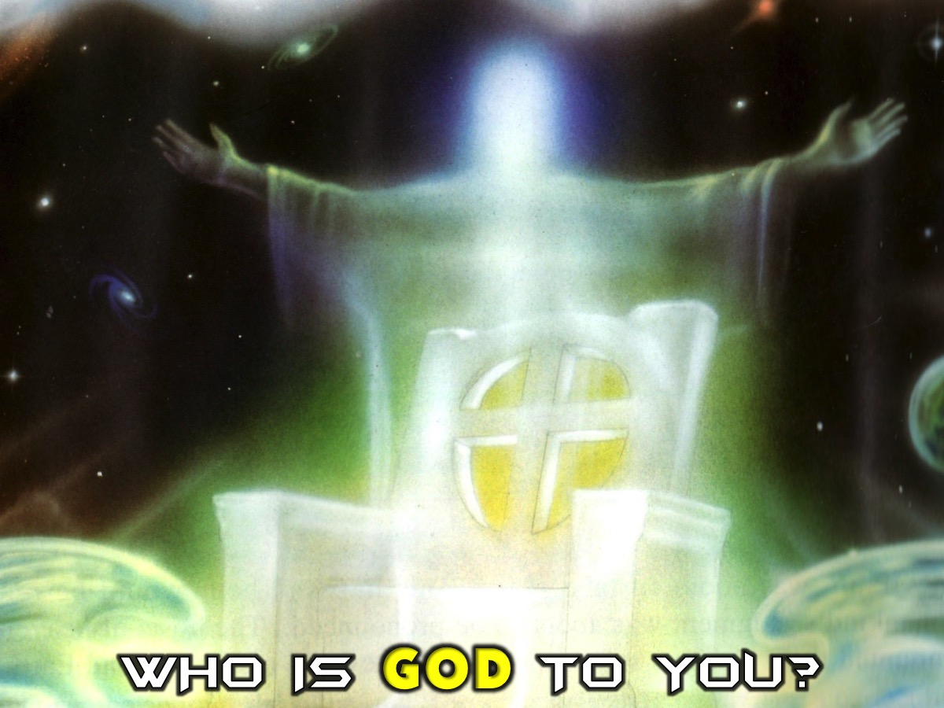
Notes:
Who is God to you? How have you come to know him? Your whole life can be an adventure of coming to know the God of the Bible!

Slide 36
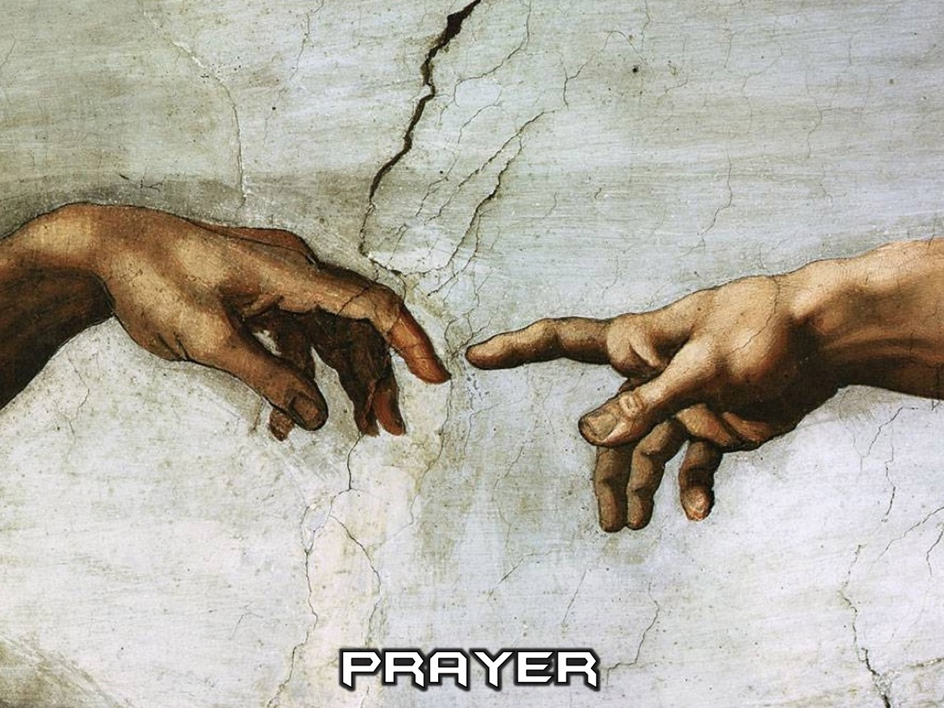
Notes:
Prayer

Slide 37

Notes:
Next week we will be looking at The Word-On Evolution.

