Slide 1

Notes:
Welcome to week 2 of the Word-On series where each week we are looking at what the Bible says about different topics.

Slide 2

Notes:
Last week we look at what the Word says about God.

Slide 3

Notes:
This week we are going to look at what the word says about Evolution.

Slide 4
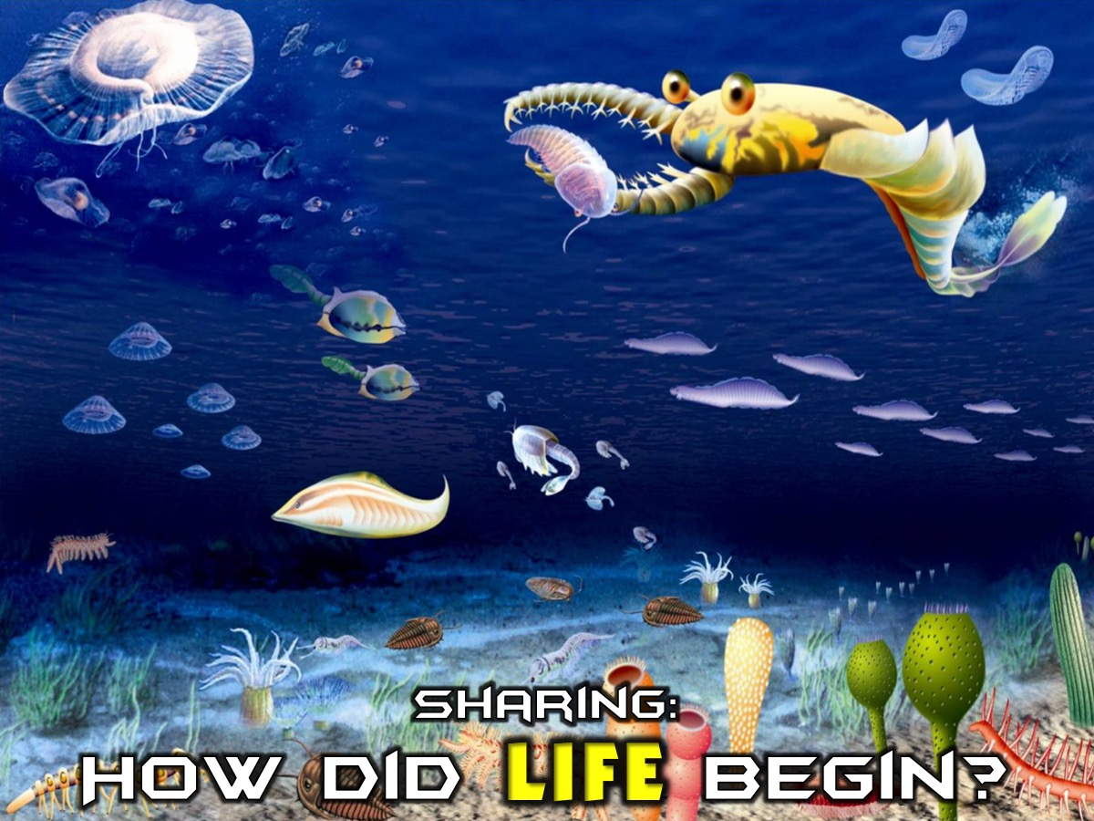
Notes:
Sharing: Ask the person next to you to share with you any theories they have heard about how life begin on earth.

Slide 5
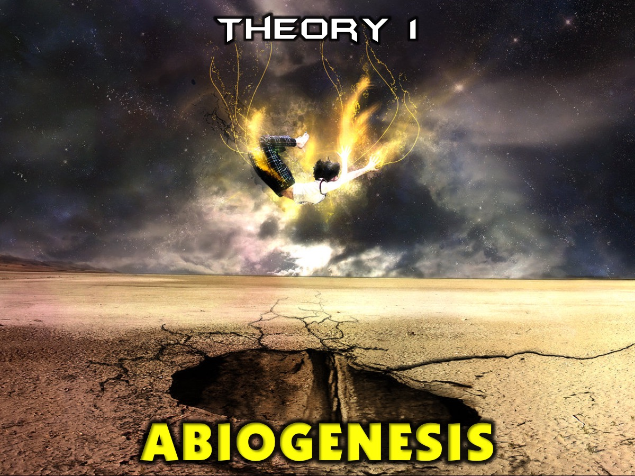
Notes:
Theory 1: Abiogenesis. One theory is that a natural process caused life to arise from non-living matter - where pre-life chemical reactions gave rise to a living system. Technically, life resulted from the natural thermodynamic imperative of increasing the entropy production of the Earth in its interaction with its solar environment.

Slide 6
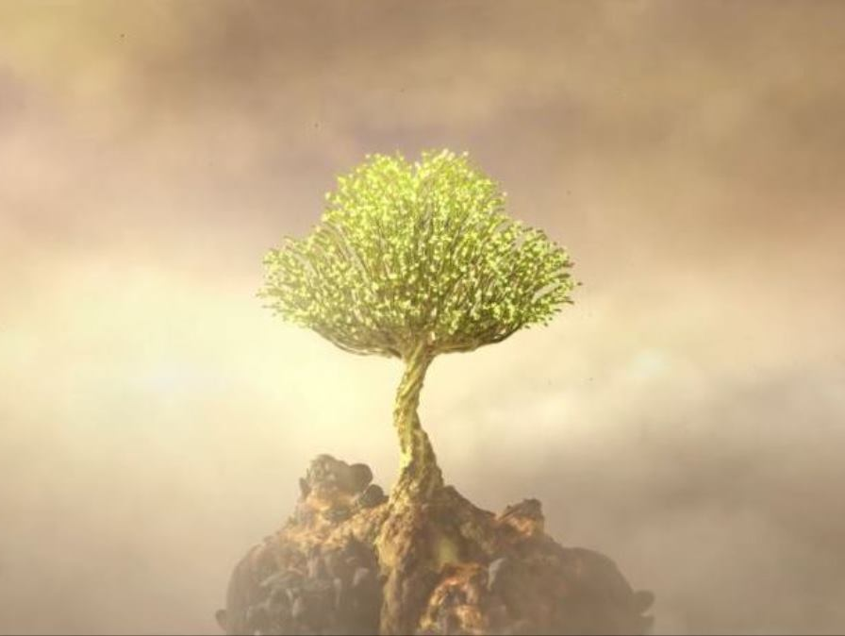
Life generated spontaneously.
Under the right conditions a living cell emerged out of a rock.
Notes:
In this theory, life generated spontaneously - a living cell came out of a rock due the right conditions being present.

Slide 7
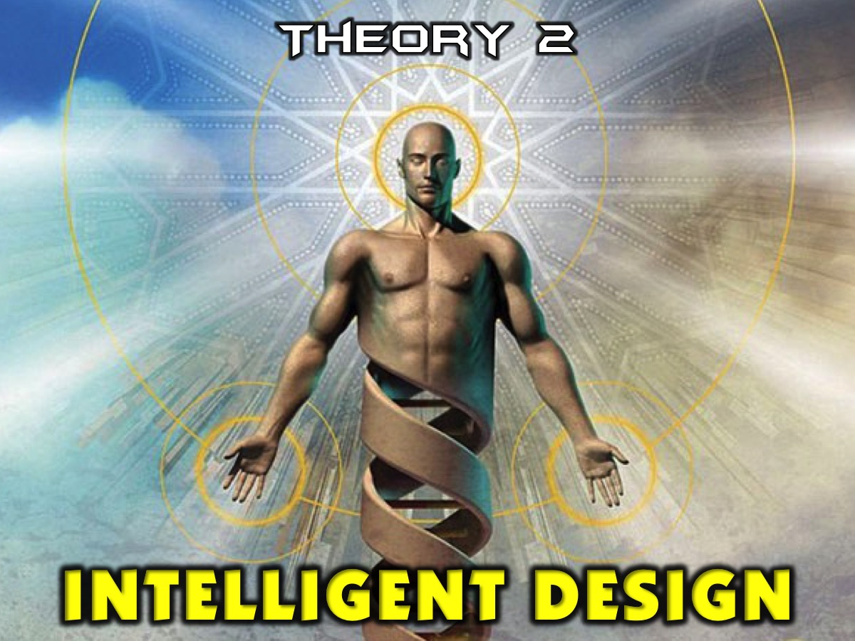
Notes:
Theory 2: Intelligent Design. This is a theory that an intelligent designer directed the process of the origin of the universe and living things. The theory focuses on the scientific side of things so does not suggest who the designer could be.

Slide 8
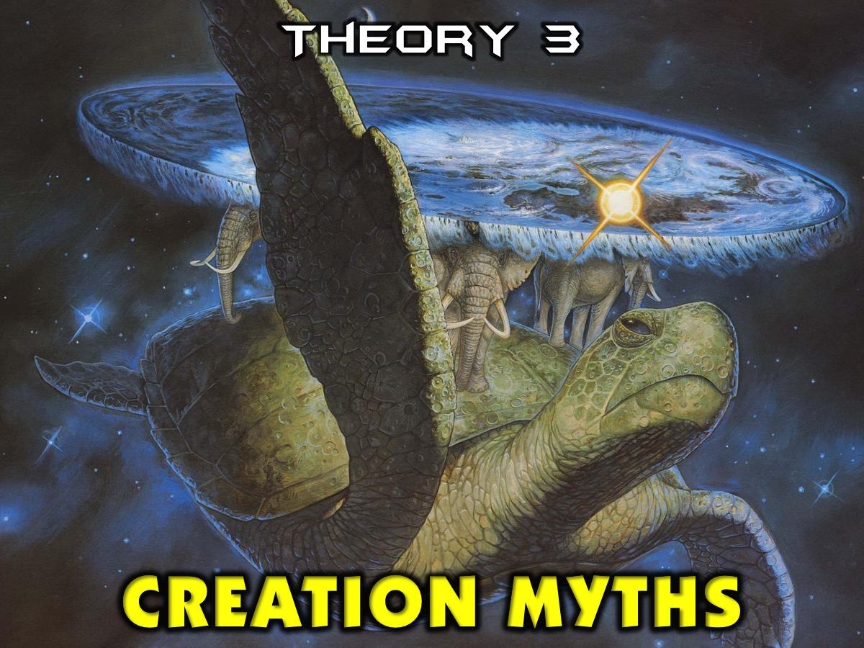
Notes:
Theory 3: Creation Myths. There exists in all cultures stories or myths about how life began on earth - there are countless version across all continents. One of the most ancient creation myths tells the story of the world riding through space with four elephants on the back of a turtle. There is also the Babylonian creation myth. It is also called the Enuma Elish and it names two primeval gods: Abzu who represents fresh water and Tiamat who represents oceanic waters. Several other gods are created - Ea and his brothers who reside in Tiamat's vast body. They make so much noise that the noise annoys Tiamat and Abzu greatly. Abzu wishes to kill the young gods, but Tiamat disagrees and he warns Ea the most powerful of the gods. Ea uses magic to put Abzu into a coma, then kills him. Ea then becomes the chief god and marries Damkina and has a son, Marduk, greater still than himself. Marduk is given wind to play with and he uses the wind to make dust storms and tornadoes. This disrupts Tiamat's great body and causes the gods still residing inside her to be unable to sleep. The gods persuade Tiamat to take revenge for the death of her husband, Abzu. Her power grows, and some of the gods join her. She creates 11 monsters to help her win the battle and elevates Kingu, her new husband, to "supreme dominion." A lengthy description of the other gods' inability to deal with the threat follows. Marduk offers to save the gods if he is appointed as their leader and allowed to remain so even after the threat passes. When the gods agree to Marduk's conditions he is selected as their champion against Tiamat, and becomes very powerful. Marduk challenges Tiamat to combat and destroys her. He then rips her corpse into two halves with which he fashions the earth and the skies. Marduk then creates the calendar, organises the planets and stars, and regulates the moon, the sun, and weather. The Gods who have pledged their allegiance to Tiamat are initially forced into labour in the service of the Gods who sided with Marduk. But they are freed from these labours when Marduk then destroys Tiamat's husband, Kingu, and uses his blood to create humankind to do the work for the Gods. Most noteworthy is Marduk's symbolic elevation over Enlil, who was seen by earlier Mesopotamian civilisations as the king of the Gods.

Slide 9
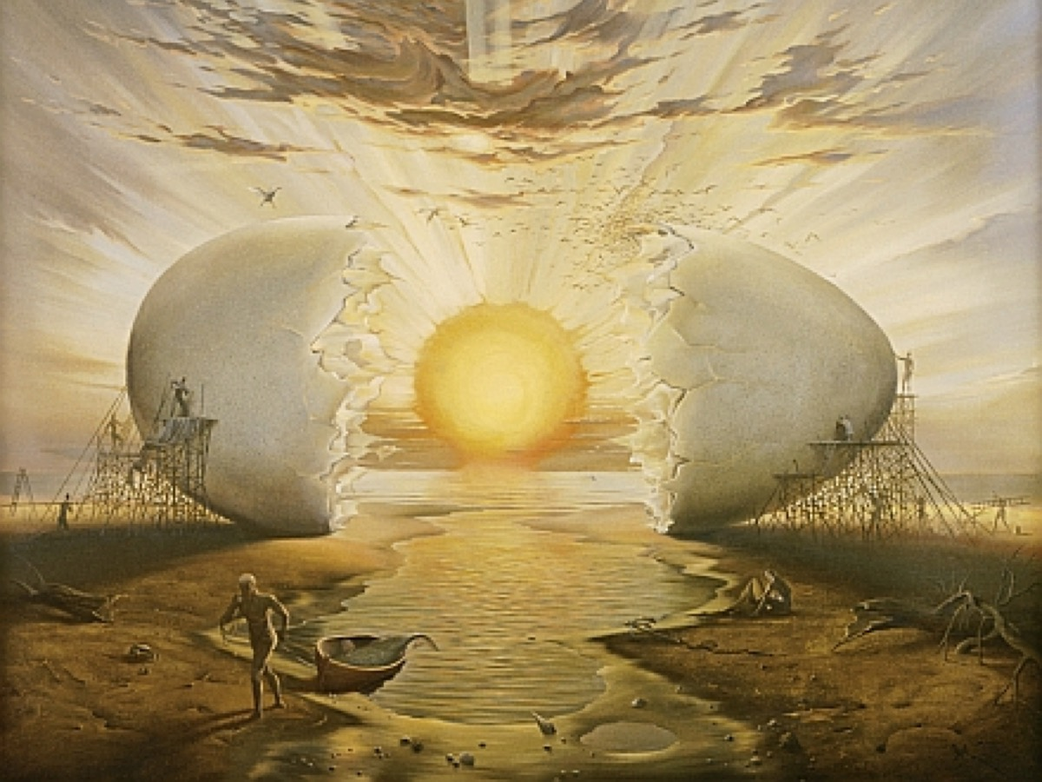
Notes:
In many myths about the creation of the world, a cosmic egg is laid by a giant bird in a formless, ancient ocean. The egg splits into two and the sky and the earth appear from the halves of it, while the sun is seen in the yolk. According to Polynesian myth, the Hawaiian Islands were born from such an egg.

Slide 10
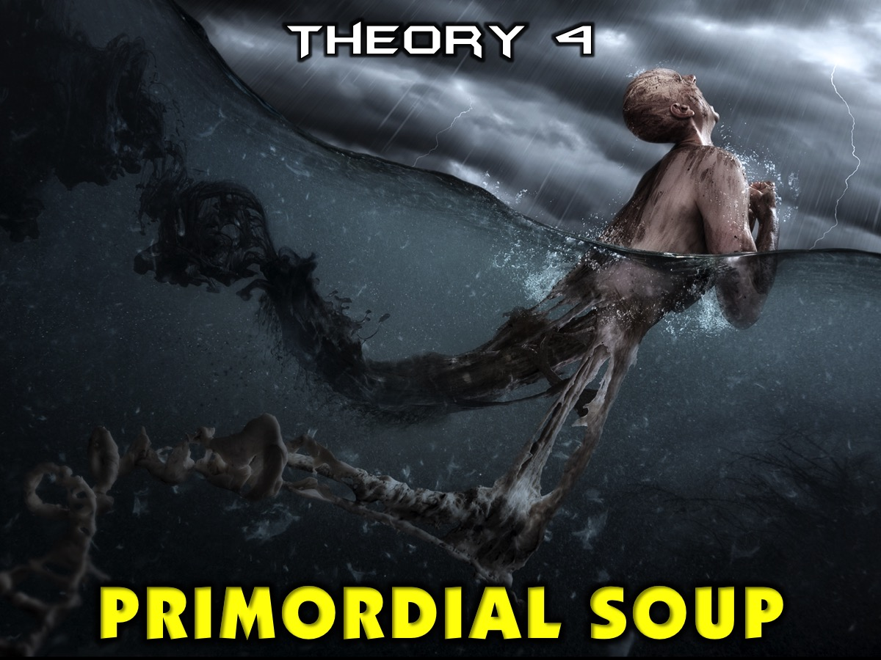
Notes:
Theory 4: Primordial Soup.

Slide 11
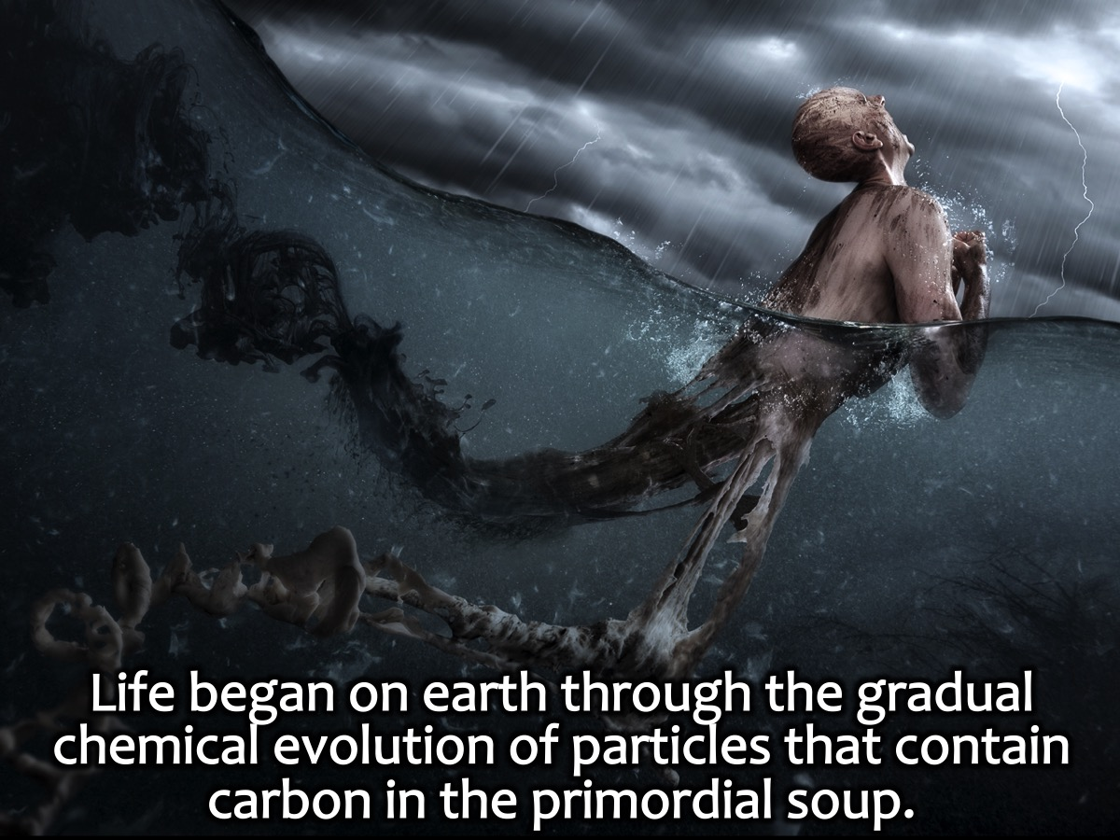
Notes:
This belief was introduced in 1924 by the Soviet biologist Alexander Oparin who proposed that life began on earth through the gradual chemical evolution of particles that contain carbon in the primordial soup. Biochemist Robert Shapiro summarized the theory as follows: (1) Early Earth had a chemically reducing atmosphere. (2) This atmosphere, exposed to energy in various forms, produced simple organic compounds. (3) These compounds accumulated in a "soup", which may have been concentrated at various locations (shorelines, oceanic vents etc.). (4) By further transformation, more complex organic polymers – and ultimately life – developed in the soup.

Slide 12
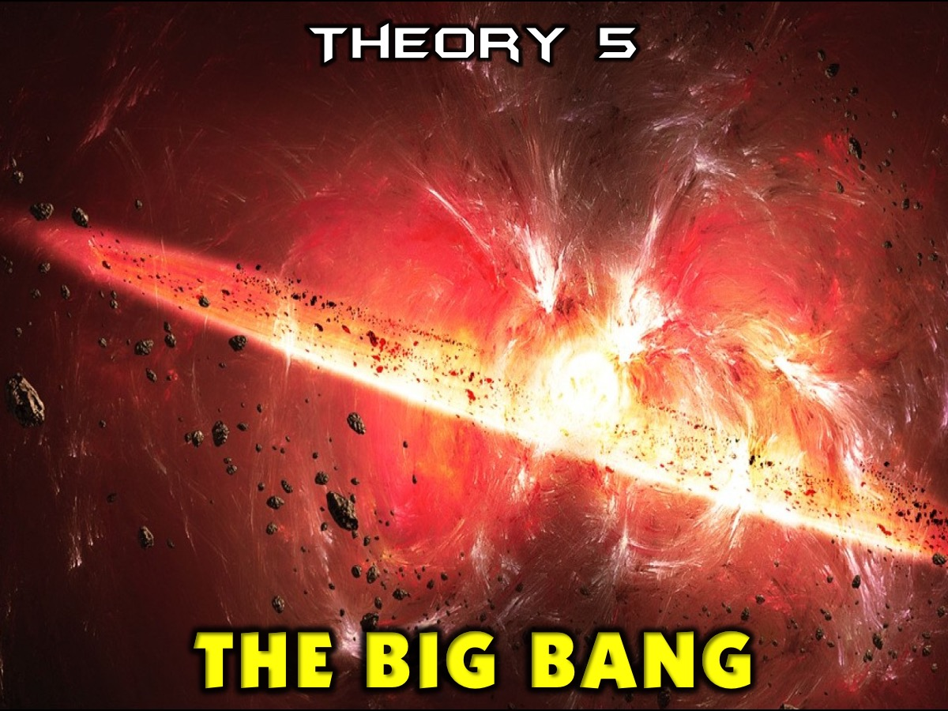
Notes:
Theory 5: The Big Bang. This is a theory that life began billions of years ago by a cosmic accident where a big explosion led to the formation of the universe.

Slide 13
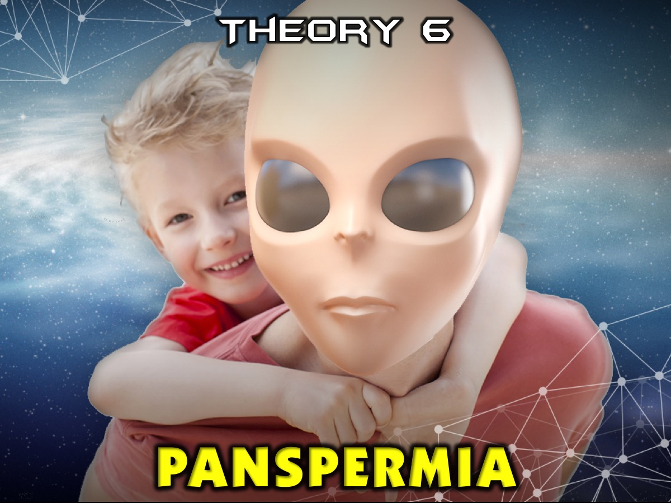
Notes:
Theory 6: Panspermia. Perhaps life did not begin on Earth at all, but was brought here from elsewhere in space. For instance, rocks regularly get blasted off Mars by cosmic impacts, and a number of Martian meteorites have been found on Earth that some researchers have controversially suggested brought microbes over here, potentially making us all Martians originally. Other scientists have even suggested that life might have hitchhiked on comets from other star systems. However, even if this concept were true, the question of how life began on Earth would then only change to how life began elsewhere in space.

Slide 14
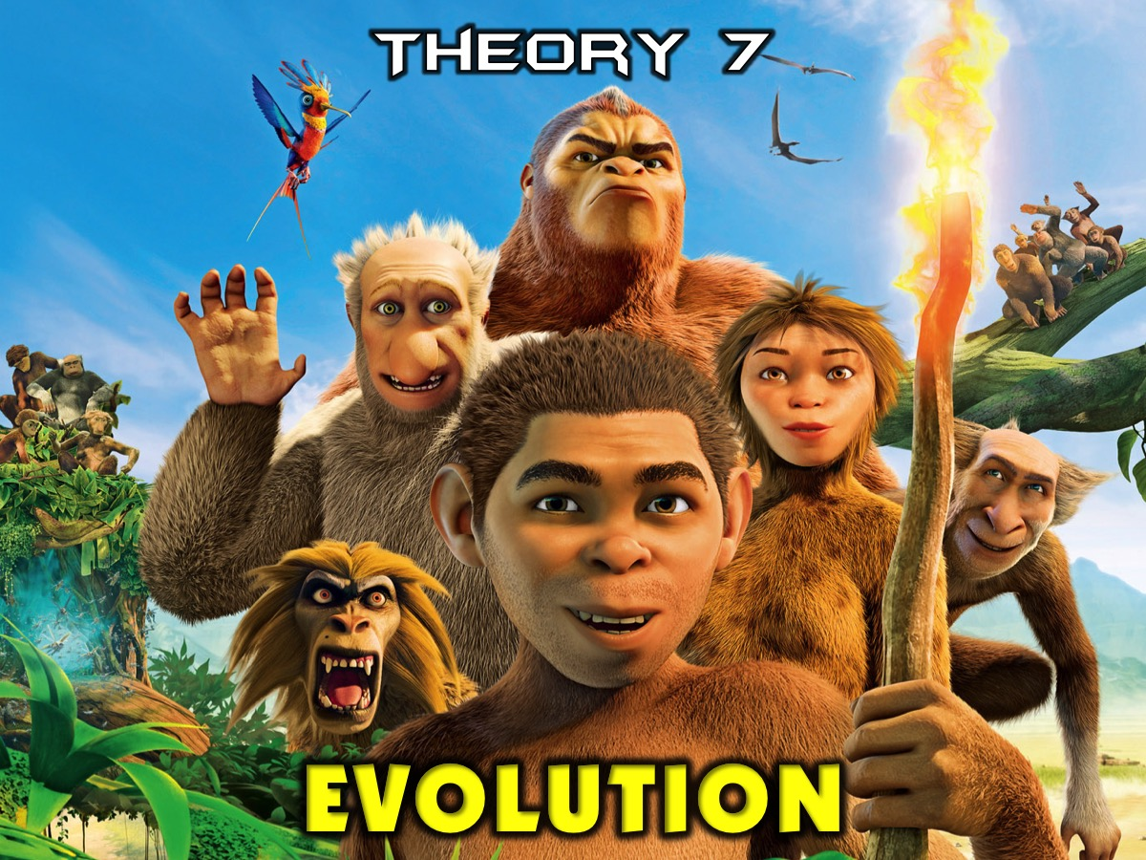
Notes:
Theory 7: Evolution.

Slide 15
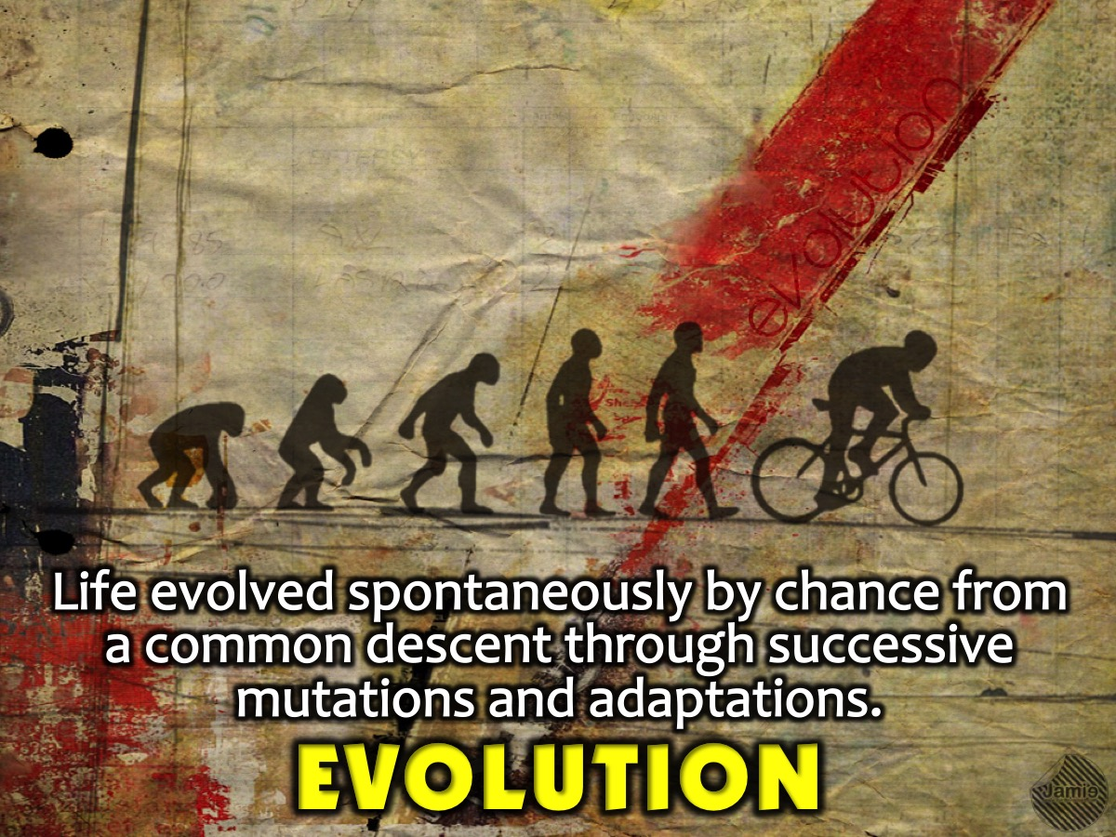
Notes:
Evolution suggests that that life evolved spontaneously by chance from a common descent through successive mutations and adaptations.

Slide 16
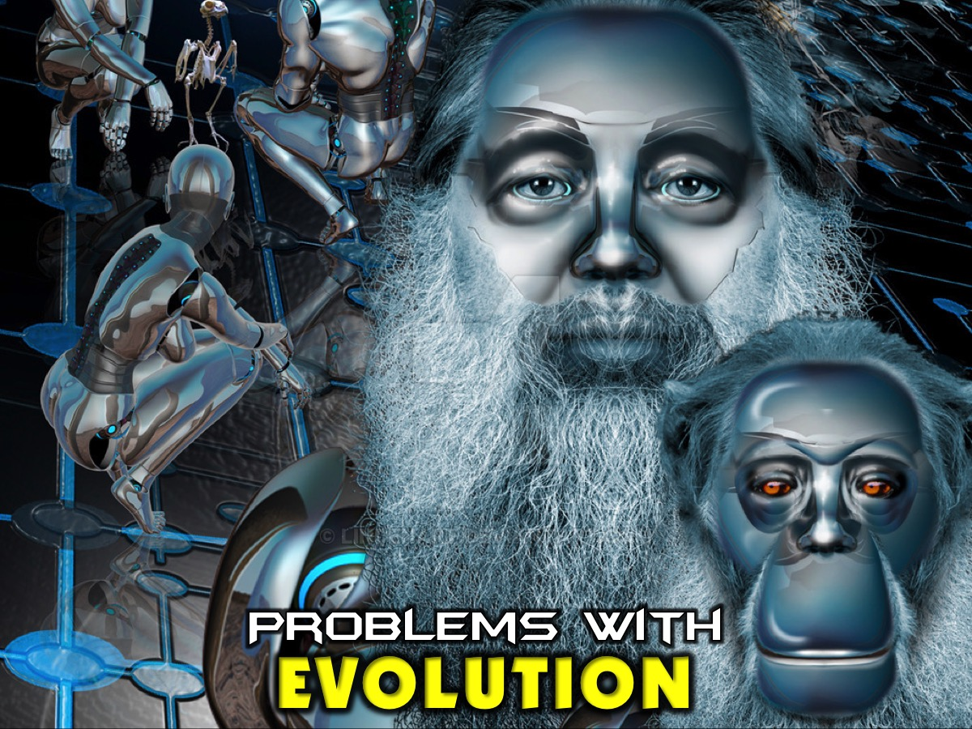
Notes:
Problems with Reconciling Evolution. Source: Audio interview with John Piper. The question was asked of John Piper: Can we reconcile creation and evolution or are they contradictory? His replied: Evolution as it is ordinarily meant in our culture namely naturalistic evolution, evolution minus God, an explanation of the origin of life where God is not there to explain it is incompatible with creation with Christianity. That is the main form we are dealing with in the world. The main reason evolution has been pursued is when you leave God out of account then what else is there? What about a kind of evolution which is compatible with Christianity - where God is the intelligent designer behind billions of years of natural selection. The answer is theoretically yes, but theologically and exegetically we have a problem. Here are at least three stumbling blocks keeping me believing that this is the way it was done:

Slide 17
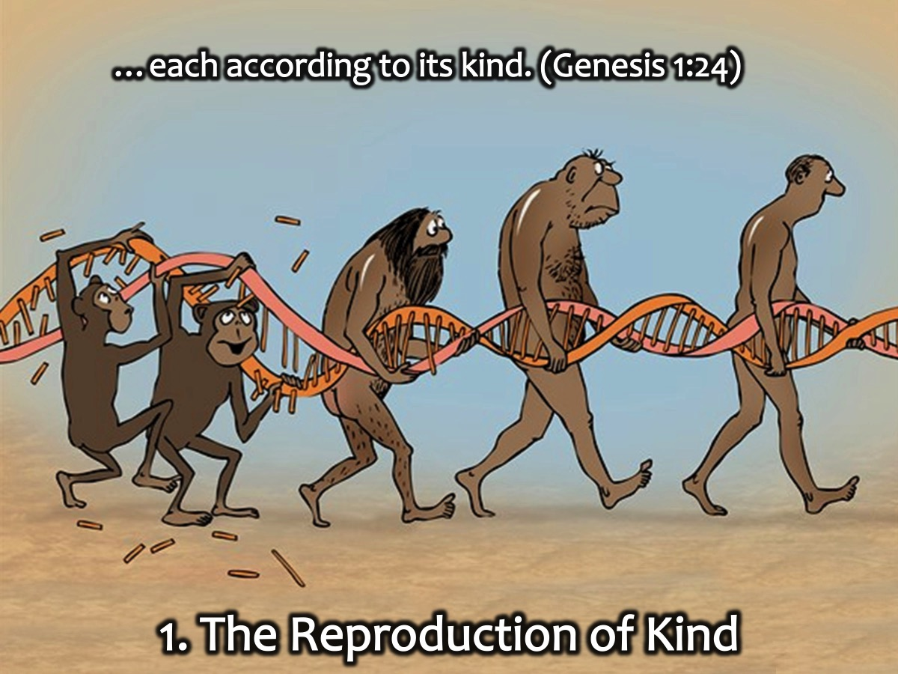
Notes:
1. The Reproduction of Kind: The Bible says that creatures reproduce according to their own kinds - does that not imply that God was involved in the direct making of specific kinds of beasts and birds and fish. And God said, “Let the water teem with living creatures, and let birds fly above the earth across the vault of the sky.” So God created the great creatures of the sea and every living thing with which the water teems and that moves about in it, according to their kinds, and every winged bird according to its kind. And God saw that it was good. (Genesis 1:21). And God said, “Let the land produce living creatures according to their kinds: the livestock, the creatures that move along the ground, and the wild animals, each according to its kind.” And it was so. (Genesis 1:24). Then God said, “Let us make mankind in our image, in our likeness, so that they may rule over the fish in the sea and the birds in the sky, over the livestock and all the wild animals, and over all the creatures that move along the ground.” So God created mankind in his own image, in the image of God he created them; male and female he created them. God blessed them and said to them, “Be fruitful and increase in number; fill the earth and subdue it. Rule over the fish in the sea and the birds in the sky and over every living creature that moves on the ground.” (Genesis 1:26-28).

Slide 18
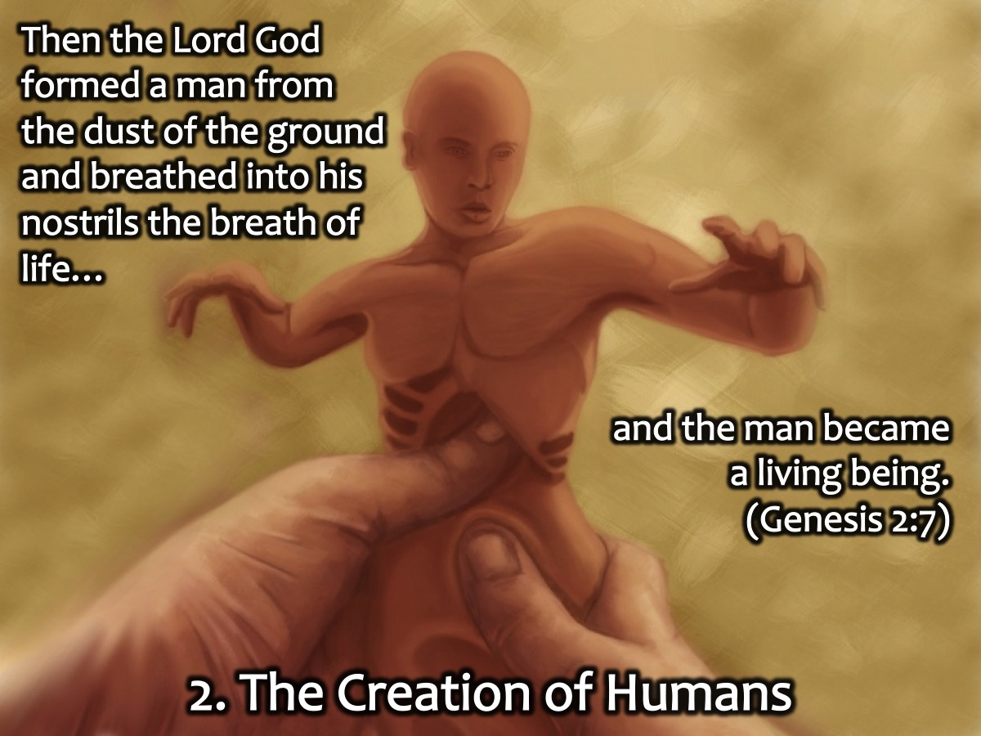
Notes:
2. The Creation of Humans. How God made man - he formed him in his own image out of the dust of the ground and breathed into his nostrils the breath of life and he became a living soul - that does not sound like God worked through millions of years of evolution to find a being that he would now regard as worthy of being breathed into.

Slide 19
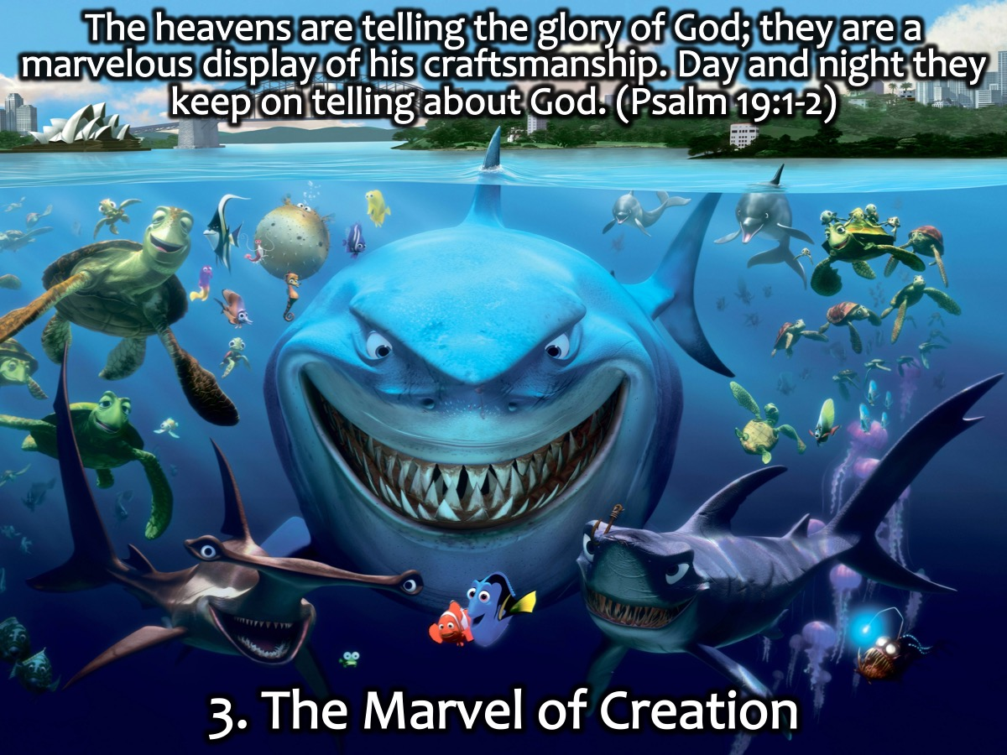
Notes:
3. The Marvel of Creation. As we watch documentaries and read magazines intuitively we can’t buy it with the complicity of all aspects of creation shouts for a Creator and not some random process driven by chance and natural selection. Where does the awesome display of diversity, and intricateness and complexity come from if not from a Creator God.

Slide 20
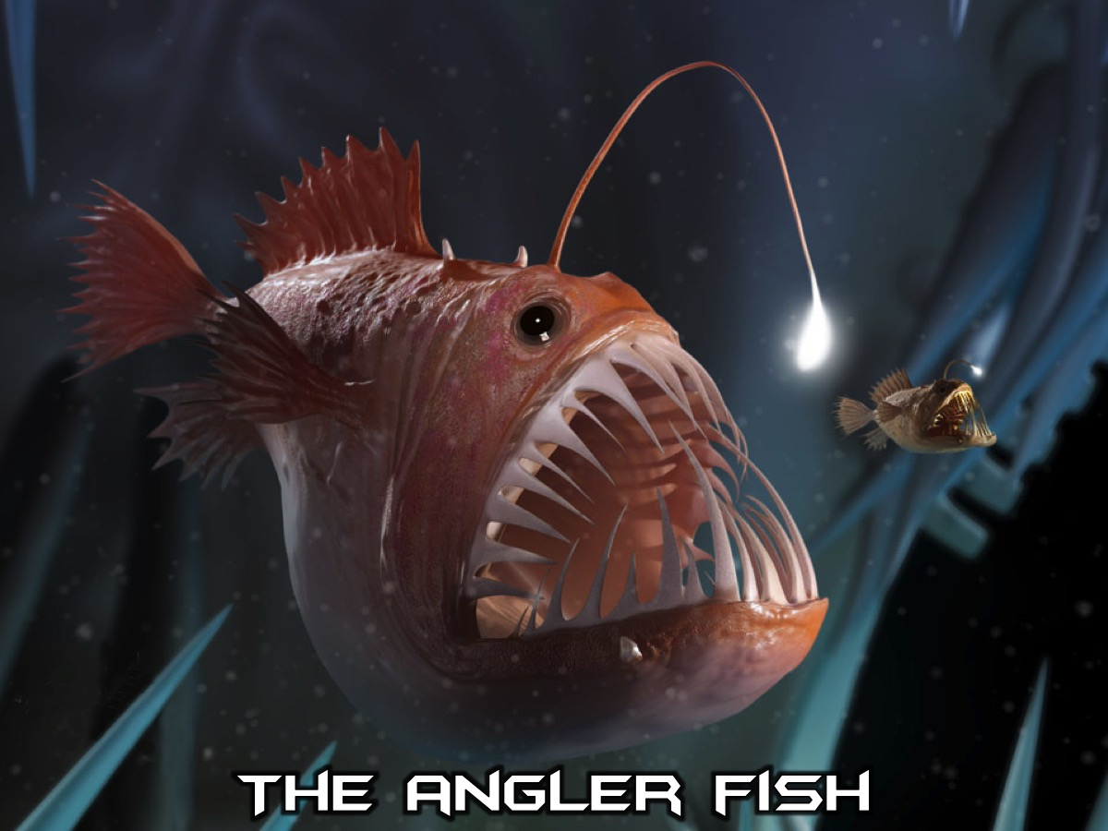
Notes:
The Angler Fish. Most adult female anglerfish have a luminescent organ called the esca at the tip of a modified dorsal ray. Like a fishing rod the organ lures prey in dark, deep-sea environments, but also calls males to the females to facilitate mating. The source of luminescence is symbiotic bacteria that dwell in and around the esca.

Slide 21

Notes:
A Boeing 747 is made up of six million components. Imagine all the part of a Jumbo Jet are lying in a scrap heap - randomly scattered all around, and a tornado sweeps through the scrapyard - what chance would there be that after the dust settles, that a fully functioning 747 emerges that you can fly away in? There is no chance that it could happen!

Slide 22
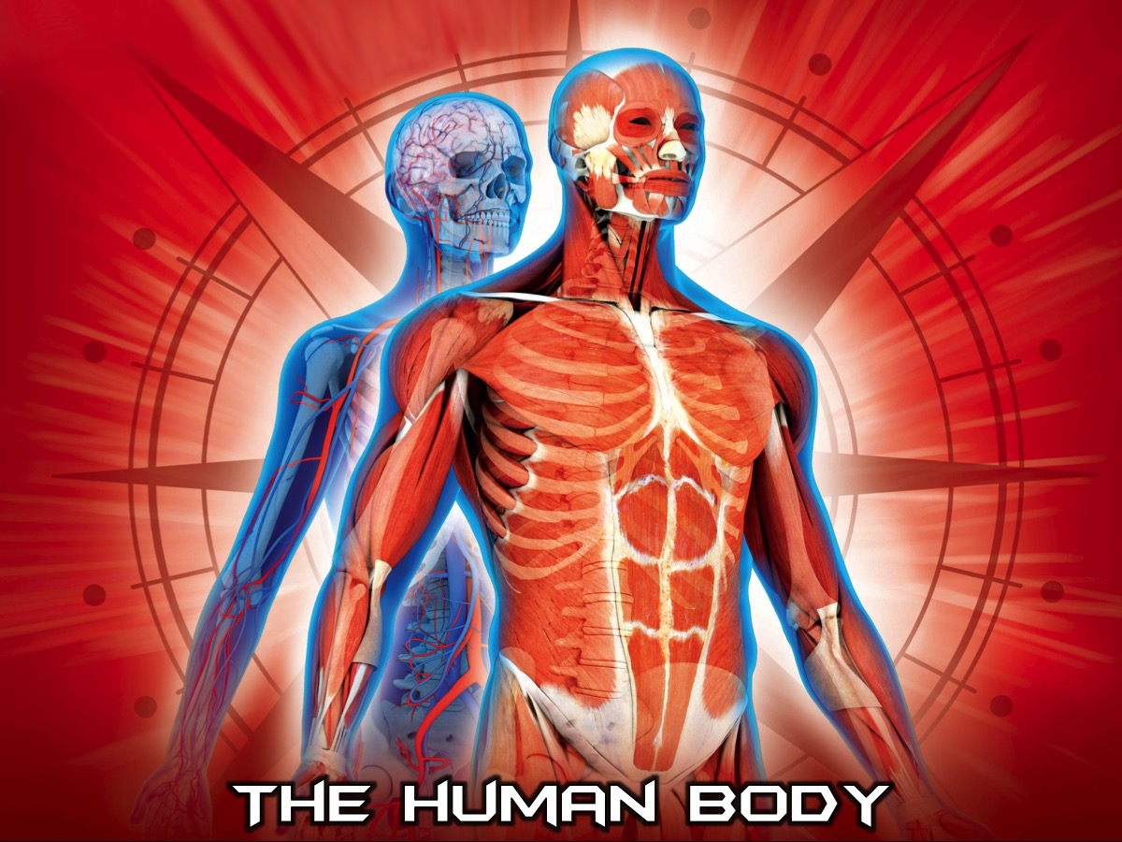
Notes:
And the human body? Could it have just evolved? We have 1 soul, 1 brain, 1 nose, 1 mouth, 2 eyes, 2 auditory apparatuses, 4 limbs, 206 bones, more than 600 muscles, Blood cells enough to circle the Earth twice, 40,000 Chemical enzymes, Millions of neurons and Billions of interconnections among them.

Slide 23
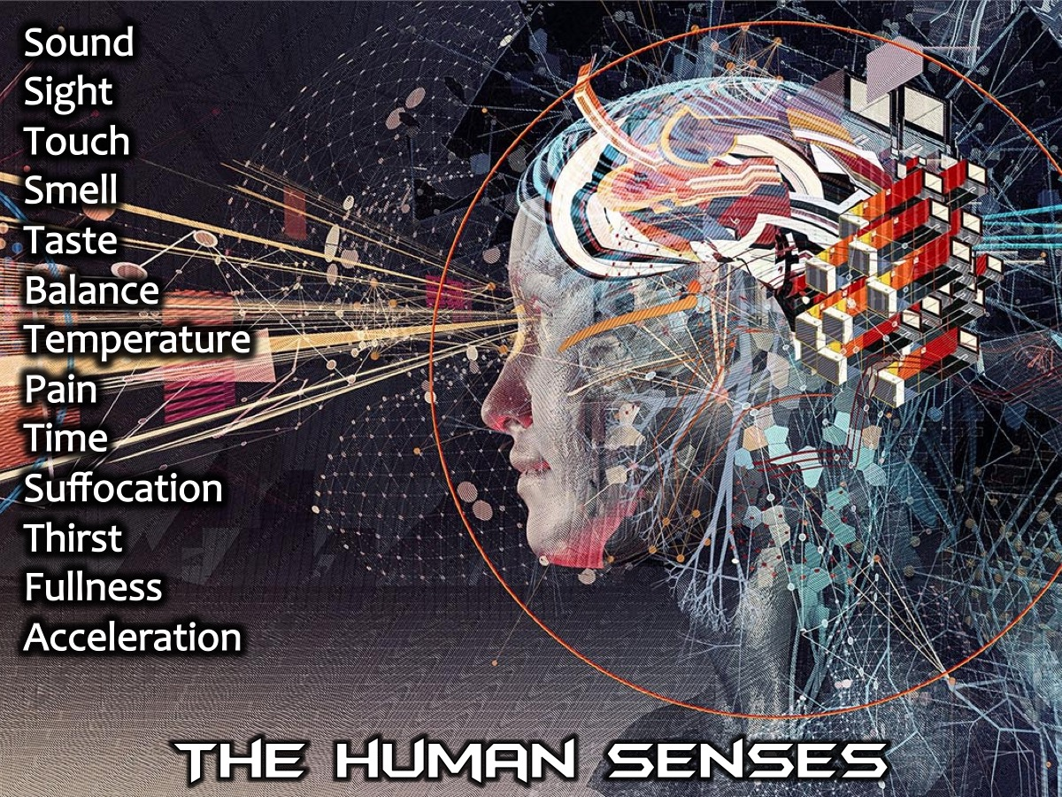
Notes:
The Human Senses. Along with the five traditional senses of sound, sight, touch, smell and taste, humans have 15 “other senses." These include balance, temperature, pain and time as well as internal senses for suffocation, thirst, and fullness.

Slide 24
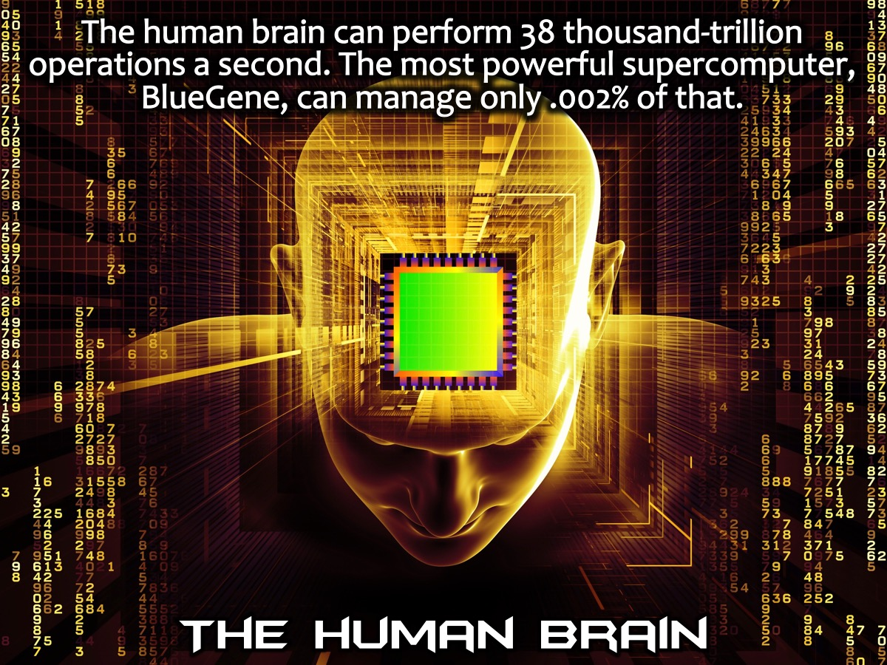
Notes:
The Human Brain. If the human brain were a computer, it could perform 38 thousand-trillion operations per second. The world's most powerful supercomputer, BlueGene, can manage only .002% of that.

Slide 25
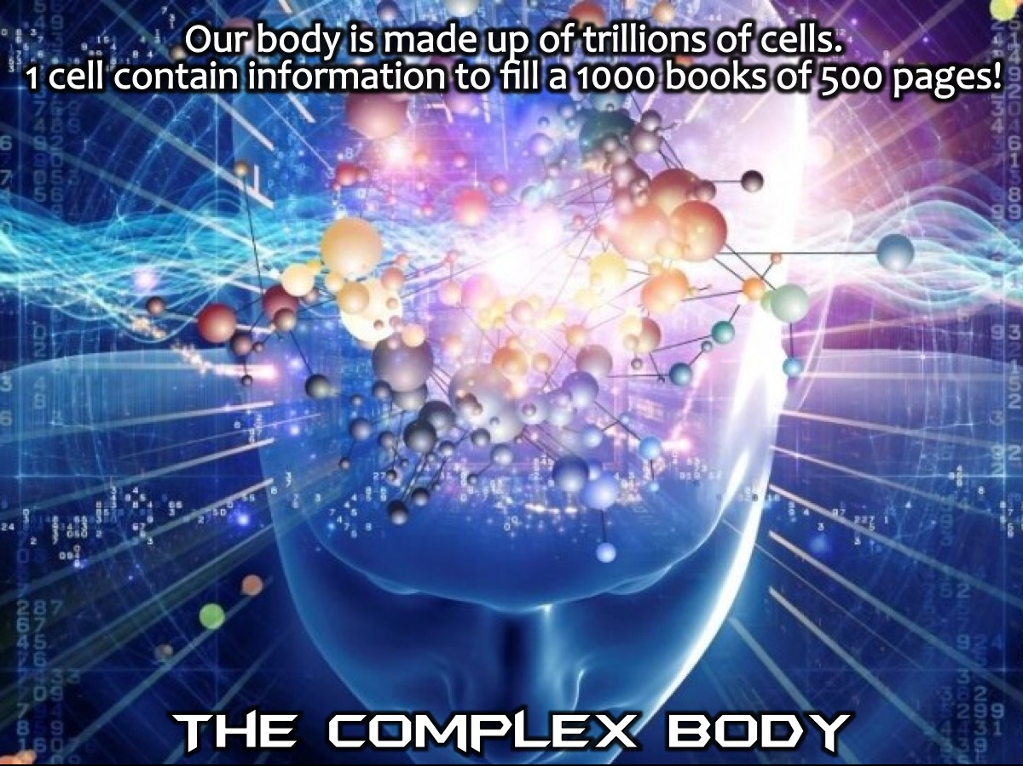
Notes:
The Complex Body. The body is made up of trillions of cells. In just one of those cells, one out of trillions, the amount of information, the amount of genetic information in one of those cells has been estimated to fill at least one thousand books of 500 pages. That's to run one cell out of trillions in one human body. And most scientists think that is an underestimation of the complexity. Where did all this information come from? Better, from whom did all this information come? To make evolution the answer is ridiculous. To make chance the energy is also ridiculous, so ridiculous as to qualify someone for a trip to the mental institution. Why then do scientists continue to advocate this ridiculous theory of evolution motivated by chance? Why do they do that? Well, the bottom line is they do it to avoid God. They do that to push God out of their lives, to avoid His law, to avoid His standards, to avoid His will, to avoid His Word and to avoid His judgment on their lives. Evolution is nothing more than what Henry Morris so aptly called it, "The long war against God."

Slide 26
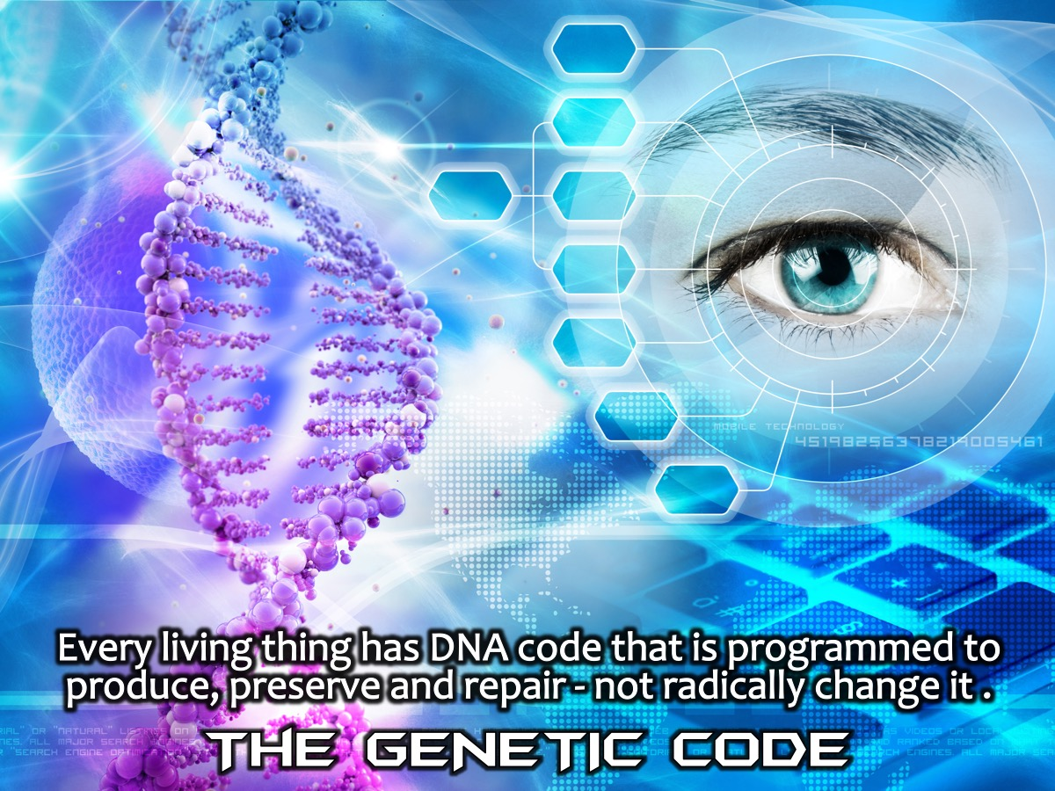
Notes:
The Genetic Code. Every living thing has a DNA code, every living organism has a genetic code programmed with the exact information to produce, preserve and repair that living thing. It has no less than that necessary information and no more than that necessary information. The genes in every organism limit that organism to what it is. It cannot be less than it is, and it cannot be more than it is. There is no genetic information to transform it into something other than what it is. The Bible talks about kinds of living things that can reproduce after their own kind. And that essentially is saying the same thing. There can be variations within a kind, but not anything beyond that.

Slide 27
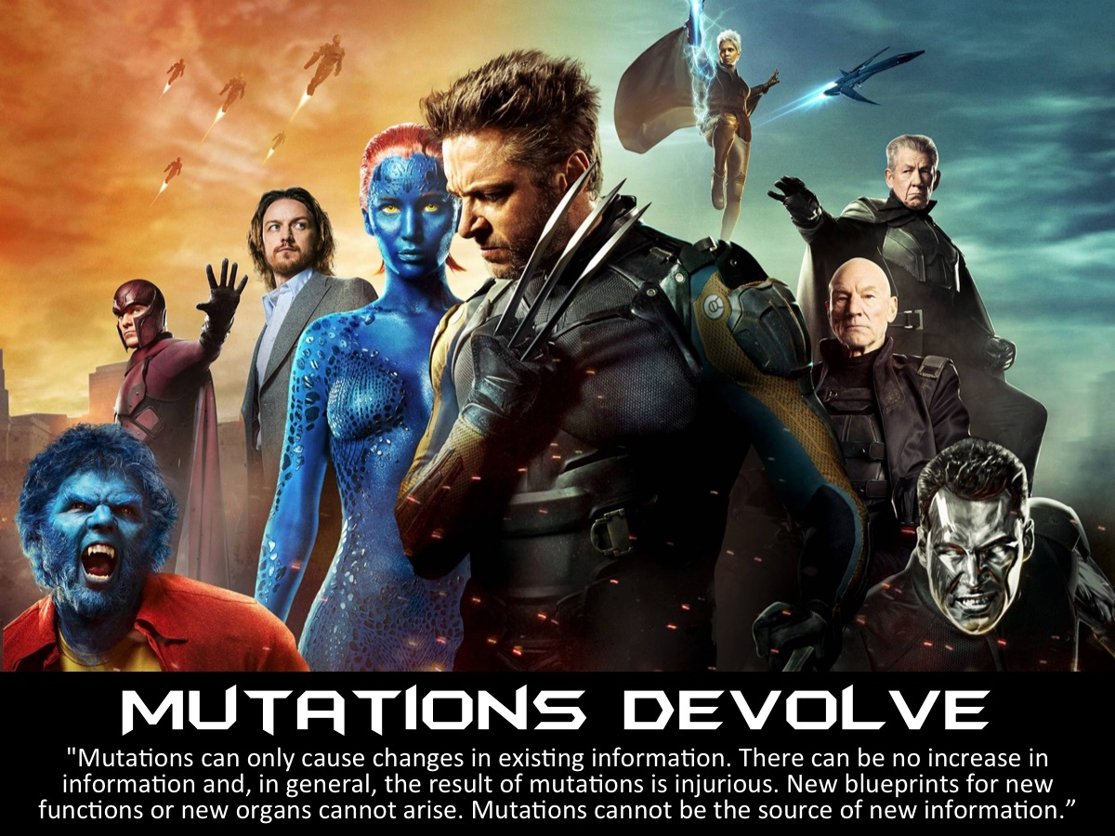
Notes:
Mutations Devolve. Science has tried to tell us that evolution is a process called mutation, that living organisms have the capacity to mutate, simply means to change. But you need to understand this: Mutations do not change the nature or the kind of any living organism. They don't make it anything other than it is. Mutations always involves is a loss of existing information - never a gain of information. Mutations never add new genetic information. Mutations therefore do not work toward an upward evolutionary process. Mutations are not a mechanism for upward evolutionary process. Dr. Werner Gitt, a director and professor at the German Federal Institute of Physics and Technology, answered this question: Can new information originate in a living organism through mutations? He said: "Mutations can only cause changes in existing information. There can be no increase in information and, in general, the result of mutations is injurious. New blueprints for new functions or new organs cannot arise. Mutations cannot be the source of new information.”

Slide 28
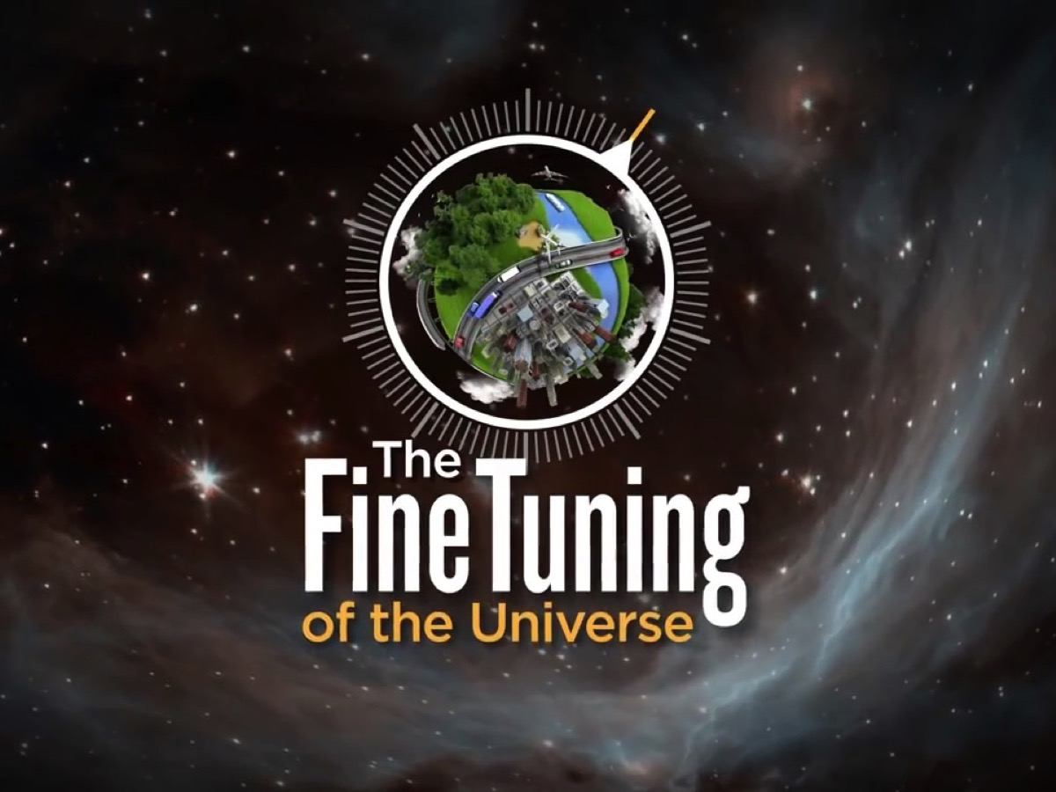
Notes:
The Fine-Tuned Universe. Scientists have come to the shocking realization that the fundamental constants and quantities of our universe have been carefully dialed to an astonishingly precise value – a value that falls within an exceedingly narrow, life-permitting range. If any one of these numbers were altered by even a hair’s breadth, no physical, interactive life of any kind could exist anywhere. There’d be no stars, no life, no planets, no chemistry.

Slide 29
Notes:
Video: The Fine Tuning of the Universe. Get it on YouTube at: https://www.youtube.com/watch?v=UpIiIaC4kRA

Slide 30

Notes:
The Watchmaker Analogy: Walking through a forest, you discover a watch lying on the ground. Due to its complex nature, you assume it is designed by some intelligence. Thus, by this reasoning, since life is even more complex, it must have also been designed by some intelligence.

Slide 31
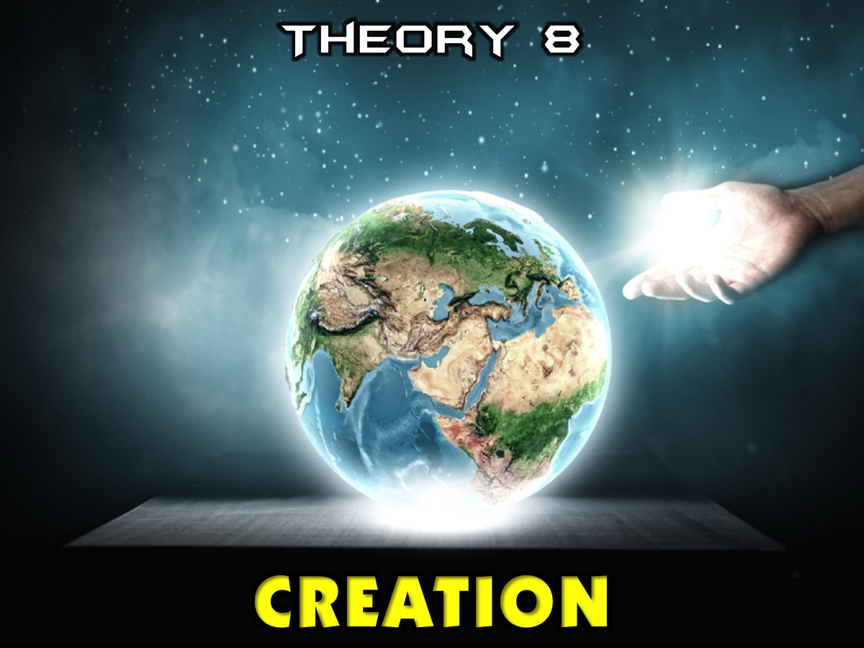
Notes:
Theory 8: Creation. And of course, the Bible has a very details explanation of how life started on earth - that God made the heavens and earth and all living creatures and Adam and Eve too.

Slide 32
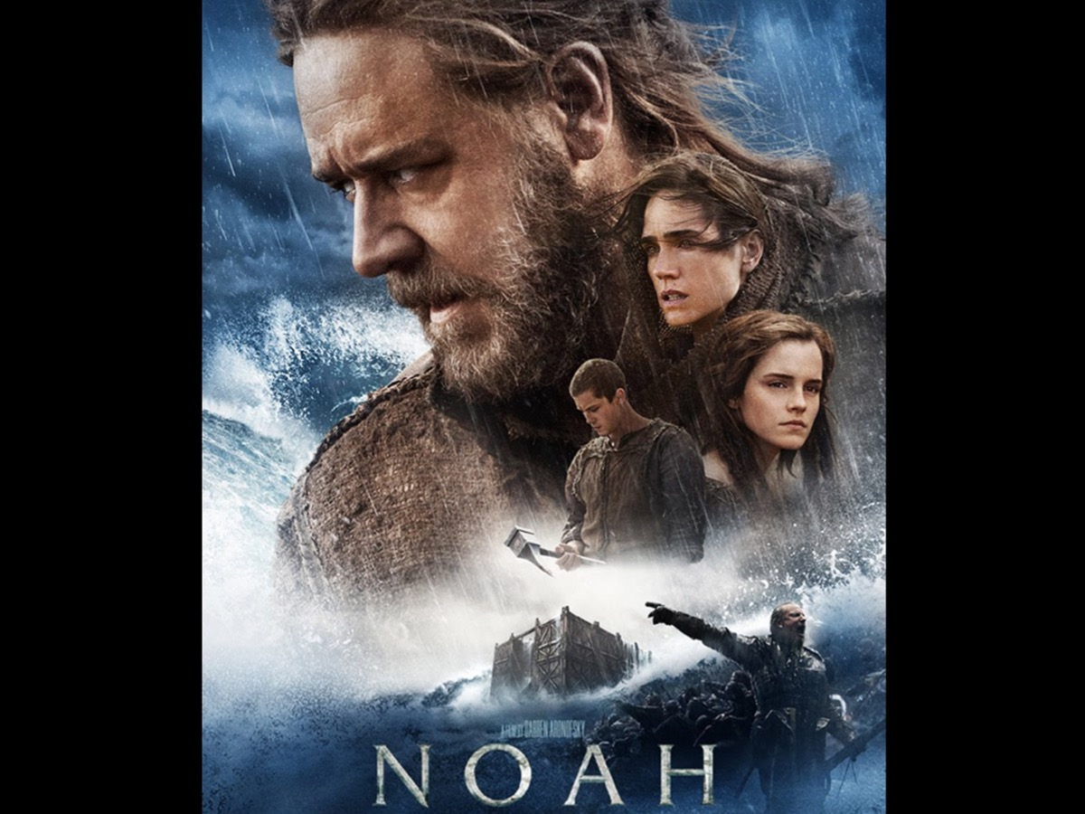
Notes:
Some of you may have seen the Noah movie that released in 2014 - well there was a scene where Noah tells the story of creation:

Slide 33
Notes:
Video: Noah Movie Creation Sequence. Get it on YouTube at: https://www.youtube.com/watch?v=FFCXHr8aKDk

Slide 34
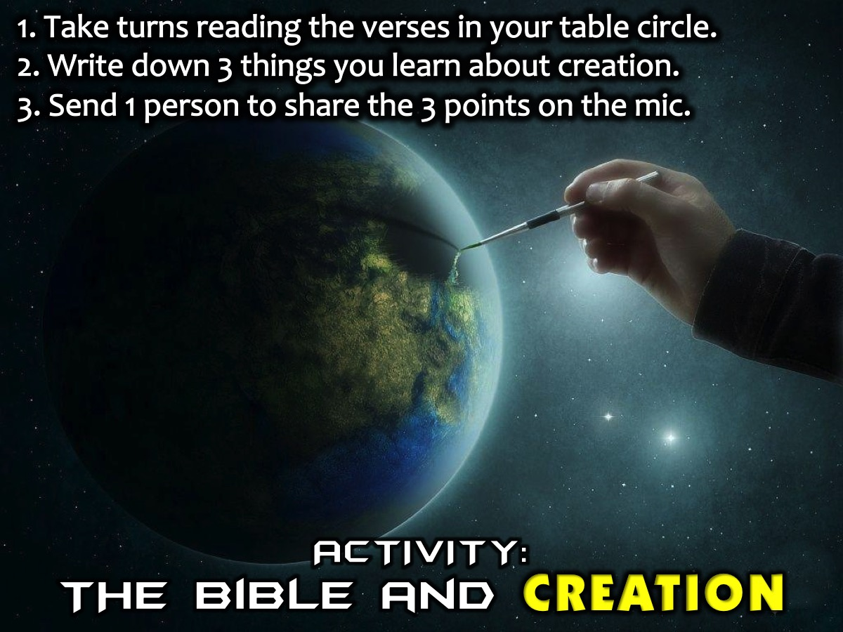
Notes:
Activity: (1) Each table has multiple copies of a handout that contains key scriptures from Genesis through to Revelation about Creation. Take turns reading each passage in a circle until you get to the end. (2) Write down 3 things that you learn about creation. (3) Send 1 person to share the 3 points on the mic.

Slide 35
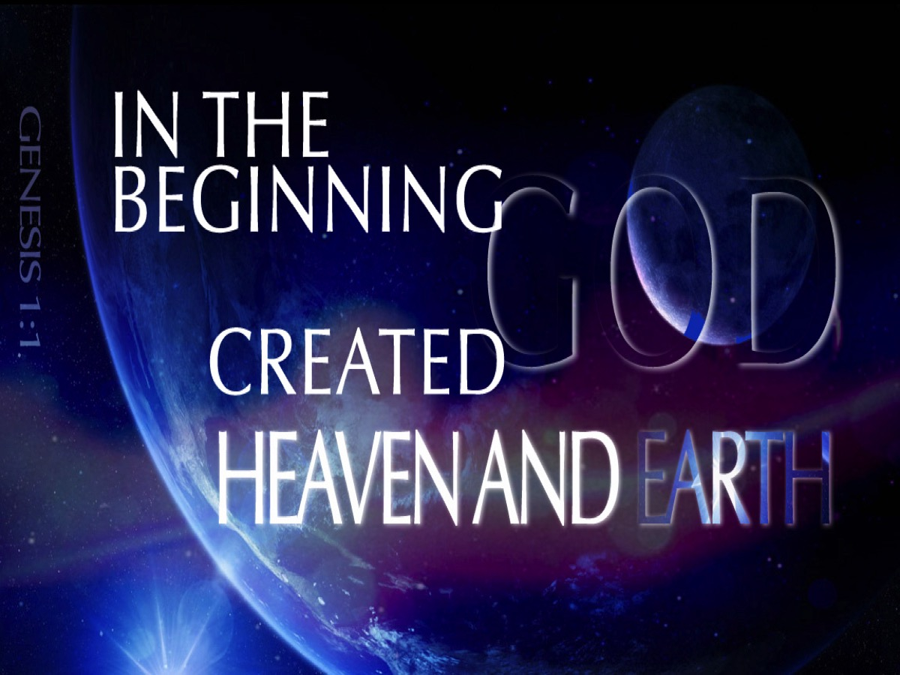
Notes:
Genesis 1:1 says:” In the beginning God created heaven and earth!”

Slide 36
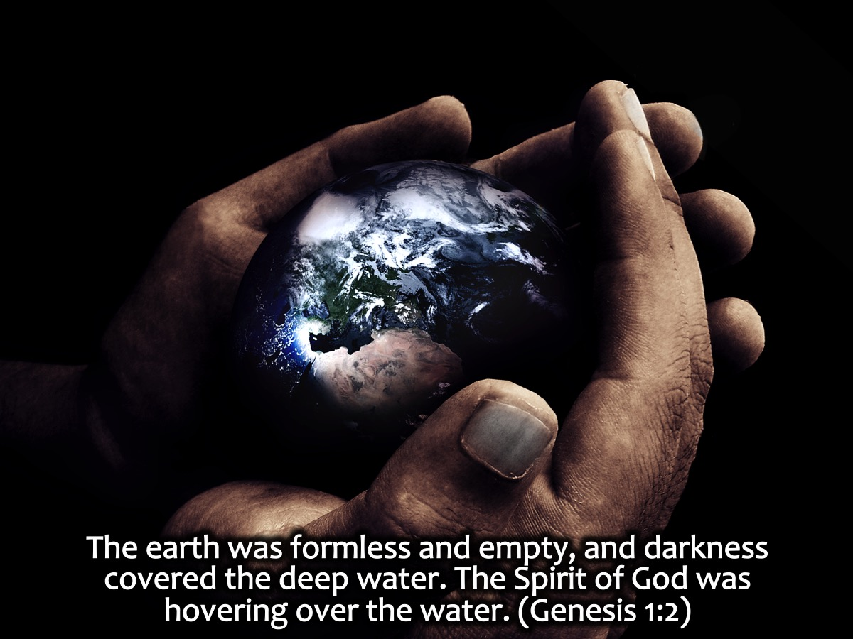
Notes:
The earth was formless and empty, and darkness covered the deep water. The Spirit of God was hovering over the water. (Genesis 1:2). What was created at first was without form and void – a clump of wet mass like play dough that God was going to shape into what He wanted it to be. The Spirit was hovering to give life! God the artist was about to sculpt it.

Slide 37
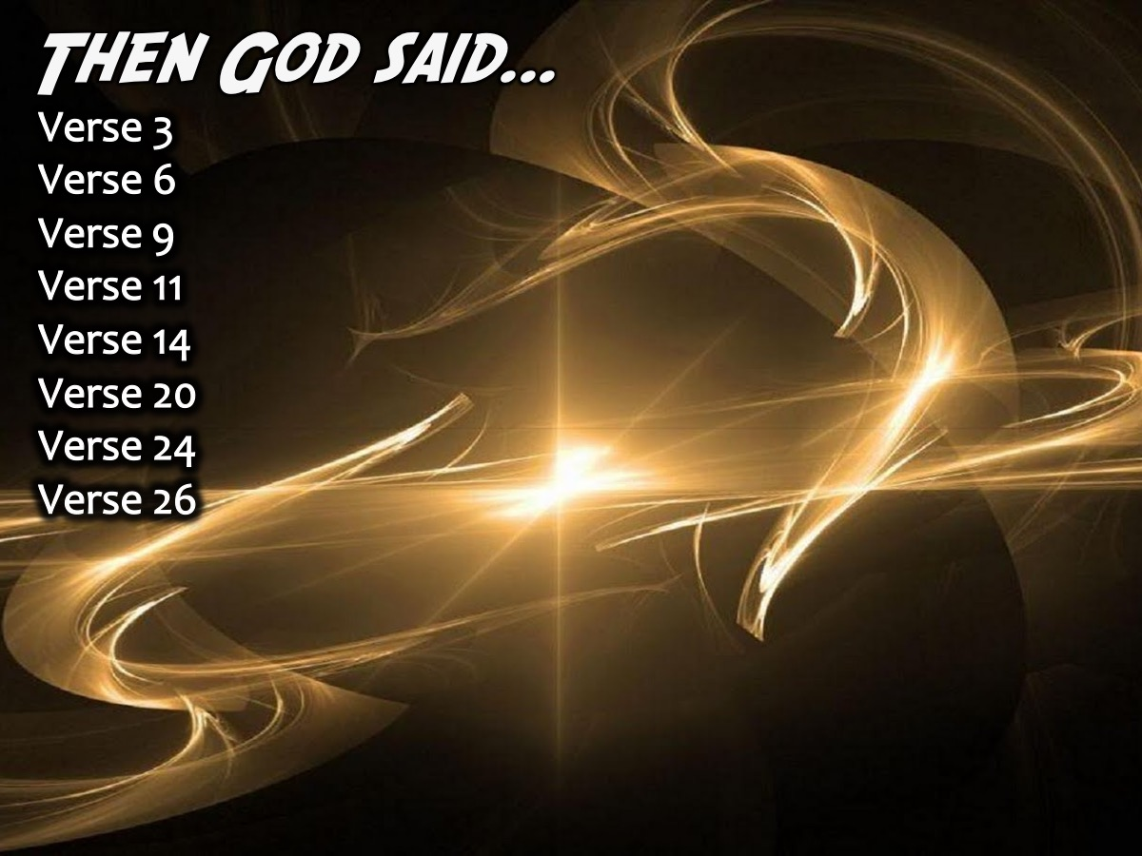
Notes:
Like an artist God used a tool to create everything. How did he do it? In verse 3, 6, 9, 11, 14, 20, 24, and 26 – eight times the tool God used is mentioned – “God said!” The tool is his Word. God just speaks and things come into existence. Can you do that? Speak to a lump of play dough and say: “giraffe”. Will it work? God did it! God speaks and life happens! Light! Etc. No one else can do this!

Slide 38

Notes:
Day 1: God made Night and Day (Genesis 1:3-5)

Slide 39
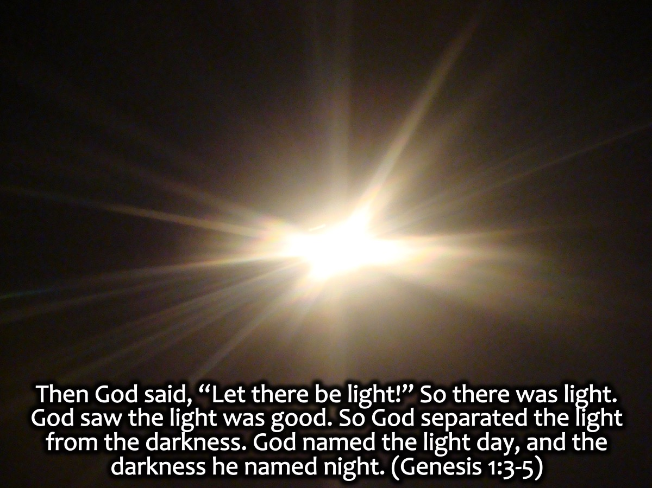
Notes:
Then God said, “Let there be light!” So there was light. God saw the light was good. So God separated the light from the darkness. God named the light day, and the darkness he named night. (Genesis 1:3-5)

Slide 40

Notes:
Day 2: Sky and Water (Genesis 1:6-8)

Slide 41
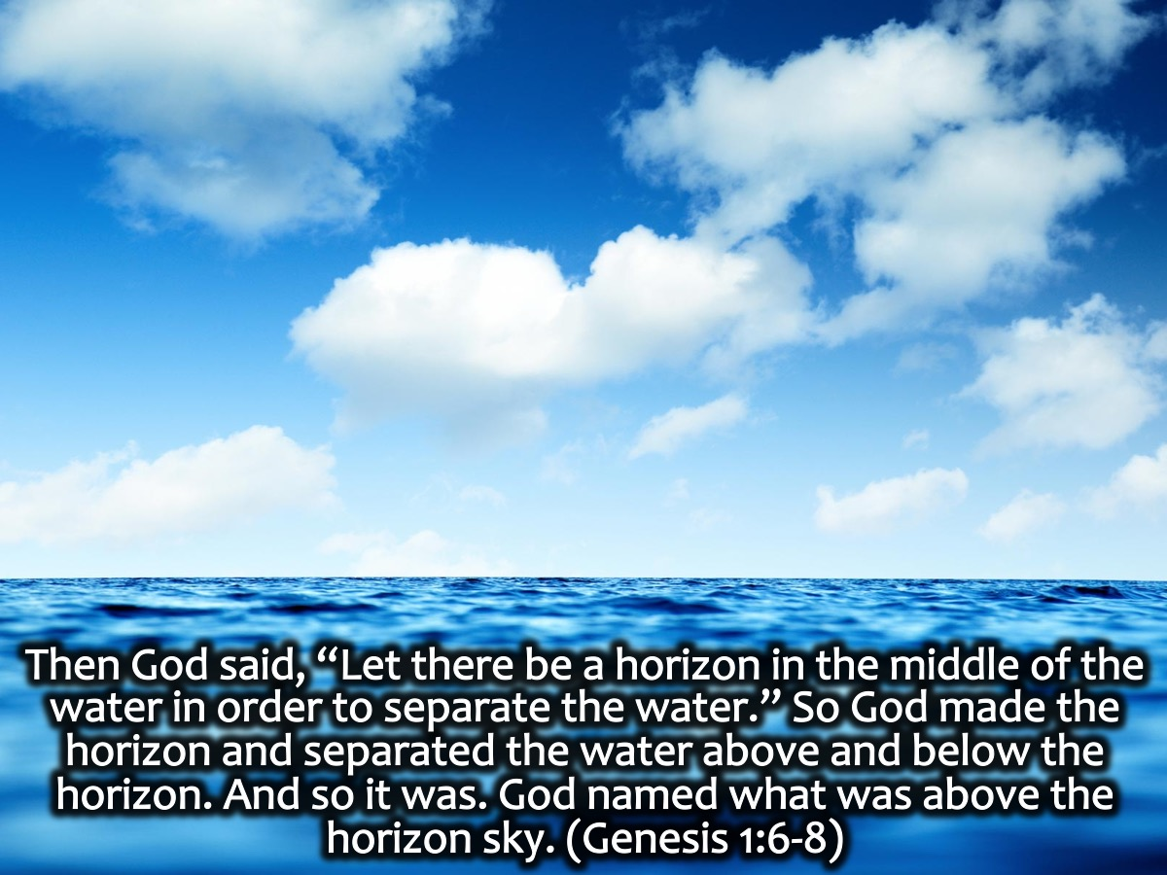
Notes:
Then God said, “Let there be a horizon in the middle of the water in order to separate the water.” So God made the horizon and separated the water above and below the horizon. And so it was. God named what was above the horizon sky. (Genesis 1:6-8)

Slide 42

Notes:
Day 3: Land and Plants (Genesis 1:9-13)

Slide 43
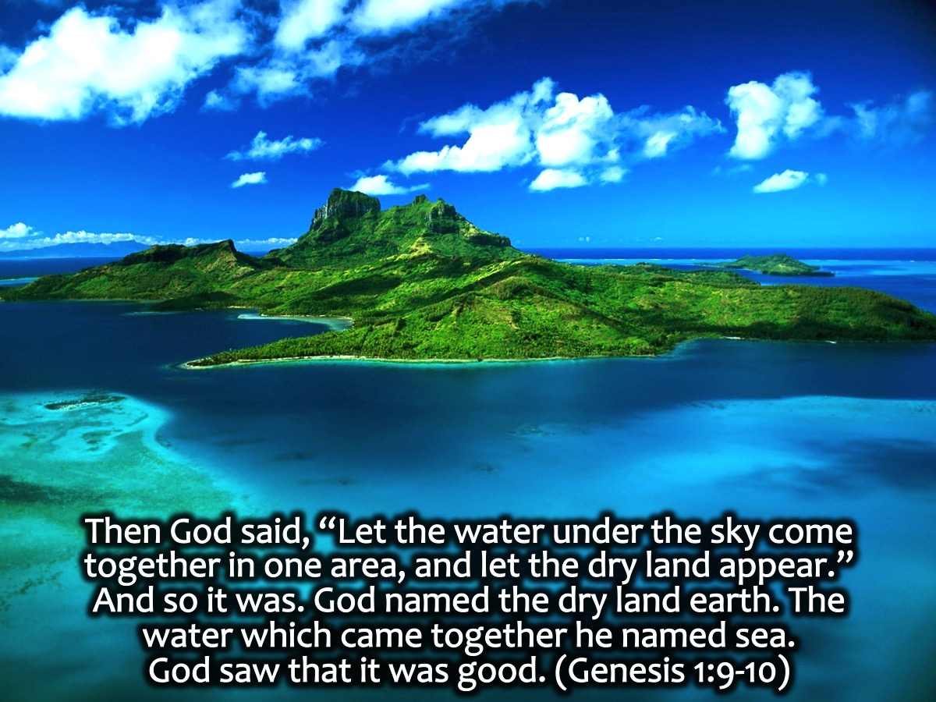
Notes:
Then God said, “Let the water under the sky come together in one area, and let the dry land appear.” And so it was. God named the dry land earth. The water which came together he named sea. God saw that it was good. (Genesis 1:9-10)

Slide 44
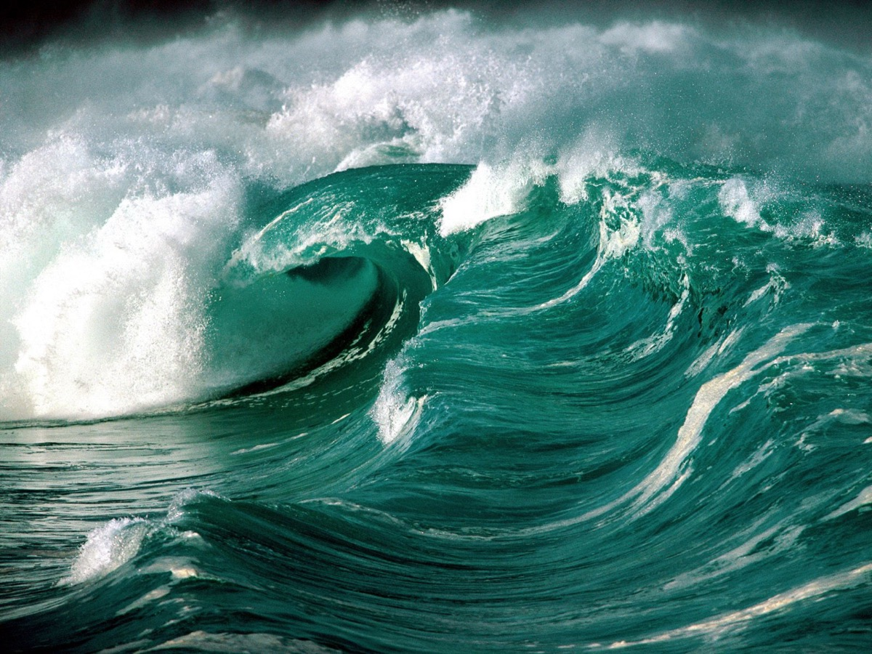

Slide 45
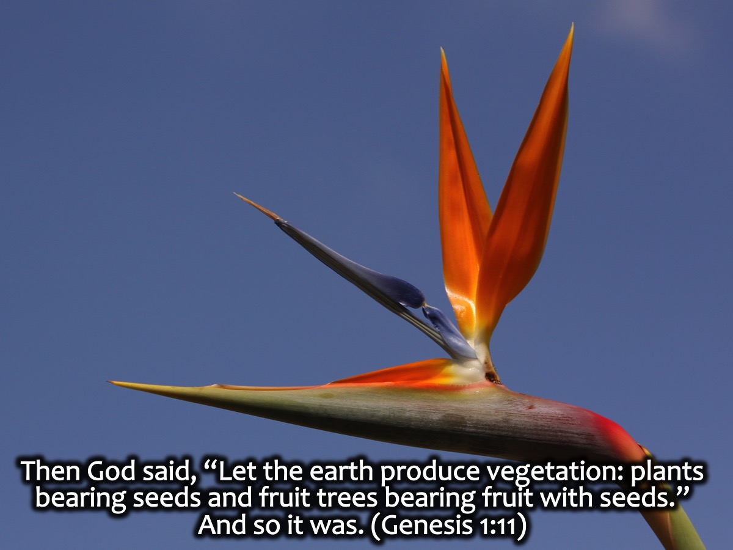
Notes:
Then God said, “Let the earth produce vegetation: plants bearing seeds, each according to its own type, and fruit trees bearing fruit with seeds, each according to its own type.” And so it was. (Genesis 1:11)

Slide 46
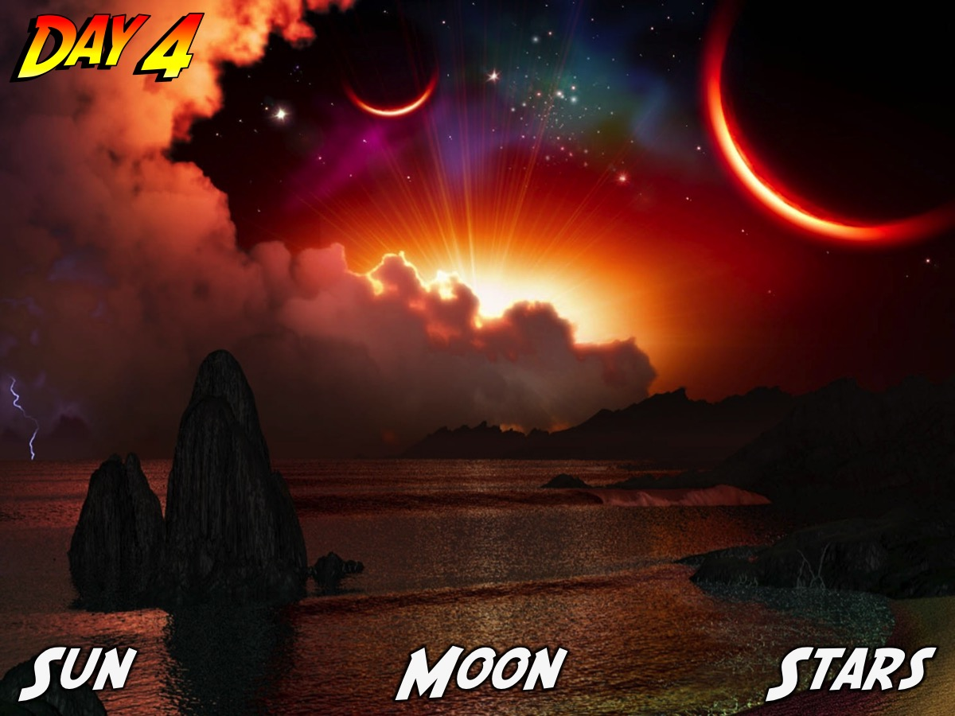
Notes:
Day 4: Sun, Moon and Stars (Genesis 1:14-19)

Slide 47
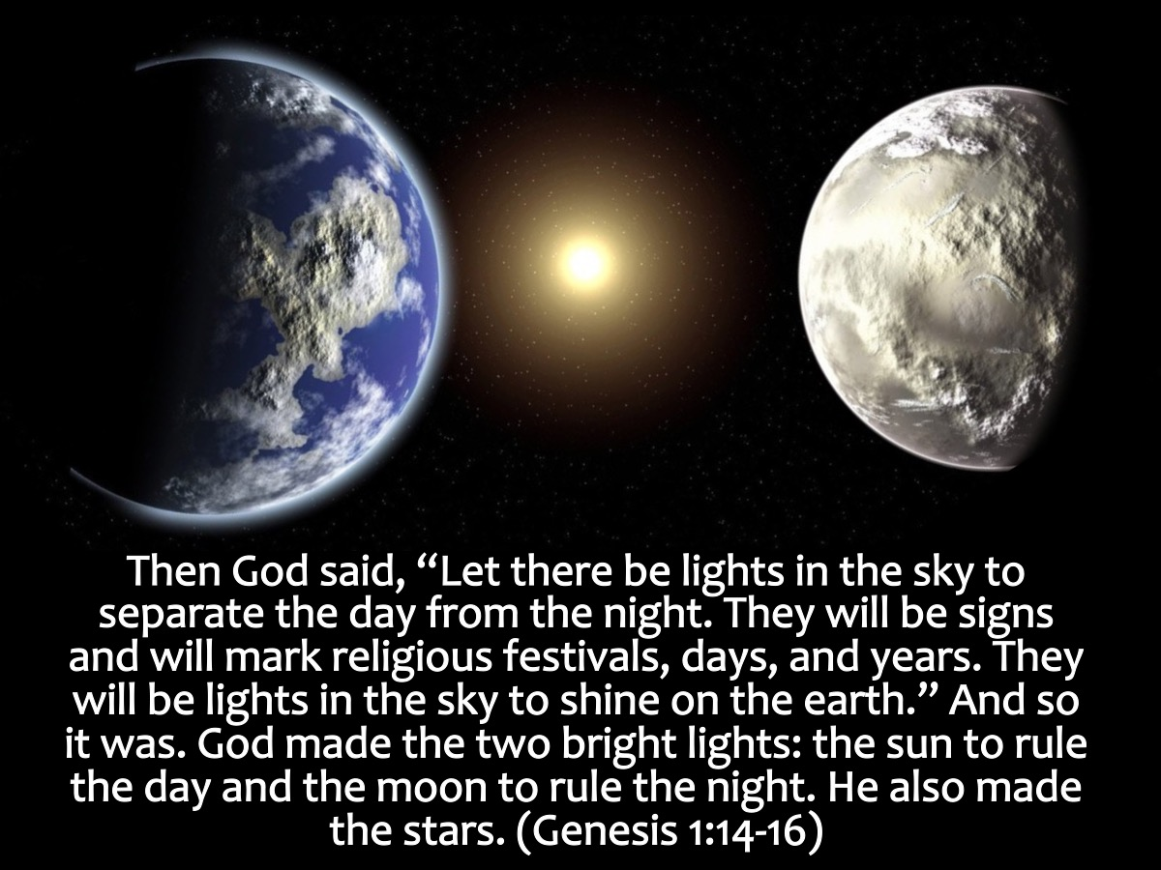
Notes:
Then God said, “Let there be lights in the sky to separate the day from the night. They will be signs and will mark religious festivals, days, and years. They will be lights in the sky to shine on the earth.” And so it was. God made the two bright lights: the sun to rule the day and the moon to rule the night. He also made the stars. (Genesis 1:14-16)

Slide 48
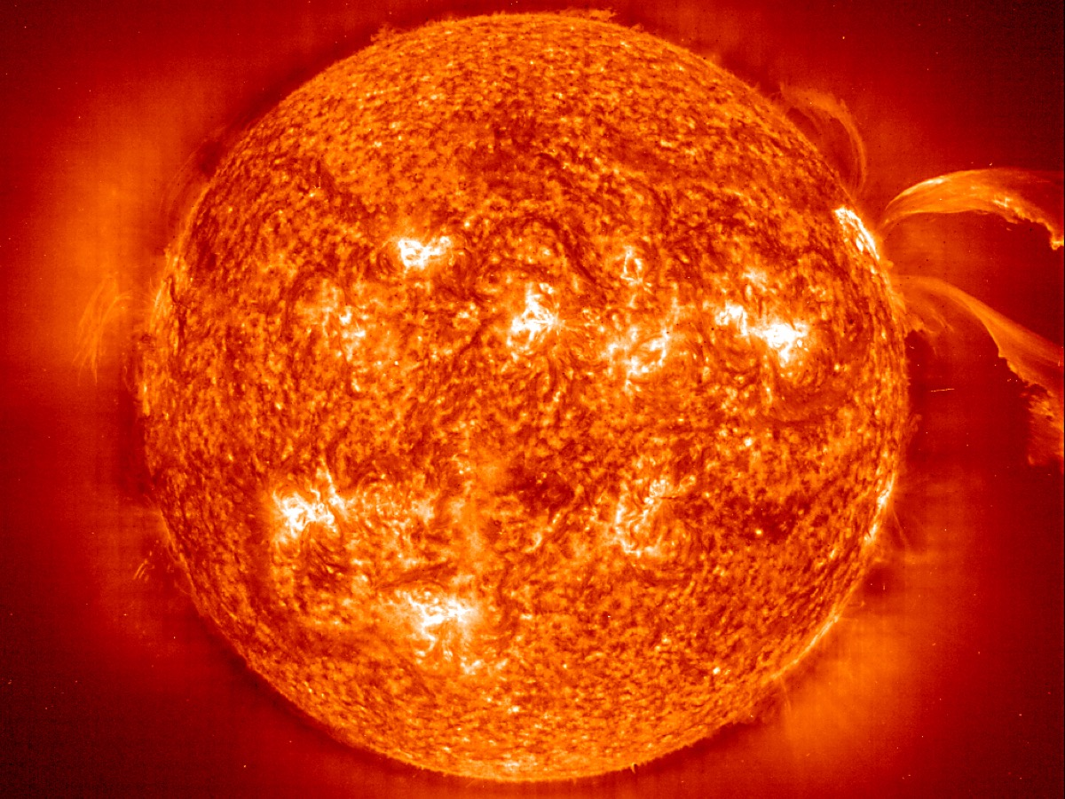

Slide 49
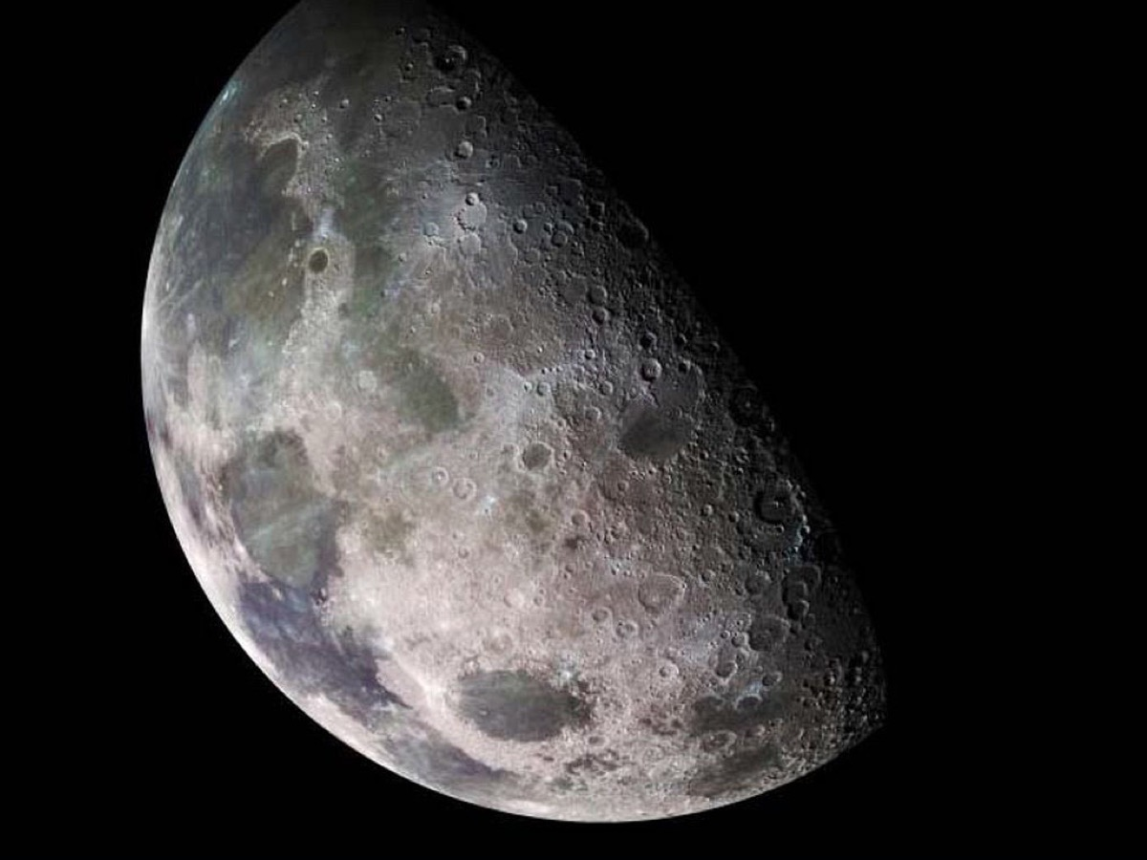

Slide 50
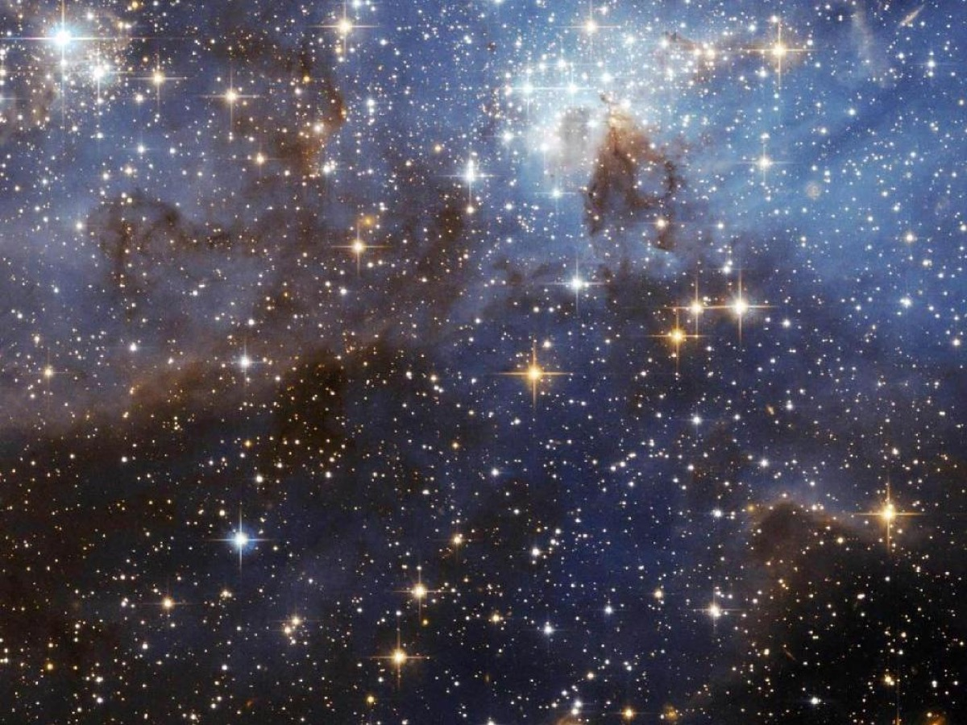

Slide 51
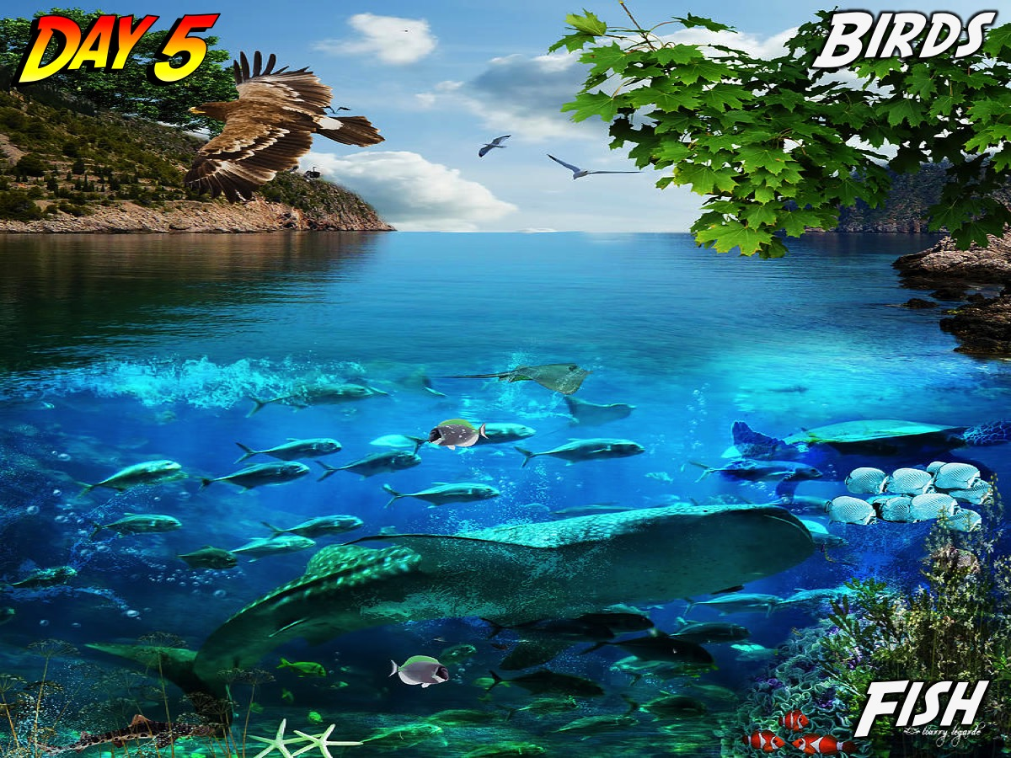
Notes:
Day 5: Birds and Fish (Genesis 1:20-23)

Slide 52
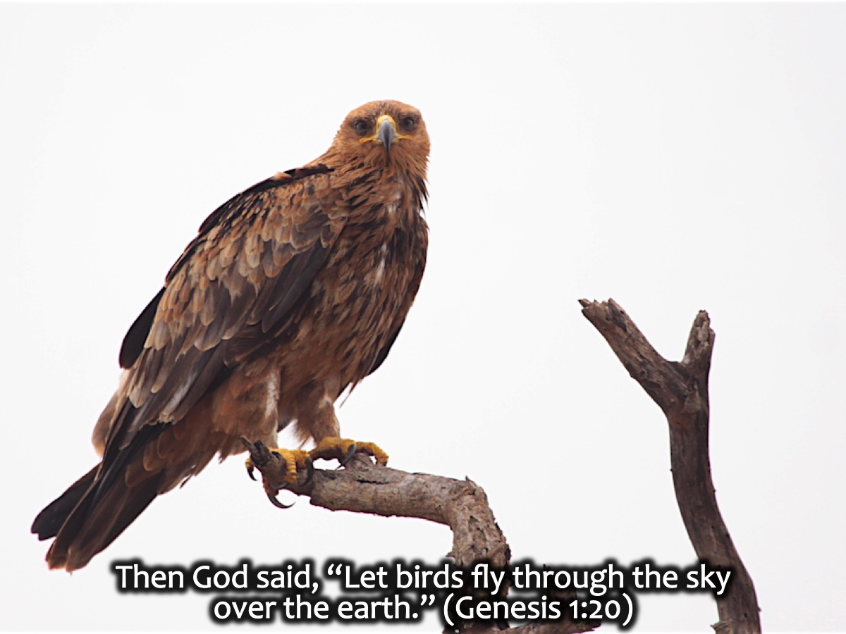
Notes:
Then God said, “Let birds fly through the sky over the earth.” (Genesis 1:20)

Slide 53
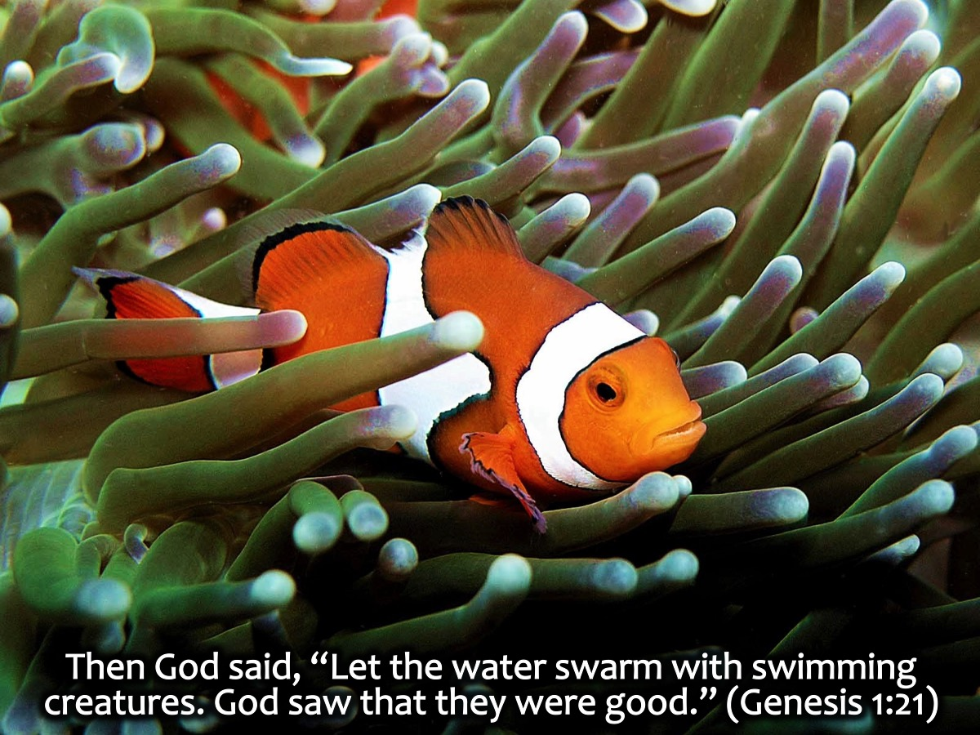
Notes:
Then God said, “Let the water swarm with swimming creatures. God saw that they were good.” (Genesis 1:21)

Slide 54
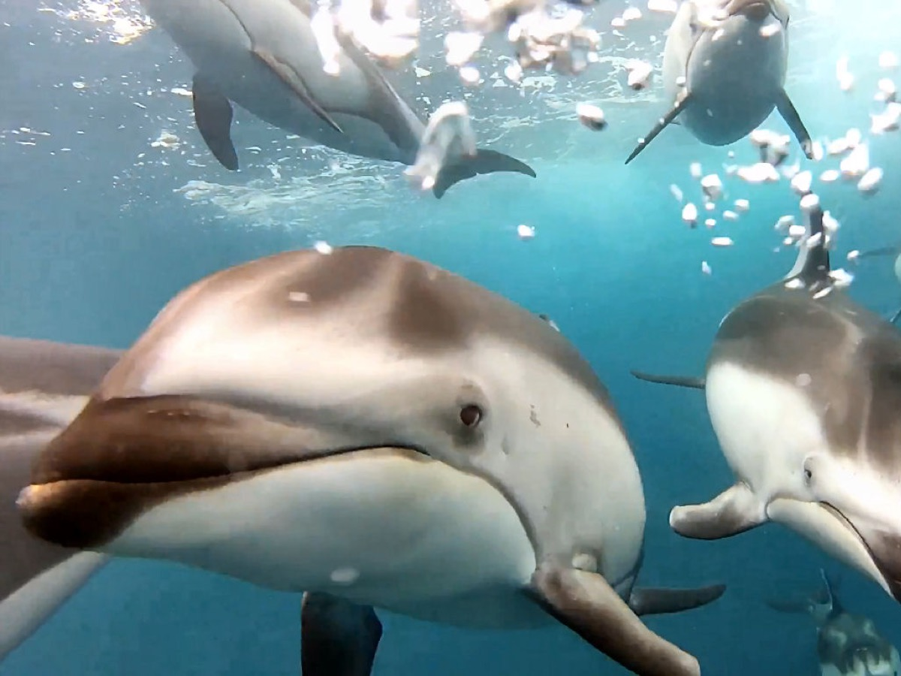

Slide 55
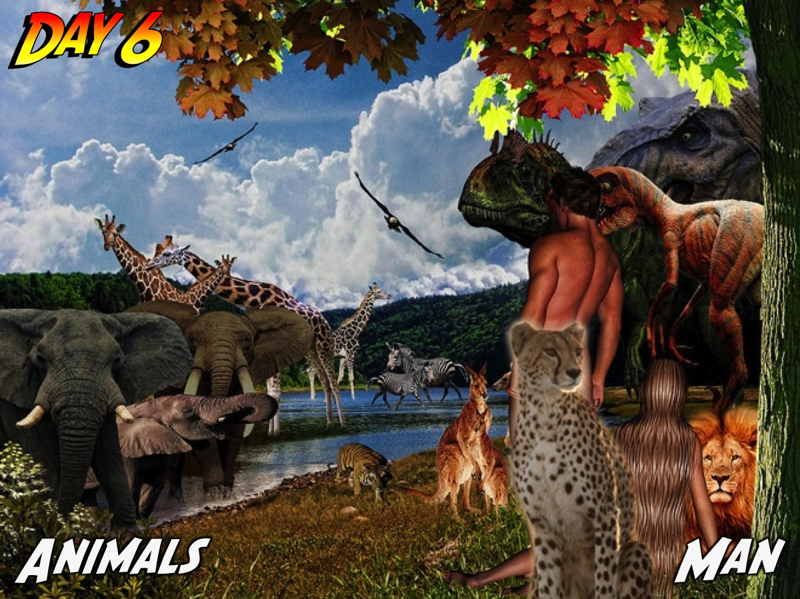
Notes:
Day 6: Animals and Man – Genesis 1:24-31

Slide 56
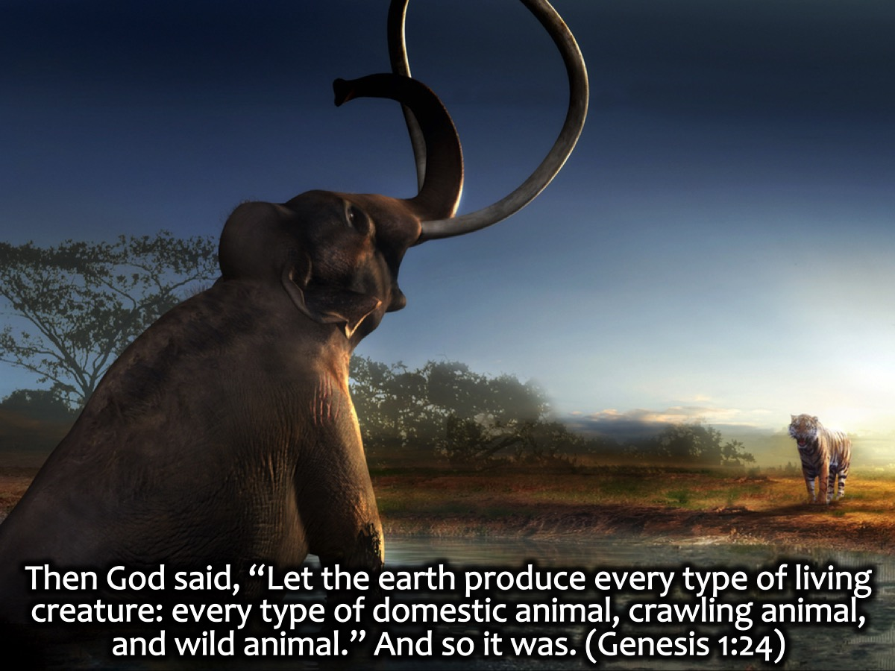
Notes:
Then God said, “Let the earth produce every type of living creature: every type of domestic animal, crawling animal, and wild animal.” And so it was. (Genesis 1:24)

Slide 57
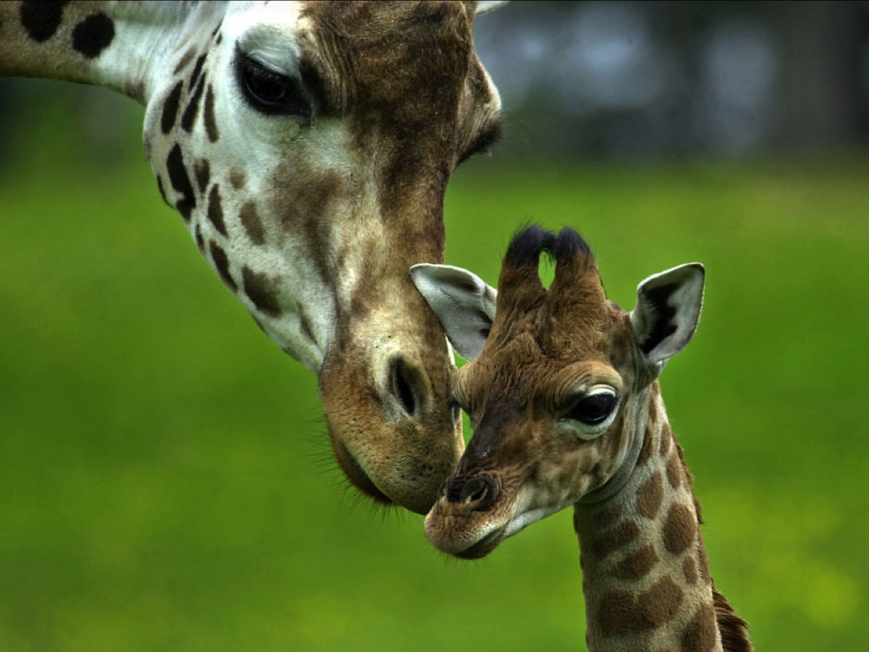

Slide 58
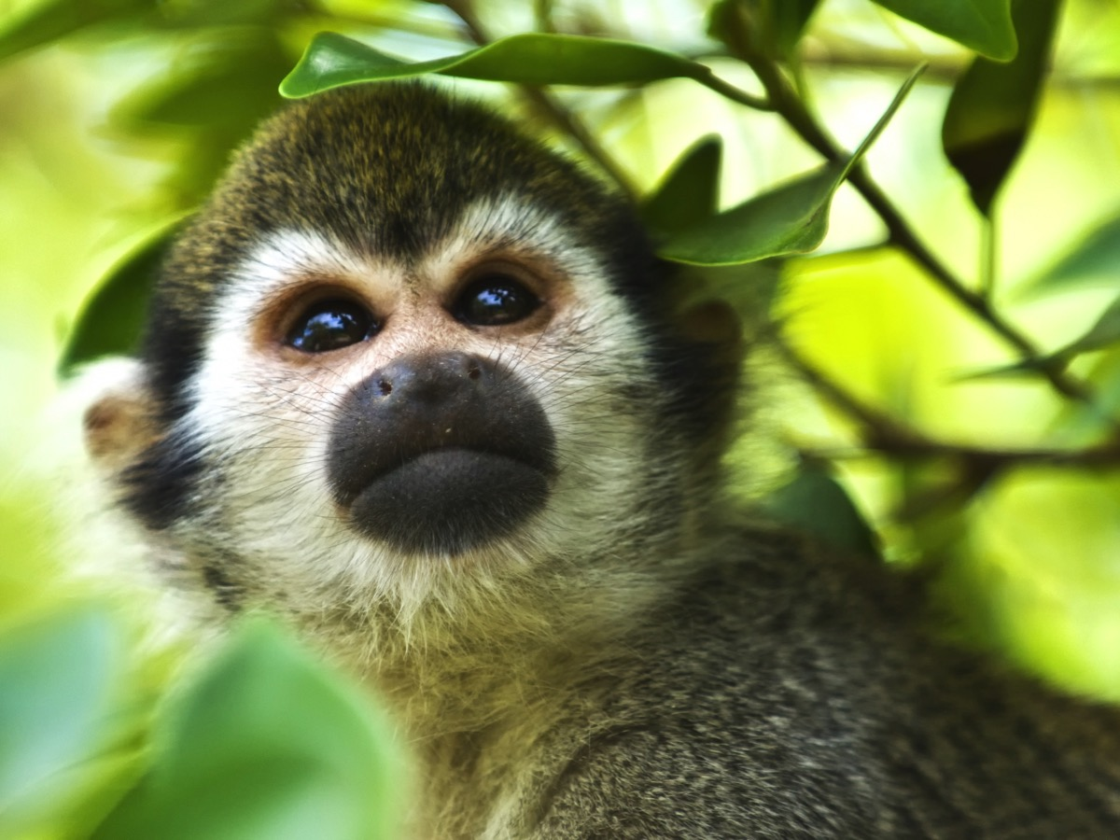

Slide 59


Slide 60


Slide 61
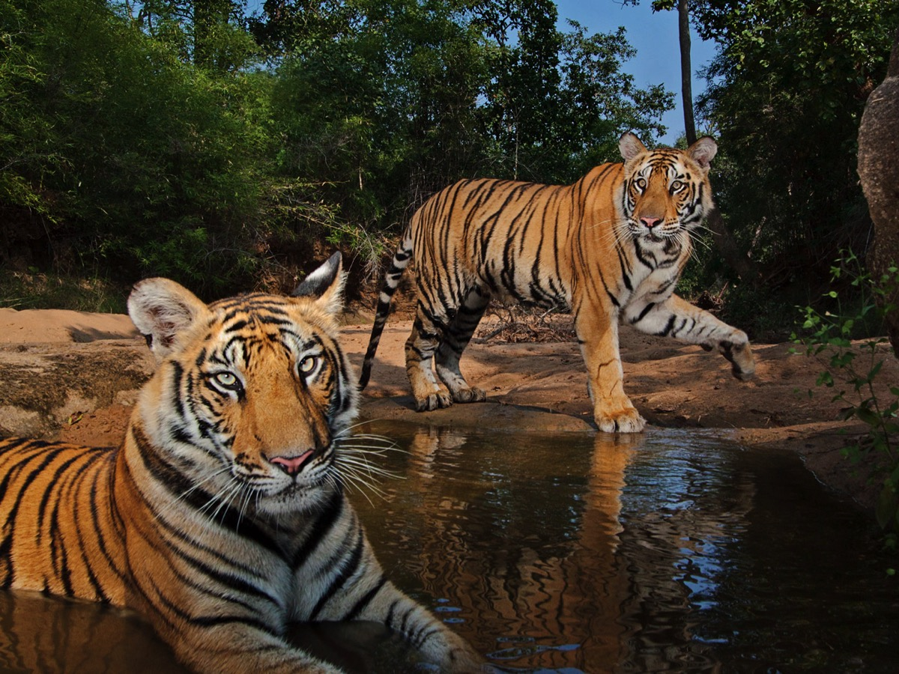

Slide 62
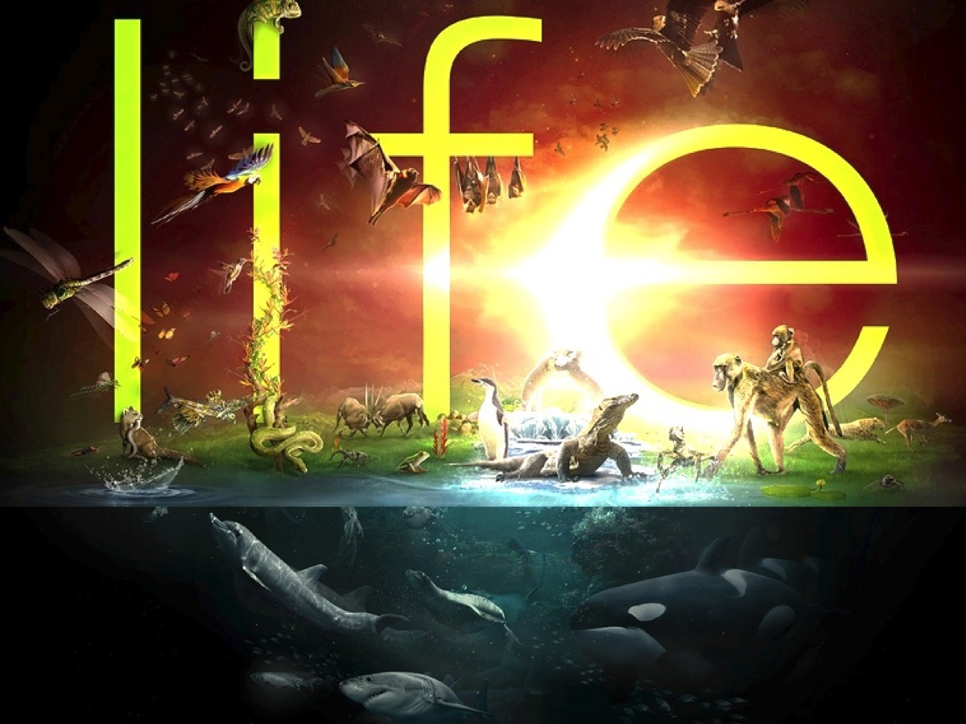
Notes:
Wow – what a creation – it is spectacular – but it is not finished yet – God is about to add His masterpiece!!!

Slide 63

Notes:
On day 6 God creates Adam: “Let us make man in our image, after our likeness”. Up until this point it is And God said – and a command for something to appear. On the other side of “and God said”: There is a conversation – “let’s us make man”. He is having a conversation with God – and he is not schizophrenic – he is triune! There is one God who eternally exists in 3 persons: distinct persons who are co-equal in power and glory, God the Father and God the Son and God the Holy Spirit. They are discussing how to purposefully and intentionally create the first man.

Slide 64


Slide 65


Slide 66

Notes:
Day 7 – God Rests.

Slide 67

Notes:
On the seventh day God stopped the work he had been doing. (Genesis 2:2)

Slide 68

Notes:
Why did God make us?

Slide 69

Notes:
1. We were made to Please God. As God looks and evaluates things he sees that things are good. At the end, verse 31 – and he said it was very good! As God looks at all he has created he is pleased. The creation was made to please the Creator. That is what we are here for! Made to please God! Made to please our Creator. He looks at our lives and says, “Good, I like that!” It is not about me…it is all about HE! We are here to please our Creator. The twist in the story is that those who try and live their own way, end up miserable! But those who live their lives in God’s way for His please find they are fulfilled and joyful!

Slide 70

Notes:
So What? Make God happy

Slide 71

Notes:
2. We were made to Reflect God. We please God when we reflect him! He created us, male and female, in his image to be a reflection of His image. When God sees his image reflected through our lives he is pleased. All of Creation exists to make much of it’s creator. Psalm 19:1 says: “The heavens declare the glory of God”. We have been made to make much of the one who made us. God is holy, righteous, honest, wise and just – we show him off when we are just like him!

Slide 72

Notes:
So What? Show God Off

Slide 73

Notes:
3. We were made to Serve God. We were made to experience an intimate relationship with God – this separates Adam and Eve from the rest of creation. God interacts with them uniquely – he blesses them, speaks to them, gives them a mission, gives them rank and responsibility over the rest of creation. He made them on purpose, with a purpose! We are here to know God and to make God known!

Slide 74

Notes:
So What? Serve God well

Slide 75

Notes:
Prayer

Slide 76

Notes:
Next Sunday we are going to look at what the Word says about Humanity.

