Slide 1
Notes:
Welcome to week 3 of the Word-On series where each week we are looking at what the Bible says about different topics.

Slide 2
Notes:
In week 1 we looked at what the Word says about God.

Slide 3
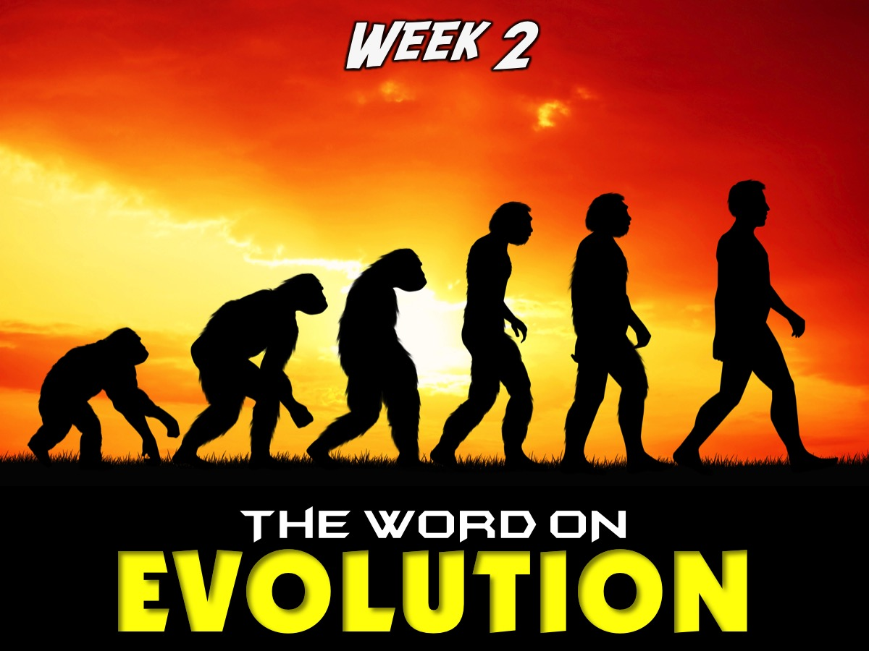
Notes:
Last week we looked at what the Word says about Evolution.

Slide 4
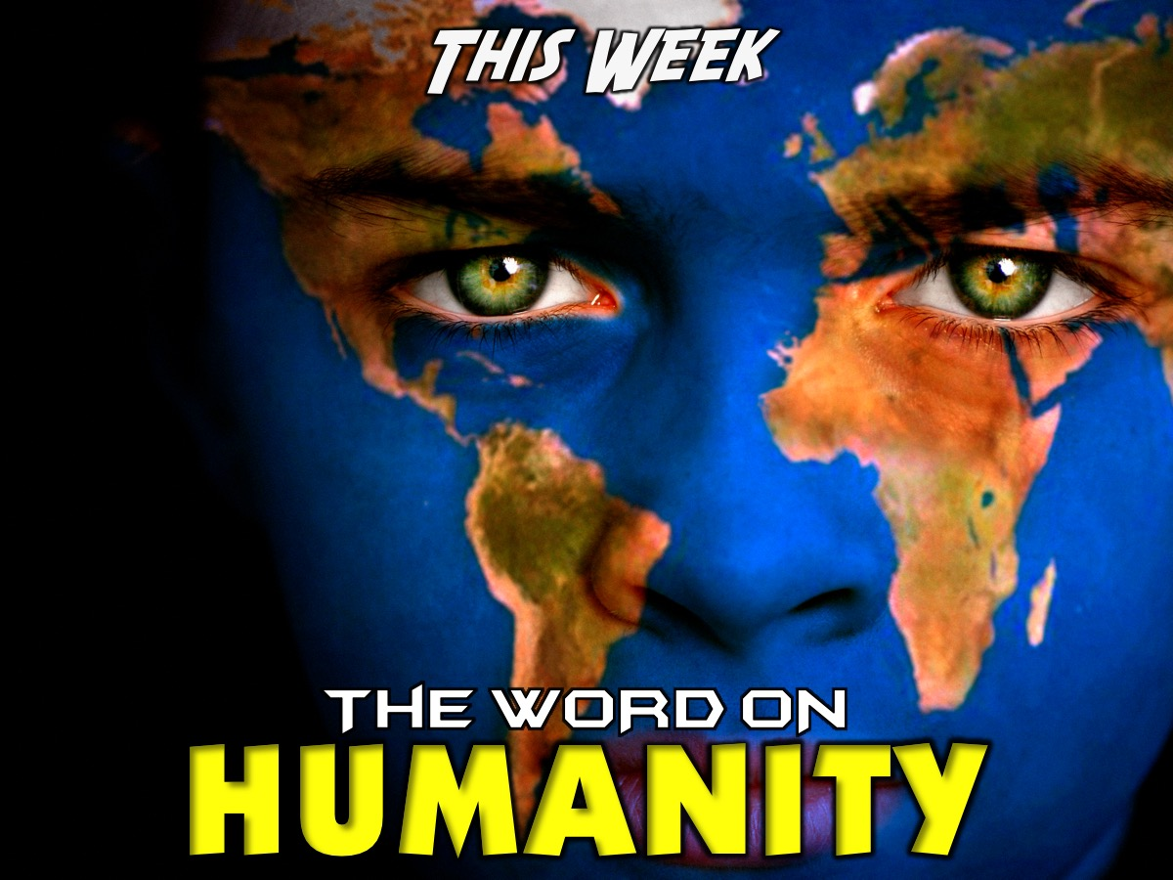
Notes:
This week we are going to look at what the word says about HUMANITY.

Slide 5
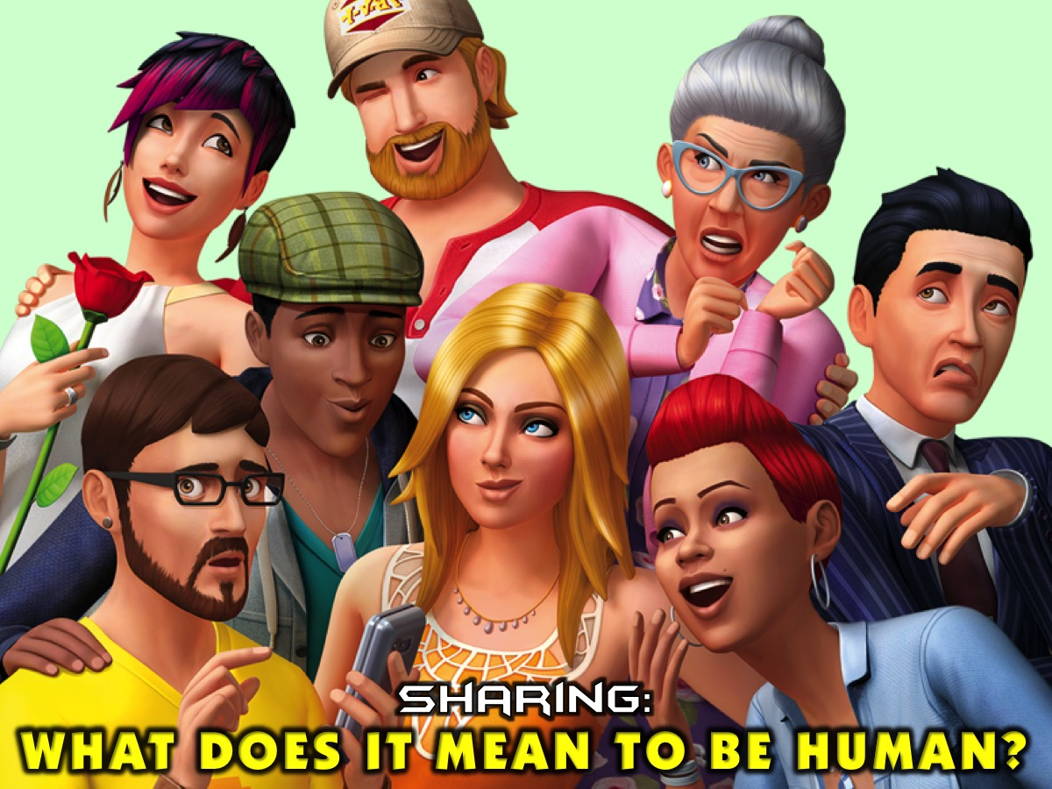
Notes:
Sharing: Ask the person next to you to share with you what it means to be human.

Slide 6
Notes:
Definition of the word “Humanity”: the quality of being humane; benevolence.

Slide 7
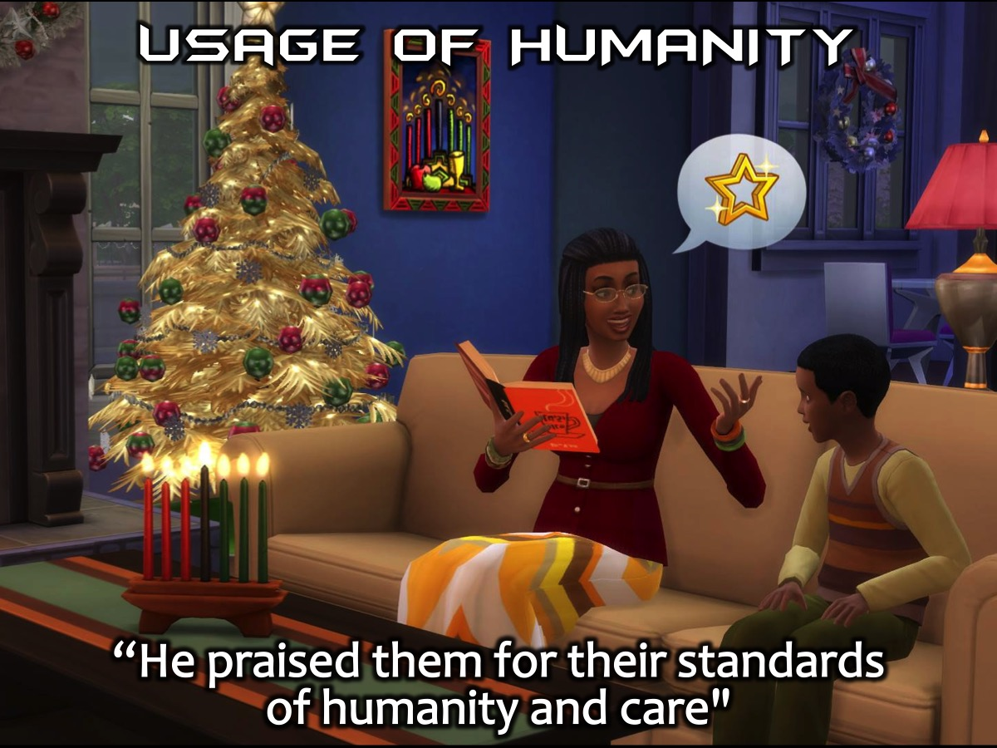
Notes:
Usage of the word “Humanity”: “He praised them for their standards of humanity and care"

Slide 8
Notes:
Synonyms of the word “Humanity”: Compassion, brotherly love, fellow feeling, humaneness, kindness, kind-heartedness, consideration, understanding, sympathy, tolerance, goodness, good-heartedness, gentleness, leniency, mercy, pity, tenderness, benevolence, charity, generosity.

Slide 9
Notes:
Activity: The Word On Humanity: Each group has been given a age of Bible verses that describe some characteristics of what it means to be human or humane! Read the verses and make a list of the top 10 characteristics that humans should have.
The Lord has told you what is good, and this is what he requires of you: to do what is right, to love mercy, and to walk humbly with your God. (Micah 6:8)
You must love the Lord your God with all your heart, and with all your soul, and with all your strength, and with all your mind. And you must love your neighbor just as much as you love yourself. (Luke 10:27)
Honor your father and your mother, so that you may live long in the land the Lord your God is giving you. (Exodus 20:12)
But he who is gracious to the needy honors God. (Proverbs 14:31)
Do not lie to one another. (Colossians 3:9)
You shall not follow the masses in doing evil. (Exodus 23:2)
Honor all people, love the brotherhood, fear God, honor the king. (1 Peter 2:17)

Slide 10
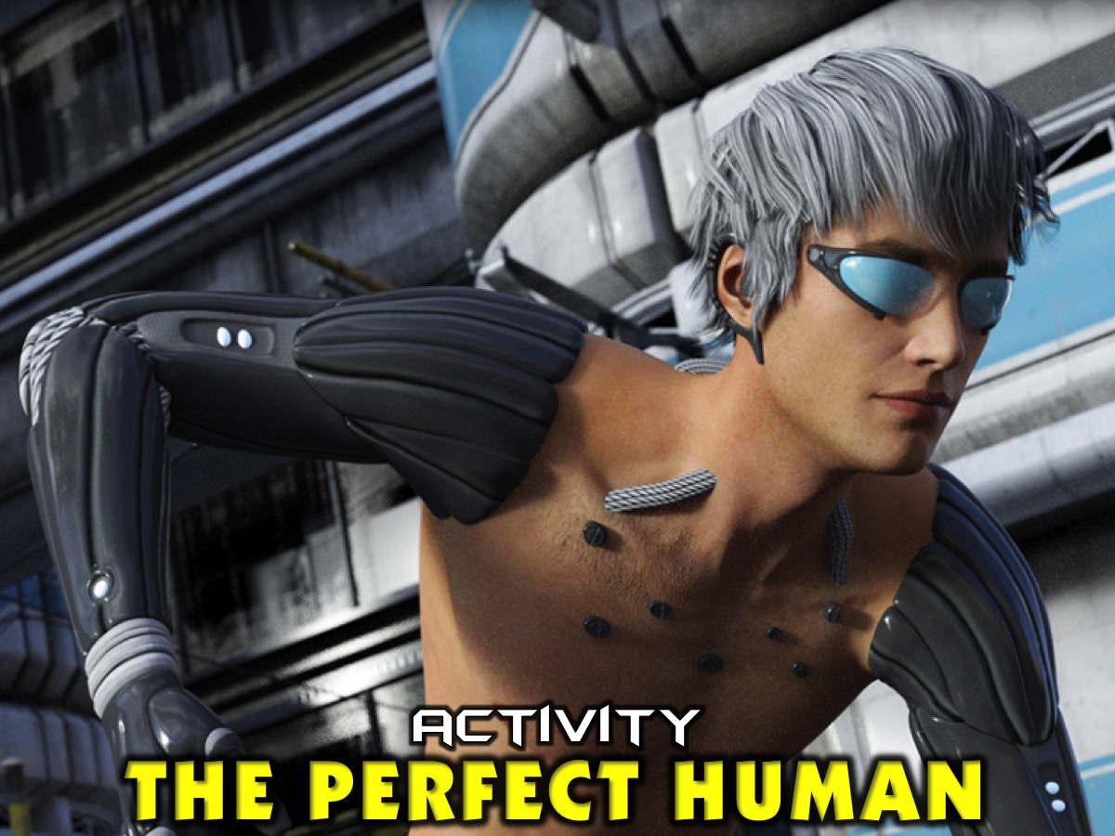
Notes:
Activity: The Perfect Human. Now that we know the definition of humanity, as a team use the paper (sheet of A3) and pens provided to create a perfect human being. What characteristics will that person have? Share your creation with the wider group.

Slide 11
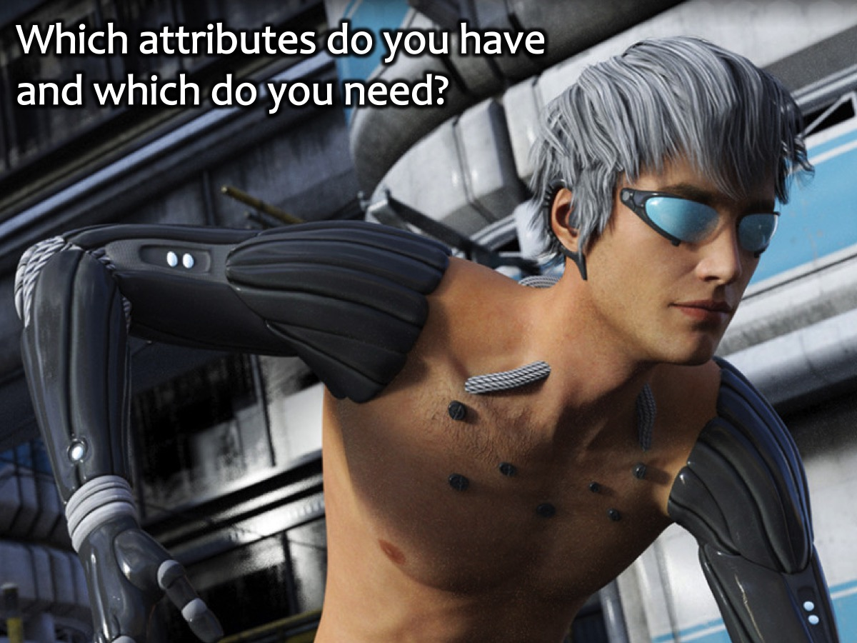
Notes:
Activity: Look at the ideal person you have created. How many of those attributes do you posses as an individual? (answer it for yourself).

Slide 12
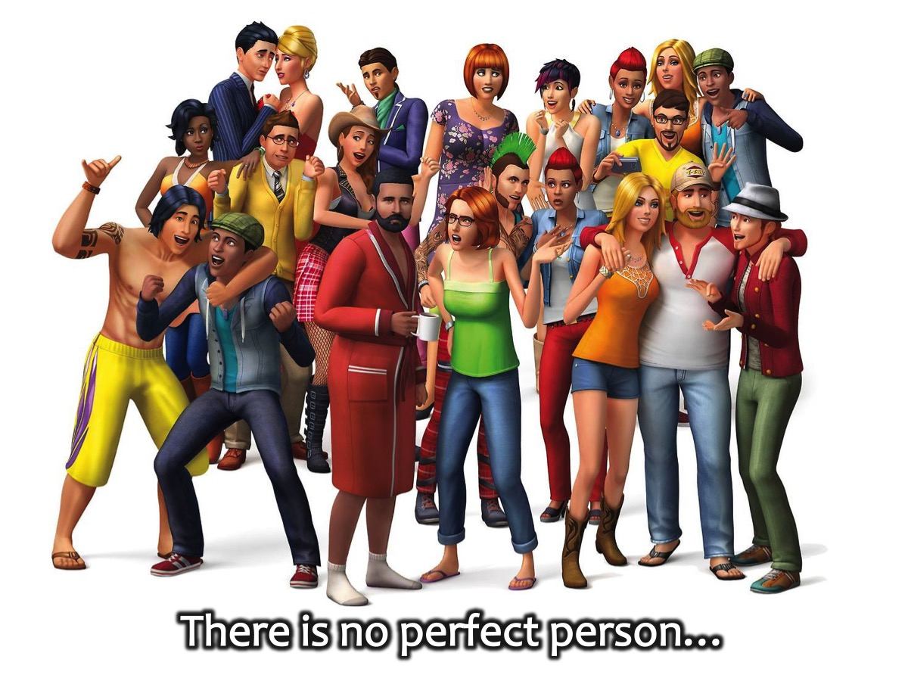
Notes:
People say there is no perfect person…

Slide 13
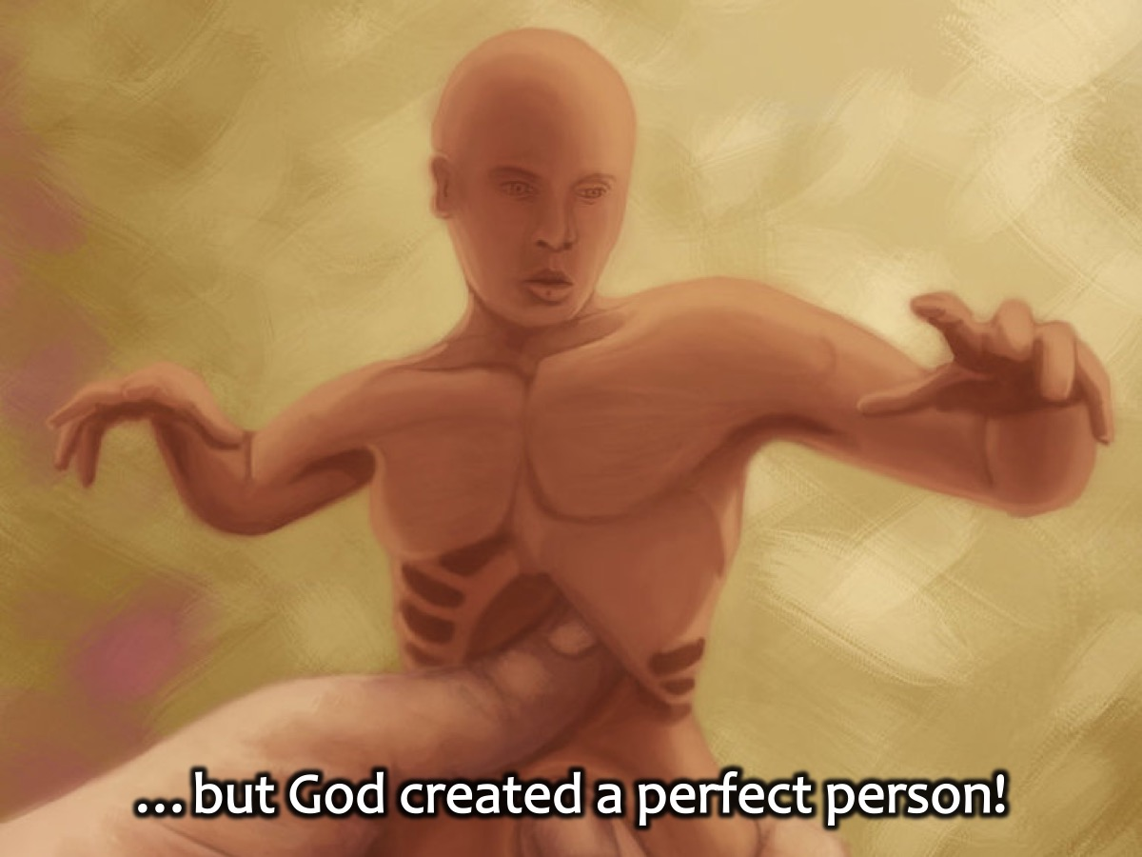
Notes:
…but God created a perfect person.

Slide 14
Notes:
So where did it all go wrong?

Slide 15
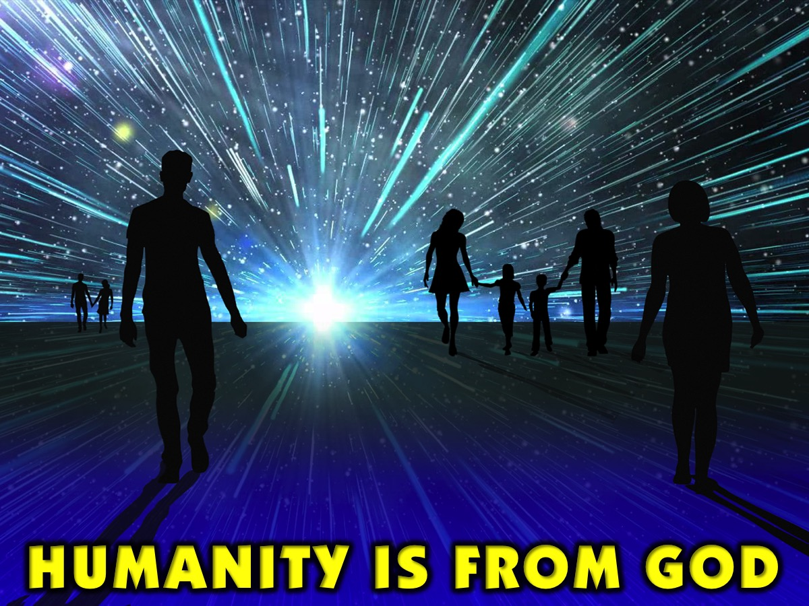
Notes:
Humanity is from God himself.

Slide 16
Notes:
“For God so loved the world that He gave his only begotten son, that whosoever believeth in Him should not perish, but have everlasting life.” (John 3:16)

Slide 17
Notes:
After sin came into the world God could have easily destroyed the world, He could have given up on us but He didn’t. Why? Because He was teaching us to do the same.

Slide 18
Notes:
“Let us love one another for love is of God, everyone that loves is born of God and knows God, he who loves not does not know God, for God is love.” (1 John 4:7-8)

Slide 19
Notes:
Jesus said that He and the father are one, so that means that they have the same character.

Slide 20
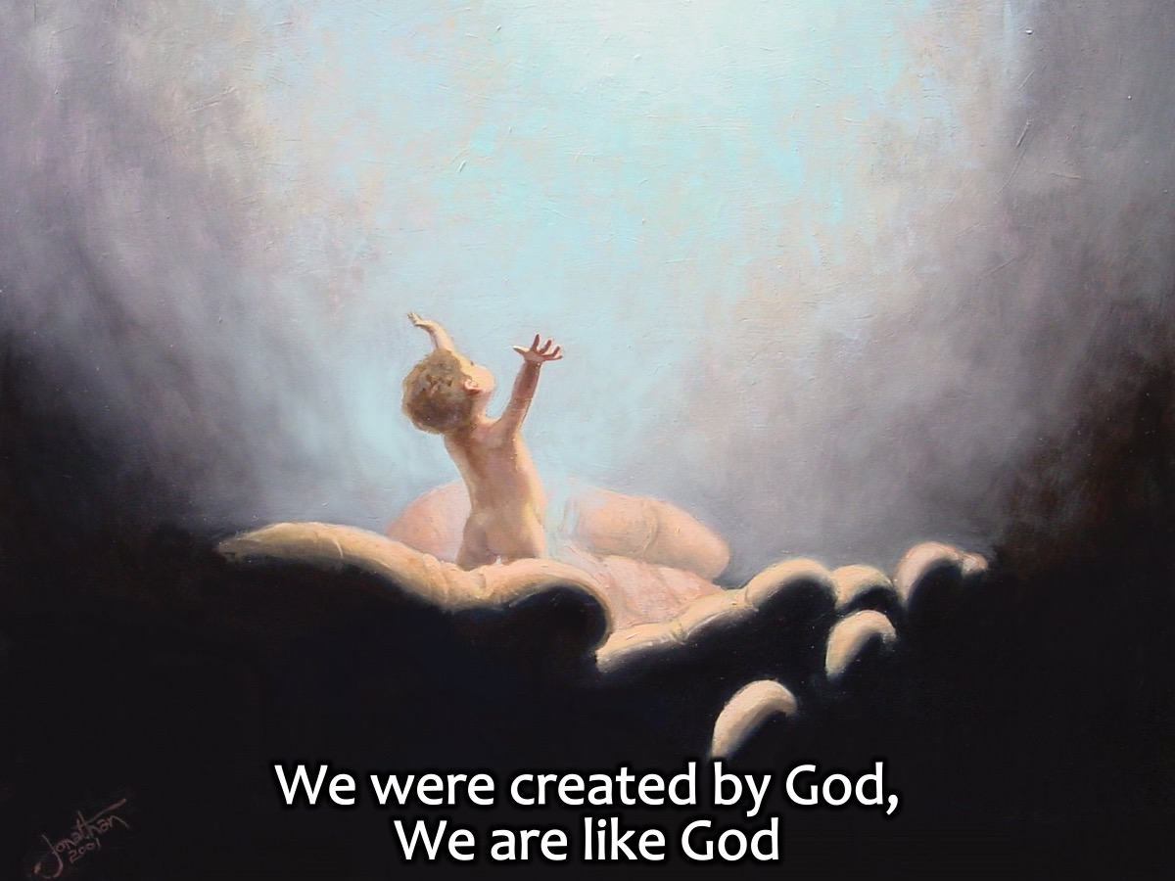
Notes:
On the other hand we were created by God, after His likeness (Gen:1:26-27) so this means we are like God.

Slide 21
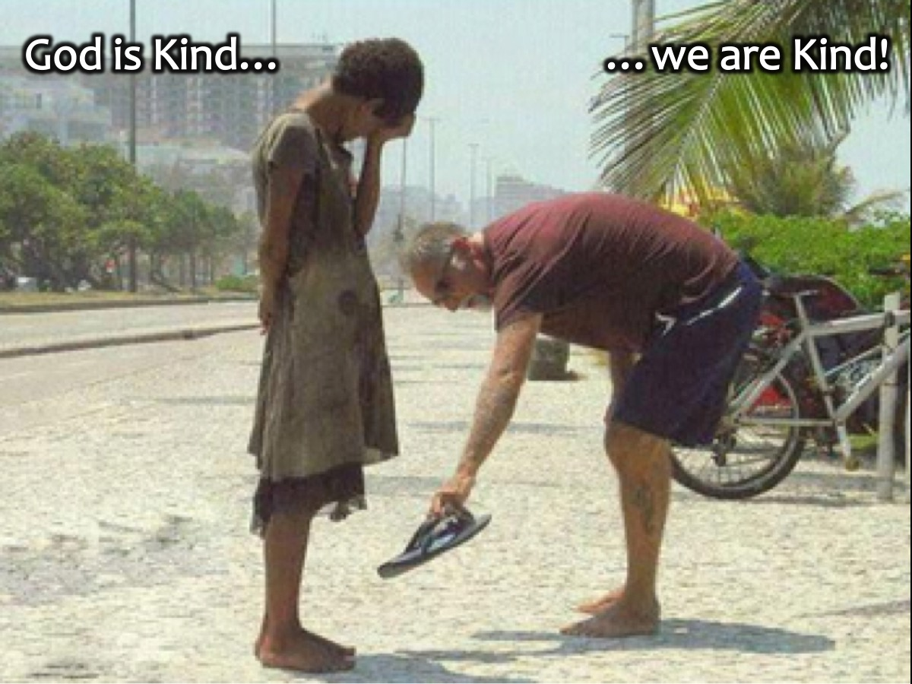
Notes:
So, if God is kind then this means that we are kind as well. Kindness is in our nature.

Slide 22
Notes:
God made us human beings and not animals, so this means we have humanity. Humanity is in our DNA.

Slide 23
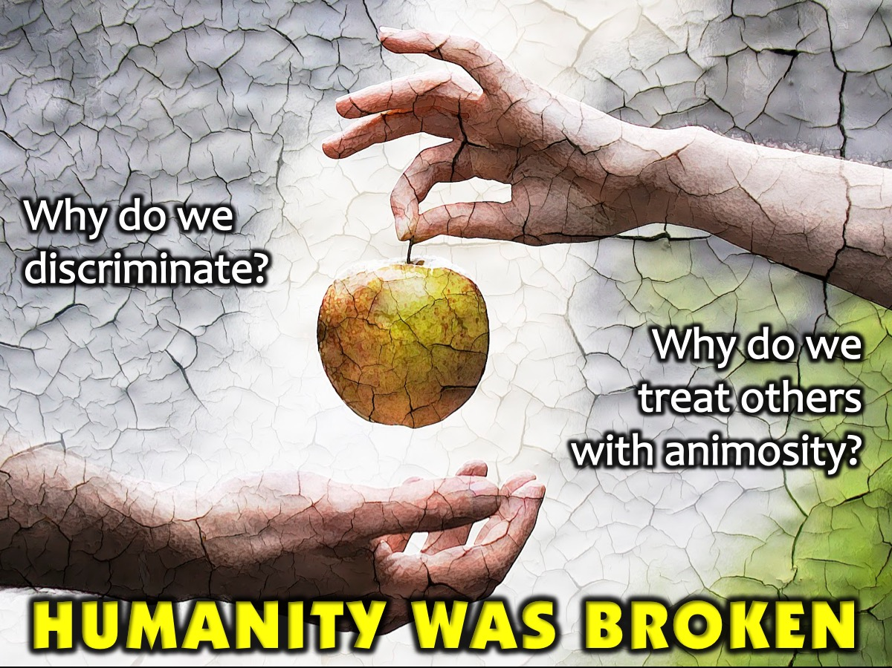
Notes:
Why then do we discriminate? Treat others with animosity even though we are not animals? The answer is easy SIN. SIN is everything that is against God’s perfect design.

Slide 24
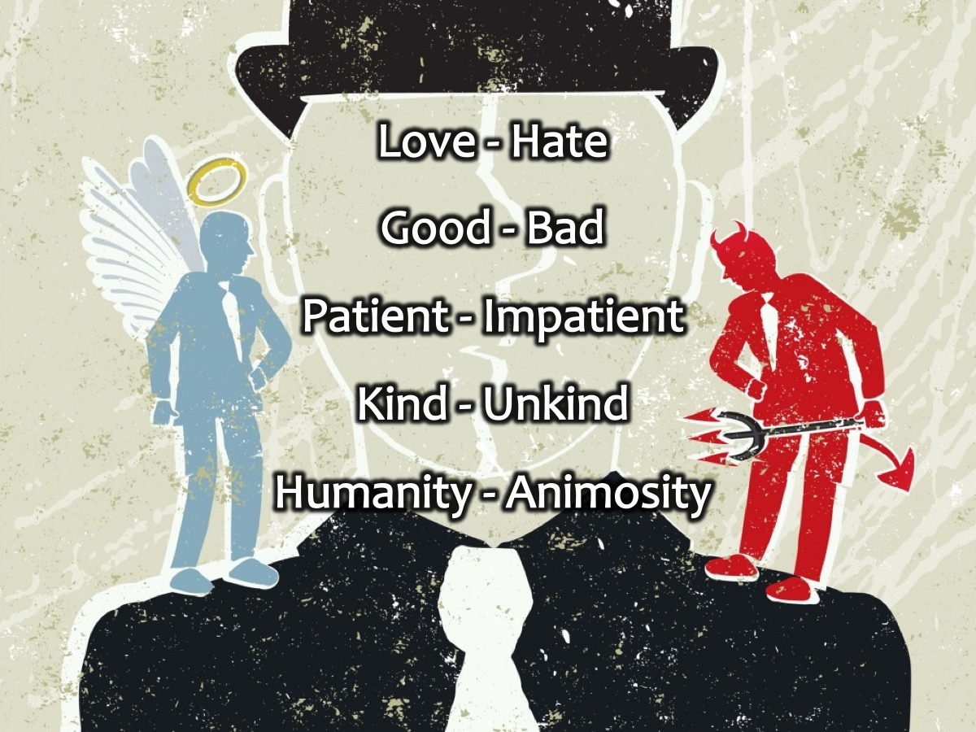
Notes:
The result is a world filled with these opposites: Love - Hate, Good - Bad, Patient - Impatient, Kind - Unkind, Humanity - Animosity.

Slide 25
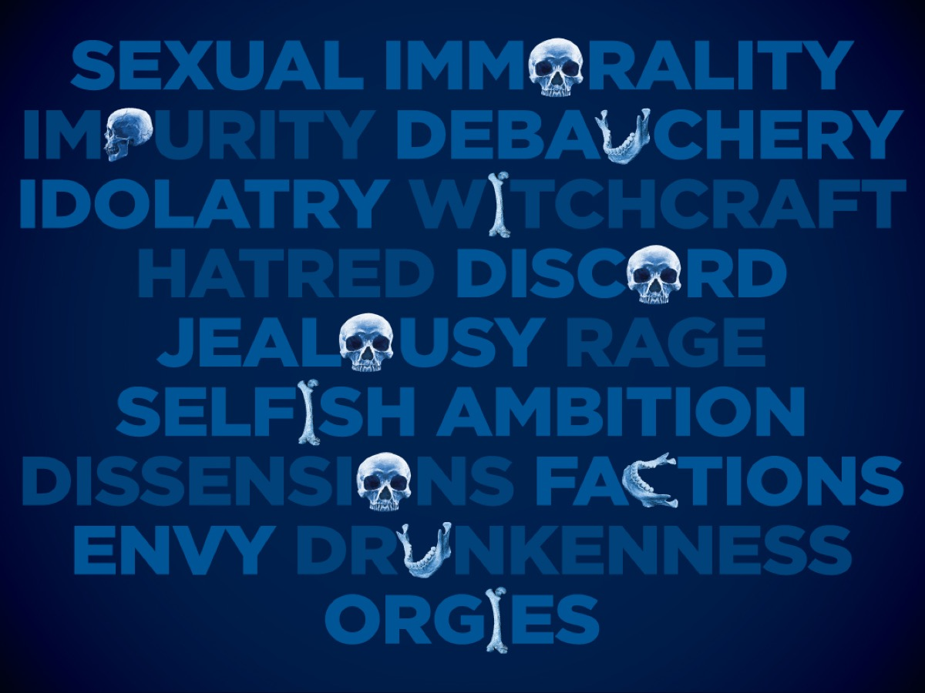
Notes:
The Works of the Flesh: “The acts of the flesh are obvious: sexual immorality, impurity and debauchery; idolatry and witchcraft; hatred, discord, jealousy, fits of rage, selfish ambition, dissensions, factions and envy; drunkenness, orgies, and the like.” (Galatians 5:19-20)

Slide 26
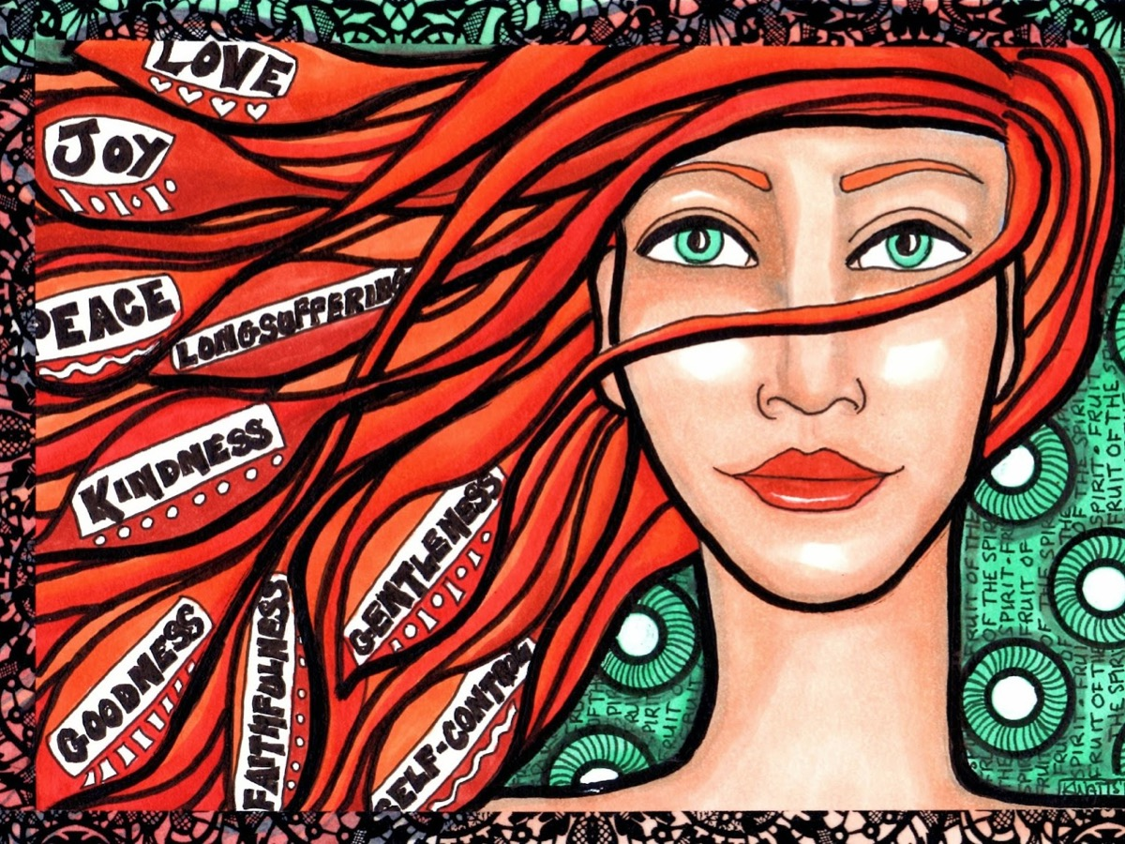
Notes:
The Fruit of the Spirit: But the fruit of the Spirit is love, joy, peace, forbearance, kindness, goodness, faithfulness, gentleness and self-control. (Galatians 5:22-23)

Slide 27
Notes:
Humanity in Jesus - Jesus was born as a human being to his mother, Mary, and father, Joseph.

Slide 28
Notes:
Jesus wept. (John 11:35)

Slide 29
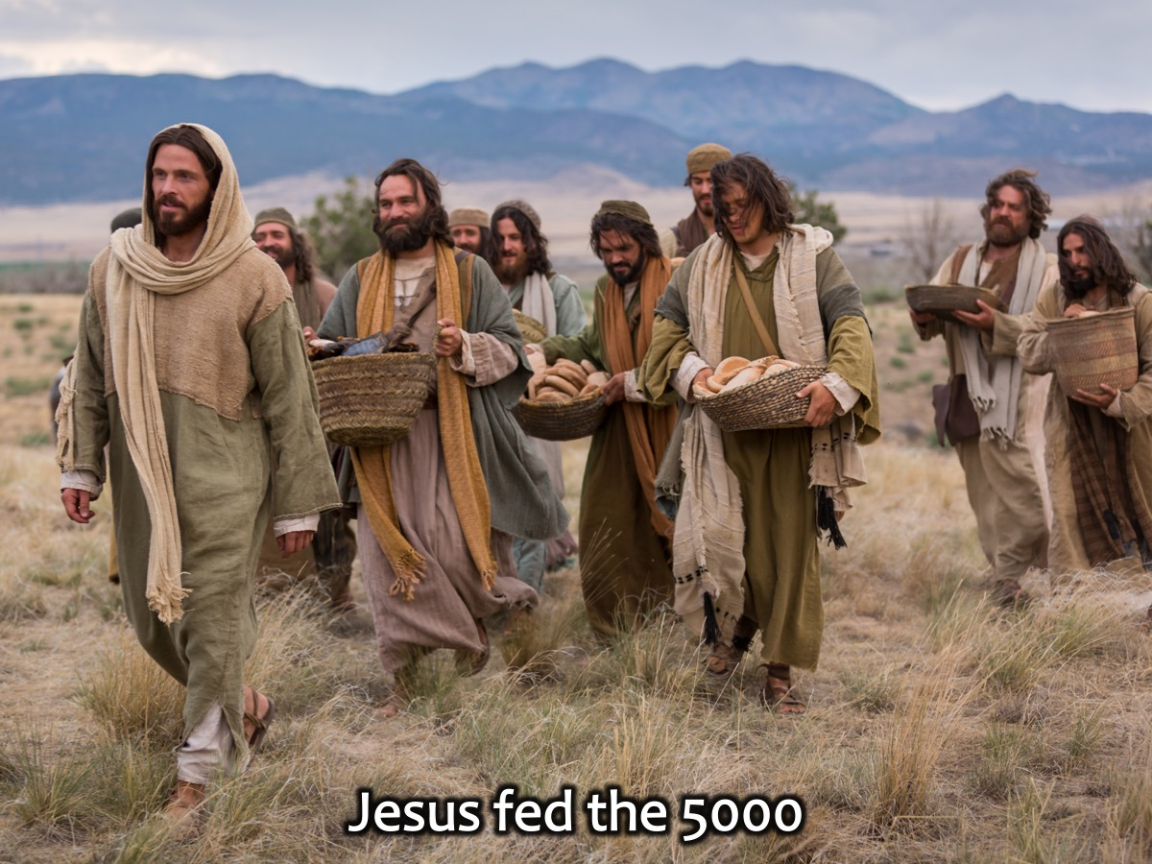
Notes:
Jesus fed the 5000. (Mark 6:30-44)

Slide 30
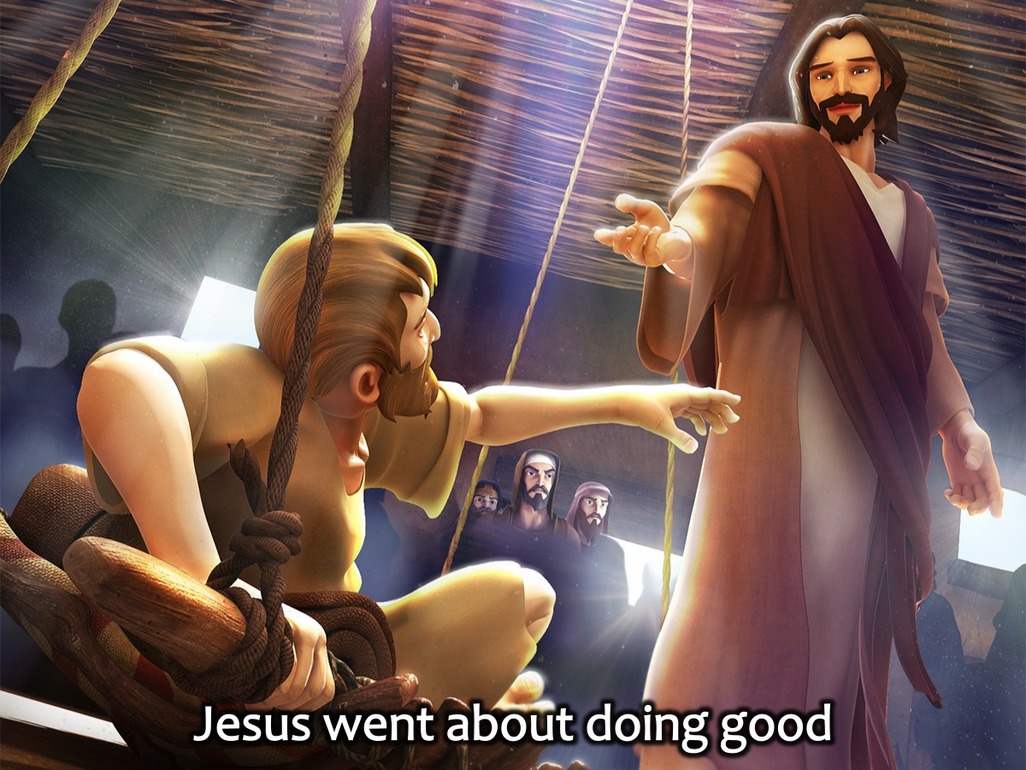
Notes:
Jesus went about doing good. “God anointed Jesus of Nazareth with the Holy Spirit and with power. Then Jesus went around doing good and healing all who were oppressed by the devil, for God was with him.“ (Acts 10:38)

Slide 31
Notes:
Jesus agonised over going to cross to die for us.

Slide 32
Notes:
Jesus died so that we could have life.

Slide 33
Notes:
“For the Son of Man did not come to be served, but to serve and to give his life as a ransom for many.” (Mark 10:45)

Slide 34
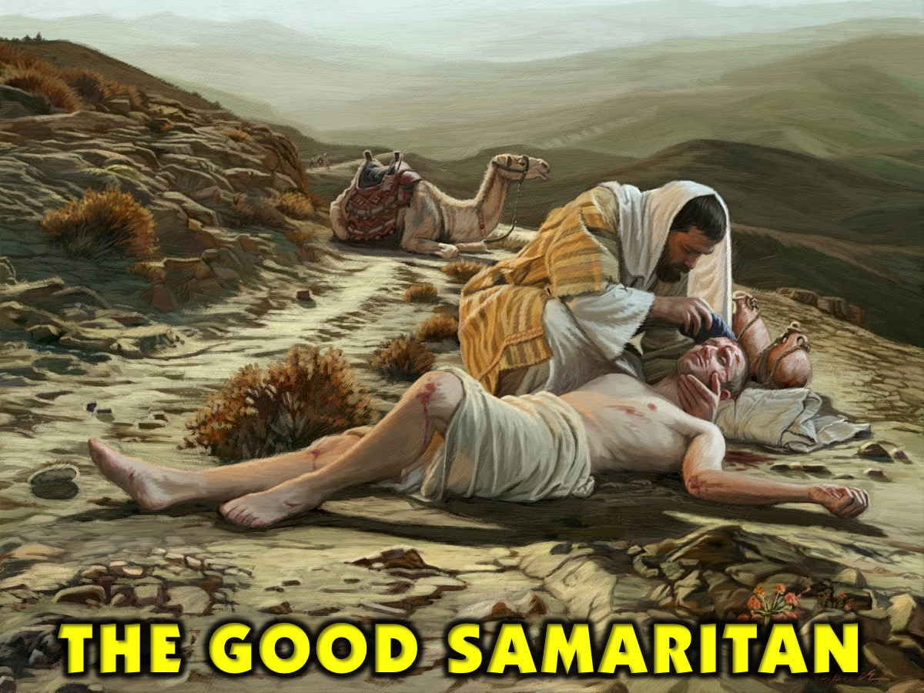
Notes:
The Good Samaritan is another example of a person with humanity. He helped a stranger who was not even from his own country. Not only that, he also spent money on him, and nursed his wounds without expecting anything in return.

Slide 35
Notes:
UBUNTU is a South African term, we need to teach people how to have Ubuntu.

Slide 36
Notes:
Desmond Tutu said: One of the sayings in our country is Ubuntu – the essence of being human. Ubuntu speaks particularly about the fact that you can't exist as a human being in isolation. It speaks about our interconnectedness. You can't be human all by yourself, and when you have this quality – Ubuntu – you are known for your generosity. We think of ourselves far too frequently as just individuals, separated from one another, whereas you are connected and what you do affects the whole World. When you do well, it spreads out; it is for the whole of humanity.

Slide 37
Notes:
Nelson Mandela once said: A traveller through a country would stop at a village and he didn't have to ask for food or for water. Once he stops, the people give him food and attend him. That is one aspect of Ubuntu, but it will have various aspects. Ubuntu does not mean that people should not enrich themselves. The question therefore is: Are you going to do so in order to enable the community around you to be able to improve?

Slide 38
Notes:
Between the year 2001 till 2009 I have been a member of the Regenbogen Projekt (Rainbow Project). In this project young people from around the world came together to build rainbow playgrounds as a symbol of hope in places that have had it hard in the past. The first one was in Soweto in 1998 and the last one in Germany last year. We got to interact with deferent people and the aim was to show the love of Christ through our actions and not what we said.

Slide 39
Notes:
The Rainbow Project.

Slide 40
Notes:
Video: Kindness Boomerang. Get it on YouTube at: https://www.youtube.com/watch?v=nwAYpLVyeFU

Slide 41
Notes:
Activity: Teaching Humanity. So here is a challenge: think of how you are going to teach people about humanity in this coming week through your actions. (silence) Now, right your thoughts down, so that you do not forget.

Slide 42
Notes:
Prayer

Slide 43
Notes:
Next Sunday we are going to stay in the sanctuary after worship as the leaders have a training weekend to attend.

