Slide 1
Notes:
Welcome to week 4 of the Word-On series where each week we are looking at what the Bible says about different topics.

Slide 2
Notes:
In week 1 we looked at what the Word says about God.

Slide 3
Notes:
In week 2 we looked at what the Word says about Evolution.

Slide 4
Notes:
Last week we looked at what the word says about HUMANITY.

Slide 5
Notes:
This week we are going to look at what the word says about Spiritual Warfare.

Slide 6
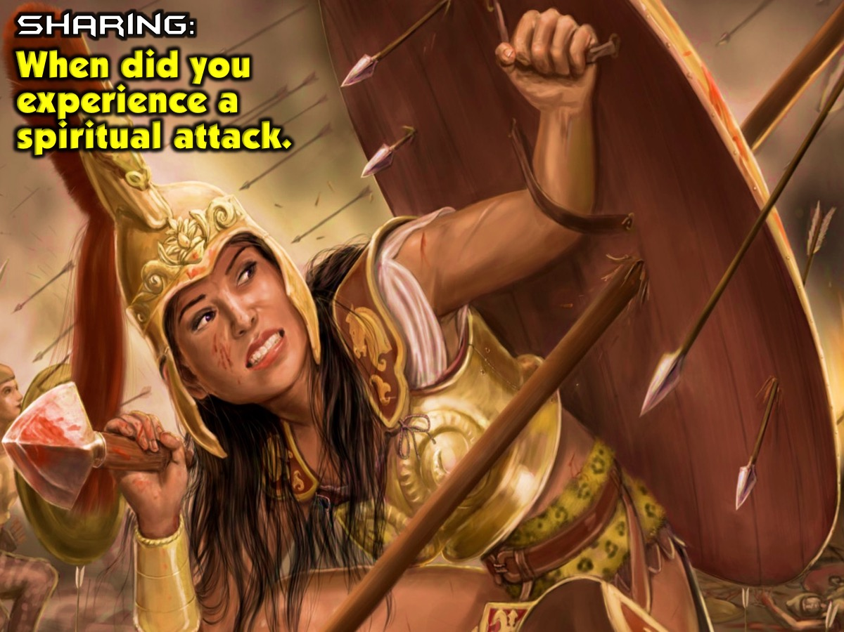
Notes:
Sharing: Ask the person next to you to tell you about a time when they experienced a spiritual attack.

Slide 7
Notes:
Imagine a superhero who has been through a battles is worn out...

Slide 8
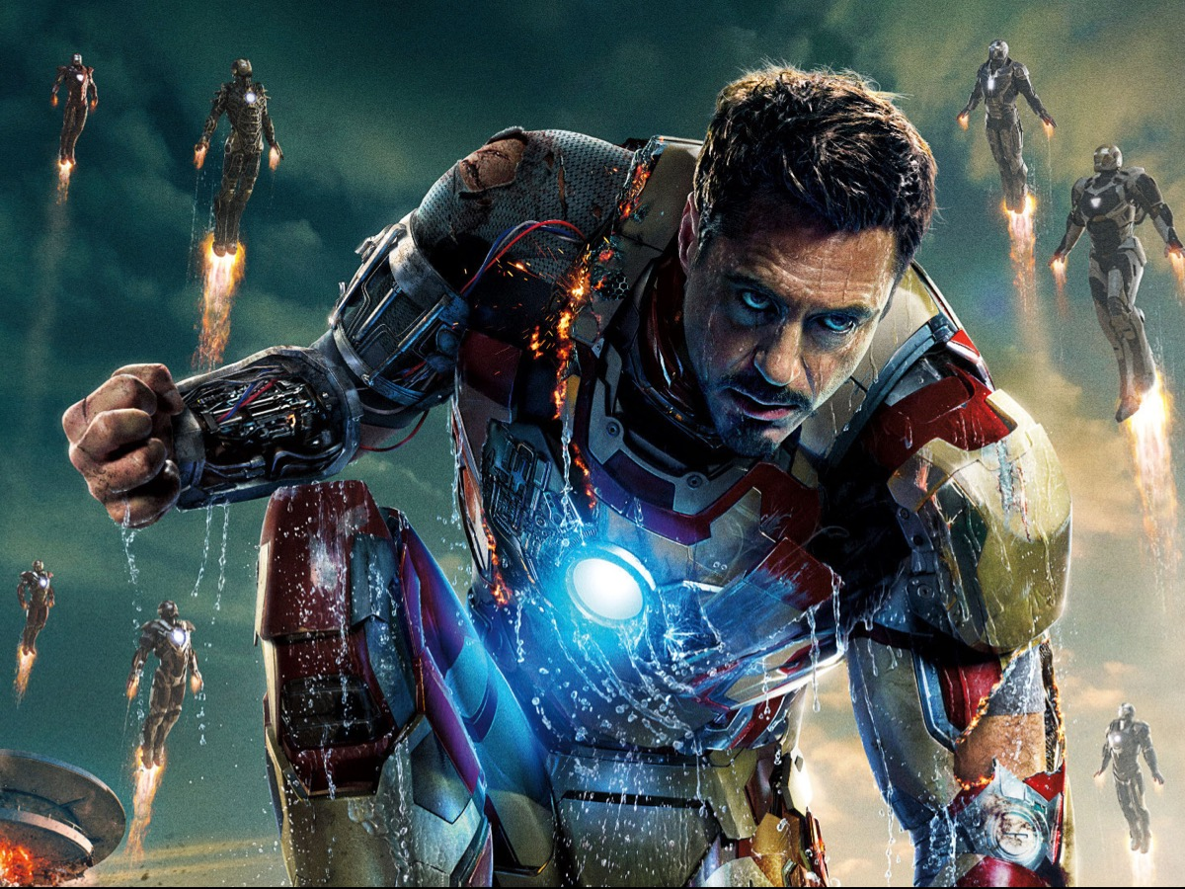
Notes:
His outfit is ripped but he gets up when the odds are stacked against him....

Slide 9
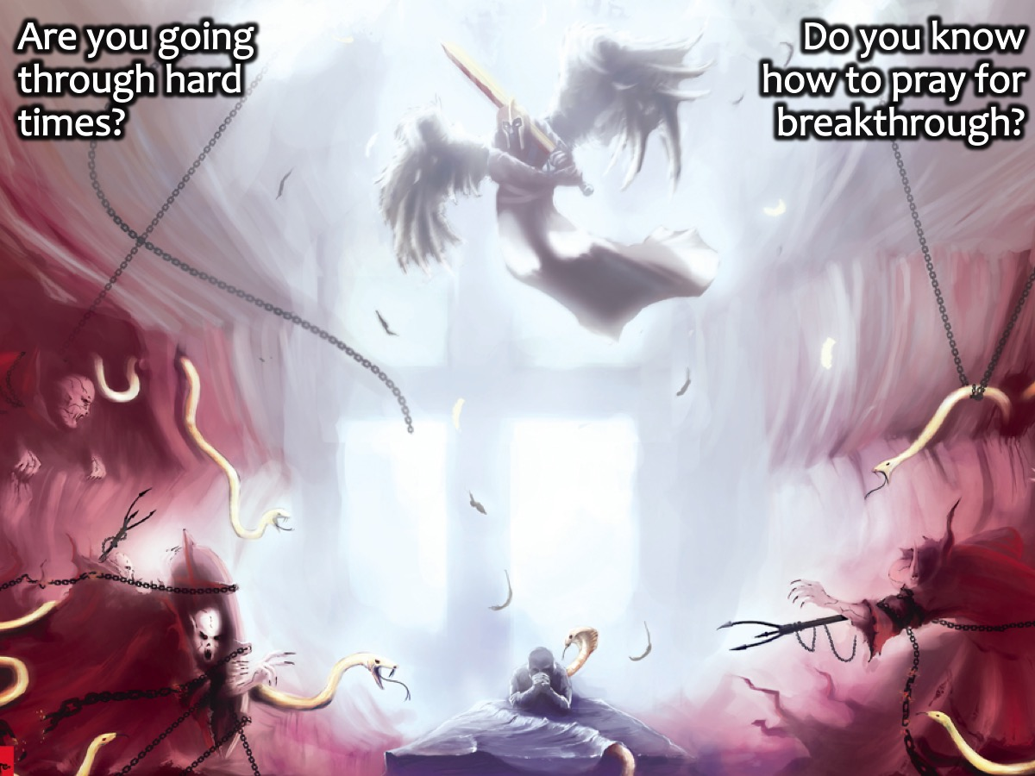
Notes:
I sense people are going thru hard times and they need to know how to fight and pray for break through the spiritual way.

Slide 10
Notes:
What is Spiritual Warfare? Let’s look at 3 scriptures and then come up with a definition for spiritual warfare:

Slide 11
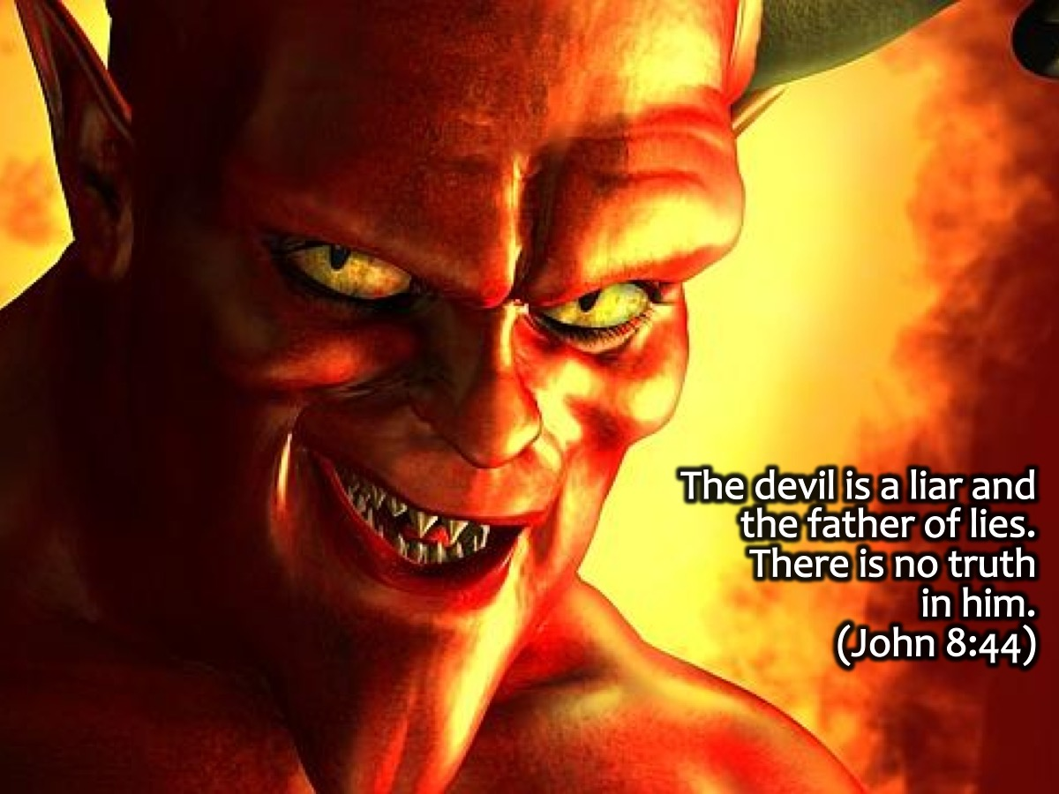
Notes:
The devil is a liar and the father of lies. There is no truth in him. (John 8:44)

Slide 12
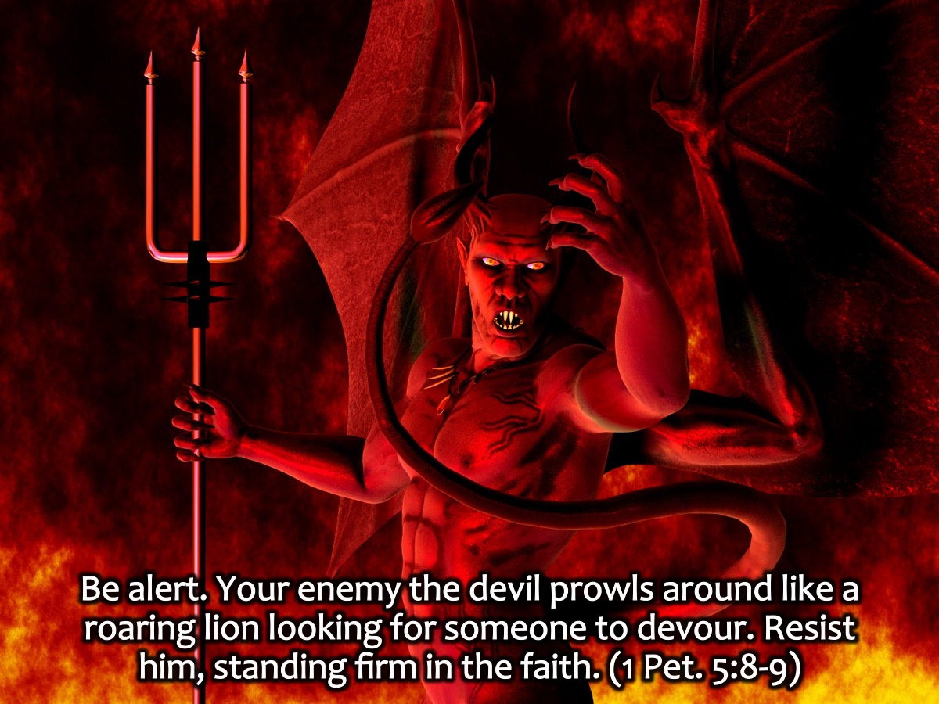
Notes:
Be alert. Your enemy the devil prowls around like a roaring lion looking for someone to devour. Resist him, standing firm in the faith. (1 Peter 5:8-9)

Slide 13
Notes:
For we wrestle not against flesh and blood, but against principalities, against powers, against the rulers of the darkness of this world, against spiritual wickedness in high places. (Ephesians 6:12)

Slide 14
Notes:
What is Spiritual Warfare? Spiritual warfare is defeating the enemies lies that he sends our way.

Slide 15
Notes:
Spiritual warfare comes in two ways: Offensive and Defensive.

Slide 16
Notes:
Offensive warfare is tearing down the strongholds the enemy has formed in your mind through deception and accusations.

Slide 17
Notes:
We demolish arguments and every pretension that sets itself up against the knowledge of God, and we take captive every thought to make it obedient to Christ. (2 Corinthians 10:5)

Slide 18
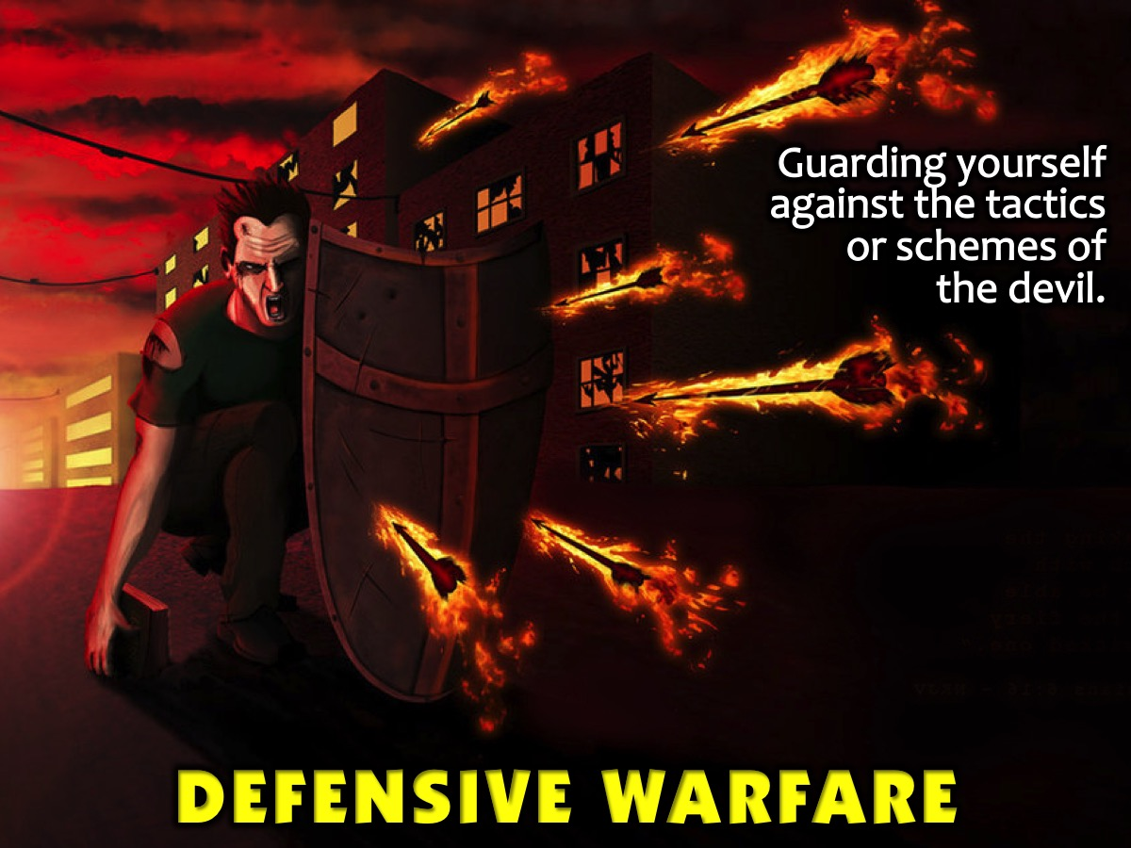
Notes:
Defensive warfare is guarding yourself against the tactics or schemes of the devil.

Slide 19
Notes:
Take up the shield of faith, so you can extinguish all the flaming arrows of the evil one. (Ephesians 6:16)

Slide 20
Notes:
The Enemy's Three Primary Weapons: There are three things that we can expect from the devil, these are the primary things we struggle against:

Slide 21
Notes:
#1 Deception: To deceive somebody means to make another person believe a lie or something that is not true. When the enemy sends deception your way, it is an attempt to deceive you into believing something that is not true, so you will fall into error.

Slide 22
Notes:
Strongholds are built when deception takes hold in a person's mind. It is a wrong thinking pattern created when we believe a lie.

Slide 23
Notes:
From the very beginning, Satan deceived Eve into believing that God's Word was not true. In Genesis 3:4, the devil told her that she will not surely die as God said she would in Genesis 2:17. An example of this can be: “God doesn't love you or care for you.”

Slide 24
Notes:
#2 Temptation: Temptation often follows deception. First the enemy tells us, "You won't surely die!", then he makes the fruit on the forbidden tree look good to us. Since Eve accepted Satan's deception (his lie), now the tree that she was not supposed to touch looked good to her. She was tempted (enticed) to sin, because she allowed herself to first be deceived. Temptation is when we are enticed or encouraged to sin in one way or another.

Slide 25
Notes:
In Matthew 4, Jesus was led out in the desert to be tempted by the devil. The devil tried to convince Jesus to turn a stone into bread and that it would be harmless to jump off a building. Jesus saw through Satan's deception, and resisted the temptation by speaking God's Word.

Slide 26
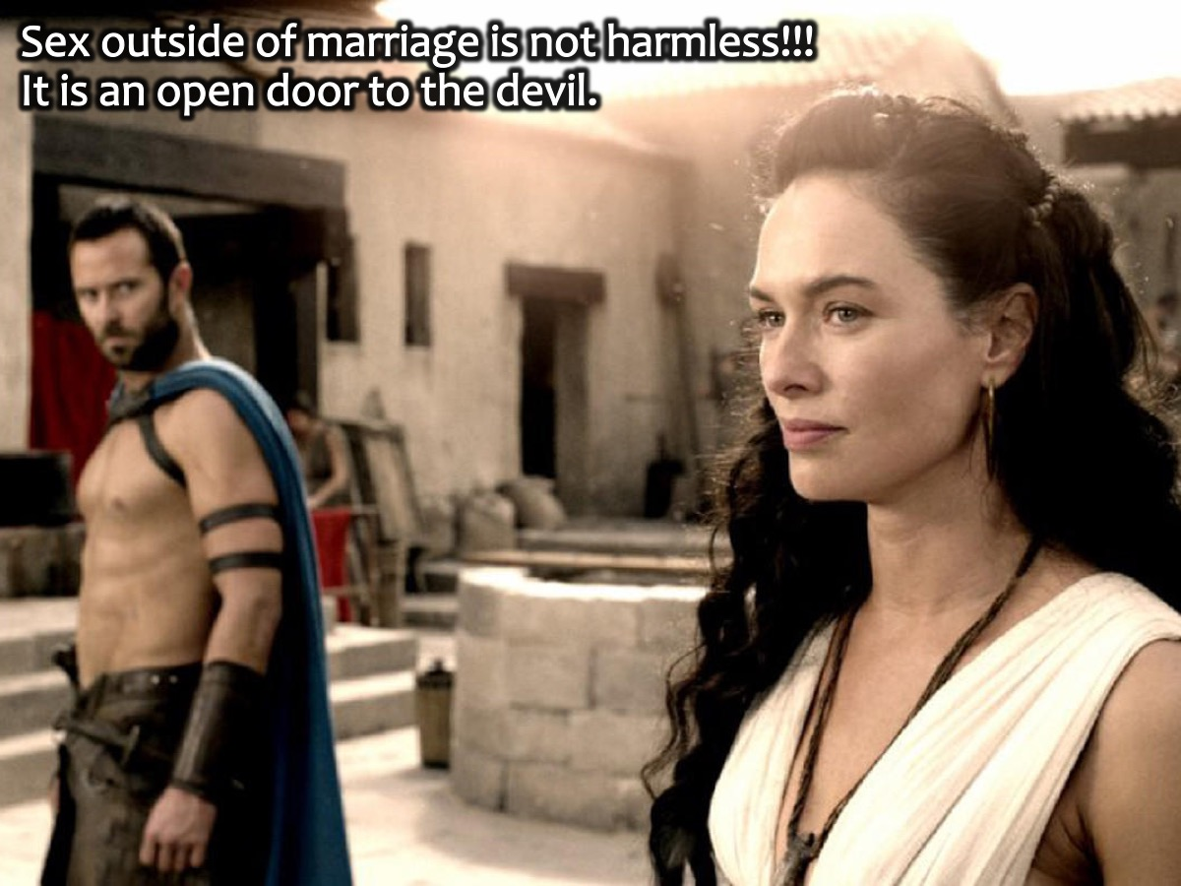
Notes:
Often people will be so drawn to sex with their boyfriend/girlfriend when the enemy tries to convince them that it is all harmless and fun, when it's not harmless at all, but an open door to the devil.

Slide 27
Notes:
When the enemy tempts you, he's showing you the worm... but behind that worm is a hook. The Word of God helps you see the hook behind the worm.

Slide 28
Notes:
King David said in Psalms 119:11, "I have hidden your word in my heart that I might not sin against you.”

Slide 29
Notes:
#3 Accusations: The devil is known as the accuser of the brethren (Rev 12:10).

Slide 30
Notes:
The devil is known to take a believer who has done an embarrassing or gross sin in their past, and continue to rub it in their faces and beat them down with guilt and condemnation over their past.

Slide 31
Notes:
Activity: Based on the three weapons that Satan uses, we are going to each share how we are under attack from the enemy and then the rest of the guys (with the help of the adult leader) will suggest Bible verses that we can used to defend ourselves.

Slide 32
Notes:
Activity: We are going to learn how to create prayer support (like air support in a real war) by praying using the P.R.A.Y. Method that is based on the Lord’s Prayer using the following outline:
1. Praise: “Our Father in heaven, hallowed be your Name.” These eight words embody who our loving, personal God is (Our Father), how sovereign He is (in heaven) and how holy He is (hallowed by your Name.) As we grasp the core truths packed into this one sentence we will know how to personally approach and praise God.
2. Request: “Your kingdom come, your will be done, on earth as it is done in heaven. Give us this day our daily bread.” The first request we bring to God is not our Santa Claus wish list…or even our own personal needs (although these are important to God!) No, the first request is for HIS Kingdom to come and HIS will to be done. We pray for God to do mighty things in our souls, in our youth group and at our schools. We pray for God’s kingdom to advance one gospel conversation at a time, until it saturates their schools and community. Then we ask for our “daily bread”—the ongoing provisions that we need and want.
3. Admit: “Forgive us our sins, as we forgive those who have sinned against us.” Next we confess our sins to God and claim His promised forgiveness (1 John 1:9). This trains us to not wallow in the mud when we fall, but to get cleaned up through confession as we passionately pursue a relationship with God.
4. Yield: “Lead us not into temptation, but deliver us from the evil one.” Finally we yield ourselves to the Holy Spirit, knowing that a spiritual battle between good and evil rages all around us. We put on the full armor of God, so we can stand against the temptations we face every day.

Slide 33
Notes:
Video: War Room Elizabeth. Get it on YouTube at: https://www.youtube.com/watch?v=Hk_m7HUoaUA

Slide 34
Notes:
Prayer

Slide 35
Notes:
Next Sunday we are going to look at what the Word says about Media.

