Slide 1
Notes:
Welcome to week 5 of the Word-On series where each week we are looking at what the Bible says about different topics.

Slide 2
Notes:
In week 1 we looked at what the Word says about God.

Slide 3
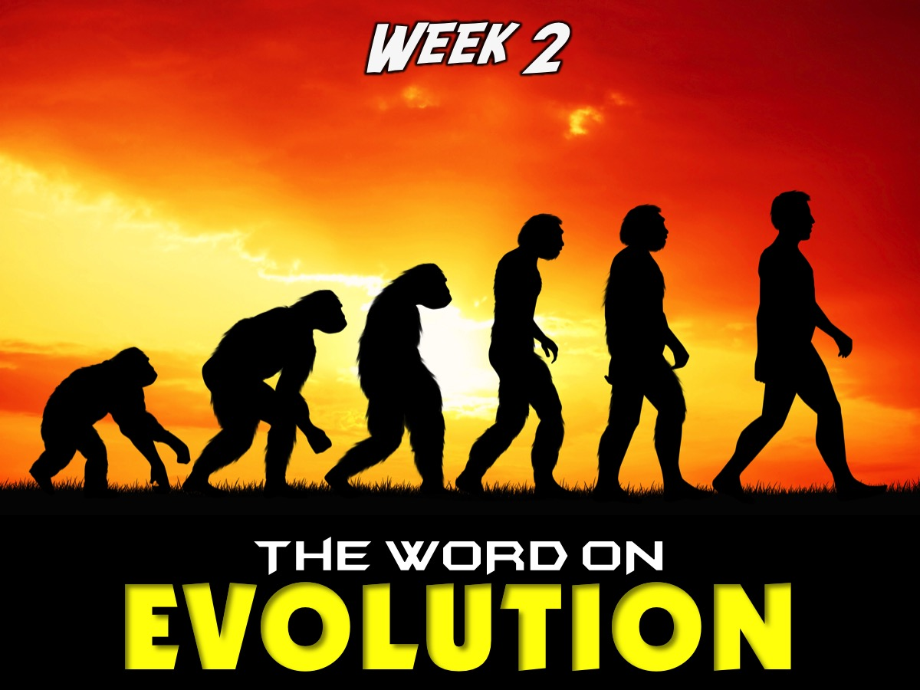
Notes:
In week 2 we looked at what the Word says about Evolution.

Slide 4
Notes:
In week 3 we looked at what the Word says about HUMANITY.

Slide 5
Notes:
Last week we looked at what the Word says about Spiritual Warfare.

Slide 6
Notes:
This week we are going to look at what the Word says about Media.

Slide 7
Notes:
Prayer: We are going to start this morning by praying using the outline based on the Lord’s Prayer that we learnt about last Sunday:
1. Praise: “Our Father in heaven, hallowed be your Name.”
2. Request: “Your kingdom come, your will be done, on earth as it is done in heaven. Give us this day our daily bread.”
3. Admit: “Forgive us our sins, as we forgive those who have sinned against us.”
4. Yield: “Lead us not into temptation, but deliver us from the evil one.”

Slide 8
Notes:
Sharing: Ask the person next to you to tell you what they think the word Media refers to.

Slide 9
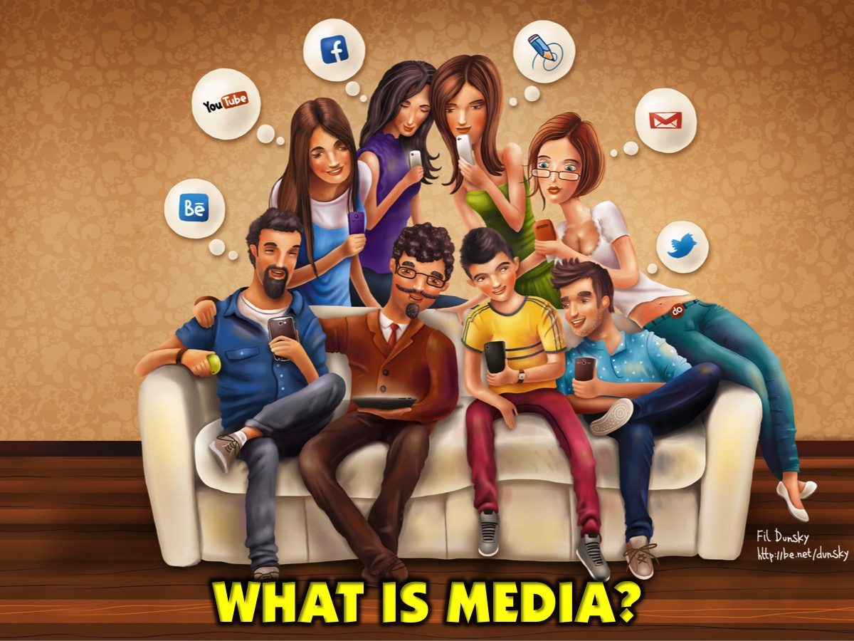
Notes:
What is Media?

Slide 10
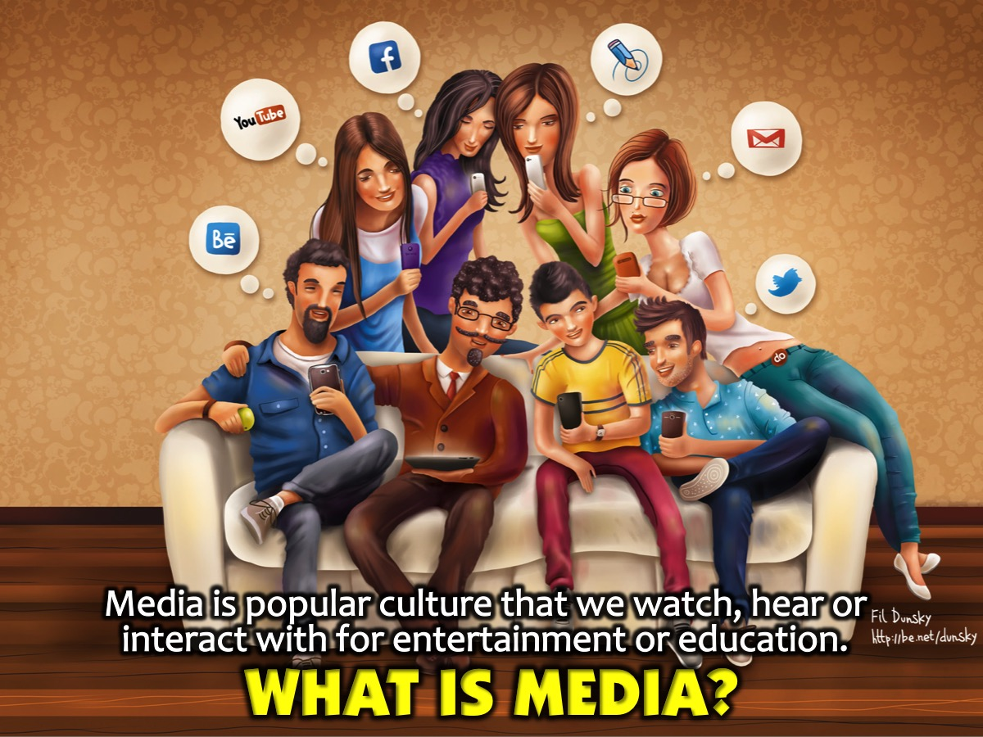
Notes:
What is Media? Media is popular culture that we watch, hear or interact with for entertainment or education.

Slide 11
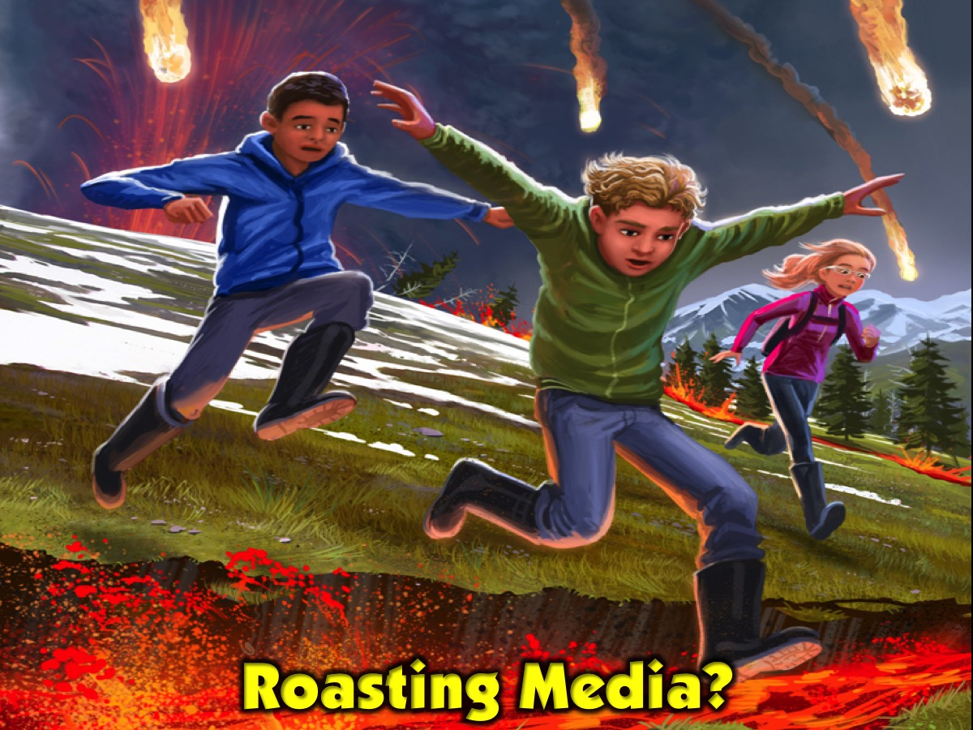
Notes:
Before we really do get into the deep stuff, I’d like to first start off by making it clear that this isn't the “roast of media”. I would rather like to compare media to fire. Fire can be used to do great things, or it can be a force of destruction. This all depends on how you allow yourself to be influenced by it and how you choose to use it. The same with media.

Slide 12
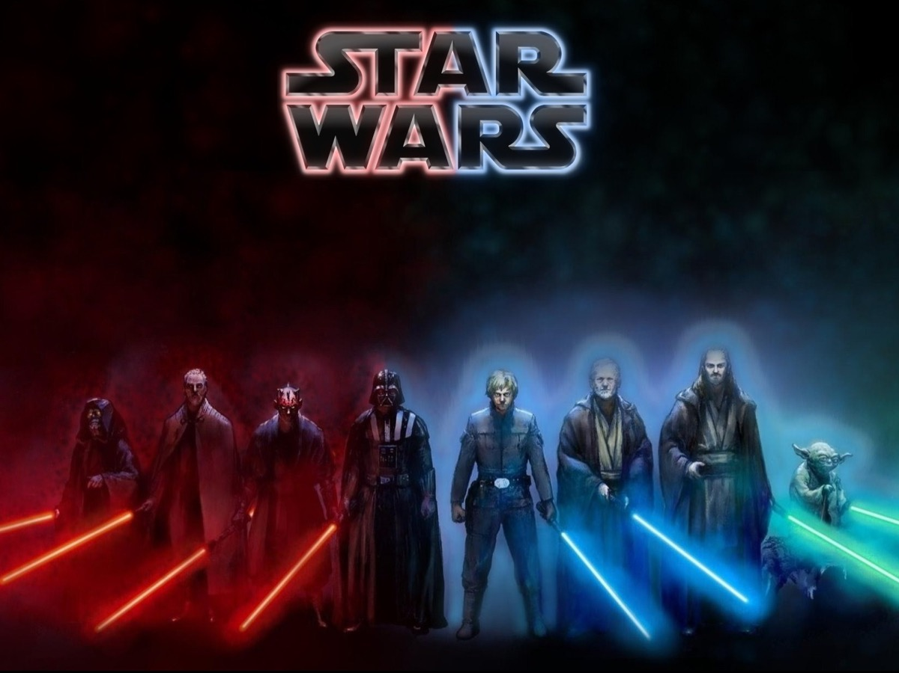
Notes:
There are always two sides to things: the dark side and the light side!

Slide 13
Notes:
Let's begin by talking about the negative influences of media.

Slide 14
Notes:
1. Media Can Make Us Cheat on God.

Slide 15
Notes:
Media can consume us and become the biggest part of our daily routine or our lives - this is like an idol.
In Exodus 2:3, God says “You shall not have other gods before me.” Many times we read this scripture and think that it doesn’t really apply to us because we’re not craving idols out of wood or worshipping golden calves. This then raises the question what actually is a god and what is idolatry. Whenever you have love or devotion towards something or someone, that is essentially idolatry. And with Media, you don’t have to dig too deep or search too far and wide to find something just like that. The core of all idolatry is the god of self. This means that we do, say and obsess over things so that we may feed our ego. Instagram is a prime example. Now please, don’t misunderstand me. There isn’t anything particularly wrong with selfies. However, it becomes a problem when you spend so much time on social media sites like Instagram, making yourself look good just so you can get “likes” and “followers” but spend very little time in comparison with God. Things easily become “gods” in our lives according to how much time we spend worshipping them. And worship is not just songs and dance. Worship is devotion and the continuous thought and focus on that object we wish to concentrate on. How often have we been left looking at the clock, wondering where the time went while we were typing a message on our phones or scrolling through our news feed? How often have we let the latest tweets and newest YouTube videos come first before the latest word that God has for your life? Part of the reason why idolatry is so bad is because it opens doors for the next point.

Slide 16
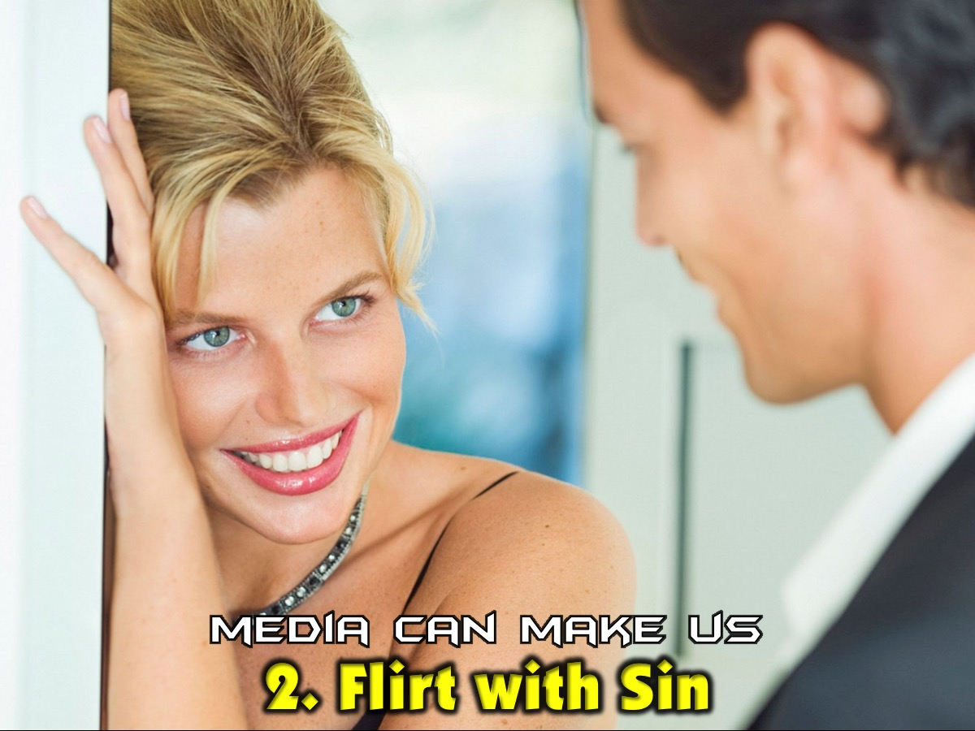
Notes:
2. Media Can Make Us Flirt with Sin. The media can give us disinformation that corrupts our minds and our hearts. There are overt or obvious negative impacts in the media but often the Devil doesn’t like to make his presence known but uses the most covert methods available to enter to our minds and begin planting the seeds of sin that germinate with time.

Slide 17
Notes:
Matthew 5:30 says that “if your right hand causes you to sin, cut it off. For it is better to lose one of your members than that your whole body goes into hell.” This scripture was intended to tackle adultery, yes. However, it can also be applied here as well. This then raises another question. Since I do use my hands to post some pics on snapchat, play candy crush on my phone or whatever, is the bible then saying that I should chop off my hands? Obviously not! Else if that were true, none of us here would have hands. I think a good number of you wouldn’t have tongues too. What Jesus is saying here is that if something is influencing in a negative way, we need to let it go. We need to eradicate that “something” from our lives and we need to do it quickly. And please understand, this isn’t me telling you that you need to now completely deprive yourself of any interaction with the media. This me is actually me telling you that if you let it, the media can and most like will impact you negatively. The music you are listening to, tweets you are reading. Even the movies that you are watching on television or in the cinema or on your computer because you downloaded them illegally. It can all stick. As Christians, we shouldn’t assume our invincibility over these matters. So long as we are off our guard, we too can be influenced. And it doesn’t require any effort, you just need to let it wash over you repeatedly time and time again. Negative influences can lead to point number three.

Slide 18
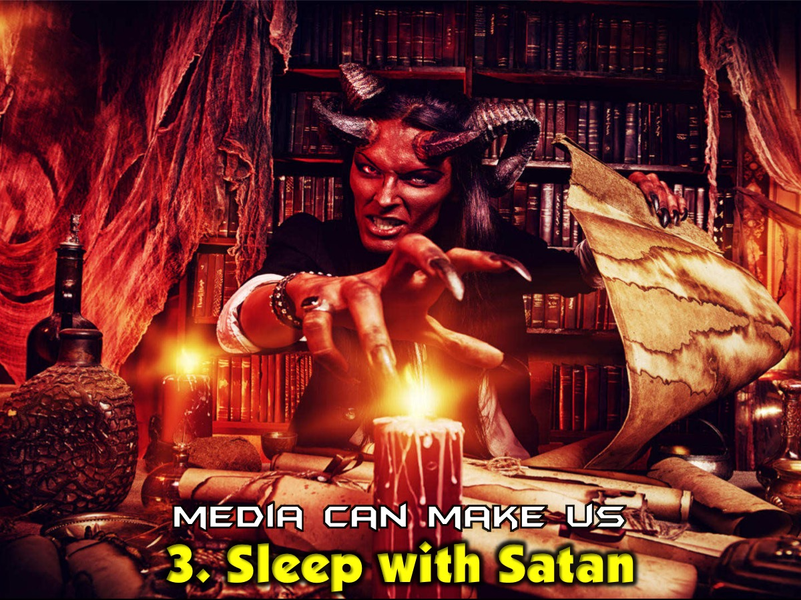
Notes:
3. Media Can Make Us Sleep With Satan - We can easily move from flirting with sin to sleeping with Satan.

Slide 19
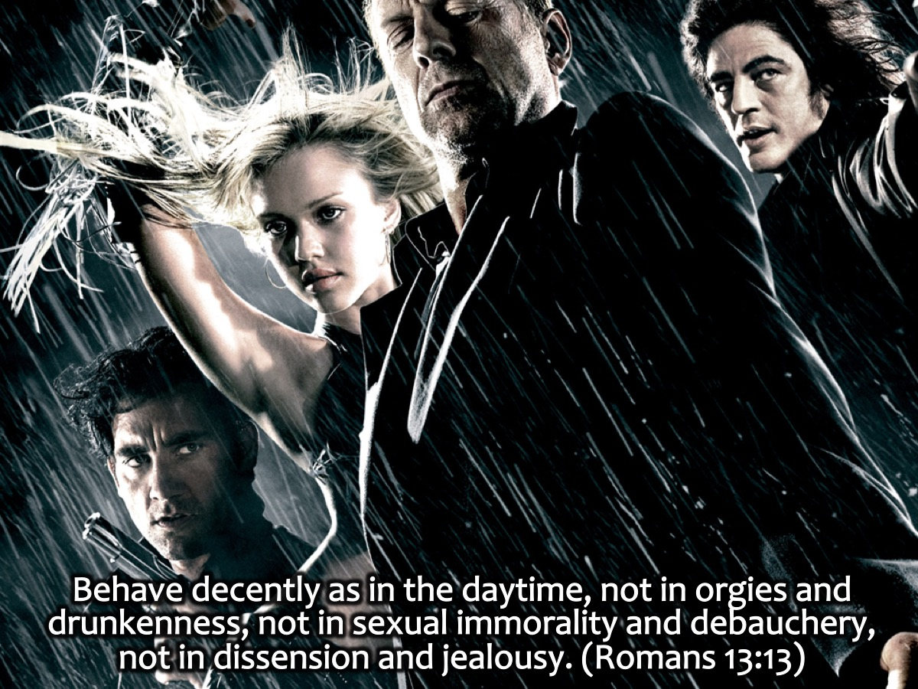
Notes:
We are warned in Romans 13:13 to “behave decently as in the daytime, not in orgies and drunkenness, not in sexual immorality and debauchery, not in dissension and jealousy.” These are things that are shown in movies and heard in music all the time. And if we flirt with the negative influences in the media we consume we will soon find ourselvs doing these thing! And so ungodly character spurs from both a negligence of God, as well as the assimilation of negative influences. In other words, both idolatry and negative influences inevitably lead you towards ungodly character. And there is very little that you can stop that unless you do actually spend a lot of time with God. Else you are not going to really know what is ungodly. Either that or you are not going to really care. The hardest thing about avoiding ungodly character is that we live in a world where it is acceptable. It is, in fact, thriving and flourishing in modern society. And media can ultimately promote its acceptability. Just watch 50 shades of grey. That’s just a joke obviously, you shouldn’t be doing that. But if I’m real with you, you don’t even have to watch a movie. In media, you see the promotion of ungodly character everywhere. And again, it doesn’t require effort. You just need to think for the slightest moment that…it’s okay. “It’s fine, it’s chilled. I’m just flirting, it’s not like I’m doing anything wrong. I mean James Bond does it all the time, and look at him. He’s practically a magnet for the females.” All it takes is for you not even to be willing, but to even be indifferent. To be hesitant, to be stagnant. We’re like sharks, us Christians. We just need to stop moving, and already we’re on the descent to death.

Slide 20
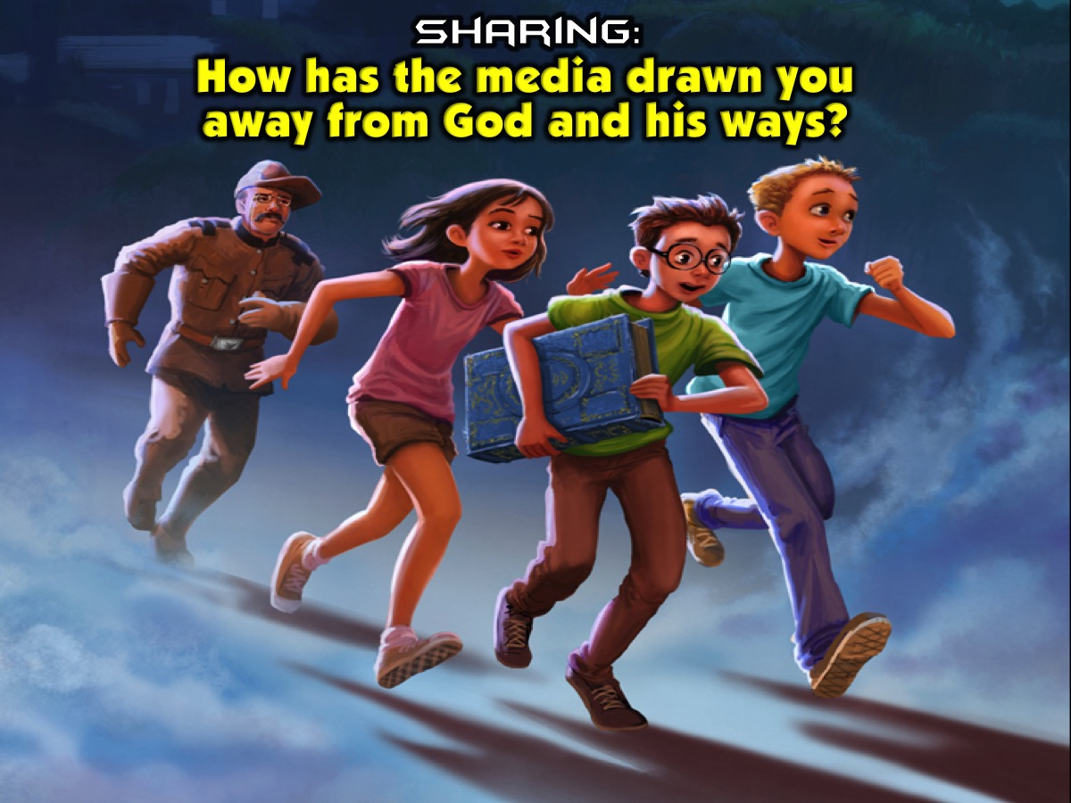
Notes:
Sharing: These are the ways in which media can draw us away from God. Let’s talk about some of the things that we have done or said because of the negative influences in the media that have drawn away from God and his ways.

Slide 21
Notes:
There are positive media influences and they are the oppositve of the negative influences.

Slide 22
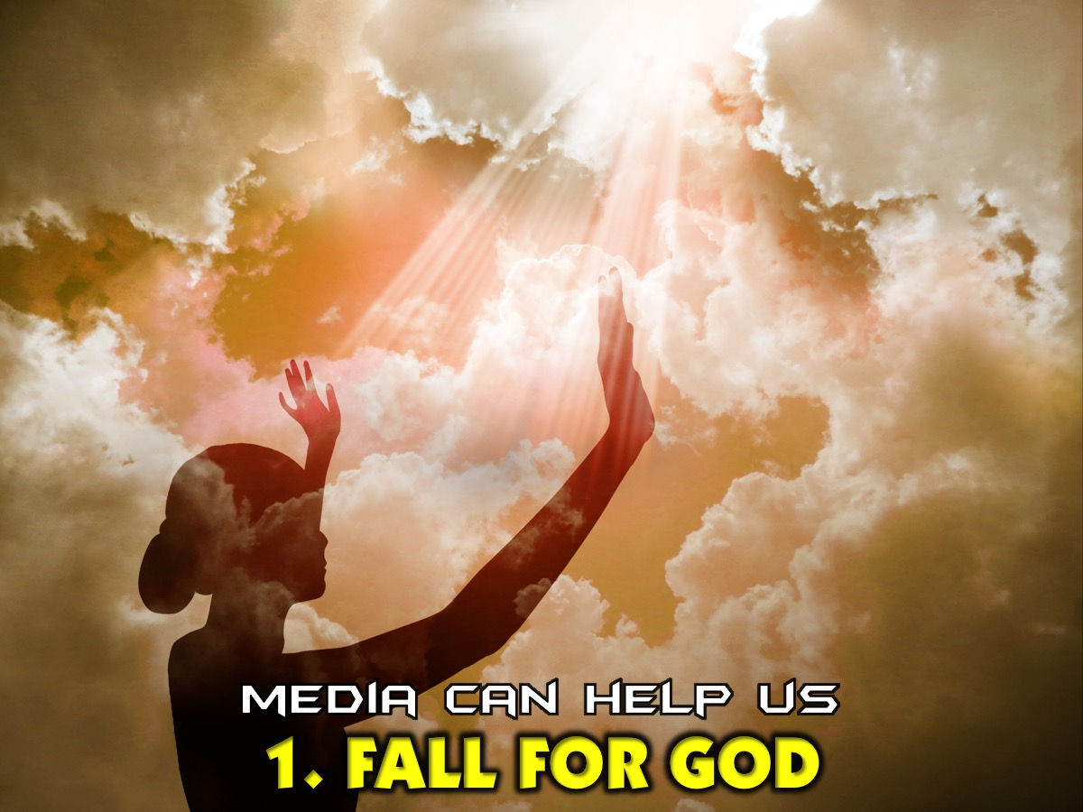
Notes:
1. Media Can Help Us Fall for God. We can actually be drawn closer to God as we glorify God with media.

Slide 23
Notes:
1 Corinthians 10:31 says: “So whether you eat or drink, or whatever you do, do it for the glory of God.” This is something that even I struggle to practice. But the truth is that we are in a new technological age where information is as easily accessible as it is sharable. And if we are loving God with all that we are, we should also be praising Him as well. For example, when a man marries a woman he doesn’t do it in private so that no one will know. Generally, he has many bare witness to his commitment to this woman whom he loves. How much more so should the same be true for our relationship with God?

Slide 24
Notes:
2. Media Can Help Us Flee from Sin. We show that we love God when we run away from negative media influences.

Slide 25
Notes:
The apostle Paul in 2 Timothy 2:22 instructs us to “Flee from youthful lusts.” We should stay away from anything (including media) that inflames our lust. Paul also goes on to say that in addition to fleeing from these things, we should also “pursue righteousness, faith, love and peace.” We should replace negative influences in our life with those things which are positive.

Slide 26
Notes:
Paul tells us in Philippians 4:8, “Finally, brothers, whatever is true, whatever is noble, whatever is right, whatever is pure, whatever is lovely, whatever is admirable—if anything is excellent or praiseworthy—think about such things.” Paul calls the Philippians to spend time thinking carefully and deeply about the best things – things that are true, noble, right, pure, lovely and so on. We should focus on what is positive and helpful to our Christian walk.

Slide 27
Notes:
3. Media Can Help Us Partner with Jesus. Finally media can help us develop godly character as we allow ourselves to be positively edified by positive media influences.

Slide 28
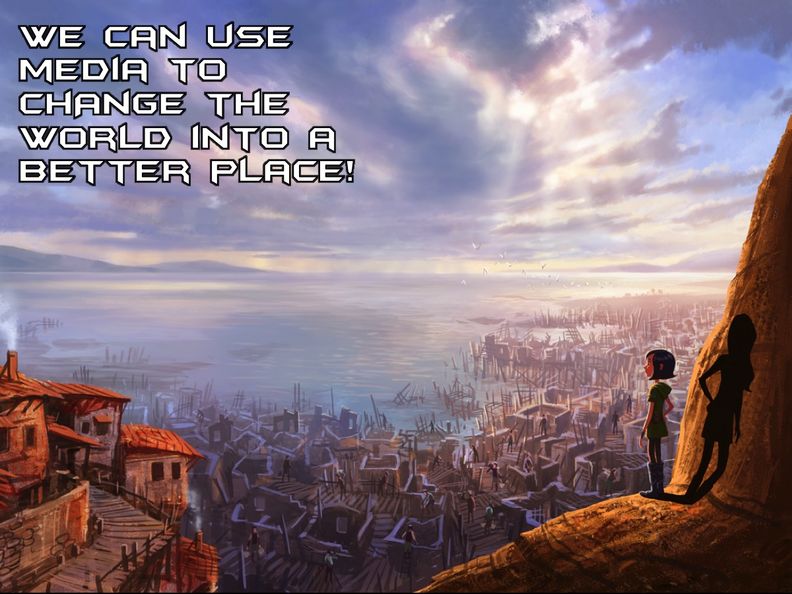
Notes:
Media can help us change the world and make it a better place. The bible is the ultimate source of positive influences in our lifestyle, but in the media there are plenty of things that we can find that can make us better global citizens as well as better heavenly citizens.

Slide 29
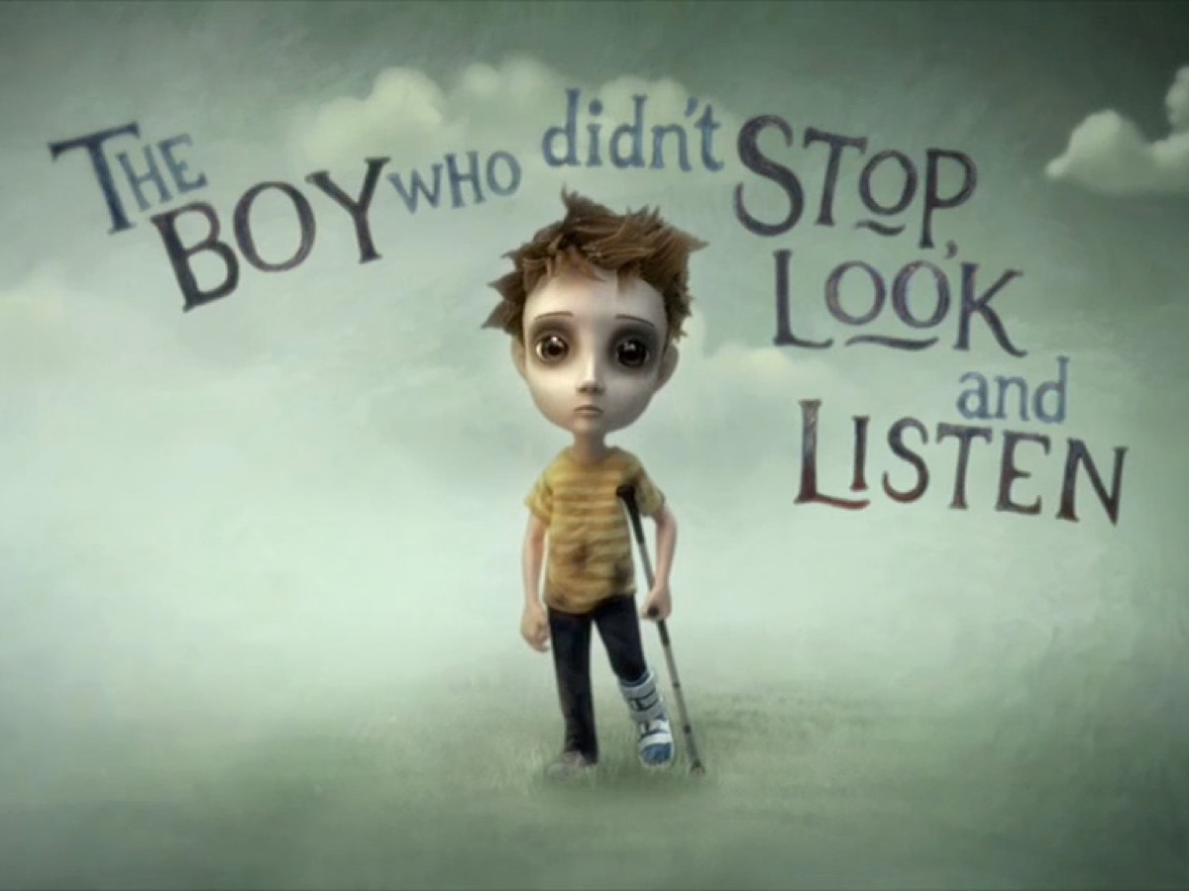
Notes:
Have you heard about the boy who did not Stop, Look and Listen? “The boy who didn’t stop, look and listen. Before his leg was bent backwards, he loved to play football all day. But the boy didn’t cross in a safe place, where he could see cars come his way. He then didn’t stop, look and listen. A car hit him at quite a pace and now he cannot play football ‘cos his leg broke in more than one place.”

Slide 30
Notes:
Video: The Boy Who Didn’t Stop, Look and Listen. Get it from: http://dekku.nofatclips.com/2009/01/tales-of-road-boy-who-didnt-stop-look.html

Slide 31
Notes:
So what can you do practically during the coming weeks? We need to Stop, Listen and Look at media in our lives.

Slide 32
Notes:
1. Stop. Firstly, we should stop what we are doing long enough to evaluate the media exposure in our life. Most of us just allow media to wash over us everyday without considering the impact it is having on us.

Slide 33
Notes:
2. Look. Secondly, we should look at the consequences of media in our lives. We should rid ourselves of influences that are negative and think on those things that are positive.

Slide 34
Notes:
3. Listen. Thirdly, we should listen. That is, we should give attention to what is being said. Is it true or false? And what is the message various media are bringing into our lives?

Slide 35
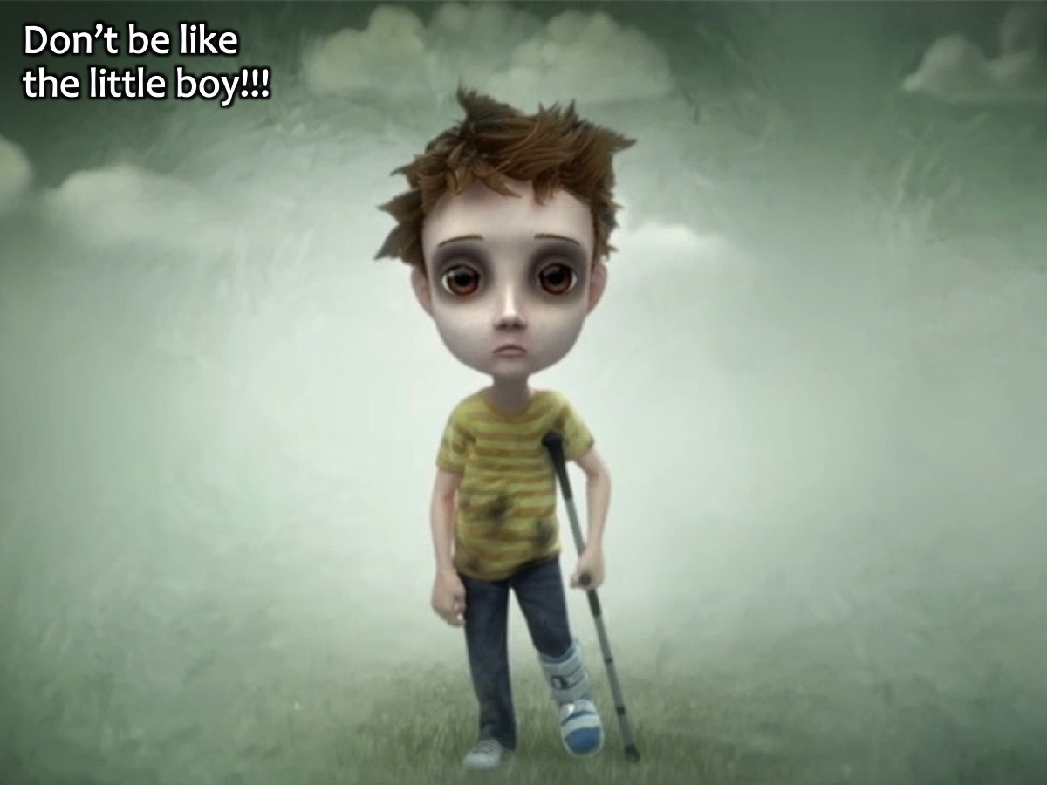
Notes:
Don’t be like the little boy!!!

Slide 36
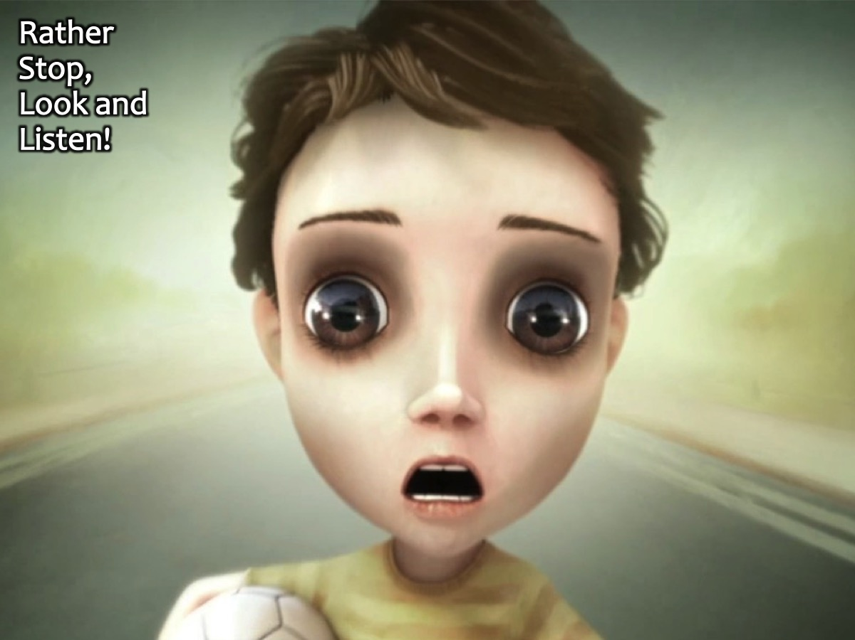
Notes:
Rather Stop, Look and Listen!

Slide 37
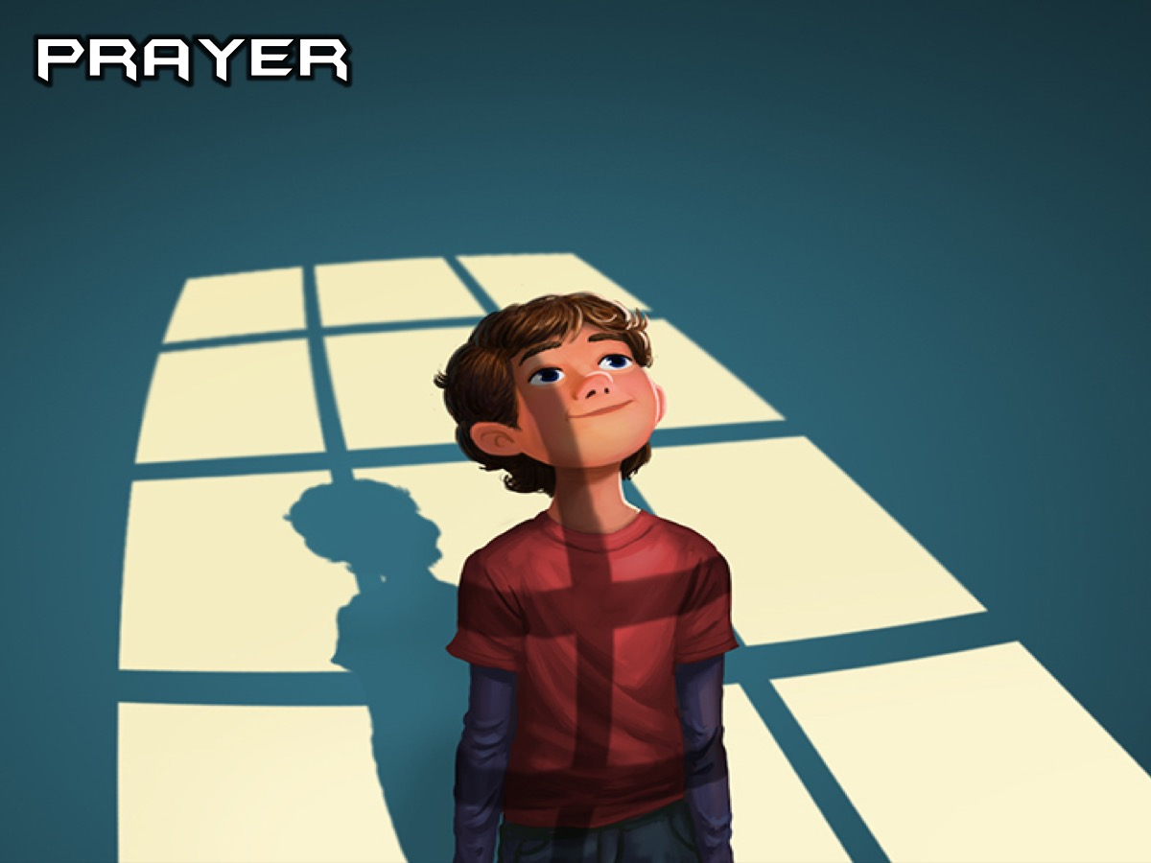
Notes:
Prayer

Slide 38
Notes:
Next Sunday we are going to look at what the Word says about Prophecy.

