Slide 1

Notes:
Welcome to week 6 of the Word-On series where each week we are looking at what the Bible says about different topics.

Slide 2
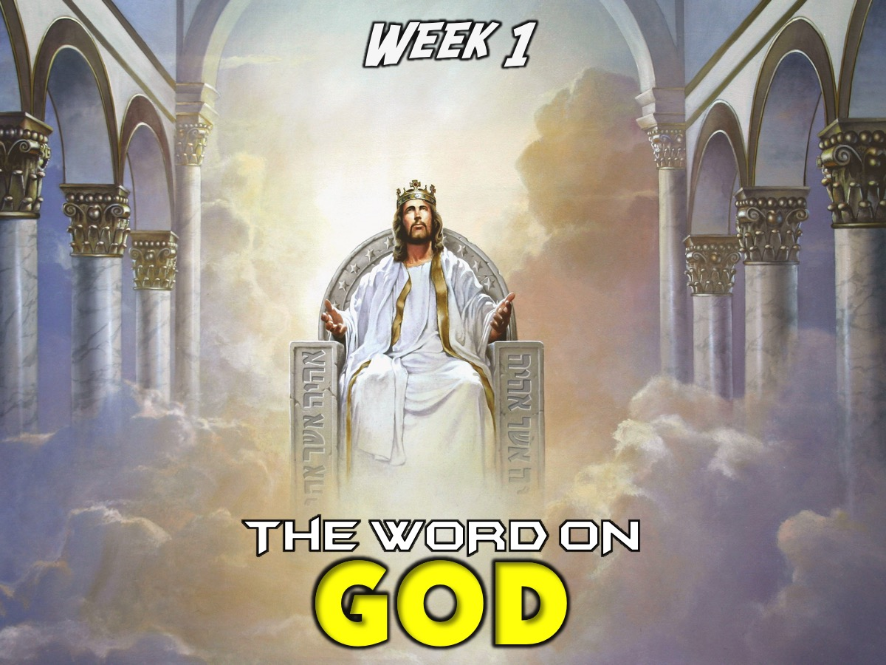
Notes:
In Week 1 we looked at what the Word says about God.

Slide 3

Notes:
In Week 2 we looked at what the Word says about Evolution.

Slide 4

Notes:
In Week 3 we looked at what the Word says about Humanity.

Slide 5

Notes:
In Week 4 we looked at what the Word says about Spiritual Warfare.

Slide 6
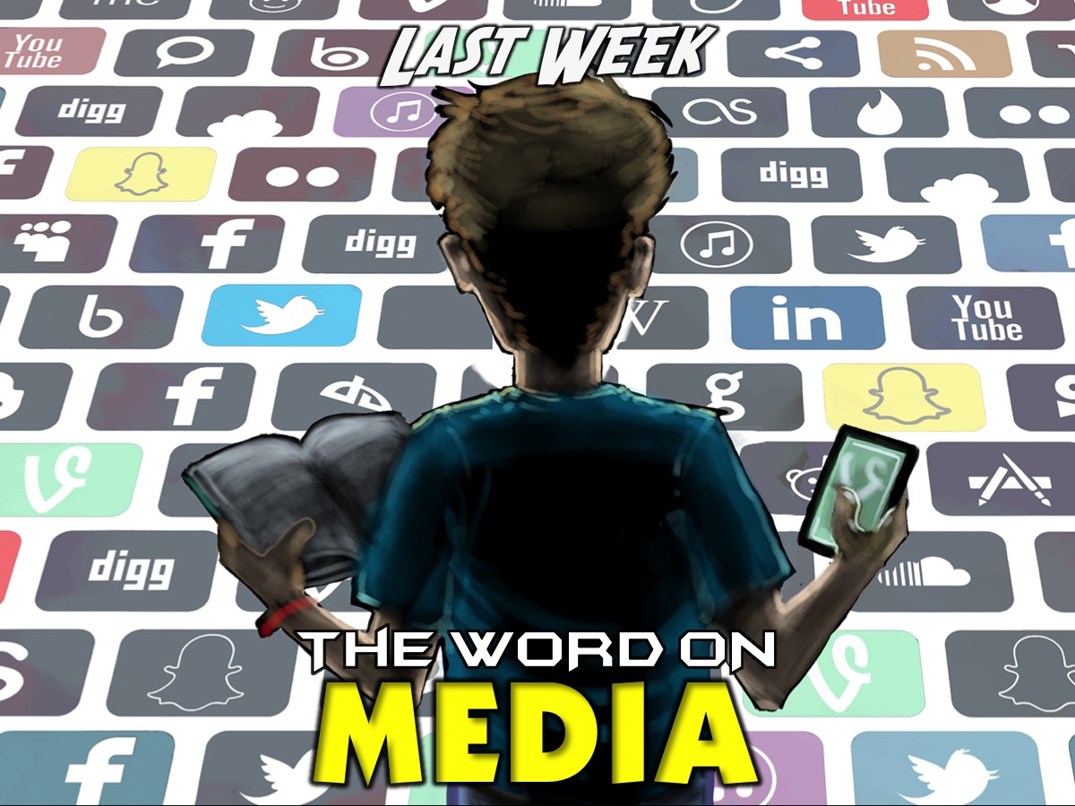
Notes:
Last Week we looked at what the Word says about Media.

Slide 7
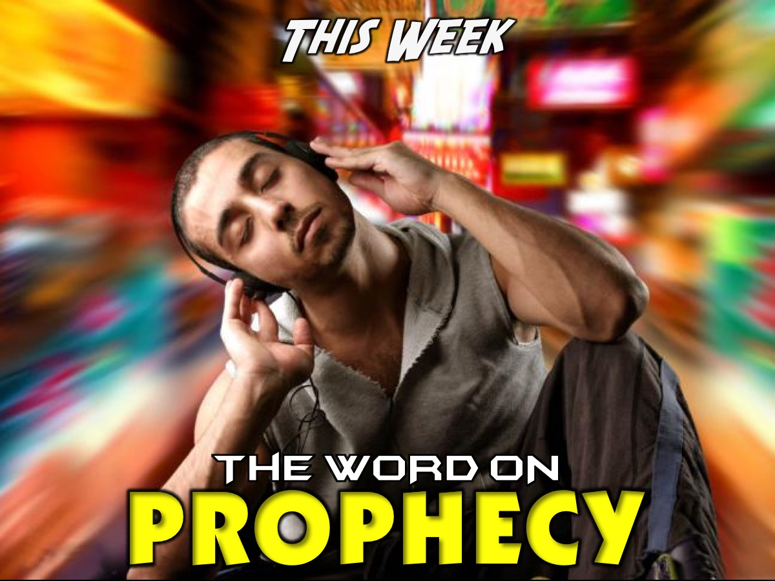
Notes:
This Week we are looking at what the Word says about Prophecy.

Slide 8

Notes:
Sharing: Would you buy a device that could help you see your own future? Why or why not? Imagine being able to know what career or careers you will have in your lifetime, who you will marry, how many children you will have and what they will be like, where you will travel to, how will you die, etc.

Slide 9

Notes:
We are surrounded by predictions about the future: In business ot forecast stock prices, the weather, there are books and movies about the future.

Slide 10
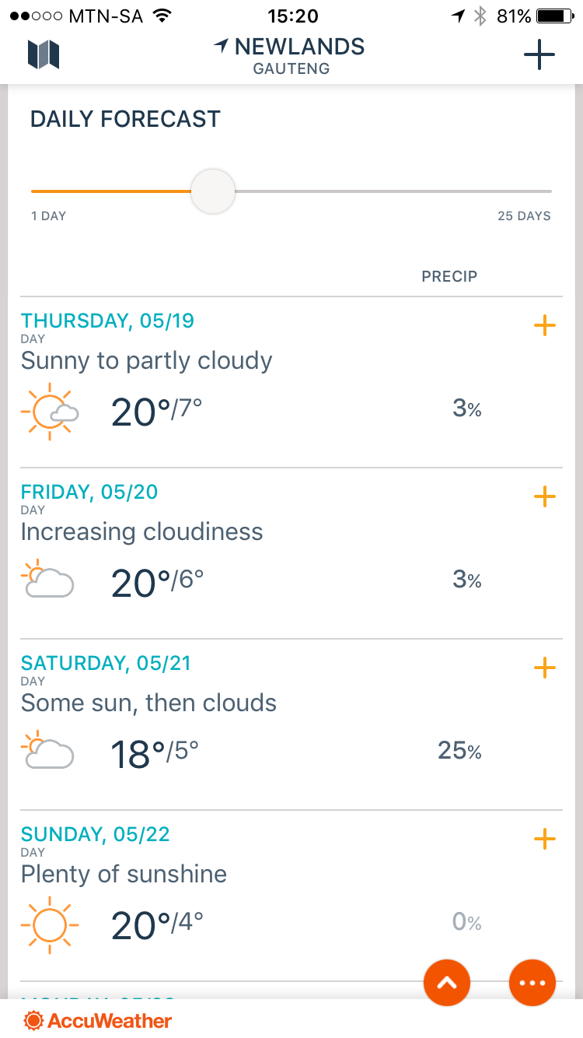
Notes:
I love looking at the weather predictons for the next week using an App on my phone called AccuWeather.

Slide 11

A movie about the destruction of Earth prophesied thousands of years ago by the Mayans.
Notes:
The disaster movie “2012” is about the near-total destruction of planet Earth based on prophecies made by the Ancient Mayans, thousands of years ago.

Slide 12

Notes:
So today I will be answering some questions about prophesy that you may had!

Slide 13
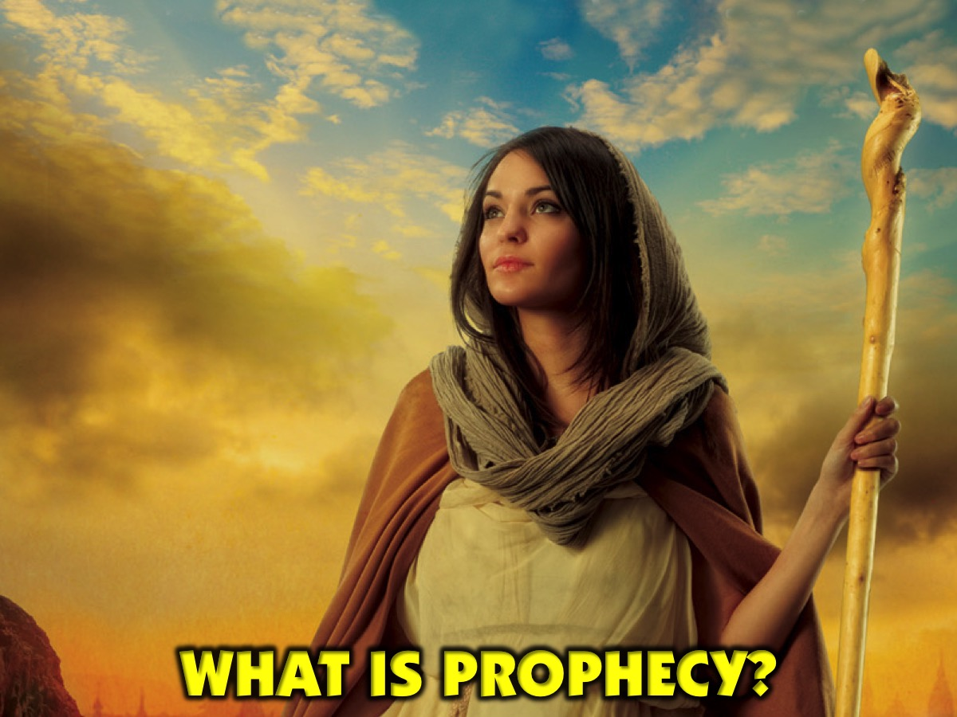
Notes:
What is Prophecy?

Slide 14
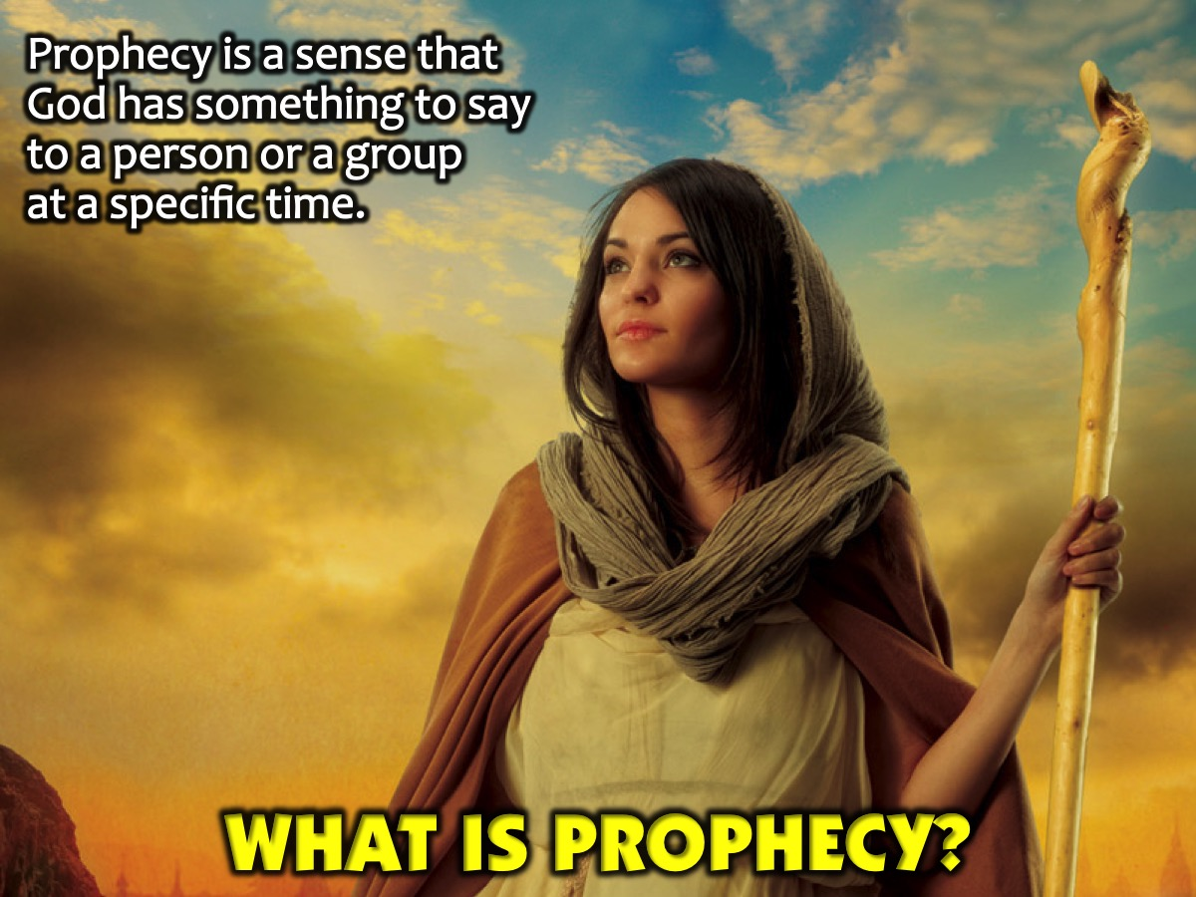
Notes:
Prophecy is a sense that God has something to say to a person or a group at a specific time.

Slide 15
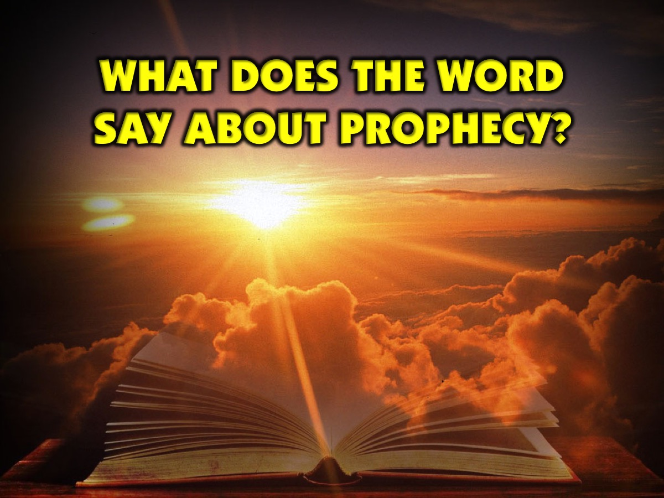
Notes:
What Does The Word Say About Prophecy?

Slide 16
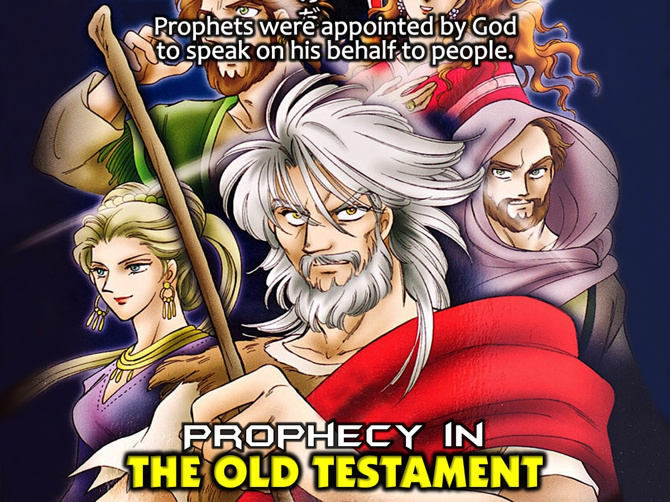
Notes:
Prophecy in the Old Testament. Prophets were appointed by God to speak on his behalf to people.

Slide 17
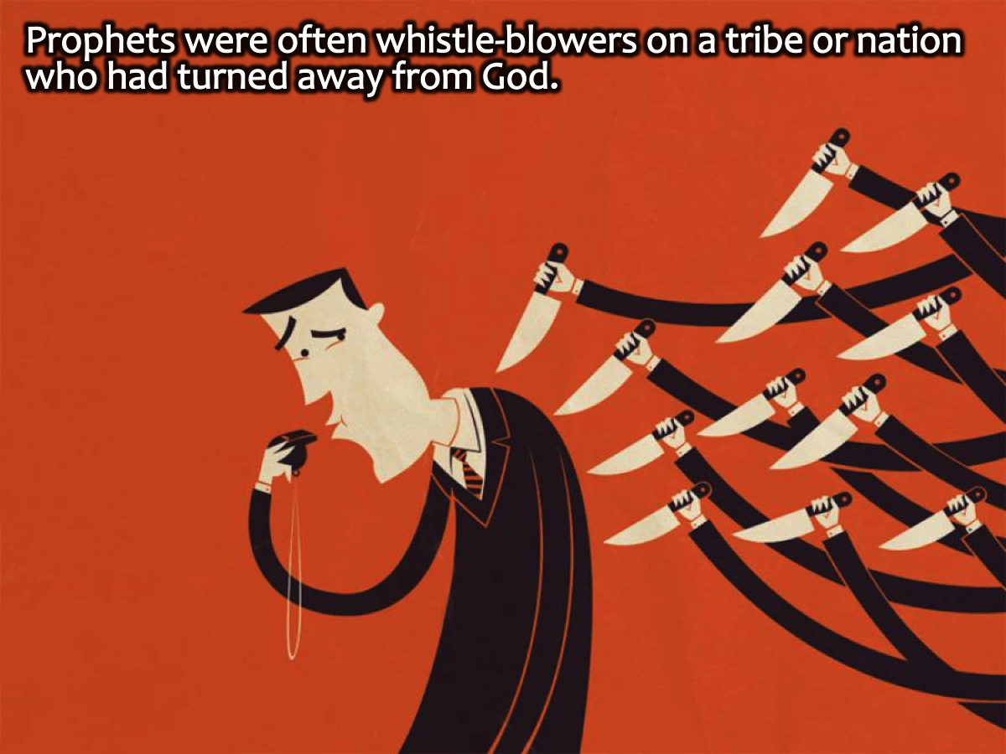
Notes:
Prophets were often whistle-blowers on a tribe or nation who had turned away from God.

Slide 18
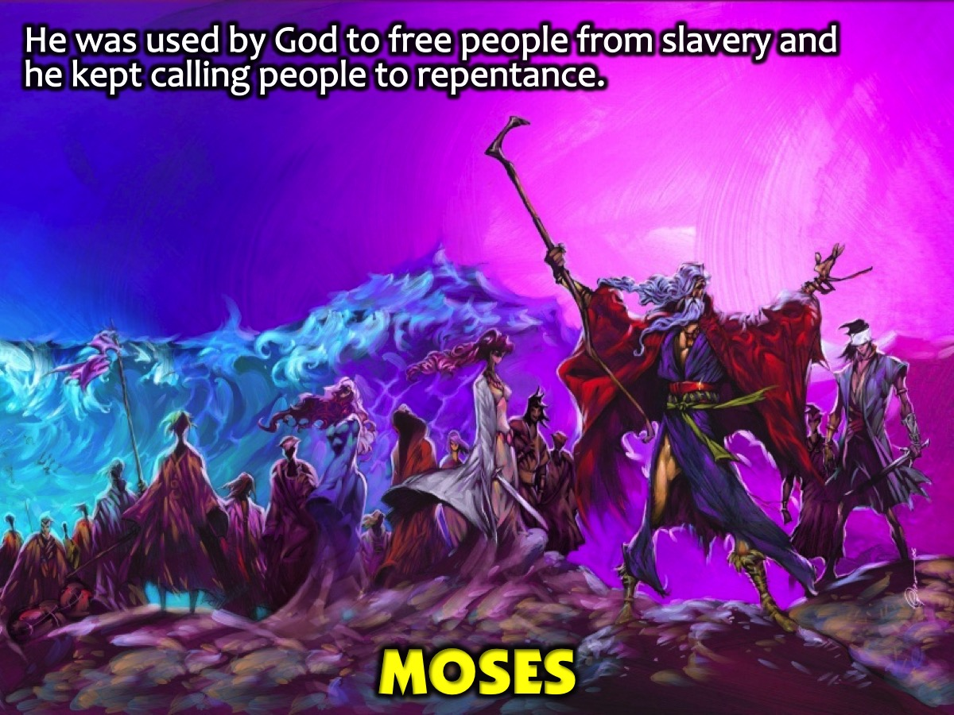
Notes:
Moses was a prophet who God used to Free the Hebrews from slavery at the hands of the Egyptians, he lead them to the promise land. Again and again, these people turned away from God; Moses was God's mouthpiece to call them to repentance.

Slide 19
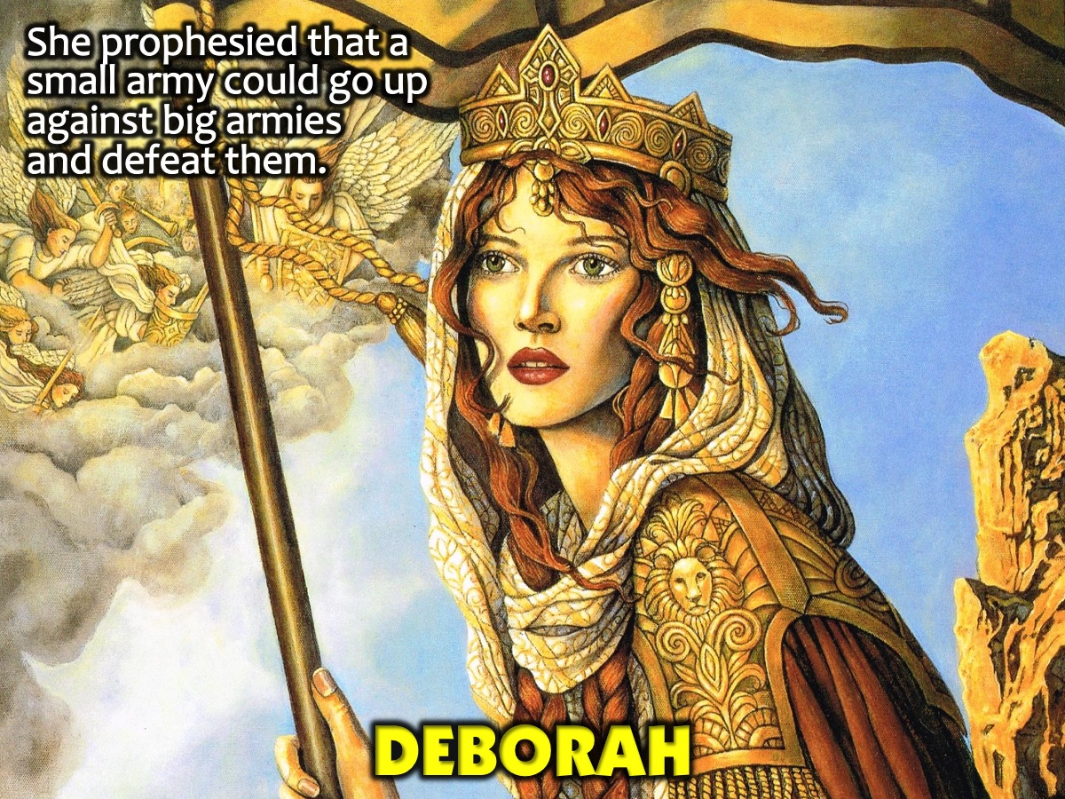
Notes:
Deborah was a judge who prophesied: She called for Barak to lead Israel in a war against the mighty armies of Jabin and his general Sisera, by utilizing only a very small army of Israelites to do so. God was planning to defeat these foreign armies and deliver Israel.

Slide 20
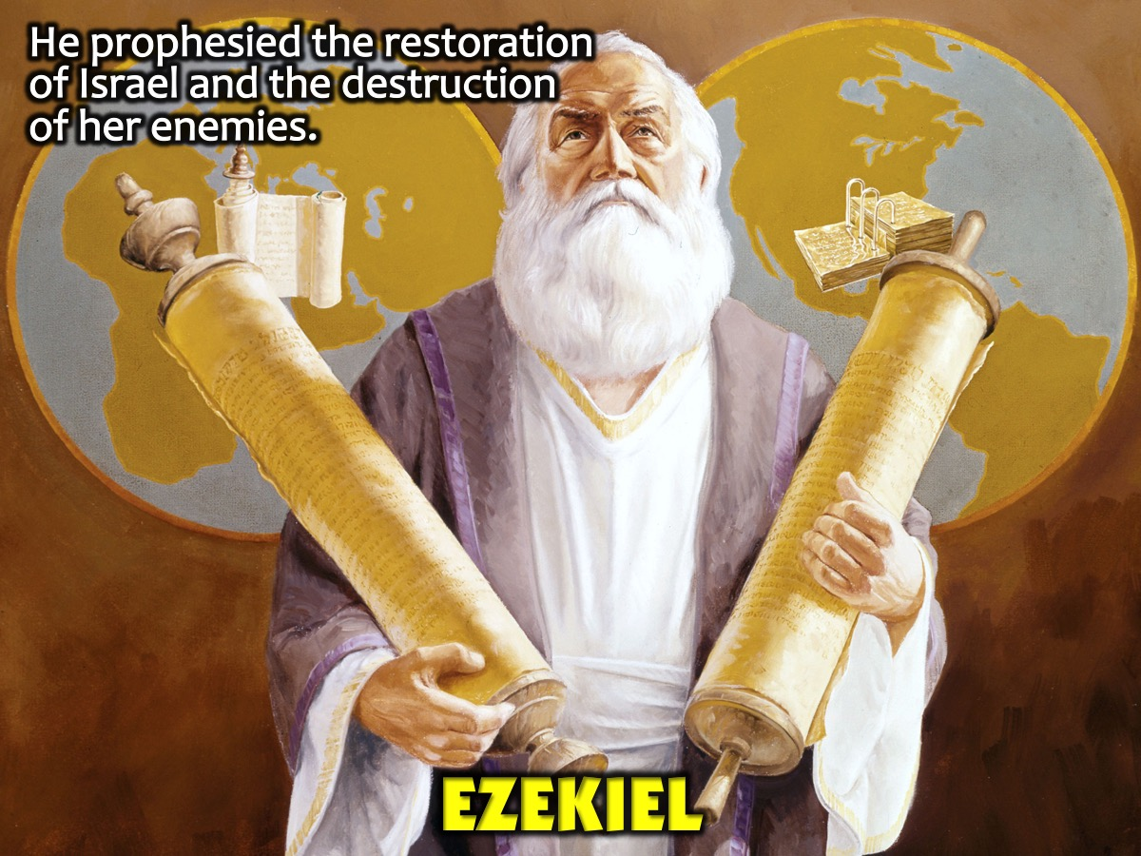
Notes:
Ezekiel spoke about the restoration of Israel and the destruction of empires that sought to destroy Israel.

Slide 21
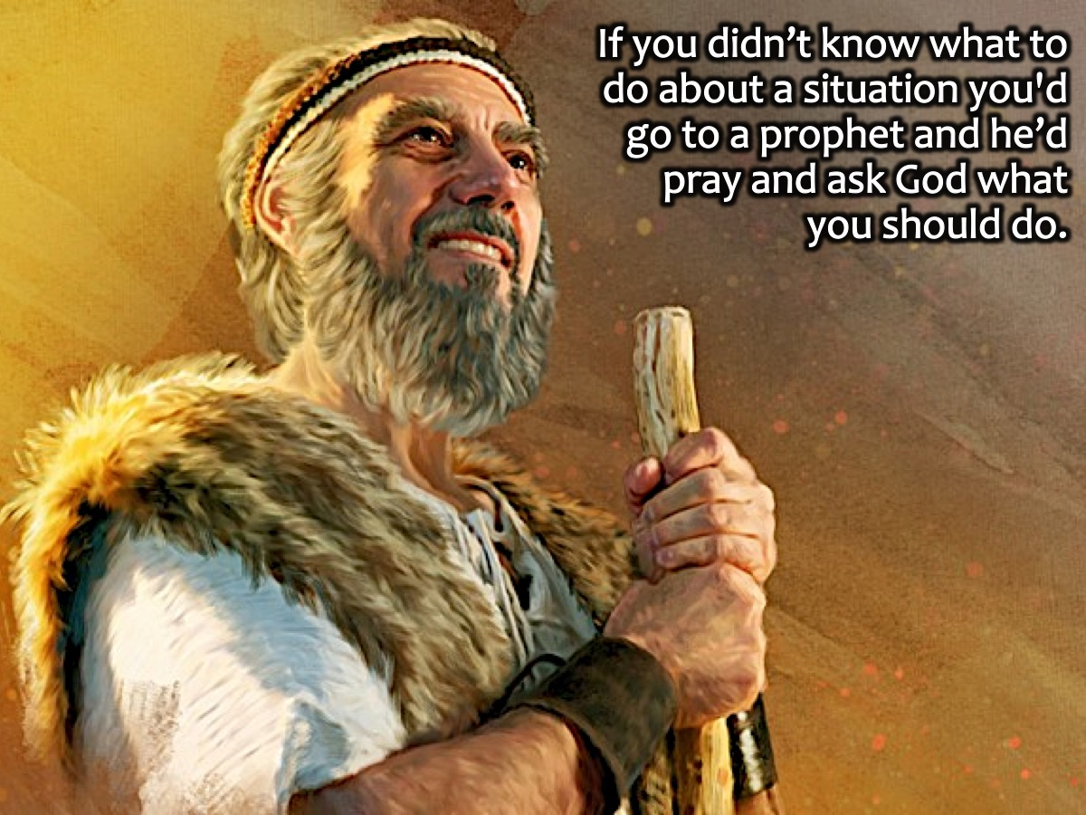
Notes:
If you didn’t know what to do about a situation you'd go to a prophet and he’d pray and ask God what you should do.

Slide 22
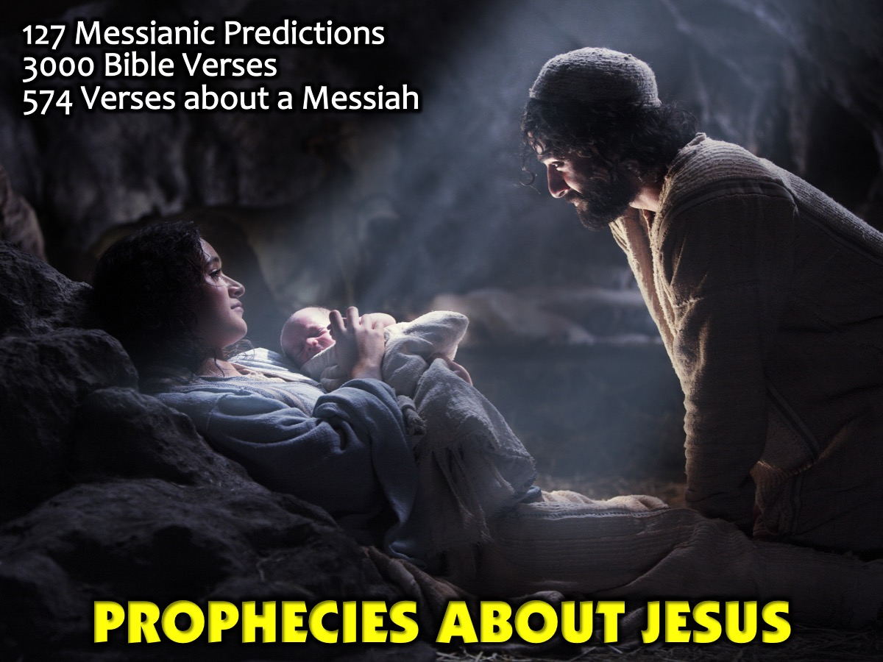
Notes:
Prophecies about Jesus. Throughout scripture there are prophecies of a messiah – someone who God will send to save the world. 127 Messianic predictions involving more than 3,000 Bible verses, with a remarkable 574 verses referring directly to a personal Messiah! These incredible promises formed one of the most central themes of the Old Testament: the coming Messiah.

Slide 23
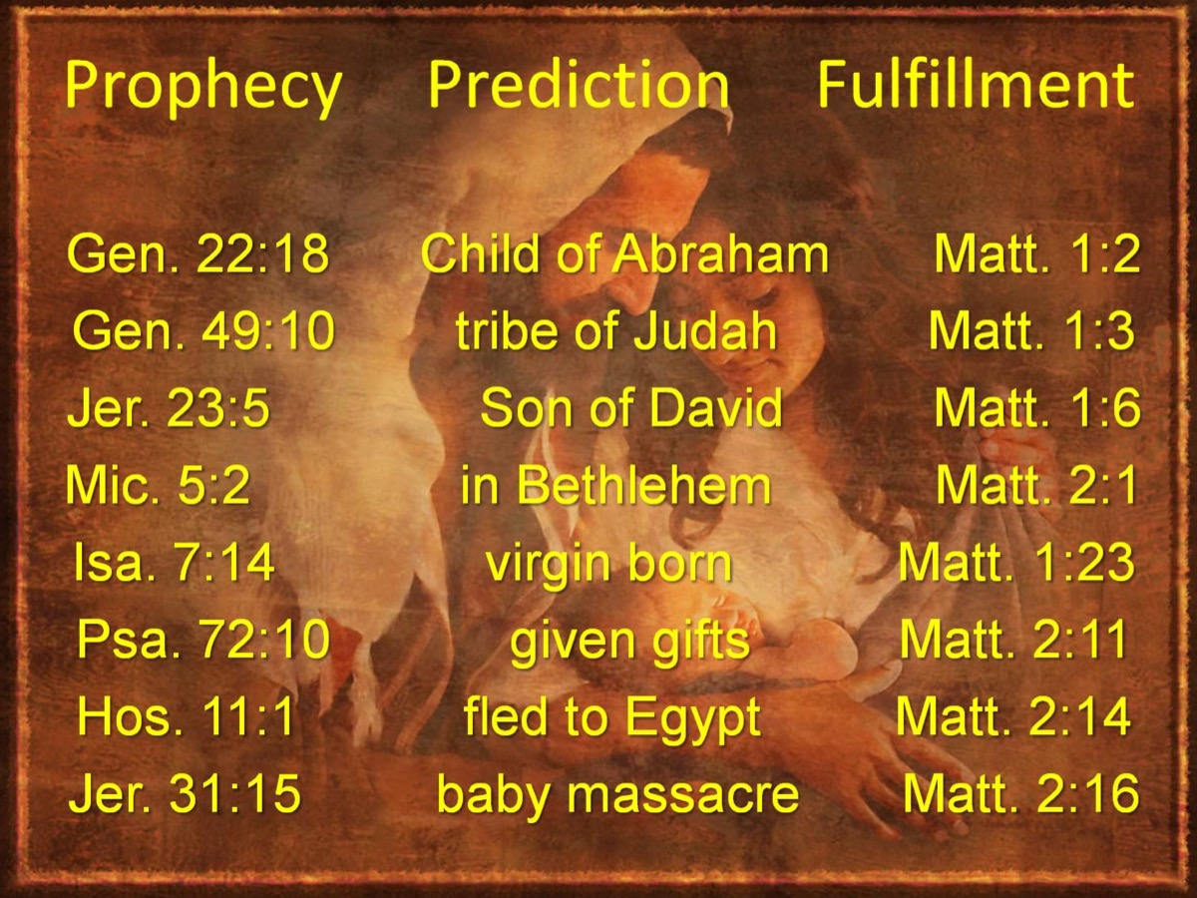
Notes:
Here are some examples of a passage in the Old Testament in which a prophecy was made and the reference in the New Testament where it was fulfilled:
Genesis 22:18 - A Child of Abraham - Matthew 1:2
Genesis 49:10 - The Tibe of Judah - Matthew 1:3
Jeremiah 23:5 - The Son of David - Matthew 1:6
Micah 5:2 - Born in Bethlehem - Matthew 2:1
Isaiah 7:14 - The Virgin Birth - Matthew 1:23
Psalm 72:10 - Given Gifts - Matthew 2:11
Hosea 11:1 - Fled to Egypt - Matthew 2:14
Jeremiah 31:15 - Baby Masacre - Matthew 2:16

Slide 24
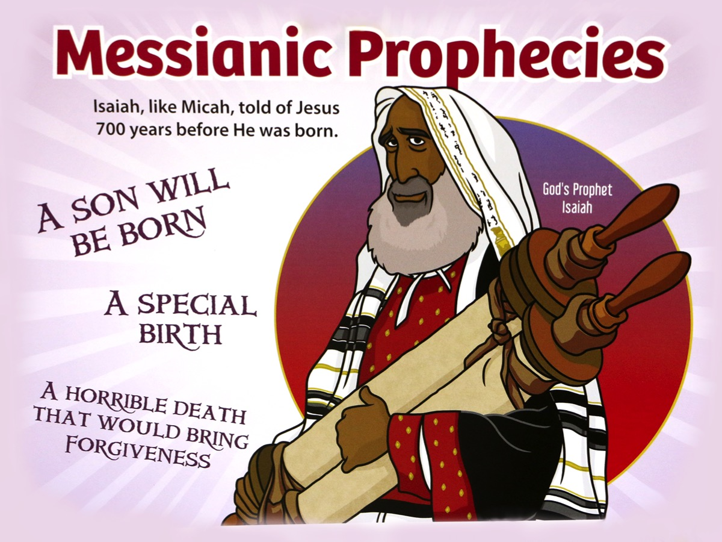
Notes:
Isaiah, like Micah, told of Jesus 700 yearsbefore He was born - he prophesied that a son will be born, it would be a special birth, and he would die a horrible death that would bring forgiveness.

Slide 25
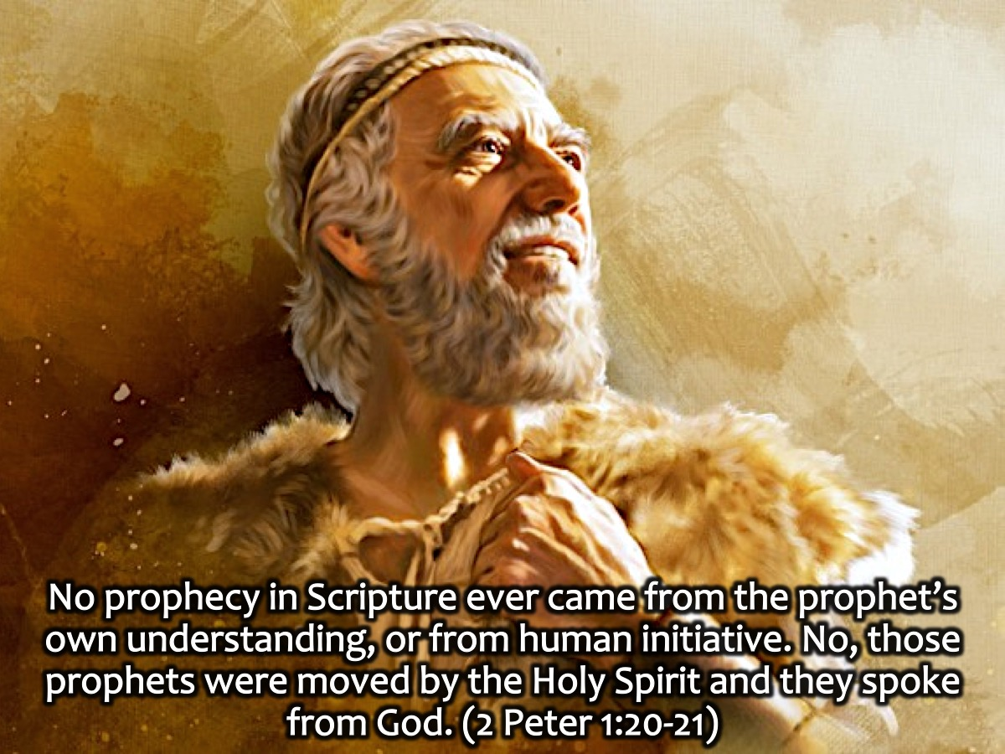
Notes:
How was it possible that the prophets were able to predict the future about Jesus? TheBible says: “No prophecy in Scripture ever came from the prophet’s own understanding, or from human initiative. No, those prophets were moved by the Holy Spirit and they spoke from God.” (2 Peter 1:20-21)

Slide 26
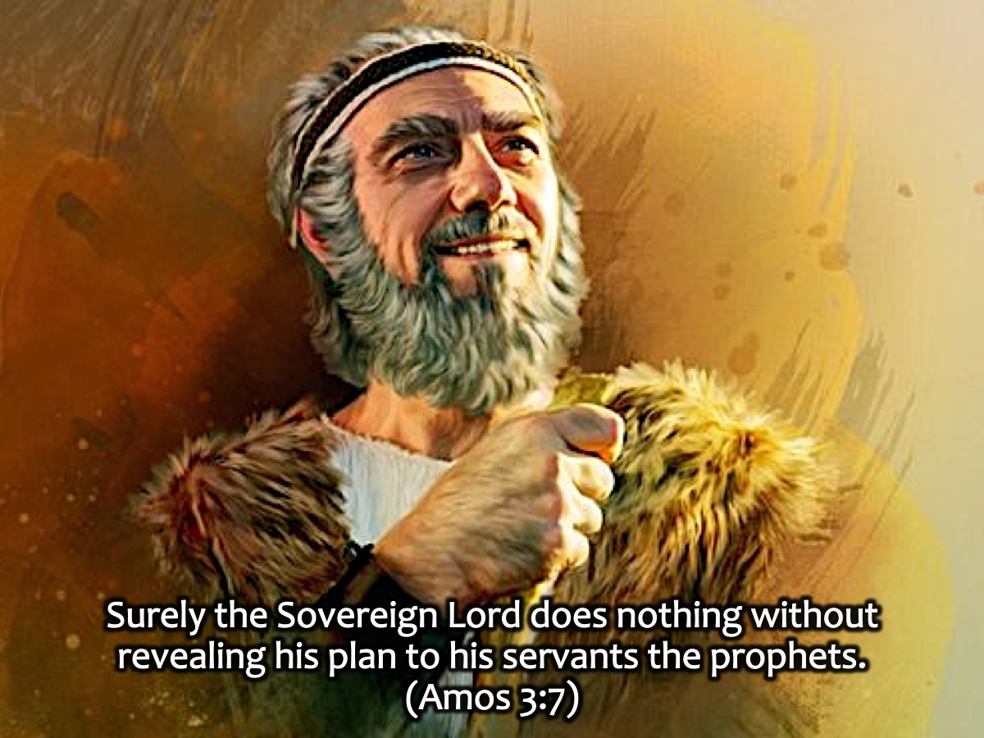
Notes:
In fact, we read that God did nothing that was not revealed to a prophet: “Surely the Sovereign Lord does nothing without revealing his plan to his servants the prophets”. (Amos 3:7)

Slide 27
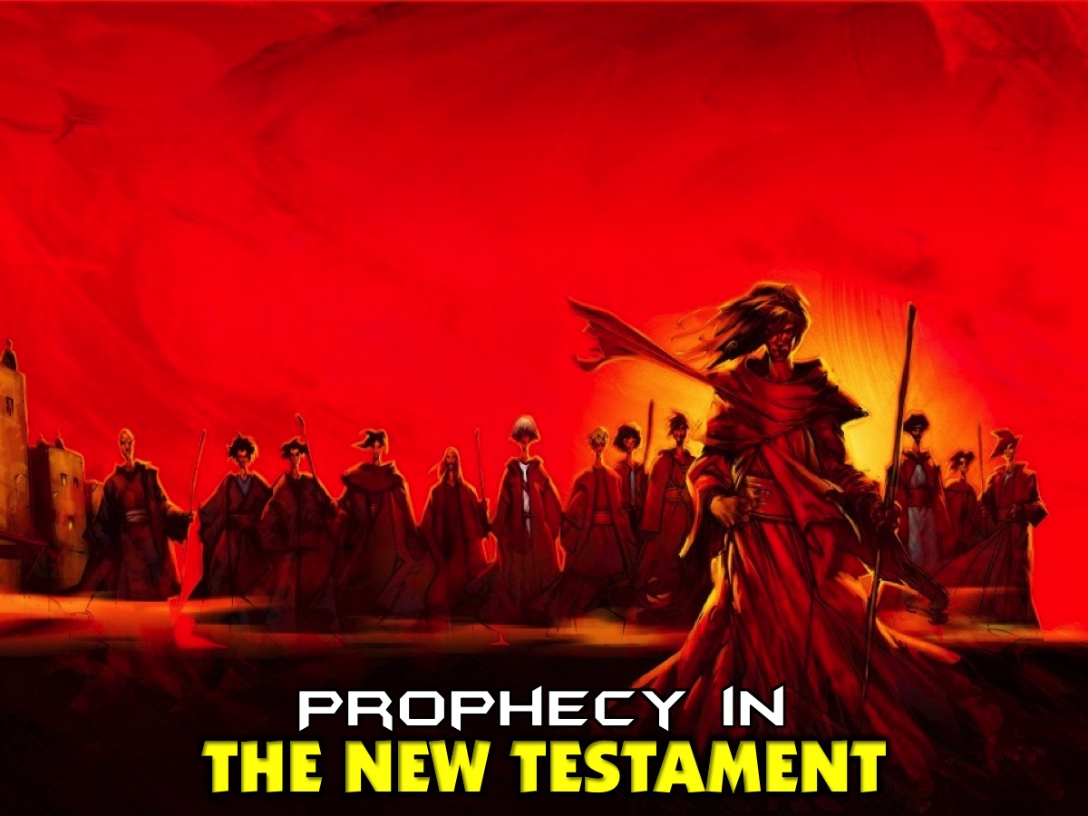
Notes:
Prophecy in The New Testament

Slide 28

Notes:
The Day Of Pentecost. When the Holy Spirit was poured out on the day of Pentecost people began to prophesy. “n the last days, I will pour out my Spirit on all people. Your sons and daughters will prophesy, your young men will see visions, your old men will dream dreams.” (Acts 2:17)

Slide 29
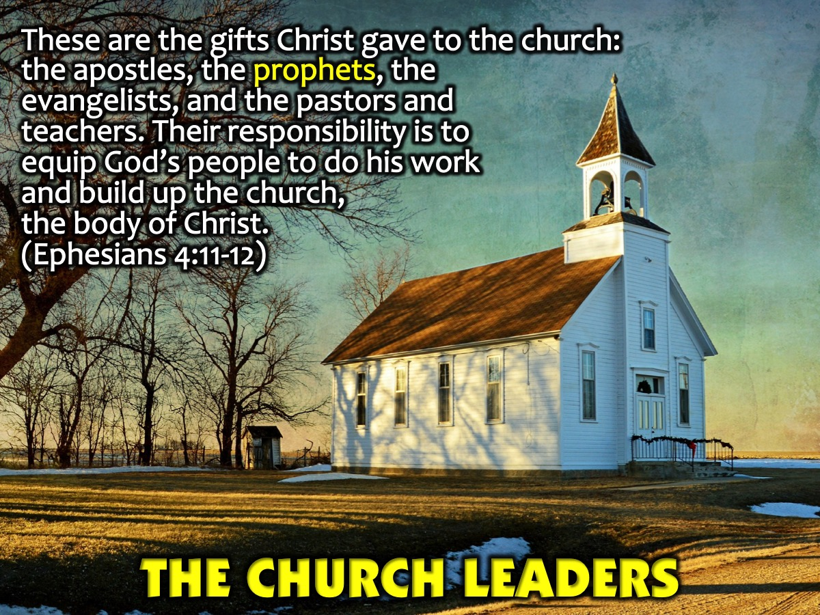
Notes:
The Church Leaders: Now these are the gifts Christ gave to the church: the apostles, the prophets, the evangelists, and the pastors and teachers. Their responsibility is to equip God’s people to do his work and build up the church, the body of Christ. (Ephesians 4:11-12)

Slide 30
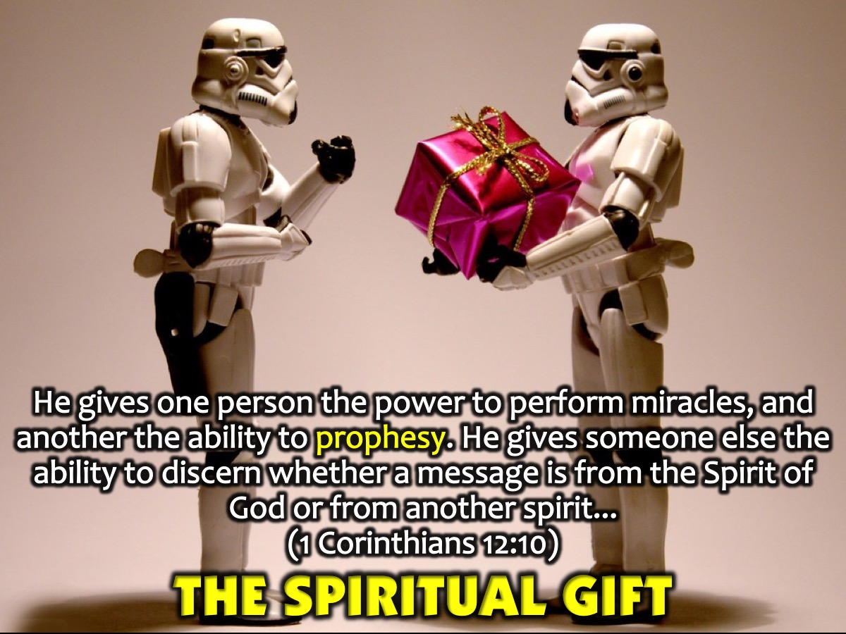
Notes:
The Spiritual Gift: Prophecy is a gift of the Holy Spirit and he gives gifts of prophecy at his own discretion. “He gives one person the power to perform miracles, and another the ability to prophesy. He gives someone else the ability to discern whether a message is from the Spirit of God or from another spirit. Still another person is given the ability to speak in unknown languages, while another is given the ability to interpret what is being said.” (1 Corinthians 12:10)

Slide 31
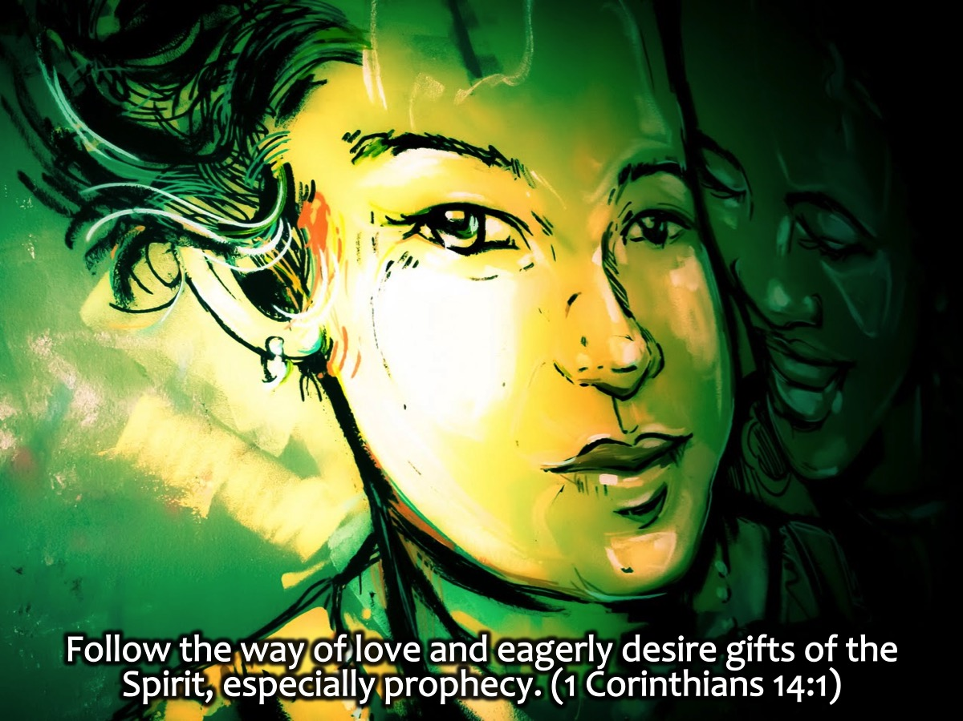
Notes:
We are actually encouraged to Pursue love, desire earnestly spiritual gifts especially that you may prophecy. (1 Corinthians 14:1)

Slide 32
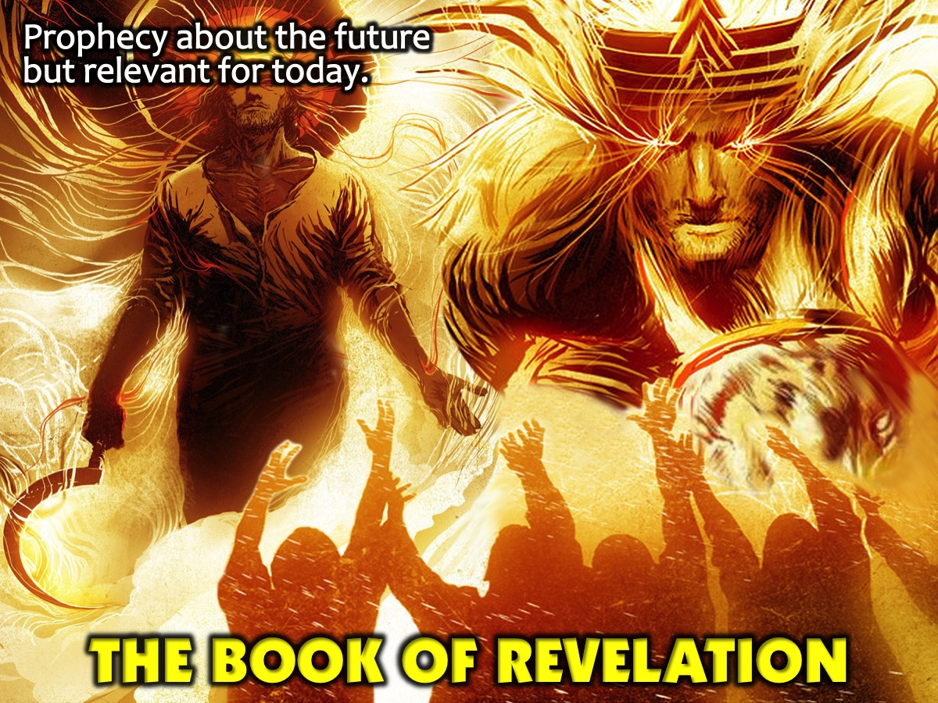
Notes:
The Book of Revelation: Prophecy about the future but relevant for today.

Slide 33
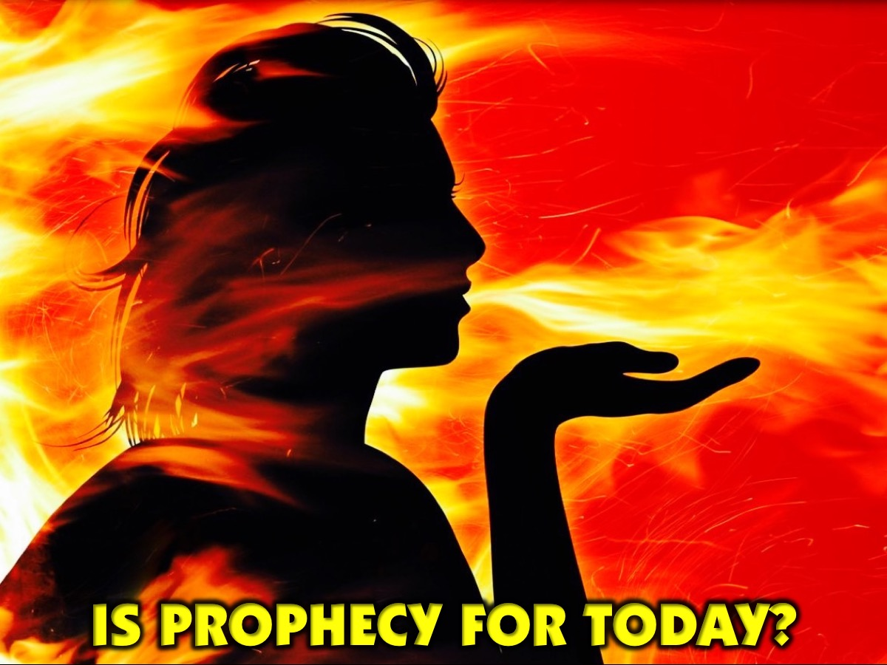
Notes:
Is Prophecy For Today?

Slide 34
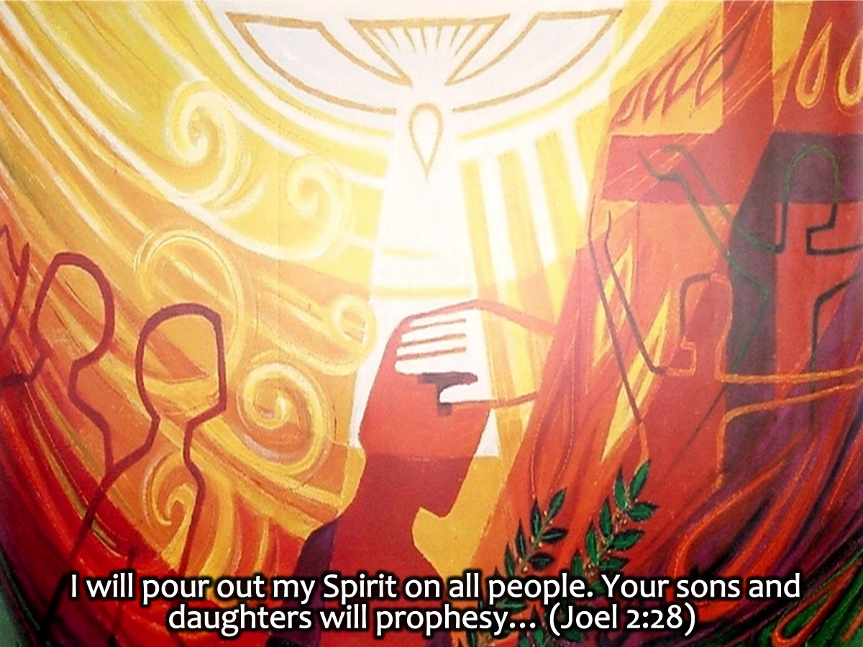
Notes:
The book of Joel says that prophecy will be big in the last days: “I will pour out my Spirit on all people. Your sons and daughters will prophesy…” (Joel 2:28)

Slide 35
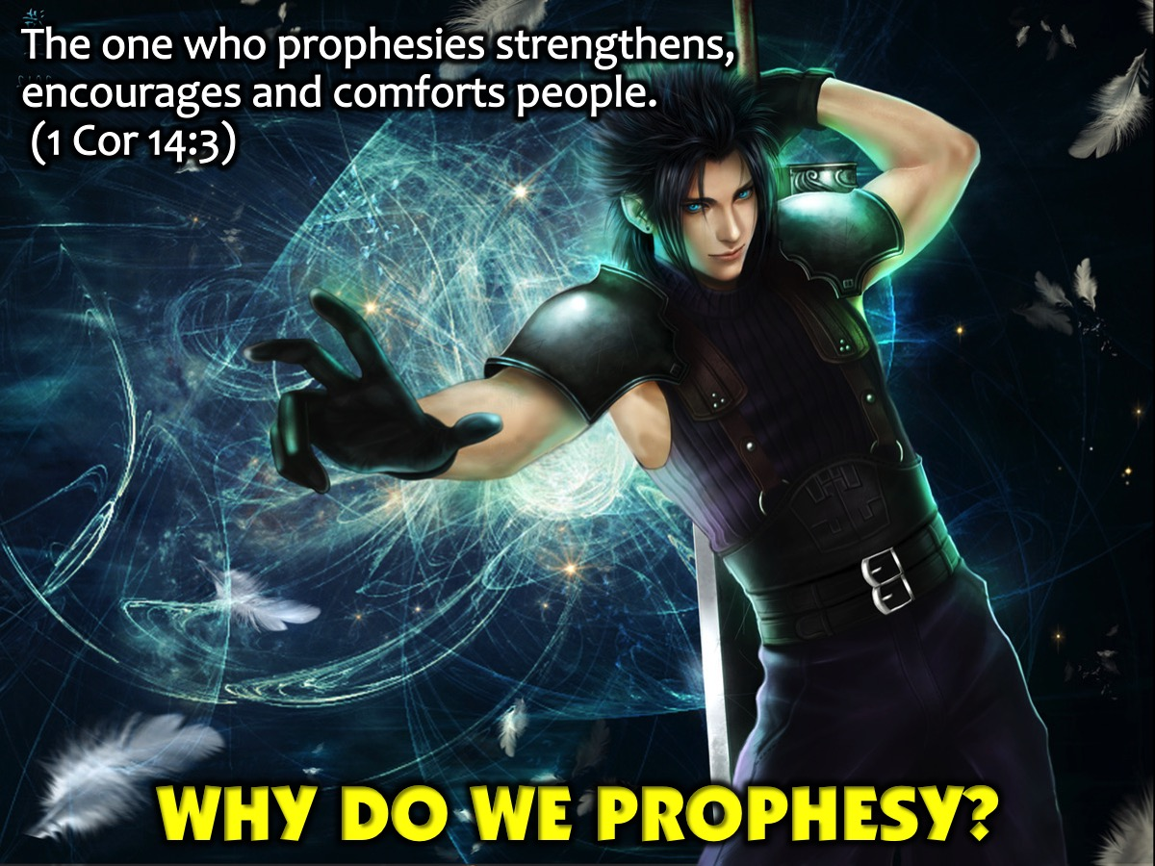
Notes:
Why Do We Prophesy? The one who prophesies strengthens, encourages and comforts people. (1 Corinthians 14:3)

Slide 36

Notes:
1. Strengthen People. Strengthening others using prophecy is the instruction or improvement of a person morally or intellectually.

Slide 37

Notes:
2. Encourage People. Encouraging others using prophecy urges someone to do something, give support, to inspire or gives hope to someone.

Slide 38
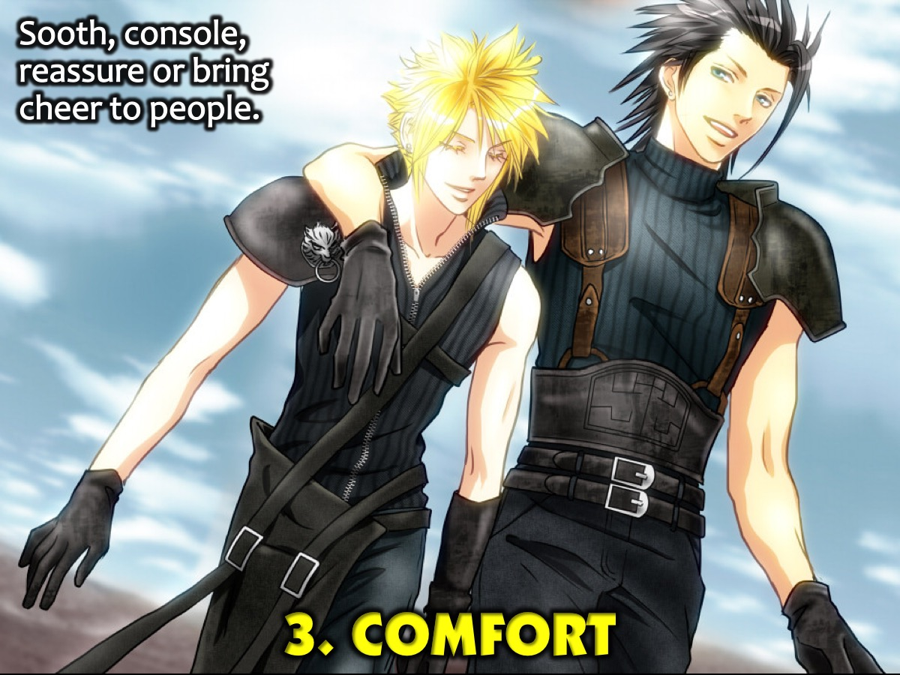
Notes:
3. Comfort People. Comforting others using prophecy is to sooth, console, reassure or bring cheer to those in need.

Slide 39
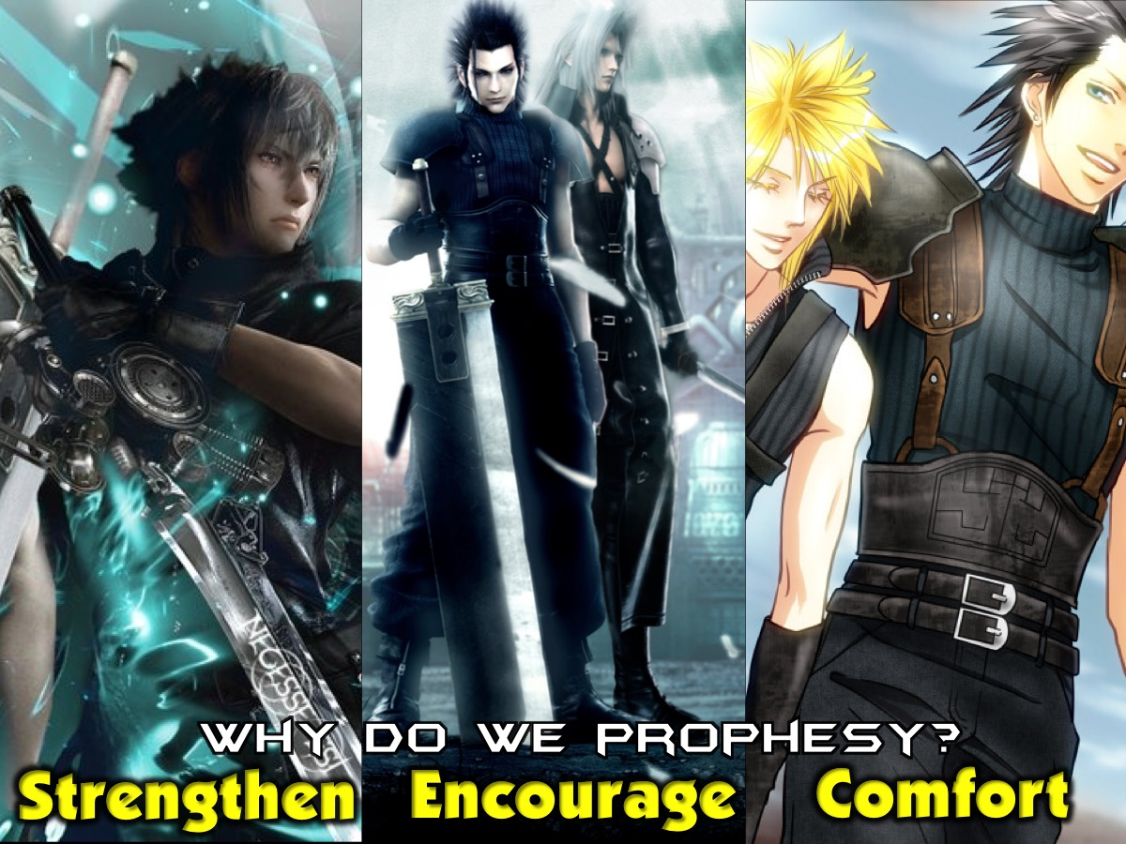
Notes:
So in summary, we prophesy to strengthen, encourage and comfort people.

Slide 40
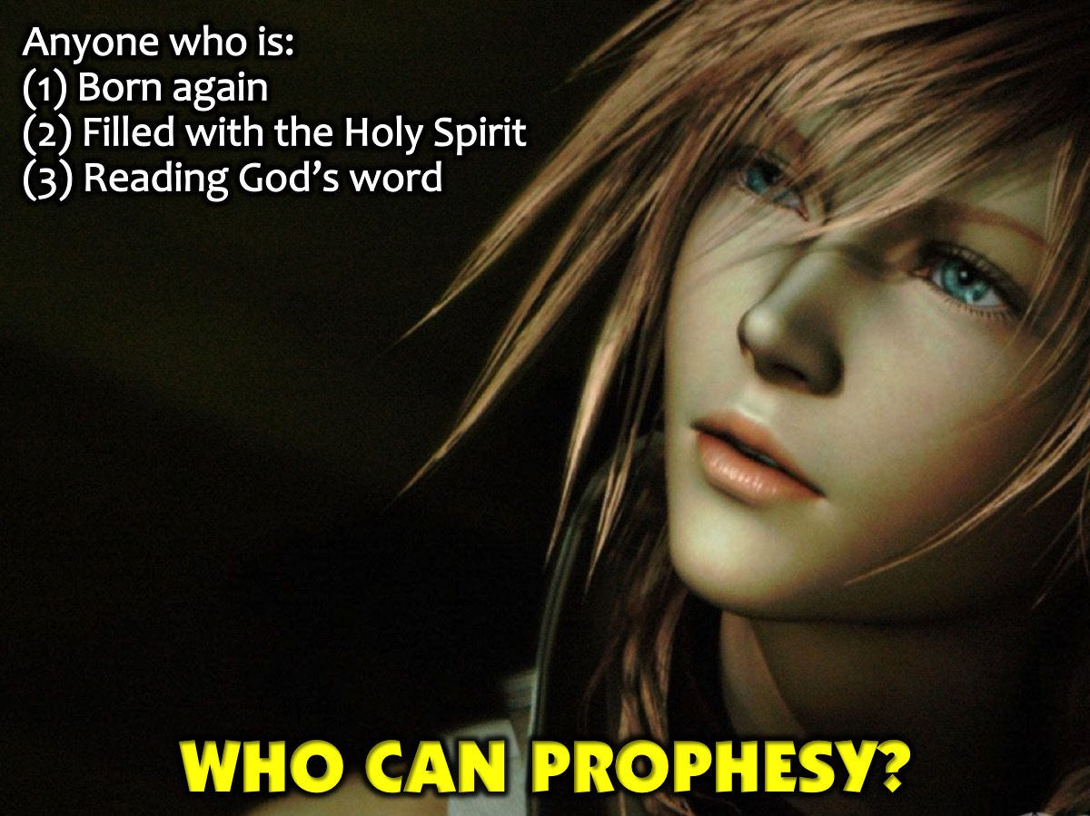
Notes:
Who Can Prophesy? Since Pentecost the Holy Spirit lives in us and guides us to do what He wants and speaks through us. So you can prophesy if you are: (1) Born again, (2) Filled with the Holy Spirit and (3) Reading His word. So, if you are a christian and you speak to God and He speaks to you then are prophetic.

Slide 41
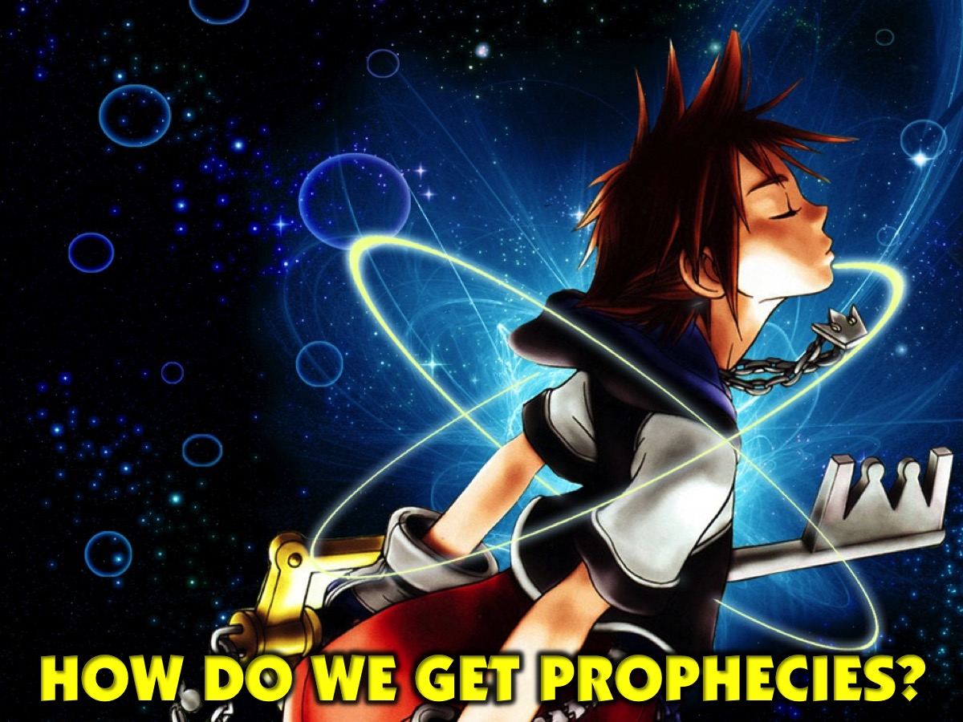
Notes:
How Do We Get Prophecies?

Slide 42

Notes:
1. Visions: Sometimes you will see an image or a “video” of a person or situation that contains a message to share.

Slide 43

Notes:
2. Dreams: Sometimes God gives you a dream about a person or a situation while you are asleep.

Slide 44

Notes:
3. Impressions: Sometimes you get an inner conviction – a strong or a faint feeling about a situation.

Slide 45

Notes:
4. Words: Sometimes you will see a word (like cancer or depression) that relates to someones situation.

Slide 46
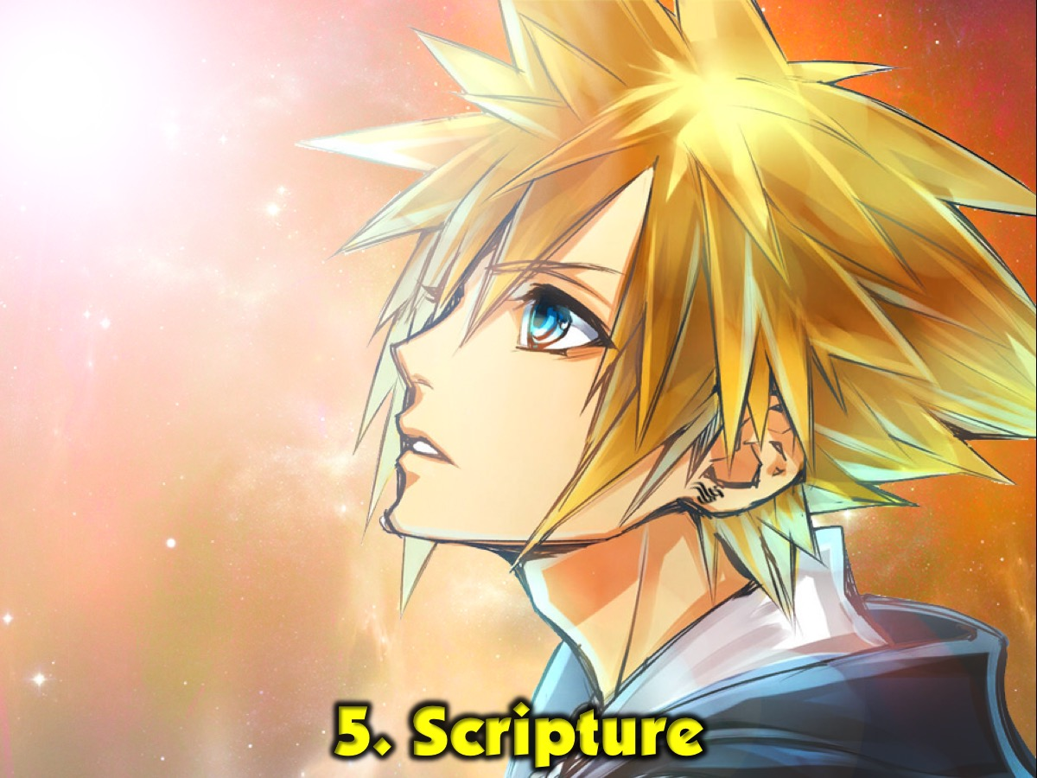
Notes:
5. Scriipture: Sometimes you will receive a verse or passage from the Bible that relates to someones situation.

Slide 47
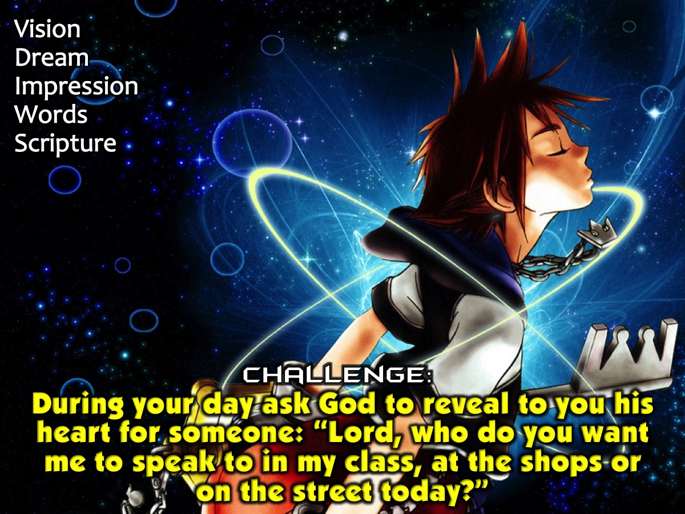
Notes:
Challenge: During your day ask God to reveal to you his heart for someone: “Lord, who do you want me to speak to in my class, at the shops or on the street today?” Then ask God to give you a word thought a vision, a dream, an impression or words or a Scripture.

Slide 48

Notes:
What Should We Avoid When Prophesying?

Slide 49

Notes:
1. Judgment. Don’t correct the person.

Slide 50

Notes:
2. Negativity. Don’t say negative things, rather ocus on the positive of who they are and are becoming.

Slide 51

Notes:
3. Fear. Don’t share any scary stuff - remember that youy aim is to encourage, strengthen and comfort.

Slide 52

Notes:
Practise: Find a partner. Ask God to give you a word for them. Share it with them. Ask them for feedback.

Slide 53
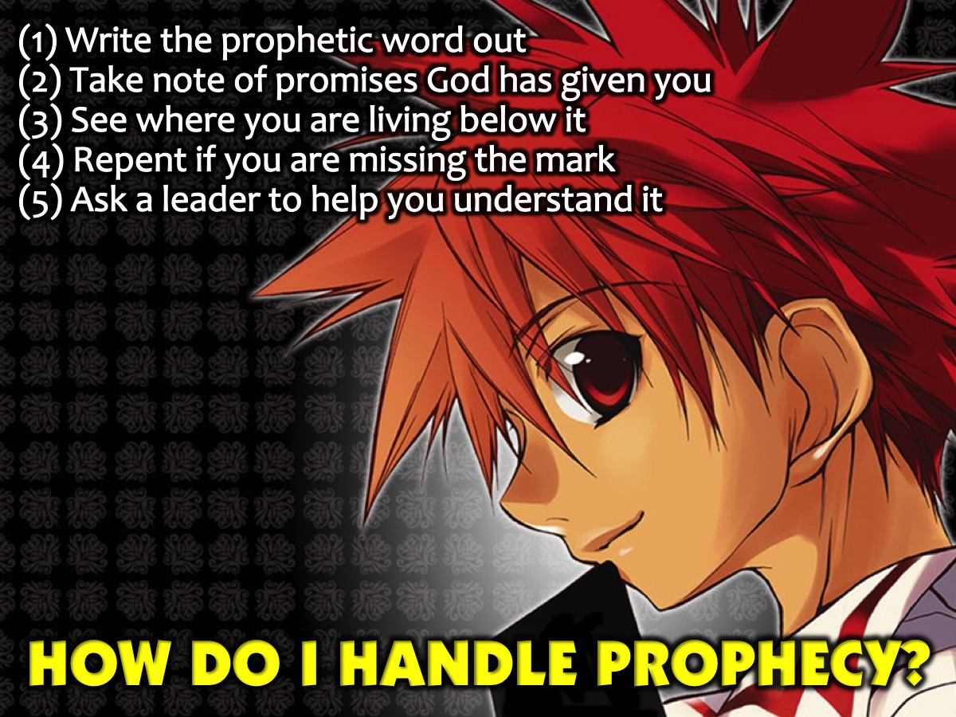
Notes:
How Do I Handle Prophecy? So what do you do when you receive a prophetic word? (1) Write the prophetic word out. (2) Take note of promises God has given you. (3) See where you are living below the word. (4) Repent if you are missing the mark. (5) Ask a leader to help you understand it.

Slide 54
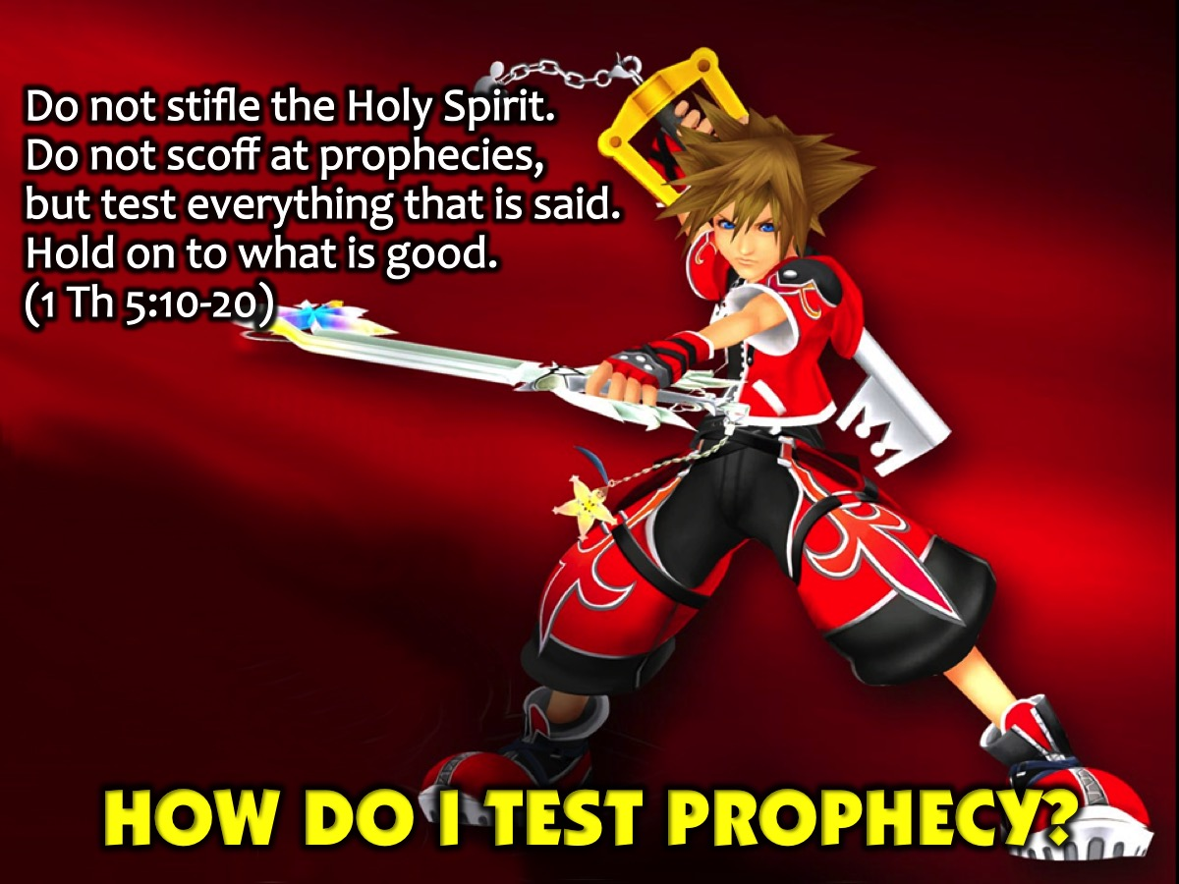
Notes:
How Do I Test Prophecy? The Bible tells us to test prophetic words: “Do not stifle the Holy Spirit. Do not scoff at prophecies, but test everything that is said. Hold on to what is good.” (1 Thessalonians 5:10-20)

Slide 55
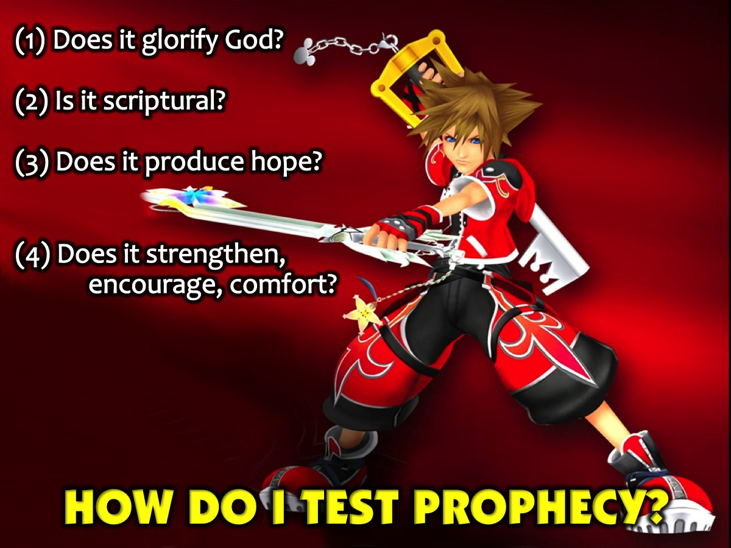
Notes:
Here are some questions you can ask to test a prophecy you are giving or receiving: (1) Does it glorify God? (2) Is it scriptural? (3) Does it produce hope? (4) Does it strengthen, encourage or comfort?

Slide 56
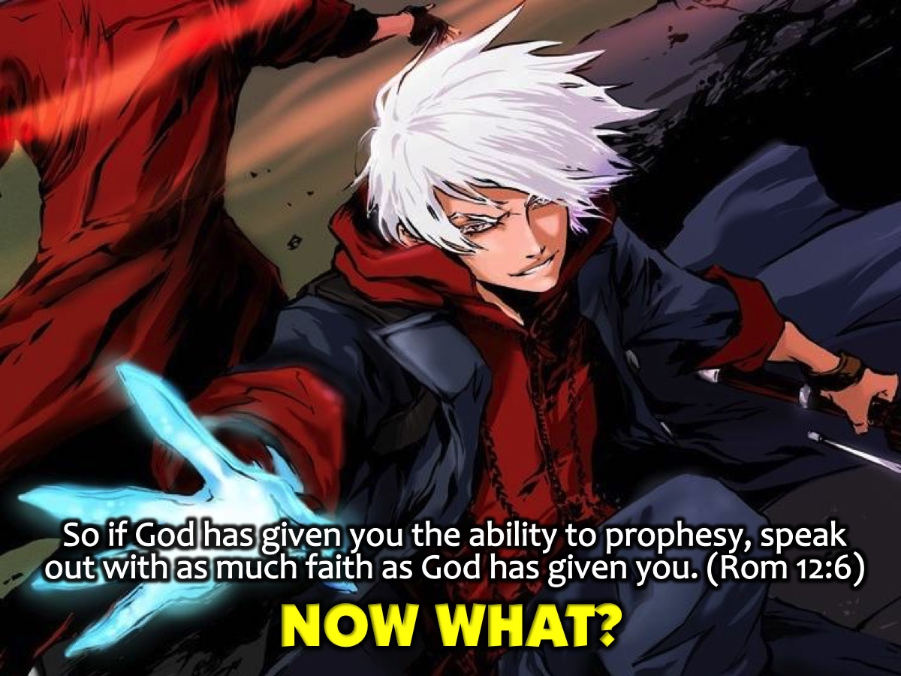
Notes:
Now What? “In his grace, God has given us different gifts for doing certain things well. So if God has given you the ability to prophesy, speak out with as much faith as God has given you.” (Romans 12:6).

Slide 57
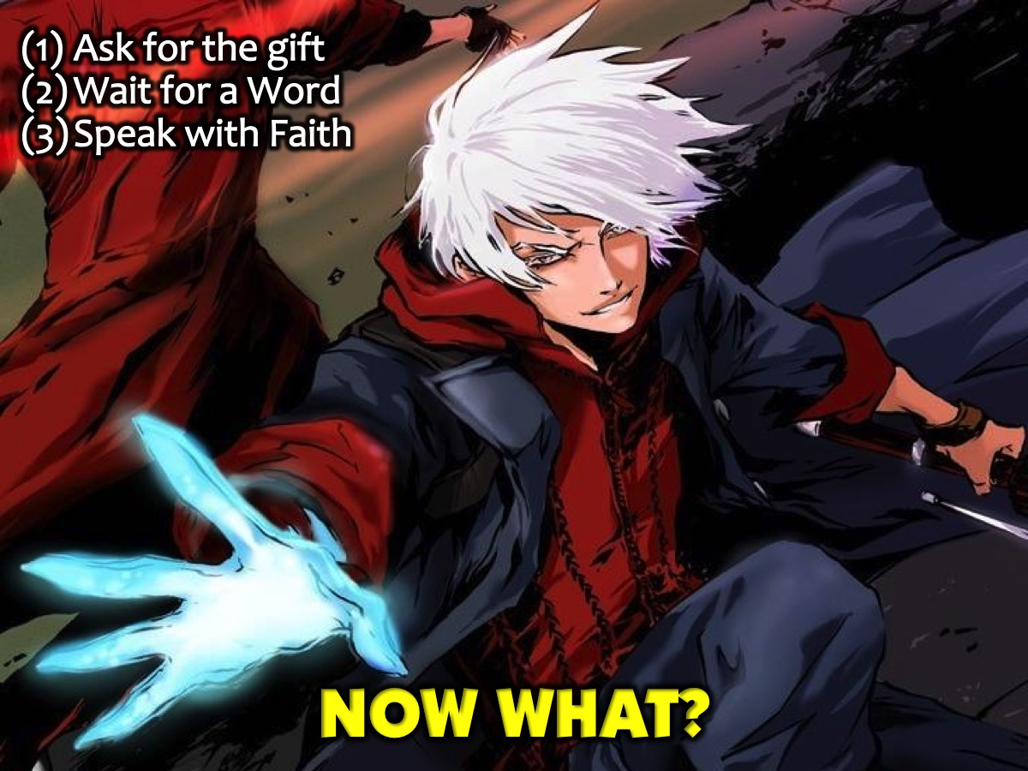
Notes:
So: (1) Ask God for the gift of prophecy, (2) Wait on God for a Word and (3) Speak with faith.

Slide 58

Notes:
Prayer

Slide 59

Notes:
Next Sunday we are going to look at what the Word says about Lifestyle.

