Slide 1

Notes:
Welcome to the Word-On series where each week we are looking at what the Bible says about different topics.

Slide 2

Notes:
In Week 1 we looked at what the Word says about God.

Slide 3

Notes:
In Week 2 we looked at what the Word says about Evolution.

Slide 4

Notes:
In Week 3 we looked at what the Word says about Humanity.

Slide 5

Notes:
In Week 4 we looked at what the Word says about Spiritual Warfare.

Slide 6

Notes:
In Week 5 we looked at what the Word says about Media.

Slide 7

Notes:
Last Week we looked at what the Word says about Prophecy.

Slide 8

Notes:
This Week we are looking at what the Word says about Lifestyle.

Slide 9
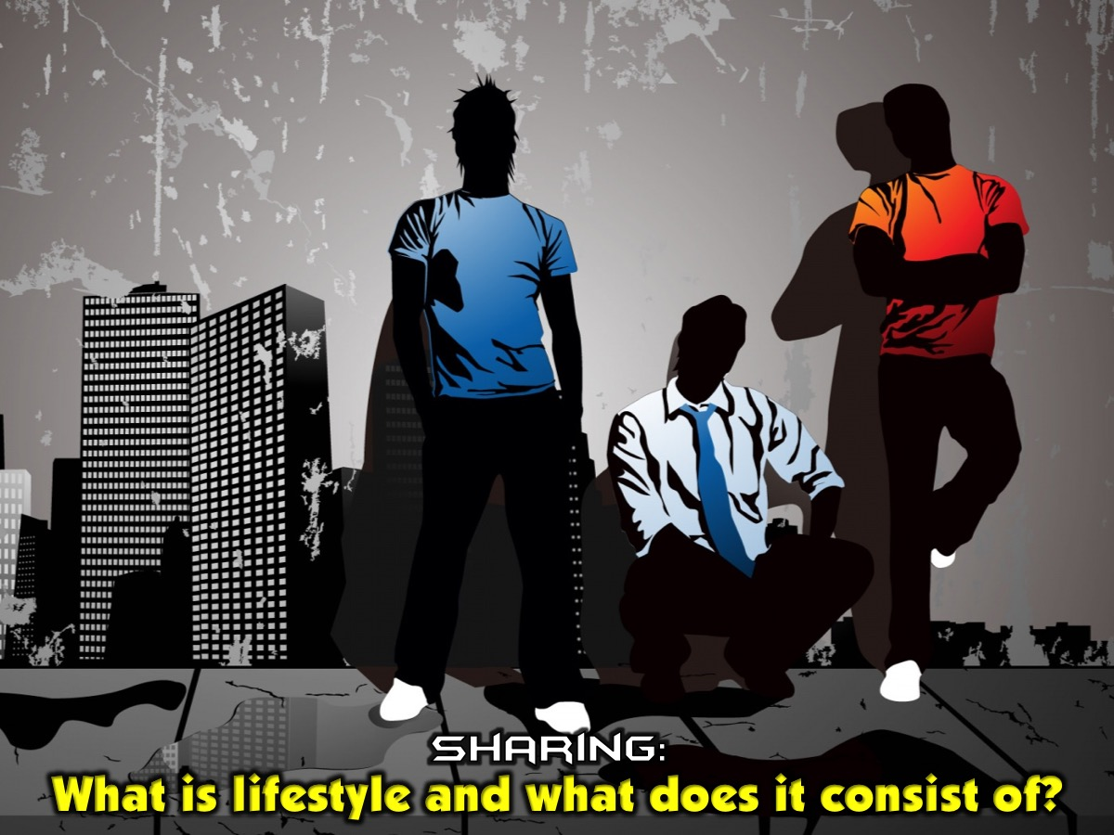
Notes:
Sharing: What is lifestyle and what does it consist of?

Slide 10

Notes:
What is Lifestyle? Lifestyle is the way in which a person, family, household or society lives.

Slide 11

Notes:
Key scripture: I am the way, the truth and the life. (John 14:6)

Slide 12

Notes:
What Makes Up Lifestyle?

Slide 13

Notes:
1. Opinions. What you think about various topics e.g. boys, girls, race, the world, etc

Slide 14

Notes:
2. Values. What you value because of your upbringing. Like Morals, Ethics, Beliefs, etc.

Slide 15

Notes:
3. Activities. What you do at school or in your free time. Like Debate, Chess, Choir, Sports, etc.

Slide 16

Notes:
4. Interests. What you do at school or in your free time. Music, Movies, Politics, Fashion, etc.

Slide 17

Notes:
How is Lifestyle Expressed?

Slide 18

Notes:
1. Behaviour. Speech (positive vs negative – Lying, Swearing), Stressing, Worry, Anxiety, Tantrums, etc.

Slide 19

Notes:
2. Habits. Drinking, Smoking, Gossiping, etc.

Slide 20
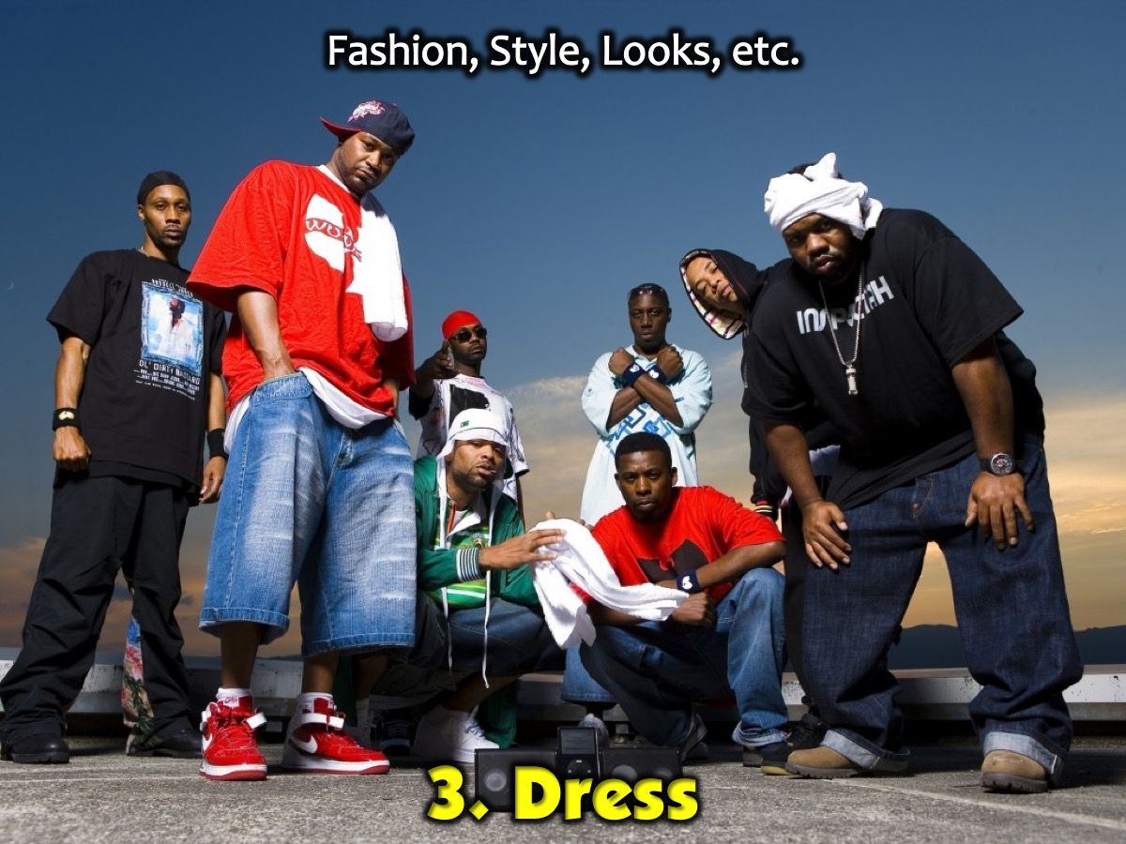
Notes:
3. Dress. Fashion, Style, Looks, etc.

Slide 21

Notes:
4. Entertainment. Movies, Parties, Youth Group, Amusement Parks, etc.

Slide 22

Notes:
5. Cultural Practices. Weddings, Funerals, Lobola, etc.

Slide 23

Notes:
6. Diet. Health fanatic, Vegetarian, Vegan, Unhealthy (Bulimia, Anorexia, etc)

Slide 24

Notes:
7. Relationships. Choice of Friends, Boyfriends, Girlfriends, etc.

Slide 25

Notes:
Sharing: What is Christian Lifestyle?

Slide 26

Notes:
Christian Lifestyle is life that is motivated by the life of Christ.

Slide 27

Notes:
Christian lifestyle is the character of Christ being developed and perfected in the character of the Christian on a daily basis.

Slide 28

Notes:
As we grow spiritually, behaviours, mindsets and interests will change because of the work of the Holy Spirit. (See Romans 12:2)

Slide 29

Notes:
Christian Lifestyle Myths: There are some myths about what Christian Lifestyle is: (1) Christianity is a list of do’s and don’ts. (2) You are not allowed to have any fun. (3) All you do is go to church. (4) As long as you are saved, you can do whatever you want and God will forgive you.

Slide 30
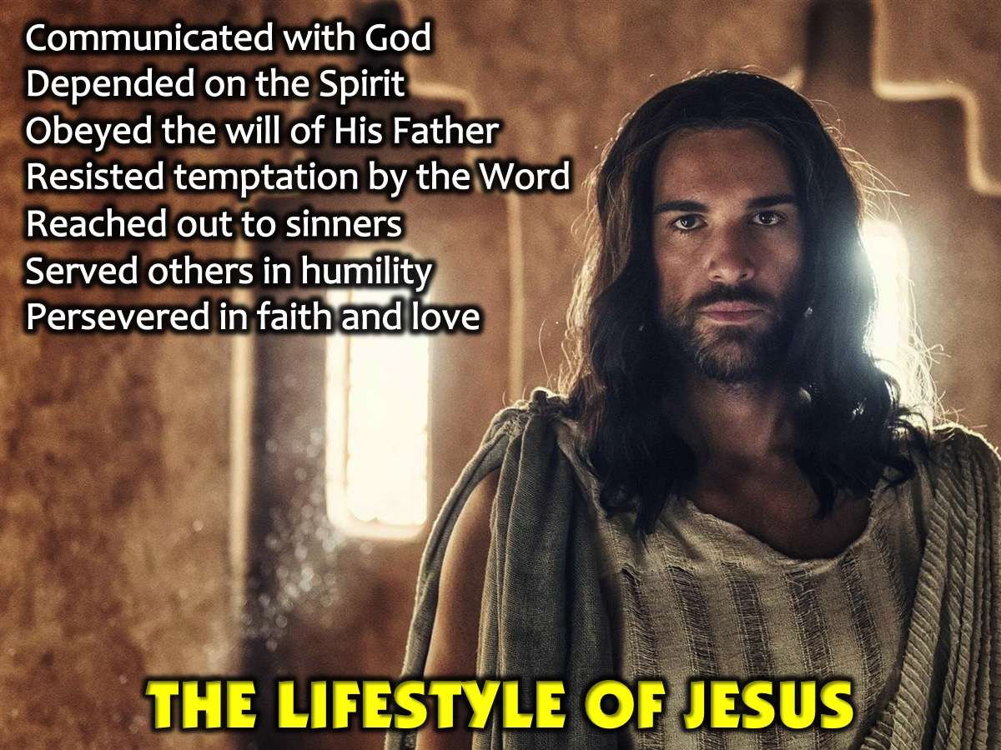
Notes:
The Lifestyle of Jesus. Here are some things that were a part of Jesus’ lifestyle: (1) Communicated continually with God (Matthew 11:25-26; Mark 6:46; 14:32). (2) Acknowledged the significance of the Holy Spirit (John 14:16-17,26). (3) Obeyed the will of His Heavenly Father (Luke 22:42; John 6:38-39). (4) Resisted temptation by steadfastness to the Word of God (Luke 4:1-13). (5) Reached out to those considered hopeless and sinners (Mark 2:15-16; Luke 19:5-9). (6) Served others, humbling Himself before His Heavenly Father (John 13:3-5, 12-15). (7) Persevered in faith and love (John 4:34, John 9:4; John 17:23).

Slide 31

Notes:
How do we live a Christian Lifestyle?

Slide 32

Notes:
1. Read the Bible Daily. Keep this Book of the Law always on your lips; meditate on it day and night, so that you may be careful to do everything written in it. Then you will be prosperous and successful. (Joshua 1:8 also Hebrews 4:12 and Psalm 119:18).

Slide 33

Notes:
2. Pray and Worship God Daily. Pray in the Spirit on all occasions with all kinds of prayers and requests. Be alert and always keep on praying for all the Lord’s people. (Ephesians 6:18 and James 5:13-15)

Slide 34

Notes:
3. Let God Transform You. Depend on the Holy Spirit and Allow Him to Transform You. Let the Spirit renew your thoughts and attitudes. Put on your new nature, created to be like God - truly righteous and holy. (Ephesians 4:21-24 also Romans 5:5 and John 14:16-17).

Slide 35

Notes:
4. Attend Church Regularly. We should not stop gathering together with other believers, as some of you are doing. Instead, we must continue to encourage each other. (Hebrews 10:25 also Acts 2:42)

Slide 36
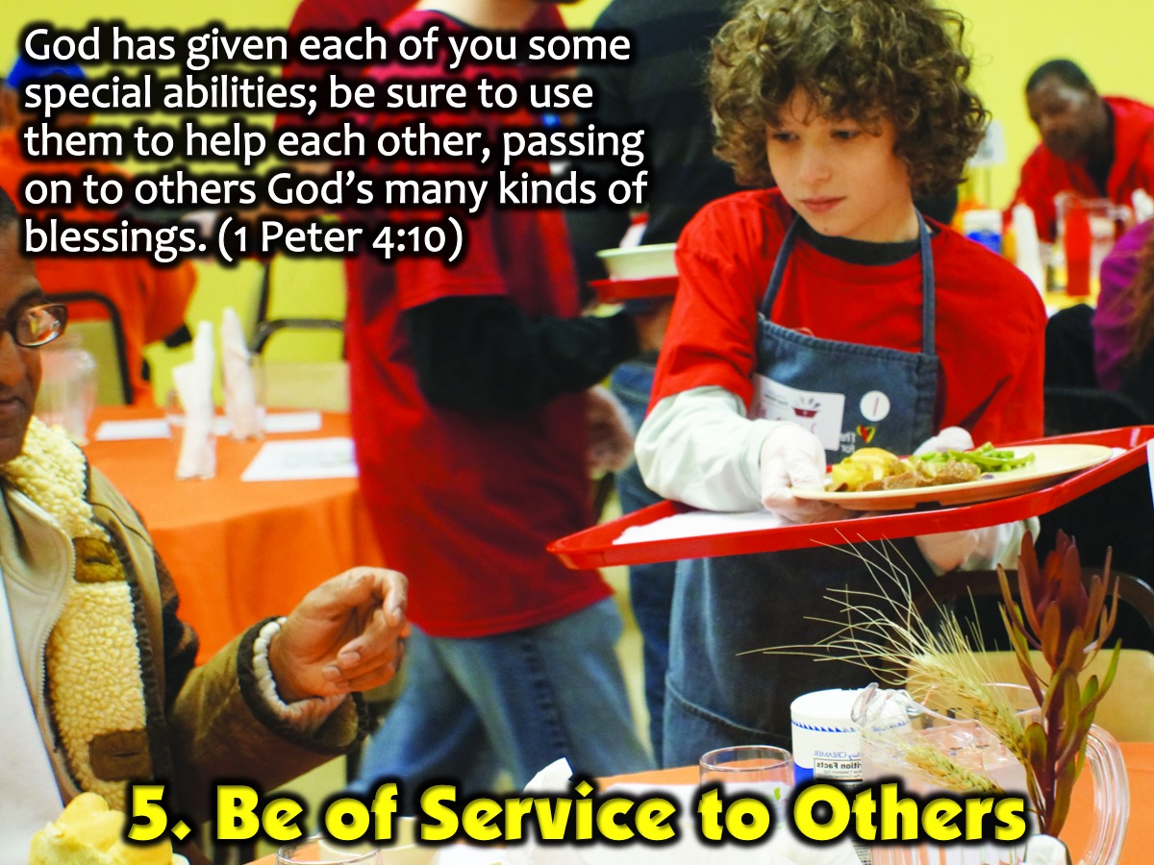
Notes:
5. Be of Service to Others. God has given each of you some special abilities; be sure to use them to help each other, passing on to others God’s many kinds of blessings. (1 Peter 4:10)

Slide 37

Notes:
6. Deal with Temptation. Learn How to Deal with Temptation and strive for righteousness. Submit yourselves, then, to God. Resist the devil, and he will flee from you. (James 4:7 also 1 Corinthians 10:13 and 1 Timothy 6:11)

Slide 38

Notes:
7. Tell Others About Jesus. Go and make disciples of all nations. (Matthew 28:19 also Philemon 1:6)

Slide 39

Notes:
Don’t let anyone look down on you because you are young, but set an example for the believers in speech, in life, in love, in faith and in purity. (1 Timothy 4:12)

Slide 40
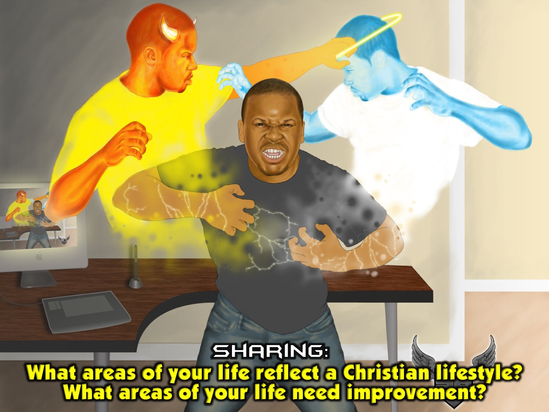
Notes:
Sharing: You will be given a piece of paper with two questions on it. Take a few minutes to write down your answers to the questions: (1) What areas of your life do you think reflect a Christian lifestyle? (2) What areas of your life do you think need improvement?

Slide 41

Notes:
Prayer

Slide 42

Notes:
Next Sunday we are going to look at what the Word says about Gifts.

