Slide 1

Notes:
Welcome to the Word-On series where each week we are looking at what the Bible says about different topics.

Slide 2

Notes:
In Week 1 we looked at what the Word says about God.

Slide 3

Notes:
In Week 2 we looked at what the Word says about Evolution.

Slide 4

Notes:
In Week 3 we looked at what the Word says about Humanity.

Slide 5

Notes:
In Week 4 we looked at what the Word says about Spiritual Warfare.

Slide 6

Notes:
In Week 5 we looked at what the Word says about Media.

Slide 7

Notes:
In Week 6 we looked at what the Word says about Prophecy.

Slide 8

Notes:
Last Week we are looking at what the Word says about Lifestyle.

Slide 9

Notes:
This Week we are looking at what the Word says about Spiritual Gifts.

Slide 10
Notes:
Video: UNCHARTED 4: A Thief's End (5/10/2016) - Story Trailer. Get it on YouTube at: https://www.youtube.com/watch?v=hh5HV4iic1Y

Slide 11

Notes:
This is a pic of TK’s car (Genevieve’s husband) and the awesome branding for the new Uncharted PS4 game.

Slide 12

Notes:
Finding Your Gifts. How many of you actually know what your spiritual gifts are? Some of you may say: “What are spiritual gifts?” and some may even say, “I have spiritual gifts?”. Yes you do!

Slide 13
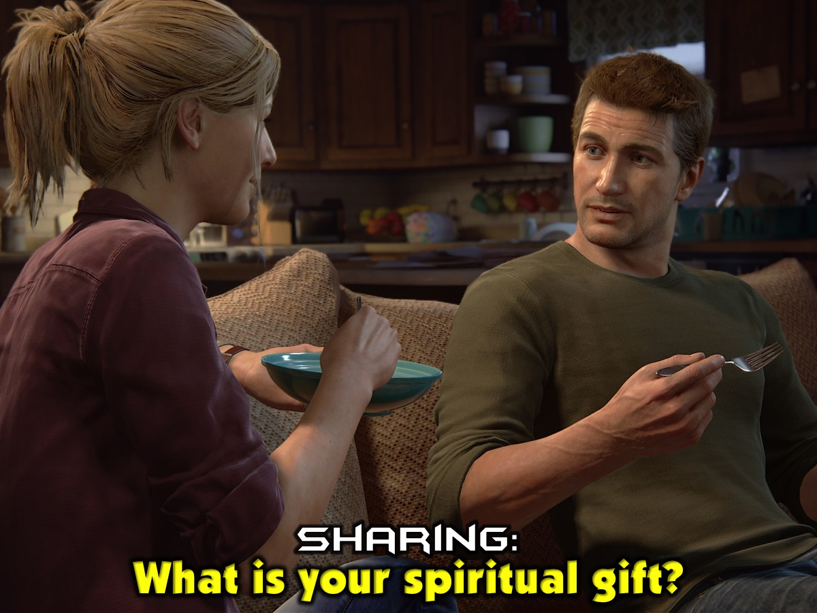
Notes:
Sharing: Turn to the person next to you and ask them: “What is your spiritual gift?

Slide 14
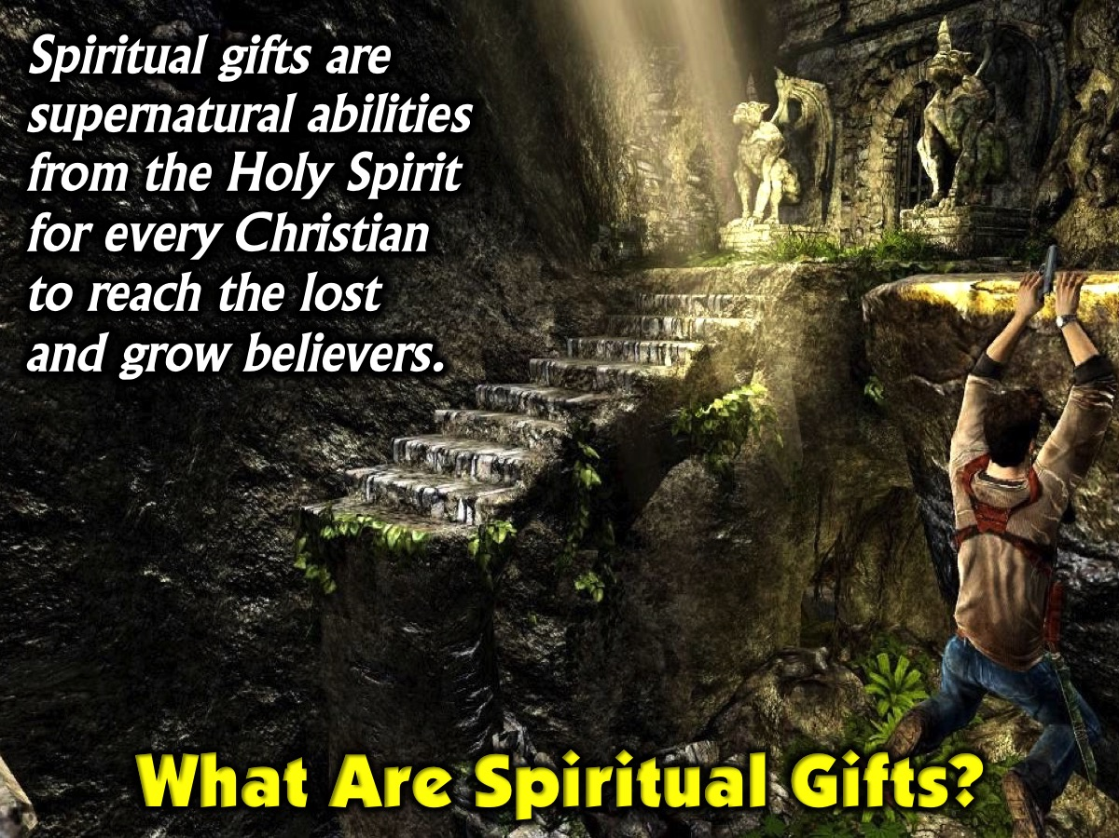
Notes:
Before we get really practical let’s answer some questions about spiritual gifts. What are spiritual gifts? Spiritual gifts are supernatural abilities from the Holy Spirit for every Christian to reach the lost and grow believers.

Slide 15
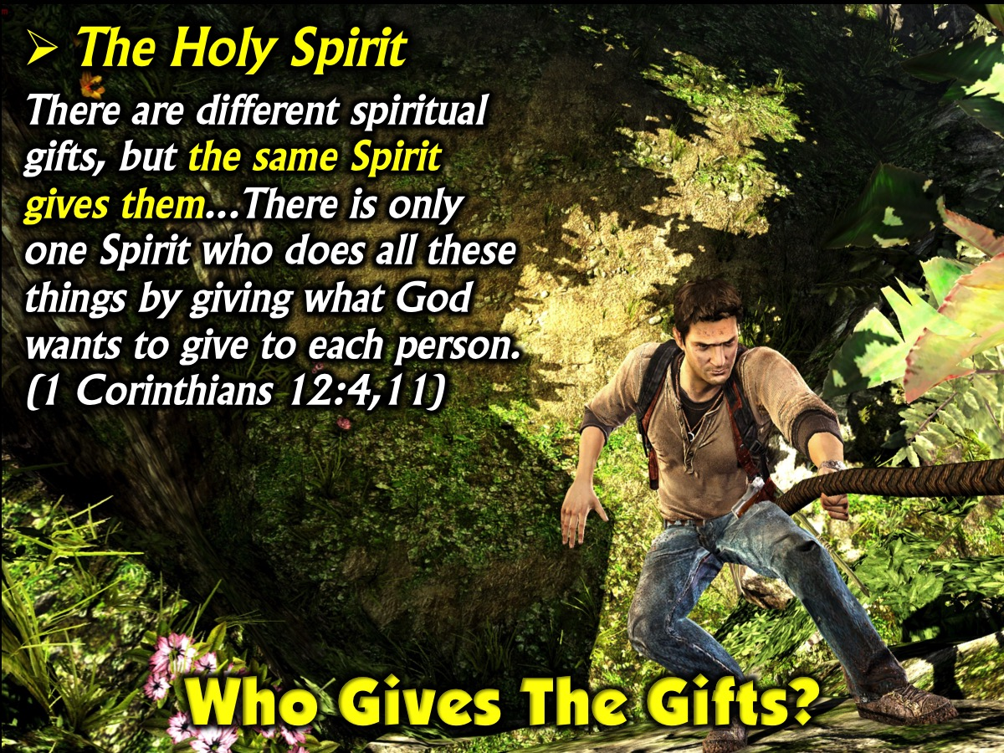
Notes:
Who Gives The Gifts? The Holy Spirit. “There are different spiritual gifts, but the same Spirit gives them...There is only one Spirit who does all these things by giving what God wants to give to each person.’ (1 Corinthians 12:4,11)

Slide 16

Notes:
Who Gets The Gifts? Every Believer is given gifts! “The evidence of the Spirit’s presence is given to each person for the common good of everyone”. (1 Corinthians 12:7)

Slide 17
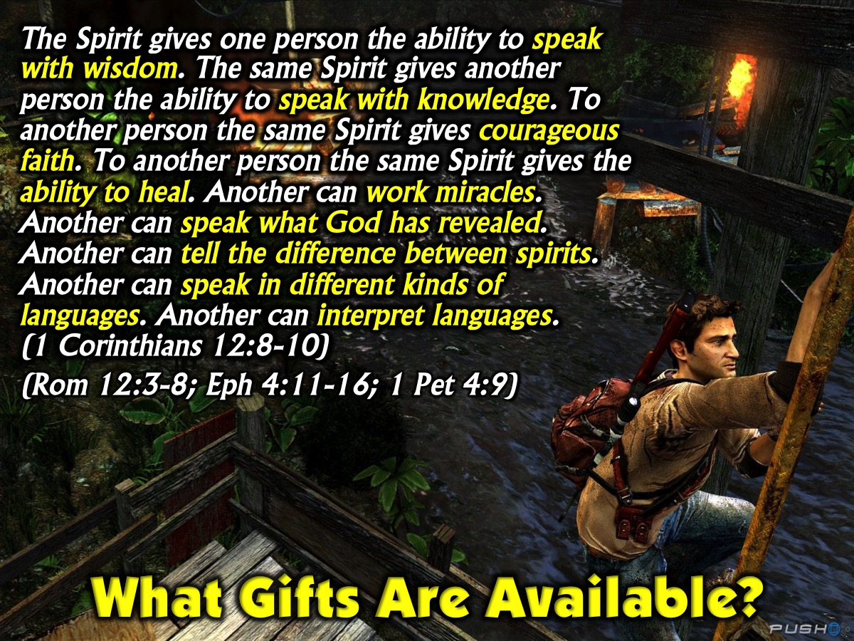
Notes:
What gifts are available? The passage in 1 Corinthians 12 mentions 9 different gifts: wisdom, knowledge, faith, healing, miracles, prophesying, discernment, tongues and interpreting tongues. There are other passages in the Bible that present lists of spiritual gifts (1 Corinthians 12:8-10 and 28-30; Romans 12:3-8; Ephesians 4:11-16 and 1 Peter 4:9).

Slide 18
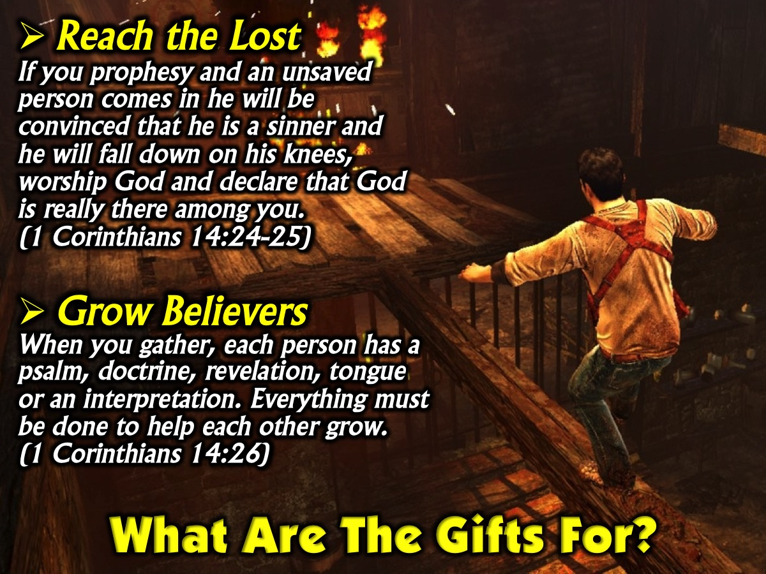
Notes:
What are the gifts for? (1) Reach the Lost – “If you prophesy and an unsaved person comes in he will be convinced that he is a sinner and he will fall down on his knees, worship God and declare that God is really there among you.” (1 Corinthians 14:24-25). (2) Grow Believers – “When you gather, each person has a psalm, doctrine, revelation, tongue or an interpretation. Everything must be done to help each other grow.” (1 Corinthians 14:26)

Slide 19
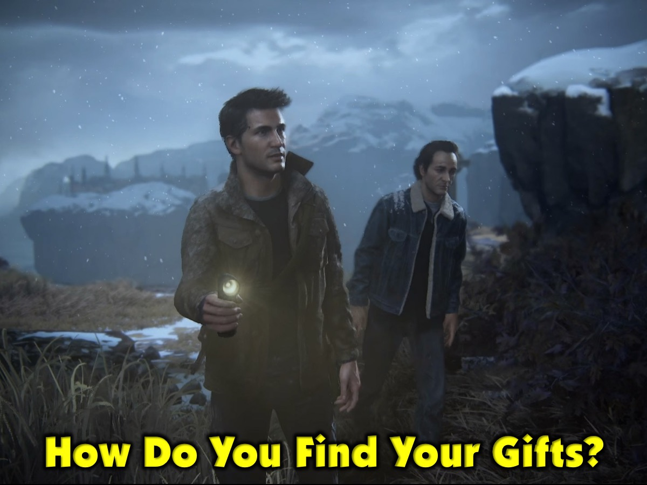
Notes:
How do you find your Spiritual Gifts?

Slide 20
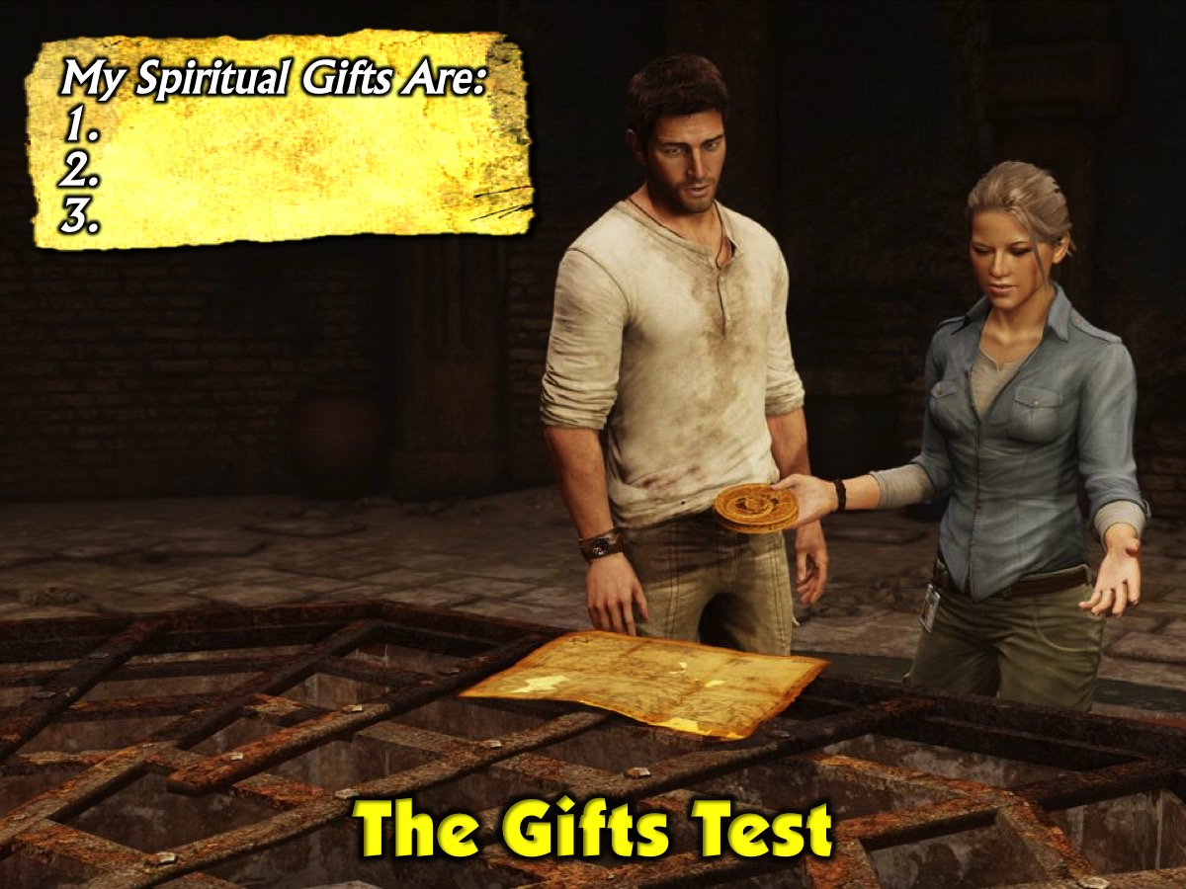
Notes:
The Gifts Test. One of the best ways to find your gifts is to take a gifts test. Take one of the handouts and work through the Gifts Test. First answer each question in the 5 categories with a score from 0 to 3 (where 0 is Never, 1 is Sometimes, 2 is Often and 3 is A Lot). You will see brackets at the end of each sentence – find the scores for each of the 15 different gifts and transfer them to the boxes on the second page and then add each line up to get a Total. On the bottom of the page write a list of your top three spiritual gifts.

Slide 21
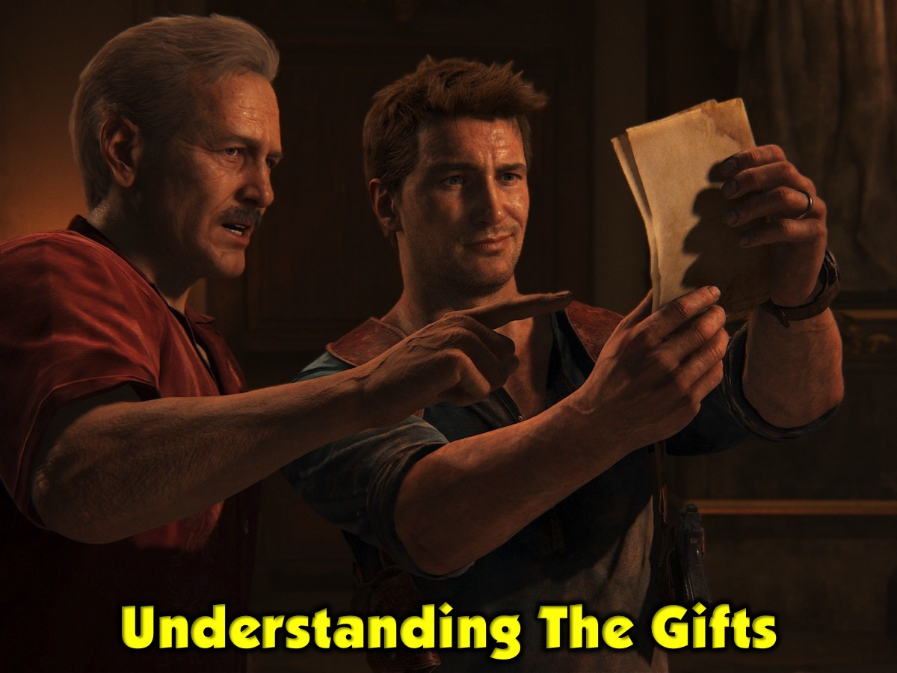
Notes:
Understanding the Gifts. Before you share your gifts with each other in your group, let me briefly define each of the gifts. Listen out especially for your top three gifts.

Slide 22

Notes:
1. Administration: To provide practical support to leaders or ministries. (1 Corinthians 12:28; Luke 14:28-30; Acts 6:1-7; 27:11; Titus 1:5)

Slide 23
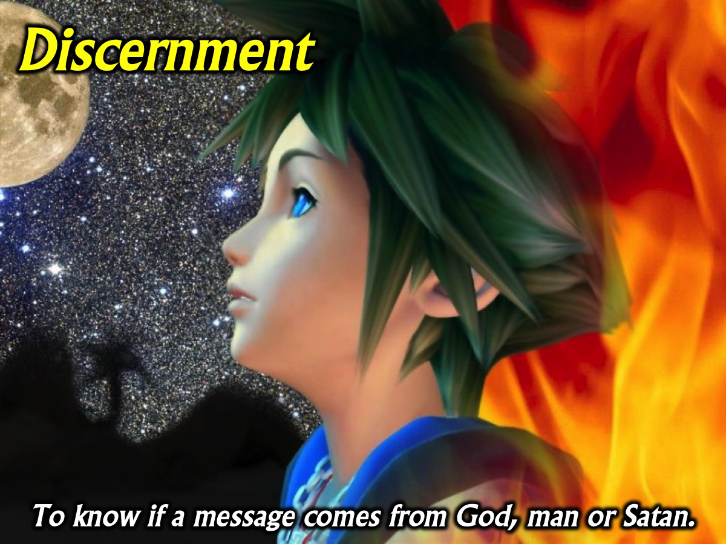
Notes:
2. Discernment: To know if a message comes from God, man or Satan. (1 Corinthians 12:10; Matthew 16:21-23; Acts 5:1-11; 16:16-18; 1 John 4:1-6)

Slide 24

Notes:
3. Encouragement: To share a word of encouragement with somebody. (Romans 12:8; Timothy 4:13; Hebrews 10:25; Acts 14:22)

Slide 25
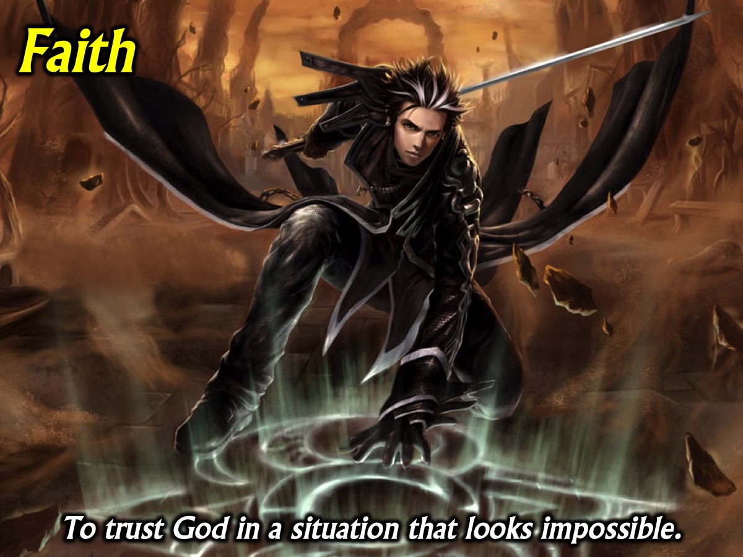
Notes:
4. Faith: To trust God in a situation that looks impossible. (1 Corinthians 12:9; Acts 11:22-24; 27:21-25; Hebrews 11; Romans 4:18-21)

Slide 26

Notes:
5. Giving: To give generously to meet needs around you. (Romans 12:8; 2 Corinthians 8:1-7; 9:2-8; Mark 12:41-44)

Slide 27
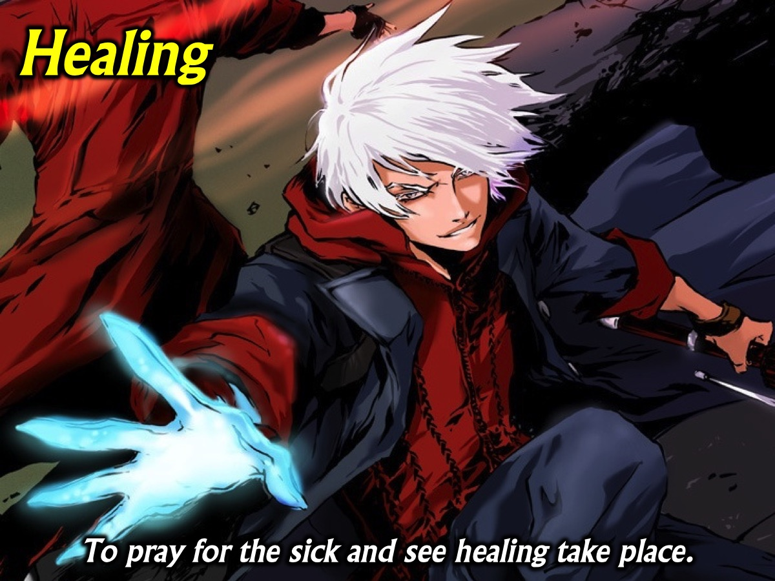
Notes:
6. Healing: To pray for the sick and see healing take place (1 Corinthians 12:9, 28; Acts 3:1-10; 5:12-16; Acts 9:32-35; 28:7-10)

Slide 28

Notes:
7. Helps: To help others reach their potential and achieve goals. (1 Corinthians 12:28; Romans 16:1-2; Acts 9:36; Luke 8:23; Mark 15:40-41)

Slide 29

Notes:
8. Knowledge: To get understanding about a situation from God. (1 Corinthians 2:14; 12:8; Acts 5:1-11; Colossians 2:2-3; 2 Corinthians 11:6)

Slide 30

Notes:
9. Leadership: To help people work together to do God’s work. (1 Timothy 5:17; Acts 7:10; 15:7-11; Romans 12:8; Hebrews 13: 17; Luke 9:51)

Slide 31

Notes:
10. Mercy: To act compassionately toward people who are suffering. (Romans 12:8; Mark 9:41; Acts 11:28-30; 16:33-34; Luke 10:33-35; Matthew 20:29-34; 25:34-40)

Slide 32

Notes:
11. Miracles: To perform supernatural acts to bring glory to God. (1 Corinthians 12:10, 28; Acts 9:36-42; 19:11-20; Acts 20:7-12; Romans 15:18-19; 2 Corinthians 12:12)

Slide 33
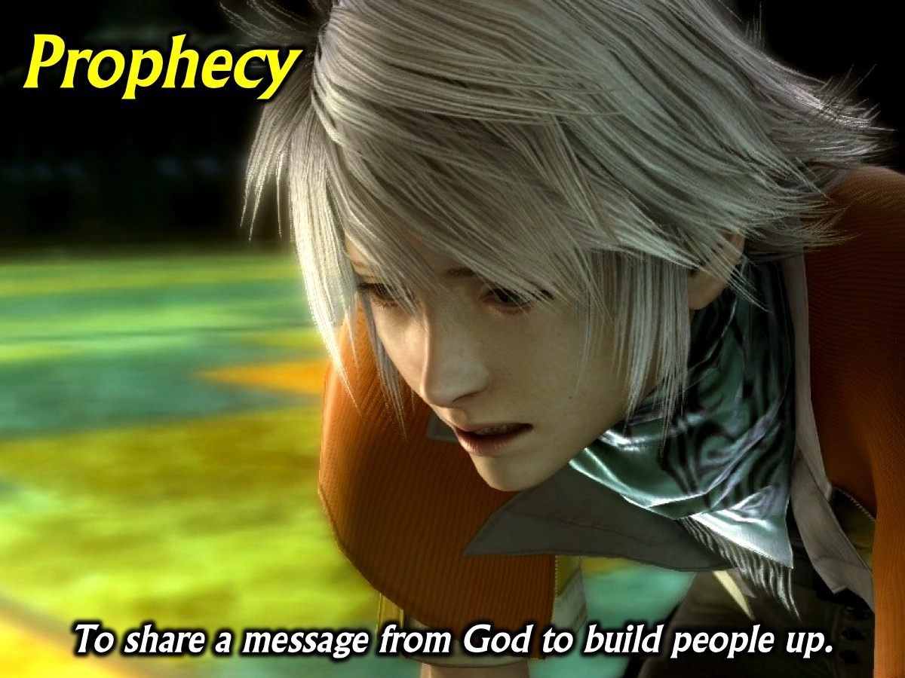
Notes:
12. Prophecy: To share a message from God to build people up. (1 Corinthians 12:10,28; Ephesians 4:11-14; Romans 12:6; Luke 7:26; Acts 15:32; 21:9-11)

Slide 34
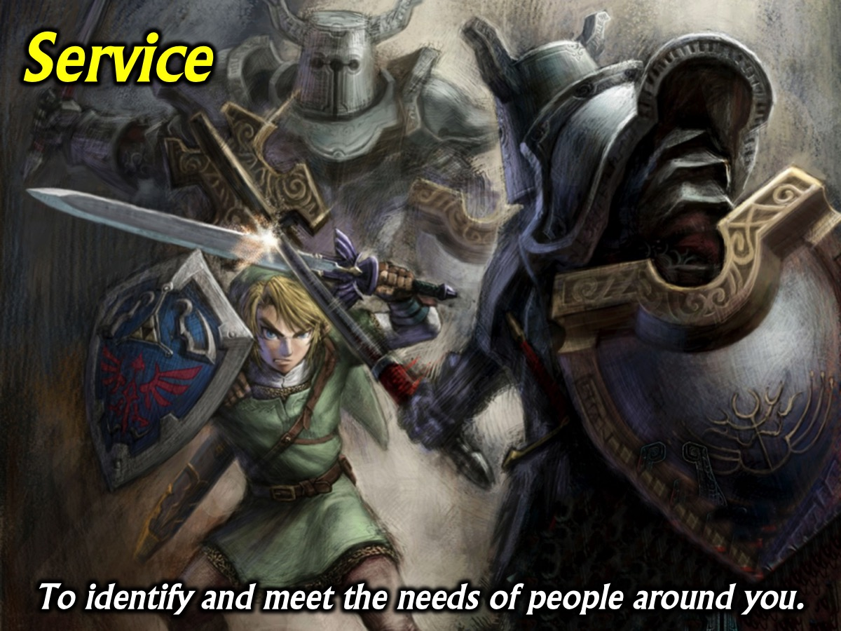
Notes:
13. Service: To identify and meet the needs of people around you. (2 Timothy 1:16-18; Romans 12:7; Acts 6:1-7; Titus 3:14; Galatians 6:2, 10)

Slide 35

Notes:
14. Teaching: To communicate Gods Word so others understand. (1 Corinthians 12:28; Ephesians 4:11-14; Romans 12:7; Acts 18:24-28; 20:20-21)

Slide 36

Notes:
15. Wisdom: To share wise insights so people know how to act. (1 Corinthians 2:1-3; 12:8; Acts 6:3,10; James 1:5-6; 2 Peter 3:15-16)

Slide 37

Notes:
Share Your Spiritual Gifts: Take turns in your small group sharing your gifts with each other.

Slide 38

Notes:
How Do You Grow Your Gifts? (1) Practise: People sometimes tell me that they think I am pretty good as a preacher. Do you know that I preached my first sermon when I was 15 and my knees were knocking and I think it was not a very good sermon. I had to practice, practice and practice some more, to develop my skills as a preacher. (2) Feedback: Ask people to evaluate your use of a gift and for ways in which they think you can improve. (3) Prayer: Ask God to increase the effectiveness of the gift that He is working through you.

Slide 39

Notes:
Prayer

Slide 40

Notes:
Next Sunday we are going to look at what the Word says about Suffering.

