Slide 1
Notes:
Welcome to the Word-On series where each week we are looking at what the Bible says about different topics.

Slide 2
Notes:
In Week 1 we looked at what the Word says about God.

Slide 3
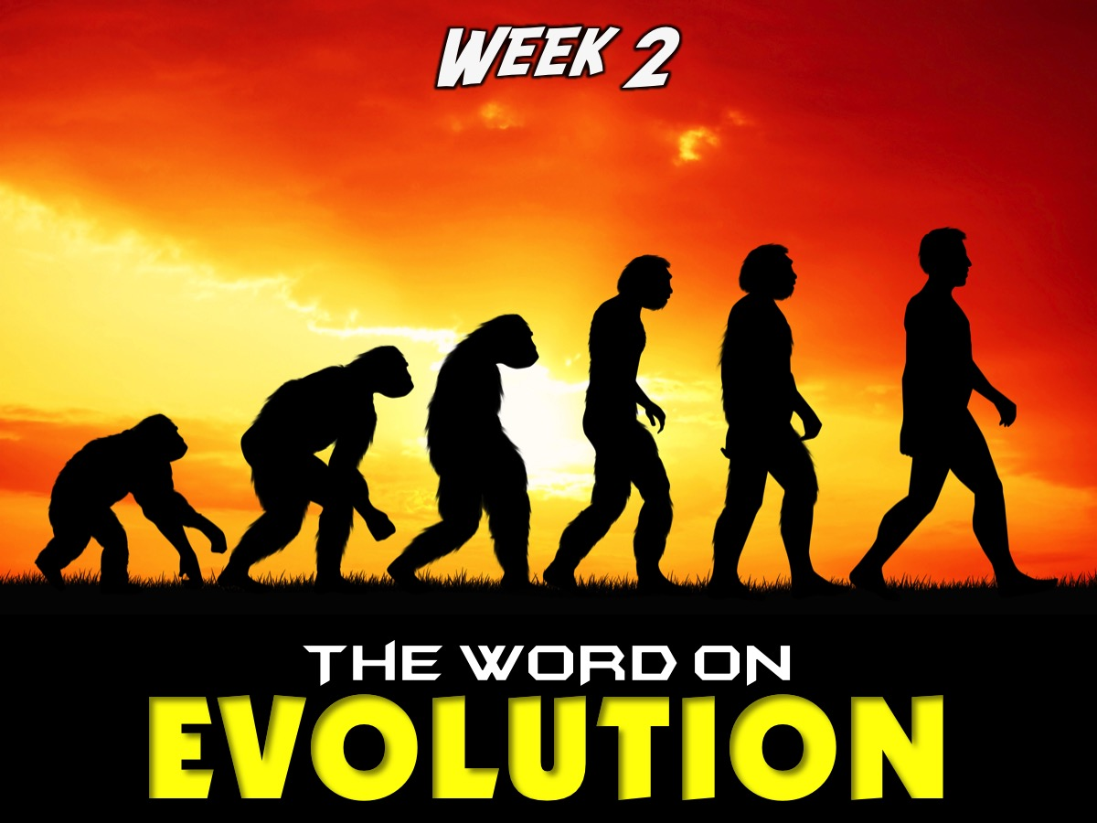
Notes:
In Week 2 we looked at what the Word says about Evolution.

Slide 4
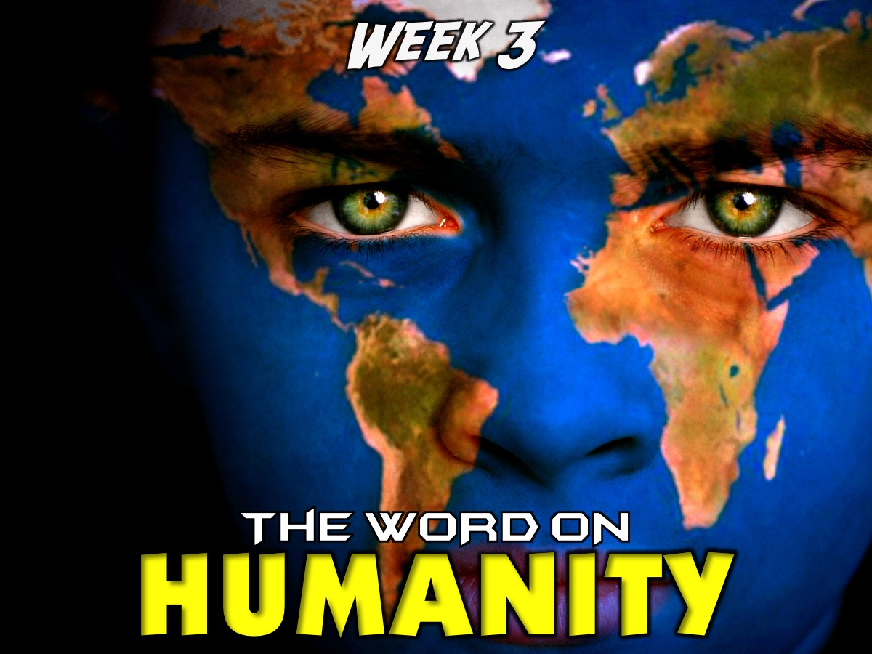
Notes:
In Week 3 we looked at what the Word says about Humanity.

Slide 5
Notes:
In Week 4 we looked at what the Word says about Spiritual Warfare.

Slide 6
Notes:
In Week 5 we looked at what the Word says about Media.

Slide 7
Notes:
In Week 6 we looked at what the Word says about Prophecy.

Slide 8
Notes:
In Week 7 we looked at what the Word says about Lifestyle.

Slide 9
Notes:
Last Week we looked at what the Word says about Spiritual Gifts.

Slide 10
Notes:
This week we are looking at the Word on Suffering.

Slide 11
Notes:
Sharing: What suffering have you experienced?

Slide 12
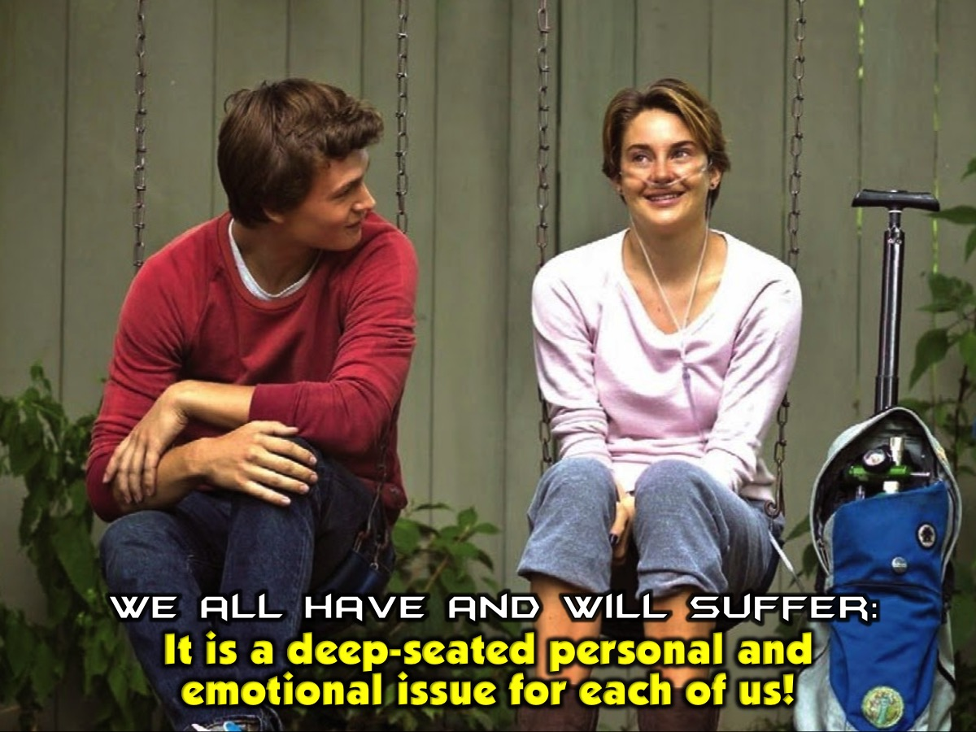
Notes:
The fact that we all have, and will, experience suffering makes it more than just a philosophical issue. It means that suffering, for each of us, is a deep-seated personal and emotional issue.

Slide 13
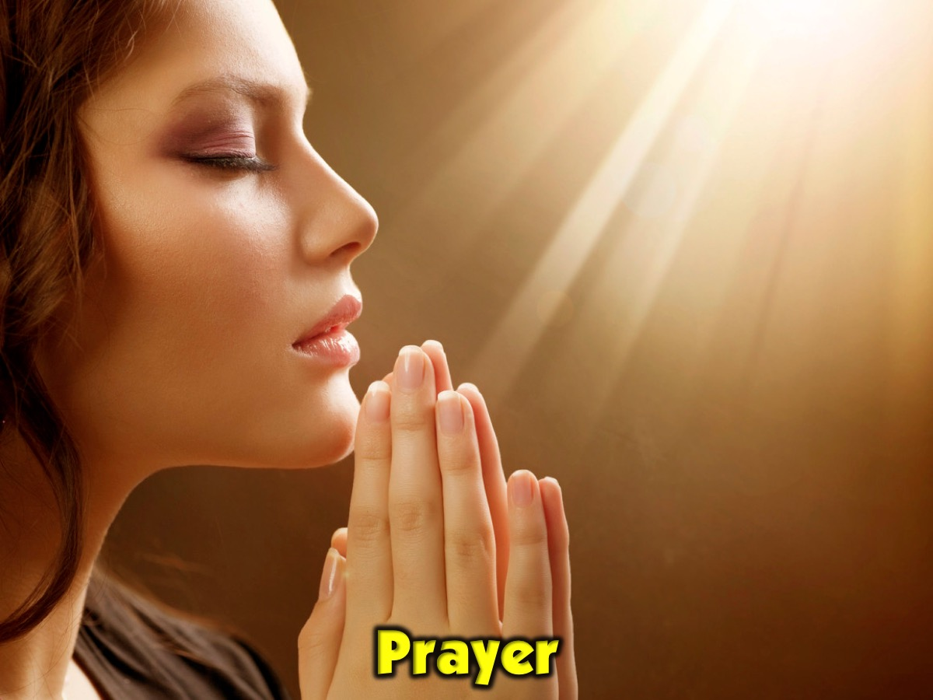
Notes:
Prayer

Slide 14
Notes:
What is Suffering? Suffering is the experience of pain, distress, or hardship. Suffering has many faces. It can be psychological, physical, emotional, or spiritual. When we experience suffering, it is often the case that we experience more than one type of suffering.

Slide 15
Notes:
There are two types of suffering: (1) Suffering caused by human beings (we call this moral evils) and (2) Suffering caused by nature (i.e. natural disasters and illness).

Slide 16
Notes:
Do You Hear Questions? Each of us have asked or heard asked the following question or variations of it: If God is all-powerful, all-loving, and all-good, why does suffering exist? Why does God allow suffering? Given that suffering exists, is God truly all-powerful, all-loving, and all-good?

Slide 17
Notes:
Video: If God exists, why do bad things happen? Get it on YouTube at: https://www.youtube.com/watch?v=WwwljT_YmSw (Cut at 3:48)

Slide 18
Notes:
How Do We Explain Suffering? The existence of suffering does not mean that God is not all-powerful, all-knowing, all-loving, and all-good. How can we better understand why suffering exists?

Slide 19
Notes:
God is all Powerful, Knowing, Loving and Good. “The Lord is the everlasting God, the Creator of the ends of the earth. He will not grow tired or weary, and his understanding no one can fathom. He gives strength to the weary and increases the power of the weak”. (Isaiah 40:28-29)

Slide 20
Notes:
The World is Good: There was no lack, disease or death. "God saw all that He had made, and it was very good.” (Genesis 1:31)

Slide 21
Notes:
The World is Fallen. “Creation itself will be liberated from its bondage to decay…we know that the whole of creation itself has been groaning as in the pains of childbirth right up to the present time.” (Romans 8:21-22)

Slide 22
Notes:
God is redeeming the world. “Then I saw a new heaven and a new earth, for the first heaven and the first earth had passed away…He will wipe every tear from their eyes. There will be no more death or mourning or crying or pain, for the old order of things has passed away.” (Revelation 21:1,4)

Slide 23
Notes:
The scale of suffering that we witness or experience does not change the underlying issues.

Slide 24
Notes:
Video: Why Does God Allow Pain and Suffering? Get it on YouTube at: https://www.youtube.com/watch?v=gjcpW_kPYq0

Slide 25
Notes:
How Did God Respond? God responded by revealing himself.

Slide 26
Notes:
God revealed Himself as Immanuel: God with us. “The Lord will give you a sign: The virgin will conceive and give birth to a son, and will call Him Immanuel.” (Isaiah 7:14). See also: “And surely I am with you always, to the very end of the age.” (Matthew 28:20) and “I will never leave you or forsake you.” (Hebrews 13:5)

Slide 27
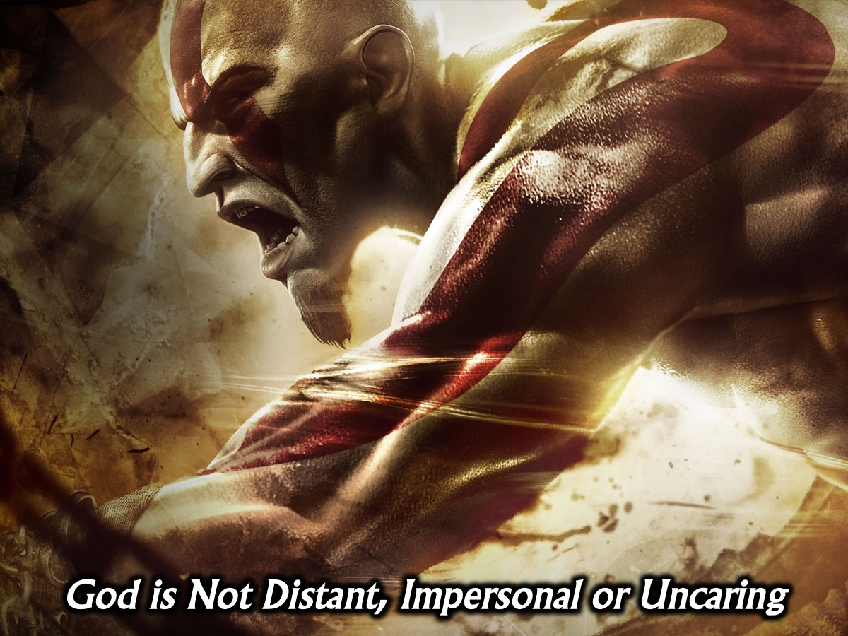
Notes:
God did not reveal Himself as distant, impersonal, or uncaring.

Slide 28
Notes:
“The Lord is like a father to His children, tender and compassionate to those who fear him.” (Psalm 103:13) See also:
“You know how troubled I am; you have kept a record of my tears.” (Psalm 56:6)
“For we do not have a high priest who is unable to empathize with our weaknesses, but we have one who has been tempted in every way, just as we are – yet he did not sin.” (Hebrews 4:15)
“Since he himself has gone through suffering and testing, he is able to help us when we are being tested.” (Hebrews 2:18)

Slide 29
Notes:
“He had no beauty or majesty to attract us to him, nothing in his appearance that we should desire him. He was despised and rejected by mankind, a man of suffering, and familiar with pain. Like one from whom people hide their faces he was despised, and we held him in low esteem. Surely he took up our pain and bore our suffering.” (Isaiah 53:2-3)

Slide 30
Notes:
How should we respond? “Praise be to the God and Father of our Lord Jesus Christ, the Father of compassion and the God of all comfort, who comforts us in all our troubles, so that we can comfort those in any trouble with the comfort we ourselves receive from God. For just as we share abundantly in the sufferings of Christ, so also our comfort abounds through Christ.” (2 Corinthians 1:3-5)

Slide 31
Notes:
Video: Why Is There Suffering In The World? Jefferson Bethke. Get it on YouTube at: https://www.youtube.com/watch?v=f_ESjoVyYGw (Cut at 3:25)

Slide 32
Notes:
Cast your burdens onto Jesus: “Come to me, all you who are weary and burdened, and I will give you rest. Take my yoke upon you and learn from me, for I gentle and humble in heart, and you will find rest for your souls. For my yoke is easy and my burden is light.” (Matthew 11:28-30). See also: “Cast all your anxiety on Him because He cares for you.” (1 Peter 5:7)

Slide 33
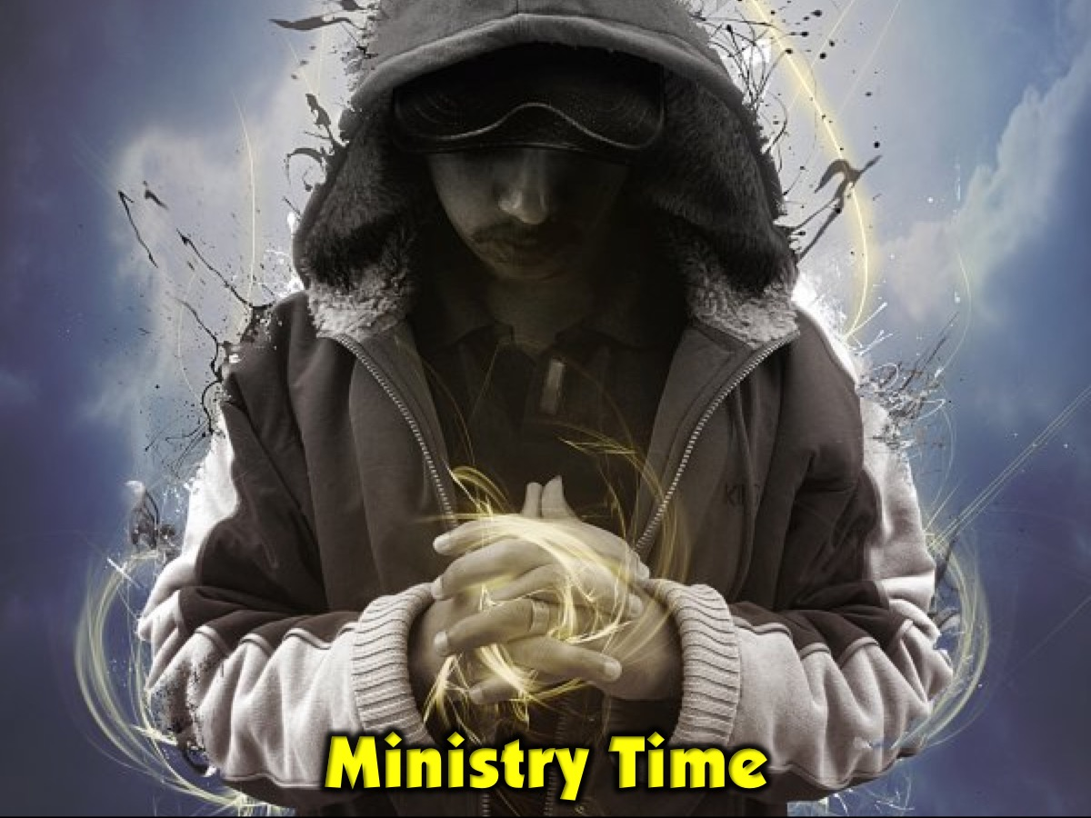
Notes:
Ministry by Holy Spirit and Adult Leaders

Slide 34
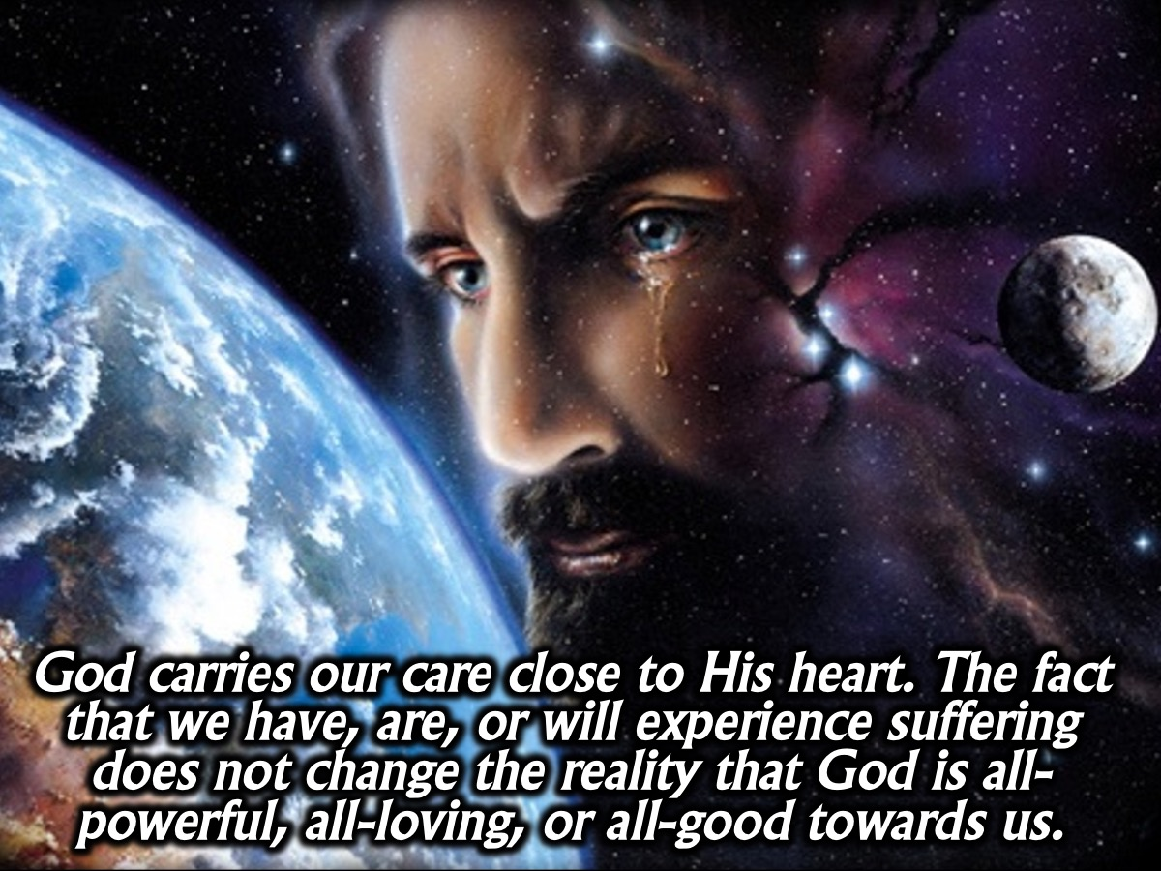
Notes:
Conclusion: God carries our care close to His heart. The fact that we have experienced, are currently experiencing, or will experience suffering does not change the reality that God is all-powerful, all-loving, or all-good towards us.

Slide 35
Notes:
Christianity is not a promise to enjoy life without suffering or to be given a shortcut through it. It is a promise that pain, sorrow, sin – both ours and others' – will NOT swallow us, destroy us, define us, or have the final word. Jesus has won the victory. And in him so have we! Let suffering be the door you walk through that draws you to deeper intimacy with Jesus. Jesus understands heartbreak, betrayal, abandonment, loneliness, sorrow, and pain. He is acquainted with grief. He cares. He cares for you.

Slide 36
Notes:
Prayer. “May the God of hope fill you with all joy and peace as you trust in Him, so that you may overflow with hope by the power of the Holy Spirit.” (Romans 15:13)

Slide 37
Notes:
Next Sunday – in the final week in this series - we are going to look at what the Word says about Miracles.

