Slide 1
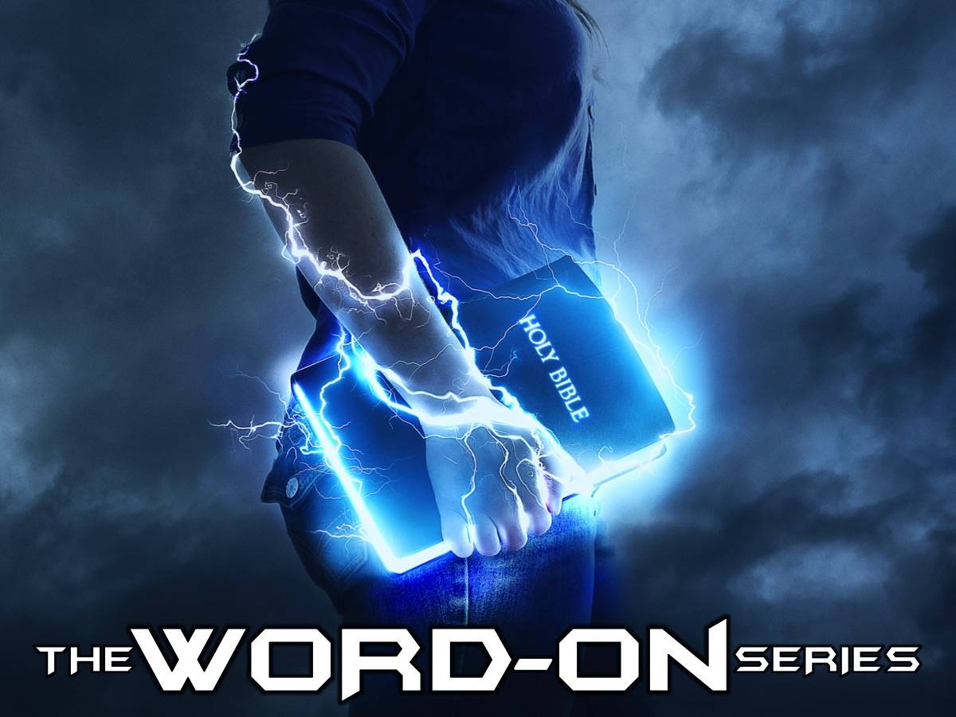
Notes:
Welcome to the Word-On series where each week we are looking at what the Bible says about different topics.

Slide 2
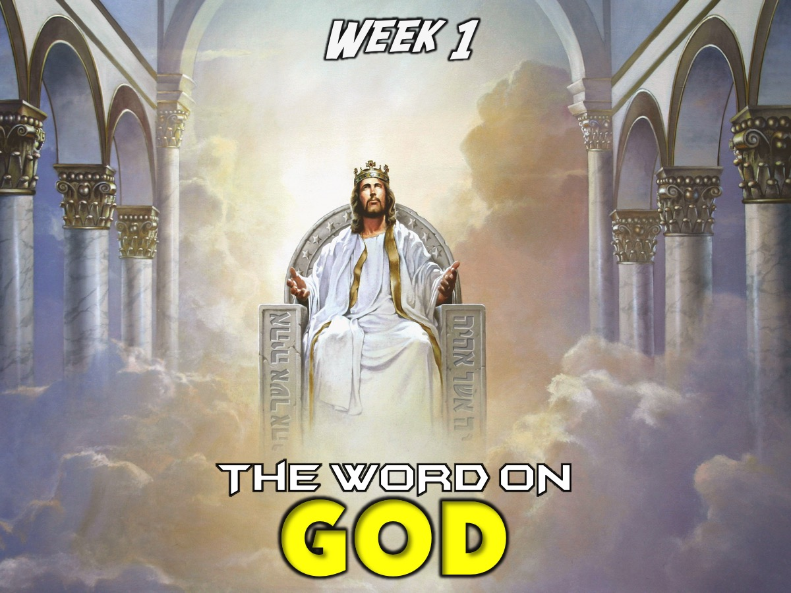
Notes:
In Week 1 we looked at what the Word says about God.

Slide 3
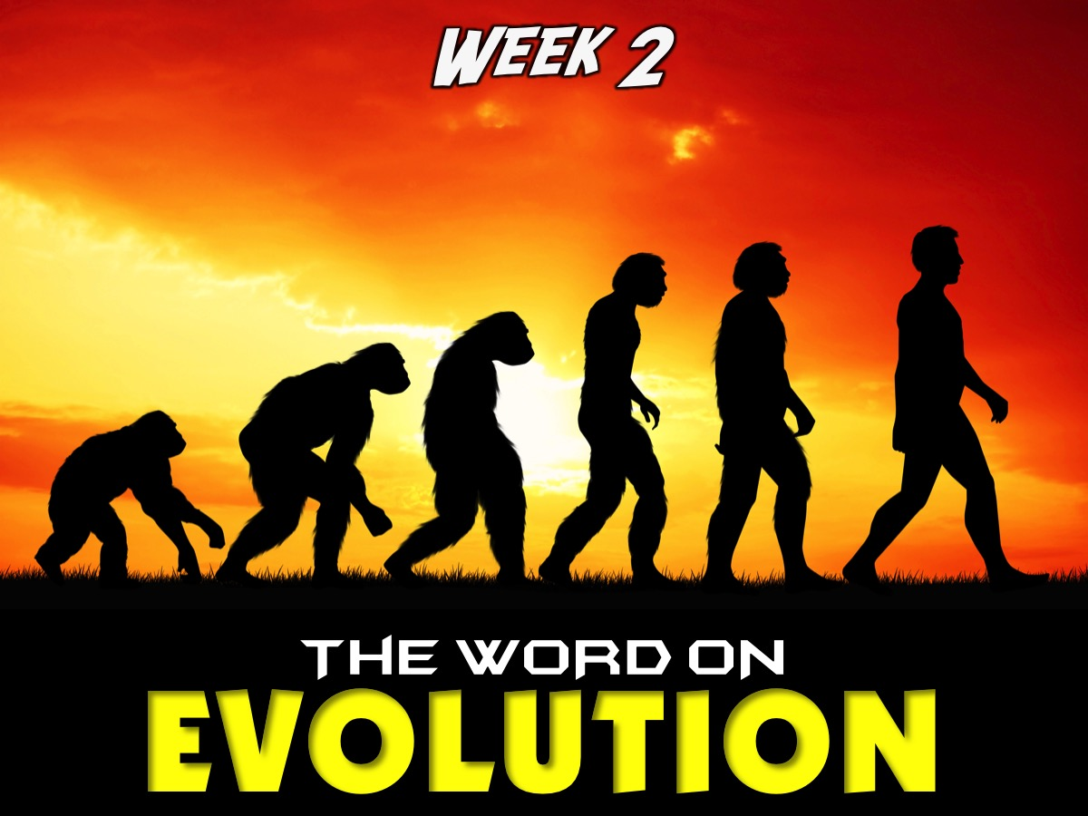
Notes:
In Week 2 we looked at what the Word says about Evolution.

Slide 4

Notes:
In Week 3 we looked at what the Word says about Humanity.

Slide 5
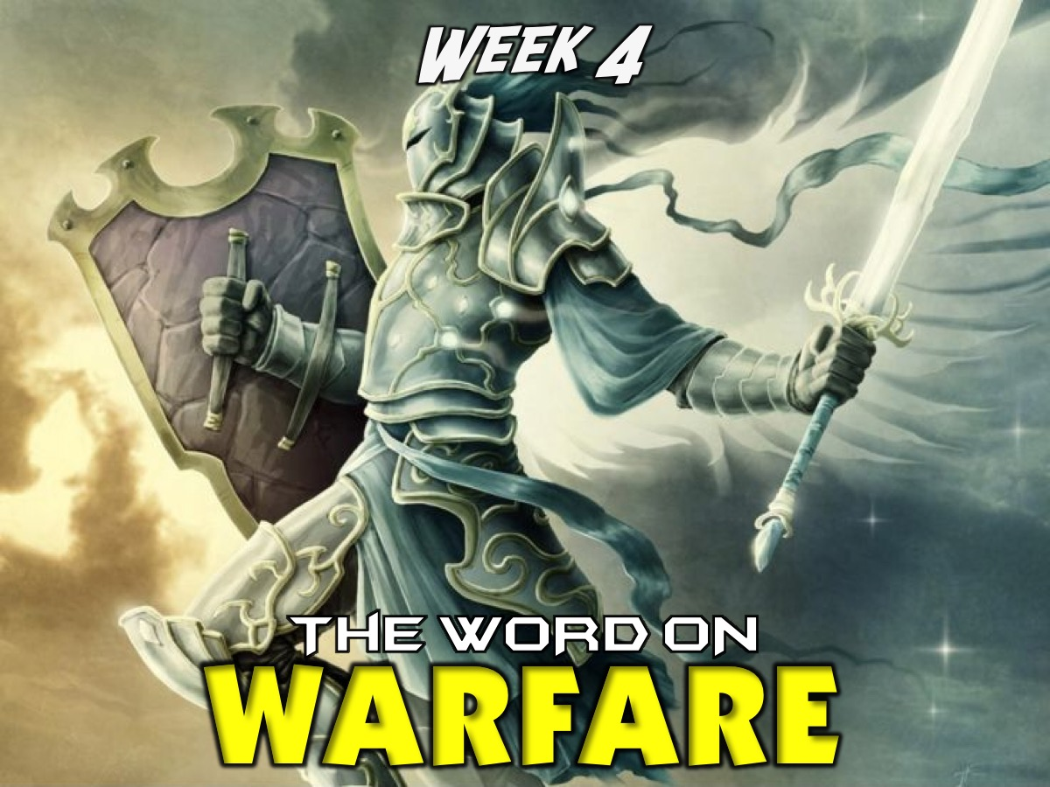
Notes:
In Week 4 we looked at what the Word says about Spiritual Warfare.

Slide 6
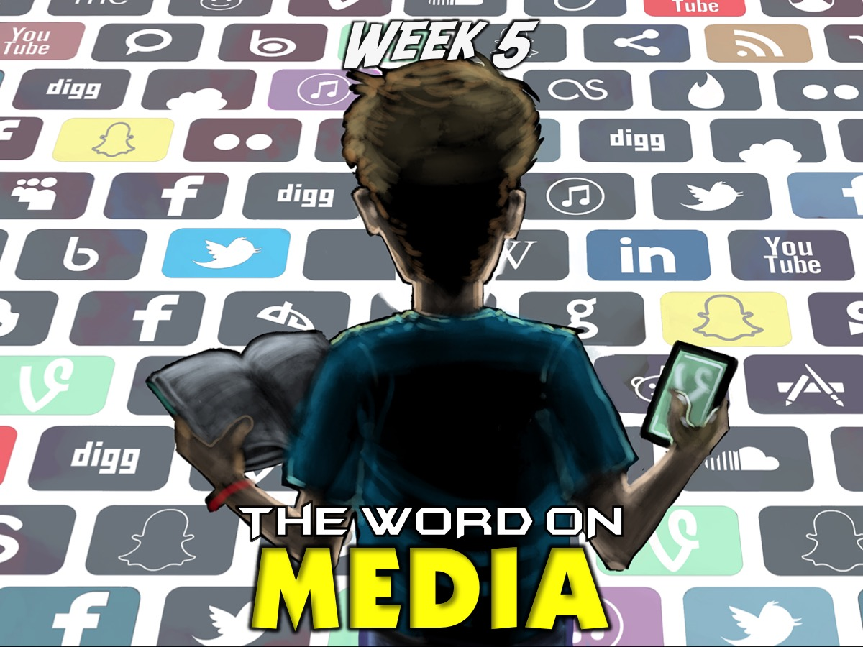
Notes:
In Week 5 we looked at what the Word says about Media.

Slide 7
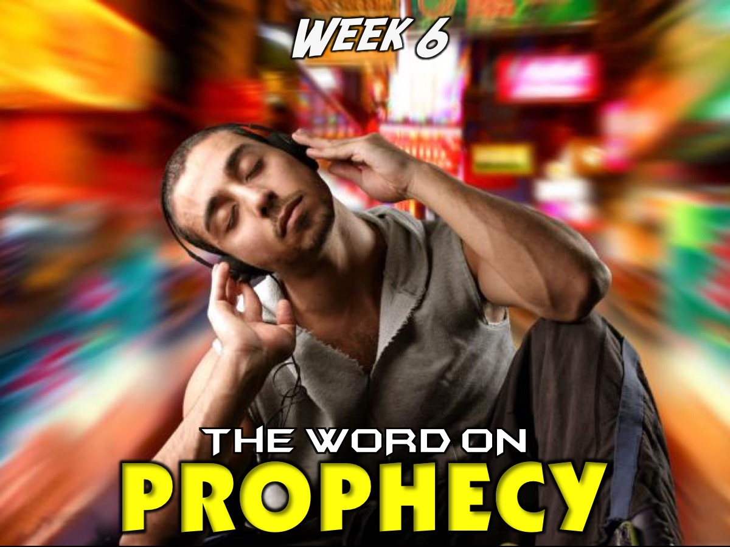
Notes:
In Week 6 we looked at what the Word says about Prophecy.

Slide 8

Notes:
In Week 7 we looked at what the Word says about Lifestyle.

Slide 9

Notes:
In Week 8 we looked at what the Word says about Spiritual Gifts.

Slide 10
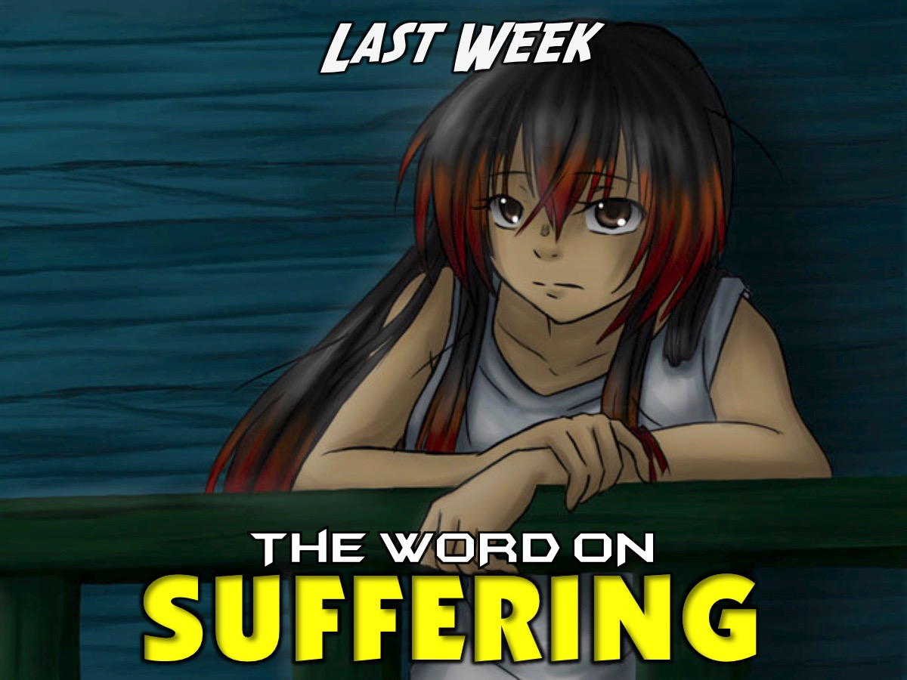
Notes:
Last week we looked at the Word on Suffering.

Slide 11

Notes:
This week we are looking at what the Word says about Miracles.

Slide 12
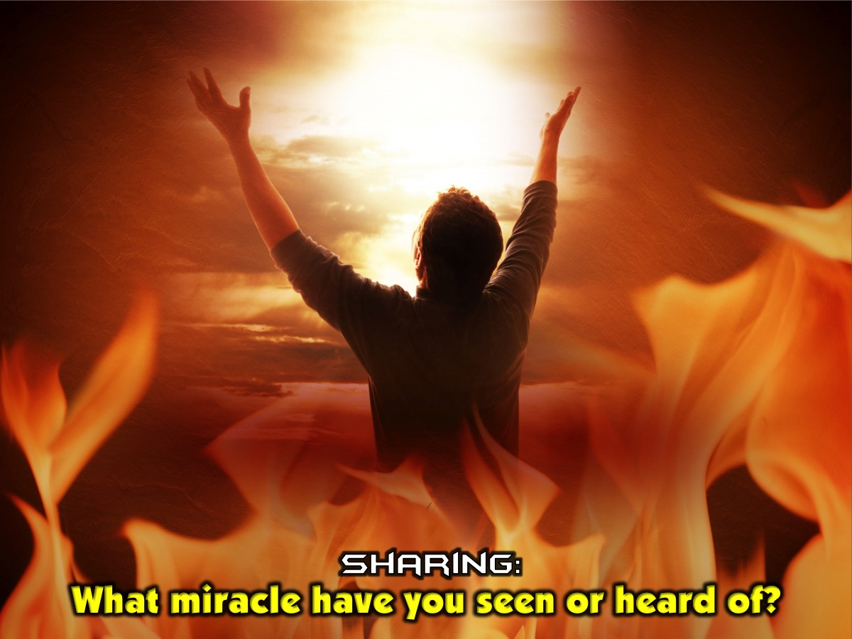
Notes:
Sharing: What miracle have you seen or heard of?

Slide 13
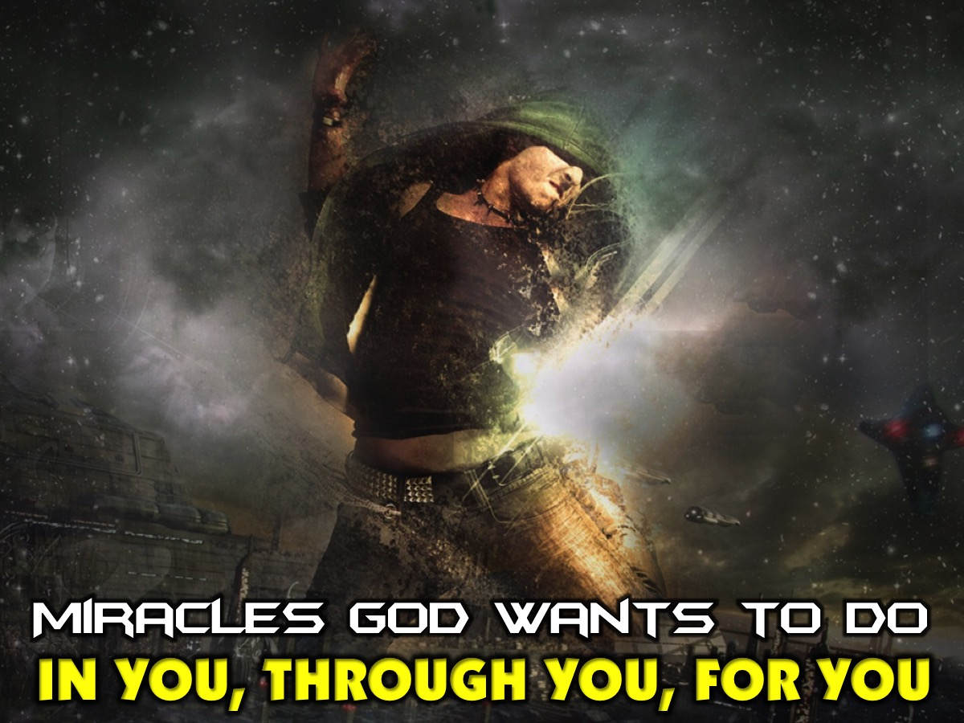
Notes:
Today I am going to talk about how God wants to do miracles IN you, THROUGH you and FOR you!

Slide 14
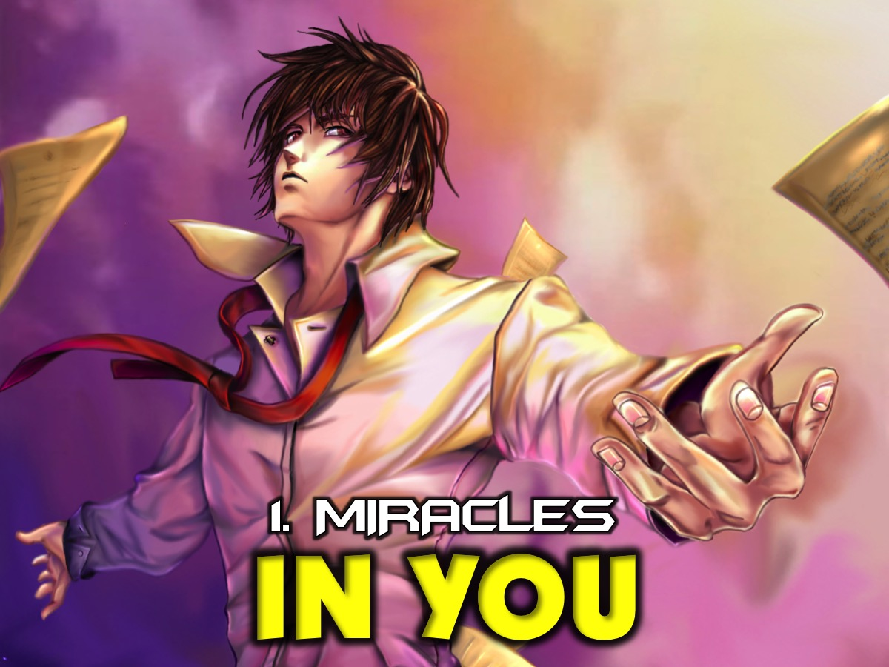
Notes:
1. Miracles God Wants to Do IN You. God wants to do amazing miracles in us.

Slide 15
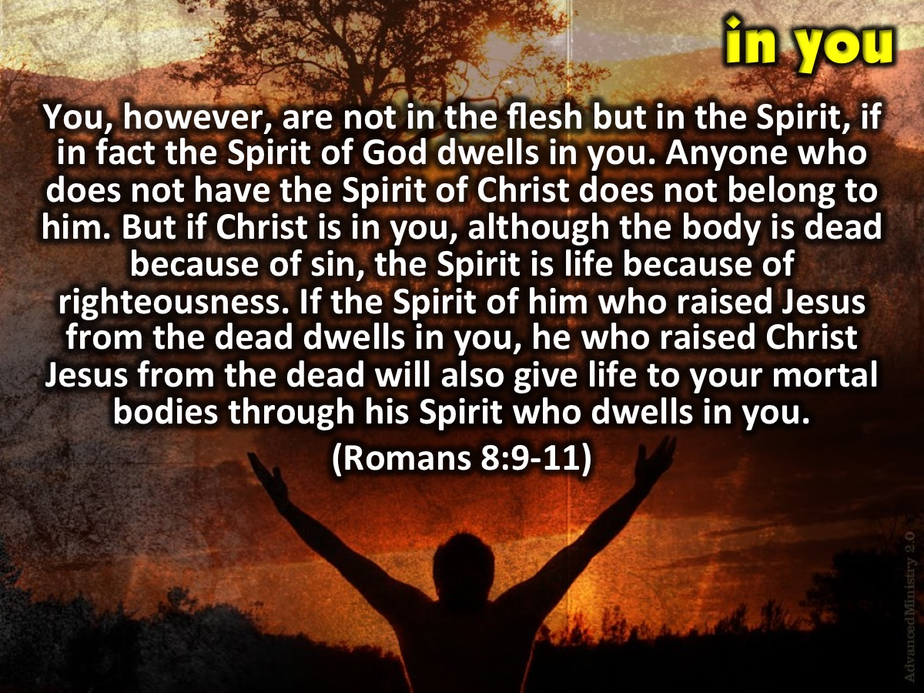
Notes:
“You, however, are not in the flesh but in the Spirit, if in fact the Spirit of God dwells in you. Anyone who does not have the Spirit of Christ does not belong to him. But if Christ is in you, although the body is dead because of sin, the Spirit is life because of righteousness. If the Spirit of him who raised Jesus from the dead dwells in you, he who raised Christ Jesus from the dead will also give life to your mortal bodies through his Spirit who dwells in you.” (Romans 8:9-11)

Slide 16
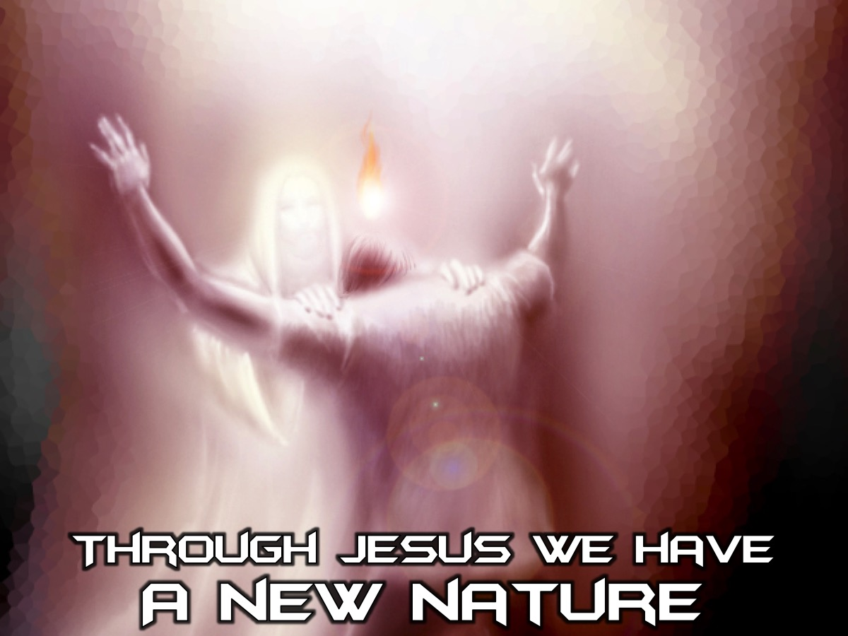
Notes:
Through Jesus we have a new nature. God comes and removes the old nature we had from us and replaced it with a new nature. It was a nature that has a bent towards rebellion against God, to sinning and doing wrong.

Slide 17
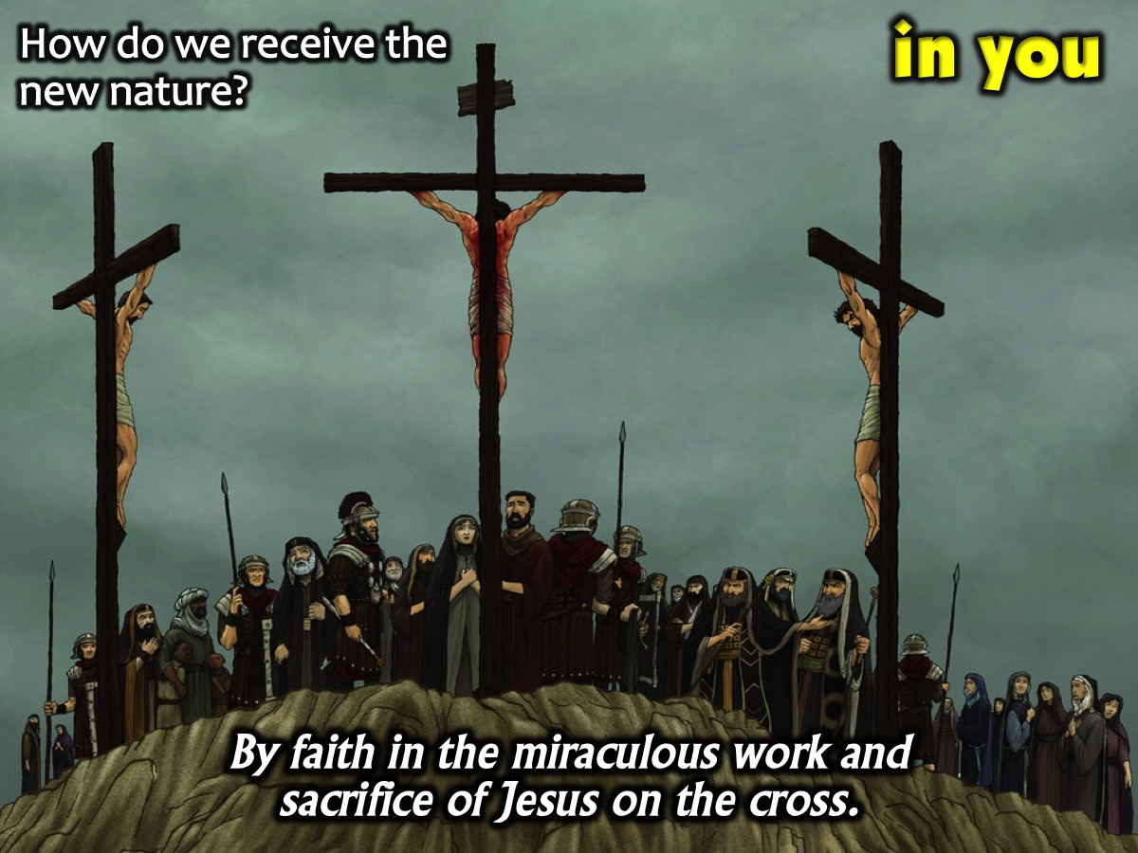
Notes:
(1) How do we receive the new nature? We receive the new nature by having faith in the miraculous work and sacrifice of Jesus on the cross. We can do what Jesus did and be what Jesus was. We can operate in the benefits of the cross towards people. We receive it by faith.

Slide 18
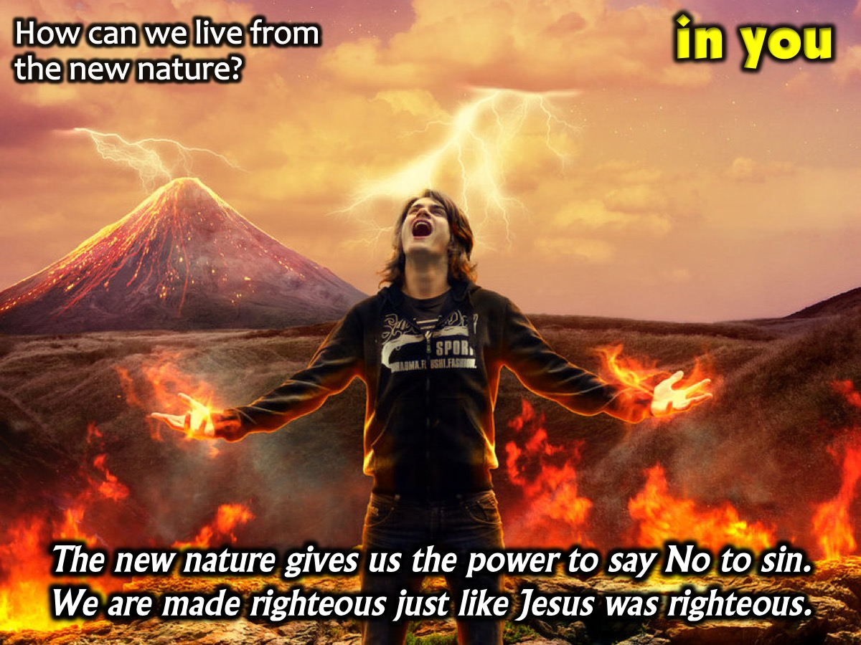
Notes:
(2) How can we live from the new nature? This new nature gives us the power to say no to sin, sin no longer controls us. We are now made righteous, just like Jesus was righteous. How do we live from the new nature? We give our lives to Jesus and start living a new life but then we feel we still commit sin. Everything that was in Christ now dwells in us. His nature is in us. We can only compare ourselves to Jesus and not others. The spirit in us has given us new potential and possibilities. Everything he is we can be on earth. But we still sin. Why? Your mind still needs to be renewed. Romans 12 says our mind must come into alignment with our the new nature. We spend time in the word and relationship with God. Have you had bad friends ever? The more you hang around that bad company the more you are pulled to do what they are doing. But when you hand around good people you are pulled up to a new place and standards. We believe we can reach out for more. The more we spend time with Christ and in his word, his presence pulls us up to a new way of thinking and loving. Miracles start with us realizing that he nature us a new nature and puts to death the old one. We are forever accepted by God.

Slide 19
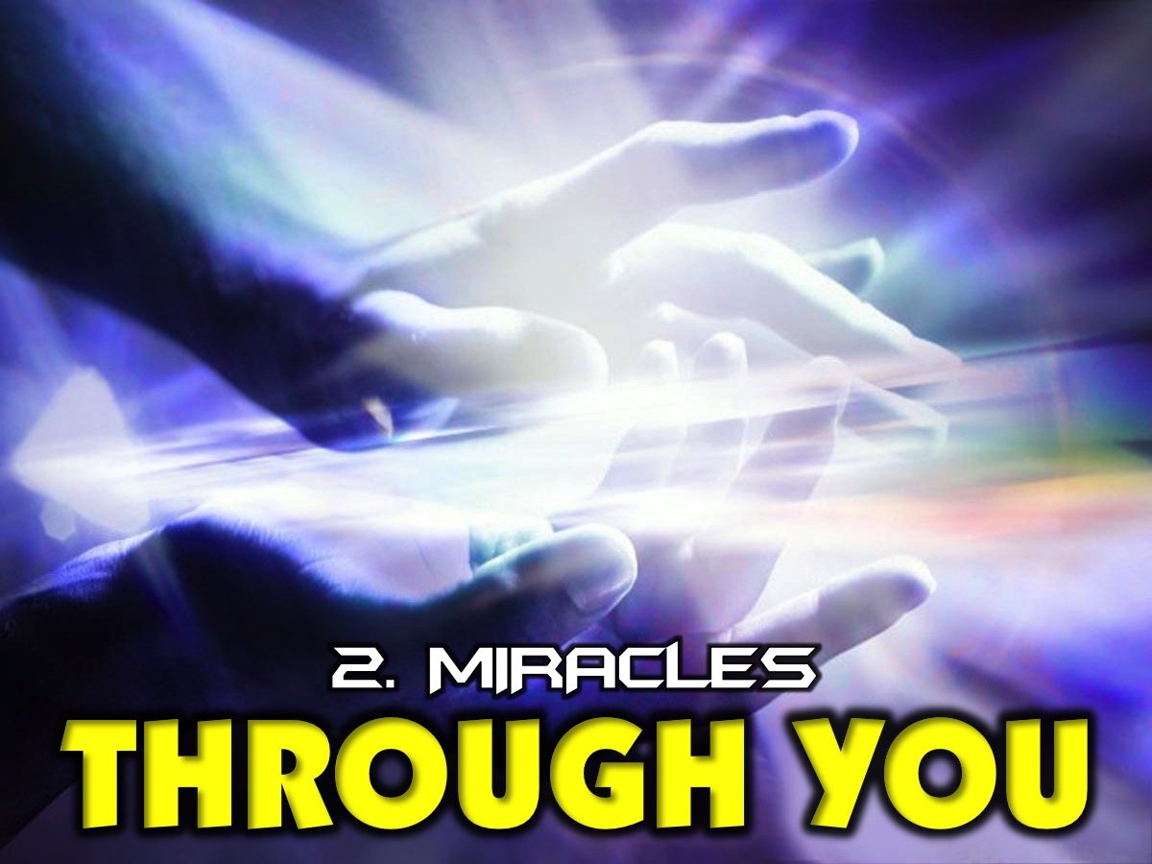
Notes:
2. Miracles God Wants to Do THROUGH You.

Slide 20
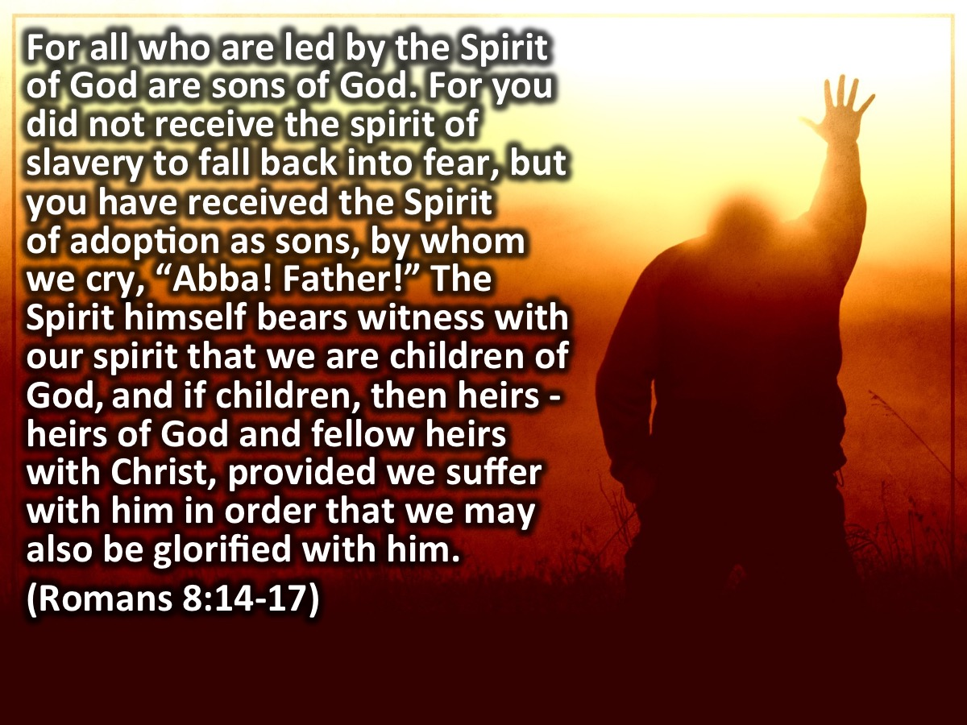
Notes:
“For all who are led by the Spirit of God are sons of God. For you did not receive the spirit of slavery to fall back into fear, but you have received the Spirit of adoption as sons, by whom we cry, “Abba! Father!” The Spirit himself bears witness with our spirit that we are children of God, and if children, then heirs - heirs of God and fellow heirs with Christ, provided we suffer with him in order that we may also be glorified with him.” (Romans 8:14-17)

Slide 21
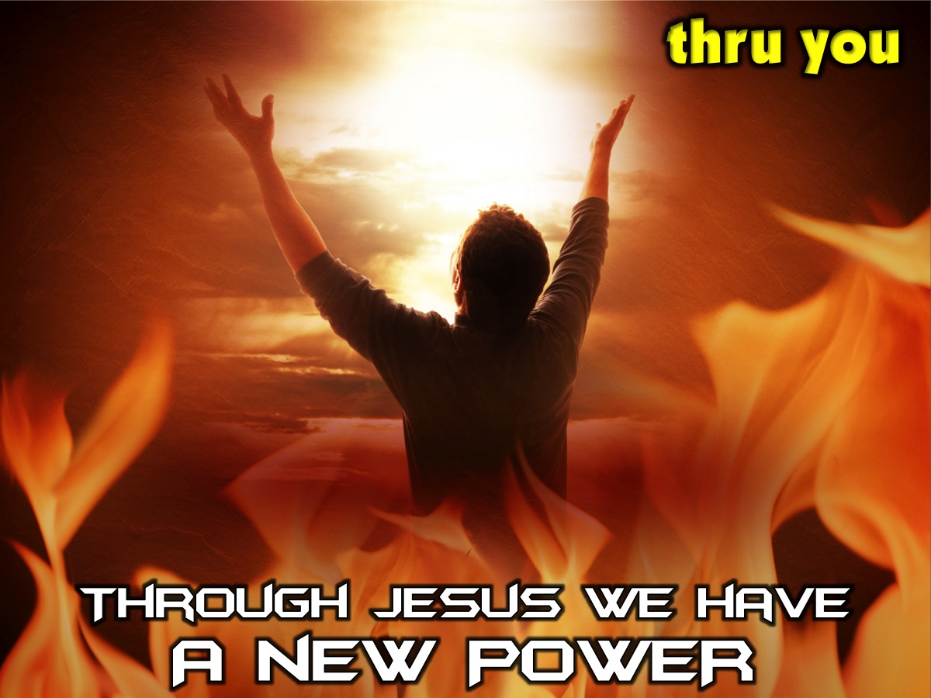
Notes:
Through Jesus we have a New Power. Traffic cops have authority but not power. They exercise authority from the government. They don't have to physically move cars just put up their hand and you comply. Through Jesus we have a new power. We have been given authority and power. We can dictate what happens in our space. We tend to think that we have to be super spiritual to see miracles through us. We just need courage and faith. Just keep praying for people. The power of God is like a lion in us just wanting to come out of us. It wants to break out of the prison of our lives to free people. Courage is how we release the power of God.

Slide 22
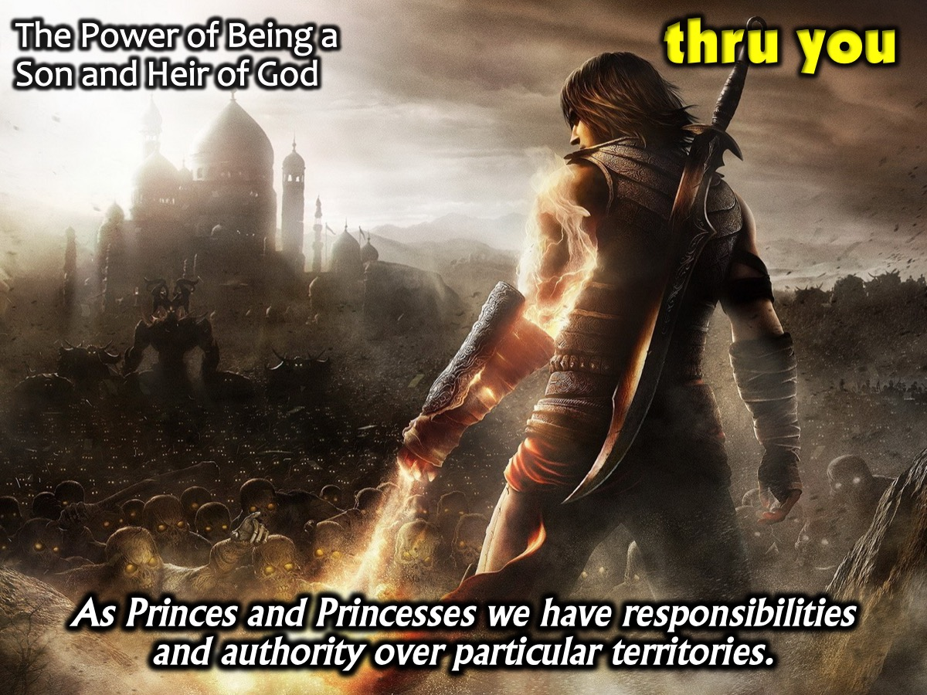
Notes:
(1) The Power of Being a Son and Heir of God. Our bloodline is important. If I had to tell you that you are the son or daughter of a King, that would make you a prince/princess in a particular territory. Because of your identity (prince/princess) you would automatically have responsibilities and authority to execute those responsibilities. How much more now that our we are sons and daughters of God? We receive this new power because we have become sons and daughters of God. He did not make us slaves but his children. Because we have his name we have his power. Names are important. God entrusts us with his name. Every knee will bow to the name of Jesus. He has given that name to us. Huge level of authority and power. When Jesus was 30 his father spoke at his baptism. God introduced Jesus. In that culture, people did business and a father would take his son to a court area and he would introduce his son to them because his son would be from then on trading with people like his father did. "When you see Chris, you are seeing me." Treat him like you would treat me. He represents me in all things and at all times. The importance of being sons and daughters is that God gives us authority to use his power to glorify him and expand his kingdom.

Slide 23
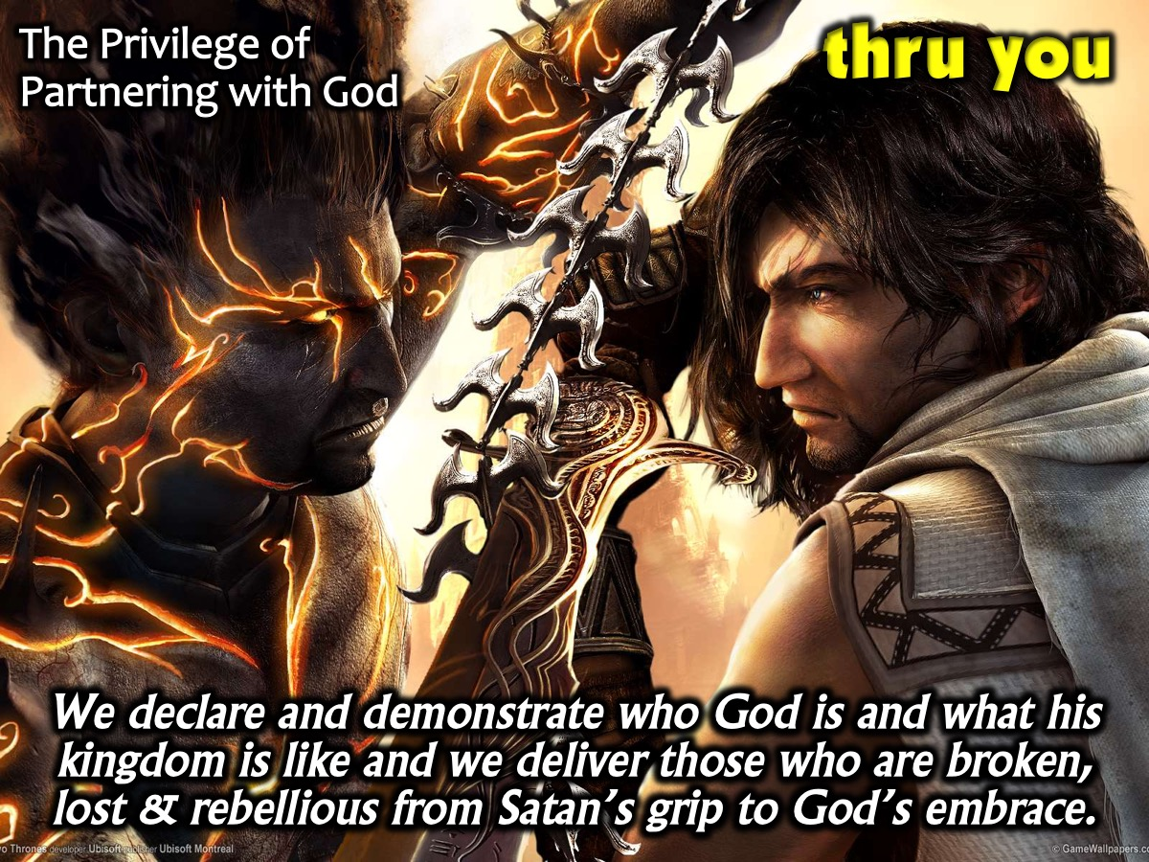
Notes:
(2) The Privilege of Partnering With God. Because of our new identity our responsibility is to declare and demonstrate to the world who God is and what his kingdom is like. We have been given the power and authority to do this and deliver those who are broken, lost and rebellious away from Satan’s grip and back to God's embrace. The Holy Spirit that empowered Jesus during his time on earth is the same Holy Spirit who empowers you to declare and demonstrate the kingdom of God to the world. We have the privilege of partnering with God. God says: "You and I and the going to go around doing my business."

Slide 24
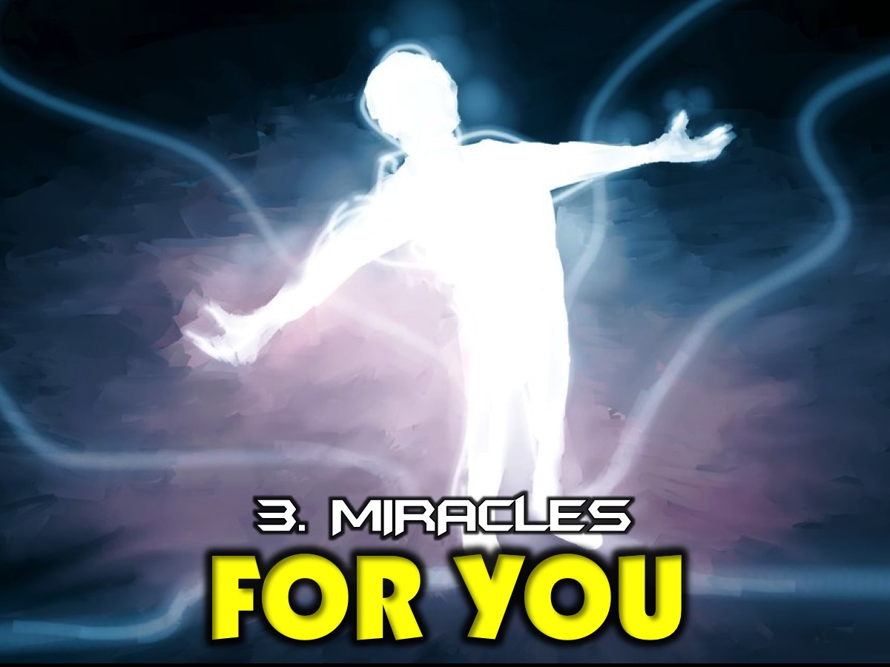
Notes:
3. Miracles God Wants to Do FOR You.

Slide 25
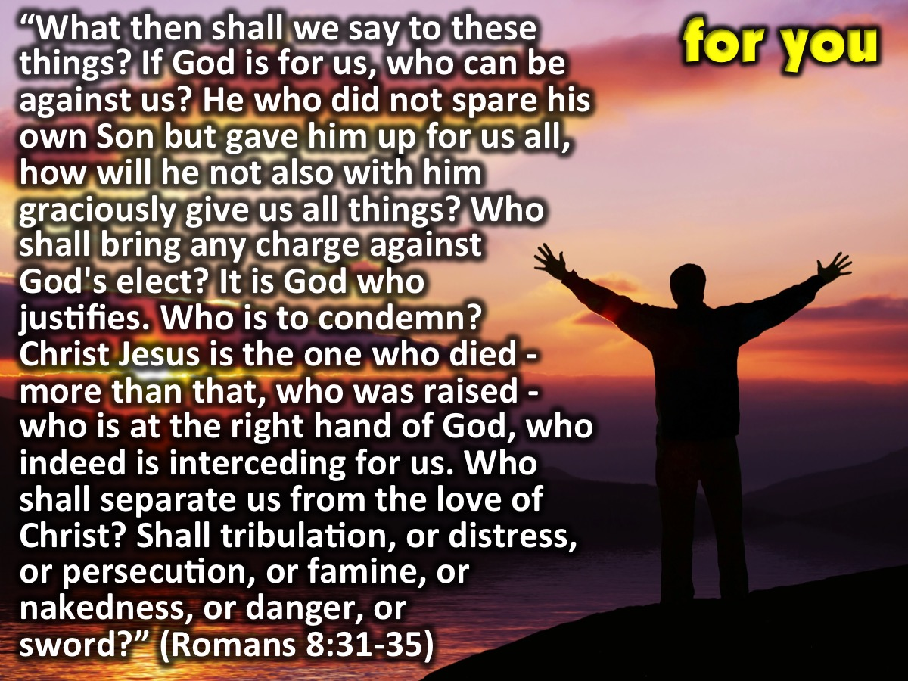
Notes:
“What then shall we say to these things? If God is for us, who can be against us? He who did not spare his own Son but gave him up for us all, how will he not also with him graciously give us all things? Who shall bring any charge against God's elect? It is God who justifies. Who is to condemn? Christ Jesus is the one who died - more than that, who was raised - who is at the right hand of God, who indeed is interceding for us. Who shall separate us from the love of Christ? Shall tribulation, or distress, or persecution, or famine, or nakedness, or danger, or sword?” (Romans 8:31-35)

Slide 26
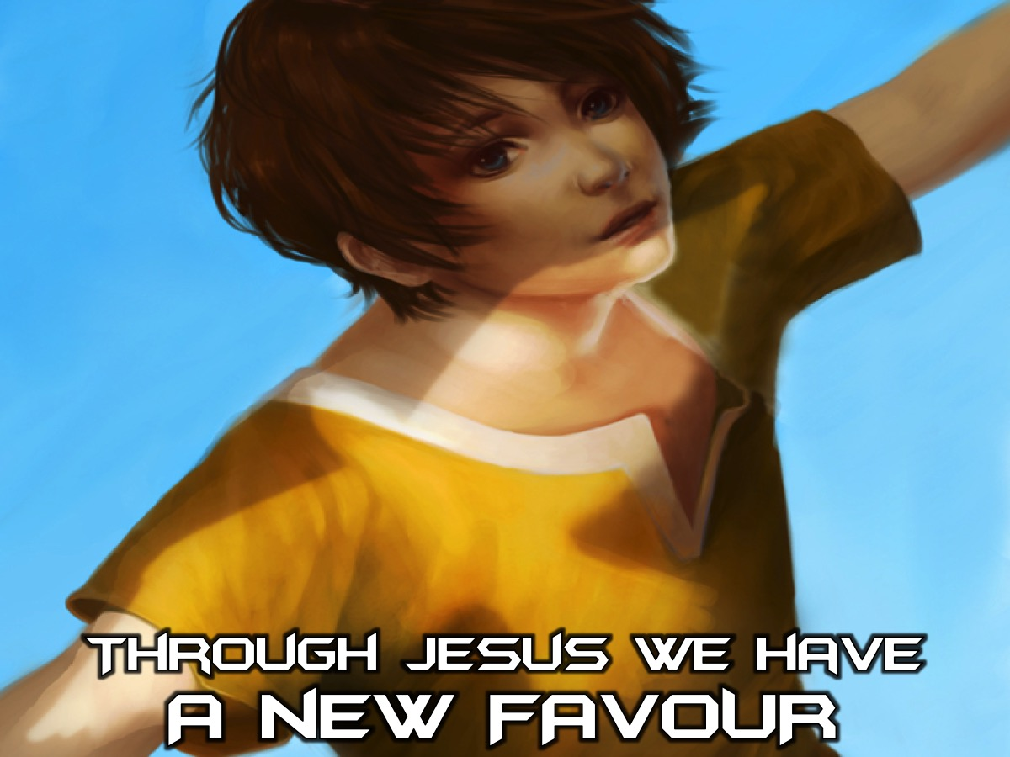
Notes:
Through Jesus we have a New Favour. So we have a new nature and new power to partner with God. We also have a new favour. Even when my kids do right or wrong I am also encouraging them. We sometimes think God is only for us when we do the right thing. He is always with us and he is for us. No matter what season we go through. When we do wrong, God takes us into the wilderness and he reasons with us. He never rejects us. Gods power is not determined by our happiness. Just because we are happy does not mean he blesses us. When we are sad he is still the same. Even on our worst day we can count on his grace to be good to us that allows us to walk into all of life with confidence. We know God is good towards us all the time. God is better that anything in the world and God is stronger than anything we can encounter. This will help us stand before people and kings with courage. Work hard to protect the reality of who God says he is. The Giants are intimidated by our God.

Slide 27
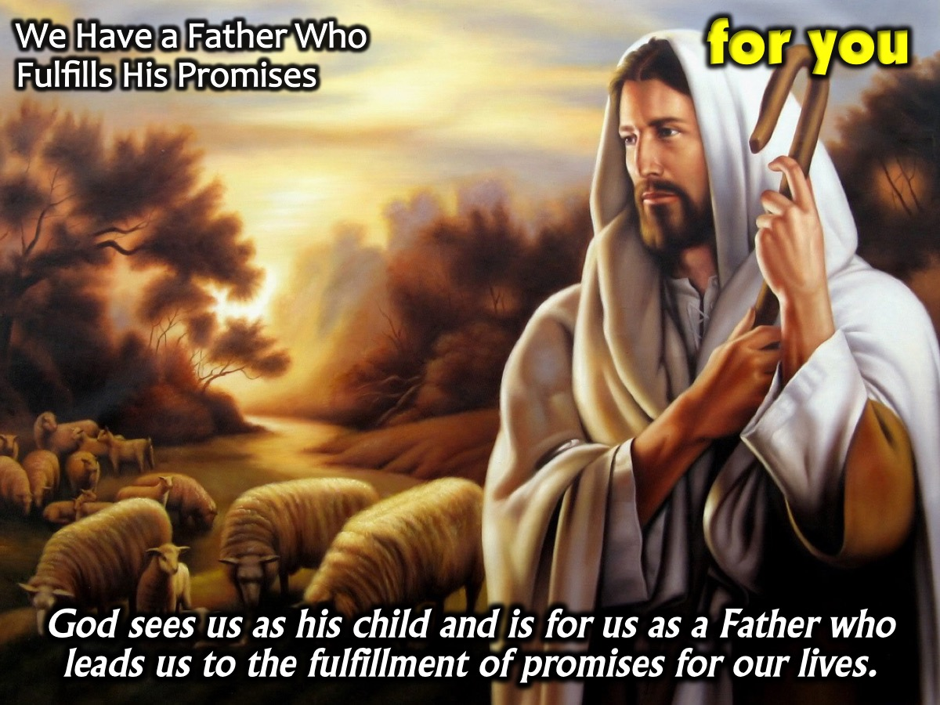
Notes:
(1) We Have a Father Who Fulfills His Promises. God sees us as his child and is for us as a Father who leads us to the fulfillment of promises for our lives. This is why we need to read our bible every day. Find out what he says about himself and about me and know that he will fulfill all his promises.

Slide 28
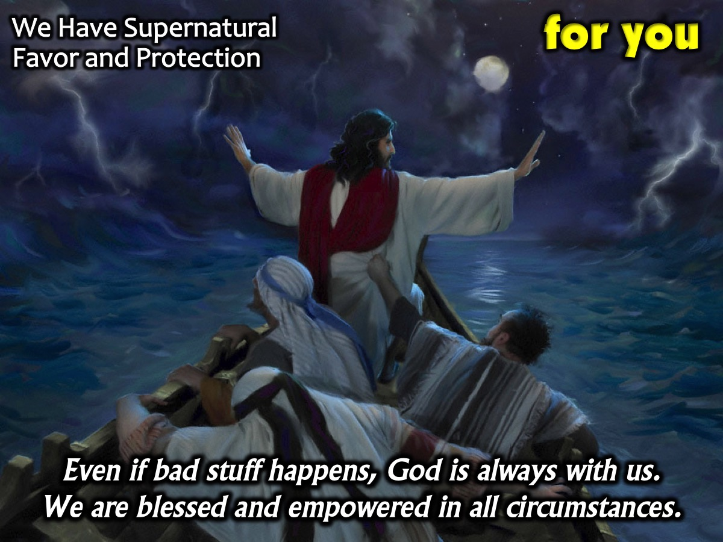
Notes:
(2) We have Supernatural Favour and Protection. Many times we confuse God being 'for us' to mean that nothing bad will ever happen to us. As a result when we go through hard times we tend to think that God does not care, does not see, does not have any power or does not exist. As someone once said, "God never promised that life would be easy, but he did promise that he will be with us." God being with us means that we are blessed and empowered with his favor in whatever circumstance we find ourselves in.

Slide 29
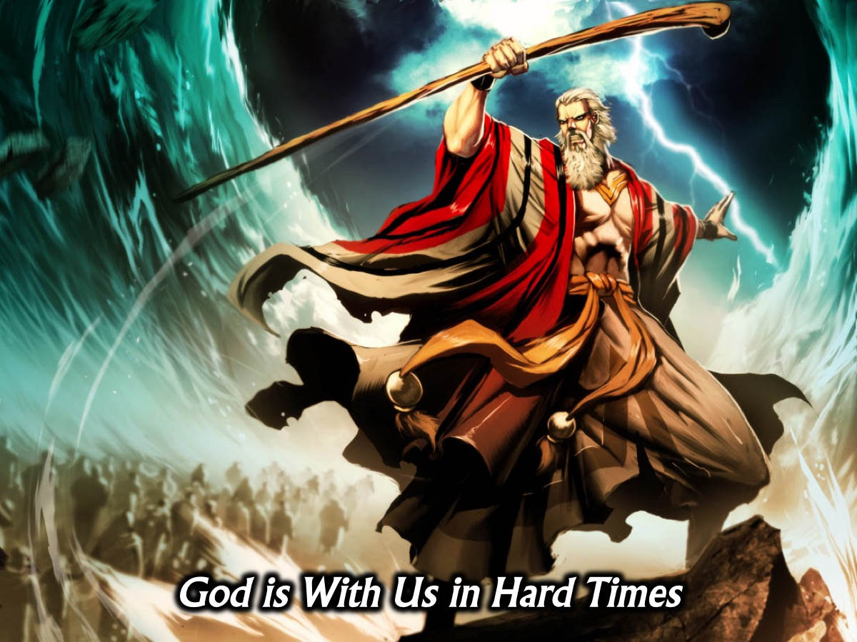
Notes:
* God is with in hard times, just like he was with the Israelites in Egypt when we demonstrated his power to Pharoah and split the Red Sea for their rescue. The Israelites still had God with them even in Egypt when enslaved.

Slide 30
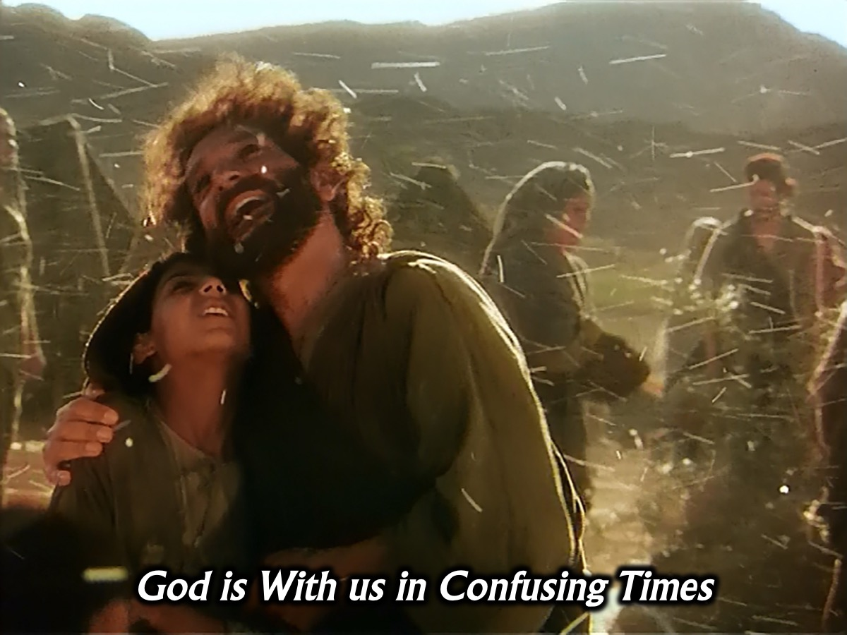
Notes:
* God is with us in confusing times, just like he was with the Israelites in the wilderness when he provided manna for them everyday. Even wandering in the wilderness God was always with them.

Slide 31
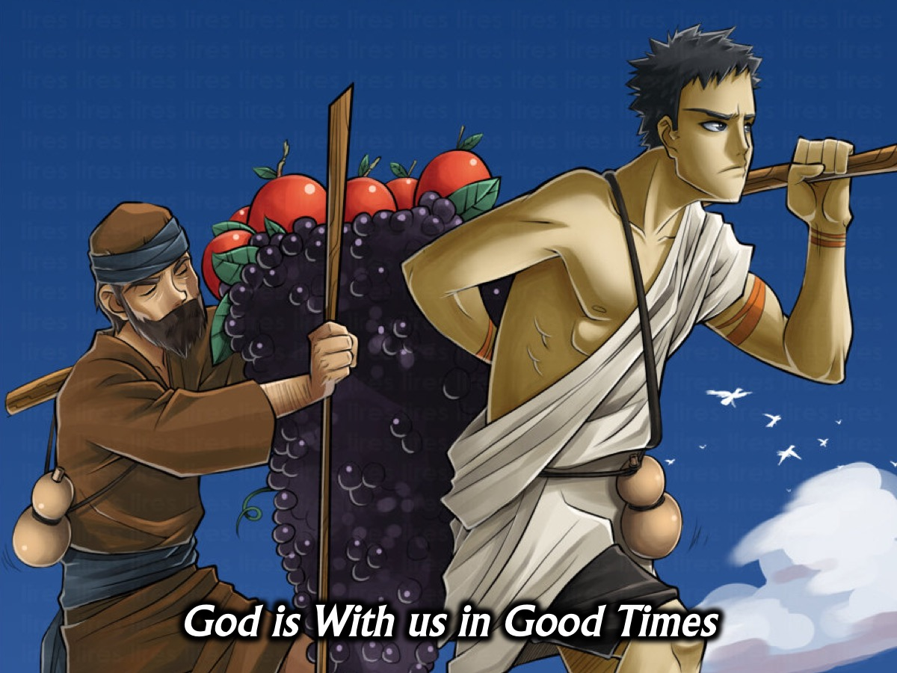
Notes:
* God is with us in good times, the bible tells us it is God who gives us the means to enjoy the blessings he gives us. Even in the Promised Land when good things were happening, God was right there with his people.

Slide 32
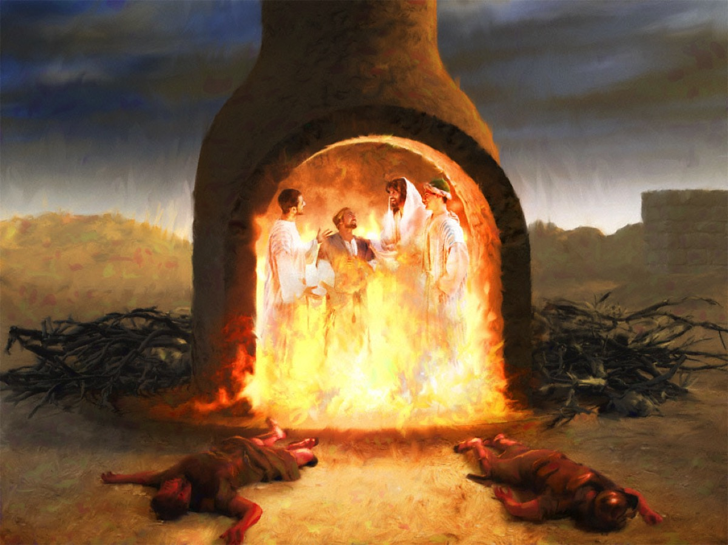
Notes:
Do you remember the story of Shadrach, Meschach and Abednego in the fiery furnace in the book of Daniel? Laws were put in place to stop them serving other gods. But they refused because they feared God more than they feared the king or death itself. So the king threw them into a furnace to kill them. It is crazy hot in there but they are still standing and the fire is not burning them. Then people see a fourth person with them. God comes in Jesus and manifests himself physically. God shows up and protects them. Whatever we go through in life God is with us.

Slide 33
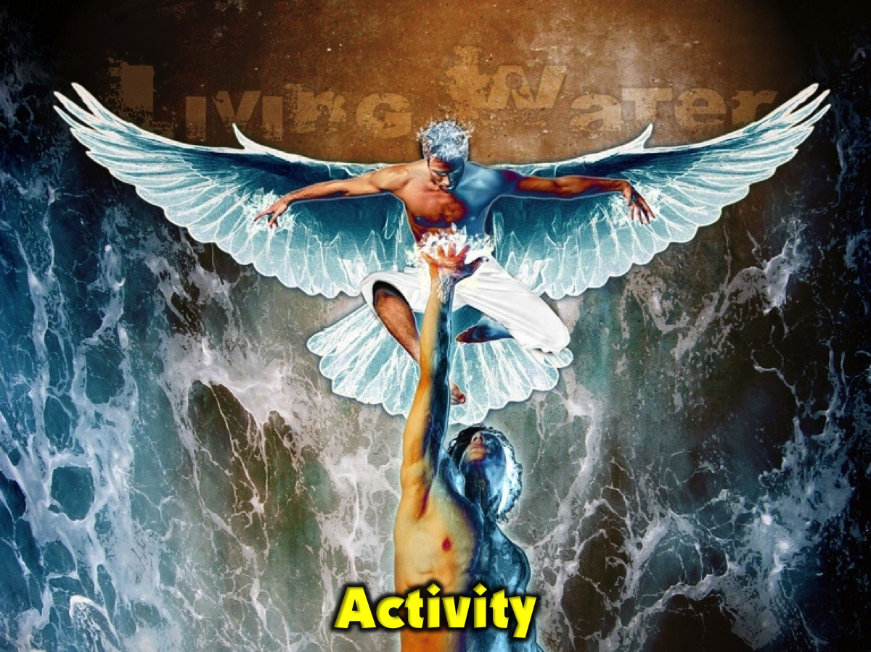
Notes:
Activity. We are handing out pieces of paper and we want you to write down one thing you are trusting God for this year. It must seem impossible for you. We will put it in a box and by the end of the year we will rejoice at what God has done in this year.

Slide 34
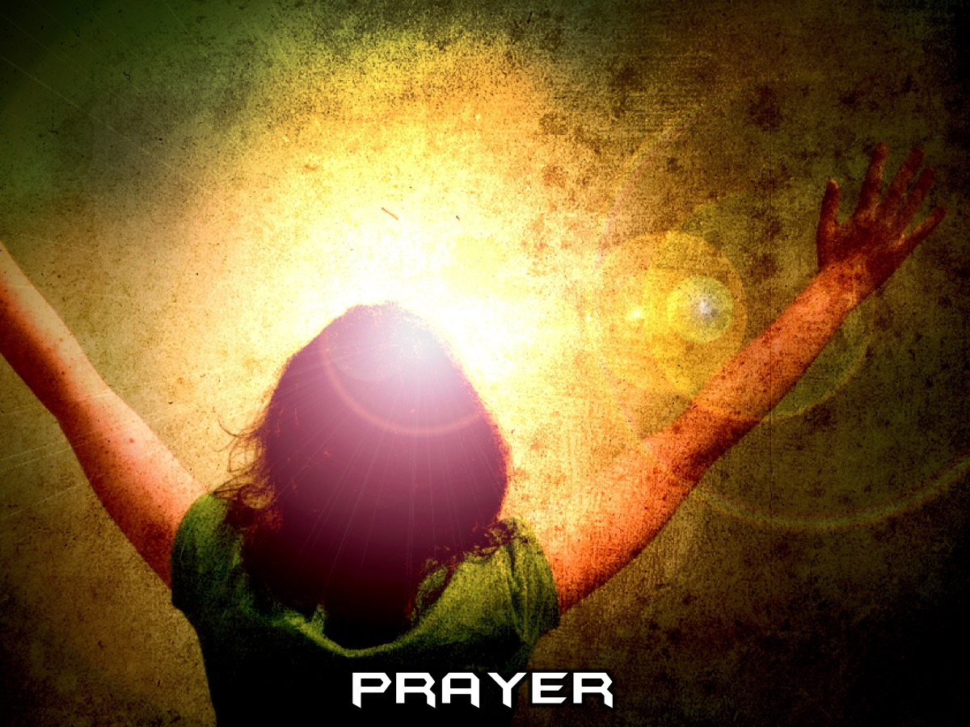
Notes:
Prayer

Slide 35
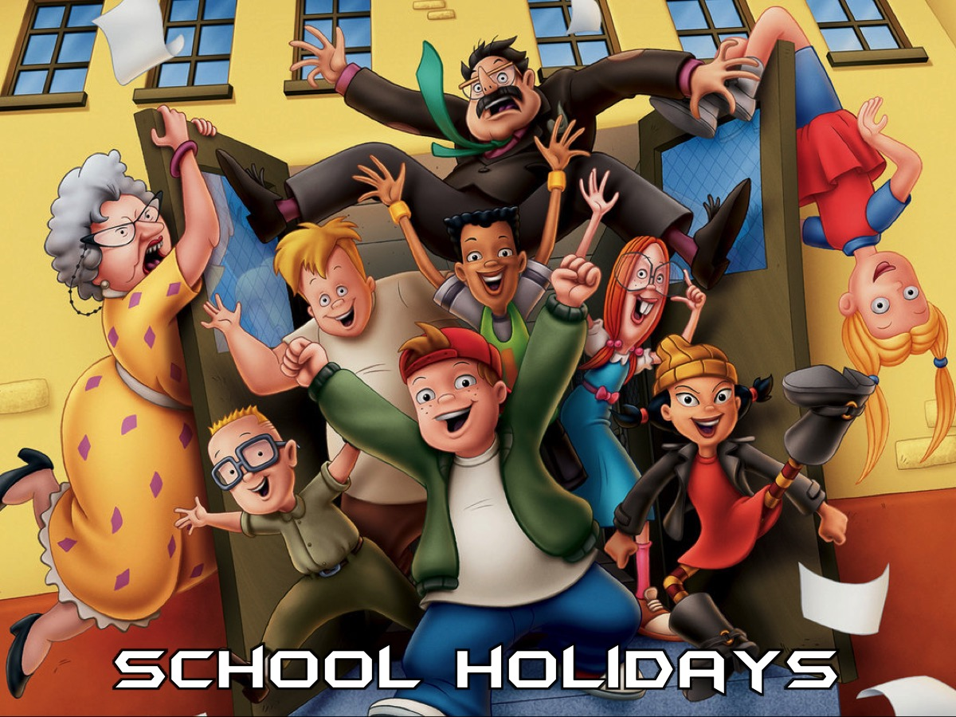
Notes:
From next Sunday we will be in the sanctuary for the whole service - until school reopens.

