Slide 1
Notes:
Welcome to the Workout Series.

Slide 2
Notes:
The Bible says you have to work out your salvation (Philippians 2:12).

Slide 3
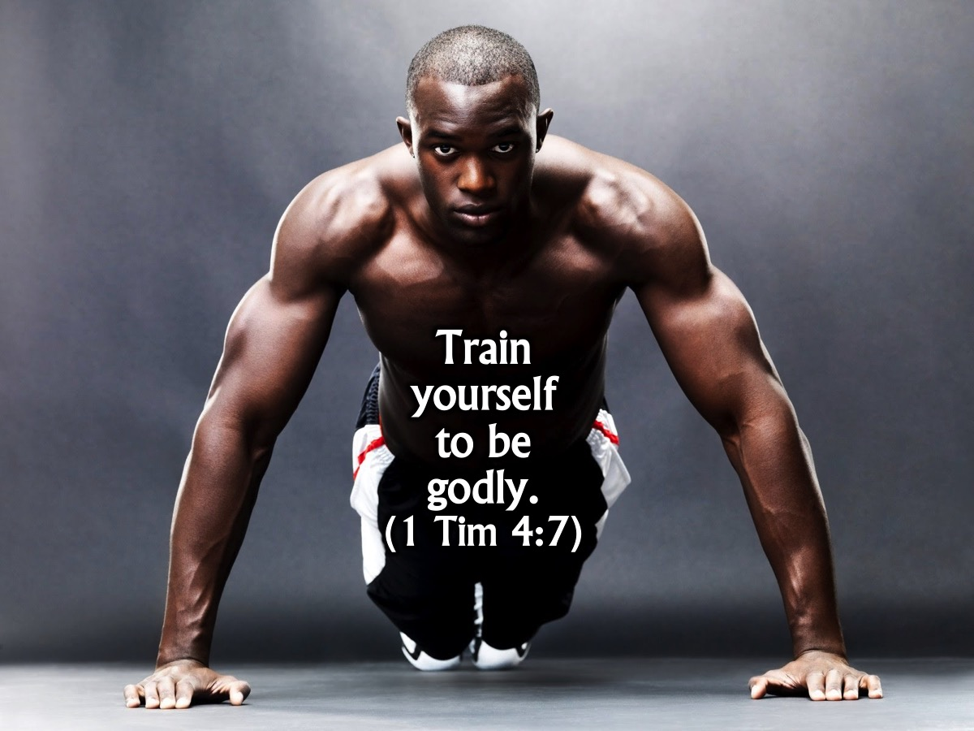
Notes:
It also says you must train yourself to be godly. (1 Timothy 4:7)

Slide 4
Notes:
In the Workout Series this term we are going to expose you to 11 Disciplines to get you spiritually fit!

Slide 5
Notes:
Next Sunday we will focus on Fasting.

Slide 6
Notes:
Then Holiness

Slide 7
Notes:
Prayer

Slide 8
Notes:
Praise

Slide 9
Notes:
Scripture

Slide 10
Notes:
Suffering

Slide 11
Notes:
Guidance

Slide 12
Notes:
Meditation

Slide 13
Notes:
Service

Slide 14
Notes:
Celebration

Slide 15
Notes:
Today we are going to explore the practise of devotions!

Slide 16
Notes:
Sharing: Who of you have made one or more New Year’s resolutions this year? Share with the person next to you what it is!

Slide 17
Notes:
Did anyone make a commitment to go to a gym or run to get fit this year? Well I did!!!

Slide 18
Notes:
But you cant just decide its time to get fit. You need a plan. Whatever you are planning on achieving this year, you first need to come up with a strategy! A plan on how you going to get there!

Slide 19
Notes:
May I encourage you that if getting Spiritually fit isn’t one of them that you add it onto your list! “Training the body helps a little, but godly living helps in every way. Godly living has the promise of life now and in the world to come.” (1 Timothy 4:8)

Slide 20
Notes:
Why is it important to get spiritually fit?

Slide 21
Notes:
1. We Love God: God wants to have a love relationship with you.

Slide 22
Notes:
“I want to hear the voice of God before I hear anyone else’s in the morning, and His is the last voice I want to hear at night.” (Stephen Olford)

Slide 23
Notes:
(2) We are in a war! You don’t go into a war without being fit and with a strategy to win.

Slide 24
Notes:
So, how do we actually go about having a time each day with God? Here are five things you should do to get going…

Slide 25
Notes:
1. Find a Time. Jesus actually instructed us to pray to God alone at times: “When you pray, go into your room, close the door and pray to your Father, who is unseen” (Matthew 6:6a) There is no right or wrong time of day. I prefer having my devotions first thing in the morning as this is the least likely time of day for an interruption and I am at my most alert and freshest. Whatever time of day you choose, let it be the best time of day for you. And there is no standard time for personal devotions. You have to decide how much time you can realistically commit to each day. Getting started with 15 minutes a day is a good start.

Slide 26
Notes:
2. Find a Place. If you try to spend quality time with God lying in bed with the lights off, failure is inevitable. Sit on a couch or a chair where there is enough light and lots of fresh air.

Slide 27
Notes:
3. Find a Plan. Spend some thought on a general structure for your devotional and how much time you’ll spend on each element of your plan. Think of this as an outline so you don’t wander about aimlessly in thought and end up accomplishing nothing. If you pick up your Bible and start reading randomly each day, you may have a difficult time understanding or applying what you've read to your daily life. But by reading through a book systematically you can see God leading more clearly. Here are three things you can do in your devotional time: (1) Pray: Prayer is simply two-way communication between you and God. Talking to him, telling him about your struggles and cares, and then listening to his voice. (2) Worship: 1 Peter 2:9 says, “But you are a chosen people ... belonging to God, that you may declare the praises of him who called you out of darkness into his wonderful light.” You can sing a song of worship in your devotional time. (3) Journal: You can journal your thoughts and prayers keeping valuable records. Later you will be amazed and encouraged when you go back and see the progress you’ve made and see the answered prayers. (4) REAP: this is a structure for your devotional time.

Slide 28
Notes:
REAP is a structure for your daily devotions:
Read: Read a short passage slowly, and repeatedly, carrying on each day.
Examine: Who was it written to? What is it about? What does it teach me about God and myself?
Apply: What is it calling me to believe? How is it challenging me to act? What can I do to live this truth?
Pray: Pray the passage over your life, for your loved ones and your friends.

Slide 29
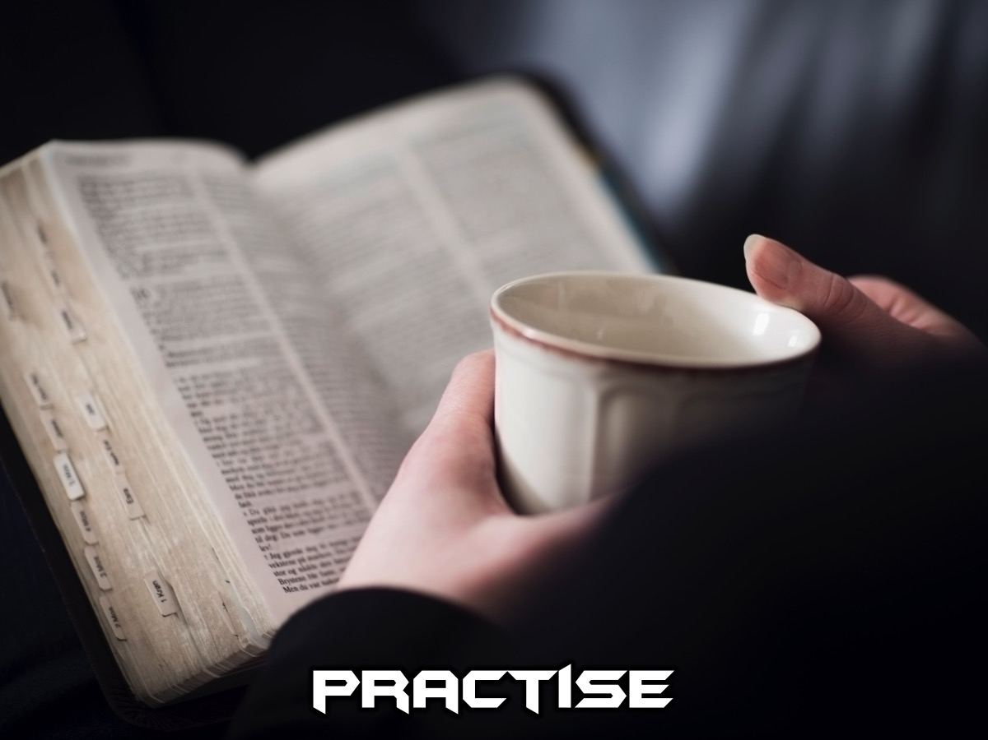
Notes:
Practise: We have created a 7–Day Devotional booklet for you to use in your Daily Devotons in the next week. We are going to give you 15 minutes to do the first day this morning.

Slide 30
Notes:
You have 15 minutes to have a quiet time using the handout.

Slide 31
Notes:
Tips For Success: Here are a few tips to help make your devotions a success. (1) Keep working on your daily devotional plan for 21 days so it can become a habit. (2) Pray for God to give you the desire and the discipline to spend time with him each day. (3) Don’t give up. (4) Eventually, you will discover the joys and blessings of your obedience.

Slide 32
Notes:
Fitness Challenge. For the next 7 days lets put aside time everyday to have a devotion and lets trust God to pitch up! Give us your name and cell number so we can journey with you in the coming week! Let’s Pray!

Slide 33
Notes:
Next Sunday we will be exploring the disciple of Fasting.

