Slide 1

Notes:
Welcome to the Workout Series.

Slide 2

Notes:
In the Workout Series this term we are going to expose you to 11 Disciplines to get you spiritually fit!

Slide 3

Notes:
Last week we looked at the practise of devotions!

Slide 4

Notes:
This week we are learning about Fasting.

Slide 5
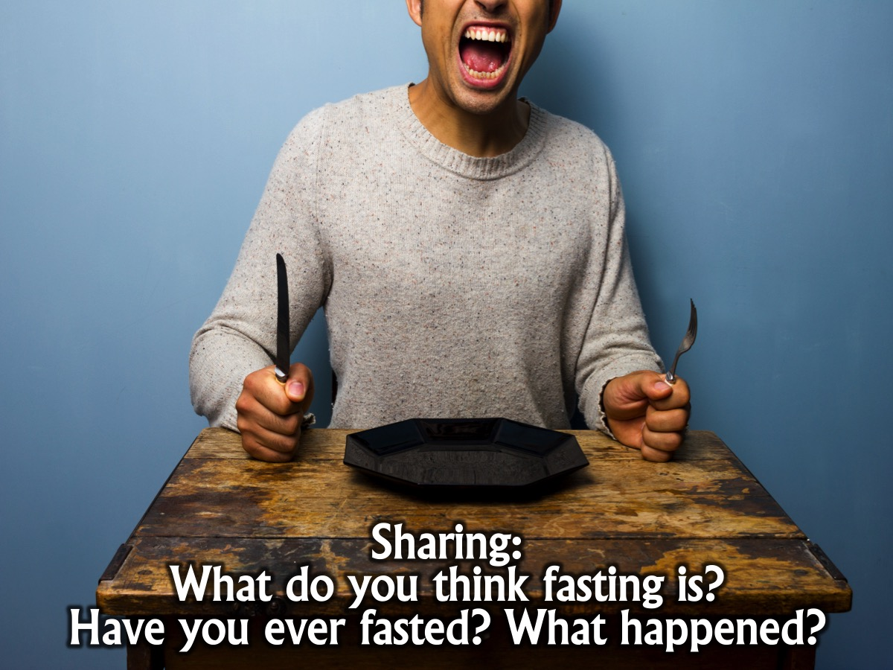
Notes:
Sharing: What do you think fasting is? Have you ever fasted? What happened?

Slide 6
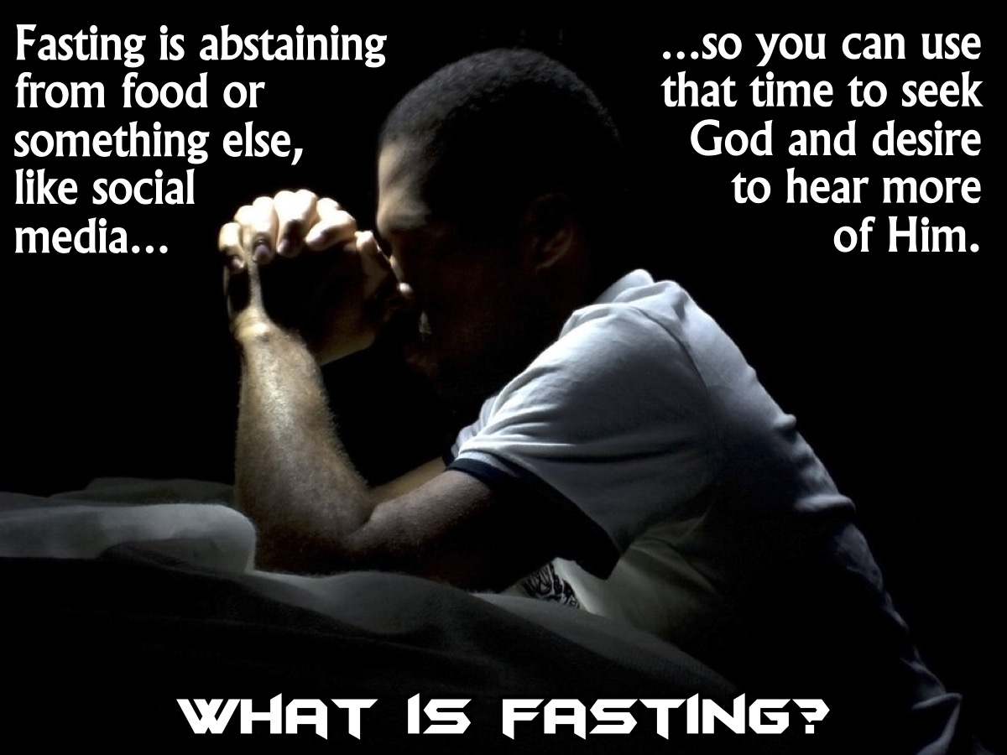
Notes:
What is fasting? Fasting is abstaining from food or something else, like social media, so you can use that time to seek God and desire to hear more of Him.

Slide 7
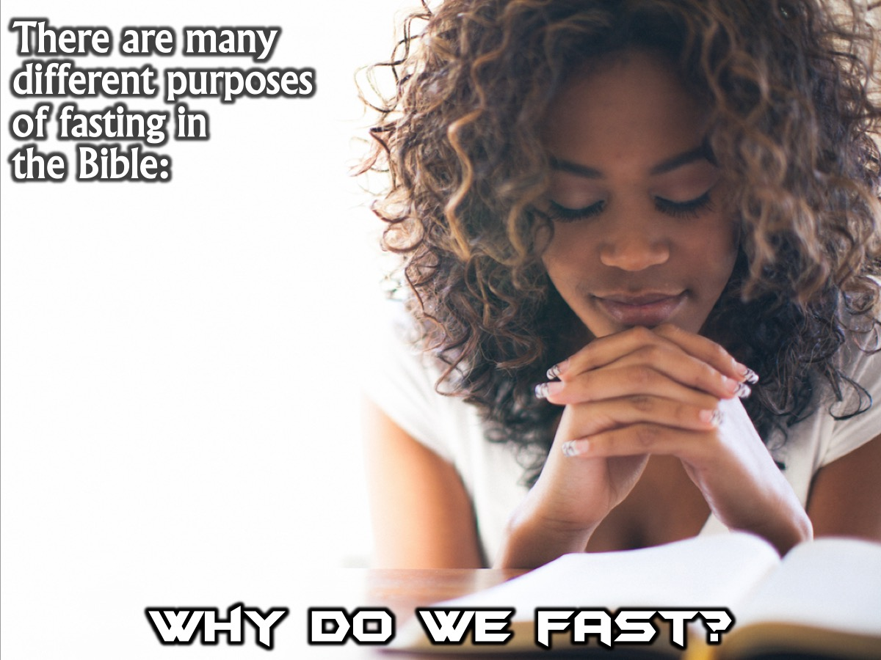
Notes:
Why do we fast? There are many different purposes of fasting in the Bible:

Slide 8
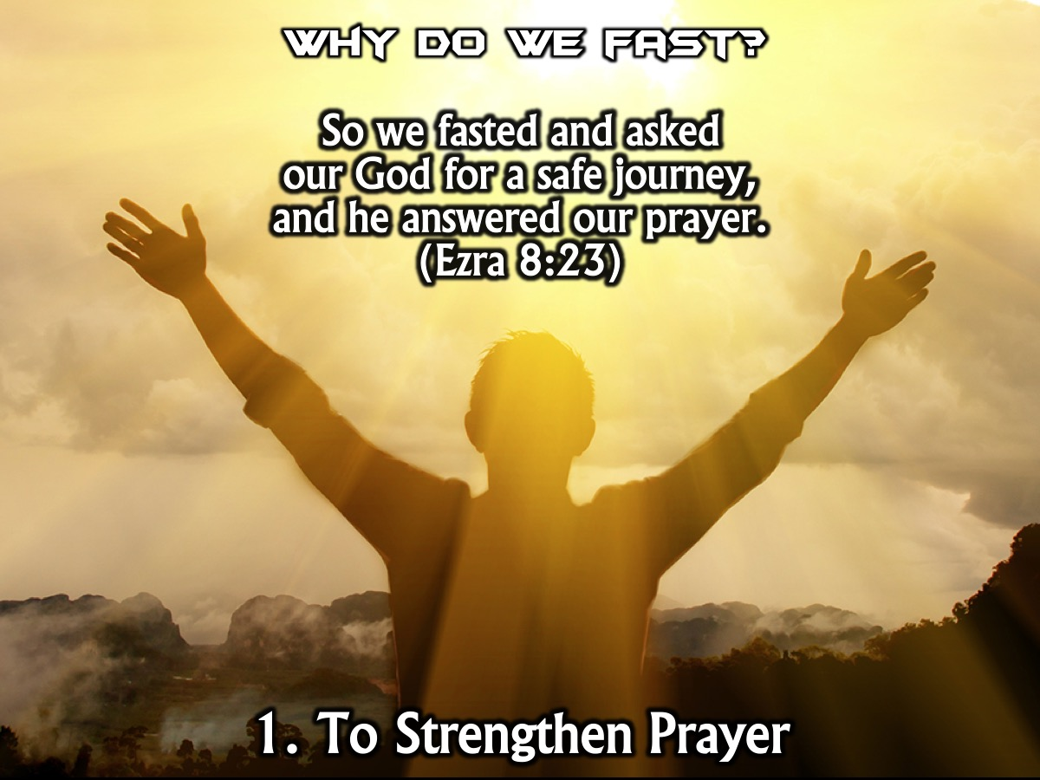
Notes:
1. We fast to strengthen prayer. “So we fasted and asked our God for a safe journey, and he answered our prayer.” (Ezra 8:23)

Slide 9
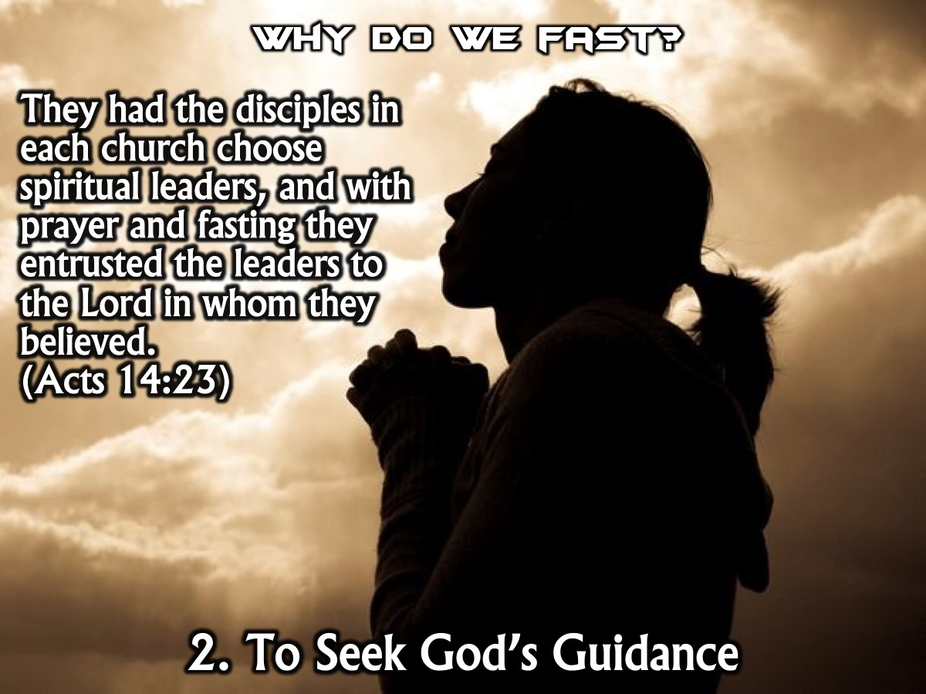
Notes:
2. We fast to seek God’s guidance. “They had the disciples in each church choose spiritual leaders, and with prayer and fasting they entrusted the leaders to the Lord in whom they believed.” (Acts 14:23)

Slide 10
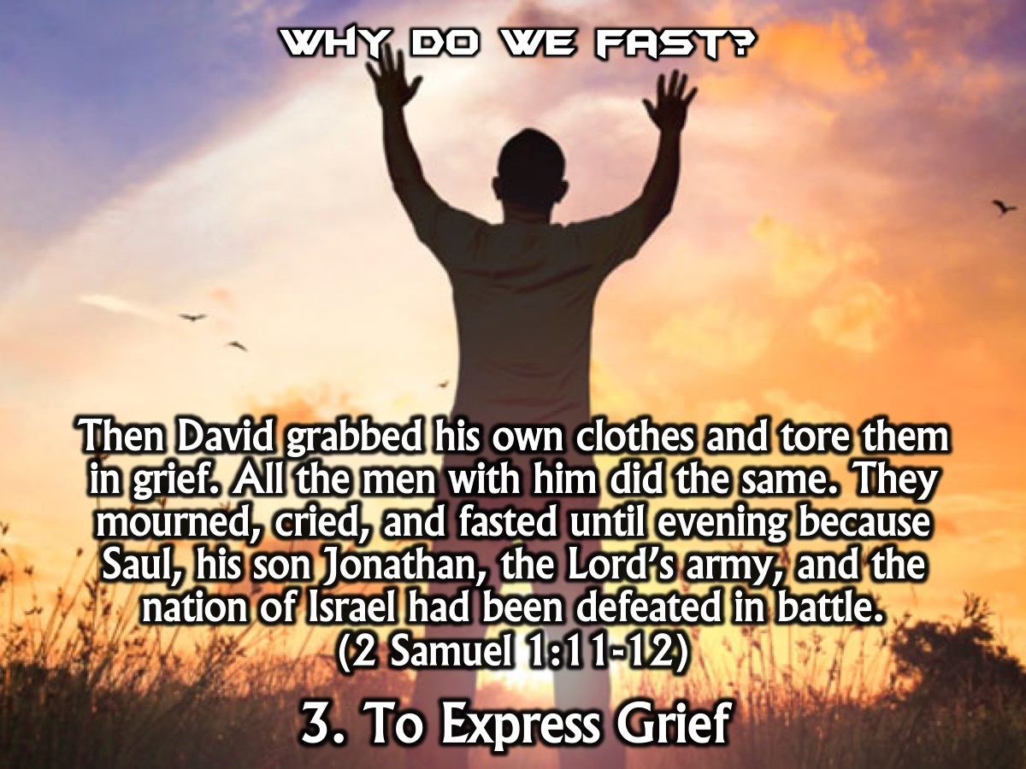
Notes:
3. We fast to express grief. “Then David grabbed his own clothes and tore them in grief. All the men with him did the same. They mourned, cried, and fasted until evening because Saul, his son Jonathan, the Lord’s army, and the nation of Israel had been defeated in battle.” (2 Samuel 1:11-12)

Slide 11
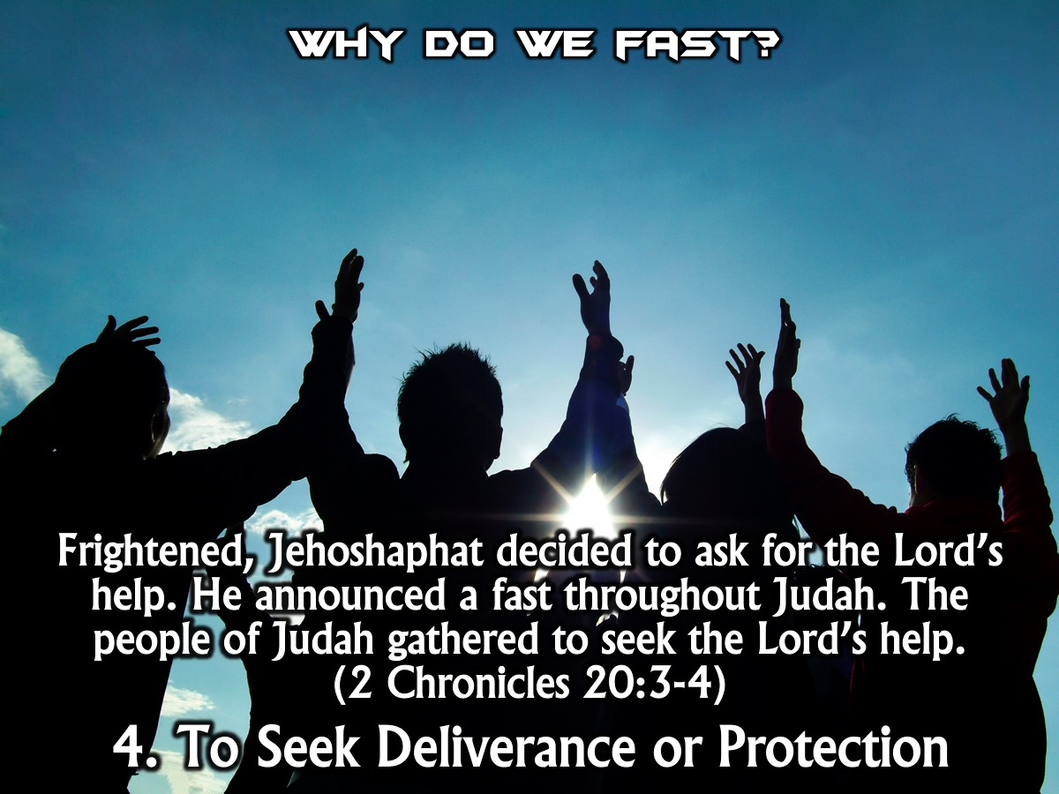
Notes:
4. We fast to seek deliverance or protection.” Frightened, Jehoshaphat decided to ask for the Lord’s help. He announced a fast throughout Judah. The people of Judah gathered to seek the Lord’s help.” (2 Chronicles 20:3-4)

Slide 12
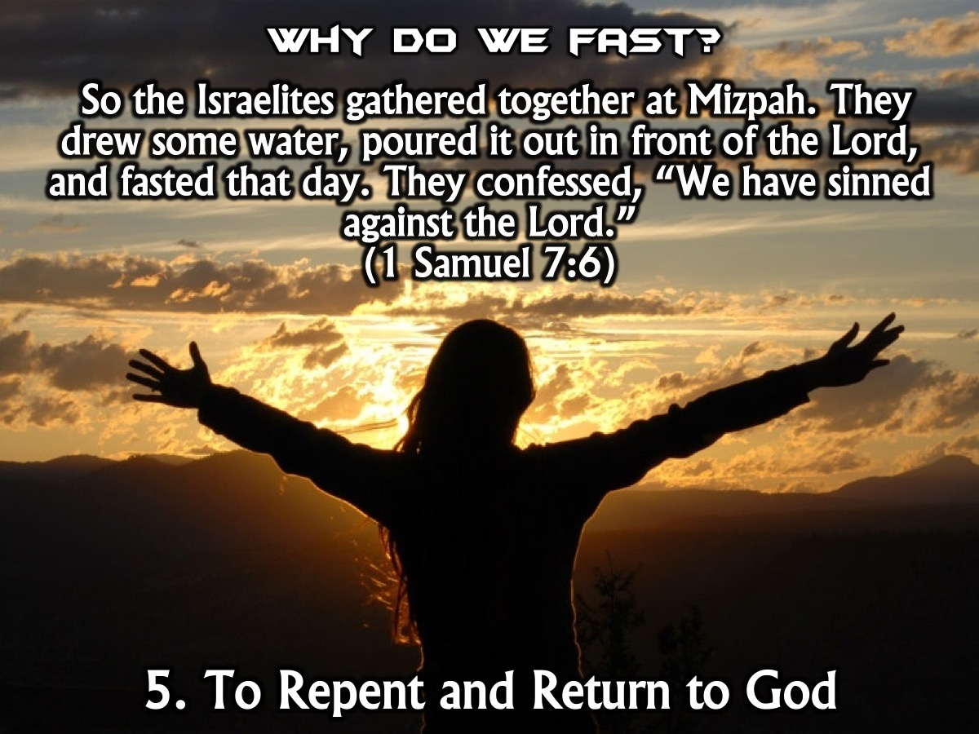
Notes:
5. We fast to express repentance and return to God. “So the Israelites gathered together at Mizpah. They drew some water, poured it out in front of the Lord, and fasted that day. They confessed, “We have sinned against the Lord.” (1 Samuel 7:6)

Slide 13
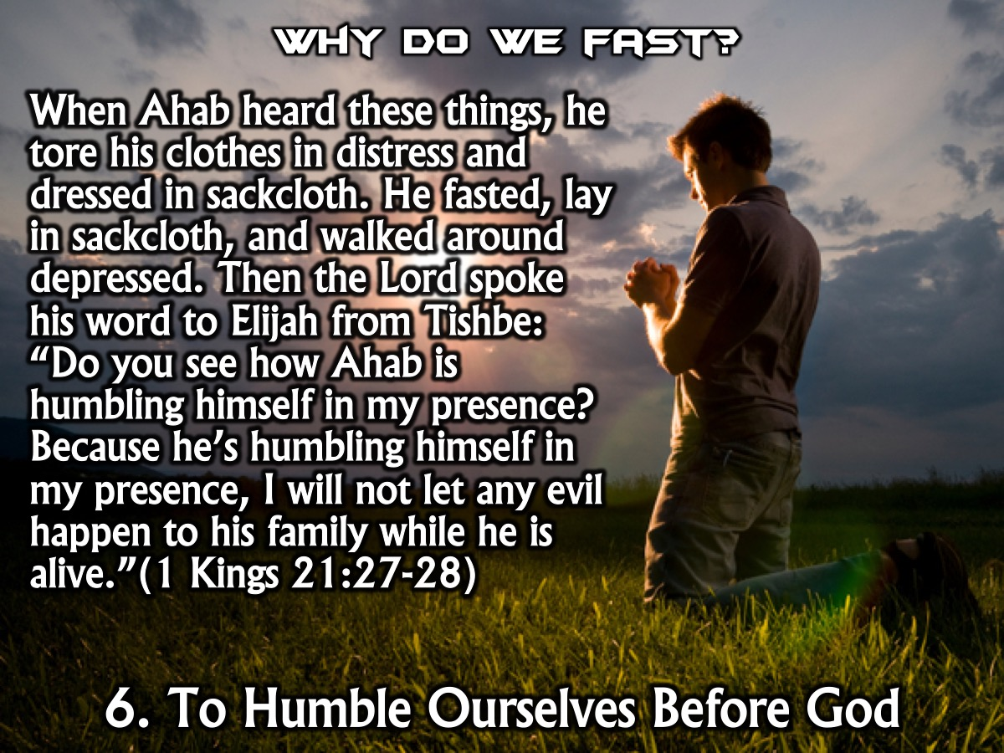
Notes:
6. We fast to humble ourselves before God. “When Ahab heard these things, he tore his clothes in distress and dressed in sackcloth. He fasted, lay in sackcloth, and walked around depressed. Then the Lord spoke his word to Elijah from Tishbe: “Do you see how Ahab is humbling himself in my presence? Because he’s humbling himself in my presence, I will not let any evil happen to his family while he is alive.” (1 Kings 21:27-28)

Slide 14
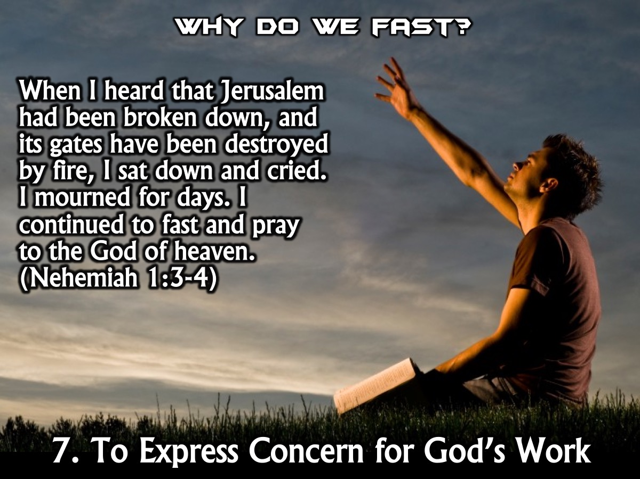
Notes:
7. We fast to express concern for the work of God. “When I heard that Jerusalem had been broken down, and its gates have been destroyed by fire, I sat down and cried. I mourned for days. I continued to fast and pray to the God of heaven.” (Nehemiah 1:3-4)

Slide 15
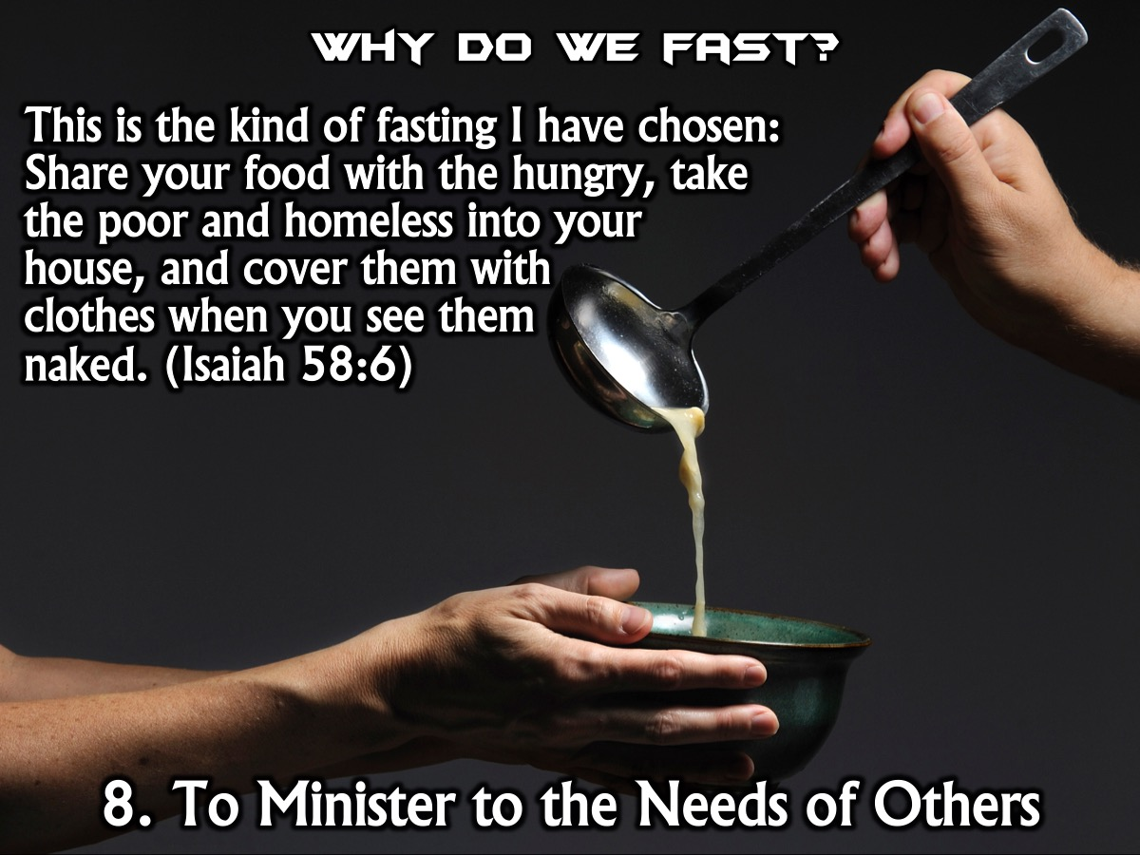
Notes:
8. We fast to minister to the needs of others. “This is the kind of fasting I have chosen: Share your food with the hungry, take the poor and homeless into your house, and cover them with clothes when you see the naked.” (Isaiah 58:6)

Slide 16
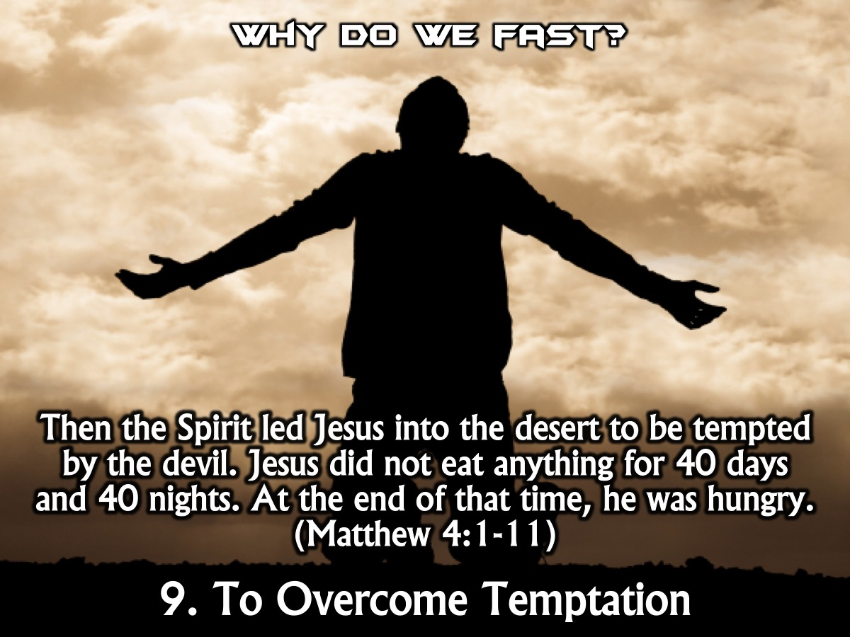
Notes:
9. We fast to overcome temptations and dedicate ourselves to God. “Then the Spirit led Jesus into the desert to be tempted by the devil. Jesus did not eat anything for 40 days and 40 nights. At the end of that time, he was hungry.” (Matthew 4:1-11)

Slide 17
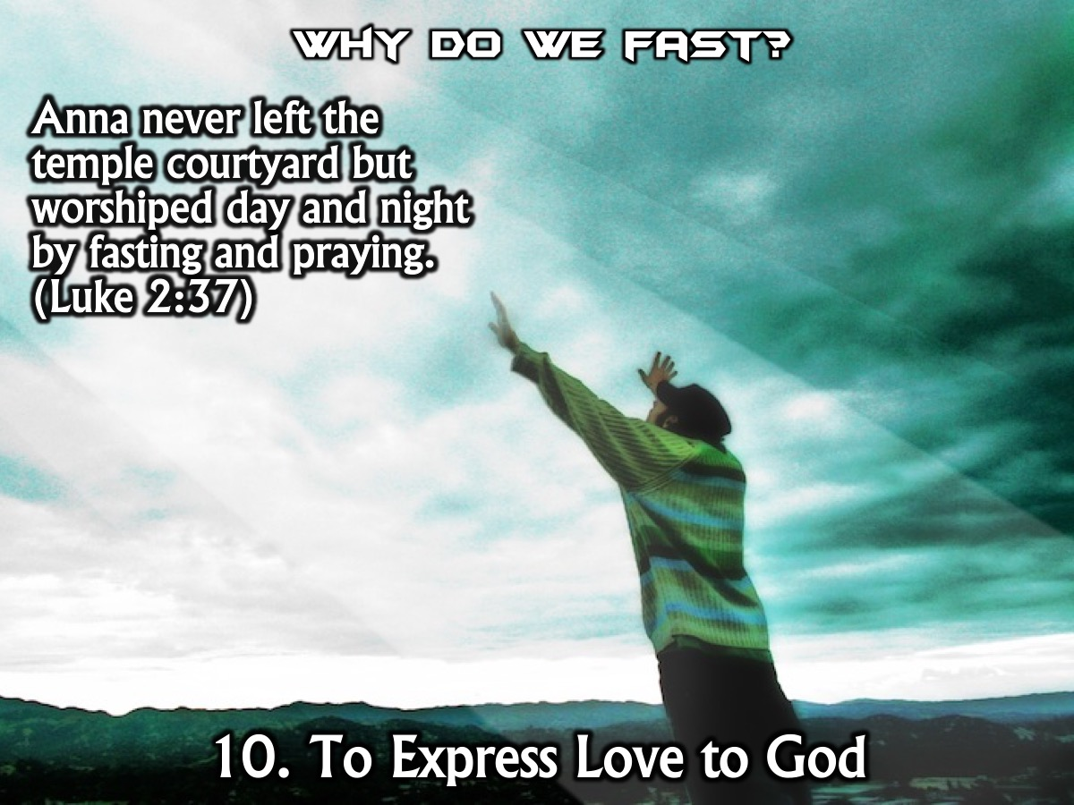
Notes:
10. We fast to express love and worship to God. “Anna never left the temple courtyard but worshiped day and night by fasting and praying.” (Luke 2:37)

Slide 18
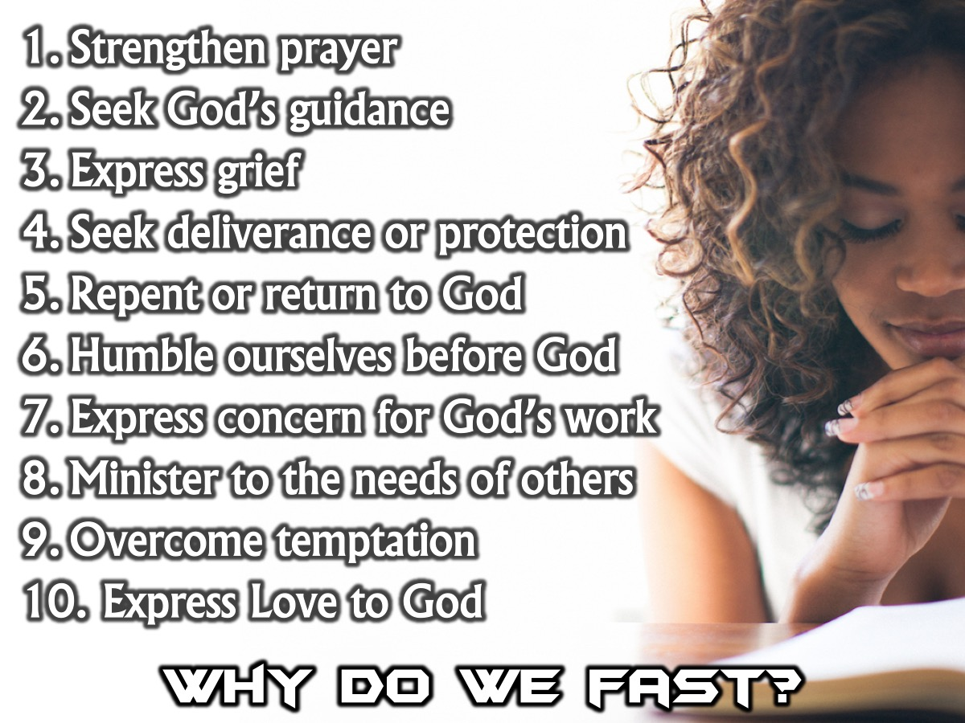
Notes:
Summary: So why do we fast? Here are some of the different purposes of fasting mentioned in the Bible: To strengthen prayer. To seek God’s guidance. To express grief. To seek deliverance or protection. To express repentance and return to God. To humble oneself before God. To express concern for the work of God. To minister to the needs of others. To overcome temptations and dedicate yourself to God. To express love to God.

Slide 19
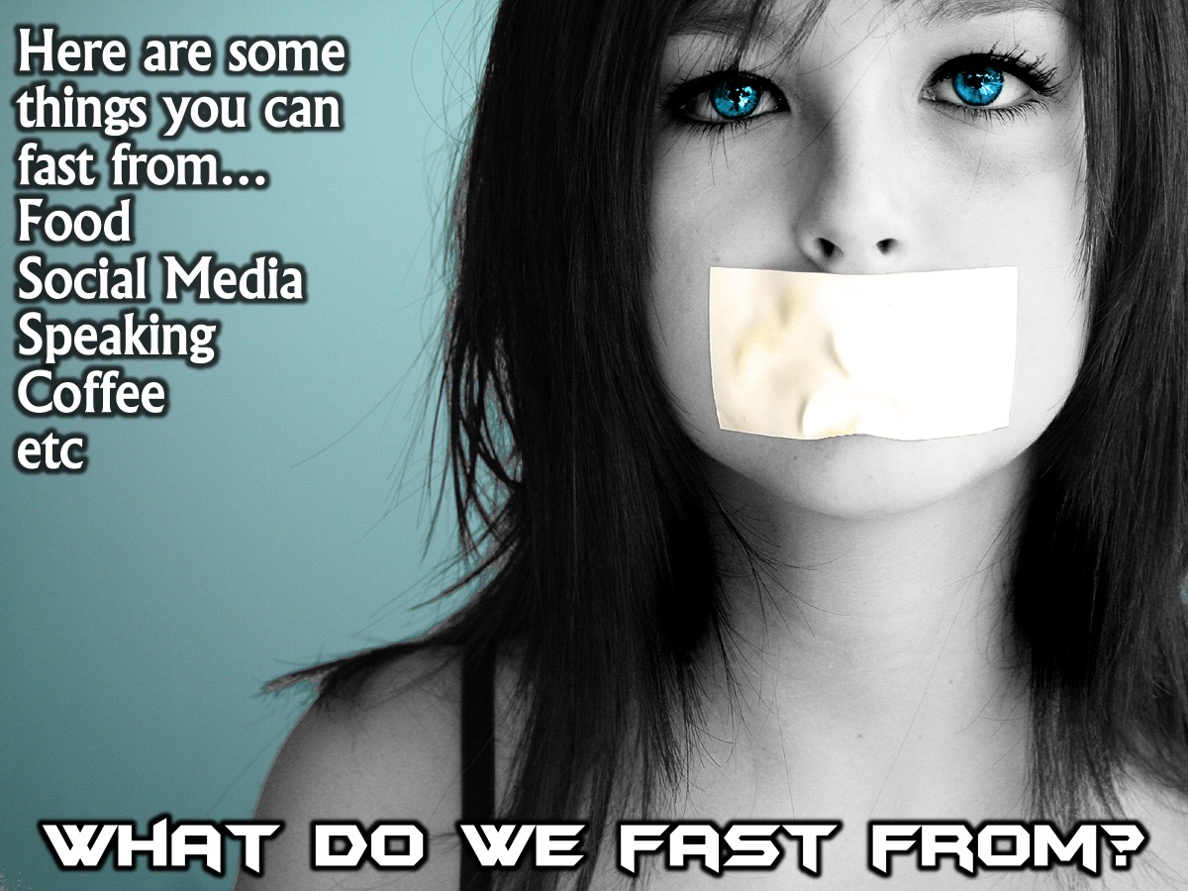
Notes:
What do we fast from? Here are some things you can fast from: Food, Social Media, Speaking, Coffee, etc.

Slide 20
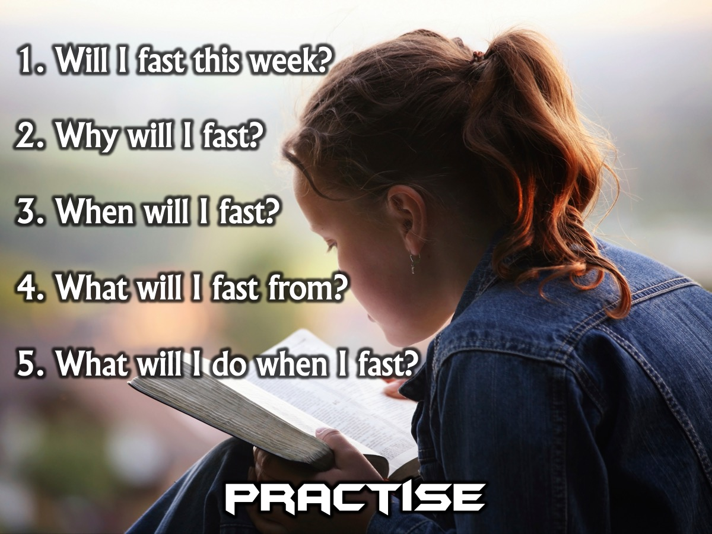
Notes:
Practise: We have created a fasting handout for you to work through in the next 10 minutes.
(1) Will I fast this week? (This is a Yes/No box that they check).
(2) Why will I fast? (They can choose one or two of the reasons they have learnt and tick them off the list).
(3) When will I fast? (Here they write down on which day they will fast - we are going to encourage them to fast on the Wednesday so we can remind people on the WhatsApp group and prepare them for it on Monday and Tuesday).
(4) What will I fast from? (Here they need to decide what they will give up or go without and write it down - so they will have a line to write down the nature of their fast).
(5) What will I do when I fast? (When they give up something, what will they be doing in that time?)

Slide 21
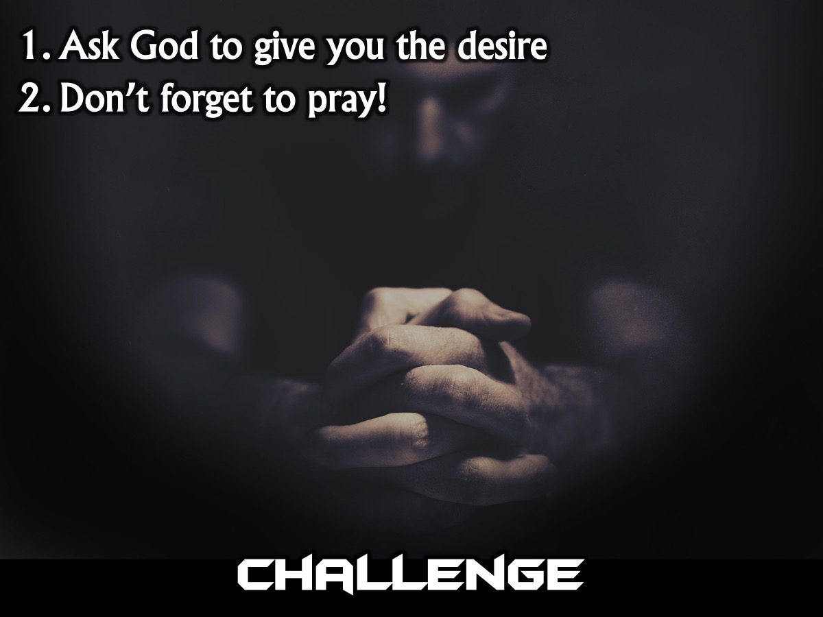
Notes:
Challenge: (1) Ask God to give you the desire. (2) Don’t forget to pray!

Slide 22
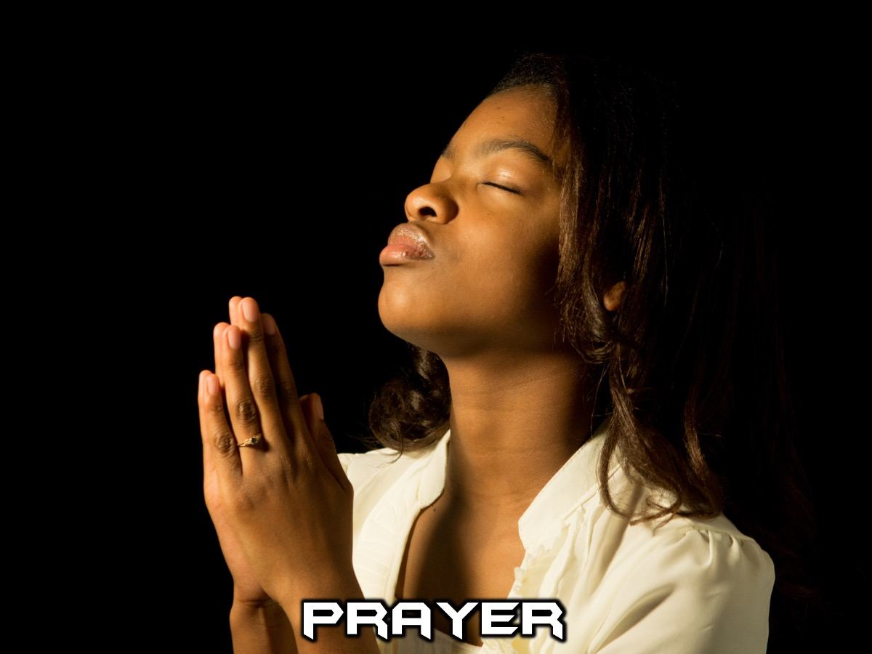
Notes:
Prayer

Slide 23
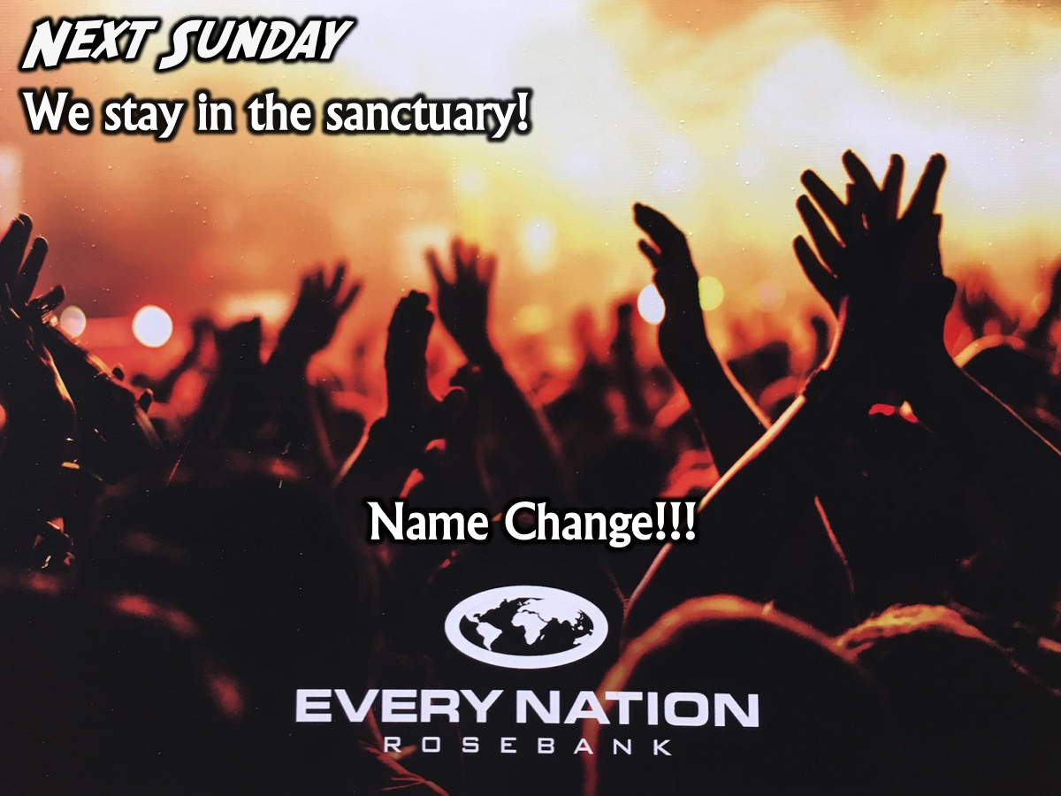
Notes:
Next Sunday we will stay in the sanctuary for the launch of the new name for our church. It is going to be an epic service.

