Slide 1

Notes:
Welcome to the Workout Series.

Slide 2

Notes:
In the Workout Series this term we are learning about Disciplines to make us spiritually fit!

Slide 3

Notes:
In week 1 we learnt about Devotions.

Slide 4
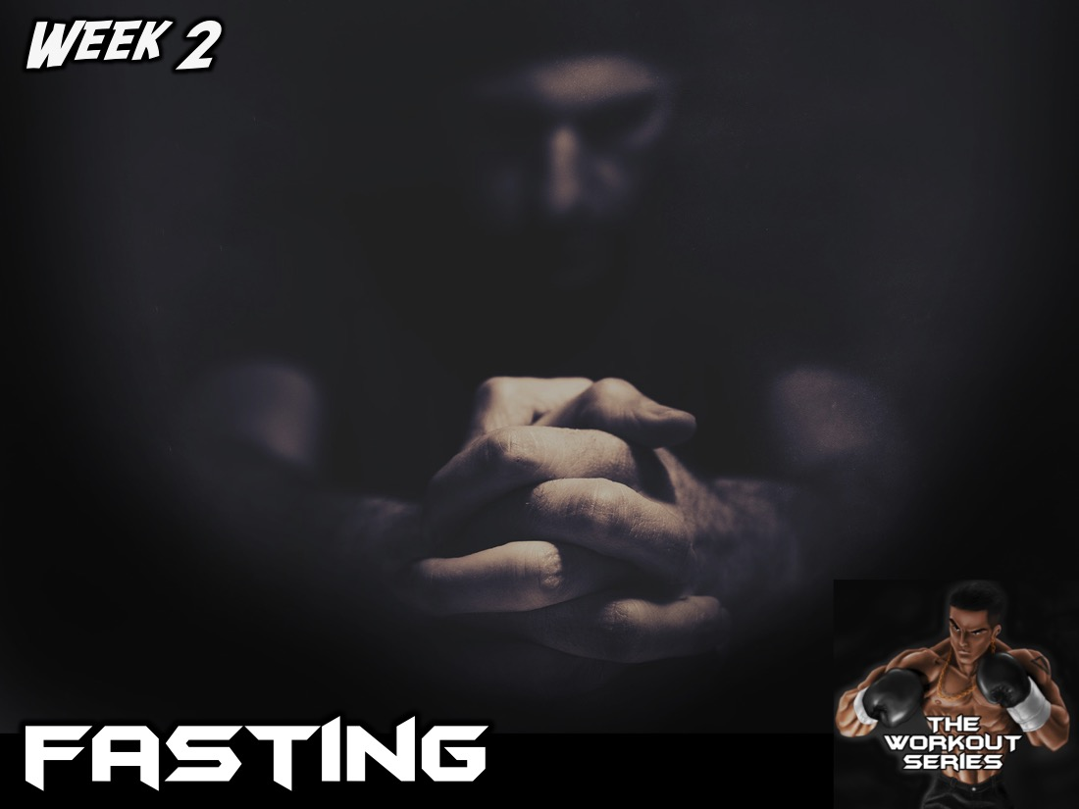
Notes:
In week 2 we learnt about Fasting.

Slide 5
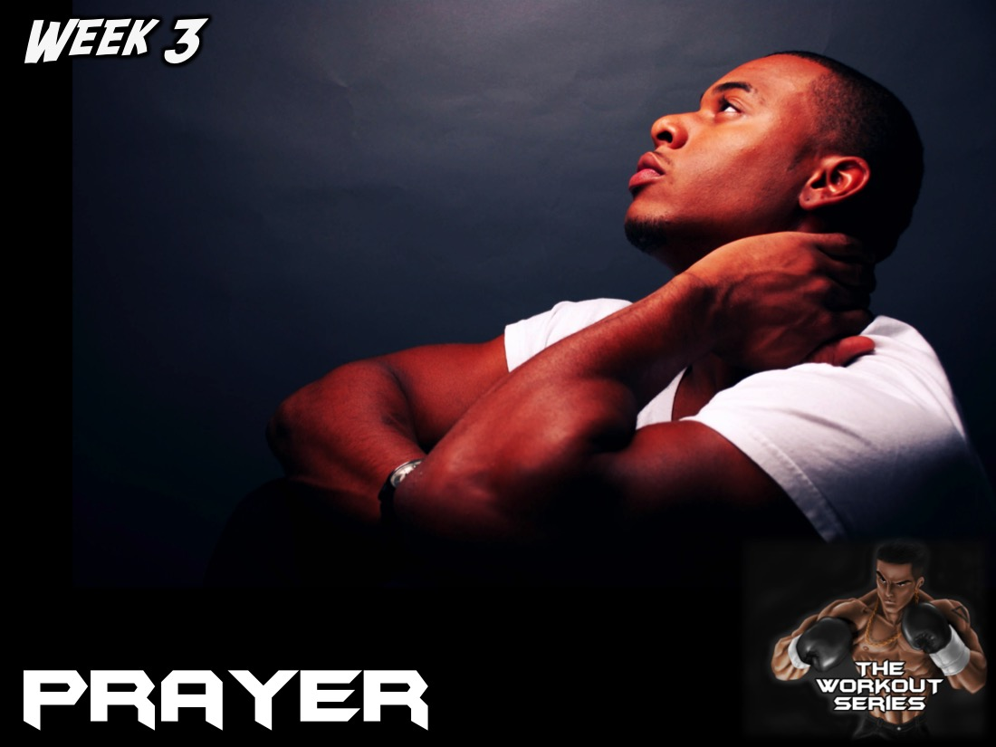
Notes:
In week 3 we learnt about Prayer.

Slide 6
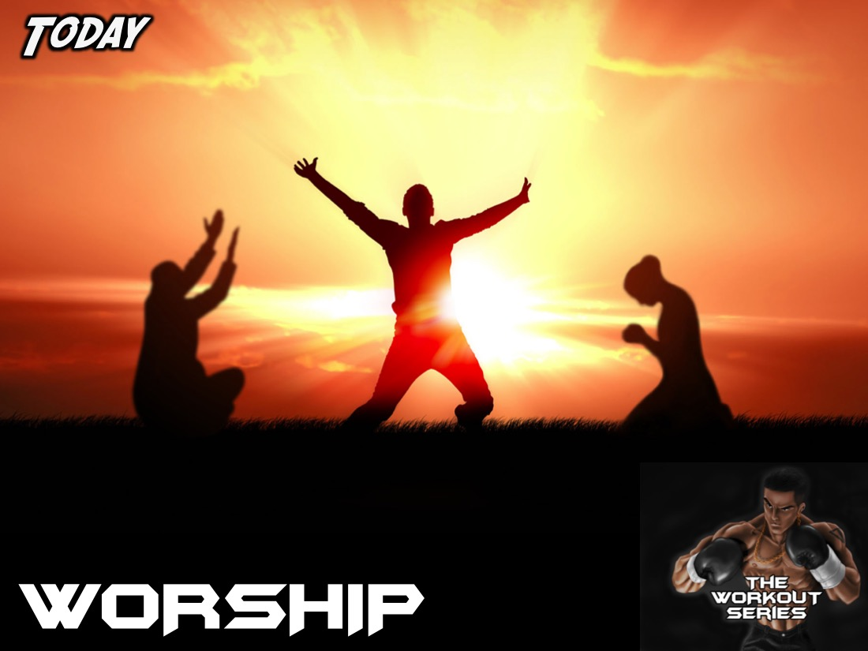
Notes:
Today we are learning about Worship.

Slide 7
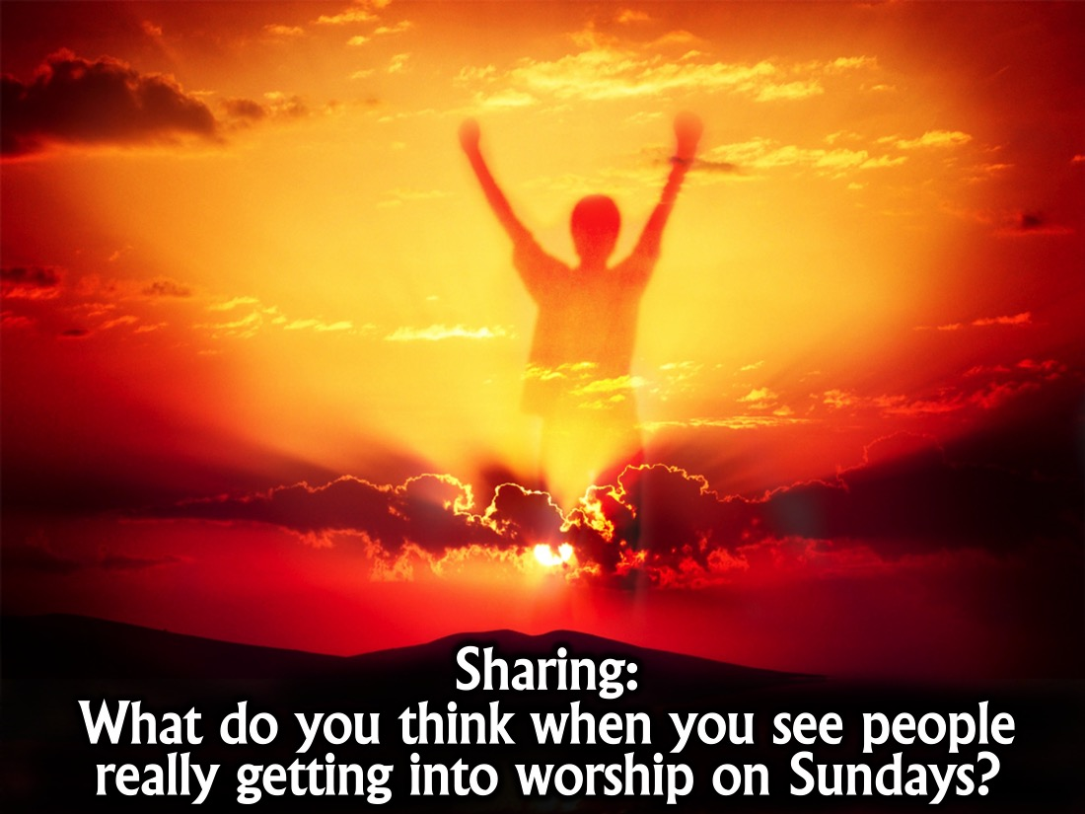
Notes:
Sharing: What do you think when you see people really getting into worship on Sundays?

Slide 8
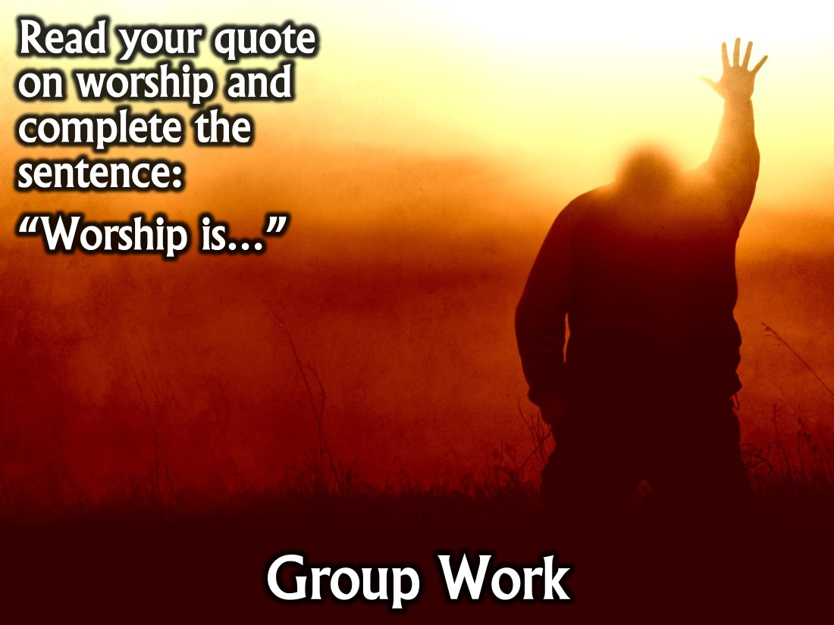
Notes:
Group Work: Each group is going to get a quote about worship and you have to come up with a short sentence to define worship and share the quote and your definition on stage.

Slide 9

Notes:
Group Feedback: Each group will read their quote and their definition of worship: “Worship is…”

Slide 10
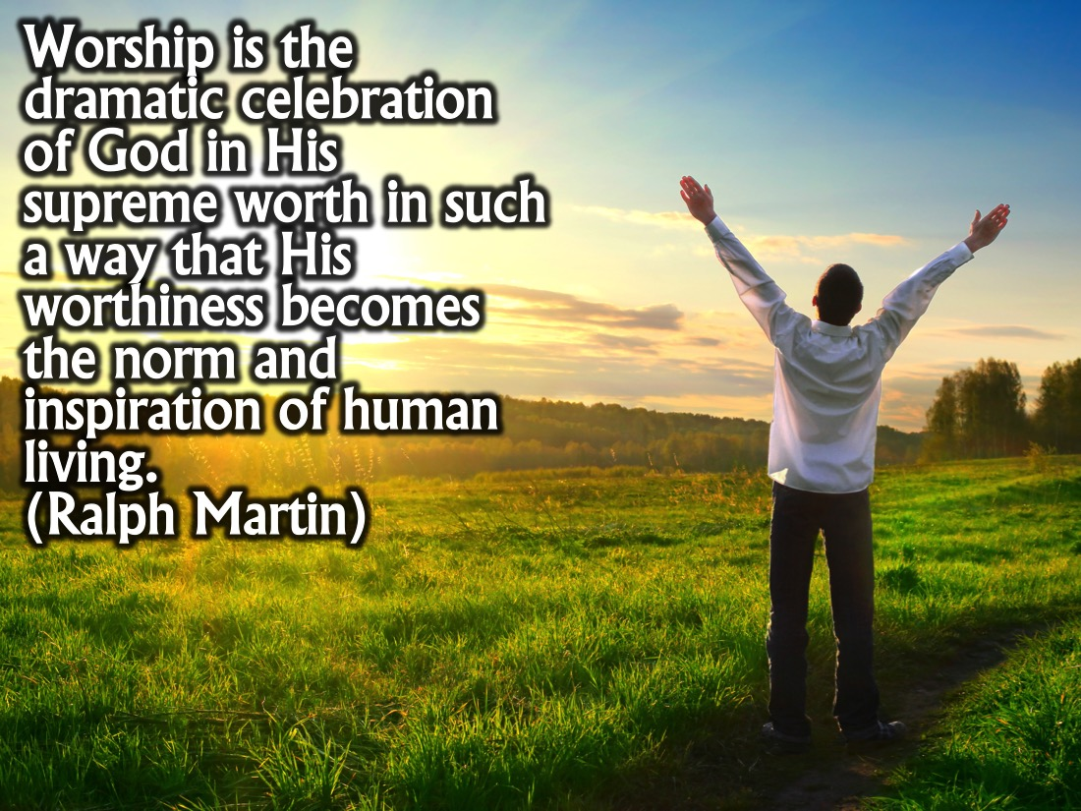
Notes:
Quote #1: Worship is the dramatic celebration of God in His supreme worth in such a way that His worthiness becomes the norm and inspiration of human living. (Ralph Martin)

Slide 11
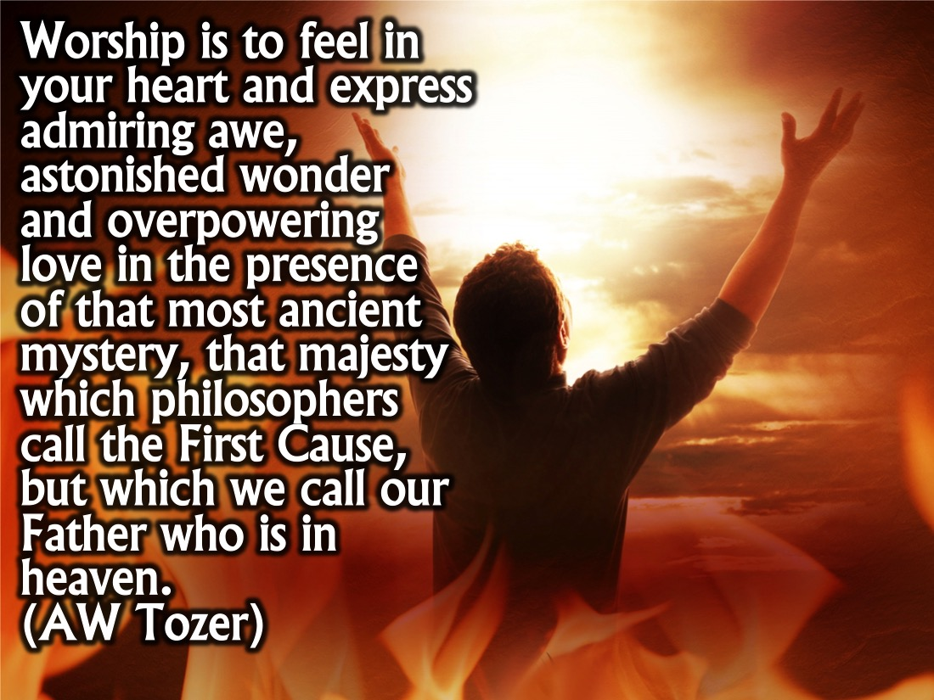
Notes:
Quote #2: Worship is to feel in your heart and express admiring awe, astonished wonder and overpowering love in the presence of that most ancient mystery, that majesty which philosophers call the First Cause, but which we call our Father who is in heaven. (AW Tozer)

Slide 12
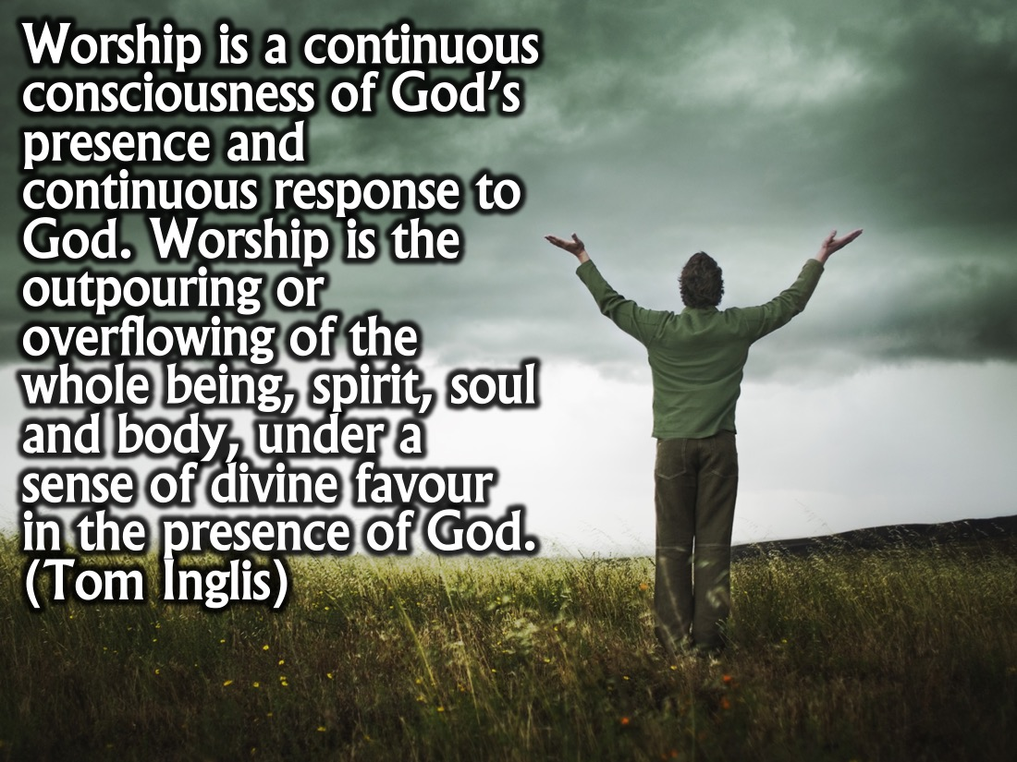
Notes:
Quote #3: Worship is a continuous consciousness of God’s presence and continuous response to God. Worship is the outpouring or overflowing of the whole being, spirit, soul and body, under a sense of divine favour in the presence of God. (Tom Inglis)

Slide 13
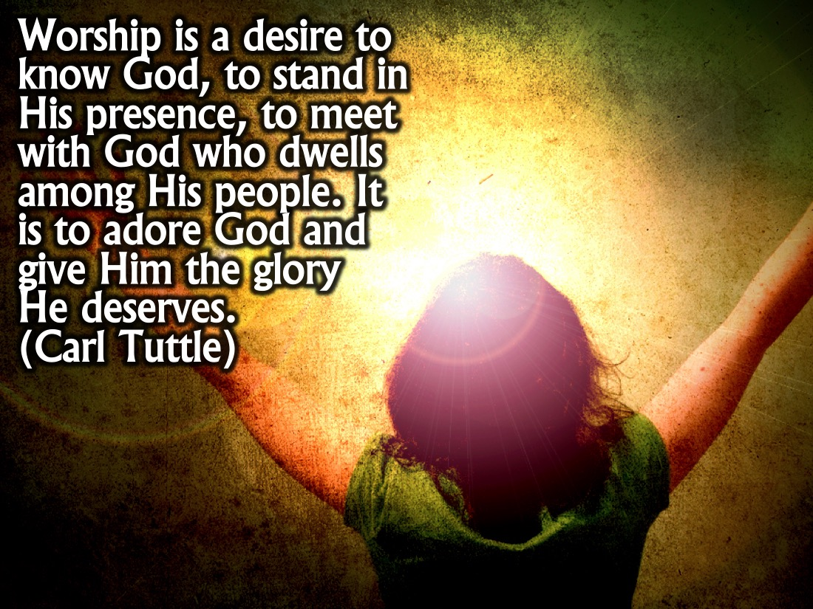
Notes:
Quote #4: Worship is a desire to know God, to stand in His presence, to meet with God who dwells among His people. It is to adore God and give Him the glory He deserves. (Carl Tuttle)

Slide 14
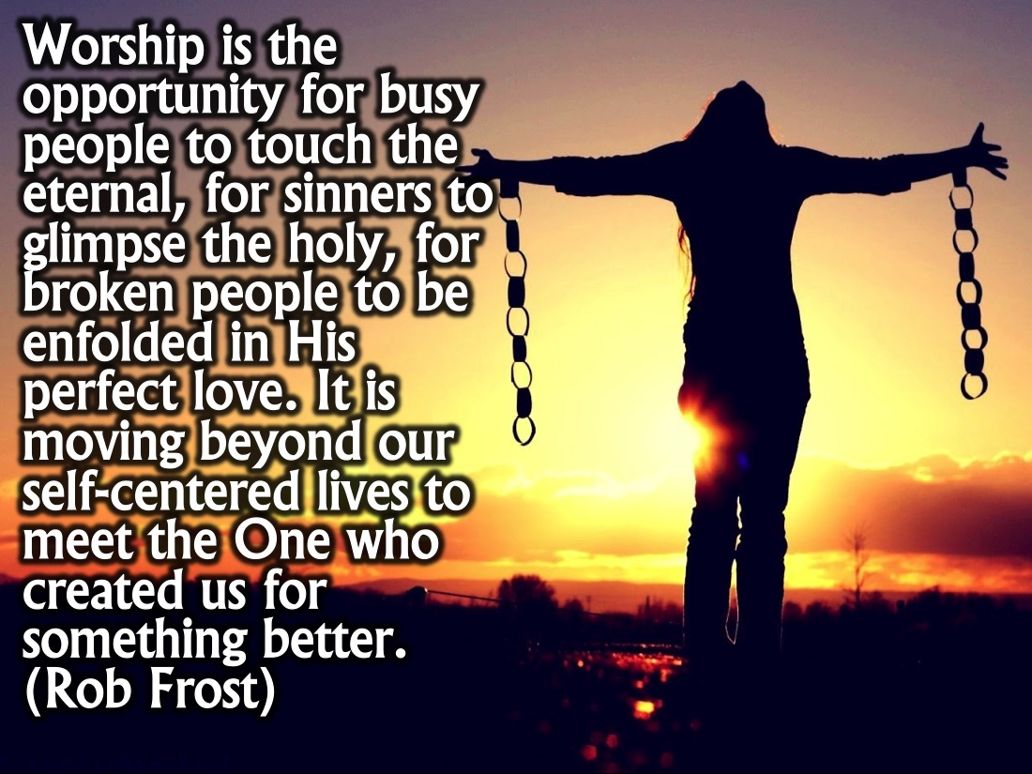
Notes:
Quote #5: Worship is the opportunity for busy people to touch the eternal, for sinners to glimpse the holy, for broken people to be enfolded in His perfect love. It is moving beyond our self-centered lives to meet the One who created us for something better. (Rob Frost)

Slide 15
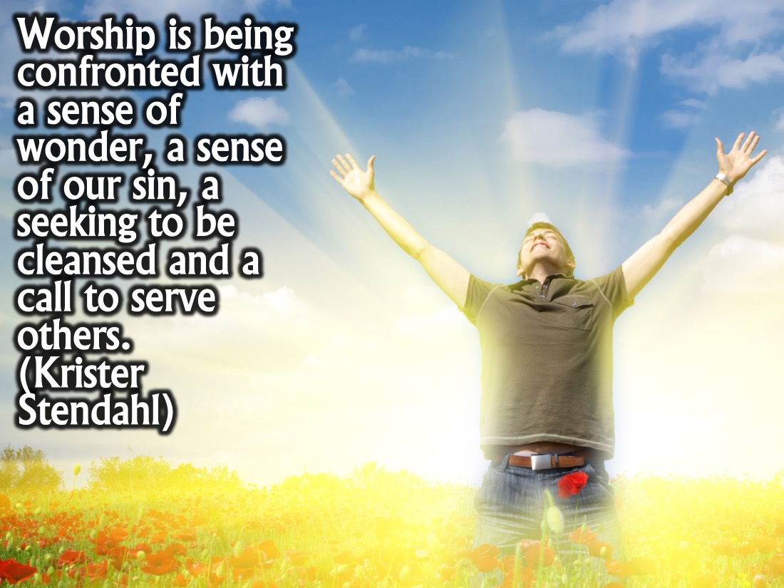
Notes:
Quote #6: Worship is being confronted with a sense of wonder, a sense of our sin, a seeking to be cleansed and a call to serve others. (Krister Stendahl)

Slide 16
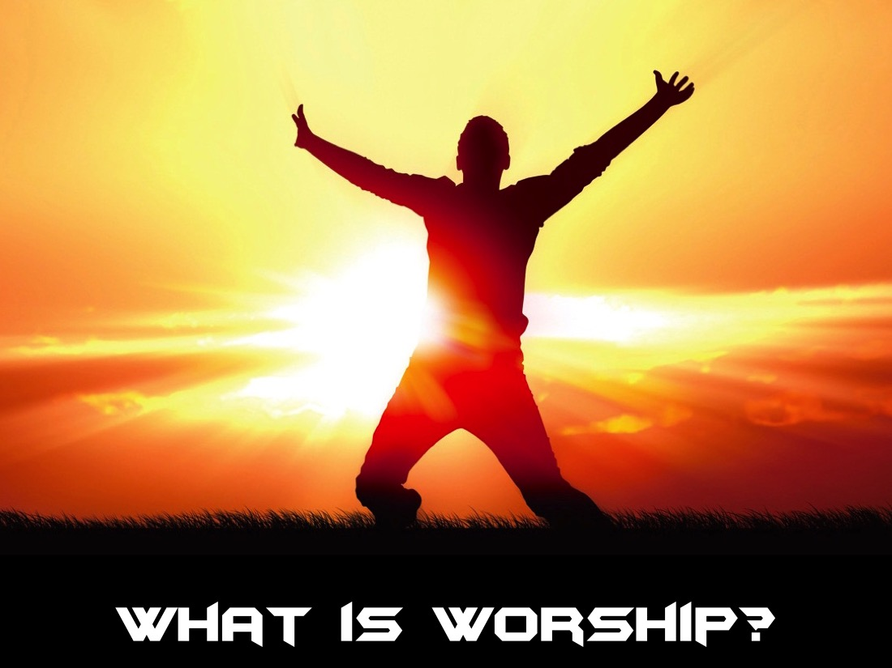
Notes:
So what is worship? Here is a reminder of some of what you came up with in your small groups (use a flipchat to summarise some of their insights on worship).

Slide 17
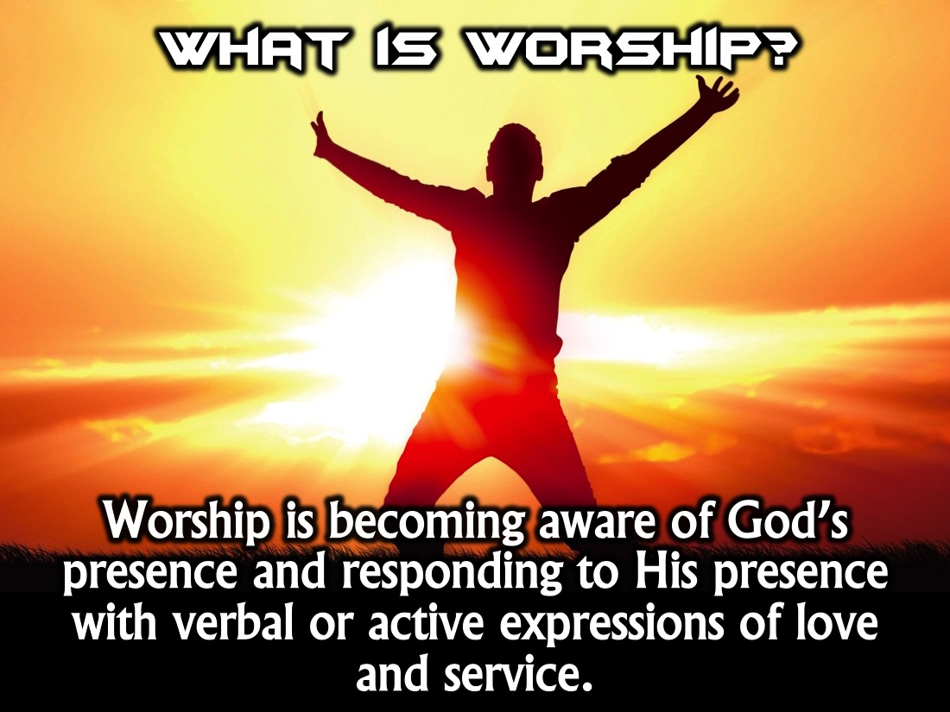
Notes:
What is worship? Worship is becoming aware of God’s presence and responding to His presence with verbal or active expressions of love and service.

Slide 18
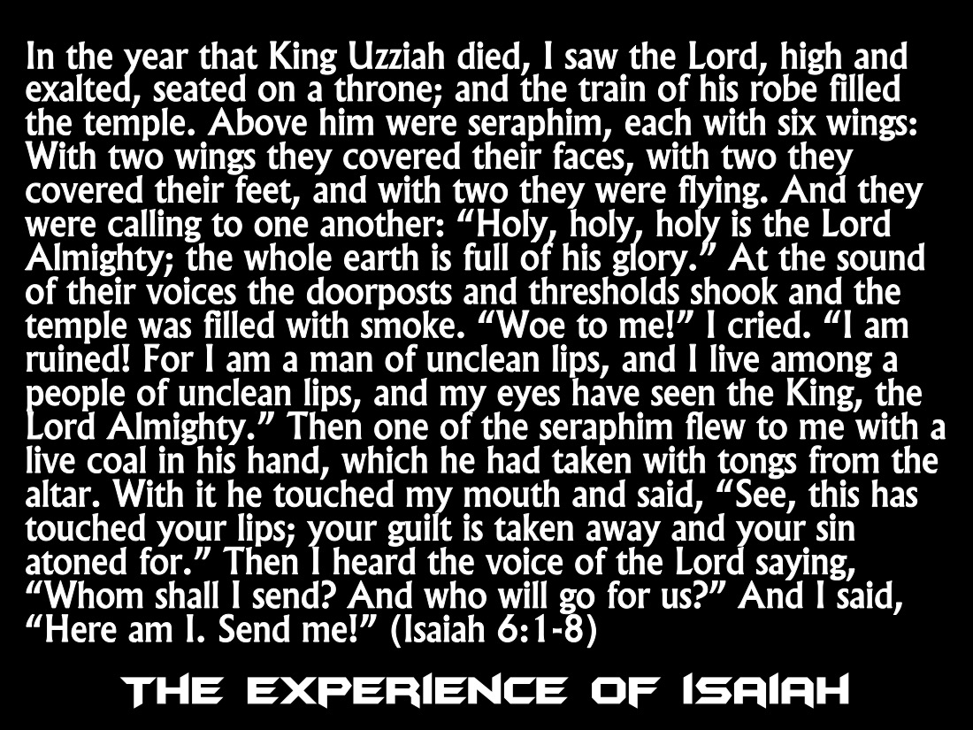
Notes:
The Experience of Isaiah (Isaiah 6). In the year that King Uzziah died, I saw the Lord, high and exalted, seated on a throne; and the train of his robe filled the temple. Above him were seraphim, each with six wings: With two wings they covered their faces, with two they covered their feet, and with two they were flying. And they were calling to one another: “Holy, holy, holy is the Lord Almighty; the whole earth is full of his glory.” At the sound of their voices the doorposts and thresholds shook and the temple was filled with smoke. “Woe to me!” I cried. “I am ruined! For I am a man of unclean lips, and I live among a people of unclean lips, and my eyes have seen the King, the Lord Almighty.” Then one of the seraphim flew to me with a live coal in his hand, which he had taken with tongs from the altar. With it he touched my mouth and said, “See, this has touched your lips; your guilt is taken away and your sin atoned for.” Then I heard the voice of the Lord saying, “Whom shall I send? And who will go for us?” And I said, “Here am I. Send me!” (Isaiah 6:1-8)

Slide 19
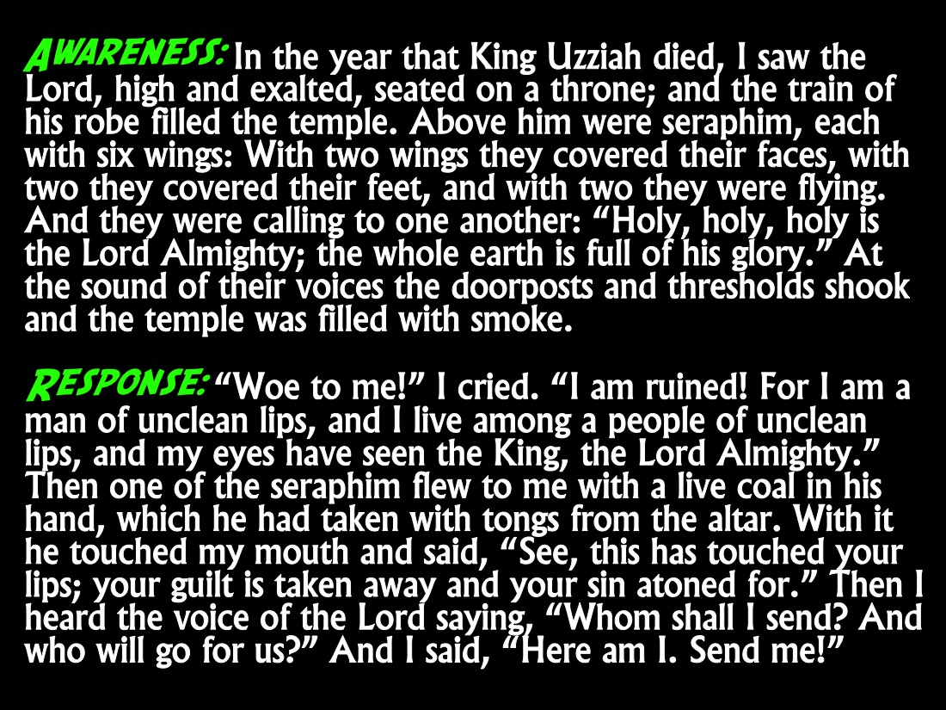
Notes:
Worship is all about Awareness and Response. Isaiah became aware of God’s presence and realised that God is holy and he saw and felt something that made him know he had just had an encounter with God.

Slide 20
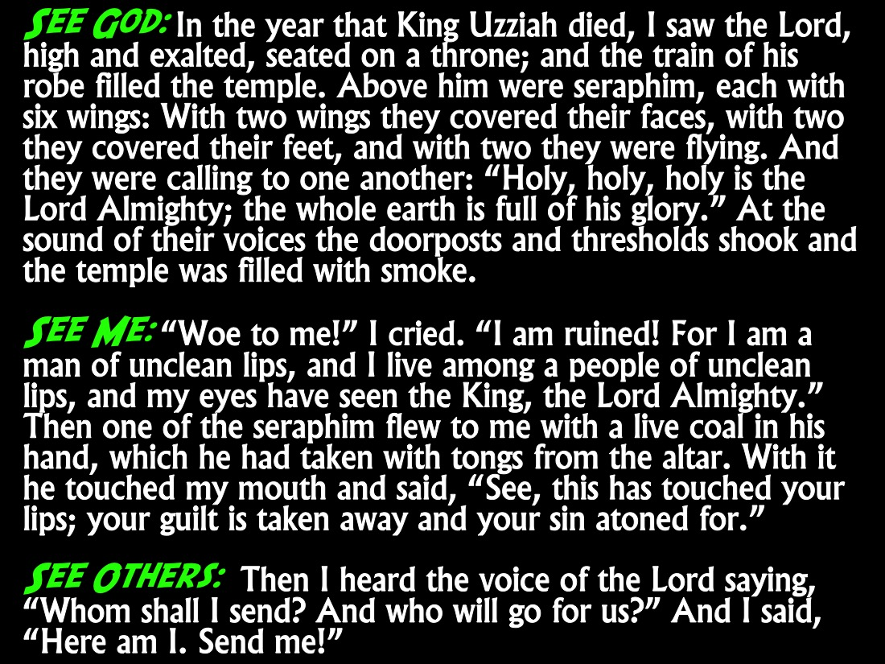
Notes:
Worship is about seeing God; seeing ourselves in the light of who God is and it is about seeing others and ministering to them.

Slide 21
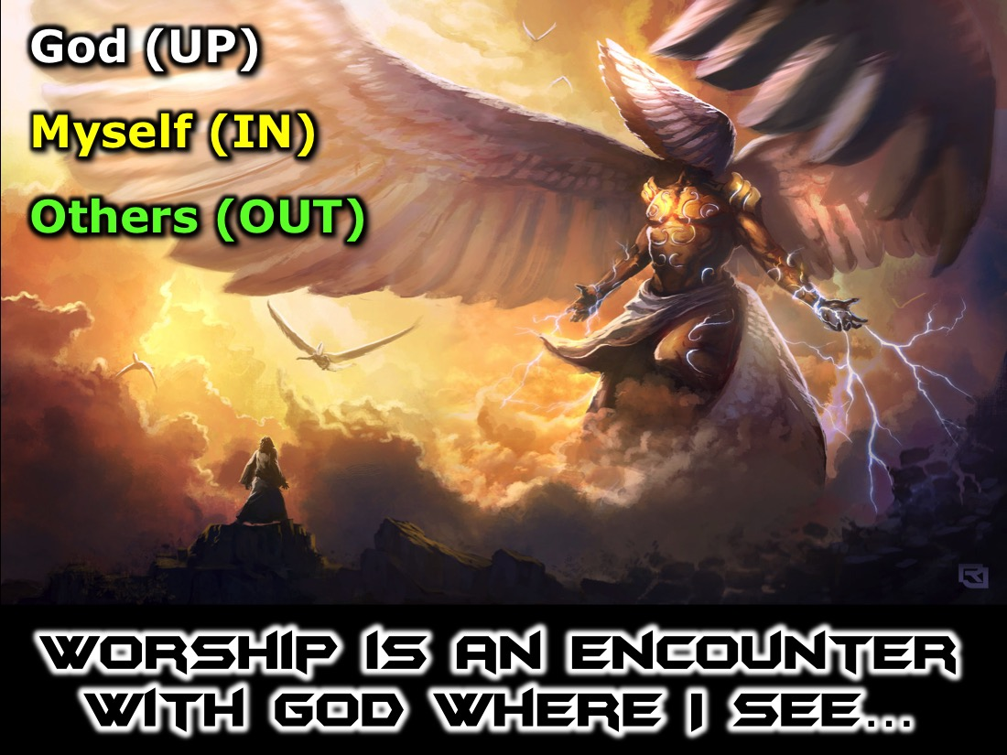
Notes:
Worship is an Encounter with God where I: (1) See God - a Journey Upward. (2) See Myself - a Journey Inward. (3) See Others - Journey Outward.

Slide 22
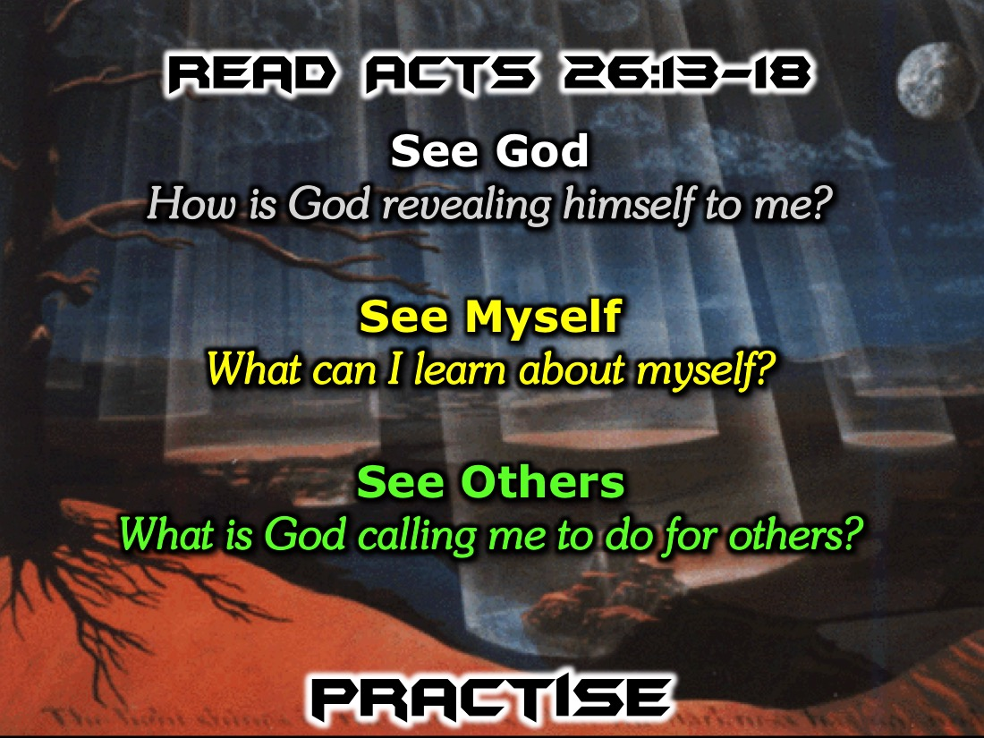
Notes:
Practice: Read Acts 26:13-18 (the story of Paul encountering Jesus). Spend some time reflecting on the three parts of the encounter: (1) See God: How is God revealing himself to me? (2) See Myself: What can I learn about myself? (3) See Others: What is God calling me to do for others?
About noon, King Agrippa, as I was on the road, I saw a light from heaven, brighter than the sun, blazing around me and my companions. We all fell to the ground, and I heard a voice saying to me, “Saul, Saul, why do you persecute me? It is hard for you to fight against my will.” Then I asked, “Who are you, Lord?” “I am Jesus, whom you are persecuting,” the Lord replied. ”Now get up and stand on your feet. I have appeared to you to appoint you as a servant and as a witness of what you have seen and will see of me. I am sending you to your own people and to Gentiles to open their eyes and turn them from darkness to light, and from the power of Satan to God, so that they may receive forgiveness of sins and a place among those who are sanctified by faith in me.” (Acts 26:13-18)

Slide 23
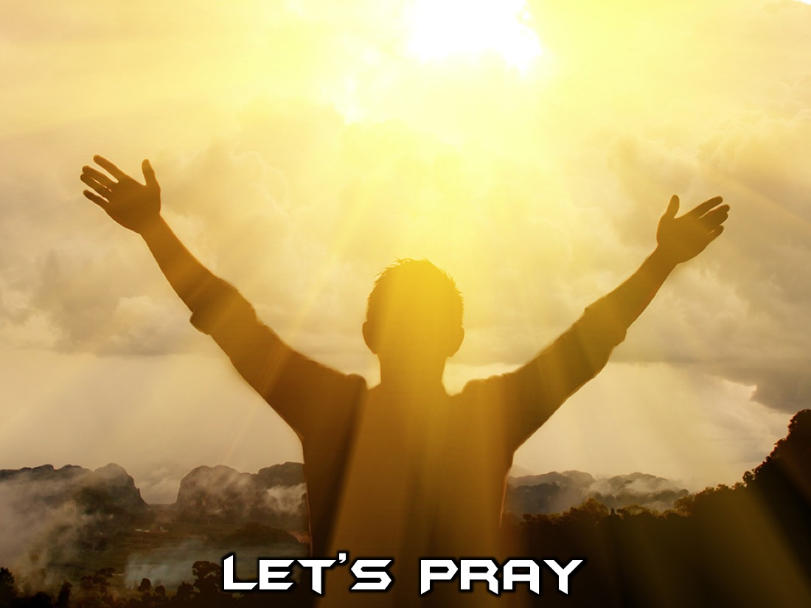
Notes:
Let's close in prayer.

Slide 24

Notes:
Next Sunday we will learn how to get into Scripture.

Slide 25
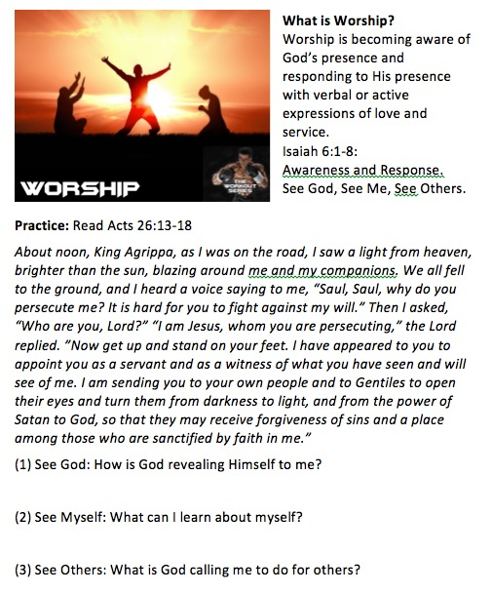
Notes:
Here is a copy of the handout the teens will use and take home.

