Slide 1
Notes:
Welcome to the Workout Series.

Slide 2
Notes:
In the Workout Series this term we are learning about Disciplines to make us spiritually fit!

Slide 3
Notes:
In week 1 we learnt about Devotions as a path to spiritual fitness.

Slide 4
Notes:
In week 2 we learnt about Fasting as a path to spiritual fitness.

Slide 5
Notes:
In week 3 we learnt about Prayer as a path to spiritual fitness.

Slide 6
Notes:
In week 4 we learnt about Worship as a path to spiritual fitness.

Slide 7
Notes:
Today we are learning about Scripture as a path to spiritual fitness.

Slide 8
Notes:
Sharing: In what way has the Bible impacted your life?

Slide 9
Notes:
Illustration: You can’t prepare for your exams by putting your text book under your pillow and hoping to know it all by the morning. You actually have to read and study the material.

Slide 10
Notes:
In the same way, God’s Word won’t change us if it is left unopened on our shelf!

Slide 11
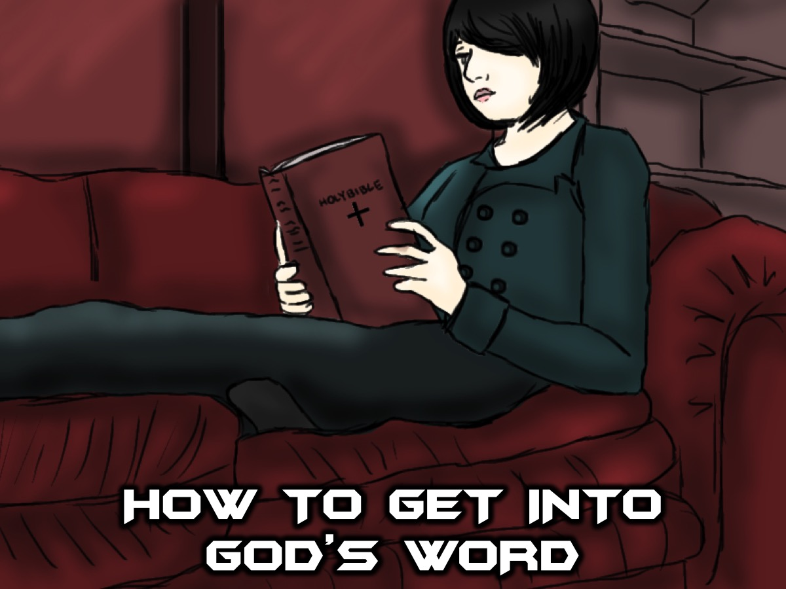
Notes:
How to Get Into God’s Word: Today I am going to show you a way you can use to help you get into God’s Word. This is a way of getting into the Word so that reading the Bible is not like trying to do math.

Slide 12
Notes:
1. Read. Choose a Bible Passage and read it through slowly. We suggest that you consider starting with a book of the Bible and each day move on to the next section in that same book. Some places to start: Psalms, one of the Gospels, or a Letter.

Slide 13
Notes:
2. Reflect. You could just sit and think about what you have written for a few minutes or you could summarise the passage in your own words.

Slide 14
Notes:
3. Apply. Read the passage again and dig deeper.

Slide 15
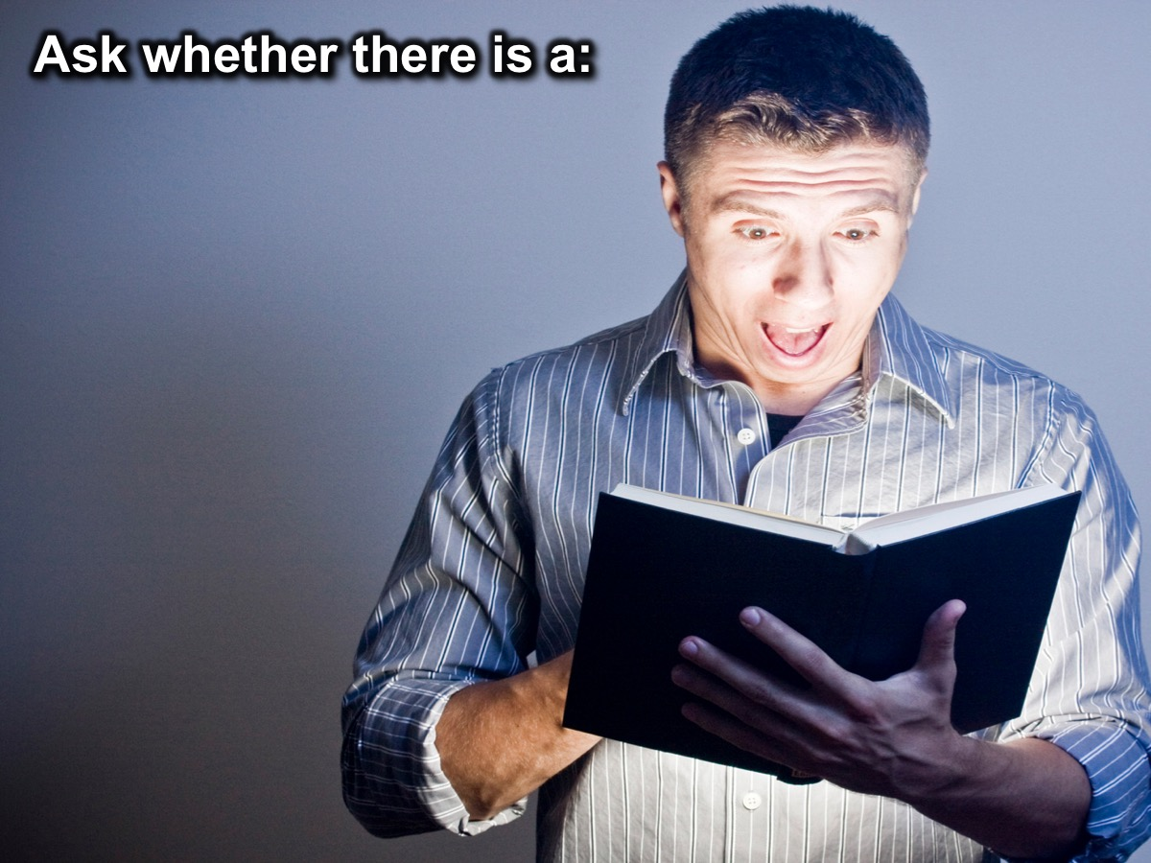
Notes:
Choose a passage and ask whether there is a:

Slide 16
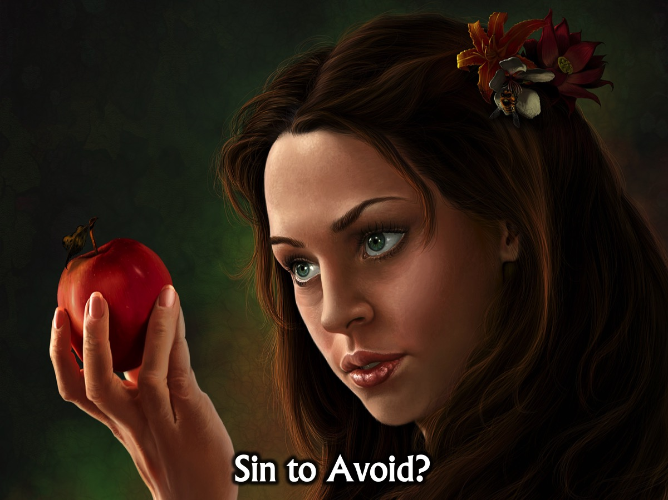
Notes:
(1) Sin to Avoid?

Slide 17
Notes:
(2) Promise to Claim?

Slide 18
Notes:
(3) Example to Follow?

Slide 19
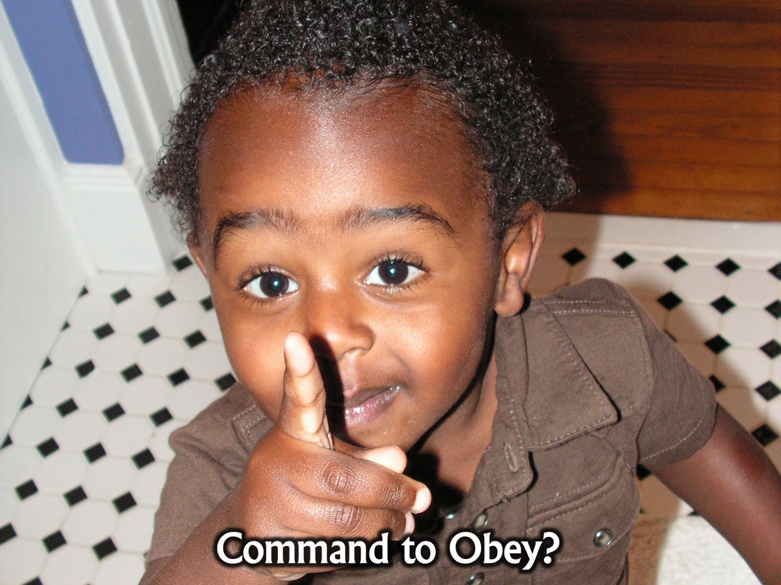
Notes:
(4) Command to Obey?

Slide 20
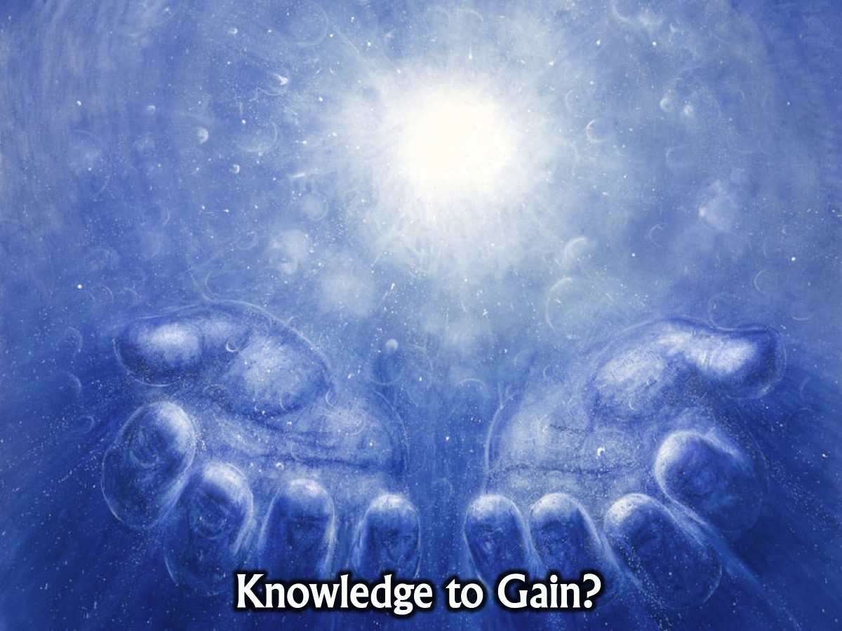
Notes:
(5) Knowledge to Gain?

Slide 21
Notes:
So every day, when you sit down to have you daily devotions, you choose a passage, read it a few times and then ask whether there is a: (1) Sin to Avoid? (2) Promise to Claim? (3) Example to Follow? (4) Command to Obey? (5) Blessing to Enjoy? Some people call this the SPECK method of getting into God’s Word!

Slide 22
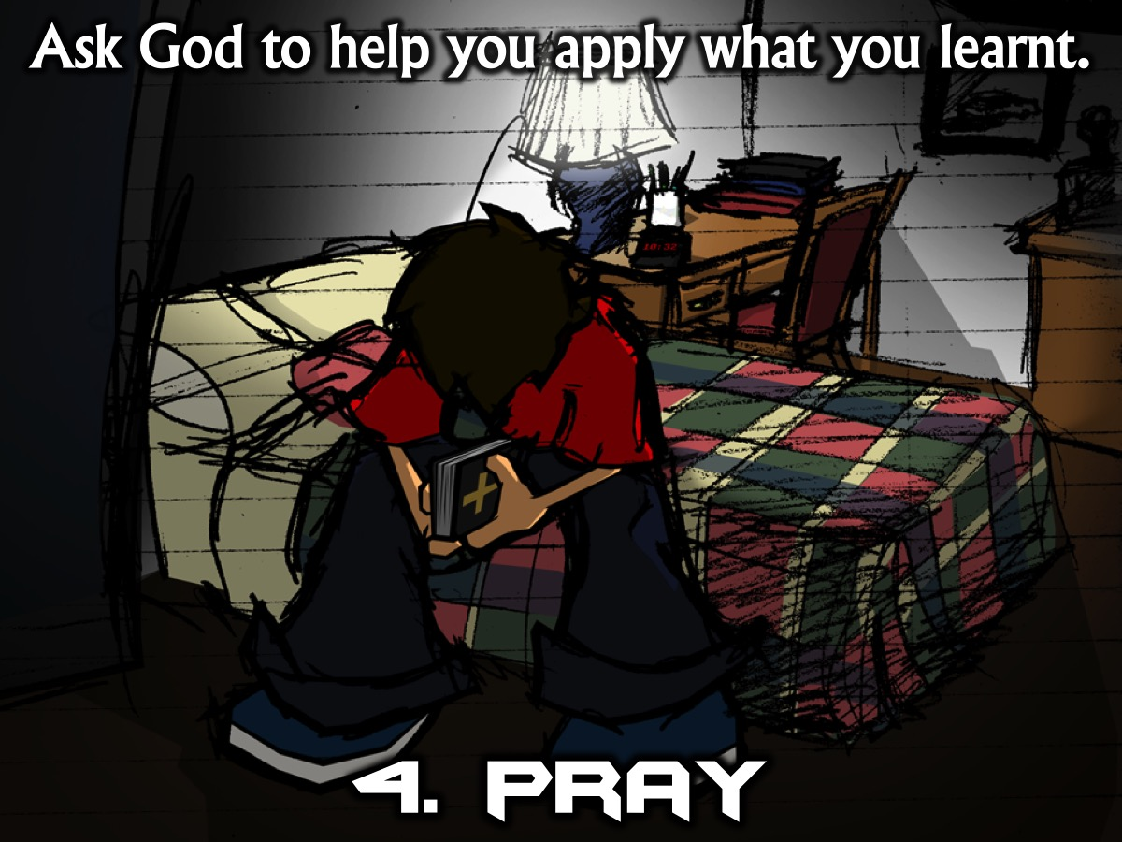
Notes:
4. Pray. Ask God to help you apply what you have learnt.

Slide 23
Notes:
5. Live. Put what you have learnt into practice.

Slide 24
Notes:
Summary: Here is the process we learnt today to help us get into God’s Word: Read, Reflect, Apply, Pray and Live.

Slide 25
Notes:
Practise: Use the handout to get into the Word. You are going to use the process you learnt today to apply the Word to your life. Read the passage: Blessed is the one who does not walk in step with the wicked or stand in the way that sinners take or sit in the company of mockers, but whose delight is in the law of the Lord, and who meditates on his law day and night. That person is like a tree planted by streams of water, which yields its fruit in season and whose leaf does not wither - whatever they do prospers. Not so the wicked! They are like chaff that the wind blows away. Therefore the wicked will not stand in the judgment, nor sinners in the assembly of the righteous. For the Lord watches over the way of the righteous, but the way of the wicked leads to destruction. (Psalm 1). Write down the answers to the questions: Is there a Sin to Avoid, a Promise to Claim, an Example to Follow, a Command to Obey, and Knowledge to Gain?

Slide 26
Notes:
Sharing: This is your chance to come to the microphone and share what you got out of your time in the Word and with God.

Slide 27
Notes:
Challenge: Do it every day for the next week! And then for the rest of your life!

Slide 28
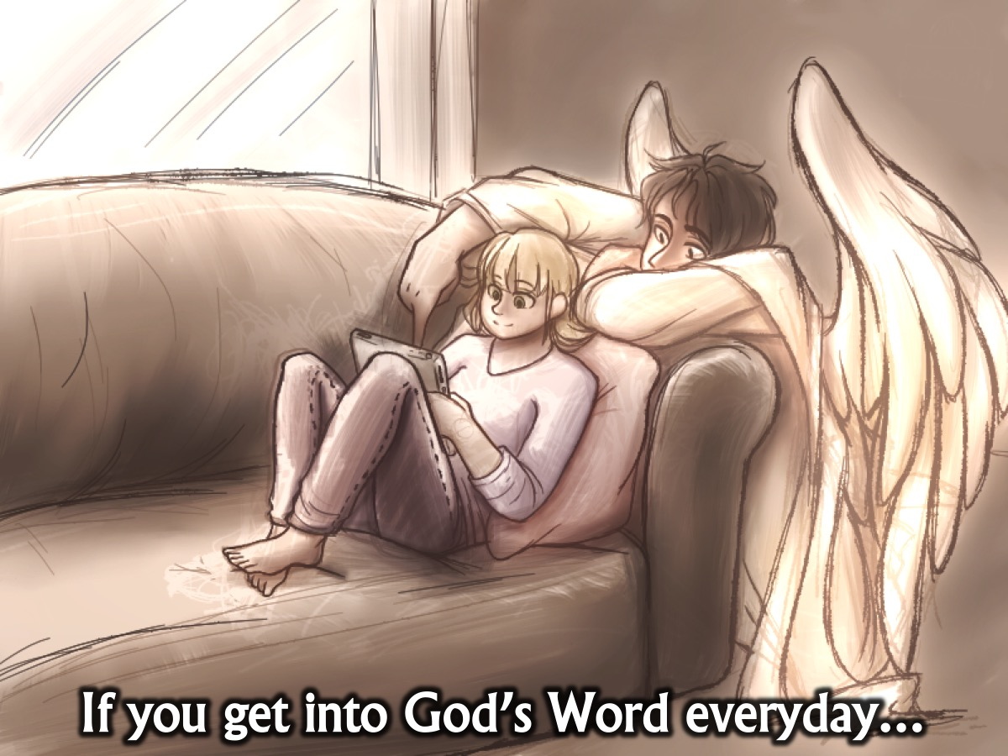
Notes:
If you get into God’s Word everyday…

Slide 29
Notes:
(1) You Will Stay Salty. “How can a young person stay pure? By obeying your word. I have hidden your word in my heart, that I might not sin against you.” (Psalm 119:9,11)

Slide 30
Notes:
(2) You Will Hear God (and he will speak through you). “Oh how I love your words. I think about them all day long. They make me wiser than my enemies because they are my constant guide.” (Psalm 119:97-98)

Slide 31
Notes:
(3) You Will Understand Truth. “I will have an answer for the one who insults me since I trust your word. I will speak about your written instructions in the presence of kings and not feel ashamed.” (Psalm 119:42,46)

Slide 32
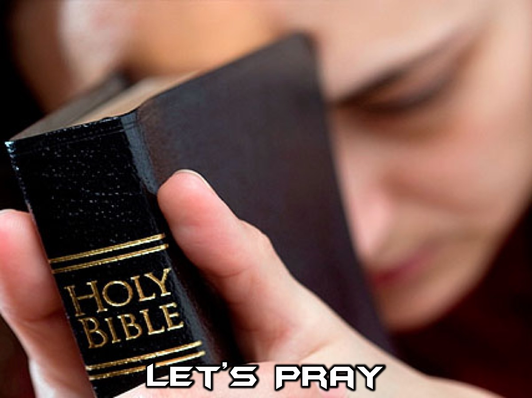
Notes:
Let's close in prayer.

Slide 33
Notes:
Next Sunday morning, Ashley is preaching on how suffering can be a path to spiritual fitness.

