Slide 1

Notes:
Welcome to the Workout Series.

Slide 2

Notes:
In the Workout Series this term we are learning about Disciplines to make us spiritually fit!

Slide 3

Notes:
In week 1 we learnt about Devotions as a path to spiritual fitness.

Slide 4
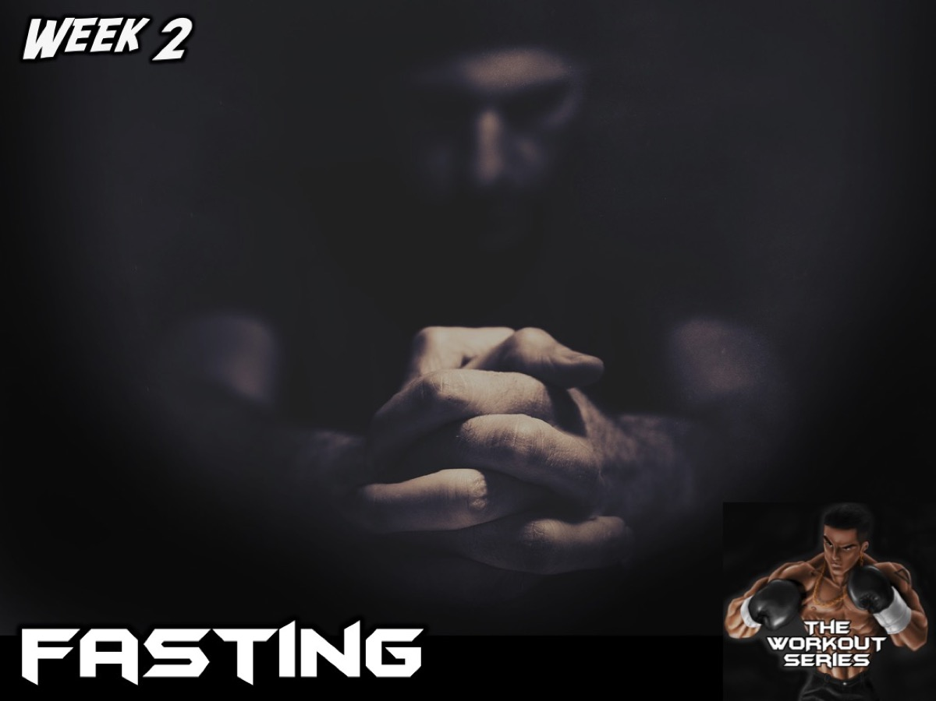
Notes:
In week 2 we learnt about Fasting as a path to spiritual fitness.

Slide 5
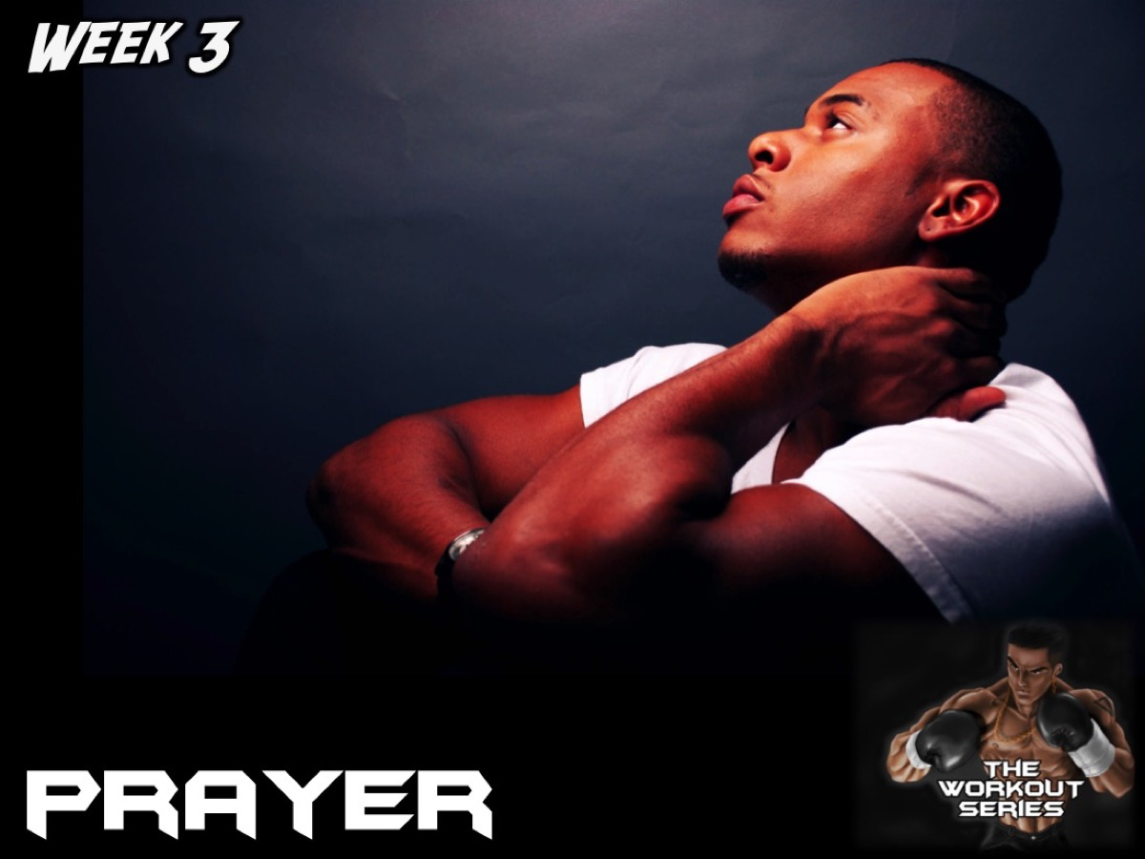
Notes:
In week 3 we learnt about Prayer as a path to spiritual fitness.

Slide 6

Notes:
In week 4 we learnt about Worship as a path to spiritual fitness.

Slide 7

Notes:
Last week we learnt about Scripture as a path to spiritual fitness.

Slide 8
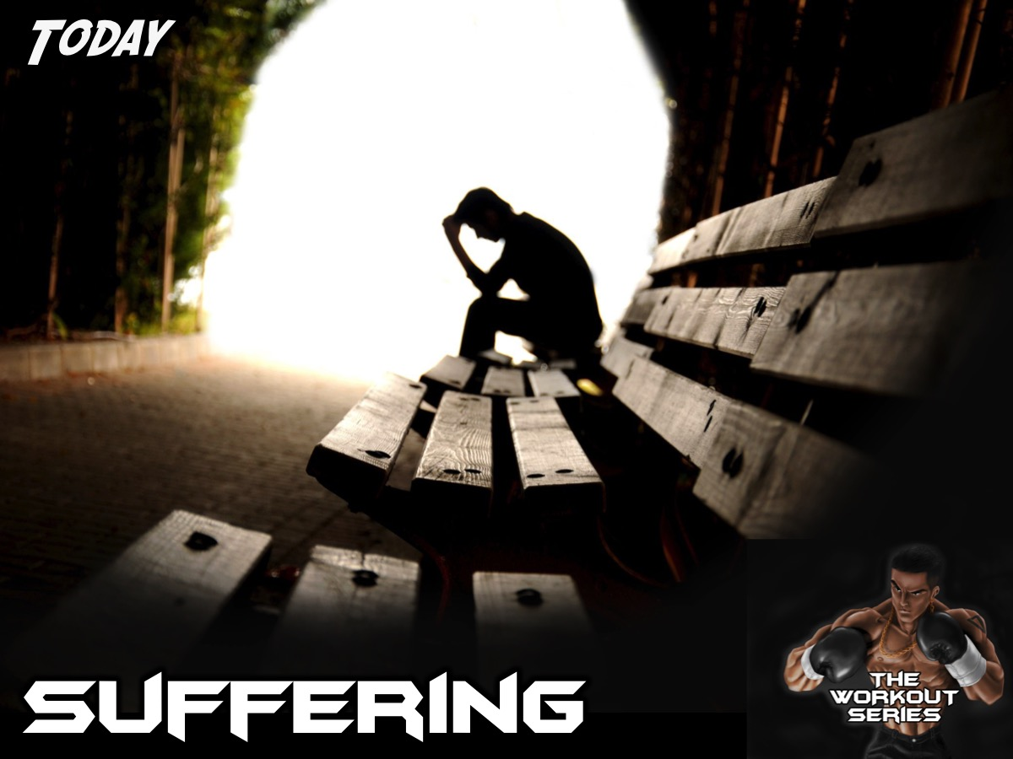
Notes:
Today we are going to learn about how suffering can help us become spiritually fit.

Slide 9
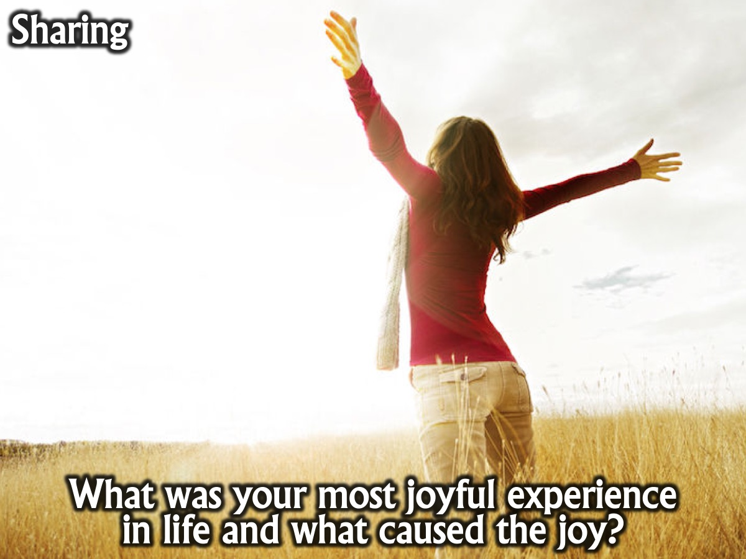
Notes:
Sharing: What was your most joyful experience in life and what caused the joy?

Slide 10
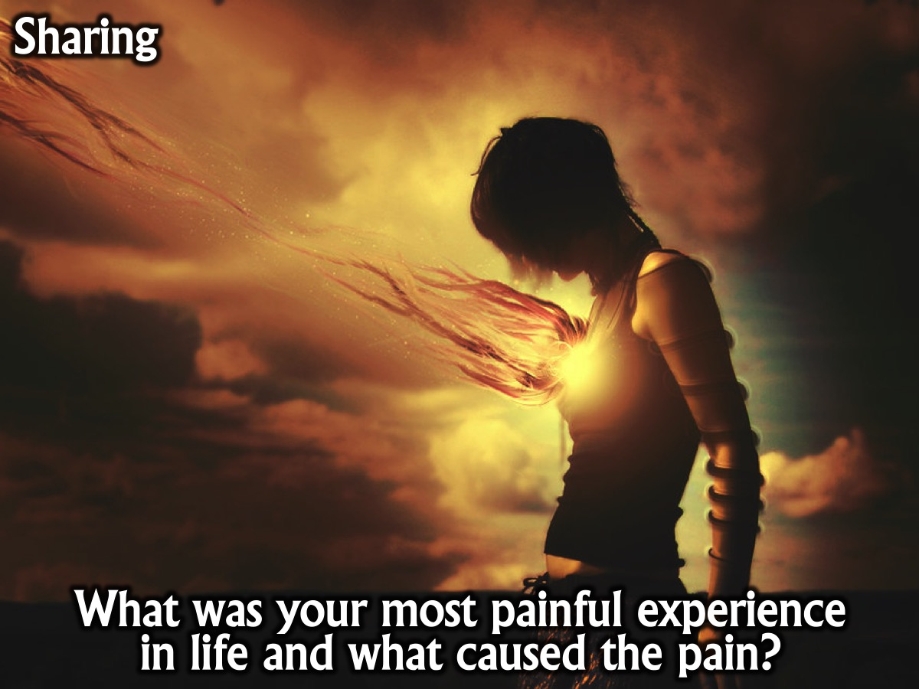
Notes:
Sharing: What was your most painful experience in life and what caused the pain?

Slide 11

Notes:
My Journey With Pain.

Slide 12
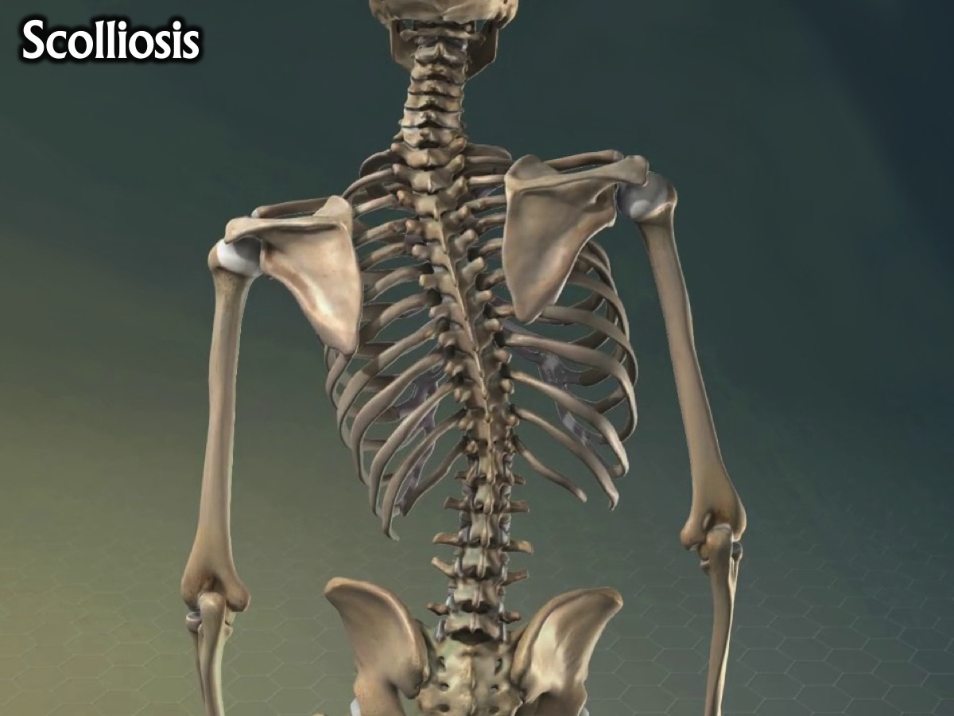
Notes:
My walk with Scolliosis

Slide 13
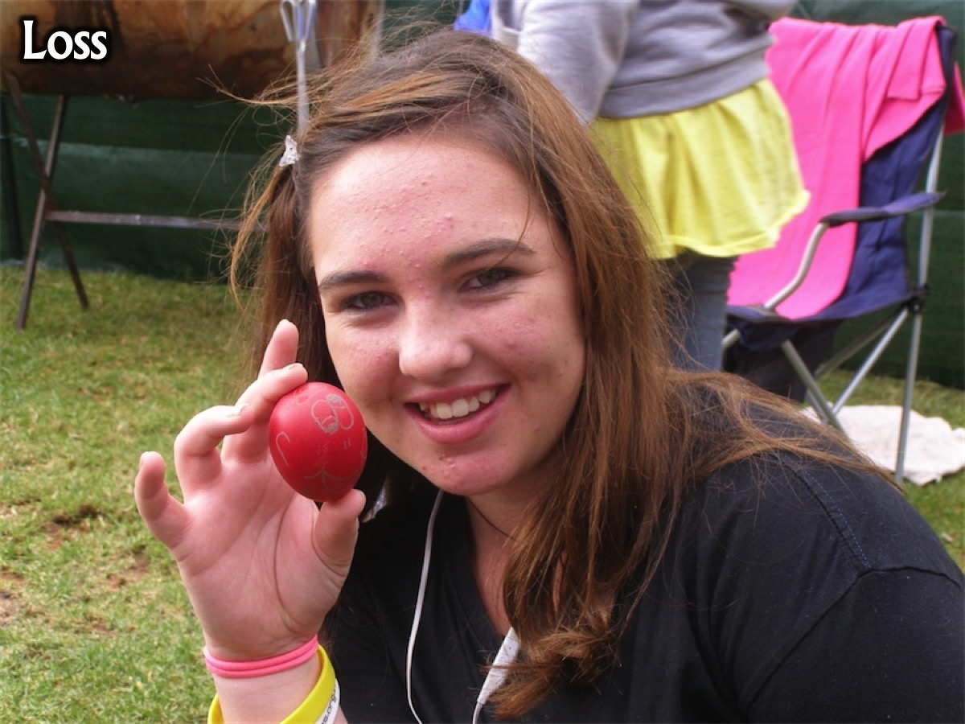
Notes:
The loss of loved ones and friends.

Slide 14

Notes:
Bullying

Slide 15
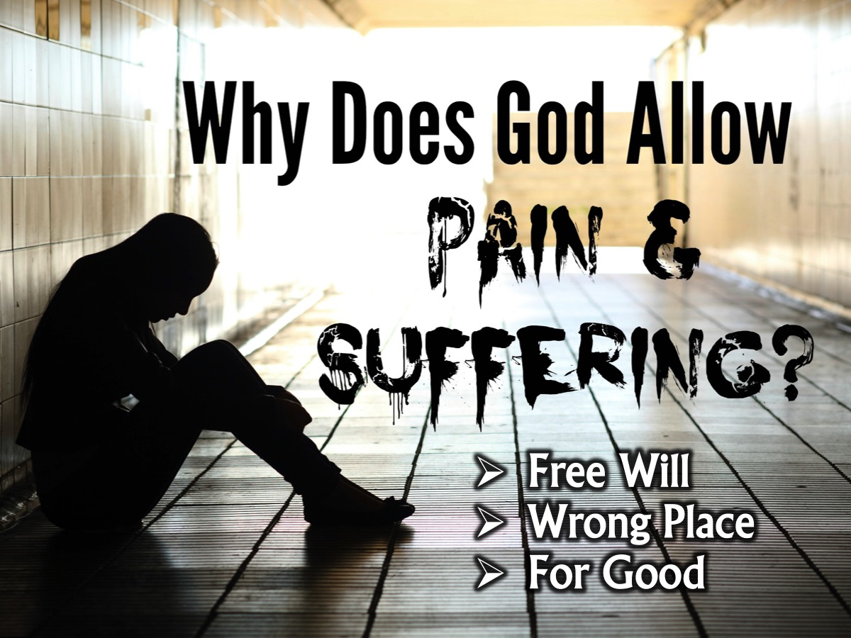
Notes:
Why does God allow suffering? If God is powerful, loving, wise, and just, why is the world so full of hatred and injustice? (1) God has given man free will. Man has been imperfect and sinful ever since the rebellion in the garden of Eden. Sinful humans tend to struggle for dominance, and this results in wars, oppression and suffering. (2) Sometimes it could just be you being in the wrong place at the wrong time. (3) Othertimes God uses our suffering for his work - Like Nick (in this video) who uses emotional struggles he experienced with bullying, self-esteem and loneliness to help others cope with whatever challenge they might have in their lives.

Slide 16
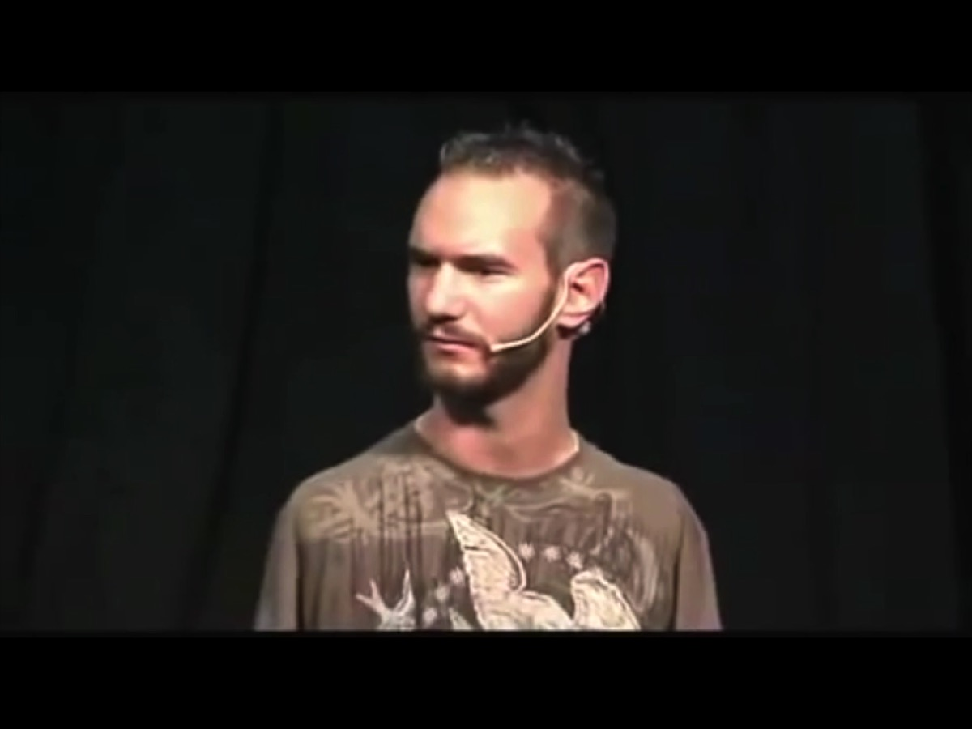
Notes:
Video: Nick Vujicic Attitude Is Altitude.com and Life Without Limbs.org. Get it on YouTube at: https://www.youtube.com/watch?v=84Kj3BfHQuI&t=983s (from 13:14-18:03).

Slide 17
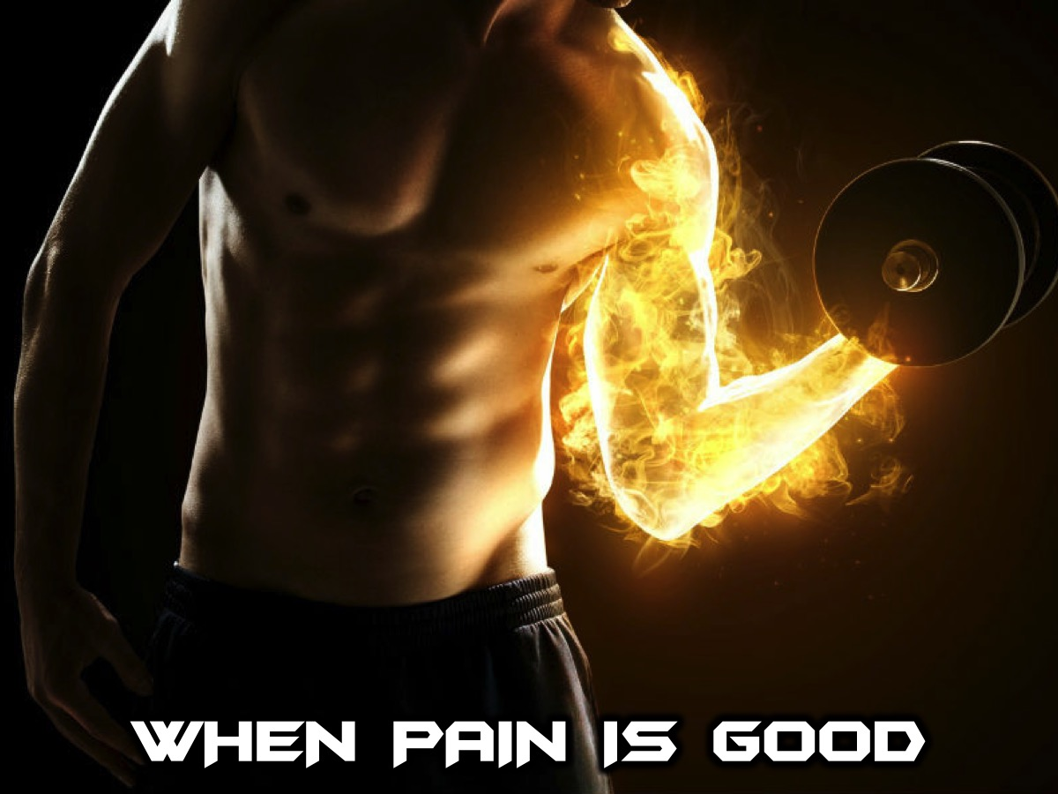
Notes:
When Pain is Good: Hold up a chair for 60 seconds. It burns, but it is a good pain. Its temporary and it makes you stronger in the end.

Slide 18
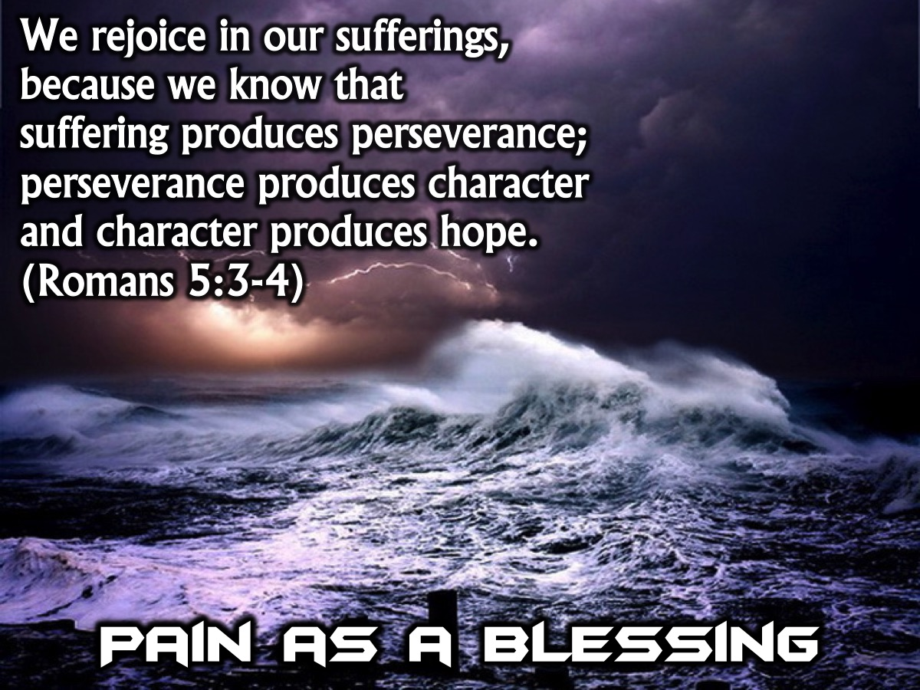
Notes:
The Bible makes it clear that suffering can be a blessing in our lives: “We rejoice in our sufferings, because we know that suffering produces perseverance; perseverance, character; and character, hope.” (Romans 5:3-4)

Slide 19
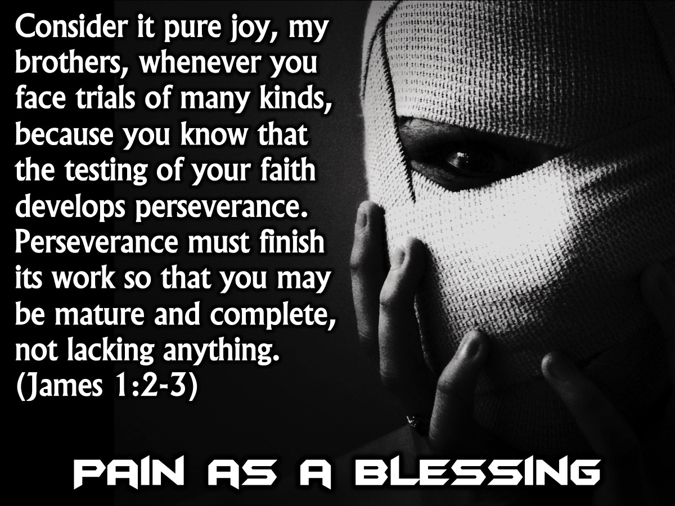
Notes:
“Consider it pure joy, my brothers, whenever you face trials of many kinds, because you know that the testing of your faith develops perseverance. Perseverance must finish its work so that you may be mature and complete, not lacking anything.” (James 1:2-3)

Slide 20

Notes:
How can we deal with pain and suffering?

Slide 21
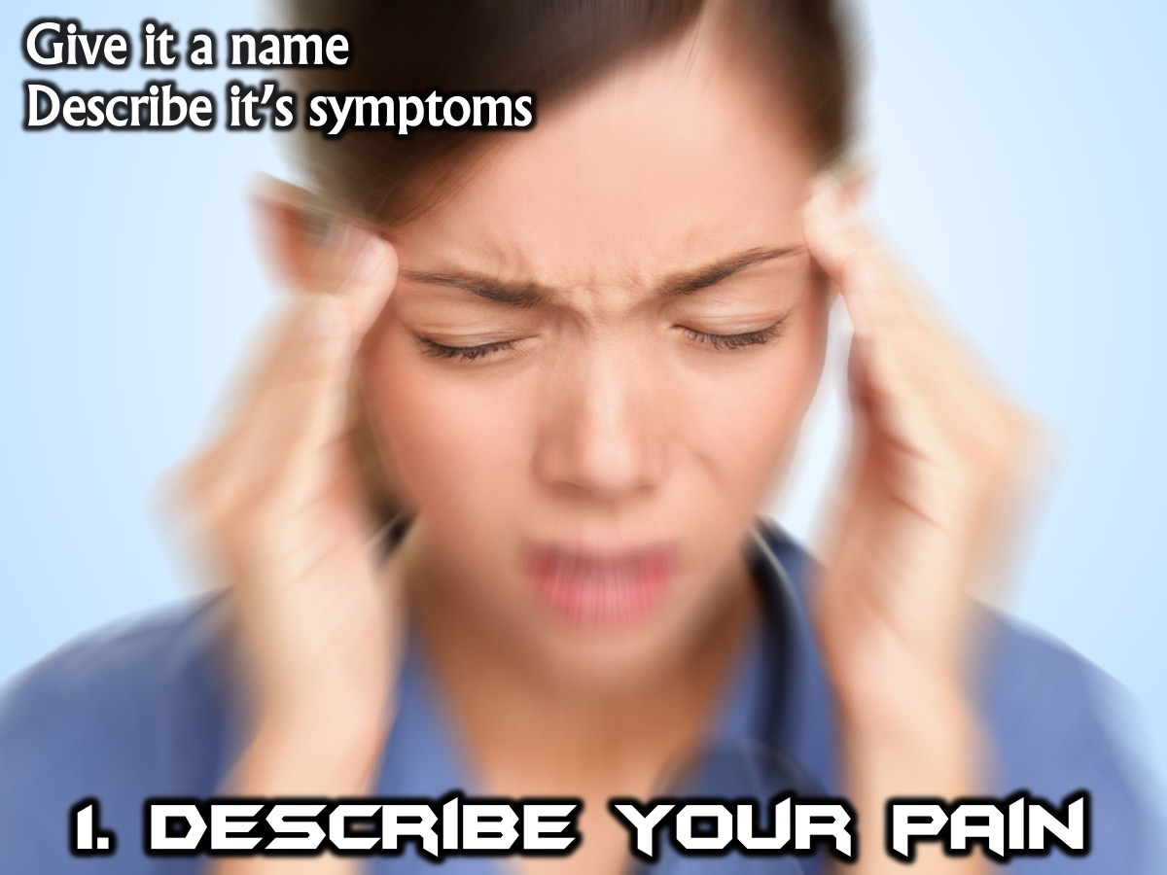
Notes:
1. Describe Your Pain: Give it a name and write down the symptoms.

Slide 22
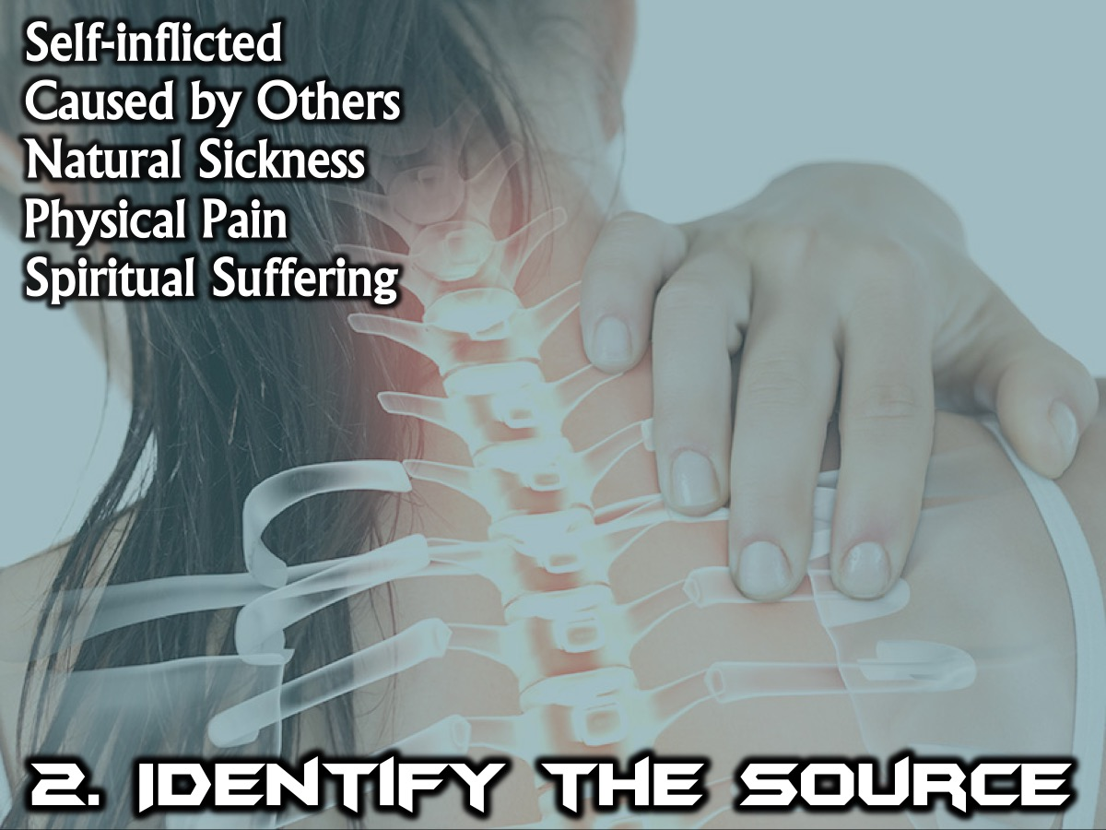
Notes:
2. Identify the Source: Is it: (a) Self-inflicted (of our own doing or as a result of bad decisions), (b) Caused by someone else (if you have been wronged by someone), (c) Natural sickness (something you born with or that you have been infected by), (d) Physical pain ( born with a deformity or if you have suffered an injury), or (e) Spiritual suffering (maybe you are no longer close to God or you have opened doors into other religeous practices or satanic influence).

Slide 23

Notes:
3. Journal About It. Write down your struggles and write down everyday what you did to reduce the pain and your plan of action for the future.

Slide 24
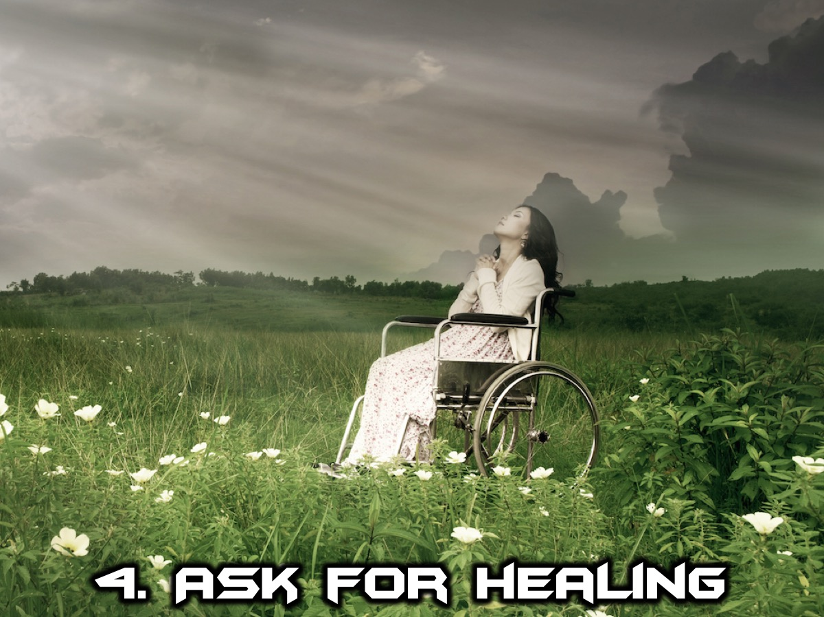
Notes:
4. Ask For Healing. Sometimes all it takes is for you to have faith in healing for your pain or suffering to lessen or go away completely.

Slide 25
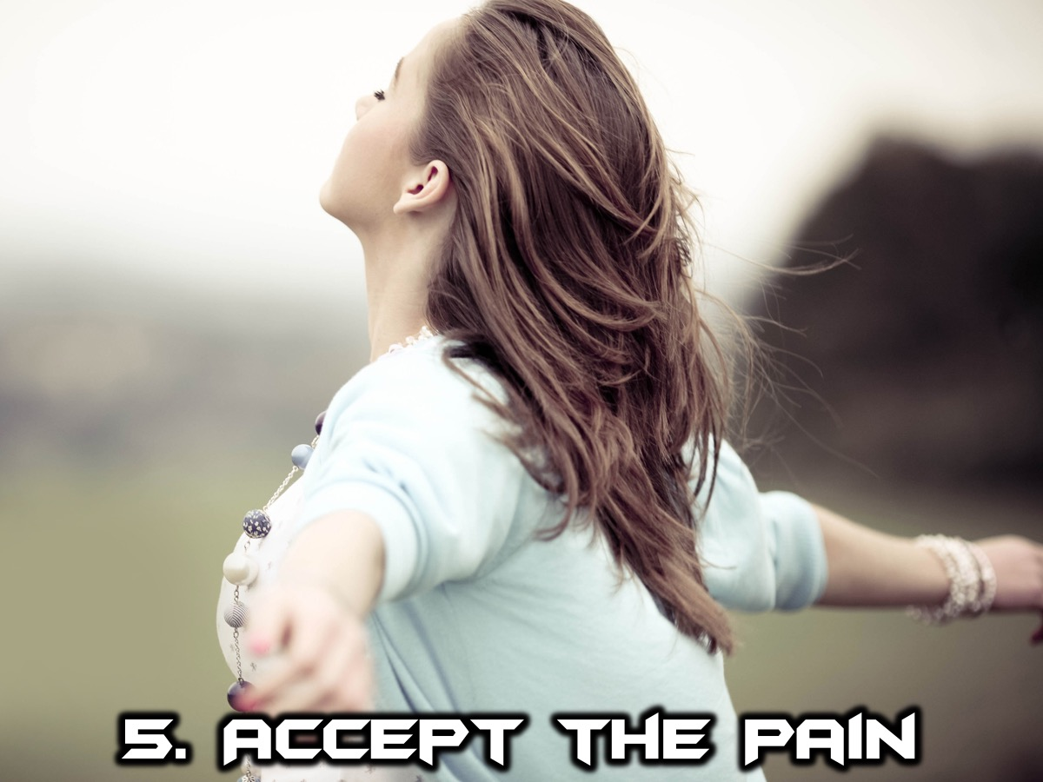
Notes:
5. Accept the Pain. Accept the hand you have been given and look for the good that will result. That doesn’t mean sit back and don’t do anything about it. Don’t be bitter about your circumstances.

Slide 26

Notes:
Practise: Think of a specific pain in your life right now and complete the worksheet.
1. Describe the pain you are experiencing:
2. Identify the source of your pain (circle one option): Self-inflicted, Caused by Others, Sickness, Physical or Spiritual.
3. Write down your thoughts about your pain:
4. Write a letter to God asking him to heal you: Dear God…
5. Ask God for help in dealing with it: Dear God…

Slide 27
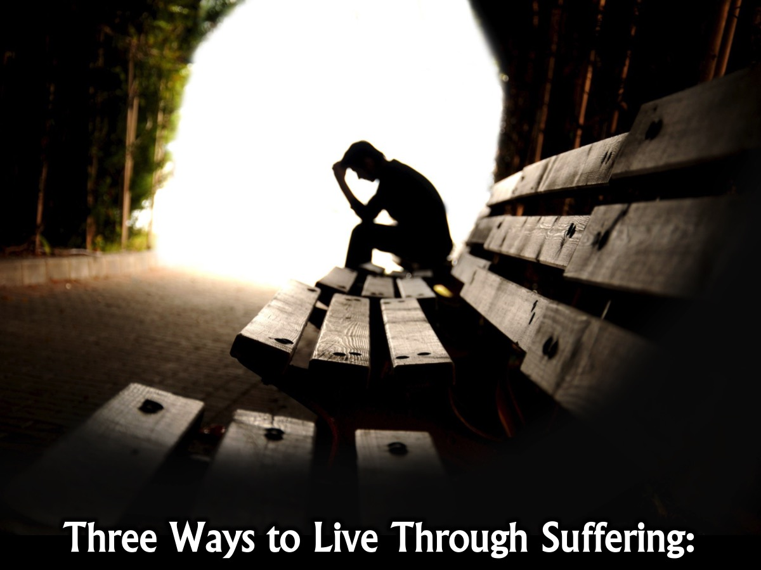
Notes:
Three ways to live through suffering:

Slide 28
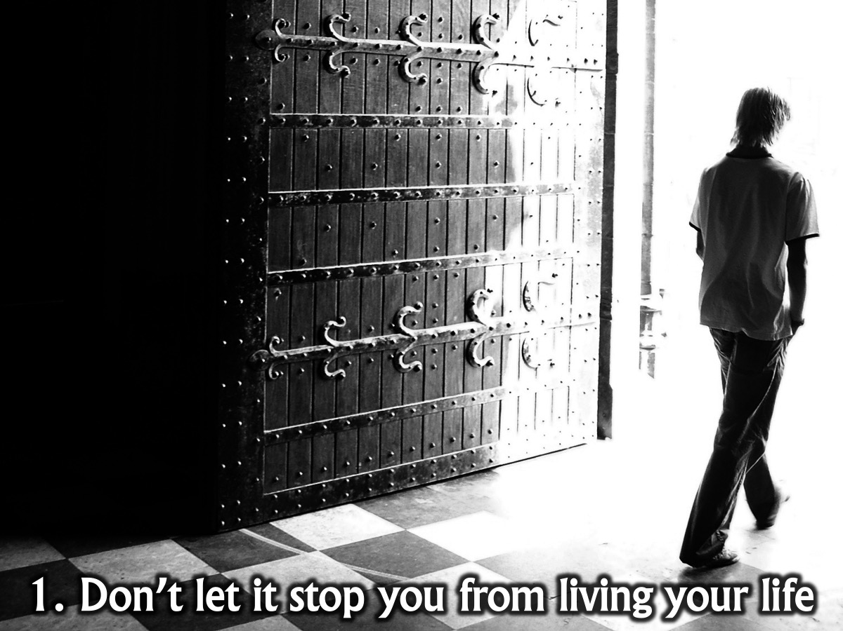
Notes:
(1) Don’t let your pain or suffering stop you from living your life (Don’t just focus on your pain and suffering - get on with living your life).

Slide 29
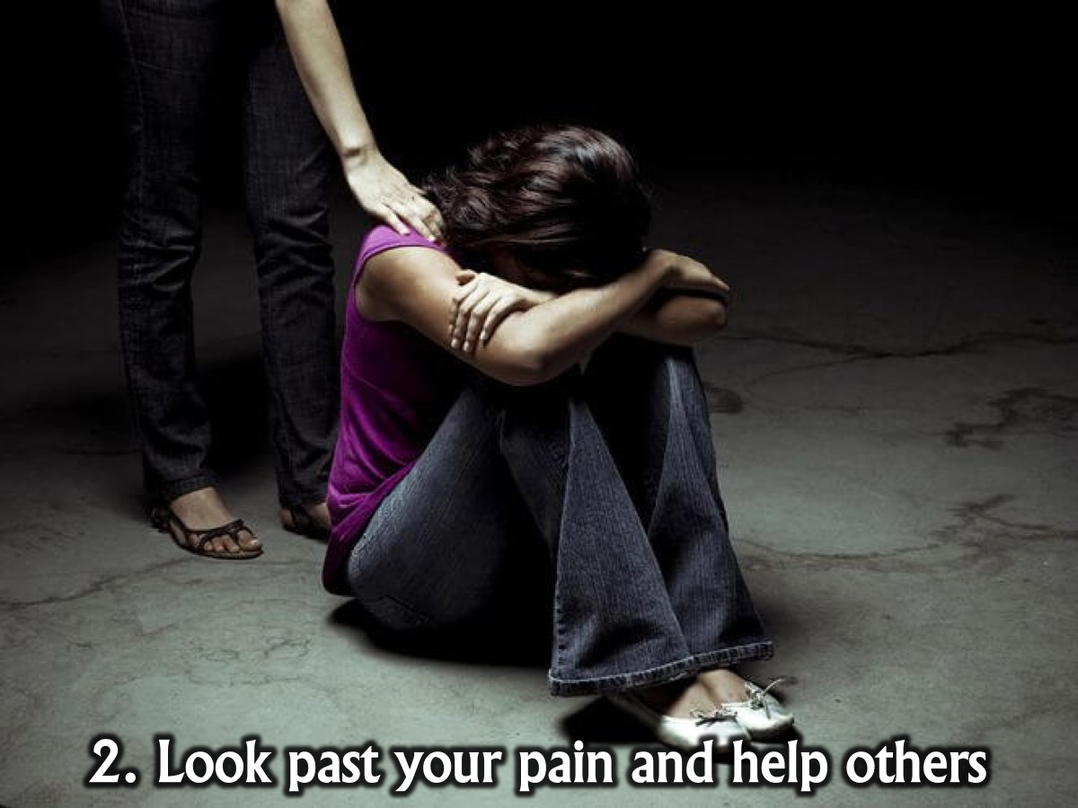
Notes:
(2) Look past your own pain and focus on helping others around you who are suffering (Find an outlet for your frustrations and focus on the positive and sometimes it takes seeing someone who is worse off to actually realise we don’t have it all that bad).

Slide 30

Notes:
(3) Identify God’s purpose in your pain (We need to find out how can God use our pain and suffering for His work.)

Slide 31
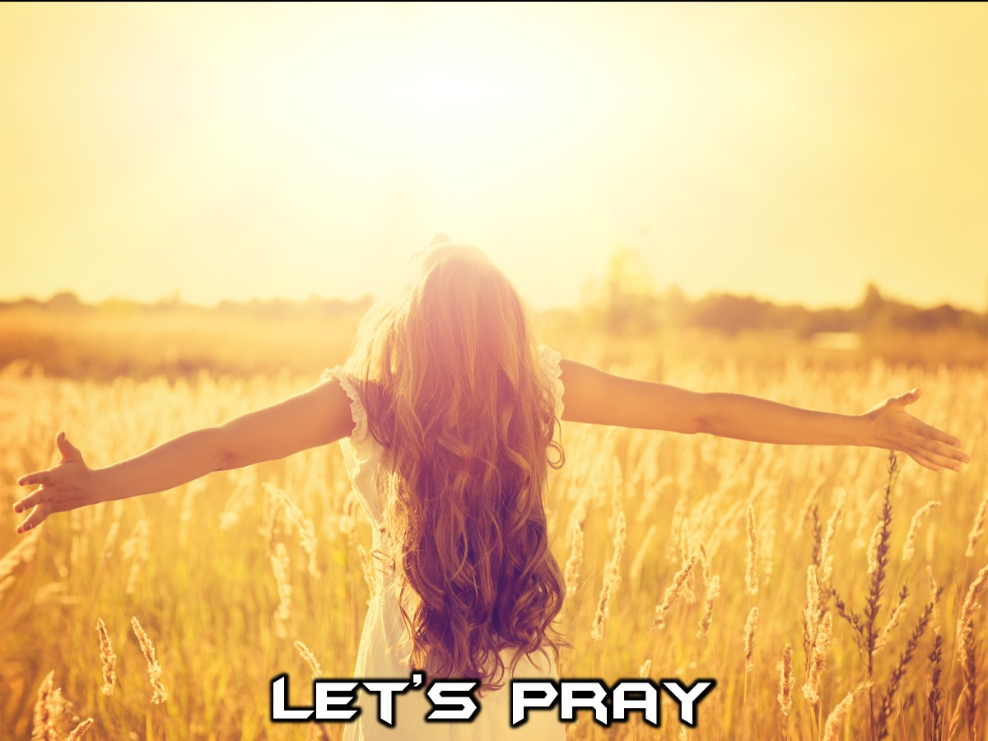
Notes:
Let's close in prayer.

Slide 32

Notes:
Next week, Mario is preaching on how the discipline of Guidance can help us become spiritually fit.

