Slide 1

Notes:
Welcome to the Workout Series.

Slide 2

Notes:
In the Workout Series we are looking at disciplines that will make us spiritually fit! So far we have looked at: Devotions, Fasting. Prayer, Worship, Scripture and Suffering.

Slide 3

Notes:
Today we are going to learn about how Guidance can help us become spiritually fit.

Slide 4

Notes:
Sharing: What is God’s will for your life?

Slide 5
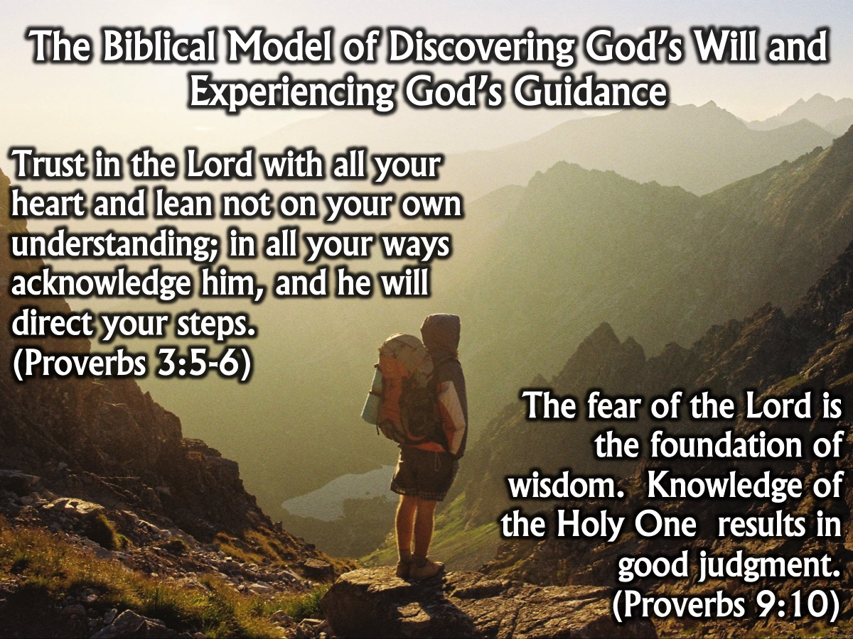
Notes:
The Biblical Model of Discovering God’s Will and Experiencing God’s Guidance:
Trust in the Lord with all your heart and lean not on your own understanding; in all your ways acknowledge him, and he will direct your steps. (Proverbs 3:5-6)
The fear of the Lord is the foundation of wisdom. Knowledge of the Holy One results in good judgment.
(Proverbs 9:10)

Slide 6
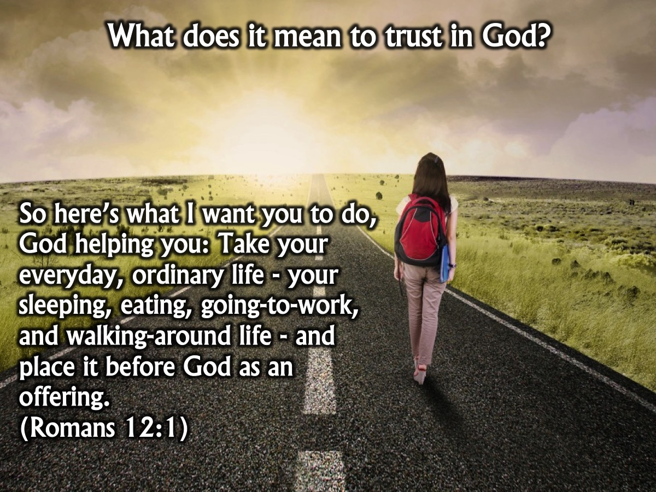
Notes:
What does it mean to trust in God? So here’s what I want you to do, God helping you: Take your everyday, ordinary life - your sleeping, eating, going-to-work, and walking-around life - and place it before God as an offering. (Romans 12:1)

Slide 7

Notes:
What is God’s Will?

Slide 8

Notes:
1. God’s will is more about Journey than Destination. It is not trying to figure out each step I need to take for the rest of my life - but building an intimate relationship with God as I live my life.
Notes: All too often, God's will is seen in terms of a program that has been laid out before us. When it is viewed this way, the emphasis falls on developing a technique that will help us discover the details of that program as we move from one important decision to another. Should I marry this person? Should I accept this job offer? Should I move to this city?
It is far better to see the will of God as a process rather than a program. Viewed this way, the emphasis falls on developing an intimate relationship with God and not on following some all-purpose technique. Who we are should take priority over what we do. The Bible concentrates on our need to cultivate intimacy with God but says little about methods of determining His will. It is not a how-to-do-it manual but rather a guidebook on who-to-know. God will not be manipulated by impatient demands and magical formulas. Instead, our paths will be illuminated by our growing and trusting relationship with Him.
"The steps of a man are established by the Lord; and He delights in his way. When he falls, he will not be hurled headlong; because the Lord is the One who holds his hand" (Psalm 37:23-24).
"Nevertheless I am continually with You; You have taken hold of my right hand. With Your counsel You will guide me, and afterward receive me to glory" (Psalm 73:23-24).
The biblical model of knowing God's will centers on a relationship, but we must be careful to use the right earthly analogy. In some relationships we simply want to be told what to do or we want to get approval for our predetermined plans. A better analogy is that of the joint decisions reached by a married couple who enjoy an intimate relationship of mutual concern, respect, and trust. In this case, both are involved in the decisions that are reached, and it is sometimes impossible to distinguish the parts each played in the process. Similarly, the will of God is a divine/human process, not solely divine or solely human. When we consciously acknowledge His presence and depend upon Him in the course of making decisions, the choices that are made are both ours and His. God's will, then, is not an end but a means of knowing Him better and becoming more like Christ.

Slide 9
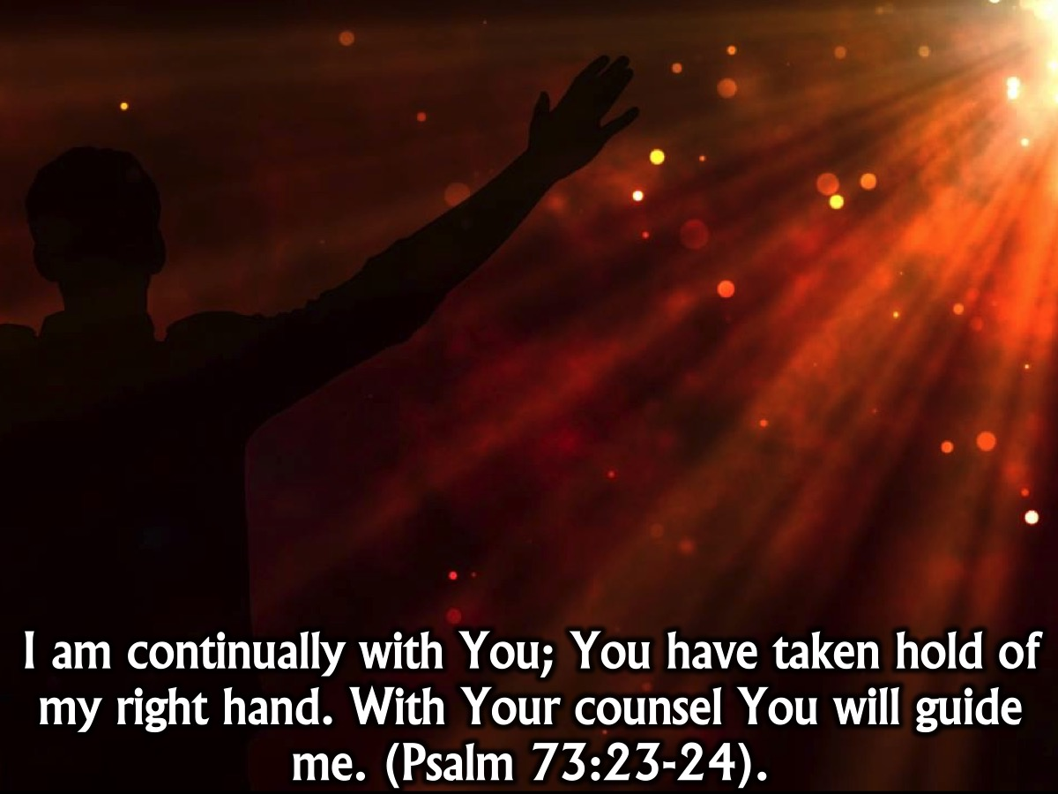
Notes:
I am continually with You; You have taken hold of my right hand. With Your counsel You will guide me. (Psalm 73:23-24).

Slide 10

Notes:
2. God’s will is more about Character than Decisions. It is more about what I become than what I do. God’s priority for us is that we become like Jesus.
Notes: God’s will for us:
“But now you must be holy in everything you do, just as God who chose you is holy. For the Scriptures say, ‘You must be holy because I am holy.” (1 Peter 1: 15-16)
“Christ is the visible image of the invisible God…For God in all His fullness was pleased to live in Christ.” (Colossians 1: 15; 19)
“For God knew His people in advance, and He chose them to become like His Son.” (Romans 8:29)
God’s primary will for you is not your achievements or status. God’s primary concern is your character: the person you become. And God wants you to become more and more like Jesus.
How do we become more and more like Jesus?
“Don’t copy the behaviour and customs of this world, but let God transform you into a new person by changing the way you think. Then you will learn to know God’s will for you, which is good and pleasing and perfect.” (Romans 12: 2)
Sow a thought, reap an action; sow an action, reap a habit; sow a habit, reap a character; sow a character, reap a destiny.
God values your free-will, and He honours your choices. God desires our unforced love and affection. He does not overpower us. Ultimately, the choices we make – both small and big – reveal whether our hearts truly belong to Jesus or whether they belong to something or someone other than God.
“Very often God’s will for you will be “I want you to decide,” because decision making is an indispensable part of character formation. God is primarily in the character-forming business, not the circumstance-shaping business.” (John Ortberg)

Slide 11
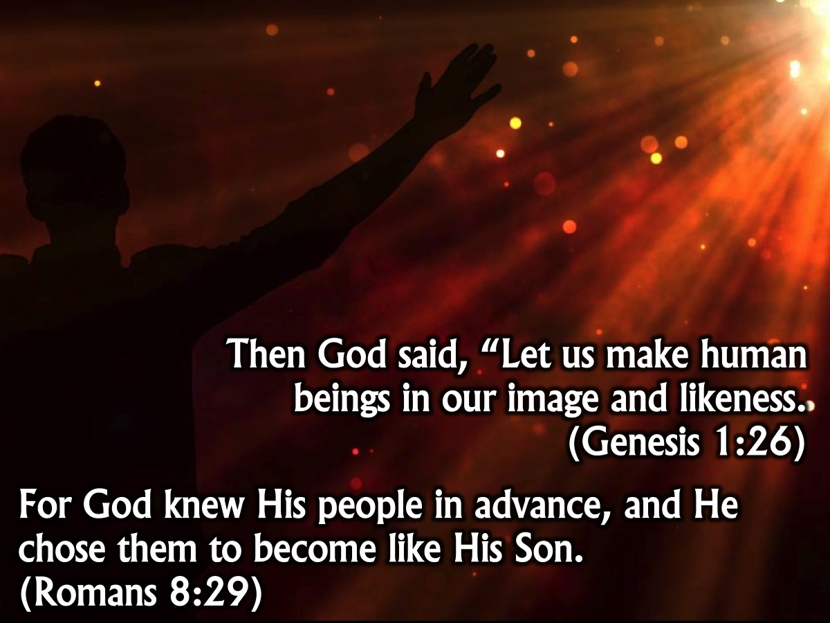
Notes:
Then God said, “Let us make human beings in our image and likeness. (Genesis 1:26)
For God knew His people in advance, and He chose them to become like His Son. (Romans 8:29)

Slide 12

Notes:
3. God’s will is more about Partnership than Control. It is a partnership like a marriage relationship in which both individuals create their life together. It works through a quiet voice or gentle nudge. It is all about a way of life that involves God.
Notes: An Analogy: The biblical model of knowing God's will centers on a relationship, but we must be careful to use the right earthly analogy. In some relationships we simply want to be told what to do or we want to get approval for our predetermined plans. A better analogy is that of the joint decisions reached by a married couple who enjoy an intimate relationship of mutual concern, respect, and trust. In this case, both are involved in the decisions that are reached, and it is sometimes impossible to distinguish the parts each played in the process. Similarly, the will of God is a divine/human process, not solely divine or solely human. When we consciously acknowledge His presence and depend upon Him in the course of making decisions, the choices that are made are both ours and His. God's will, then, is not an end but a means of knowing Him better and becoming more like Christ. A Subtle Voice: Because God honors our choices and desires our unforced love, He does not overpower or coerce us. "God never burglarizes the human will. He may long to come in and help, but he will never cross the picket line of our unwillingness" (James Jauncey). He speaks to us in a subtle voice, and we may be unable to hear Him when there are too many distractions in our lives. Just as we would have trouble carrying on a telephone conversation in a room full of blaring music and chattering people, in the same way the clamoring voices of selfish desires, lack of submission, pride, independence, and unforgiveness prevent us from being receptive to the quiet voice of God. "Does God guide? Yes, I believe that he does. Most times, I believe, he guides in subtle ways, by feeding ideas into our minds, speaking through a nagging sensation of dissatisfaction, inspiring us to choose better than we otherwise would have done, bringing to the surface hidden dangers of temptation, and perhaps by rearranging certain circumstances. . . . God's guidance will supply real help, but in ways that will not overwhelm my freedom.” (Philip Yancey)

Slide 13
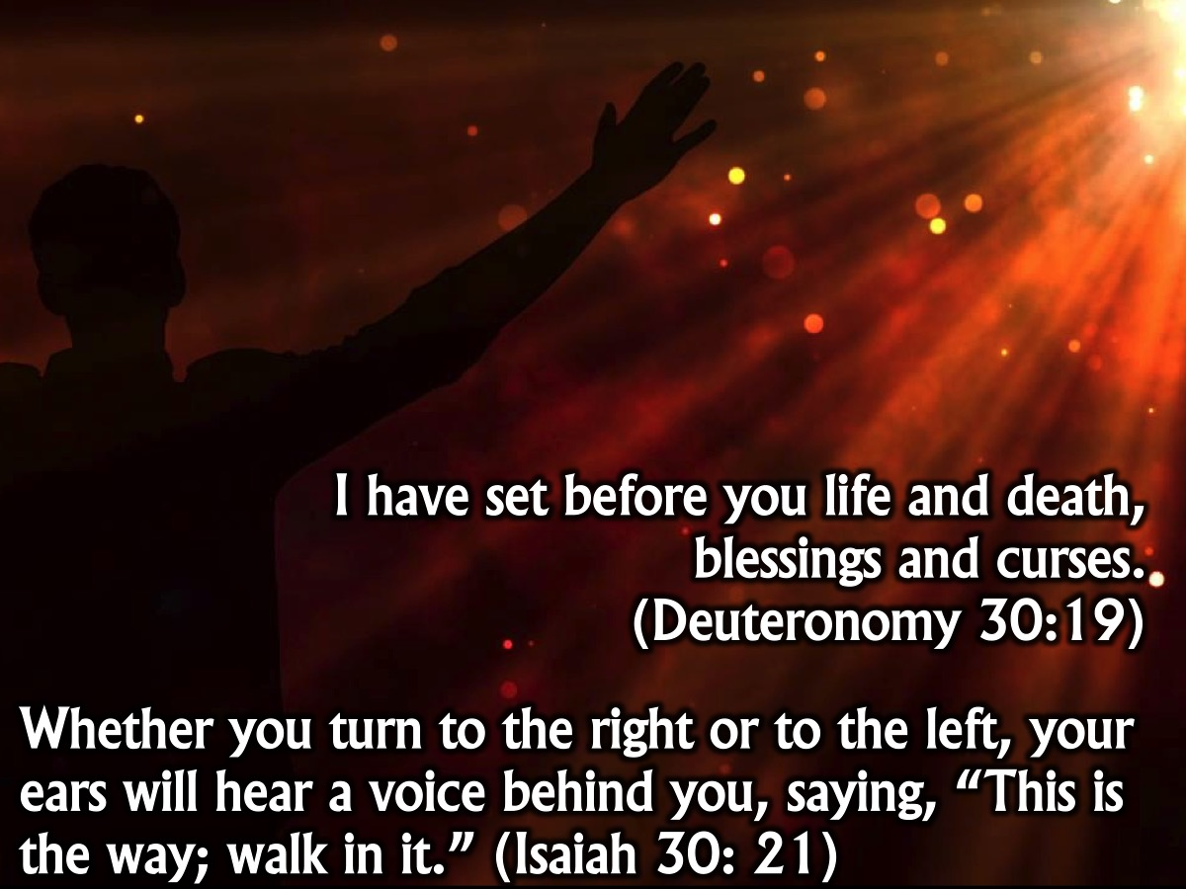
Notes:
I have set before you life and death, blessings and curses. (Deuteronomy 30:19)
Whether you turn to the right or to the left, your ears will hear a voice behind you, saying, “This is the way; walk in it.” (Isaiah 30: 21)

Slide 14

Notes:
So, How Does God Guide Us?

Slide 15

Notes:
1. God guides us through the Bible. “Your word is a lamp to my feet, and a light to my path”. (Psalm 119:105)
Extra Notes: If we want to know and experience God's direction, we must communicate with Him through prayer and Scripture. Many Christians are concerned about knowing the will of God, but how many spend even five minutes a day asking God for His wisdom and direction? Prayer should envelop the whole process of guidance. Communication with God also involves a regular time of reading the Bible with an open heart and mind to hear God's Word for our lives. The Bible is the central revelation for all believers, and its precepts and principles clearly give us the answers to most questions about the will of God in decision-making situations. The Scriptures were provided not only to teach us the way of salvation, but also to guide us in the way we should live after becoming God's children. ”Your word is a lamp to my feet, and a light to my path" (Psalm 119:105). God designed His Word to equip us to accomplish "every good work" (2 Timothy 3:16-17), that is, to fulfill His purposes for our lives. God clearly reveals His moral will in the positive and negative commands of the Bible, and these precepts by themselves can guide us through the majority of the decisions we will ever make. In addition, the Bible offers a multitude of general principles that can be effectively applied to very specific circumstances. There is no need for us to seek guidance in areas that have been expressly commanded or forbidden in Scripture. A believer does not need to wrestle, for example, over whether to marry an unbeliever, since the answer is already in the Bible. We can be sure that God will never lead us to do anything that is contrary to His Word. Since the Bible is our primary source of guidance, we owe it to ourselves to become so familiar with its contents that its precepts and principles become ingrained in our patterns of thought. This process of renewing our minds with the Word takes time and effort, but there is no other way to "prove what the will of God is, that which is good and acceptable and perfect" (Romans 12:2). If we do not program our minds on a daily basis with Scripture, we will find our minds programmed by default with the temporal value system of the world, and our lives will soon reflect those values. Inner renewal is the prerequisite to outer transformation. As we seek to renew our minds with the commandments and counsel of God's revealed Word, we must approach it with a resolve to do whatever it says, even if it goes against our wishes. Content without conviction will do us little good, because it is always possible to distort the Scriptures to match the shape of selfish desires. We will avoid self-deception only to the extent that we are willing and open to respond to God's light.

Slide 16

Notes:
2. God guides us through Common Sense. “Sensible people always think before they act. (Proverbs 13:16)”. Does doing this make sense practically? What are the pros and cons that will help me make this decision?
Extra Notes: A Christian may be committed to the Lord, willing to comply with wherever God leads him, communicating with Him in prayer and in the Word, and enjoying a clear conscience. Even so, he still may not know which option to choose in a specific situation. It is within this framework that common sense should play an important role in the choices we make (outside this framework, common sense may simply feed the me-first mentality). God was not erratic or capricious in the way He designed the universe, and He is not haphazard in His design for the lives of His children. He gave us minds and He wants us to use them to evaluate the consequences of our actions. The Scriptures tell us to "think so as to have sound judgment" (Romans 12:3). We should be level-headed and not rash in the way we evaluate our gifts and opportunities. Paul, for example, stayed where there were open doors (Ephesus) and left when his life was threatened. However, common sense has its limitations and it should never be our only criterion for discerning God's guidance. There are times when He leads people do things that are contrary to our concept of good judgment. We are often too nearsighted to see the goal He has in mind. Because we see such a small part of the puzzle, we should always be willing to submit our thoughts and plans to His. "The mind of man plans his way, but the Lord directs his steps" (Proverbs 16:9). "For as the heavens are higher than the earth, so are My ways higher than your ways, and My thoughts than your thoughts" (Isaiah 55:9).

Slide 17

Notes:
3. God guides us through Our Passions. “Take delight in the Lord, and he will give you the desires of your heart”. (Psalm 37:4)
Extra Notes: In Romans 8:14 Paul wrote that "all who are being led by the Spirit of God, these are sons of God." In Philippians 2:13, he said that "it is God who is at work in you, both to will and to work for His good pleasure." One of the ways God works in us is to give us the desire to do the things that are pleasing to Him. A compelling desire to move in a specific direction or a burden to minister to certain people may be coming directly from God as a means of guidance. But we should bear in mind that God never gives us desires that are contrary to the commandments and counsel of His Word. Burdens and desires can be a significant input in our decisions as long as they are evaluated in the larger context of communication (prayer and Scripture), conscience, common sense, circumstances, and counsel. Otherwise, we may become victims of desires and inclinations that are not from God.

Slide 18

Notes:
4. God guides us through Wise Advice. The way of a fool is right in his own eyes, but a wise man is he who listens to counsel. (Proverbs 12:15)
Extra Notes: "Where there is no guidance, the people fall, but in abundance of counselors there is victory" (Proverbs 11:14). "The way of a fool is right in his own eyes, but a wise man is he who listens to counsel" (Proverbs 12:15). "Without consultation, plans are frustrated, but with many counselors they succeed" (Proverbs 15:22). The Bible is full of examples of people who profited by heeding wise counsel and of people who suffered by ignoring it. We are called to exercise wisdom in "teaching and admonishing one another" (Colossians 3:16), and wise counsel involves both. If a decision has significant implications, we should not limit ourselves to our own judgment, but we should also seek the perspective of mature and godly people who have wisdom and experience. Good counsel is both instructive and corrective, and requires frankness, not flattery. Remember, however, that the counsel available in the precepts and principles of Scripture must always be the first and foremost influence in the choices we make. Even the wisest of people are finite and biased, and we must avoid the pitfall of uncritically accepting the advice we receive as if it were a word from the Lord. Ultimately, we alone are responsible for the decisions we make.

Slide 19

Notes:
5. God guides us through The Spirit. God is working in you, giving you the desire and the power to do what pleases him. (Philippians 2:13). When we are moving towards making a decision, the Holy Spirit will give us peace if we are heading in the right direction. “The fruit of the Spirit is love, joy, peace, …” (Galatians 5:23)
Notes: Philippians 4:6-7 tells us that we are to turn our anxieties into peace by offering our problems and needs up to the Lord. God wants us to let the peace of Christ rule in our hearts (Colossians 3:15). If a decision gives us a sense of doubt, distress, or confusion, something is wrong because it is not accompanied by the peace of God. Paul, for example, had an open door for ministry in Troas, but because he had no rest in his spirit, he went instead to Macedonia (2 Corinthians 2:12-13). By itself, peace is a supplemental, not a sufficient principle of guidance. But if a particular option passes the test of the other principles and fails to provide peace, the wisest course of action is to wait on the Lord (if the decision can be deferred) and allow Him to provide further input. The option may be right, but the timing may be wrong.

Slide 20

Notes:
Practise: Think of a specific decision that you need to make and use the worksheet to discover God’s will.
1. What has God already said in The Bible about this issue?
2. What are the Common Sense positives and negatives of each decision?
POSITIVES:
NEGATIVES:
3. How does this decision connect with My Passions in life?
4. Who can I ask to get Wise Advice about making this decision?
5. Do I have peace from the Holy Spirit about the decision I am making?
6. How will this decision help me Become More like Jesus?
7. How will this decision help me Get Closer to God

Slide 21

Notes:
In closing, here are some myths that we need to bust about God's Will:
1. I must pray about each decision I make. Some decisions follow logically from others, and do not need to be prayed about. If you decide to go to college, you do not need to ask God whether you should attend classes and do the required work. Many other decisions, like what clothes to wear and how to behave in different social situations, are matters of common sense.
2. God's will is often contrary to human reason. While it is true that God's thoughts are much higher than our own, this does not mean that His will for our lives is erratic and peculiar. He gave us a rational capacity and wants us to use our minds in the decisions we make. It is our responsibility to submit our thinking to the truths of Scripture and the illumination of the Spirit so that we will have "the mind of Christ" (1 Corinthians 2:16). God may direct a believer to do something that does not seem to make the best sense, but this is exceptional, not normative.
3. I must give up my happiness to do God’s will. God is not a majestic monster who wants to make us miserable. His will for us is in fact the only pathway to freedom, fulfillment, and joy (Psalm 37:4; John 15:11). He loves us and offers an abundant life to those who walk in His ways (John 10:10).
4. My problems are over if I follow God's will. A quick reading of the book of Acts makes it clear that an abundant life does not mean a trouble-free life. Obedience to God prevents and corrects many problems, but does not exempt a believer from trials and temptations. Nor is the abundant life the American dream; an obedient Christian may or may not be successful in the eyes of men. God's standard of success is different from that of the world, and we cannot serve both.
5. God can’t use me again if I miss His will. God does not exempt us from the consequences and scars of sin, but this does not mean that He puts us on the shelf. When we acknowledge our sins He forgives and cleanses us (Psalm 51:1-13; 1 John 1:9) so that we can be used again in His service. Some of the heroes of Hebrews 11 were also great sinners.

Slide 22

Notes:
Let's close in prayer.

Slide 23

Notes:
Next Sunday we are going to look at how Meditation is a way to get spiritually fit. Pastor Mark will be the preacher.

