Slide 1

Notes:
Welcome to the Workout Series.

Slide 2
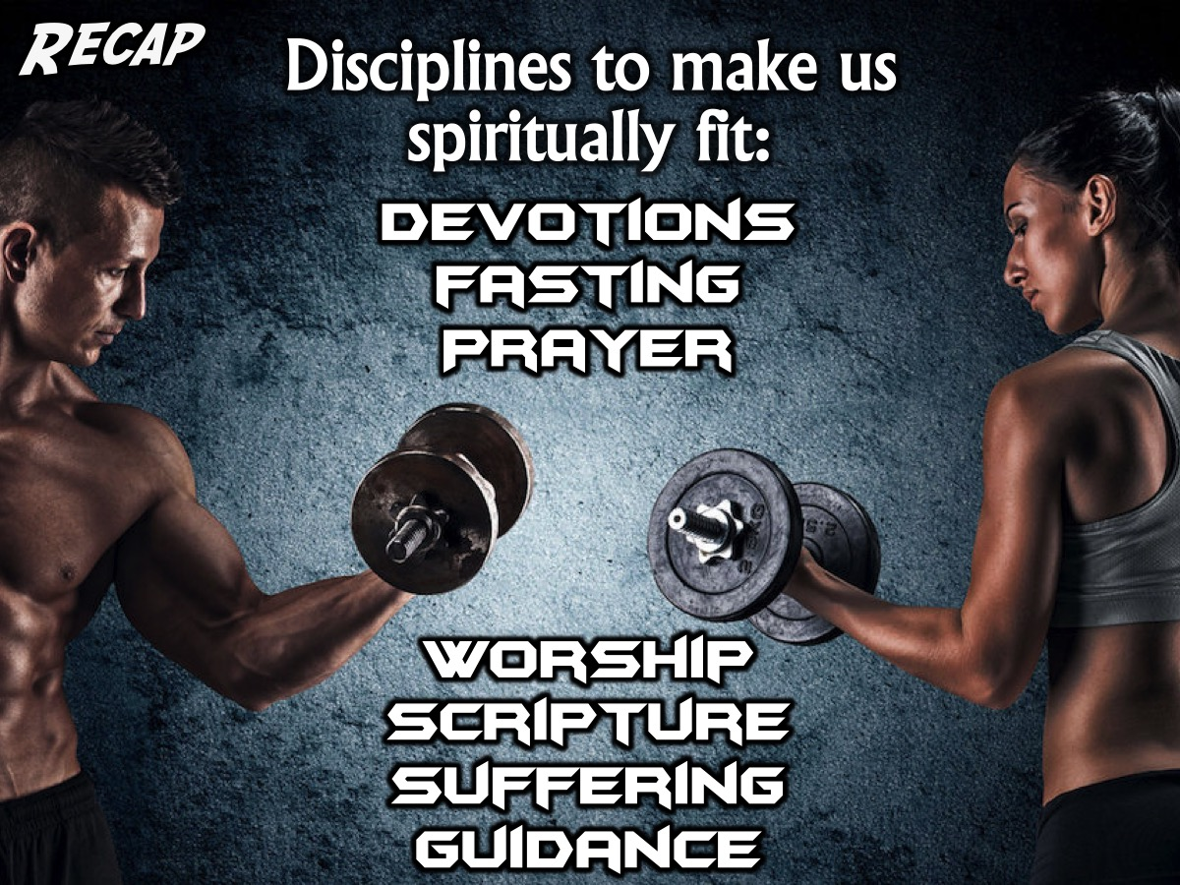
Notes:
In the Workout Series we are looking at disciplines that will make us spiritually fit! So far we have looked at: Devotions, Fasting. Prayer, Worship, Scripture, Suffering and Guidance.

Slide 3
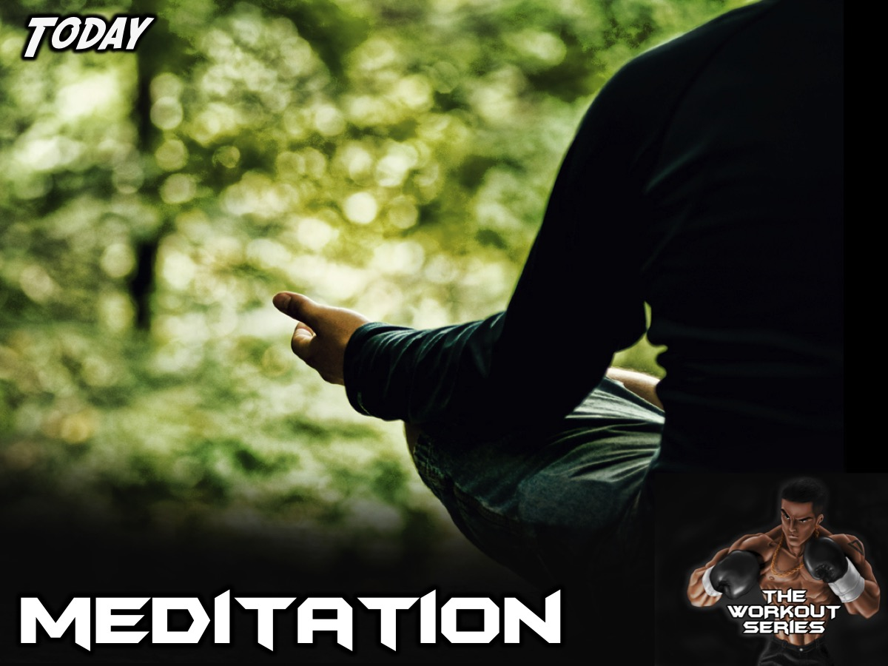
Notes:
Today we are going to learn about how Meditation can help us become spiritually fit.

Slide 4
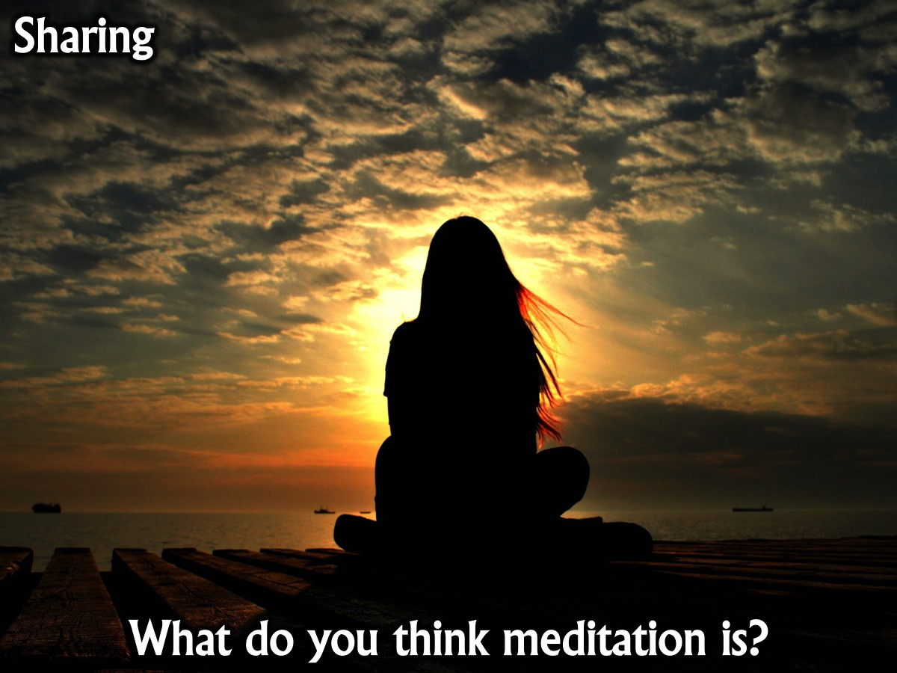
Notes:
Sharing: What do you think meditation is?

Slide 5
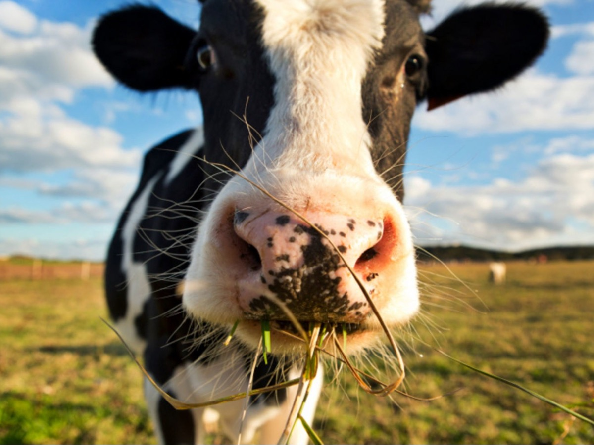
Notes:
Here is a picture of meditation. Meditating is like a cow chewing the cud. If you look at synonyms for the word “meditation,” you’ll find the word “rumination.” Rumination is what a cow does when she chews her cud. She rolls her cud over and over in her mouth. That’s similar to how you meditate on Scripture. Cows eat the grass, chew it up, and send it to their stomachs pretty quickly. There it lies in the stomach, soaking up all of those acids and chemicals. Then, after a while, the cow burps it back up with a new and renewed flavor, chews on that grass and some other grass, and does the whole process over again. Cows repeat this several times. They get every ounce of nutrition out of the grass. Biblical meditation is kind of like that; it’s thought digestion. God wants us to get every ounce of spiritual nutrition out of his Word. He wants us to chew on it, digest it, and then chew on it some more.

Slide 6
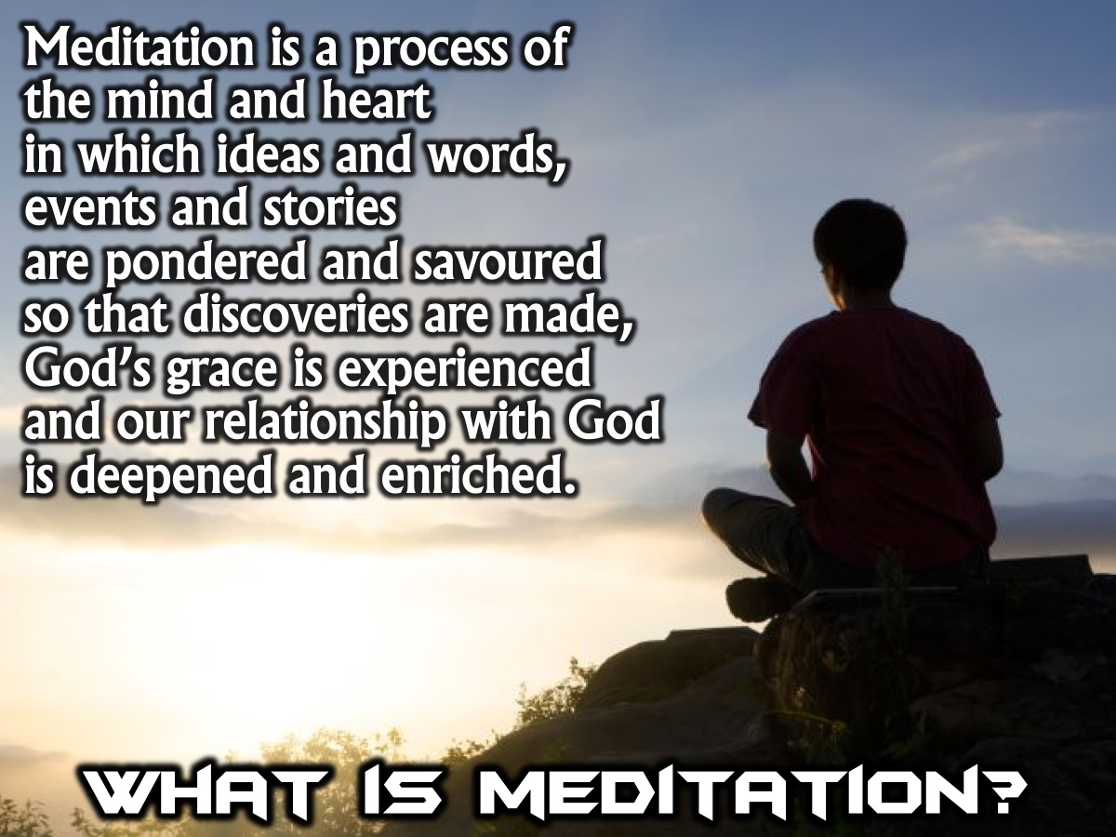
Notes:
What is Meditation? Meditation is a process of the mind and heart in which ideas and words, events and stories are pondered and savoured so that discoveries are made, God’s grace is experienced and our relationship with God is deepened and enriched. It is about taking time and making space for something important to go deeper. Whether it is a verse of Scripture, an encounter with Jesus or an aspect of creation, meditation is one of the best ways to take seriously the life-giving resources God offers us.

Slide 7
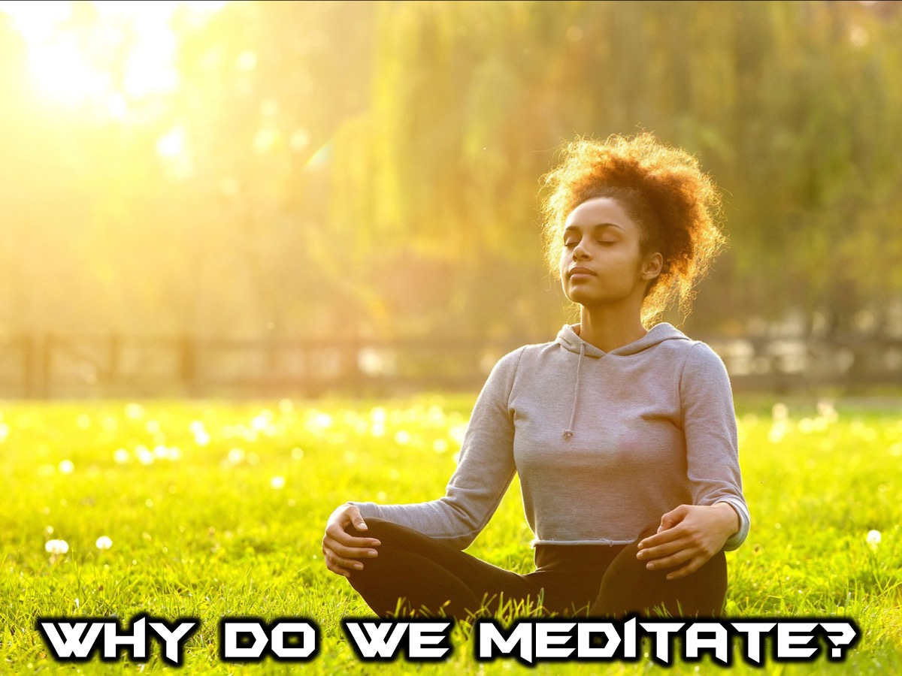
Notes:
Why Do We Meditate?

Slide 8
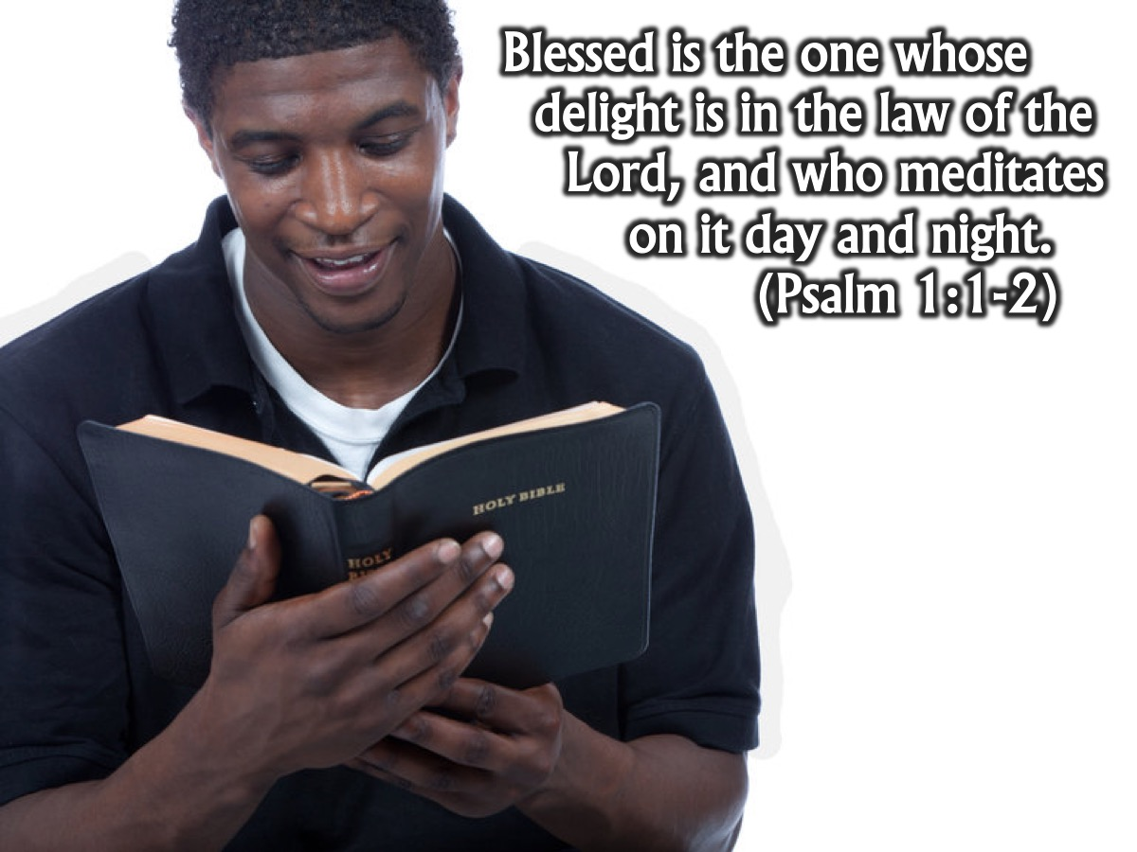
Notes:
Blessed is the one whose delight is in the law of the Lord, and who meditates on it day and night. (Psalm 1:1-2)

Slide 9
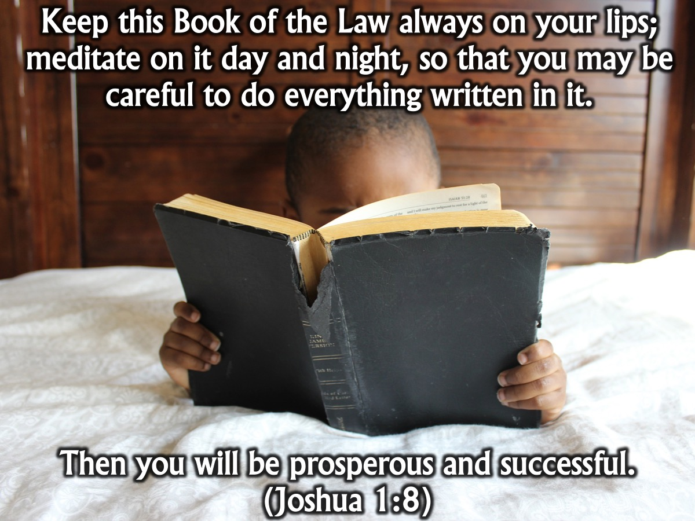
Notes:
Keep this Book of the Law always on your lips; meditate on it day and night, so that you may be careful to do everything written in it. Then you will be prosperous and successful. (Joshua 1:8)

Slide 10
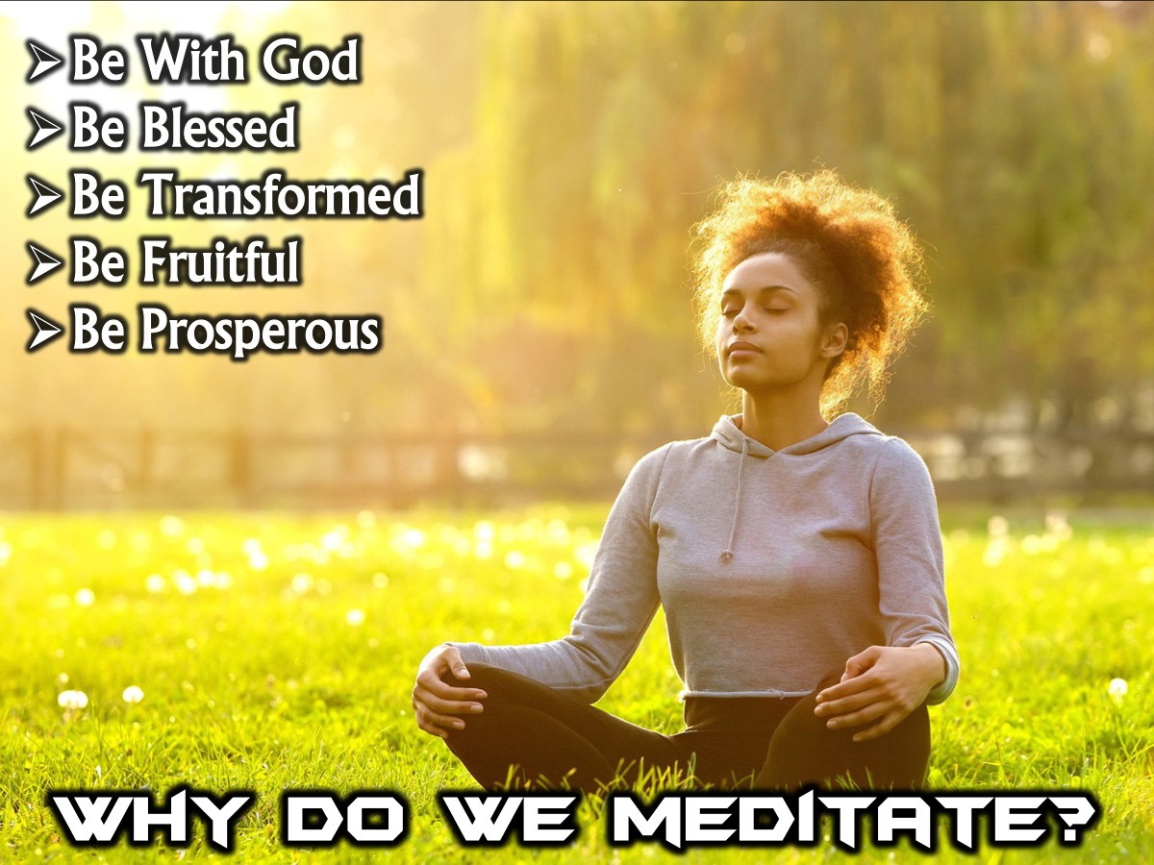
Notes:
Why do we Meditate? When we look at the different references to meditation in the Bible (Deuteronomy 11:18-21; Joshua 1:8; Psalm 1:1-3; Psalm 119) we find many reason for meditating, here are a few: (1) Be With God - to spend quality time with God. (2) Be Blessed. (3) Be Transformed. (4) Be Fruitful. (5) Be Prosperous and Successful.

Slide 11
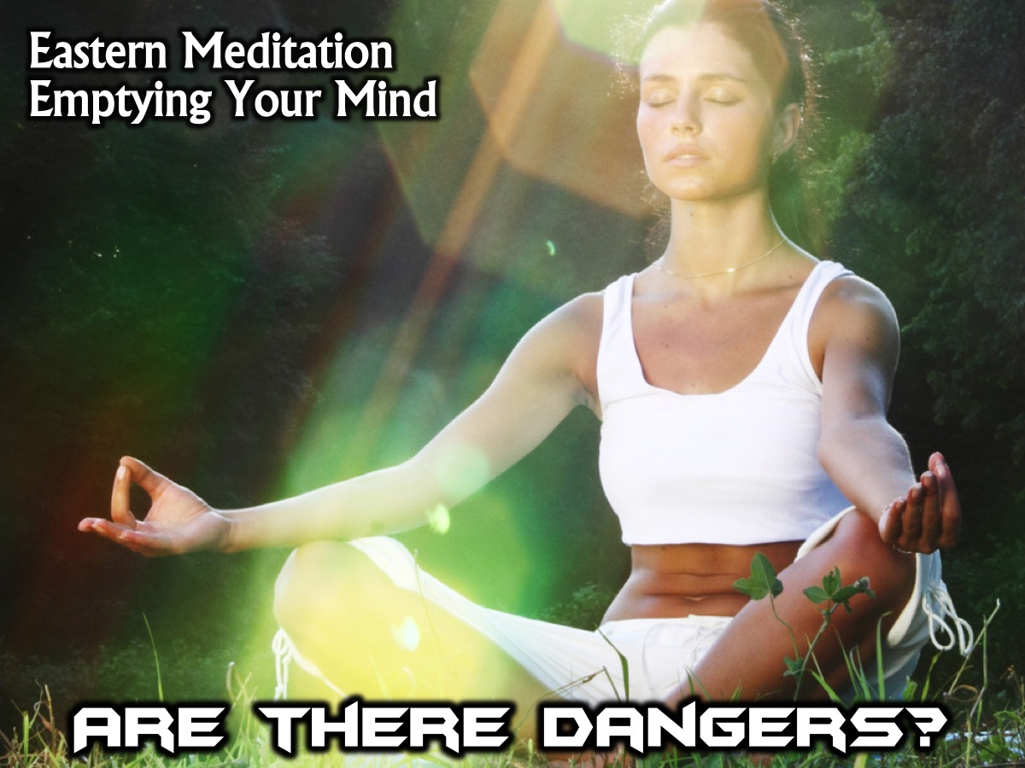
Notes:
Are There Dangers? Meditation as practised in Eastern religions or philosophies has some dangers in that it encourages us to empty our minds and that may leave us open to evil spiritual forces - but that is not what we do in Christian Meditation!

Slide 12
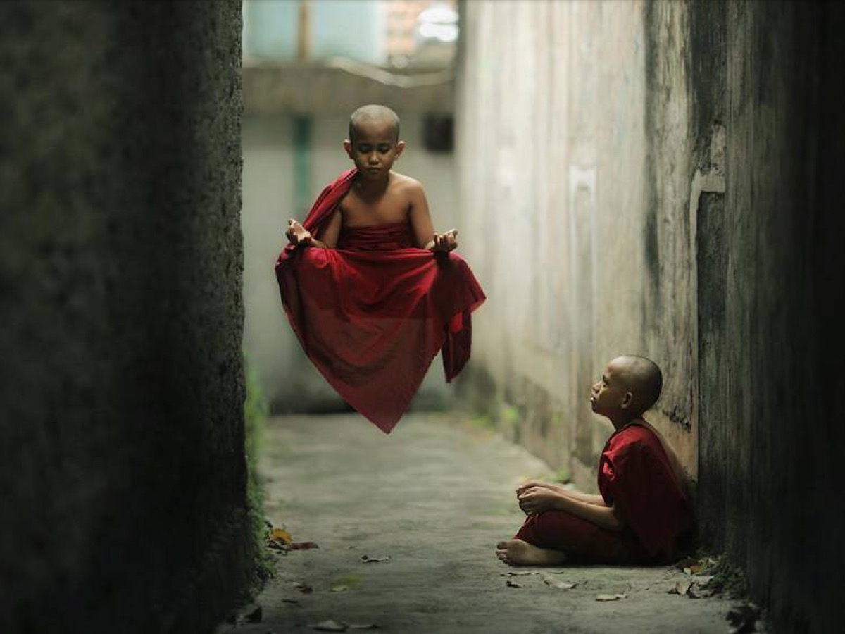
Notes:
I suppose we should be careful that we don’t levitate and float into outer space. Okay, I am kidding!

Slide 13
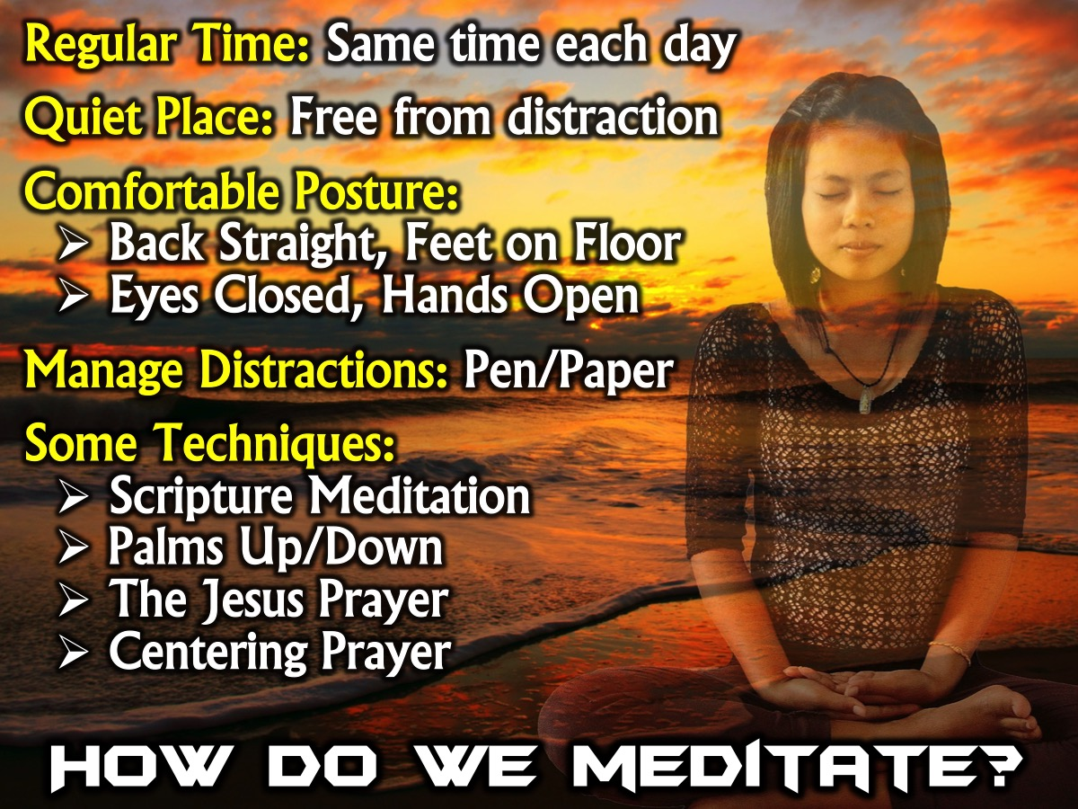
Notes:
How Do We Meditate? Here are some guidelines for meditating: (1) Regular Time: Find a time for meditation - it is wise to find a regular time each day to engage in meditation. (2) Quiet Place: we should find a place that is quiet and free from interruption. (3) Comfortable Posture: It is best to find a position in which you are most comfortable and least distracted. It is probably best to sit in a straight chair, with the back straight, and with both feet flat on the floor. It is often best to close the eyes to avoid distractions. The aim is all of this is to center the attention of the body, emotions, the mind and the spirit on the glory of God. (4) Some Approaches: Here are some approaches you can try: (a) Scripture Meditation; (b) Palms Up/Down; (c) The Jesus Prayer; (d) Centering Prayer.

Slide 14
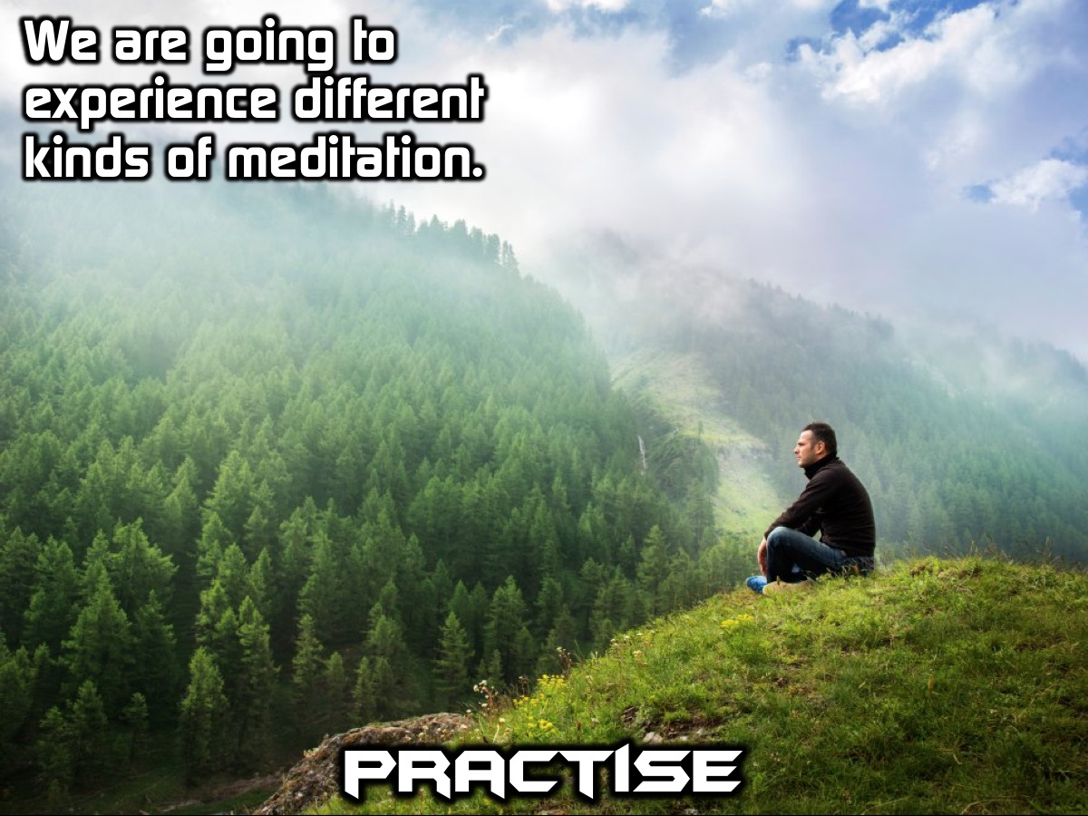
Notes:
Practise: We are going to experience different kinds of meditation.

Slide 15
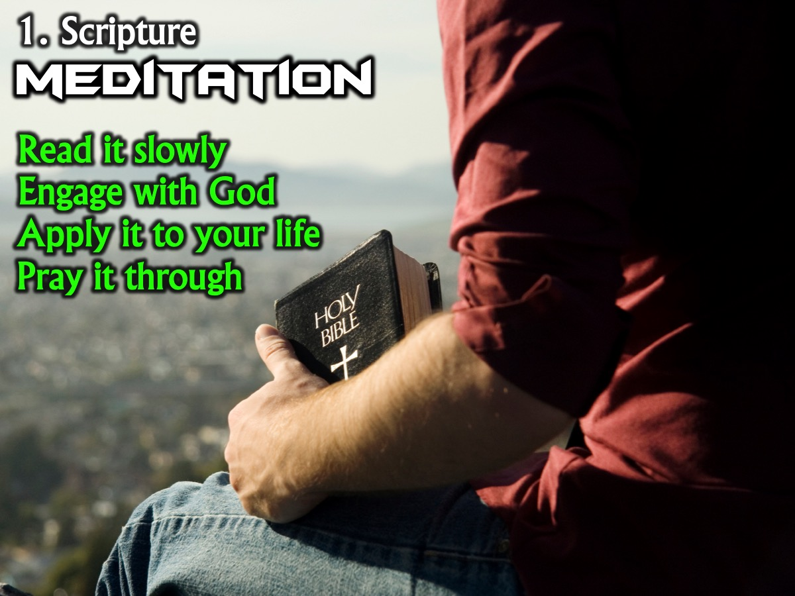
Notes:
1. Scripture Meditation. To pray Scripture you choose a passage that is simple and practical. Read the passage very slowly, only a portion at a time. Do not focus on how much you read, but the way you are reading. One author has described this as the difference between a bee that merely skims the surface of a flower and one that penetrates into the depths of the flower. As the Scripture begins to sink in to your soul, spend time interacting with God about what the passage is saying to your life. Here are some specific guidelines to meditating on Scripture: (1) Select a passage; (2) Repeat it in different ways; (3) Rewrite it in your own words; (4) Look for applications to your life; (5) Pray through the text; (6) Take your time with the passage.

Slide 16
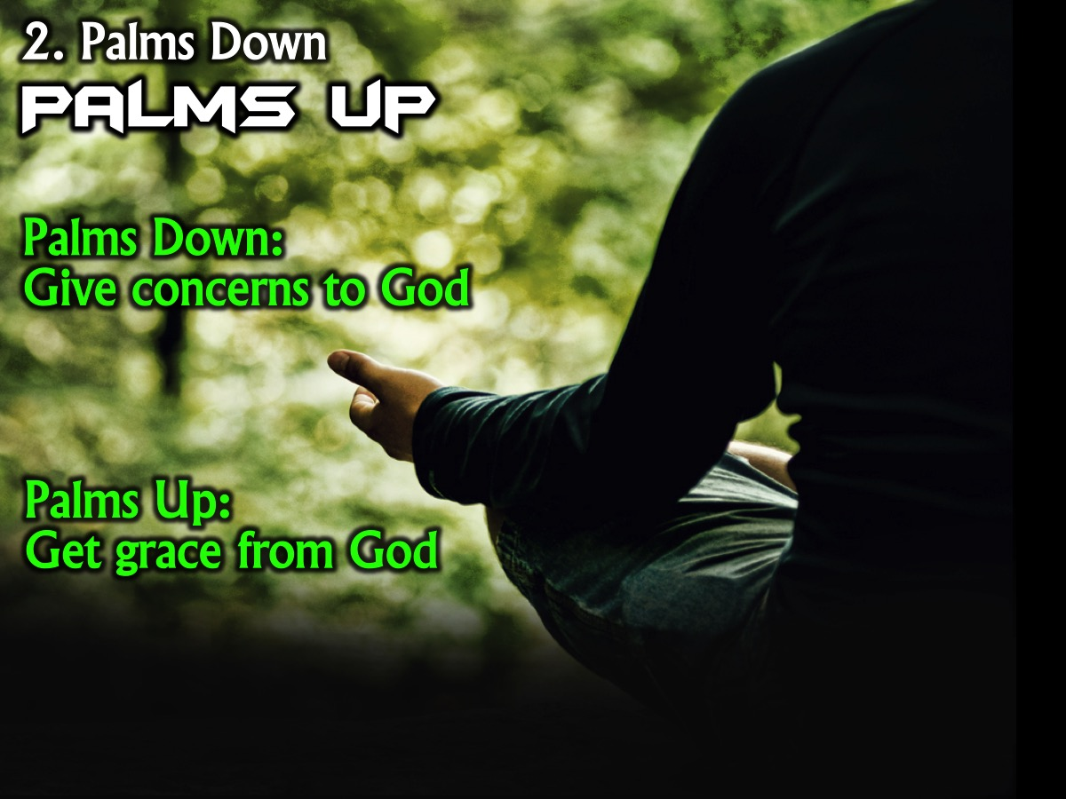
Notes:
2. Palms Down, Palms Up. You begin by placing your palms down as a symbolic indication of your desire to turn over any concerns you may have to God. Pray about your concerns as you do this. Next, turn your palms up as a symbol of your desire to receive from the Lord. As you meditate in this posture, pray in a way as if receiving directly from the Lord. There is something very helpful about using our hands to illustrate what is going on in our heart.

Slide 17
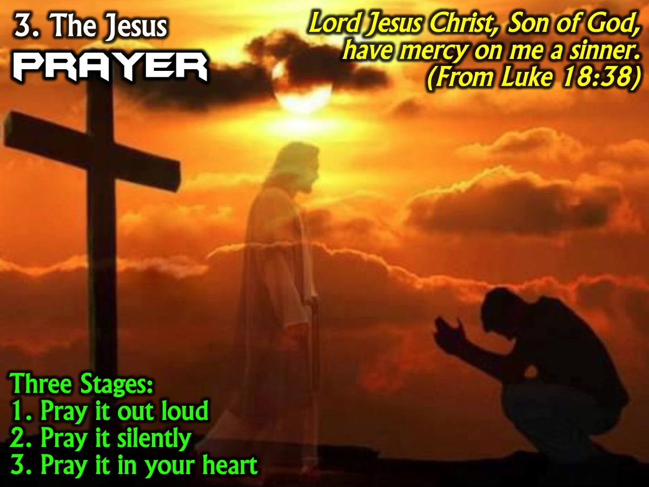
Notes:
3. The Jesus Prayer. From very early in the Christian Church people took the words of blind Bartimaeus when he called out to Jesus for help, “Jesus, son of David, have mercy on me a sinner” (Luke 18:38) and turned it into a prayer. The most common form is: "Lord Jesus Christ, Son of God, have mercy on me a sinner," to simply the name of Jesus. Traditionally, one moves through three stages: Praying it out loud, Praying it silently with the breath, and Praying it in the heart.

Slide 18
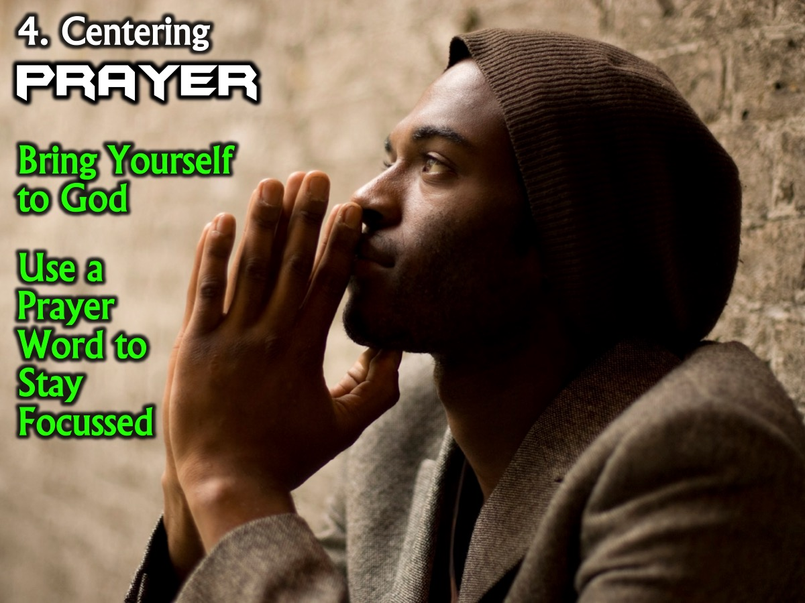
Notes:
4. Centering Prayer. This is a way of bringing ourselves before God, focussing on Him - a way of simply being in His presence. This is probably the hardest kind of meditative prayer, because you're not seeking any experience, thought, word, or feeling for yourself, just Him alone. The goal is to just be, and just love, without trying to think about anything. You can use a short "prayer word" such as "God," "love," "Spirit," or "Jesus" to quiet the mind when thoughts try and distract you from being with God. You need to choose a word to use and stick with it.

Slide 19

Notes:
5. Using Your Imagination. This is using the imagination to help you engage with God, yourself or your world. Here are a few ways to use your imagination in meditation: (a) Imagine yourself in a scene from the Gospels. (b) Picture yourself sharing someone’s suffering. (c) Imagine yourself as a pebble, dropped into a lake, making a different for God in the world. (d) Imagine yourself have a meeting with God.

Slide 20
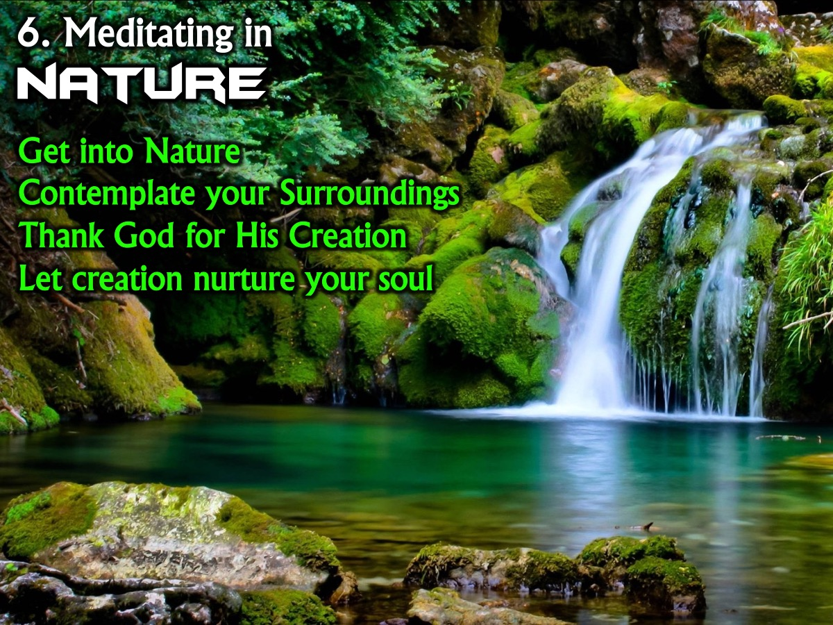
Notes:
6. Meditating in Nature. Go somewhere to be in nature. Spend at least 30 minutes contemplating all that is around you. As you take this in, thank God for His creation. Allow the beautiful surroundings to nurture your soul.

Slide 21
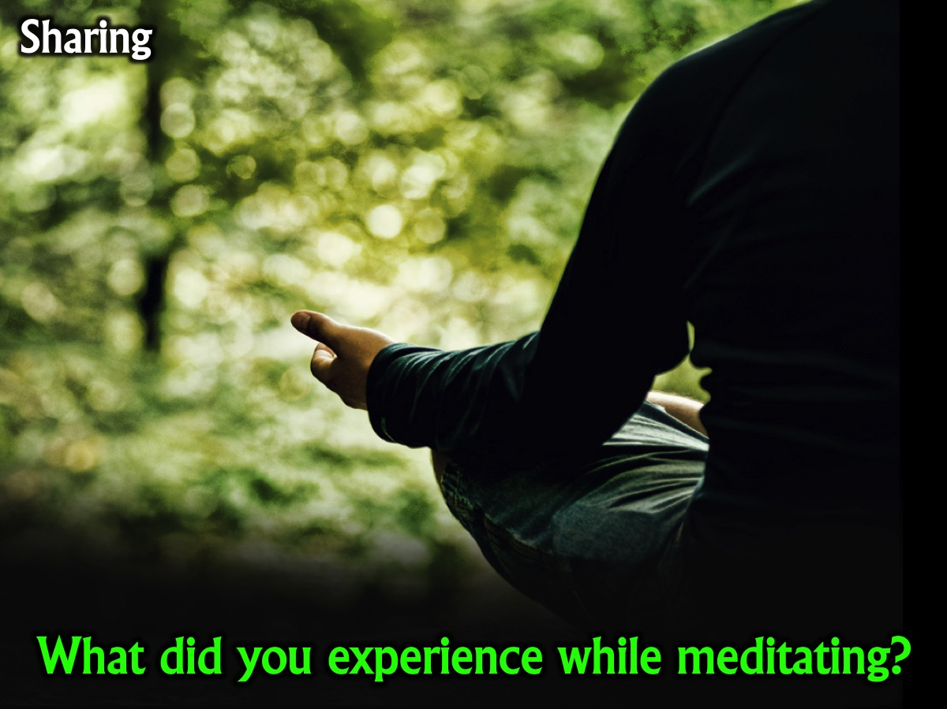
Notes:
Sharing: What did you experience while meditating?

Slide 22
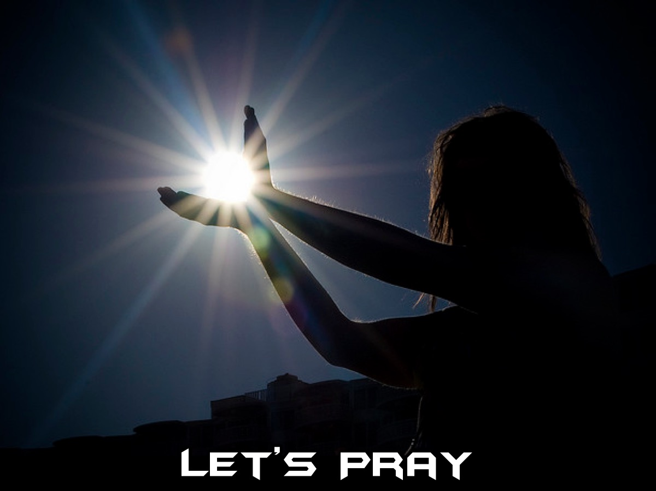
Notes:
Let's close in prayer.

Slide 23

Notes:
Next Sunday we are going to look at how Service is a way to get spiritually fit. Genevieve will be the preacher.

