Slide 1
Notes:
Welcome to the Workout Series.

Slide 2
Notes:
In the Workout Series we are looking at disciplines that will make us spiritually fit! So far we have looked at: Devotions, Fasting. Prayer, Worship, Scripture, Suffering, Guidance and Meditation.

Slide 3
Notes:
Today we are going to learn about how Service can help us become spiritually fit.

Slide 4
Notes:
Sharing: Turn to the person next to you and ask them this question: “Who did you serve in the past week?”

Slide 5
Notes:
What is Service? The dictionary defines service as the action of helping or doing work for someone. Like in this sentence: “Millions are involved in voluntary service.” Here are some synonyms of the word: act of assistance, good turn, favour, kindness, helping hand; assistance, help, aid. Like in the sentence: “He has done us a great service.”

Slide 6
Notes:
Who is Jesus? When I think of Christ I believe he was many things…

Slide 7
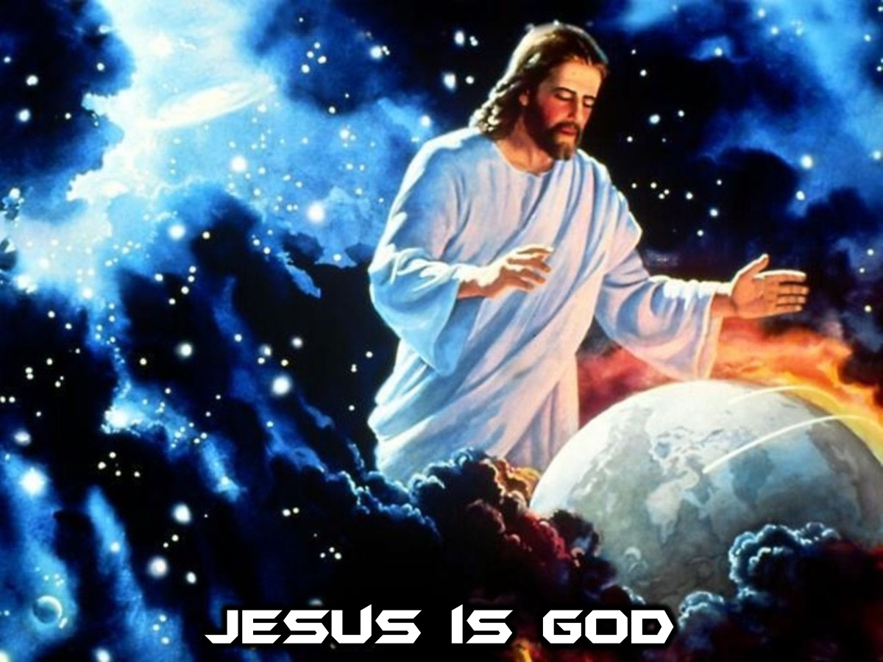
Notes:
Jesus is God

Slide 8
Notes:
Jesus is King

Slide 9
Notes:
Jesus is Leader

Slide 10
Notes:
Jesus is Healer

Slide 11
Notes:
But, Jesus is also Servant!

Slide 12
Notes:
For the Son of Man came not to be served but to serve, and to give his life as a ransom for many. (Mark 10:45)

Slide 13
Notes:
And He calls us to be servants too...
Illustration: The thing I love about service is that it satisfies and fulfills you and your needs when you focus on helping the needs of others.., I recall before I started serving at Youth I was attending services I felt this longing like a void in my heart I couldn't put my finger on it till I left my purse at youth and I New I found my purpose and that purpose was for me to serve at youth... most nights it was being my crazy self or making juice and biscuits but the fulfillment of impacting lives through serving gave me such satisfaction and through serving I have seen God supernaturally come through for my needs and the needs of those I serve.

Slide 14
Notes:
For you were called to freedom. Only do not use your freedom as an opportunity for the flesh, but through love serve one another. (Galatians 5:13)

Slide 15
Notes:
Blessings of Service: Here are some of the blessing we get from serving others:

Slide 16
Notes:
1. Serving allows us to discover and develop our spiritual gifts. 1 Corinthians 12 compares the church to a human body. Just like our bodies are made of many parts serving specific functions, the church is made up of people with different skills and abilities. Alone these pieces aren’t very useful, but together we create something beautiful.

Slide 17
Notes:
2. Serving allows us to experience miracles, joy and peace that comes from obedience. In John 2, Jesus was at a wedding and the couple was running out of wine for its guests. He tells the servants to fill several big jars to the brim. When they served the water to the guests, it was wine! The guests never knew what happened; the servants were the ones who witnessed the miracle. The same is true for us when we serve. 1 Peter 4:10-11 says, “Each of you should use whatever gift you have received to serve others, as faithful stewards of God’s grace in its various forms... so that in all things God may be praised through Jesus Christ.” Serving is a form of worship, a way to express gratitude for what Jesus has done for us, and to share the love and grace we've been given.

Slide 18
Notes:
3. Serving surrounds us with other Christians who can help us follow Jesus. When we’re working side by side with other people, a bond inevitably forms. This was part of God’s plan for how the church is supposed to work. That’s why Hebrews 10:24-25 instructs us to “spur one another on toward love and good deeds, not giving up meeting together… but encouraging one another.”

Slide 19
Notes:
4. Serving allows us to experience God’s presence in new ways. Encouragement and healing go hand in hand. As we encourage others and they find healing, we’re encouraged. It’s the reason so many people who go on mission trips say they came home feeling like they got more than they gave.

Slide 20
Notes:
5. Serving helps us to be more like Jesus. We shift our focus off of ourselves onto others through serving. We begin to see others as Jesus sees them. And we see Jesus IN others (Matthew 25:40).
We make all sorts of rational explanations for not serving: I don’t have time. I don’t know what I would do. I don’t have any special skills to contribute. They don’t need me. But the reality is the Lord doesn't call the equipped; He equips the called. God used men and women with similar doubts to change the course of history. Moses didn’t think he was a leader or speaker, but God worked through Moses to bring Israel out of slavery. David was the youngest (and therefore most insignificant) of all his brothers, but God worked through David to defeat a giant and eventually made him a king. Paul used to kill Christians before he met Jesus, but he went on to become one of the most highly-regarded and prolific writers/church planters in history.

Slide 21
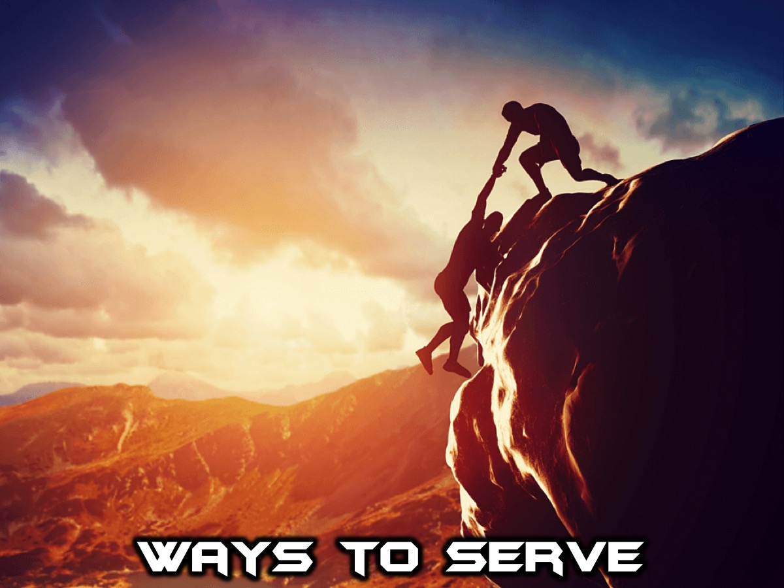
Notes:
Great Ways to Serve Others. When we truly understand what Jesus has done for us, we desperately want others to know Him and to find the same joy and hope we have. Telling people is not enough. We have to show them. James wrote in the Bible: “Show me your faith without deeds, and I will show you my faith by what I do.” (James 2:18). The way we serve people shows them who Jesus is. Here are some practical ways we can serve people:

Slide 22
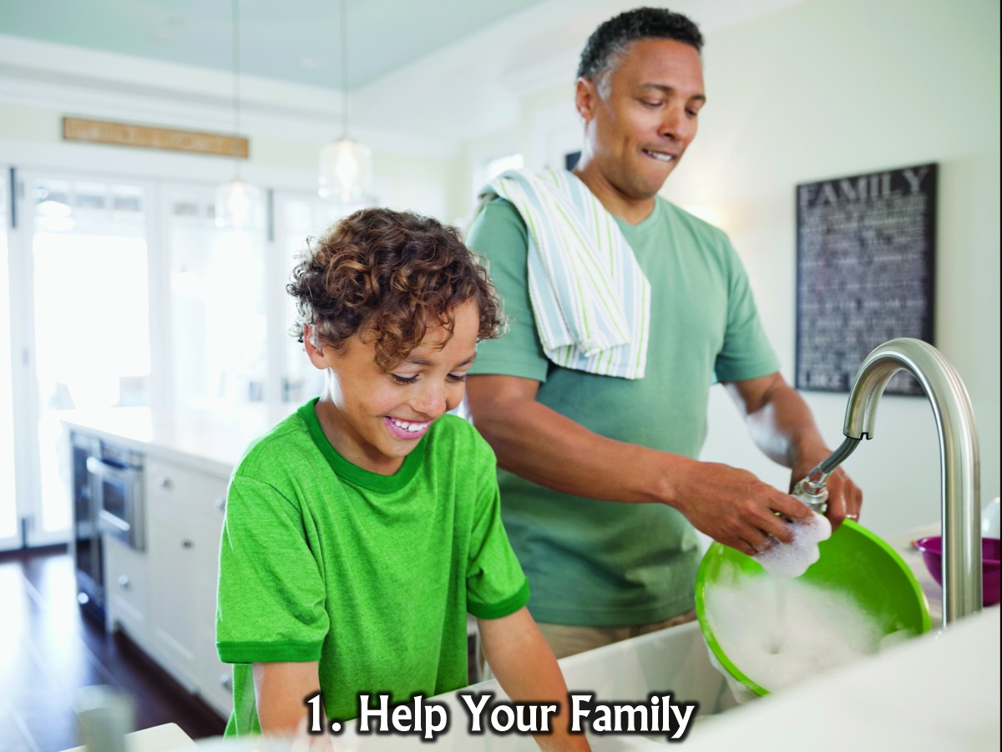
Notes:
1. Help your family. When was the last time you cleaned the dishes or made dinner, not because it was your turn, but just because you can? It’s easy to forget that the ones we need to serve the most are often the ones closest to you. How would the attitudes in our homes change if we started each day by asking, “How can I help you today?” then followed through on the response.

Slide 23
Notes:
2. Volunteer at Church. You could volunteer to setup and tidy up after youth events, or you could volunteer to serve in the kids ministry at church.

Slide 24
Notes:
3. Donate Your Stuff. We all have more than we need. Get the family together and clean out the house gathering clothes, toys, books and coats to donate the items to charity.

Slide 25
Notes:
4. Send a Note. Encouragement is a gift we can give that costs us nothing. Pick a friend or family member each week and send an email, text or handwritten note telling that person you are proud of them, that you’re praying for them, or that you’re here to help.

Slide 26
Notes:
Practise: And today we are going to be practice serving ... we are going to work in teams to make hotdogs and then deliver them outside the church to those who need something to eat.

Slide 27
Notes:
Let's close in prayer.

Slide 28
Notes:
Next Sunday we are going to look at how Celebration is a way to get spiritually fit.

