Slide 1

Notes:
Welcome to the Workout Series.

Slide 2
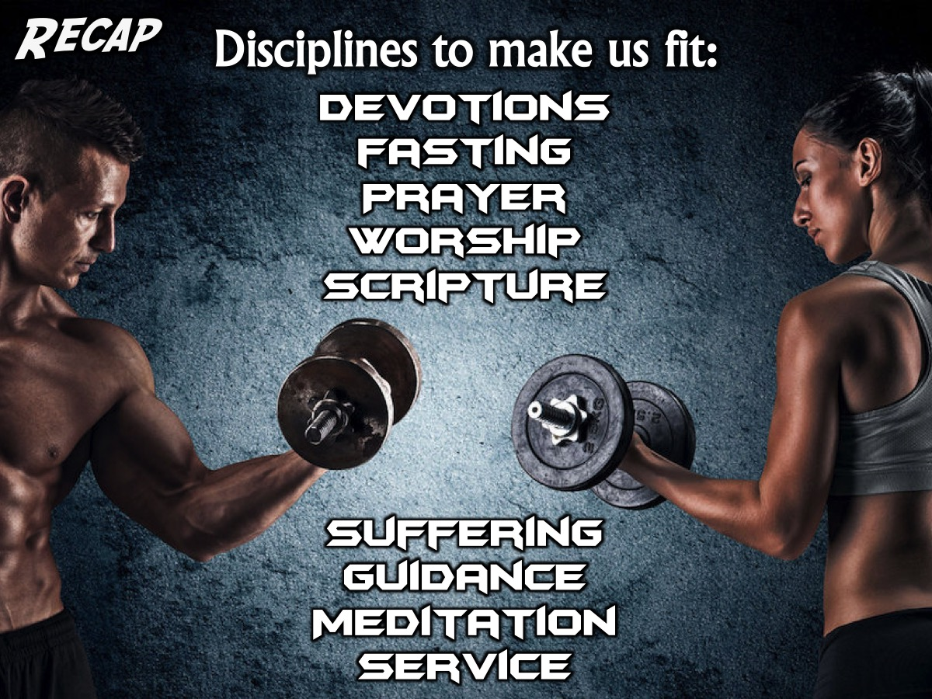
Notes:
In the Workout Series we are looking at disciplines that will make us spiritually fit! So far we have looked at: Devotions, Fasting. Prayer, Worship, Scripture, Suffering, Guidance, Meditation and Service.

Slide 3
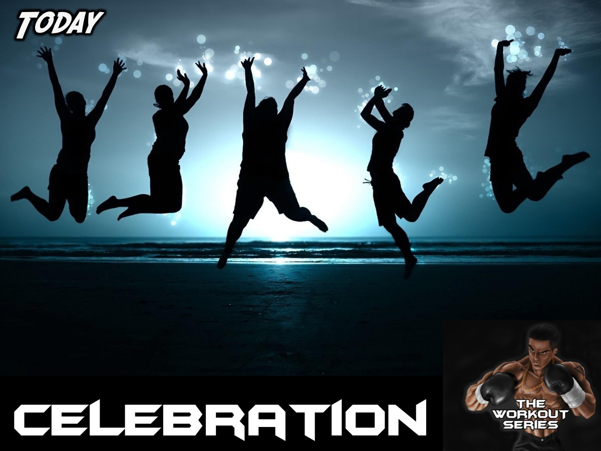
Notes:
Today we are going to learn about how Celebration can help us become spiritually fit.

Slide 4
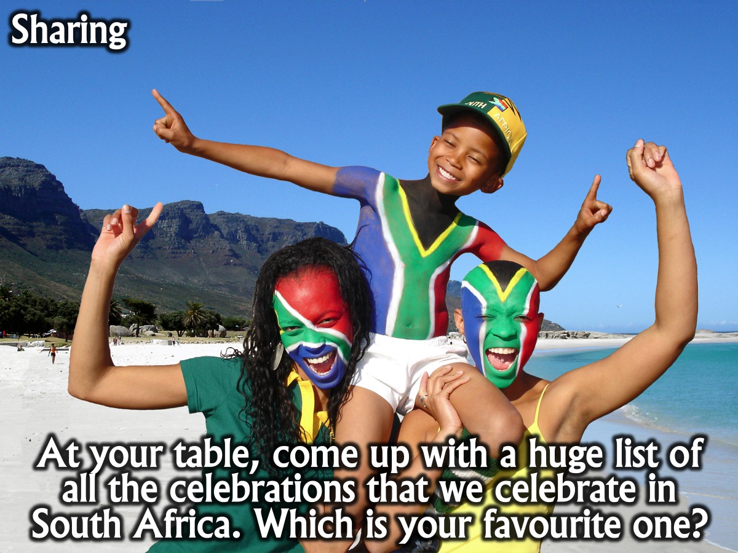
Notes:
Sharing: At your table, come up with a huge list of all the celebrations that we celebrate in South Africa. Of all of them, which is your favourite one?

Slide 5
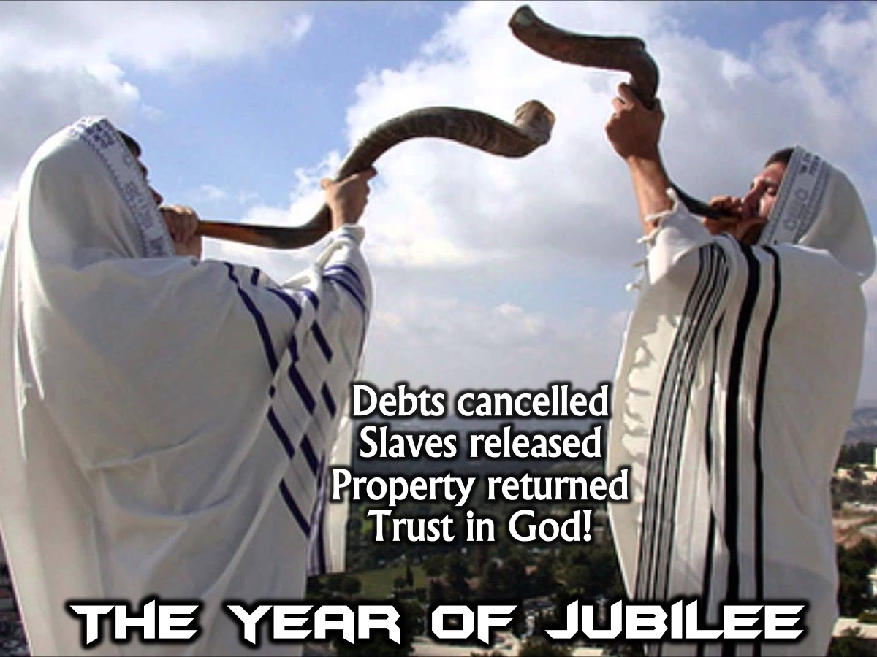
Notes:
Let’s take a look at one of the celebrations God created The Year of Jubilee. This was a festival that took place every 50 years and debts were cancelled, slaves were released and property was returned to it’s original owners. God was using the festival to teach his people to trust in Him fully.

Slide 6

Notes:
My goal for today is to show you that God loves and encourages us to celebrate, but God being God does give us some guidelines to keep us safe while celebrating.

Slide 7

Notes:
God Celebrate! Here is proof from the Bible that God loves to celebrate and even enjoys a good party:

Slide 8
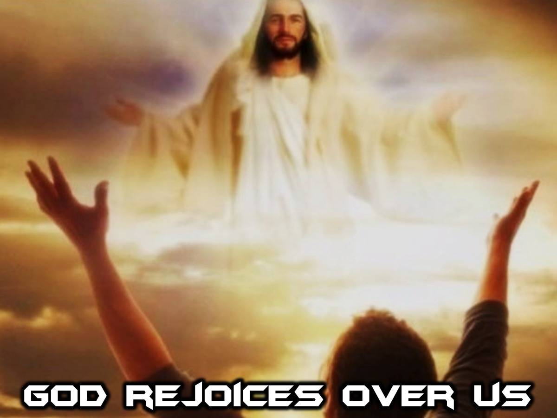
Notes:
1. God Rejoices Over Us

Slide 9
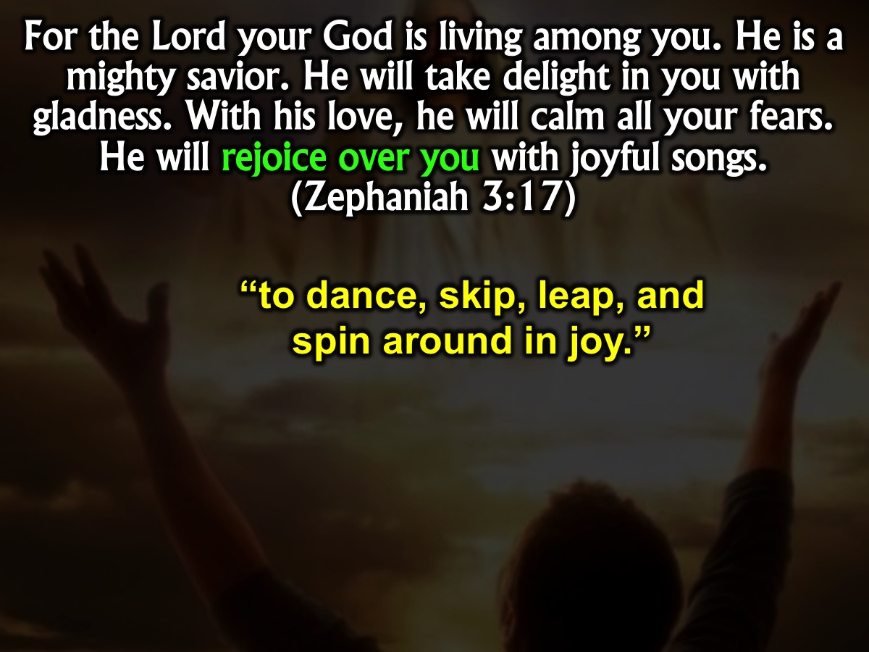
Notes:
“For the Lord your God is living among you. He is a mighty savior. He will take delight in you with gladness. With his love, he will calm all your fears. He will rejoice over you with joyful songs.” (Zephaniah 3:17). The phrase “rejoice over you” literally means “to dance, skip, leap, and spin around in joy.” God dances with shouts of joy over us! How much more should we dance with joy since He is in our midst?

Slide 10
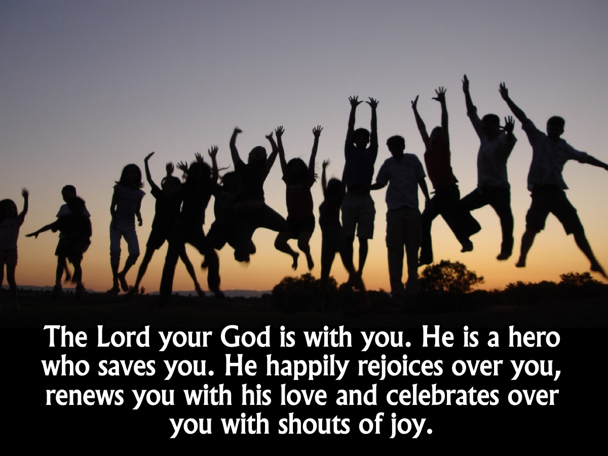
Notes:
Another translation of this verse says: “The Lord your God is with you. He is a hero who saves you. He happily rejoices over you, renews you with his love, and celebrates over you with shouts of joy.”

Slide 11
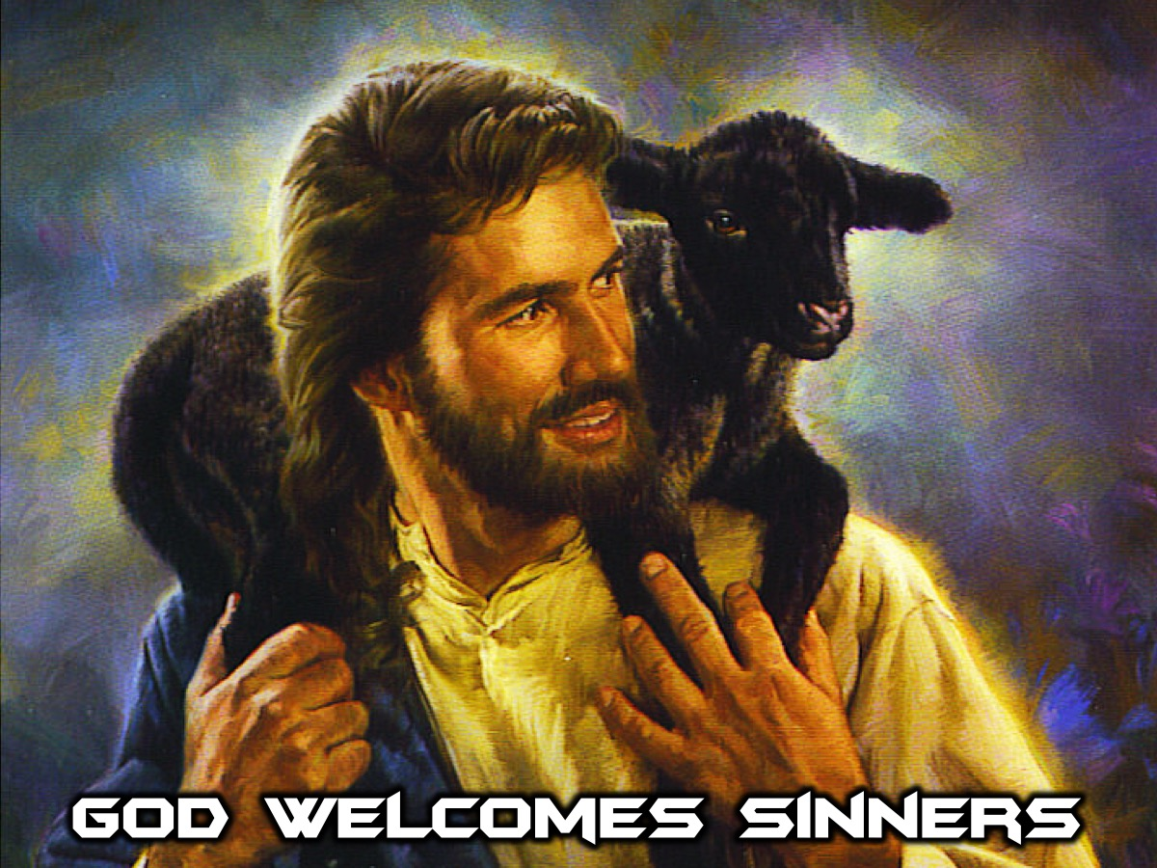
Notes:
2. God Welcomes Sinners

Slide 12
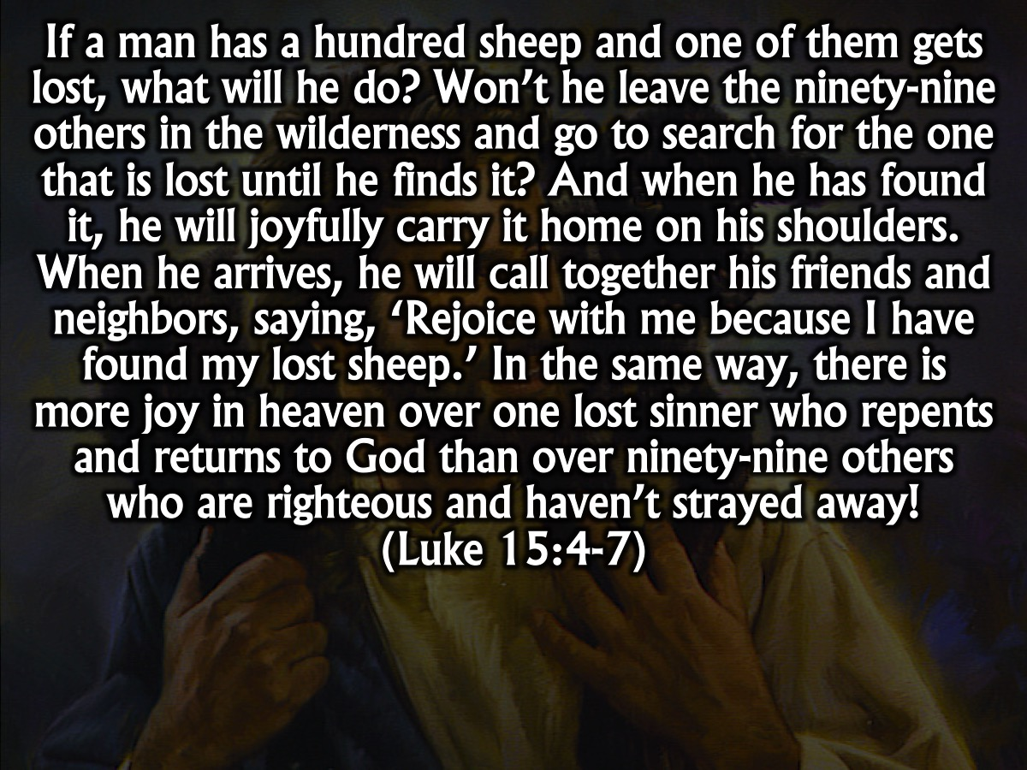
Notes:
Jesus once told a parable of how a shepherd celebrates the return of a lost sheep even though he has 99 more sheep. “If a man has a hundred sheep and one of them gets lost, what will he do? Won’t he leave the ninety-nine others in the wilderness and go to search for the one that is lost until he finds it? And when he has found it, he will joyfully carry it home on his shoulders. When he arrives, he will call together his friends and neighbors, saying, ‘Rejoice with me because I have found my lost sheep.’ In the same way, there is more joy in heaven over one lost sinner who repents and returns to God than over ninety-nine others who are righteous and haven’t strayed away! (Luke 15:4-7). The point of the story is that God and all of heaven rejoices when just one person receives Jesus as their Lord and Saviour.

Slide 13
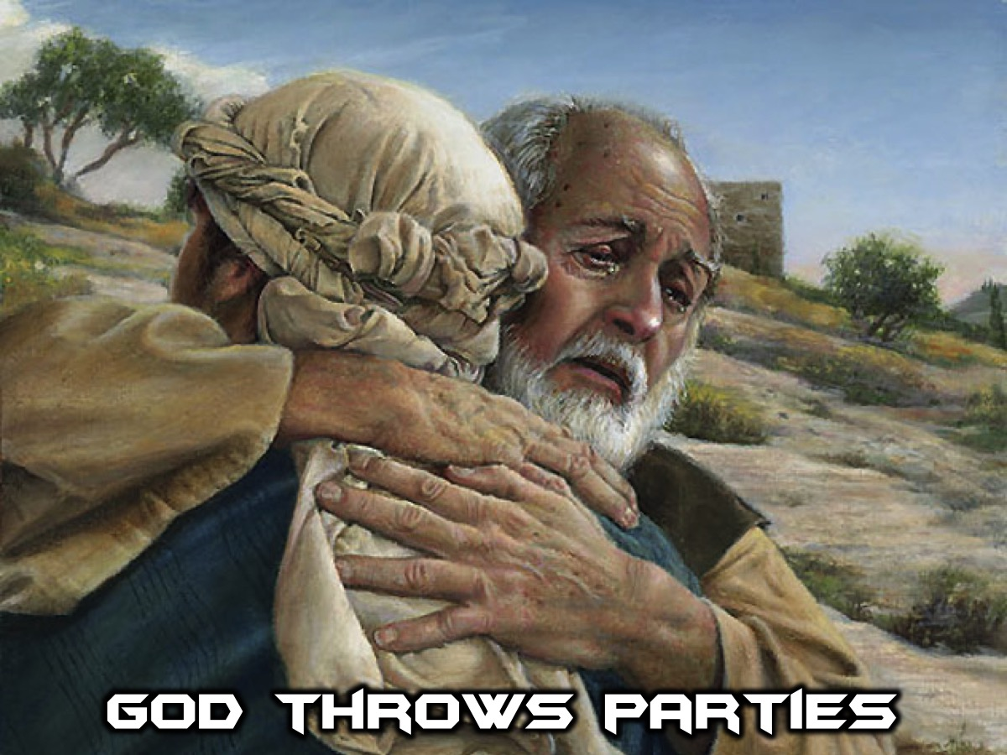
Notes:
3. God Throws Parties

Slide 14
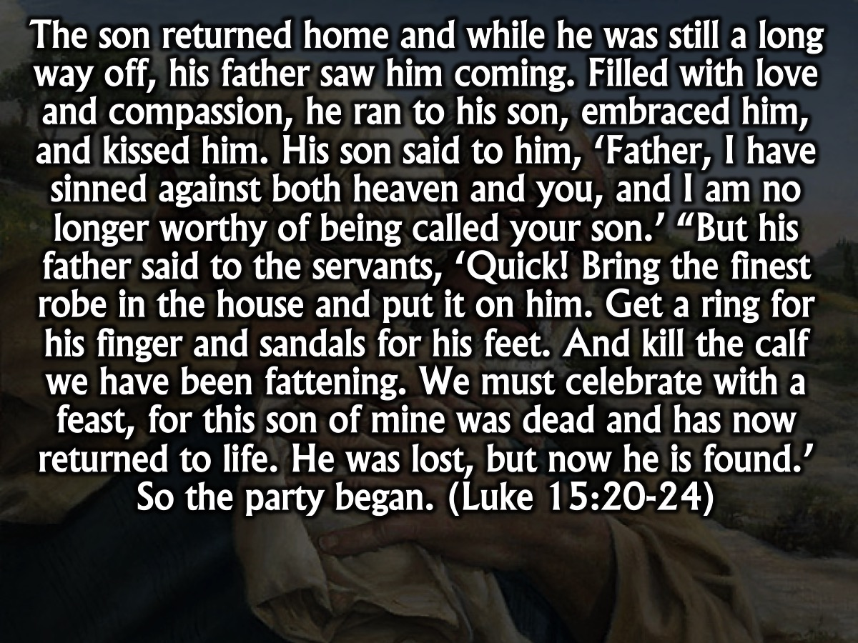
Notes:
Jesus also told a parable about a Father who threw a party when his lost son returned to him. “So he returned home to his father. And while he was still a long way off, his father saw him coming. Filled with love and compassion, he ran to his son, embraced him, and kissed him. His son said to him, ‘Father, I have sinned against both heaven and you, and I am no longer worthy of being called your son.’ “But his father said to the servants, ‘Quick! Bring the finest robe in the house and put it on him. Get a ring for his finger and sandals for his feet. And kill the calf we have been fattening. We must celebrate with a feast, for this son of mine was dead and has now returned to life. He was lost, but now he is found.’ So the party began. (Luke 15:20-24)

Slide 15
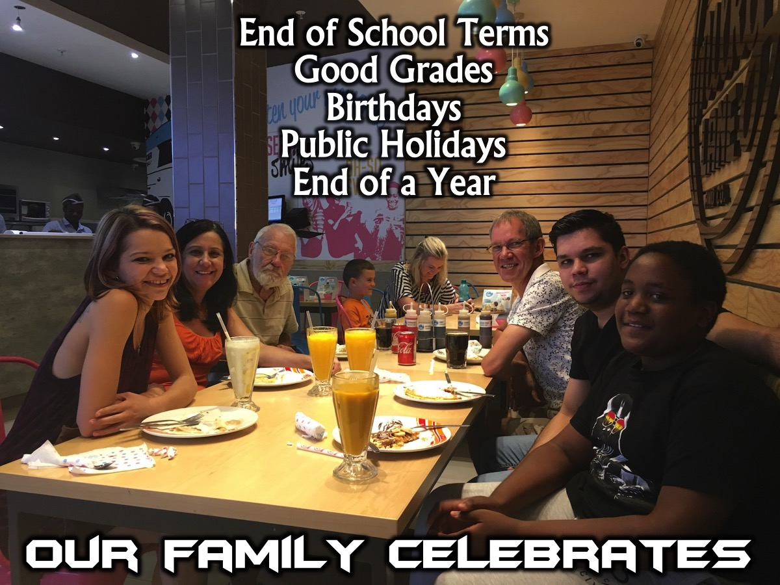
Notes:
Our Family Celebrates: As a family we celebrate well: (1) At the end of a school term we go out for a celebratory meal. (2) If Drew gets good grades we celebrate by giving him money – this motivates him to keep on working hard. (3) For birthdays we spoil the person by giving them a gift and I make their favourite meal and throughout the day we will treat them that little more special. (4) We celebrate public holidays with a special outing. (5) We celebrate the end of a year and the beginning of a new one with a holiday at a special location.

Slide 16
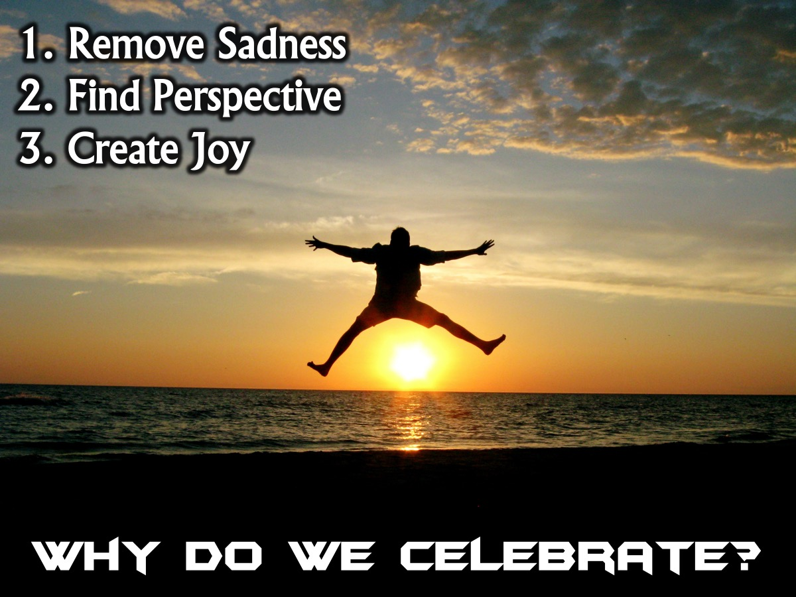
Notes:
Why Do We Celebrate? (1) Remove Sadness: Celebration helps to take away feelings of sadness that can oppress us – like depression. (2) Find Perspective: Celebration helps us find perspective because we laugh at our silliness and it saves us from taking ourselves too seriously. (3) Create Joy: Celebration creates more celebration and brings joy into our lives!

Slide 17
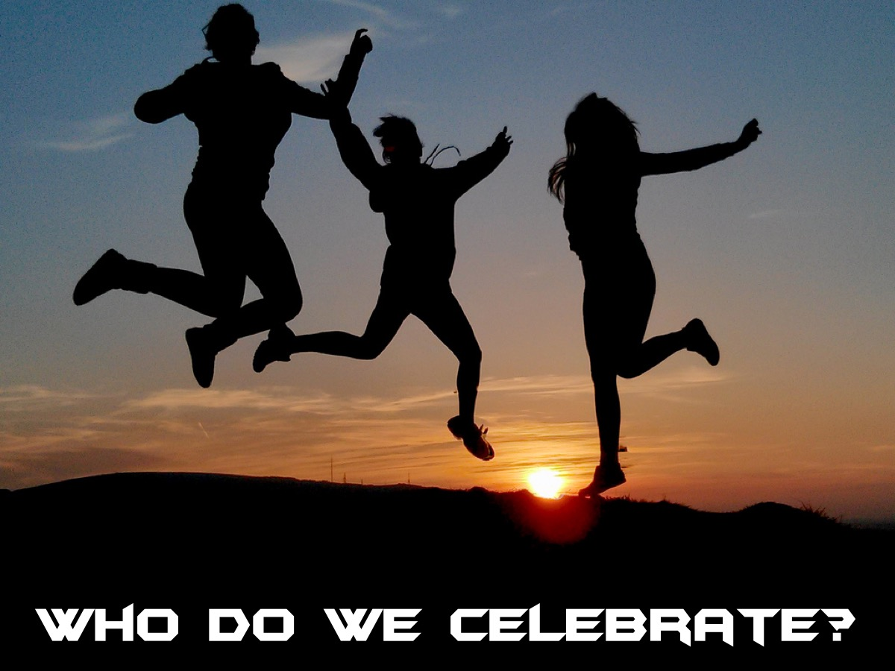
Notes:
Who Do We Celebrate?

Slide 18
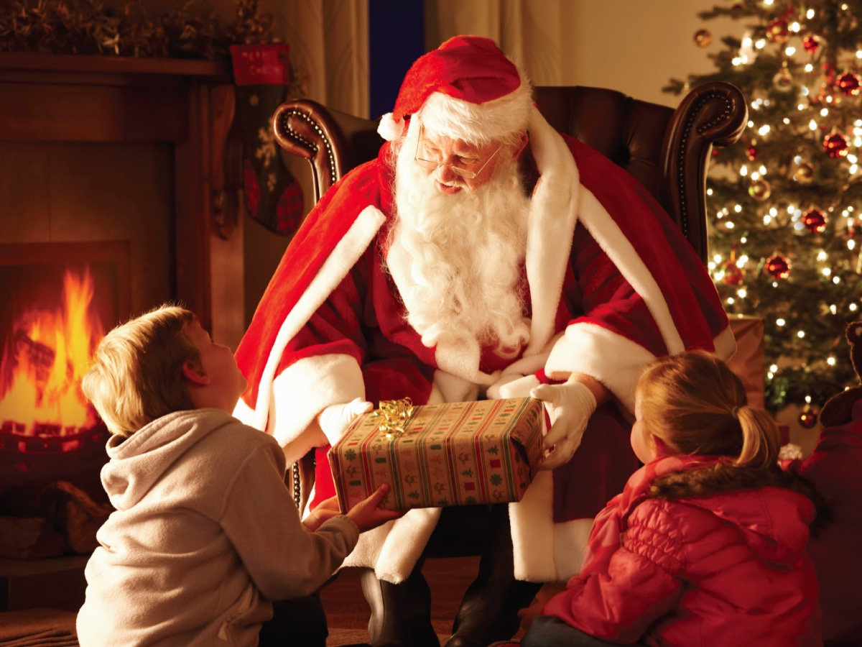
Notes:
Is Christmas a time to celebrate Father Christmas? That cheerful old man with the white beard who brings us presents?

Slide 19
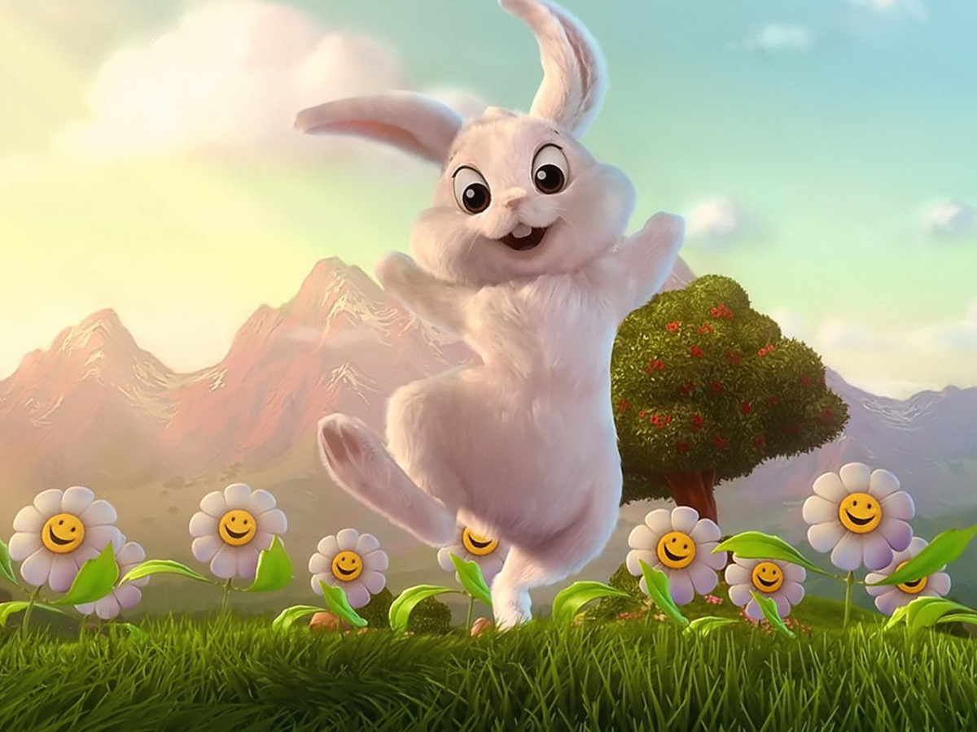
Notes:
Is Easter a time to celebrate the Easter Bunny? That little white rabbit who brings us chocolate eggs?

Slide 20
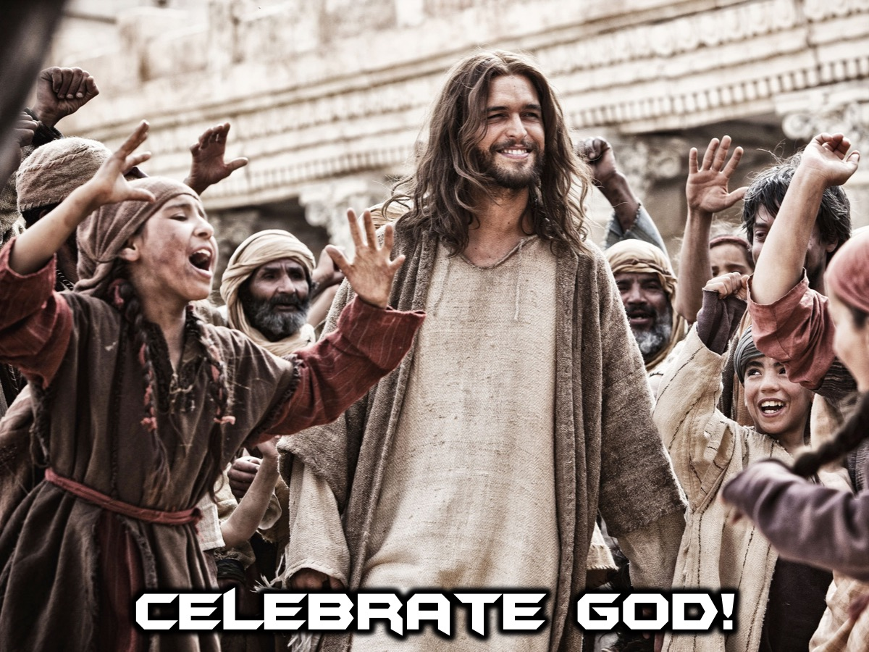
Notes:
As Christians we need to make sure that we celebrate the person behind these special events – our God! When we celebrate something good that happens in our lives we need to make sure that we thank God for all that he has done.

Slide 21
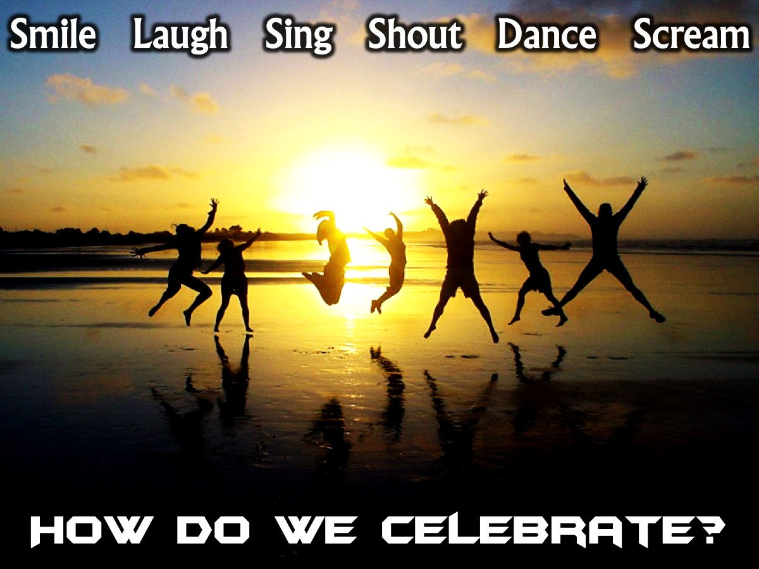
Notes:
How Do We Celebrate? When you celebrate, make sure that you smile and laugh and sing and shout and even dance. Celebrate like you would if your favourite team scored a goal of like when you favourite pop star comes out onto the stage to sing.

Slide 22
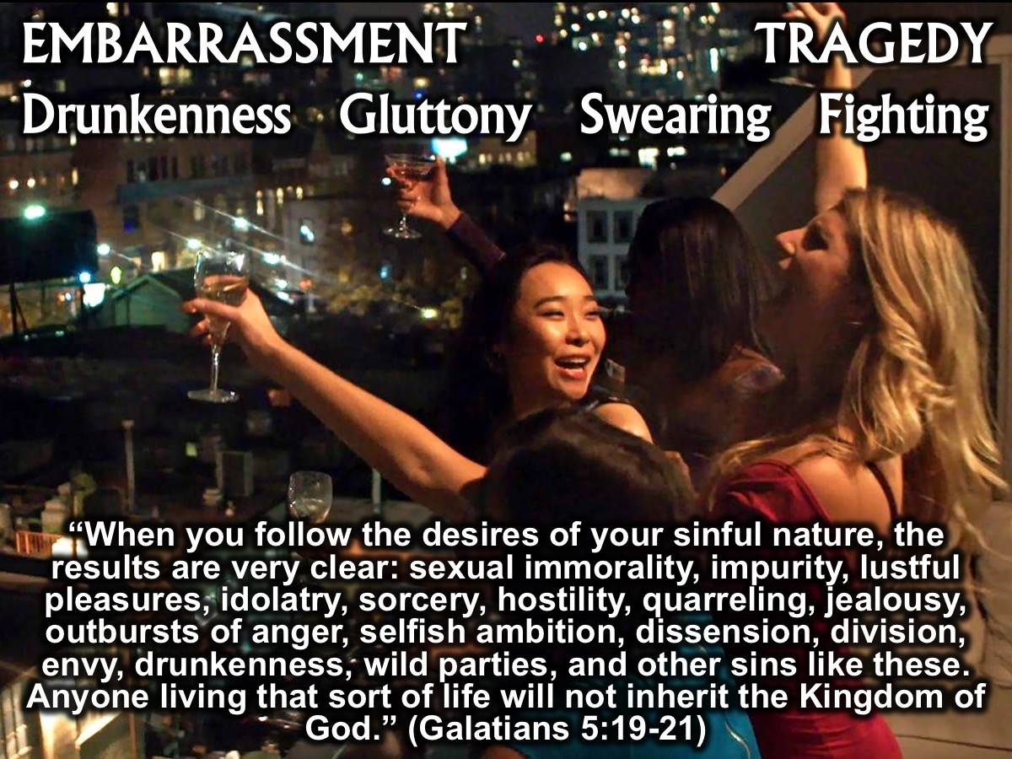
Notes:
But sadly, when people celebrate it often ends up with embarrassment and it can even be tragic because they have drunk too much or they do something really foolish. God wants us to celebrate but not to sin. Our Celebration should not include drunkenness, gambling, over-spending, gluttony, foul language, arguing, backbiting, immorality or stress. The Bible warns us to stay away from things like this: “When you follow the desires of your sinful nature, the results are very clear: sexual immorality, impurity, lustful pleasures, idolatry, sorcery, hostility, quarreling, jealousy, outbursts of anger, selfish ambition, dissension, division, envy, drunkenness, wild parties, and other sins like these. Let me tell you again, as I have before, that anyone living that sort of life will not inherit the Kingdom of God.” (Galatians 5:19-21).

Slide 23
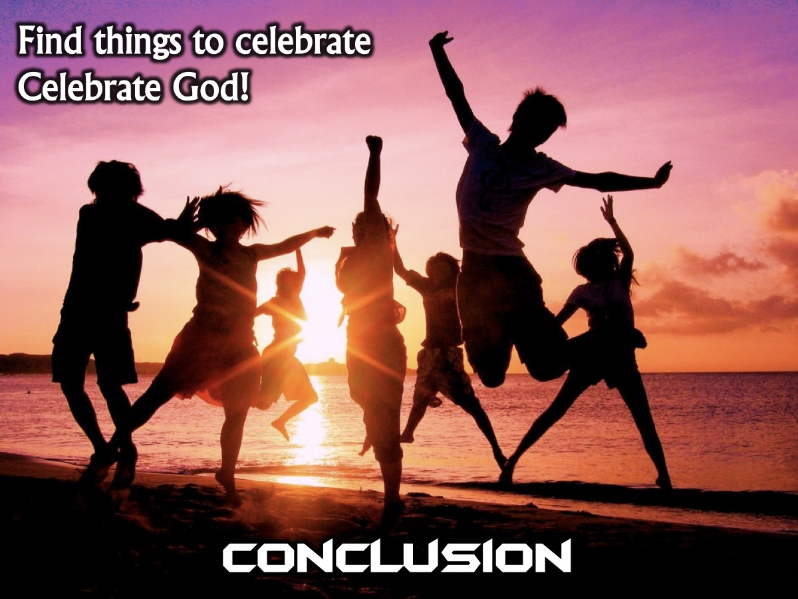
Notes:
Conclusion. My challenge to you is to find significant things in your life to celebrate. Good grades, birthdays, achieving a goal, a milestone in your life. But never forget to thank the one who is above all else because if it wasn’t for our Lord and Saviour we would never achieve these things. Lets also celebrate what God has done in our lives.

Slide 24
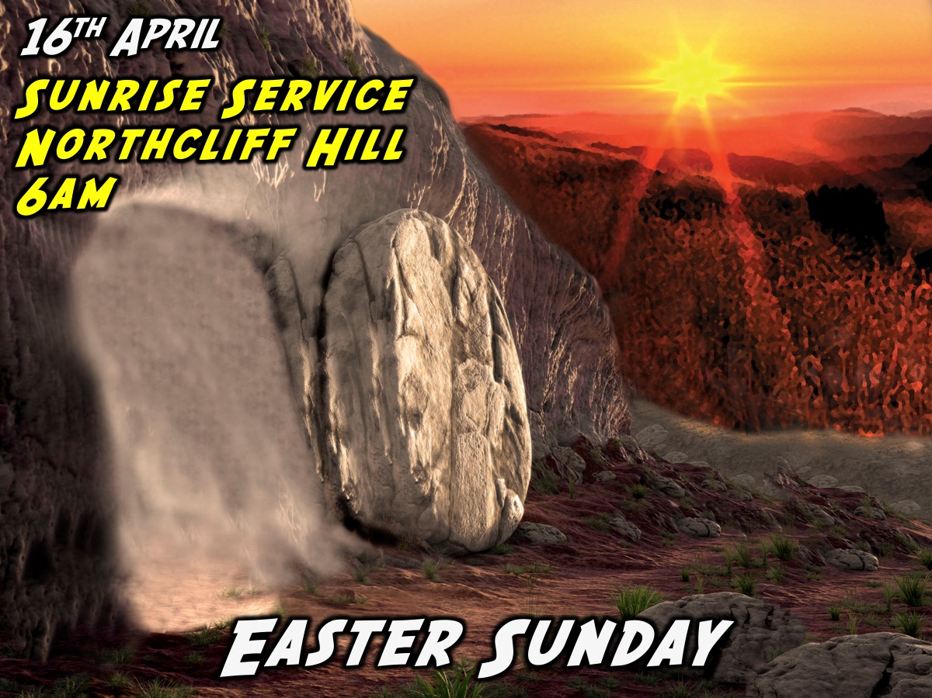
Notes:
We celebrate Easter in just a few weeks. May we celebrate it well. We are going to celebrate the resurrection of Jesus on the top of northcliff hill at sunrise on Easter Sunday the 16th April. Meet us at the water tower by 6am. We will celebrate with hot cross buns and hot chocolate and then make our way to church for the morning service.

Slide 25
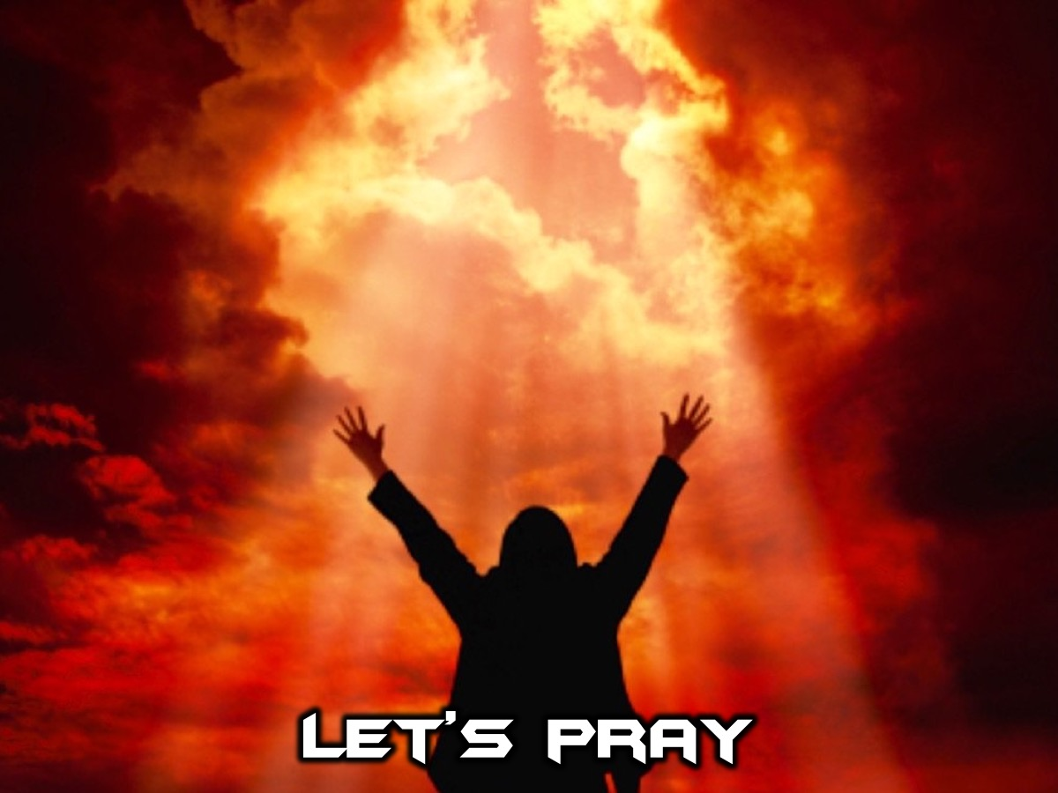
Notes:
Let’s Pray

Slide 26
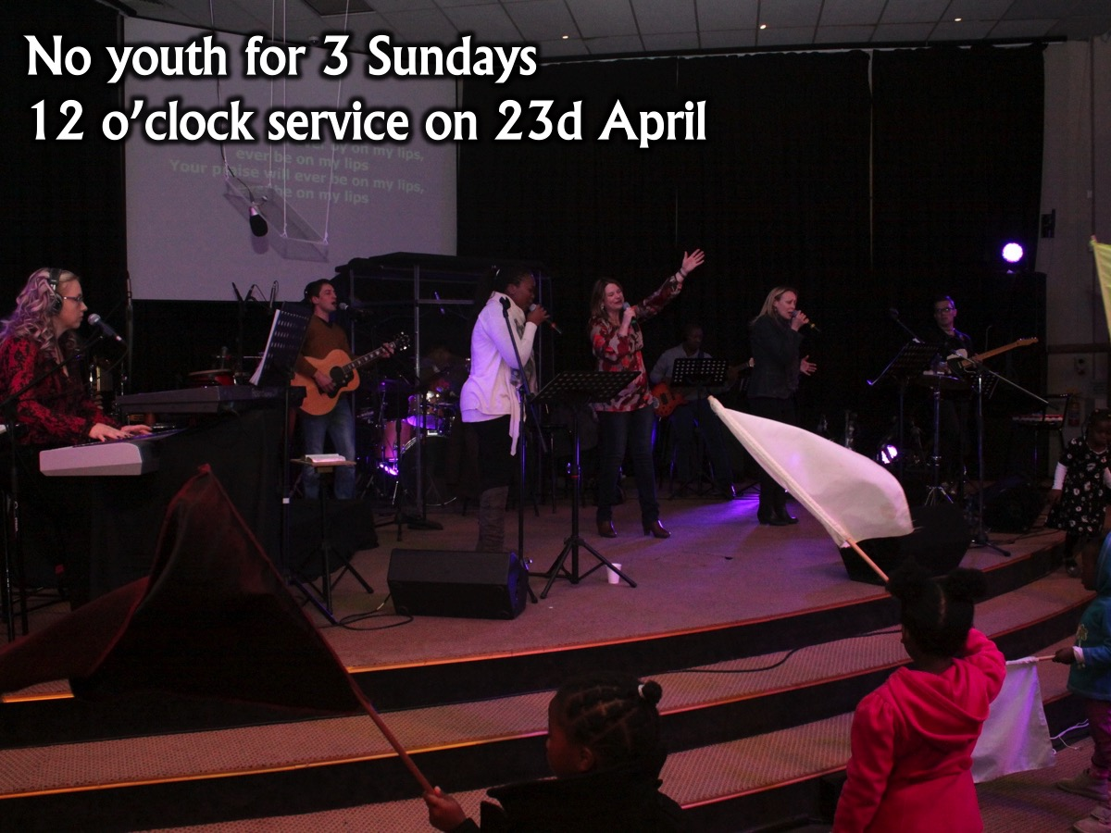
Notes:
We won’t have youth services on Sunday mornings for the next 3 Sunday mornings and when School starts again we will be launching our 3rd morning service – at 12 o’clock.

Slide 27

Notes:
Next term we will be launching the Shine Series on Sunday mornings. We will be equipped to shine our light in the world.

Slide 28
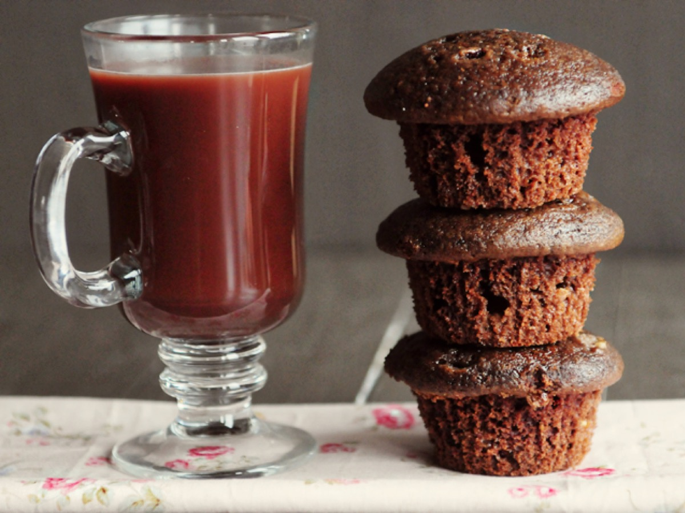
Notes:
It is now time to celebrate – we are going to enjoy muffins and hot chocolates. Be sure to pause and celebrate all that God has done in and through you in this past term.

