Slide 1
Youth Group
Rules
Notes:
Youth Group Rules

Slide 2
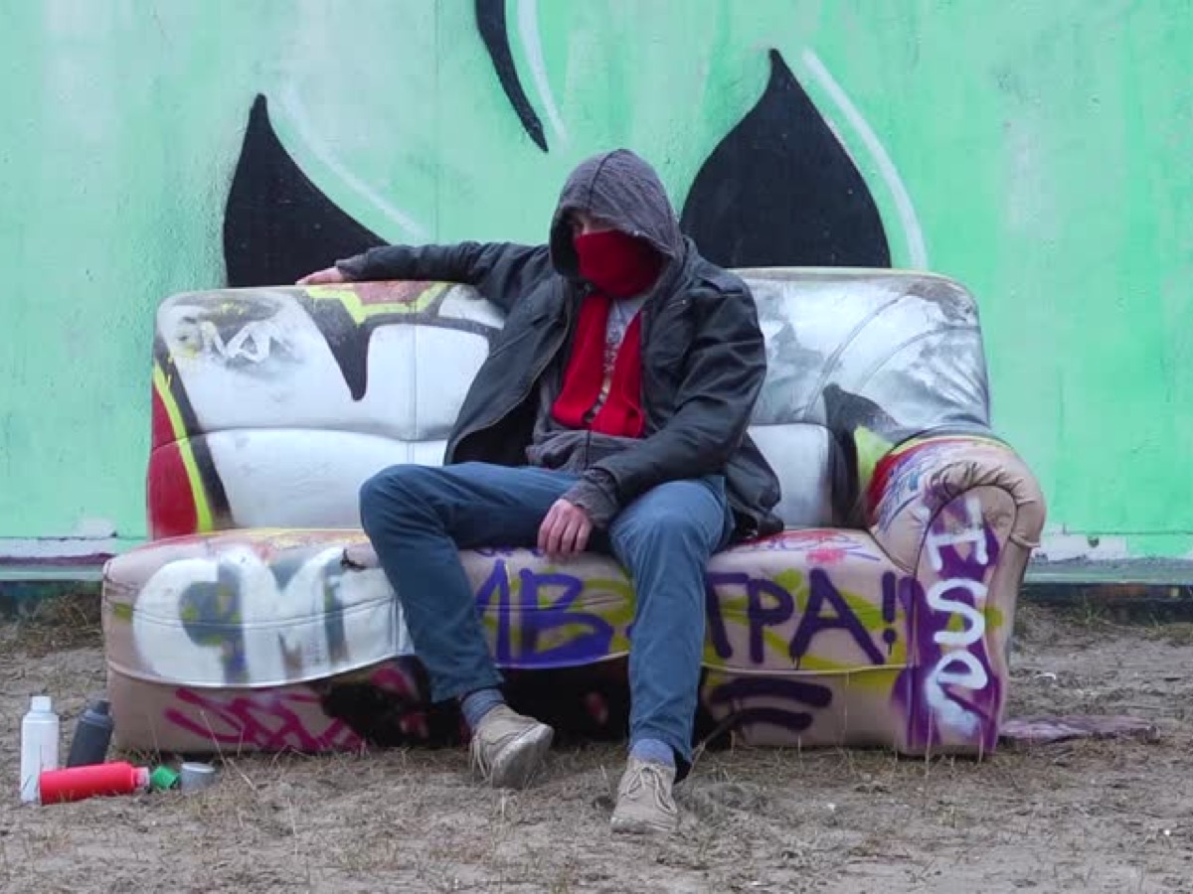
We are streetwise
and don’t leave our stuff lying around.
Notes:
We are streetwise and don’t leave our stuff lying around.

Slide 3
We look after other’s stuff
and don’t steal from each other.
Notes:
We look after other’s stuff and don’t steal from each other.

Slide 4
We fight against evil
and don’t have a code of silence.
Notes:
We take action to combat evil and don’t have a code of silence.

Slide 5
We speak to each other positively
and don’t disrespect anyone.
Notes:
We speak to each other positively and don’t disrespect anyone.

Slide 6
We respect the person speaking
and don’t speak at the same time.
Notes:
We respect the person speaking and don’t speak at the same time.

Slide 7
We ask permission to leave the room
and don’t leave in groups.
Notes:
We ask permission to leave the room and don’t leave in groups.

Slide 8
We handle conflict by talking
and don’t get physical.
Notes:
We handle conflict by talking and don’t get physical.

Slide 9
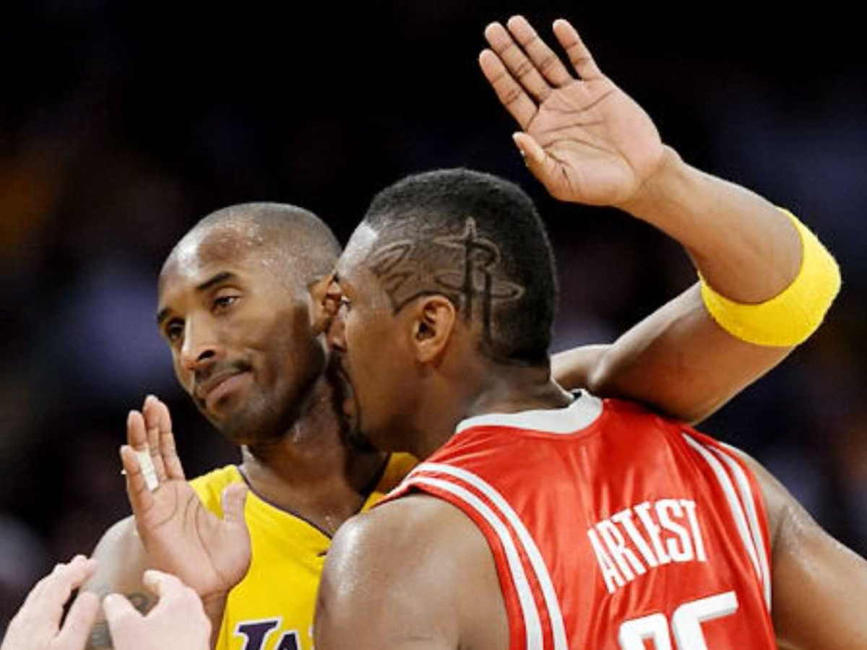
We respect people’s physical space
and don’t cross boundaries.
Notes:
We respect people’s physical space and don’t cross boundaries.

Slide 10
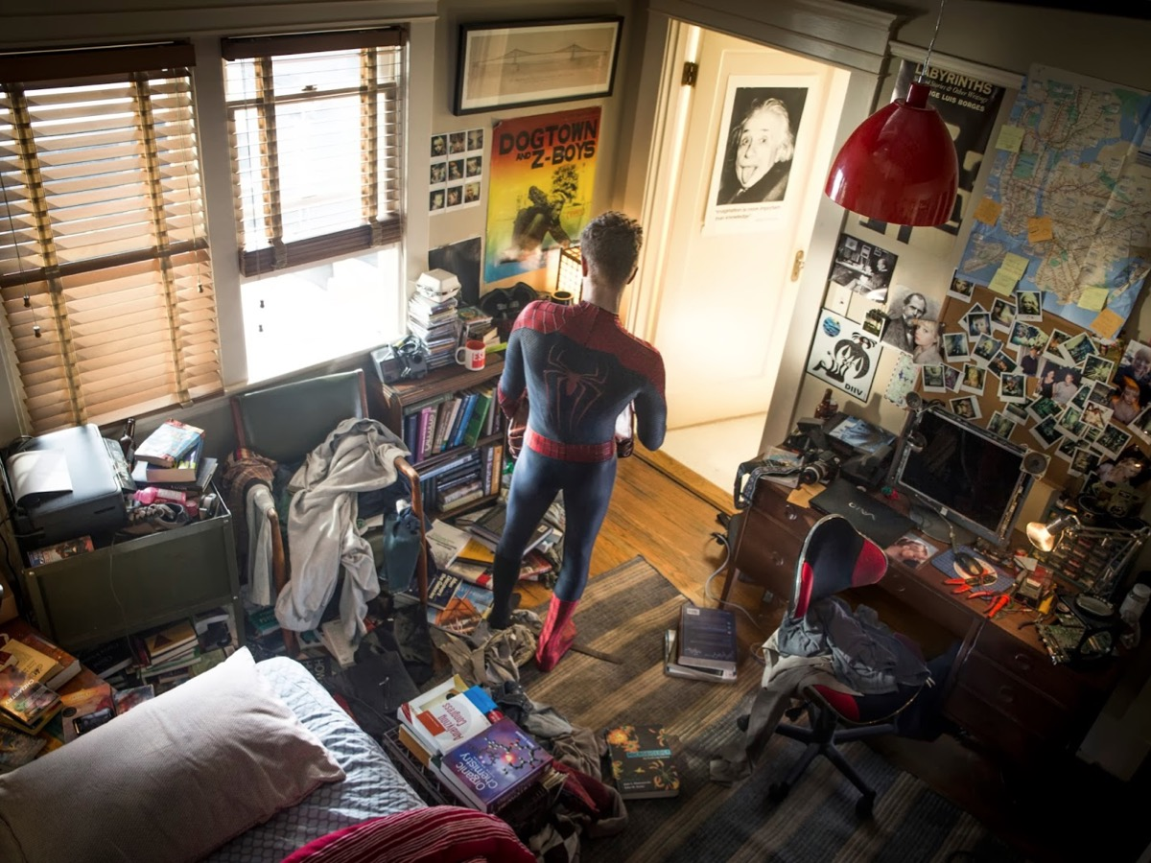
We respect the room
and don’t mess it up.
Notes:
We respect the room and don’t mess it up.

Slide 11
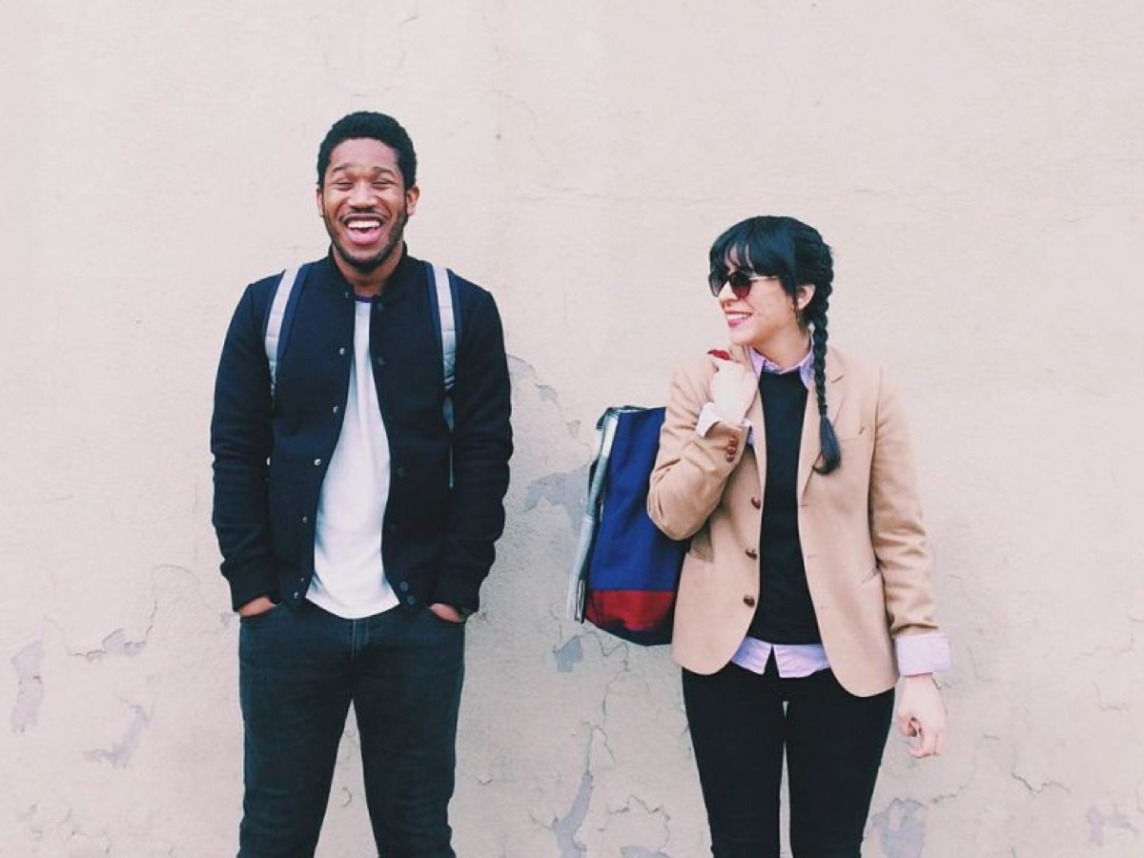
We arrive sober
and don’t leave high.
Notes:
We arrive sober and don’t leave high.

Slide 12
We stay to the end
and don’t leave early.
Notes:
We stay to the end and don’t leave early.

Slide 13
We are streetwise and don’t leave our stuff lying around.
We look after other’s stuff and don’t steal from each other.
We fight against evil and don’t have a code of silence.
We speak to each other positively and don’t disrespect anyone.
We respect the person speaking and don’t speak at the same time.
We ask permission to leave the room and don’t leave in groups.
We handle conflict through communication and don’t get physical.
We respect people’s physical space and don’t cross boundaries.
We respect the room and don’t mess it up.
We arrive sober and don’t leave high.
We stay the end and don’t leave early.
Youth Group Rules
Notes:
Youth Group Rules
We are streetwise and don’t leave our stuff lying around.
We look after other’s stuff and don’t steal from each other.
We fight against evil and don’t have a code of silence.
We speak to each other positively and don’t disrespect anyone.
We respect the person speaking and don’t speak at the same time.
We ask permission to leave the room and don’t leave in groups.
We handle conflict through communication and don’t get physical.
We respect people’s physical space and don’t cross boundaries.
We respect the room and don’t mess it up.
We arrive sober and don’t leave high.
We stay the end and don’t leave early.

