Slide 1

Notes:
This week is our Christmas Party.

Slide 2
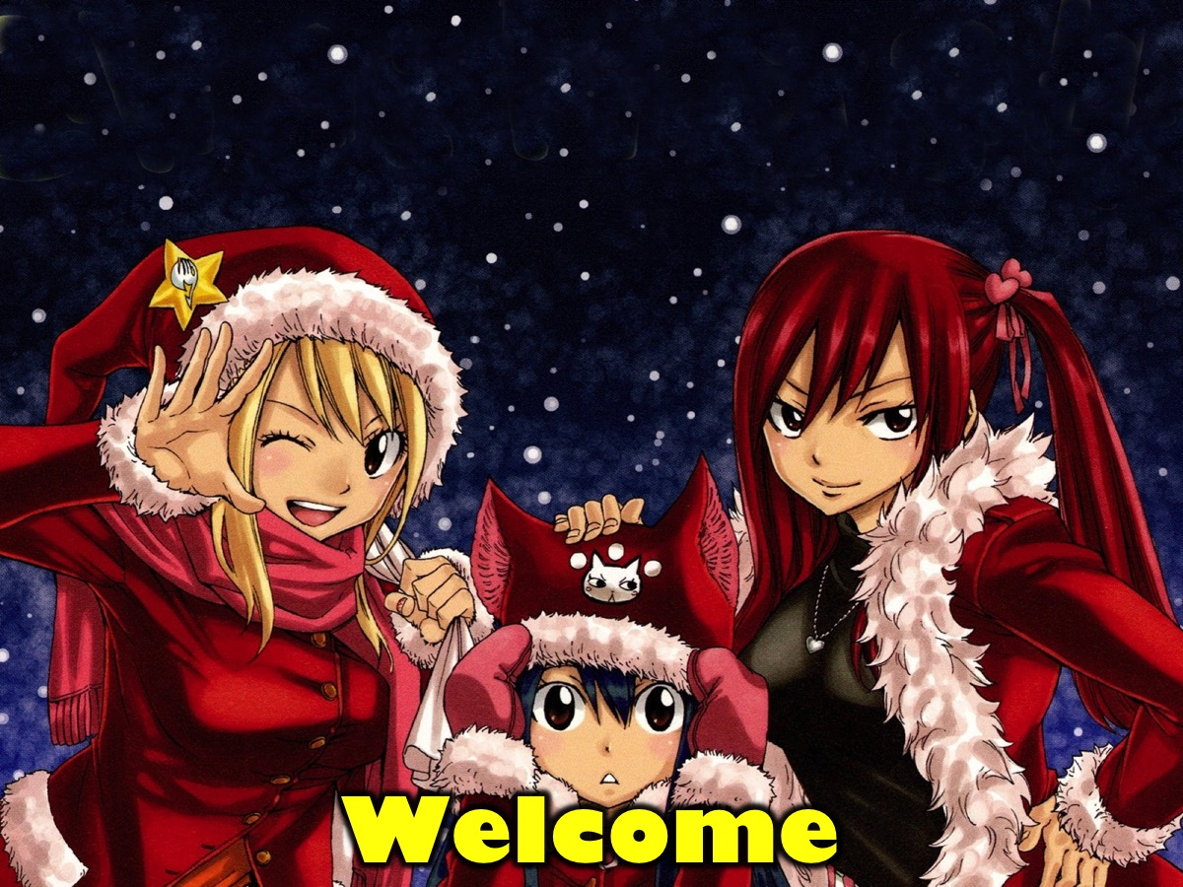
Notes:
Welcome to regulars and newcomers.

Slide 3
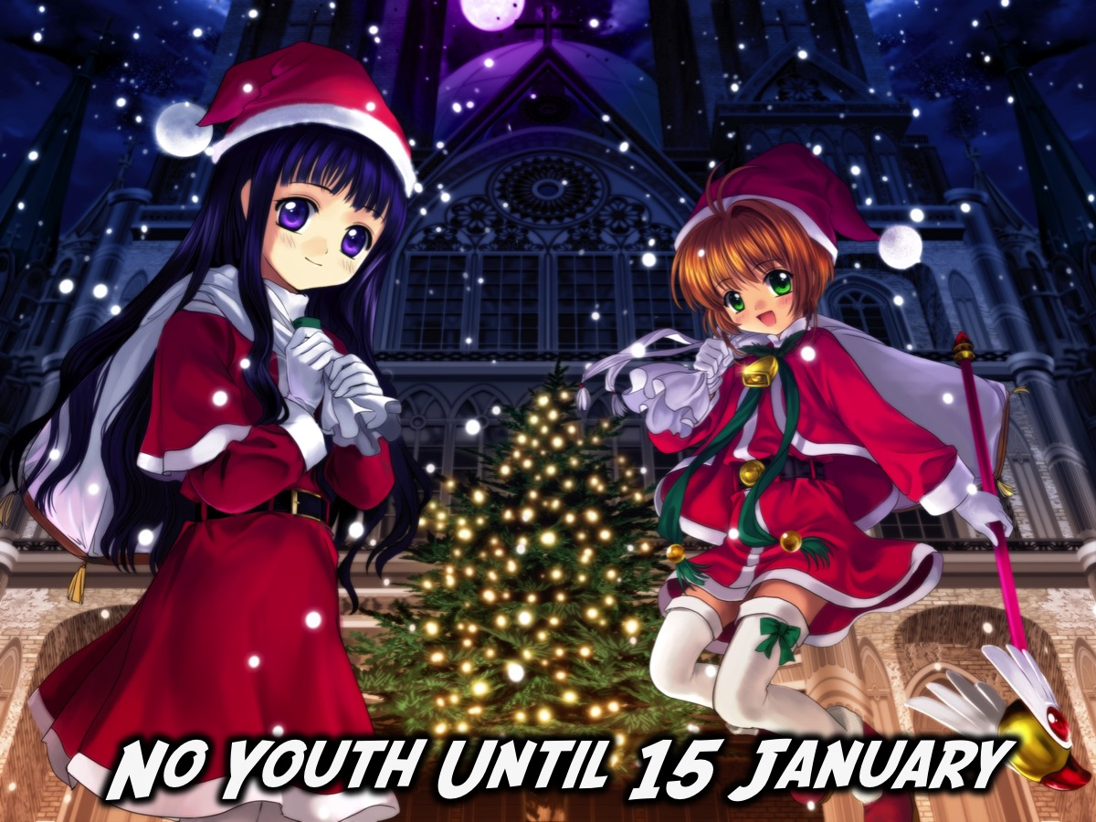
Notes:
We are taking a break until school re-opens on the 15 January 2016.

Slide 4

Notes:
When we will be launching our brand new Escape Friday series.

Slide 5

Notes:
Join us on Sunday morning either at 8:30 or at 10:30 for The Revelation Series. It is the last Sunday in this series.

Slide 6
Notes:
So, welcome to our Christmas Party.

Slide 7
Notes:
Video: Happy Christmas from the Angry Birds Hatchlings. Get it on YouTube at: https://www.youtube.com/watch?v=6e_ERHp7ms0

Slide 8
Notes:
Video: Mogs Christmas Calamity. Get it on YouTube at: https://www.youtube.com/watch?v=kuRn2S7iPNU

Slide 9

Notes:
The BIG Feast: It is time for our Christmas Dinner and Desert. Enjoy!

Slide 10
Notes:
Video: Angels We Have Heard on High Pentatonix. Get it on YouTube at: https://www.youtube.com/watch?v=VAMzAIH12yc

Slide 11
Notes:
Video: Joy To The World Pentatonix. Get it on YouTube at: https://www.youtube.com/watch?v=-Xo64Q2ucQ8

Slide 12
Notes:
Video: Mistletoe Justin Bieber. Get it on YouTube at: https://www.youtube.com/watch?v=LUjn3RpkcKY

Slide 13
Notes:
Video: Little Drummer Boy Pentatonix. Get it on YouTube at: https://www.youtube.com/watch?v=qJ_MGWio-vc

Slide 14
Notes:
Video: Mary, Did You Know Pentatonix. Get it on YouTube at: https://www.youtube.com/watch?v=ifCWN5pJGIE

Slide 15
Notes:
Video: Silent Night Pentatonix. Get it on YouTube at: https://www.youtube.com/watch?v=sme8N2pzRx8

Slide 16
Notes:
Video: That’s Christmas To Me Pentatonix. Get it on YouTube at: https://www.youtube.com/watch?v=pFjdfjrtf1Q

Slide 17

Notes:
The GIFT Game: You were asked to bring a wrapped gift tonight. And we are going to sit in a big cricle (2 circles if there are way too many people for the game) and the first person will get a gift from the middle of the circle and open it. They keep the gift. The next person selects a gift and opens it - and can either keep it or swop with the person before them. No one can refuse to swop! The next person selects a gift opens it and can either keep it or swop with anyone who went before. In the end the last person gets to swop with anyone in the group.

Slide 18

Notes:
Take it Deeper - It is time to think a bit deeper about Christmas!

Slide 19
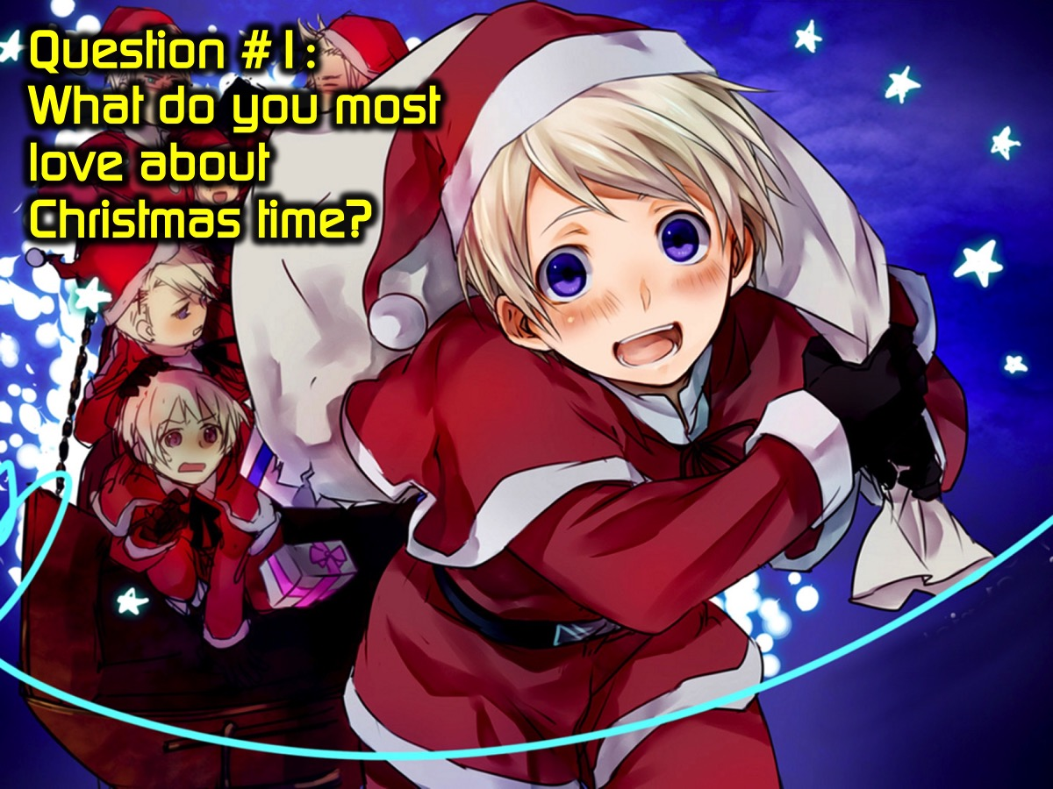
Notes:
Question #1: What do you love most about Christmas time?

Slide 20
Notes:
Video #1. The Story Short Film. Get it on YouTube at: https://www.youtube.com/watch?v=f0gfIvN9zv4

Slide 21
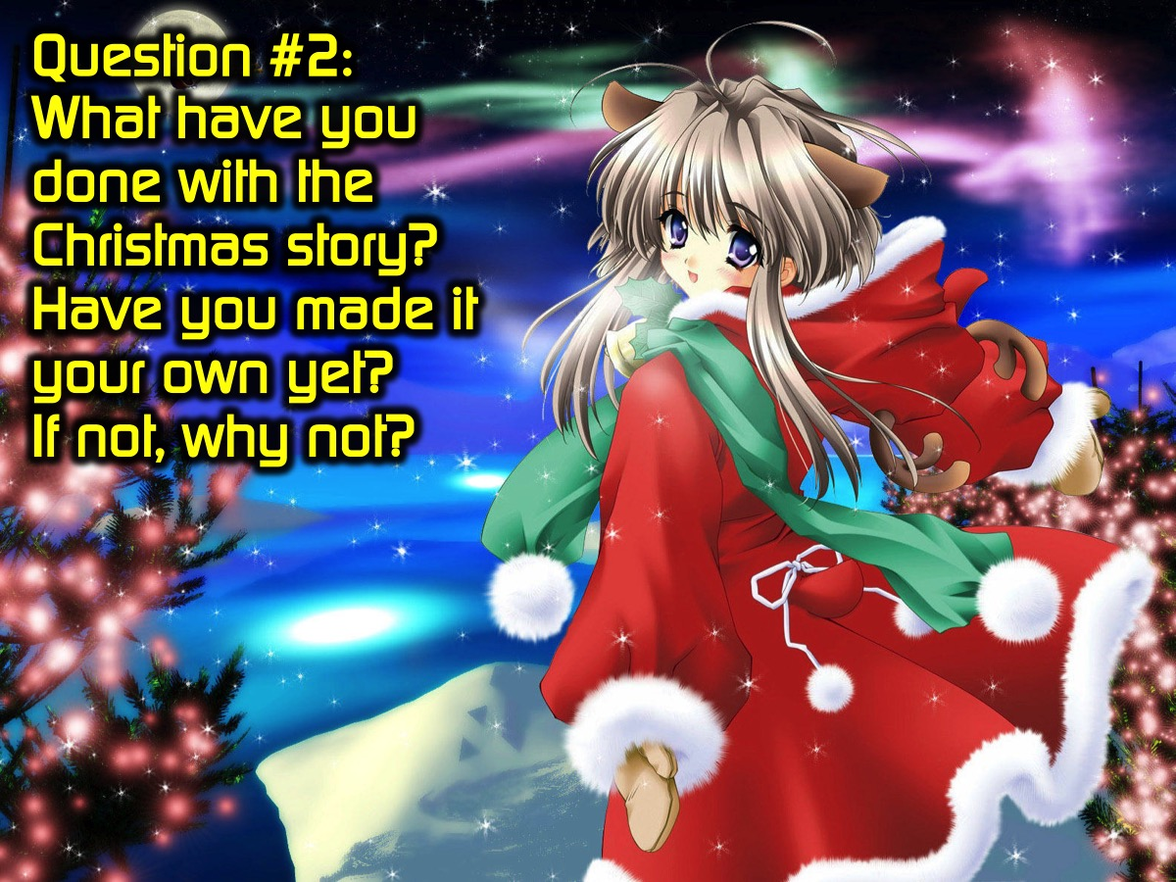
Notes:
Question #2: What have you done with the Christmas story? Have you made it your own yet? If not, why not?

Slide 22
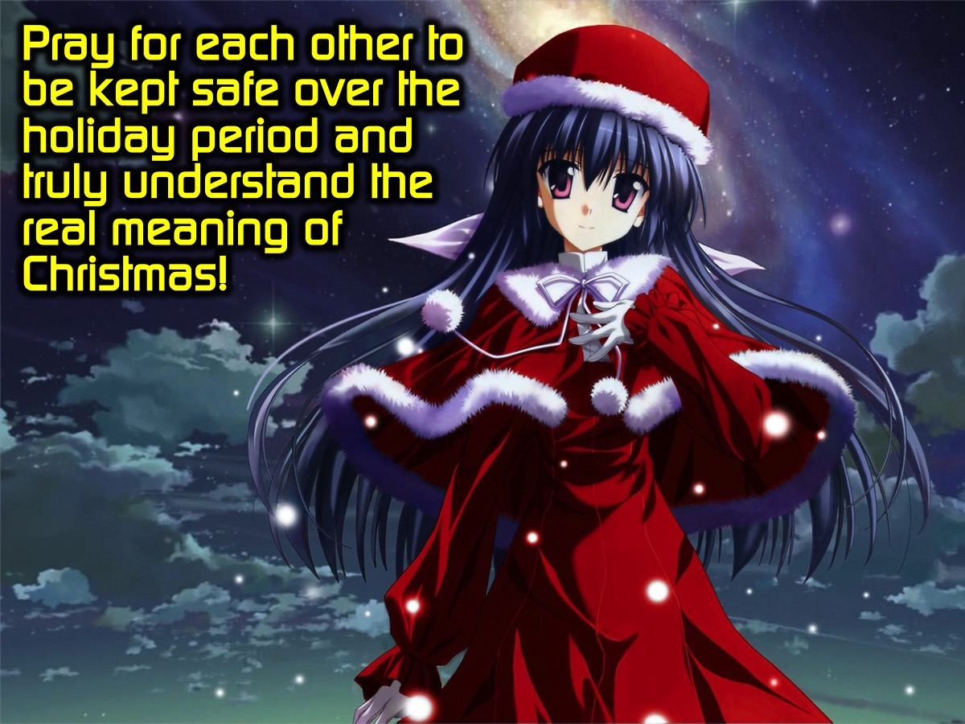
Notes:
Pray for each other to be kept safe over the holiday period and truly understand the real meaning of Christmas!

Slide 23
Notes:
We are taking a break until school re-opens on the 15 January 2016.

