Slide 1

Notes:
This week is cr8 DRAMA nite.

Slide 2

Notes:
Welcome to regulars and newcomers.

Slide 3

Notes:
Welcome to cr8ivFRIDAY.

Slide 4

Notes:
Join us on Sunday mornings either at 8:30 or at 10:30 for The Revelation Series.

Slide 5

Notes:
Next week is cr8 IMAGE nite.

Slide 6
Notes:
But tonight it is cr8DRAMA nite.

Slide 7
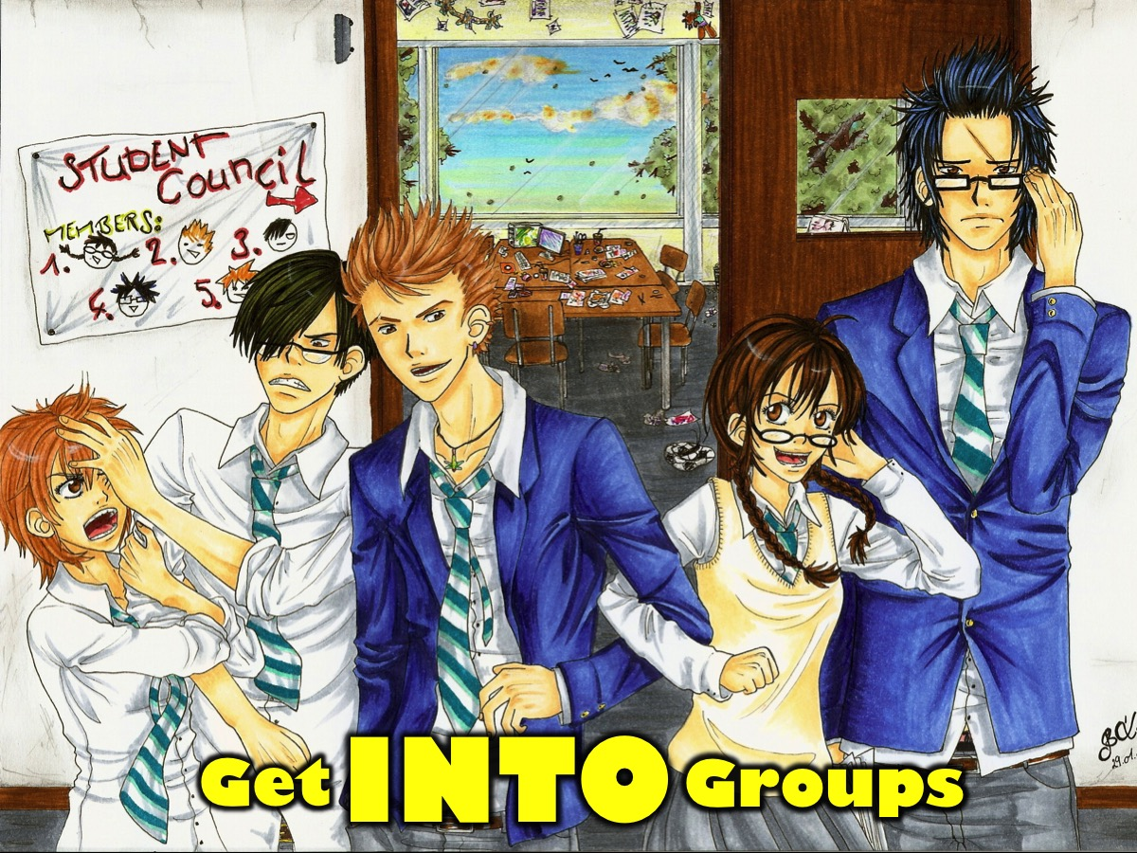
Notes:
Get INTO Groups - there are 4 groups tonight.

Slide 8
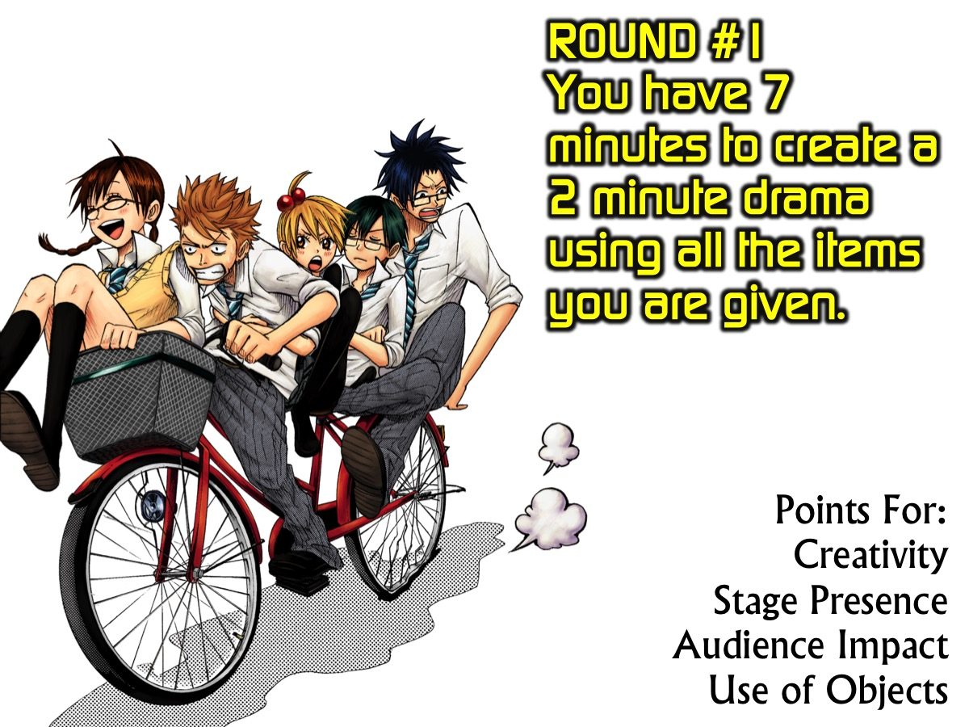
Notes:
ROUND #1: You have 7 minutes to create a 2 minute drama using all the items you are given. Our judges will award points for creativity, stage presence, audience impact and use of objects.

Slide 9
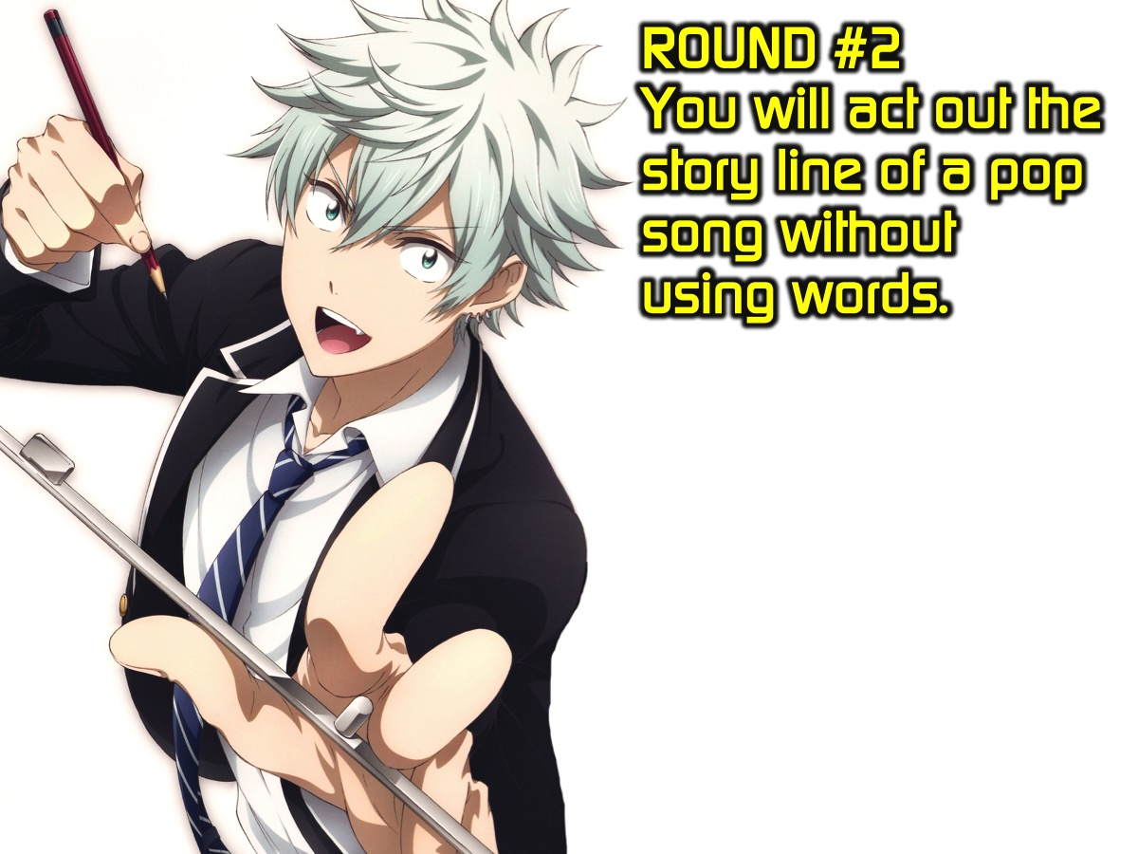
Notes:
ROUND #2. You will act out the story line of a pop song without using words.

Slide 10

Slide10
Notes:
Here are the four songs that will be randomly allocated to each group. Each song will be about 2 minutes long and will play while you perform.

Slide 11

Notes:
Group #1: Hold Back The River by James May
Tried to keep you close to me,
But life got in between
Tried to square not being there
But think that I should've been
Hold back the river, let me look in your eyes
Hold back the river, so I
Can stop for a minute and see where you hide
Hold back the river, hold back
Once upon a different life
We rode our bikes into the sky
But now we're caught against the tide
Those distant days all flashing by
Hold back the river, let me look in your eyes
Hold back the river, so I
Can stop for a minute and be by your side
Hold back the river, hold back
Hold back the river, let me look in your eyes
Hold back the river, so I
Can stop for a minute and see where you hide
Hold back the river, hold back

Slide 12
Notes:
Video: Hold Back the River by James Bay. Get it on YouTube at: https://www.youtube.com/watch?v=mqiH0ZSkM9I

Slide 13
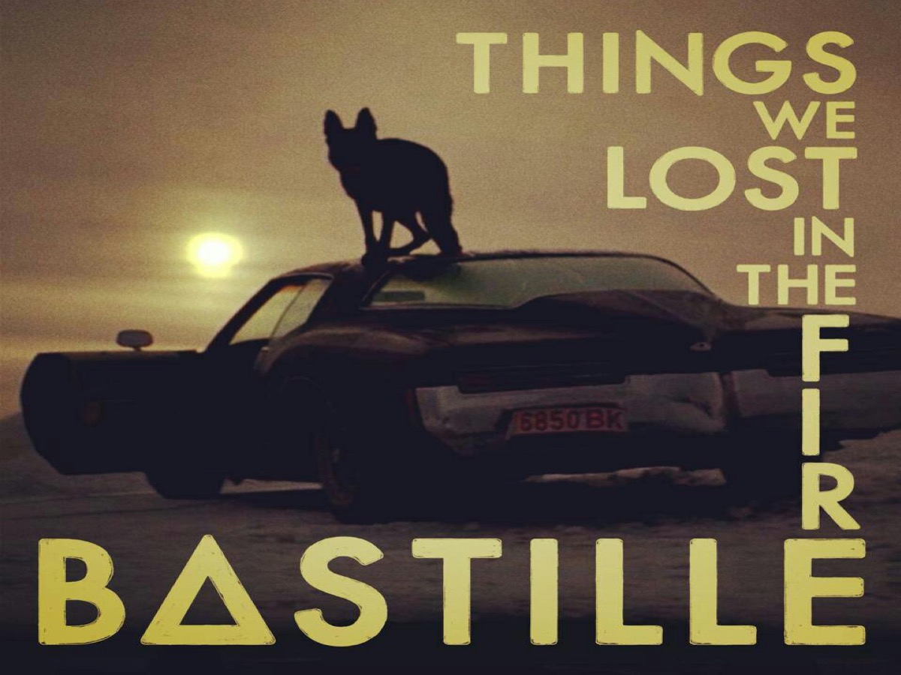
Notes:
Group #2: Things We Lost in the Fire
Things we lost to the flames
Things we'll never see again
All that we've amassed
Sits before us, shattered into ash
Chorus:
These are the things, the things we lost
The things we lost in the fire fire fire
These are the things, the things we lost
The things we lost in the fire fire fire
We sat and made a list
Of all the things that we had
Down the backs of table tops
Ticket stubs and your diaries
I read them all one day
When loneliness came and you were away
Oh they told me nothing new,
But I love to read the words you used
Chorus:
I was the match and you were the rock
Maybe we started this fire
We sat apart and watched
All we had burned on the pyre

Slide 14
Notes:
Video: Things We Lost in the Fire by Bastille. Get it on YouTube at: https://www.youtube.com/watch?v=MGR4U7W1dZU

Slide 15

Notes:
Group #3: On Top Of The World by Imagine Dragons
Verse 1:
If you love somebody better tell them while they’re here ’cause
They just may run away from you
You’ll never know quite when, well then again it just depends on
How long of time is left for you
I’ve had the highest mountains, I’ve had the deepest rivers
You can have it all but life keeps moving
I take it in but don’t look down
Chorus:
‘Cause I’m on top of the world, ‘ay, I’m on top of the world, ‘ay
Waiting on this for a while now
Paying my dues to the dirt, I’ve been waiting to smile, ‘ay
Been holding it in for a while, ‘ay
Take you with me if I can
Been dreaming of this since a child
I’m on top of the world.
Verse 2:
I’ve tried to cut these corners, try to take the easy way out
I kept on falling short of something
I coulda gave up then but then again I couldn’t have ’cause
I’ve traveled all this way for something
I take it in but don’t look down
Chorus:
And I know it’s hard when you’re falling down
And it’s a long way up when you hit the ground
Get up now, get up, get up now.

Slide 16
Notes:
Video: On Top of the World by Imagine Dragons. Get it on YouTube at: https://www.youtube.com/watch?v=w5tWYmIOWGk

Slide 17

Notes:
Group #4: The Nights by Avicii
Hey, once upon a younger year
When all our shadows disappeared
The animals inside came out to play
Hey, went face to face with all our fears
Learned our lessons through the tears
Made memories we knew would never fade
Chorus:
One day my father—he told me,
"Son, don't let it slip away."
He took me in his arms, I heard him say,
"When you get older
Your wild heart will live for younger days
Think of me if ever you're afraid."
He said, "One day you'll leave this world behind
So live a life you will remember."
My father told me when I was just a child
These are the nights that never die
My father told me
When thunder clouds start pouring down
Light a fire they can't put out
Carve your name into those shining stars
He said, "Go venture far beyond these shores.
Don't forsake this life of yours.
I'll guide you home no matter where you are."
Chorus:

Slide 18
Notes:
Video: The Nights by Avicii. Get it on YouTube at: https://www.youtube.com/watch?v=UtF6Jej8yb4

Slide 19
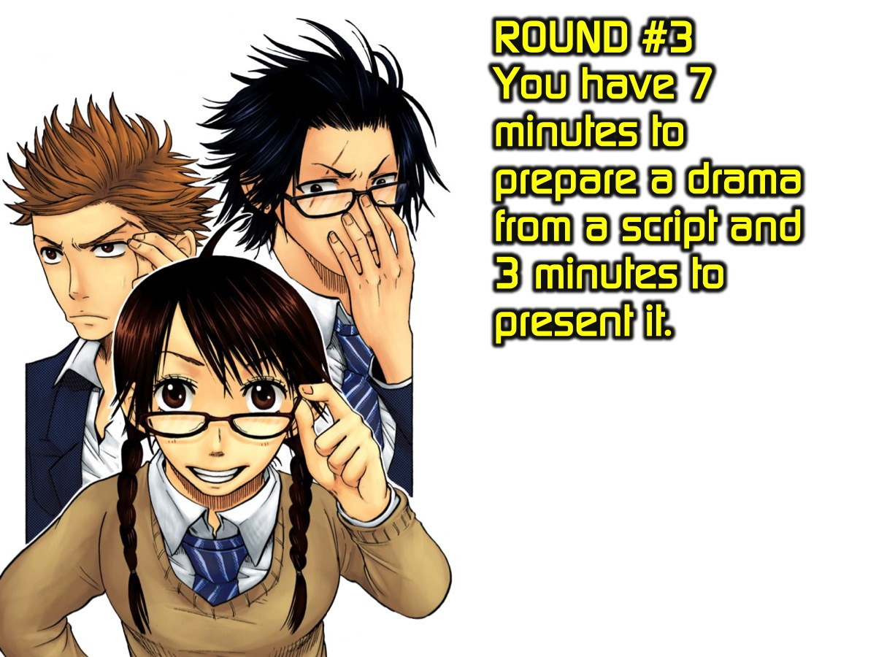
Notes:
ROUND #3. You have 7 minutes to prepare a drama from a script and 3 minutes to present it. The Skits are:
(1) Rock Sword Firecracker.
(2) Back Seat Driver
(3) The Land of Mirrors
(4) Ranger Rescue Station

Slide 20

Notes:
Take it Deeper - It is time to think a bit deeper about what who we are. We are going to watch two videos and discuss each one in our groups.

Slide 21
Notes:
Video #1: Ed Sheeran - Who You Are. Get it on YouTube at: https://www.youtube.com/watch?v=MThmp5AFv-I

Slide 22
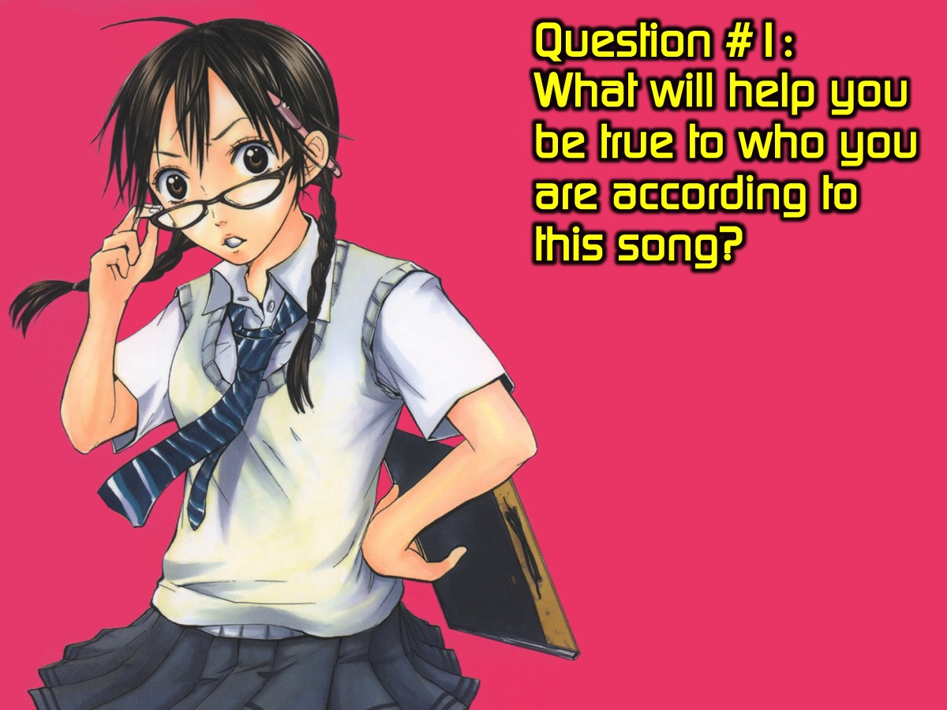
Notes:
Question #1: What will help you be true to who you are according to this song?

Slide 23
Notes:
Video #2: He is my identity. Watch it on YouTube at: https://www.youtube.com/watch?v=tyHMmyUCrJY
I purchased a fairly decent quality version from this website:
http://beamerfilms.com/sermon-videos/sermon-videos-illustrations/he-is-my-identity

Slide 24
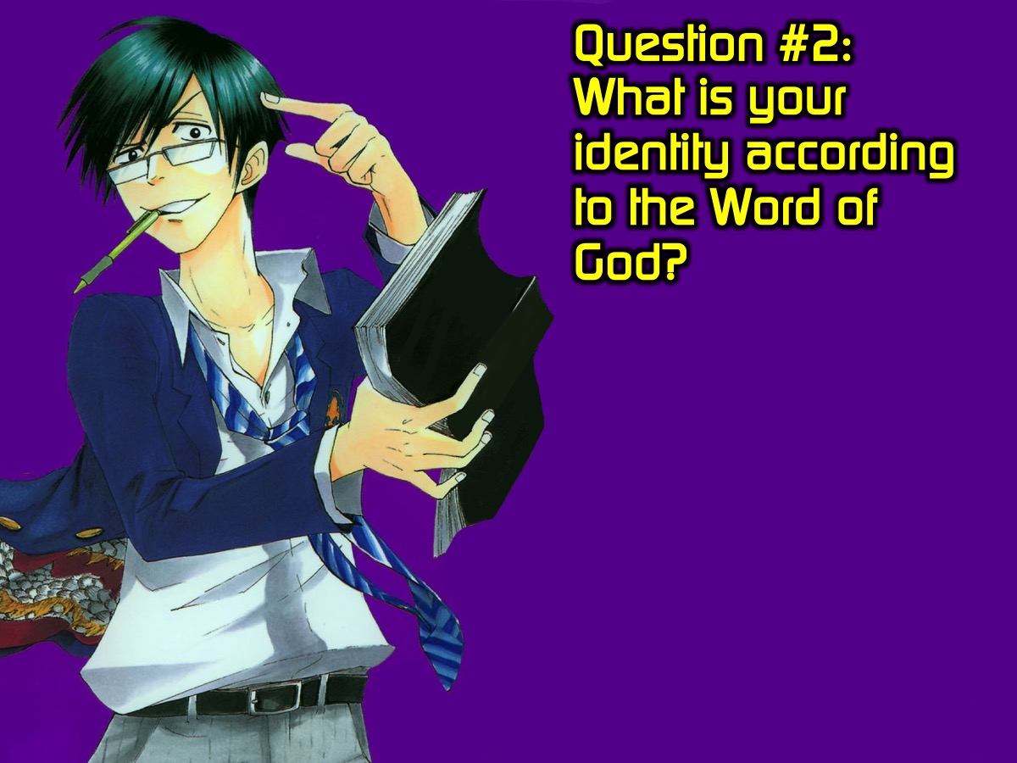
Notes:
Question #2: What is your identity according to the Word of God?

Slide 25
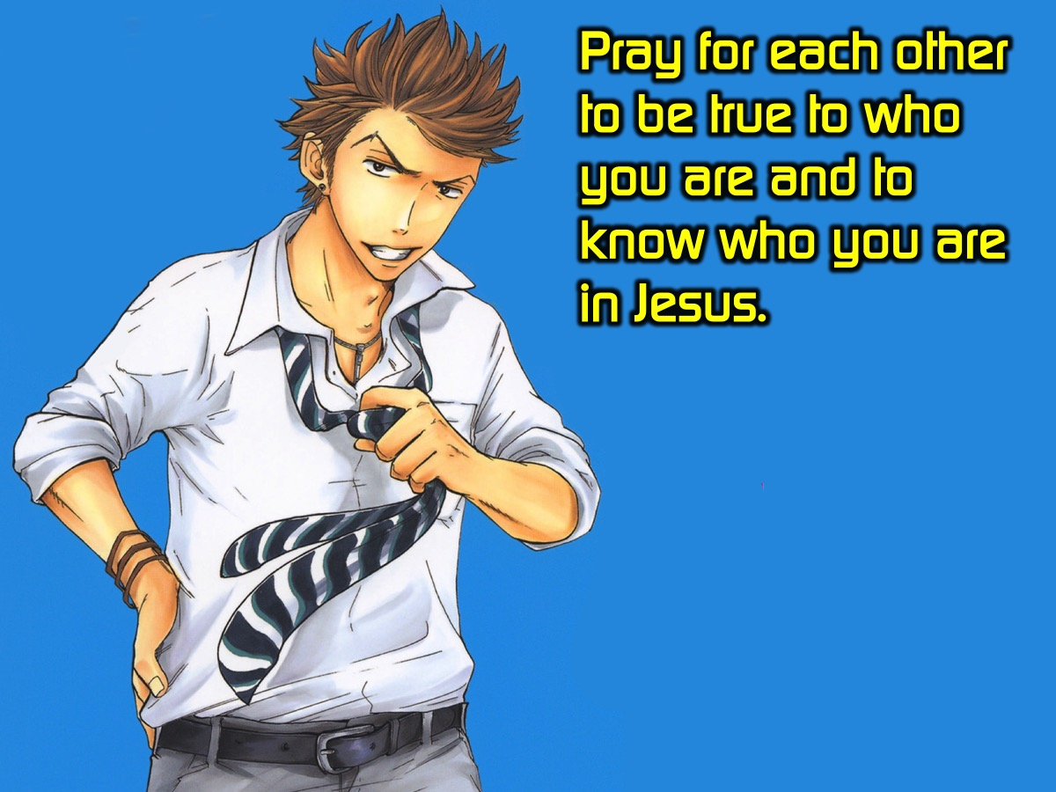
Notes:
Prayer: Pray for each other to be true to who you and to know who you are in Jesus.

Slide 26
Notes:
Next week is cr8 DRAMA nite.

Slide 27

Notes:
Refreshments are served.

