Slide 1

Notes:
This week is cr8 GAMES nite

Slide 2
Notes:
Pre-Start Video: Haikyuu Trailer. Get it on YouTube at: https://www.youtube.com/watch?v=2Xctr-OHaJQ
Video Length: 1:30.

Slide 3

Notes:
Welcome to regulars and newcomers.

Slide 4

Notes:
Welcome to cr8iv Friday.

Slide 5

Notes:
Join us on Sunday mornings either at 8:30 or at 10:30 for The Revelation Series.

Slide 6

Notes:
Next week is cr8 WORDS nite.

Slide 7
Notes:
But tonight it is cr8 GAMES nite

Slide 8

Notes:
Get into Groups

Slide 9

Notes:
Choose One of Four Design Groups. We have 4 groups based on four different game designer companies - each design group will be creating a different kind of game.

Slide 10

Notes:
Team Hasbro will design a brand new ball game using tennis balls.

Slide 11

Notes:
Team Lego will design a brand new action game using only their bodies.

Slide 12

Notes:
Team Ubisoft will design a brand new dice game.

Slide 13

Notes:
Team Mattel will design a brand new card game.

Slide 14

Notes:
So go to one of the four game designer stations: Hasbro, Lego, Mattel or Ubisoft. Each design group will be creating a different kind of game:
Hasbro: A Ball Game
Lego: A Body/Action Game
Ubisoft: A Dice Game
Mattel: A Card Game

Slide 15
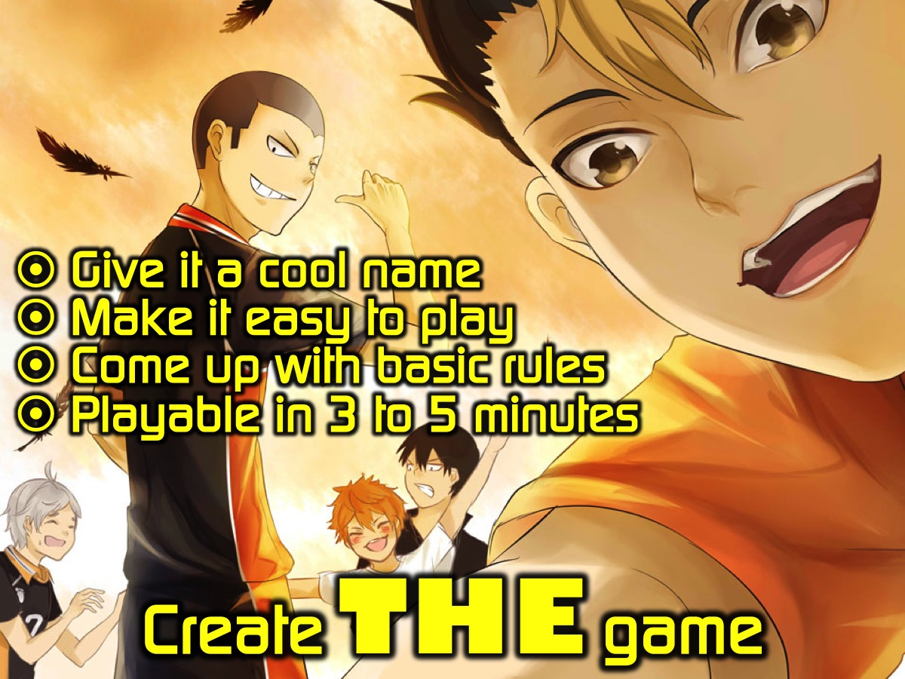
Notes:
Create THE Game – you have 15 minutes to create your game in your design groups. You need to give it a cool name, make it easy to play, come up with basic rules and ensure it is playable in 3 to 5 minutes.

Slide 16

Notes:
Play THE Games - it is time for you to play the games that have been created. The groups are going to rotate so each group gets a chance to play each of the other games. One or two members of each group will have to stay behind to run the groups’ game.

Slide 17

Notes:
Judge THE Games - our judges are going to let us know which games they have chosen to reward!

Slide 18

Notes:
Take it Deeper - It is time to think a bit deeper about creativity - we are going to watch three videos and discuss each one in our groups.

Slide 19
Notes:
Video: will.i.am on Creativity. Get it on YouTube at: https://www.youtube.com/watch?v=yEnVShUZXks
Video Length: 2:00
(will.i.am puts into words what it feels like to be in the creative zone).

Slide 20
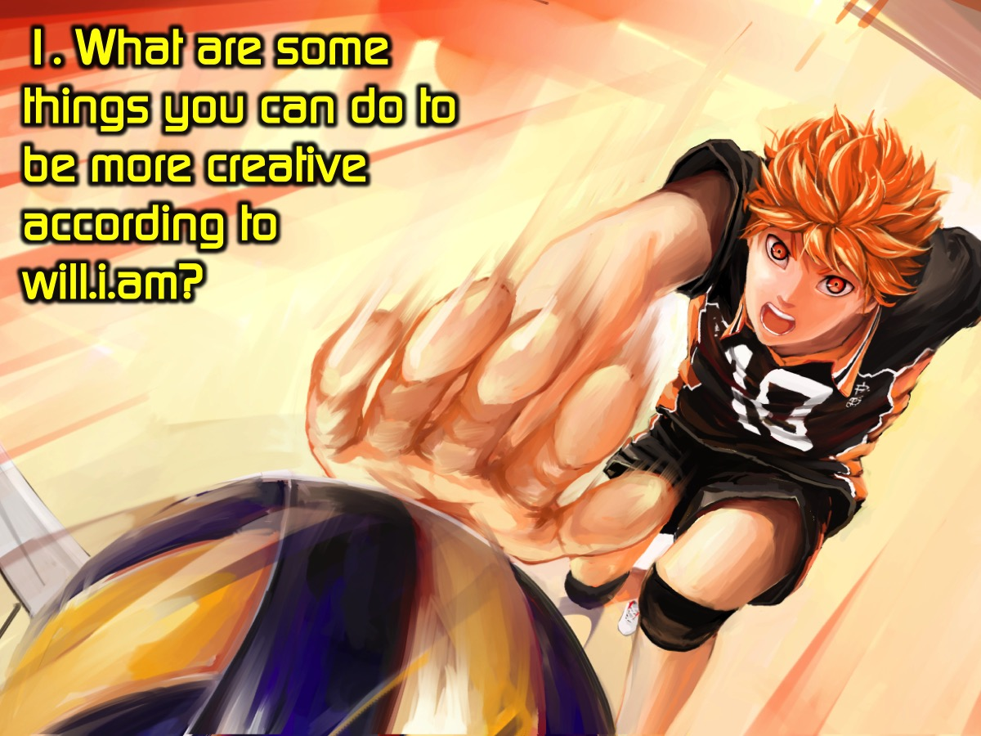
Notes:
Question #1: What are some things you can do to be more creative according to will.i.am?

Slide 21
Notes:
Video: What is Creativity? By Jason Silva. Get it on YouTube at: https://www.youtube.com/watch?v=tYbA_-mAtUY
Video Length: 1:35

Slide 22
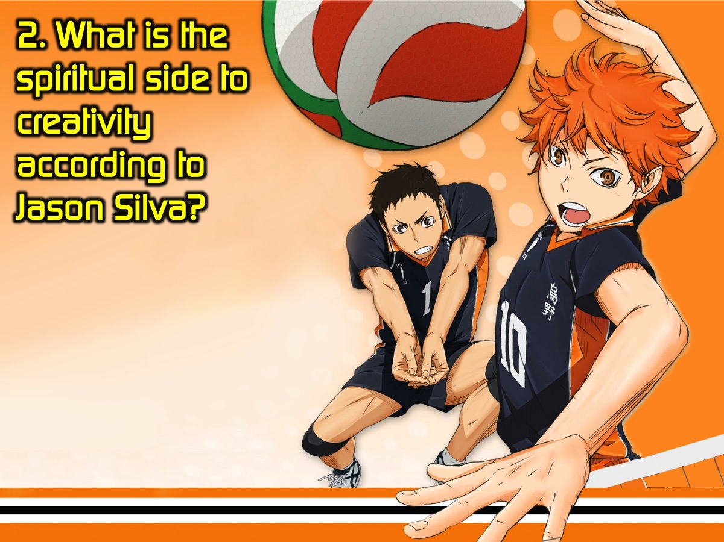
Notes:
Question #2: What is the spiritual side to creativity according to Jason Silva?

Slide 23
Notes:
Video: Gospel Grafitti. Get it on YouTube at: http://www.youtube.com/watch?v=rQvTNrS5bJU
Video Length: 4:10

Slide 24
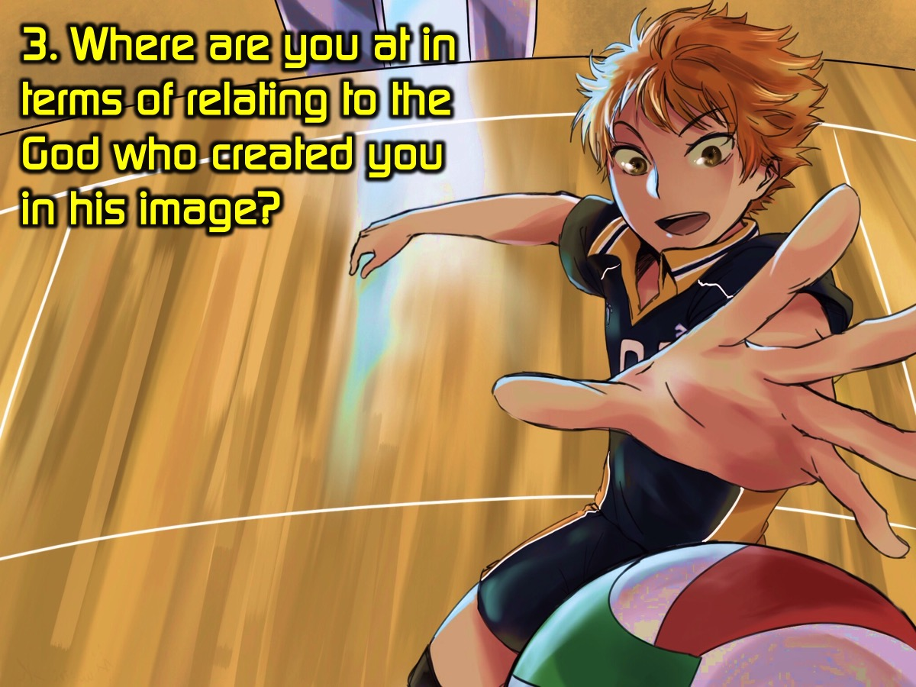
Notes:
Question #3: Where are you at in terms of relating to the God who created you in his image?

Slide 25
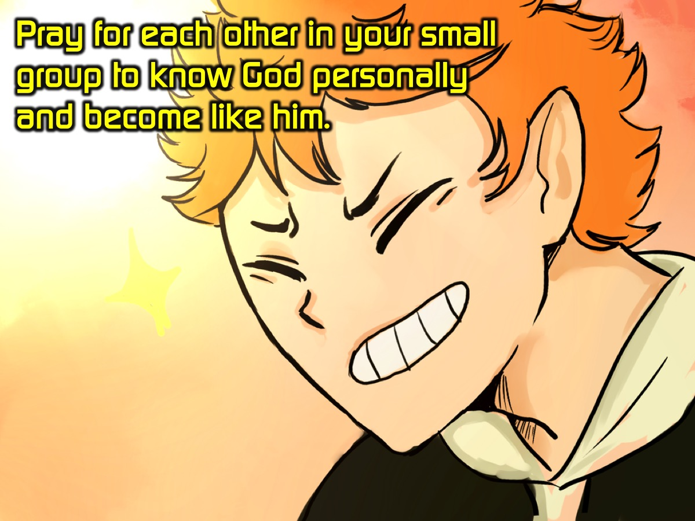
Notes:
Prayer: Pray for each other in your small group to know God personally and become like him.

Slide 26

Notes:
Refreshments

Slide 27
Notes:
Next week is cr8 WORDS nite.

