Slide 1

Notes:
This week is cr8 IMAGE nite.

Slide 2
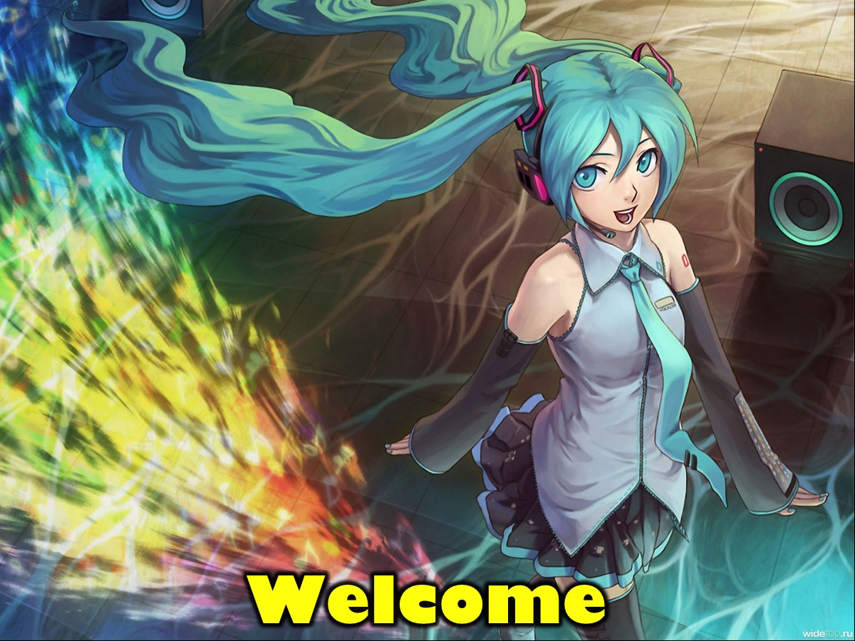
Notes:
Welcome to regulars and newcomers.

Slide 3

Notes:
Welcome to cr8ivFRIDAY.

Slide 4

Notes:
Join us on Sunday mornings either at 8:30 or at 10:30 for The Revelation Series.

Slide 5

Notes:
Next week is our Christmas Party.

Slide 6
Notes:
But tonight it is cr8IMAGE nite.

Slide 7
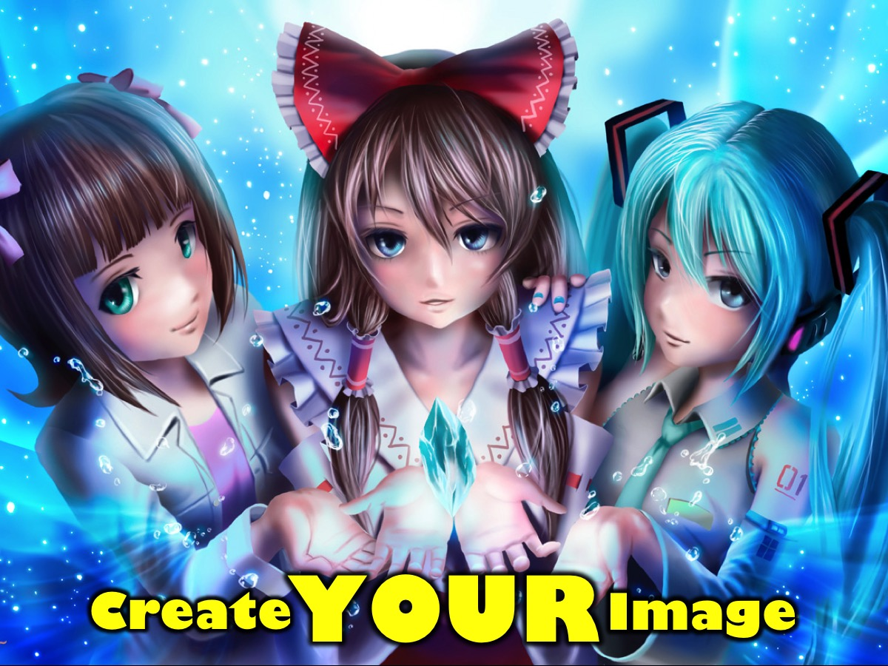
Notes:
You are going to use the supplies from the art station to create your image on three sheets of paper.

Slide 8
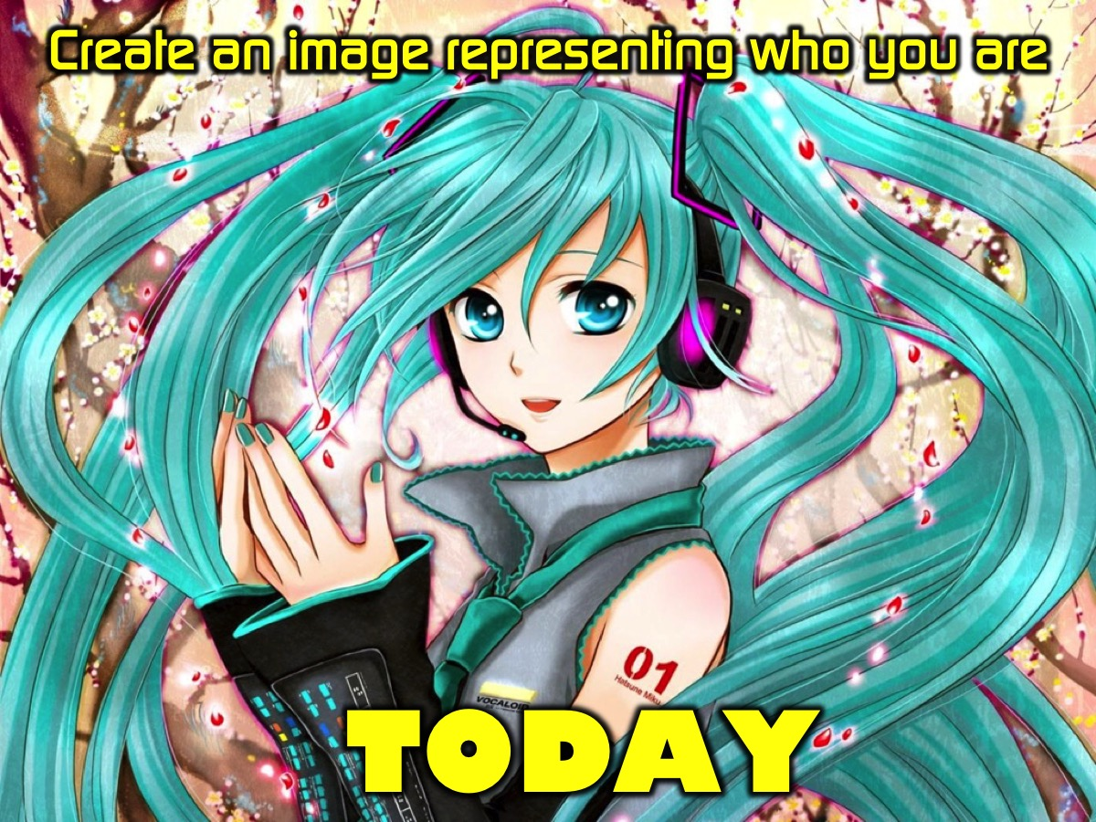
Notes:
1. Create an image representing who you are today.

Slide 9
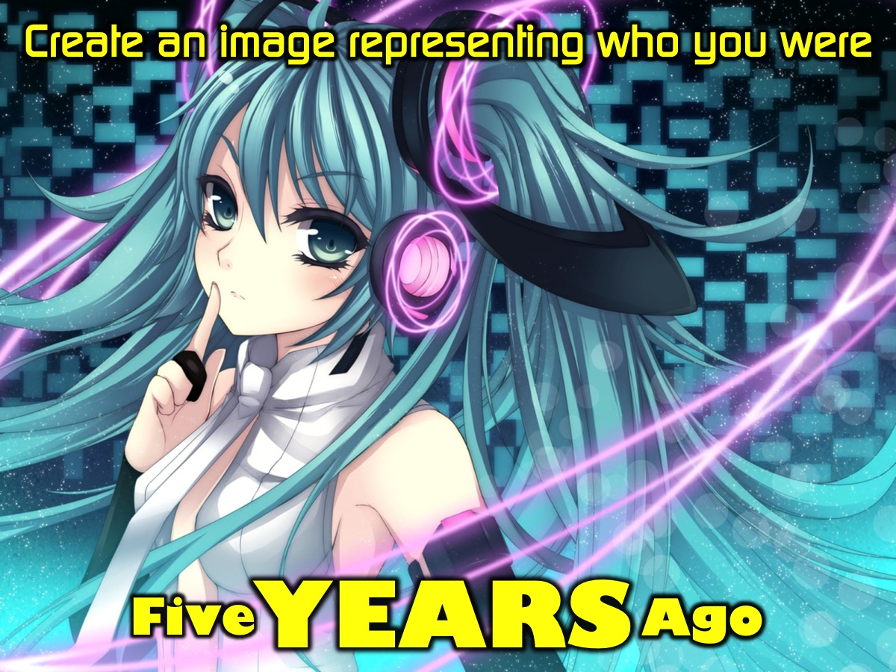
Notes:
2. Create an image representing who you were five years ago.

Slide 10
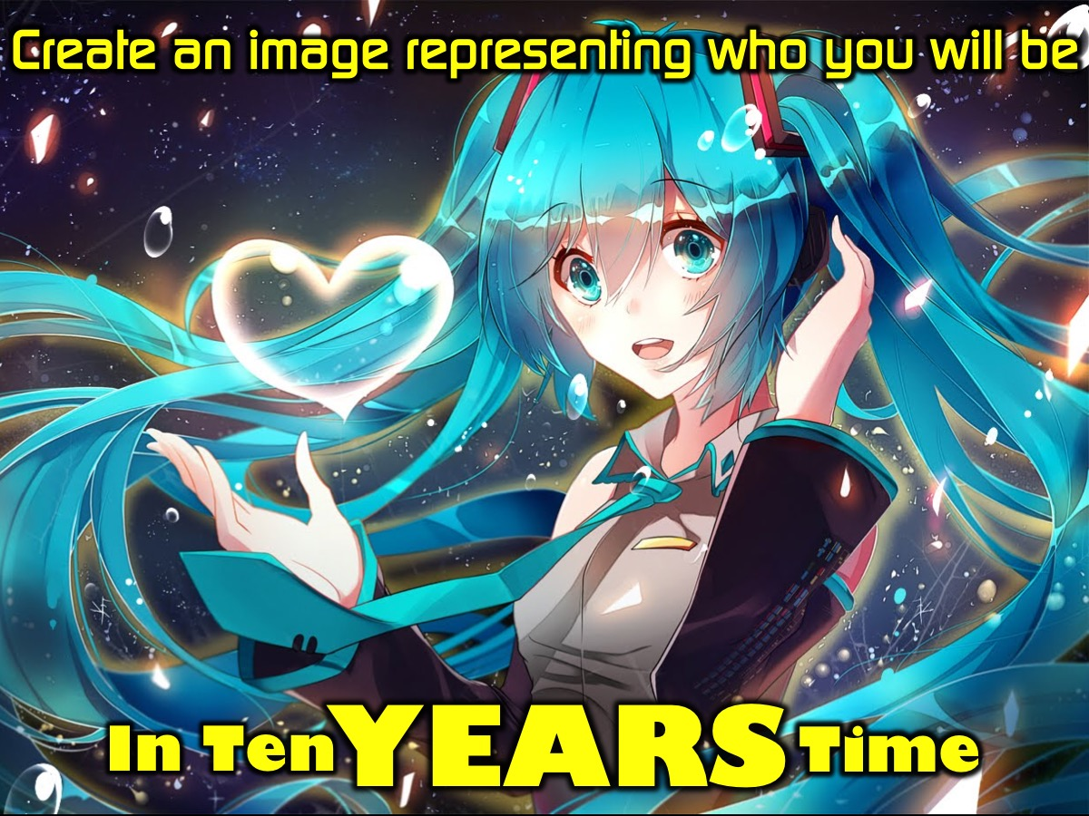
Notes:
3. Create an image representing who you will be in ten years time.

Slide 11

Notes:
Take it Deeper - It is time to think a bit deeper about your image.

Slide 12
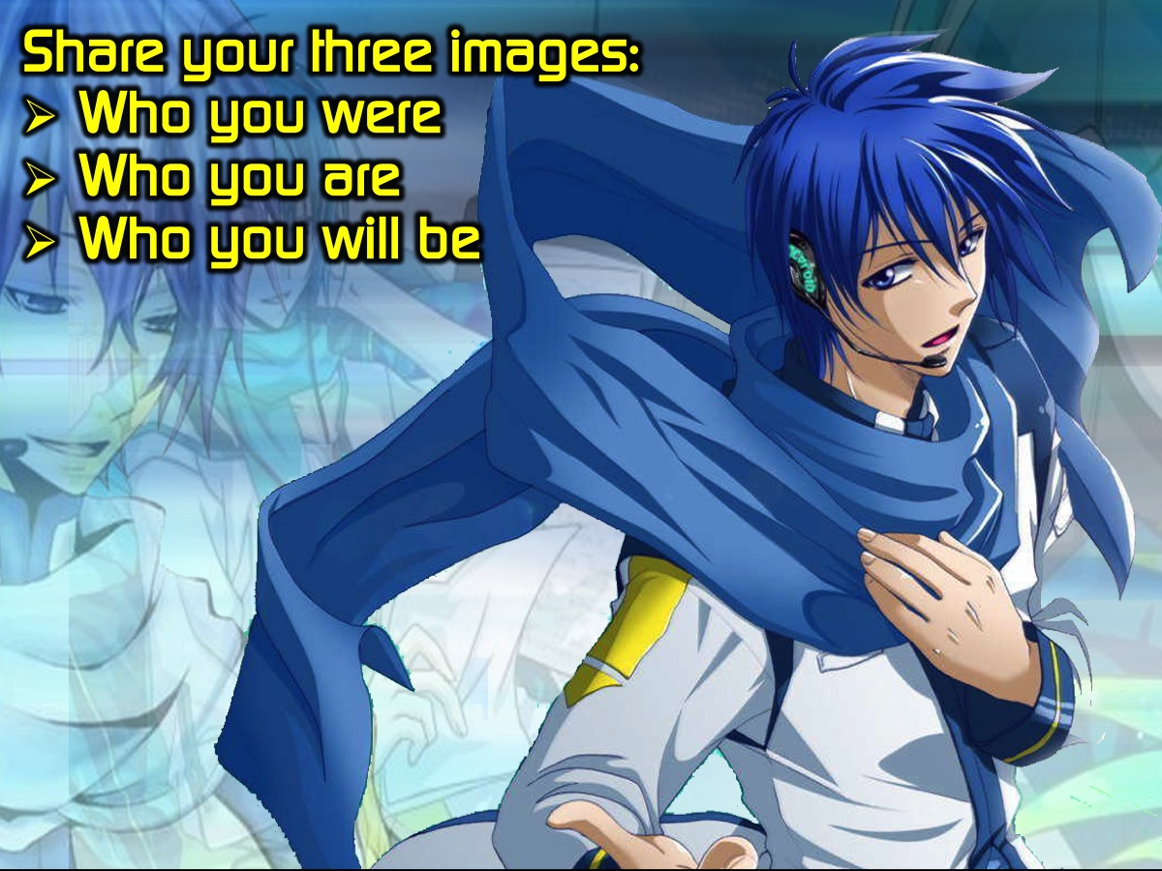
Notes:
Share your three images with people in your small group: (1) Who you were. (2) Who you are. (3) Who you will be.

Slide 13
Notes:
Video #1. I Have Worth Spoken Word. Get it on YouTube at: https://www.youtube.com/watch?v=NNf9RS0UJxc

Slide 14
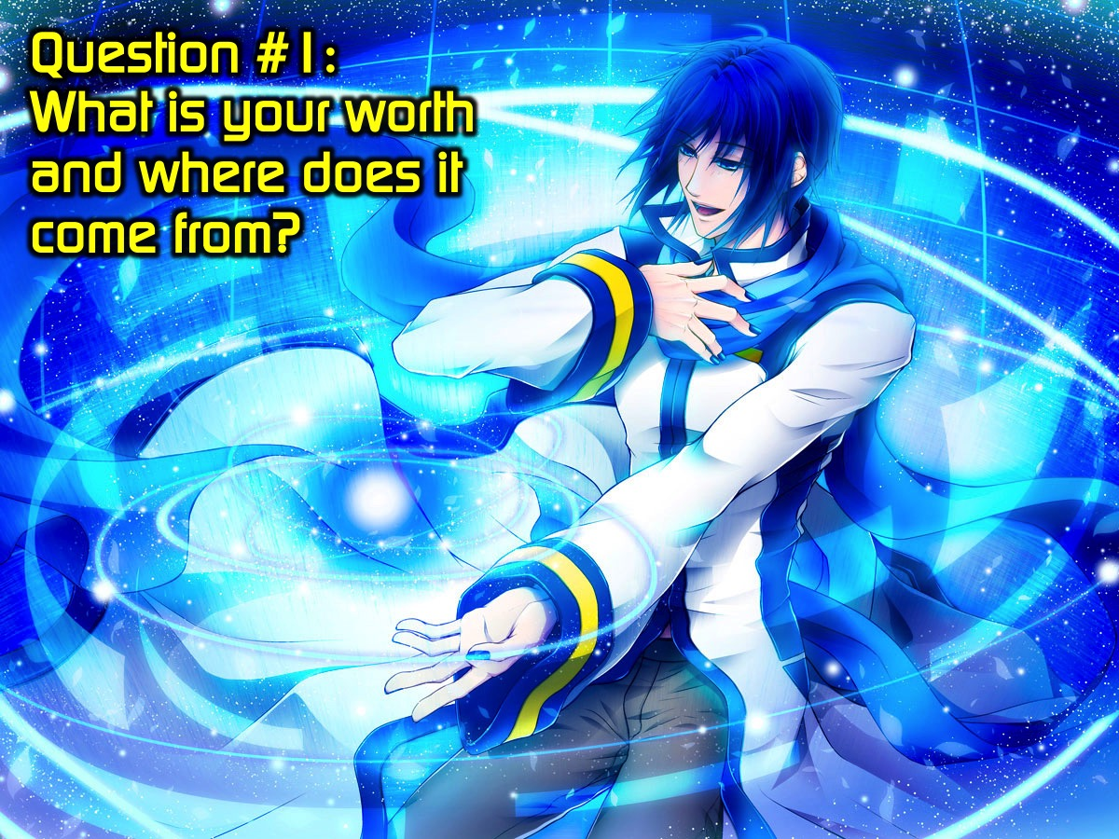
Notes:
Question #1: What is your worth and where does it come from?

Slide 15
Notes:
Video #2. God Knows You Spoken Word Tim Cooke. Get it on YouTube at: https://www.youtube.com/watch?v=yMzIYW5NbSc

Slide 16
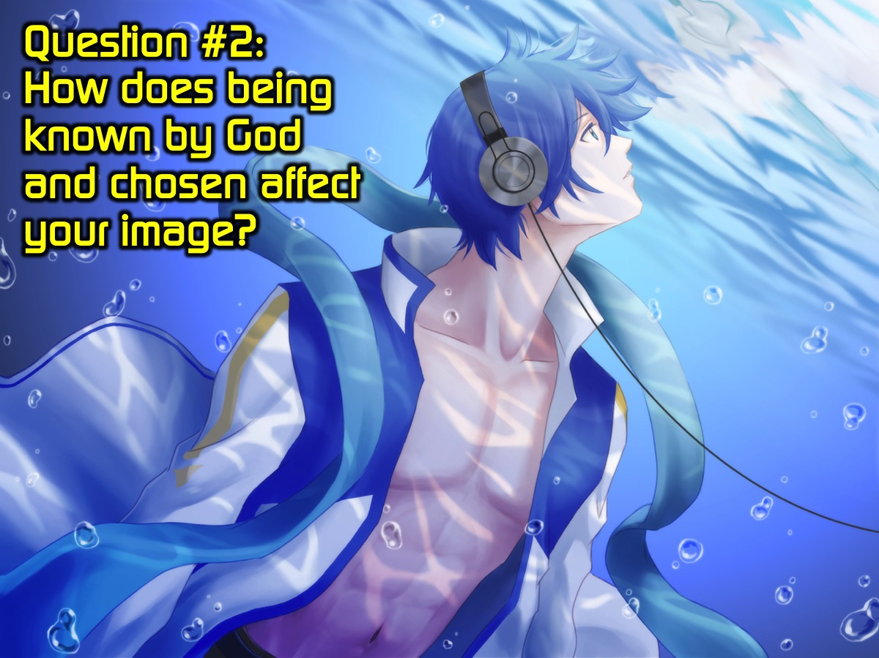
Notes:
Question #2: How does being known by God and chosen affect your image?

Slide 17
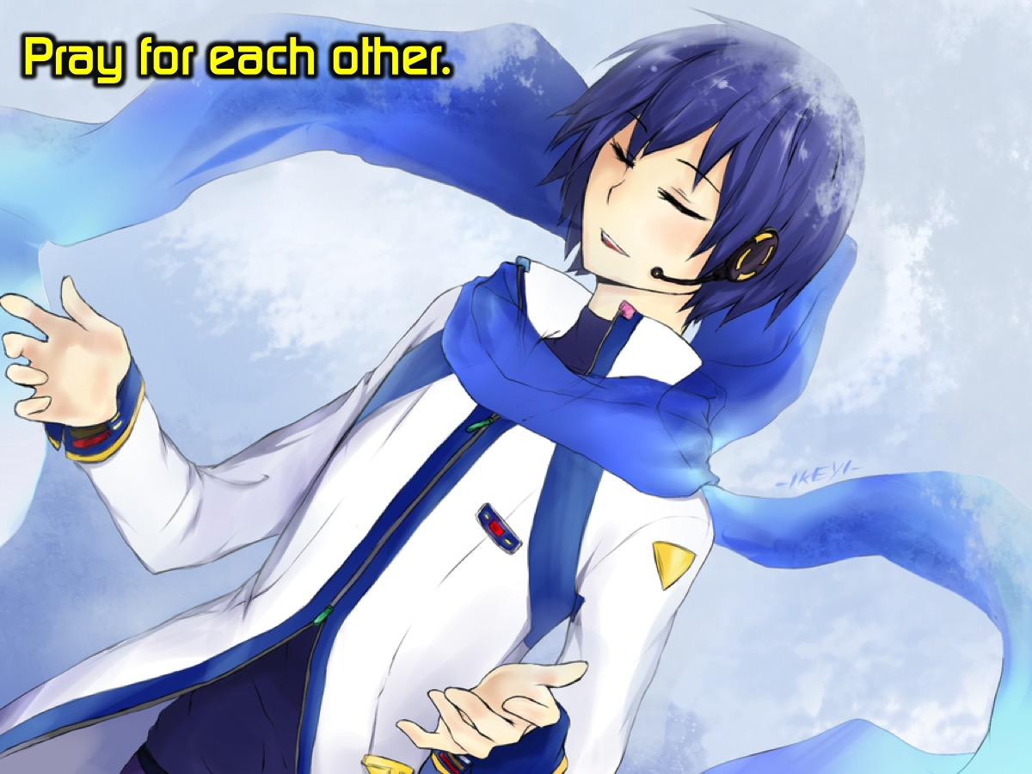
Notes:
Pray for each other.

Slide 18
Notes:
Next week is our end of the year Christmas party. Each person has to bring a wrapped gift worth less than R20.

Slide 19

Notes:
Refreshments are served.

