Slide 1
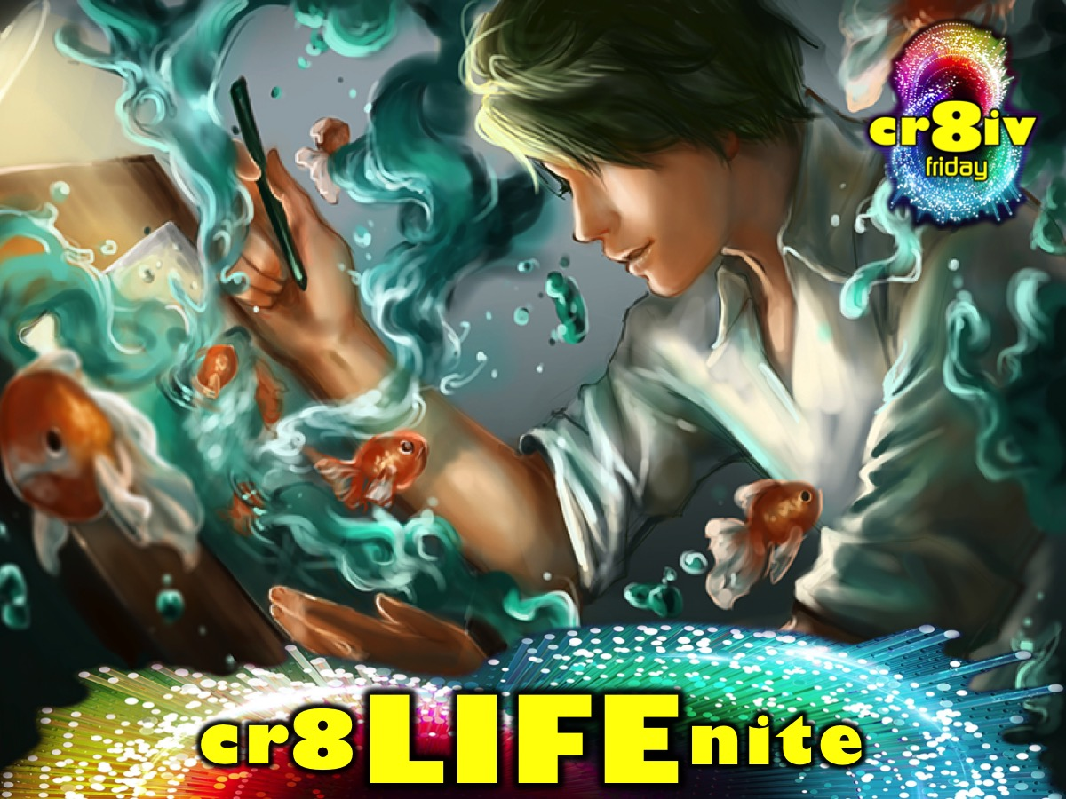
Notes:
This week is cr8 LIFE nite.

Slide 2

Notes:
Welcome to regulars and newcomers.

Slide 3

Notes:
Welcome to cr8ivFRIDAY.

Slide 4

Notes:
Join us on Sunday mornings either at 8:30 or at 10:30 for The Revelation Series.

Slide 5

Notes:
Next week is cr8 DRAMA nite.

Slide 6
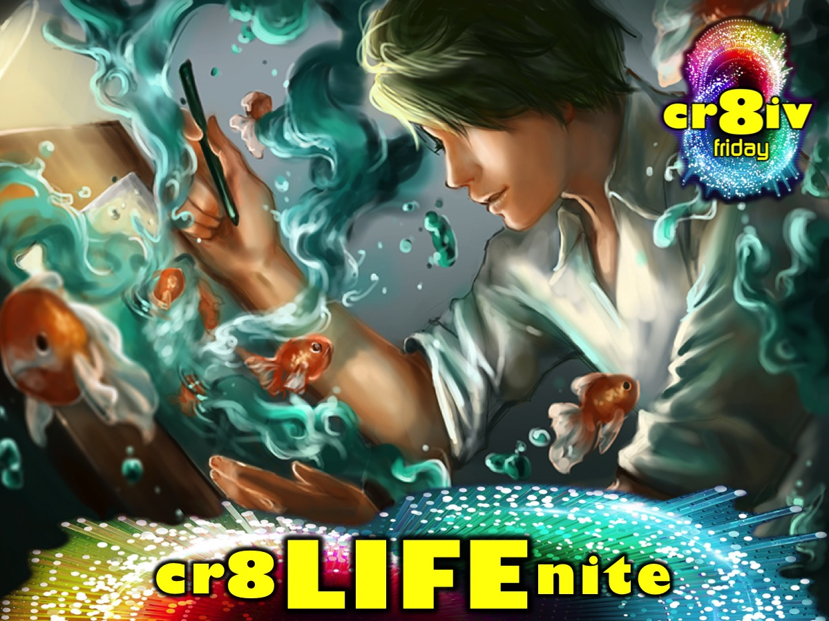
Notes:
But tonight it is cr8LIFE nite.

Slide 7

Notes:
Get INTO Groups – We are starting with small group time tonight - so get into the groups as you normally do at the end of the night.

Slide 8
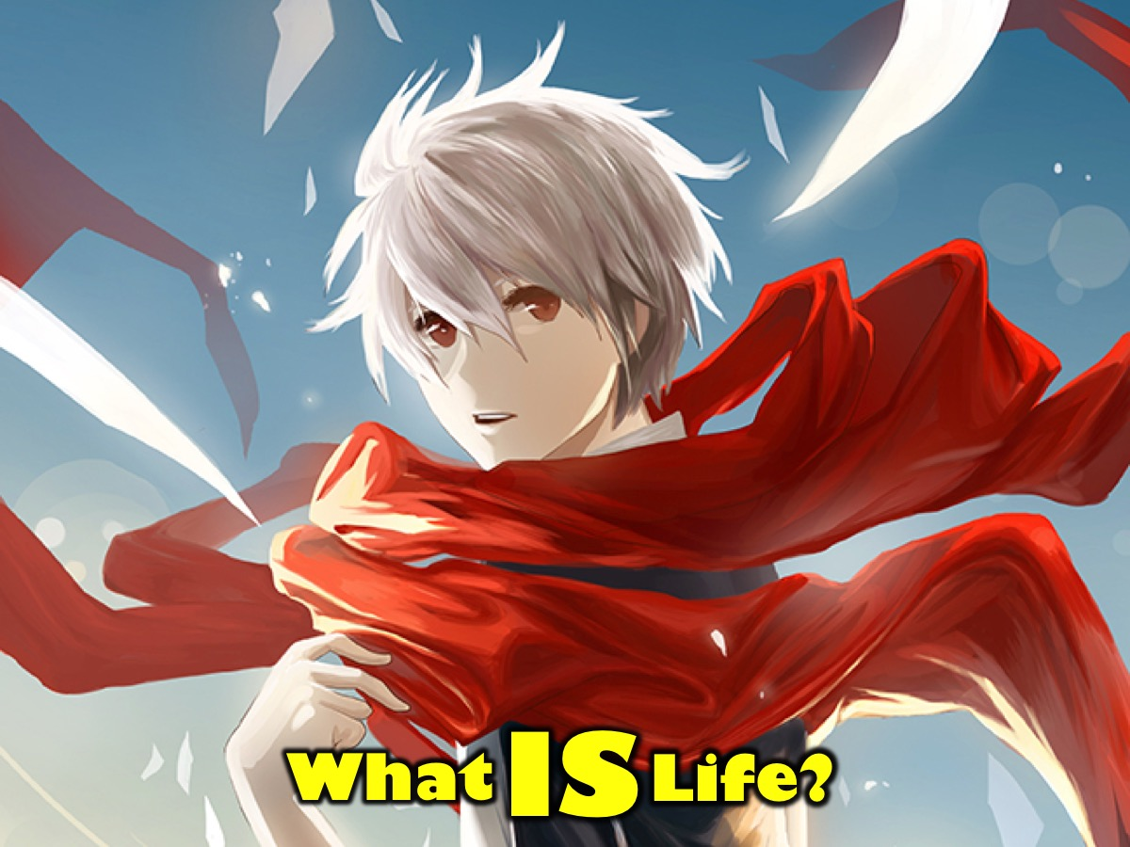
Notes:
Discuss in your small groups: What is Life?

Slide 9
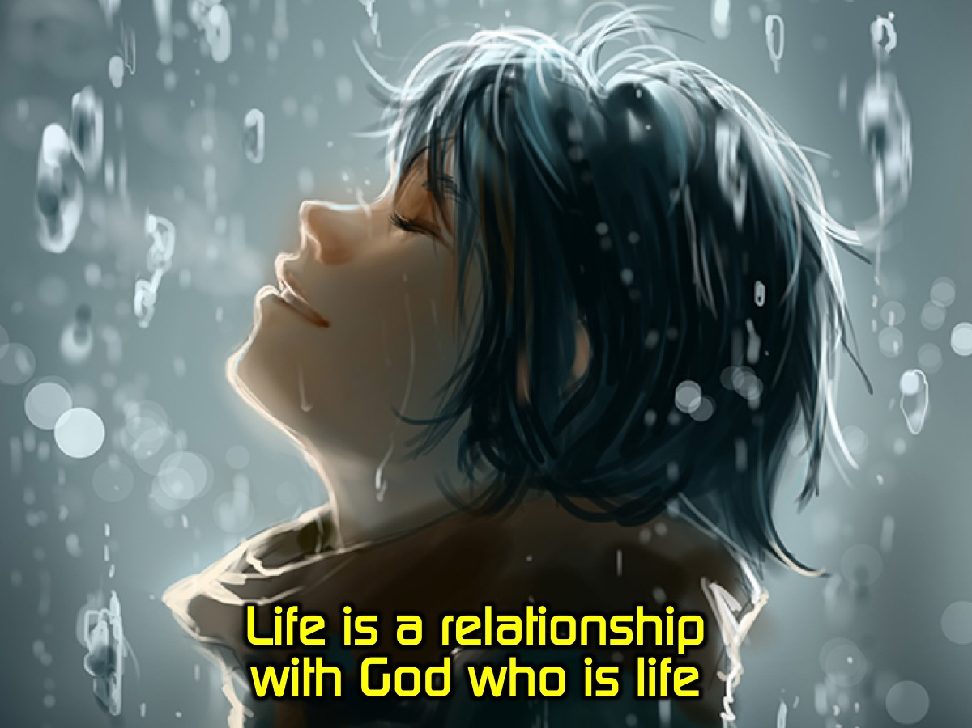
Notes:
Impartation: Life is a relationship with God who is life!

Slide 10
Notes:
Video #1: Gary Vaynerchuk Gave Before He Got. Get it on YouTube at: https://youtu.be/A_UfX8FM2ew

Slide 11
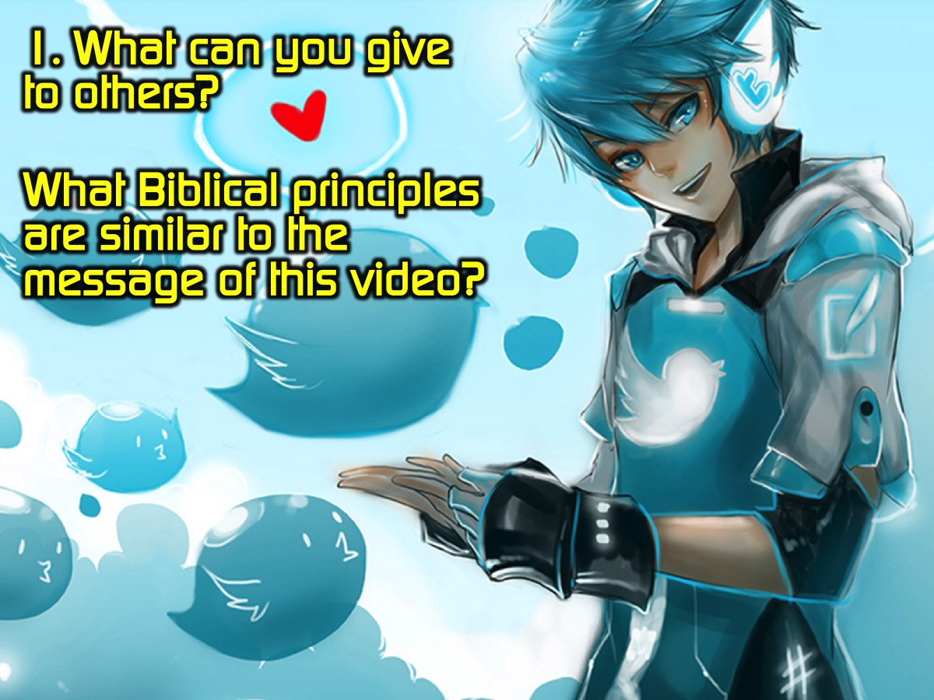
Notes:
Question #1: What can you give to others? What Biblical principles are similar to this message of this video?

Slide 12
Notes:
Video #2: Missional Communities - Mission. Get it on YouTube at: https://youtu.be/SmnpNttMonQ

Slide 13
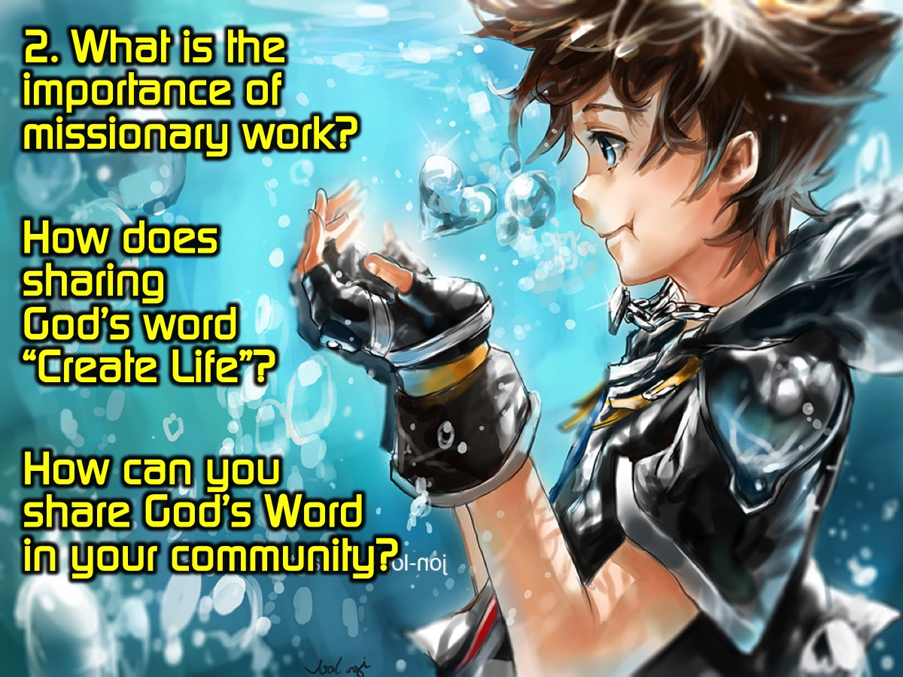
Notes:
Question #2: What is the importance of missionary work? How does sharing God’s word “Create Life”? How can you share God’s Word in your community?

Slide 14
Notes:
Video #3: Wilderness, Depression, & Stars in the Night. Get it on YouTube at: https://youtu.be/EhUHdcamprY

Slide 15
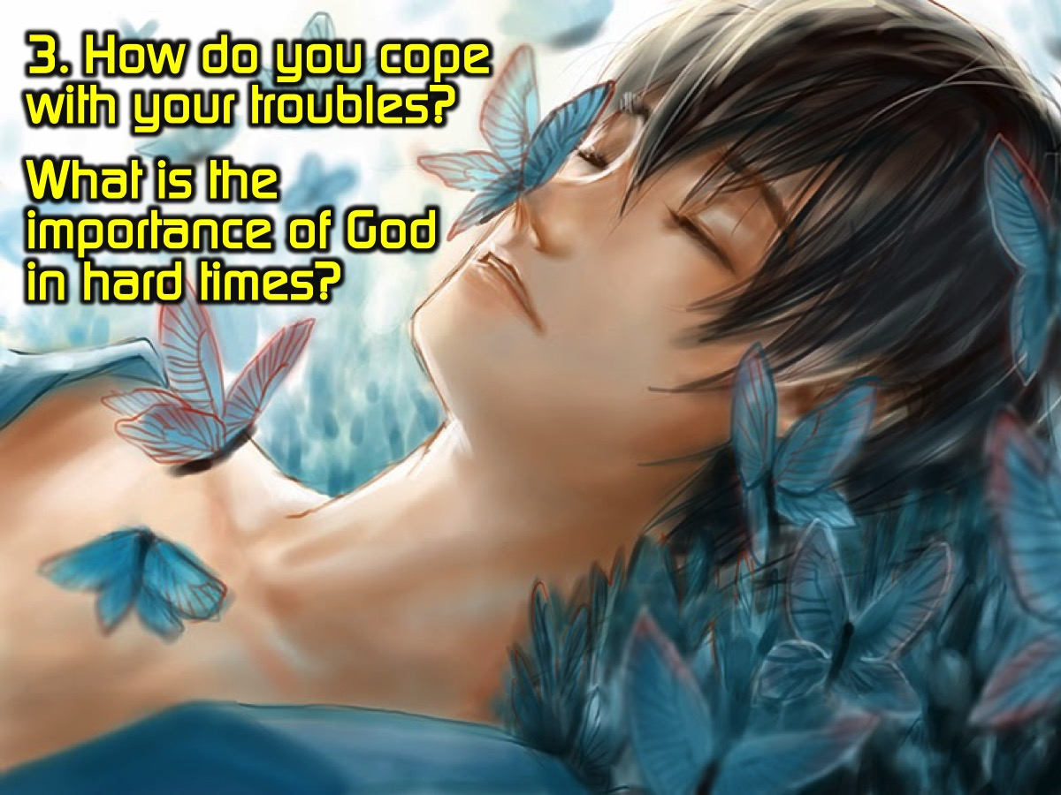
Notes:
Question #3: How do you cope with your troubles? What is the importance of God in hard times?

Slide 16

Notes:
Search the Book: Pick a Bible verse and share what it says about life.

Slide 17
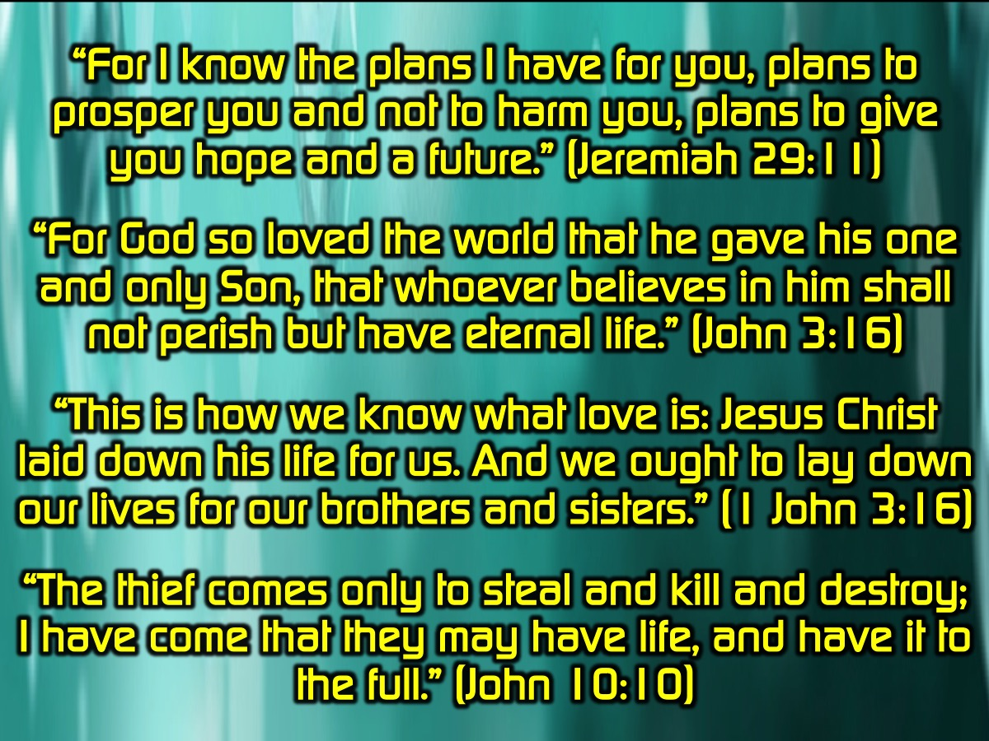
Notes:
“For I know the plans I have for you, plans to prosper you and not to harm you, plans to give you hope and a future.” (Jeremiah 29:11)
“For God so loved the world that he gave his one and only Son, that whoever believes in him shall not perish but have eternal life.” (John 3:16)
“This is how we know what love is: Jesus Christ laid down his life for us. And we ought to lay down our lives for our brothers and sisters.” (1 John 3:16)
“The thief comes only to steal and kill and destroy; I have come that they may have life, and have it to the full.” (John 10:10)

Slide 18
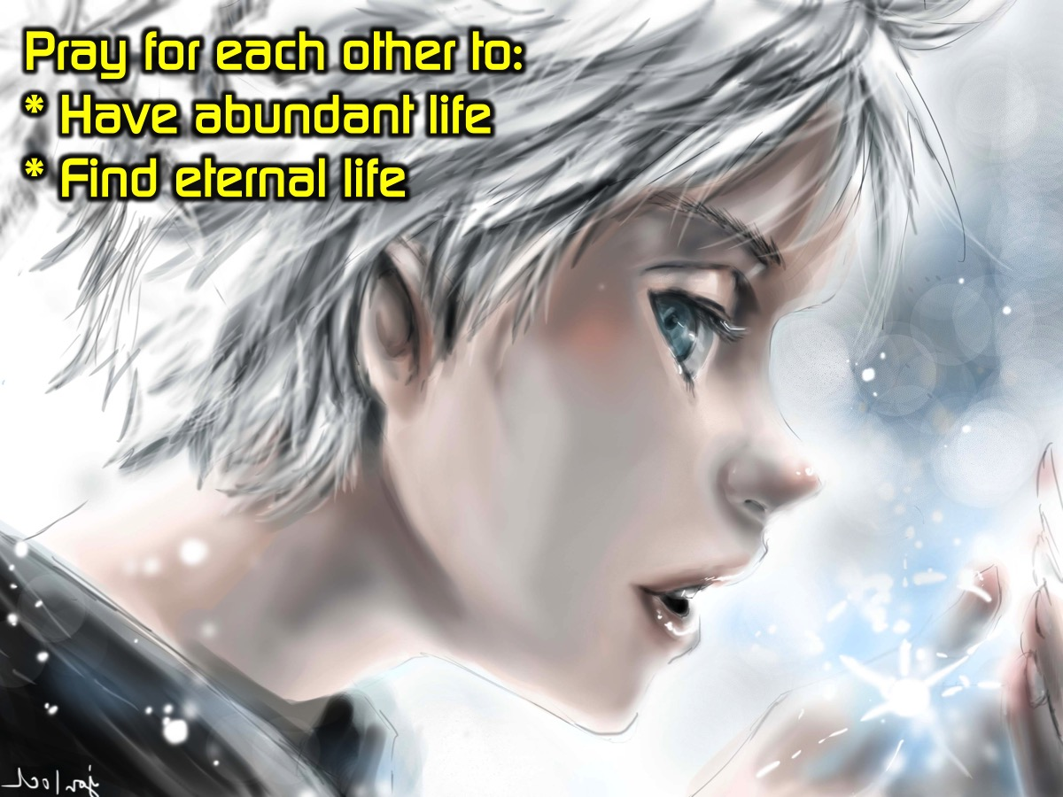
Notes:
Prayer: Pray for each other to have abundant life and find eternal life.

Slide 19
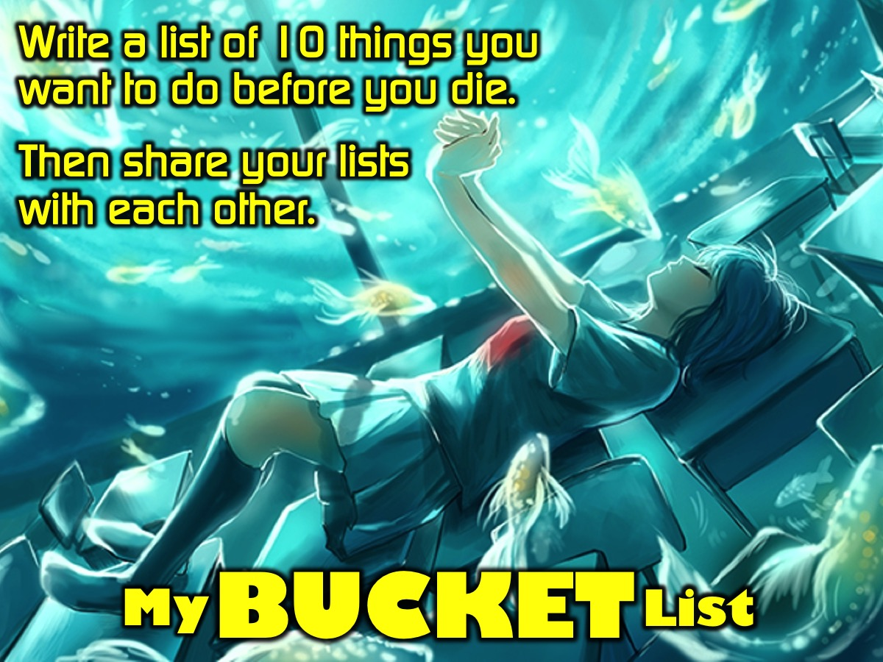
Notes:
We then give people pieces of paper and allow them to draw up bucket lists (things they want to do with their lives before they die, places they want to visit, etc.); we can play some relaxed music, give some inspiration as to what is out there. After they have drawn up their lists, we break into small groups and discuss those lists as well as the meaning of life, maybe touch on origins. We pray for each other to life lives that are noble and good in the eyes of God and to impact the lives of others.

Slide 20

Notes:
We finish the night off with a game, introducing the game with something like, "One of the things that is likely to be on everyone's list is to have fun. So we are going to give you the opportunity to tick that off your list this evening.” The Zap Bang Game: Everyone stands in a circle facing inwards. I'll point to a random person and say "Zap". The person I point to has to duck as quickly as possible while the two people adjacent to him have to turn to each other and "kill" (pointing at the person and say "BANG!") the each other. 2 outcomes occur: (1) The person I point to doesn't duck in time and is "shot" by the other two. (2) The person ducks successfully and the first shooter to point and say "bang!" Eliminates the other. "Killed" person is out and the circle gradually gets smaller. We play until last man standing. After the game, we let everyone socialize as usual, encouraging them to live their lives and pursue their dreams.

Slide 21
Notes:
Next week is cr8 DRAMA nite.

Slide 22
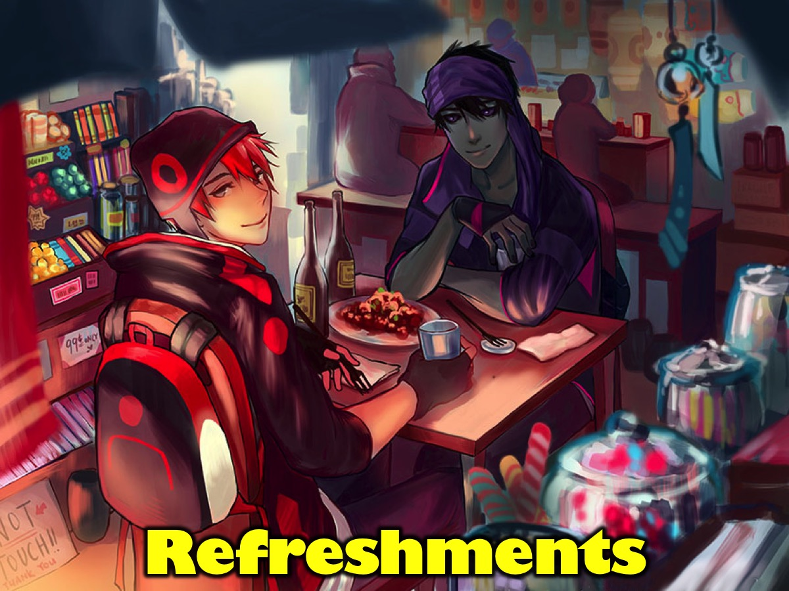
Notes:
Refreshments are served.

