Slide 1
Notes:
cr8 STORIES nite

Slide 2
Notes:
Welcome to regulars and newcomers.

Slide 3
Notes:
Get into Groups - we are going to watch a video that will introduce four storytelling groups that you can choose to join…

Slide 4
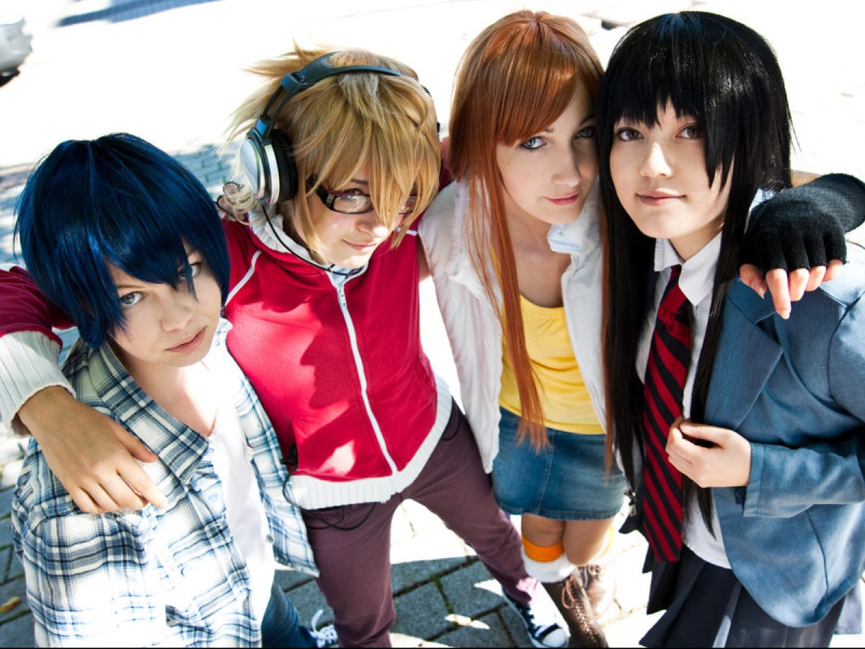
Notes:
We have 4 groups based on the main characters in Bakuman.

Slide 5
Notes:
Team Mashiro

Slide 6
Notes:
Team Takagi

Slide 7
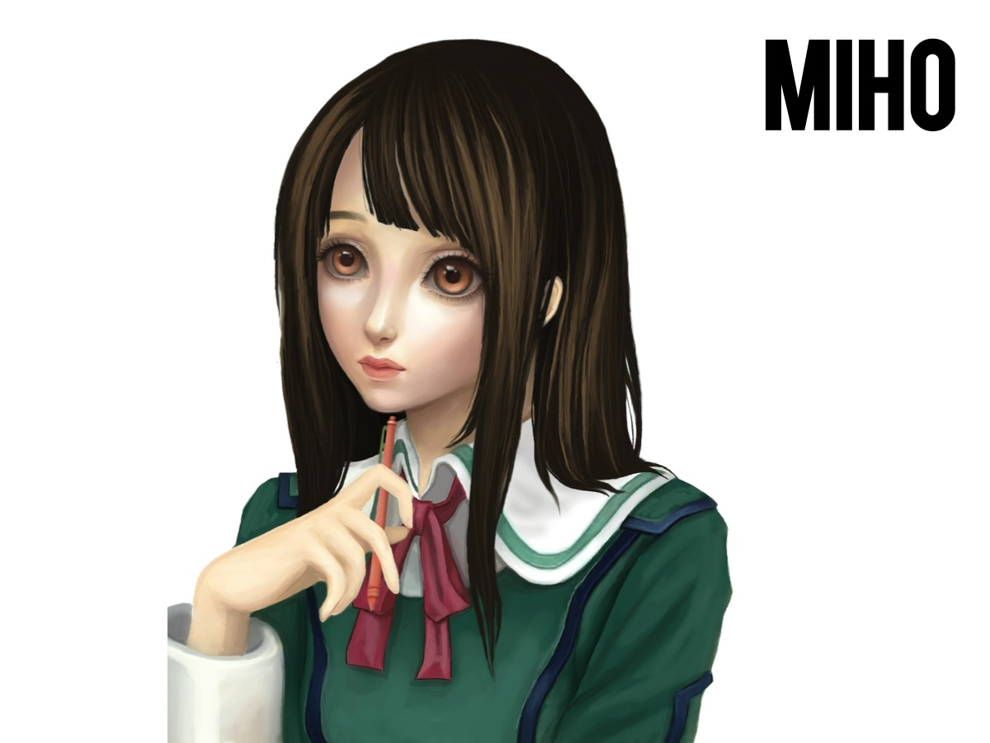
Notes:
Team Miho

Slide 8
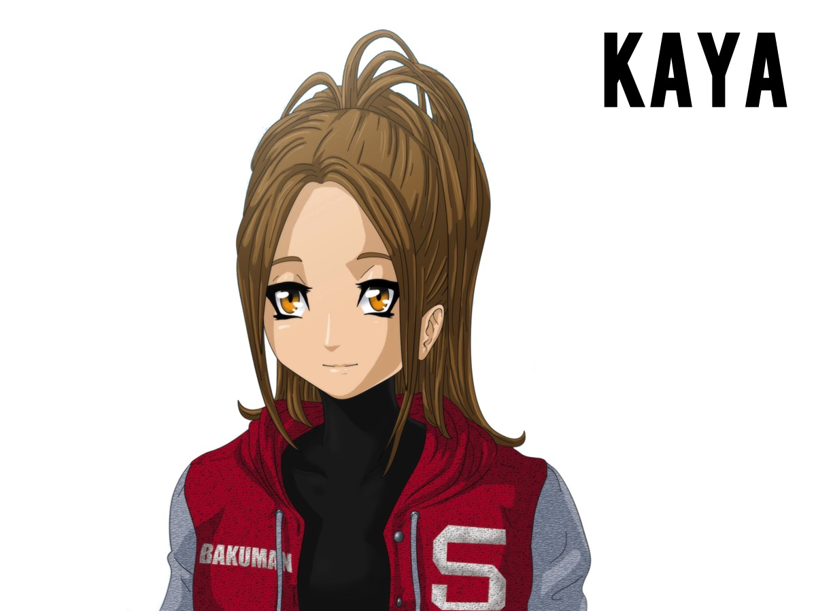
Notes:
Team Kaya

Slide 9
Notes:
So go and sit at one of the four tables: Mashiro, Takagi, Miho or Kaya.

Slide 10
Notes:
So welcome to cr8iv Friday - our brand new series for the last term of 2014. Here is a preview of what to expect in the next 8 weeks…

Slide 11
Notes:
Next week is cr8 GAMES nite

Slide 12
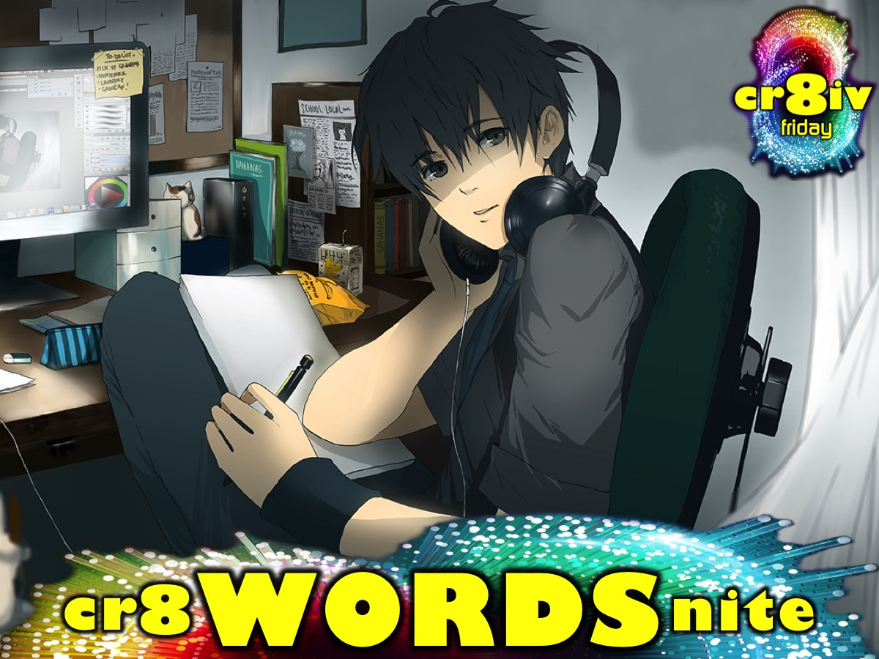
Notes:
Week 3 is cr8 WORDS nite

Slide 13
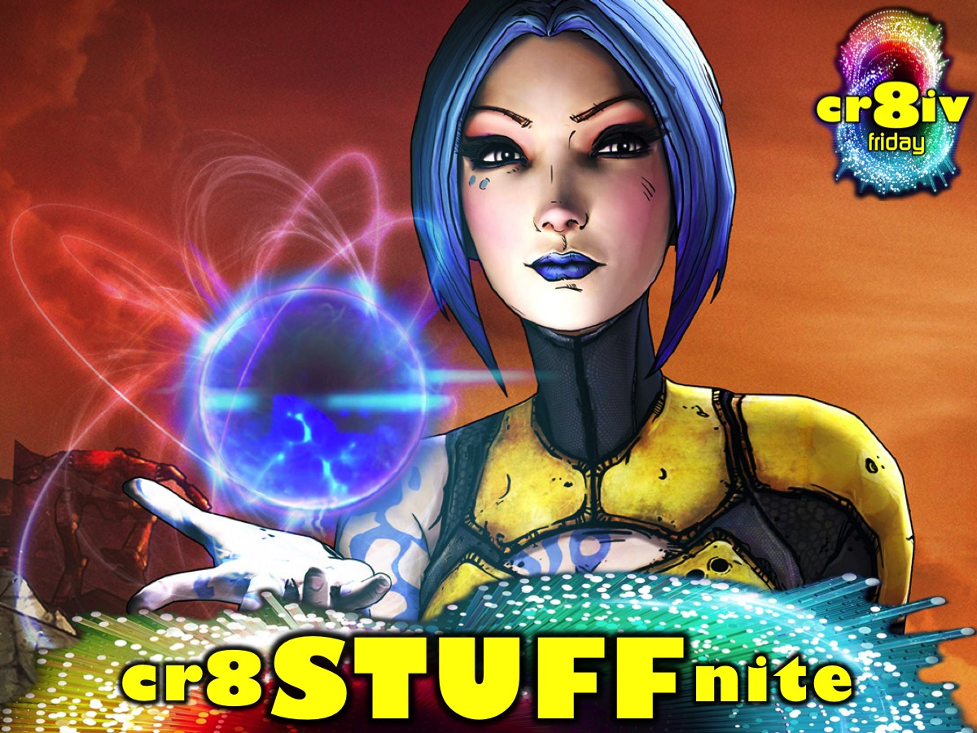
Notes:
Week 4 is cr8 STUFF nite

Slide 14
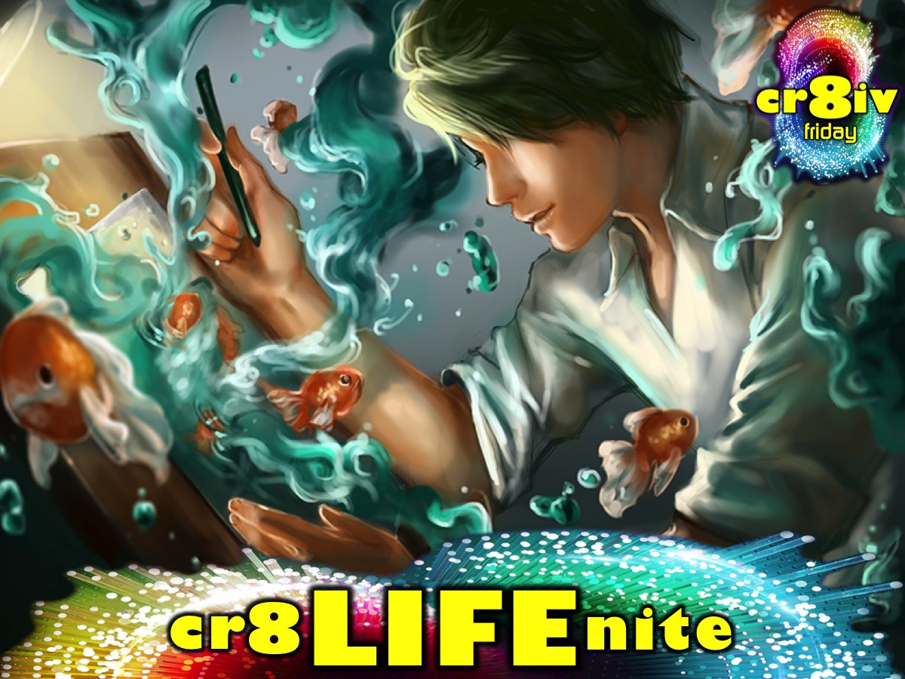
Notes:
Week 5 is cr8 LIFE nite

Slide 15
Notes:
Week 6 is cr8 DRAMA nite

Slide 16
Notes:
Week 7: cr8 IMAGE nite

Slide 17
Notes:
It is going to be an awesome and fun Friday series.

Slide 18
Notes:
We end the term with a Christmas Party.

Slide 19
Notes:
Join us on Sunday mornings either at 8:30 or at 10:30 for The Revelation Series.

Slide 20
Notes:
Tonight is cr8 STORIES nite!

Slide 21
Notes:
Let’s start our night focusing on story by watching the trailer for a movie (The Golden Compass) that took story telling to a whole new level…

Slide 22
Notes:
Video: The Golden Compass - Extended Preview Trailer. Get it on YouTube at: https://youtu.be/qN2P0FP2BWI
Video Length: 4:45

Slide 23
Notes:
This movie is based on a brilliant book (Northern Lights) about people who have their souls outside their bodies instead of in. They take the form of animals and no one's is the same in character and personality. They also speak too if you're wondering why animals would have character and personality. We all express ourselves in unique ways and can tell our story in a way literally no one else can because of that uniqueness.

Slide 24
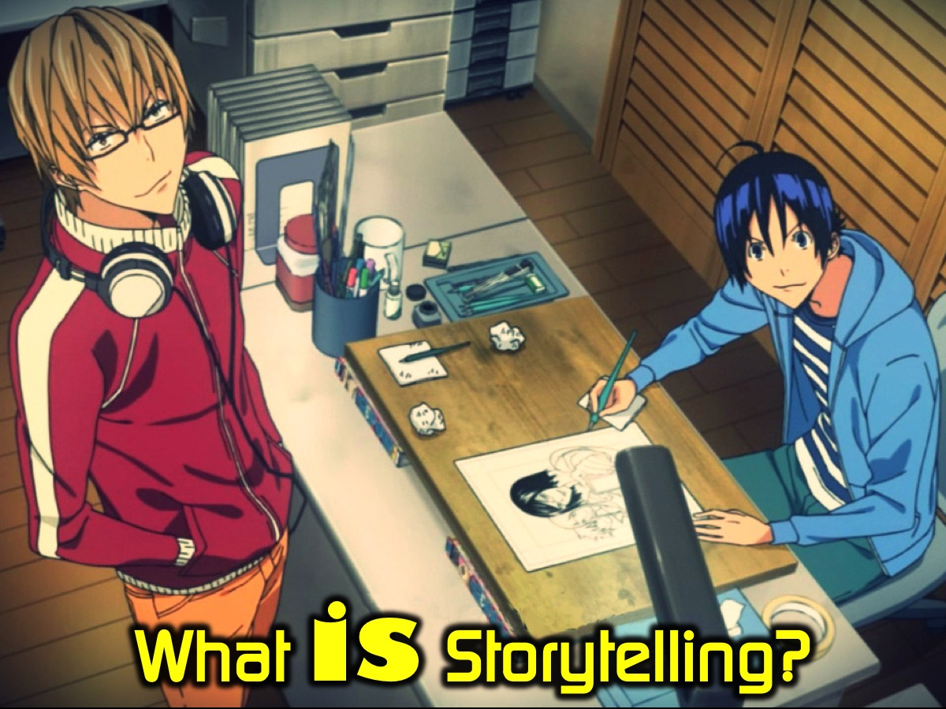
Notes:
What is Storytelling? Watch this video to find out a little more about it.

Slide 25
Notes:
Video: A (brief) history of storytelling. Get it on YouTube at: https://youtu.be/fGDltpfITgY
Video Length: 2:10

Slide 26
Notes:
Who Started It? Here is a video to help answer this question…

Slide 27
Notes:
Video: A Whiteboard History of Storytelling. Get it on YouTube at: https://youtu.be/p6E8jpFasR0
Video Length: 1:30

Slide 28
Notes:
Here is an example of storytelling - using the Spider-Man: Web of Shadows game trailer.

Slide 29
Notes:
Video: Spider-Man: Web of Shadows Launch Trailer. Get it on YouTube at: https://youtu.be/IssycbYMyaw

Slide 30
Notes:
Hear a Story - I (Jesse) am going to share a short story that I wrote.

Slide 31
Notes:
Get into Storytelling groups - and write your story - it can be a true or fictional story.

Slide 32
Notes:
Give teens a while to start writing and then interrupt them with this short video about developing their plot using key words (rathen than the word THEN) to connect the bveats of the story - the words are BUT, SO, AND, AS, OR and IF.
Video: How to Write a Plot for your Story [Writer's Dice - Kickstarter Video]. Get it on YouTube at: https://www.youtube.com/watch?v=SuA51-GWaWA

Slide 33
Notes:
Continue with your story writing - don’t forget to use the writer’s dice words (BUT, SO, AND, AS, OR and IF) to help you develop a great story.

Slide 34
Notes:
Share Your Story - teens will share their stories in their small groups.

Slide 35
Notes:
Select The Story - each group will select one story to be shared with the whole group.

Slide 36
Notes:
Listen to Stories - one person from each small group will share their story with the big group.

Slide 37
Notes:
Take it Deeper - It is time to think a bit deeper about creativity - we are going to watch three videos and discuss each one in our small groups.

Slide 38
Notes:
Video: Where Does Creativity Come From? Get it on YouTube at: https://youtu.be/uMUNe3Pnv04
Video Length: 1:30mins

Slide 39
Notes:
Question #1: What is the source of our creativity and what can we do to let it flow through us?

Slide 40
Notes:
Video: Animated Explanation of 'The Messiah’. Get it on YouTube at: https://youtu.be/3dEh25pduQ8
Video Length: 4:40

Slide 41
Notes:
Question #2: How does this true story connect with our lives and how can it influence how we live?

Slide 42
Notes:
Video: The Greatest Artist Of All Time (ft. Jenny Snipstead) | Spoken Word. Get it on YouTube at: https://youtu.be/AZHRpi4z7zk
Video Length: 5mins

Slide 43
Notes:
Question #3: What did you hear in that spoken word that will inspire you to be more creative?

Slide 44
Notes:
Pray for each other in your small groups to be channels of God’s life and creativity.

Slide 45
Notes:
Refreshments

