Slide 1
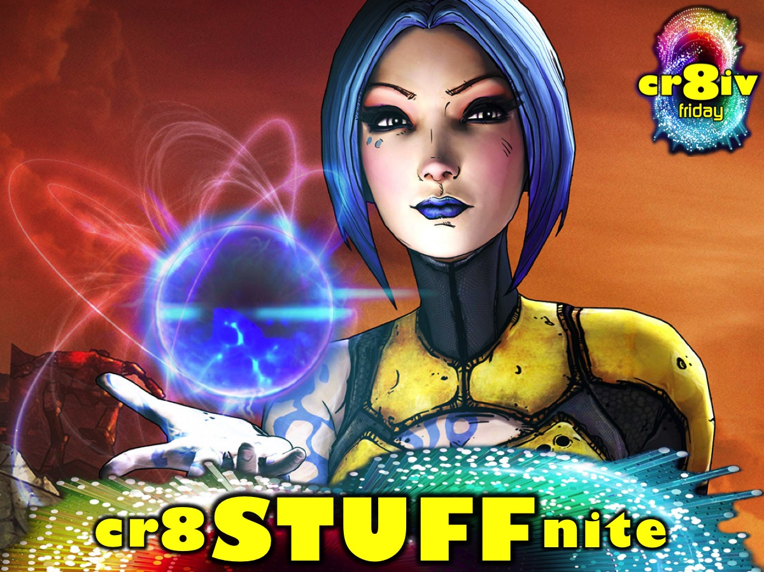
Notes:
This week is cr8 WORDS nite

Slide 2
Notes:
Welcome to regulars and newcomers.

Slide 3
Notes:
Welcome to cr8ivFRIDAY.

Slide 4
Notes:
Join us on Sunday mornings either at 8:30 or at 10:30 for The Revelation Series.

Slide 5
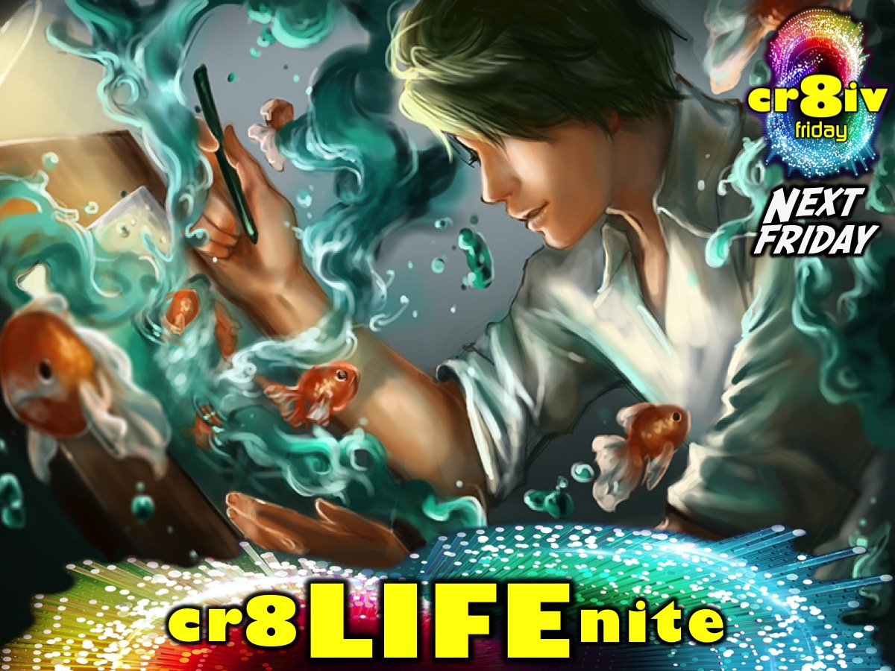
Notes:
Next week is cr8LIFE nite.

Slide 6
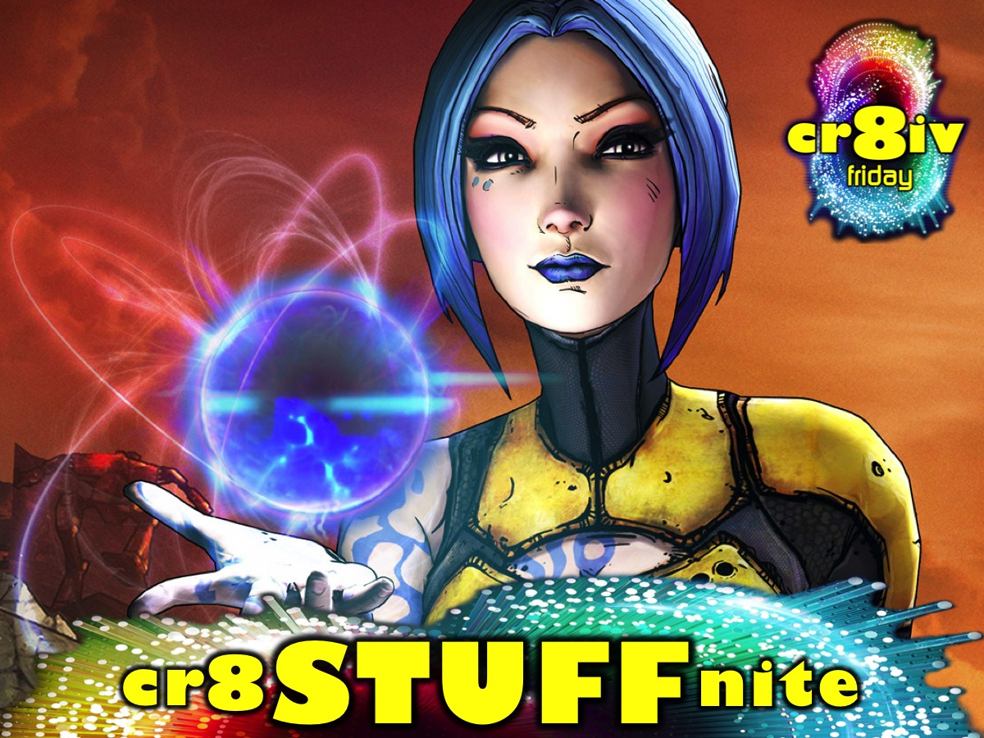
Notes:
But tonight it is cr8STUFF nite.

Slide 7
Notes:
Are you ready for the His Youth Create STUFF Challenge?

Slide 8
Notes:
Video: Edited Version of Borderlands 2 Launch Trailer. Get it on YouTube at: https://www.youtube.com/watch?v=5TW0wJTFLiw

Slide 9
Notes:
Get INTO Teams – there will be 4 teams competing against each other.

Slide 10
Notes:
Team Axton

Slide 11
Notes:
Team Maya

Slide 12
Notes:
Team Salvador

Slide 13
Notes:
Team Zero!

Slide 14
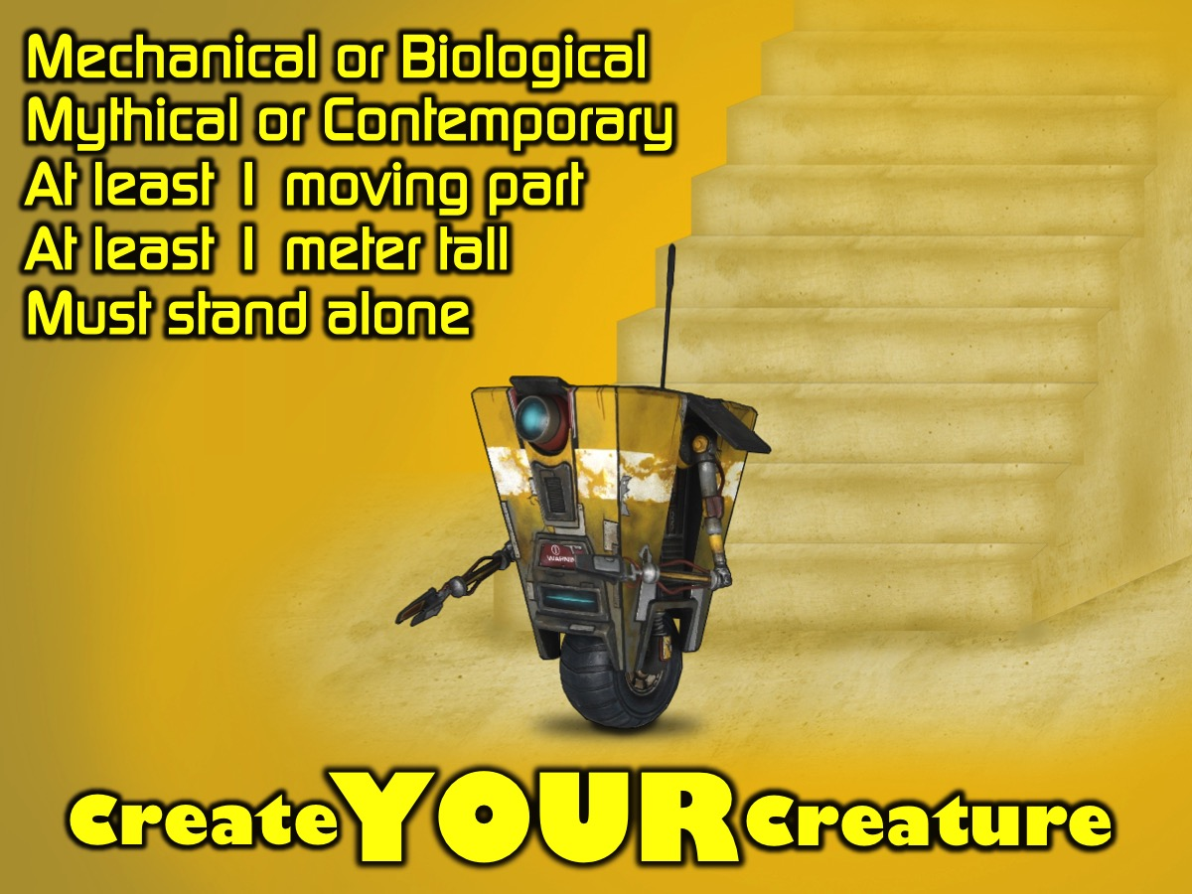
Notes:
Create YOUR Creature - you are going to create a creature - it can be mechanical or biological but it must have at least 1 moving part and it must be at least 1 meters tall and must be able to stand alone.

Slide 15
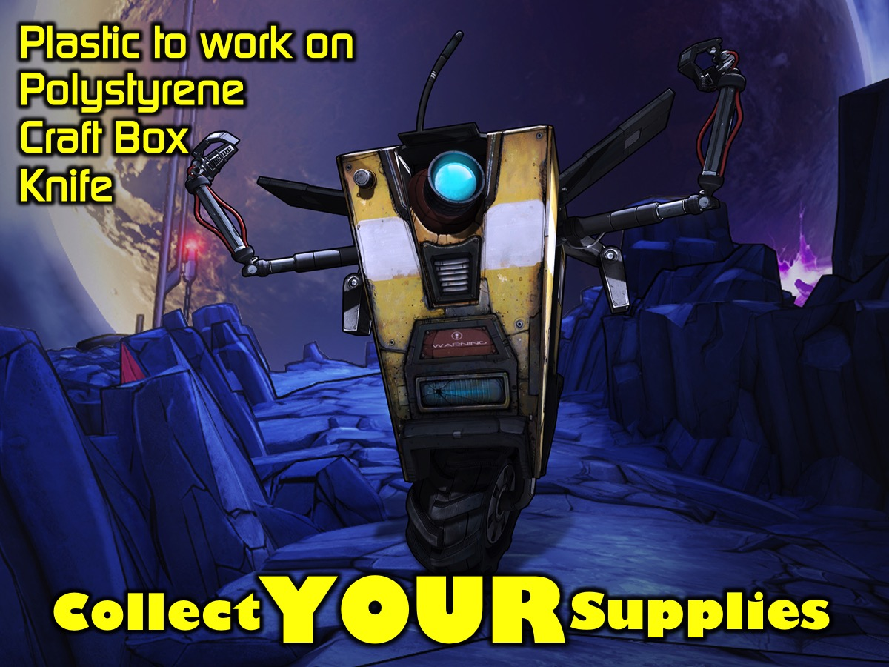
Notes:
Collect YOUR Supplies. Each team gets a sheet of plastic to work on, a sheet of polystyrene, Craft Box (Contains toothpicks, mirror tape, paint, cotton wool, big eyes etc.) and a knife.

Slide 16
Notes:
Create FOR Prizes. There are prizes for the winning creations - so design well and work smart!

Slide 17
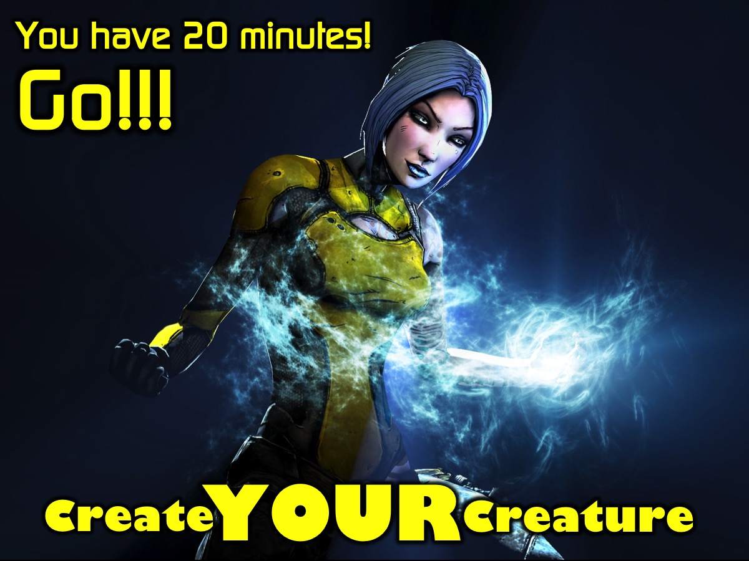
Notes:
Create YOUR Creature - You have 20 minutes! Go!!!
Video: 20 Minutes Countdown. Get it on YouTube at: https://www.youtube.com/watch?v=wZQ7lZRgHHo

Slide 18
Notes:
Display YOUR Creature. It is time for you to show off your creature on stage.

Slide 19
Notes:
Collect YOUR Prizes. The judge(s) will now announce the winners who will come up and collect their prizes.

Slide 20
Notes:
Take IT Deeper - It is time to think a bit deeper about what we create. We are going to watch three videos and discuss each one in our groups.

Slide 21
Notes:
Video 1: What legacy will you create? Get it on YouTube at: https://www.youtube.com/watch?v=yMokN69C4gY

Slide 22
Notes:
Question #1: What legacy do you want to create?

Slide 23
Notes:
Video 2: Created to Create. Get it on YouTube at: https://www.youtube.com/watch?v=9iHxfmQyPrc

Slide 24
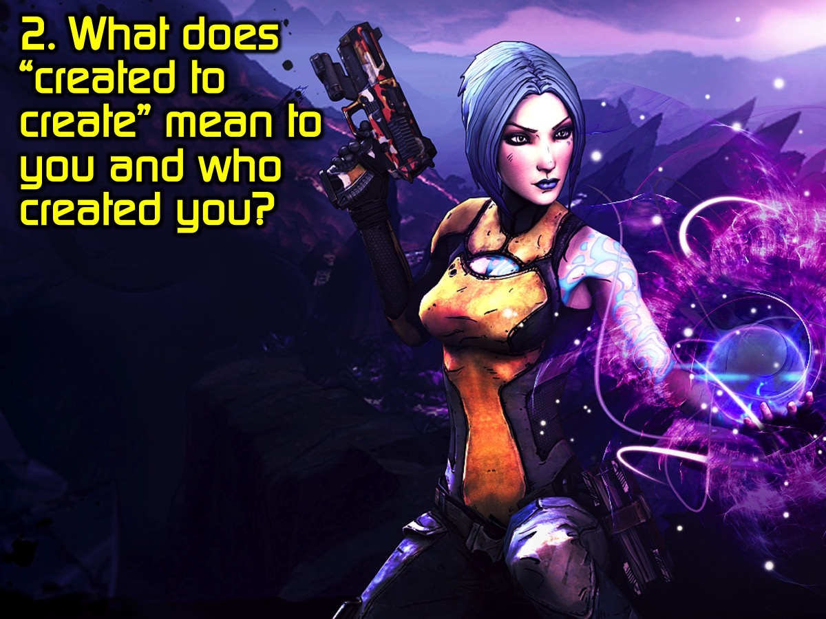
Notes:
Question #2: What does “created to create” mean to you and who created you?

Slide 25
Notes:
Video 3: Work in Progress Jon Jorgenson Spoken Word. Get it on YouTube at: https://www.youtube.com/watch?v=mHuMEo1pkfE

Slide 26
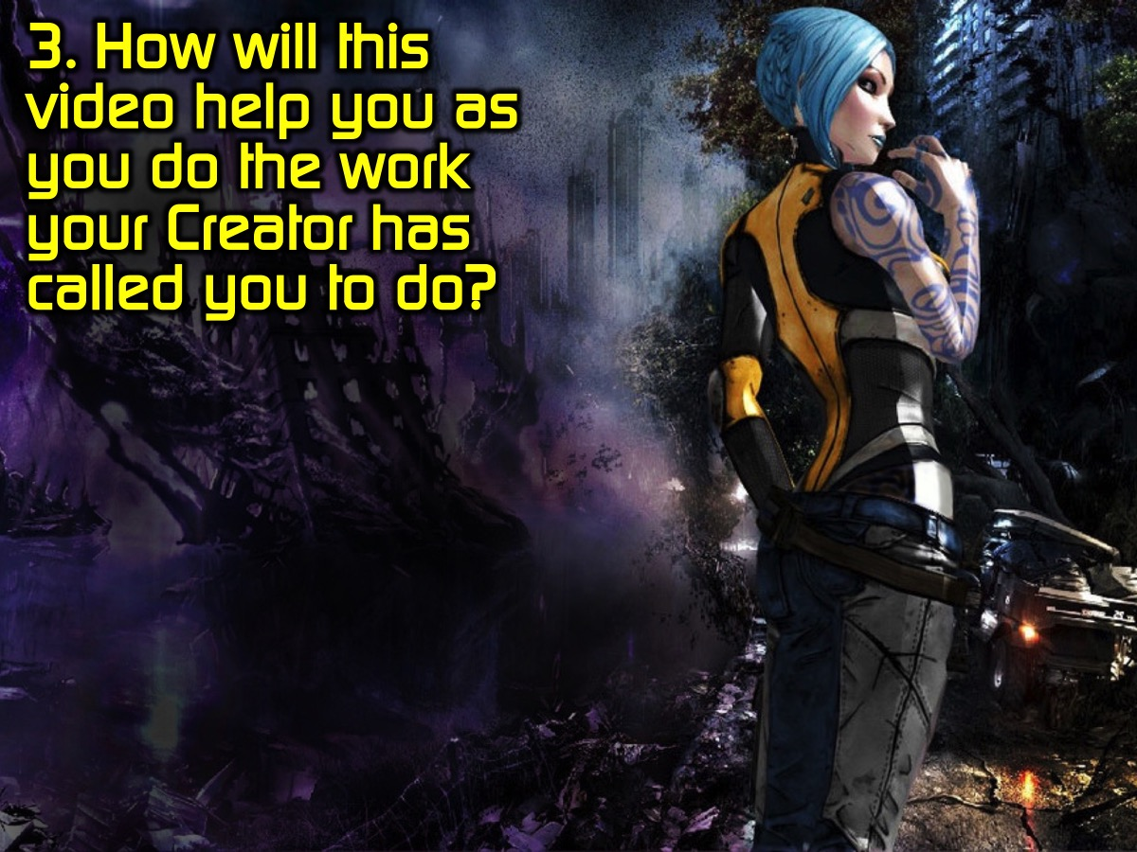
Notes:
Question #3: How will this video help you as you do the work your Creator has called you to do?

Slide 27
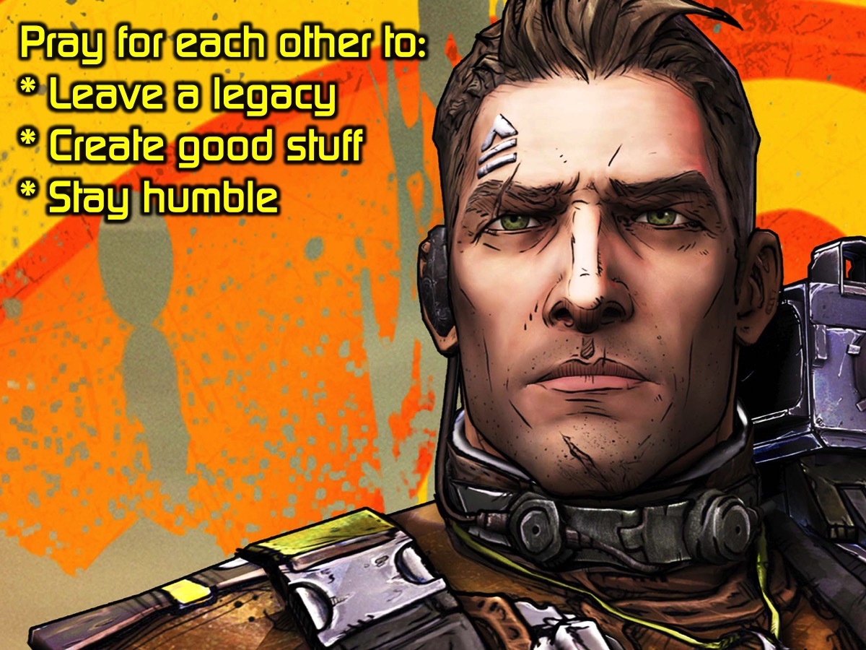
Notes:
Prayer: Pray for each other to Leave a legacy, Create good stuff and Stay humble.

Slide 28
Notes:
Next week is cr8 LIFE nite.

Slide 29
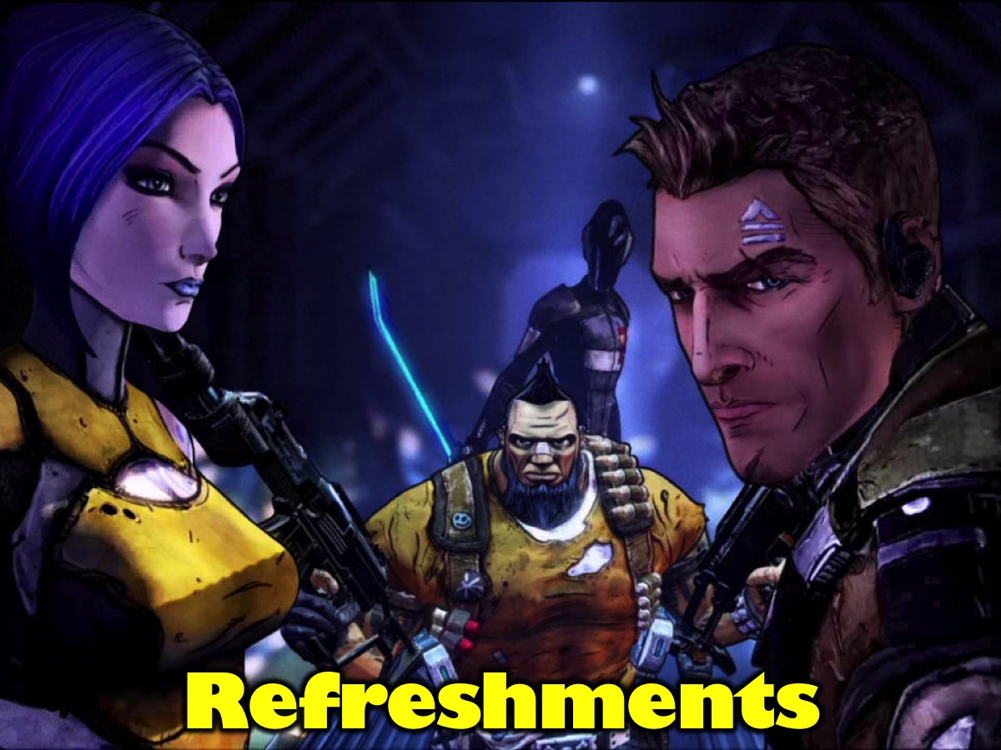
Notes:
Refreshments are served.

