Slide 1
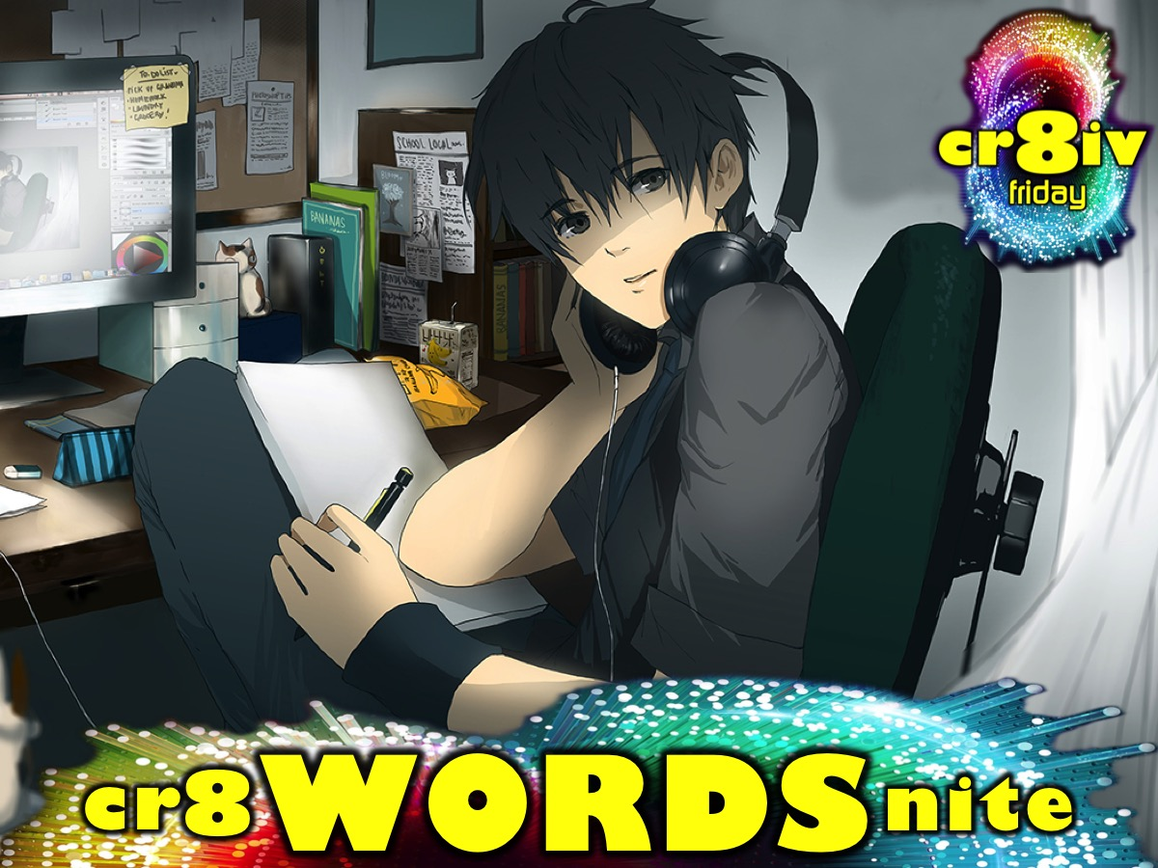
Notes:
This week is cr8 WORDS nite

Slide 2
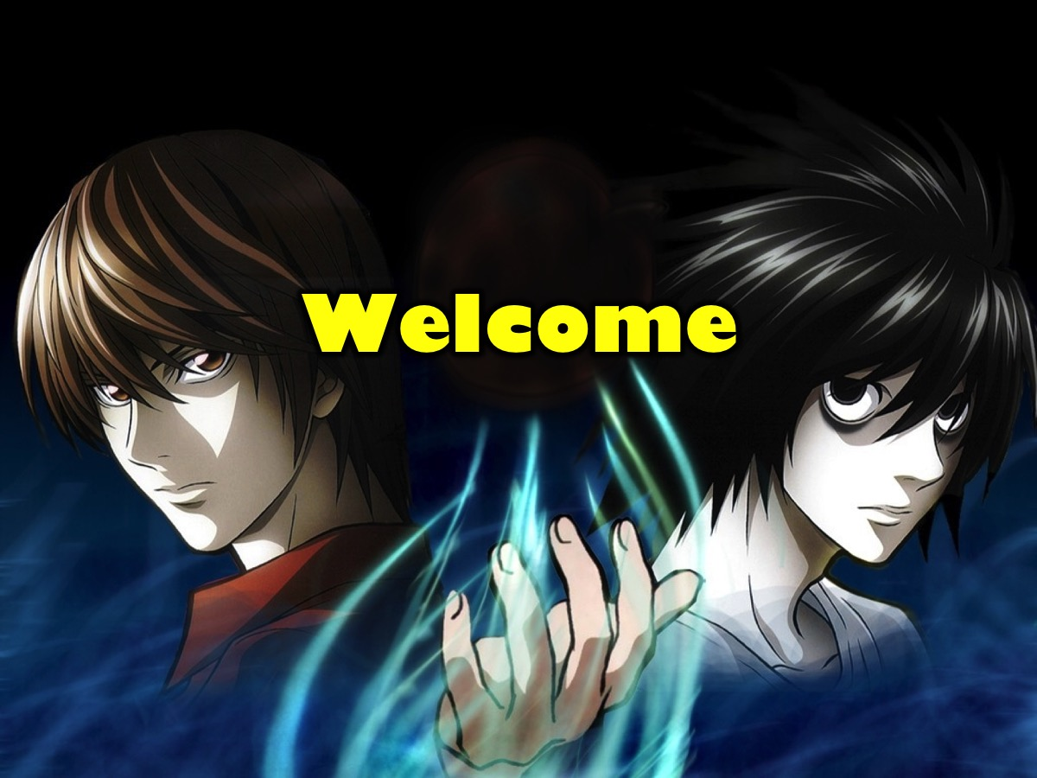
Notes:
Welcome to regulars and newcomers.

Slide 3

Notes:
Welcome to cr8iv Friday.

Slide 4

Notes:
Join us on Sunday mornings either at 8:30 or at 10:30 for The Revelation Series.

Slide 5

Notes:
Next week is cr8 STUFF nite.

Slide 6
Notes:
But tonight it is cr8 WORDS nite.

Slide 7
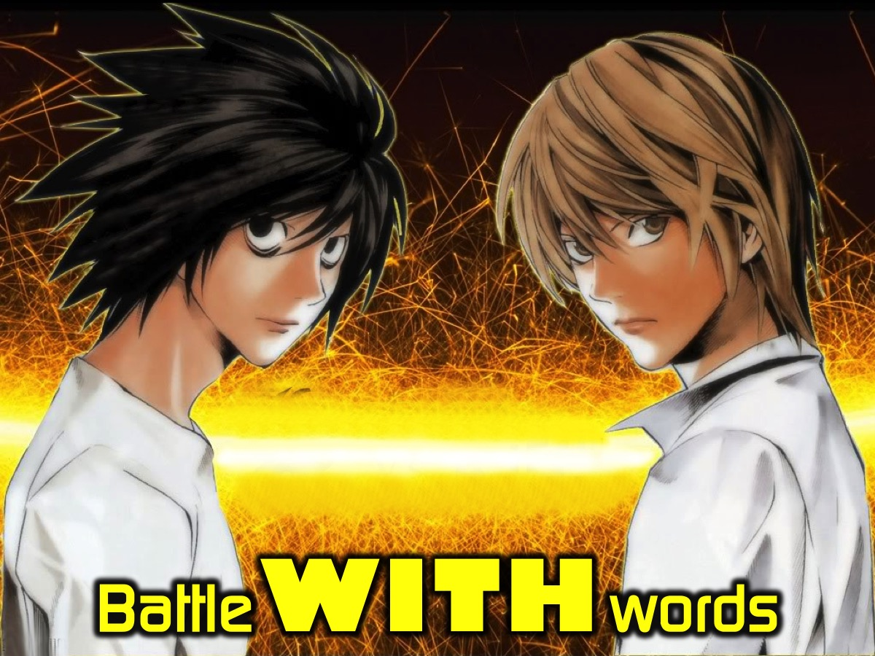
Notes:
Tonight we are going to Battle WITH Words.

Slide 8
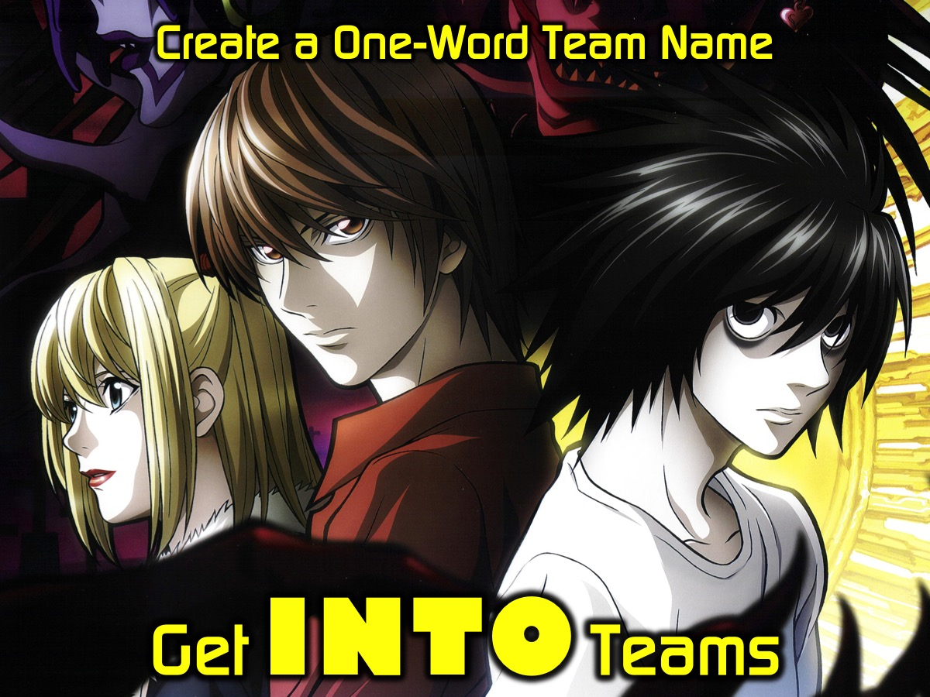
Notes:
Get INTO Teams – there will be 4 teams competing against each other in 4 games. Each team comes up with a one-word name for their team.

Slide 9
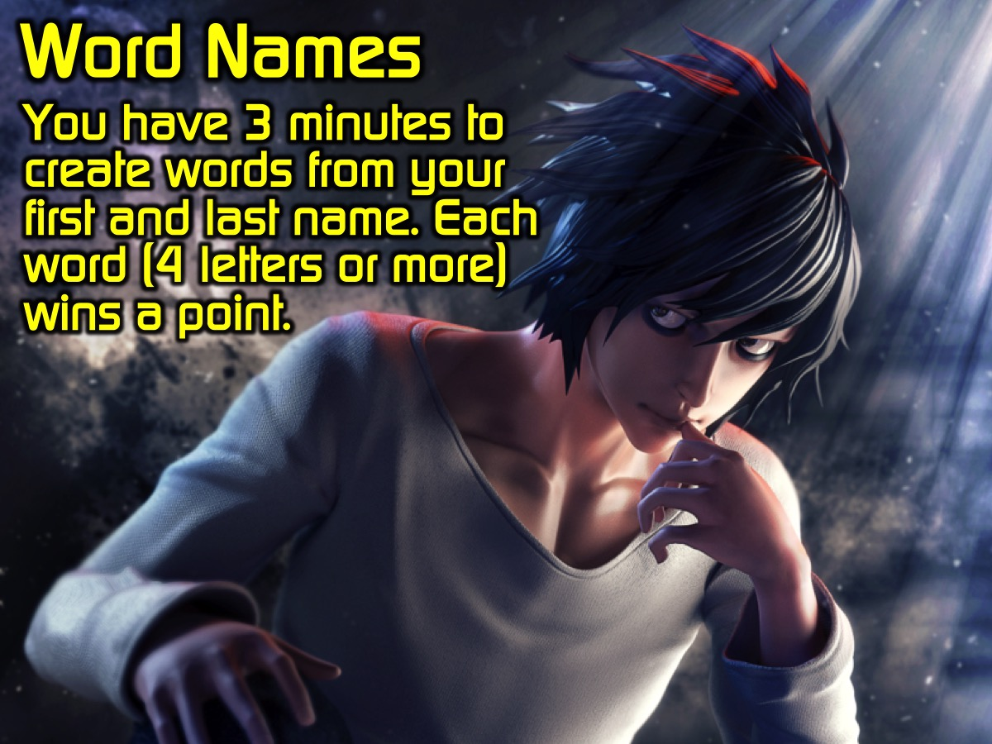
Notes:
Word Names: You have 3 minutes to create words from your first and last name. Each word (4 letters or more) wins a point for your team. Intructions: Each person gets an A4 piece of paper and a pen and has 2 minutes to create as many words (4 letters or more) from the letters of their first and last name. At the end of 2 minutes - the pages are handed in and will be tallied to get the total points earned for each team in that round.
SUPPLIES:
* A4 page for each person
* A pen for each person
Video: 3 Minute Countdown (no audio needed). Get it on YouTube at: https://www.youtube.com/watch?v=NVz5AyrxLBY

Slide 10
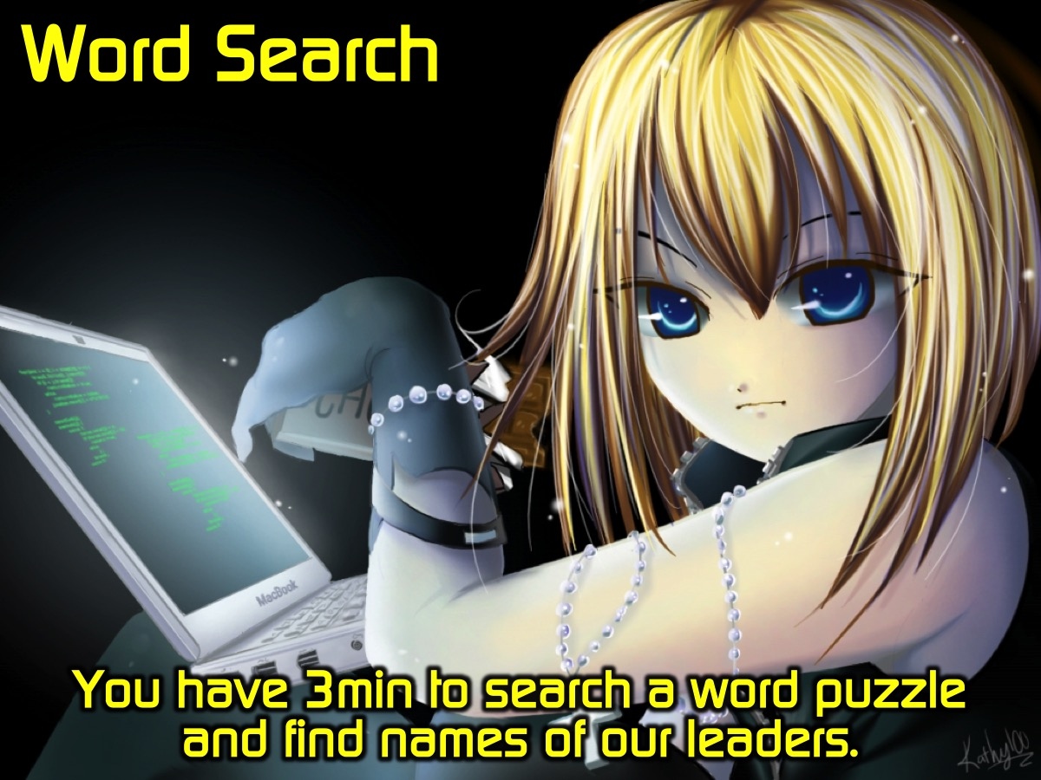
Notes:
Word Search: You will search a word puzzle to find as many names of our leaders as possible. Instructions: Each team is given an A3 sheet of paper that contains the word puzzle and a list of names of youth leaders hidden among the letters.
SUPPLIES:
* Copies of the A3 Word Puzzle page for each team
* A Black Marker for each team
Video: 3 Minute Countdown (no audio needed). Get it on YouTube at: https://www.youtube.com/watch?v=NVz5AyrxLBY

Slide 11
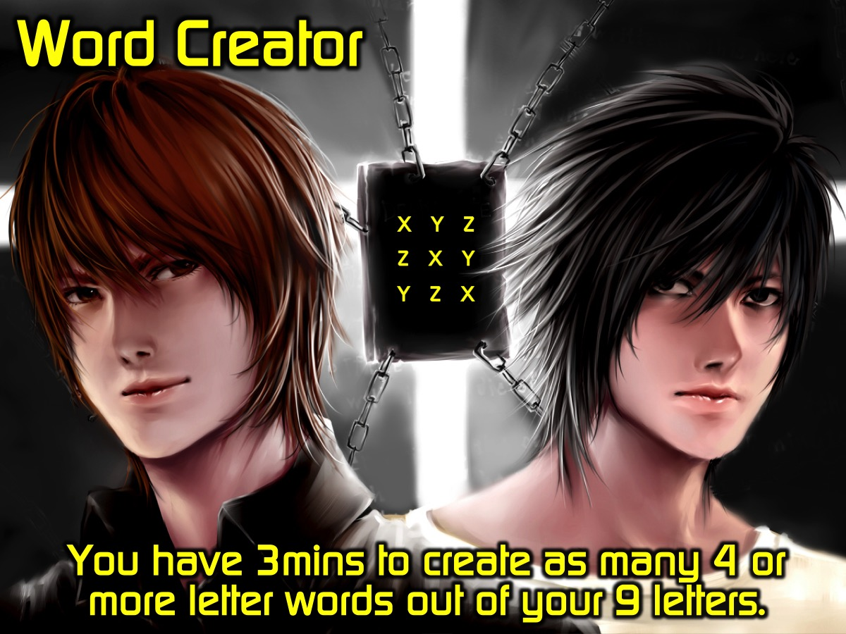
Notes:
Word Creator: You have 3 minutes to create as many 4 or more letter words out of the 9 letters. You get a point for every correct word you come up with. Instructions: Each team is given an A3 sheet of paper with 9 letters on it and they have to come up with as many words as possible – 4 letters and more are acceptable.
ITEMS NEEDED:
* Copies of the A3 page with the 9 words
* A Black Marker for each team
* A Blank A3 page for their words
Video: 3 Minute Countdown (no audio needed). Get it on YouTube at: https://www.youtube.com/watch?v=NVz5AyrxLBY

Slide 12
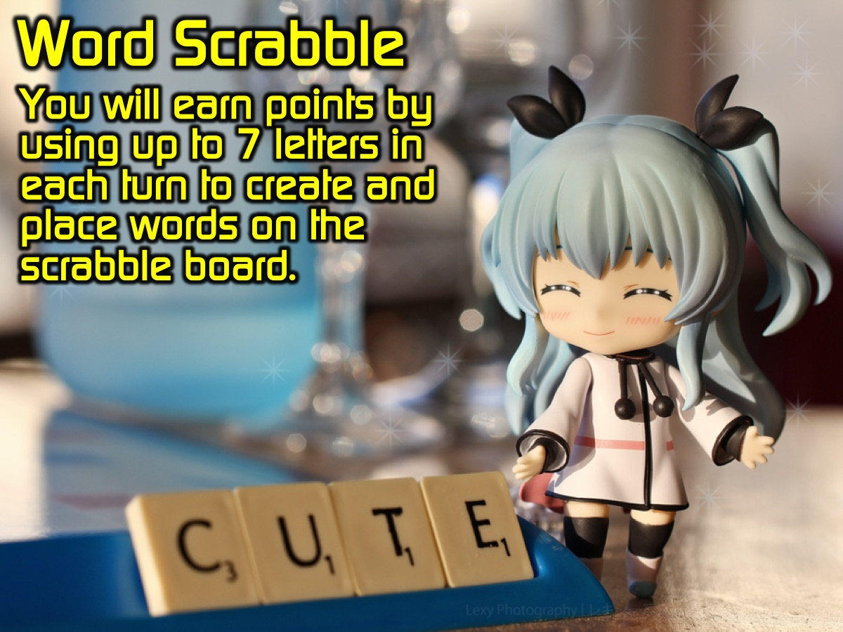
Notes:
Word Scrabble: You are going to play gant Word Scrabble - You will earn points by using up to 7 letters in each turn to create and place words on the scrabble board. Instructions: Each team will be given 7 letters to start with and the first team will place a word on the board and in a clockwise direction teams will add words to the existing words - scoring their points each time. They will have their played letters topped up.
SUPPLIES:
* The giant scrabble board
* The letters
* Score keeper sheet

Slide 13
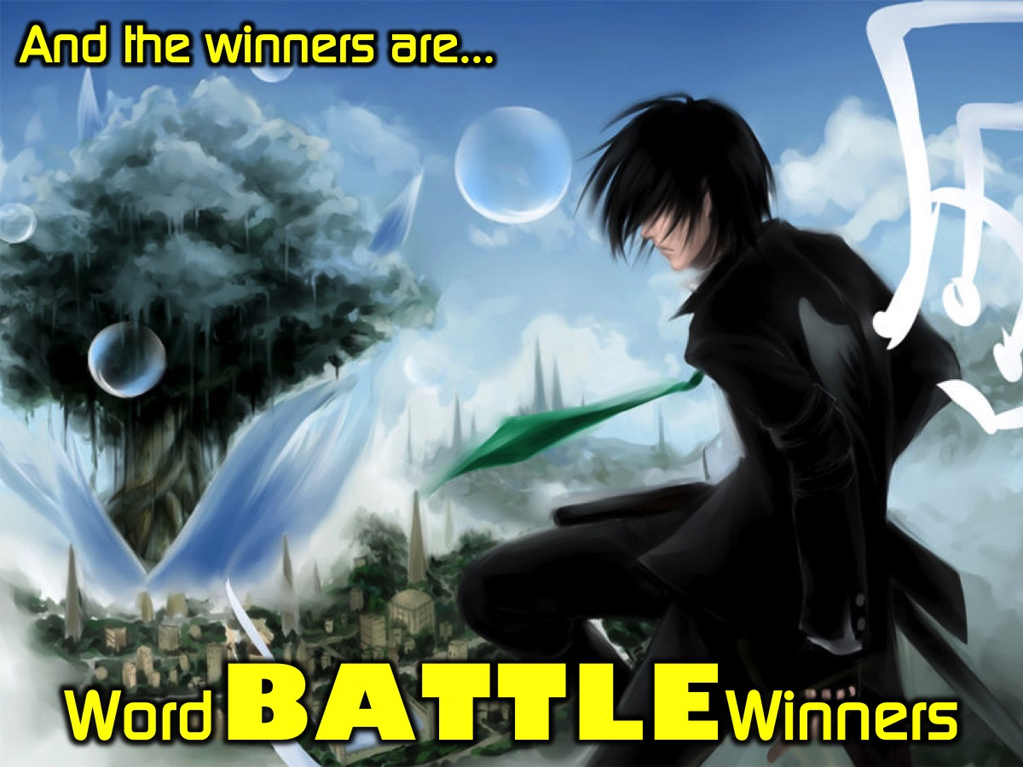
Notes:
Word BATTLE Winners - and the winners of our word battle competition are...

Slide 14

Notes:
Take it Deeper - It is time to think a bit deeper about words - we are going to watch three videos and discuss each one in our groups.

Slide 15
Notes:
Video: The Power of Words - A girl Changed a Blind Man’s Day. Get it on YouTube at: https://www.youtube.com/watch?v=CNhYbJbqg-Y
Video Length: 1:30

Slide 16
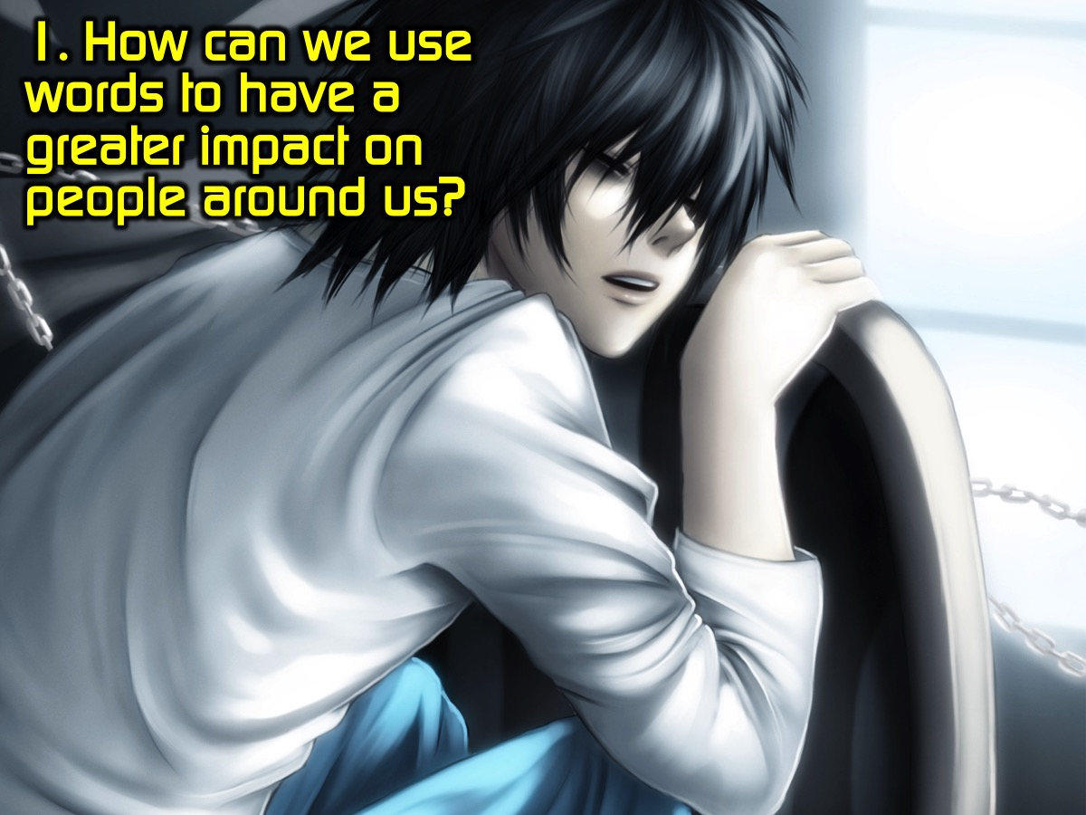
Notes:
Question #1: How can we use words to have a greater impact on people around us?

Slide 17
Notes:
Video: What If... (The Power of Words). Get it on YouTube at: https://www.youtube.com/watch?v=jURJv2t9VJo
Video Length: 1:20

Slide 18
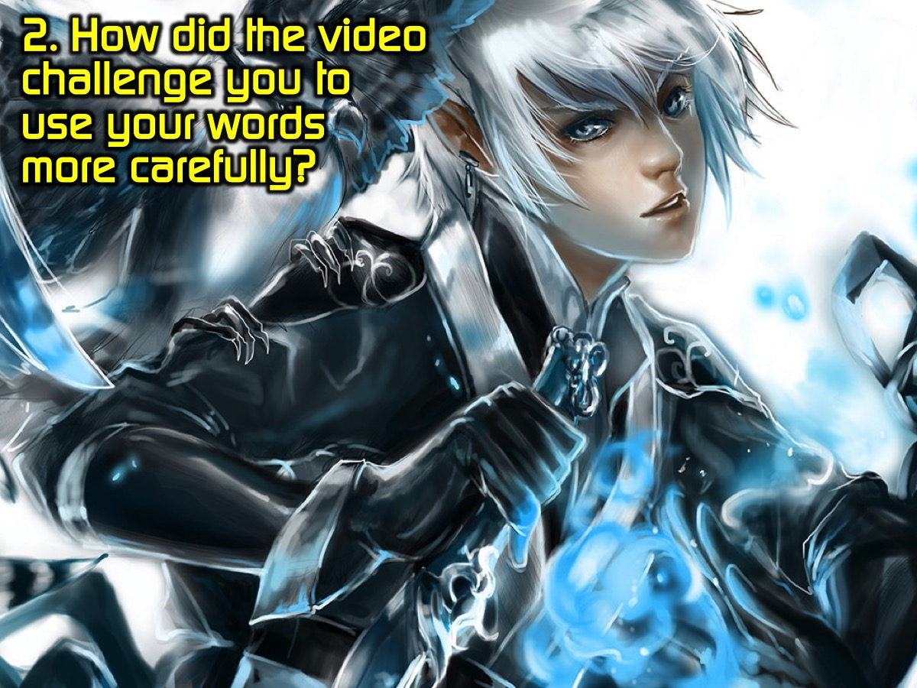
Notes:
Question #2: How did the video challenge you to use your words more carefully?

Slide 19
Notes:
Video: Jesus Till I Die Spoken Word. Get it on YouTube at: https://youtu.be/rjavBRLskpI
Video Length: 3:40

Slide 20
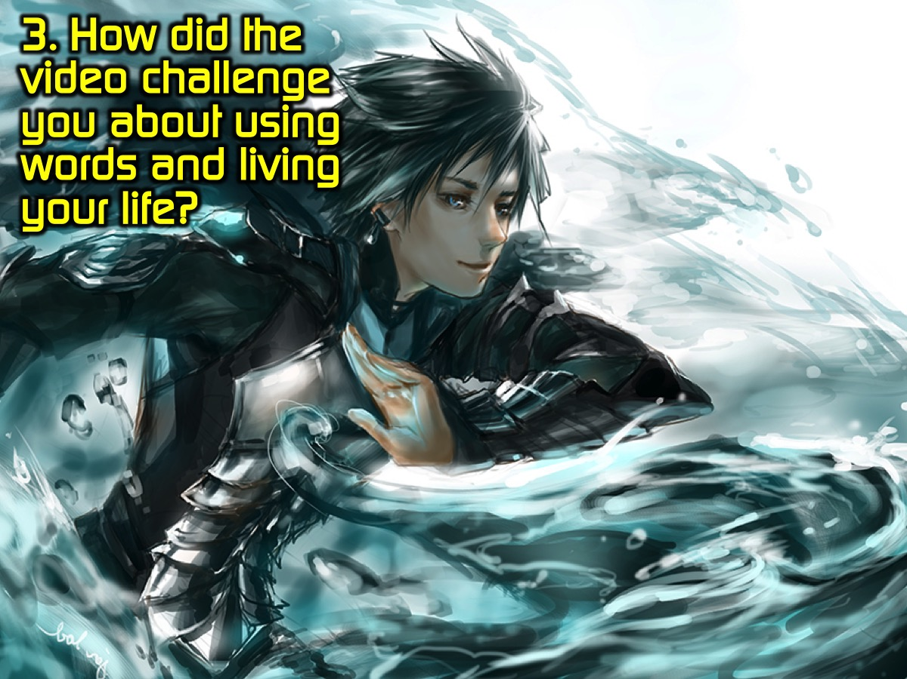
Notes:
Question #3: How did the video challenge you about using words and living your life?

Slide 21
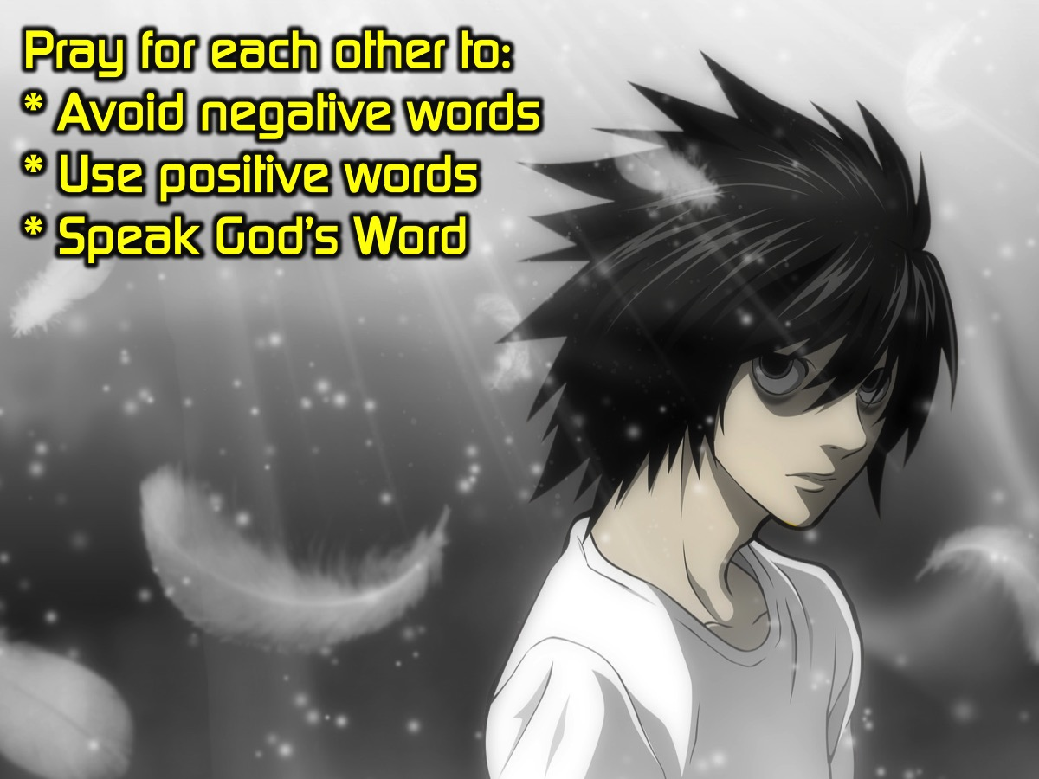
Notes:
Prayer: Pray for each other to avoid negative words, use positive words and speak God’s Word.

Slide 22
Notes:
Next week is cr8 STUFF nite.

Slide 23
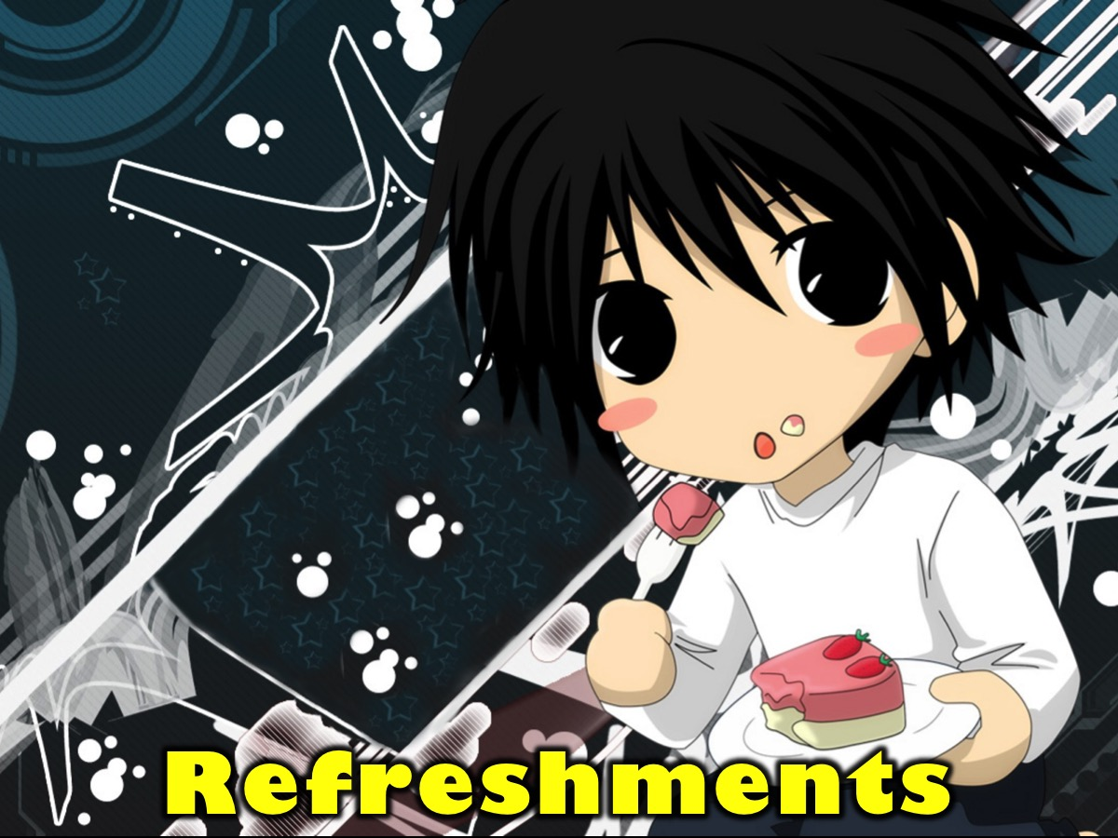
Notes:
Refreshments are served.

